Slide 1

Liver Cirrhosis
Dimitrios S Karagiannakis
Assistant Professor of Internal Medicine and Hepatology
4th Department of Internal Medicine
Attikon University Hospital

Slide 2
Liver Cirrhosis
Every chronic liver disease may lead to liver cirrhosis

Slide 3
Definition of Liver Cirrhosis
Chronic inflammation
Diffuse liver damage
Fibrosis
Regenerative nodules
Pathological-anatomical definition

Slide 4

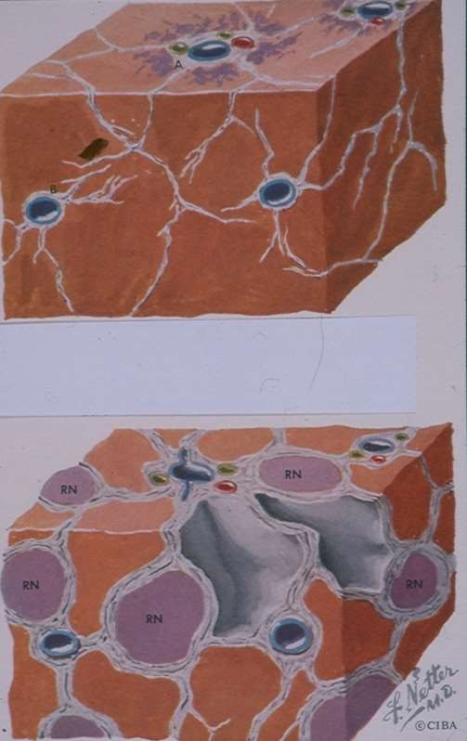

Slide 5
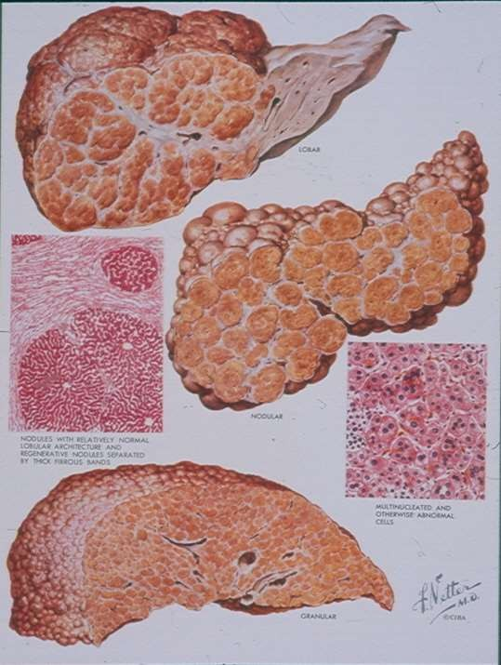

Slide 6
Morphological Classification
Micronodular (<3 mm)
Macronodular (>3 mm)
Mixed type

Slide 7
Micronodular
Alcoholic
Secondary cholestasis
Hemochromatosis
Budd-Chiari syndrome

Slide 8
Macronodular
Alcoholic after alcohol abstinence
Viral hepatitis
Wilson’s disease

Slide 9

Etiological Classification
Hereditary causes
Exogenous causes
Biliary cirrhosis
Venous congestion
Cryptogenic

Slide 10
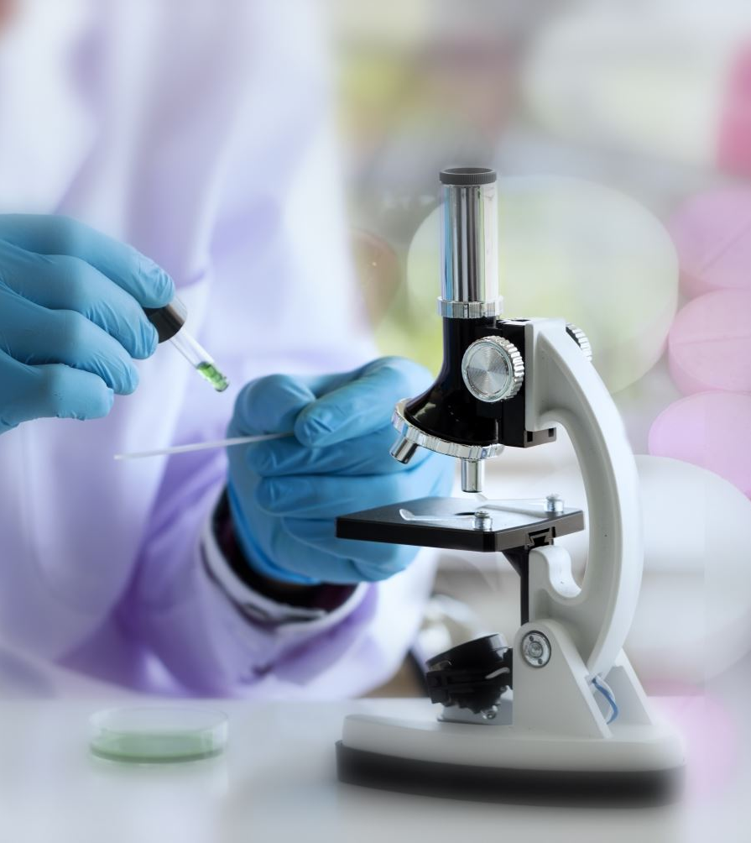
A. HEREDITARY CAUSES (ENDOGENOUS)
Rare diseases
Galactosemia
Fanconi syndrome
Hereditary fructose intolerance. Hereditary tyrosinemia
Gaucher disease
Glycogen storage disease
Cystic fibrosis
Hemochromatosis
Alpha-1 antitrypsin deficiency
Wilson’s disease

Slide 11
B. EXOGENOUS CAUSES
Alcohol
MASLD (Obesity, T2DM, Hyperlipidemia)
Autoimmune hepatitis
Infectious causes (Chronic hepatitis B, C, D)
Schistosomiasis
Medications, toxins

Slide 12
C. BILIARY CIRRHOSIS
Primary biliary cholangitis
Primary sclerosing cholangitis

Slide 13

D. Venous Stasis
Cardiac cirrhosis (right-sided congestive heart failure)
Hepatic vein thrombosis (Budd-Chiari syndrome)

Slide 14
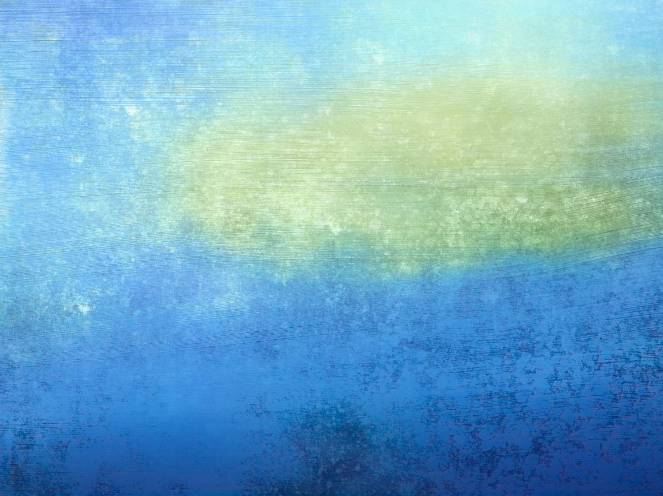
E. OTHER
Sarcoidosis
Polycystic liver disease
Hereditary hemorrhagic telangiectasia (Rendu-Osler-Weber)

Slide 15

Pathophysiology
Chronic inflammation and necrosis
Fibrosis and nodular regeneration
Cytokines and growth factors

Slide 16
Disruption of microcirculation and the normal architecture of the liver
Nodular reconstruction of the normal lobular hepatic parenchyma and diversion of blood flow away from the hepatic parenchyma through collateral networks.
Portal hypertension
Liver failure

Slide 17
Distorted architecture
Portal hypertension
Hepatic failure

Slide 18
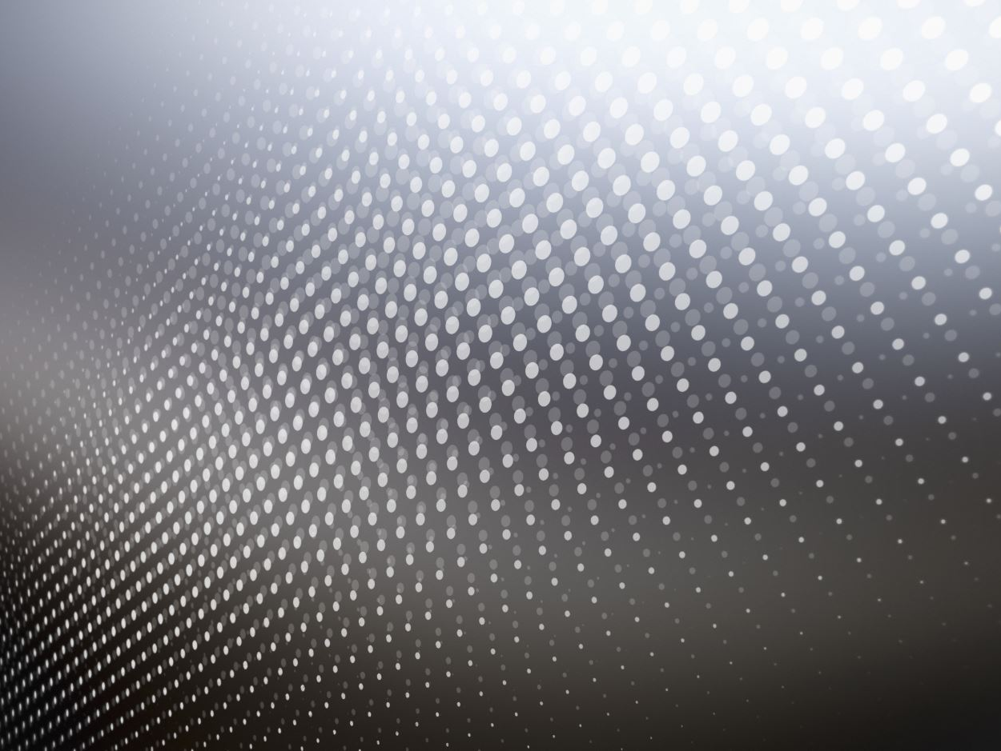
Portal Hypertension
Increased portal pressure
(HVPG > 5mmHg)

Slide 19
Balloon-Tipped Catheter Positioning: A catheter is inserted into the right jugular vein and is forwarded to the right or middle hepatic vein under fluoroscopic guidance.
WHVP (Wedged Position): The balloon is inflated, obstructing flow and creating a "standing column of blood" that reflects sinusoidal pressure, which in cirrhosis equals portal pressure.
FHVP (Free Position): The balloon is deflated, and the catheter records the pressure in the hepatic vein, which reflects systemic vena cava pressure.
Sinusoidgram/Venography: Contrast is often injected during the procedure to confirm the balloon's position, visualize veno-venous communications, and detect intrahepatic portal veins.

Slide 20
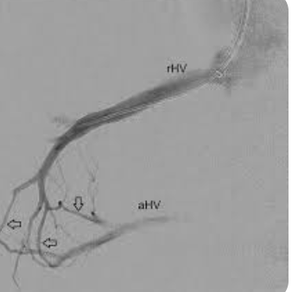
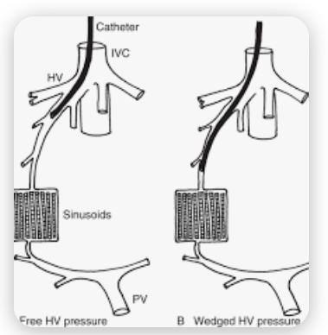

Slide 21
HVPG= WHVP-FHVP

Slide 22

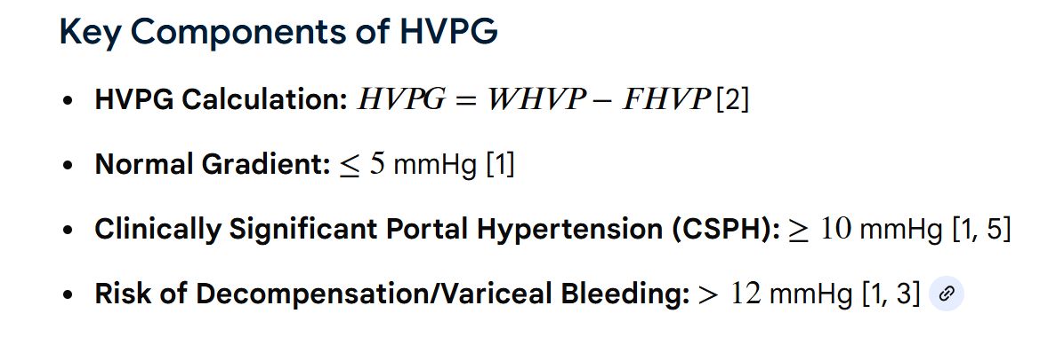
HVPG > 5 mmHg = Portal Hypertension
HVPG > 10 mmHg = Clinically Significant Portal Hypertension (CSPH).
CSPH is associated with the presence of complications

Slide 23
In the first phase of portal hypertension, increased pressure is caused by external compression of the intrahepatic portal venous tree by fibrotic tissue (scarring) and regenerative nodules. In addition, intrahepatic vasoconstriction contributes (approximately 30%), further reducing intrahepatic blood flow velocity.
During this phase, no complications are present (compensated liver cirrhosis).
Collateral veins open to divert blood flow away from the intrahepatic venous system into the extrahepatic veins.

Slide 24
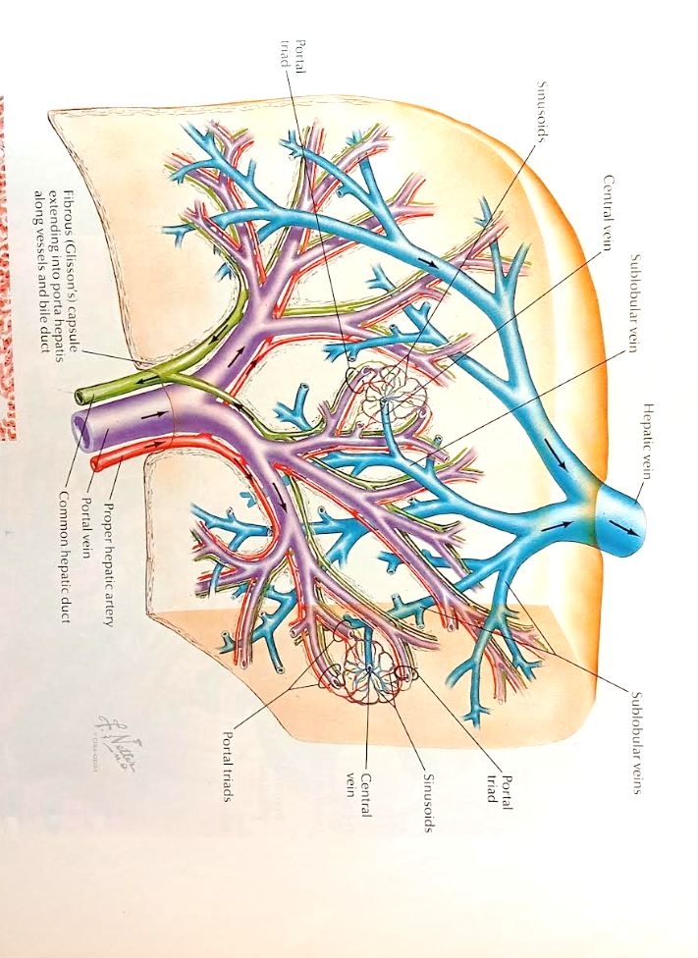

Slide 25
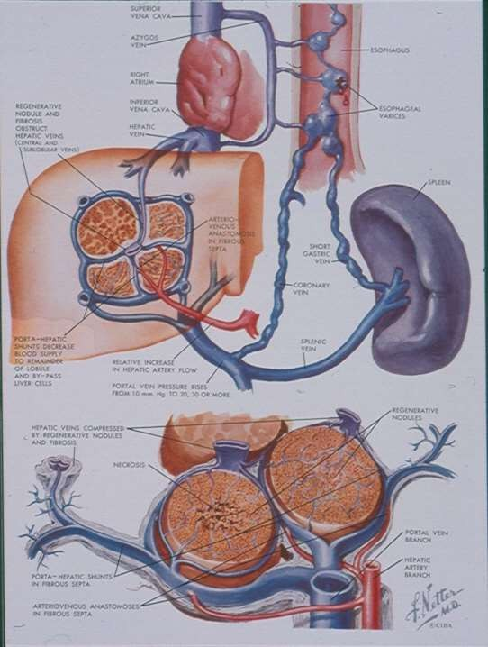

Slide 26
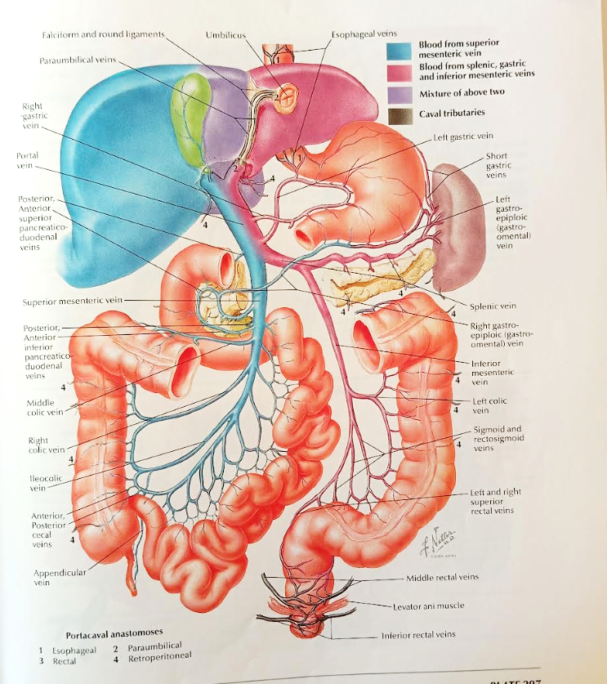

Slide 27

Collateral veins
1. Lower esophagus–fundus of the stomach
Left gastric and short gastric veins–lower oesophageal plexus
2. Lower rectum
Superior hemorrhoidal vein—middle and inferior hemorrhoidal veins
3. Subcutaneous veins of the abdominal wall
Periumbilicus veins—thoracoepigastric and superficial epigastric veins
4. Others
Posterior abdominal wall, diaphragm, and anastomosis of the splenic and left renal veins
Oesophageal and gastric varices formation
Enlarged hemorrhoidal veins

Slide 28
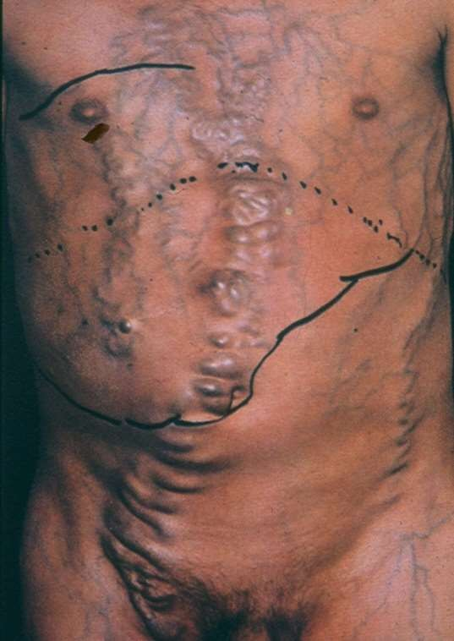
Subcutaneous veins of the abdominal wall

Slide 29
Clinical Presentation during the compensated state
40% are asymptomatic
60% exhibit symptoms
(General, no specific symptoms: muscle weakness, fatigue, weight loss)

Slide 30
As liver function deteriorates, portal hypertension is further aggravated, and severe complications develop (decompensated cirrhosis).
During this phase, a second mechanism of portal hypertension is involved.
Specifically, there is increased production and circulation of vasodilatory factors (including nitric oxide, NO). These factors are not adequately cleared because they bypass the liver or are not effectively metabolised due to impaired liver function, leading to splanchnic vasodilation, which, in turn, reduces the effective circulating blood volume.

Slide 31
As a result, the sympathetic nervous system is activated in an attempt to maintain blood pressure and circulation by increasing heart rate and cardiac output. However, as liver disease progresses, this compensatory response becomes insufficient to maintain hemodynamic stability.
Consequently, additional mechanisms are activated, including the renin–angiotensin–aldosterone system and the release of antidiuretic hormone.
These changes ultimately lead to ascites formation and reduced renal blood flow due to vasoconstriction of the afferent arteriole.

Slide 32
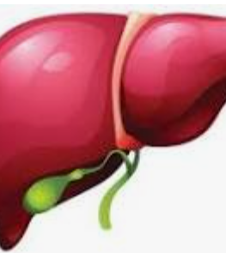
Compensated cirrhosis:
Asymptomatic or mild symptoms.
No complications
Decompensated cirrhosis:
Development of complications of cirrhosis

Slide 33
Liver-related complications
Ascites
GI bleeding
Hepatic encephalopathy
Hepatorenal Syndrome
Spontaneous bacterial peritonitis
Hepatocellular carcinoma

Slide 34
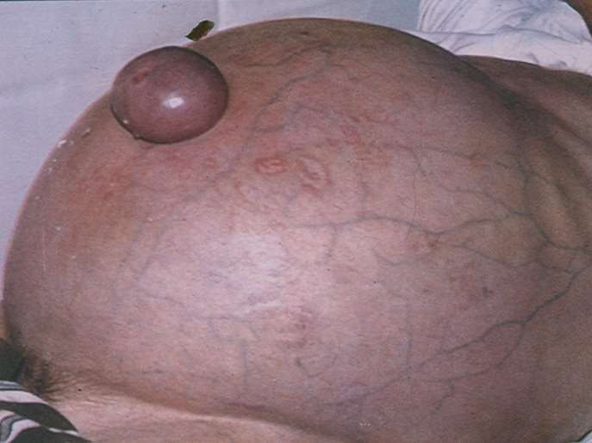

Slide 35
CAUSES OF ASCITES
SAAG= Serum albumin-Ascitic fluid albumin
SAAG>1.1 g/dl | SAAG<1.1 g/dl
PORTAL HYPERTENSION Cirrhosis (80%) Budd-Chiari syndrome Heart Failure (3%) | NO PORTAL HYPERTENSION Peritoneal carcinomatosis (10%) Peritoneal Tuberculosis (2%) Pancreatic Ascites Nephrotic syndrome

Slide 36
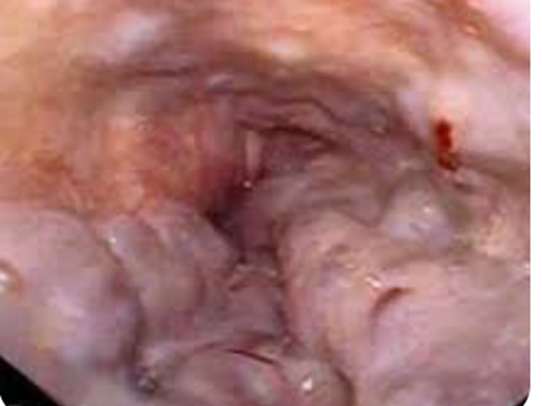

Slide 37
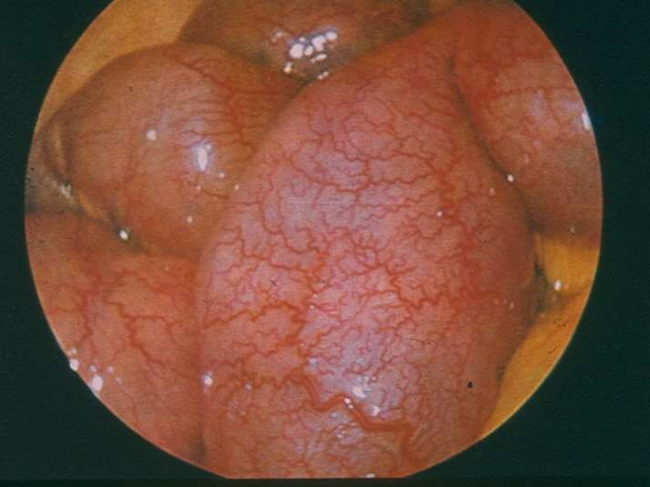

Slide 38
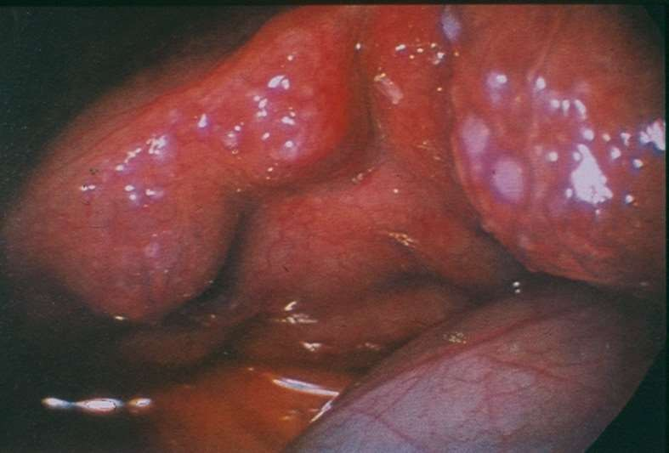

Slide 39
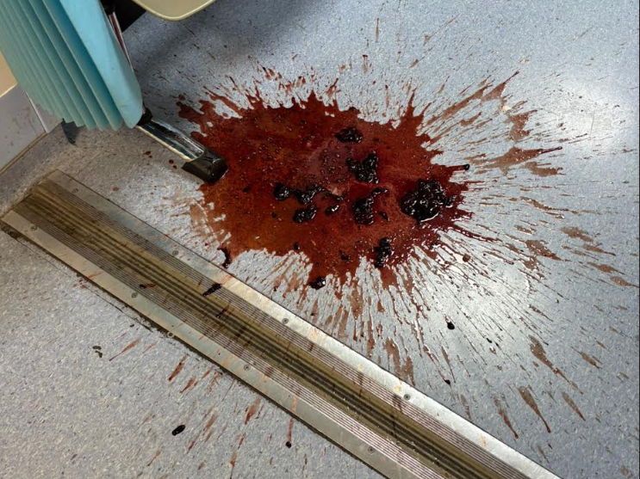

Slide 40
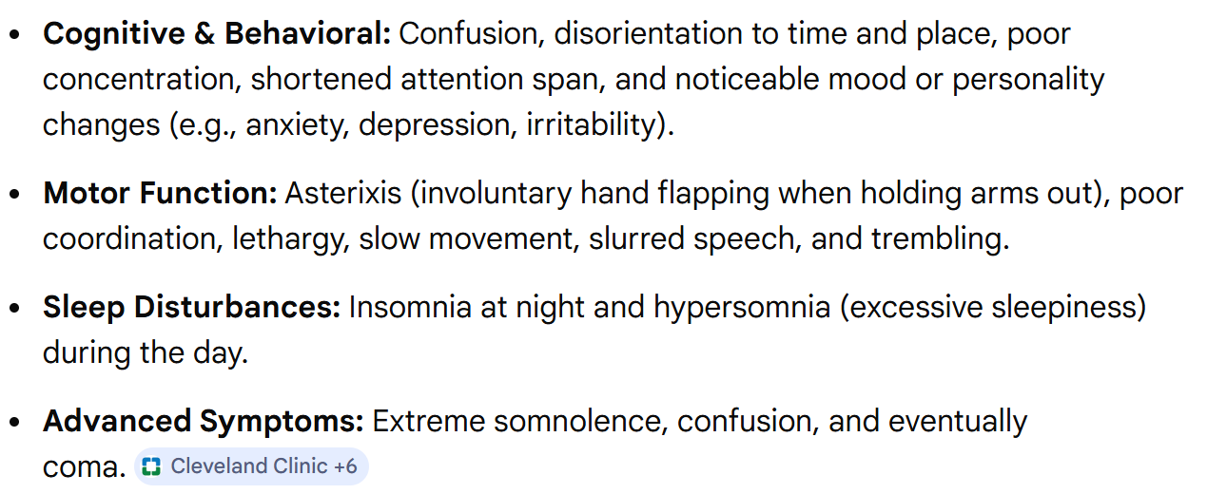
HEPATIC ENCEPHALOPATHY

Slide 41
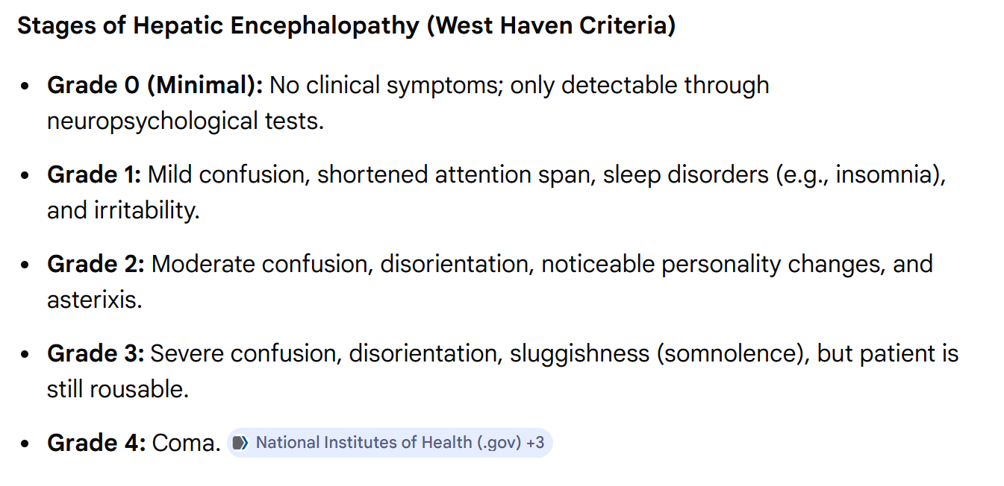

Slide 42
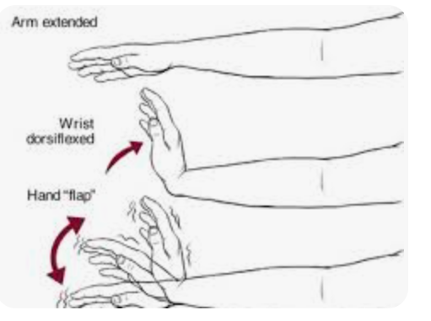
We ask the patient to outstretch the arms and dorsiflex the wrists. In the presence of hepatic encephalopathy, flapping tremor develops.

Slide 43
SBP
Infection of the ascitic fluid
Neutrocells ≥ 250 mm³

Slide 44
Diagnosis of Cirrhosis
History and examination
Laboratory tests
Imaging
Liver biopsy

Slide 45
May be normal in compensated cirrhosis
Reduced platelets
Leucopenia
Anemia
Increased INR
Lower serum albumin
Increased bilirubin?
Sgot, sgpt, ALP, γgt may be normal
Laboratory tests
In compensated cirrhosis, blood tests may be normal
Lower serum albumin levels
Increased INR
Increased serum bilirubin?
Decreases platelets levels Anemia Leucopenia
Due to splenomegaly

Slide 46
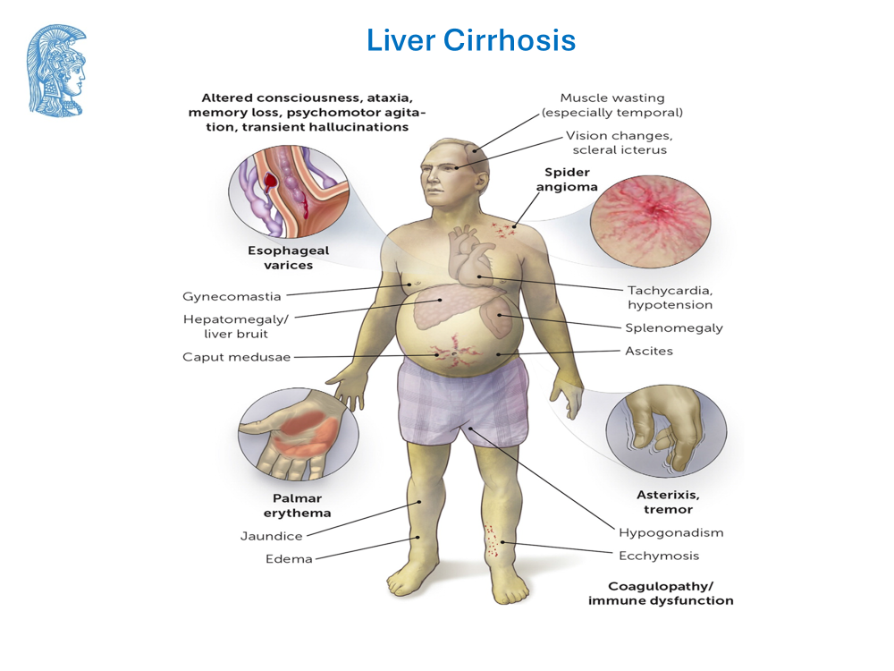

Slide 47
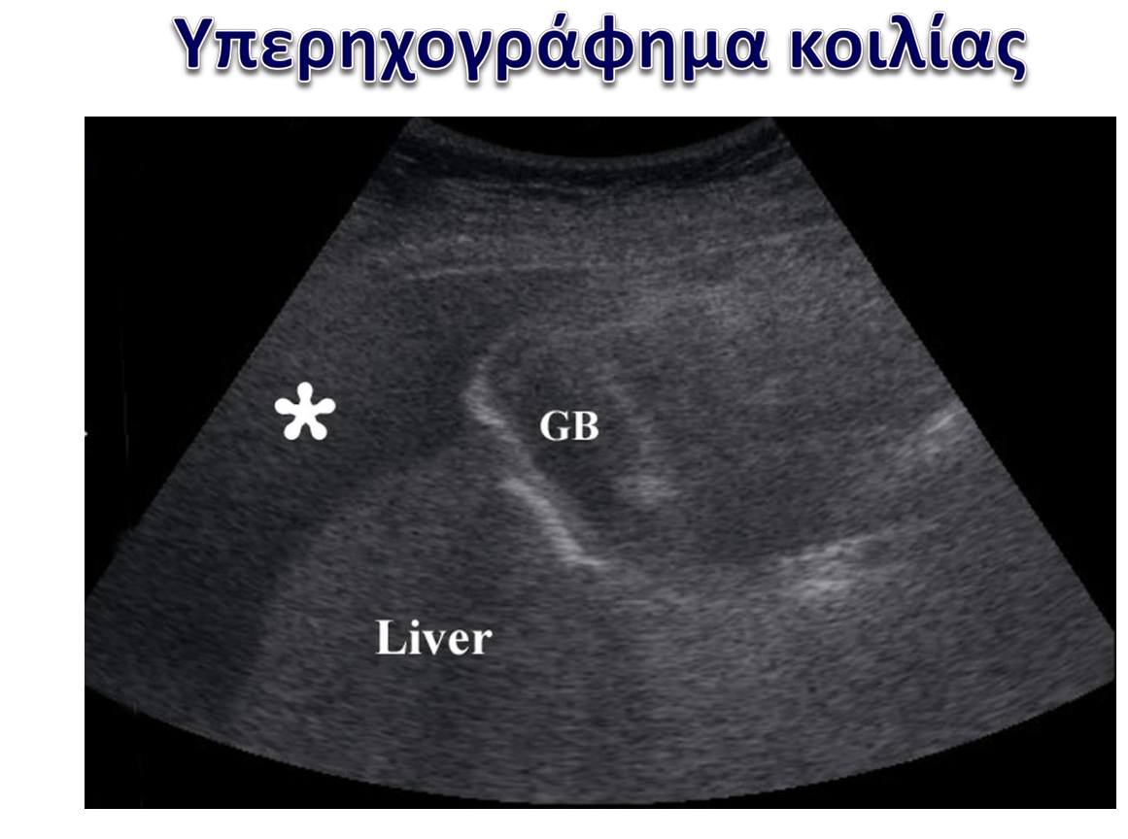
Imaging

Slide 48
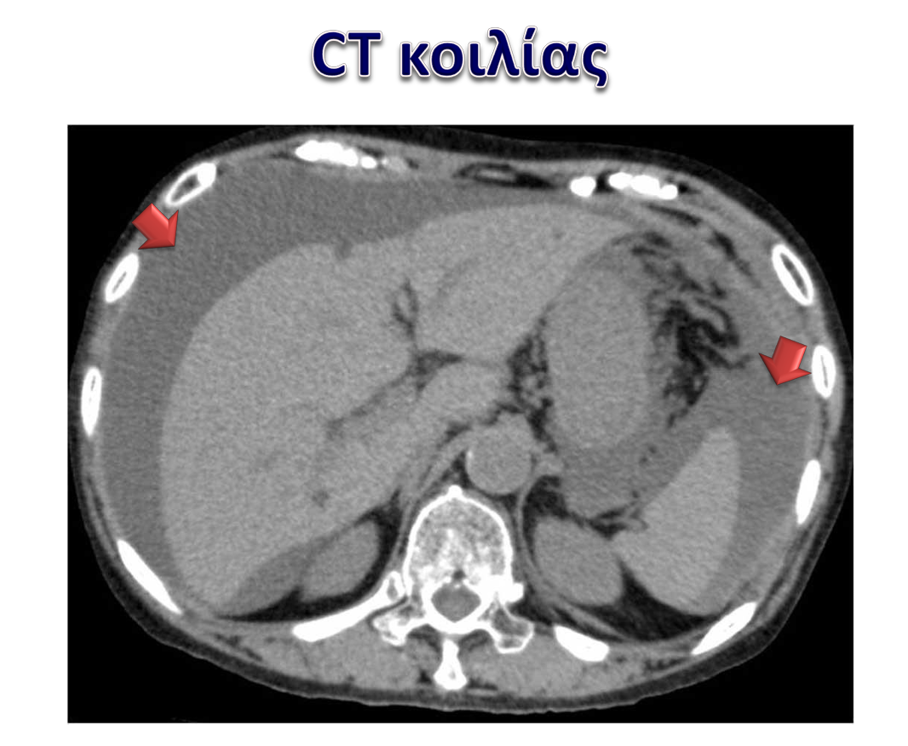

Slide 49
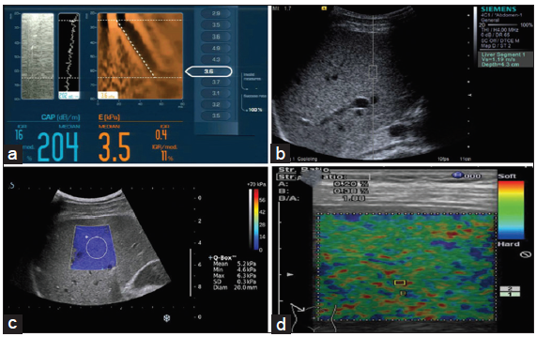
LIVER ELASTOGRAPHY
Ultrasound Elastography: It uses noninvasive low-frequency vibrations to assess the elasticity of organs
Sheer Wave Imaging*
(measures the speed of sheer waves that is related to the tissue stiffness)
1D Transient elastography
ARFI (Acoustic radiation force impulse)
Transient Elastography (Fibroscan®)
2D Shear wave Elastography
Types of ultrasound elastography
2D-Shear wave elastography
Strain-based elastography
Acoustic radiation force impulse (ARFI)
Strain Imaging$
Strain based Elastography
Magnetic resonance elastography (MRE): Most accurate noninvasive imaging technique€ for detection of liver fibrosis by assessing entire liver cross-section
*Transient elastography (TE) [Fibroscan®] uses a mechanically induced impulse shear-wave to obtain a single measurement. Shear-Wave elastography (SWE) uses a dedicated ultrasound machine to generate a shear-wave pulse to produce real time 2D/ 3D images; shear waves are generated by an external mechanical push in TE or by the push pulse of a focused ultrasound beam to achieve acoustic push in the ARFI techniques; $Strain imaging measures the strain response of tissue to stress such as manual compression taking advantage of soft tissue tendency to compress than hard tissue. The strain response can reflect the tissue stiffness, which is displayed on ultrasonography as a colour map overlaid to the grey scale image. €The MRE sequence is carried out with four short breath-holds and completed within 1 to 2 minutes, without the need for intravenous contrast injection. An active driver generates low frequency mechanical waves (typically at 60 Hz) which are conducted to the passive driver through a long plastic tube. The passive driver vibrates and produces shear waves that are propagated across the liver. The wavelength of the propagating shear wave is directly proportional to the stiffness of the liver, that is, the stiffer the liver, the longer the wavelength.
ARFI, acoustic radiation force impulse; 2D, 2 dimension
Praktiknjo M, et al. J Hepatol. 2020;72:1140-1150; Wang JH. J Med Ultrasound. 2019;27:1-2; Weston, Allan P. et al. American Journal of Gastroenterology 2018;113:S483; Sigrist RMS, et al. Theranostics. 2017 Mar 7;7(5):1303-1329; Kan Q.C. et al. J Hepatol. 2025; 63:525-535; Ferraioli G, et al. Ultrasound Med Biol. 2018 Dec;44(12):2419-2440; Tan CH, Venkatesh SK. Gut Liver. 2016 Sep 15;10(5):672-86.

Slide 50
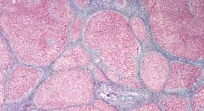
LIVER BIOPSY

Slide 51
Interestingly, liver cirrhosis seems not to be the end of the game as we previously thought.
The management of the causative factor may reverse the liver damage.
There are cases in which, after effective treatment of the causative factor, liver fibrosis has reversed.
Thus, patients with compensated cirrhosis may revert to more moderate fibrosis stages, reducing the risk of development of liver-related complications. There are also some patients with decompensated disease who manage to revert to a compensated state, getting withdrawn from the transplant list.
Surely, not all cirrhotic patients achieve a reversal. Definitely, the more severe the liver damage, the less the possibility of reversal.

