Slide 1
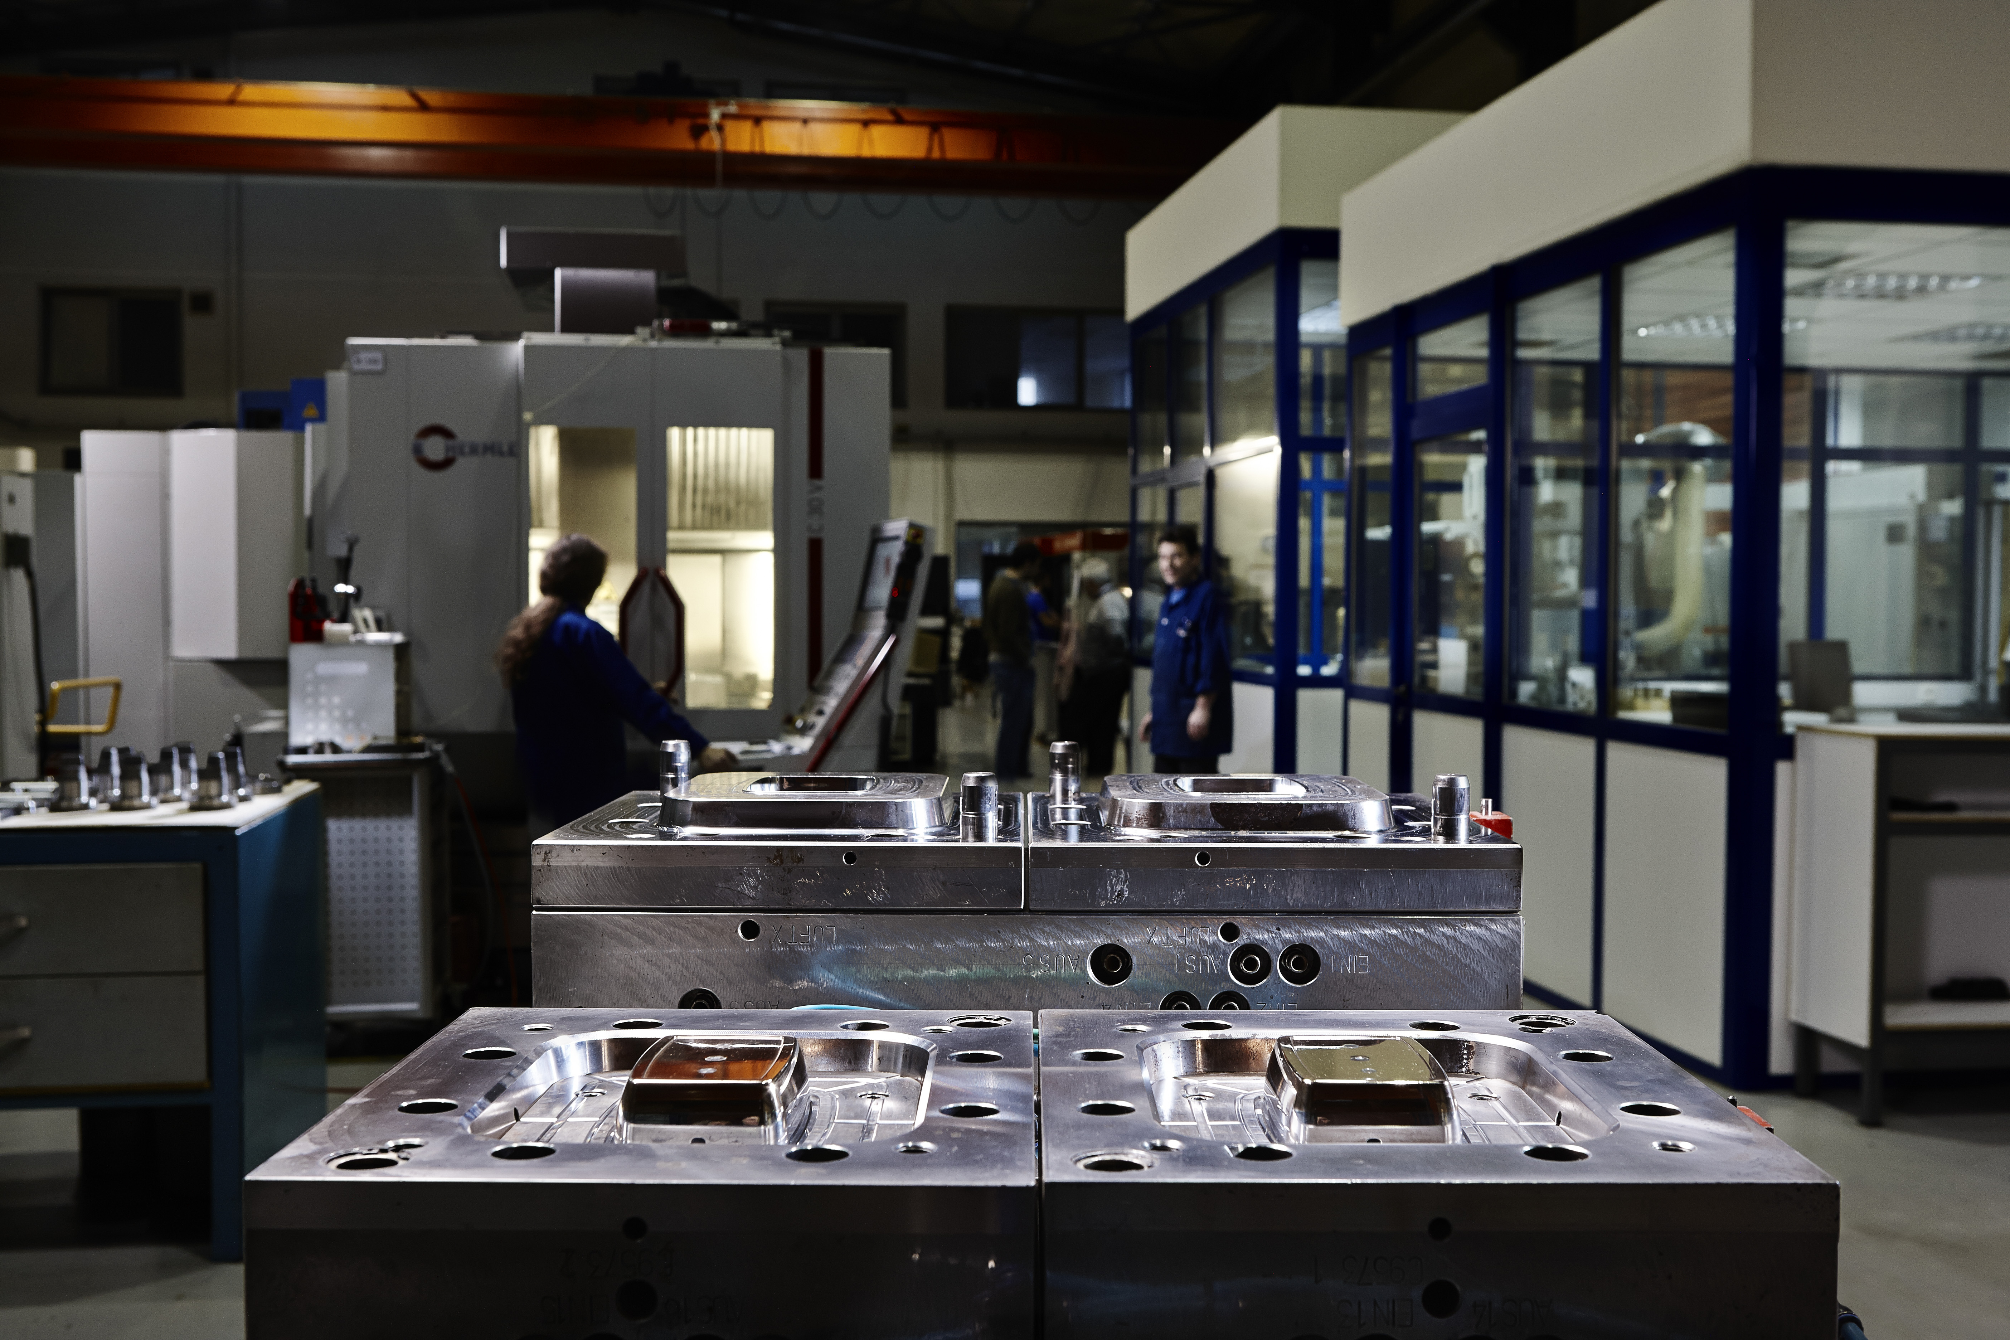

Company Profile and presentation Intravis
May 2022

Slide 2
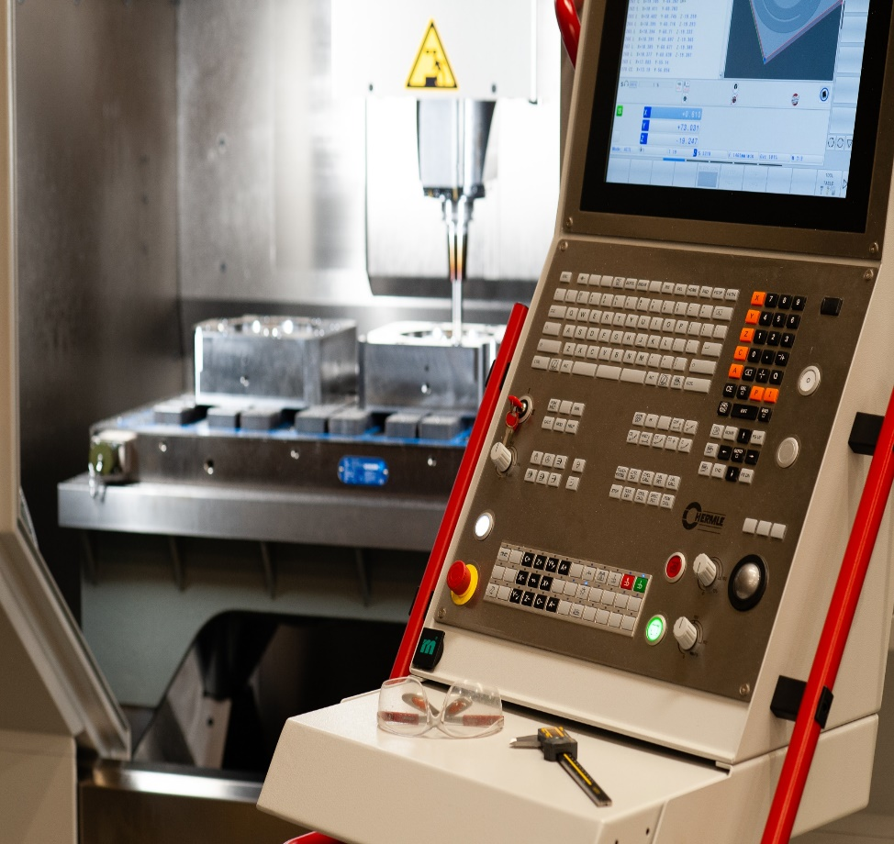


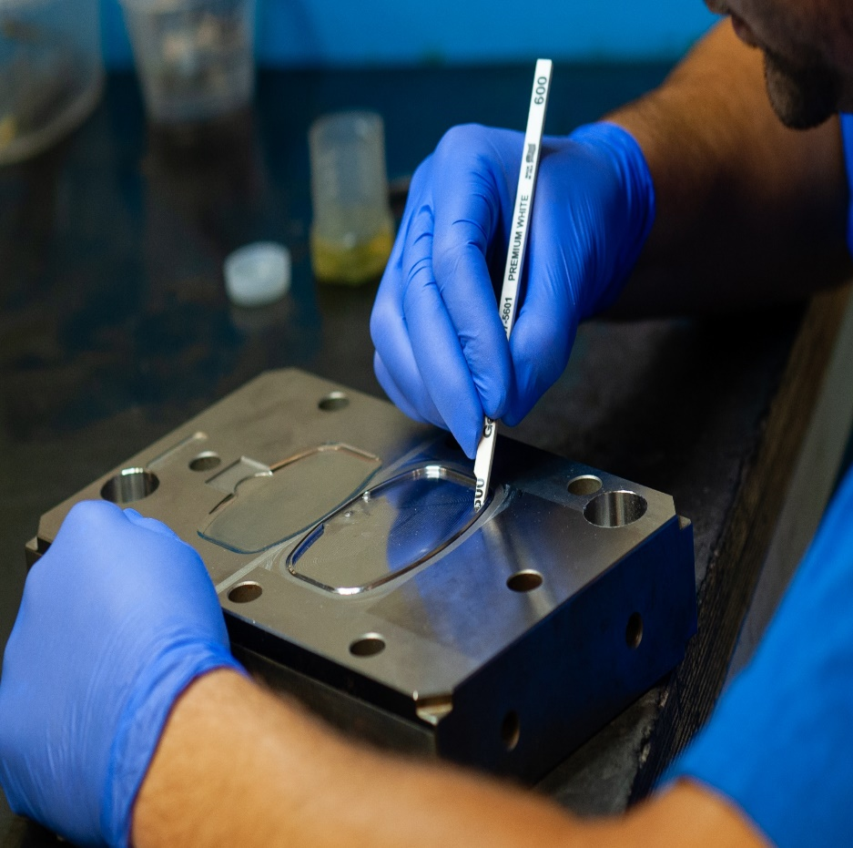


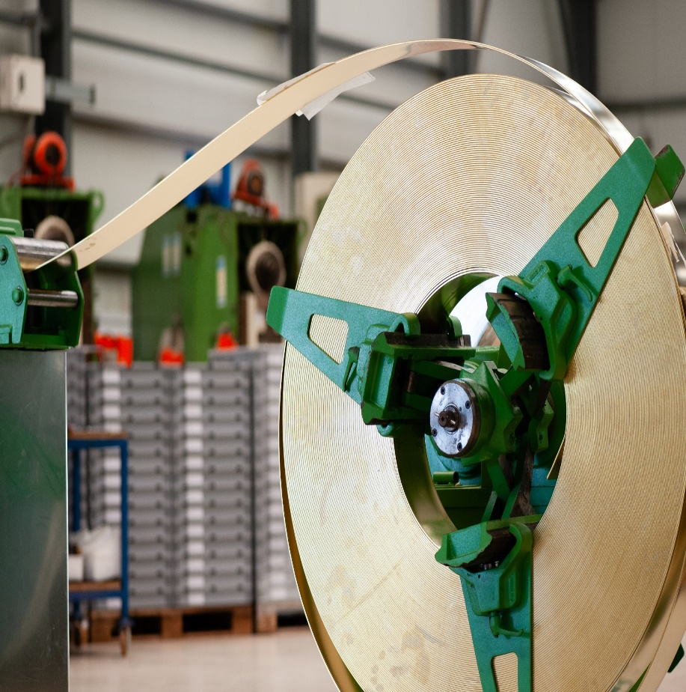





Agenda
Company Profile
Bazigos Philosophy, Vision & Mission
The Bazigos Market
Why with Bazigos
Partners or Customers
The Bazigos Know-how
Facilities
Our future
www.bazigos.eu

Slide 3
Company Profile
The company was founded in 1973 by Mr. Nikolaos Bazigos in Athens.
Initially, it focused on the metallurgy industry with very high precision parts.
Now with a workforce of 75 people, mainly consisting of Engineers and specialized technicians/machine operators. (25 Mechanical Engineers, 2 Chemical Engineers)
Manufacturer of state-of-the-art mold technology and high-precision equipment, design and custom studies for companies operating in the European and global market.
A production unit with Injection machines, hydraulic and mechanical presses is in operation for the production of technical parts.
Start in Piraeus - Athens
Large Injection molds
Start of production in cooperation with Bic
Relocation in the new Mandra plant
Steppingstone cooperation for Packaging Injection Molds
Further expansion with new buildings and production facilities
1992
2006
2022
1973
1994
2010
www.bazigos.eu

Slide 4
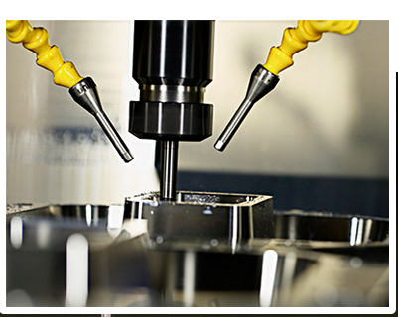

Company Philosophy
Responsibility
With a deep understanding of the industrial value chain, Bazigos prides itself on being a reliable partner and not just a supplier, given that customer requirements are essentially common goals.
Integrity and Transparency
The established long-term partnerships are based on the collaborative approach at the very initial stages of each project, as well as on the support at all levels at any time of the life cycle.
Effectiveness and Innovation
The annual CapEx on Hi-Tech and training as well as the continuous improvement of people and innovation of our processes, are the pillars, of the development so far and for the future.
www.bazigos.eu

Slide 5
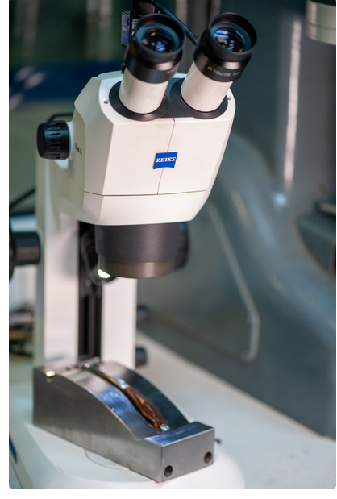
Vision 2025
The company Bazigos , aims to establish itself as one of the leading mold manufacturers in Europe
With its’ collaborative and innovative approach to engineering design, its’ flexibility and commitment to implementation, the company welcomes opportunities for new partnerships and consortia to develop new products and services.
www.bazigos.eu

Slide 6

Our Mission
Maintaining the highest standards of reliability, quality and accuracy, while reducing delivery time, it adopts new technologies that the digital age brings to the construction industry, integrates them in the production to offer innovative products and services to its’ customers.
www.bazigos.eu

Slide 7
The Bazigos Market
BAZIGOS is the leader in the domestic market and a key player in the Balkan region. Bazigos competes at European level with the leading companies in the industry. Supporting throughout the life cycle of the product, from the design and development of new products, to the construction and implementation of integrated solutions and after-sales services, BAZIGOS is established as a reliable partner for major manufacturers and companies in Europe. Around 80% of the turnover comes either directly from the foreign market, or through multinational partners with a global presence.
www.bazigos.eu

Slide 8
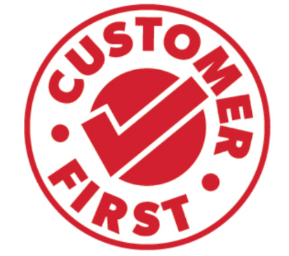


Why with Bazigos?
For our mentality which is "Customer first".
"Above all, we see partners in our customers, and we never leave them alone."
This means quick and accurate answers, whether it is technical information, services or offers.
For the Quality we provide and the confidence in our abilities.
We provide the quality you seek and expect, we are the people you can trust. We keep our promises without exceptions or discounts.
Quality control is our strength. Experienced and well-trained engineers are supported by quality control reports for each individual component.
For the Research & Development that has become part of our culture.
25% of the annual CapEx, is used for R&D, process optimization and continuous training.
For our mindset and actions that are based on innovation and on the most modern technology.
www.bazigos.eu

Slide 9














Partners - Customers
Bazigos' s partners’ list, includes large pharmaceutical industries, multinational companies of personal care products, manufacturers of smart electricity meters and electromechanical systems, solar panel manufacturers, gas bottling industries, as well as packaging manufacturers for food and chemicals .
www.bazigos.eu

Slide 10
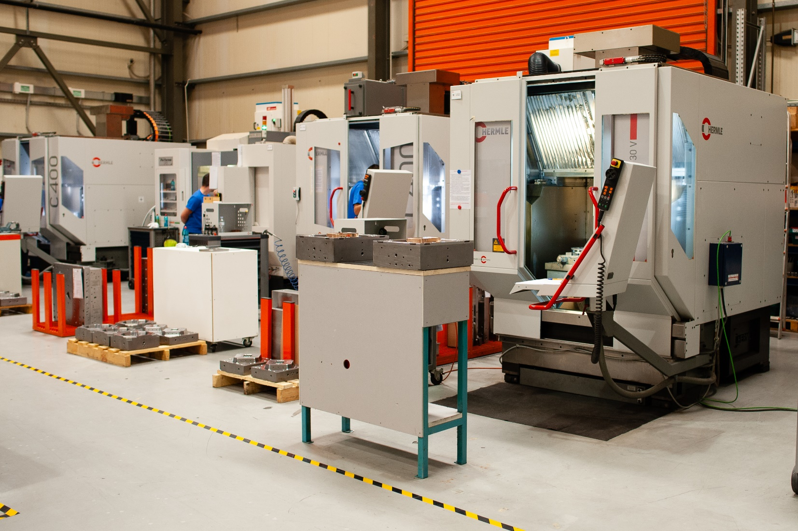
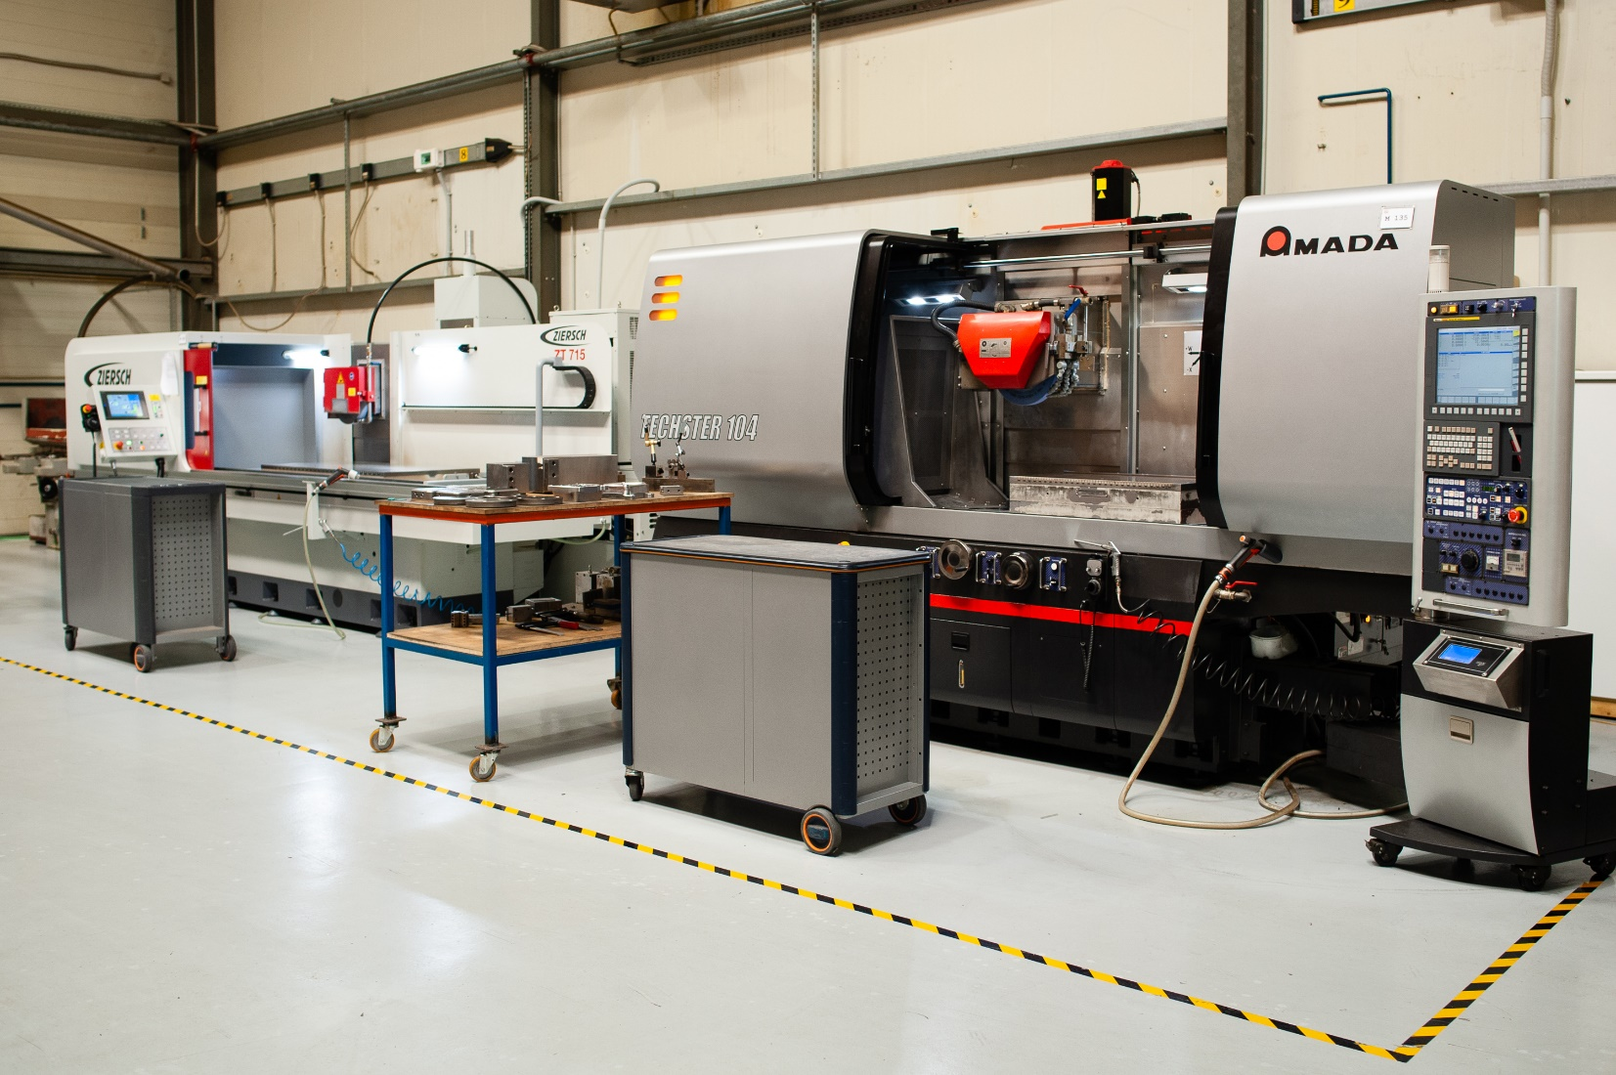
The Bazigos Know-How
Production of very high precision components (+/- 5m)
Design and development of molds for metal products:
Design and development of injection molds for plastic products (Injection molds)
Thermoforming Inserts
Turn-key solutions, Industrial Automation, Press Repairs, Product Development, Industrial Projects, Production Lines.
Progressive cutting and shaping dies
Deep draw double action molds
www.bazigos.eu

Slide 11
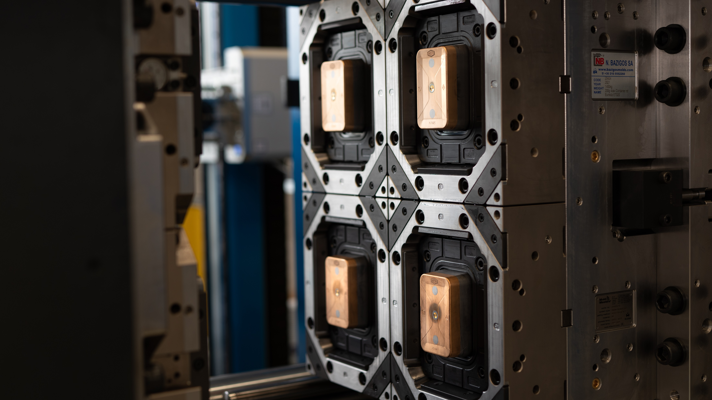
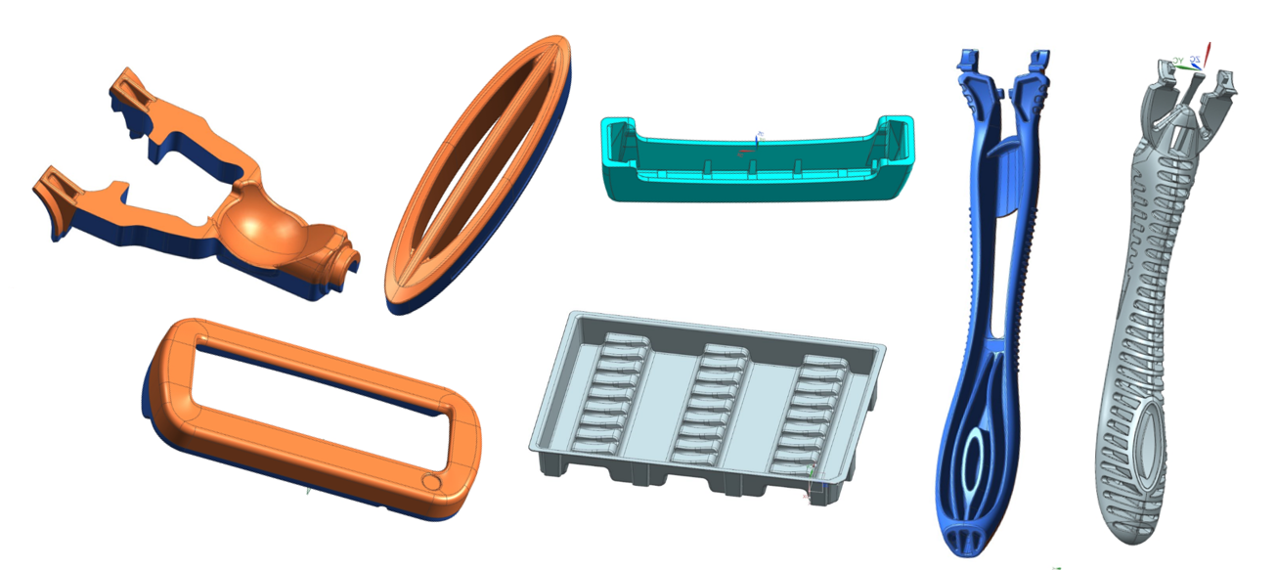
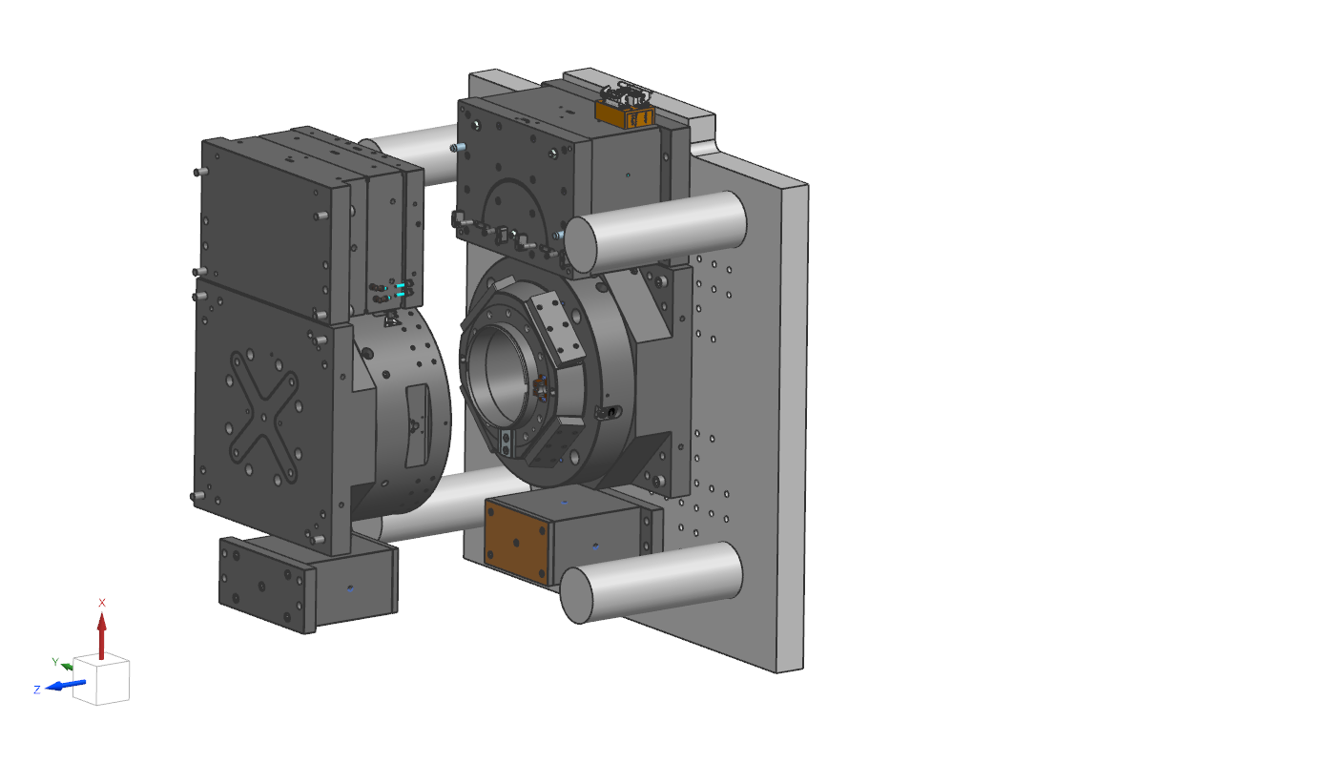
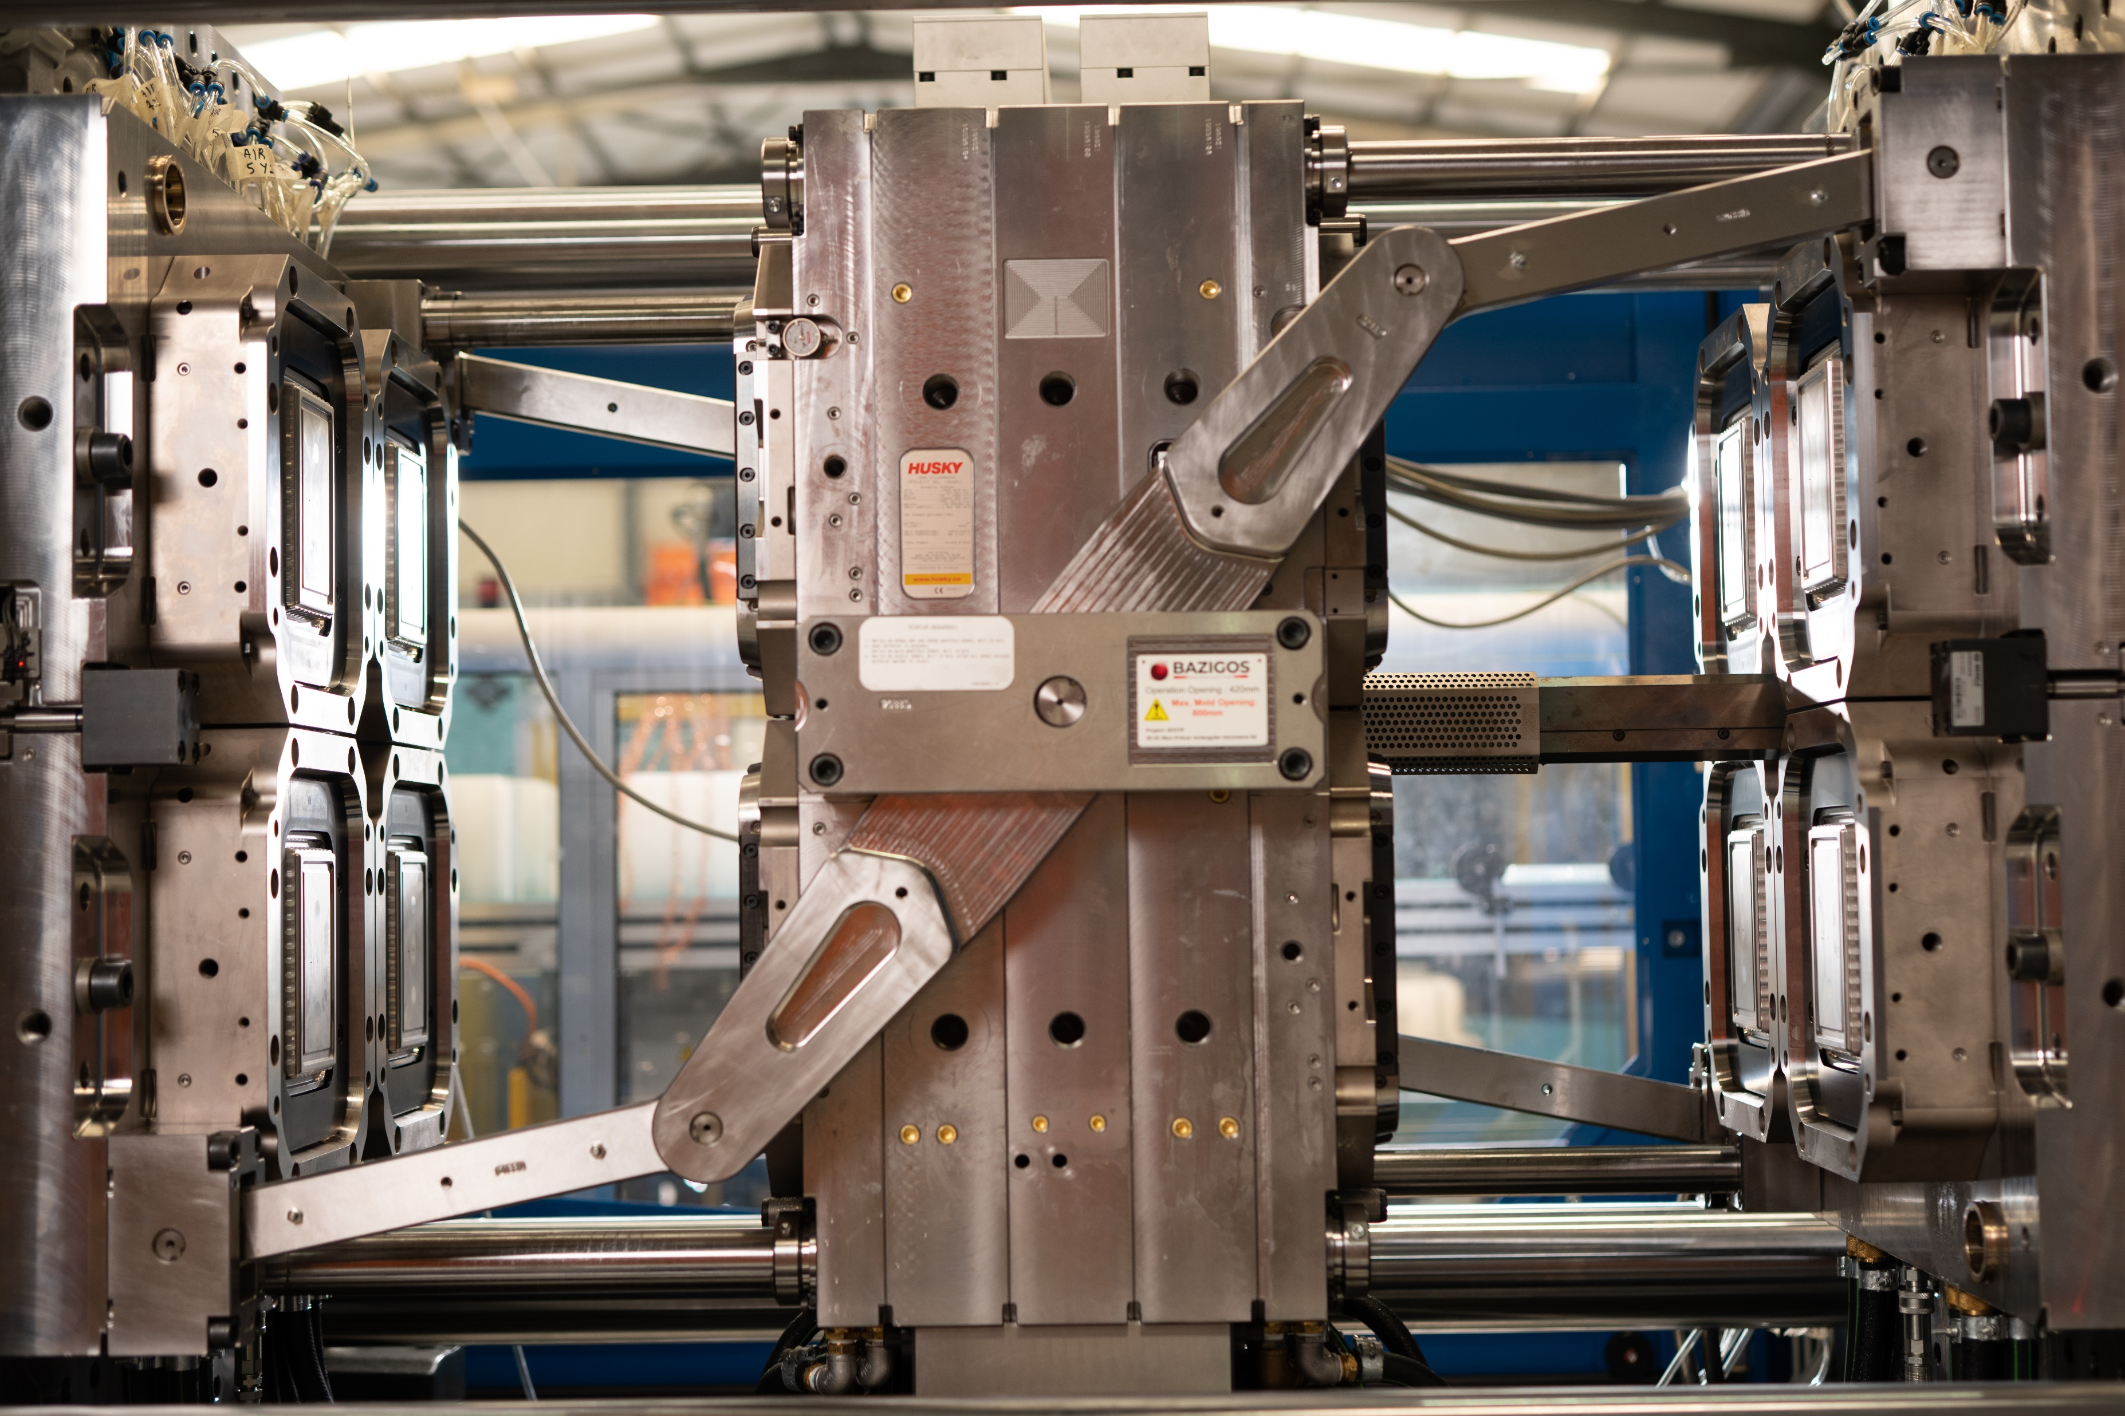
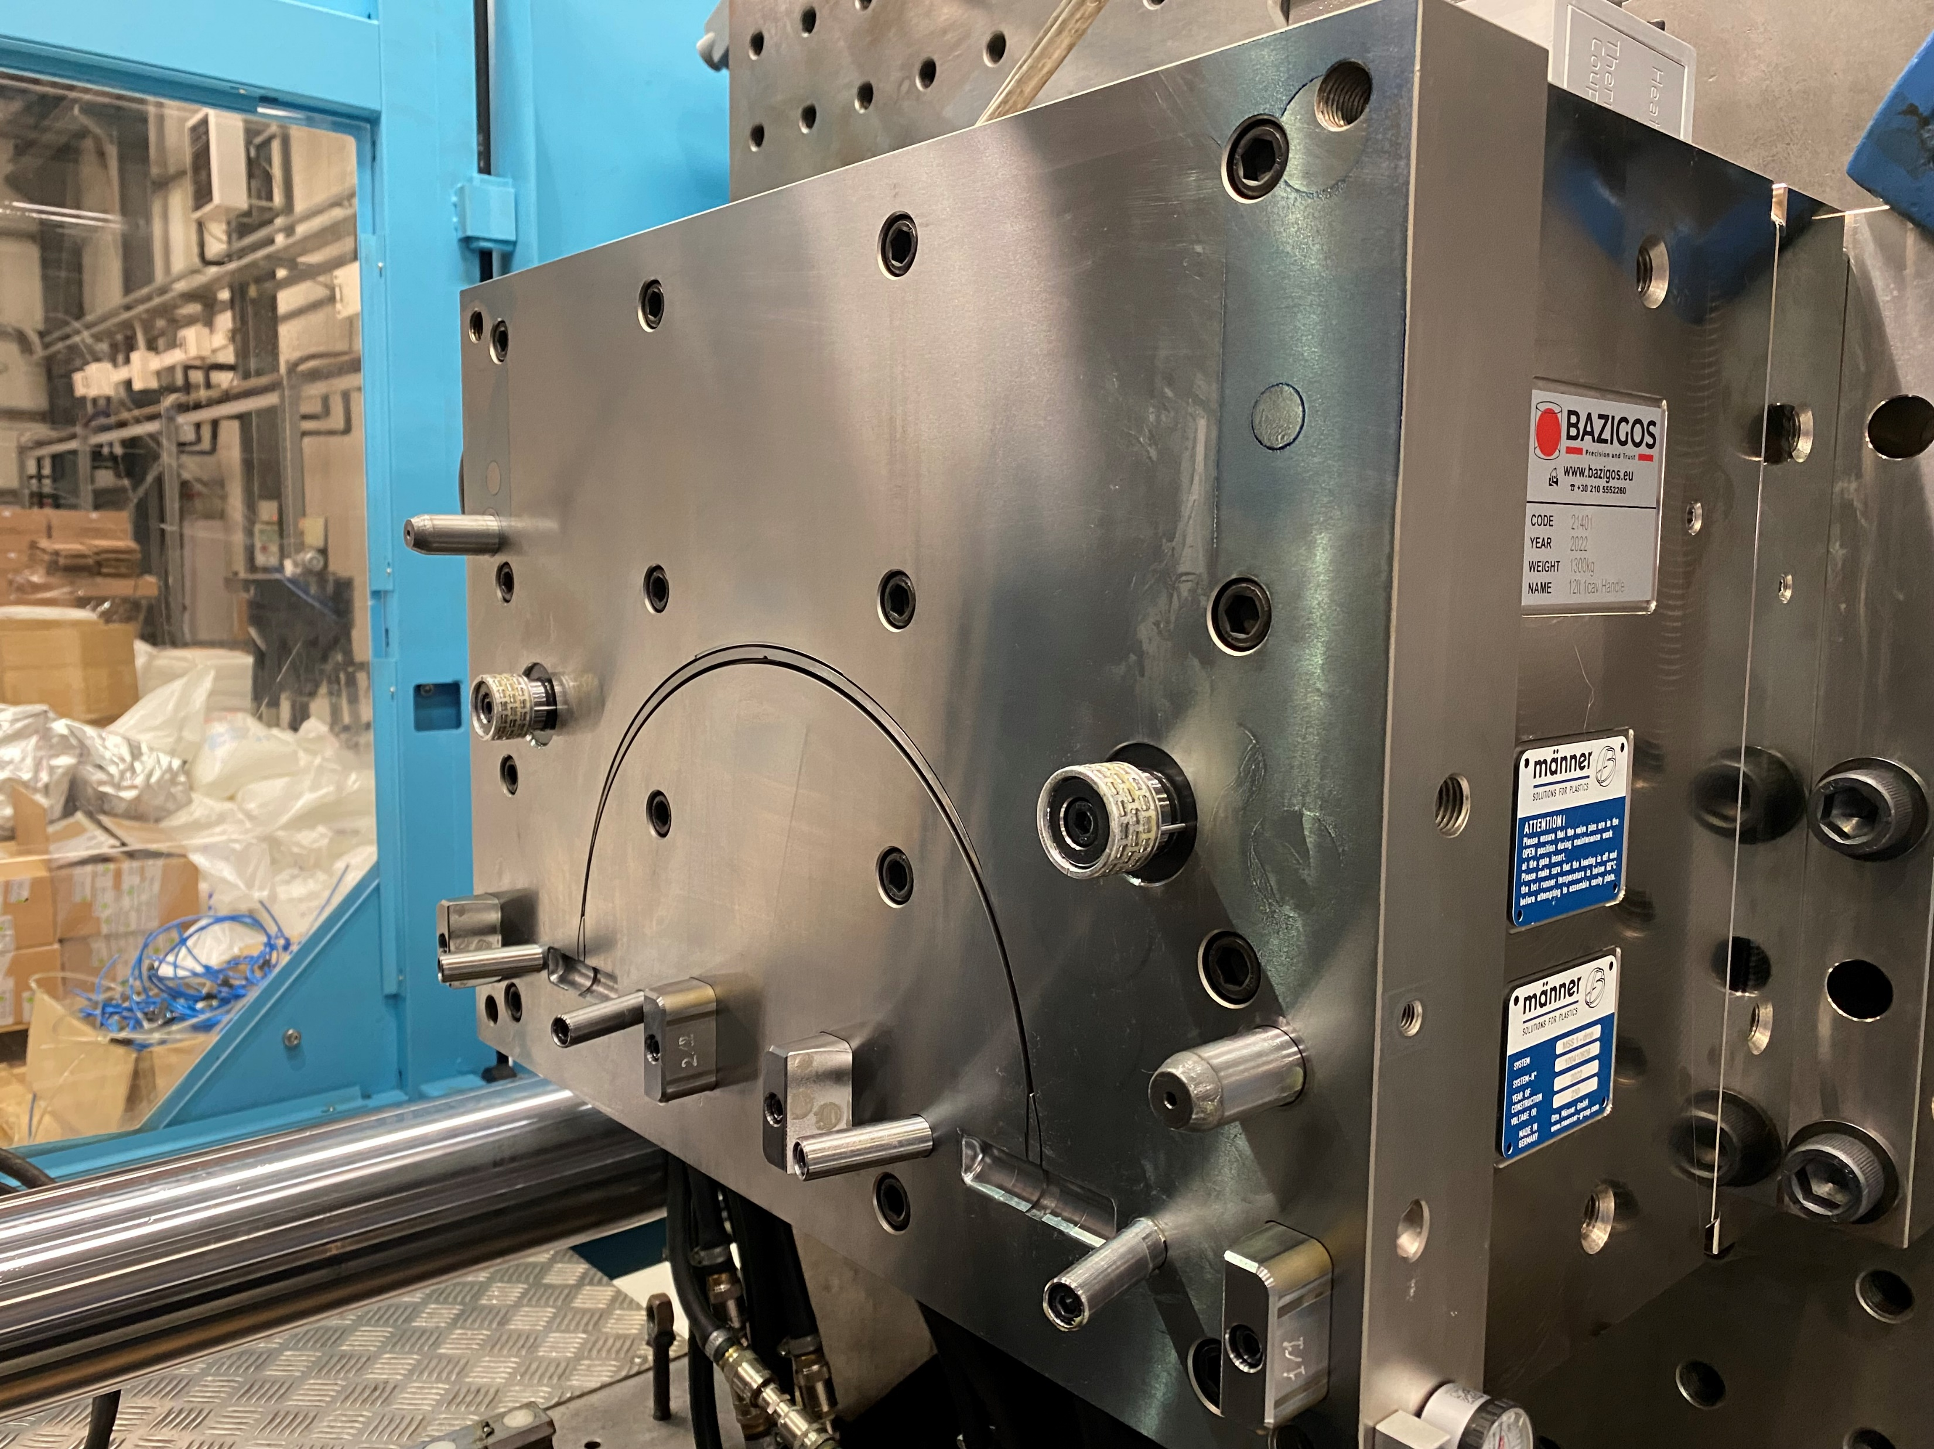
Injection molds I
Design and development of molds for:
Thin-walled packaging products. (TWP)
Shaver parts.
Technical components.
Automation solutions for Injection molds.
Bazigos has extensive experience in the manufacturing of precision, short cycle, multi-cavity injection molds for thin-walled containers, sealing lids and other plastic product solutions.
www.bazigos.eu

Slide 12
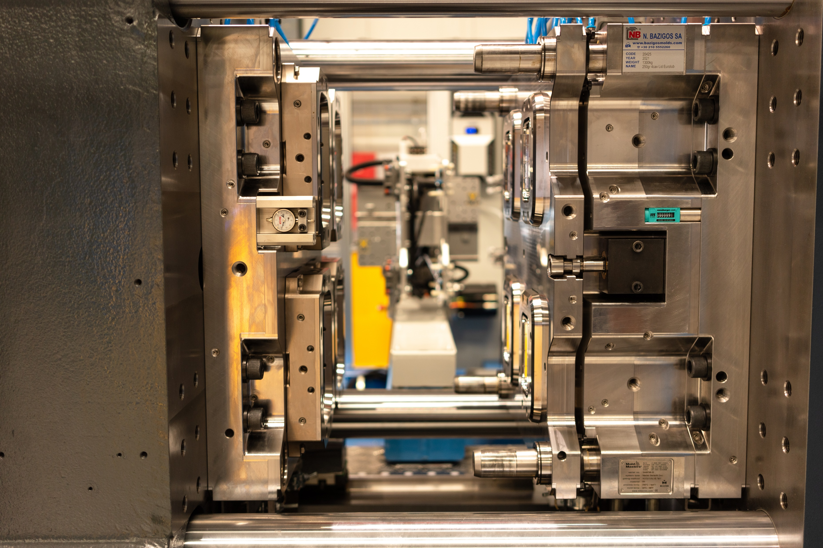
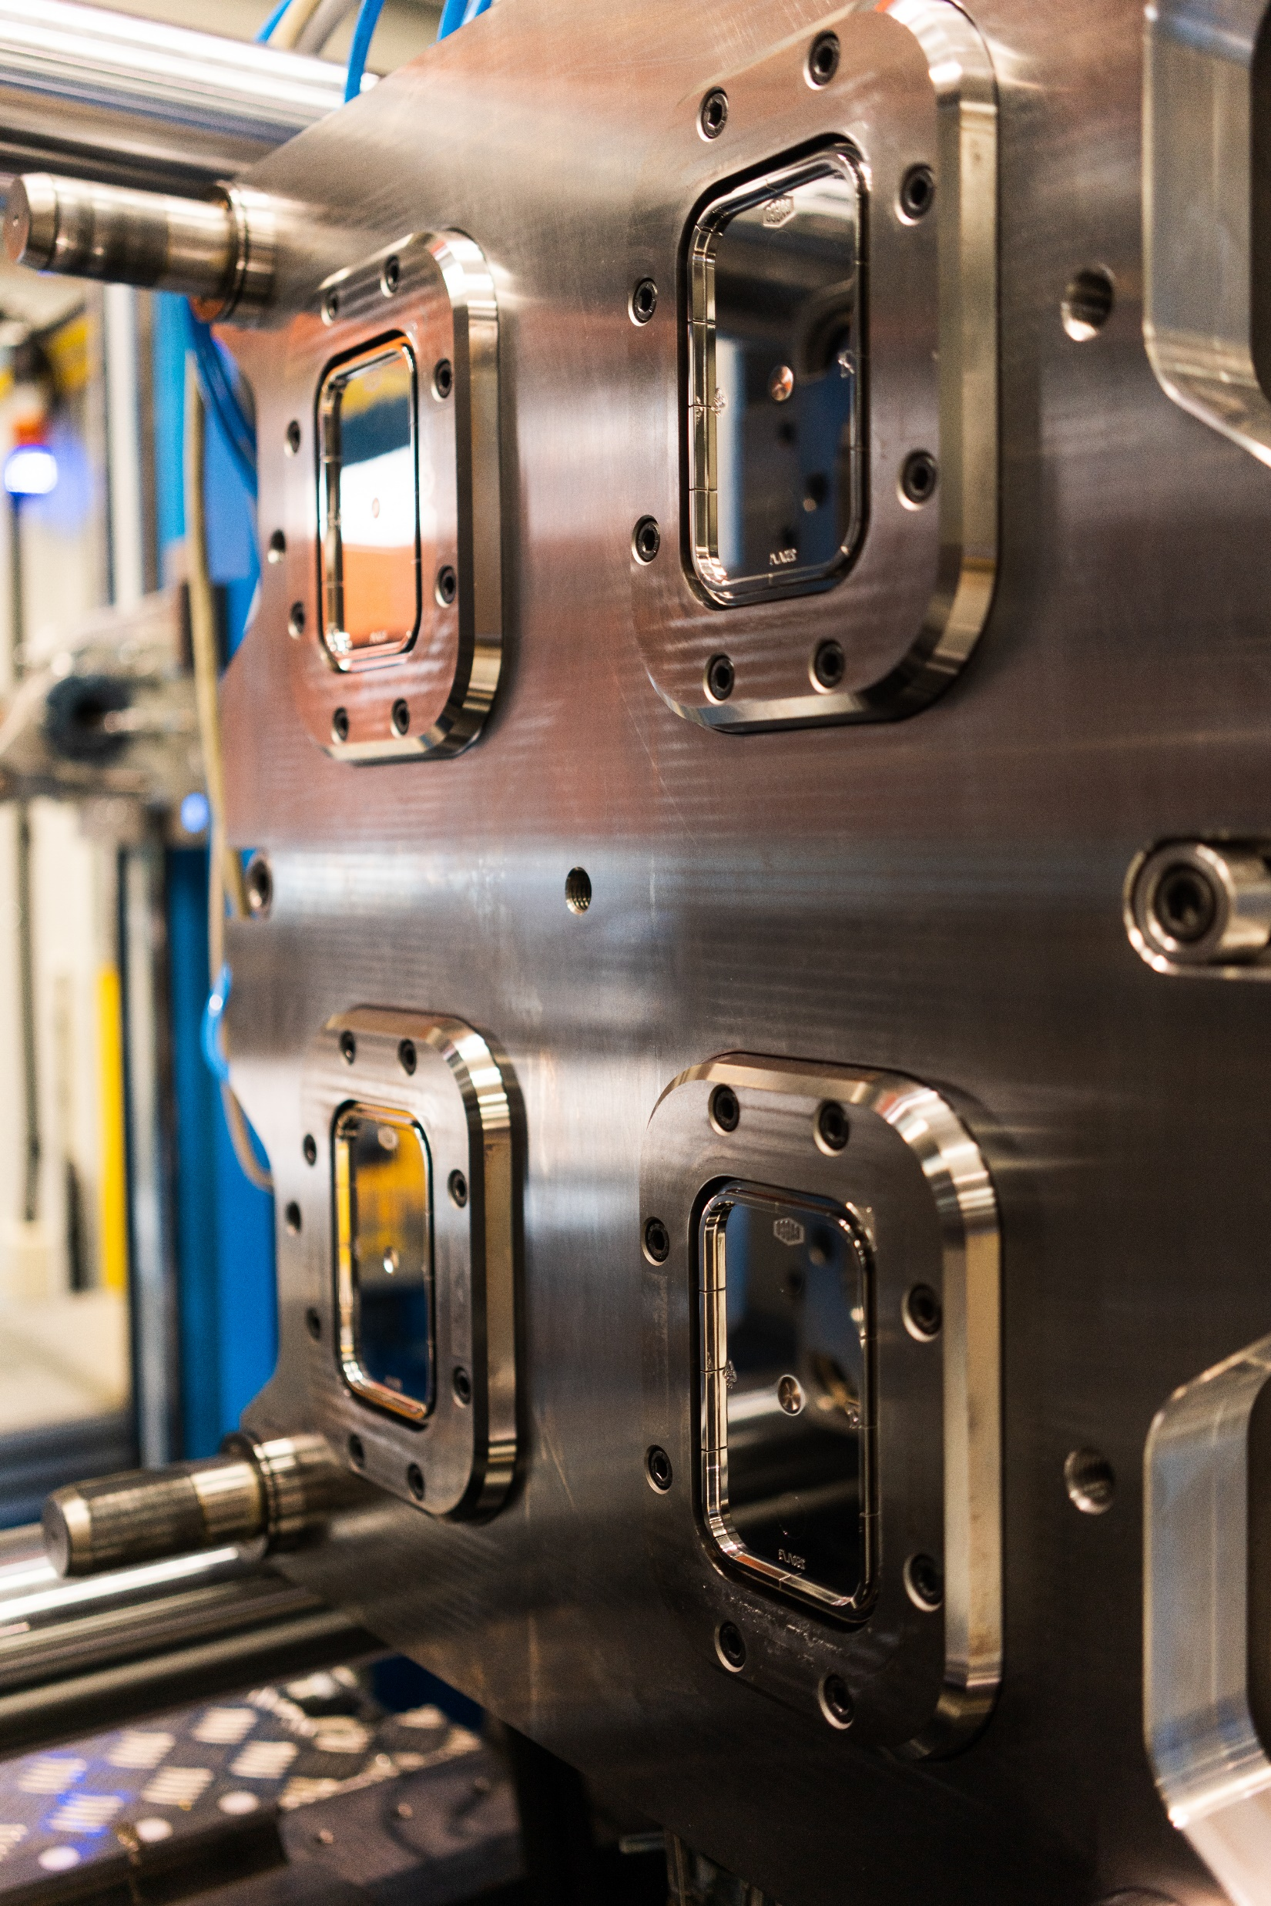
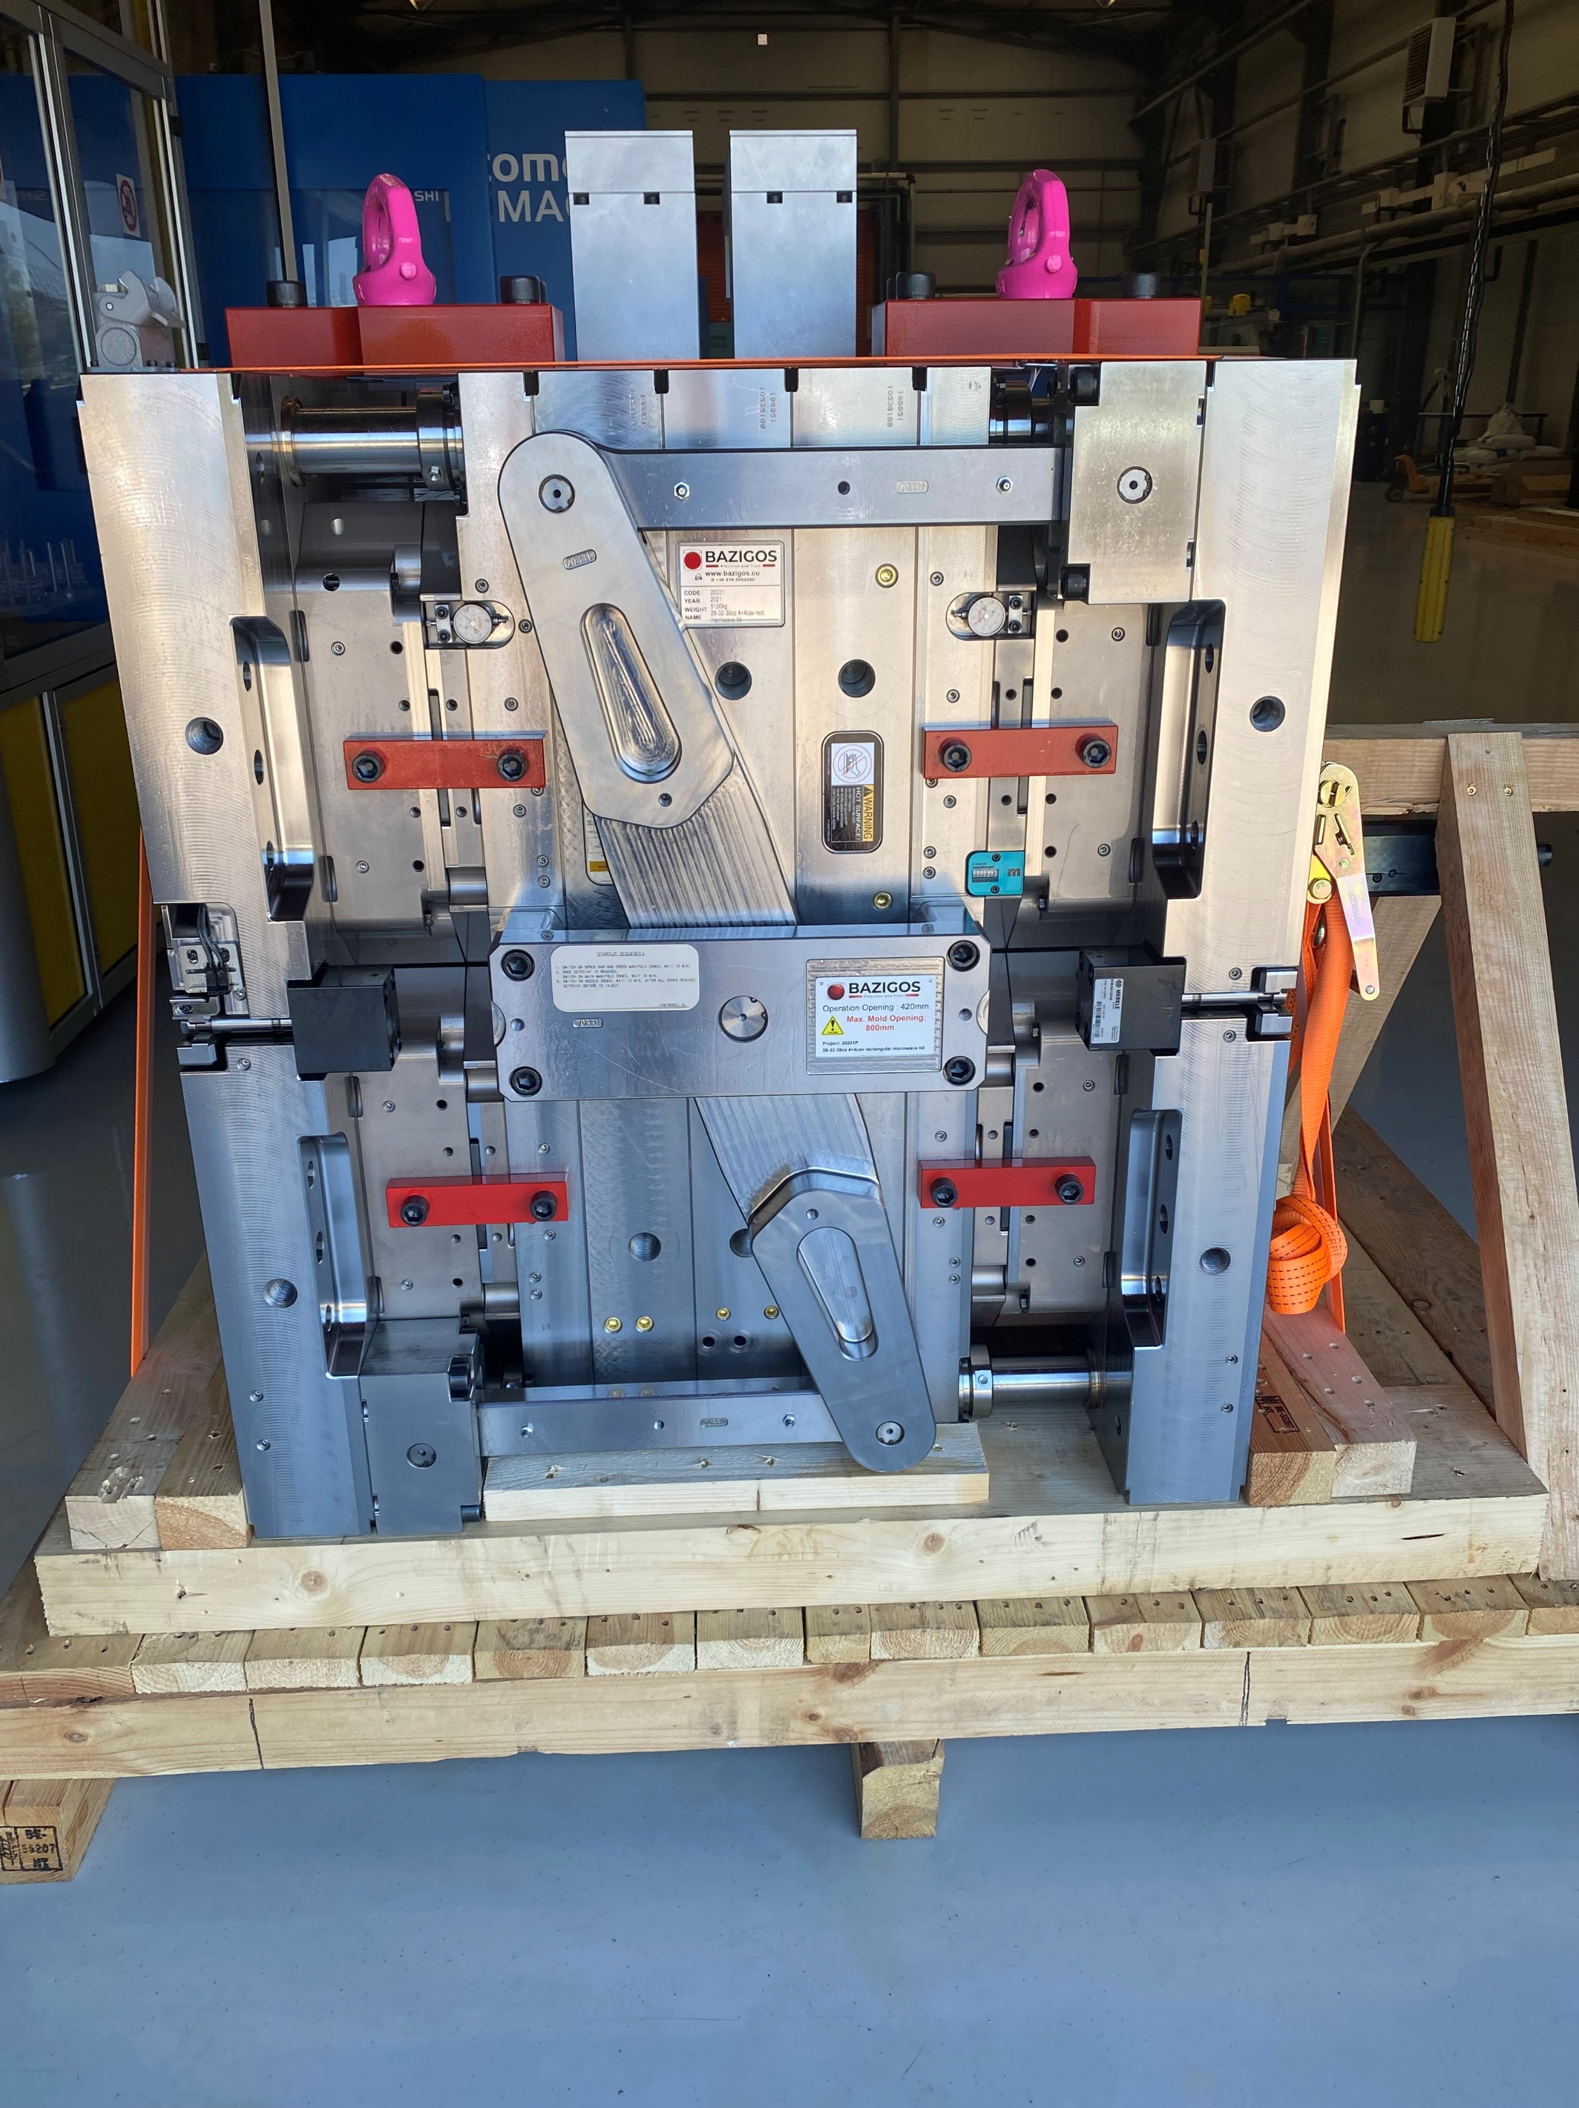
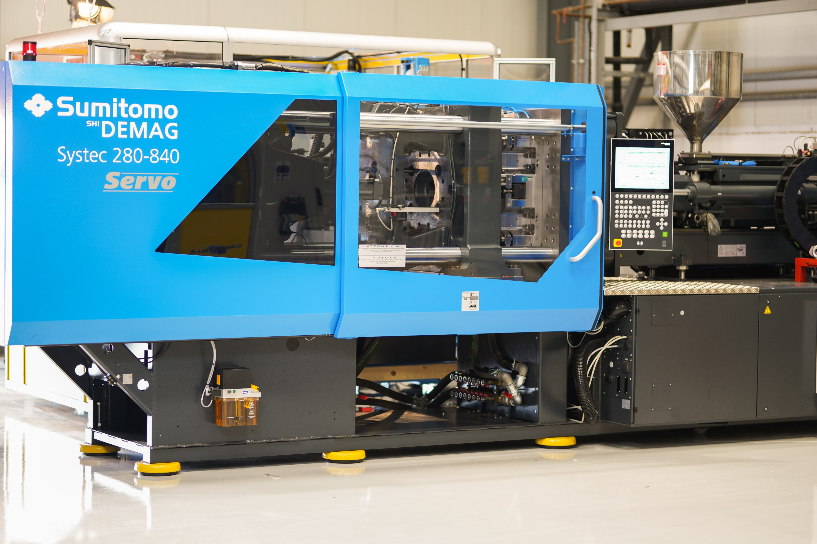
Injection molds II
All mold components are of the highest standards as Husky, Moldmasters or Maenner for balanced meltflow , Merkle for core pullers and Udeholm or Meusburger for steel plates.
Hardening and coating is done at Oerlikon , Nickel plating is done inhouse.
Ready to go !
Turnkey Project Demag/Campetella/Bazigos
www.bazigos.eu
Nickel plating at Eurotub lid

Slide 13
Injection molds III
Communication, Order Process, Design, Concept and Manufacturing
Project | 21280P | JANUARY |  |  |  | FEBRUARY |  |  |  | MARCH |  |  |  | APRIL |  |  |  | MAY |  |  |  |  | JUNE
 |  |  |  |  |  |  |  | CONCEPT APPROVED |  | PLATES ORDERED
Real time events |  | ORDER CONFIRMATION | TECHNICAL SPECS RECEIVED |  |  |  | UPDATE | PRODUCT APPROVED |  |  |  | UPDATE |  |  | ok |  | UPDATE |  |  |  |  | UPDATE |  |  |  | DELIVERY DATE
Plan | WEEK | 2 | 3 | 4 | 5 | 6 | 7 | 8 | 9 | 10 | 11 | 12 | 13 | 14 | 15 | 16 | 17 | 18 | 19 | 20 | 21 | 22 | 23 | 24 | 25 | 26
Engineering | Product | sent to customer |  |  |  |  |  | product approved
 | Mold Concept |  |  | concept design | concept design | concept design | concept design | mold concept approval
 | 3d Mold |  | mold 3d | mold 3d | mold 3d | mold 3d | mold 3d | mold 3d | mold 3d
 | dxf 2d |  |  |  |  |  |  |  | dxf 2d | dxf 2d | dxf 2d
 | Stacks |  |  |  |  |  |  | order stacks |  |  | deliver stacks | deliver stacks
 | Plates |  |  |  |  |  |  |  |  | order plates | RECEIVE PLATES | RECEIVE PLATES
 | Hotrunner |  |  |  |  |  |  | ask for hotrunner | hotrunner approval | hotrunner drawings |  |  |  |  |  |  |  |  |  |  | receive hotrunner
 | Components |  |  |  |  |  |  |  |  |  |  | order components | deliver components | deliver components
Manufacturing | Roughing Stacks |  |  |  |  |  |  |  |  |  |  |  | roughing stacks | roughing stacks | roughing stacks
 | Hardening |  |  |  |  |  |  |  |  |  |  |  |  | hardening stacks | hardening stacks | hardening stacks | hardening stacks
 | Finish Stacks |  |  |  |  |  |  |  |  |  |  |  |  |  |  |  |  | finish stacks | finish stacks | finish stacks | finish stacks | finish stacks
 | Polishing |  |  |  |  |  |  |  |  |  |  |  |  |  |  |  |  |  |  | polishing | polishing | polishing | polishing
 | Roughing Plates |  |  |  |  |  |  |  |  |  |  |  |  |  | roughing plates | roughing plates | roughing plates
 | Finish Plates |  |  |  |  |  |  |  |  |  |  |  |  |  |  |  |  | finish plates | finish plates | finish plates | finish plates
 | Mold Parts |  |  |  |  |  |  |  |  |  |  |  | Mold Parts | Mold Parts | Mold Parts | Mold Parts | Mold Parts | Mold Parts
Finalization | Assembly |  |  |  |  |  |  |  |  |  |  |  |  |  |  |  |  |  |  |  | Assembly | Assembly | Assembly | Assembly | Assembly
 | Test |  |  |  |  |  |  |  |  |  |  |  |  |  |  |  |  |  |  |  |  |  |  | test | test
 | Coating |  |  |  |  |  |  |  |  |  |  |  |  |  |  |  |  |  |  |  |  |  |  |  | deliver | deliver
Time Plan | 18 | WEEKS to completion
Offered time | 24 | WEEKS
Remainingl Time | -6 | WEEKS
www.bazigos.eu

Slide 14
Mold Trial
Sample Dimension checking
Sample approval
Customers send inquiry (2D, 3D,photos,samples)
Bazigos provides technical checking and suggestion / product study & development-optimization if needed
Bazigos provides quotation
How the project flows… step by step…
Upon request , we accept pilot run, low volume and mass production job
Product delivery
D
Mold Trial
Order confirmation
Mold design layout preparation (concept)
Mold design layout approval
Shipping documents preparation
Wooden case fumigation proceeded
Mold packing with standard export packed
Mold delivery and report to customer
A
Inquiry Period
E
Molding products
Steel ordering
Mold Making
Mold assembly
B
Order confirmation
F
Mold delivery
C
Mold
Making
www.bazigos.eu
Nickel plating at Et lid

Slide 15
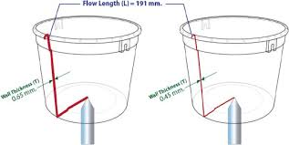
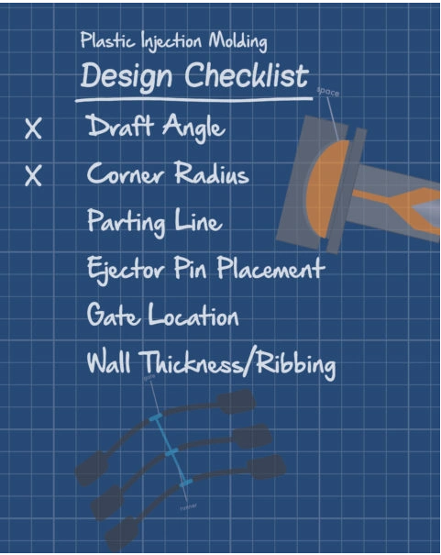
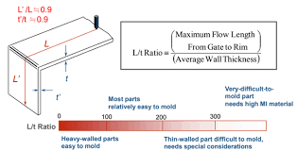
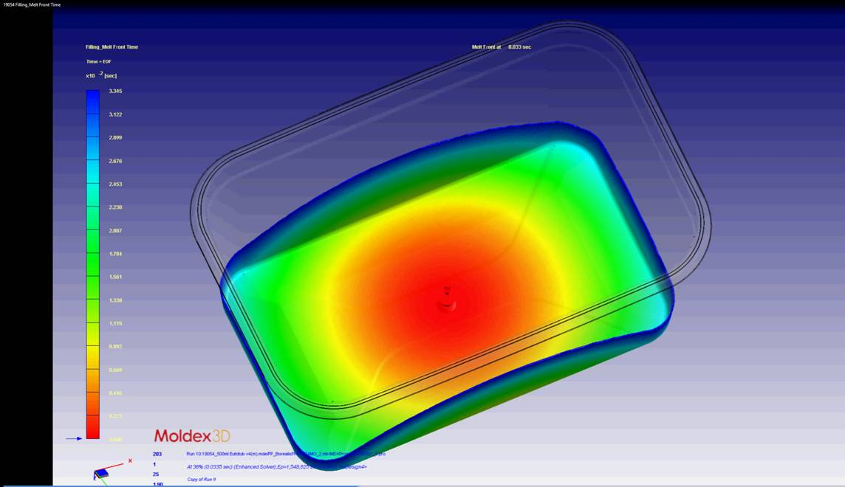
Product optimization studies
Design and development study for packaging products of food and chemicals, Improvements and adaptations to new requirements of functionality and weight.
Flow analysis, special treatment on metals to reduce friction and increase strength.
Regular maintenance, repairs and remodeling of used molds.
Production size Tests on machines that are dedicated to this purpose:
1 x Arburg Allrounder 50T (Pilot molds)
1 x Arburg Allrounder 100T (Pilot molds)
1 x Demag El-Exis 350 T NC5 +
1 x Demag El-Exis 650 T NC5 +
www.bazigos.eu

Slide 16
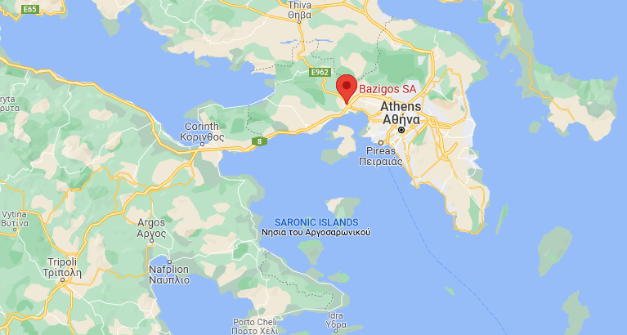
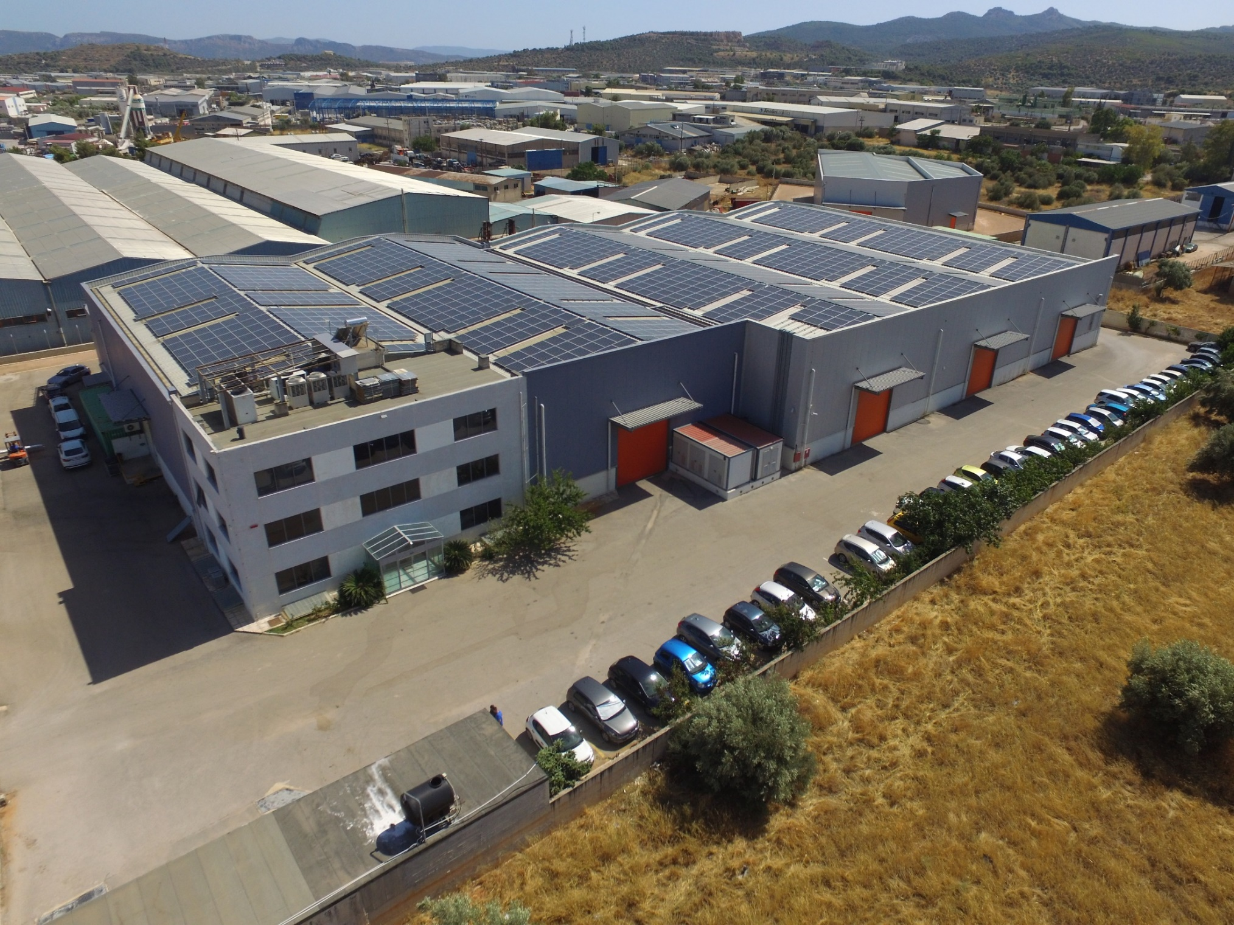
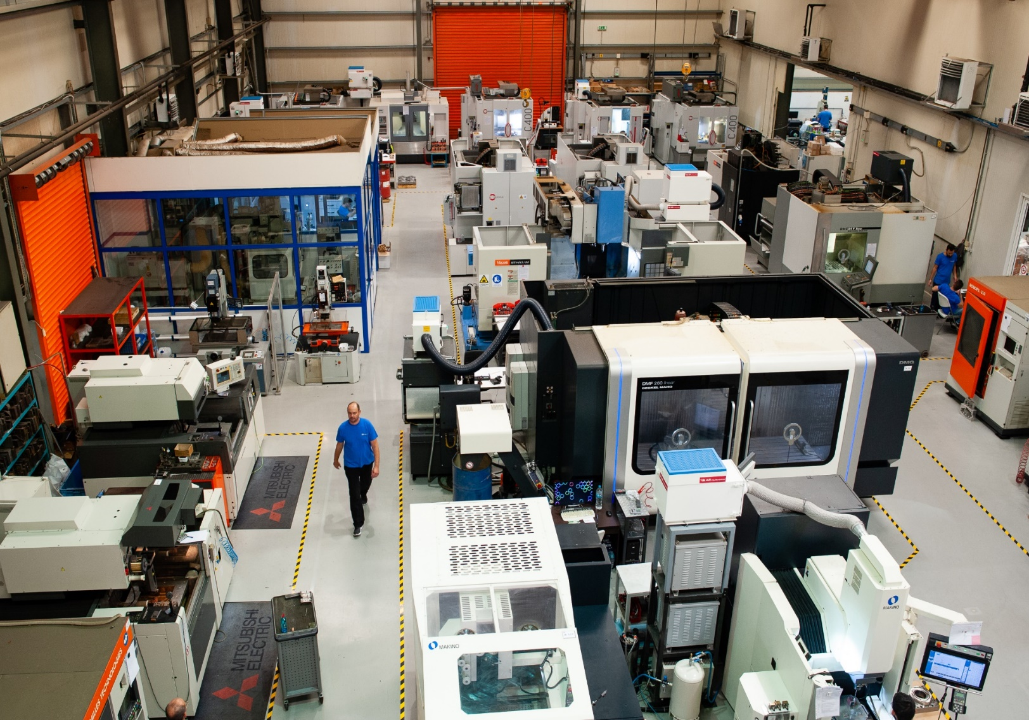
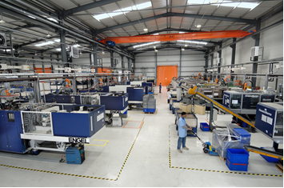
Facilities
The company is in Athens, in the industrial zone of Mandra, in a privately owned space of 21,000 m².
Production buildings 6,500 m²
Photovoltaic power plants 900 MW
Available space for building extensions 1,500 m²
www.bazigos.eu

Slide 17


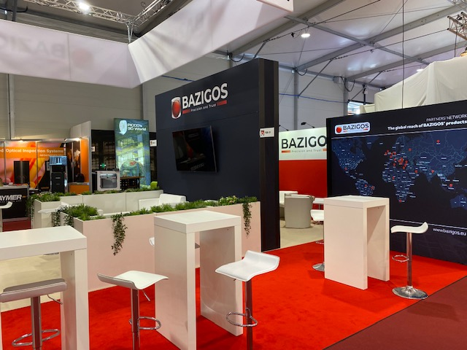
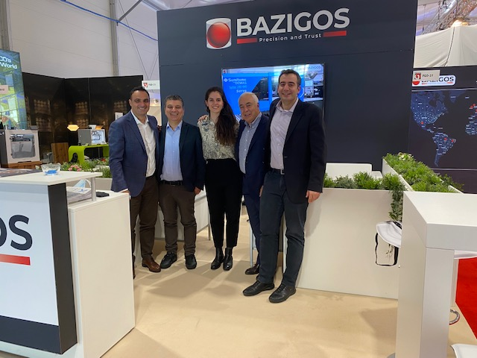
International shows
Bazigos has participated in in-house shows and major exhibitions in its field and will continue in 2022 at K’ 2022 in Dusseldorf 19-26 / 10
Bazigos SA booth @ Fakuma 2021
V. Thanos BDM,K. Papadakis Tech Director, L.Fouriki Engineer/Designer, Mr. Nico Bazigos - Owner, & Mano Bazigos CEO @ Fakuma2021
www.bazigos.eu

Slide 18
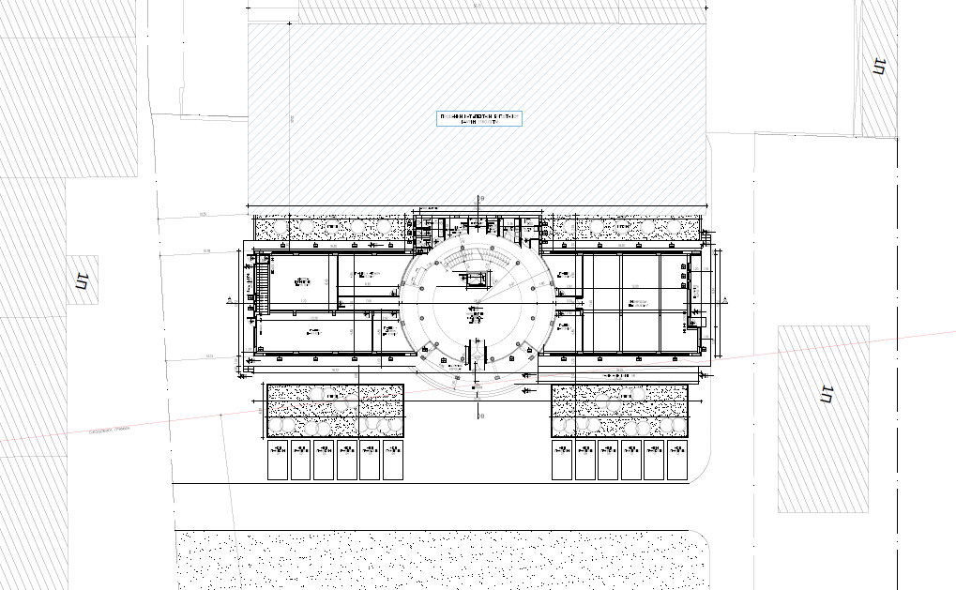
Growing
Construction of a new space within 2022, for expansion of production and housing of the high-precision and finishing machines. Furthermore, a new “green” building will be created to include functional areas for the CAD designers as well as training rooms for the in-house school of apprentices, meeting rooms, a showroom of our products and offices for the administration.
www.bazigos.eu

Slide 19
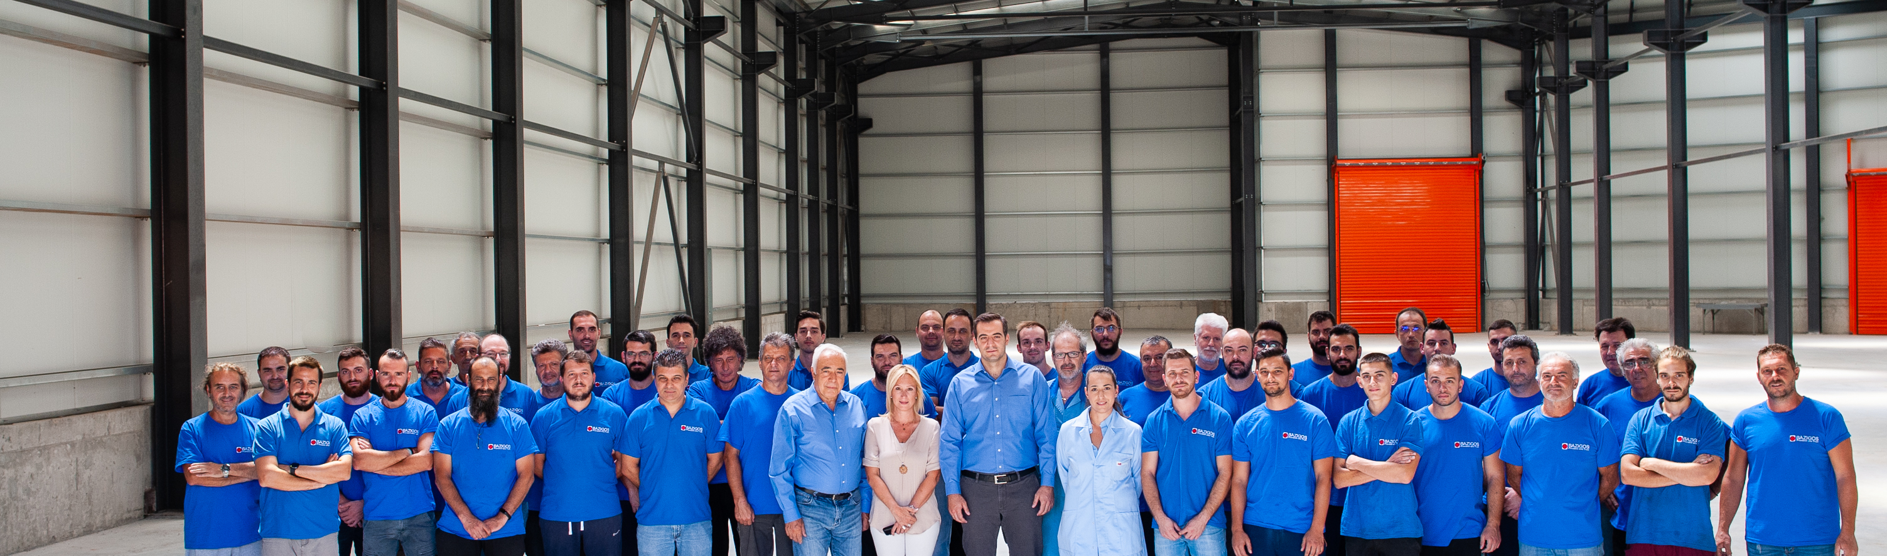

Precision that matters by people to trust

Slide 20

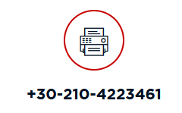



www.bazigos.eu

Slide 21
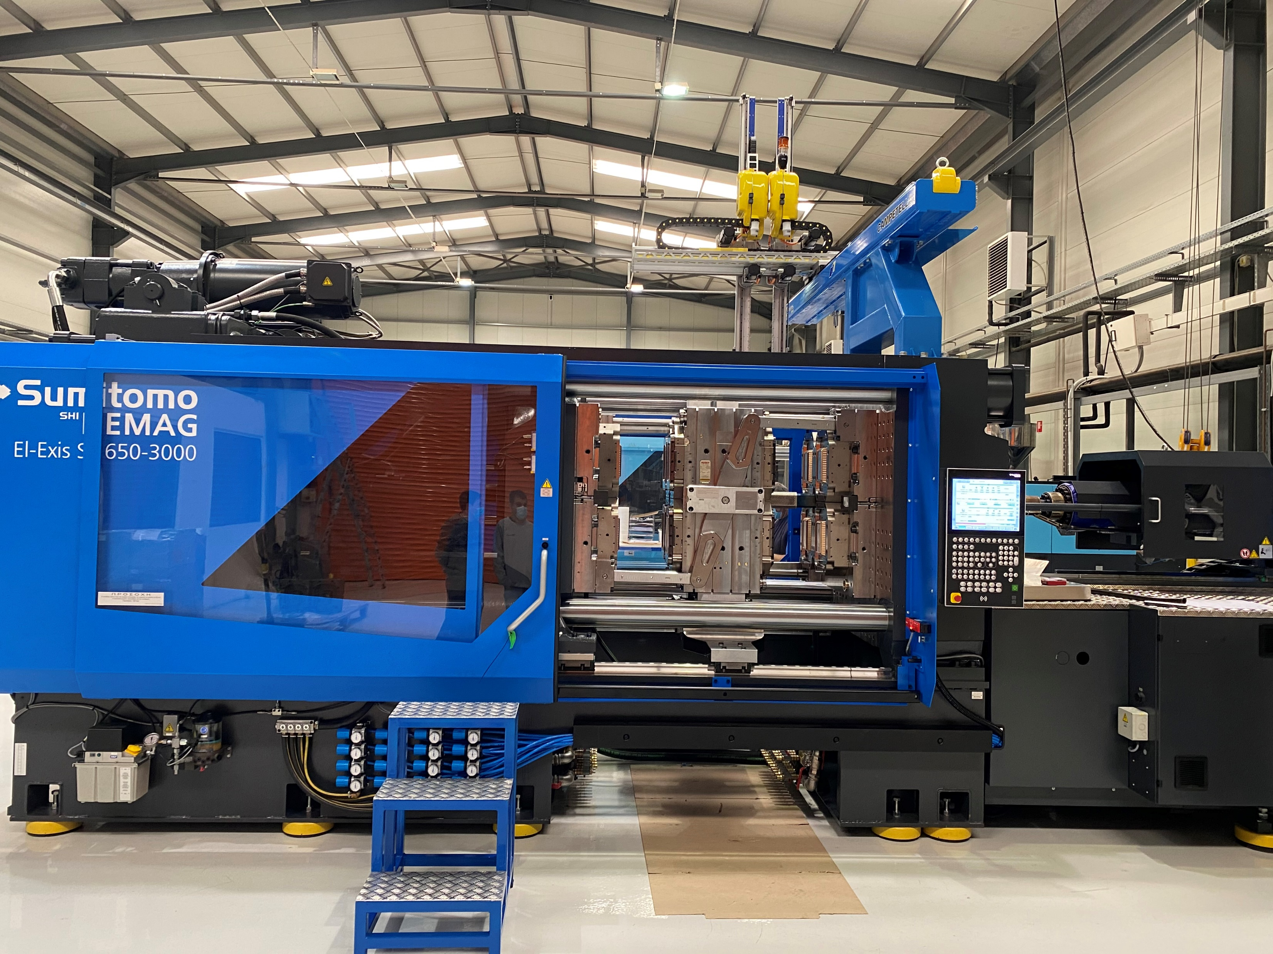
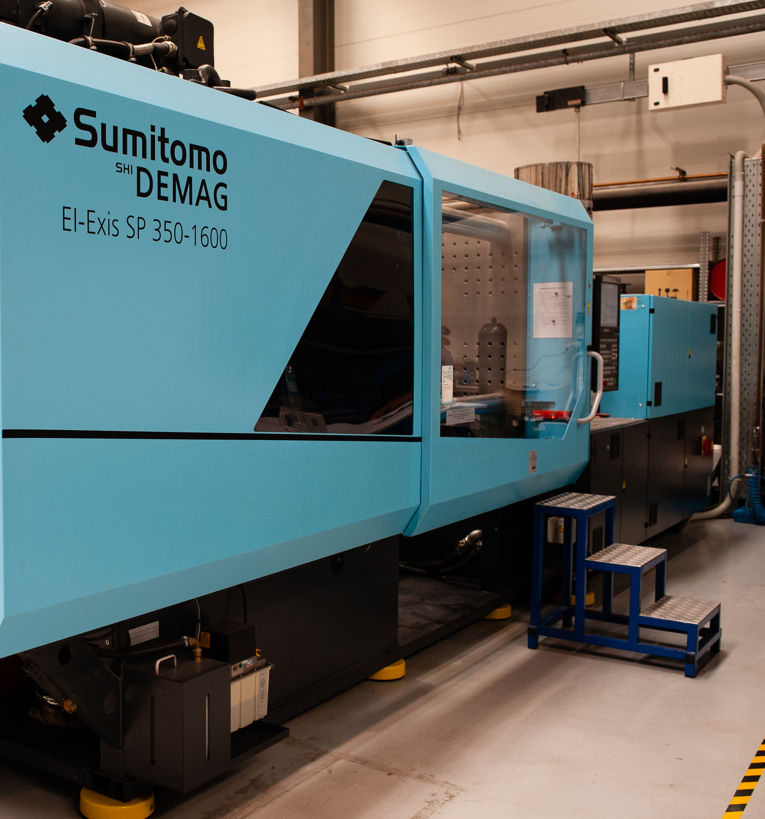

Slide 22
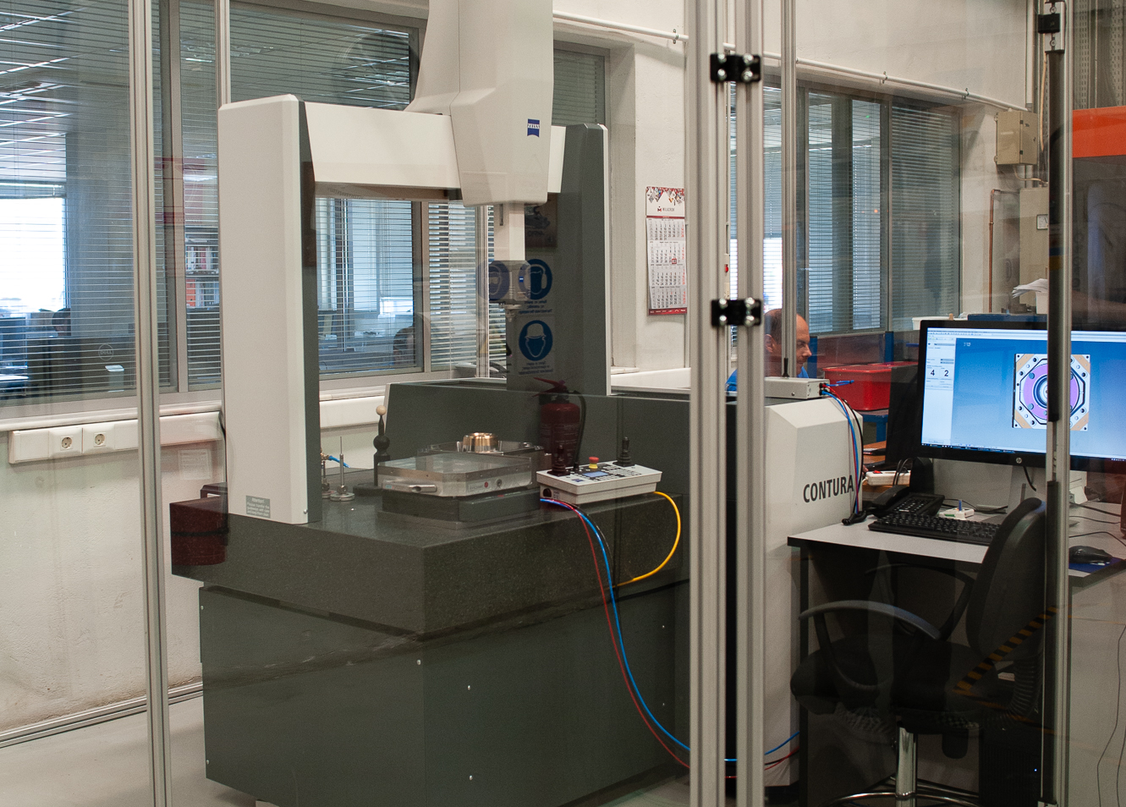

Quality control
The focus of Bazigos is quality control.
We guarantee excellent performance of our tools and usability of the final products

Slide 23
Mold flow analysis
Every project starts with the filling simulation of the plastic part which allows us to optimize the part itself, the molding process, and the design of our molds to ensure cost saving from possible weight reductions and less wear/service needs of the molds, during production
Mold flow analysis demonstrates a commitment to quality and indicates the competency, reliability and production of quality solutions of our company and staff.
Dimensional Measurements and Visual control
Our experienced Engineers and accurate Quality control systems allow us to measure and inspect our steel manufacturing from the raw material to a finished mold.
All measurements are recorded for future reference.
After the mold Trial phase in our injection machines a fully report with all critical dimensions attributes –i.e. water tightness is generated and sent to the customer.

Slide 24
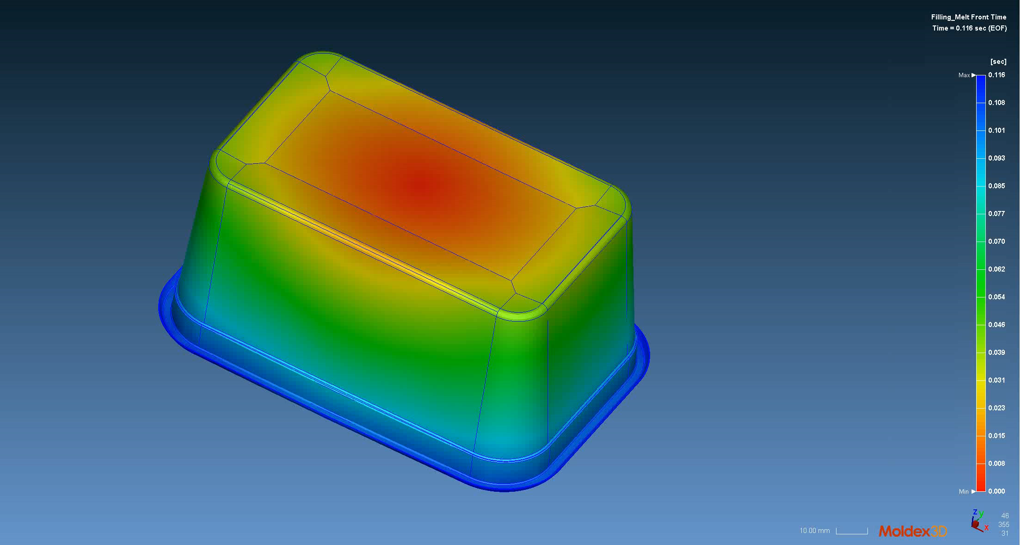

Slide 25
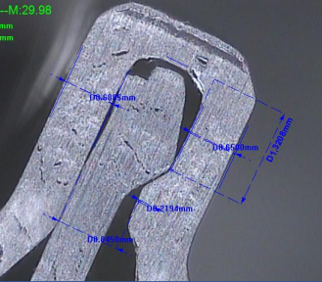
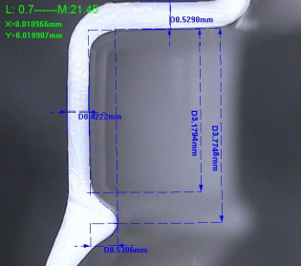
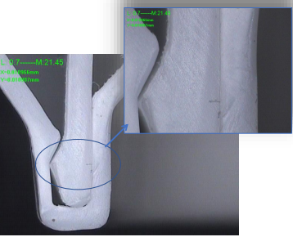
Quality control ( watertight )
Measurements of lid and container

Slide 26
Laboratory Instruments
Zeiss & 2xTesa CNC CMM for
Reverse Engineering,
Product scanning
(Metrology accuracy 0.001mm)
Instron for
Tensile
Compression
Kason for
Vickers/Rockwell hardness
Stemi 305 for High resolution Magnification
High precision scales 1/10000g
Custom made Drop tests , Leakage test , pop off test
etc etc

