Slide 1
Η Εξέλιξη των Φυτών
3

Slide 2
Τα 8 γεγονότα-ορόσημα
στην ιστορία της εξέλιξης
της φυτικής ζωής
Εμφάνιση των πρώτων μορφών ζωής
Φωτοσύνθεση
Το ευκαρυωτικό κύτταρο
Η πολυκύτταρη κατασκευή

Slide 3
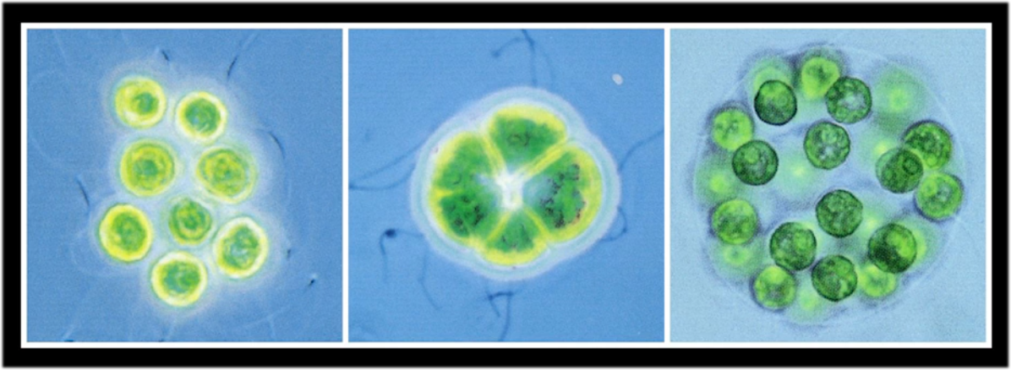
Πρόδρομες μορφές πολυκυτταρικότητας

Slide 4
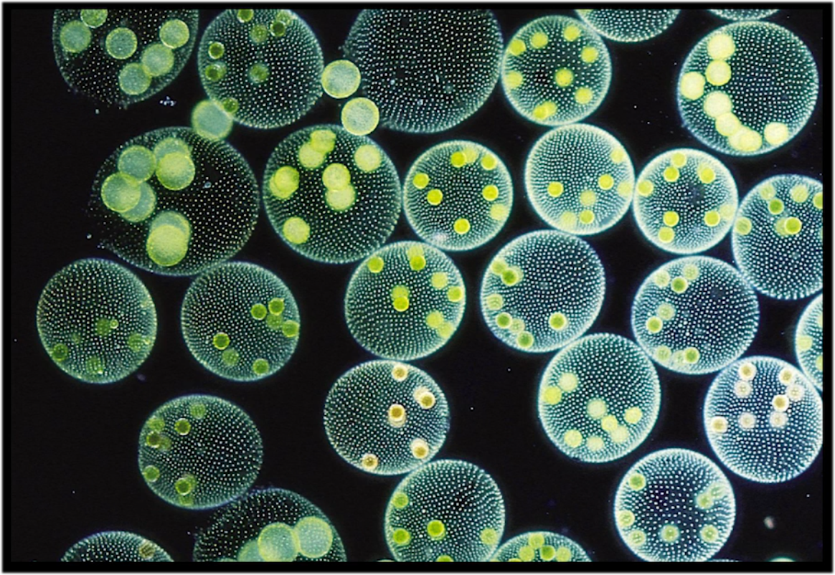
Volvox sp.

Slide 5
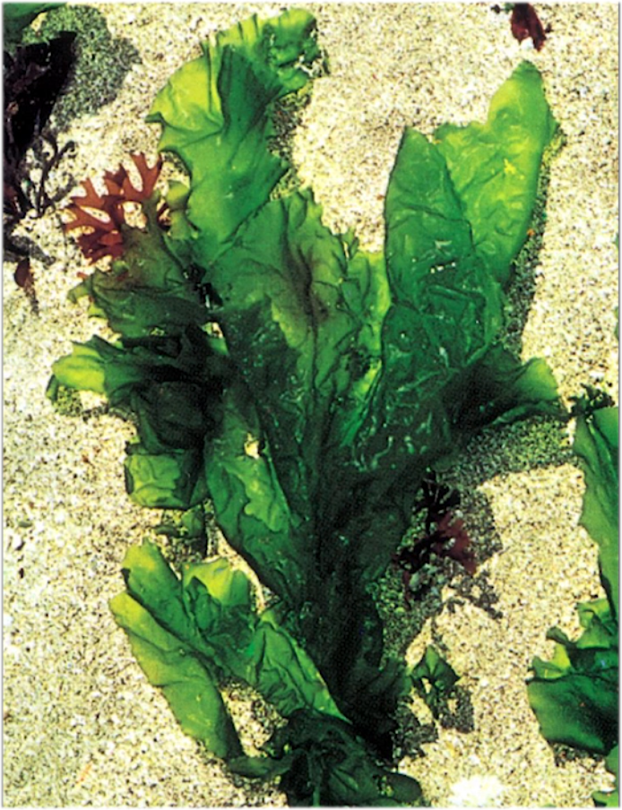
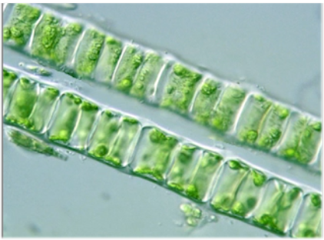

Slide 6
Macroscopic multicellular life had been dated to around 600 million years ago, but new fossils suggest that centimetres-long multicellular organisms existed as early as 1.56 billion years ago.
Nature Commun. 7, 11500 (2016)

Slide 9
Τα 8 γεγονότα-ορόσημα
στην ιστορία της εξέλιξης
της φυτικής ζωής
Εμφάνιση των πρώτων μορφών ζωής
Φωτοσύνθεση
Το ευκαρυωτικό κύτταρο
Η πολυκύτταρη κατασκευή
470 MA
Ορδοβίκιο
Η έξοδος στη στεριά
Πολυκύτταρο έμβρυο
Παραμονή ωαρίου και εμβρύου μέσα στο αρχεγόνιο
Εφυμενίδα
Στόματα (υποτυπώδη και μόνο στο σποριόφυτο των φυλλοβρύων και των ανθοκερωτών)

Slide 10
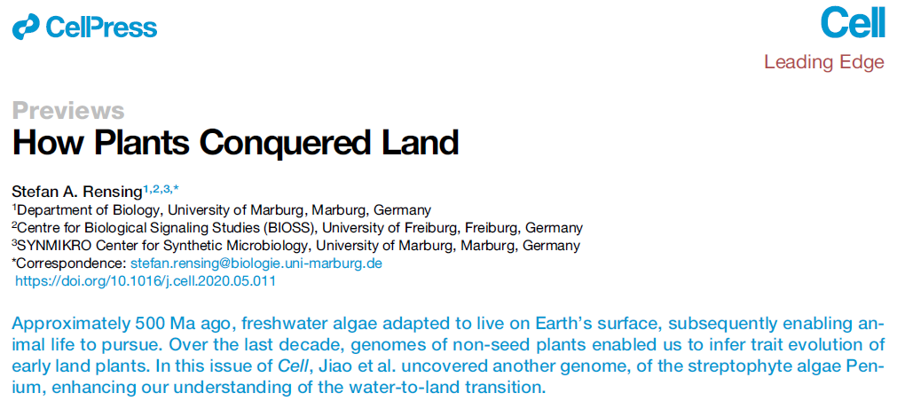
The green plants (Viridiplantae) live in very diverse habitats such as seawater, freshwater, soil, rock, and snow. They encompass organisms of very different anatomy, such as single-cell algae (e.g., the model organism Chlamydomonas), multicellular green seaweeds such as Ulva (sea lettuce), morphologically complex freshwater algae such as Chara, mosses such as the small-in-stature evo-devo model organism P. patens, and giant trees such as the iconic sequoia. Traits such as multicellularity or the adaptation to diverse habitats evolved several times within the green plants. However, the transition to the terrestrial habitat that eventually led to the stunning diversity of land plants (Embryophyta) most likely occurred only once. The Zygnematophyceae (conjugating algae) are the sister lineage to the land plants (One Thousand Plant Transcriptomes, 2019) and thus are of key importance to determine how molecular adaptation of plant life to land occurred. The genome of one of these algae (Penium) is published in this issue of Cell (Jiao et al., 2020) and shows that carbohydrate-active enzymes (CAZymes) are expanded in this species, probably involved in the generation of mucilage that acts as a protective sheet against drought, one of the prime abiotic stress factors that land plants have to cope with.

Slide 11
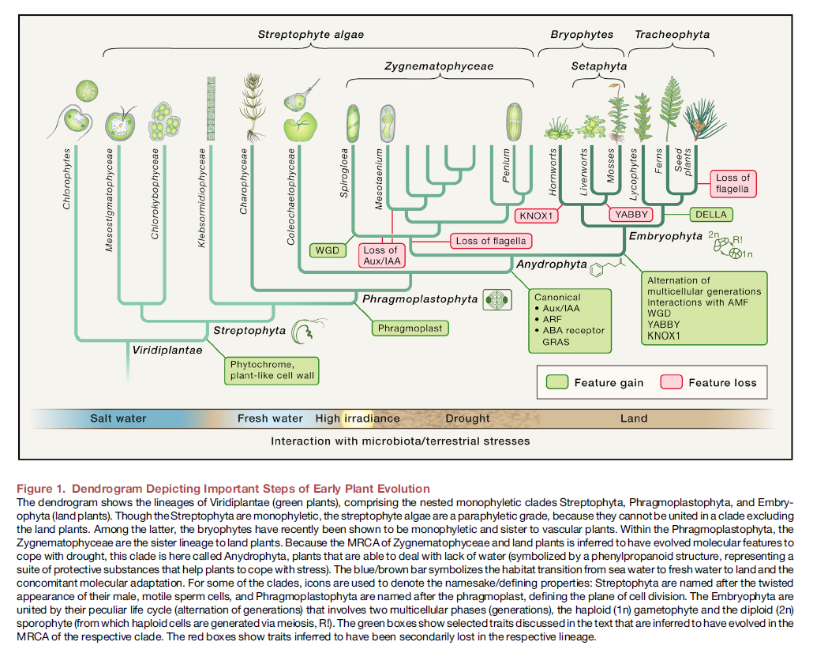

Slide 12
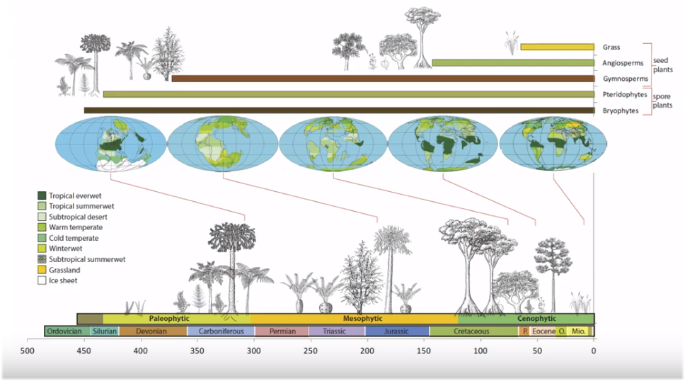

Slide 13
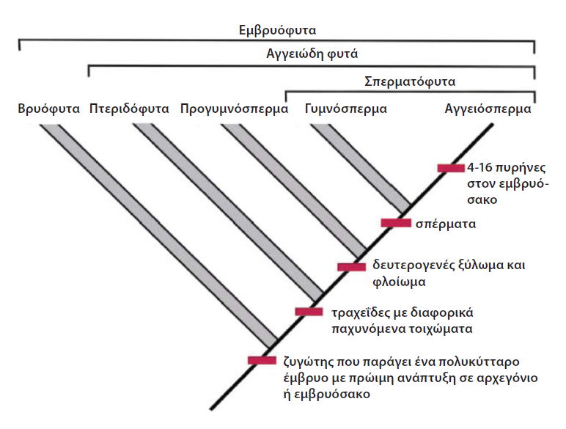
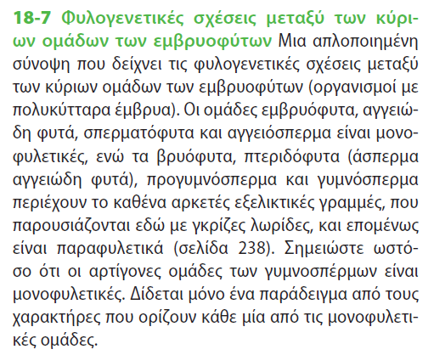
Ή Αγγειόφυτα ή Τραχεόφυτα
Άσπερμα Αγγειόφυτα
Άνθη καρποί
Notes:
Raven, Evert & Eichhorn (2014) Βιολογία των Φυτών. 8η Αμερικανική-1η Ελληνική Έκδοση, Εκδόσεις Utopia. Αθήνα.

Slide 14
ΒΡΥΟΦΥΤΑ

Slide 15
Notes:
Major transitions in the evolution of early land plants: a bryological perspective
Roberto Ligrone1,*, Jeffrey G. Duckett2 and Karen S. Renzaglia3
Annals of Botany 109: 851–871, 2012

Slide 16
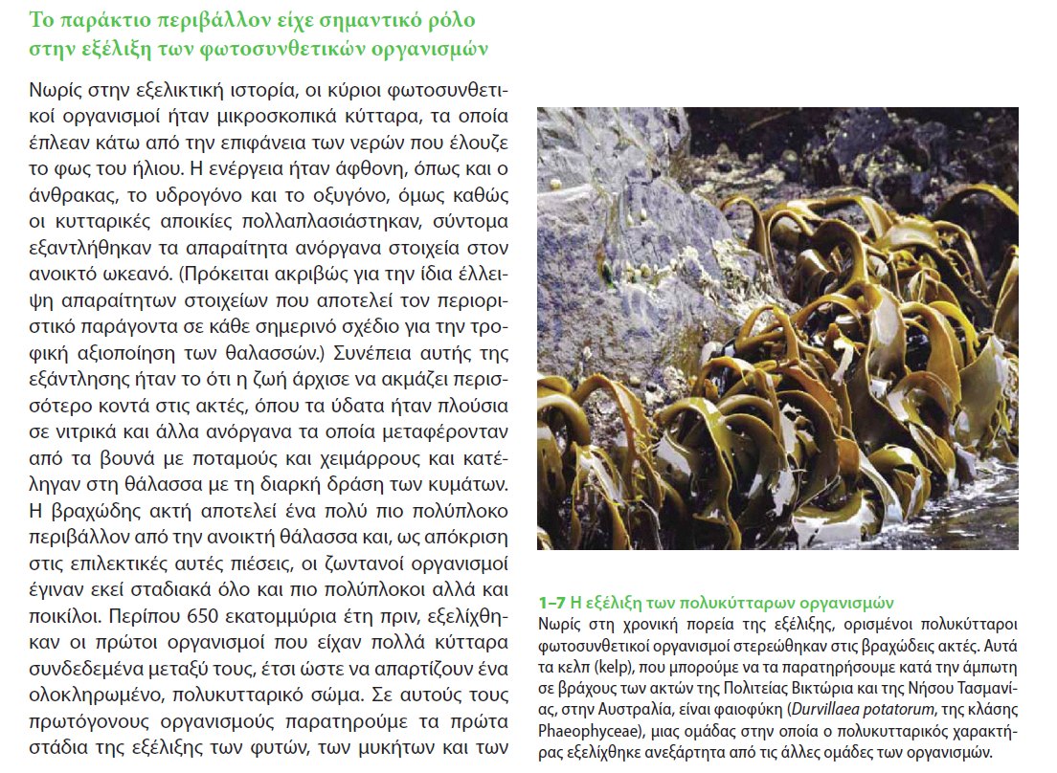
Notes:
Raven, Evert & Eichhorn (2014) Βιολογία των Φυτών. 8η Αμερικανική-1η Ελληνική Έκδοση, Εκδόσεις Utopia. Αθήνα.

Slide 17
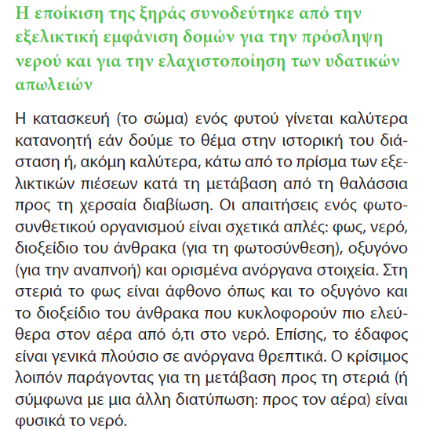
Notes:
Raven, Evert & Eichhorn (2014) Βιολογία των Φυτών. 8η Αμερικανική-1η Ελληνική Έκδοση, Εκδόσεις Utopia. Αθήνα.

Slide 18
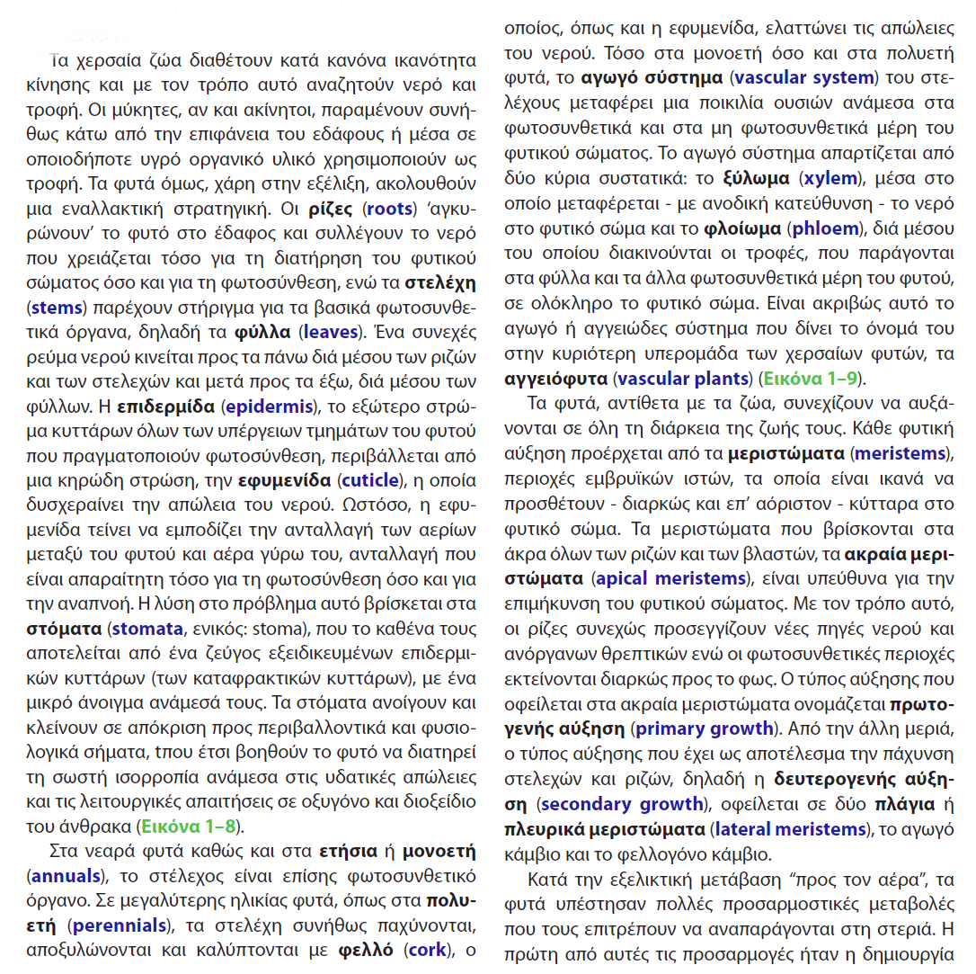
Notes:
Raven, Evert & Eichhorn (2014) Βιολογία των Φυτών. 8η Αμερικανική-1η Ελληνική Έκδοση, Εκδόσεις Utopia. Αθήνα.

Slide 19
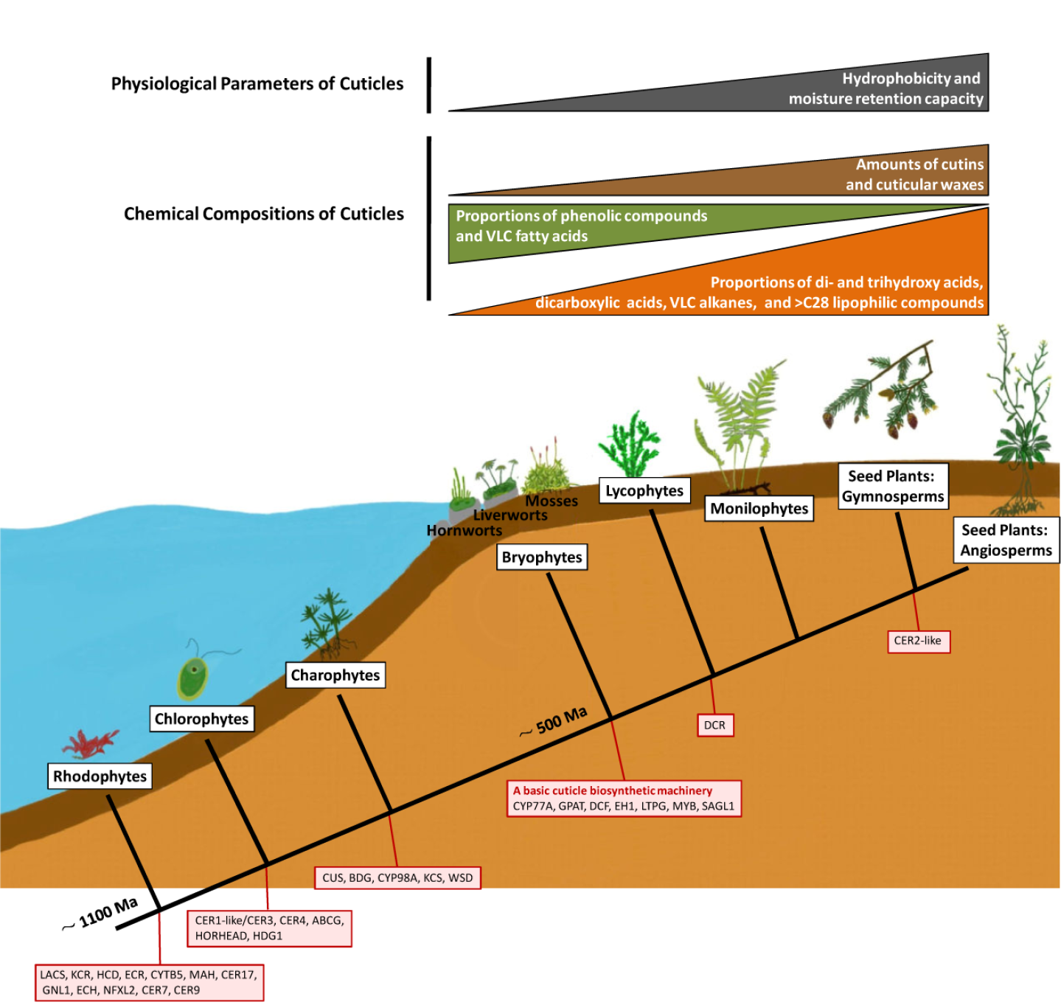
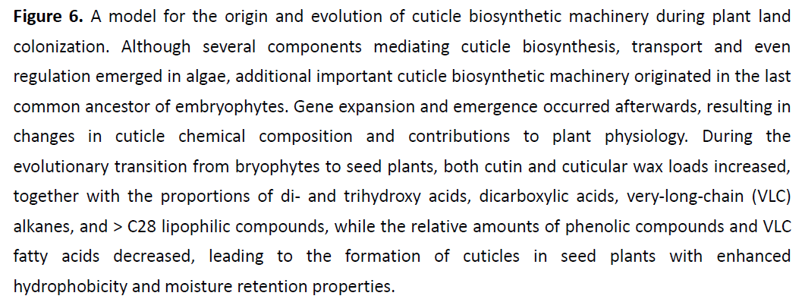
Εξέλιξη της εφυμενίδας

Slide 20
Από τα Βρυόφυτα στα
Άσπερμα Τραχεόφυτα
(Λυκόφυτα και Πτεριδόφυτα)
Στόματα
Σποριόφυτο διακλαδιζόμενο
Αγωγός ιστός

Slide 21
Notes:
Raven, Evert & Eichhorn (2014) Βιολογία των Φυτών. 8η Αμερικανική-1η Ελληνική Έκδοση, Εκδόσεις Utopia. Αθήνα.

Slide 22
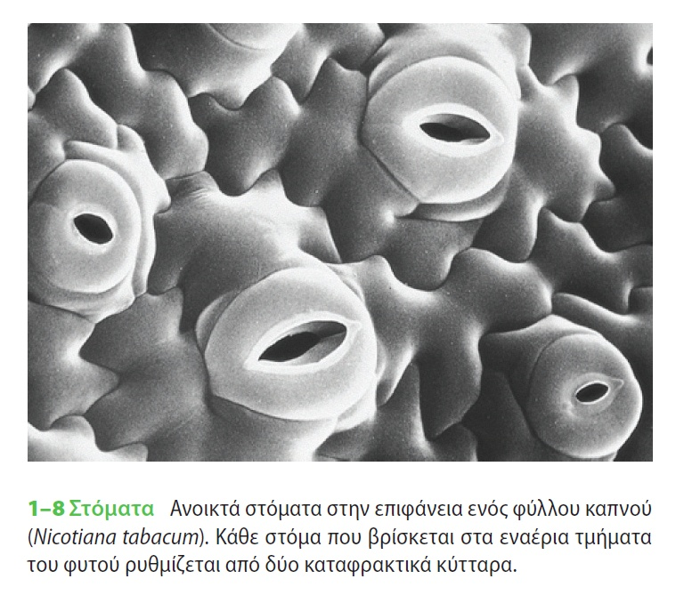
Notes:
Raven, Evert & Eichhorn (2014) Βιολογία των Φυτών. 8η Αμερικανική-1η Ελληνική Έκδοση, Εκδόσεις Utopia. Αθήνα.

Slide 23
Notes:
Raven, Evert & Eichhorn (2014) Βιολογία των Φυτών. 8η Αμερικανική-1η Ελληνική Έκδοση, Εκδόσεις Utopia. Αθήνα.

Slide 24
Notes:
Raven, Evert & Eichhorn (2014) Βιολογία των Φυτών. 8η Αμερικανική-1η Ελληνική Έκδοση, Εκδόσεις Utopia. Αθήνα.

Slide 25
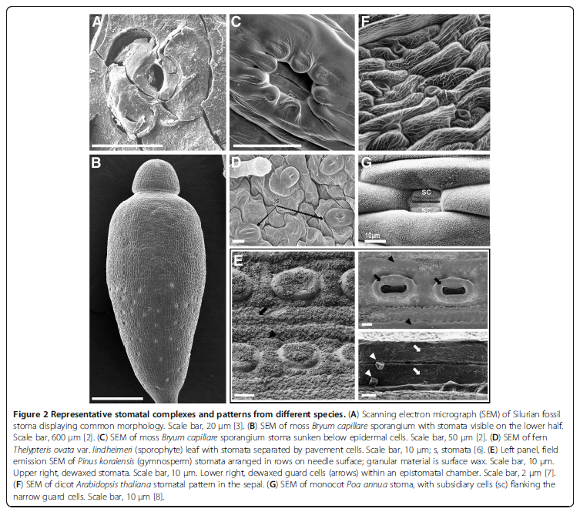

Slide 26
Notes:
Raven, Evert & Eichhorn (2014) Βιολογία των Φυτών. 8η Αμερικανική-1η Ελληνική Έκδοση, Εκδόσεις Utopia. Αθήνα.

Slide 27
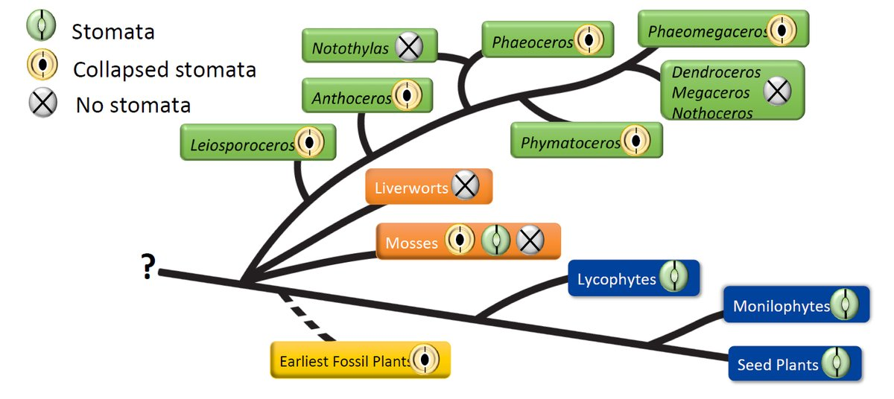
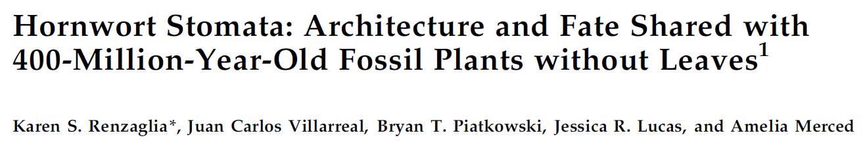

Slide 28
Ομοιόυδρα (Homoiohydrous)
Ομοιοϋδρία (Homoiohydry)
≠
Ποικιλόυδρα (Poikilohydrous)
Ποικιλοϋδρία (Poikilohydry)
Ομοιόσταση (Homeostasis)

Slide 29
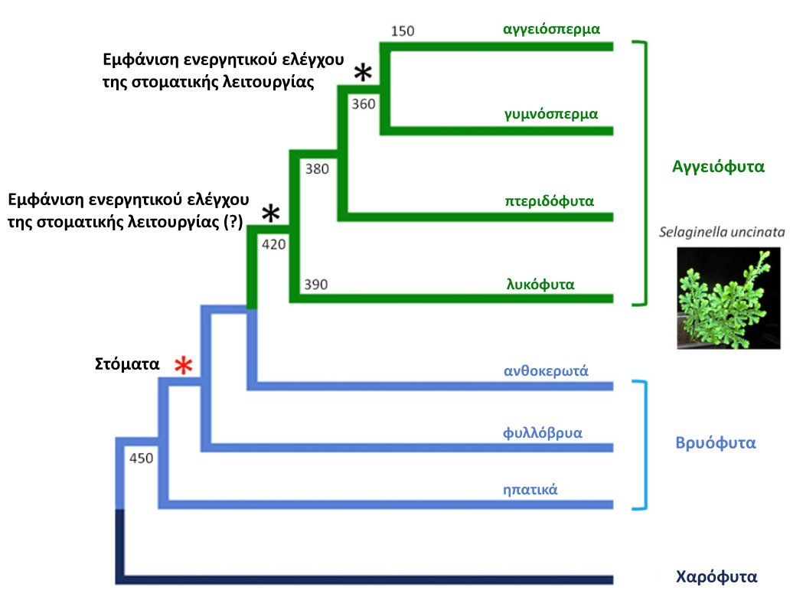
Notes:
Current Biology 21, 1030–1035, June 21, 2011
Land Plants Acquired Active Stomatal Control Early in Their Evolutionary History
Elizabeth M. Ruszala,1 David J. Beerling,2 Peter J. Franks,2,4 Caspar Chater,2 Stuart A. Casson,1 Julie E. Gray,3 and Alistair M. Hetherington1
Figure 1. Phylogenetic Tree Showing Relationships
between Major Groups of Extant Land
Plants
Land plants are divided into vascular (green)
and nonvascular (bryophyte, light blue) groups,
with the sister group to the land plants (charophycean
algae) shown in dark blue. Approximate
timings of divergence (millions of years
ago) are displayed [11–14]. The red asterisk
marks the acquisition of stomata; the upper
black asterisk marks the acquisition of active
stomatal control reported by Brodribb and
McAdam [8], whereas the lower black asterisk
marks the acquisition of active stomatal control
demonstrated in the current study. An image of
Selaginella uncinata, the model lycophyte used
for these physiological experiments, is shown
at right.
Figure 2. Stomata of the Basal Vascular Plant Selaginella uncinata Respond to Abscisic Acid
(A) Stomatal aperture measurements show abscisic acid (ABA) inhibition of light-induced opening of preclosed stomata.
(B) ABA promotion of stomatal closure in preopened stomata. Data are mean values 6 standard error of the mean (SEM) of three independent experiments
(n = 120). All ABA treatments in (A) and (B) are significantly different from control treatment (p < 0.005; Student’s t test).
(C) S. uncinata steady-state stomatal conductance to water vapor (gw) is reduced in the presence of ABA and returns to higher gw after ABA treatment
ceases (indicated by dashed vertical line). Data are mean gw values 6 SEM (n = 3) from three independent experiments.
These

Slide 30
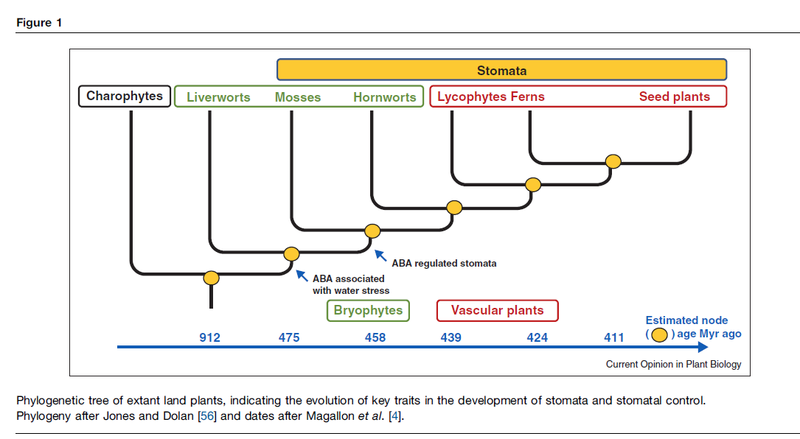
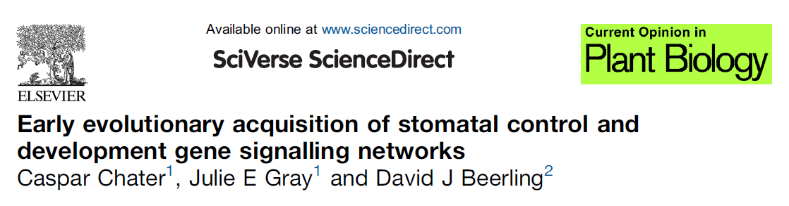

Slide 31
Διακλαδισμένο σποριόφυτο
Notes:
Major transitions in the evolution of early land plants: a bryological perspective
Roberto Ligrone1,*, Jeffrey G. Duckett2 and Karen S. Renzaglia3
Annals of Botany 109: 851–871, 2012

Slide 32
Διακλαδισμένο σποριόφυτο ενός πτεριδοφύτου
Notes:
Major transitions in the evolution of early land plants: a bryological perspective
Roberto Ligrone1,*, Jeffrey G. Duckett2 and Karen S. Renzaglia3
Annals of Botany 109: 851–871, 2012

Slide 33
Τα 8 γεγονότα-ορόσημα
στην ιστορία της εξέλιξης
της φυτικής ζωής
Εμφάνιση των πρώτων μορφών ζωής
Φωτοσύνθεση
Το ευκαρυωτικό κύτταρο
Η πολυκύτταρη κατασκευή
Η έξοδος στη στεριά
Ο αγωγός ιστός
Αγγειόφυτα ή Τραχεόφυτα
(Vascular plants or Tracheophytes)

Slide 34
Πρόδρομη μορφή αγωγού ιστού στα βρυόφυτα
Notes:
Raven, Evert & Eichhorn (2014) Βιολογία των Φυτών. 8η Αμερικανική-1η Ελληνική Έκδοση, Εκδόσεις Utopia. Αθήνα.

Slide 35
Hadron – Lepton
Hadrome – Leptome
[Hydron, Hydrome]
hydroid - leptoid

Slide 36
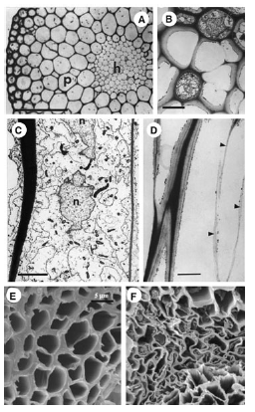
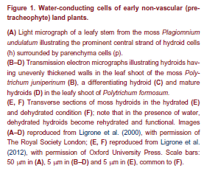

Slide 37
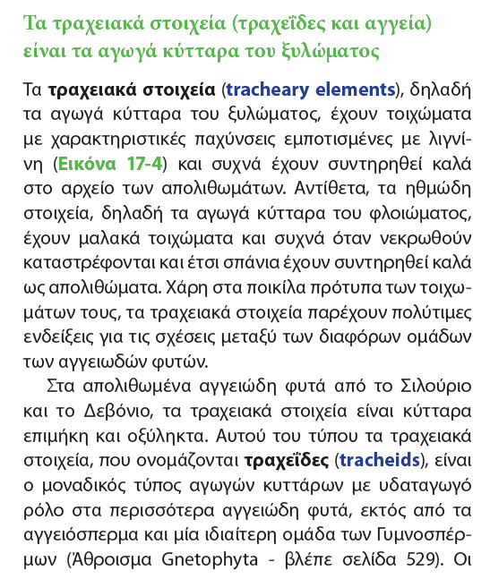
Notes:
Raven, Evert & Eichhorn (2014) Βιολογία των Φυτών. 8η Αμερικανική-1η Ελληνική Έκδοση, Εκδόσεις Utopia. Αθήνα.

Slide 38
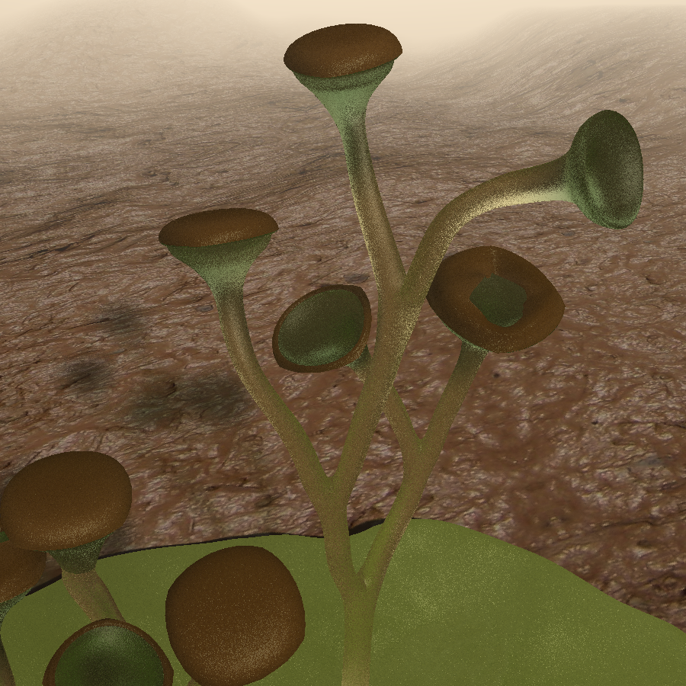
Το πρώτο αγγειόφυτο
Cooksonia pertoni
~410 MA
Notes:
Animated reconstruction of Cooksonia pertoni. The stems have been reconstructed as non-photosynthetic, according to Boyce (2008). The axes are imagined to be around 100μm in diameter. It is left to the viewer's imagination whether or not the thallus is associated with the Cooksonia axes! Sources: C. Kevin Boyce. "How green was Cooksonia? The importance of size in understanding the early evolution of physiology in the vascular plant lineage". Paleobiology, 34(2), 2008, pp. 179–194. DOI:[0179:HGWCTI2.0.CO;2 10.1666/0094-8373(2008)034[0179:HGWCTI]2.0.CO;2]. Habgood, K.S.; Edwards, D.; Axe, L. (2002). "New perspectives on Cooksonia from the Lower Devonian of the Welsh Borderland". Botanical Journal of the Linnean Society 139 (4): 339-359. DOI:10.1046/j.1095-8339.2002.00073.x. D. Edwards (1980). "Records of Cooksonia-type sporangia from late Wenlock strata in Ireland". Nature 287: 41–42. DOI:10.1038/287041a0.

Slide 39
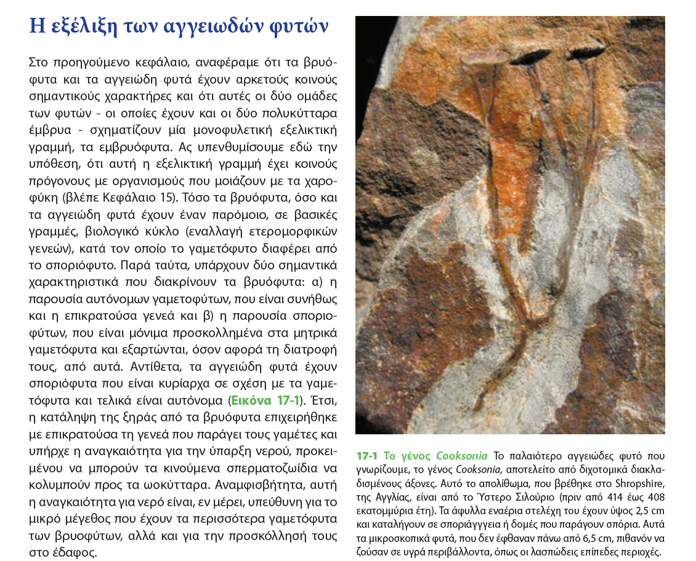
Notes:
Raven, Evert & Eichhorn (2014) Βιολογία των Φυτών. 8η Αμερικανική-1η Ελληνική Έκδοση, Εκδόσεις Utopia. Αθήνα.

Slide 40
410 MA

Slide 41
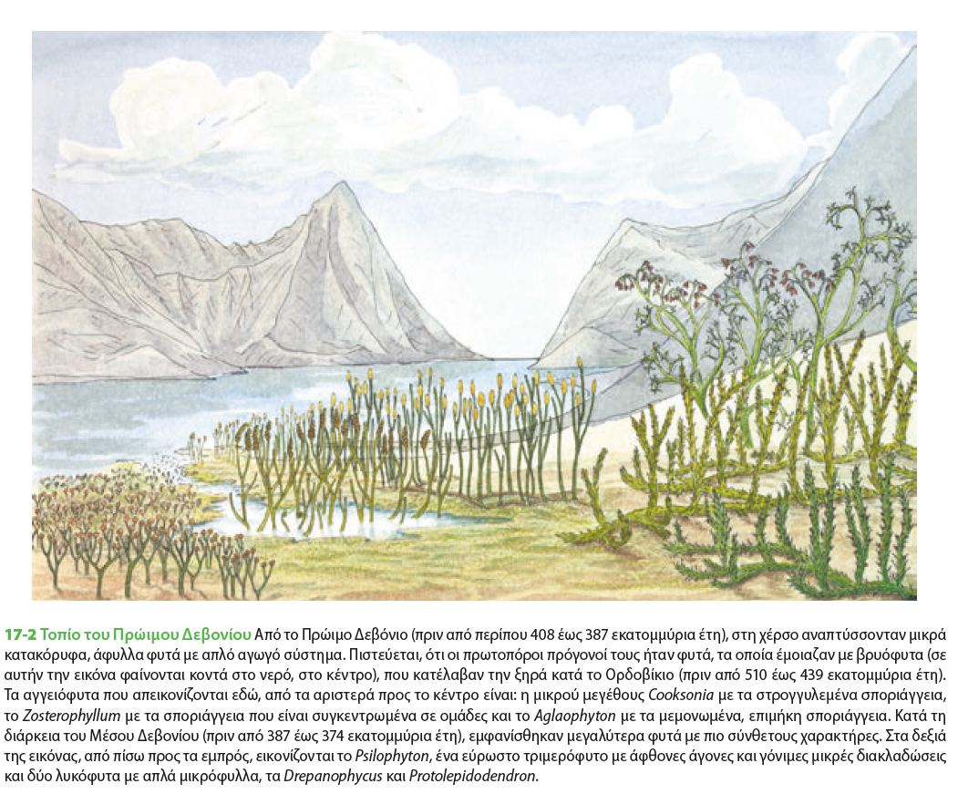
409-386 MA BP, κατώτερο Δεβόνιο
Φυτά με αγωγό ιστό (αγγειόφυτα ή τραχεόφυτα)
αλλά ΧΩΡΙΣ σπέρματα

Slide 42
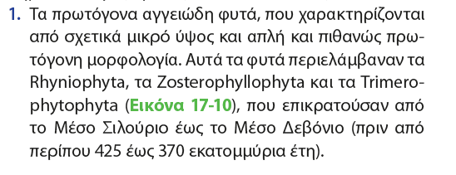
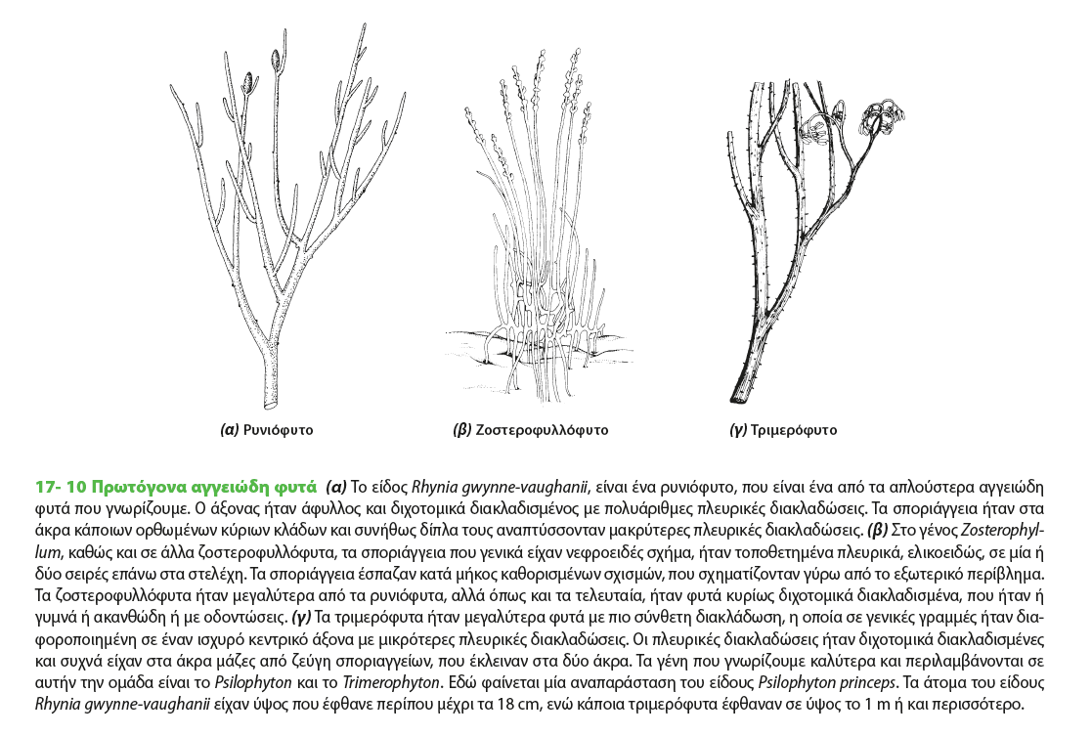
Notes:
Raven, Evert & Eichhorn (2014) Βιολογία των Φυτών. 8η Αμερικανική-1η Ελληνική Έκδοση, Εκδόσεις Utopia. Αθήνα.

Slide 43
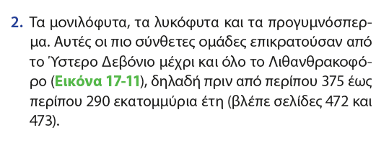
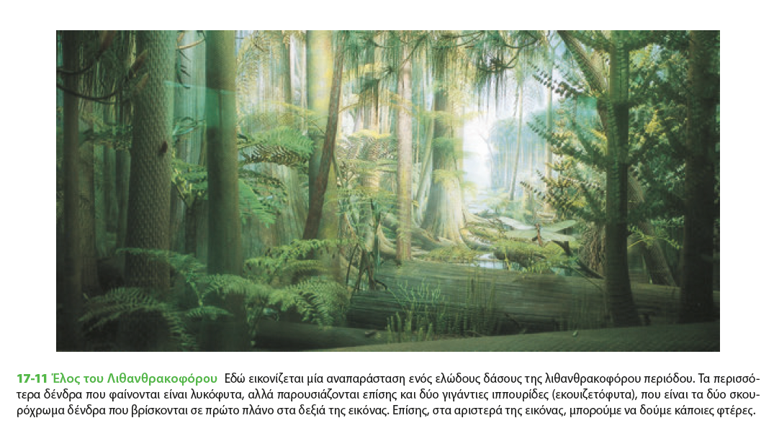
Notes:
Raven, Evert & Eichhorn (2014) Βιολογία των Φυτών. 8η Αμερικανική-1η Ελληνική Έκδοση, Εκδόσεις Utopia. Αθήνα.

Slide 44
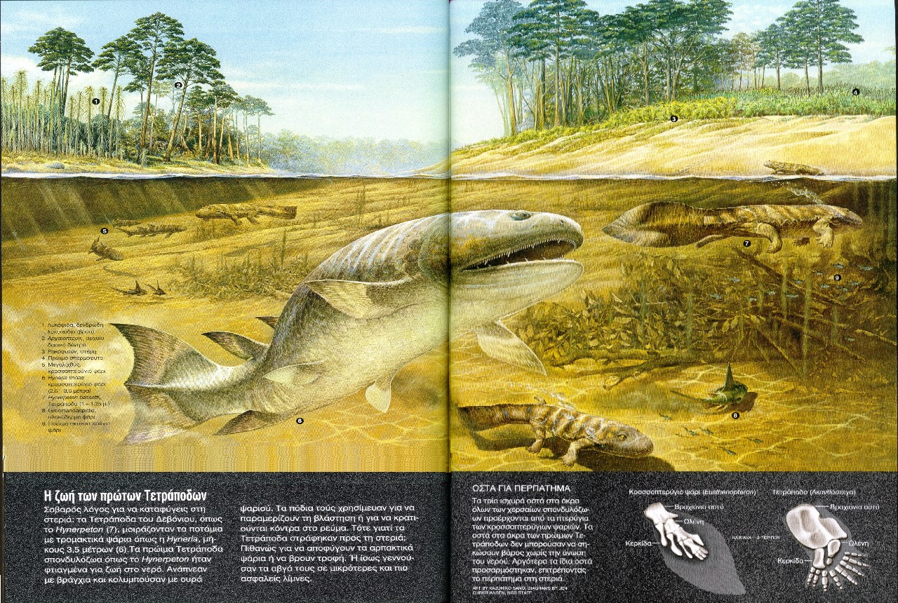
Υστερο
Δεβόνιο
Notes:
National Geographic

Slide 45
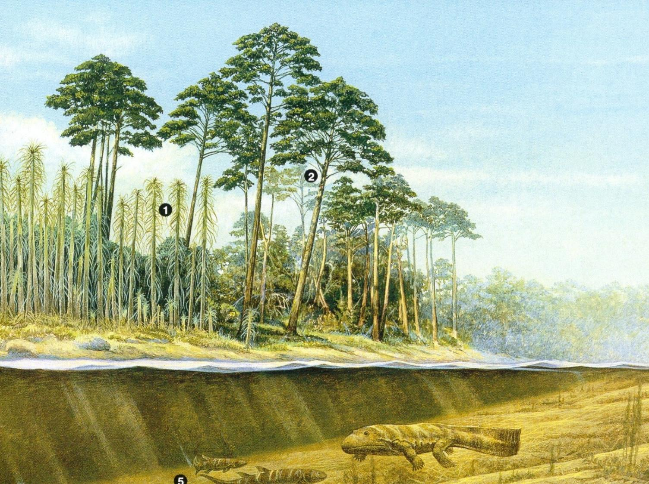
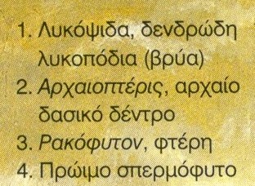
Προγυμνόσπερμο
(άσπερμο)

Slide 46
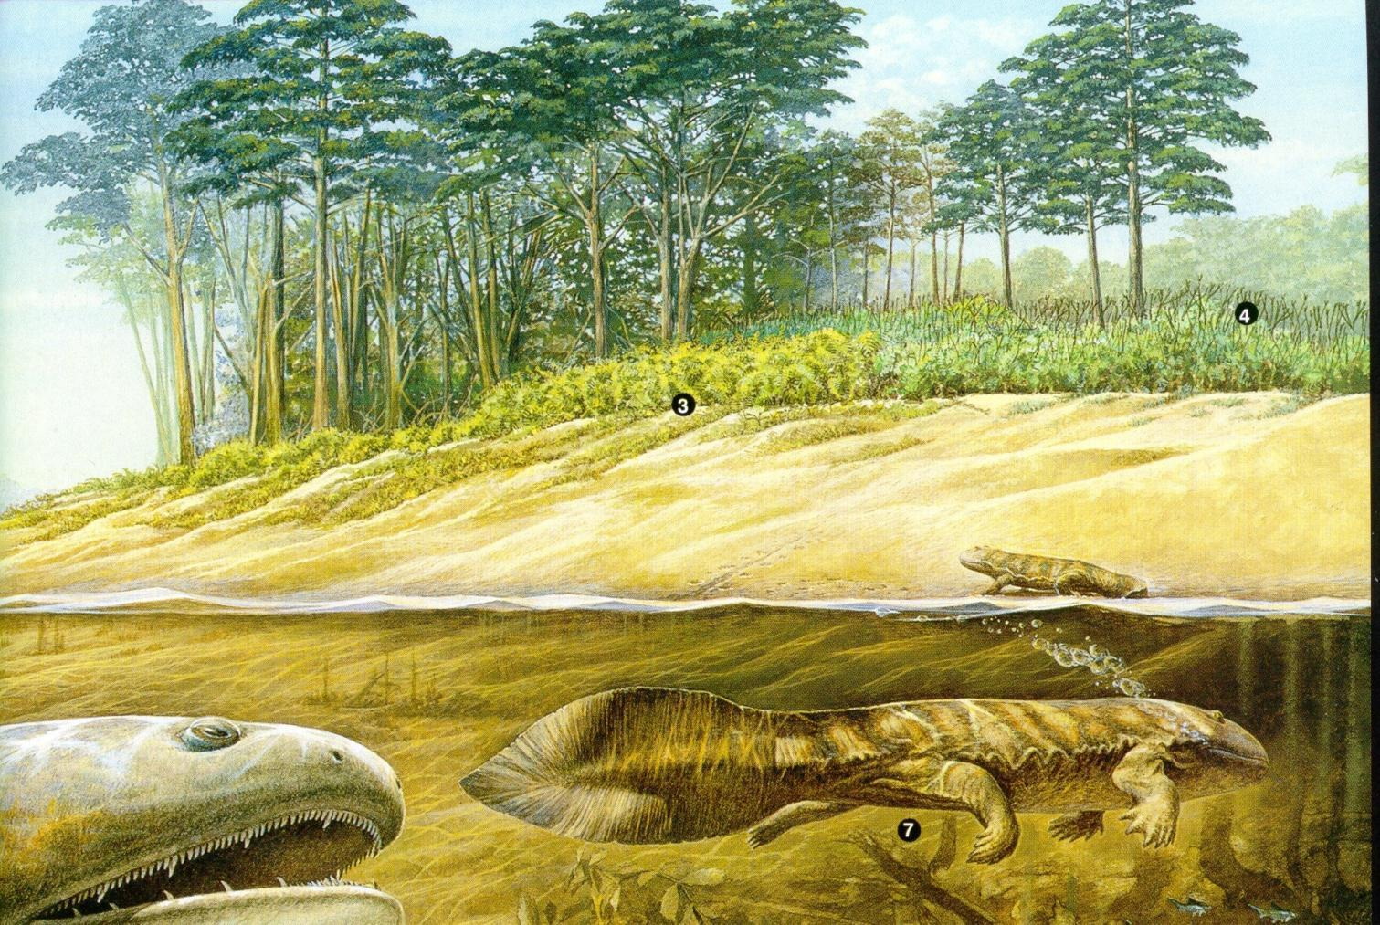

Προγυμνόσπερμο (άσπερμο)

Slide 47
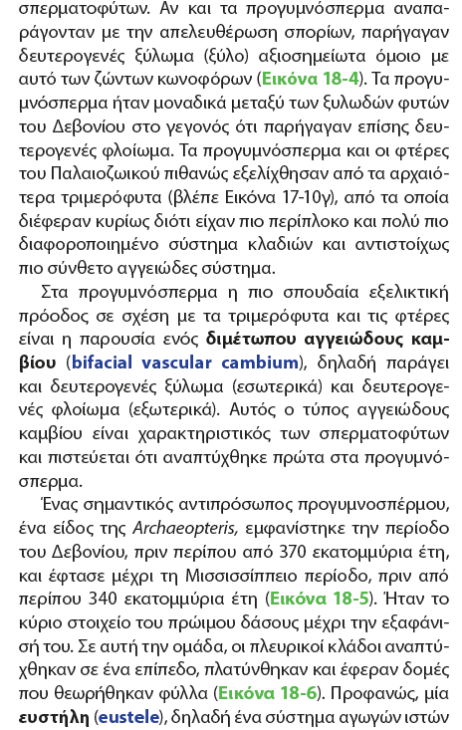

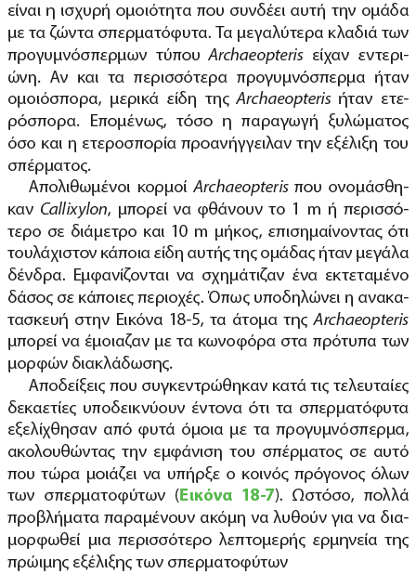
Notes:
Raven, Evert & Eichhorn (2014) Βιολογία των Φυτών. 8η Αμερικανική-1η Ελληνική Έκδοση, Εκδόσεις Utopia. Αθήνα.

Slide 48
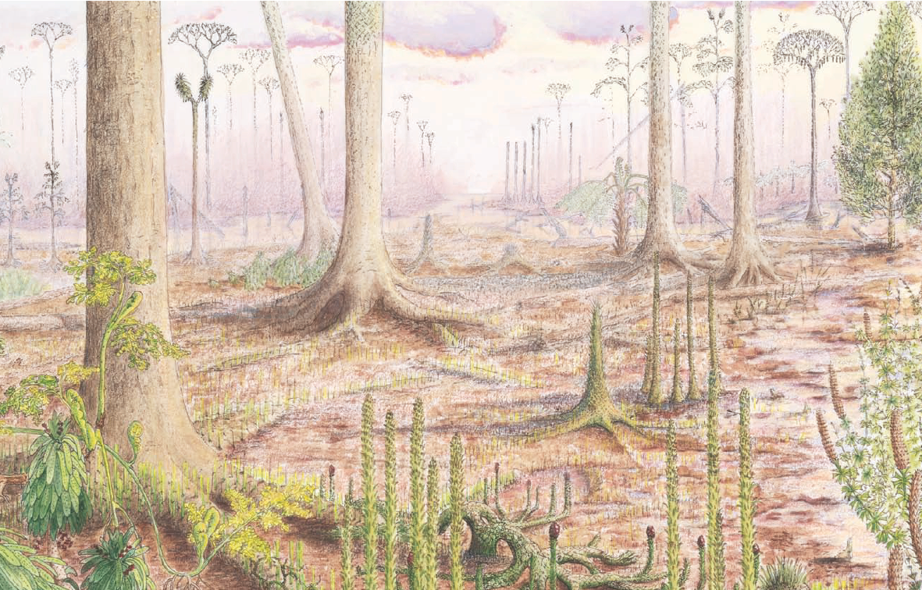
Upper Carboniferous
340 ΜΑ
18-8 Τοπίο του Ανώτερου Λιθανθρακοφόρου Τροπικά έλη του Ανώτερου Λιθανθρακοφόρου όπου κυριαρχούσαν διάφορα γένη γιγαντιαίων δένδρων λυκοφύτων, τα οποία όταν ωρίμαζαν, σχημάτιζαν έναν δασικό όροφο εναέριων, διάχυτα διακλαδισμένων κορυφών, που εδώ φαίνονται στο βάθος. Αυτά τα δένδρα είχαν ογκώδεις κορμούς (εμπρός αριστερά και αλλού) που σταθεροποιούνταν στα λασπώδη έλη με υψηλούς άξονες και διακλαδιζόμενους στη βάση, από όπου εκτείνονταν πολυάριθμες μικρότερες ρίζες, πιθανότατα φωτοσυνθετικές. Παρατηρήστε επίσης μερικά λυκόφυτα χαμηλού ύψους με κώνους (κέντρο εμπρός). Πλημυρισμένες και βαλτώδεις εκτάσεις του δασικού εδάφους ευνοούσαν άλλους τύπους λυκοφύτων, όπως το αδιακλάδωτο Chaloneria (κέντρο και δεξιά εμπρός) και μορφές ιππουρίδας, όπως ο θάμνος Sphenophyllum (κάτω δεξιά γωνία) και ο Diplocalamites με μορφή χριστουγεννιάτικου δένδρου (στη μέση πίσω δεξιά). Λιγότερο υγρά, ή ελαφρώς ανυψωμένα εδάφη, όπως φαίνονται στα αριστερά, φιλοξενούσαν μικτή βλάστηση, που περιλαμβάνει πρώιμα κωνοφόρα, φτέρες που καλύπτουν το έδαφος, υψηλές δενδρώδεις φτέρες και πτεριδοσπερματόφυτα. Μεταξύ των σπερματοφύτων ήταν το Cordaixylon, ένας θαμνώδης συγγενής των κωνοφόρων με ταινιοειδή φύλλα (εμπρός αριστερά) και το Callistophyton, ένα αναρριχητικό πτεριδοσπερματόφυτο, που φαίνεται εδώ να αναπτύσσεται στη βάση του μεγαλύτερου δένδρου λυκόφυτου. Πίσω αριστερά είναι το Psaronius, ένα πρώιμο πτεριδοσπερματόφυτο. Αλλού διακρίνονται εύρωστα φυτά όπως το όρθιο σκιαδόμορφο πτεριδοσπερματόφυτο Medullosa που καταλαμβάνει ηλιόλουστες, περισσότερο διαταραγμένες περιοχές ανοιγμένες από προγενέστερες πλημύρες (δεξιά στη μέση εμπρός και στο βάθος).
Notes:
Raven, Evert & Eichhorn (2014) Βιολογία των Φυτών. 8η Αμερικανική-1η Ελληνική Έκδοση, Εκδόσεις Utopia. Αθήνα.

Slide 49
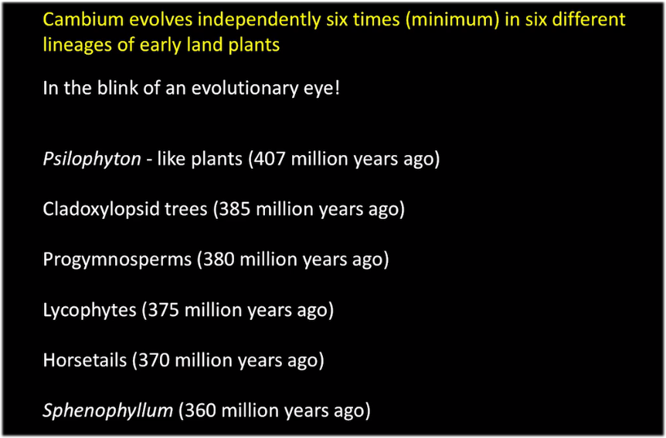
Notes:
https://www.youtube.com/watch?v=MWttTYrw3HU&t=1115s

Slide 50
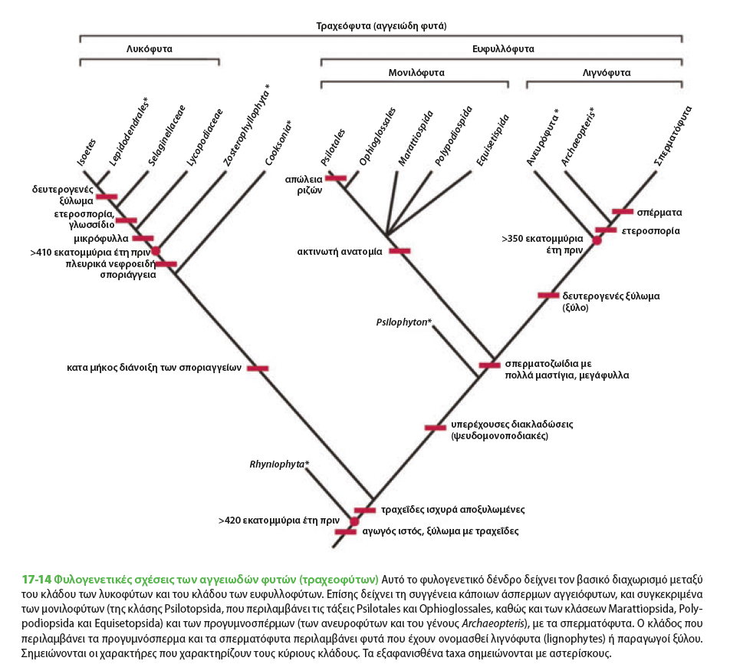
1
2
3
3 εμφανίσεις δευτερογενούς αύξησης (παραγωγής ξύλου)
σε άσπερμα αγγειόφυτα
1: Λυκόφυτα*
2: Δενδρώδεις πτέριδες
3: Archaeopteris sp.*
(*: εξαφανισμένα)
ΚΑΜΒΙΟ =
ΔΕΥΤΕΡΟΓΕΝΗΣ ΑΥΞΗΣΗ =
ΠΑΡΑΓΩΓΗ ΞΥΛΟΥ
(ΚΑΙ ΚΟΡΜΩΝ)
Notes:
Raven, Evert & Eichhorn (2014) Βιολογία των Φυτών. 8η Αμερικανική-1η Ελληνική Έκδοση, Εκδόσεις Utopia. Αθήνα.

Slide 51
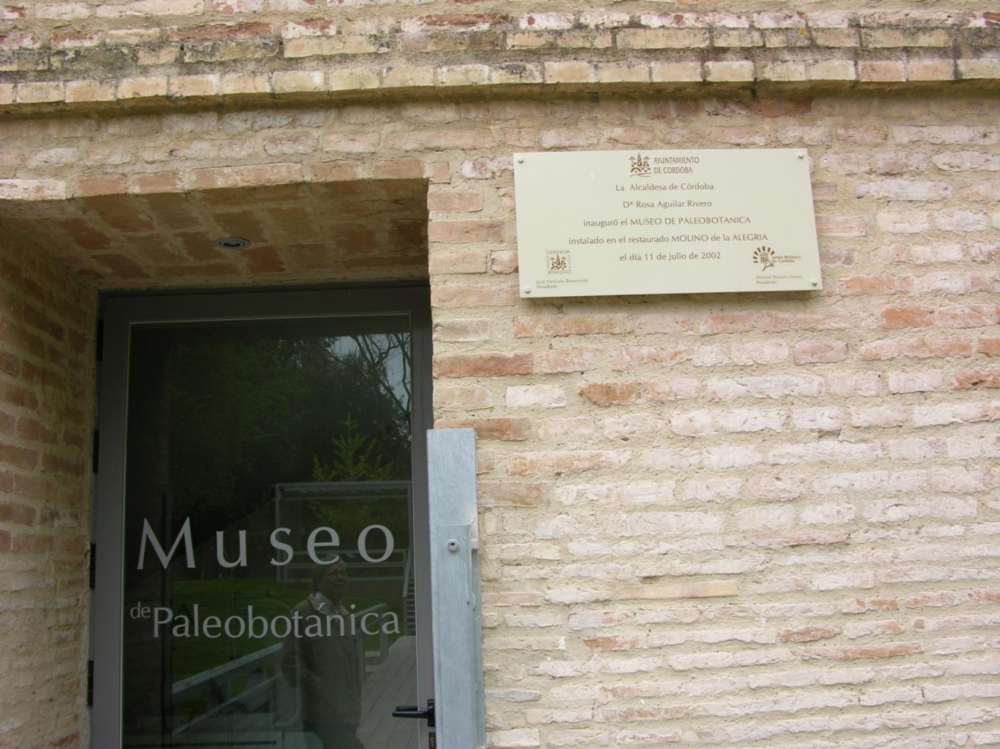
1

Slide 52
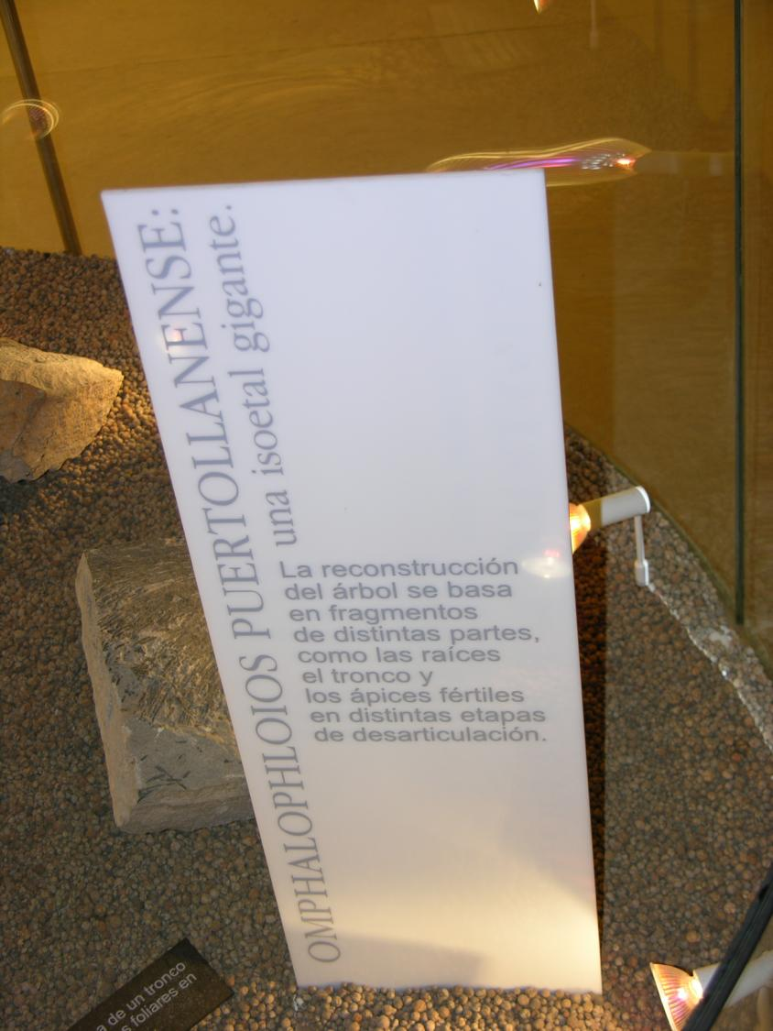
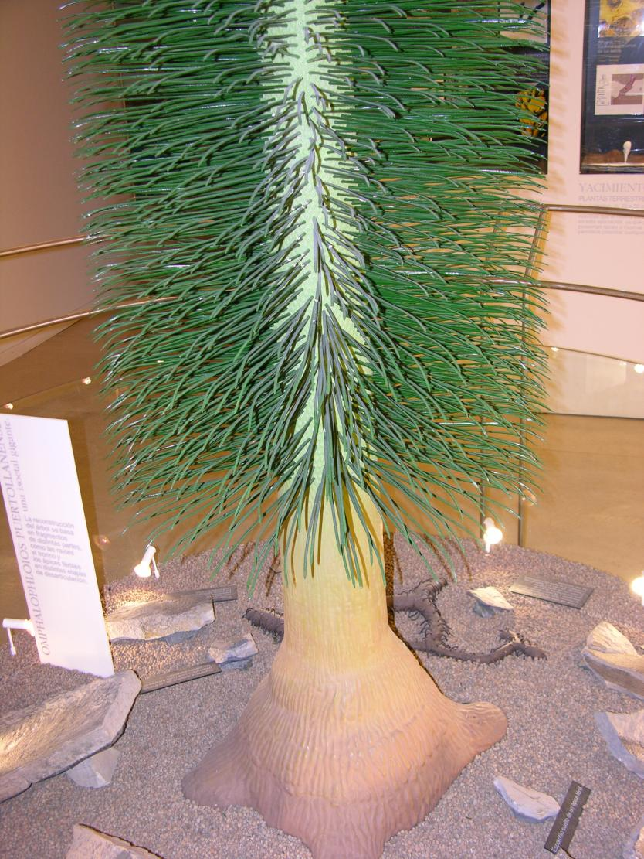
Omphalophloios puertollanense (Isoetales)

Slide 53
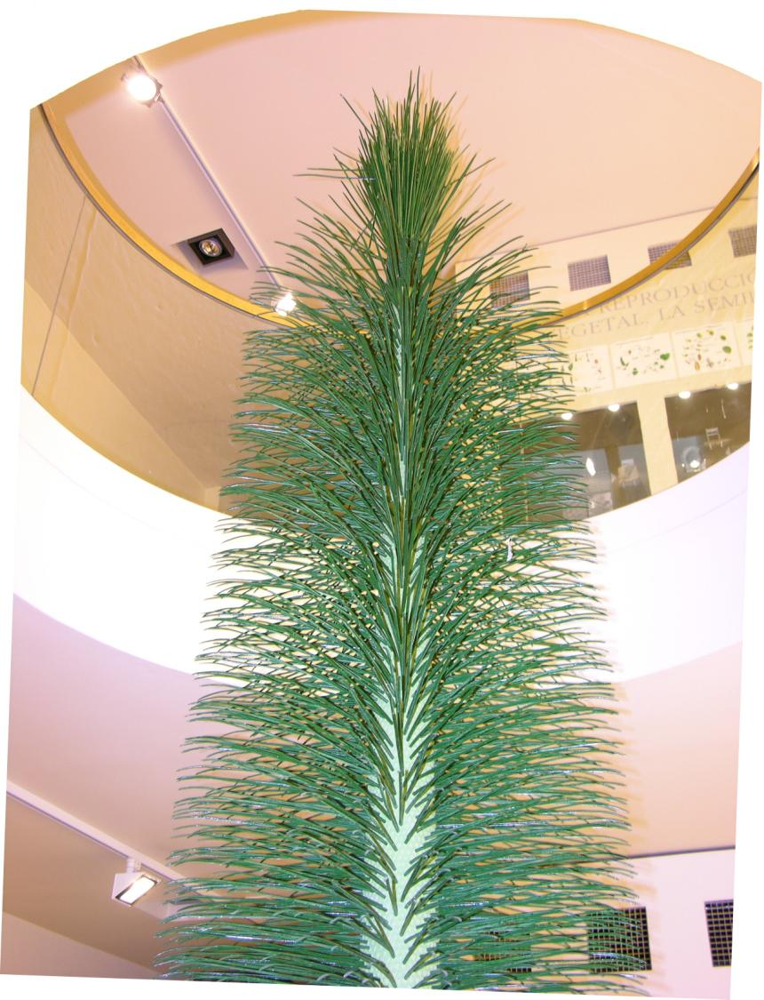
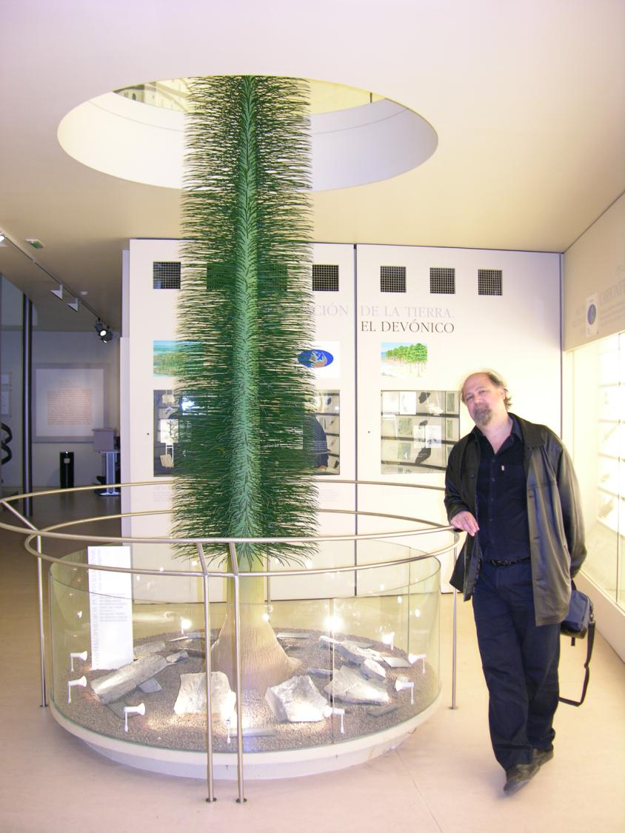
~300 MA - ανώτ. Λιθανθρακοφόρο

Slide 54
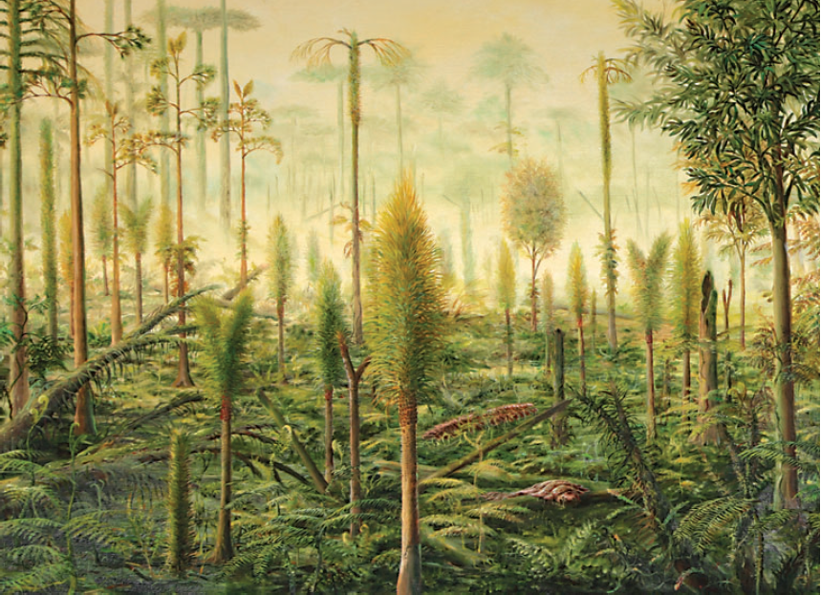
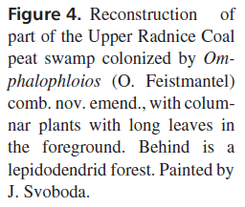
Notes:
BEK, J., OPLUŠTIL, S., DRABKOVA, J. & PŠENIČKA, J. 2015. The sub-arborescent lycopsid Omphalophloios feistmantelii
(O. Feistmantel) comb. nov. emend. from the Middle Pennsylvanian of the Czech Republic. Bulletin of Geosciences
90(1), 227–279 (35 figures). Czech Geological Survey, Prague. ISSN 1214-1119. Manuscript received February
26, 2014; accepted in revised form October 22, 2014; published online January 21, 2015; issued January 26, 2015.

Slide 55
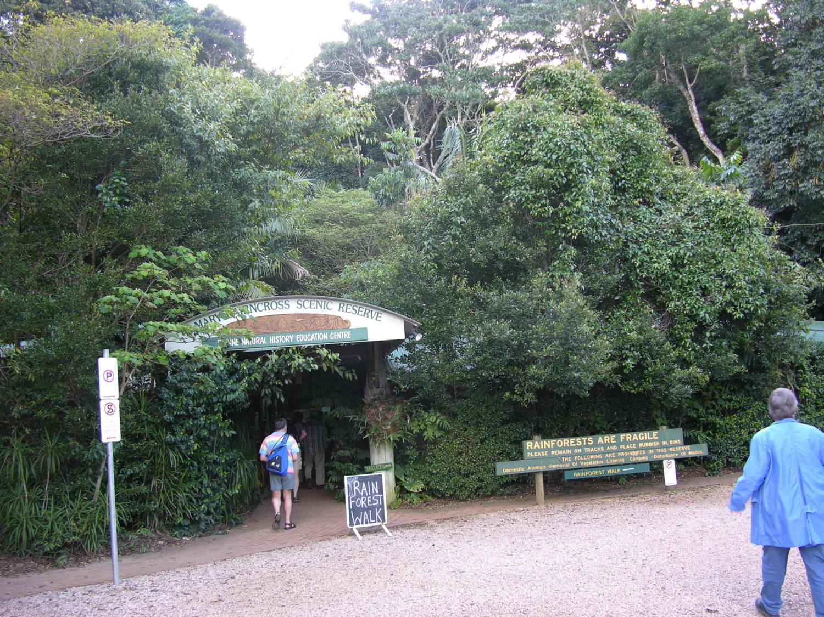
2
Notes:
Queensland 2005

Slide 56
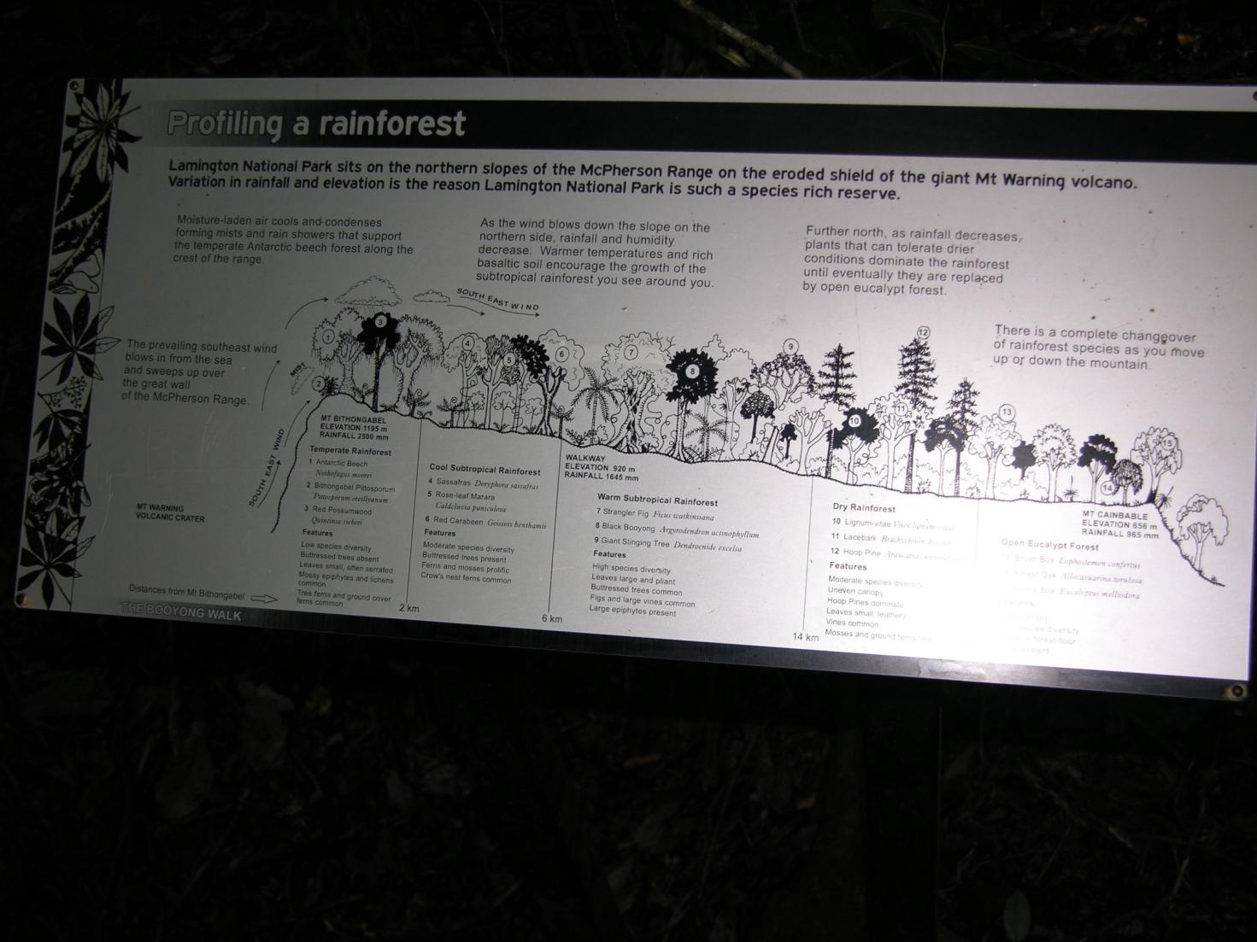
Notes:
Queensland 2005

Slide 57
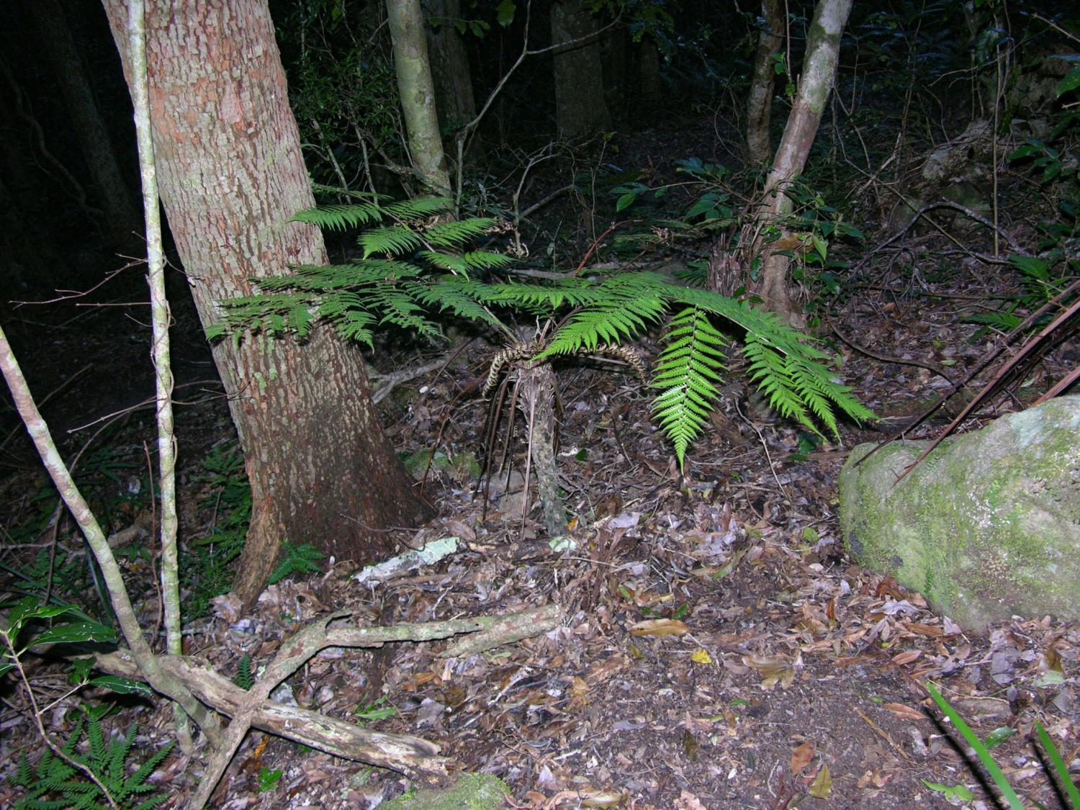
Notes:
Queensland 2005

Slide 58

Notes:
Queensland 2005

Slide 59

Notes:
Queensland 2005

Slide 60

Notes:
Taiwan 2010

Slide 61


Δενδρώδεις πτέριδες
(tree ferns)
Cyathea australis (Cyatheaceae, Cyatheales, Polypodiopsida)
Notes:
Queensland 2005

Slide 62



3
Notes:
Fig 20-08
Biology of Plants, Raven-Evert-Eichhorn
Chapter 20, Gymnosperms

Slide 63



Notes:
Raven, Evert & Eichhorn (2014) Βιολογία των Φυτών. 8η Αμερικανική-1η Ελληνική Έκδοση, Εκδόσεις Utopia. Αθήνα.

Slide 64
Τα 8 γεγονότα-ορόσημα
στην ιστορία της εξέλιξης
της φυτικής ζωής
Εμφάνιση των πρώτων μορφών ζωής
Φωτοσύνθεση
Το ευκαρυωτικό κύτταρο
Η πολυκύτταρη κατασκευή
Η έξοδος στη στεριά
Ο αγωγός ιστός
Η εμφάνιση των σπερμάτων
380
MA
Ετεροσπορία και σχηματισμός περιβλήματος

Slide 65
Η εμφάνιση και η εξέλιξη των σπερμάτων

Slide 66
ΣΠΕΡΜΑΤΑ
φορείς γενετικής ποικιλότητας
μονάδες πολλαπλασιασμού
κινητές μορφές
ανθεκτικές δομές

Slide 67

Notes:
http://www.ucmp.berkeley.edu/paleozoic/paleozoicstrat.html

Slide 68


Εμφάνιση των πρώτων σπερμάτων
Notes:
http://www.ucmp.berkeley.edu/devonian/devstrat.html

Slide 69


The oldest known seed plant is Elkinsia polymorpha, a "seed fern" from Late Devonian (Famennian) of West Virginia. Though the fossils consist only of small seed-bearing shoots, these fragments are quite well-preserved. This has allowed us to learn details about the evolutionary development of the seed. Another such fossil from about this time is Archaeosperma, also known only from fragments. At right is a diagram (modified from Stewart & Rothwell, 1993) of Archaeosperma arnoldii, showing four ovules surrounded by claw-like appendages.
Notes:
http://www.ucmp.berkeley.edu/seedplants/seedplantsfr.html
Raven, Evert & Eichhorn (2014) Βιολογία των Φυτών. 8η Αμερικανική-1η Ελληνική Έκδοση, Εκδόσεις Utopia. Αθήνα.

Slide 70

360 MA BP
Reconstruction of a loose cluster of ovules in the late Devonian (360 million years BP). Ovules with finger-like projections.
Notes:
Fig. 30-1 Moore et al. Reconstruction of a loose cluster of ovules in the late Devonian (360 million years BP). Ovules with finger-like projections.

Slide 71

Ovule evolution towards a more closed ovule structure - early Carboniferous. (progressively enclosed by ovule integuments)
Notes:
Fig. 30-2 Moore et al. Ovule evolution towards a more closed ovule structure - early Carboniferous. (progressively enclosed by ovule integuments)

Slide 72


Notes:
Raven, Evert & Eichhorn (2014) Βιολογία των Φυτών. 8η Αμερικανική-1η Ελληνική Έκδοση, Εκδόσεις Utopia. Αθήνα.

Slide 73

Λιθανθρακοφόρο [Carboniferous]
360-286 MA BP
Notes:
Fig. 19.11 Raven et al. Reconstruction of a Carboniferous period swamp forest

Slide 74
The Carboniferous saw an increase in the number and kinds of seed plants. In the coal swamps of North America grew pteridosperms like Medullosa, a seed plant that resembles modern tree-ferns, but which bore seeds. Cordaites also grew in these swamps, and in a number of other habitats including ocean-edge environments similar to that of the modern mangrove. However, the cordaites are believed to be closer relatives of modern conifers. Both the medullosans and cordaites were small trees when compared to the great scale-trees which dominated these Late Paleozoic coal swamps. Seed plants were thus overshadowed in their early evolution by plants which did not produce seeds.
Notes:
http://www.ucmp.berkeley.edu/seedplants/seedplantsfr.html

Slide 75
By the Westphalian (Late Carboniferous), the Voltziales first show up. These are believed to be the closest relatives of modern conifers, and in fact some paleobotanists classify them as conifers.
By the Permian, the seed plants were beginning to produce large trees, and by the Triassic, all major groups of seed plants had appeared, except for the flowering plants.
Notes:
http://www.ucmp.berkeley.edu/seedplants/seedplantsfr.html

Slide 76


Ginkgo biloba
https://www.youtube.com/watch?v=WBogvipUIK8

Slide 77
Ginkgo biloba
Ginkgo biloba is the sole surviving member of the Ginkgophyta, a phylum of vascular plants that arose more than 200 million years ago. Dinosaurs roamed in Jurassic forests populated by ginkgos. The tree has remained virtually unchanged since then, leading Charles Darwin to call the ginkgo "a living fossil." While species of ginkgos once inhabited the entire planet—there is a ginkgo petrified forest in Washington State—they gradually lost out to increasing competition from angiosperms. Ginkgo biloba itself came perilously close to extinction, preserved only by cultivation on temple grounds in Japan and China, where it was revered as a symbol of longevity.
Individual ginkgo trees can be extremely long-lived. One famous specimen is found in Kamakura, a capital of ancient Japan. Planted next to a Buddhist shrine, it was already mature in 1290, when the assassin of the Shogun hid beneath it before committing his crime. Still alive and thriving, it continues to produce enormous numbers of nuts each year, which are gathered to make a custard-like dish called chanmushi.
Though the nuts are prized by some, they are reviled by others for the rank odor released when they become overripe. Comparing unfavorably to rancid butter and vomit, the odor has been called "probably the worst thing you'll ever smell." Luckily, the ginkgo sexes are found on separate trees. Outside of Asia, males are planted almost exclusively.
The leaves of ginkgo contain their own rich mix of chemicals, many of them unique to the species. While ginkgo nuts have been a part of traditional Chinese herbal medicine for centuries, the widespread use of its leaves is much more recent. In the mid 1960s, a German pharmaceutical company showed that leaf extracts of ginkgo contained several potent chemicals. Among them were compounds that helped control production of free radicals, the toxic molecular fragments that are implicated in an increasing number of degenerative diseases.
One particular leaf compound, a 20-carbon terpenoid dubbed ginkgolide B, inhibits a blood protein called platelet activating factor, or PAF. This protein is a critical part of the clotting process, but it can cause problems, too. Stimulated by PAF, microscopic clots can block capillary beds, preventing adequate blood flow to regions of the brain and other parts of the body. By inhibiting PAF, ginkgo extract is thought to improve circulation and preserve tissues that would otherwise be at risk. Ginkgo's promise for treatment of Alzheimer's disease stems from this circulation-enhancing ability. In a controlled study published in the October 22, 1997, issue of the Journal of the American Medical Association, researchers reported ginkgo extract "appears capable of stabilizing and, in a substantial number of cases, improving the cognitive performance and the social functioning of demented patients for 6 months to 1 year."
Ginkgo extract also shows potential for other circulatory conditions and has become one of the most widely prescribed medications in Europe. In the United States, it is available without prescription as a "nutritional supplement" sold at health food stores and increasingly at mainstream pharmacies throughout the country. Proponents claim its virtues as a "memory enhancement" drug, although no carefully controlled studies have yet shown any benefit for young people already in good health. Nonetheless, with few side effects and proven value in at least some conditions, ginkgo's appeal is growing. To keep up with a billion-dollar-per-year demand, plantations totaling more than 4000 hectares have been established in South Carolina, China, and France. With further studies likely to extend the role of ginkgo in fighting disease, a healthy future seems assured for this singular tree.
Notes:
Biology of Plants, Raven-Evert-Eichhorn
Chapter 20, Gymnosperms
Richard Robinson
Science Writer

Slide 78

Ginkgo biloba is the sole surviving member of the Ginkgophyta, a phylum of vascular plants that arose more than 200 million years ago. Dinosaurs roamed in Jurassic forests populated by ginkgos. The tree has remained virtually unchanged since then, leading Charles Darwin to call the ginkgo "a living fossil." While species of ginkgos once inhabited the entire planet—there is a ginkgo petrified forest in Washington State—they gradually lost out to increasing competition from angiosperms. Ginkgo biloba itself came perilously close to extinction, preserved only by cultivation on temple grounds in Japan and China, where it was revered as a symbol of longevity.
Notes:
Biology of Plants, Raven-Evert-Eichhorn
Chapter 20, Gymnosperms
Richard Robinson
Science Writer
Fig. 20.12 Raven et al. Flagellated sperm in Gingko biloba

Slide 79


Slide 80


Slide 81


Slide 82
Τα 8 γεγονότα-ορόσημα
στην ιστορία της εξέλιξης
της φυτικής ζωής
Εμφάνιση των πρώτων μορφών ζωής
Φωτοσύνθεση
Το ευκαρυωτικό κύτταρο
Η πολυκύτταρη κατασκευή
Η έξοδος στη στεριά
Ο αγωγός ιστός
Η εμφάνιση των σπερμάτων
Η εμφάνιση του άνθους
Ωοθήκη και περιάνθιο

Slide 83


H ανταγωνιστική εκτόπιση των Γυμνοσπέρμων από τα Αγγειόσπερμα
Notes:
Fig 41
Raynal-Roques, La Botanique redecouverte

Slide 84


Notes:
Raven, Evert & Eichhorn (2014) Βιολογία των Φυτών. 8η Αμερικανική-1η Ελληνική Έκδοση, Εκδόσεις Utopia. Αθήνα.

Slide 85

Notes:
Fig 30.9 Moore et al

Slide 86
Τα 8 γεγονότα-ορόσημα
στην ιστορία της εξέλιξης
της φυτικής ζωής
Εμφάνιση των πρώτων μορφών ζωής
Φωτοσύνθεση
Το ευκαρυωτικό κύτταρο
Η πολυκύτταρη κατασκευή
Η έξοδος στη στεριά
Ο αγωγός ιστός
Η εμφάνιση των σπερμάτων
Η εμφάνιση του άνθους
Ωοθήκη και περιάνθιο

Slide 87


Α: σπερματοβλάστη Γυμνοσπέρμου
Β: καρπόφυλλο και σπερματοβλάστη Αγγειοσπέρμου
C: εμβρυόσακκος Αγγειοσπέρμου κατά την γονιμοποίηση
Notes:
Fig 1.32
Colour Atlas of Plant Structure, Bowes

Slide 88


https://doi.org/10.1016/j.tplants.2022.05.005

Slide 89
Highlights
Two decisive endosymbiotic events, the emergence of eukaryotes followed by the further incorporation of a photosynthesizing cyanobacterium, laid the foundation for the development of plant life.
Increasing cellular complexity, the development of new body plans, new molecular adaptations, and constant colonization of novel habitats probably paved the way for plant evolution from fresh water to salt water and, at least 500 million years ago, to land.
The history of plant life, and particularly the greening ashore, is inseparably linked to the success of all life as we know it today.
Plant life enriched the atmosphere with oxygen and fixed CO2, thereby paving the way for the success of further life in this previously hostile habitat – and ultimately enabled the emergence of our own species.

Slide 90

The evolution of the Archaeplastida with a focus on the green lineage
(Chloroplastida)
The phylogenetic diagram commences at the bottom right with the origin of eukaryotes (eukaryogenesis) through the endosymbiotic integration of a bacterium (today's mitochondrion) into an archaeal host. The Archaeplastida emerged as a eukaryotic supergroup after the endosymbiotic integration of a cyanobacterium (today's plastid). Archaeplastida comprise red and glaucophyte algae, as well as the green lineage (Chloroplastida). The latter splits into Chlorophyta and Streptophyta, which gradually evolved new features such as the phragmoplast, plasmodesmata, alternating generations, and polyplastidity that support life on land. Finally, the Anydrophyta (that can cope without a constant supply of water) achieved a transition to land and gave rise to the Embryophyta in which the bryophytes are sisters to the vascular plants (Tracheophyta). The latter comprise lycophytes, ferns, and seed plants (Spermatophyta). The gymnosperms and the flowering plants (top right) dominate today's macroscopic floral life in the majority of habitats. The elements around the phylogram provide some detail on individual aspects of plant evolution and their impact on the atmosphere. A high-resolution version of this figure can be found in the supplemental information online and at www.madland.science/greening.php.
https://doi.org/10.1016/j.tplants.2022.05.005

Slide 91


Slide 93

https://doi.org/10.1016/j.tplants.2022.05.005

Slide 94
Η ‘εξελικτική έκρηξη’
των Αγγειοσπέρμων
& το ‘απεχθές μυστήριο’
του Δαρβίνου

Slide 95


Slide 96




Κάρολος Δαρβίνος
... και σπουδαίος φυτολόγος
Notes:
1840 (31), 1867 (58), 1868 (59), 1880 (71)

Slide 97


Slide 98


Slide 99
C. Darwin (1859)
On the Origin of Species
(chapter 4)
Notes:
Figure 1 | Darwin’s view of the link between microevolution and
macroevolution. This figure appears in chapter 4 of Darwin’s On the
Origin of Species. The x axis represents a hypothetical ecological variable.
The y axis represents time. Each horizontal line, associated with roman
numerals I to XIV, represents a long but unspecified interval of time. A to
L are 11 species in a hypothetical genus. Two of these species (A and I)
diversify over time, whereas eight become extinct. One species (F) does
not diversify but has surviving descendants, and it represents what Darwin
described as “living fossils” — slowly evolving lineages that survived
in marginal habitats where they were shielded from interactions with
more rapidly diversifying lineages. At each intersection between the
diversifying lineages and the divisions in time, the lineage is represented
by diverging dashed lines, which are varieties that differ from one another
in characteristics and habitat use. Most of these become extinct. Some,
labelled with lower-case letters and numerical superscripts, represent
distinct descendent subspecies or species. The descendants seen at each
time horizon are not simply modified versions of their immediate ancestor
but new and improved organisms that outcompeted their parental lineage
and drove it to extinction. Thus a2 is not just a1 1,000 generations later; it is
a daughter lineage that outcompeted a1. If there is more than one surviving
lineage at a node, the survivors tend to be the ones most different from one
another. For example, a1 and m1 are the most divergent populations derived
from A at the end of the first time interval, and these are the ones that
survive. As each lineage diversifies, its descendants fan out along the x axis,
occupying progressively more ecological space. They do so at the expense
of the species that lie closest to them on the x axis, which become extinct,
presumably because they lost out in competition for resources. (Figure
reproduced from ref. 1.)
Darwin’s bridge between microevolution and macroevolution
David N. Reznick1 & Robert E. Ricklefs2
NATURE|Vol 457|12 February 2009,837-842

Slide 100
ΤΟ ΑΠΕΧΘΕΣ ΜΥΣΤΗΡΙΟ
(THE ABOMINABLE MYSTERY)
Natura non facit saltum – C. Darwin
I have just read Ball’s Essay. It is pretty bold. The rapid development as far as we can judge of all the higher plants within recent geological times is an abominable mystery.
Απόσπασμα από επιστολή του Charles Darwin στις 22 Ιουλίου 1879 προς τον Joseph Hooker
d. 1882
Notes:
American Journal of Botany 96(1): 5–21. 2009.
I have just read Ball ’ s Essay. It is pretty bold. The rapid development
as far as we can judge of all the higher plants within
recent geological times is an abominable mystery. Certainly it
would be a great step if we could believe that the higher plants
at fi rst could live only at a high level; but until it is experimentally
[proved] that Cycadeae, ferns, etc., can withstand much
more carbonic acid than the higher plants, the hypothesis seems
to me far too rash. Saporta believes that there was an astonishingly
rapid development of the high plants, as soon [as] fl owerfrequenting
insects were developed and favoured intercrossing.
I sh d like to see this whole problem solved. I have fancied that
perhaps there was during long ages a small isolated continent
in the S. hemisphere which served as the birthplace of the
higher plants — but this is a wretchedly poor conjecture. — Excerpt
of a letter written by Charles Darwin on 22 July 1879 to
Joseph Hooker
Charles Darwin ’ s fascination and frustration with the epic set
of evolutionary events associated with the origin and early radiation
of fl owering plants are legendary. Perhaps no other group of
organisms merited Darwin ’ s attention in such dramatic terms:
“ abominable mystery,” “ most perplexing phenomenon,” “ nothing...
more extraordinary. ” But of all of the comments made by
Darwin about the early evolutionary history of fl owering plants,
his “ abominable mystery ” has captured the imaginations of generations
of plant biologists. Beginning just months after Darwin
’ s letter of 22 July 1879 to Joseph Hooker ( Figs. 1A – G ) was
fi rst published in More Letters of Charles Darwin ( Darwin and
Seward, 1903 ), biologists have used the phrase “ abominable
mystery ” unabated, through the modern synthesis and on to the
current synthesis of molecular phylogenetics, developmental genetics,
morphology, and paleobotany (e.g., Seward, 1904 ; Grew,
1911; Stopes, 1913; Parkin, 1925; Scott, 1925; Wieland, 1929;
Baker, 1963; Stebbins, 1965; Regal, 1977; Crepet, 1998, 2000;
Bowe et al., 2000 ; Chaw et al., 2000 ; Ma and dePamphilis, 2000 ;
Davies et al., 2004 ; Feild and Arens, 2005 ; Friedman, 2006 ;
Frohlich and Chase, 2007 ; Theissen and Melzer, 2007 ). A Google
search of the internet for “ abominable mystery ” and “ Darwin ”
will yield hundreds (if not thousands) of results, often in science
headlines referring to the mystery as “ solved. ”
Over the course of the last century, Darwin ’ s abominable
mystery has become synonymous with the complexities and often
seemingly impenetrable questions surrounding the origin
and earliest phases of angiosperm evolutionary history. Meanings
ascribed to Darwin ’ s abominable mystery are highly variable
and include the phylogenetic relationships of angiosperms
to other seed plant lineages; the phylogenetic relationships of
major clades within angiosperms; the search for the fossil precursors
of fl owering plants; the search for the earliest fossil
1 Manuscript received 28 April 2008; revision accepted 11 June 2008.
The author thanks J. Browne, P. Crane, P. Diggle, S. Renner, R.
Robichaux, and R. Stockey for suggestions for the improvement of the
manuscript, Y. Linhart and E. Smith for assistance with French – English
translation, A. Mayer for assistance with German – English translation, P.
Endress for help tracking down a portrait of Oswald Heer, and A. Pearn and
E. Smith of the Darwin Correspondence Project for the extraordinary
measures taken to provide access to previously unpublished letters to and
from Charles Darwin. This research was supported by grants from the
National Science Foundation and the University of Colorado Committee
on Research and Creative Works. To B.L.F., whose love of literature and
history inspired this.
2 E-mail: ned@colorado.edu
doi:10.3732/ajb.0800150
THE MEANING OF DARWIN ’ S “ ABOMINABLE MYSTERY ” 1
William E. Friedman 2
Department of Ecology and Evolutionary Biology, University of Colorado, Boulder, Colorado 80309 USA
Charles Darwin ’ s “ abominable mystery ” has come to symbolize just about all aspects of the origin and early evolution of fl owering
plants. Yet, there has never been an analysis of precisely what Darwin thought was so abominably mysterious. Here I explicate
Darwin ’ s thoughts and frustrations with the fossil record of fl owering plants as revealed in correspondence with Joseph
Hooker, Gaston de Saporta, and Oswald Heer between 1875 and 1881. I also examine the essay by John Ball that prompted Darwin
to write his “ abominable mystery ” letter to Hooker in July of 1879. Contrary to what is generally believed, Darwin ’ s abominable
mystery has little if anything to do with the fossil prehistory of angiosperms, identifi cation of the closest relatives of
fl owering plants, questions of the homologies (and character transformations) of defi ning features of fl owering plants, or the phylogeny
of fl owering plants themselves. Darwin ’ s abominable mystery and his abiding interest in the radiation of angiosperms were
never driven primarily by a need to understand the literal text of the evolutionary history of fl owering plants. Rather, Darwin was
deeply bothered by what he perceived to be an abrupt origin and highly accelerated rate of diversifi cation of fl owering plants in
the mid-Cretaceous. This led Darwin to create speculative arguments for a long, gradual, and undiscovered pre-Cretaceous history
of fl owering plants on a lost island or continent. Darwin also took refuge in the possibility that a rapid diversifi cation of fl owering
plants in the mid-Cretaceous might, if real, have a biological explanation involving coevolutionary interactions between pollinating
insects and angiosperms. Nevertheless, although generations of plant biologists have seized upon Darwin ’ s abominable mystery
as a metaphor for their struggle to understand angiosperm history, the evidence strongly suggests that the abominable mystery
is not about angiosperms per se. On the contrary, Darwin ’ s abominable mystery is about his abhorrence that evolution could be
both rapid and potentially even saltational. Throughout the last years of his life, it just so happens that fl owering plants, among all
groups of organisms, presented Darwin with the most extreme exception to his strongly held notion natura non facit saltum , nature
does not make a leap.

Slide 101


Slide 102


Slide 103



Stasis - Στάση [Eldredge & Gould 1972]
Punctuated Equilibrium - Εστιγμένη Ισορροπία

Slide 104


Slide 107
Morphology of Welwitschia mirabilis, a gnetophyte. (a) Welwitschia mirabilis plant with female cones on stalks emerging from the scaly body at the base of the leaves, at Huntington Botanical Gardens, San Marino, (CA, USA). (b) Female cone. (c) Male cone. (d) Close-up of a dissected male axillary unit showing the bracts (b) and the pollen-producing synangia (Sy) at the tips of the antherophores which surround the sterile ovule (So) with its integument. One bract and part of the antherophore have been removed to show the central ovule.

Slide 108

Notes:
Shenyang, Liaoning Province

Slide 109


Slide 110


Slide 111


Slide 112

Το παλαιότερο (ίσως)
απολίθωμα ανθοφύτου
(Archaefructus sp.)
125 MA

Slide 113



Slide 114


Slide 115

Notes:
Raven, Evert & Eichhorn (2014) Βιολογία των Φυτών. 8η Αμερικανική-1η Ελληνική Έκδοση, Εκδόσεις Utopia. Αθήνα.

Slide 116

Notes:
A review of recent advances in the study of early
angiosperms from northeastern China
Ge Suna,b,c,∗, David L. Dilcher c,d, Shao-Lin Zheng e

Slide 117



Slide 118


Slide 119


Slide 120




Slide 121


Slide 122


Slide 123


Notes:
Από εργασία διαφάνειας 122

Slide 124


Notes:
Από εργασία διαφάνειας 122

Slide 125

Τα αρχέγονα άνθη είναι
ΕΡΜΑΦΡΟΔΙΤΑ
Notes:
Από εργασία διαφάνειας 122

Slide 127

Figure 1 | Fossil ranges of major angiosperm lineages, focused on the Cretaceous diversification. The fossil record of plant micro-, meso- and macrofossils shows that the first major radiation of angiosperms took place in the Early Cretaceous. Fossil flowers recognized so far from the Early Cretaceous are either extinct forms, apparently with no close relatives among living angiosperms, or are related to Austrobaileyales, Chloranthales, Nymphaeales, various groups of eumagnoliids, or early branches of eudicots or monocots. Floral diagrams of Early Cretaceous angiosperms from left to right: ANA: Monetianthus (Nymphaeales); chloranthoids: Canrightia and Canrightiopsis; eumagnoliids: Virginianthus, Powhatania and Potomacanthus (Laurales); basal eudicots: Kajanthus (Ranunculales) and Kenilanthus (uncertain position). Floral diagrams of mid-Cretaceous angiosperms from left to right: chloranthoid: unnamed Chloranthistemon-like flower; eumagnoliids: Archaeanthus (Magnoliales) and Mauldinia (Laurales); basal eudicots: Spanomera (Buxales) and Friisicarpus (Proteales); rosids: Caliciflora and unnamed Rose Creek rosid (precise placement among Pentapentalae uncertain). Floral diagrams of Late Cretaceous angiosperms from left to right: chloranthoids: Chloranthistemon; eumagnoliids: Futabanthus (Magnoliales), Neusenia and Lauranthus (Laurales); basal eudicots: Quadriplatanus (Proteales); rosids: Platydiscus (Oxidales), Archaefagacea and Manningia (Fagales); asterids: Paradinandra and Parasaurauia (Ericales), Silvianthemum and Bertilanthus (Paracryphiales). ANA, Amborellales–Nymphaeales–Austrobaileyales.
Notes:
Από εργασία διαφάνειας 126

Slide 128


2019

