Slide 1
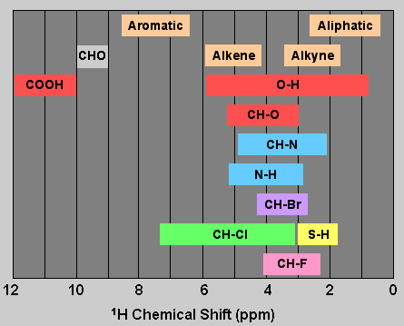

Slide 2
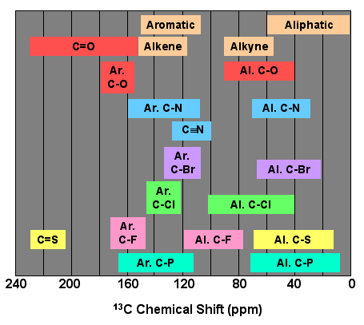

Slide 3
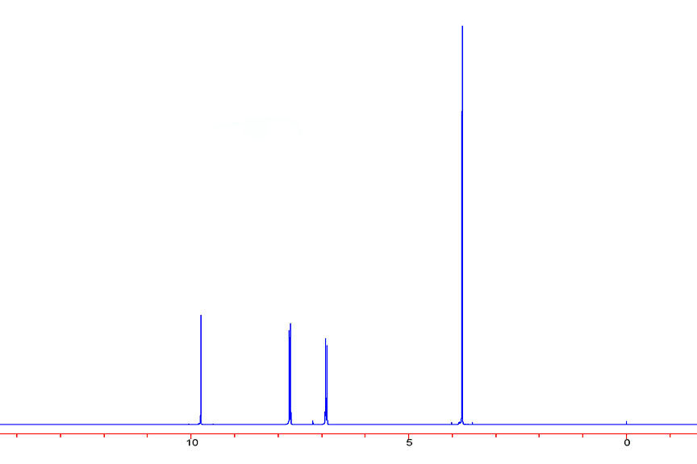
Shift (ppm)Area
9.78 1.00
7.75 2.02
6.90 2.01
3.77 3.17
(C8H8O2)
s
s
d
d

Slide 4
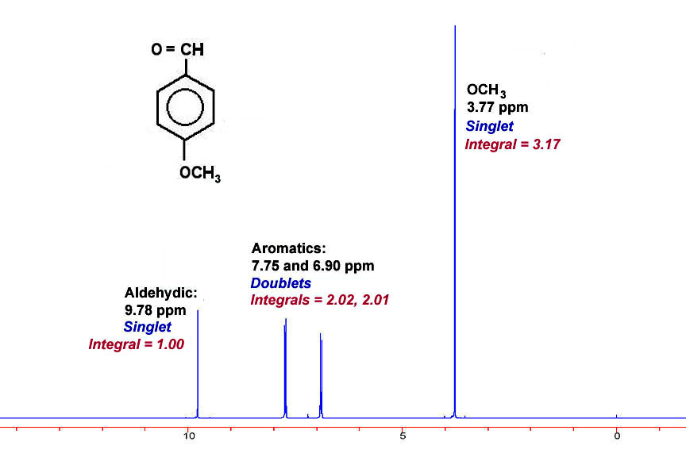

Slide 5
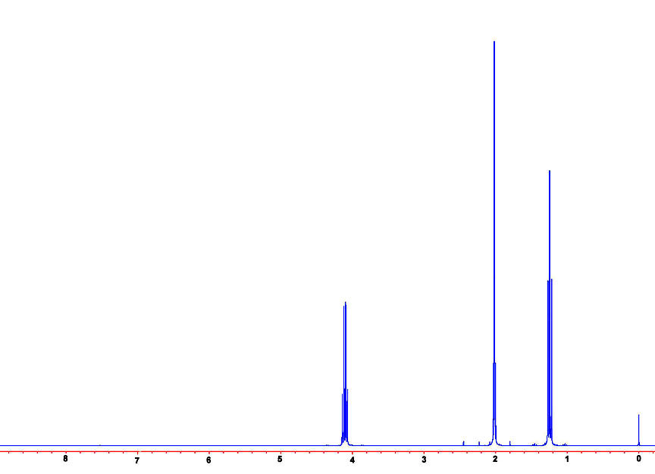
Shift (ppm) | Area
4.13 | 2.05
2.02 | 2.98
1.15 | 3.08
s
t
C4H8O2
q

Slide 6
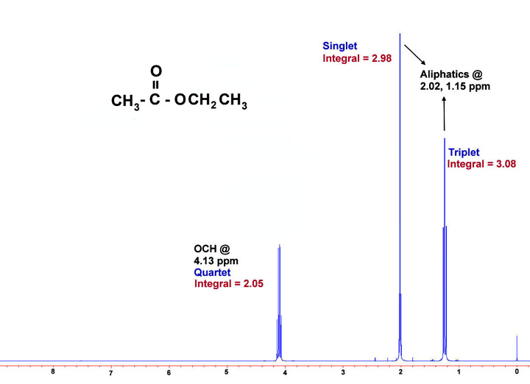

Slide 7
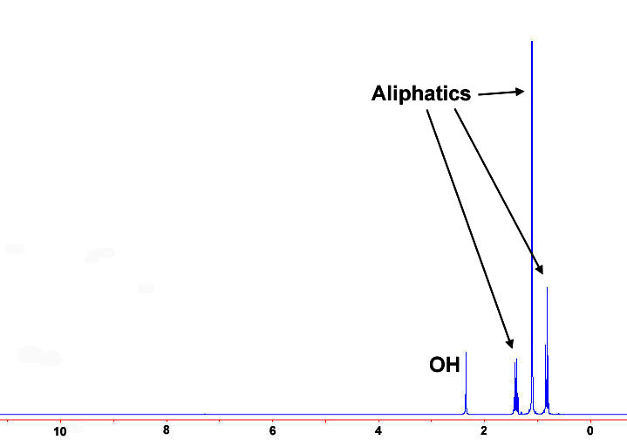
C5H12O
s
Shift (ppm) | Area
2.4 | 1.00
1.4 | 2.03
1.1 | 5.98
0.8 | 3.01
q
t

Slide 8
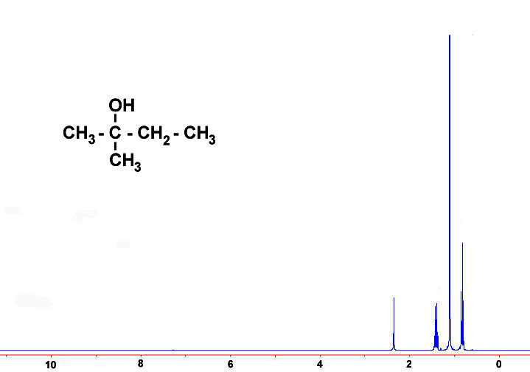

Slide 9
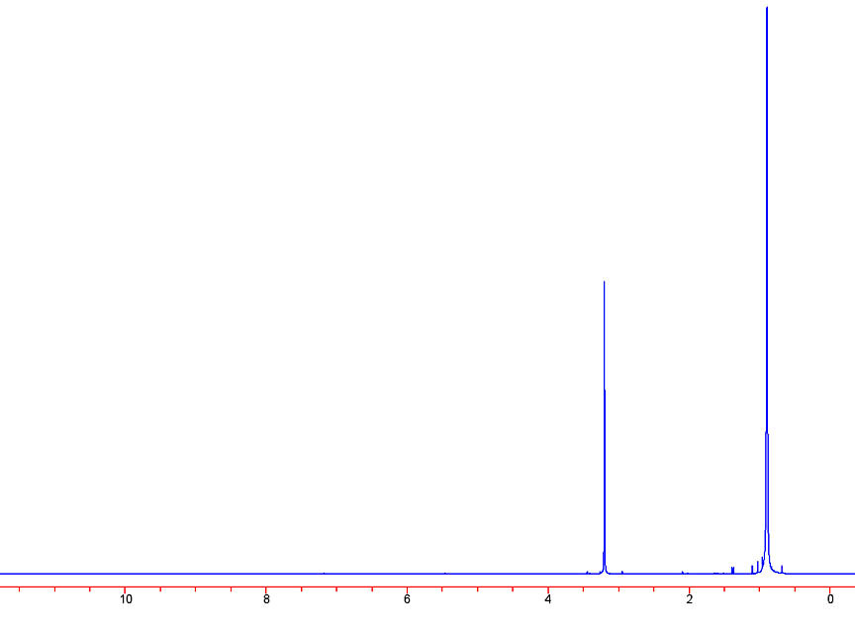
Shift (ppm)Area
3.19 1.00
0.89 4.65
1
C₅H₁₁Cl

Slide 10
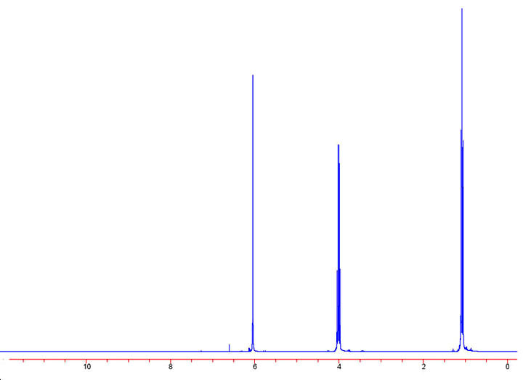
C₈H₁₂O₄
Shift (ppm) | Area
6.05 | 1.00
4.01 | 2.00
1.08 | 3.12
2
q
t
s

Slide 11
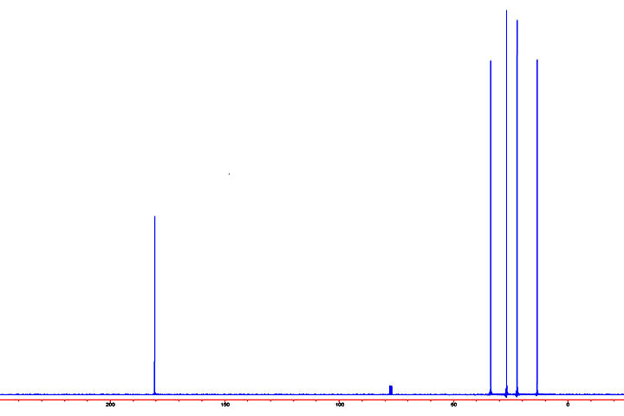
Shift (ppm) | Mult.
180.8 | S
33.8 | T
26.8 | T
22.4 | T
3.58 | Q
C₅H₁₀O₂
3

Slide 12
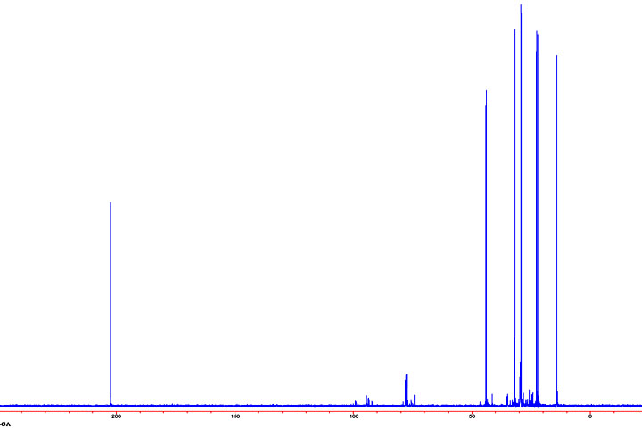
Shift (ppm)
202.5 | 29.2
43.5 | 22.6
31.8 | 22.1
29.3 | 14.1
C₈H₁₆O
4

Slide 13
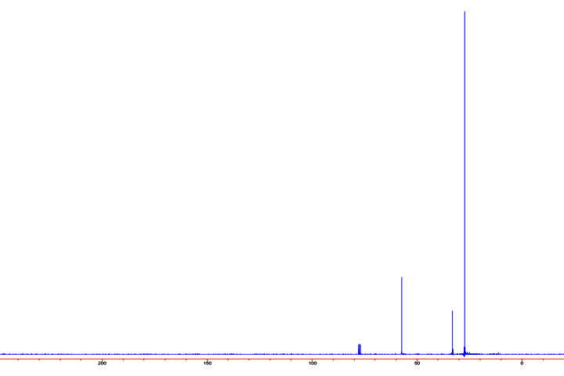
C₅H₁₁Cl
Shift (ppm)
57.3
33.1
27.3
5

Slide 14
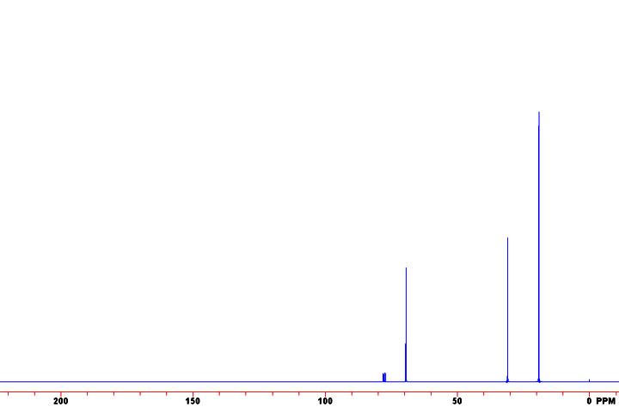
Shift (ppm) | Mult.
69.4 | T
30.9 | D
19.0 | Q
C₅H₁₀O
6

Slide 15
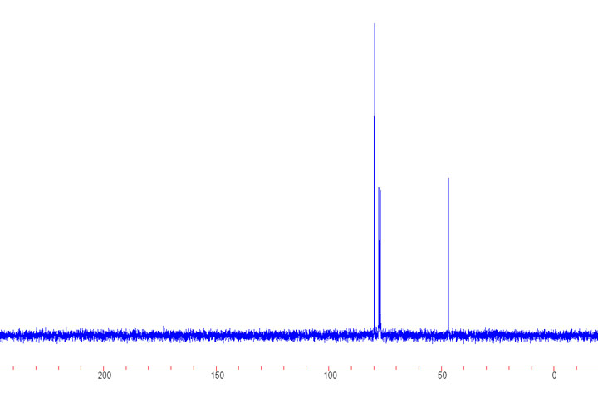
C₂H₃OBr₃
Shift (ppm) | Mult.
79.9 | S
46.7 | T
7

Slide 16
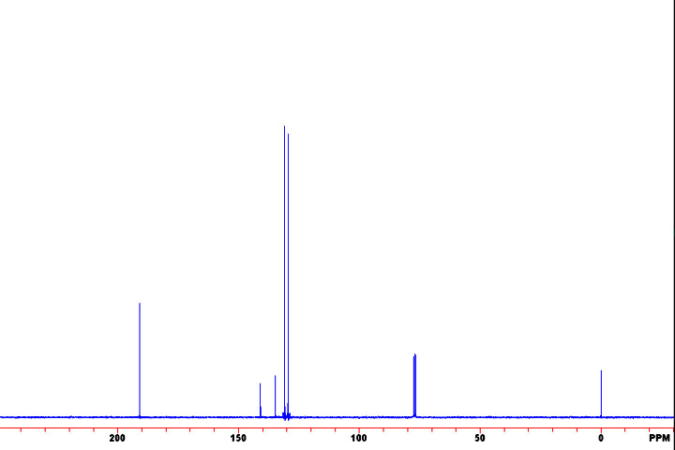
C₇H₅OCl
Shift (ppm)
191.0 | 131.0
141.1 | 129.4
134.8
8

Slide 17
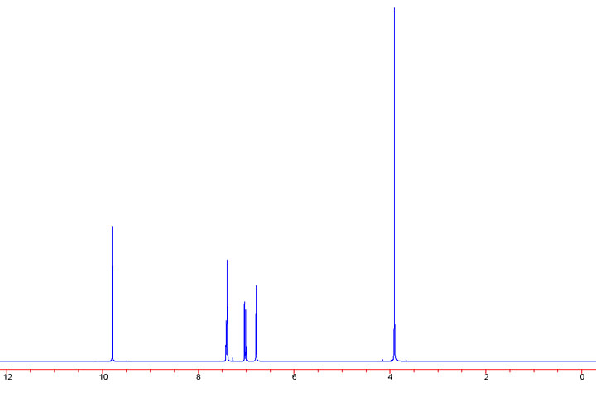
Shift (ppm) | Area
9.79 | 0.05
7.40 | 0.09
7.02 | 0.04
6.79 | 0.05
3.91 | 0.15
C₈H₈O₃
9

Slide 18
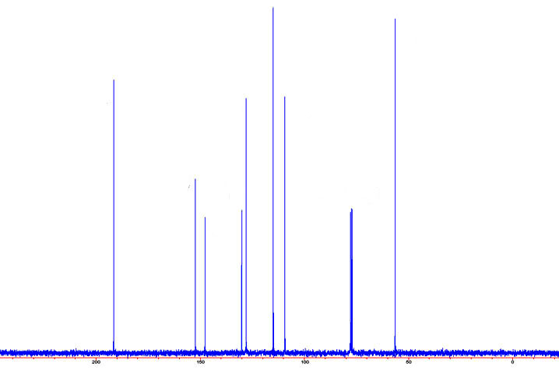
C₈H₈O₃
Shift (ppm)
191.6 | 128.0
152.4 | 115.0
147.7 | 109.4
130.0 | 56.6
10

Slide 19
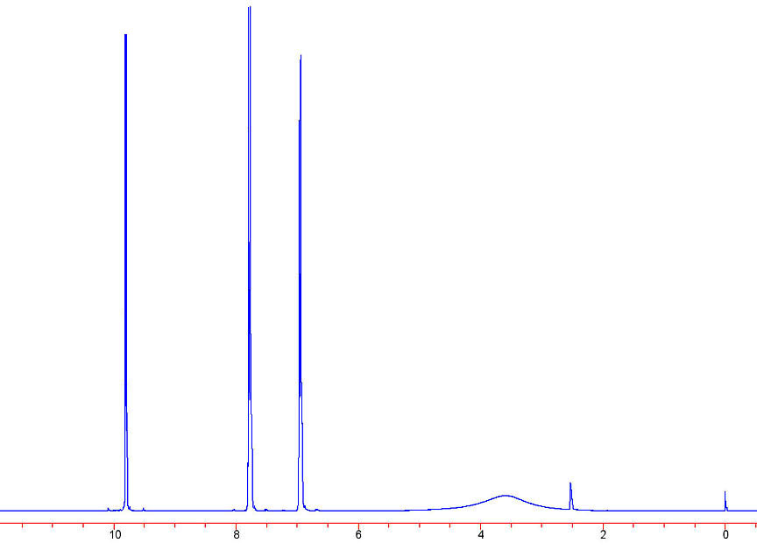
C₇H₆O₂
Shift (ppm) | Area
9.81 | 1.00
7.79 | 1.90
6.95 | 1.96
11

Slide 20
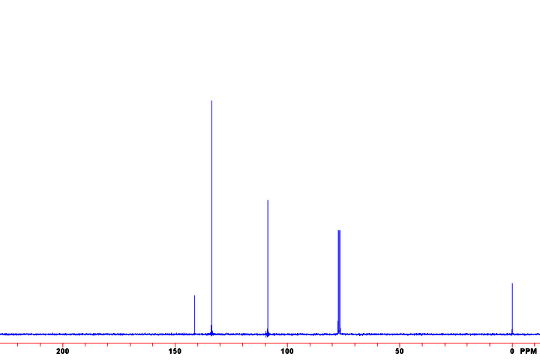
C₆H₄NBr₃
Shift (ppm)
141.3
133.7
108.7
12

