Slide 1
Georgios Arabatzis
Philosophy and Cultural Space
3.

Slide 2
The retreat of realism
The rise of culturalism
The rise of constructivism

Slide 3
Failure of phenomenology to describe the transcendental Ego
The subject in Descartes = transparent to itself, it can have clear and distinct ideas about the reality.
The possibility to have general representations due to the foundational position of the subject.
The subject can represent reality.

Slide 4
Criticism against Descartes = the theory of the subject (the cogito) is a vicious circle (Kant).
Effort to re-establish the subject by Husserl – impossibility to do so.
Yet:
Success of the eidetic reduction = everything is a “thing” and its “meaning”

Slide 5
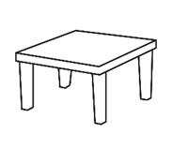
A table is a
And a “t-a-b-l-e”
And the concept of the “table”
All at once

Slide 6
Against the empiricist psychology : association of ideas through experience
Against the Aristotelian psychology = things are known through distinct mental faculties
(Faculty psychology)

Slide 7
Practical consequences:
Impossibility to establish realism
There is not a realist entity on which one could develop a philosophical realism
(like Platonic ideas or Cartesian cogito or the simple experience)

Slide 8
Thus, everything is cultural
Rise of the culturalism
Cultural means are construed
Rise of the constructivism

Slide 9
Impossibility to insert something into a larger frame
Historical
Economical
Social
Etc.

Slide 10
Instead we have to “contextualize”
What does this mean?
Find the crucial distinctions in a given situation
For example:
Before the war : war or peace
After the war: victory or defeat

Slide 11
Impossibility to take a universal subject as foundation
There is no universal subject (deconstruction of the subject)
Rather differences:
Gender
Race
Colonialism (subaltern subject) – post-colonialism (cultural hybridization)

Slide 12
Space = the geometrical and the cultural space
Yet, the geometrical space is already a cultural space
Relations of propriety
Relations of domination
Hierarchical Relations
Through Geometry

Slide 13
Rather: 1) figurative space – 2) space of representation
1) Figurative space
Perspective = domination, expansion
Objectivism – relation of masses within space
The point of view of a dominant spectator
The state and the individual
The public and the private

Slide 14
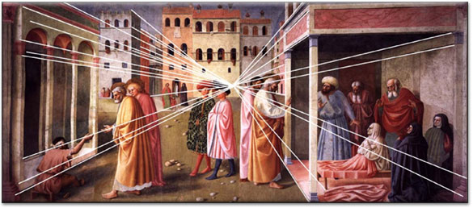

Slide 15
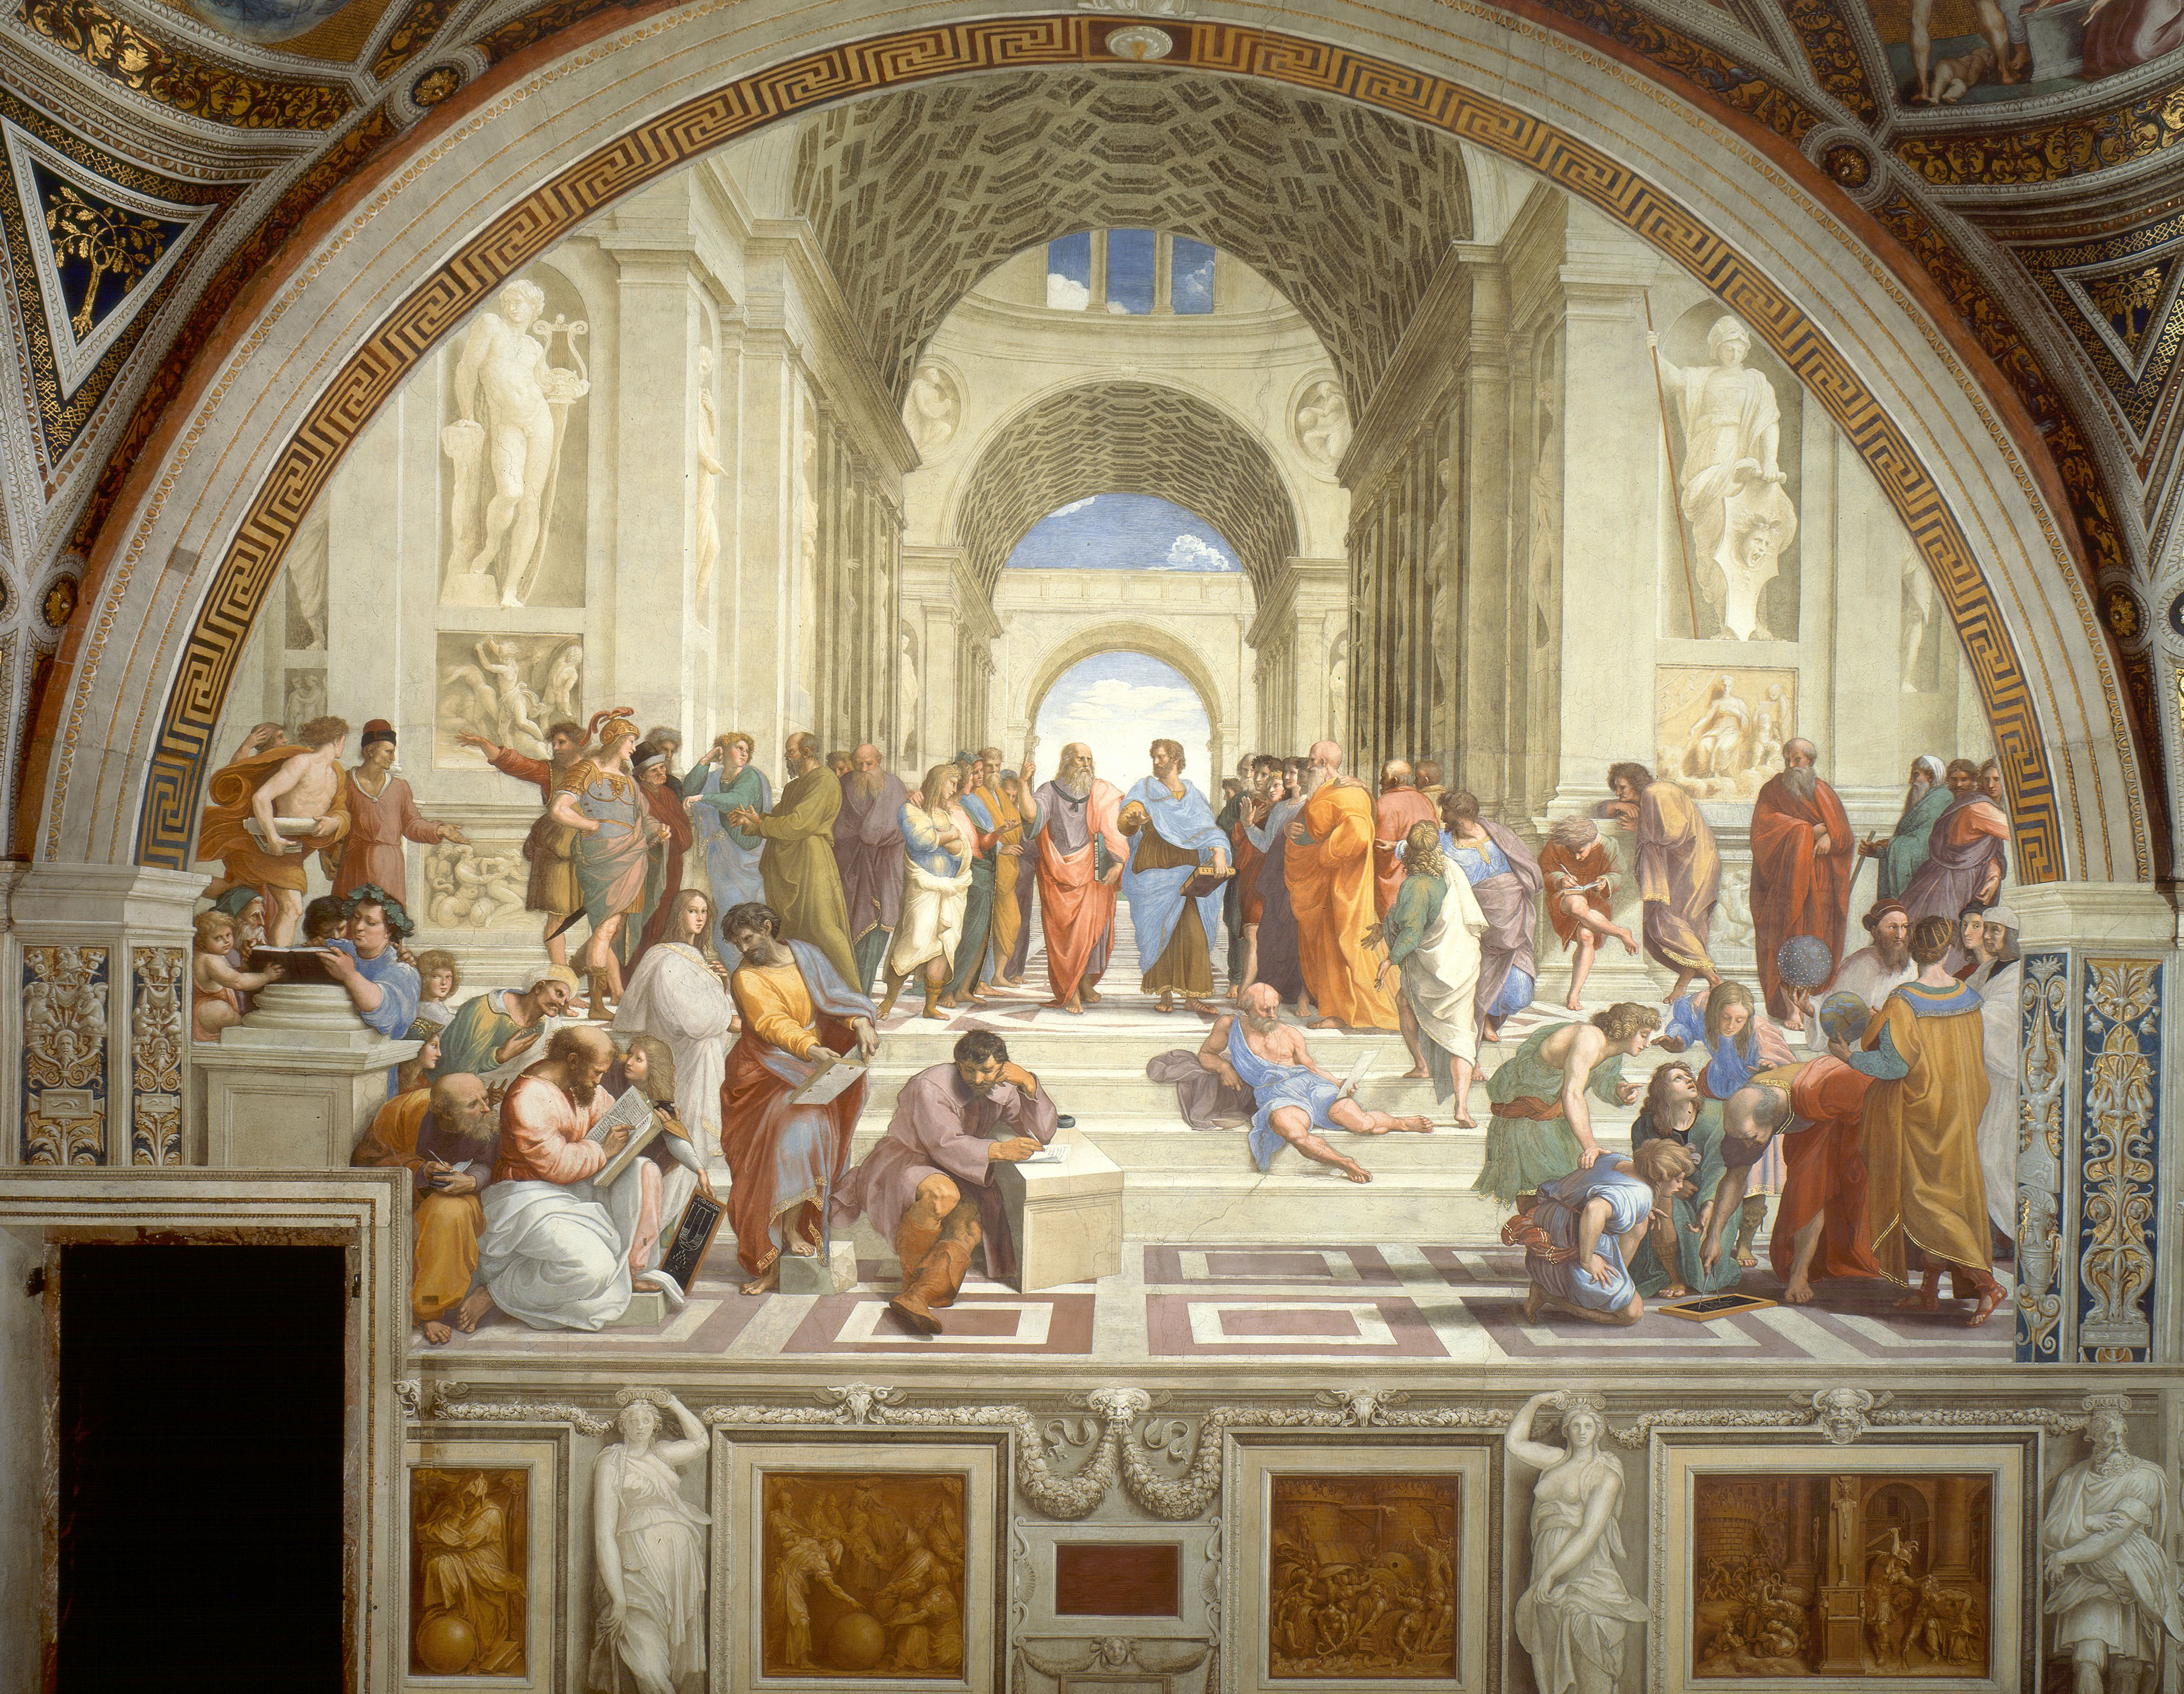

Slide 16
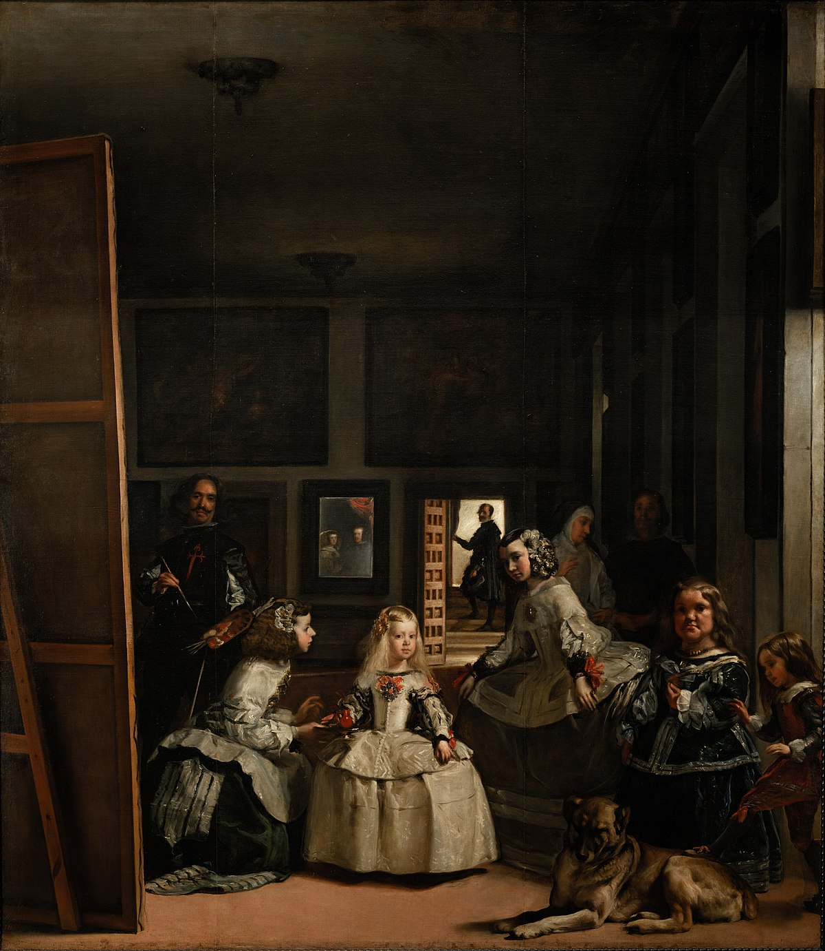

Slide 17
2) Space of representation
The Commons
The commons, between state and private sector, are treated as invisible.
Political and social weight of the commons?
Economists, policymakers, big organizations.
Urban and virtual spaces (imagination) – creating social bonds

Slide 18
Space and social bonds
Transformation of everyday life
A different epistemology of everyday life

Slide 19
Against vicious effects
Economic crisis
Disappropriation
Isolation
Climate change
Silence and media = cultural space

Slide 20
Alternative idea of the space
Two characteristics:
- Unmanaged
- Institutional
Spaces that matter (in analysis also)
Care for the ecosystems

Slide 21
Against the impasses of contemporary world
Against subjective appropriation
Against objectivation
Commons is the cultural sphere

Slide 22
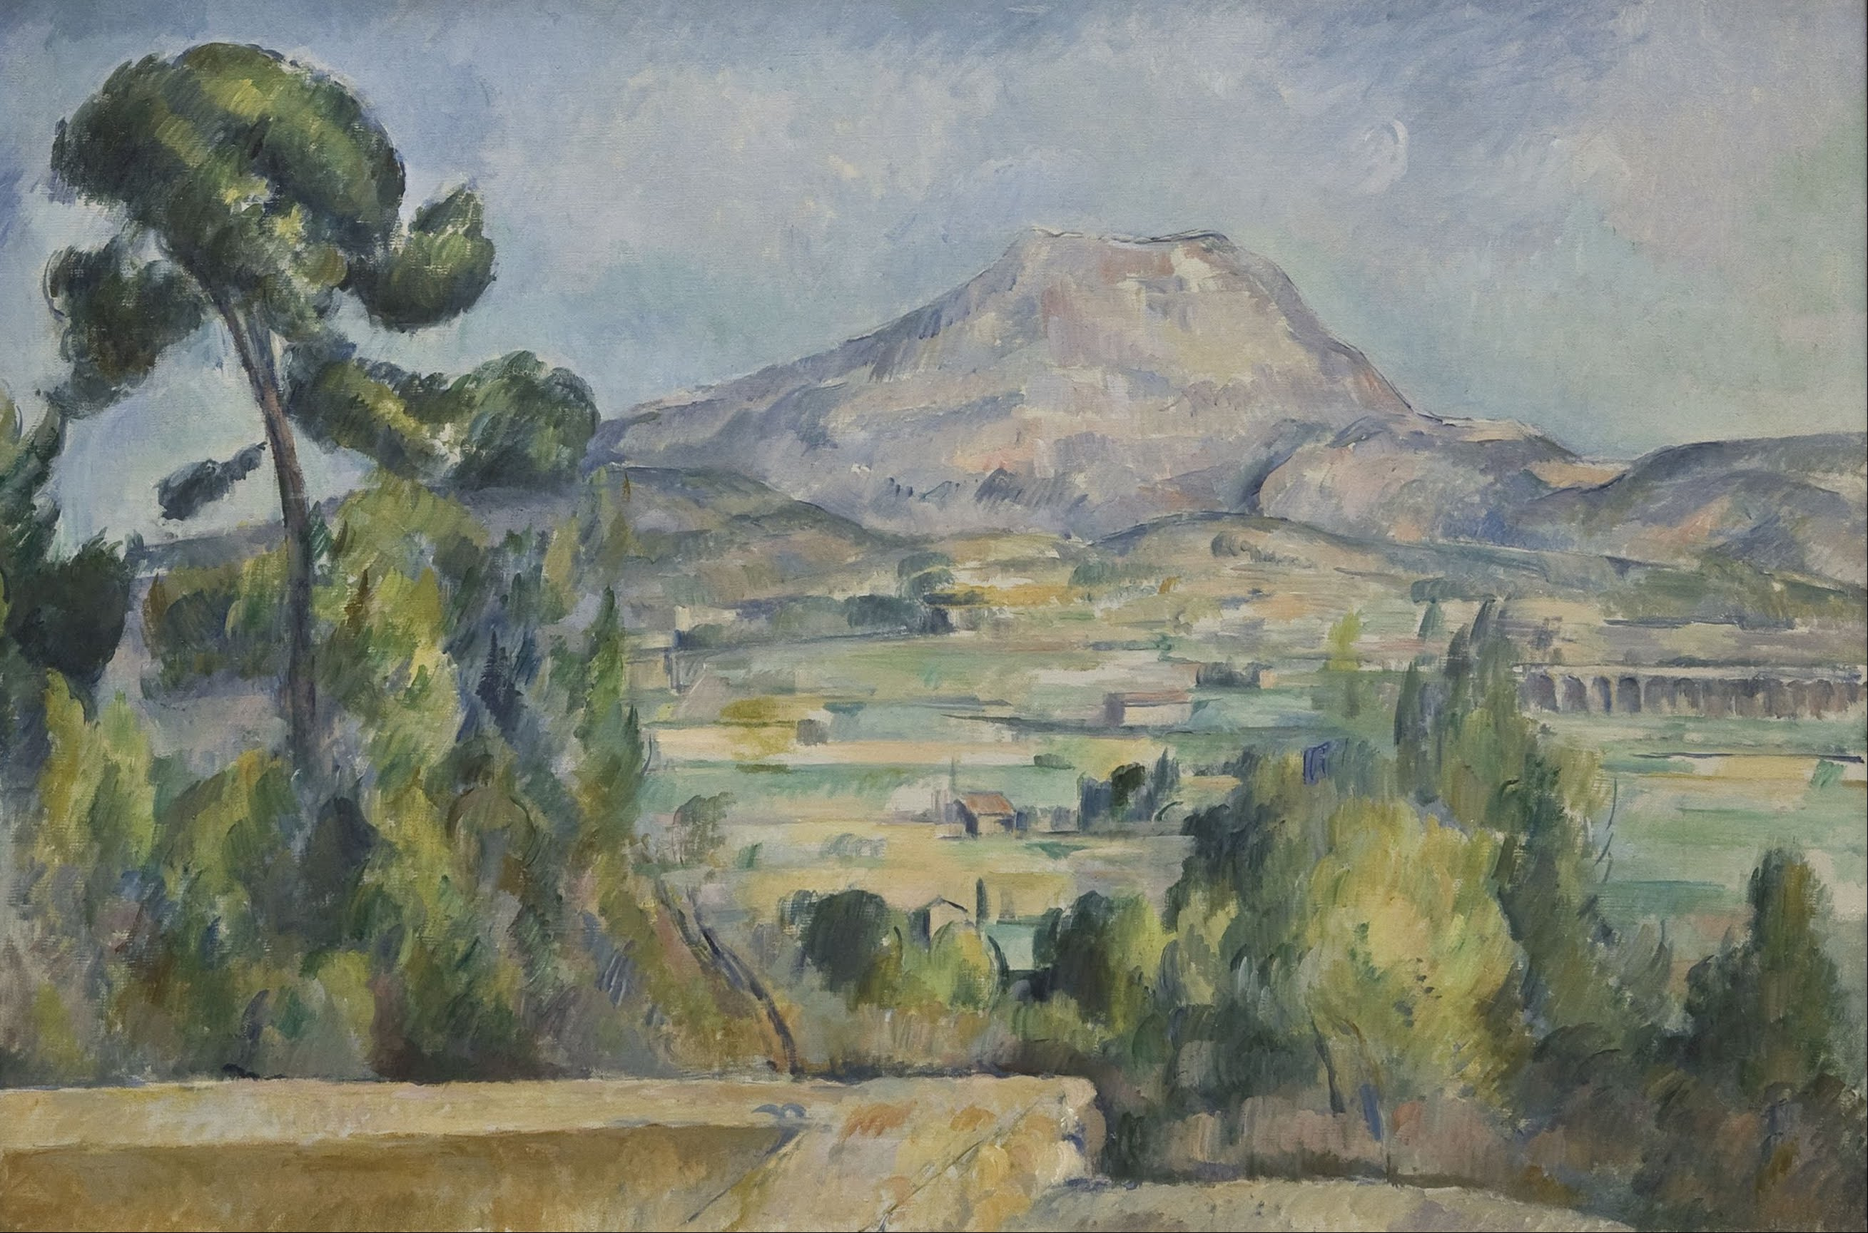

Slide 23
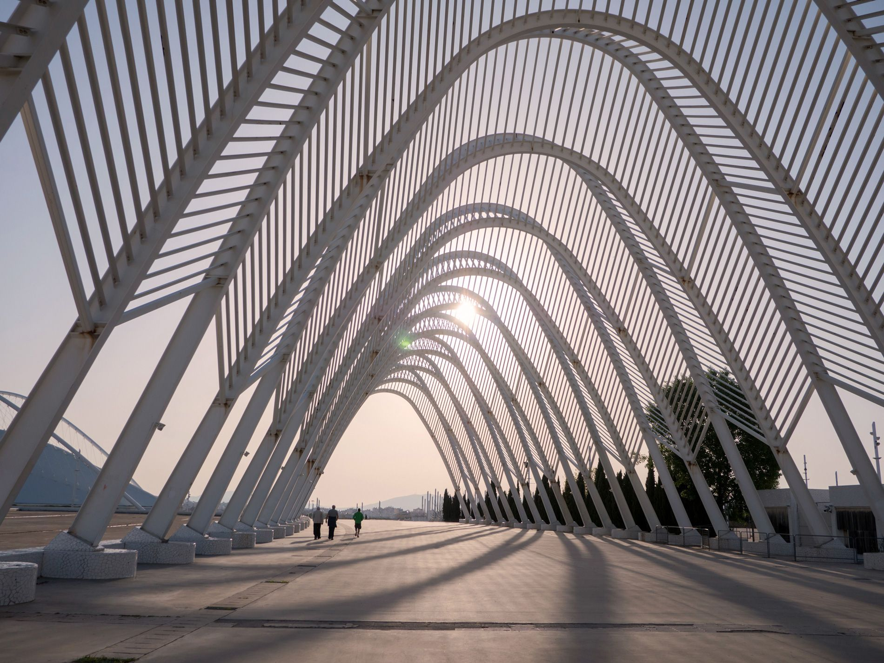

Slide 24
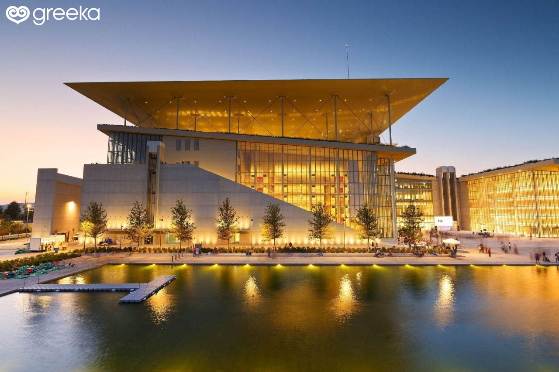

Slide 25
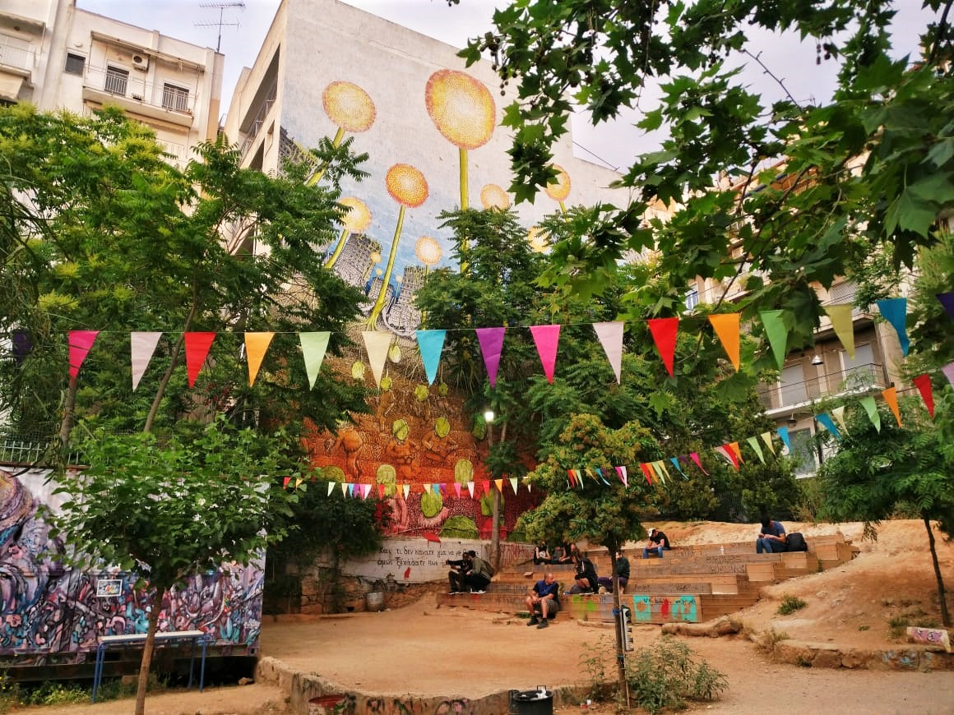

Slide 26
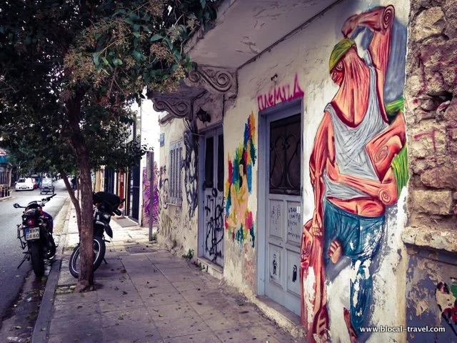

Slide 27
