Slide 1
CIVIS program “Governing in times of crisis”
Crisis legislation and jurisprudence
George Katrougalos
Professor of Public Law
UN Independent Expert on a Democratic and Equitable International Order
Former Foreign Minister of Greece
Athens, 23May 2024

Slide 2
A- Crisis in global context

Slide 3
An unprecedented crisis of trust in Western countries

Slide 4
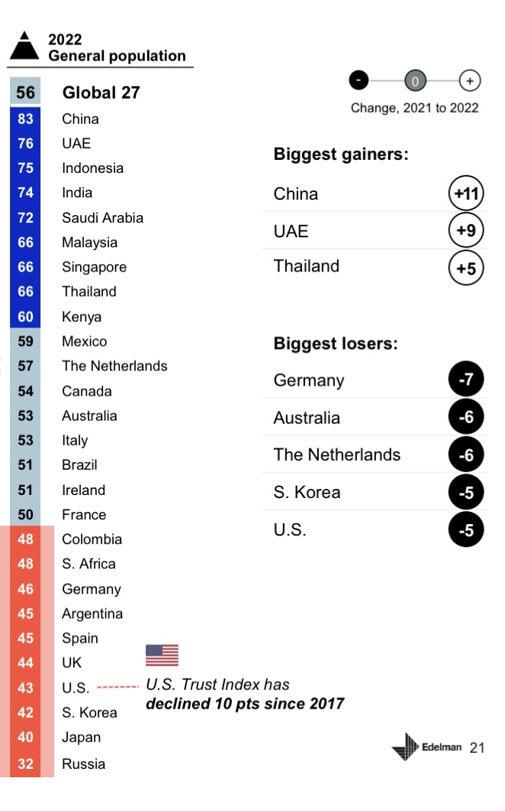
Global trust to Government

Slide 5
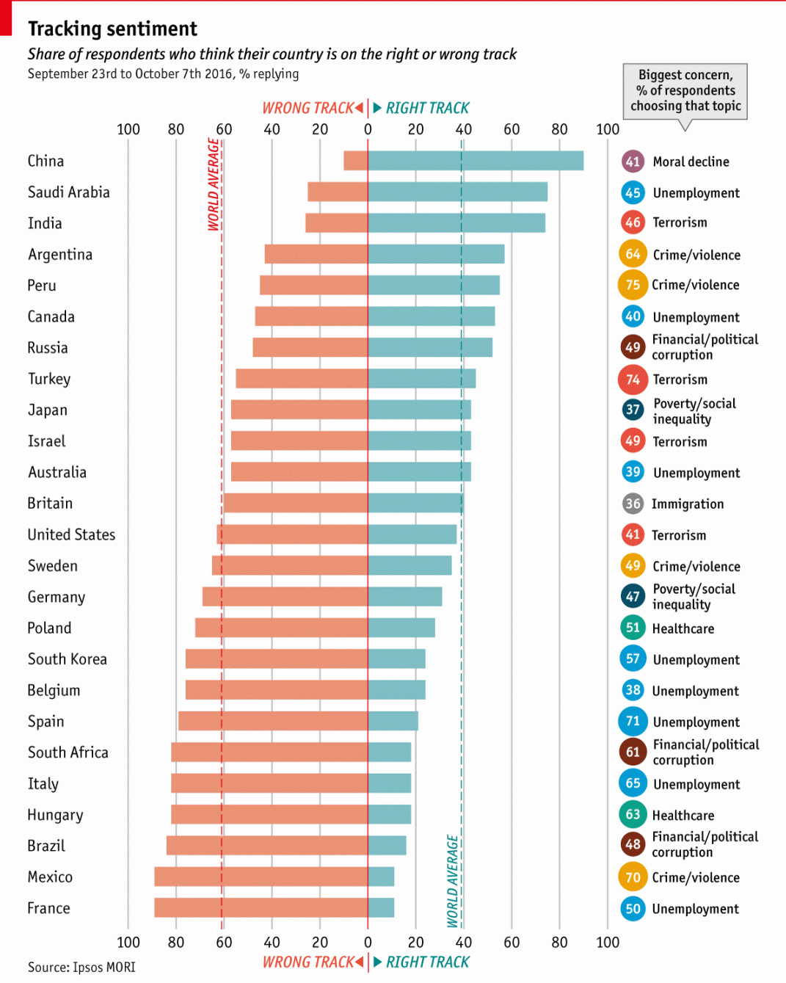
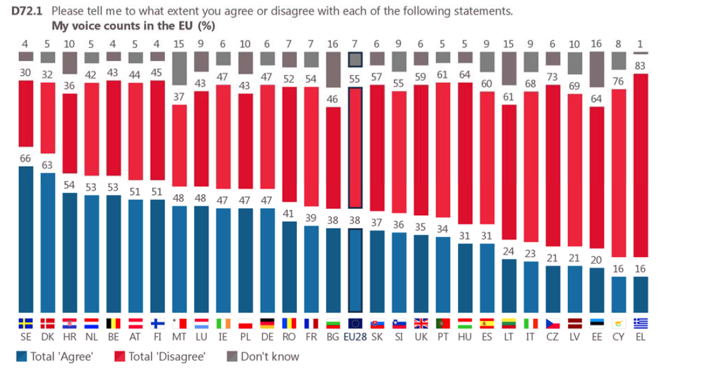
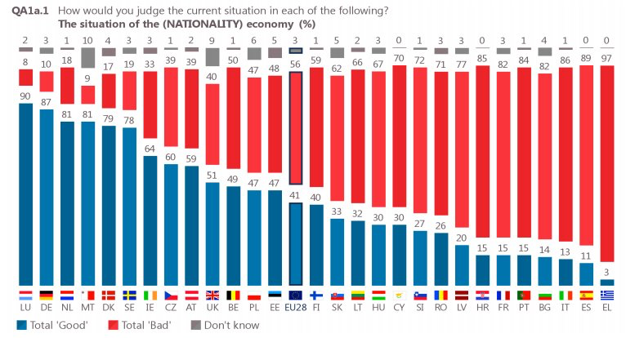
Alienation from EU / State of the Economy (subjective)
Source: Standard Eurobarometer 85, Public opinion in the European Union, May 2016.

Slide 6
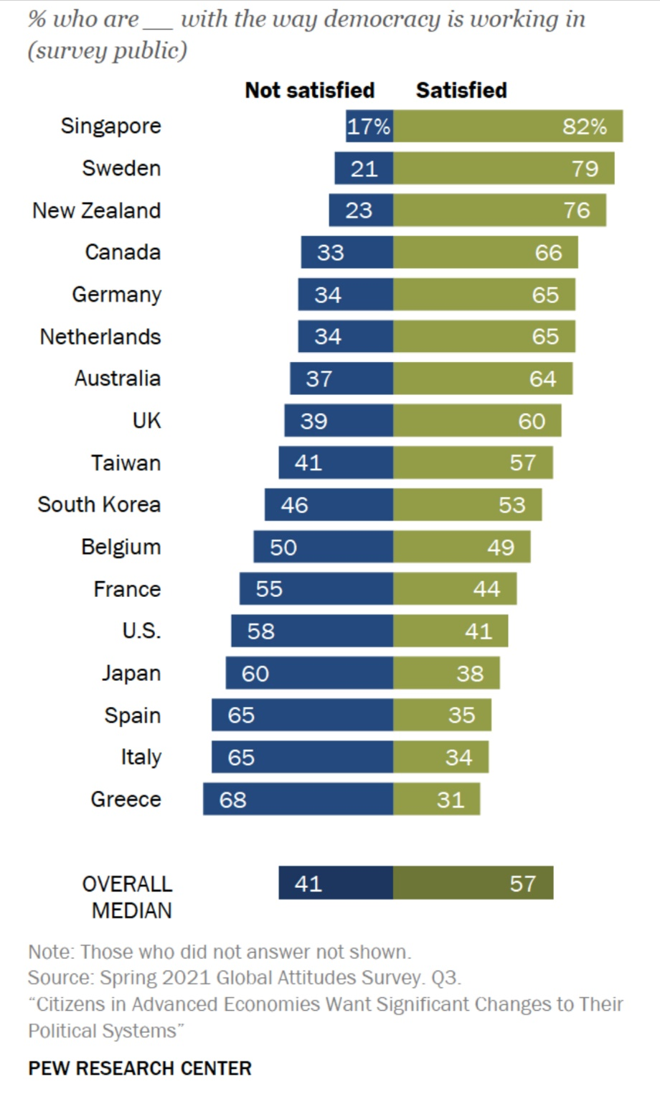
Global (dis)satisfaction with democracy, western countries

Slide 7
Confidence in EU and National Institutions
Source: Standard Eurobarometer, Public opinion in the European Union, 2018, QA 8A

Slide 8
…due to an explosion of inequalities and the subjective feeling that they derive from political decisions favoring the strong and powerful

Slide 9
A reversal of the politological change of the transition from the “liberal” state of the 19th Century to the “Social” of the 20th
“Two nations; between whom there is no intercourse and no sympathy; who are as ignorant of each other’s habits, thoughts, and feelings, as if they were dwellers in different zones, or inhabitants of different planets; who are formed by a different breeding, are fed by a different food, are ordered by different manners, and are not governed by the same laws.” “You speak of — ”said Egremont, hesitantly. “ THE RICH AND THE POOR.”
B. Dirsraeli, Sybil, or the Two Nations (1845)

Slide 10
The globalization effect
Economic globalization is an irreversible trend of global economic development, and is in line with the desire for development and cooperation held by people of all countries. Economic globalization has greatly facilitated trade, investment, flows of people, and technological advances, making an important contribution to global economic development.
The current model of economic globalization fails to reflect the demands or represent the interests of developing countries

Slide 11
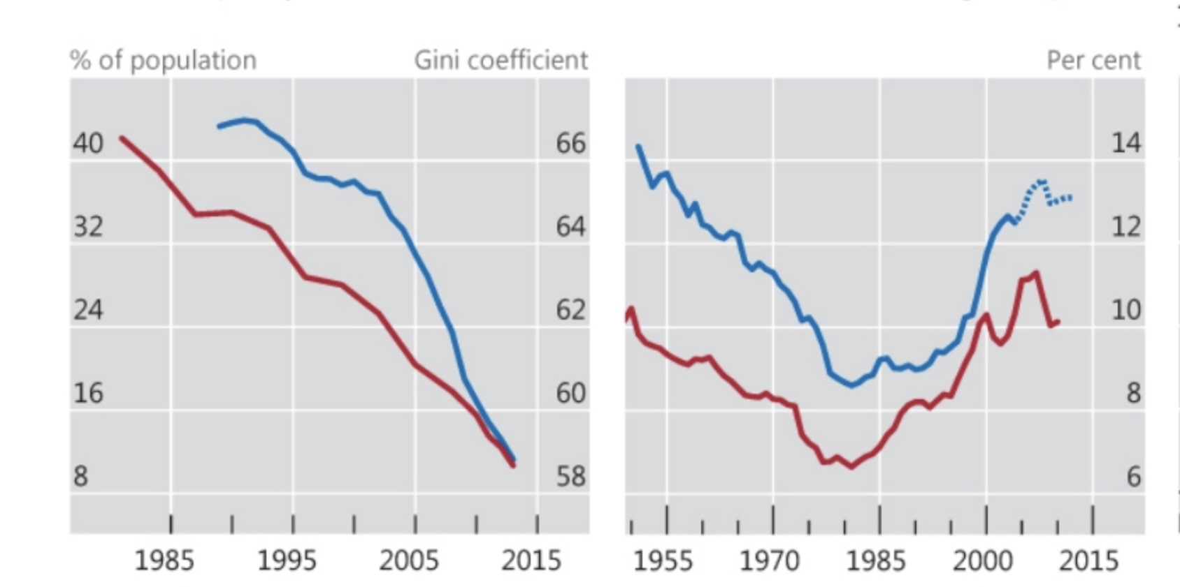
World Inequality Share of Income of top 1%
Source: BIS 87 Annual Report, 2017, https://www.bis.org/statistics/ar2017.stats.htm
Global economic trends: reduction global poverty and inequality, but increase of inequalities within western countries

Slide 12
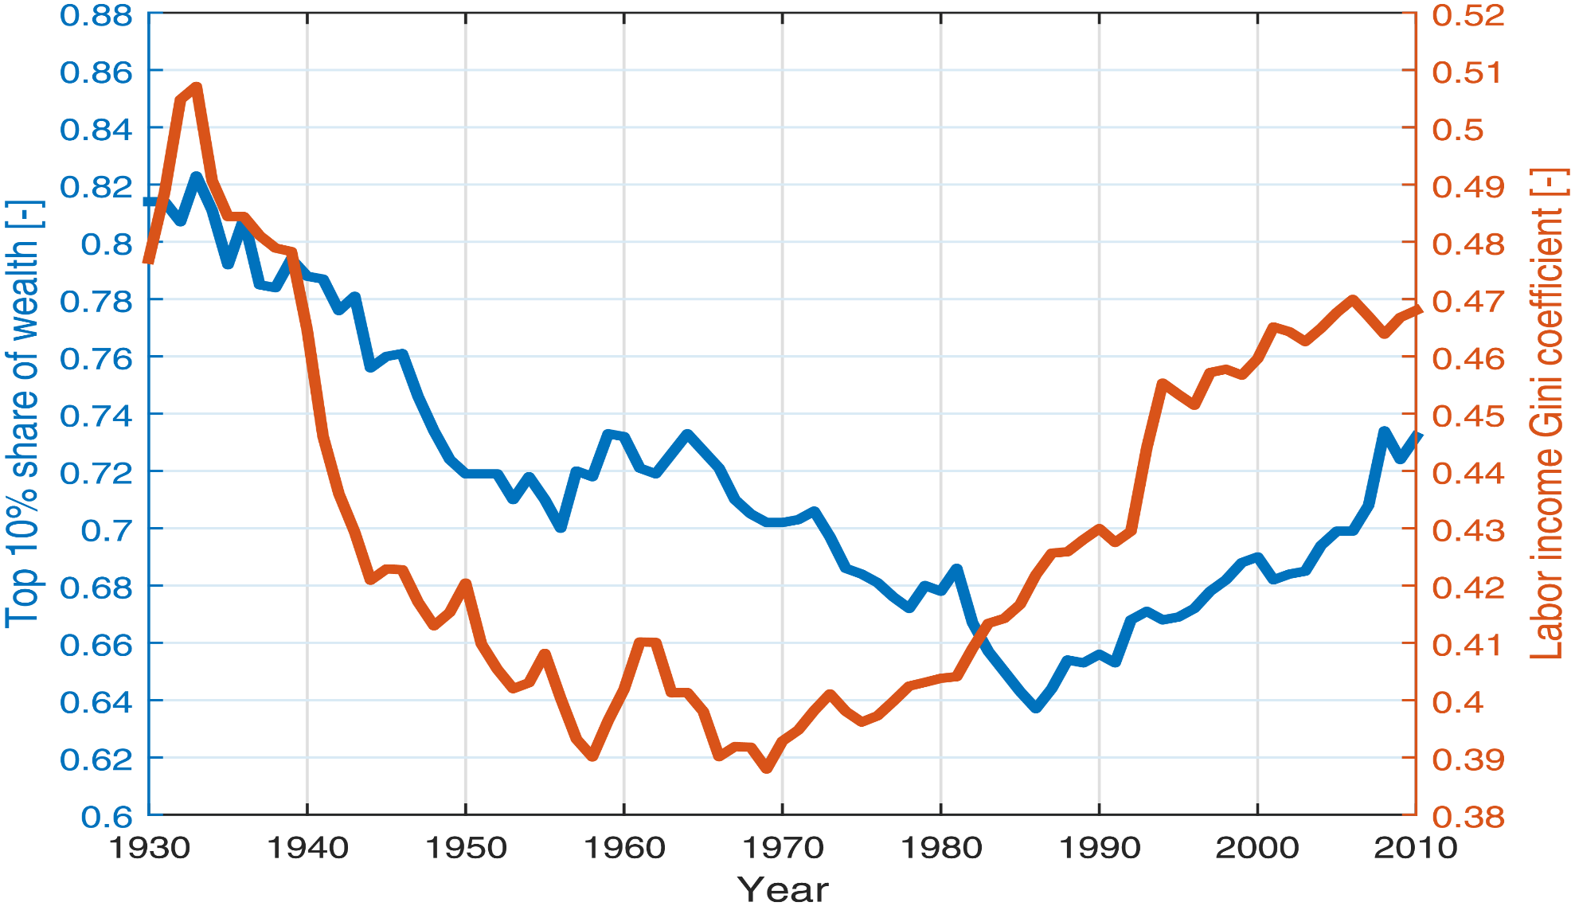
Inequality in USA
Source: Y. Berman ,E. Ben-Jacob ,Y. Shapira , The Dynamics of Wealth Inequality and the Effect of Income Distribution, Plos One, : April 22, 2016
https://doi.org/10.1371/journal.pone.0154196

Slide 13
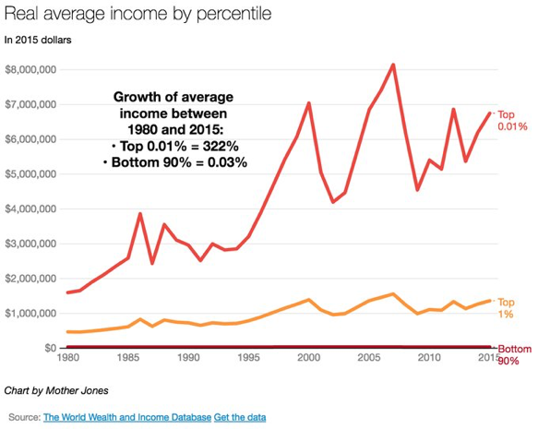
Real Average Income by Percentile (Top 0,01%, Top 1%, Bottom 90%, 1980-2015
Between 1980 and 2015 the average real income of 0.01% of the population has grown by 322%, whereas the income of the lowest 90% has stagnated, rising only by 0.003%.
Source: World Wealth and Income Database, http://52.209.180.1/country/usa/

Slide 14
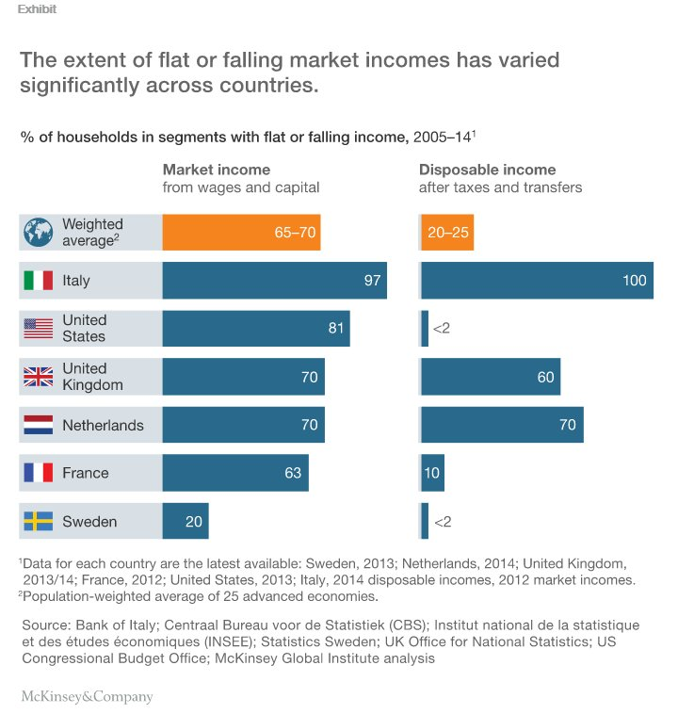
% of Households with stable of falling income 2005-2014
Source: Richard Dobbs et alii, Poorer than their Parents?, Flat or falling economies in advanced economies, McKinsey Global Institute, July, 2016, http://www.mckinsey.com/global-themes/employment-and-growth/poorer-than-their-parents-a-new-perspective-on-income-inequality

Slide 15
Rise of inequalities is not a result of rise of international trade, but a direct consequence of neoliberal policies
Labour market deregulation. Anti-trade union laws.
Wages stagnate or increasing less than productivity growth .
Decrease of social spending. Cuts of social transfers such as welfare assistance or public retirement benefits
A huge decline in the progressivity of taxation. Top marginal tax rates: 80% in 1960, they have fallen from 59% in 1980 to 30% in 2009.

Slide 16
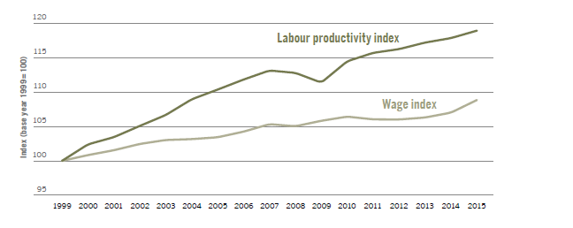
Trends in growth in average real wages and labour productivity in developed economies, 1999–2015
Source: ILO, Global Wage Report 2016-1017, Wage inequality in the workplace, ILO, Geneva, 2016. http://www.ilo.org/wcmsp5/groups/public/---dgreports/---dcomm/---publ/documents/publication/wcms_537846.pdf4.

Slide 17
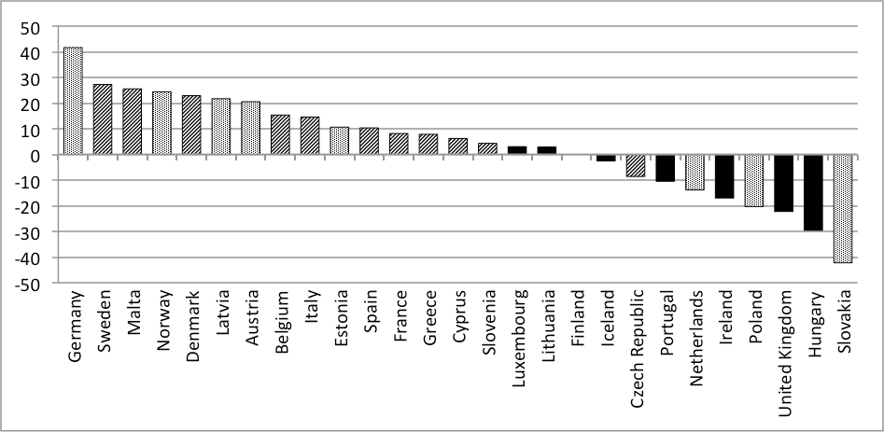
Change Of In-Work Poverty Rates 2004-2008 In % (2004=100)
Source: Daniel Seikel , Activation Into In-Work Poverty? In https://www.socialeurope.eu/activation-work-poverty

Slide 18
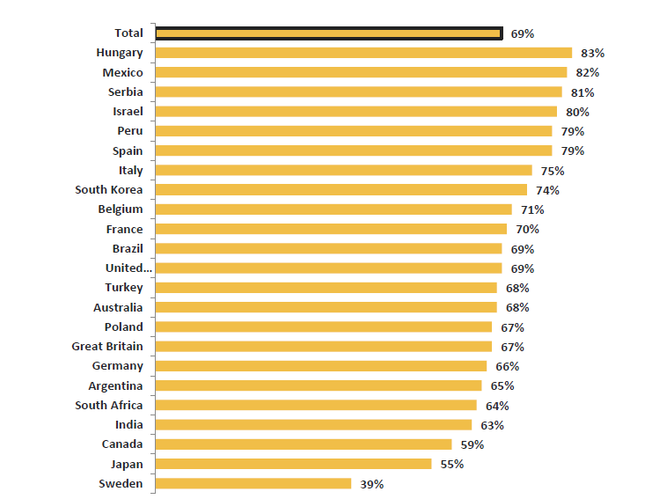
Respondents agreeing that the economy is rigged to advantage the rich and the powerful
Source: IPSOS, Global @dvisor, Power to the People?, 2017, https://www.ipsos-mori.com/Assets/Docs/Polls/ipsos-global-advisor-power-to-the-people-tables.pdf.

Slide 19
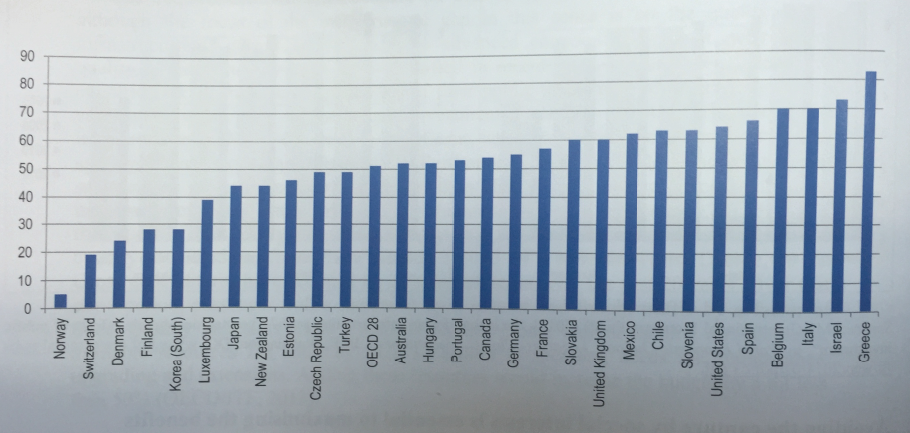
Percentage of respondents who think the government is run by a few big entities in their own best interests (2013)
Source: OECD Public Governance Reviews, Paris, 2016, p. 18, based on Transparency International , Global Corruption Barometer 2013, OECD Integrity Framework for Public Investment.

Slide 20
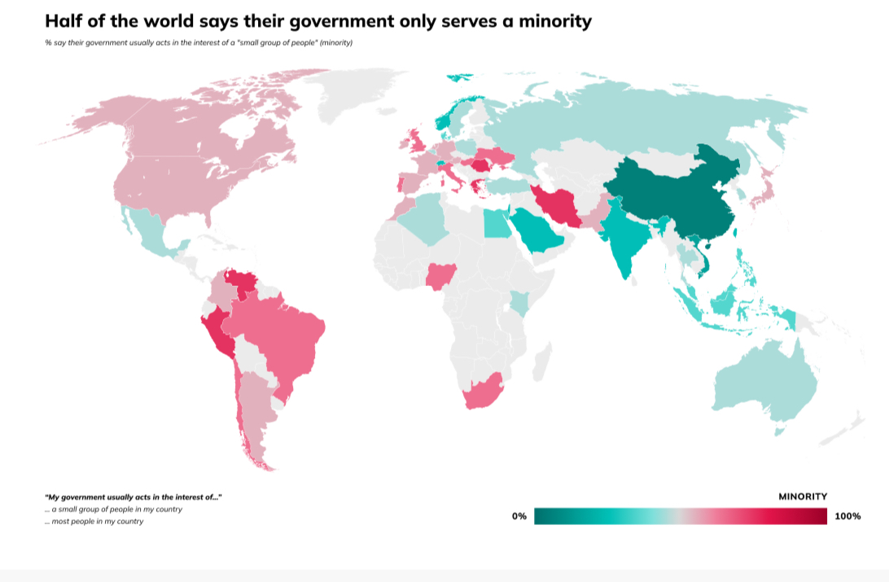
Source: DPI-2024, Democracies Perception Index, Alliance of Democracies, 2004, https://www.allianceofdemocracies.org/wp-content/uploads/2024/05/DPI-2024.pdf

Slide 21
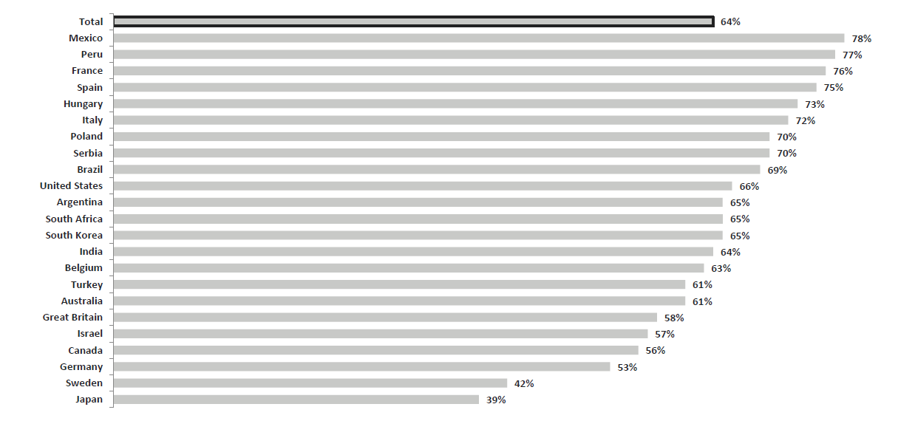
Agreeing that traditional political parties don’t care about people “like them”
Source: IPSOS, Global @dvisor, Power to the People?, 2017, https://www.ipsos-mori.com/Assets/Docs/Polls/ipsos-global-advisor-power-to-the-people-tables.pdf:

Slide 22
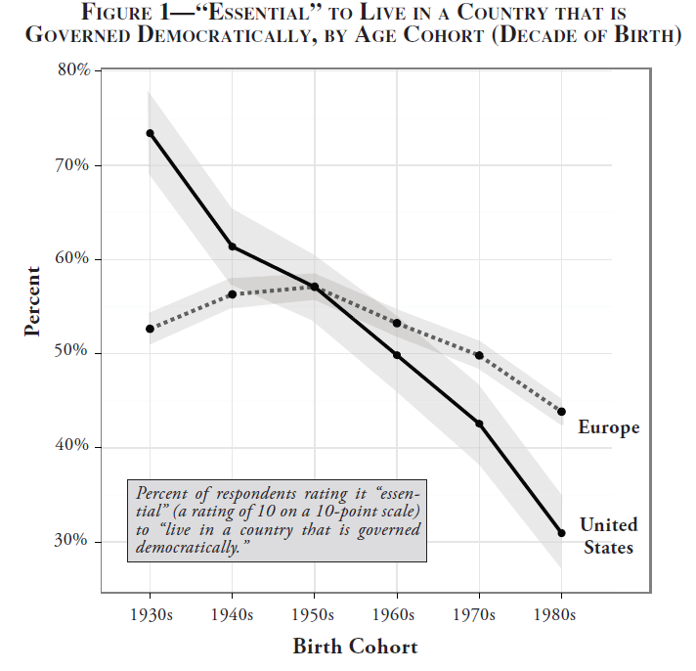
Is it “essential” living in a Democracy? Responses by Birth Cohorts (decade oF Birth) 1930-1980
Source: World Values Surveys, Waves 5 and 6 (2005–14). Data pooled from EU member
states. Valid responses: United States, 3,398; European Union, 25,789, Yascha Mounk and Roberto Stefan Foa, “The Signs of Democratic Deconsolidation,” Journal of Democracy, vol. 27, nr. 3, 2016 p. 5-17,

Slide 23
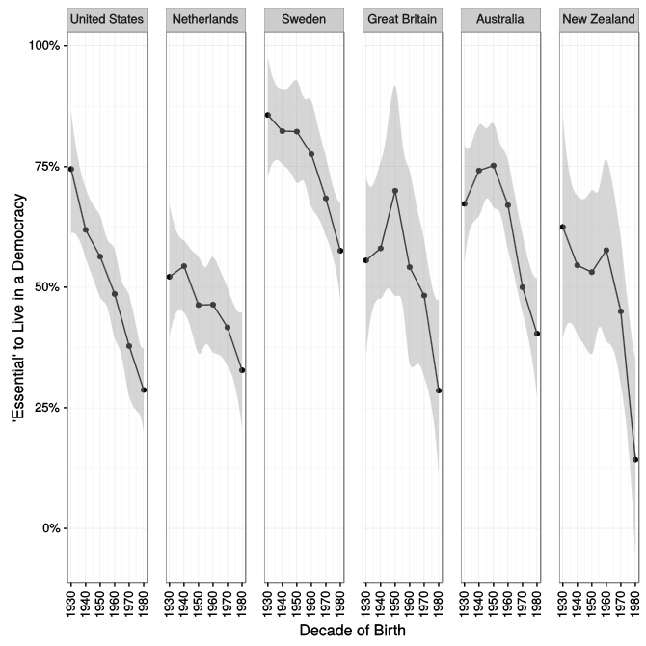
USA Netherlands Sweden UK Australia N.Zealand Horizontal axis: decade of birth from 1930 till 1980
Source: Yascha Mounk and Roberto Stefan Foa, “The Signs of Democratic Deconsolidation,” Journal of Democracy, vol. 27, nr. 3, 2016 p. 5-17, presented at “Warning Signs ‘Flashing Red’ for Democracies, “New York Times, 29/11/2016, http://www.nytimes.com/2016/11/29/world/americas/western-liberal-democracy.html?mwrsm=Email: .

Slide 24
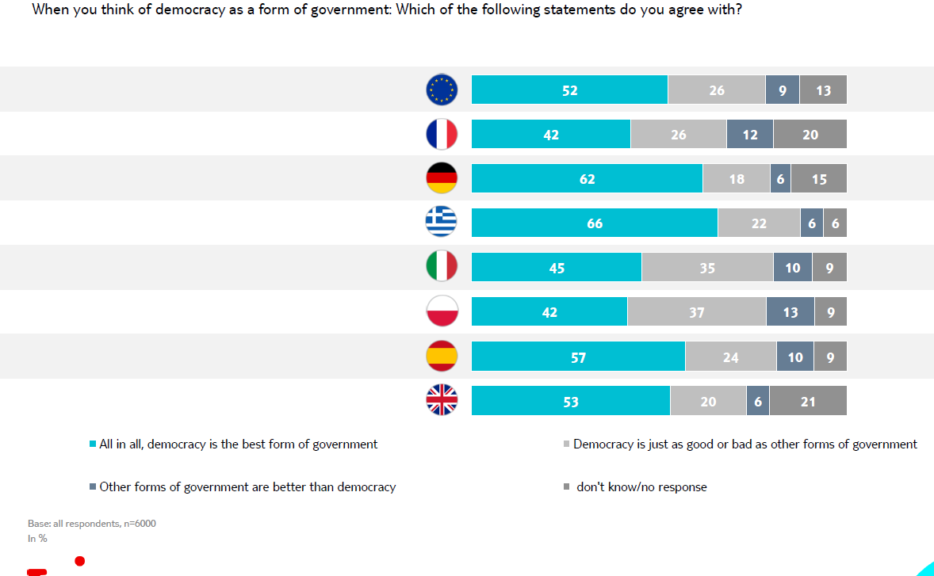
Responses of Young Europeans with regard to Democracy as
“Best form of Government”
Source: Young Europe 2017, What young Europeans think about Europe, Survey conducted by YouGov on behalf of TUI Foundation, TUI Stiftung 2017.

Slide 25
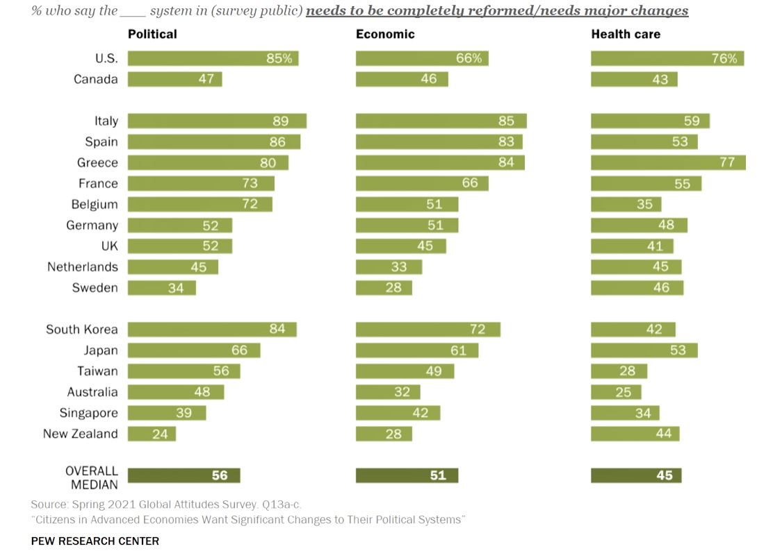
A clear majority of citizens demand deep, thorough changes of the political and the economic system

Slide 26
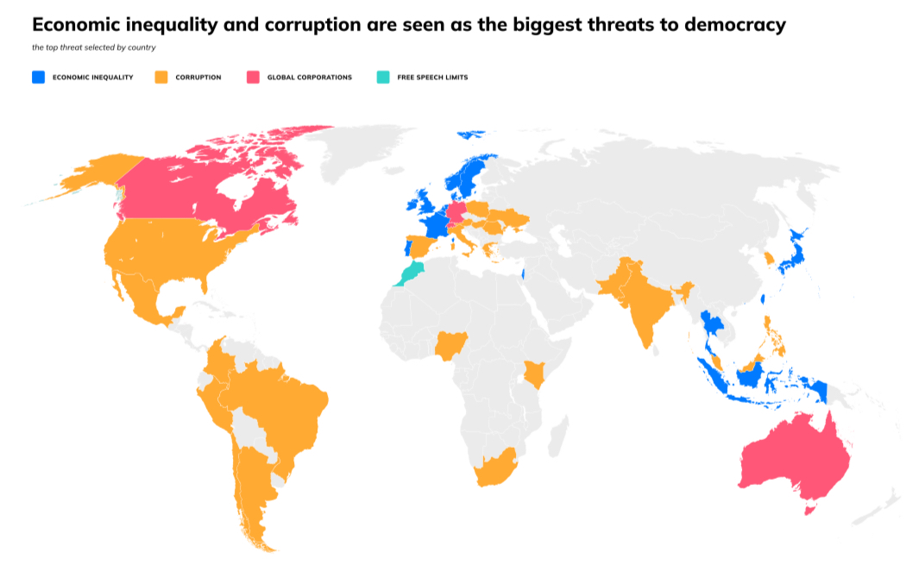
DPI-2024, Democracies Perception Index, Alliance of Democracies, 2004, https://www.allianceofdemocracies.org/wp-content/uploads/2024/05/DPI-2024.pdf

Slide 27
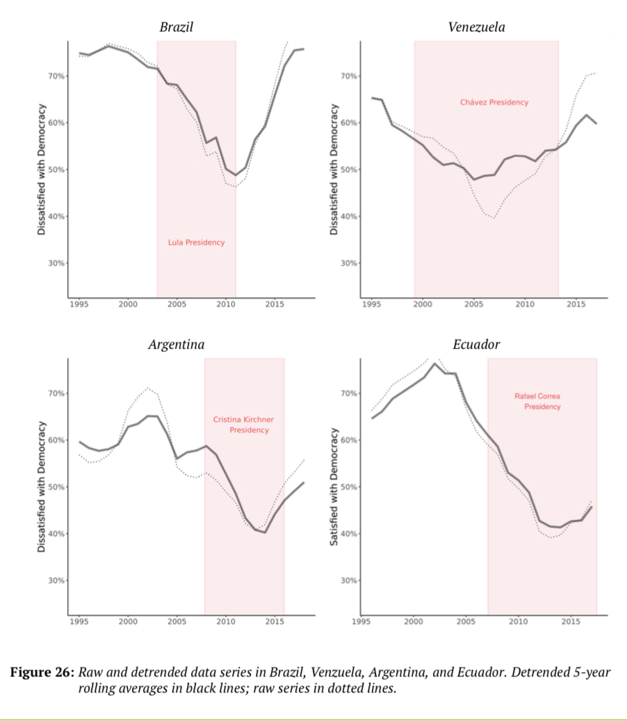
Countries which tried to decrease inequalities with progressive policies increase public trust: the example of Latin America
Source: Bennett Institute for Public Policy at the University of Cambridge, Report on Global Satisfaction with Democracy, https://www.bennettinstitute.cam.ac.uk/publications/global-satisfaction-democracy-report-2020/

Slide 28
B- The Crisis in Greece
‘We have not made any kind of preparatory work. Just at the last minute we have copied and pasted isolated segments from earlier Letters of Intent to the IMF by Turkey, Mexico or Hungary and hastily adapted them to synthesize the Greek Memorandum.’ … ‘It's a bad compilation, a Frankenstein Memorandum”.
Anonymous interviews of PASOKs ministers reported by Paul Papadopoulos, ‘The dramatic background of two years of the Memorandum’. To Vima, 16 October 2011

Slide 29
Domestic aspects of the crisis
The Greek political system was in deep crisis even before the bail-out and in urgent need of radical reform. It was suffering from an unbalanced, irrationally built, uncoordinated public administration and a distorted relationship between the political and economic agents.

Slide 30
The “Memoranda”
In essence, the recipe called for horizontal reduction of all public expenses, although the primary reduction was for social expenditures, it also called for a thorough deregulation of labour law legislation, and a massive transfer of wealth from the public to private sector through privatizations of public enterprises. These privatizations were to take place regardless of their strategic nature or their financial utility for the state budget.

Slide 31
‘Both democracy and the chance of creating good policy are undermined when ineffective and blatantly unjust policies are dictated by leaders. The obvious failure of the austerity mandates imposed so far has undermined not only public participation — a value in itself — but also the possibility of arriving at a sensible, and sensibly timed, solution.’
Amartya Sen, 2012

Slide 32
The Case Law: Greek Courts
Initially the Courts uphold the legislation implementing memoranda, recognizing a
“state of exception”.
Later, aspects of the legislation, especially regarding pensions and labor law have been found unconstitutional.

Slide 33
The European Committee of Social Rights
In a series of collective complaints against Greece the European Committee of Social Rights considered that the cumulative effect of the measures violated the European Social Charter:
“The Government has not established, as is required, that efforts have been made to maintain a sufficient level of protection for the benefit of the most vulnerable members of society, even though the effects of the adopted measures risk bringing about a large scale pauperisation of a significant segment of the population, as has been observed by various international organizations”.
General Federation of employees of the national electric power corporation (GENOP-DEI) / Confederation of Greek Civil Servants’ Trade Unions (ADEDY) v. Greece, Complaint No. 65/2011, decision on the merits of 23 May 2012, § 18, cf. also Complaints 78-80/2012

Slide 34
C-Impact of crisis on Democracy
1 Populism vs Technocracy
2 Democracy vs Epistocracy
3 Globalization losers and winners as the basic political division, beyond left and right

Slide 35
-How democratic political systems can become more responsive to globalization challenges?
Problems of democracy are resolved by more democracy: the case of Progressivism in early 20th century USA
The need for more democracy in EU
Democracy at global level

