Slide 1
JSP and Servlets
Lecture notes by Theodoros Anagnostopoulos

Slide 2
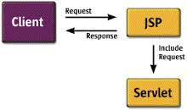
JSP and Servlets
What is it?

Slide 3
JSP and Servlets
Step 1: Eclipse Web Tool Platform (WTP)
Step 2:Tomcat Installation
Step 3: Installation of WTP
Step 4: WTP configuration

Slide 4
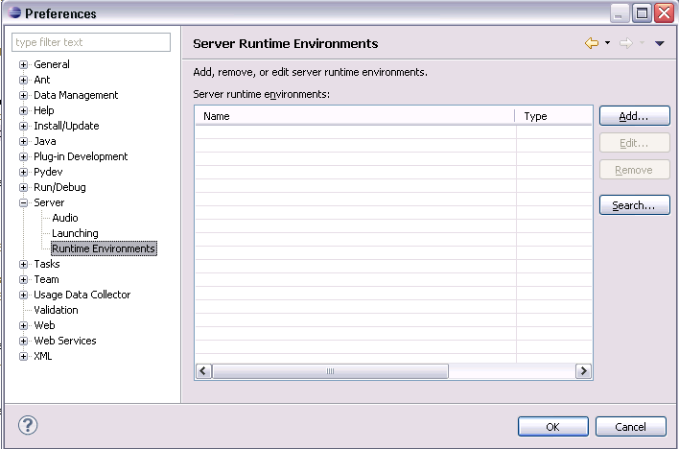
JSP and Servlets
4.1: Setting Run Time Environments
To configure Eclipse WTP, select from the menu Window → Preferences → Server → Runtime Environments. Press the Add button.

Slide 5
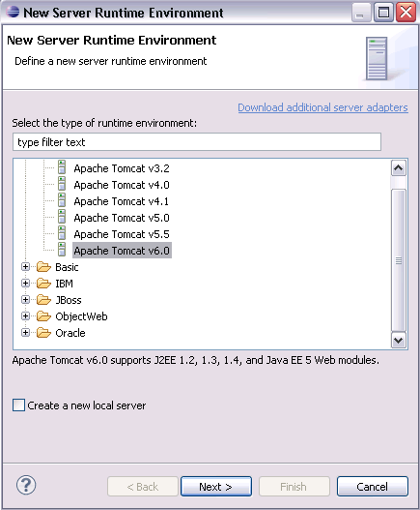
JSP and Servlets
4.1: Setting Run Time Environments (more…)
Select your version of Tomcat.

Slide 6
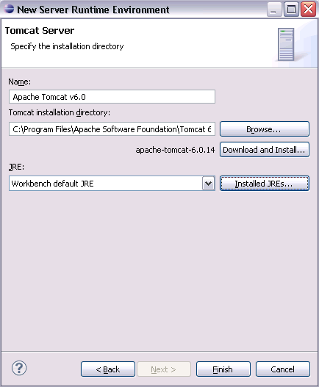
JSP and Servlets
4.1: Setting Run Time Environments (more…)
To compile the JSP into servlets, you need to use the JDK. You can check your setup by clicking on the Installed JRE button.
Press Finish and then OK. You are now ready to use Tomcat with WTP.

Slide 7
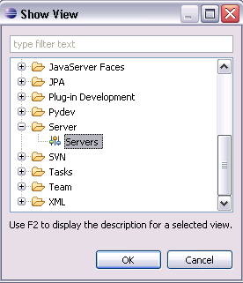
JSP and Servlets
4.2: Server
During development, you will create your server. You can manage your server via the Server view.

Slide 8
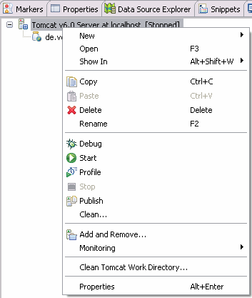
JSP and Servlets
4.2: Server (more…)
You can stop and start the server via the Window → Show View → Servers → Servers menu menu.

Slide 9
JSP and Servlets
Step 5: Servlets
5.1: Project
We will create a servlet which works as a webpage counter. This servlet keeps track of the number of visitors of a webpage. The servlet will persist the number of visitors in a text file.

Slide 10
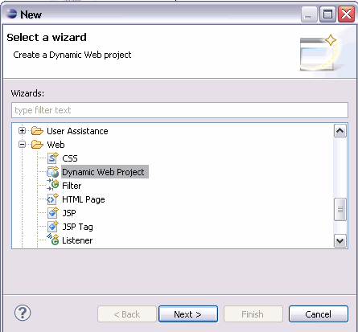
JSP and Servlets
5.1: Project (more…)
Create a new Dynamic Web Project called de.vogella.wtp.filecounter by selecting File → New → Other... → Web → Dynamic Web Project.

Slide 11
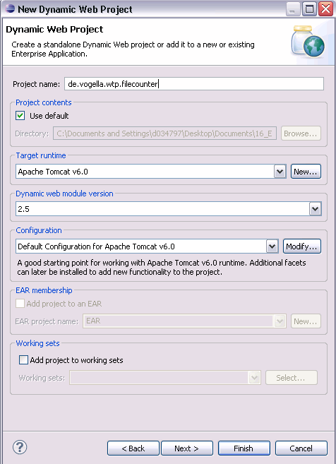
JSP and Servlets
5.1: Project (more…)
Press finished. If Eclipse asks you, to switch to the Java EE Perspective answer yes.
A new project has been created with the standard structure of a Java web application. The WEB-INF/lib directory holds all the JAR files that the Java web application requires.

Slide 12
JSP and Servlets
5.2: Creating Data Access Object
Create a new package called de.vogella.wtp.filecounter.dao.
Create the Java class which will provide the number of visitors and write this value to a file.

Slide 13
JSP and Servlets
5.2: Creating Data Access Object (more…)
This Java class is not a servlet, it is a normal Java class.

Slide 14
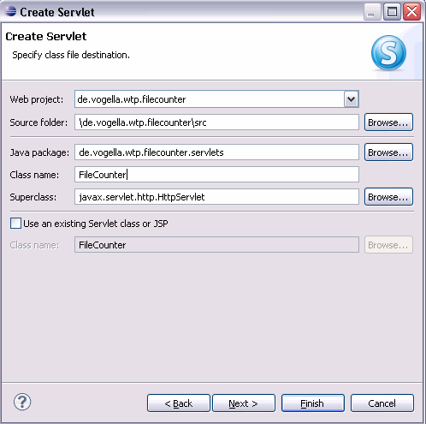
JSP and Servlets
5.3: Creating the Servlet
Create a servlet. Right-click on the folder Webcontent and select New → Other. Select Web → Servlet. Enter the following data.
Press finish.

Slide 15
JSP and Servlets
5.3: Creating the Servlet (more…)
You could also create a servlet without the wizard. The wizard creates a Java class which extends the javax.servlet.http.HttpServlet and adds the servlet settings to the web.xml file.
Enter the following code.

Slide 16
JSP and Servlets
5.3: Creating the Servlet (more…)
This code will read the counter from a file on the server and return plain text to the browser. The servlet will increase the counter if the user was inactive for 5 seconds.

Slide 17
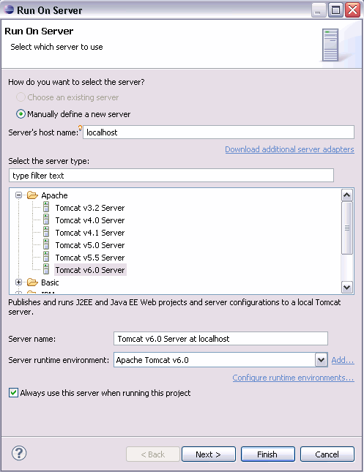
JSP and Servlets
5.4: Run
Select your servlet, right-click on it and select Run As → Run on Server.
Select your server and include your servlet so that is runs on the server.

Slide 18
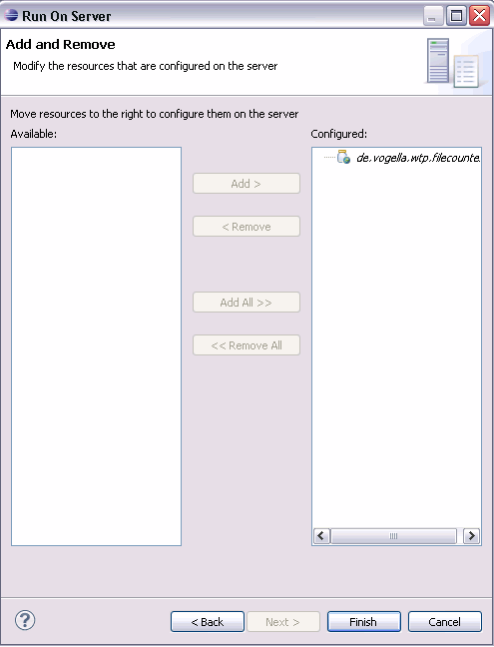
JSP and Servlets
5.4: Run (more…)
Select your servlet, right-click on it and select Run As → Run on Server.
Select your server and include your servlet so that is runs on the server.

Slide 19
JSP and Servlets
5.4: Run (more…)
Press Finish. You should see the Eclipse internal web browser displaying the count number to you. If you wait 5 seconds and refresh, the number should increase.

Slide 20
JSP and Servlets
Java Server Pages (JSP’s)
JSP’s and Servlets
Web Archive - How to create a war file from Eclipse
Additional Eclipse WTP resources
What is it?
http://www.vogella.com/tutorials/EclipseWTP/article.html
Online tutorial:
http://www.youtube.com/watch?v=b42CJ0r-1to

