Slide 1
Installing Tomcat

Slide 2
Web Application
A web application (or webapp), unlike standalone application, runs over the Internet
A webapp is typically a 3-tier (or multi-tier) client-server database application run over the Internet
HTTP Server: e.g., Apache HTTP Server, Apache Tomcat Server, Microsoft Internet Information Server (IIS), nginx, Google Web Server (GWS), and others.
HTTP Client (or Web Browser): e.g., Internet Explorer (MSIE), FireFox, Chrome, Safari, and others.
Database: e.g., Open-source MySQL, Apache Derby, mSQL, SQLite, PostgreSQL, OpenOffice's Base; Commercial Oracle, IBM DB2, SAP SyBase, MS SQL Server, MS Access; and others.
Client-Side Programs: could be written in HTML Form, JavaScript, VBScript, Flash, and others.
Server-Side Programs: could be written in Java Servlet/JSP, ASP, PHP, Perl, Python, CGI, and others.

Slide 3
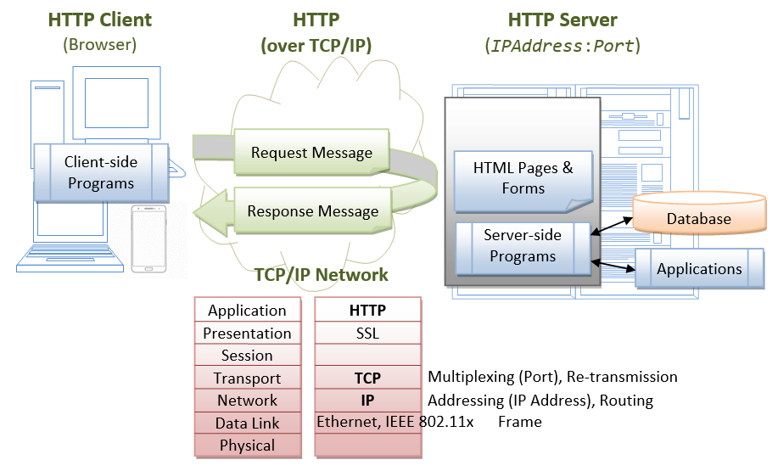
Web Application

Slide 4
Hypertext Transfer Protocol (HTTP)
HTTP is an application layer protocol runs over TCP/IP
HTTP is an asynchronous request-response application-layer protocol
A client sends a request message to the server
The server then returns a response message to the client

Slide 5
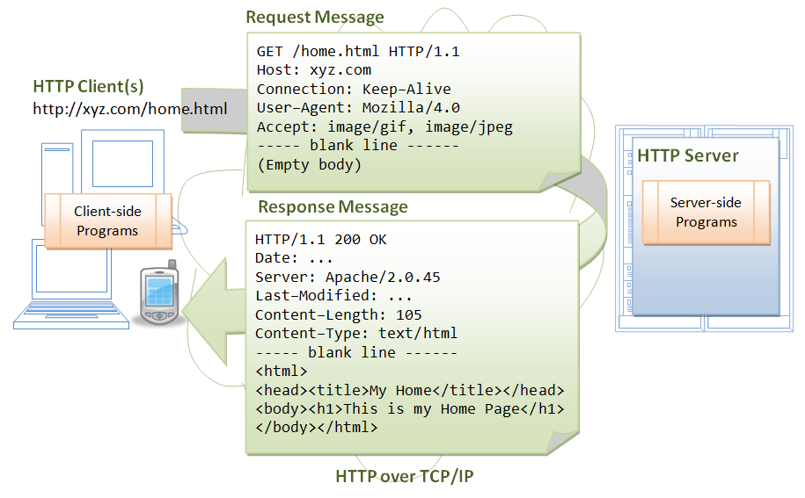
Hypertext Transfer Protocol (HTTP)

Slide 6
Apache Tomcat HTTP Server
Apache Tomcat is a Java-capable HTTP server, which could execute special Java programs known as "Java Servlet" and "Java Server Pages (JSP)“
Tomcat is an open-source project
The mother site for Tomcat is http://tomcat.apache.org
The various Tomcat releases are:
Tomcat 3.x (1999): Reference Implementation (RI) for Servlet 2.2 and JSP 1.1.
Tomcat 4.x (2001): RI for Servlet 2.3 and JSP 1.2.
Tomcat 5.x (2002): RI for Servlet 2.4 and JSP 2.0.
Tomcat 6.x (2006): RI for Servlet 2.5 and JSP 2.1.
Tomcat 7.x (2010): RI for Servlet 3.0, JSP 2.2 and EL 2.2.
Tomcat 8.x (2013): RI for Servlet 3.1, JSP 2.3, EL 3.0 and WebSocket 1.0.
Tomcat 9.x (2018): RI for Servlet 4.0, JSP 2.3, EL 3.0, WebSocket 1.0, JASPIC 1.1.

Slide 7
Installing Tomcat
STEP 1: Download and Install Tomcat
Goto http://tomcat.apache.org ⇒ Under "Tomcat 9.0.{xx} Released" (where {xx} is the latest upgrade number) ⇒ Click "Download" ⇒ Under "9.0.{xx}" ⇒ Binary Distributions ⇒ Core ⇒ "ZIP" package (e.g., "apache-tomcat-9.0.{xx}.zip", about 9.8 MB).
UNZIP the downloaded file into your project directory "c:\myWebProject". Tomcat will be unzipped into directory "c:\myWebProject\apache-tomcat-9.0.{xx}“
OR
Download and use the installer

Slide 8
Installing Tomcat
bin: contains the binaries; and startup script (startup.bat for Windows and startup.sh for Unixes and Mac OS), shutdown script (shutdown.bat for Windows and shutdown.sh for Unix and Mac OS), and other binaries and scripts.
conf: contains the system-wide configuration files, such as server.xml, web.xml, and context.xml.
webapps: contains the webapps to be deployed. You can also place the WAR (Webapp Archive) file for deployment here.
lib: contains the Tomcat's system-wide JAR files, accessible by all webapps. You could also place external JAR file (such as MySQL JDBC Driver) here.
logs: contains Tomcat's log files. You may need to check for error messages here.
work: Tomcat's working directory used by JSP, for JSP-to-Servlet conversion.

Slide 9
Installing Tomcat
STEP 2: Create an Environment Variable JAVA_HOME
You need to create an environment variable (system variable available to all applications) called "JAVA_HOME", and set it to your JDK installed directory
(for Mac you don’t need to do anything)

Slide 10
Installing Tomcat
STEP 3: Configure Tomcat Server
The Tomcat configuration files are located in the "conf" sub-directory
There are configuration XML files:
server.xml
web.xml
context.xml

Slide 11
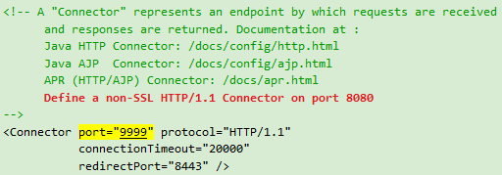
Installing Tomcat
Step 3(a) "conf\server.xml" - Set the TCP Port Number
Use a programming text editor (e.g., NotePad++, TextPad) to open the configuration file "server.xml“
The default TCP port number configured in Tomcat is 8080
We can change it to anything we want (between 1024, 65535)

Slide 12
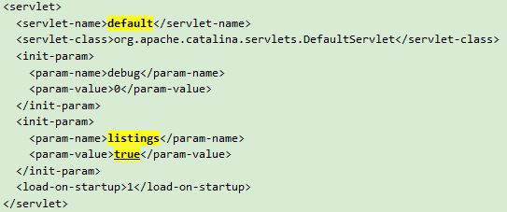
Installing Tomcat
Step 3(b) "conf\web.xml" - Enabling Directory Listing
Use a programming text editor to open the configuration file "web.xml“
We shall enable directory listing by changing "listings" from "false" to "true" for the "default" servlet

Slide 13
Installing Tomcat
Step 3(c) "conf\context.xml" - Enabling Automatic Reload
We shall add the attribute reloadable="true" to the <Context> element to enable automatic reload after code changes

Slide 14
Installing Tomcat
STEP 4: Start Tomcat Server
Step 4(a) Start Server
A new Tomcat console window appears
Future error messages will be send to this console. System.out.println() issued by your Java servlets will also be sent to this console
Step 4(b) Start a Client to Access the Server
Start a browser (Firefox, Chrome) as an HTTP client
Issue URL "http://localhost:8080" to access the Tomcat server's welcome page
The hostname "localhost" (with IP address of 127.0.0.1) is meant for local loop-back testing inside the same machine

Slide 15
Installing Tomcat
Step 4(c) Shutdown Server
Run "<TOMCAT_HOME>\bin\shutdown.bat" script

Slide 16
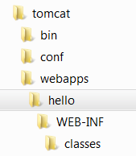
Installing Tomcat
STEP 5: Develop and Deploy a WebApp
Step 5(a) Create the Directory Structure for your WebApp
Goto Tomcat's "webapps" sub-directory and create the following directory structure for your webapp "hello“
Under Tomcat's "webapps", create your webapp's root directory "hello“
Under "hello", create a sub-directory "WEB-INF“
Under "WEB-INF", create a sub-sub-directory "classes“

Slide 17
Installing Tomcat
You need to keep your web resources (e.g., HTMLs, CSSs, images, scripts, servlets, JSPs) in the proper directories:
"hello": The is called the context root (or document base directory) of your webapp. You should keep all your HTML files and resources visible to the web users (e.g., HTMLs, CSSs, images, scripts, JSPs) under this context root.
"hello/WEB-INF": This directory, although under the context root, is not visible to the web users. This is where you keep your application's web descriptor file "web.xml".
"hello/WEB-INF/classes": This is where you keep all the Java classes such as servlet class-files.
Restart the Tomcat

Slide 18
Installing Tomcat
Step 5(b) Write a Welcome Page
Create the following HTML page and save as "HelloHome.html“
<html> <head>
<title>My Home Page</title>
</head>
<body>
<h1>My Name is so and so. This is my HOME.</h1>
</body> </html>
Try to access it – Rename it to index.html

Slide 19
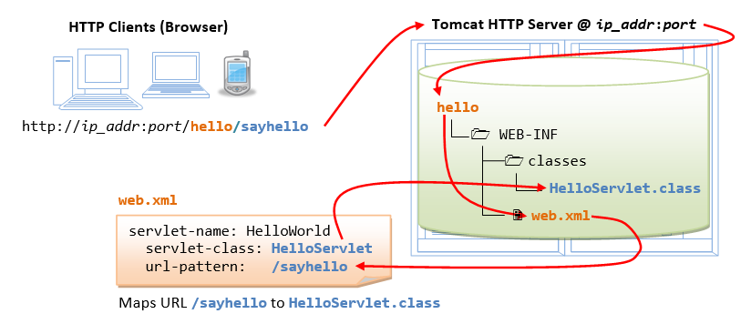
Installing Tomcat
STEP 6: Write a "Hello-world" Java Servlet
A servlet is Java program that runs inside a Java-capable HTTP Server, such as Apache Tomcat
A web user invokes a servlet by issuing an appropriate URL from a web browser
Step 6(a) Write a "Hello-world" Java Servlet
We are going to write a Java servlet called HelloServlet, which says "Hello, world!"

Slide 20
Installing Tomcat
Write a code called "HelloServlet.java" and save it under your application "classes" directory
Step 6(b) Compiling the Servlet
We need the Servlet API to compile the servlet
We need to include this JAR file in the compilation via the -cp (classpath) option
The output of the compilation is "HelloServlet.class"

Slide 21
Installing Tomcat
Step 6(c) Configure Servlet's Request URL in "webapps\hello\WEB-INF\web.xml"
A web user invokes a servlet, which is kept in the web server, by issuing a request URL from the browser
We need to configure this request URL for our HelloServlet
Create the configuration file called "web.xml", and save it under "webapps\hello\WEB-INF“
In the configuration, a servlet having a class file "HelloServlet.class" is mapped to request URL "/sayhello“
The complete request URL for this servlet is http://hostname:port/hello/sayhello
RESTART your Tomcat server to refresh the "web.xml" file

Slide 22
Installing Tomcat
Step 6(d) Invoke the Servlet
http://localhost:9999/hello/sayhello
Refresh the browser, you shall see a new random number upon each refresh.
The doGet() method of the servlet runs once per request
Right-click the page ⇒ "View Page Source"
The web browser receives only the output of the servlet (generated via the out.println() statements)

Slide 23
Installing Tomcat
Use the installer
Just click on the installer and provide the necessary info

Slide 24
Create Servlet with Eclipse
Steps
File -> New -> Dynamic Web Project
Give a Name to your Project and click Next
Check Generate web.xml Deployment Descriptor and click Finish
Click on First project, go to Java Resources -> src. Right click on src select New -> Servlet
Give Servlet class name and click Next
Give your Servlet class a Name of your choice
Leave everything else to default and click Finish
Now your Servlet is created, write some code inside it

Slide 25
Create Servlet with Eclipse
(ctd)
Add servlet-api.jar JAR file to your project. Click on Libraries, right click on Web App Libraries select Build Path -> Configure Build Path
Now all you have to do is Start the server and run the application
OR
Create the war file and upload it to the server

