Slide 1
Web Proxy Server

Slide 2
Introduction
Sun Java System Web Proxy Server represents the HTTP caching and acceleration foundation for high performance Internet and Intranet
The Proxy Server is a system for caching and filtering web content
It acts as a network traffic manager, distributes and manages information efficiently
The Proxy Server also helps ensure that users can access network resources safely and productively, providing a secure gateway for content distribution

Slide 3
Installation
We visit http://www.sun.com/download/
We download the file sun-web-proxy-server-4.0-win.zip
We unzip the .zip file to extract its contents to the chosen folder
When the extraction is complete, you will see a /ProxyServer directory

Slide 4
Installation
There are three modes of installation:
  Installing in GUI Mode
  Installing in CLI Mode
  Installing in Silent Mode
The setup command allows you to specify the method of installation

Slide 5
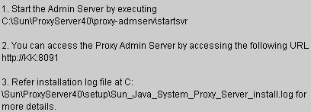
Installation
Change to the directory where the installation files exist
Type ./setup to start the server installation
We follow the steps described in https://docs.oracle.com/cd/E19575-01/821-0050/adxaq/index.html
If the installation is successful, we will see the following screen

Slide 6
Administration
The list reports on the Administration Server tabs
  Servers - Manage, add, remove, migrate Proxy Servers
  Preferences - Shutdown the Administration Server, edit listen sockets, etc
  Global Settings - Configure directory services, specify access control, configure SNMP master agent settings
  Users and Groups - Add and manage users, groups, and organizational units, etc
  Security - Create new trust databases, request and install VeriSign and other certificates
  Cluster - Control remote servers in a cluster, add and remove remote servers, modify server information

Slide 7
Server manager
Server Manager settings are organized by tabs that correspond to specific tasks
  Server Manager settings are organized by tabs that correspond to specific tasks, etc
  Routing - Enable and disable proxying, set routing preferences, forward client credentials, etc
  URLs - View, create, and manage URL mappings and redirections
  Caching - Set cache specifics, add and modify cache partitions, move sections among existing partitions, set the cache capacity, etc
  Filters - Create filter files, set content URL rewriting, set user-agent restriction and request blocking, etc
  Server Status - View log files, archive logs, set log preferences, generate reports, etc
  Security
  Templates - Create, remove, apply, and view templates, and remove resources

Slide 8
Server Manager
Access
  Access the Administration Server
  On the Manage Servers page, click the link for the server instance you want to manage

Slide 9
Configuration File
server.xml. Most of the server configuration (new in this Proxy Server release)
magnus.conf. Global server initialization information
obj.conf. Instructions for handling requests from clients
mime.types. Information for determining the content type of requested resources

Slide 10
Administration in Windows
Information for determining the content type of requested resources
  Use Start->Programs->Sun Microsystems->Sun Java System Web Proxy Server version->Start Admin
  Use Control Panel->Administrative Tools->Services->Sun Java System Web Proxy Server 4.0 Administration Server->Start
  From a command prompt, go to server-root\proxy-admserv and type startsvr.bat to start the Administration Server (or ./restart to restart the Administration Server)

Slide 11
Administration in Windows
You can stop the Administration Server on Windows in either of the following ways
  Use the Sun Java System Proxy Server 4.0 Administration Server service in the Services window: Control Panel->Administrative Tools->Services->Sun Java System Web Proxy Server 4.0 Administration Server> Stop
  From the command prompt, go to server-root\proxy-admserv and type stopsvr.bat

Slide 12
Administration in Windows
Install Multiple Proxy Servers
  Access the Administration Server.
  On the Servers tab, click Add Server.
  Provide the requested information and click OK.
  For more information about specific fields, see the online Help.
  If desired, click the Configure Your New Server link on the Success page that displays after successfully adding a new server instance.
  The Server Manager interface appears. You can use it to configure server instances.

Slide 13
Administration in Windows
Remove a Server
  Access the Administration Server.
  On the Servers tab, click Remove Server.
  From the drop-down list, select the server instance you want to remove.
  Select the Confirming Server Removal checkbox and click OK.

Slide 14
Listen Sockets
Before the server can process a request, the request must be accepted by a listen socket
Addition
  Click the Edit Listen Sockets link.
  Click the New button.
  Specify the settings and click OK.
Edit
  Click the Edit Listen Sockets link.
  Click the New button.
  Specify the settings and click OK.
Deletion
  Click the Edit Listen Sockets link.
  Select the checkbox next to the listen socket you want to delete and click OK.
  When prompted to confirm deletion, click OK

Slide 15
Logs
Administration Server log files are located in server-root/proxy-admserv/logs
View access log files
  Click the View Access Log link
View error log files
  Click the View Error Log link

Slide 16
Users and Groups
The Administration Server provides access to application data about user accounts, group lists, access privileges, organizational units, and other user- and group-specific information
A directory service enables all user information to be managed from a single source
Three different types of directory services can be configured: LDAP, key file, and digest file

Slide 17
Ldap
With an LDAP directory service, user and group information is stored in an LDAP-based directory server
If the LDAP service is the default service, the dbswitch.conf file is updated as
  directory default ldap://test22.india.sun.com:589/dc%3Dindia%2Cdc%3Dsun%2Cdc%3Dcomdefault:binddn cn=Directory Managerdefault:encoded bindpw YWRtaW5hZG1pbg==
If the LDAP service is a non-default service, the dbswitch.conf file is updated as shown in the example below:
  directory ldap ldap://test22.india.sun.com:589/dc%3Dindia%2Cdc%3Dsun%2Cdc%3Dcomldap:binddn cn=Directory Managerldap:encoded bindpw YWRtaW5hZG1pbg==

Slide 18
Key File Directory
A key file is a text file that contains the user’s password in a hashed format and the list of groups to which the user belongs
When a key file-based database is created, the dbswitch.conf file is updated as shown in the example below:
  directory keyfile filekeyfile:syntax keyfilekeyfile:keyfile D:\\test22\\keyfile\\keyfiledb

Slide 19
Digest File Directory
A digest file stores user and group information based on encrypted user name and password
A digest file stores user and group information based on encrypted user name and password
When a digest-based database is created, the dbswitch.conf file is updated as shown in the example below:
  directory digest filedigest:syntax digestdigest:digestfile D:\\test22\\digest\\digestdb

Slide 20
Create Directory Services
Access the Administration Server and click the Global Settings tab.
Click the Configure Directory Service link.
From the Create New Service of Type drop-down list, select the type of directory service you want to create and click New.
The configuration page for that directory service appears.
Provide configuration information, and then click Save Changes.

Slide 21
Edit Directory Services
Access the Administration Server and click the Global Settings tab.
Click the Configure Directory Service link.
Click the link for the directory service you want to edit.
Make the desired changes, and then click Save Changes

Slide 22
Creating Users in Ldap
Access the Administration Server and click the Users and Groups tab.
Click the Create User link.
Select the LDAP directory service from the drop-down list and click Select.
Provide the information on the page that displays.
Click Create to create the user entry, or Create and Edit to create the user entry and proceed to the edit page for the entry just created

Slide 23
Creating Users in Key Files
Access the Administration Server and click the Users and Groups tab.
Click the Create User link.
Select the key file-based directory service from the drop-down list and click Select.
Type the information on the page that displays, and then click Create User.

Slide 24
Creating Users in Digest Files
Access the Administration Server and click the Users and Groups tab.
Click the Create User link.
Select the digest file-based directory service from the drop-down list and click Select.
Type the information on the page that displays, and then click Create User

Slide 25
Creating Groups
Access the Administration Server and click the Users and Groups tab.
Click the Create Group link.
Select New Group from the Type of Group drop-down list, and then click Go.
Type the information on the Create Group page.
Click Create to create the group, or Create and Edit to create the group and display the edit page for the group just created.

Slide 26
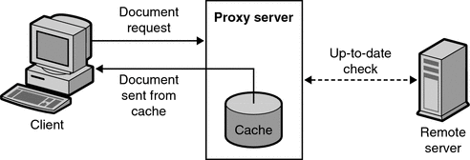
Caching
Caching reduces network traffic and offers faster response time for clients
When a client requests a web page or document from the proxy server, the proxy server copies the document
When a client requests a document that was previously requested and copied into the proxy cache, the proxy returns the document from the cache

Slide 27
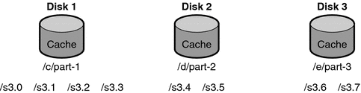
Caching
A cache consists of one or more partitions
A partition is a storage area on a disk that you set aside for caching
If you want to have your cache span several disks, configure at least one cache partition for each disk
If you want to have your cache span several disks, configure at least one cache partition for each disk

Slide 28
Caching
Storing a large number of cached files in a single location can slow performance
We can create several directories, or sections, in each partition
Sections are the next level under partitions in the cache structure
You can have up to 256 sections in your cache across all partitions

Slide 29
Caching
The final level in the cache structure hierarchy is the subsection
Subsections are directories within sections
Each section has 64 subsections
Cached files are stored in the subsections which is the lowest level in your cache

Slide 30
Caching
The Proxy Server uses a specific algorithm to determine the directory where a document should be stored
This algorithm ensures equal distribution of documents in the directories
The Proxy Server uses the RSA MD5 algorithm (Message Digest 5) to reduce the URL to 16 bytes
It uses 8 bytes of this data to calculate a 16-character hexadecimal file name that is used to store the document in the cache

Slide 31
Caching
Set cache specifics
  Click the Set Cache Specifics link.
  You can enable or disable the cache by selecting the appropriate option.
  Provide the working directory.
  Click the partition configuration link. The Add/Edit Cache Partitions page is displayed. You can add a new cache partition or edit existing cache paritions. The maximum cache size is 32Gbytes.
  Click the cache capacity configuration link.
  Select the Cache HTTP to enable caching of HTTP documents.

Slide 32
Caching
Set cache specifics
  Set the refresh interval for cached FTP documents.
  You can set the refresh interval for cached Gopher documents.
  Click OK.
  Click Restart required. The Apply Changes page is displayed.
  Click the Restart Proxy Server button to apply the changes.

Slide 33
Caching
Cache working directory
  The cache files are under cache partitions
  The working directory you specify on the Set Cache Specifics page is often the parent directory
  All cached files appear in an organized directory structure under the caching directory
  If you change the cache directory name or move it to another location, you have to provide the proxy with the new location

Slide 34
Caching
Caching HTTP documents
  All HTTP documents have a descriptive header section that the Proxy Server uses to compare and evaluate the document
  When the proxy does an up-to-date check on an HTTP document, the proxy sends one request to the server
  To reduce transactions with remote servers, the Proxy Server enables you to set a Cache Expiration setting for HTTP documents
  The Cache Expiration setting provides information to the proxy to estimate whether the HTTP document needs an up-to-date check

Slide 35
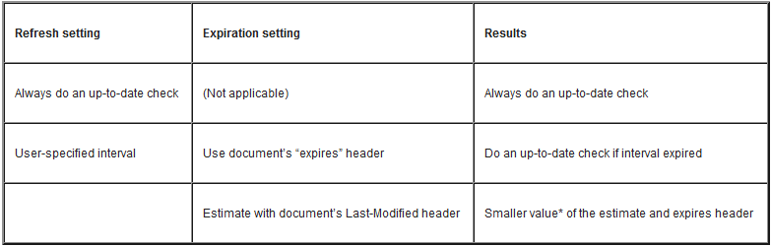
Caching
Caching HTTP documents
  With HTTP documents, you can also use a Cache Refresh setting
  This option specifies whether the proxy always does an up-to-date check

Slide 36
Caching
Add cache partitions
  Access the Server Manager, and click the Caching tab.
  Click the Add/Edit Cache Partitions link.
  Click the Add Cache Partition button.
  Provide the appropriate values for the new partition.
  Click OK.
  Click Restart Required.
  The Apply changes page is displayed.
  Click Restart Proxy Server button to apply the changes

Slide 37
Caching
Modify cache partitions
  Access the Server Manager, and click the Caching tab.
  Click the Add/Edit Cache Partitions link.
  Click on the name of the partition that you would like to change.
  Edit the information.
  Click OK.
  Click Restart Required.
  Click the Restart Proxy Server button to apply the changes.

