Slide 1
One of the main differences between HTTP/1 and HTTP/2 is that HTTP/2 is a binary, packet-based protocol, whereas HTTP/1 is entirely text-based.
Text-based protocols are easy for humans to understand but more difficult for computers to parse.
This situation was acceptable for the simple request-and-response protocol that HTTP started out as, but is increasingly limiting the use of the protocol for the modern internet.
With the text-based protocol, requests need to be sent and responses received in full before another request can be processed.
HTTP/1.0 introduced binary HTTP bodies, for example, where images and other media could be sent in response, and HTTP/1.1 introduced pipelining and chunked encoding.
Chunked encoding allowed part of the message body to be sent first, with the rest to follow as it became available.
The HTTP body is split into chunks, and the client receiving the chunked response (or the server receiving the chunked request) could start processing the message before it was fully received.
This technique is often used when the length of data that’s generated dynamically isn’t known in advance.
Both chunked encoding and pipelining have head-of-line (HOL) blocking issues whereby the message at the top of the queue prevents subsequent responses from being sent, not to mention the fact that pipelining was not well supported in the real world.

Slide 2
HTTP/2 bin representation
HTTP/2 moves to a full binary protocol, in which HTTP messages are split and sent in clearly defined frames.
These frames are similar to the TCP packets that underlie most HTTP connections.
When all the frames are received, the full HTTP message can be reconstructed.
The binary representation of HTTP/2 is for the sending and receiving of messages, but the messages themselves are similar to older HTTP/1 messages.

Slide 3
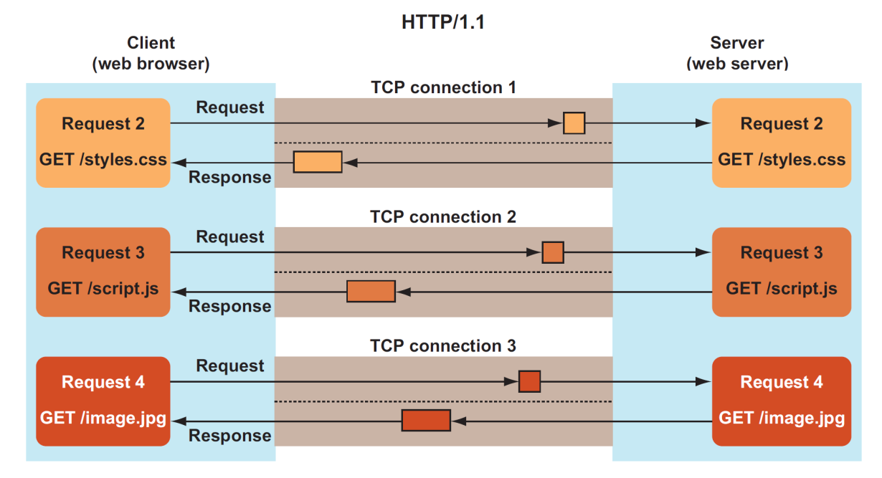
Multiplexing
HTTP/1 was a synchronous, single request-and-response protocol. The client sent an HTTP/1 message, and the server got an HTTP/1 response back.
Multiple HTTP/1 requests in parallel require multiple TCP connections.

Slide 4
HTTP/2 Muxing
HTTP/2 allows multiple requests to be in progress at the same time, on a single connection, using different streams for each HTTP request or response.
This concept of multiple independent requests happening at the same time is possible by moving to the binary framing layer, where each frame has a stream identifier.
The receiving party can reconstruct the full message when all frames for that stream have been received.
Frames are the key to allowing multiple messages to be sent at the same time. Each frame is labeled to indicate which message it belongs to (the stream), which allows 2, 3, or 100 messages to be sent or received at the same time on the same multiplexed connection, as opposed to the 6 parallel HTTP/1 connections that most browsers allow.
responses can be sent back intermingled (streams 5 and 7 in next slide), or sequentially (stream 9). The order in which the server sends back responses is entirely up to the server, though the client can indicate priorities.
If multiple responses can be sent, the server can prioritize the important resources (such as CSS and JavaScript) over less important resources (e.g., images).

Slide 5
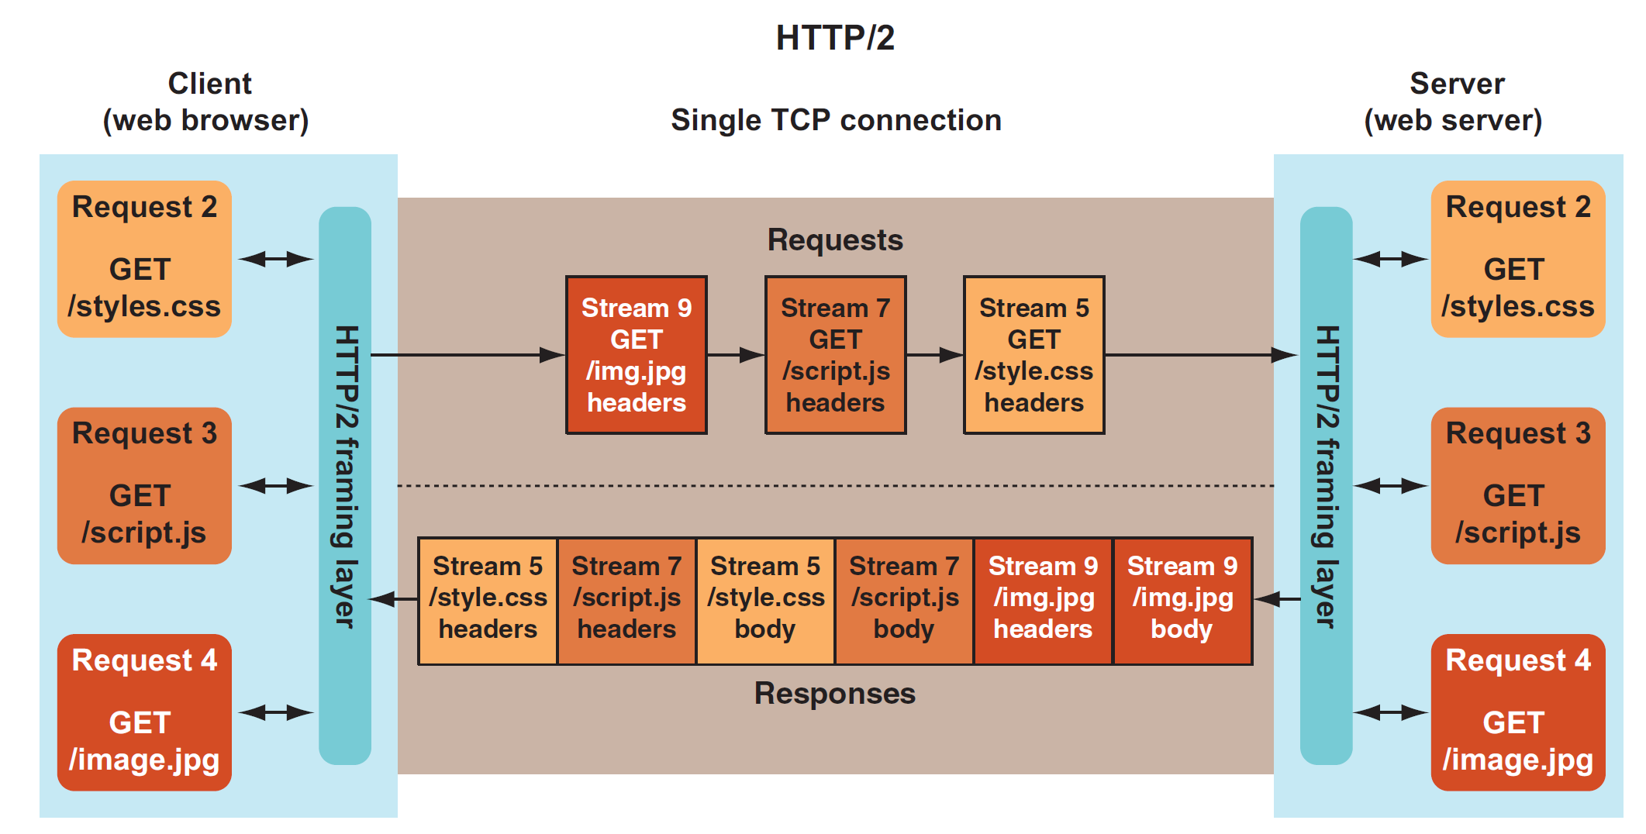
Resource Requests in a muxed HTTP/2 connection

Slide 6
Streams
Each request is given a new, incremental stream ID (5, 7, and 9 in previous slide), and responses are sent back on the same stream ID, so streams are bidirectional, as HTTP connections were.
Streams are closed when the response is finished.
An HTTP/2 stream isn’t directly analogous to an HTTP/1.1 connection, because streams are discarded and not reused, whereas HTTP/1.1 keeps the connection open and it can be reused to send another request.
To prevent a clash of stream IDs, client-initiated requests are given odd stream IDs (stream IDs 5, 7, and 9 in previous slides), and server-initiated requests are given even stream IDs.
Responses to requests are marked with the same stream ID, as mentioned earlier.
Stream ID 0 is a control stream used by both client and server to manage the connection.

Slide 7
Main points
HTTP/2 uses multiple binary frames to send HTTP requests and responses across a single TCP connection, using a multiplexed stream.
HTTP/2 is mostly different at the message-sending level, and at even a slightly higher level, the core concepts of HTTP remain the same.
Requests have a method (such as GET), a resource you want to get (such as /styles.css), headers, body, status codes (such as 200, 404), caching, cookies, and so on, which stay the same.

Slide 8
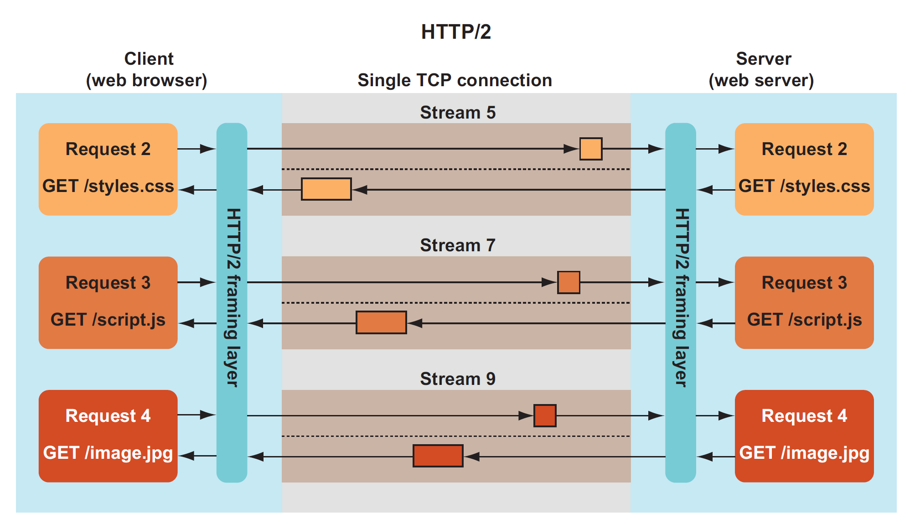
HTTP/2 streams similar to HTTP/1 connections

Slide 9
Priorities in HTTP/1
Before HTTP/2, HTTP was a single request-and-response protocol, so there was no need for prioritization within the protocol.
The client (browser) decided the priority outside of HTTP by deciding what order to send the messages in, using the limited number of HTTP/1 connections (typically, 6).
This prioritization usually required requesting critical resources (HTML, render blocking CSS, and critical JavaScript) first and requesting non-blocking items (such as images and asynchronous JavaScript) later.
Requests were queued, awaiting a free HTTP/1 connection, and the queuing, managed by the browser, decided the priority.

Slide 10
Priorities in HTTP/2
HTTP/2 now has a much higher limit on the number of requests in flight at any time (typically, 100 active streams by default in many implementations), so many requests no longer need to be queued by the browser and can be sent immediately.
This fact could lead to bandwidth being wasted on lower-priority resources (e.g., images) and, therefore, cause the page to appear to load slower over HTTP/2.
Stream prioritization is needed so that the most critical resources can be sent with higher priority.
Stream prioritization is implemented by the server sending more frames for higher-priority requests than for lower-priority requests when a queue of frames is ready to be sent.
Stream prioritization also allows greater control than under HTTP/1, in which the separate connections are independent.
In HTTP/1, other than not using a connection, it wasn’t possible to prioritize certain connections. If you have five critical resources and a sixth noncritical one, under HTTP/1, all the resources can be sent with the same priority on the six separate connections, or the first five can be sent while the sixth held back.
Under HTTP/2, all 6 requests can be sent with the appropriate priority, and this priority is used to decide how much resource to allocate to sending each response.

Slide 11
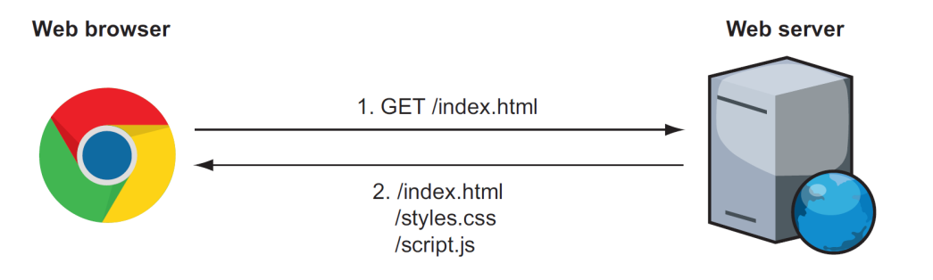
Server Push
Another important difference between HTTP/1 and HTTP/2 is that HTTP/2 adds the concept of server push, which allows the server to respond to a request with more than one response.
Under HTTP/1, when the home page is returned, the browser must read it and then request the other resources (such as CSS and JavaScript) before it starts rendering the page.
With HTTP/2 server push, those resources can be sent with the initial response and should be available when the browser looks to use them.
HTTP/2 server push is a new concept in HTTP, but if care isn’t taken, it can easily cause wasted bandwidth, when resources that a browser doesn’t need are pushed anyway, particularly if the resources being pushed were sent with a previous request and are already available in the browser cache.

Slide 12
Connection Establishment
HTTP/2 (and SPDY) decided not to use a new scheme, but looked at alternative methods to establish the HTTP/2 connection.
The HTTP/2 specification3 provides three ways to create the HTTP/2 connection:
  Use HTTPS negotiation.
  Use the HTTP Upgrade header.
  Use prior knowledge.

Slide 13
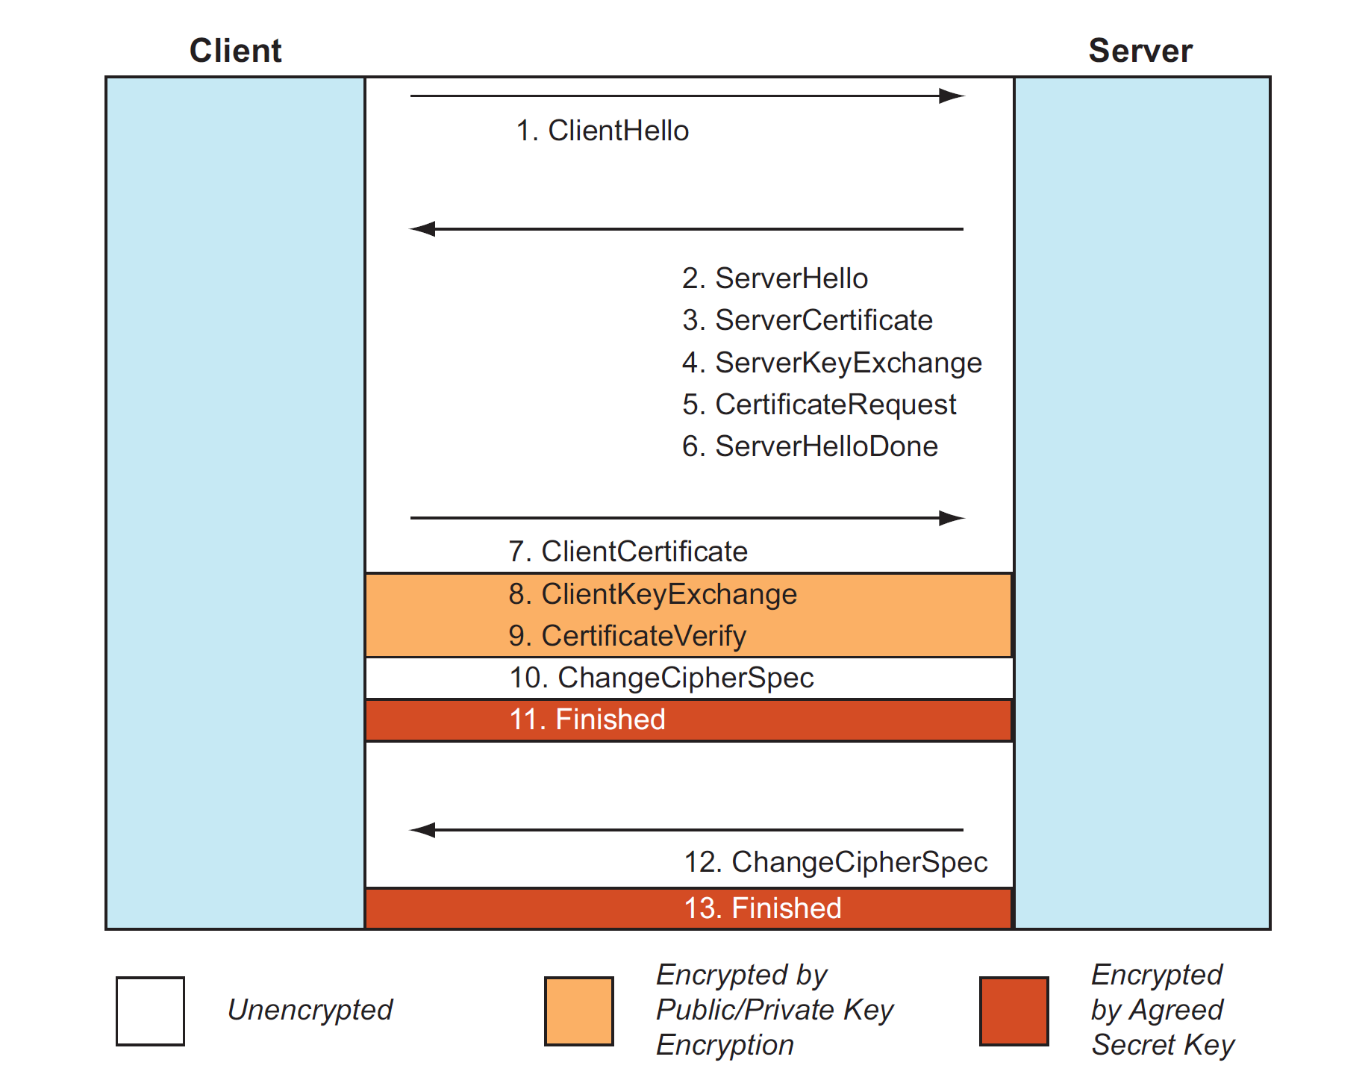
Connection Establishment: HTTPS negotiation

Slide 14
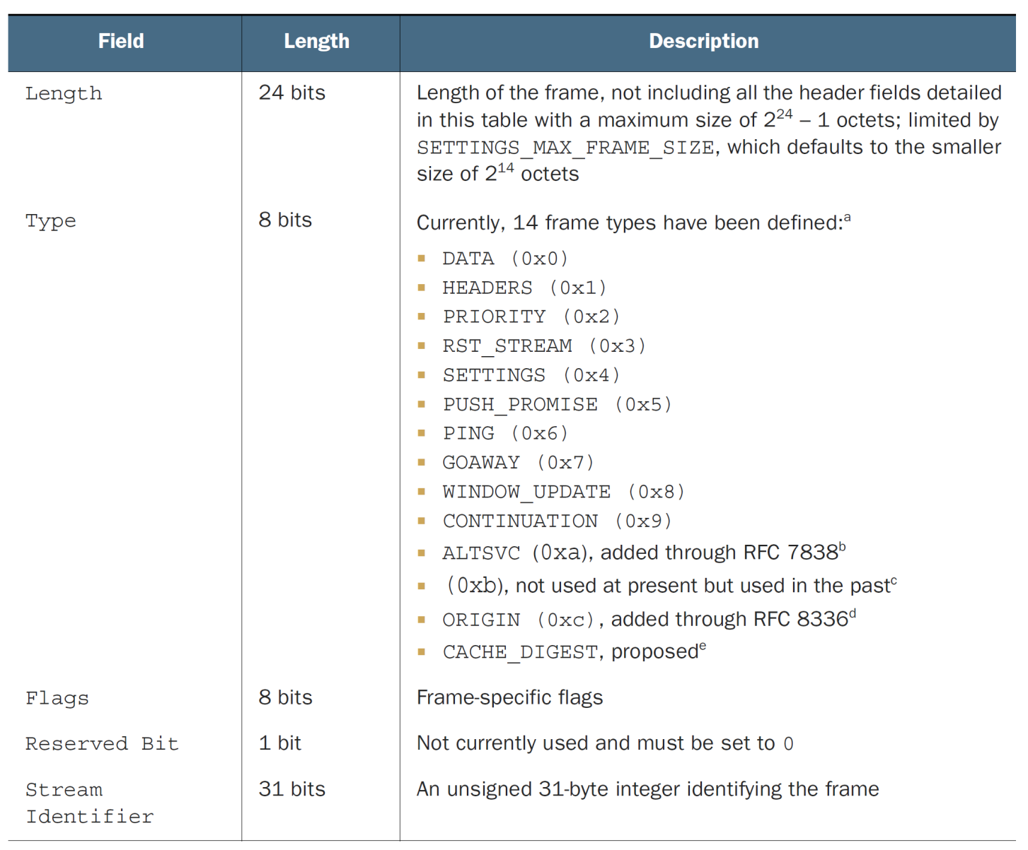
HTTP/2 frame format

Slide 15
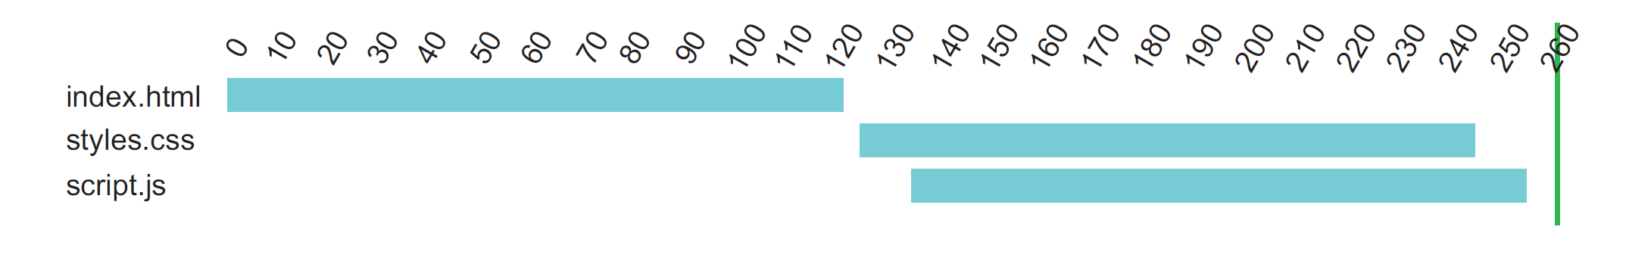
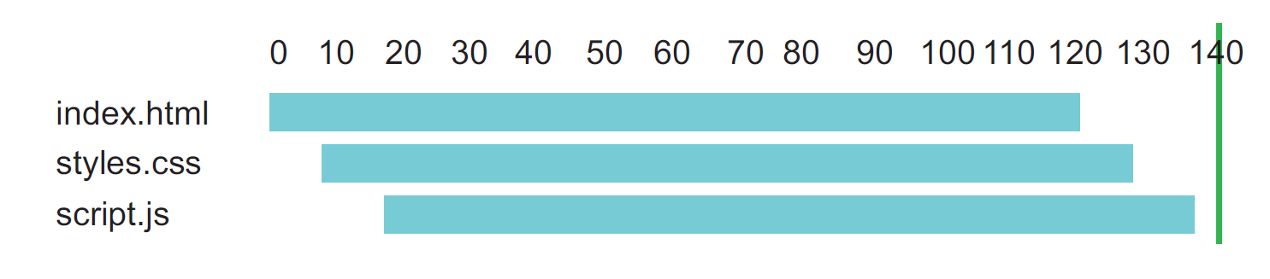
Server push
Vs

Slide 16
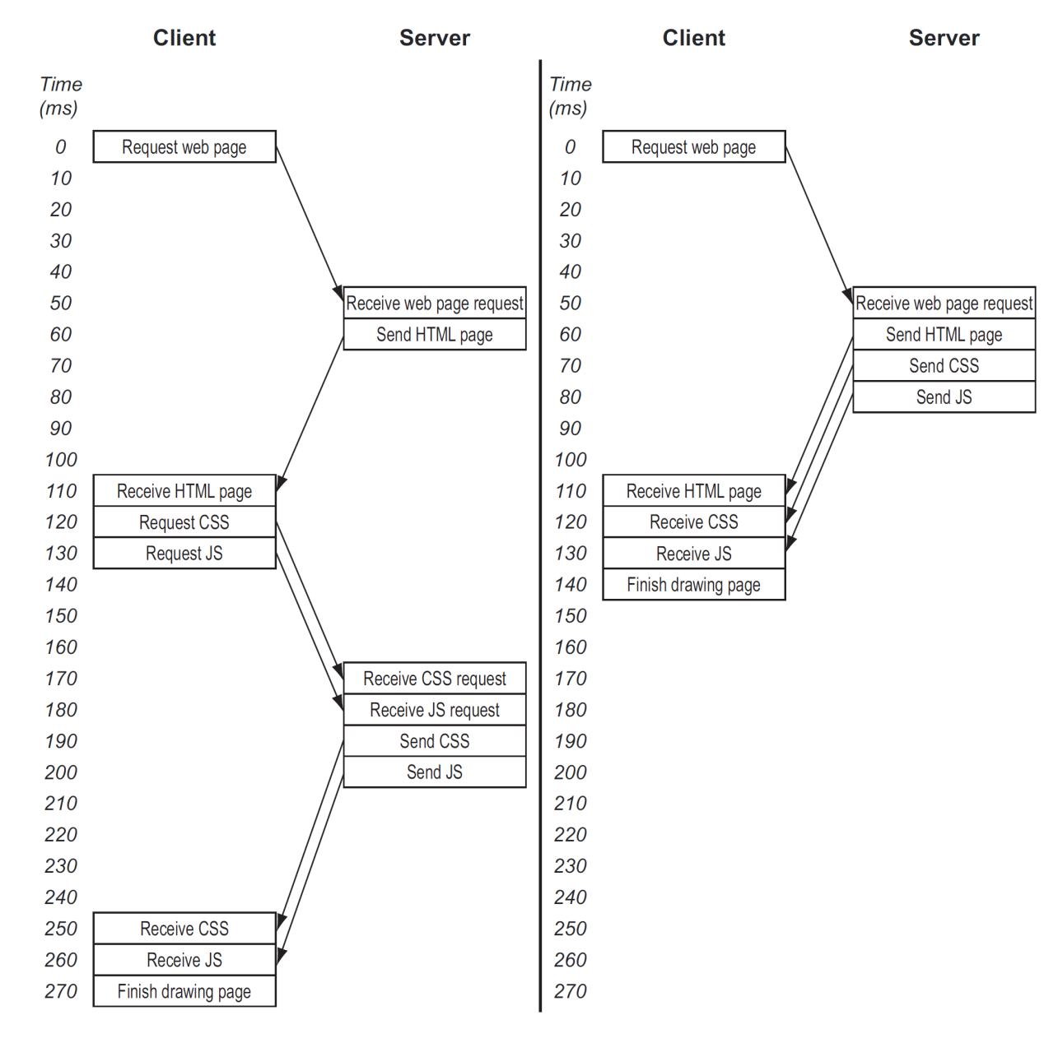
Basic web page request

Slide 17
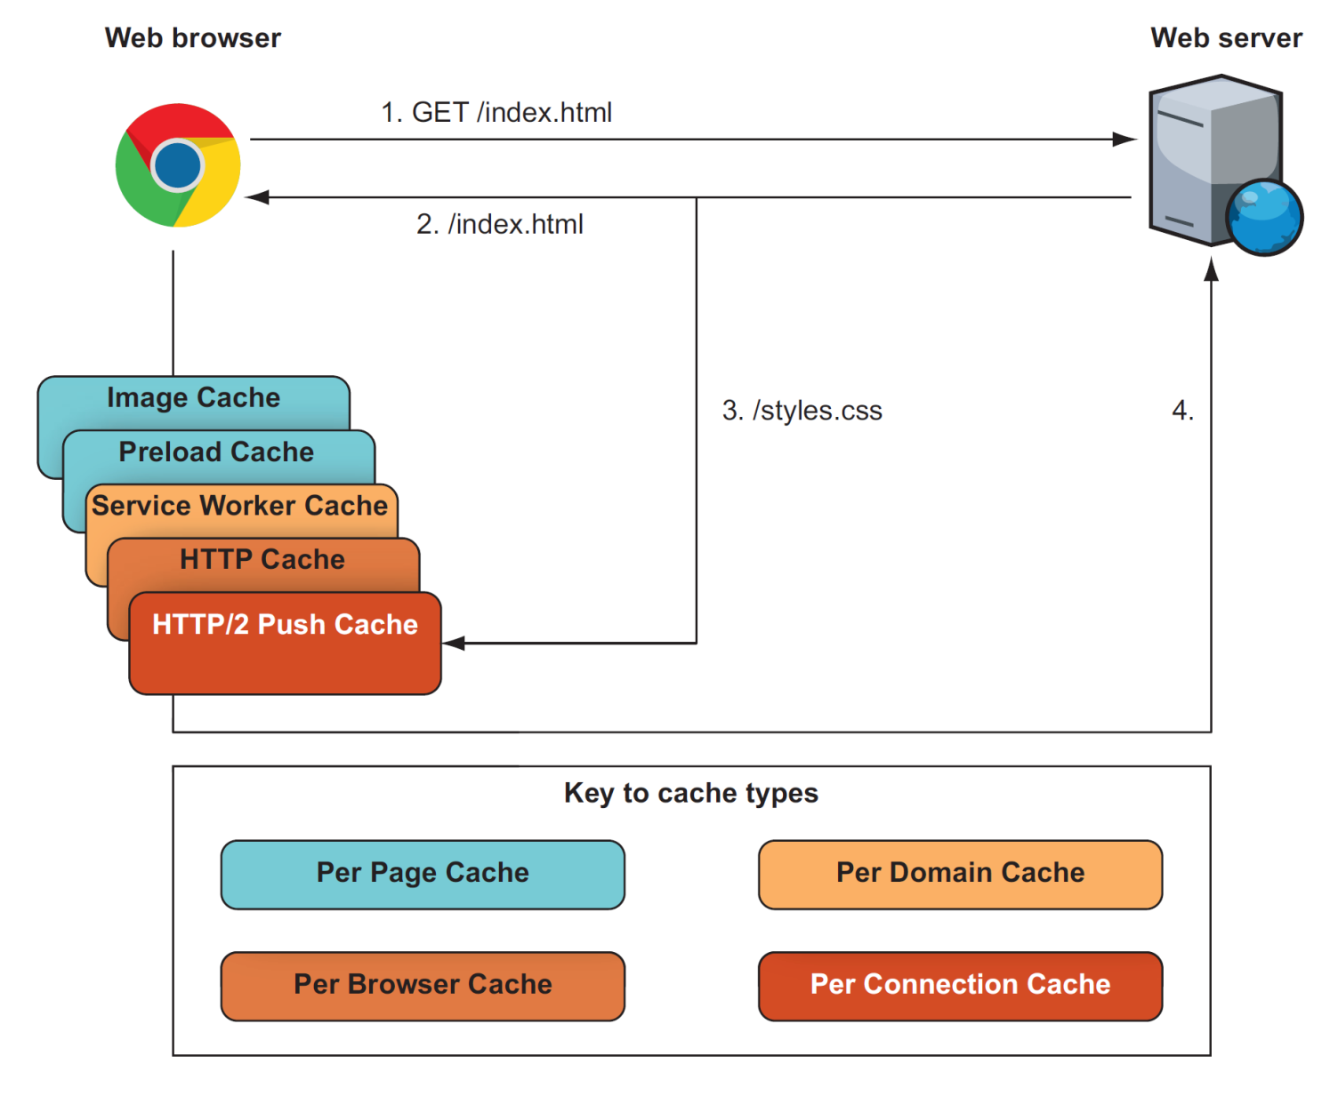
Browser cache for HTTP/2 push

Slide 18
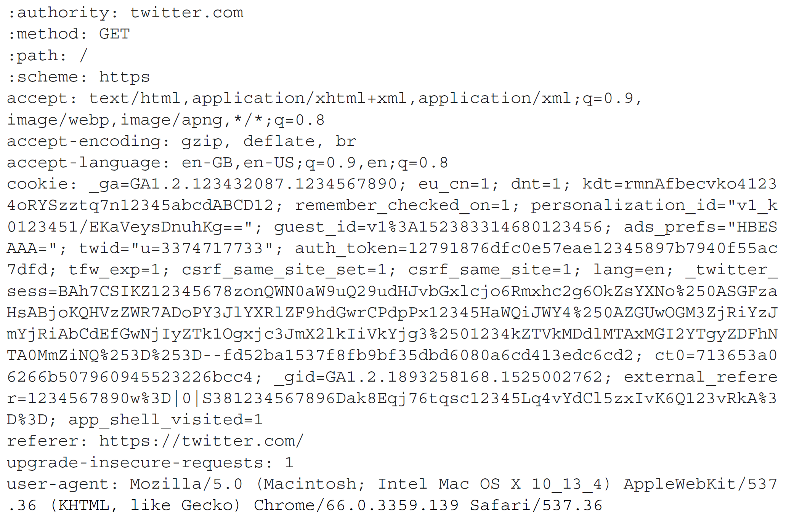
Header compression
Request header addressed to Tweeter …

Slide 19
HC methods
Lookup tables
Encoding techniques
Lookback compression

Slide 20
Lookup tables
Simple GET request:
  :authority: www.example.com
  :method: GET
  :path: /url
  :scheme: https
Lookup table:
  $1=:authority:
  $2=:method:
  $3=:path:
  $4=:scheme:
  Compressed request:
  $1 www.example.com
  $2 GET
  $3 /url
  $4 https

Slide 21
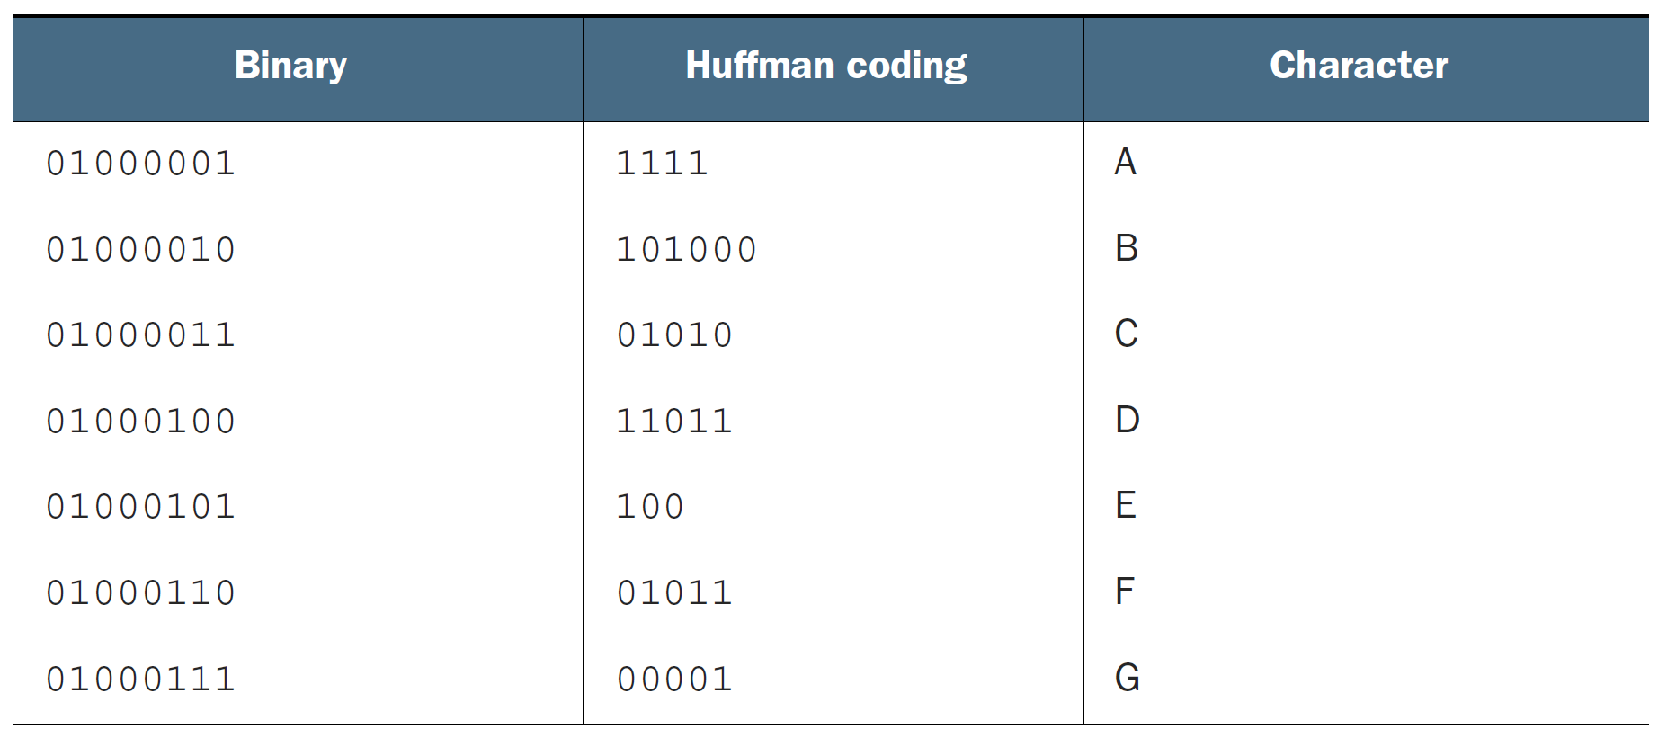
More efficient coding

Slide 22
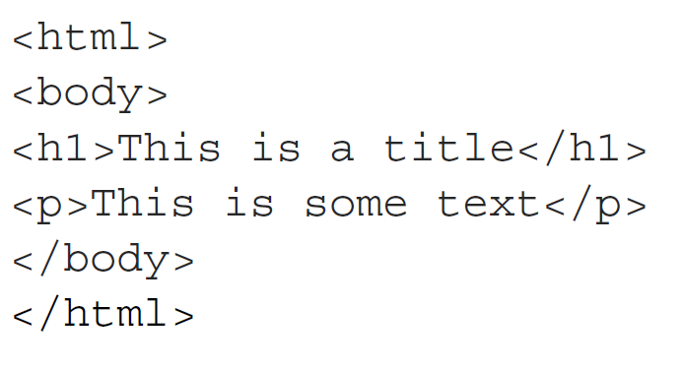
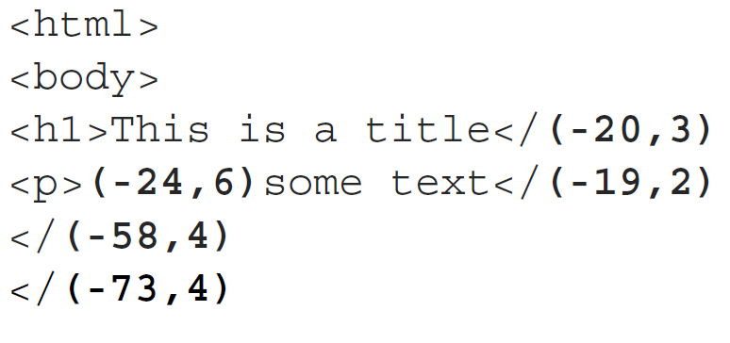
Lookback compression

Slide 23
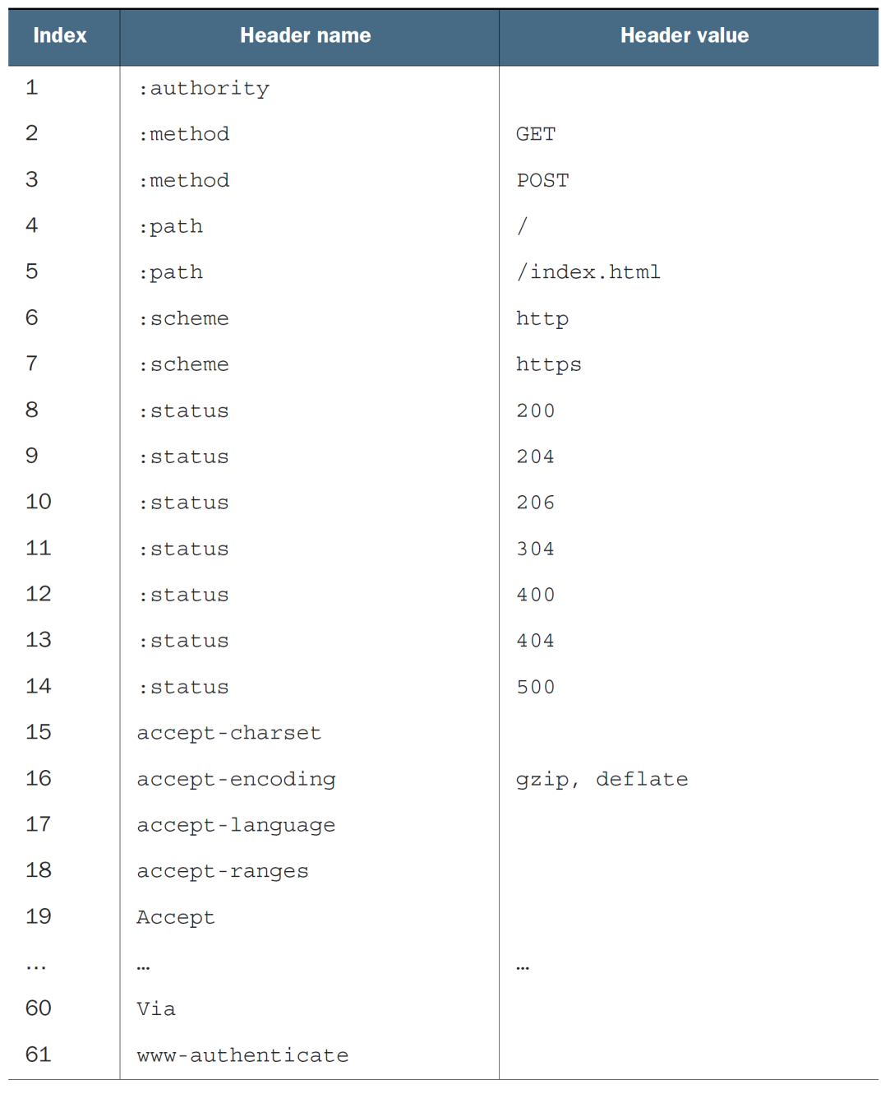
HPACK Static table

