Slide 1
Smart TVs
Vassilis Tsetsos

Slide 2
What is Smart TV
A TV device (or set-top-box/media player) that enables the delivery of Internet-based services and content
Local devices and content can be also connected and accessed
  DLNA, UPnP, Network-attached Storage
A combination of a TV device and a computer
  … and a metaphor of smart phones to TV
It executes an operating system and runs Smart TV apps
Apps can be developed with SDKs (Software Development Kits), proprietary or open
Various business models are supported

Slide 3
Smart TV services and content
TV channels
Video on demand
Social networking applications
EPGs
Games
Interactive advertising
Browsing Web content
Browsing “local” multimedia
…

Slide 4
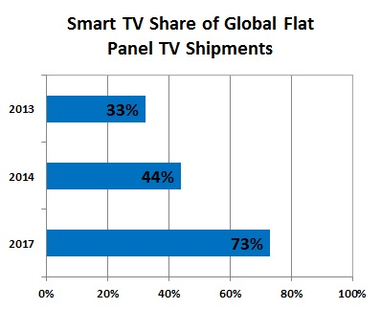
Smart TV market
78 Million Smart TVs Shipped in 2013 (55% increase from 2012)
~ 50% of Smart TV owners across the USA and major European markets are currently using their TV's Internet capabilities
1 Billion connected TV devices
  Smart TVs, Set-top-boxes (e.g., Apple TV, Android TV), game consoles
  The market is predicted to double in size between now and 2018, reaching the 2 billion mark, with smart TVs carrying embedded platforms as the main segment to watch

Slide 5
The evolution of Smart TV
The Past
  “Individual” attempts from TV vendors
The Present
  Highly fragmented market: many vendors, many platforms, frequent changes
  Some synergies emerge
The Future
  The fail of 3DTV attempts gives Smart TV more place to grow.
  Higher resolution and built-in features will be the target in the next years
  Premium TV subscriptions fall and streaming video services rise

Slide 6
Key Smart TV vendors
Samsung
LG Electronics
Panasonic
Sony
Google
TPVision
Toshiba
…

Slide 7
Smart TV platforms
Android TV (Google, Sony, …)
Mediaroom (Microsoft)
Yahoo! Connected TV
Samsung Smart TV (new Tizen-based available)
Smart TV Alliance (STA)
Kodi Entertainment Center (formerly XBMC Media Center)
…

Slide 8
The Smart TV Alliance (STA)
Founded in 2012 by LG Electronics, Toshiba, TPVision (Phillips), Panasonic
A new industry standard to allow for:
  Unified contract procedures between app developers and manufacturers
  Single SDK with IDE and Emulator
    Free to download
  “Build once, publish everywhere"
(Common) Developer Portal opened at 1/3/2014

Slide 9
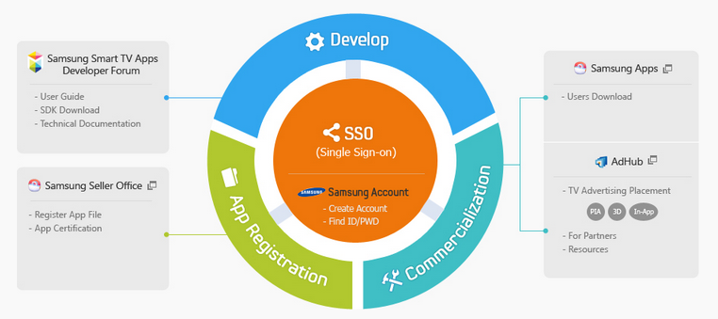
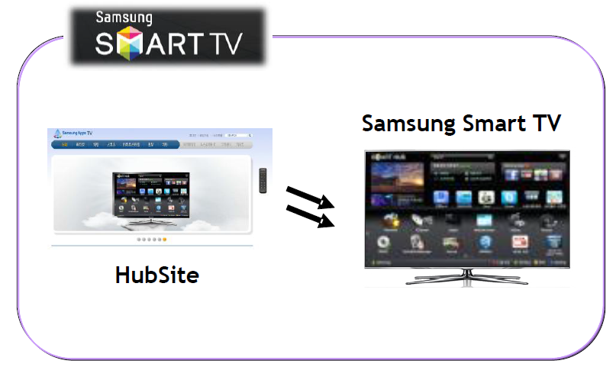
Samsung Smart TV App Development

Slide 10
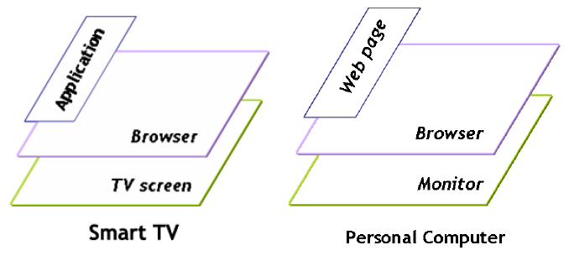
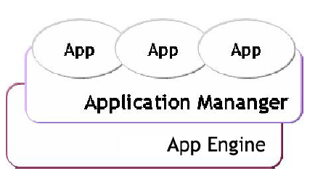
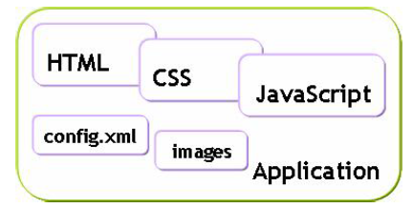
Smart TV app lifecycle
Source: Samsung

Slide 11
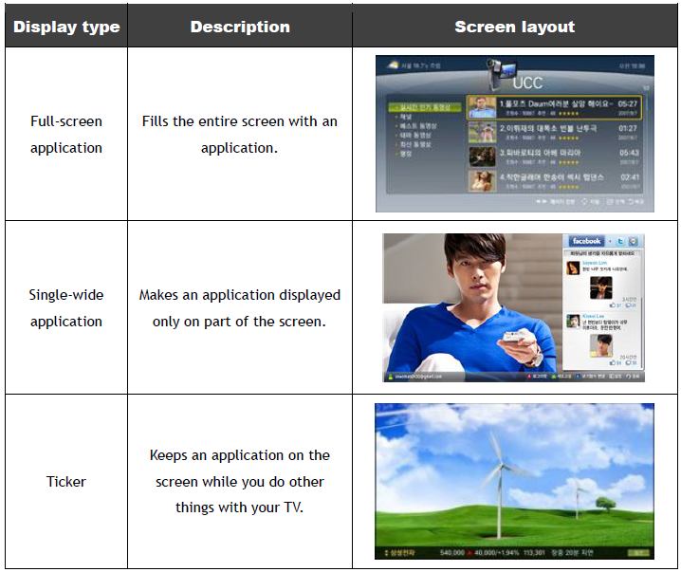
App types
Source: Samsung

Slide 12
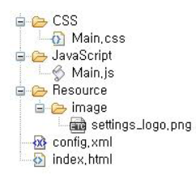
Main app file structure
Application manager: authenticate, install, delete, update, open, finish applications
Index.html: the initial access point for the app
Config.xml: a mandatory file with settings (p.23 Developer Guide)
Source: Samsung

Slide 13
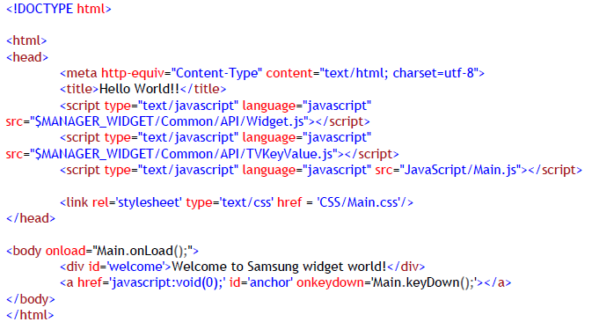
Sample index.html
Source: Samsung

Slide 14
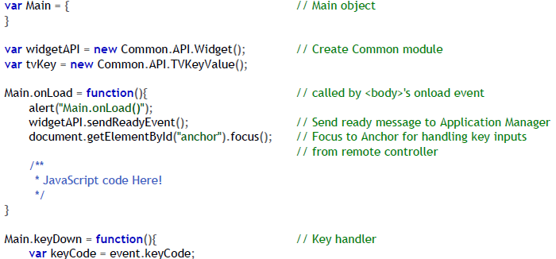

Sample Main.js
Source: Samsung

Slide 15
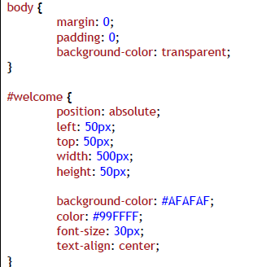
Main.css
Source: Samsung

Slide 16
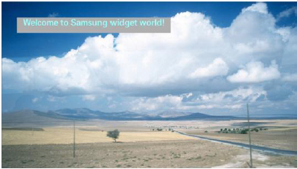
The result
Source: Samsung

Slide 17
UX issues
1. The average distance between a TV and its viewers is 3 meters (10ft).
2. The standard Remote is the fundamental TV control.
3. TV is used by more than one person.
Special attention to:
  Focus in visual elements
  Navigation sequence
  Not many screen transitions

Slide 18
Business models
Hardware selling
App revenue models
Advertising
…

Slide 19
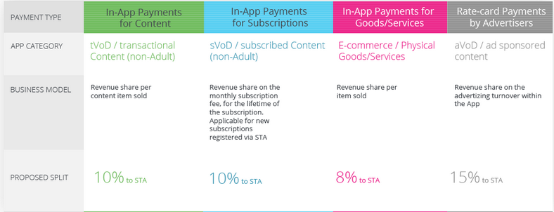
STA revenue sharing model

Slide 20
Samsung Smart TV revenue models
PIA - Premium Interactive Advertising
In-app - available on thousands of TV applications
3D - World's First 3d advertising
In-App Purchase
  70% Seller -30% Samsung

