Slide 1
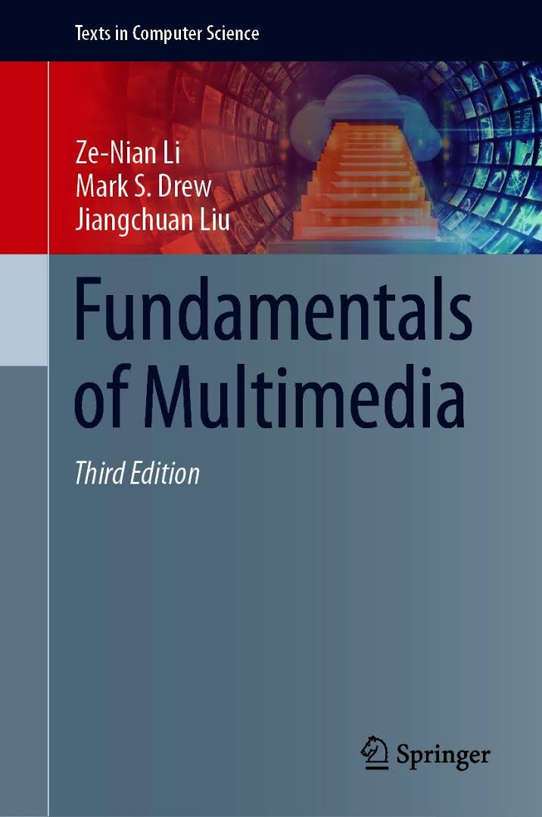
Fundamentals of Multimedia
Ze-Nian Li, Mark S. Drew, Jiangchuan Liu
Chapter 6
Basics of Digital Audio

Slide 2
Outline
6.1 Digitization of Sound
6.2 MIDI (skip)
6.3 Quantization and Transmission of Audio
  6.3.2 Pulse Code Modulation
  6.3.3 Differential Coding of Audio
  6.3.4 Lossless Predictive Coding
  6.3.5 DPCM
  6.3.6 DM

Slide 3
6.1 Digitization of Sound
Sound is a wave phenomenon like light.
Digitization means conversion to a stream of numbers, and preferably these numbers should be integers for efficiency.
Fig. 6.1 shows the 1-dimensional nature of sound: amplitude values depend on a 1D variable, time.
Images depend instead on a 2D set of variables, x and y.
Chap 6 Basics of Digital Audio

Slide 4
Fig. 6.1: An analog signal: continuous measurement of
pressure wave.
Chap 6 Basics of Digital Audio

Slide 5
Digitization
To digitize, the signal must be sampled in each dimension: in time, and in amplitude.
The first kind of sampling, using measurements only at
evenly spaced time intervals, is simply called, sampling.
The rate at which it is performed is called the
sampling frequency.
For audio, typical sampling rates are from 8 kHz
(8,000 samples per second) to 48 kHz.
This range is determined by Nyquist theorem.
Sampling in the amplitude dimension is called quantization.
Chap 6 Basics of Digital Audio

Slide 6
Fig. 6.2: Sampling and Quantization.
(a): Sampling the analog signal in the time dimension.
(b): Quantization is sampling the analog signal
in the amplitude dimension.
Chap 6 Basics of Digital Audio

Slide 7
Digitization
To decide how to digitize audio data we need to answer the following questions:
What is the sampling rate?
How finely is the data to be quantized?
Is quantization uniform?
How is audio data formatted? (file format)
Chap 6 Basics of Digital Audio

Slide 8
Nyquist Theorem
Signals can be decomposed into a sum of sinusoids.
Fig. 6.3 shows how weighted sinusoids can build up quite a complex signal.
Chap 6 Basics of Digital Audio

Slide 9
Fig. 6.3: Building up a complex signal by superposing sinusoids.
Chap 6 Basics of Digital Audio

Slide 10
Nyquist Theorem
The Nyquist theorem states how frequently we must sample in time to be able to recover the original sound.
Fig. 6.4(a) shows a single sinusoid: it is a single frequency
If sampling rate just equals the actual frequency,
Fig. 6.4(b) shows that a false signal is detected:
it is simply a constant, with zero frequency.
Chap 6 Basics of Digital Audio

Slide 11
Nyquist Theorem
If sample at 1.5 times the actual frequency, Fig. 6.4(c) shows that we obtain an incorrect (alias) frequency that is lower than the correct one.
For correct sampling, we must use a sampling rate equal to at least twice the maximum frequency content in the signal. This rate is called the Nyquist rate.
Chap 6 Basics of Digital Audio

Slide 12
Chap 6 Basics of Digital Audio

Slide 13
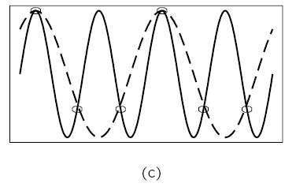
Fig. 6.4: Aliasing. (a): A single frequency.
(b): Sampling at exactly the frequency produces a constant.
(c): Sampling at 1.5 times per cycle produces
an alias perceived frequency.
Chap 6 Basics of Digital Audio

Slide 14
Nyquist Theorem
Nyquist Theorem: If a signal is band-limited, i.e., there
is a lower limit f₁ and an upper limit f₂ of frequency
components in the signal, then the sampling rate
should be at least 2(f₂ − f₁).
Nyquist frequency: half of the Nyquist rate.
Since it would be impossible to recover frequencies
higher than Nyquist frequency in any event, most
systems have an antialiasing filter that restricts
the frequency content in the input to the sampler to
a range at or below Nyquist frequency.

Slide 15
Nyquist Theorem
The relationship among the sampling frequency,
true frequency, and the alias frequency is as follows:
falias = fsampling − ftrue,
for ftrue < fsampling < 2×ftrue
Chap 6 Basics of Digital Audio

Slide 16
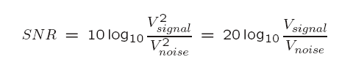
Signal to Noise Ratio (SNR)
The ratio of the power of the correct signal and
the noise is called the signal to noise ratio (SNR)
  - a measure of the quality of the signal.
The SNR is usually measured in decibels (dB)
The SNR value, in units of dB, is defined in terms of
base-10 logarithms of squared voltages:
Chap 6 Basics of Digital Audio

Slide 17
6.3 Quantization and Transmission of Audio
Coding of Audio: quantization and transformation of
data are collectively known as coding of the data.
Differences in signals between the present and a past time can reduce the size of signal values and also concentrate the histogram of pixel values into a much smaller range.
Chap 6 Basics of Digital Audio

Slide 18
The result of reducing the variance of values is that
lossless compression methods produce a bitstream
with shorter bit lengths for more likely values
In general, producing quantized sampled output for audio is called PCM (Pulse Code Modulation).
The differences version is called DPCM (and a crude but efficient variant is called DM).
The adaptive version is called ADPCM.
Chap 6 Basics of Digital Audio

Slide 19
Pulse Code Modulation
The basic techniques for creating digital signals from
analog signals are sampling and quantization.
Quantization consists of selecting breakpoints (boundary levels) in magnitude, and then re-mapping any value within an interval to one of the representative output levels.
Chap 6 Basics of Digital Audio

Slide 20
Fig. 6.2: Sampling and Quantization.
Chap 6 Basics of Digital Audio

Slide 21
Pulse Code Modulation
The set of interval boundaries are called decision
boundaries, and the representative values are called
reconstruction levels.
The boundaries for quantizer input intervals that will
all be mapped into the same output level form a coder
mapping.
The representative values that are the output values
from a quantizer are decoder mapping.
Chap 6 Basics of Digital Audio

Slide 22
Every compression scheme has three stages:
The input data is transformed to a new representation
that is easier or more efficient to compress.
2. We may introduce loss of information. Quantization is the main lossy step → we use a limited number of reconstruction levels, fewer than in the original signal.
3. (Lossless) Coding. Assign a codeword (thus forming a binary bitstream) to each output level or symbol.
This could be a fixed-length code, or a variable length code such as Human coding (Chap. 7).
Chap 6 Basics of Digital Audio

Slide 23
For audio signals, we first consider PCM for digitization.
This leads to Lossless Predictive Coding as well as the DPCM scheme; both methods use differential coding.
As well, we look at the adaptive version, ADPCM, which can provide better compression.
Chap 6 Basics of Digital Audio

Slide 24
Fig. 6.13: Pulse Code Modulation (PCM). (a) Original analog signal
and its corresponding PCM signals. (b) Decoded staircase signal.
(c) Reconstructed signal after low-pass filtering.

Slide 25
Differential Coding of Audio
Audio is often stored not in simple PCM but instead in a form that exploits differences - which are generally smaller numbers, so offer the possibility of using fewer bits to store.
If a time-dependent signal has some consistency over time (temporal redundancy), the difference signal will have a more peaked histogram, with a maximum around zero.

Slide 26
Differential Coding of Audio
If we then go on to assign bit-string codewords to differences, we can assign short codes to prevalent values and long codewords to rarely occurring ones.
Chap 6 Basics of Digital Audio

Slide 27
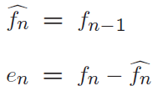
Lossless Predictive Coding
For Predictive coding: simply means transmitting differences - predict the next sample as being equal to the current sample.
Predictive coding consists of finding differences, and transmitting these using a PCM system.
(Predicted signal)
(error signal)
Chap 6 Basics of Digital Audio

Slide 28
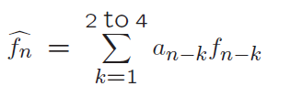
Lossless Predictive Coding
Linear predictor function: function of a few of the previous values
Chap 6 Basics of Digital Audio

Slide 29
Fig. 6.15: Differencing concentrates the histogram.
Digital speech signal. (b) Histogram of digital speech signal values.
(c) Histogram of digital speech signal differences.

Slide 30
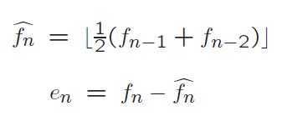
Lossless Predictive Coding
Lossless predictive coding: the decoder produces the same signals as the original.
Predictor example
Chap 6 Basics of Digital Audio

Slide 31
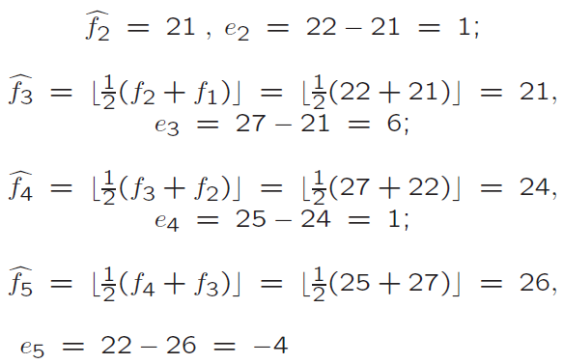
Lossless Predictive Coding
Explicit example
Chap 6 Basics of Digital Audio

Slide 32
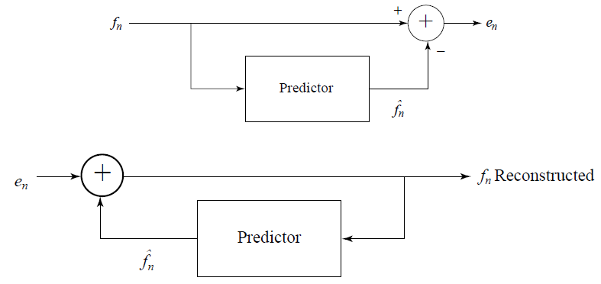
Fig. 6.16: Schematic diagram for predictive coding encoder and decoder

Slide 33
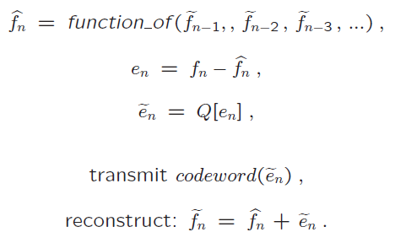
DPCM
Differential PCM is exactly the same as Predictive Coding, except that it incorporates a quantizer step.
(predicted signal)
(error signal)
(quantized error signal)
(entropy coding)
(reconstructed signal)

Slide 34
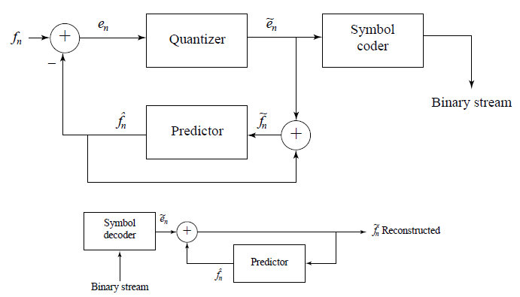
Fig. 6.16: Schematic diagram for DPCM encoder and decoder

Slide 35



DPCM
Quantization noise is equal to the quantization effect on the error term
(predicted signal)
(error signal)
Quantization example
(reconstructed signal)
Chap 6 Basics of Digital Audio

Slide 36
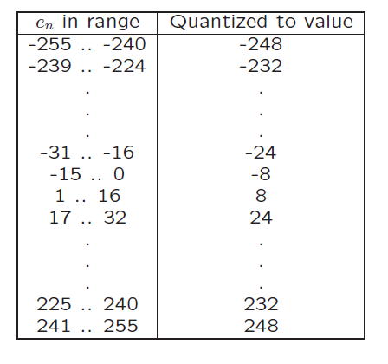
DPCM
Quantization example
Table 6.7 DPCM quantizer reconstruction levels

Slide 37

DPCM
Example stream of signal values

Slide 38
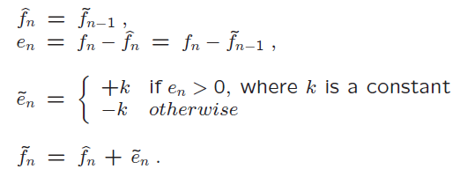
DM
DM (Delta Modulation): simplified version of DPCM
Uniform-Delta DM: use only a single quantized error value, either positive or negative

Slide 39


DM
Example
If k=4:
Chap 6 Basics of Digital Audio

Slide 40
Chapter 14
MPEG Audio Compression
14.1 Psychoacoustics
14.2 MPEG Audio
14.3 Other Audio Codecs
14.4 MPEG-7 Audio and Beyond

Slide 41
14.1 Psychoacoustics
The range of human hearing is about 20 Hz to about 20 kHz
The frequency range of the voice is typically only from about 500 Hz to 4 kHz
The dynamic range, the ratio of the maximum sound amplitude to the quietest sound that humans can hear, is on the order of about 120 dB
Chap 14 Audio Compression

Slide 42
Equal-Loudness Relations
Fletcher-Munson Curves
  Equal loudness curves that display the relationship between perceived loudness (“Phons”, in dB) for a given stimulus sound volume (“Sound Pressure Level”, also in dB), as a function of frequency
Fig. 14.1 shows the ear’s perception of equal loudness:
  The bottom curve shows what level of pure tone stimulus is required to produce the perception of a 10 dB sound
  All the curves are arranged so that the perceived loudness level gives the same loudness as for that loudness level of a pure tone at 1 kHz
Chap 14 Audio Compression

Slide 43
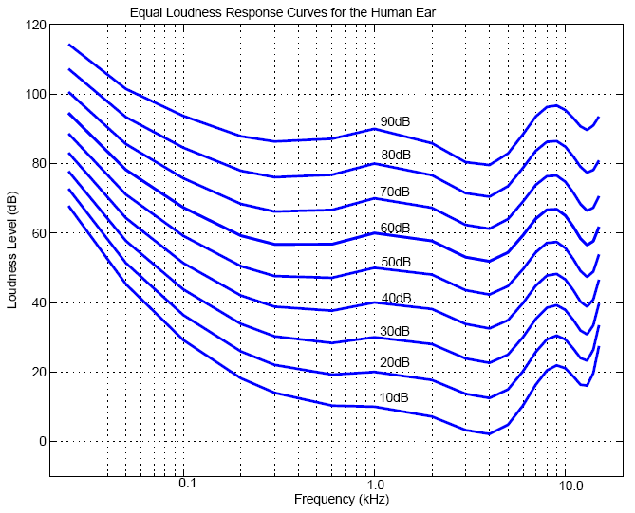
Fig. 14.1: Fletcher-Munson Curves (re-measured by Robinson and Dadson)
Chap 14 Audio Compression

Slide 44
Frequency Masking
Lossy audio data compression methods, such as MPEG/Audio encoding, remove some sounds which are masked anyway
The general situation in regard to masking is as follows:
  A lower tone can effectively mask (make us unable to hear) a higher tone
  The reverse is not true – a higher tone does not mask a lower tone well
  The greater the power in the masking tone, the wider is its influence – the broader the range of frequencies it can mask.
  As a consequence, if two tones are widely separated in frequency then little masking occurs

Slide 45
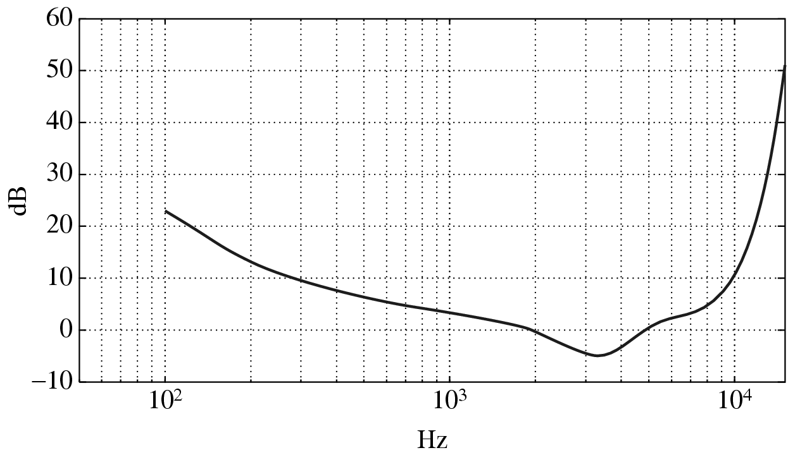
Threshold of Hearing
A plot of the threshold of human hearing for a pure tone
Fig. 14.2: Threshold of human hearing, for pure tones

Slide 46
Threshold of Hearing (Cont’d)
The threshold of hearing curve: if a sound is above the dB level shown then the sound is audible
Turning up a tone so that it equals or surpasses the curve means that we can then distinguish the sound
An approximate formula exists for this curve:
(14.1)
The threshold units are dB; the frequency for the origin
(0,0) in formula (14.1) is 2,000 Hz: Threshold(f) = 0 at f =2 kHz

Slide 47
Frequency Masking Curves
Frequency masking is studied by playing a particular pure tone, say 1 kHz again, at a loud volume, and determining how this tone affects our ability to hear tones nearby in frequency
  one would generate a 1 kHz masking tone, at a fixed sound level of 60 dB, and then raise the level of a nearby tone, e.g., 1.1 kHz, until it is just audible
The threshold in Fig. 14.3 plots the audible level for a single masking tone (1 kHz)
Fig. 14.4 shows how the plot changes if other masking tones are used

Slide 48
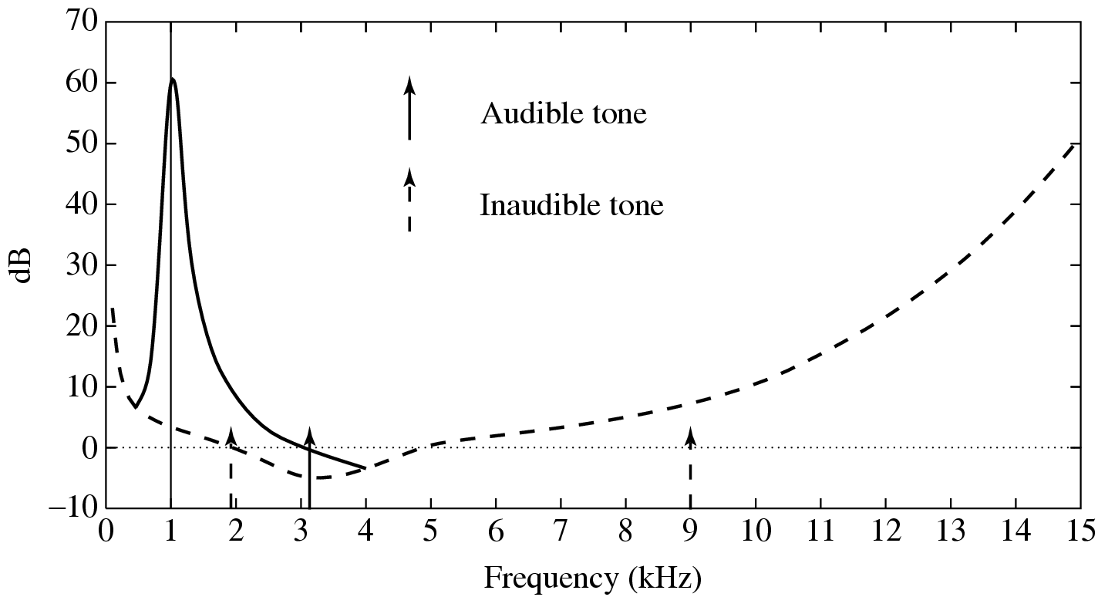
Fig. 14.3: Effect on threshold for 1 kHz masking tone

Slide 49
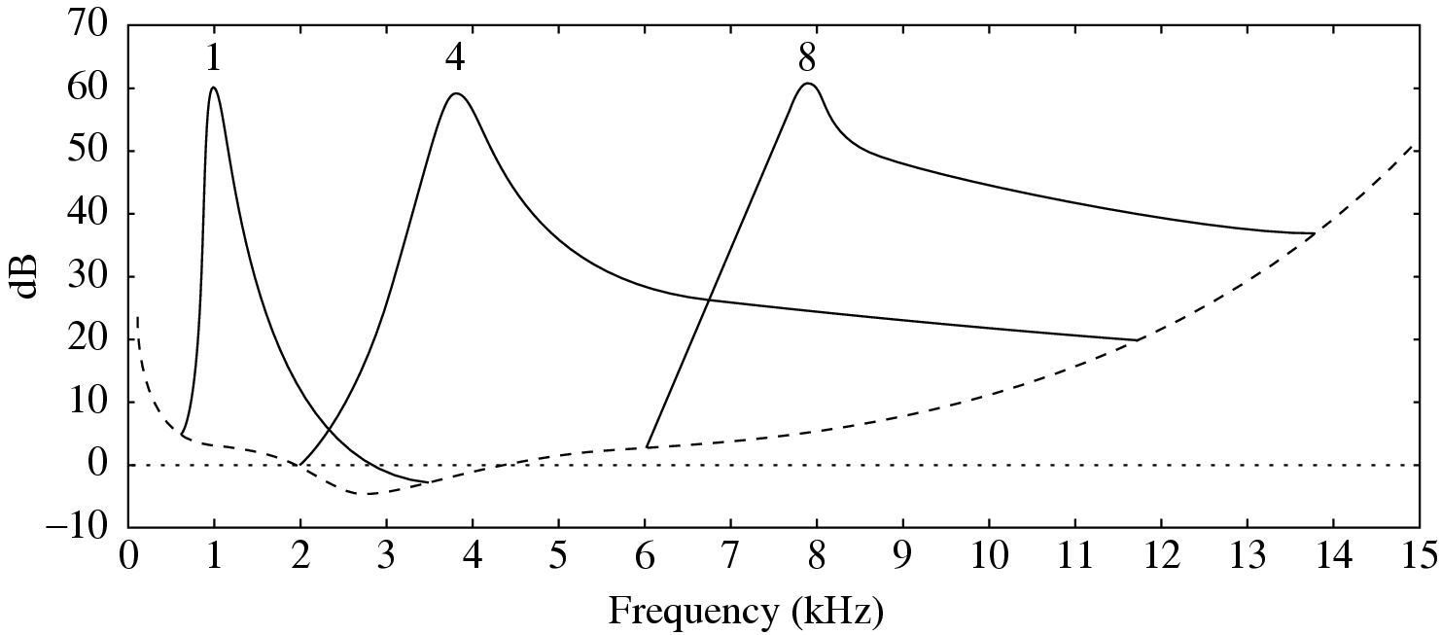
Fig. 14.4: Effect of masking tone at three different frequencies

Slide 50
Critical Bands
Critical bandwidth represents the ear’s resolving power for simultaneous tones or partials
  At the low-frequency end, a critical band is less than 100 Hz wide, while for high frequencies the width can be greater than 4 kHz
Experiments indicate that the critical bandwidth:
  for masking frequencies <500Hz: remains approximately constant in width ( about 100 Hz)
  For masking frequencies >500Hz: increases approximately linearly with frequency
Chap 14 Audio Compression

Slide 51
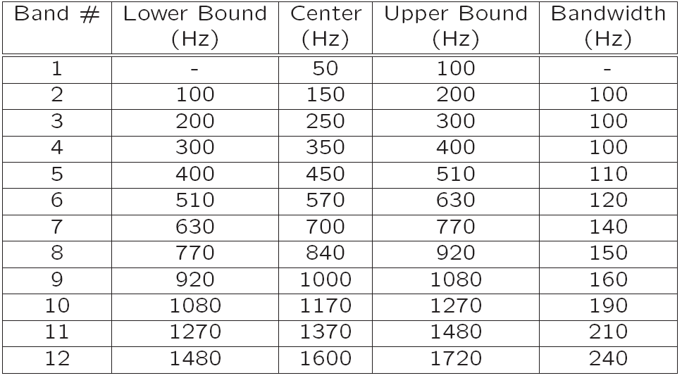
Table 14.1: 25-Critical Bands and Bandwidth

Slide 52
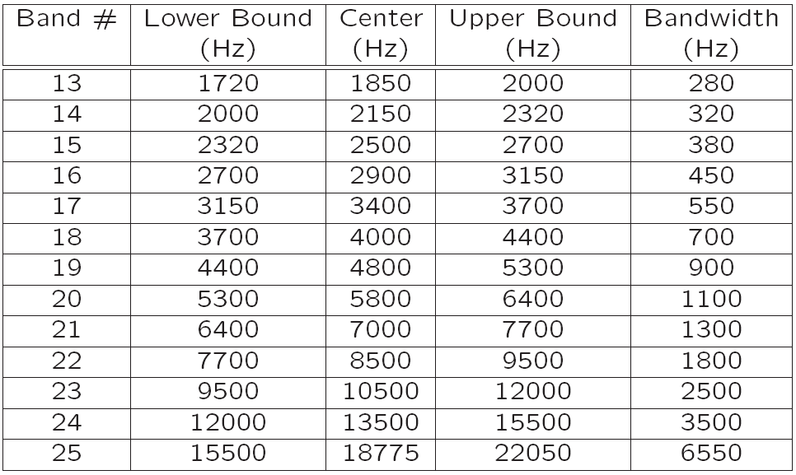

Slide 53
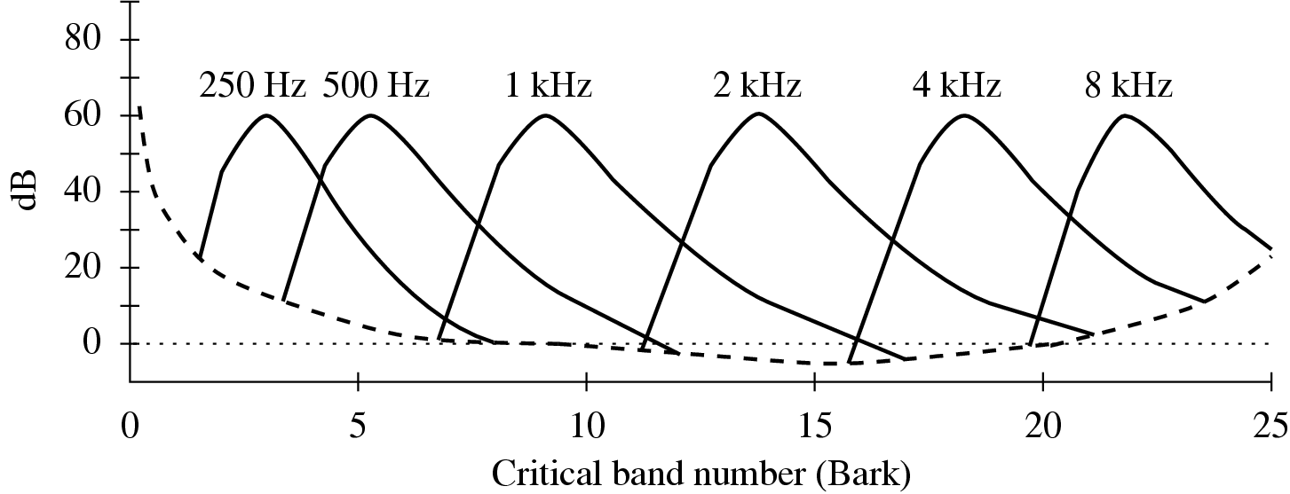
Bark Unit
Bark unit is defined as the width of one critical band, for any masking frequency
The idea of the Bark unit: every critical band width is roughly equal in terms of Barks (refer to Fig. 14.5)
Fig. 14.5: Effect of masking tones, expressed in Bark units
Chap 14 Audio Compression

Slide 54
Conversion: Frequency & Critical Band Number
• Conversion expressed in the Bark unit:
(14.2)
• Another formula used for the Bark scale:
(14.3)
where f is in kHz and b is in Barks (the same applies to all below)
The inverse equation:
(14.4)
The critical bandwidth (df) for a given center frequency f can also be approximated by:
(14.5)
Chap 14 Audio Compression

Slide 55
Temporal Masking
Phenomenon: any loud tone will cause the hearing receptors in the inner ear to become saturated and require time to recover
The following figures show the results of masking experiments:
Chap 14 Audio Compression

Slide 56
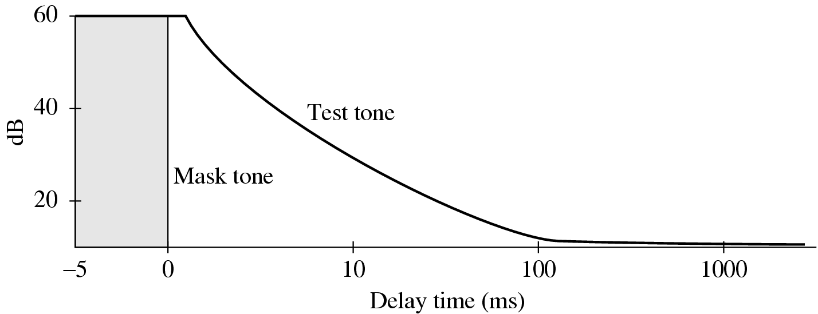
Fig. 14.6: The louder the test tone, the shorter the amount of time required before the test tone is audible once the masking tone is removed.
Chap 14 Audio Compression

Slide 57
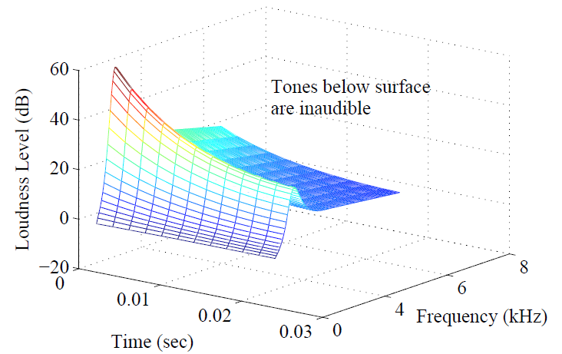
Fig. 14.7: Effect of temporal masking depends on both time and closeness in frequency.

Slide 58
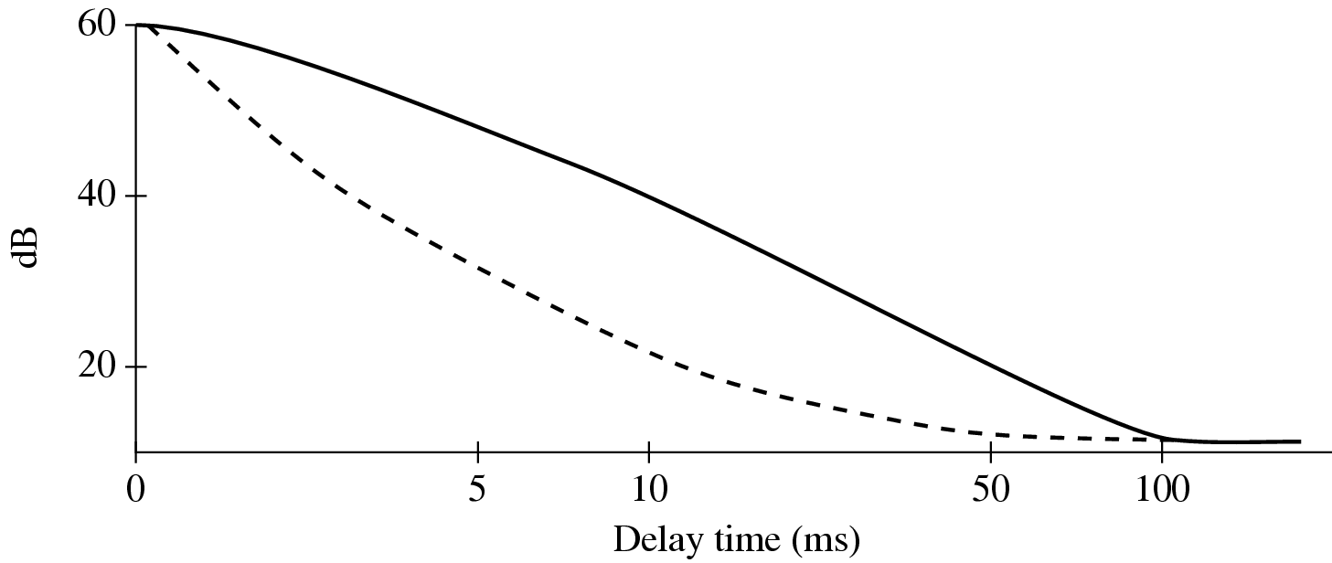
Fig. 14.8: For a masking tone that is played for a longer time, it takes longer before a test tone can be heard. Solid curve: masking tone played for 200 msec; dashed curve: masking tone played for 100 msec.

Slide 59
14.2 MPEG Audio
MPEG audio compression takes advantage of psychoacoustic models, constructing a large multi-dimensional lookup table to transmit masked frequency components using fewer bits
MPEG Audio Overview
  Applies a filter bank to the input to break it into its frequency components
  In parallel, a psychoacoustic model is applied to the data for bit allocation block
  The number of bits allocated are used to quantize the info from the filter bank – providing the compression

Slide 60
MPEG Layers
MPEG audio offers three compatible layers:
  Each succeeding layer able to understand the lower layers
  Each succeeding layer offering more complexity in the psychoacoustic model and better compression for a given level of audio quality
  each succeeding layer, with increased compression effectiveness, accompanied by extra delay
The objective of MPEG layers: a good tradeoff between quality and bit-rate

Slide 61
MPEG Layers (Cont’d)
Layer 1 quality can be quite good provided a comparatively high bit-rate is available
  Digital Audio Tape typically uses Layer 1 at around 192 kbps
Layer 2 has more complexity; was proposed for use in Digital Audio Broadcasting
Layer 3 (MP3) is most complex, and was originally aimed at audio transmission over ISDN lines
Most of the complexity increase is at the encoder, not the decoder – accounting for the popularity of MP3 players
Chap 14 Audio Compression

Slide 62
MPEG Audio Strategy
• MPEG approach to compression relies on:
  Quantization
  Inaccuracy of human auditory system within the width of a critical band
• MPEG encoder employs a bank of filters to:
  Analyze the frequency (“spectral”) components of the audio signal by calculating a frequency transform of a window of signal values
  Decompose the signal into subbands by using a bank of filters (Layer 1 & 2: “quadrature-mirror”; Layer 3: adds a DCT; psychoacoustic model: Fourier transform)

Slide 63
MPEG Audio Strategy (Cont’d)
Frequency masking: by using a psychoacoustic model to estimate the just noticeable noise level:
  Encoder balances the masking behavior and the available number of bits by discarding inaudible frequencies
  Scaling quantization according to the sound level that is left over, above masking levels
May take into account the actual width of the critical bands:
  For practical purposes, audible frequencies are divided into 25 main critical bands (Table 14.1)
  To keep simplicity, adopts a uniform width for all frequency analysis filters, using 32 overlapping subbands

Slide 64
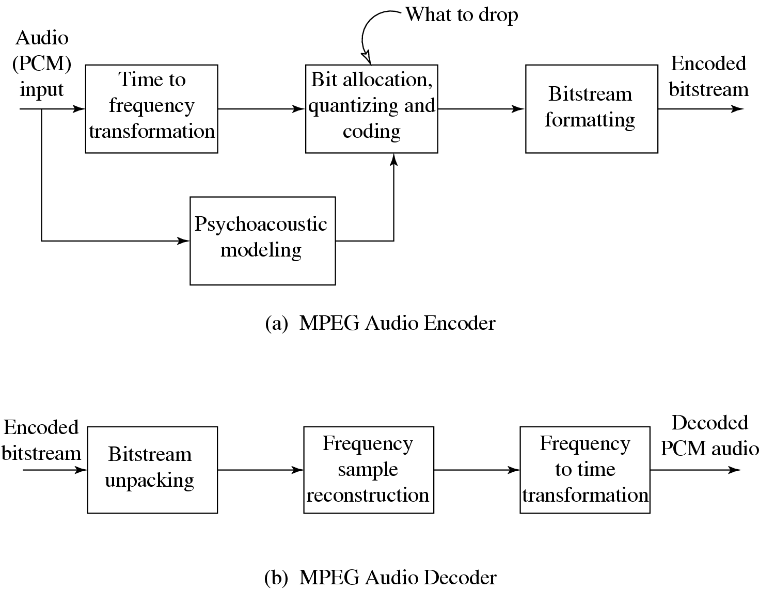
MPEG Audio Compression Algorithm
Fig. 14.9: Basic MPEG Audio encoder and decoder.

Slide 65
Basic Algorithm (Cont’d)
The algorithm proceeds by dividing the input into 32 frequency subbands, via a filter bank
  A linear operation taking 32 PCM samples, sampled in time; output is 32 frequency coefficients
In the Layer 1 encoder, the sets of 32 PCM values are first assembled into a set of 12 groups of 32s
  an inherent time lag in the coder, equal to the time to accumulate 384 (i.e., 12×32) samples
Fig.14.11 shows how samples are organized
  A Layer 2 or Layer 3, frame actually accumulates more than 12 samples for each subband: a frame includes 1,152 samples

Slide 66
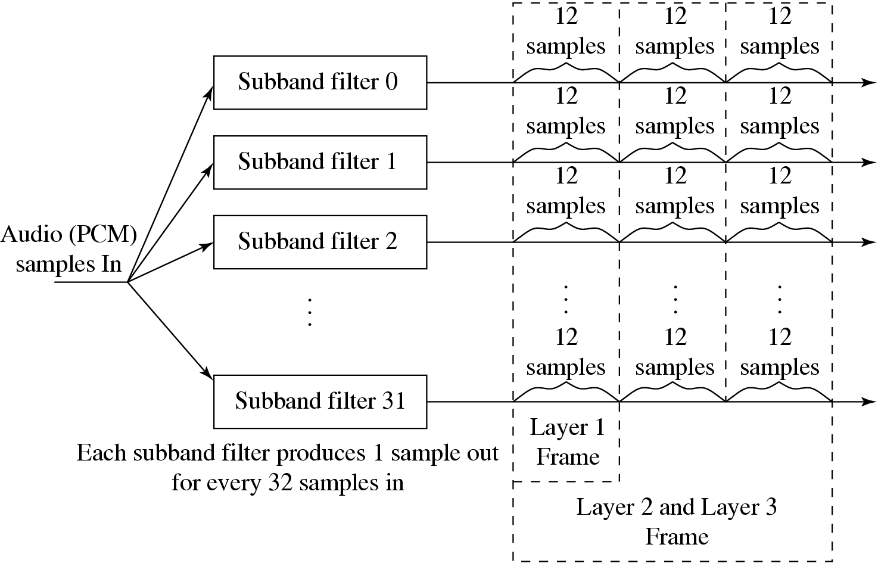
Fig. 14.11: MPEG Audio Frame Sizes

Slide 67
Bit Allocation Algorithm
Aim: ensure that all of the quantization noise is below the masking thresholds
One common scheme:
  For each subband, the psychoacoustic model calculates the Signal-to-Mask Ratio (SMR)in dB
  Then the “Mask-to-Noise Ratio” (MNR) is defined as the difference (as shown in Fig.14.12):
  (14.6)
  The lowest MNR is determined, and the number of code-bits allocated to this subband is incremented
  Then a new estimate of the SNR is made, and the process iterates until there are no more bits to allocate

Slide 68
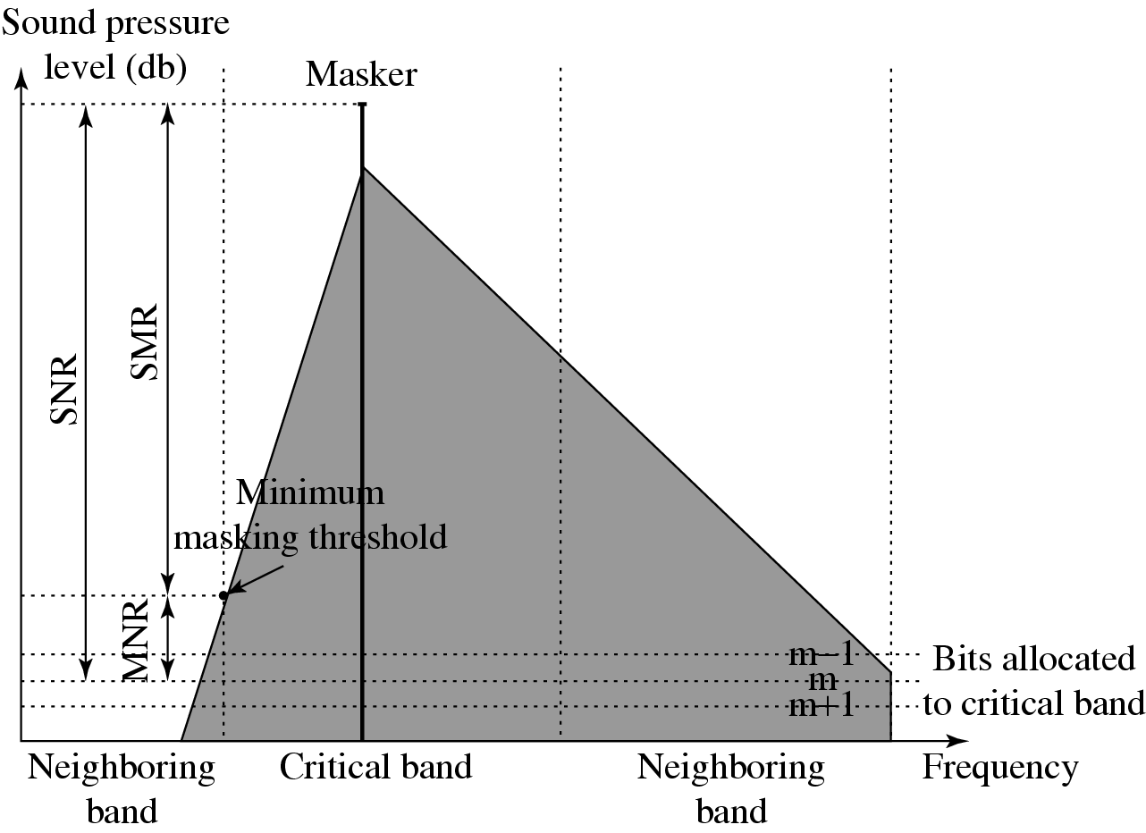
Fig. 14.12: MNR and SMR. A qualitative view of SNR, SMR and MNR are shown, with one dominate masker and m bits allocated to a particular critical band.
Chap 14 Audio Compression

Slide 69
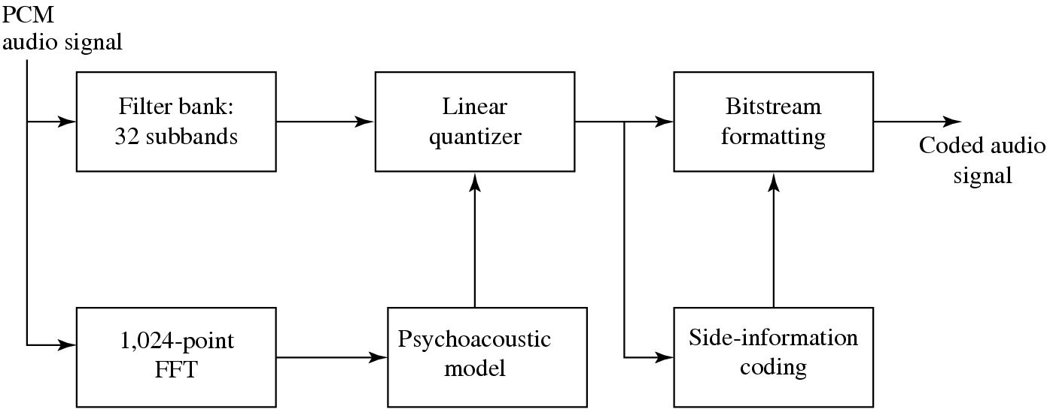
• Mask calculations are performed in parallel with subband filtering, as in Fig. 4.13:
Fig. 14.13: MPEG-1 Audio Layers 1 and 2.

Slide 70
Layer 2 of MPEG-1 Audio
• Main difference:
  Three groups of 12 samples are encoded in each frame and temporal masking is brought into play, as well as frequency masking
  Bit allocation is applied to window lengths of 36 samples instead of 12
  The resolution of the quantizers is increased from 15 bits to 16
• Advantage:
  a single scaling factor can be used for all three groups

Slide 71
Layer 3 of MPEG-1 Audio
• Main difference:
  Employs a similar filter bank to that used in Layer 2, except using a set of filters with non-equal frequencies
  Takes into account stereo redundancy
  Uses Modified Discrete Cosine Transform (MDCT) — addresses problems that the DCT has at boundaries of the window used by overlapping frames by 50%:
  (14.7)

Slide 72
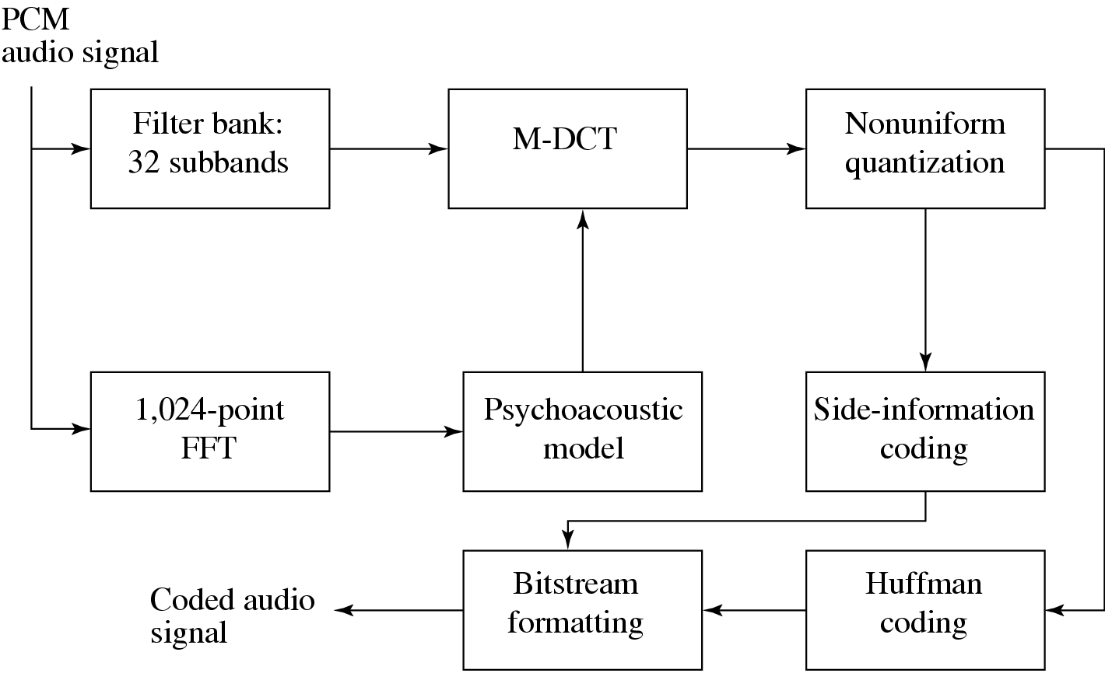
Fig 14.14: MPEG-Audio Layer 3 Coding.
Chap 14 Audio Compression

Slide 73
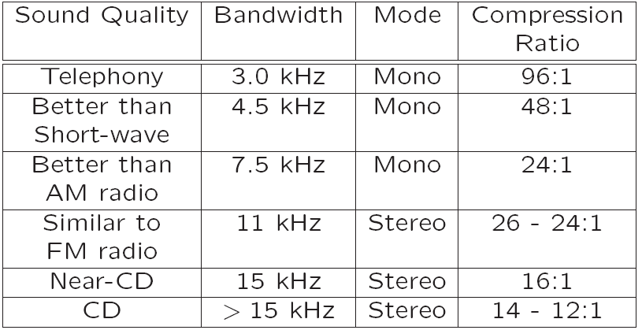
Table 14.2 shows various achievable MP3 compression ratios:
Table 14.2: MP3 compression performance

Slide 74
MPEG-2 AAC (Advanced Audio Coding)
AAC was developed to succeed MP3 for digital audio; delivers better sound quality than MP3 for the same bitrate
Default audio format for YouTube, iPhone, iTunes, Nintendo, and PlayStation
The standard vehicle for DVDs:
  Audio coding technology for the DVD-Audio Recordable (DVD-AR) format, also adopted by XM Radio
Aimed at transparent sound reproduction for theaters
  Can deliver this at 320 kbps for five channels so that sound can be played from 5 different directions: Left, Right, Center, Left-Surround, and Right-Surround
  5.1 channel systems also include a low-frequency enhancement (LFE) channel (a “woofer”)
Also capable of delivering high-quality stereo sound at bit-rates below 128 kbps
Chap 14 Audio Compression

Slide 75
MPEG-2 AAC (Cont’d)
Support up to 48 channels, sampling rates between 8 kHz and 96 kHz, and bit-rates up to 576 kbps per channel
Like MPEG-1, MPEG-2, supports three different “profiles”, but with a different purpose:
  – Main profile
  – Low Complexity(LC) profile
  – Scalable Sampling Rate (SSR) profile
Chap 14 Audio Compression

Slide 76
MPEG-4 Audio
Integrates several different audio components into one standard: speech compression, perceptually based coders, text-to-speech, and MIDI
MPEG-4 AAC (Advanced Audio Coding), is similar to the MPEG-2 AAC standard, with some minor changes
Perceptual Coders
  Incorporate a Perceptual Noise Substitution module
  Include a Bit-Sliced Arithmetic Coding (BSAC) module
  Also include a second perceptual audio coder, a vector-quantization method entitled TwinVQ

Slide 77
MPEG-4 Audio (Cont’d)
• Structured Coders
  Takes “Synthetic/Natural Hybrid Coding” (SNHC) in order to have very low bit-rate delivery an option
  Objective: integrate both “natural” multimedia sequences, both video and audio, with those arising synthetically – “structured” audio
  Takes a “toolbox” approach and allows specification of many such models.
  E.g., Text-To-Speech (TTS) is an ultra-low bit-rate method, and actually works, provided one need not care what the speaker actually sounds like
Chap 14 Audio Compression

Slide 78
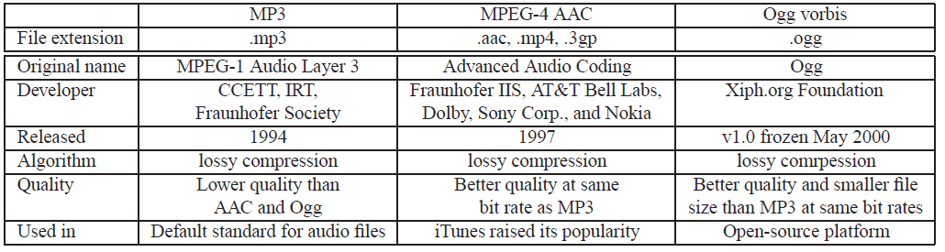
14.3 Other Commercial Audio Codecs
Table 14.3 summarizes the target bit-rate range and main features of other modern general audio codecs
Table 14.3: Comparison of MP3, MPEG-4 AAC, and Ogg vorbis

Slide 79
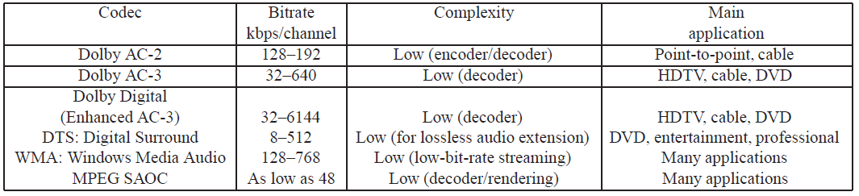
14.4 MPEG-7 Audio and Beyond
Table 14.4 summarizes the target bitrate range and main features of other modern general audio codecs
Table 14.3: Comparison of audio coding systems

Slide 80
14.4 MPEG-7 Audio and Beyond
Difference from current standards:
MPEG-4 is aimed at compression using objects.
MPEG-7 is mainly aimed at “search”: How can we find objects, assuming that multimedia is indeed coded in terms of objects
  The objective, in terms of audio, is to facilitate the representation and search for sound content, perhaps through the tune or other descriptors
  An example application supported by MPEG-7 is automatic speech recognition (ASR)
  Further standards in the MPEG sequence are mostly not aimed at further audio compression standardization. For example, MPEG-DASH (Dynamic Adaptive Streaming over HTTP) is aimed at streaming of multimedia
Chap 14 Audio Compression

Slide 81
Ερωτήσεις

Slide 82
Κεφάλαια 6 και 14

