Slide 1
Chapter 12 Modern Video Coding Standards: H.264, H.265 and H.266
12.1 H.264
12.2 H.265
12.3 H.266

Slide 2
12.1 Overview of H.264
H.264 is known as MPEG-4 Part 10, AVC (Advanced Video Coding). It is often referred to as the H.264/AVC (or H.264/MPEG-4 AVC) video coding standard.
H.264 provides a higher video coding efficiency, up to 50% better compression than MPEG-2 and up to 30% better than H.263 and MPEG-4 Advanced Simple Profile, while maintaining the same quality of the compressed video.

Slide 3
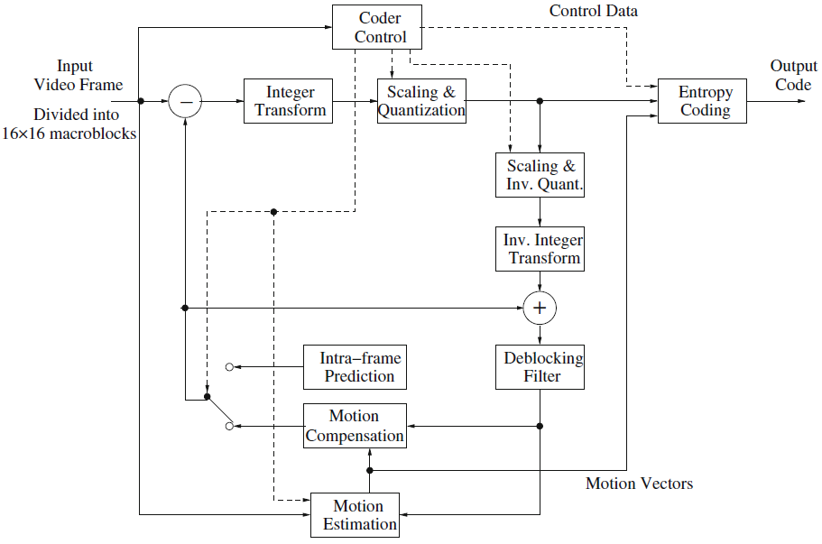
Fig. 12.1: H.264 encoder

Slide 4
12.1 Overview of H.264 (Cont’d)
Main features of H.264/AVC are:
Integer transform in 4 × 4 blocks.
Block-size motion compensation in luma images.
Quarter-pixel accuracy in motion vectors.
Multiple reference picture motion compensation.
Directional spatial prediction for intra frames.
In-loop deblocking filtering.
CAVLC and CABAC.
Robust to data errors and data losses.

Slide 5
12.1 Overview of H.264 (Cont’d)
Major blocks in decoder
Entropy decoding.
Inverse quantization and transform of residual pixels.
Motion compensation or intra-prediction.
Reconstruction.
In-loop deblocking filter on reconstructed pixels.

Slide 6
12.1.1 Motion compensation
Similar to MPEG-2 and H.263, H.264 employs the technology of hybrid coding, i.e., a combination of inter-picture motion predictions and intra-picture spatial prediction, and transform coding on residual errors.

Slide 7
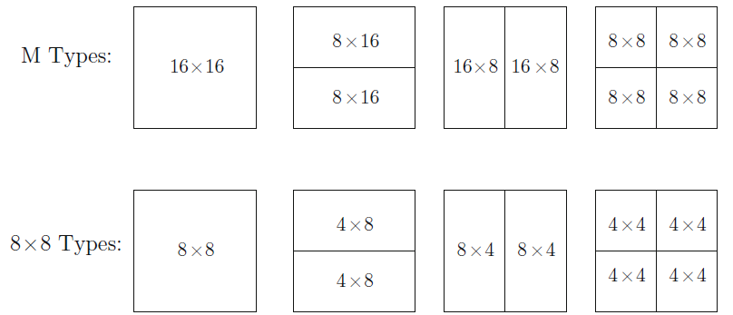
Variable Block-Size Compensation
Initial macroblock size is 16×16, could be further divided into smaller blocks.
Fig. 12.2: H.264 macroblock segmentation

Slide 8


Quarter-Pixel Precision
The accuracy of motion compensation is quarter-pixel precision in luma images. Pixel values at half-pixel and quarter-pixel positions can be derived by interpolation
In Figure 12.3, the half pixel b and h could be calculated by

Slide 9
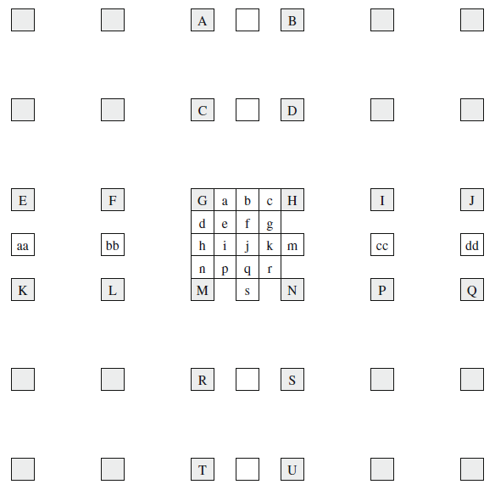
Fig. 12.3: H.264 fractional sample interpolation

Slide 10
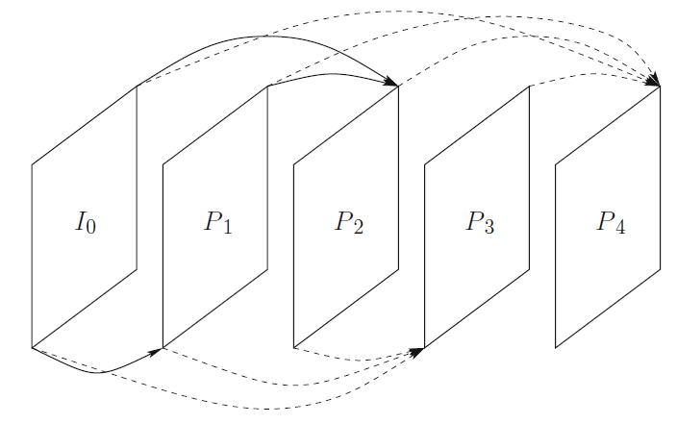
Additional Options in Group of Pictures
• No B-frames
• Multiple reference frames
• Hierarchical prediction structure

Slide 11
12.1.2 Integer transform
DCT is known to cause prediction shift because of floating point calculation and rounding errors in the transform and inverse transform. It could be accumulated, causing a large error.
In H.264, a simple integer-precision 4 × 4 DCT is utilized to eliminates the encoder/decoder mismatch problems.
H.264 also provides a quantization scheme with nonlinear step-sizes to obtain accurate rate control.

Slide 12


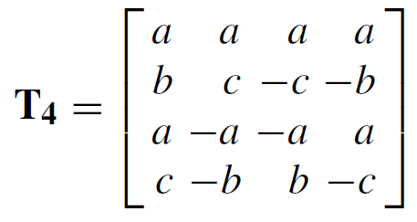
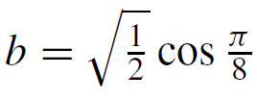
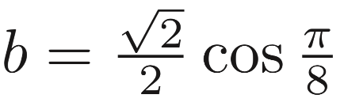
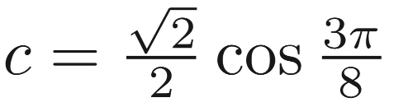

12.1.2 Integer transform (Cont’d)
2D DCT can be realized by two consecutive 1D transforms
The 4 x 4 DCT matrix is

Slide 13


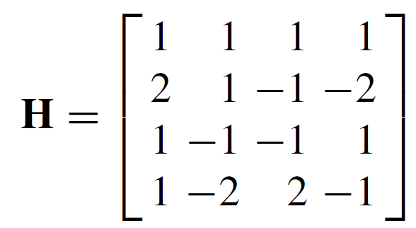
12.1.2 Integer transform (Cont’d)
To derive a scaled 4 × 4 integer transform, we can simply scale the entries of T4 up and round them to nearest integers
Set , it yields

Slide 14
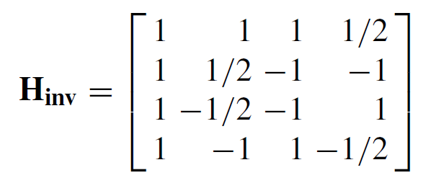
12.1.2 Integer transform (Cont’d)
The H is orthogonal, although its rows no longer have the same norm. The normalization step is postponed into the quantization step.
The inverse transform is

Slide 15
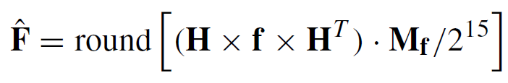
12.1.3 Quantization and Scaling
Let f be the 4 × 4 input matrix, and the transformed and then quantized output. The forward integer transform, scaling and quantization are
Mf is the 4 × 4 quantization matrix derived from 6×3 matrix m and quantization parameter QP .

Slide 16

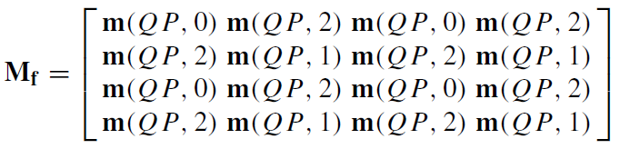



12.1.3 Quantization and Scaling (Cont’d)
•
when ,, each element is
replaced by .

Slide 17
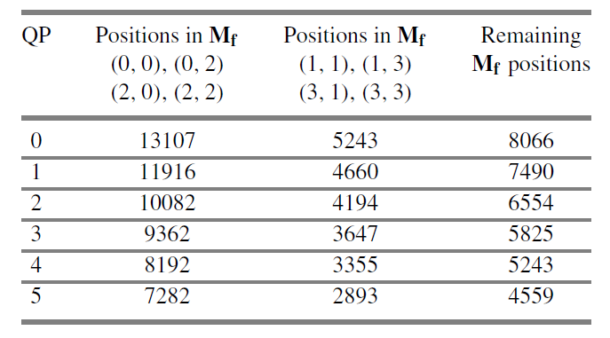
12.1.3 Quantization and Scaling (Cont’d)

Slide 18


12.1.3 Quantization and Scaling (Cont’d)
Let be the de-quantized and then inversely transformed result. The scaling, de-quantization, and inverse integer transform are
Vi is the 4 × 4 de-quantization matrix derived from 6 × 3 matrix v and quantization parameter QP .

Slide 19
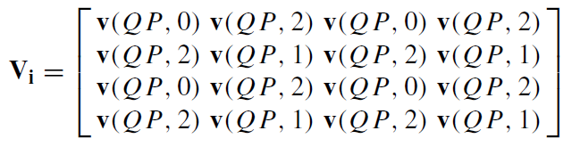


12.1.3 Quantization and Scaling (Cont’d)
•
, each element is replaced
by .

Slide 20
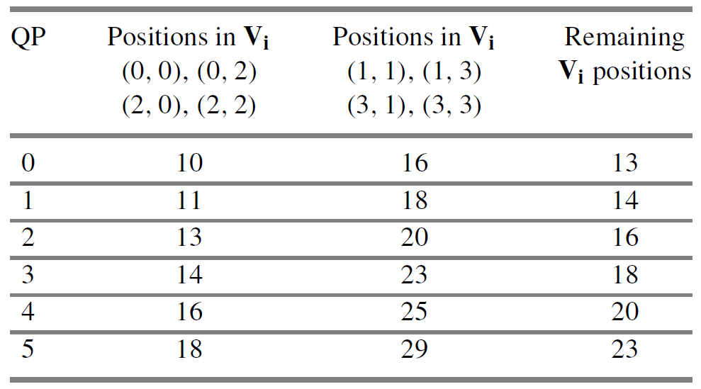
12.1.3 Quantization and Scaling (Cont’d)

Slide 21
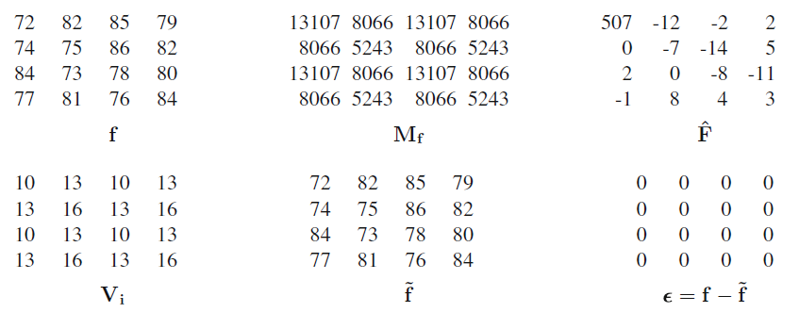
12.1.4 H.264 Examples
(a) QP = 0, no scale-down of F values in the quantization step, so no reconstruction error.

Slide 22
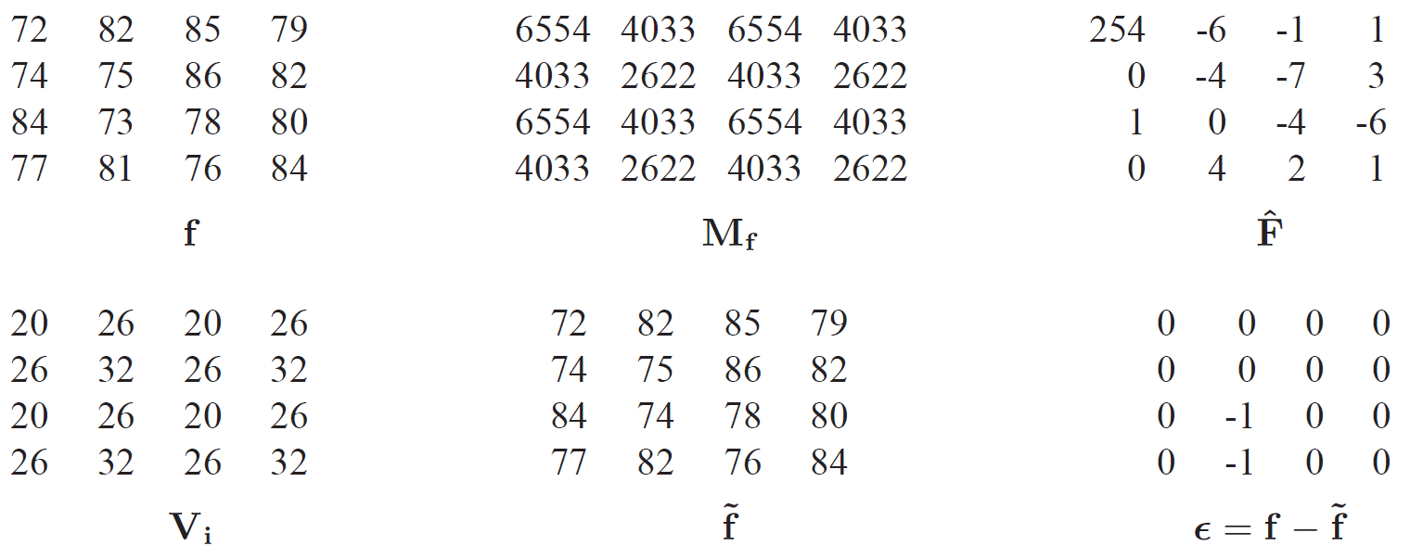
12.1.4 H.264 Examples (Cont’d)
(b) QP = 6. Compared to for QP = 0, Mf are reduced in half, Vi are about twice. The quantization factor is now approximately 1.25. Slight error.

Slide 23
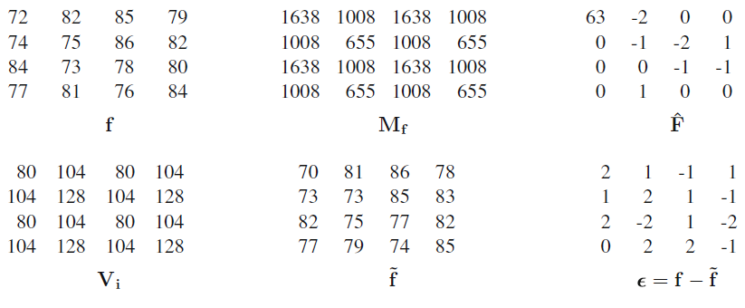
12.1.4 H.264 Examples (Cont’d)
(c) QP = 18, quantization factor is approximately 5, larger errors.

Slide 24
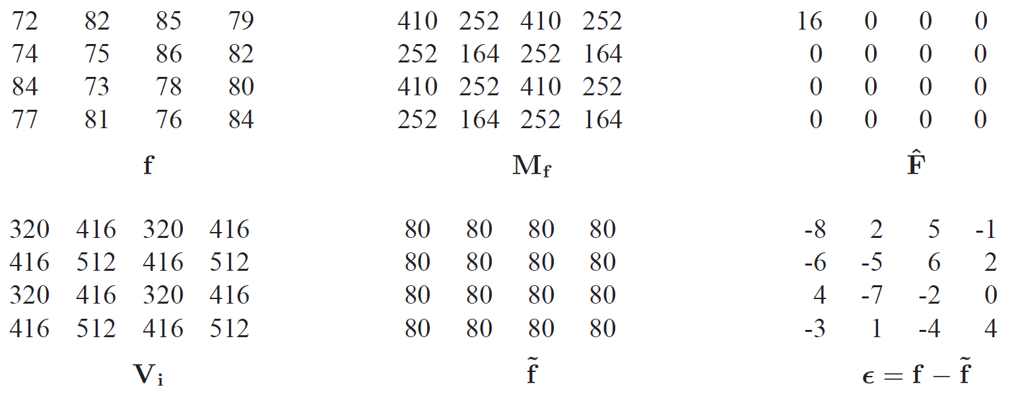
12.1.4 H.264 Examples (Cont’d)
(d) QP = 30, quantization factor is approximately 20, all AC coefficients become zero, very large errors, unacceptable!

Slide 25
12.1.5 Intra coding
Intra-coded macroblocks are predicted using some of the neighboring reconstructed pixels.
Different intra prediction block sizes (4 × 4 or 16 × 16) can be chosen.
Nine prediction modes for the 4 × 4 blocks
Four prediction modes for the 16 × 16 blocks.

Slide 26
12.1.5 Intra coding (Cont’d)
For each prediction mode, the predicted value and the actual value will be compared to produce the prediction error.
The mode that produces the least prediction error will be chosen as the prediction mode for the block.
The prediction errors (residuals) are then sent to transform coding where the 4 × 4 integer transform is employed.

Slide 27
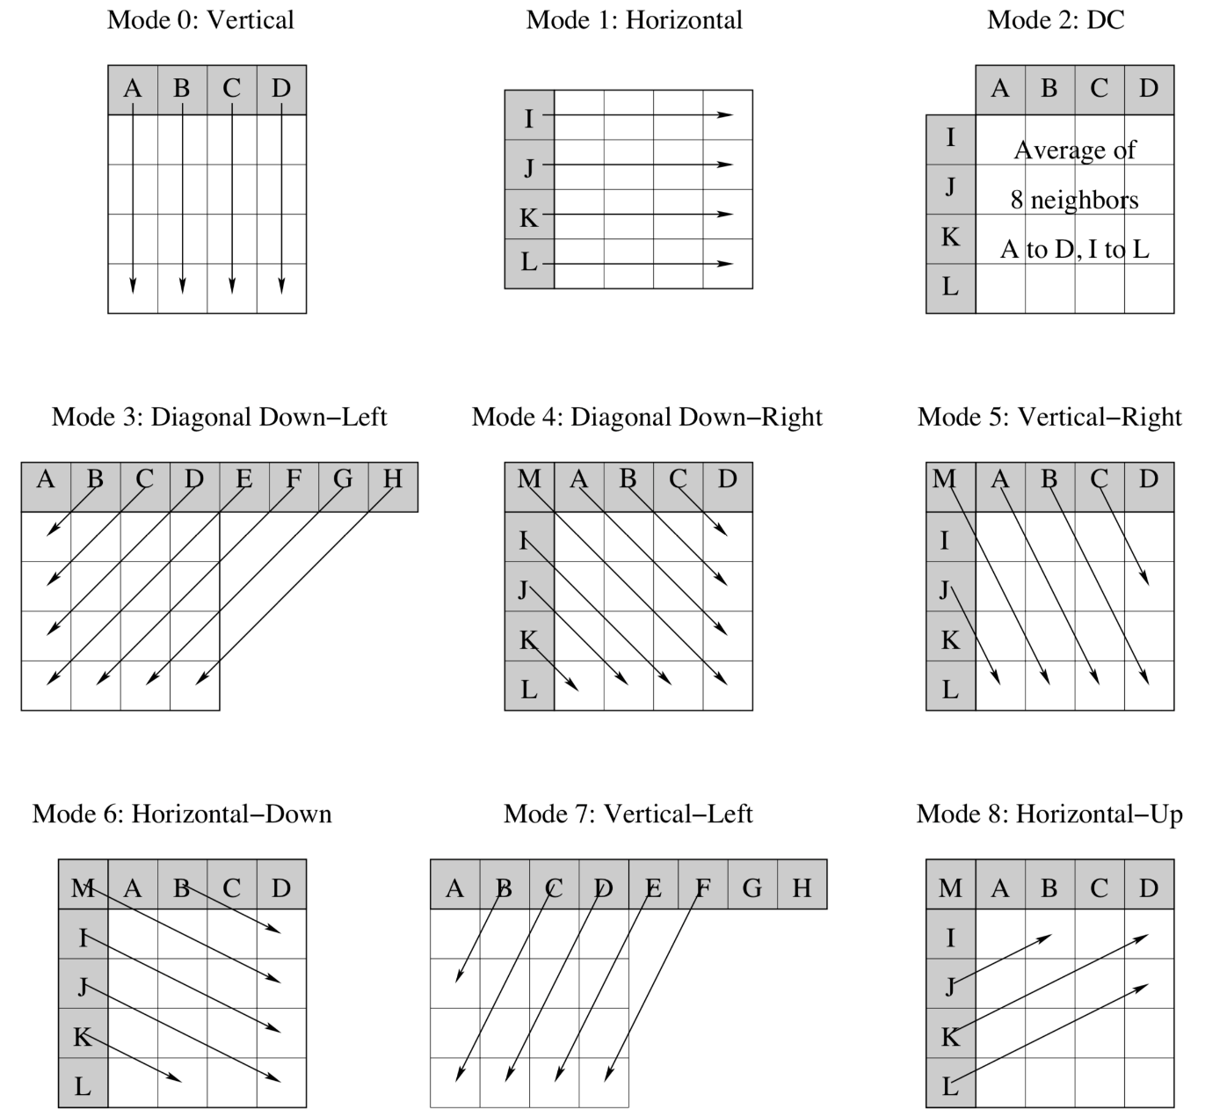
Fig. 12.7: The nine intra_4 × 4 prediction modes in H.264 intra frame prediction.

Slide 28
12.1.6 In-Loop Deblocking Filtering
H.264 specifies a signal-adaptive deblocking filter in which a set of filters is applied on the 4 × 4 block edges.
The deblocking filtering takes place in the loop, after the inverse transform in the encoder, before the decoded block data are fed to Motion Estimation.

Slide 29
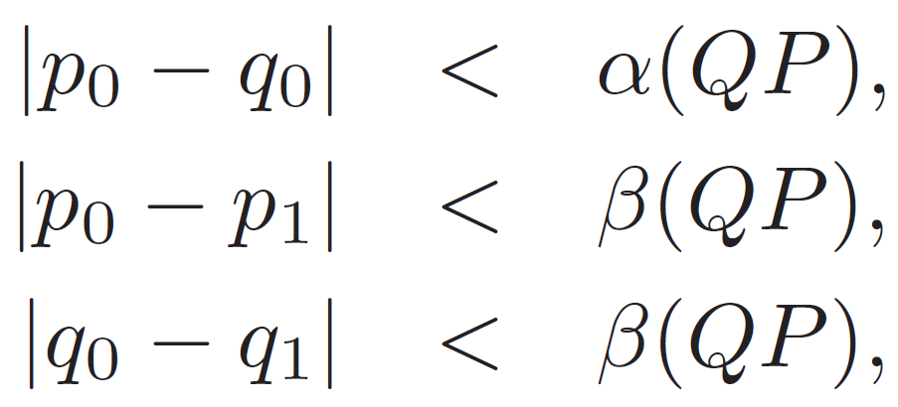
In-Loop Deblocking Filtering (Cont’d)
To protect real edges across the block boundary, the deblocking filtering on p0 and q0 will be applied only if all the following criteria are met:
where α and β are thresholds.

Slide 30
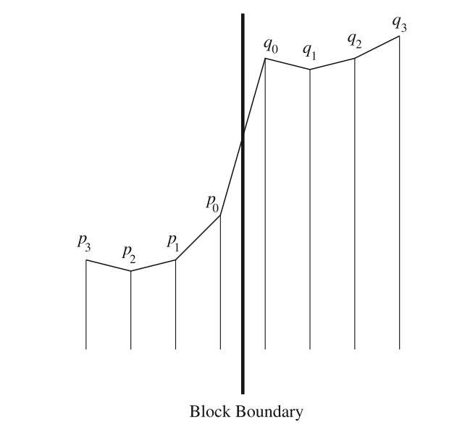
Fig. 12.8: The height for the pixels p0, q0, etc. indicates their value. The function of deblocking filtering is basically smoothing of the block edges.

Slide 31


12.1.7 Exp-Golomb code
The simplest Exp-Golomb code (0th order) consists of three parts: [Prefix] [1] [Suffix]
The prefix is a sequence of l zeros. Given an unsigned (positive) number N to be coded, The suffix S is the binary number in l bits.
The unsigned numbers are used to indicate, e.g., macroblock type, reference frame index. For signed numbers, they will simply be squeezed in to produce a new set of table entries (Table 12.3).

Slide 32
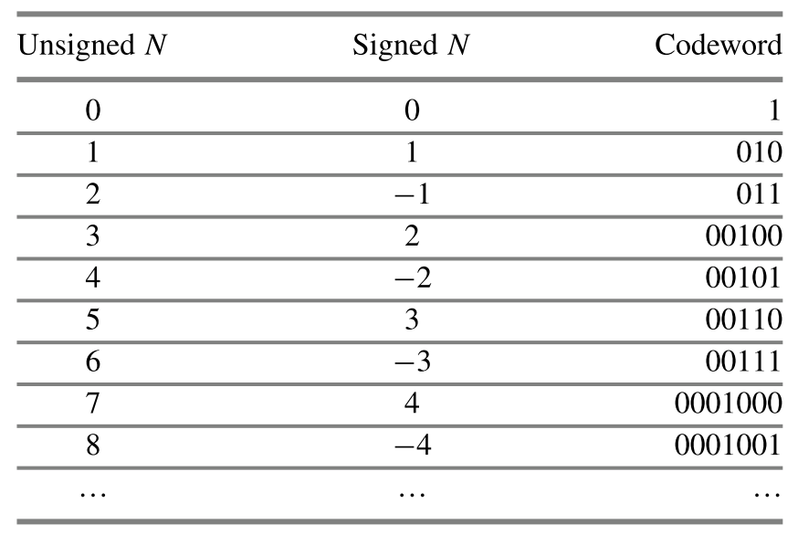
Table 12.3: The 0th order Exp-Golomb codewords

Slide 33


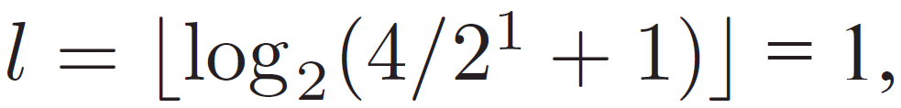
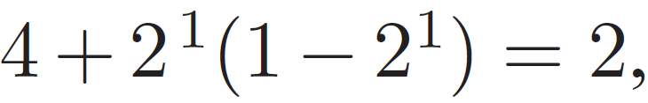
Exp-Golomb code (Cont’d)
The kth order Exp-Golomb encoding consists of three parts: [Prefix] [1] [Suffix]
The prefix is a sequence of l zeros. Given an unsigned (positive) number N to be coded, . The suffix S is the binary
number in l+k bits.
For example, the EG1 code for N = 4 is 0110. It is because the prefix is 0; the suffix is the binary representation of
in l+k = 1+1 = 2 bits, it is 10.

Slide 34
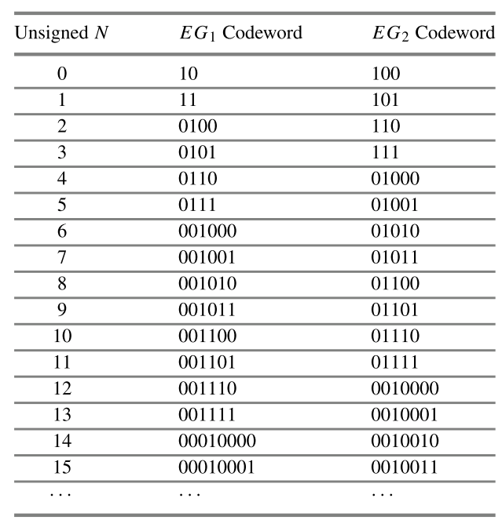
Table 12.4: First- and second-order Exp-Golomb codewords

Slide 35
12.1.8 CAVLC
In CAVLC (Context-Adaptive Variable Length Coding), multiple VLC tables are predefined for each data type, and predefined rules predict the optimal VLC table based on the context.
CAVLC checks several parameters from the block data, including total number of nonzero coefficients, number of trailing ± 1s, signs of the Trailing 1s, sign of magnitude of the other zero coefficients, … and then generate the coding result.

Slide 36
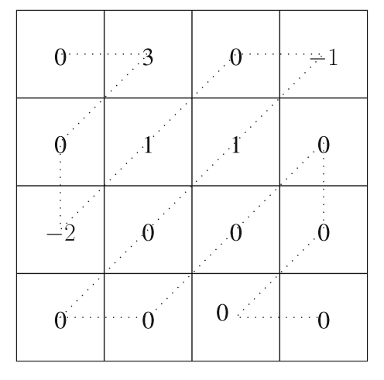
After the zigzag scan, the 1-D sequence is:
0 3 0 −2 1 0 −1 1 0 0 0 0 0 0 0 0.
The resulting CAVLC is
0000100 0 1 0 0001 001 0 111 11 10 1 01
following the procedure in Table 12.5.

Slide 37
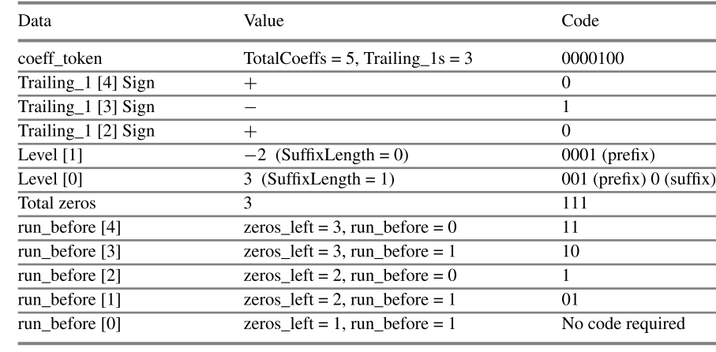
Table 12.5: CAVLC code generation process

Slide 38
12.1.9 CABAC
For better coding efficiency in H.264 Main and High profiles, Context-Adaptive Binary Arithmetic Coding (CABAC) is used for some data and quantized residual coefficients.
CABAC has three components, binarization, context modeling, and binary arithmetic coding.
The implementation of CABAC has a tremendous amount of details. Referred to Marpe’s CSVT 03 paper for detailed discussions.
Notes:
D. Marpe, H. Schwarz, T. Wiegand, Context-based adaptive binary arithmetic coding in the H.264/AVC video compression standard. IEEE Trans. Circ. Syst. Video Technol. 13(7), 620–636 (2003)

Slide 39
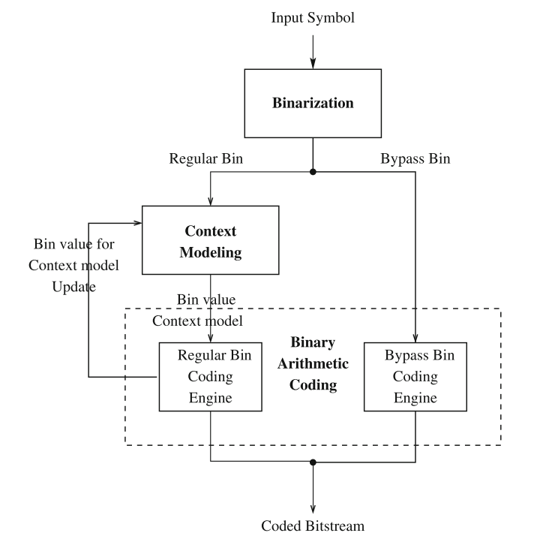
Fig. 12.10: Block diagram of CABAC in H.264

Slide 40
12.1.10 H.264 profiles
Four profiles for different applications.
Baseline Profile for real-time conversational applications, e.g., teleconference.
Arbitrary slice order (ASO). The decoding order of slices within a picture may not follow monotonic increasing order.
Flexible macroblock order (FMO). Macroblocks can be decoded in any order.
Redundant slices. Redundant copies of the slices can be decoded, to further improve error resilience.

Slide 41
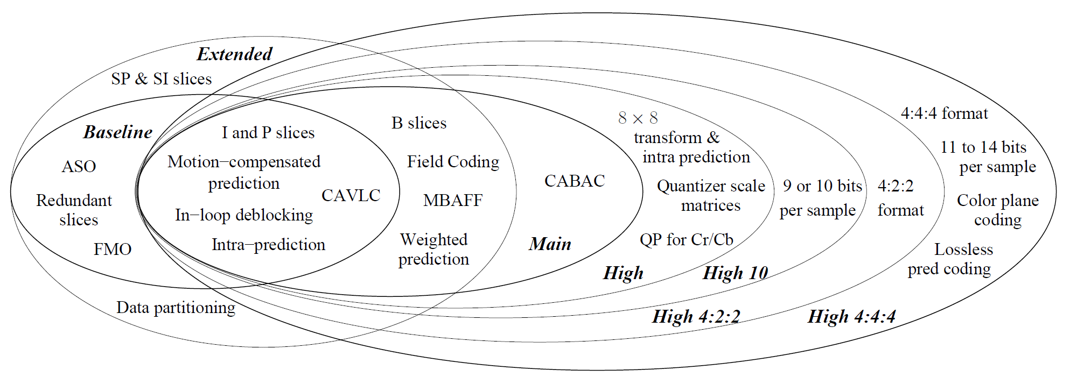
Fig. 12.11: H.264 profiles

Slide 42
12.1.10 H.264 profiles (Cont’d)
The main profile defined represents non-low-delay applications such as standard definition (SD) digital broadcast TV and stored-medium.
B slices. Bi-predicted pictures as reference frames
CABAC. replaces VLC-based entropy coding with binary arithmetic coding with a different adaptive model
Weighted Prediction. Global weights (multiplier and an offset) for modifying the motion-compensated prediction samples can be specified
Extended profile and high profile

Slide 43
12.1.11 H.264 Scalable Video Coding
The Scalable Video Coding (SVC) provides the bit stream scalability which is especially important for multimedia data transmission through various networks that may have very different bandwidths.
H.264/AVC SVC provides temporal scalability, spatial scalability, quality scalability, and their possible combinations. Compared to previous standards, the coding efficiency is greatly improved.

Slide 44
12.1.12 H.264 Multi-view Video Coding
Multi-view Video Coding (MVC) is an emerging issue. It has potential applications in some new areas such as Free Viewpoint Video (FVV) where users can specify their preferred views.
The two most important features in MVC is the interview prediction, and Hierarchical B Pictures.

Slide 45
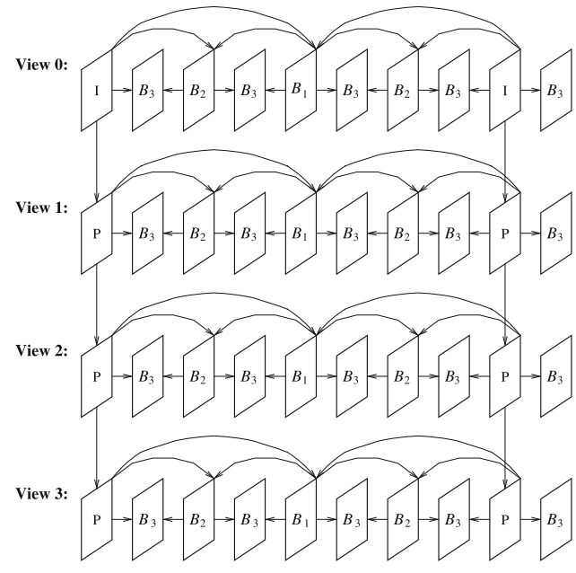
Fig. 12.12: H.264 MVC prediction structure

Slide 46
12.2 Overview of H.265
HEVC (High Efficiency Video Coding) C became MPEG-H Part 2 (ISO/IEC 23008-2). It is also known as ITU-T Recommendation H.265.
The development of this new standard was largely motivated by two factors: (a) The need to further improve coding efficiency due to ever increasing video resolution. (b) The need to speed up the more complex coding/decoding methods by exploiting the increasingly available parallel processing devices and algorithms.

Slide 47
12.1 Overview of H.265 (Cont’d)
Main features of H.265 are:
Variable block-size motion compensation, from 4 × 4 up to 64 × 64 in luma images implemented by a quadtree
Exploration of parallel processing.
Integer transform in various sizes, from 4 × 4 to 32 × 32.
Improved interpolation methods for the quarter-pixel
Expanded directional spatial prediction for intra coding.
The potential use of DST in luma intra coding.
In-loop filters including deblocking-filtering and SAO
Only CABAC

Slide 48
12.2.1 Motion compensation
H.265 does not use the simple and fixed structure of macroblocks. Instead, a quadtree hierarchy of various blocks is introduced for its efficiency
CTB and CTU (Coding Tree Block and Coding Tree Unit). LumaCTB: N×N, N = 16, 32, 64. Chroma CTB is N/2 × N/2. A CTU consists of 1 luma CTB and 2 chroma CTBs.
CB (Coding block) is a square block that can be as small as 8 × 8 in luma and 4 × 4 in chroma images. CBs in CTB are coded in Z-order. One luma CB and two chroma CBs form a CU.

Slide 49
12.2.1 Motion compensation (Cont’d)
Quadtree hierarchy (Cont’d)
PB and PU (Prediction Block and Prediction Unit): A CB can be further split into PBs for the purpose of prediction. The prediction mode for a CU can be intra-picture (spatial) or inter-picture (temporal). The PU contains the luma and chroma PBs and their prediction syntax.
TB and TU (Transform Block and Transform Unit): A CB can be further split into TBs for the purpose of transform coding of residual errors. A TU consists of TBs from luma and chroma images.

Slide 50
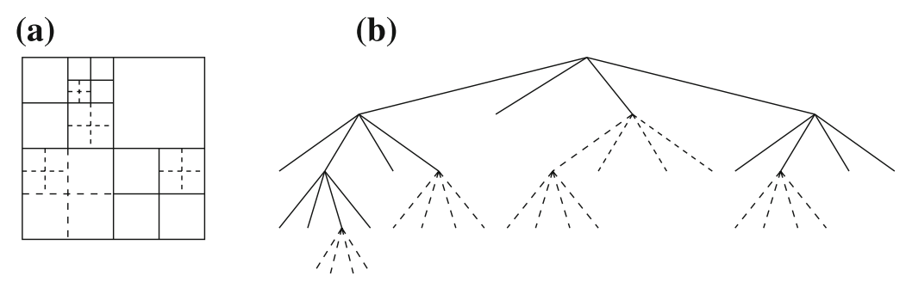
Fig. 12.13: Partitioning of a CTB. (a) The CTB and its partitioning (solid lines CB boundaries, dotted line TB boundaries). (b) The corresponding quadtree, the original CTB is 64 × 64 and the smallest TB is 4 × 4.

Slide 51
Slices and Tiles
H.265 supports Slices of any length consisting of a sequence of CTUs, I-slices, P-slices, or B-slices.
A tile is a rectangular structure consisting of CTUs.
An additional feature is the inclusion of the Wavefront Parallel Processing (WPP) technology. Basically, rows of CTUs can be processed in parallel, in multiple threads in the wavefront.

Slide 52
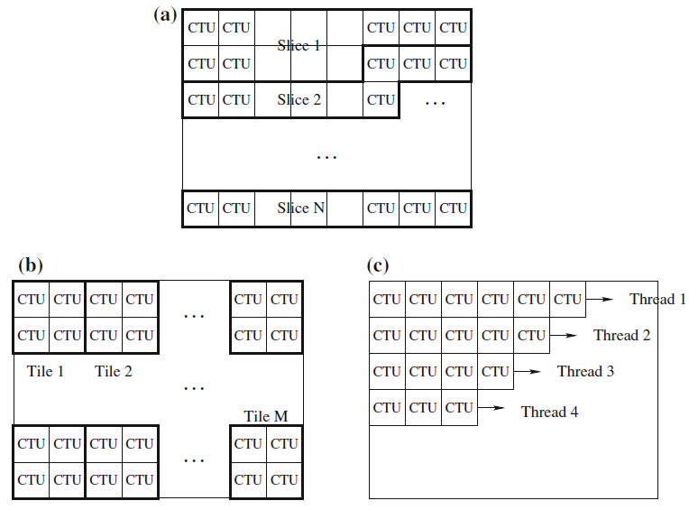
Fig. 12.14: (a) Slices, (b) Tiles, (c) Wavefronts

Slide 53
Quarter-Pixel in Luma Images
In inter-picture prediction for luma images, the precision for motion vectors is again at quarter-pixel as in H.264. interpolations.
An eight-tap filter hfilter is used for half-pixel positions and a seven-tap filter qfilter is used for quarter-pixel positions.
All values at subpixel positions are derived through separable filtering steps vertically and horizontally, then averaging to obtain the values at quarter-pixel positions

Slide 54
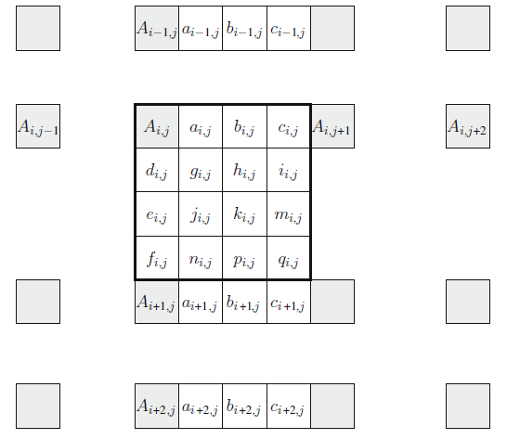
Fig. 12.15: Interpolation for fractional samples in H.265.

Slide 55
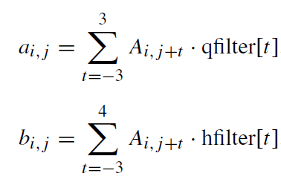
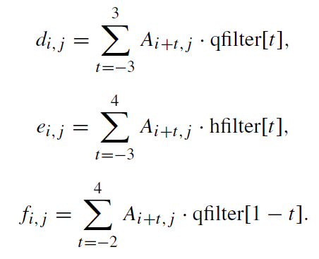
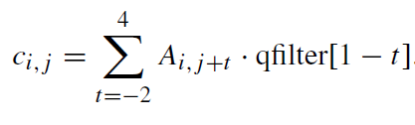
Quarter-Pixel Interpolation
The value of a, b, c, d, e, f could be derived by

Slide 56
Quarter-Pixel Interpolation (Cont’d)
The eight-tap hfilter is symmetric, so it works well for the half-pixel positions which are in the middle of pixels that are on the image grid.
The seven-tap qfilter is asymmetric, well-suited for the quarter-pixel positions not in the middle.
The other subpixel samples can be obtained from the vertically nearby a, b, or c pixels as below. To enable 16-bit operations, a right shift of six bits is introduced.

Slide 57
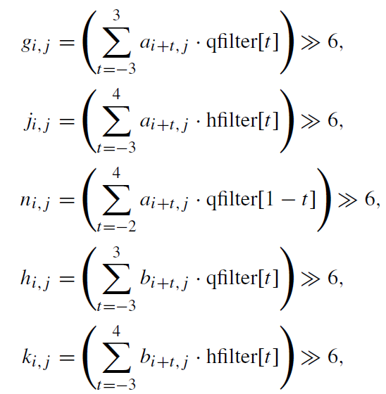
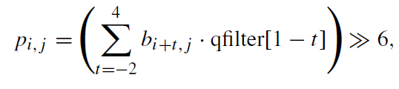
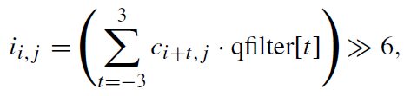
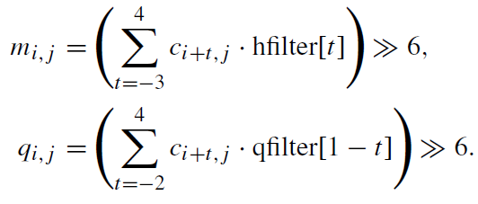
Quarter-Pixel Interpolation (Cont’d)

Slide 58

12.2.2 Integer transform
As in H.264, transform coding is applied to the prediction error residuals.
The 2-D transform is accomplished by applying a 1-D transform in the vertical and then horizontal direction, where f is the input residual data and F is the transformed data. H is the Integer Transform matrix that approximates the DCT-matrix.
Transform block sizes of 4 × 4, 8× 8, 16 × 16, and 32 × 32 are supported.

Slide 59
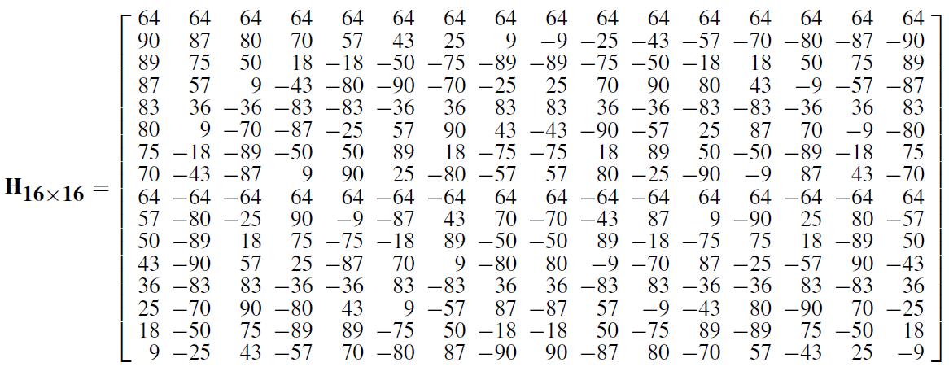
12.2.2 Integer transform (Cont’d)
For example, H_{8x8} can be obtained by using the first 8 entries of Rows 0, 2, 4, 6, ... of H_{16x16}. For H_{4×4}, use the first 4 entries of Rows 0, 4, 8, and 12.

Slide 60
12.2.3 Quantization and Scaling
Unlike the H matrix in H.264, the numbers in the H.265 integer transform matrices, are proportionally very close to the actual values of the DCT basis functions. Hence, the ad hoc scaling factors are no longer needed.
For quantization, the quantization matrix and the same parameter QP as in H.264 are employed. The range of QP is [0, 51]. Similarly, the quantization step size doubles when the QP value is increased by 6.

Slide 61
12.2.4 Intra Coding
As in H.264, spatial predictions are used in intra coding in H.265. The neighboring boundary samples from the blocks at the top and/or left of the current block are used for the predictions.
The transform block ranges from 4×4 to 32×32.
The possible number of prediction modes is increased from 9 in H.264 to 35 in H.265 because of (a) the potentially larger TB size, and (b) the effort to reduce prediction errors.

Slide 62
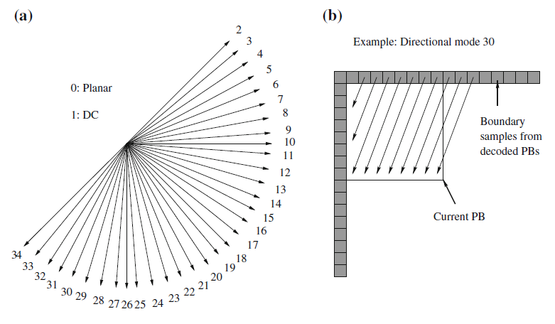
Fig. 12.16: H.265 intra prediction. a Modes and intra prediction directions, b Intra prediction for an 8 × 8 block.

Slide 63
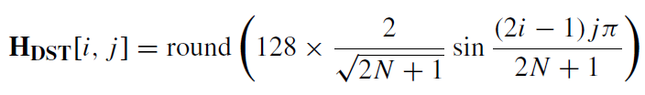
12.2.5 Discrete Sine Transform
In Intra_4 × 4, for luma residual blocks, HEVC introduced an alternative transform based on one of the variants of the Discrete Sine Transform (DST) (the so-called DST-VII). DST is found to cope with this situation better than DCT at the transform coding step.
The integer matrix for DST can be described by,
where i and j are indices of row and column.

Slide 64
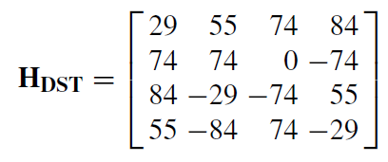
12.2.5 Discrete Sine Transform (Cont’d)
If N = 4, the H_{DST} is
Category 1: the samples for prediction are either all from the left neighbors, or all from the top neighbors of the block.
Category 2: the samples for prediction are from both the top and left neighbors of the current block.
DC: a special prediction mode in which the average of a fixed set of neighboring samples is used.

Slide 65
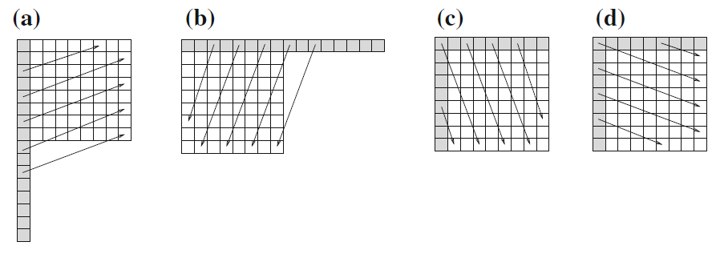
Fig. 12.17: Intra prediction directions in H.265.
and (b): Category 1 – from left or top only,
(c) and (d): Category 2 – from both left and top.

Slide 66
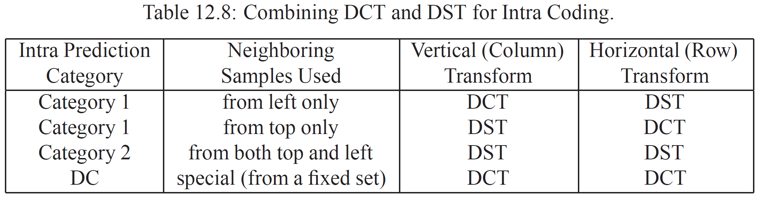
The prediction error tends to increase for the nodes in the block that are farther away from the top or left neighboring samples.
In general, DST is better than DCT for this.
The following could be adopted to alleviate this problem.

Slide 67
12.2.6 In-Loop Filtering
Similar to H.264, in-loop filtering processes are applied in order to remove the blocky artifacts.
Instead of applying deblocking filtering to 4×4 blocks as in H.264, it is applied only to edges that are on the 8×8 image grid in H. 265.
A Sample Adaptive Offset (SAO) process is introduced.

Slide 68
12.2.6 In-Loop Filtering (Cont’d)
Two modes are defined for applying the SAO: Band offset mode and Edge offset mode.
In the band offset mode, the range of the sample amplitudes is split into 32 bands. A band offset can be added to the sample values in four of the consecutive bands simultaneously.
In the Edge Offset Mode, the gradient (edge) information is analyzed first. A positive or negative offset, or zero offset can be added to the sample.

Slide 69
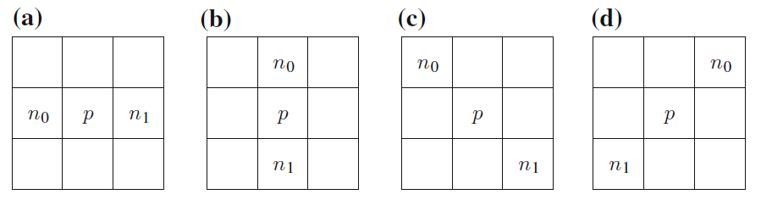
12.2.6 In-Loop Filtering (Cont’d)
Positive: local minimum (p < n₀ & p < n₁), or edge pixel (p < n₀ & p = n₁ or p = n₀ & p < n₁).
Negative: local maximum (p > n₀ & p > n₁), or edge pixel (p > n₀ & p = n₁ or p = n₀ & p > n₁).
Zero: None of the above.

Slide 70
12.2.7 Entropy Coding
H.265 only uses CABAC in entropy coding, i.e., CAVLC is no longer used.
Three simple scanning methods are defined to read in the transform coefficients. i.e., Diagonal up-right, Horizontal, and Vertical.
The goal is still to maximize the length of zero-runs. For different TB size, the scanning method is different.

Slide 71
12.2.8 Special Coding Modes
I_PCM As in H.264, the prediction, transform coding, quantization, and entropy coding steps are bypassed. The PCM-coded (fixed-length) samples are sent directly.
Lossless The residual errors from inter- or intra-predictions are sent to entropy coding directly.
Transform skipping Only the transform step is bypassed. This works for certain data (e.g., computer-generated images or graphics). It can only be applied to 4×4 TBs.

Slide 72
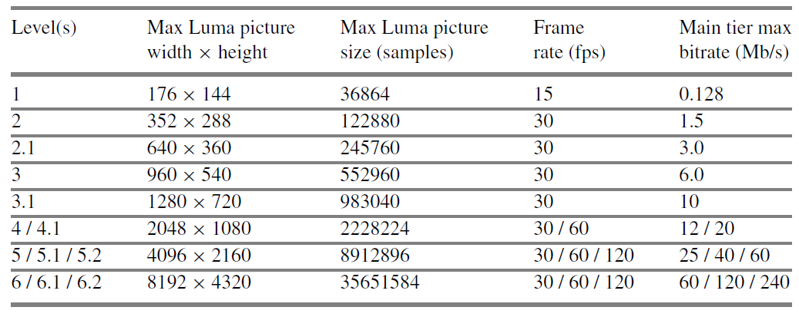
12.2.9 H.265 profiles
At this point, only three profiles are defined: Main profile, Main 10 profile, and Main Still Picture profile. The sample video formats supported by H.265 main profile is illustrated.

Slide 73
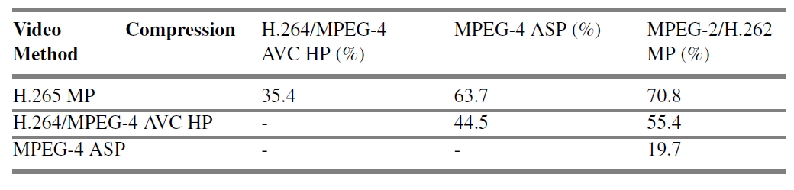
Table 12.10: Average bitrate reductions under equal PSNR. MP—Main Profile, HP—High Profile, ASP—Advanced Simple Profile. For example, when H.265 MP is compared with H.264/MPEG-4 AVC HP, a saving of 35.4% is realized.

Slide 74
12.2.10 H.265 Extensions
Initially (in Version 2 HEVC), the extensions included Range Extensions (RExt), Scalable HEVC (SHVC) and Screen Content Coding (SCC).
Later, the Joint Collaborative Team on 3D Video Coding Extension Development (JCT-3V) was established to work on Multiview and 3D Video Coding Extensions (MV-HEVC and 3D-HEVC, respectively).
Version 3 of HEVC including all the above extensions was finalized in February 2015.

Slide 75
Range Extensions
The main objective is the support for 4:2:2 and 4:4:4 chroma formats and bit depth of more than 10 bits (e.g., 12 or 16 bits) per sample.
Coding of screen content, direct coding of R’G’B’ source material, and coding of auxiliary pictures, e.g., alpha planes, depth maps, and lossless video coding.
The implementation of the range extensions is mostly realized by enhanced coding algorithms and tools, although in many case, it also demands higher dynamic range of the processing elements.

Slide 76
Scalability Extensions
In addition to the temporal scalability which was already supported by Version 1 of HEVC, SHVC supports spatial scalability, SNR (signal-to-noise ratio) scalability, as well as bit depth scalability and color gamut scalability needed for UHD video where higher bit depth and wider color gamut are employed.
SHVC employs a multi-loop coding framework in which reference layers must be fully decoded first so that they can be used as prediction references.

Slide 77
Multiview and 3D Video Extensions
The multiview extension (MV-HEVC) enables efficient coding of multiple camera views and associated auxiliary pictures.
The 3D extension (3D-HEVC) is designed for videos consisting of multiple views and associated depth maps. It also supports the generation of additional intermediate views in advanced 3D displays.
The technique of Depth-Image-Based Rendering (DIBR) is often employed to generate these images.

Slide 78
12.3 Overview of H.266
The new standard will be suitable for SDR, HDR, 360◦ video, and other new video formats e.g., panoramic, hence the name Versatile Video Coding (VVC), aka. MPEG-I Part 3, or H.266.
H.266 supports up to 16K UHD videos, YCbCr 4:4:4, 4:2:2, 4:2:0 with 10 to 16 bits for each sample. It supports HDR of more than 16 stops (with peak brightness up to 10,000 nits) and BT.2100 wide color gamut, auxiliary channels for depth, transparency, etc.
It is aimed to achieve about 50% more compression than H.265 for the same perceptual quality.

Slide 79
12.3.1 Motion Compensation
As in H.264 and H.265, H.266 employs the block-based hybrid coding scheme that supports motion compensation and transform coding.
In H.264 and H.265 the precision for Motion Vectors is one-quarter pixel for luma images. In H.266, it has been increased to up to 1/16 pixel for luma images.
As shown in Fig. 12.19, Block Partitions allow Multi-Type Tree (MTT), Asymmetric Binary Tree (ABT), Generalized Binary Tree with Shifts (GBS), and Non-Rectangular Partitions.

Slide 80

Fig. 12.19 H.266 Block Partitioning

Slide 81
12.3.2 Adaptive Multiple Transforms
Discrete Sine transform (DST-VII) was introduced in H.265 for prediction residual errors in Intra coding, because the Sine basis function can fit to the pattern of the errors better.
The transforms in Table 12.11 are found to be beneficial for different modes in H.266 Intra coding.
These are some of the 16 variants of DCT (DCT Type I to VIII) and DST (DST Type I to VIII) with different symmetry of their symmetric-periodic sequences.

Slide 82

Table 12.11 Basis Functions for Certain Types of DCT and DST Transforms

Slide 83

Table 12.12 Predefined Transform Sets
for H.266 Intra Coding
The above three predefined Transform Sets are recommended for H.266 Intra Coding.

Slide 84
Transform Sets for Intra Prediction
H.266 supports 67 angular modes in Intra prediction, i.e., Planar (Mode 0), DC (Mode 1), plus 65 directional angular modes, basically doubling the number (hence the precision) of the modes in H.265.
Table 12.13 lists the transform sets that should be considered for the two consecutive 1D transforms applied vertically (V) and horizontally (H).

Slide 85

Table 12.13 Selected Transform Sets for Each Intra Prediction Mode in H.266
For each of the V and H transforms, the encoder should try both of the transforms in the set, and the one that is better in dealing with the residual errors will be adopted.

Slide 86
12.3.3 Non-Separable Secondary Transform
For complex texture patterns, arbitrary edge directions in the image, Non-Separable Secondary Transforms (NSST) may provide a better fit to their prediction residual errors.
To limit the complexity, NSST will only be applied to the frequency coefficients after the primary separable transforms (DCT/DST).
The Mode Dependent NSST (MD-NSST) will only be applied to the low frequency coefficients after the primary transform.

Slide 87


Let X be the coefficient block after the primary transform,
Example: the implementation of NSST on a 4 × 4 block:
(12.19)
It is turned into a 1D vector:
(12.20)

Slide 88


Then a 16 × 16 transform matrix T is used to calculate the NSST,
(12.21)
The 1D NSST coefficient vector $\vec{F}$ can be reorganized as another 4 × 4 block following the coefficient scanning order applied on the block for entropy coding.
In the JEM, 35 × 3 transforms Ts for MD-NSST are predefined for both 4 × 4 and 8 × 8 NSST, where 3 is the number of NSST candidates for each intra prediction mode.

Slide 89


To reduce the complexity, a reduced transform (RT) is realized by an R × N matrix, where R < N. For a 4 × 4 block, N = 16.
(12.22)
(12.23)
The ratio of N/R is the reduction factor. T_{RT} basically provides the first R bases of the N dimensional space.

Slide 90
12.3.4 In-loop Filtering
The JEM proposes four in-loop filters and they are applied sequentially. (a) Bilateral filter, (b) Deblocking filter, (c) Sample Adaptive Offset (SAO) filter, and (d) Adaptive Loop Filter (ALF).
Filters (b) and (c) are basically the same as in H.265, although stronger deblocking filters with longer taps are proposed as responses for call for proposal after the JEM.

Slide 91


Bilateral Filter
Applied to all luma blocks, four neighboring (top, bottom, right, left) samples are used to filter the current sample.
The weight w(i, j, k, l) that determines the amount of filtering by the neighboring sample at (k, l) is:
(12.24)
where R(i, j) and R(k, j) are the original reconstructed intensity values at (i, j) and (k, l), respectively, the two are the spatial and range parameters.
$$σ^{′}s$$

Slide 92
Adaptive Loop Filter (ALF) is applied after SAO. The horizontal and vertical gradients of each block are derived first and used to determine the direction D of the block. The blocks are then classified into 15 categories based on D and the 2D-Laplacian activity so that different sets of filter coefficients can be applied for ALF filtering.
Convolutional Neural Network (CNN) Loop Filters: reported good improvements, ranging from approximately−3% to −7% BD-rates over the JEM target for luma and chroma images.
Nevertheless, the development of CNN-based methods for video coding is still in its early stage.

Slide 93
12.3.5 Tools for HDR (High Dynamic Range) Video
The coding tools are of three types:
Encoder-only Adaptations: e.g., lumaDQP below.
Out-of-loop Sample Mapping: pre-processing steps before the signals are sent to the encoder, and post-processing steps after the signals are recovered by the decoder.
- : cannot be readily adapted to slice or block level.
In-loop Sample Mapping: realized in the motion compensation loop in the encoder and decoder, e.g., In-loop Luma Reshaper below.

Slide 94
Luma-Dependent Quantization Scheme (lumaDQP)
HDR videos adopt the Perceptual Quantization (PQ) in which many bits are redistributed from the bright areas of a video frame to the dark areas.
However, PQ can introduce more undesirable artifacts in bright areas in the compressed video.
Adjustment of quantization steps depending on the luminance of the HDR content at the CTU level in order to shift the bits (back) from the dark areas to the bright areas.
The original QP can be adaptively modified ― subtracted by dQP.

Slide 95
In-loop Luma Reshaper
In general, the quantizer (e.g., PQ for HDR) is designed to cover the full range of the video signals (e.g., from 0 to 10,000 nits). Due to large variations of actual scenes, the intent of the person who creates the video, and the limit of the display device, a large portion of the full range may be unused.
For better coding efficiency, a reshaper can be introduced to modify or re-quantize the signal.
In its implementation, a pair of Look Up Tables (LUTs) are employed, i.e., Forward LUT in encoding and Inverse LUT in decoding.

Slide 96

In-loop Luma Reshaper (cont’d)
The Forward LUT (FwdLUT) can be obtained by the following steps:

Slide 97

12.3.6 Tools for 360◦ Video
Hybrid Angular Cubemap Projection (HAC):
Further reduce the non-uniform sampling, especially towards the edges on each face of the CMP (Cubemap Projection) cube.
The forward mapping functions from CMP to HAC are defined as:
(12.26)
(12.27)

Slide 98
Adaptive Frame Packing (APF):
In frame packing the six projection images from the six faces of the CMP cube are packed into a 2D rectangular picture. No matter how one arranges the six images, there will be discontinuities at the boundaries between some faces, hence the “face seam” artifacts.
With APF, the six face images can be “shuffled” and/or yaw-rotated by 0◦, 90◦, 180◦, and 270◦ to dynamically create the needed continuity between frame-packed faces during the motion estimation.
Geometry Padding:
The content of the spherical neighbors is utilized for padding to provide more continuous and usable samples for areas outside of the face boundaries in motion estimation.

Slide 99
12.3.7 H.266 Performance Report
BD-rate (short for Bjontegaard’s delta-rate) is again employed to measure the performance of the proposed H.266 compression methods.
Due to the substantial difference between SDR and HDR content (gray-level and color) distributions, several new evaluation metrics are introduced for the HDR performance measurement: (a) wPSNR (weighted PSNR) in which larger weights are given to brighter areas than darker areas in the image, (b) PSNR-L100, and (c) DE100. Both PSNR-L100 and DE100 are derived from DE2000 that has been used in measuring color difference in the CIELAB color space.

Slide 100


Table 1.14: H.266 BD-Rates for the SDR-A (Random Access) Category
Table 12.15: H.266 BD-Rates for the SDR-B (Low Delay) Category

Slide 101

Table 12.16: H.266 BD-Rates for the HDR-B (PQ) Category
Table 12.17: H.266 BD-Rates for the 360◦ Video Category

