Slide 1
Chapter 13 Basic Audio Compression Techniques
13.1 ADPCM in Speech Coding
13.2 Vocoders
13.3 Open Source Speech Codecs

Slide 2
13.1 ADPCM in Speech Coding
ADPCM forms the heart of the ITU’s speech compression standards G.721, G.723, G.726, G.727, G.728, and G.729.
The difference between these standards involves the bitrate and some algorithm details.
The default input is μ-law coded PCM 16-bit samples.

Slide 3
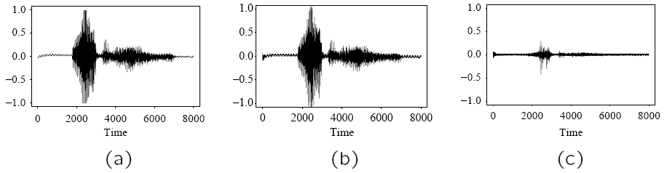
Fig. 13.1: Waveform of Word “Audio”: (a) Speech sample, linear PCM at 8 kHz/16 bits per sample. (b) Speech sample, restored from G.721-compressed audio at 4 bits/sample. (c) Difference signal between (a) and (b).

Slide 4
13.1.2 G.726 ADPCM, G.727-9
ITU G.726 provides another version of G.711, including companding, at a lower bitrate. G.726 can encode 13- or 14-bit PCM samples or 8-bit μ-law or A-law encoded data into 2-, 3-, 4-, or 5-bit codewords.
Rationale: works by adapting a fixed quantizer in a simple way. The different sizes of codewords used amount to bit-rates of 16 kbps, 24 kbps, 32 kbps, or 40 kbps, at 8 kHz sampling rate.

Slide 5
The standard defines a multiplier constant α that will change for every difference value, e_{n}, depending on the current scale of signals. Define a scaled difference signal g_{n} as follows:
(13.1)
ŝ_{n} is the predicted signal value. g_{n} is then sent to the quantizer for quantization.

Slide 6
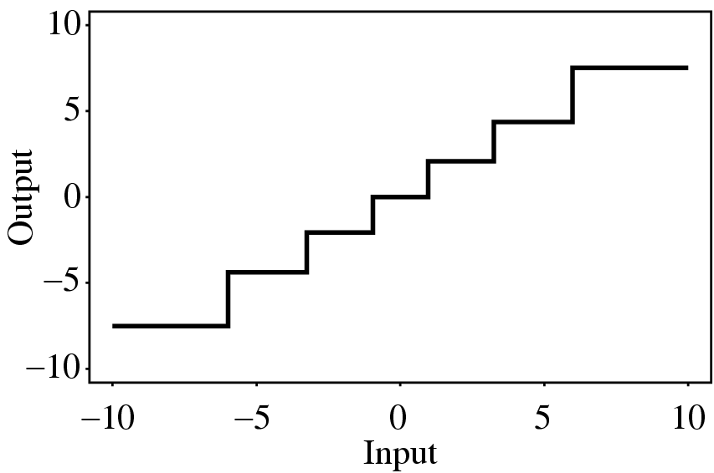
Fig. 13.2: G.726 Quantizer
The input value is a ratio of a difference with the factor α.
By changing α, the quantizer can adapt to change in the range of the difference signal — a backward adaptive quantizer.

Slide 7
Backward Adaptive Quantizer
Backward adaptive works in principle by noticing either of the cases:
too many values are quantized to values far from zero — would happen if quantizer step size in f were too small.
too many values fall close to zero too much of the time — would happen if the quantizer step size were too large.
Jayant quantizer allows one to adapt a backward quantizer step size after receiving just one single output.
Jayant quantizer simply expands the step size if the quantized input is in the outer levels of the quantizer, and reduces the step size if the input is near zero.

Slide 8
The Step Size of Jayant Quantizer
Jayant quantizer assigns multiplier values M_{k} to each level, with values smaller than unity for levels near zero, and values larger than 1 for the outer levels.
For signal f_{n}, the quantizer step size Δ is changed according to the quantized value k, for the previous signal value f_{n−1}, by the simple formula
Δ ← M_{k} Δ (13.2)
Since it is the quantized version of the signal that is driving the change, this is indeed a backward adaptive quantizer.

Slide 9
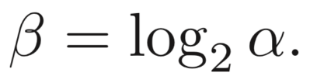
G.726 — Backward Adaptive Jayant Quantizer
G.726 uses fixed quantizer steps based on the logarithm of the input difference signal, e_{n} divided by α. The divisor α is:
(13.3)
When difference values are large, α is divided into:
locked part α_{L} – scale factor for small difference values.
unlocked part α_{U} — adapts quickly larger differences.
These correspond to log quantities β_{L} and β_{U}, so that:
(13.4)
* A changes so that it is about unity, for speech, and about zero, for voice-band data.

Slide 10
The “unlocked” part adapts via the equation
α_{U} ← M_{k}α_{U} ,
(13.5)
β_{U} ← log₂M_{k} + β_{U} ,
where M_{k} is a Jayant multiplier for the k^{th} level.
The locked part is slightly modified from the unlocked part:
β_{L} ← (1 − B) β_{L} + Bβ_{U} (13.6)
where B is a small number, say 2⁻⁶.
The G.726 predictor is quite complicated: it uses a linear combination of 6 quantized differences and two reconstructed signal values, from the previous 6 signal values f_{n}.

Slide 11
13.2 Vocoders
Vocoders – voice coders, which cannot be usefully applied when other analog signals, such as modem signals, are in use.
concerned with modeling speech so that the salient features are captured in as few bits as possible.
use either a model of the speech waveform in time (LPC (Linear Predictive Coding) vocoding), or ...
break down the signal into frequency components and model these (channel vocoders and formant vocoders).
Vocoder simulation of the voice is not very good yet.

Slide 12
13.2.1 Phase Insensitivity
A complete reconstituting of speech waveform is really unnecessary, perceptually: all that is needed is for the amount of energy at any time to be about right, and the signal will sound about right.
Phase is a shift in the time argument inside a function of time.
Suppose we strike a piano key, and generate a roughly sinusoidal sound cos(ωt), with ω = 2πf.
Now if we wait sufficient time to generate a phase shift π/2 and then strike another key, with sound cos(2ωt + π/2), we generate a waveform like the solid line in Fig. 13.3.
This waveform is the sum cos(ωt) + cos(2ωt + π/2).

Slide 13
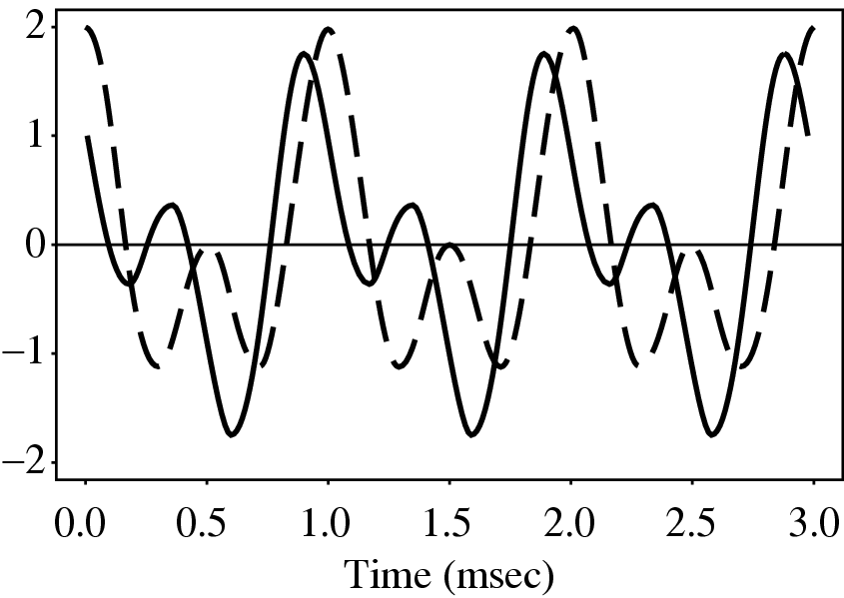
Fig. 13.3: Solid line: Superposition of two cosines, with a phase shift. Dashed line: No phase shift. The wave is very different, yet the sound is the same, perceptually.
If we did not wait before striking the second note, then our waveform would be cos(ωt) + cos(2ωt). But perceptually, the two notes would sound the same sound, even though in actuality they would be shifted in phase.

Slide 14
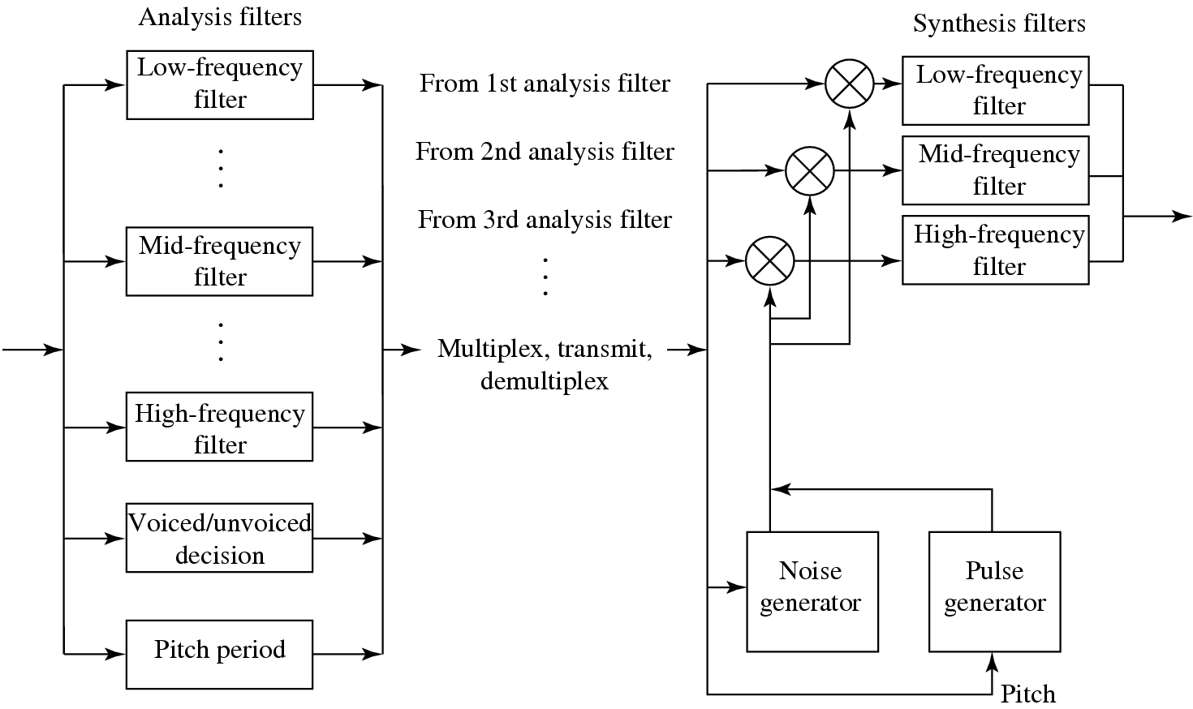
13.2.2 Channel Vocoder
Vocoders can operate at low bit-rates, 1–2 kbps. To do so, a channel vocoder first applies a filter bank to separate out the different frequency components:
Fig 13.4: Channel Vocoder

Slide 15
Due to Phase Insensitivity (i.e. only the energy is important):
The waveform is “rectified” to its absolute value.
The filter bank derives relative power levels for each frequency range.
A subband coder would not rectify the signal, and would use wider frequency bands.
A channel vocoder also analyzes the signal to determine the general pitch of the speech (low — bass, or high — tenor), and also the excitation of the speech.
A channel vocoder applies a vocal tract transfer model to generate a vector of excitation parameters that describe a model of the sound, and also guesses whether the sound is voiced or unvoiced.

Slide 16
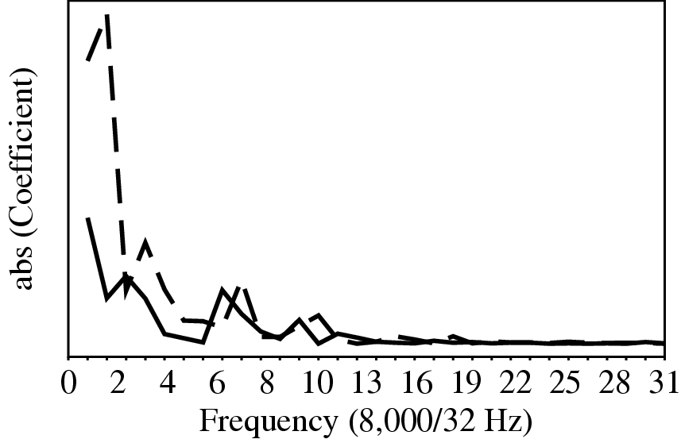
13.2.3 Format Vocoder
Formants: the salient frequency components that are present in a sample of speech, as shown in Fig 13.5.
Rationale: encoding only the most important frequencies.
Fig. 13.5: The solid line shows frequencies present in the first 40 msec of the speech sample in Fig. 6.16. The dashed line shows that while similar frequencies are still present one second later, these frequencies have shifted.

Slide 17
13.2.4 Linear Predictive Coding (LPC)
LPC vocoders extract salient features of speech directly from the waveform, rather than transforming the signal to the frequency domain
LPC Features:
uses a time-varying model of vocal tract sound generated from a given excitation
transmits only a set of parameters modeling the shape and excitation of the vocal tract, not actual signals or differences → small bit-rate
About “Linear”: The speech signal generated by the output vocal tract model is calculated as a function of the current speech output plus a second term linear in previous model coefficients

Slide 18
LPC Coding Process
• LPC starts by deciding whether the current segment is voiced or unvoiced:
For unvoiced: a wide-band noise generator is used to create sample values f (n) that act as input to the vocal tract simulator
For voiced: a pulse train generator creates values f (n)
Model parameters a_{i}: calculated by using a least-squares set of equations that minimize the difference between the actual speech and the speech generated by the vocal tract model, excited by the noise or pulse train generators that capture speech parameters

Slide 19
LPC Coding Process (Cont’d)
If the output values generate s(n), for input values f(n), the output depends on p previous output sample values:
(13.7)
G – the “gain” factor coefficients; a_{i} – values in a linear predictor model
• LP coefficients can be calculated by solving the following minimization problem:
(13.8)

Slide 20
LPC Coding Process (Cont’d)
By taking the derivative of a_{i} and setting it to zero, we get a set of p equations:
(13.9)
Letting ϕ(i, j) = E{s(n − i)s(n − j)}, then:
(13.10)

Slide 21
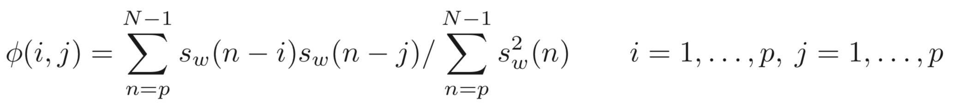
LPC Coding Process (Cont’d)
An often-used method to calculate LP coefficients is the autocorrelation method:
(13.11)
s_{w}(n) = s(n + m)w(n) — the windowed speech frame starting from time m .

Slide 22
LPC Coding Process (Cont’d)
Since ϕ(i, j) can be defined as ϕ(i, j) = R(|i − j|), and when R(0) ≥ 0, the matrix {ϕ(i, j)} is positive symmetric, there exists a fast scheme to calculate the LP coefficients:
E(0) = R(0), i = 1
while i ≤ p
for j = 1 to i − 1
i ← i+1
for j = 1 to p

Slide 23
LPC Coding Process (Cont’d)
Gain G can be calculated:
(13.12)
The pitch P of the current speech frame can be extracted by correlation method, by finding the index of the peak of:
(13.13)

Slide 24
13.2.5 Code Excited Linear Prediction (CELP)
CELP is a more complex family of coders that attempts to mitigate the lack of quality of the simple LPC model.
CELP uses a more complex description of the excitation:
An entire set (a codebook) of excitation vectors is matched to the actual speech, and the index of the best match is sent to the receiver.
The complexity increases the bit-rate to 4,800-9,600 bps.
The resulting speech is perceived as being more similar and continuous.
Quality achieved this way is sufficient for audio conferencing.

Slide 25
The Predictors for CELP
CELP coders contain two kinds of prediction:
LTP (Long time prediction): try to reduce redundancy in speech signals by finding the basic periodicity or pitch that causes a waveform that more or less repeats.
STP (Short Time Prediction): try to eliminate the redundancy in speech signals by attempting to predict the next sample from several previous ones.

Slide 26
Relationship between STP and LTP
STP captures the formant structure of the short-term speech spectrum based on only a few samples.
LTP, following STP, recovers the long-term correlation in the speech signal that represents the periodicity in speech using whole frames or subframes (1/4 of a frame).
LTP is often implemented as “adaptive codebook searching”.
Fig. 13.6 shows the relationship between STP and LTP.

Slide 27
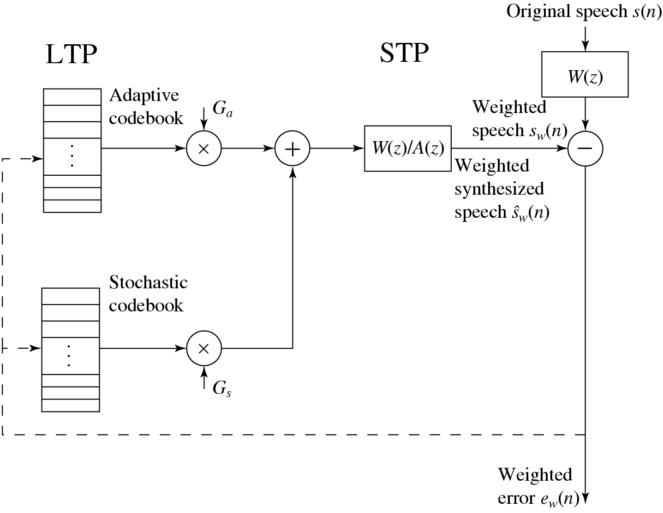
Fig 13.6: CELP Analysis Model with Adaptive and Stochastic Codebooks

Slide 28
Adaptive Codebook Searching
Rationale:
Look in a codebook of waveforms to find one that matches the current subframe.
Codeword: a shifted speech residue segment indexed by the by the lag τ corresponding to the current speech frame or subframe in the adaptive codebook.
The gain corresponding to the codeword is denoted as g₀ .

Slide 29
Open-Loop Codeword Searching
Tries to minimize the long-term prediction error but not the perceptual weighted reconstructed speech error,
(13.14)
By setting the partial derivative of g₀ to zero, ∂E(τ)/ ∂g₀ = 0, we get
(13.15)
and hence a minimum summed-error value
(13.16)

Slide 30
Close-Loop Codeword Searching
Closed-loop search is more often used in CELP coders — also called Analysis-By-Synthesis (A-B-S).
Speech is reconstructed and perceptual error for that is minimized via an adaptive codebook search, rather than simply considering sum-of-squares.
The best candidate in the adaptive codebook is selected to minimize the distortion of locally reconstructed speech.
Parameters are found by minimizing a measure of the difference between the original and the reconstructed speech.

Slide 31
13.2.6 Hybrid Excitation Vocoders*
Hybrid Excitation Vocoders are different from CELP in that they use model-based methods to introduce multi-model excitation.
Includes two major types:
MBE (Multi-Band Excitation): a blockwise codec, in which a speech analysis is carried out in a speech frame unit of about 20 msec to 30 msec.
MELP (Multiband Excitation Linear Predictive) speech codec is a new US Federal standard to replace the old LPC-10 (FS1015) standard with the application focus on very low bit rate safety communications.

Slide 32
MBE Vocoder
MBE utilizes the A-B-S scheme in parameter estimation:
The parameters such as basic frequency, spectrum envelope, and sub-band U/V decisions are all done via closed-loop searching.
The criterion of the closed-loop optimization is based on minimizing the perceptually weighted reconstructed speech error, which can be represented in frequency domain as
(13.29)
S_{w}(ω) – original speech short-time spectrum
S_{wr}(ω) – reconstructed speech short-time spectrum
G(ω) – spectrum of the perceptual weighting filter

Slide 33
MELP Vocoder
MELP: also based on LPC analysis, uses a multiband soft-decision model for the excitation signal.
The LP residue is bandpassed and a voicing strength parameter is estimated for each band.
Speech can be then reconstructed by passing the excitation through the LPC synthesis filter.
Differently from MBE, MELP divides the excitation into five fixed bands of 0-500, 500-1000, 1000-2000, 2000-3000, and 3000-4000 Hz.

Slide 34
MELP Vocoder (Cont’d)
A voice degree parameter is estimated in each band based on the normalized correlation function of the speech signal and the smoothed rectified signal in the non-DC band.
Let s_{k}(n) denote the speech signal in band k, u_{k}(n) denote the DC-removed smoothed rectified signal of s_{k}(n). The correlation function:
(13.33)
P – the pitch of current frame
N – the frame length
k – the voicing strength for band (defined as )

Slide 35
MELP Vocoder (Cont’d)
MELP adopts a jittery voiced state to simulate the marginal voiced speech segments – indicated by an aperiodic flag.
The jittery state is determined by the peakiness of the full-wave rectified LP residue e(n):
(13.34)
If peakiness is greater than some threshold, the speech frame is then flagged as jittered.

Slide 36
13.3 Open Source Speech Codecs
Different from traditional communication channels, Internet provides dramatically different bandwidths and thus speech and audio codecs should be able to support different bit rates.
Interactive applications also require the codecs to have a short delay.
Modern speech codecs often use hybrid structures which can handle both low bandwidth speech and high bandwidth audio simultaneously.

Slide 37
13.3.1 Speex
Speex is designed for Voice over Internet.
Speex is a CELP type speech codec. It supports different input bandwidths: narrowband (8 kHz), wideband(16 kHz) and ultrawideband (32 kHz).
Its target bitrate is from 2 to 44 kbps and it supports variable bit rate encoding.
For the narrowband mode (8 kHz), Speex is quite similar to a regular CELP.
In the wideband mode (16 kHz), Speex uses a filter to split the input into two bands (0 to 8 kHz and the 8 kHz to 16 kHz). The lower band is processed the same as the narrowband. The upper band does not estimate the pitch.

Slide 38
13.3.2 Opus
Opus is designed for audio over Internet.
It is a standard of the Internet Engineering Task Force (IETF) known as RFC 6716.
Opus supports bitrate from 6 kbps to 510 kbps, and can deal with input with bandwidth from 8 kHz to 48 kHz.
Opus audio codec’s diagram is illustrated in Fig. 13.7.
Opus can operate in three different modes: SILK-only mode for narrow, median and wideband speech; hybrid of SILK and CELT mode for superband or fullband speech; and CELT-only mode for narrow or fullband music.

Slide 39
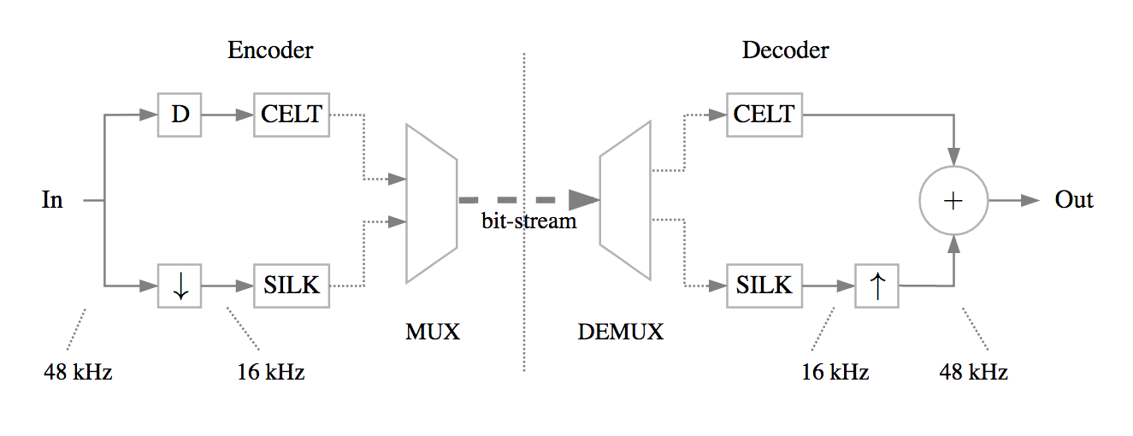
Fig. 13.7: Opus audio codec diagram

Slide 40
CELT
CELT (Constrained Energy Lapped Transform) targets at wideband audio. Its design borrows ideas from the CELP speech codecs.
It provides an audio codec with a short delay so that it can be used in the interactive applications.
Different from CELP, CELT mainly operates in the spectrum domain. It flattens the MDCT spectrum by normalizing the energy in different frequency bands.
Similar to CELP, CELT’s adaptive codebook is based on pitch estimation and time shifted to the past with the associated gains, and the innovation part is predicted using the adaptive codebook.

Slide 41
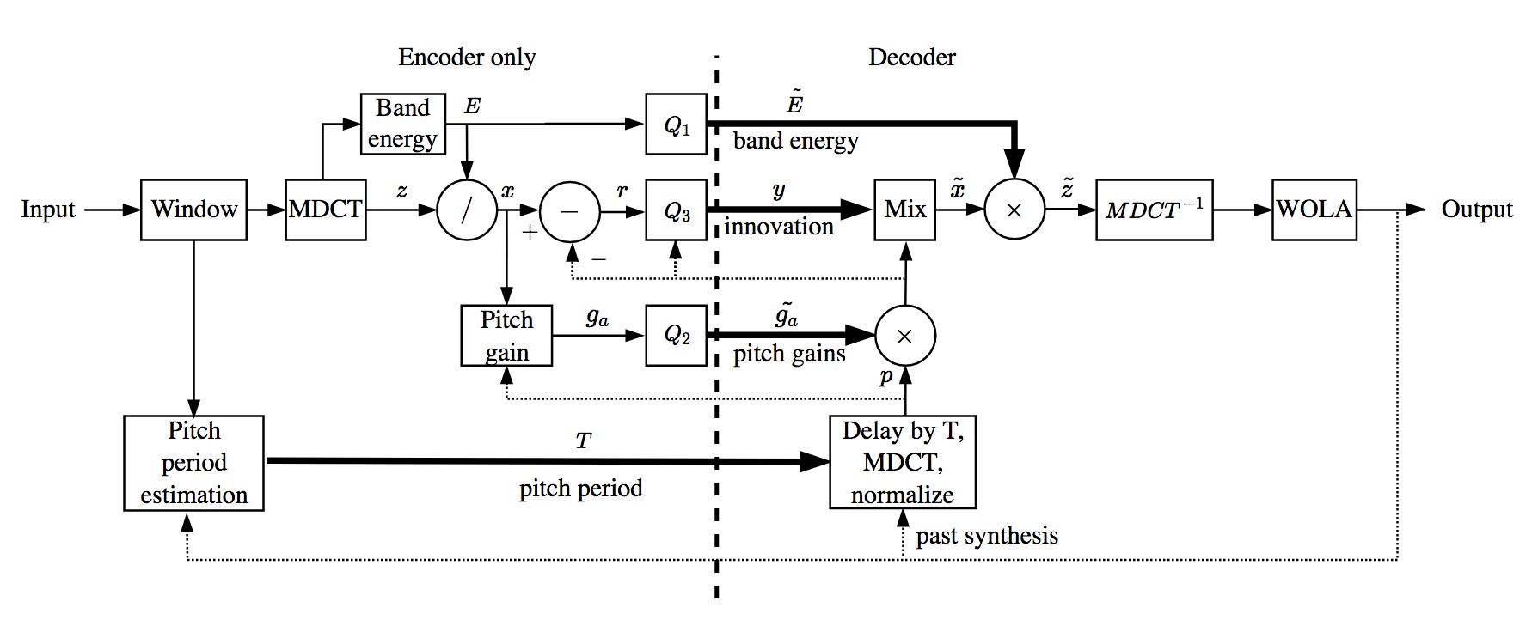
Fig. 13.8: CELT audio codec diagram

