Slide 1
Chapter 16
Internet Multimedia Content Distribution
16.1 Proxy Caching
16.2 Content Distribution Networks (CDNs)
16.3 Broadcast/Multicast Video Distribution
16.4 Application-Layer Multicast and Peer-to-Peer Streaming
16.5 Web-Based Media Streaming

Slide 2
16.1 Proxy Caching
Cache frequently used data at proxies close to clients
Enhances the availability of objects
Different from conventional web object caching:
  An audio/video object is rarely updated
  Caching each media object entirely at a proxy is hardly practical

Slide 3
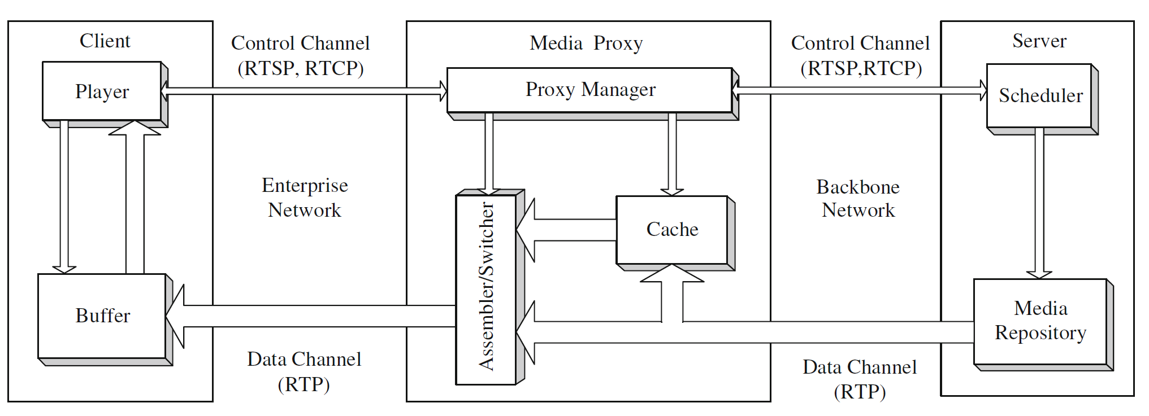
Fig. 16.2: A generic system diagram of proxy-assisted media streaming using RTP/RTCP/RTSP

Slide 4
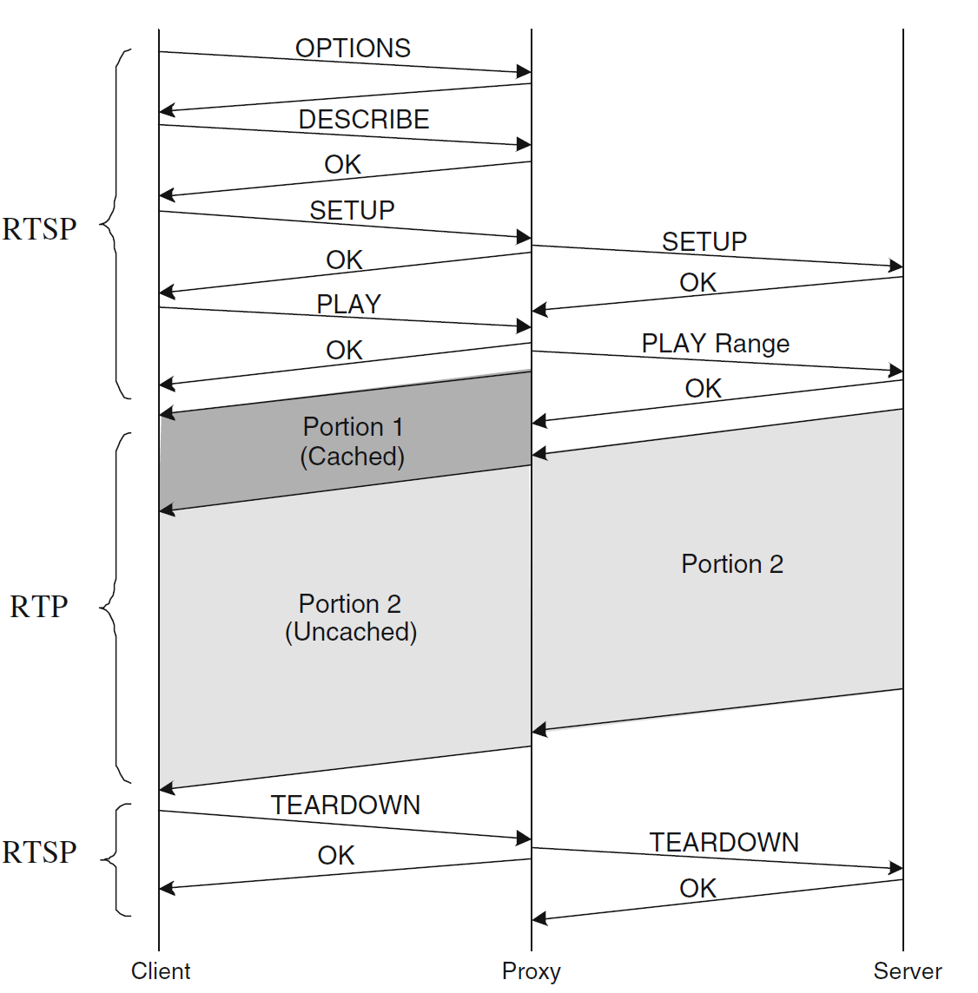
Fig. 16.3: Operations for streaming with partial caching

Slide 5
Proxy Caching Algorithms
16.1.1 Sliding-Interval Caching
16.1.2 Prefix Caching and Segment Caching
16.1.3 Rate-Split Caching and Work-Ahead Smoothing
16.1.4 Summary and Comparison

Slide 6
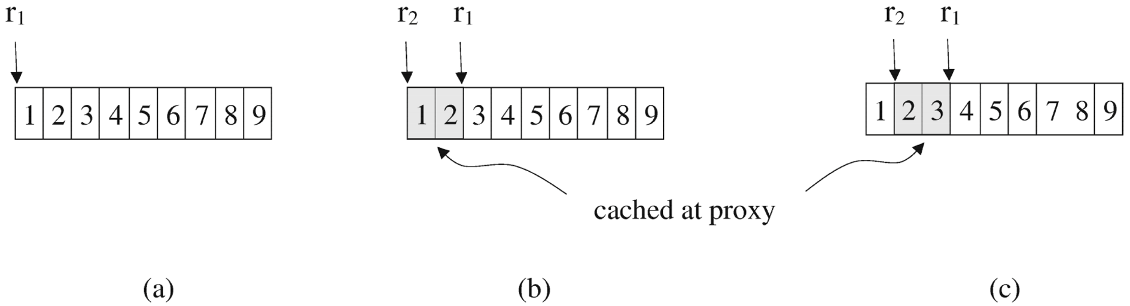
16.1.1 Sliding-Interval Caching
Cache a sliding interval of a media object to facilitate consecutive accesses
Significantly reduce the network bandwidth consumption and start-up delay for subsequent accesses
High disk bandwidth demands: double in the worst case

Slide 7
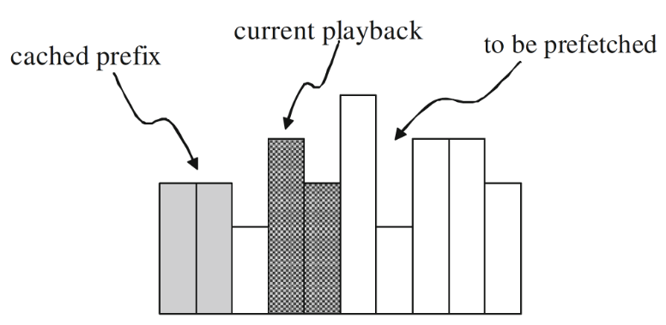
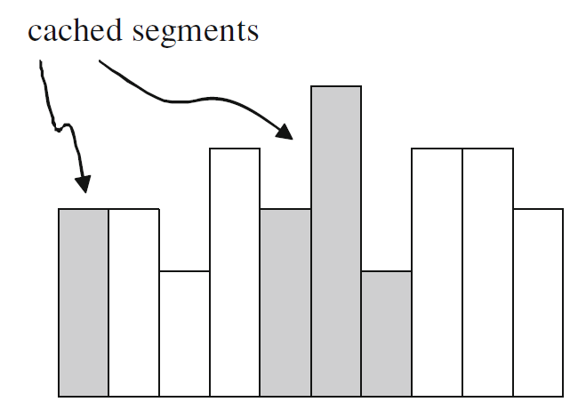
16.1.2 Prefix Caching and Segment Caching
Cache the initial portion of a media object, called prefix, at a proxy
Then fetch the remaining portion, the suffix.
Reduce start up delay
Segment caching generalizes the prefix caching paradigm by partitioning a media object into a series of segments
Fig. 16.5 A snapshot of prefix caching
Fig. 16.6 An illustration of segment caching

Slide 8
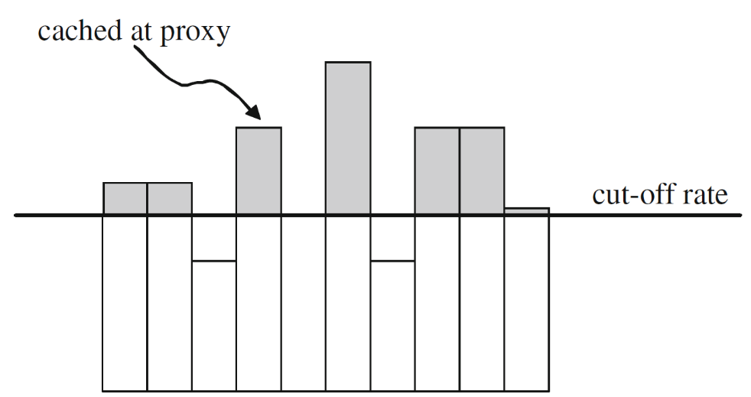
16.1.3 Rate-Split Caching and Work-Ahead Smoothing
All the aforementioned caching algorithms partition a media object along the time axis
Rate-split caching partitions a media along the rate axis
Attractive for VBR streaming
Nearly constant rate to be delivered through the backbone network
Improves backbone network utilization for a QoS network with resource reservation
Fig. 16.7: An illustration of rate-split caching

Slide 9
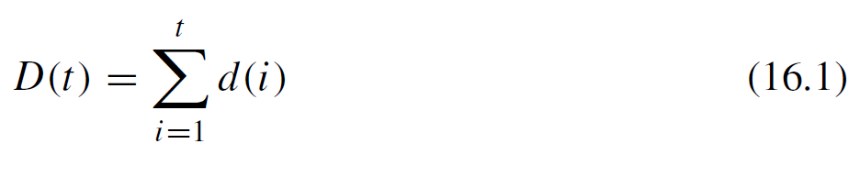
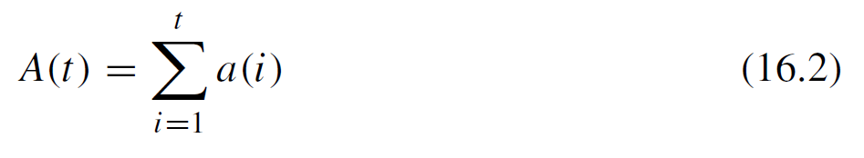
Work-ahead Smoothing
Subject to client’s buffer capability
Define d(t) to be the size of frame t, where t ∈ 1, 2, . . . , N, and N are the total number of frames in the video. Similarly, define a(t) to be the amount of data transmitted by the video server during the playback time for frame t (for short, call it at time t). Let D(t) be the total data consumed and A(t) be the total data sent at time t.
The conditions for a server transmission rate that avoids buffer overflow or underflow

Slide 10
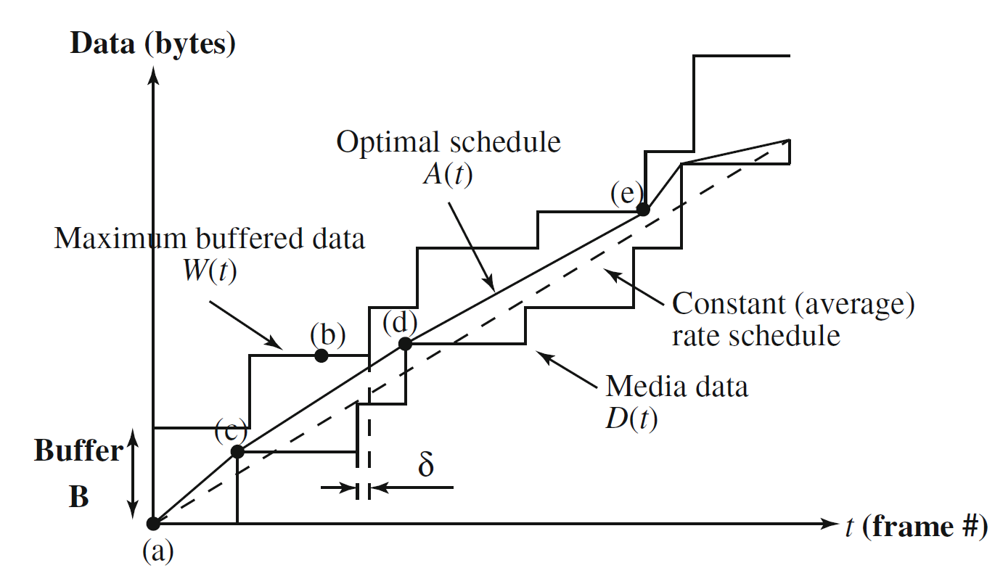
Work-ahead Smoothing (Cont’d)
Fig. 16.8: The optimal smoothing plan for a specific video and buffer size. In this case, it is not feasible to transmit at the constant (average) data rate

Slide 11
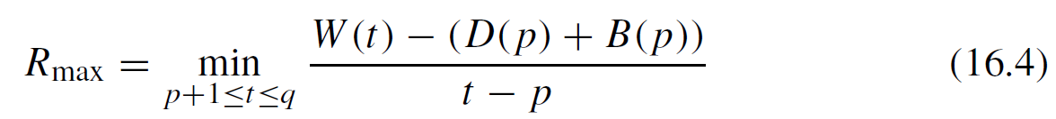
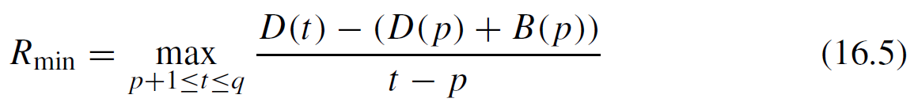
Work-ahead Smoothing (Cont’d)
The maximum constant data rate that can be used without overflowing the buffer is given by R_{max}
The minimum data rate that must be used over the same interval to avoid underflow is given by R_{min}
Consider any interval [p, q] and let B(t) represent the amount of data in the buffer at time t.

Slide 12
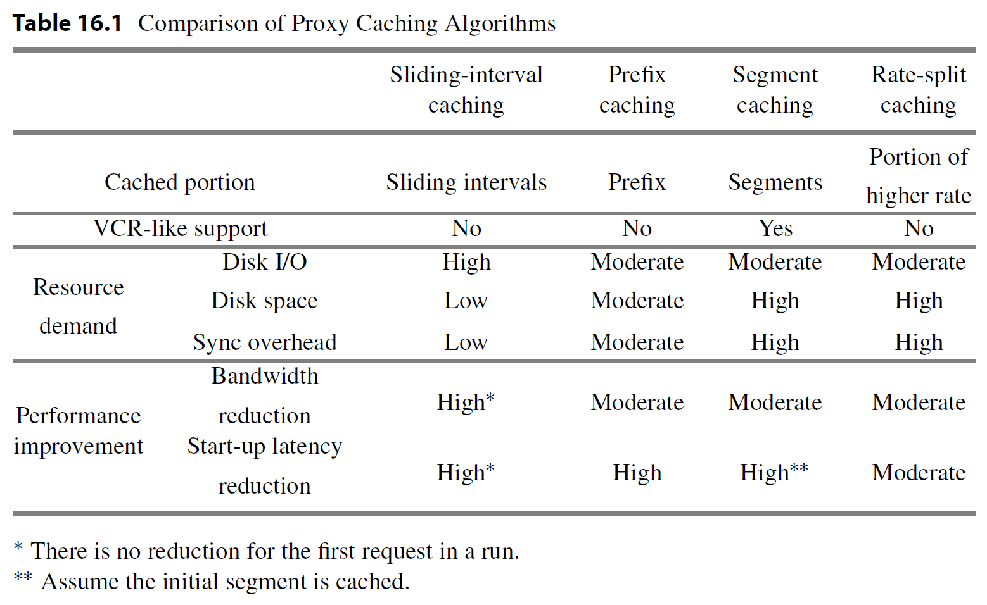
Summary and Comparison

Slide 13
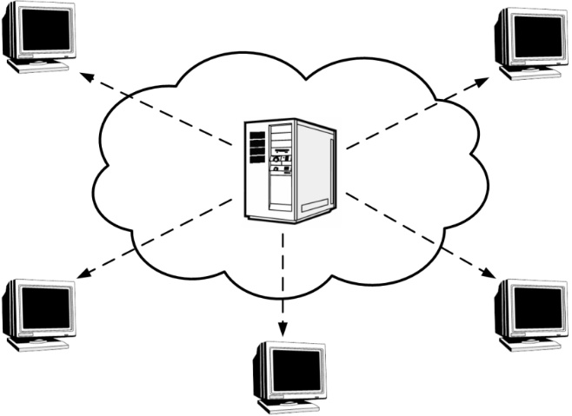
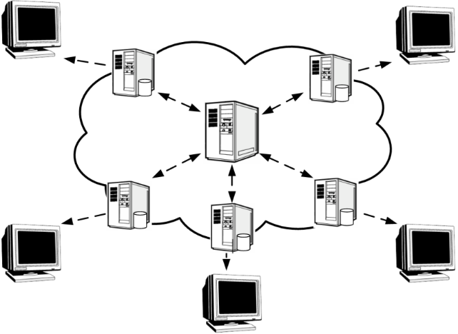
16.2 Content Distribution Networks (CDNs)
Caching is generally passive
Content Delivery Network or Content Distribution Network (CDN) is proactive
Fig. 16.9: Comparison between traditional single server and CDN.
Left: Traditional Client/Server solution.
Right: Content distribution network (CDN) solution

Slide 14
Overview of Content Distribution Networks (CDNs)
The request-routing in a CDN environment:
  Step 1. The user requests content from the content provider by specifying its URL
  in the web browser, and the request is directed to its origin server.
  Step 2. When the origin server receives the request, it makes a decision to provide only the basic content (e.g. index page of the website), leaving others to CDN.
  Step 3. To serve the high bandwidth demanding and frequently asked content (e.g., embedded objects fresh content, navigation bar, banner ads, etc.), the origin server redirects user’s request to the CDN provider.
  Step 4. Using the mapping algorithm, the CDN provider selects the replica server.
  Step 5. The selected server serves the user by providing the replicated copy of the requested object.

Slide 15
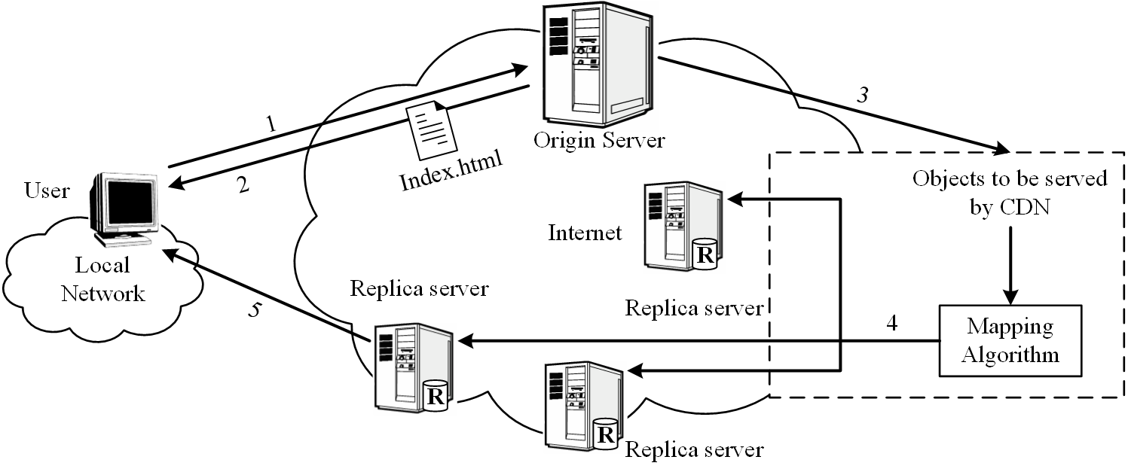
Overview of Content Distribution Networks (CDNs)
Fig. 16.10: A high-level view of request-routing in a CDN

Slide 16
Assigning the user to the CDN server
The mapping system based on large amounts of historical and real-time data
For performance optimization: the locations of the fewest hops or the highest server availability will be chosen
For cost-optimization, the least-expensive locations can be chosen instead
The real world: combined both performance and cost-optimization considerations.

Slide 17
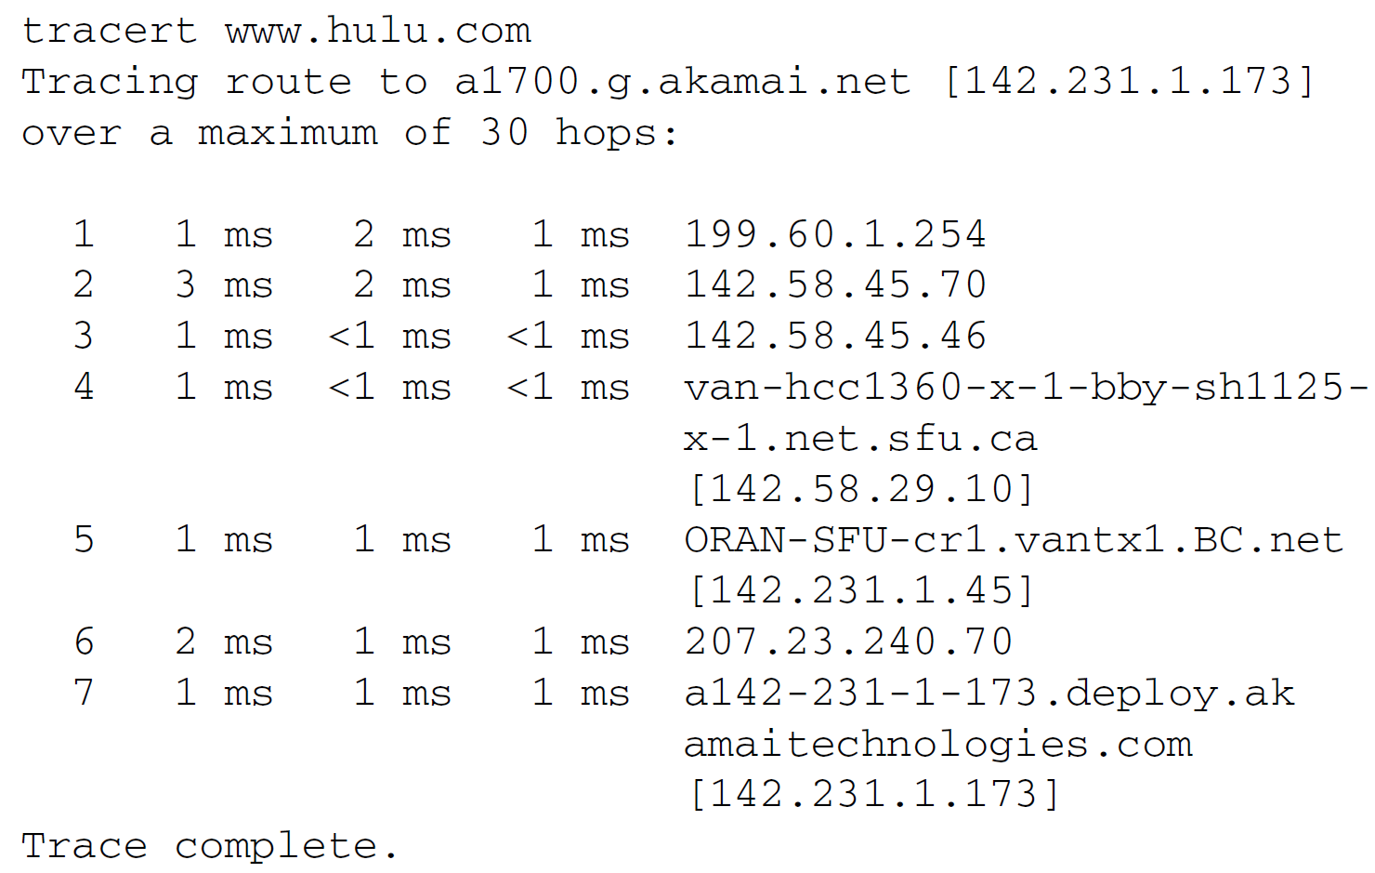
An Example
The trace between SFU and Hulu using Traceroute tools (tracert in MS Windows):

Slide 18
16.2.1 Representative: Akamai Streaming CDN
The service platform could comprise multiple delivery networks
Each delivery network is tailored to a specific type of content, e.g., static web content, dynamic news update, or streaming media
At a high level, these delivery networks share a similar architecture
The underlying technology and implementation of each system component may differ so as to best suit the specific type of content

Slide 19
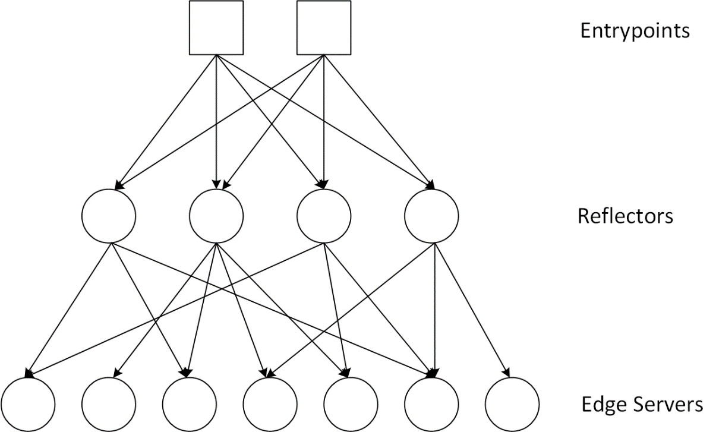
16.2.1 Representative: Akamai Streaming CDN (cont.)
Akamai’s media streaming CDN is widely used by such companies as Apple, Microsoft, and BBC for their video services

Slide 20
16.3 Broadcast/Multicast Video Distribution
Both proxy caching and CDN explore the temporal and geographical locality of users’ interests in media objects.
Such locality can also be explored through broadcast or multicast services:
  Deliver the same content simultaneously to a massive amount of concurrent users.
  Works well for live media streaming
  Scalable broadcast/multicast solutions for media-on-demand with such asynchronous requests are discussed here

Slide 21
16.3.1 Smart TV and Set-Top Box (STB)
Interactive TV (iTV) or Smart TV:
  TV (basic, subscription, pay-per-view)
  Video-on-Demand (VoD)
  Information services (news, weather, magazines, sports events, etc.)
  Interactive entertainment (Online games, etc.)
  E-commerce (online shopping, stock trading, etc.)
  Digital libraries and distance education (e-learning, etc.)
A smart TV invites user interactions: two-way traffic, downstream & upstream
A smart TV is rich in information and multimedia services

Slide 22
16.3.2 Scalable Multicast/Broadcast VoD
Most of the demands are usually concentrated on a few (10–20) popular movies or TV shows
Smart multicast or broadcast is possible when clients are put into different groups
Batching
A series of periodical broadcast VoD solutions:
  Staggered Broadcasting
  Pyramid Broadcasting
  Harmonic Broadcasting
  Stream Merging

Slide 23
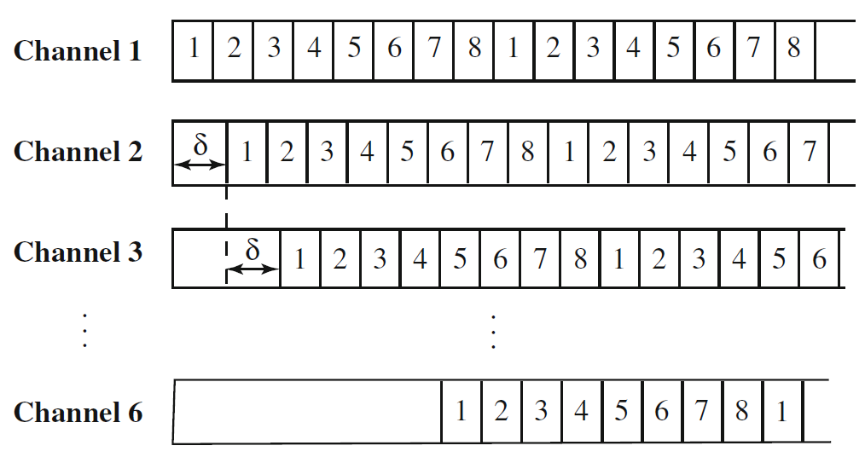
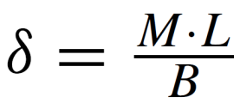
Staggered Broadcasting
Fig. 16.13: Staggered broadcasting with M = 8 videos and K = 6 channels
The access time for any video is

Slide 24
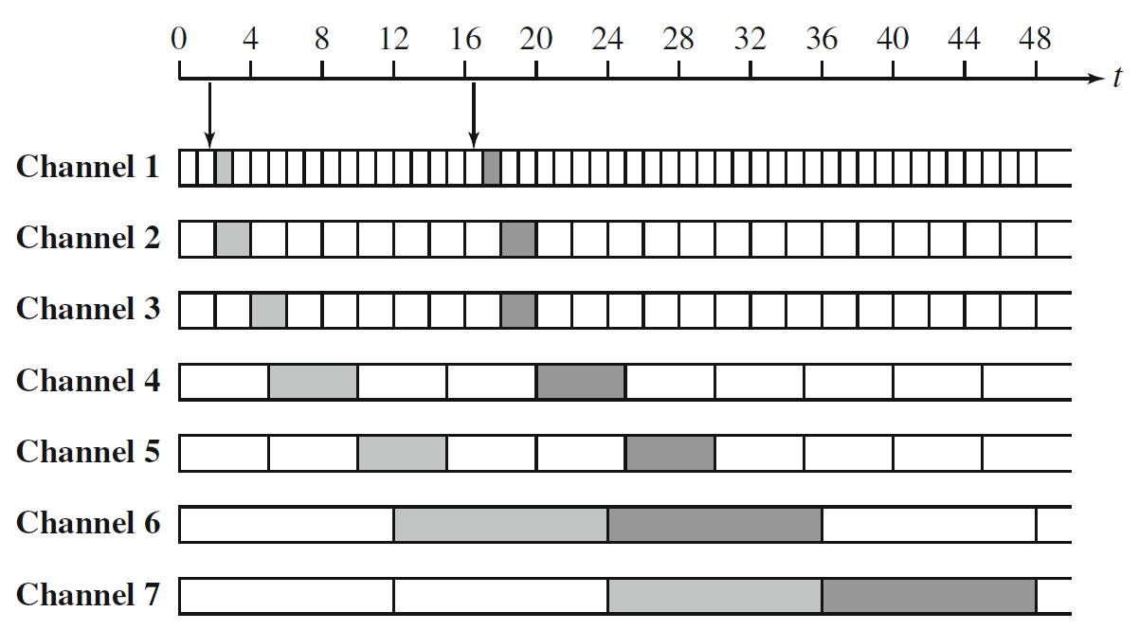
Pyramid Broadcasting
Fig. 16.14: Skyscraper broadcasting with seven segments

Slide 25
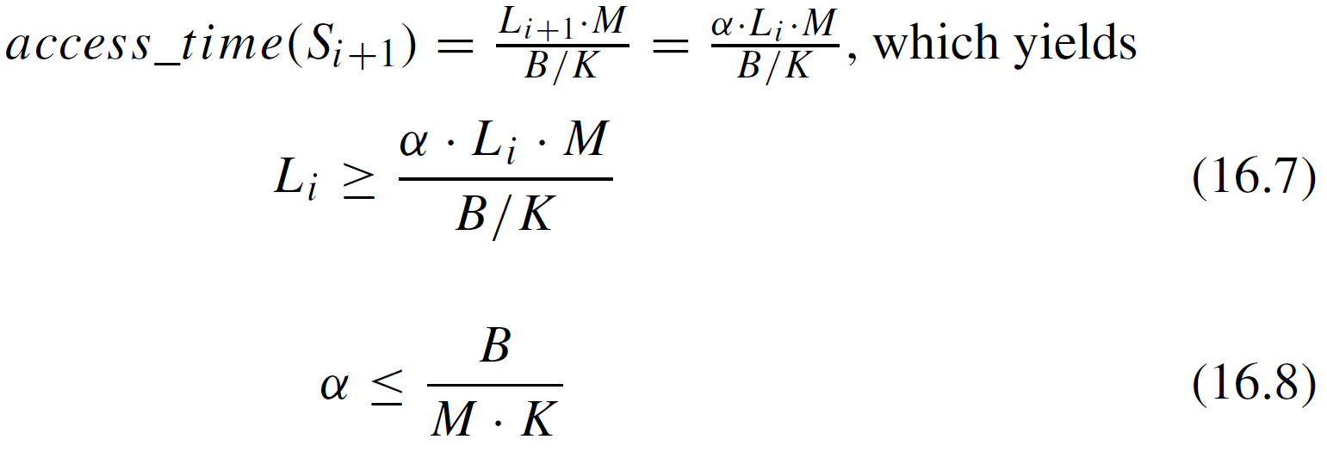
Pyramid Broadcasting (Cont’d)
Pyramid broadcasting divides a video into segments of increasing sizes. That is, L_{i}+1 = α· L_{i} , where L_{i} is the size (length) of Segment S_{i} and α > 1.
Condition to guarantee continuous (noninterrupted) playback:
Access time:

Slide 26
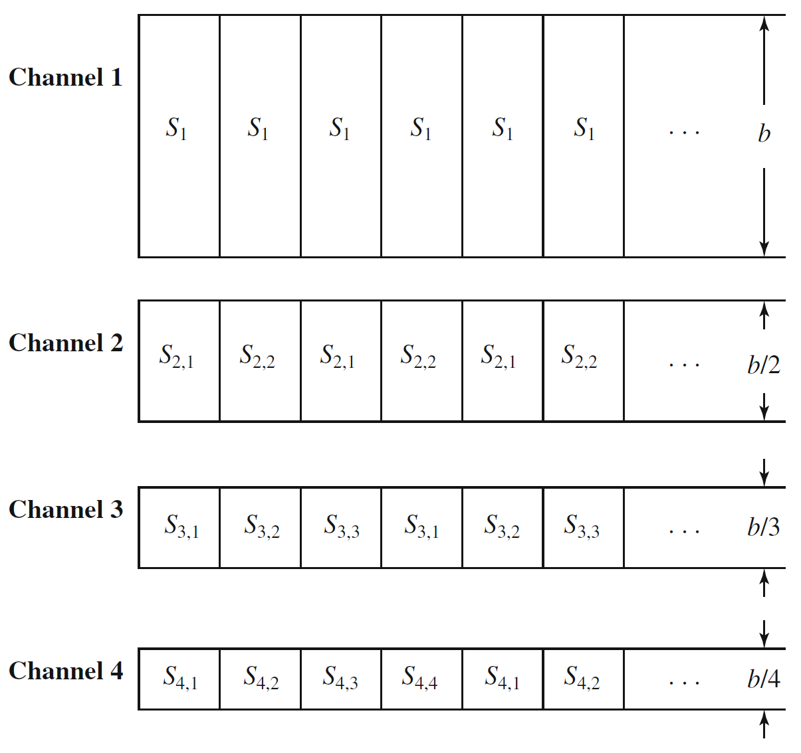
Harmonic Broadcasting
Fig. 16.15: Harmonic broadcasting

Slide 27
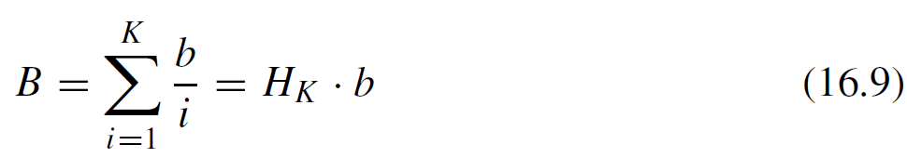
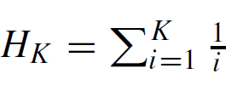
Harmonic Broadcasting (Cont’d)
The size of all segments remains constant
The bandwidth of channel i is B_{i} = b/i , where b is the video’s playback rate.
The channel bandwidths follow the decreasing pattern b, b/2, b/3, . . . b/K.
The total bandwidth allocated for delivering the video is:
where K is the total number of segments, and H_{K} is the harmonic number of K.

Slide 28
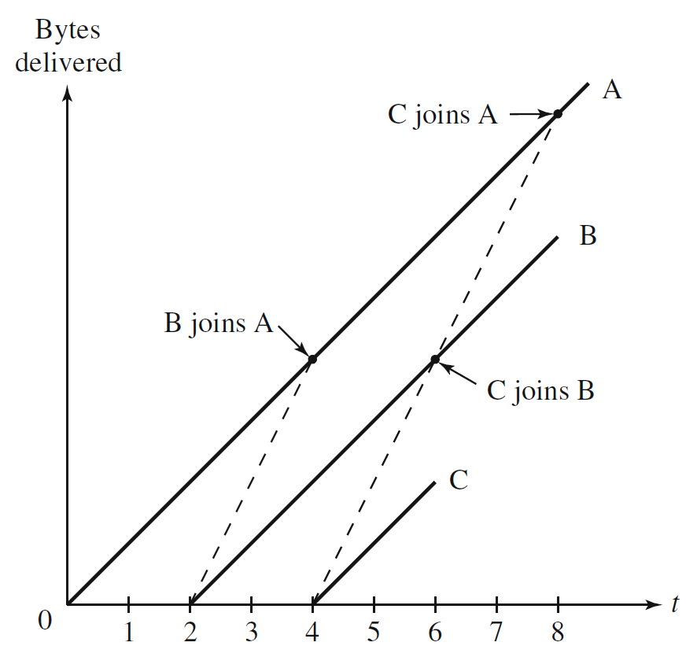
Stream Merging
The server deliver a video stream as soon as it receives the request from a client
Meanwhile, the client can also access a second stream of the same
video, which initiated earlier by another client
At a certain point, the first stream becomes unnecessary because of prefetched content from the second stream
The first stream merge with (or “join”) the second
Fig. 16.16: Stream merging

Slide 29
16.3.3 Broadcast/Multicast for Heterogeneous Users
The Internet’s intrinsic heterogeneity poses another challenge to multimedia multicast.
  Traditional end-to-end adaptation schemes: the sender adjusts its transmission rate according to some feedback from its receiver.
  In a broadcast/multicast environment: the traditional solution tends to be suboptimal because there is no single target rate for a group of heterogeneous users.
It is thus necessary to use multi-rate multicast.

Slide 30
16.3.3 Broadcast/Multicast for Heterogeneous Users (Cont’d)
From the viewpoint of a media source, multi-rate streams can be producedvia two methods.
  Information replication.
  Information decomposition.
Replication and decomposition can be implemented through transcoding and scalable audio/video coding , respectively.
The remaining question is the efficient transmission.

Slide 31
Stream Replication
Stream replication can be viewed as a trade-off between single-rate multicast and multiple point-to-point connections.
Its feasibility is well justified in a typical multicast environment where the bandwidths of the receivers usually follow some clustered distribution.

Slide 32
Layered Multicast
For cumulative layered video (or scalable video), Receiver-driven Layered Multicast (RLM) has been suggested.
RLM specifications.
  Takes advantage of the dynamic group concept in the IP multicast model.
  An RLM sender transmits each video layer over a separate multicast group.
  The number of layers as well as their rates is predetermined.
  Adaptation is performed only at the user’s end by a probing-based scheme.

Slide 33
Layered Multicast
RLM specifications.
  A user periodically joins a higher layer’s group to explore the available bandwidth.
  If packet loss exceeds a tolerable threshold after the join-experiment, the user should leave the group; otherwise it will stay at the new subscription level.
  An exponential backoff ensures that the receiver will not be too aggressive in joining new layers and cause frequent congestion.

Slide 34
Layered Multicast
Fig. 16.17: An illustration of receiver-driven layered multicast
Received-driven layered multicast
  Started from layer 1.
  Congestion occured and it had to leave this highest layer 4.
  Then waited for a while, seeing no congestion, and rejoined layer 4.
  This triggered congestion again, and the receiver had to leave again.
  Note that the waiting time for the next join-experiment is longer than that of the previous one;
  Exponential backoff ensures that the receiver will not be too aggressive.

Slide 35
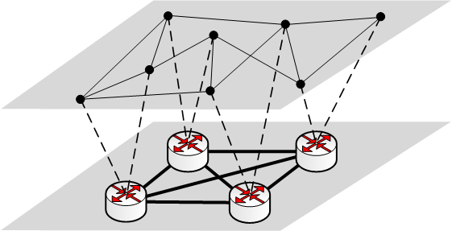
16.4 Application-Layer Multicast and Peer-to-Peer Streaming
Today the scope and reach of IP multicast remain limited, and many ISPs simply block or disable IP multicast due to various security and economic concerns.
The solution: Using the application layer for multicast data forwarding.
Fig. 16.18: An illustration of application-level overlay network

Slide 36
16.4.1 Application-Layer Multicast Tree
When organizing the end-hosts into an overlay for disseminating video streams, a series of important criteria must be considered for overlay construction and maintenance.
  Overlay efficiency.
  Scalability and load balancing.
  Self-organizing.
  Node constraints.
Application-layer multicast proposals.
  overlay multicast.
  end-system multicast.

Slide 37
16.4.2 Representative: End-System Multicast (ESM)
The ESM system employs a tree-based overlay protocol that is distributed, self-organizing, and performance-aware.
The tree, rooted at the source, is optimized primarily for bandwidth, and secondarily for delay.
Issues about ESM.
  Group Management.
  Membership Dynamics.
  Performance-Aware Adaptation.
  Parent Selection.

Slide 38
Multi-tree Structure
The tree-based designs are perhaps the most natural approach.
One concern of the tree-based designs is that the failure of nodes.
More resilient structures, multi-tree, thus have been introduced.
Two key advantages of the multi-tree solution.
  The overall resiliency of the system is improved.
  The potential bandwidth of all nodes can be utilized.

Slide 39
Multi-tree Structure
Fig. 16.19: A multi-tree application-layer multicast with two trees.

Slide 40
16.4.3 Peer-to-Peer Mesh Overlay
It was first brought to spotlight by the advent of Napster (1998) and Gnutella (2001).
Later, the design philosophy in the highly popular BitTorrent software has converged with academic solutions in applicationlayer multicast.
A new generation of data-driven peer-to-peer streaming protocols on random mesh topologies emerged .
It contrast with tree-based application-layer multicast in that they do not construct and maintain an explicit structure for delivering data.

Slide 41
16.4.3 Peer-to-Peer Mesh Overlay
A naive approach to distribute data without explicitly maintaining a structure is to use gossip algorithms.
Gossip cannot be used directly for video content distribution.
  Its random push may cause significant redundancy with the high bandwidth video.
  Without an explicit structure support, start-up and transmission delays can be significant, too.
To handle this, mesh overlays adopts a pull-based technique for data dissemination.
  It is much simpler to design.
  It is more amenable to real-world implementations.
  It has the potential to scale with group size, as greater demand also generates more resources.

Slide 42
16.4.3 Peer-to-Peer Mesh Overlay
There are common issues existing in both peer-to-peer file sharing and video streaming. for example,
  pricing for uploading/downloading
  copyright protecting.
The key difference is the timing constraints that a streaming protocol must accommodate.
Thus, an important component of the data driven overlay is a scheduling algorithm, which strives to schedule the segments that must be downloaded from various partners to meet the playback deadlines.

Slide 43
16.4.4 Representative: CoolStreaming
CoolStreaming is the first large-scale data-driven peer-to-peer systems that was deployed in the real world.
Other successful companies such as PPLive, PPStream, and UUSee also adopted mesh-based pull techniques to deliver live or on-demand media content to millions of users.

Slide 44
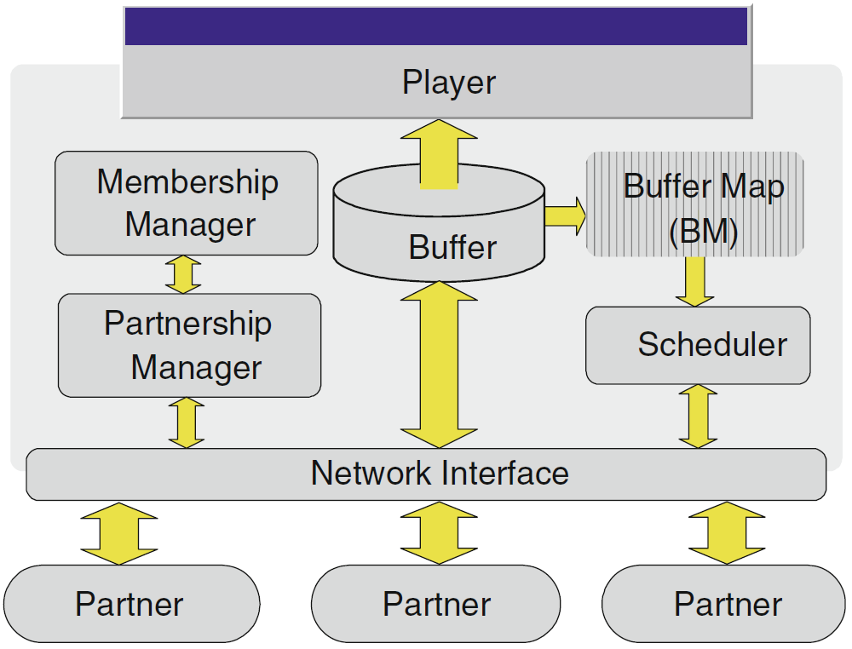
16.4.4 Representative: CoolStreaming
Fig. 16.20: A generic system diagram for a CoolStreaming node

Slide 45
16.4.4 Representative: CoolStreaming
CoolStreaming node consists of three key moduals:
  A membership manager.
  A partnership manager.
  A scheduler.
For each segment of a video stream, a CoolStreaming node can be either a receiver or a supplier, or both.
An exception is the video source, which, as the origin node, is always a supplier.

Slide 46
16.4.4 Representative: CoolStreaming
CoolStreaming Module Specification
  Membership and Partner management.
  Buffer Map Representation and Exchange.
  Scheduling Algorithm.
  Failure Recovery and Partnership Refinement

Slide 47
Membership and Partner Management
Each CoolStreaming node has a unique identifier and maintains a membership cache (mCache).
  In a basic node joining algorithm, a newly joined node first contacts the origin node, which randomly selects a deputy node from its mCache and redirects the new node to the deputy.
  The new node can then obtain a list of partner candidates from the deputy, and contacts these candidates to establish its partners in the overlay.
This process is generally viable because the origin node persists during the lifetime of streaming and its identifier/address is universally known.

Slide 48
Membership and Partner Management
A key practical issue here is how to create and update the mCache.
Each node periodically generates a membership message to announce it existence.
  Each message is a 4-tuple <seq_num, id, num_partner, time_to_live>
    seq_num is the sequence number of the message.
    id is the node’s identifier.
    num_partner is its current total number of partners.
    time_to_live records the remaining valid time of the message.
Upon receiving a message of a new seq_num, the node updates its mCache entry for node id, or create the entry if not existing.
  The entry is a 5-tuple <seq_num, id, num_partner, time_to_live,last_update_time>.
    The first four components are copied from the received membership message.
    The fifth is the local time of the last update for the entry.

Slide 49
Membership and Partner Management
The following two events also trigger updates of an mCache entry:
  The membership message is forwarded to other nodes through gossiping;
  The node serves as a deputy and the entry is included in the partner candidate list.

Slide 50
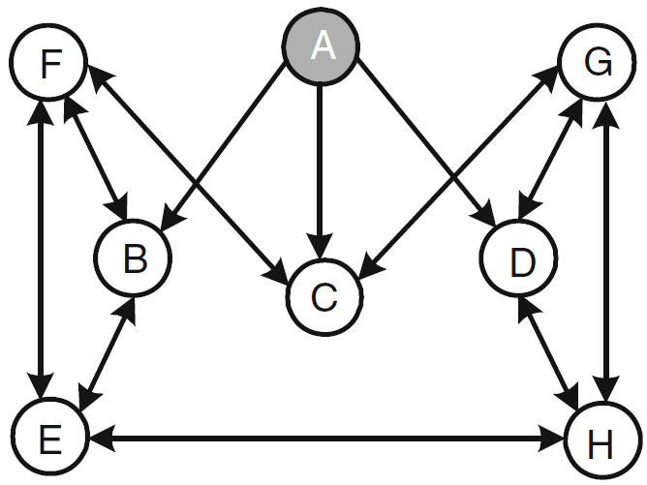
Membership and Partner Management
Fig. 16.21: An illustration of partnerships in CoolStreaming with A being the origin node. The partnership is bi-directional, except for node A, which serves as a supplier only. For example, node F is a partner of nodes B, C, and E, and node E is a partner of nodes B, F, and H.

Slide 51
Buffer Map Reprentation and Exchange
  A video stream is divided into segments of a uniform length, and the availability of the segments in the buffer of a node can be represented by a Buffer Map (BM).
  Each node continuously exchanges its BM with the partners, and then schedules which segment is to be fetched from which partner accordingly.

Slide 52
Buffer Map Reprentation and Exchange (Cont’d)
  Timely and continuous segment delivery is crucial to media streaming, but not to file download.
  In BitTorrent, the download phases of the peers are not synchronized, and new segments from anywhere in the file are acceptable.
  In CoolStreaming, the playback progress of the peers is roughly synchronized, and any segment downloaded after its playback time will be useless.

Slide 53
Buffer Map Reprentation and Exchange
  Fig. 16.22: Buffer snapshots.
  (a) BitTorrent
  (b) CoolStreaming.
    A sliding window represents the active buffer portion.

Slide 54
Scheduling Algorithm
  Given the BMs of a node and its partners, a schedule is then generated for fetching the expected segments from the partners.
  For a homogeneous and static network, a simple round-robin scheduler may work well, but for a dynamic and heterogeneous network, a more intelligent scheduler is necessary.
  The scheduling algorithm strikes to meet two constraints:
    The playback deadline for each segment.
    The heterogeneous streaming bandwidth from the partners.
  This problem is a variation of the Parallel machine scheduling, which is known to be NP-hard.

Slide 55
Scheduling Algorithm (Cont’d)
  CoolStreaming resorts to a simple heuristic of fast response time.
  Calculates the number of potential suppliers for each segment.
  Determines the supplier of each segment starting from those with only one potential supplier, then those with two, and so forth.
  Among the multiple potential suppliers, the one with the highest bandwidth and enough available time is selected.
  There have been many enhancements to the basic scheduling algorithm in CoolStreaming.
  Existing studies have also suggested that the use of advanced network coding can possibly enable optimal scheduling.

Slide 56
Failure Recovery and Partnership Refinement
  A CoolStreaming node can depart gracefully or accidentally due to an unexpected failure.
  The departure can be easily detected after an idle time of TFRC or BM exchange
  An affected node can quickly react through rescheduling using the BM information about the remaining partners.
  CoolStreaming also lets each node periodically establish new partnerships with nodes randomly selected from its local membership list for two purposes:
  Helps each node maintain a stable number of partners in the presence of node departures;
  Helps each node explore partners of better quality;

Slide 57
16.5 Web-Based Media Streaming
  Peer-to-peer has proven to be highly scalable in video delivery, there are critical issues for peer-to-peer system deployment by content providers:
  Ease-of-use. The users are usually required to install customized client software or plugins.
  Copyright. The users exchange contents with each other autonomously—it is very difficult for the content providers to control the copyright in the video streaming.
  Peer-to-peer also relies on peers’ contribution to the system. There are many free riders who do not want to contribute their resources.
  Peers are exposed to security threats and are often blocked by firewalls.

Slide 58
16.5 Web-Based Media Streaming
  We use the Hyper Text Transfer Protocol (HTTP) for streaming.
  HTTP is generally firewall-friendly.
  HTTP server resources are also widely available commodity.
  Cost-effective using the existing web infrastructure to support HTTP streaming for massive audience.
  HTTP was not initially designed for streaming applications.
  The key to support streaming with HTTP is to break the overall media stream into a sequence of small HTTP-based file downloads.

Slide 59
HTTP for Streaming
Fig. 16.23: An illustration of HTTP Streaming

Slide 60
HTTP for Streaming (Cont’d)
  HTTP does not maintain session states on the server.
  Does not impose significant cost on server resources.
  Quite different from RTP/RTCP/RTSP-based streaming.
  Each client can keep a record of its playback progress.
  The progressive download allows a client to seek to a specific position in the media stream by downloading the corresponding file.
  HTTP streaming has been implemented in commercial products.
  Netflix
  Youtube
  Hulu
  HTTP streaming is benefiting from the rapidly expanding capacity and dropping pricing of today’s CDNs.

Slide 61
16.5.1 Dynamic Adaptive Streaming Over HTTP (DASH)
  The Dynamic Adaptive Streaming over HTTP (DASH) standard has been developed by the MPEG group for the following reasons.
  The demand for standardization so that different devices can inter-operate.
  The heterogeneous networks and devices also require the media streaming to be dynamical and adaptive.
  The process of the development of DASH.
  Work on DASH started in 2010；
  It became an international standard in November 2011;
  It was officially published as ISO/IEC 23009-1:2012 in April 2012;
  Further revised in 2019 as ISO/IEC 23009-1:2019

Slide 62
16.5.1 Dynamic Adaptive Streaming Over HTTP (DASH) (Cont’d)
  DASH defines a set of implementation protocols across the servers, clients, and description files.
  In DASH, a video stream is encoded and divided into multiple segments.
  Initialization segments that contain required information for initializing the media decoder.
  Media segments that contain the following data.
    The media data.
    The stream access point.
  A Media Presentation Description (MPD) describes the relation of the segments and how they form a video presentation, which facilitates segment fetching for continuous playback.

Slide 63
16.5.1 Dynamic Adaptive Streaming Over HTTP (DASH) (Cont’d)
  A sample MPD file is shown below.
  <MPD>
  <BaseURL>http://www.baseurl_1.com</BaseURL>//Destination URL(s)
  <Period>
  <AdaptationSet>//Video Set
  <Representation bandwidth=“4190760" height=“1080" width=“1920">
  <SegmentInfo>... </SegmentInfo>//Quality_1
  </Representation>
  <Representation bandwidth=“2073921" height=“720" width=“1280">
  <SegmentInfo>... </SegmentInfo>//Quality_2
  </Representation>
  </AdaptationSet>
  <AdaptationSet>//Audio Set
  <Representation bandwidth=“127234" sampleRate=“44100">
  <SegmentInfo>... </SegmentInfo>//Quality_1
  </Representation>
  </AdaptationSet>
  </Period>
  </MPD>

Slide 64
16.5.1 Dynamic Adaptive Streaming Over HTTP (DASH) (Cont’d)
Fig.16.24: A scenario of DASH-based streaming
  Figure 16.24 illustrates the DASH-based streaming with the two video levels and one audio level.
  The client can use an adaption algorithm to choose the appropriate audio and video levels.

Slide 65
16.5.1 Dynamic Adaptive Streaming Over HTTP (DASH)
  The exact adaptation algorithm in DASH is left to specific implementations.
  As a new and open standard, there are many issues worthy of further investigations in its development:
  Rate adaptation components.
  Rate adaptation strategies.

Slide 66
16.5.2 Common Media Application Format (CMAF)
  The underlying transport layer protocol for HTTP streaming is TCP. Each request requires opening a separate connection then closing after completing the request.
    a latency of 5 seconds or more
  To reduce the latency, CMAF optimizes the media data packaging and delivering process in HTTP streaming.
    Theoretically as low as 1 second
    practically around 2-3 seconds.
  CMAF is not a protocol, but a standardized container that defines the segment format as well as codecs and media profiles.

Slide 67
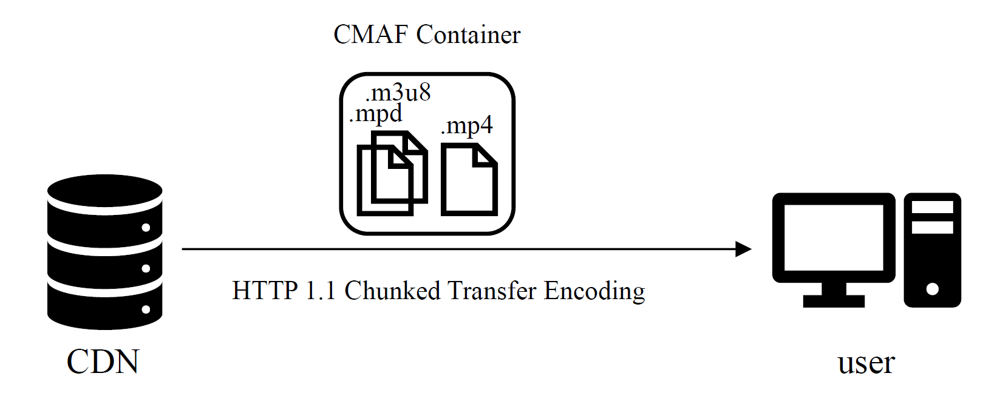
CMAF-based Streaming Example
  The encoder wraps a single .mp4 file and a .mpd & .m3u8 file inside one CMAF container. Then, the data is pushed via HTTP 1.1 Chunked Transfer Encoding via the CDN to the end users video player. The system no longer waits for a request because, with progressive delivering, the chunks are pushed to the player as soon as they are available.

Slide 68
16.5.3 Web Real Time Communication (WebRTC)
  An open source project and specification that was initiated by Google in 2011, targeting high quality realtime communication applications within browsers on both desktop and mobile platforms
  Works directly in a web browser without requiring additional plugins or downloading native apps.
  Unlike CMAF, it does not use HTTP to send media data. Instead, it establishes a connection using UDP and delivers encrypted media data over RTP.
    - Latency of 500 milliseconds or less.

Slide 69
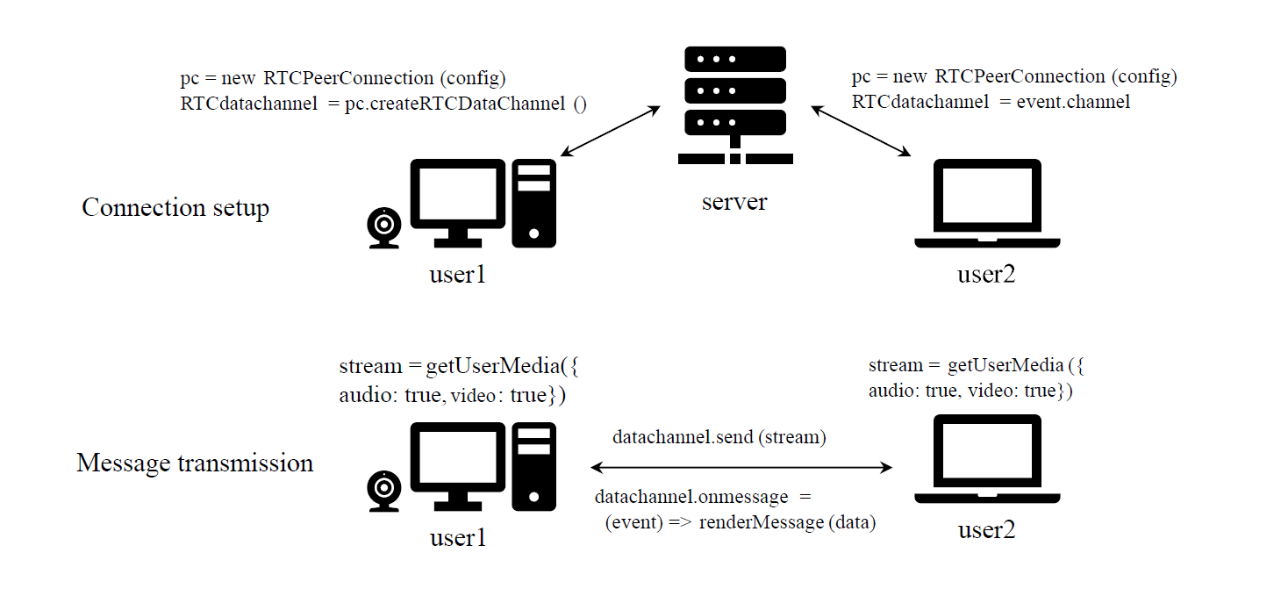
A Live Chat Application using WebRTC

Slide 70
A Live Chat Application using WebRTC
getUserMedia: accesses the audio and video media data from storage or device;
RTCPeerConnection: performs signal processing, codec handling, peer-to-peer communication, security, and bandwidth management;
RTCDataChannel: enables bidirectional communication of data between peers with low latency.

