Slide 1
Chapter 17 Multimedia Over Wireless and Mobile Networks
17.1 Characteristics of Wireless Channels
17.2 Wireless Networking Technologies
17.3 Multimedia Over Wireless Channels
17.4 Mobility Management

Slide 2
17.1 Characteristics of Wireless Channels
Wireless radio transmission channels are far more error-prone than wire-line communications.
Various effects cause radio signal degradation in the receiver side:
For outdoor channels, long-range communication is dominated by atmospheric attenuation:
Radio waves can penetrate the ionosphere (> 3 GHz) and establish a Line Of Sight (LOS) communication.
For lower frequencies reflect off it and off the ground, or travel along it to the receiver.
At frequencies over 3 GHz though (which are necessary for satellite transmissions to penetrate the ionosphere) there are gaseous attenuations, primarily influenced by oxygen and water (vapor and rain)
For indoor channels, multipath fading is the main factor for signal degradation.

Slide 3
Path Loss
Long-range signal loss is dominated by atmospheric attenuation.
Free-space attenuation model for LOS is given by the Friis radiation equation:
(17.1)
S_{r} and S_{t} – received and transmitted signal power
G_{r} and G_{t} – antenna gain factors
λ – signal wavelength
L – receiver loss
Attenuation increases to be proportional to d⁴ with ground reflection.

Slide 4
Path Loss (Cont’d)
Hata model: empirically derived based on the Okumura path loss data in Tokyo.
Path loss equation in dB is given by:
(17.2)
A – a function of the frequency and antenna heights
B – an environment function
C – a function depending on the carrier frequency
d – the distance from the transmitter to the receiver

Slide 5
Multipath Fading
Fading: the received signal power (suddenly) drops due to reflection, refraction, scattering, and diffraction. A common phenomenon in wireless communications.
Fig 17.1: An example of multipath
Multipath fading occurs when a signal reaches receiver via multiple paths.
Multiple instances of signal arrive at different times and phases, and cancel each other — cause loss of signal and connection.

Slide 6
Multipath Fading (Cont’d)
Doppler spread: the distribution of the signal power over frequency spectrum.
Narrowband signals: Doppler spread is small enough and signal is coherent — there is only one distinguishable signal at the receiver.
Wideband signals: different frequencies of the signal have different fading paths, and a few distinguishable signal paths are observed at the receiver, separated in time.

Slide 7
Narrowband Signal Fading
For narrowband signals, the most popular models are Rayleigh fading and Rician fading.
The Rayleigh model assumes an infinite number of signal paths with non line of sight (NLOS) to the receiver. The probability density function of received signal amplitude is given by:
(17.3)
where σ is the standard deviation of the probability density function.
Rayleigh model does provide a good approximation when the number of paths is over 5.

Slide 8
Narrowband Signal Fading (Con’d)
A Rayleigh fading channel can be approximated using a Markov process with a finite number of states, referred to as a Finite State Markov Channel.
Gilbert-Elliott model: the simplest form with only two states, good and bad channel conditions.
Fig.17.2: The Gilbert-Elliott two-state Markov chain model
State 0: Good; State 1: Bad

Slide 9
Narrowband Signal Fading (Con’d)
A more general model that assumes a LOS is the Rician model.
Defines a K-factor as a ratio of the signal power to the scattered power. K is the factor by which the LOS signal is greater than the other paths. The Rician probability density function P_{c} is:
(17.4)
r and σ are the signal amplitude and standard deviation respectively, and s is the LOS signal power. I_{o} is a modified Bessel function of the first kind with 0 order.
When K=0, there is no LOS and the model reduces to a Rayleigh distribution; when K=∞, the model reflects additive white Gaussian noise (AWGN) conditions.

Slide 10
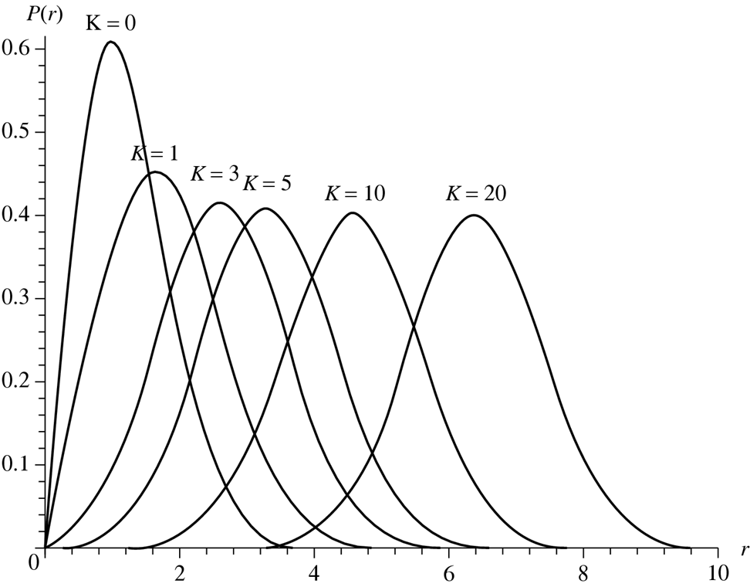
Fig. 17.3: Rician PDF plot with K-factor = 0, 1, 3, 5, 10, and 20 (σ = 1.0)

Slide 11
Wideband Signal Fading
Wideband signal fading paths are more empirically driven:
One way is to model the amplitude as a summation over all the paths, each having randomized fading.
The number of paths can be 7 for a closed room environment (6 walls and LOS), or a larger number for other environments.
An alternative technique of modeling the channel fading is by measuring the channel impulse response.
A similar technique is to use rake receivers:
Multiple radio receivers are tuned to signals with different phases and amplitudes, to recompose the transmission that is split to different distinguishable paths.
The signal at each rake receiver is added up to achieve better SNR.
A special pilot channel is needed to tune the rake receivers to proper fading paths.

Slide 12
17.2 Wireless Networking Technologies
Wide-area cellular networks:
A field covered by a number of cells (the geographical division unit of wireless networks).
The range of a cell is typically of 1000 m in cities, but can be larger (macrocell) or smaller (microcell) depending on the location and the density of users.
Access Point: gateway to the network for mobile phones in a cell to contacts. Connected through high-speed wired lines, or wireless networks or satellites that form the backbone network.
Handoff (or handover) is required to maintain communication when crossing APs.
Wireless Local Area Networks (WLANs):
Cover a much shorter range, generally within 100 m.
High bandwidth, low access cost and power consumption.
Ideal for use within a house or an office building.

Slide 13
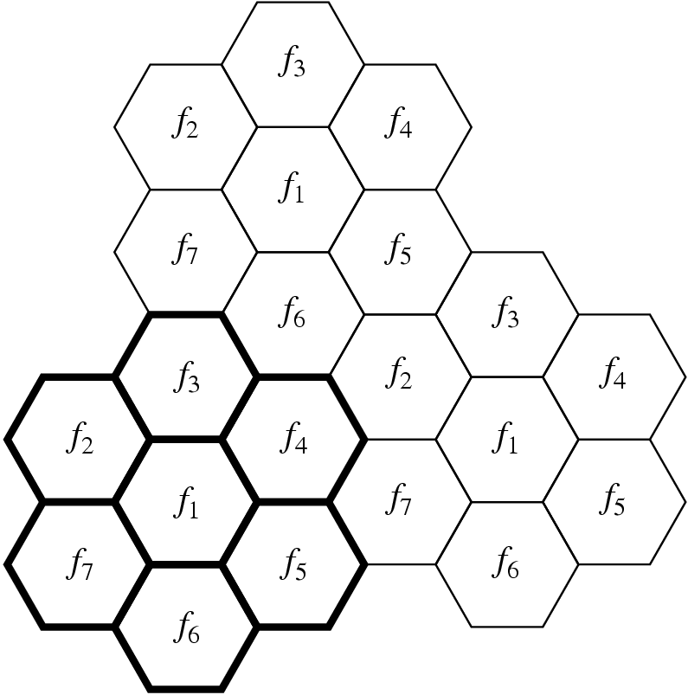
1G Cellular Analog Wireless Networks
1G cellular phones used analog technology with Frequency Division Multiple Access (FDMA). Each user is assigned a separate frequency channel during communication.
Used mostly for voice communications, such as telephone and voice mail.
Fig. 17.4: An example of geometric layout for an FDMA cellular system with a cluster size of seven hexagon cells.

Slide 14
2G Cellular Networks: GSM and Narrowband CDMA
2G wireless networks use digital technology.
Enable digital data transmitted for applications such as text messaging, streaming audio, and electronic publishing.
Two competing technologies since 1993:
Time Division Multiple Access (TDMA).
Code Division Multiple Access (CDMA).
Global System for Mobile communications (GSM), which was based on TDMA, is the most widely used worldwide.

Slide 15
TDMA and GSM
TDMA creates multiple channels in multiple time slots while allowing them to share the same carrier frequency.
TDMA usually combined with FDMA – the entire allocated spectrum is first divided into multiple carrier frequency channels, each of which is further divided in the time dimension by TDMA.
GSM was established by European Conference of Postal and Telecommunications Administrations (CEPT) in 1982.
GSM 900: operate in the 900 MHz frequency range.
GSM 1800: the original GSM standard modified to operate at the 1.8 GHz frequency range.
GSM 1900: In North America, GSM network uses frequencies at the range of 1.9 GHz.

Slide 16
Data Services in GSM
General Packet Radio Service (GPRS), referred to as 2.5G, developed in 1999.
Support packet-switched data over GSM.
Theoretical maximum speed of GPRS is 171.2 kbps when all eight TDMA time slots are taken by a single user. Maximum data rate for each GPRS user will drop if network is shared by multiple users.

Slide 17
CDMA
CDMA is a major breakthrough in wireless communications.
A spread spectrum technology: the bandwidth of a signal is spread before transmission.
Distinct advantages of being secure and robust against intentional interference (jamming).
Applicable to digital as well as analog signals because both can be modulated and “spread”.
Two ways of implementing spread spectrum: frequency hopping and direct sequence.

Slide 18
Direct Sequence (DS) Spread Spectrum
The foundation of CDMA is Direct Sequence (DS) spread spectrum.
Multiple CDMA users can make use of the same (and full) bandwidth of the shared wideband channel during the entire period of transmission.
Reuse factor K = 1. It has the potential of greatly increasing the maximum number of users as long as the interference from the multiple users is manageable.

Slide 19
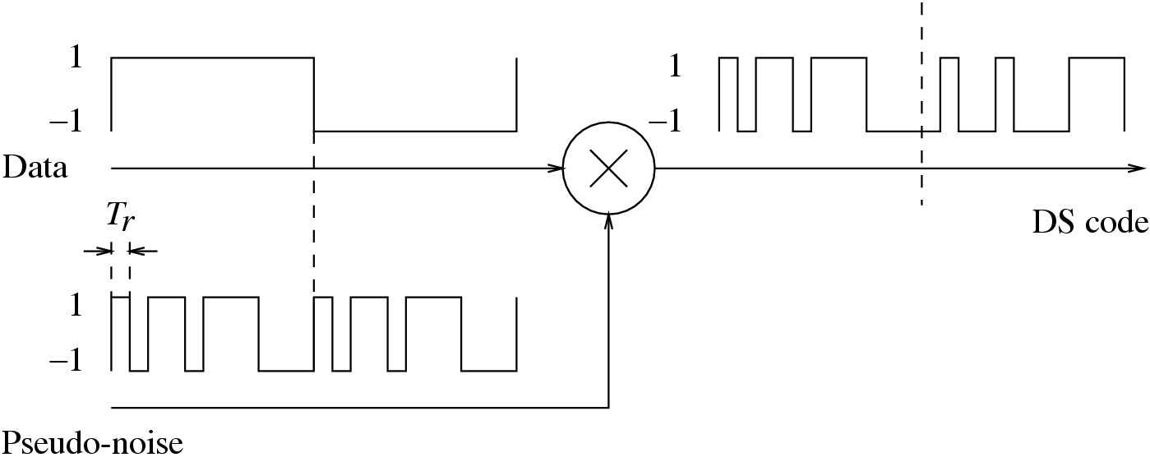
DS Spread Spectrum (Con’d)
Fig. 17.5: Spreading in DS Spread Spectrum
For each CDMA transmitter, a unique pseudo-noise spreading code is assigned to a DS spreader.
The spreading code (also called chip code) consists of a stream of narrow pulses called chips, with a bit width of T_{r}.
Its bandwidth B_{r} is on the order of 1/ T_{r}.

Slide 20
DS Spread Spectrum (Con’d)
The spreading code is multiplied with the input data by the DS spreader.
When the data bit is 1 the output DS code is identical to the spreading code, and when the data bit is 0 (represented by −1) the output DS code is the inverted spreading code.
As a result, the spectrum of the original narrowband data is spread, and the bandwidth of the DS signal is:
(17.5)
The despreading process involves the multiplication of the DS code and the spreading sequence.

Slide 21
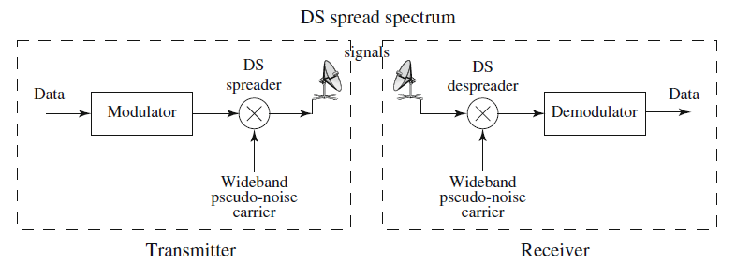
Fig. 17.6: Transmitter and Receiver of DS spread spectrum
Two ways to implement CDMA multiple access:
Orthogonal Codes: the spreading codes in a cell are orthogonal to each other.
Non-orthogonal codes: Pseudo-random Noise (PN) sequences.
Support more users and achieve better spectrum utilization.
Based on the observation that in general not all users are active in a cell.
Much more flexible than TDMA or FDMA (soft capacity vs. hard capacity).

Slide 22
3G Cellular Networks: Wideband CDMA
Since 3G, multimedia services have become the core issues for the cellular network development.
Applications include continuous media on demand, mobile interactive video call, remote medical service, and so on.
GPRS is the first step in the evolution of GSM networks toward 3G. Evolved to Enhanced Data rates for GSM Evolution (EDGE) networks, as an extension over the standard GSM, known as 2.75G. Still limited support for multimedia.
The 3G standardization process started in 1998. The project has been know for 3G or Universal Mobile Telecommunications System (UMTS).

Slide 23
Wideband CDMA (WCDMA)
3G wireless networks have been predominantly using Wideband CDMA (WCDMA).
The key differences in WCDMA air interface from a narrowband CDMA air interface:
To support bitrates up to 2 Mbps, a wider channel bandwidth is allocated. The
WCDMA channel bandwidth is 5MHz, as opposed to 1.25MHz for IS-95 and other earlier standards.
To effectively use the 5MHz bandwidth, longer spreading codes at higher chip rates are used. The chip rate specified is 3.84 Mcps, as opposed to 1.2288 Mcps.
WCDMA supports variable bitrates, from 8 kbps up to 2 Mbps.
Global standardization:
Third Generation Partnership Project (3GPP)
Third Generation Partnership Project 2 (3GPP2)

Slide 24
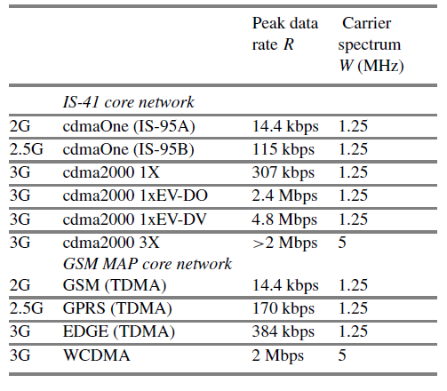
Table 17.1: Evolution from 2G to 3G Wireless Networks

Slide 25
New Generation of Multimedia Services
Bandwidth made available by 3G networks gives rise to applications not previously available to mobile phone users.
Online maps, online gaming, mobile TV, and instant picture/video content sharing
Rapid development of new generations of handsets, where support for high-quality video, better software and user interface, and longer battery life are key factors.
Greatly changed the way for people to interact with mobile devices and even their social behaviors.

Slide 26
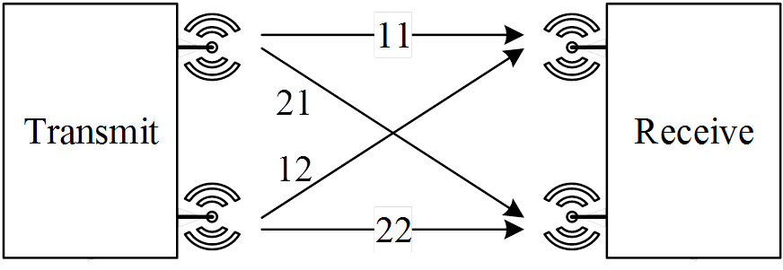
4G Cellular Networks
New radio techniques are employed to achieve higher rates and lower latencies than 3G:
Space Division Multiplexing via Multiple Input/Multiple Output (MIMO). Using multiple sending and receiving antennas leads to higher capacity and less impact from interference.
Fig. 17.7: A 2x2 MIMO antenna system

Slide 27
4G Cellular Networks
Space Time Coding (STC). Using higher order of modulation and encoding schemes improves number of bits transmitted per Hz.
Beam forming and beam directionality control. The properties of a beam are tuned or customized for a subscriber to achieve higher capacity for a limited duration.
Reduce interference through Orthogonal Frequency Division Multiplexing (OFDM).

Slide 28
IMT-Advanced
IMT-Advanced, as defined by ITU, has been commonly viewed as the guideline for 4G standards:
Based on an all-IP packet switched network.
Peak data rates of up to 100Mbps for high mobility and up to 1Gbps for nomadic/local wireless access.
Dynamically share and use the network resources to support more simultaneous users per cell.
Smooth handovers across heterogeneous networks.
High quality of service for next generation multimedia support.
Candidates systems:
LTE Advanced standardized by the 3GPP.
802.16m standardized by the IEEE (i.e., WiMAX).

Slide 29
3GPP LTE Advanced
Has largely taken the place of WiMAX, and has been considered as the standard for 4G.
Peak download rates up to 299.6Mbps and upload rates up to 75.4Mbps depending on the user equipment category (e.g.,with 4 × 4 MIMO antennas using 20MHz of spectrum).
Lower data transfer latencies (< 5ms latency for small packets), and lower latencies for handover and connection setup time.
Improved mobility support. Allows terminals to move at speeds up to 350 km/h (220 mph) or 500 km/h (310 mph), depending on frequency band .

Slide 30
5G Cellular Networks and Beyond
5G NR (New Radio has begun deployment in 2019.
According ITU-R, 5G will support three types of generic services
Enhanced mobile broadband (eMBB). The objective of this service is to maximize the data rate, while guaranteeing a moderate reliability.
Ultra-reliable and low-latency communications (URLLC). The objective of this service is to accommodate mission-critical low-latency transmissions of small payloads.
Massive machine-type communications (mMTC). This service accommodates a massive amount of Internet of Things (IoT) devices, which in general are inactive mostly of the time, and during the sporadically active times, send small data payloads only.

Slide 31
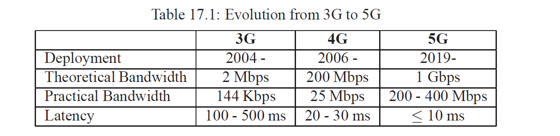
Evolution from 3G to 5G

Slide 32
5G Key Technologies
Massive MIMO.
a large number of individually-controlled antennas, each with embedded radio transceiver components.
The number of antennas even exceeds the number of users.
In practice, there can be 32 or even 64+ logical antenna ports in a 5G base station.
Small cells.
low power, short range wireless transmission for base stations to cover a limited geographical area for indoor or outdoor applications.

Slide 33
5G Networks Slicing
Partition the original network into multiple logical and independent networks that are configured to effectively meet the various services requirements.
E.g.,a low-latency slice, a maximum throughput/high bandwidth slice, and a slice enabling massive IoT deployment
Operator provides separate resources for each of them with fine-grained QoS monitoring.
Virtualization
- provides an abstract representation of the physical resources under a unified and homogeneous framework.
Orchestration
- coordinates all the different network functions that are involved in the life-cycle of each network slice.

Slide 34
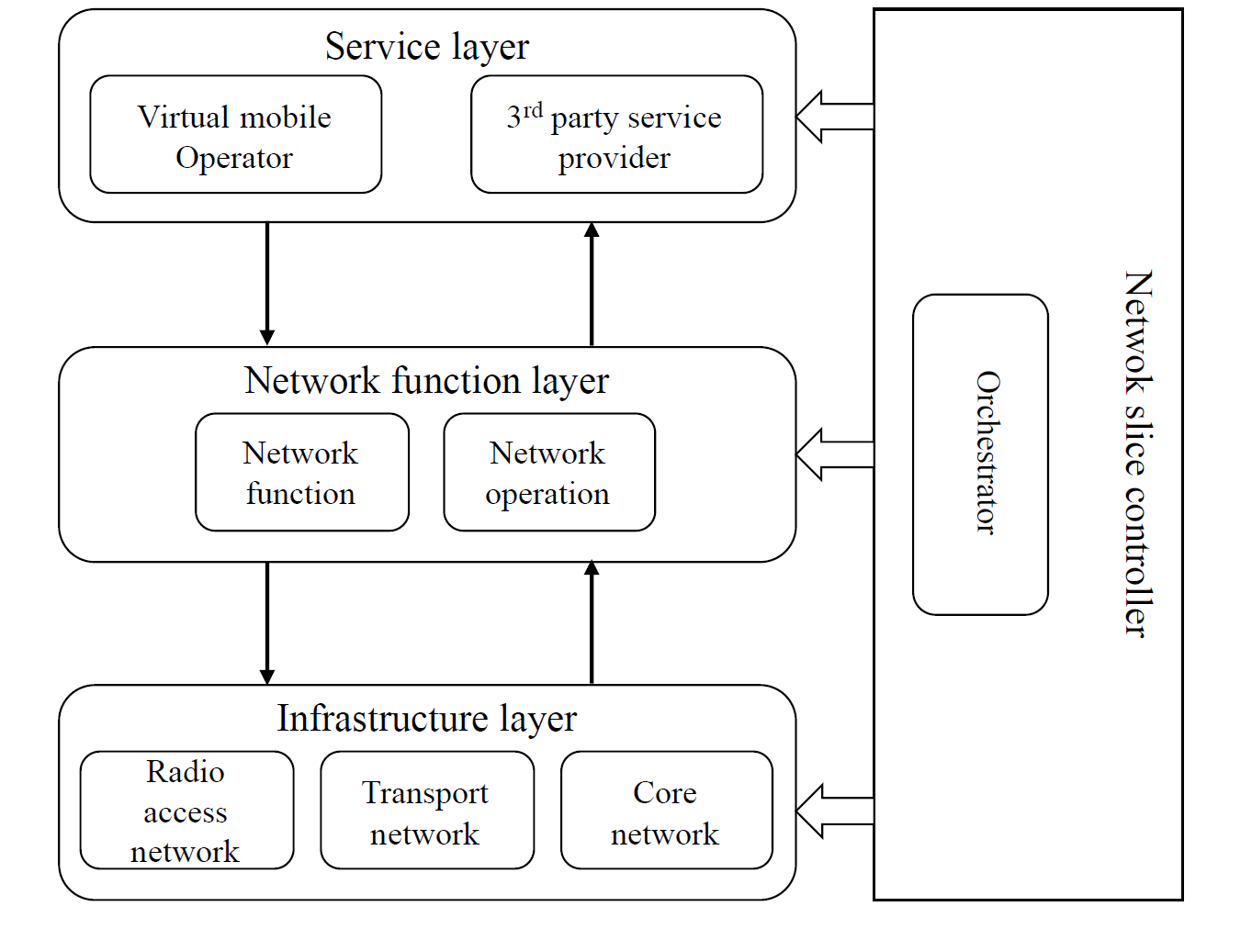
5G Networks Slicing

Slide 35
Wireless Local Area Networks (WLANs)
IEEE 802.11: Most of today’s WLANs are based on the 802.11 family of standards (also known as Wi-Fi), developed by the IEEE 802.11 working group.
Specify MAC (Medium Access Control) and PHY (Physical) layers for wireless connectivity in a local area within a radius less than 100 m.
Address the following important issues:
Security. Enhanced authentication and encryption, since the broadcast over-the-air is more susceptible to break-ins.
Power management. Saves power during no transmission and handles doze and awake.
Roaming. Permits acceptance of the basic message format by different AP.
The initial 802.11 standard uses the Industrial, Scientific and Medical (ISM) 2.4GHz radio band. Faces interferences from both of its own users and many other wireless systems, e.g., cordless phones

Slide 36
Carrier Sense Multiple Access with Collision Avoidance (CSMA/CA)
Collision Detection (CD) is not used due to the Hidden Terminal problem in wireless communications.
Fig. 17.9: An illustration of the hidden terminal problem. S2 is the AP; S1 and S3 are “hidden” to each other due to the long distance, but they can cause interference at S2.

Slide 37
CSMA/CA (Con’d)
802.11 uses Collision Avoidance (CA) to address the hidden terminal problem.
During carrier sensing, if another node’s transmission is heard, the current node should wait for a period of time for transmission to finish before listening again for a free communications channel.
Optional Request to Send and Clear to Send (RTS/CTS).

Slide 38
IEEE 802.11b/g
IEEE 802.11b: an enhancement of basic 802.11.
Uses DS Spread Spectrum and operates in the 2.4 GHz band.
Supports 5.5 and 11 Mbps in addition to the original 1 and 2 Mbps, and its functionality is comparable to Ethernet.
In North America, for example, the allocated spectrum for 802.11b is 2.400–2.4835GHz.
Regardless of the data rate (1, 2, 5.5 or 11 Mbps), the bandwidth of a DS Spread Spectrum channel is 20 MHz.
Three non-overlapped DS channels can be accommodated simultaneously, thus allowing a maximum of 3 access points in a local area.
IEEE 802.11g: an extension of 802.11b.
Achieves data rates up to 54 Mbps.
Still uses the 2.4GHz band to be downward compatible with 802.11b.
OFDM is used instead of DS spread spectrum.

Slide 39
IEEE 802.11a
IEEE 802.11a operates in the 5 GHz band and it supports data rates in the range of 6 to 54 Mbps.
Uses Orthogonal Frequency Division Multiplexing (OFDM).
Allows 12 non-overlapping channels, hence a maximum of 12 access points in a local area.
Operates in the higher frequency (5 GHz) band, so it faces much less Radio Frequency (RF) interference.
Coupled with the higher data rate, it has a great potential of supporting various multimedia applications in a LAN environment.
802.11a products started shipping late, lagging 802.11b products due to the 5GHz components being more difficult to manufacture.
Mostly used in enterprise network environments which require increased capacity and reliability over 802.11b/g-only networks.

Slide 40
IEEE 802.11n and 802.11ac
IEEE 802.11n
Maximum net data rate to 600 Mbps with the use of four spatial streams at a channel width of 40MHz.
Builds on previous 802.11 standards by adding MIMO, and frame aggregation to the MAC layer.
Channels operating with a width of 40MHz.
It can be enabled in the 5GHz mode, or within the 2.4GHz mode if no interference.
IEEE 802.11ac
Offers multistation WLAN throughput of at least 1Gbps and a single link throughput of at least 500 Mbps.
Wider radio bandwidth (up to 160MHz), more MIMO streams (up to 8), multiuser MIMO, and high-density modulation.

Slide 41
802.11ax (WiFi 6)
IEEE 802.11ax, the latest WLAN standard:
also known as Wi-Fi 6
succeeds 802.11ac by introducing better power control methods to avoid interference with neighboring networks.
also incorporates OFDMA and down-link MIMO and MU-MIMO
real-world speeds that are roughly 30% faster than 802.11ac
Theoretical maximum transfer speeds up around 10 Gbps

Slide 42
Bluetooth and Short-Range Technologies
Bluetooth: a protocol intended for short-range (piconet) wireless communications.
Uses Frequency Hopping (FH) at the 2.4 GHz ISM band.
Employs a master-slave structure. One master may communicate with up to seven slaves in a piconet; all devices share the master’s clock.
Principally designed as a low-bandwidth technology. Yet the transmission speed can be over 700 kbps, within a distance of 10 m.
Near Field Communication (NFC) and Wi-Fi Direct.
Ultra Wide Band (UWB) and cognitive radio.
Batteryless backscatter communication.

Slide 43
17.3 Multimedia Over Wireless Channels
Multimedia communications over wireless is the main driving force toward the new generation of higher speed wireless networks:
Streaming video, videoconferencing, online gaming, collaborative work, slide show presentations, and so on.
Characteristics of wireless handheld devices worth keeping in mind when designing multimedia transmission:
Both the handheld size and battery life limit the processing power and memory – low complexity in encoding and decoding.
Due to memory constraints and other reasons, real-time communication will likely be required.
Wireless channels have much more interference and much more limited bitrate than wired channels – error-resilient coding and coding efficiency are very important.

Slide 44
3GPP QoS Requirements for Multimedia Transmission
Synchronization — video and audio should be synchronized to within 20 ms.
Throughput. The minimum video bitrate to be supported is 32 kbps. Video rates of 128 kbps, 384 kbps, and above should be supported as well.
Delay. The maximum end-to-end transmission delay is defined to be 400 ms.
Jitter. The maximum delay jitter (maximum difference between the average delay and the 95th percentile of the delay distribution) is 200 ms.
Error rate. A frame error rate of 10⁻² or a bit error rate of 10⁻³ should be tolerated.

Slide 45
Error Detection
Error detection is to identify errors caused by noise or other impairments during transmission from the sender to the receiver.
Commonly used error detection tools:
Parity checking.
Checksum.
Cyclic Redundancy Check (CRC).

Slide 46
Parity Checking
With binary data, errors appear as bit flips, namely 0 to 1, or 1 to 0.
Parity checking adds a parity bit to a source bitstring to ensure that the number of set bits (i.e., bits with value 1) in the outcome is even (called even parity) or odd (called odd parity). For example, with even parity checking, a bit 1 should be appended to bitstring 10101000, and a bit 0 should be appended to 10101100.
Can be used to detect any single or odd number of errors on the receiver’s side.
However, cannot detect an even number of flipped bits.

Slide 47
Checksum
A checksum of an input message is a modular arithmetic sum of all the codewords in the message.
Sender appends the checksum to the message; Receiver performs the same sum operation to check whether there is any error.
Implemented in many network protocols, from data link and network layers, to transport and application layers.

Slide 48
Internet checksum algorithm (RFC 1071)
Pair the bytes of the input data to form 16-bit integers. If there is an odd number of bytes, then append a byte of zero in the end.
Calculate the 1’s complement sum of these 16-bit integers. Any overflow encountered during the sum will be wrapped around to the lowest bit.
The result serves as the checksum field, which is then appended to the 16-bit integers.
On the receiver’s end, the 1’s complement sum is computed over the received 16-bit integers, including the checksum field. Only if all the bits are 1 will the received data be correct.

Slide 49
An Example of Checksum
Suppose we have the following input data: 10111011, 10110101, 10001111, and 00001100. They are grouped as 1011101110110101 and 1000111100001100.
The sum of these two 16 bit integers is:
1011101110110101
+1000111100001100
0100101011000010
The overflow is wrapped around to the lowest bit.
The 1’s complement is then obtained by converting all the 0s to 1s and all the 1s to 0s. Thus the 1s complement of the above sum becomes 1011010100111101, which is the checksum.

Slide 50
An Example of Checksum (Con’d)
The receiver will perform the same grouping and summation for the receive bytes, and then add the received checksum too.
If there is no error, the outcome should be 1111111111111111. Otherwise, if any bit becomes 0, then errors happen during transmission.

Slide 51
Cyclic Redundancy Check (CRC)
Divide a binary input by a keyword K that is known to both sender and receiver. The remainder R after division constitutes the check word for the input.
Sender sends both the input data and the check word, and receiver can then check the data by repeating the calculation and verifying whether the remainder is still R.
To ensure R is fixed to r bits (zeros can be padded at the highest bits if needed), the keyword K should be of r + 1 bits.

Slide 52
CRC Implementation
Computing the remainder of dividing with modulo-2 in GF(2) (Galois field with two elements):
0 – 0 = 0 + 0 = 0
1 – 0 = 1 + 0 = 1
0 – 1 = 0 + 1 = 1
1 – 1 = 1 + 1 = 0
Addition and subtraction are identical and both are equivalent to exclusive OR (XOR, ⊕).
Multiplication and division are the same as in conventional base-2 arithmetic, too, except that, with the XOR operation, any required addition or subtraction is now without carries or borrows. Make hardware implementation much simpler and faster.

Slide 53
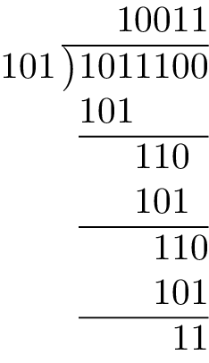
CRC Implementation (Con’d)
Given the message word M, and the keyword K, we can manually calculate the remainder R using conventional long division with modulo-2 arithmetic.
We also append r zeros to M before division, which makes the later verification easier.
For example, for M = 10111 and K = 101, we have
R = 11, which is appended as the check word to the message.

Slide 54
CRC Implementation (Con’d)
In the above case, M · 2^{r}⊕R is perfectly divisible by K (leave as an exercise).
Receiver can simply divide M · 2^{r}⊕R by K and check whether the remainder is zero or not. If it is zero, then there is no error; otherwise, the error is detected.
The keyword K comes from a generator polynomial whose coefficients are the binary bits of the keyword K. For example, for K = 100101 in the binary format, its polynomial expression is x⁵ + x² + 1.

Slide 55
CRC Implementation (Con’d)
Choosing a good generator is a nontrivial job.
For a well-chosen generator, two facts are known:
If the generator polynomial contains two or more terms, all single-bit errors can be detected.
An r -bit CRC can detect all burst errors of length no more than r . Burst means that the first and last bits are in error, and the bits in between may or may not be in error.
Standard generators of 8-, 12-, 16-, and 32-bits have been defined in international standards:
For example, GCRC−32 = 100000100110000010001110110110111 has been used in many places (e.g., IEEE Internet link-layer protocols, and MPEG-2) since 1975.

Slide 56
Error Correction
For real-time multimedia,
The delay for retransmission is too long.
Forward Error Correction (FEC) is often used instead.
FEC adds redundant data to a bitstream in order to recover some random bit errors in it.
FEC codes in general fall into two categories:
Block codes: apply to a group of bits at once to generate redundancy.
Convolutional codes: apply to a string of bits one at a time, and have memory that can store previous bits as well.

Slide 57
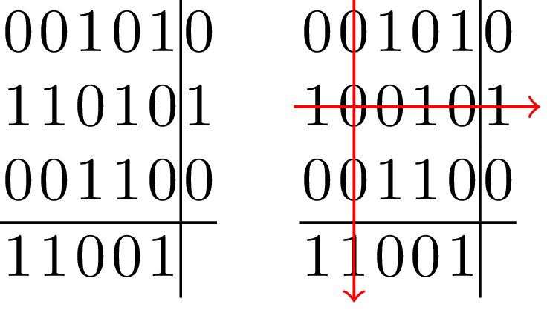
Two-dimensional parity checking
Two-dimensional parity checking: calculate the parity bit for each bitstring of M bits, and group every M bitstrings to form a matrix and calculate the parity bit of each column of the matrix.
Can both detect and correct errors.
Doubles the amount of parity bits.
If two errors occur in a row, cannot detect them.
parity error
parity error
Fig.17.10: An example of a two-dimensional even parity checking. Left No error; Right A single-bit error detected and corrected

Slide 58
Block Codes
Block codes take an input of k bits and append r = n − k bits of FEC data, resulting in an n-bit-long string — referred to as (n, k) codes.
Two types of block codes:
Linear codes are simple to compute but have higher coding overhead than cyclic codes. For example, Hamming codes.
Cyclic codes are stated in terms of generator polynomials of maximum degree equal to the number of source bits. The source bits are the coefficients of the polynomial, and redundancy is generated by multiplying with another polynomial. For example, BCH and RS Codes.

Slide 59
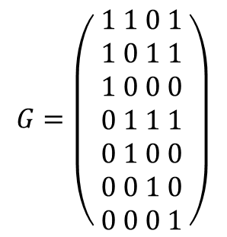
Hamming Codes
Hamming distance: the minimum number of bits between any coded strings that need to be changed so as to be identical to another valid string.
To detect r errors, the Hamming distance has to be at least equal r +1.
To correct r errors, the Hamming distance must be at least 2r + 1.
The first block code, the Hamming(7,4)-code, was invented in 1950. It encodes 4 data bits into 7 bits by adding 3 parity bits based on a generator matrix G, say

Slide 60
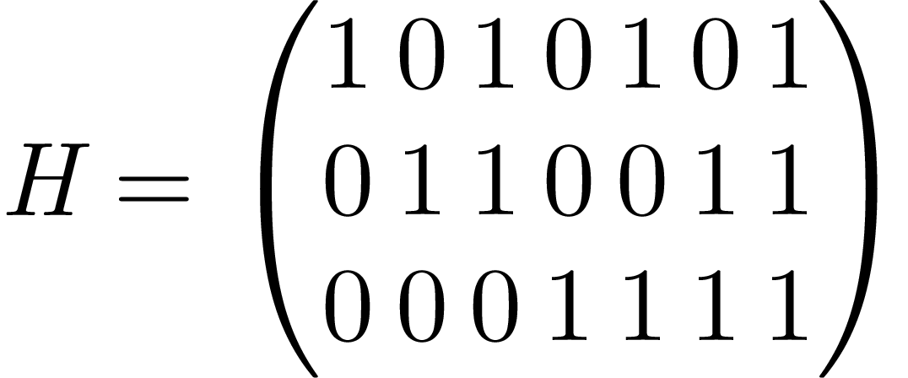
Hamming Codes (Con’d)
Given an input data p (4 bits as a vector), the output code x is obtained by taking the product G · p and then performing modulo 2.
As an example, for bits 1001, the input vector p is (1,0,0,1)^{T} the product will be vector (2,2,1,1,0,0,1)^{T}, and the encoded output x will be (0,0,1,1,0,0,1)^{T} after modulo 2, or a 7-bit data block of 0011001
The Hamming(7,4)-code can detect and correct any single-bit error. To do this, a parity-check matrix H is used

Slide 61
Similar to encoding, we take the product H · x with modulo 2, which yields a vector z of length 3. We can treat z as a 3-bit binary number.
If it is zero, then there is no error;
otherwise, it indicates the location of the error (by checking the corresponding column in H).
For example, for x = 0011001, we have z = 0, i.e., no error; on the other hand, for x′ = 0111001, we have z = 010, which corresponds to the second column of H, indicating bit 2 is erroneous.
Extended Hamming codes can detect up to 2-bit errors or correct 1-bit errors without detection of uncorrected errors. By contrast, the simple 1D parity code can detect only an odd number of bits in error and cannot correct errors.

Slide 62
BCH and RS Codes
Bose-Chaudhuri-Hocquenghem (BCH) codes: one of the most used classes of cyclic codes.
The generator polynomial for BCH is also given over a Galois Field (GF) and is the lowest degree polynomial with roots of αi , where α is a primitive element of the field and i goes over the range of 1 to twice the number of bits we wish to correct.
BCH codes can be encoded and decoded quickly using integer arithmetic
Reed–Solomon (RS) codes: an important subclass of BCH codes that applies to multiple packets.
Have a generator polynomial over GF(2^{m}), with m being the packet size in bits
Take a group of k source packets and output n packets with r = n − k redundancy packets
Up to r lost packets can be recovered from n coded packets if we know the erasure points.

Slide 63
In RS codes, only packets can be recovered.
In the packet FEC scenario, the packet itself often contains a sequence number and checksum or CRC in its header. In most cases, a packet with an error is dropped, and we can tell the location of the missing packet from the missing sequence number.
RS codes are useful for both storage and transmission over networks. Possible to detect which packets were received incorrectly and recover them using available redundancy in burst packets losses.
Disadvantage of block codes: cannot be selectively applied to certain bits. On the other hand, convolutional codes can do this. More efficient for data where unequal protection is advantageous, such as videos.

Slide 64
Convolutional Codes
Convolutional FEC codes are defined over generator polynomials as well.
Computed by shifting k message bits into a coder that convolves them with the generator polynomial to generate n bits. The rate of such code is defined to be k/n.
After producing the n bits, some redundancy bits can be deleted (or “punctured”) to decrease the size of n, and increase the rate of the code. Such FEC schemes are known as rate compatible punctured convolutional (RCPC) codes.
Different amount of FEC can be applied to provide different level of protection, which is known as Unequal Error Protection (UEP).

Slide 65
RCPC puncturing is done after generation of parity information. Knowing the significance of the source bits for video quality, we can apply a different amount of puncturing and hence achieve UEP.
Applying unequal protection using RCPC according to bit significance information results in better video quality (up to 2 dB better) than using RS codes in wireless radio models.
For example, the Picture layer in a video protocol should get the highest protection, the macroblock layer that is more localized will get lower protection, and the DCT coefficients in the block layer can get little protection, or none at all.
Adaptively apply transport coding of the video stream with enough unequal redundancy suitable to channel conditions at the time and QoS requested in 3G networks.

Slide 66
Packet Interleaving
Packet interleaving is used to increase resilience to burst packet loss.
Uses column-major order, instead of transmitting with the original order. The first packet of each of the h rows is transmitted first, then the second, and so on.
Effectively converts a burst loss to a series of smaller uniform losses across the original rows. Much easier to handle given the enough redundancy in each row.
Could tolerate more than r erasures with error correction and concealment.
Does not increase bandwidth overhead but introduces additional delay.

Slide 67
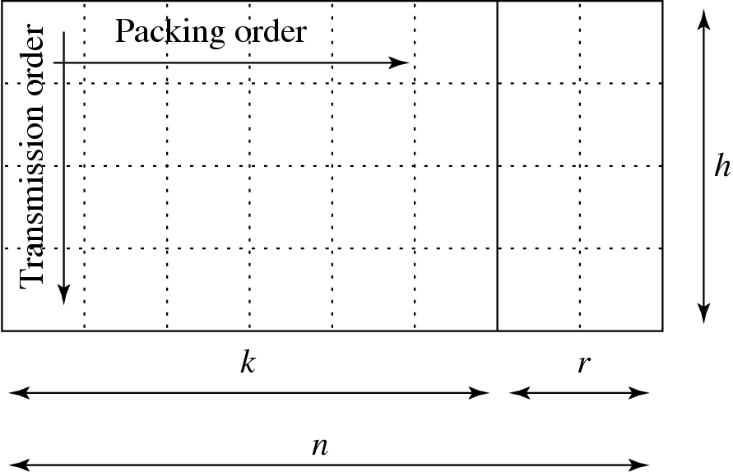
Fig. 17.11: Interleaving scheme for redundancy codes. Packets or bits are stored in rows, and redundancy is generated in the last r columns. The sending order is by columns, top to bottom, then left to right.

Slide 68
Error-Resilient Coding
Loss of decoder synchronization: for digital video coding, when there is damage to a packet containing variable bit-length data, that error, if unconstrained, will propagate all the way throughout the stream.
Slices reset spatial prediction parameters; differential coding across slice boundaries is not permitted.
Other than synchronization loss, errors in prediction reference frames cause much more damage to the signal quality than errors in frames not used for prediction. Similarly, if the video is scalable, an error at the base layer will deteriorate the quality of video stream more than in enhancement layers.

Slide 69
Reversible Variable-Length Code (RVLC)
An RVLC makes instantaneous decoding possible both in the forward and backward directions.
Random access of a coded stream. Halve the amount of indexing overhead with the same average search time as compared to the standard one-directional VLC.
An RVLC, must satisfy the prefix condition for instantaneous forward decoding and also a suffix condition for instantaneous backward decoding. A conventional VLC, say, Huffman coding, satisfies only the prefix condition and can only be decoded from left to right.

Slide 70
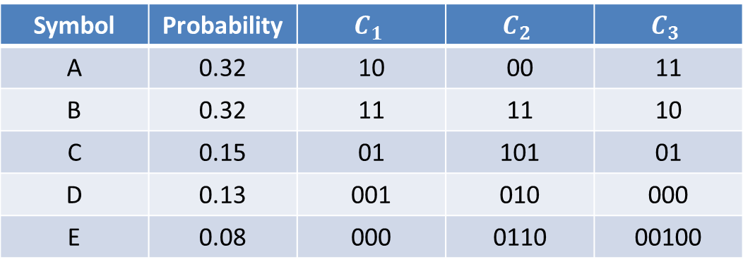
Table 17.2: Huffman code (C1), Symmetric RVLC (C2), and Asymmetric RVLC (C3)
Symbol | Probability
A | 0.32 | 10 | 00 | 11
B | 0.32 | 11 | 11 | 10
C | 0.15 | 01 | 101 | 01
D | 0.13 | 001 | 010 | 000
E | 0.08 | 000 | 0110 | 00100
Compared to Huffman coding (average code length of 2.21), symmetric RVLC has a slightly longer average code length (2.44). More efficient asymmetric RVLC can also be systematically constructed, which has an average code length of 2.37. The overhead is acceptable given the potential benefit of bidirectional decoding.

Slide 71
Error-Resilient Entropy Coding (EREC)
EREC can achieve synchronization after every single macroblock (MB), without any of the overhead of the slice headers or GOB headers.
Takes entropy-coded, variable-length macroblocks and rearranges them in an error-resilient fashion. Can provide graceful degradation.
Takes a coded bitstream of a few blocks and rearranges them so that the beginning of all the blocks is a fixed distance apart.

Slide 72
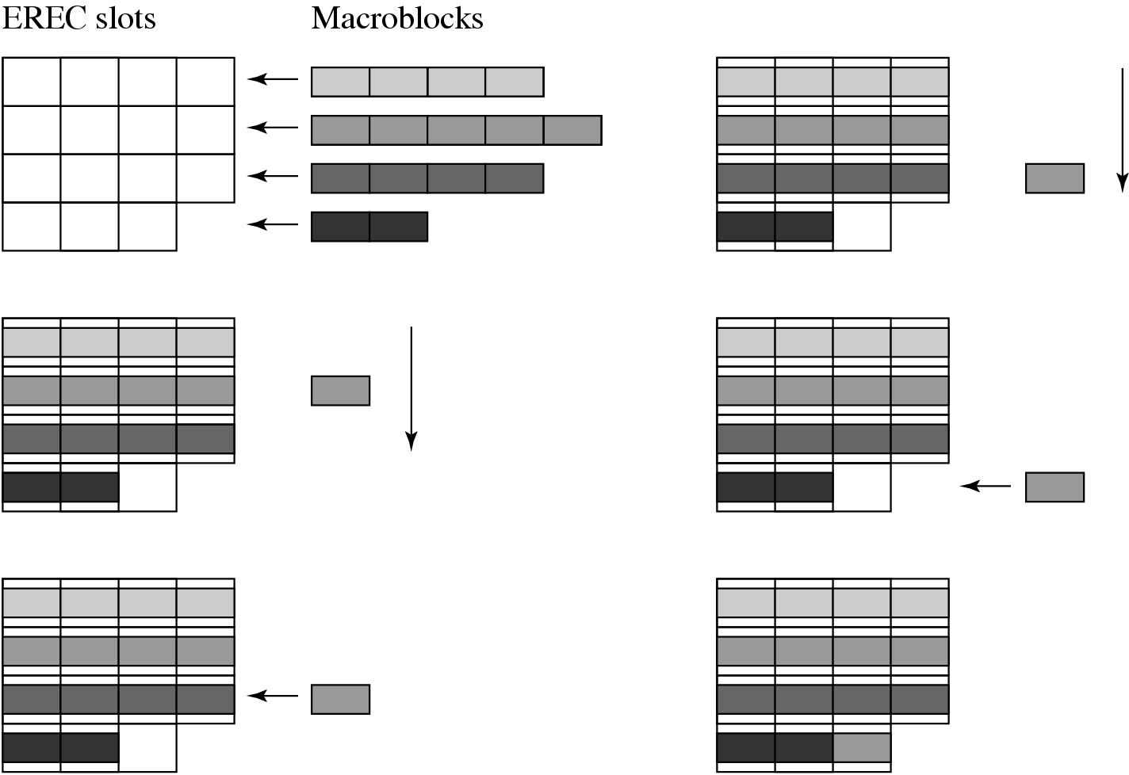
Fig. 17.12: Example of macroblock encoding using EREC

Slide 73
PROCEDURE EREC Encode
Let k be the number of macroblocks = the number of slots, l be the total bit-length of all the MBs, mbs[ ] be the MBs, slots[ ] be the EREC slots, then:
PROCEDURE 17.1 EREC Encode
BEGIN
j = 0;
DO until l = 0
{
FOR i = 0 to k - 1
{
m = (i+j) mod k;
Shift as many bits as possible (without overflow) from mbs[i] into slots[m];
sb = number of bits successfully shifted into slots[m] (without overflow);
l = l - sb;
}
j = j +1; // shift the MBs downwards
}
END

Slide 74
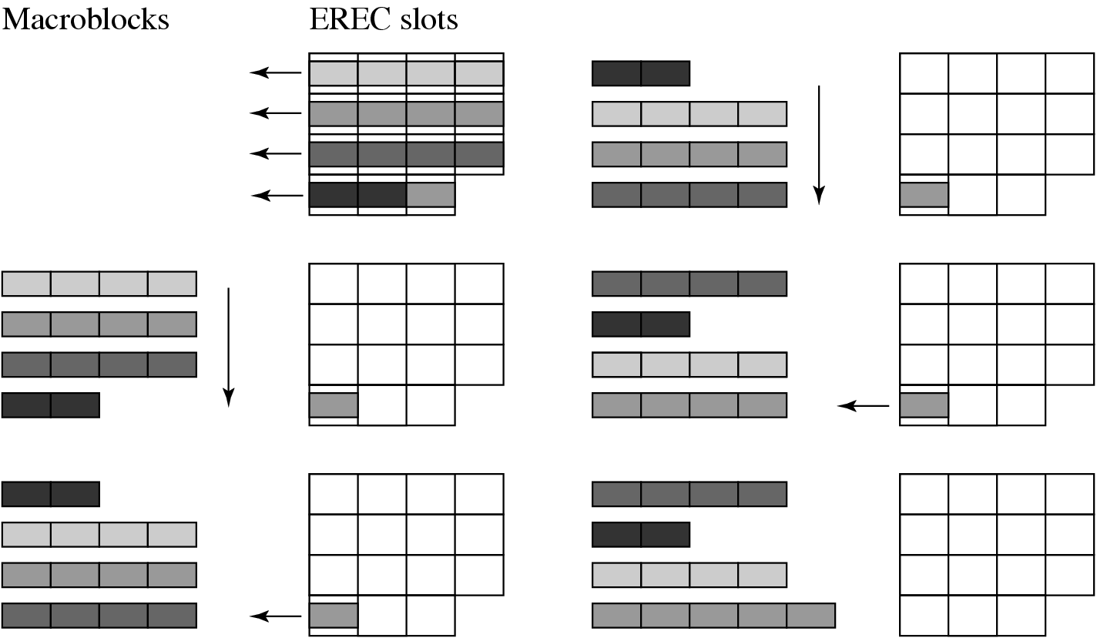
Fig. 17.13: Example of macroblock decoding using EREC

Slide 75
Error Concealment
Error concealment: techniques used to approximate the lost data on the decoder side, so as to mitigate their negative audio or visual impact.
Error concealment techniques apply in the spatial, temporal, or frequency domains, or a combination of them.
Necessary for wireless video communication since the error rates are higher than for wired channels and might even be higher than can be transmitted with appropriate bit protection.

Slide 76
Summary of Techniques for Error Concealment
Dealing with lost macroblock(s) – A simple and very popular technique for concealment can be used when DCT blocks are damaged but the motion vectors are received correctly.
Combining temporal, spatial and frequency coherences – By having rules for estimating missing block coefficients using the received coefficients and neighboring blocks in the same frame, can conceal errors for intra-frames and for frames with damaged motion vector information.
Frequency smoothing for high frequency coefficients – The simplest remedy is to set high-frequency coefficients to 0 if they are damaged.
Estimation of lost MVs – The loss of motion vectors prevents the decoding of an entire predicted block, so it is important to estimate them well.

Slide 77
17.4 Mobility Management
Mobility is another distinct feature of wireless portable devices.
Traditional TCP/UDP/IP networks were originally designed for communications between fixed ends — many issues need to be resolved to support mobility.
Mobility of a user in a network can be broadly classified into three categories:
Micromobility (intra-subnet mobility), where movement is within a subnet.
Macromobility (intradomain mobility), where movement is across different subnets within a single domain.
Global mobility (interdomain mobility), where movement is across different domains in various geographical regions.

Slide 78
Broad spectrum of device and user mobility, in terms of both range and speed:
Fig. 17.14: Real-world mobility range and mobility speed

Slide 79
Handoff (also known as handover) is required to avoid interruption during communication, by which a mobile terminal keeps its connection active when it moves from one network access point to another.
location management is also needed to support mobility, which tracks the locations of mobile terminals, and provides such popular location-based services as searching nearby users or media content related to the locations of interest.

Slide 80
Network Layer Mobile IP
The most widely used protocol is Mobile IP.
The Initial version was developed by IETF in 1996. IETF released Mobile IPv4 (RFC3220) and Mobile IPv6 (RFC3775) standards in 2002 and 2004, respectively.
The key support offered by Mobile IP is to assign a mobile host two IP addresses:
Home address (HoA): the fixed address of the mobile node (MN).
Care-of-address (CoA): changes with the IP subnet to which the MN is currently attached.
Each mobile node has a home agent (HA) in its home network, from which it acquires its HoA. In Mobile IPv4, the foreign network where the MN currently is attached should have a foreign agent (FA), replaced by an access router (AR) in Mobile IPv6). The mobile node obtains its CoA from its current FA or AR.

Slide 81
Fig. 17.15: The operations in mobile IP

Slide 82
The Operations in Mobile IP (Fig. 17.15)
The MN obtains the CoA and informs its HA of the new address by sending a Registration Request message to the HA.
The HA, upon receiving the message, shall reply to the MN with a Registration Reply message. The HA keeps the binding record of the MN, which is transparent to a correspondent node (CN) that intends to communicate with the MN.
Once a packet from the CN to the MN arrives at the home network, the HA will intercept the packet.
The HA then forward it to the FA by a tunnel that encapsulates the original packets (with the HoA in the headers) into packets with the CoA in the headers. Once the FA receives the tunneled packets, it removes the extra header and delivers it to the MN.
When the MN wishes to send data back to the CN, the packets are sent directly from the MN to the destination since the CN’s IP address is known by the MN.

Slide 83
Fig. 17.16: The data path in mobile IP

Slide 84
Link-Layer Handoff Management
Link-layer handoff or handover occurs when a mobile device changes its radio channels to minimize interference under the same AP or BS (called intracell handoff) or when it moves into an adjacent cell (called intercell handoff).
For intercell handoff, there are two types of implementations, namely, hard handoff and soft handoff

Slide 85
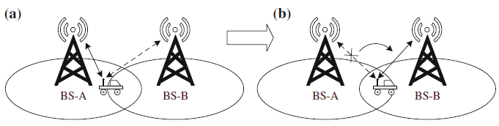
Hard Handoff
Fig. 17.17: An illustration of hard handoff. Before handoff, the mobile node is connected to BS-A, but the signal strength becomes weaker when it is moving toward BS-B. At a certain time when the signal strength of BS-B is above a threshold (and that of BS-A becomes very weak), a hard handoff decision will be made, such that the connection to BS-A is first broken and the connection to BS-B is then established. (a) Before hand off and (b) After hand off

Slide 86
Drawback of Hard Handoff
The ongoing session can be temporarily disrupted if the hard handoff fails. Reestablishment is then needed, which may be noticeable to the users and sometimes could fail, causing a session to be terminated abnormally.
Also when the mobile stays between BSs, it can bounce back and forth, causing an undesirable ping-pong phenomenon.

Slide 87
Soft Handoff
In a soft handoff, the channel in the source cell is retained and used for a while in parallel with the channel in the target cell.
Make before break: the connection to the target is established before the connection to the source is broken. Two connections are used in parallel in a soft handoff.
Advantages of soft handoff over hard handoff:
The connection to the source cell is broken only when a reliable connection to the target cell has been established — lower chances that the call is terminated abnormally due to failed handoffs; higher reliability of connection.
Smooth handoff permits a smooth handoff that is critical to continuous media data flows. Comes at the cost of more complex hardware in the device — capable of receiving and processing several channels in parallel.

Slide 88
Vertical Handoff
Vertical handoff: the handoff between different types of networks.
A typical example is between Wi-Fi and cellular networks, as the former is cheaper and fast and the latter is of broader and ubiquitous coverage. Switching between them combines their advantages.
A typical vertical handoff consists three steps:
System discovery: mobile terminal determines which networks can be used.
Handoff decision: mobile terminal determines whether the connections should continue using the current network or be switched to the target network.
Handoff execution: connections in the mobile terminal are rerouted from the existing network to the target network in a seamless manner.
Additional support from the transport and application layer with cross-layer optimizations are needed to enable smooth transitions.

