Slide 1
Chapter 18 Cloud Computing for Multimedia Services
18.1 Cloud Computing Overview
18.2 Multimedia Cloud Computing
18.3 Multimedia Content Sharing over Cloud
18.4 Multimedia Computation Offloading
18.5 Interactive Cloud Gaming
18.6 Edge Computing and Serverless Computing for Multimedia

Slide 2
18.1 Cloud Computing Overview
A new paradigm, allowing for computing resources to be purchased or shared using a pay for usage model.
Much like traditional utility resources, such as electrical power, users are now free to purchase or lease resources as needed.
Many existing applications, from content sharing to media streaming have been migrated to this model with great success in terms of costs and system efficiency.
Examples include the file synchronization system DropBox and the media streaming service Netflix

Slide 3
Cloud Computing: Private vs Public
Clouds a generally split into two categories private and public.
Private clouds are generally maintained on private networks and usually only utilized by a single datacenter tenant to provide services to their customers.
Public Clouds are available as a public utility where multiple tenants can purchase resources to provide services to their customers. For example, Amazon Elastic Compute Cloud (EC2).
3

Slide 4
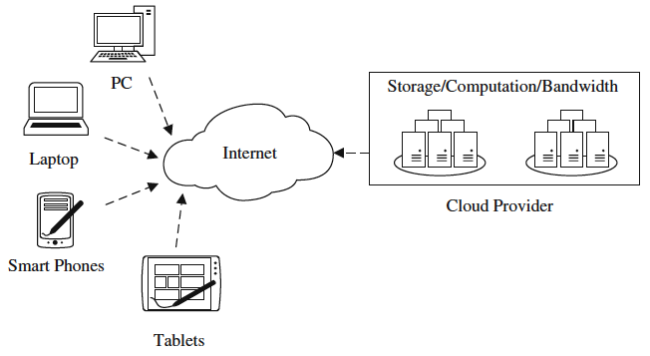
Conceptual Overview of Cloud Computing
Fig 18.1: A conceptual overview of cloud computing
Cloud users use an Internet enabled device to connect to a cloud service provider.
The cloud provider can provide superior computing resources such as storage, computation and bandwidth.
End users can store data in the cloud, making ubiquitous data access possible.
4

Slide 5
Cloud Computing: Characteristics
Common set of characteristics identified by National Institute of Standards and Technology (NIST).
On-Demand Self Service.
A user can unilaterally provision computing resources.
Resource Pooling and Rapid Elasticity.
Cloud resources are available for provisioning by multiple users and resources can be dynamically assigned.
Measured Service.
Computing resource usage (eg. computation, storage, bandwidth) can be monitored, controlled and reported to both the cloud provider and user.
Broad Network Access.
Persistent and high quality network access is available.
5

Slide 6
Different Cloud Service Models
Infrastructure as a Service (IasS)
Provides a pool of resources, which the user accesses and configures for their needs. Users are usually free to install their own operating systems and applications. Examples include the virtual machine based Amazon EC2 and the storage service Amazon S3.
Platform as a Service (PaaS)
Delivers a development environment, typically include preselected operating systems, programming environments, databases management systems, and webservers. Google’s App Engine is a typical example.
Software as a Service (SaaS)
Allows applications to run on the infrastructure and platforms offered by the cloud. Often storing both the users data and application in the cloud. Examples include Google Drive (Formely Google Docs).
6

Slide 7
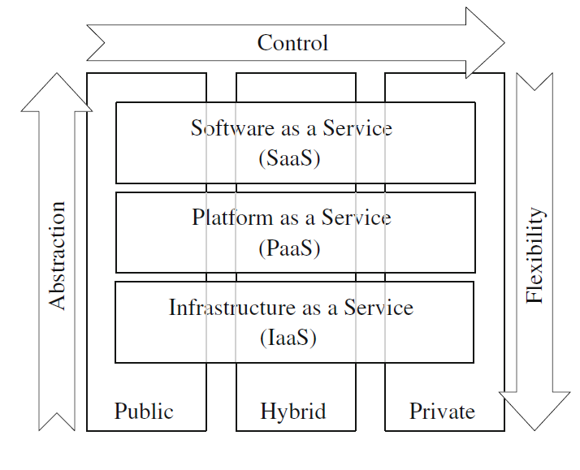
Relations Among Different Service Models
Fig 18.2: An illustration of cloud service models
7

Slide 8
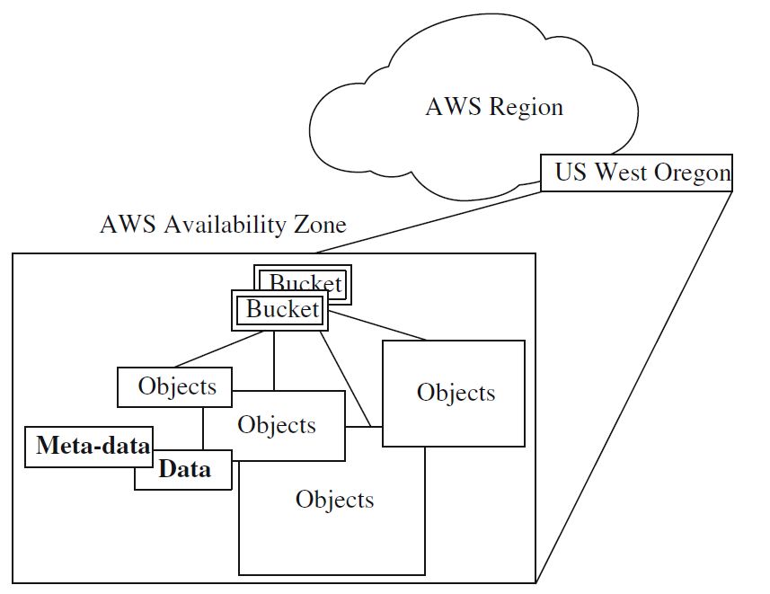
Cloud Storage Example: Amazon S3
Fig 18.3: An example of a data object stored in an Amazon AWS region (US West)
S3 provides a web interface to store and retrieve practically any amount of data.
Intentionally built with a minimal feature set, to provide maximum performance and flexibility for end users and developers.
Features include encryption, access control as well a durability for stored data. With these features developers can create robust applications.
8

Slide 9
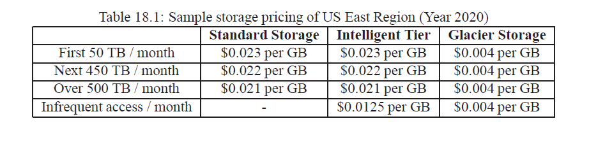
Cloud Storage Example: Amazon S3
9

Slide 10
Cloud Computation Example:
Amazon EC2
Amazon’s Elastic Compute Cloud (EC2) is a public computational cloud that provides resizable compute instances.
Implemented using Virtual Machines (VM) provided by the Xen virtualization system.
VMs can be resized dynamically by the users, ex. To increase CPU resources, available ram, and disk space.
Different instance provisioning strategies exist, namely “on-demand” and “spot” instances.
On-Demand: Allows users to purchase computation capacity by the hour at a set price.
Spot: Users bid on unused EC2 capacity and their instances run while their bid price exceeds the current spot price.
EC2 user has the choice of highly configurable instance types, including memory, CPU, storage and operating system.
10

Slide 11
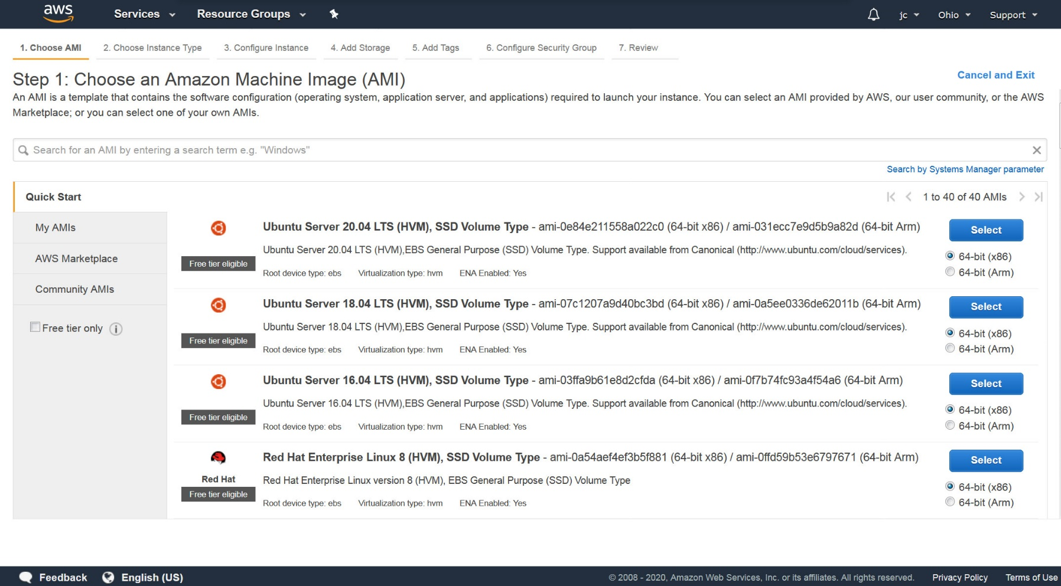
Amazon EC2: Create an Instance
11

Slide 12
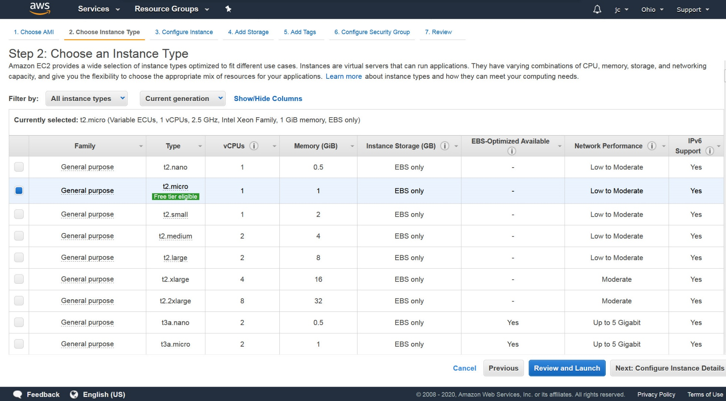
Amazon EC2: Choose Instance Type
12

Slide 13
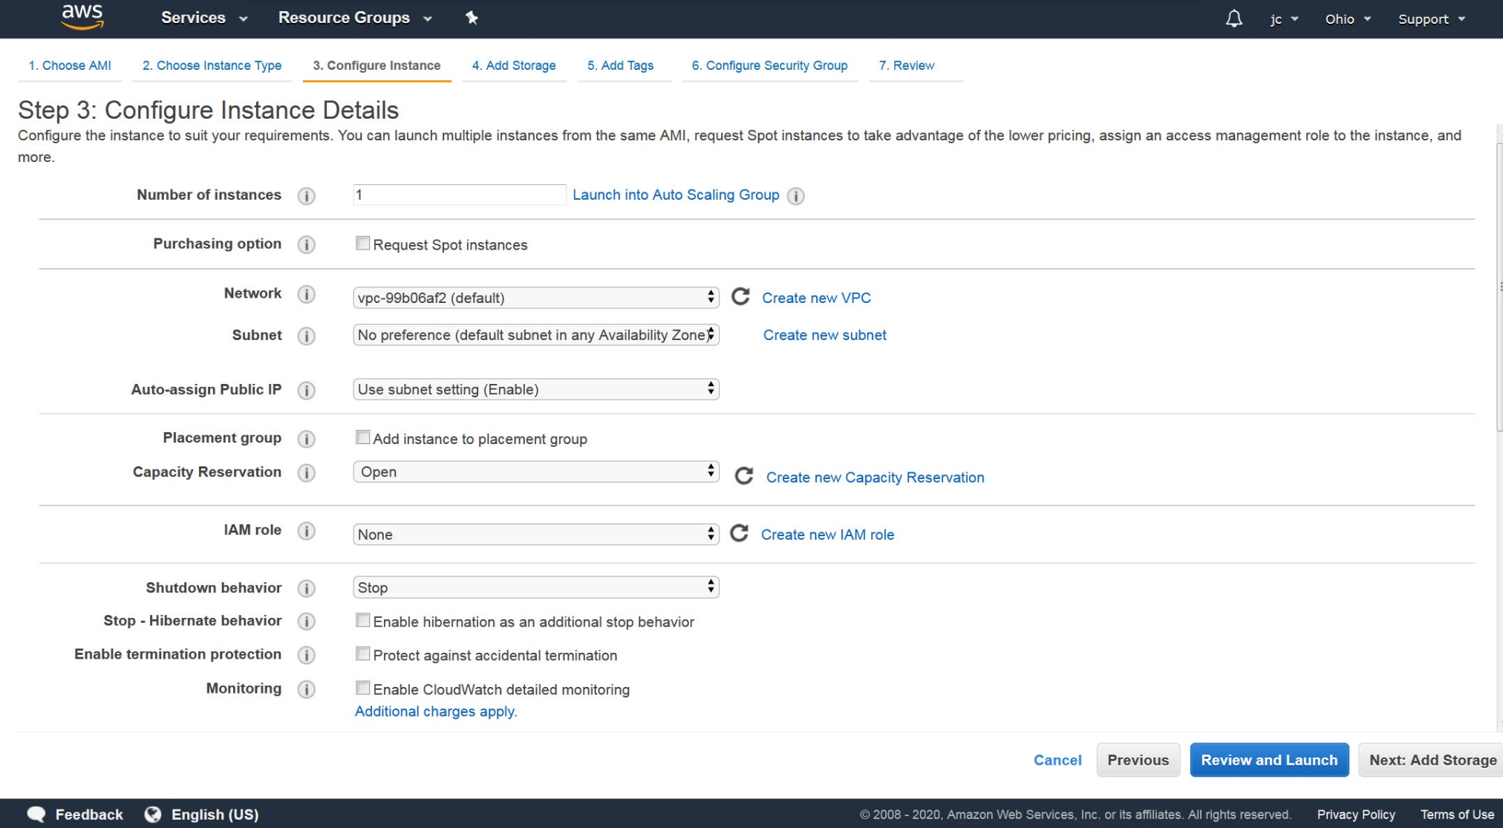
Amazon EC2: Configure Instance
13

Slide 14
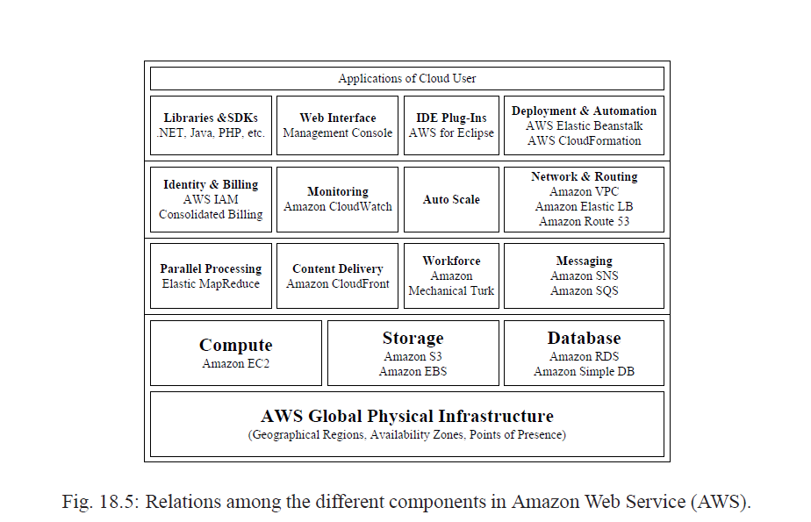
Amazon Web Service (AWS)
Designed for use with other AWS modules, EC2 works seamlessly in conjunction with Amazon S3, and such other Amazon services as Relational Database Service (RDS), SimpleDB and Simple Queue Service (SQS) to provide a complete solution for computing, query processing and storage across a wide range of applications.
14

Slide 15
18.2 Multimedia Cloud Computing
Distribution of multimedia content has always been a fundamental issue for media service and content providers.
The large computational, storage and bandwidth capacity of the Cloud make it a very attractive platform for multimedia applications. Further, large public cloud often have many strategically geographically located data-centers allowing for more efficient distribution of content.
Multimedia Cloud Computing and general purpose Cloud Computing share many commonalties. However, multimedia services are highly diverse, examples include voice over IP, video conferencing, and video streaming.
15

Slide 16
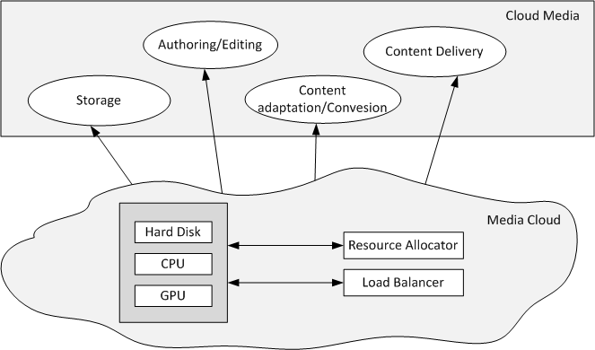
Modules and their relation in Multimedia Cloud Computing
Fig 18.7: Modules and their relations in multimedia cloud computing
16

Slide 17
18.3 Multimedia Content Sharing over Cloud
Media sharing and distribution services are evolving extremely quickly. New services and applications are being developed constantly, some become hugely successful like Youtube, many others fade into obscurity.
Developers face a trade off in the early stage of any multimedia service.
How to provision enough resources to provide a high quality experience to their current users, as well as allowing room for the user base to grow, while not overextending themselves on costly infrastructure projects and overhead.
The Cloud’s “pay-as-you-go” service allows a service to start small and scale large without huge initial capital investments.
17

Slide 18
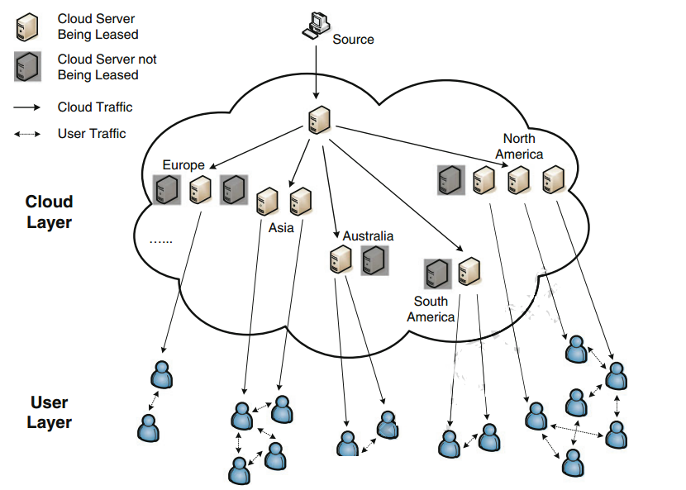
Generic Framework Media Streaming
Fig 18.8: A generic framework for migrating live media streaming service to the cloud
18

Slide 19
Case Study: NetFlix
Combing huge network traffic requirements and dynamic unpredictable demand bursts Netflix has become a prominent example of a business greatly enhanced by multimedia Cloud Computing.
As of 2018, all of Netflix’s media infrastructure has been moved to Amazon public cloud.
Netflix leverages Amazon’s cloud services to provide the following features:
Content Conversion: Using EC2 to convert master copies to over 50 different versions, with varying levels of video resolution, video quality and audio quality.
Content Storage: Utilizing S3 to store the many converted copies.
Content Distribution: Data is distributed from S3 to OpenConnect, the company’s proprietary CDN, where the media is ultimately streamed to the end user.
19

Slide 20
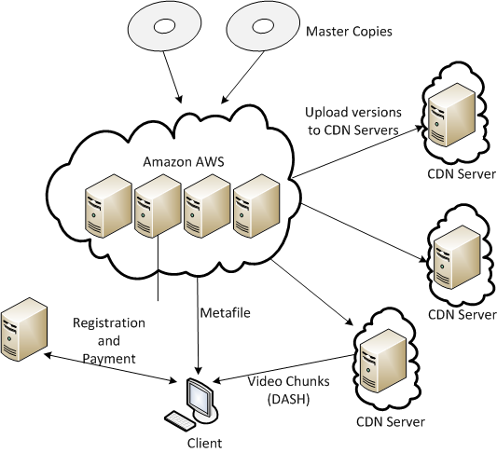
Case Study: NetFlix
Fig 18.11: The cloud-based Netflix architecture during migration. Its own servers were finally eliminated by 2018.
20

Slide 21
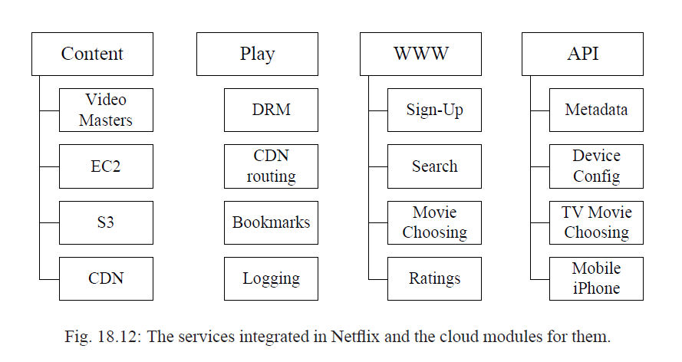
Case Study: NetFlix
21

Slide 22
18.4 Multimedia Computation Offloading
Many computation-intensive applications are now being migrated to the cloud.
Users can access high-performance servers and clusters as needed meaning they do not have to maintain expensive infrastructure.
Further, users on relatively weak computational platforms such as cell phones and tablets can offload some of their computational tasks to save battery and improve performance.
For example, Apple’s Siri can offload some tasks to a remote cloud server if the computation would be too expensive to perform locally.
22

Slide 23
Requirements for Offloading
Motivation for offloading.
to save energy locally, to improve computation performance, or both.
Gain of offloading.
A profiling or breakdown analysis of the application is needed.
Decision of offloading.
Offloading decision can be made statically or dynamically.
23

Slide 24
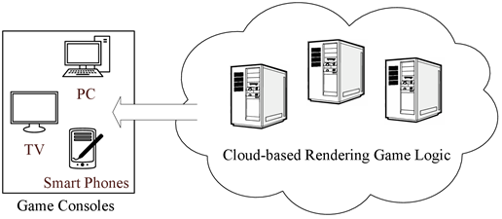
18.5 Interactive Cloud Gaming
Cloud Gaming at its core uses thin-clients to interact with powerful cloud-based servers to render interactive games remotely and stream the images back.
Many of today’s top interactive games require powerful desktop class components to provide an enjoyable gaming experience. Many relatively weaker devices such as tablets and smart phones do not meet the minimum requirements.
24

Slide 25
Cloud Gaming Challenges
From ultra low latency live video streaming to high performance 3D processing, cloud gaming has overcome considerable challenges.
In the time frame of only 100-200 milliseconds a cloud gaming system must collect a player's actions, transmit them to the cloud server, process the action, render the results, encode/compress the resulting changes to the game-world, and stream the video (game scenes) back to the player.
Very little time to employ video streaming buffers often found in other media streaming applications.
Many optimizations and technologies must be used to lower the players interaction delay (delay between a player’s action and resultant game scene).
GPU manufactures such as NVidia are developing cloud enable GPUs specifically targeted at cloud gaming.
25

Slide 26
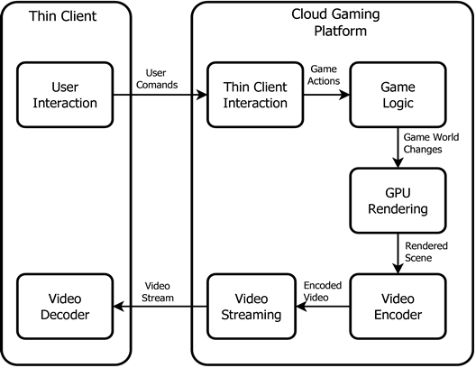
Cloud Gaming Architecture Overview
Fig 18.14: A generic framework of cloud gaming

Slide 27
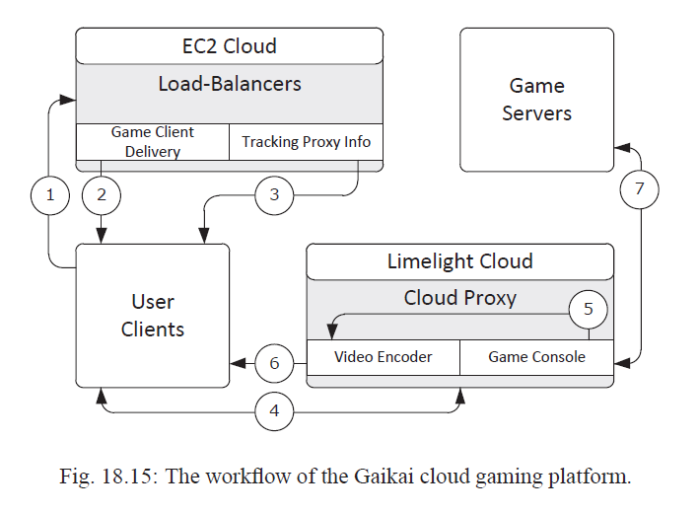
Case Study: Gaikai
Gaikai is implemented using two public clouds, namely Amazon EC2 and Limelight.
When a user selects a game on Gaikai (Step1 in Figure 18.15), an EC2 virtual machine will first deliver the Gaikai game client to the user (Step2).
After that, it forwards the IP addresses of game proxies that are ready to run the selected games to the user (Step3). The user will then select one game proxy to run the game (Step4). The game proxy starts to run the game and the game screens will be streamed to the user via UDP (Step5 and Step6).
For multi-player games, these proxies also forward user operations to game servers (mostly deployed by the game companies) and send the related information/reactions back to the users (Step7).

Slide 28
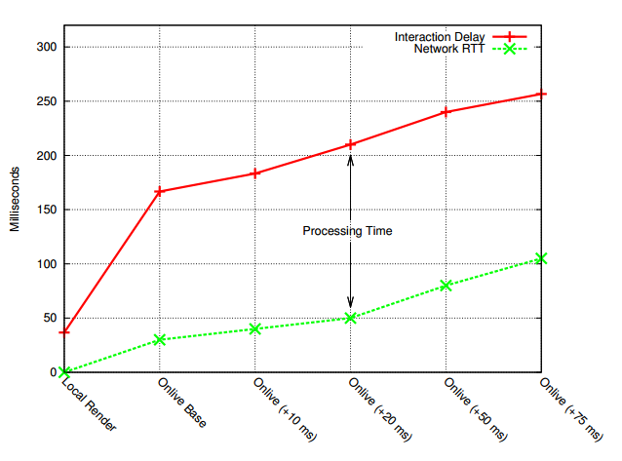
Case Study: Onlive
Fig 18.16: Interaction delay in Onlive
Measurements of the Onlive cloud gaming service indicate that given good network conditions total interaction delay can be just over 150 milliseconds. A local rendering of the same game takes approximate 37 milliseconds to render the same action.

Slide 29
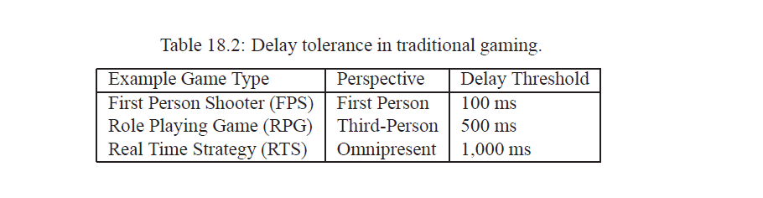
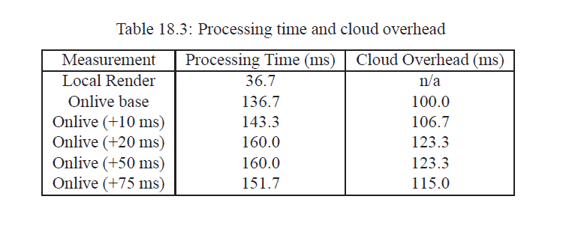
Case Study: Onlive

Slide 30
18.6 Edge Computing and Serverless
Computing for Multimedia
For delay-sensitive multimedia applications, aggregating all the resources in a centralized data center is not ideal.
Fine-grained resource partition and distribution is needed.
Two directions:
Edge computing (on geo-distribution)
Serverless computing (on service abstraction).
30

Slide 31
18.6.1 Edge Computing
Edge computing
A distributed computing paradigm that expands the cloud computing paradigm by bringing computation and data storage closer to the location where it is needed, i.e., network edge, so as to improve response times and save bandwidth.
Examples: AWS IoT Greengrass, CloudFront, Azure IoT Edge, Akamai Intelligent Edge.
Key Modules
Service module, which includes containers that run native or third-party services locally at the edge node;
Runtime, which runs and manages the service modules deployed to the node;
Cloud interface, which offers the connection, interaction and collaboration with the cloud data center.
31

Slide 32
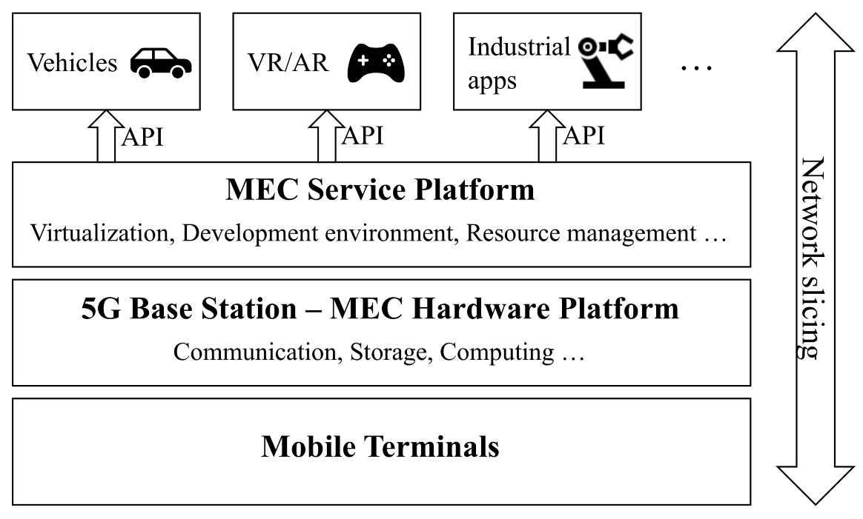
Mobile Edge Computing
Mobile Edge Computing
Or Multi-access Edge Computing (MEC)
Initially presented by European Telecommunications Standards Institute (ETSI) in 2015.
Bring storage and computing capability into cellular base stations.
Fig. 18.17: An architectural view of mobile edge computing (MEC)
Mobile Edge Computing

Slide 33
Mobile Edge Computing
Enabling technology of 5G
URLLC (Ultra-reliable and low-latency communications) cases
With the assistance of an edge server, Augmented Reality (AR) will be accelerated and timely feedback will help with modify a live representation of the world.
Video streaming services will operate much more efficiently given the awareness of local network conditions.
For smart transportation, connected and automated cars can efficiently and reliably coordinate with other cars nearby in realtime, in particular, within the coverage of the same base station.
mMTC (massive Machine Type Communications) cases
The tiny connected devices in smart home and smart city can more easily access the computing resources at the edge than from the remote cloud data center, in terms of speed, cost, and reliability.
33

Slide 34
18.6.2 Serverless Computing
Offloads the task of server provisioning and management from developers to platforms.
Developers only need to break up application codes into a collection of stateless functions and set events to trigger their executions.
Platforms are responsible for handling every trigger and scaling precisely with the size of workloads.
Examples: AWS Lambda, Google Cloud Functions (GCF), and Apache OpenWhisk
34

Slide 35
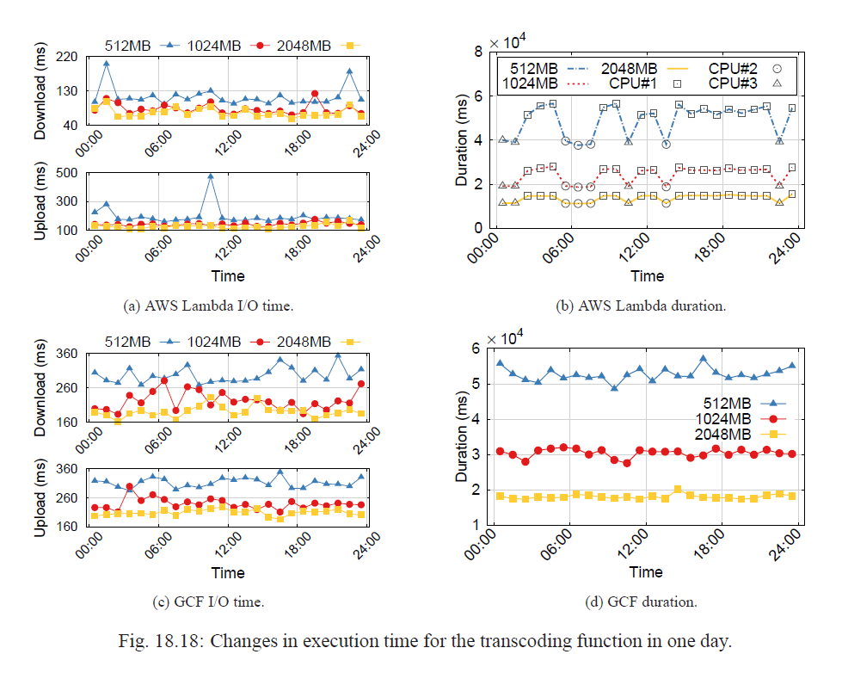
Transcoding with Serverless Computing
35

Slide 36
Transcoding with Serverless Computing
Increasing the memory size from 1,024MB to 2,048MB does not improve the download and upload latencies much
For larger memory sizes, CPU power is not the bottleneck for I/O tasks.
As the memory size decreases, the execution duration changes more and more dramatically
The longest execution duration of 512MB (56,640ms) is 1.5 times as much as the shortest execution duration (37,735ms), and the increment is even larger than the average execution duration of 2,048MB (13,754ms)
The influence of the heterogeneous underlying infrastructures on performance cannot be ignored
36

Slide 37
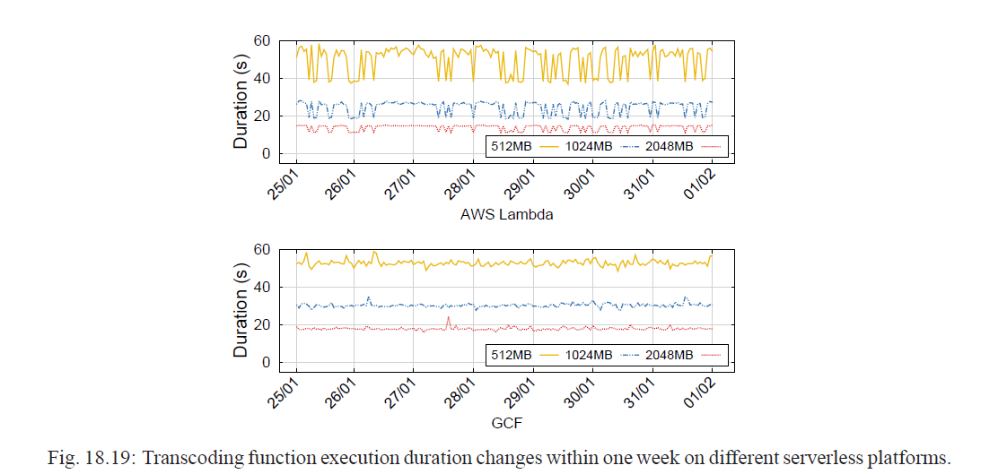
Transcoding Function Execution Duration
37

Slide 38
Transcoding Function Execution Duration
For AWS Lambda, the performance shows more drastic changes as the memory size decreases.
The changes do not show a daily periodic pattern but are closely related to the heterogeneous underlying infrastructures.
This implies that the scheduling and allocation of VMs are random and independent of time.
In contrast, GCF exhibits a more stable execution duration regardless of the memory size.
38

Slide 39
Further Exploration
Cloud and edge computing remains a new field for both industry and research community.
Many of the related materials can be found as white papers from such major cloud and edge computing providers as Amazon, Google, and Microsoft.
39

