Slide 1
Chapter 2
A Taste of Multimedia
2.1 Multimedia Tasks and Concerns
2.2 Multimedia Presentation
2.3 Data Compression
2.4 Multimedia Production
2.5 Multimedia Sharing and Distribution
2.6 Some Useful Editing and Authoring Tools

Slide 2
2.1 Multimedia Tasks and Concerns
More basic concerns will impact multimedia as it now appears in products e.g., we expect impact from Computer Vision: a camera owner might be encouraged to think like a computer scientist and ask:
  “What is going on in an image?”
    A less high-level question is “Where has this image been taken?” (scene recognition)
  “Does the image contain a particular object?” (object classification)
  “Where is an object of interest?” (object detection)
  “Which object does each pixel belong to?” (image segmentation)
== a classic Computer Vision hierarchy of high-level to detailed description of an image, with scene recognition at the top and image segmentation at the bottom.
2

Slide 3
2.2 Multimedia Presentation
Graphics Styles: Human visual dynamics impact how presentations must be constructed.
  Color principles and guidelines: Some color schemes and art styles are best combined with a certain theme or style. A general hint is to not use too many colors, as this can be distracting.
  Fonts: For effective visual communication in a presentation, it is best to use large fonts (i.e., 18 to 36 points), and no more than 6 to 8 lines per screen (fewer than on this screen!). Fig. 2.1 shows a comparison of two screen projections:
3

Slide 4
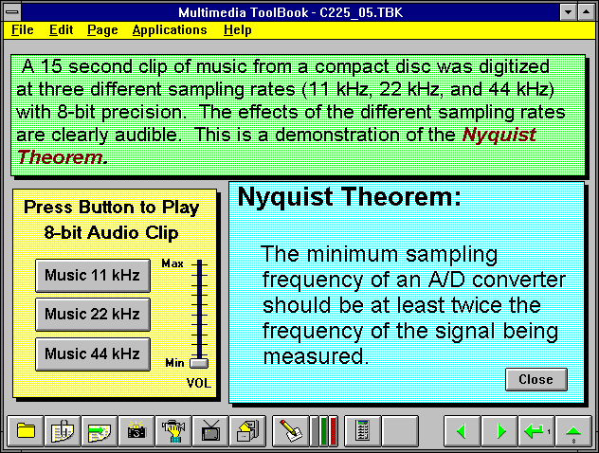
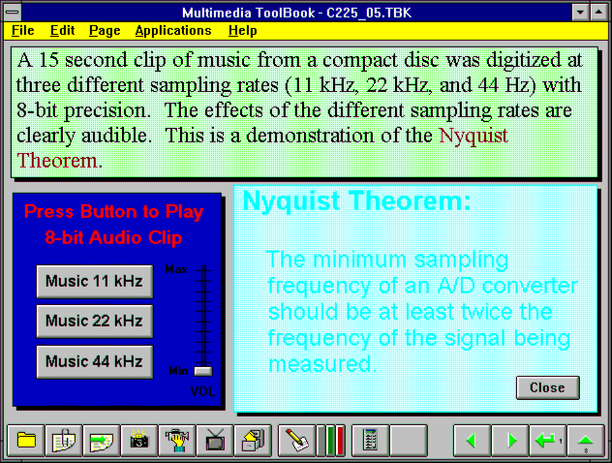
Fig. 2.1: Colours and fonts [from Ron Vetter].
4

Slide 5
  A color contrast program: If the text color is some triple (R,G,B), a legible color for the background is that color subtracted from the maximum (here assuming max=1):
(R, G, B) ➔ (1 − R, 1 − G, 1 − B) (2.1)
Some color combinations are more pleasing than others; e.g., a pink background and forest green foreground, or a green background and mauve foreground.
Fig. 2.2 shows a small Java program in operation:
  Link to TextColor src.zip
  Link to textcolor.exe
5

Slide 6
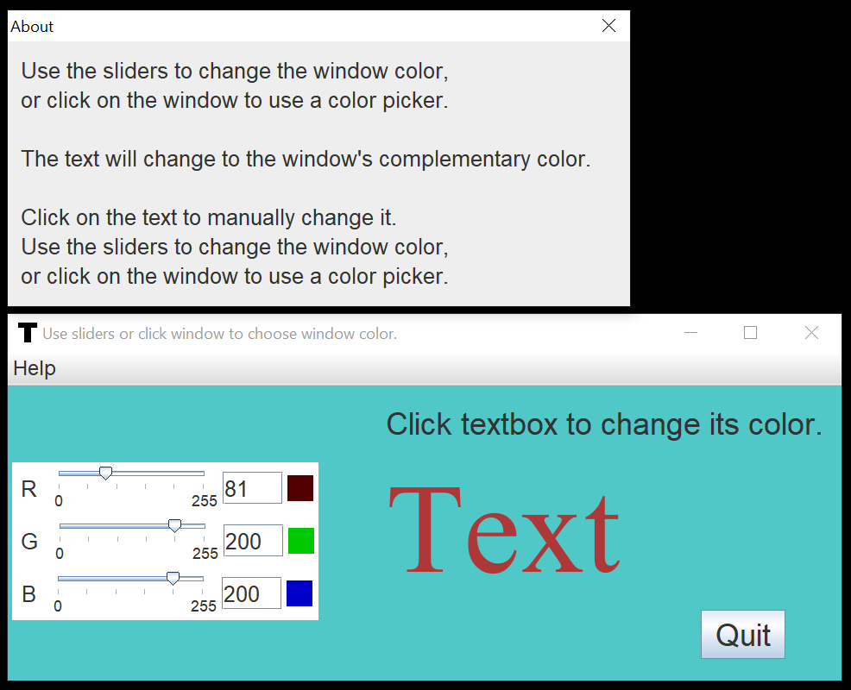
Fig. 2.2: Program to investigate colors and readability.
6

Slide 7

- Fig. 2.3, shows a “colour wheel”, with opposite colors equal to (1-R, 1-G, 1-B)
Fig. 2.3: Colour wheel
7

Slide 8



Sprite Animation
The basic idea: Suppose we have an animation figure, as in Fig. 2.4 (a). Now create a 1-bit mask M, as in Fig. 2.4 (b), black on white, and accompanying sprite S, as in Fig. 2.4 (c).
(a)
(b)
(c)
Fig. 2.4: Sprite creation: Original, mask image M, and sprite S
(“Duke” figure courtesy of Sun Microsystems.)
8

Slide 9
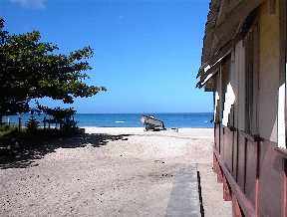
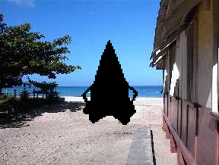

We can overlay the sprite on a colored background B, as in Fig. 2.5 (a) by first ANDing B and M, and then ORing the result with S, with final result as in Fig. 2.5 (e).
(a)
(b)
(c)
(d)
(e)
Fig. 2.5: Sprite animation: (a): Background B. (b): Mask M
(c): B AND M. (d): Sprite S (e): B AND M OR S
9

Slide 10



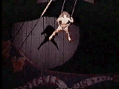
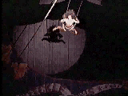
Video Transitions
Video transitions: to signal “scene changes”.
Many different types of transitions:
Cut: an abrupt change of image contents formed by abutting two video frames consecutively. This is the simplest and most frequently used video transition.
10

Slide 11



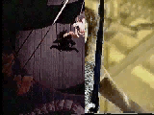
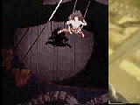
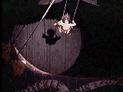
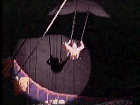
2. Wipe: a replacement of the pixels in a region of the viewport with those from another video. Wipes can be left-to-right, right-to-left, vertical, horizontal, like an iris opening, swept out like the hands of a clock, etc.
3. Dissolve: replaces every pixel with a mixture over time of the two videos, gradually replacing the first by the second. Most dissolves can be classified as two types: cross dissolve and dither dissolve.
11

Slide 12
Type I: Cross Dissolve
Every pixel is affected gradually. It can be defined by:
(2.2)
where A and B are the color 3-vectors for video A and video B. Here, α(t) is a transition function, which is often linear:
(2.3)
12

Slide 13

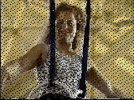
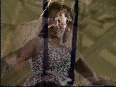
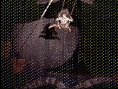
Type II: Dither Dissolve
Determined by α(t), increasingly more and more pixels in video A will abruptly (instead of gradually as in Type I) change to video B.
13

Slide 14
Fade-in and fade-out are special types of Type I dissolve: video A or B is black (or white). Wipes are special forms of Type II dissolve in which changing pixels follow a particular geometric pattern.
Build-your-own-transition: Suppose we wish to build a special type of wipe which slides one video out while another video slides in to replace it: a slide (or push).
14

Slide 15


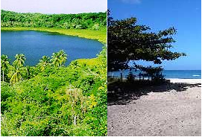
  Unlike a wipe, we want each video frame not be held in place, but instead move progressively farther into (out of) the viewport.
  (b) Suppose we wish to slide Video_{L} in from the left, and push out Video_{R}. Figure 2.6 shows this process:
Fig. 2.6: (a): Video_{L}. (b): Video_{R}. (c): Video_{L} sliding into place and pushing out Video_{R}.
(a)
(b)
(c)
15

Slide 16
Slide Transition (Cont’d)
As time goes by, the horizontal location x_{T} for the transition boundary moves across the viewport from x_{T} = 0 at t = 0 to x_{T} = x_{max} at t = t_{max}. Therefore, for a transition that is linear in time,
x_{T} = (t/t_{max})x_{max}
So for any time t the situation is as shown in Fig. 2.7 (a). Let’s assume that dependence on y is implicit since we use the same y as in the source video. Then for the red channel (and similarly for the green and blue), R = R(x, t).
16

Slide 17
Suppose that we have determined that pixels should come from Video_{L}.
Then the x-position x_{L} in the unmoving video should be, x_{L} = x + (x_{max} − x_{T}),where x is the position we are trying to fill in the viewport, x_{T} is the position in the viewport that the transition boundary has reached, and x_{max} is the maximum pixel position for any frame.
From Fig. 2.7(b), we can calculate the position x_{L} in Video_{L}’s coordinate system as the sum of the distance x, in the viewport, plus the difference x_{max} − x_{T} .
17

Slide 18
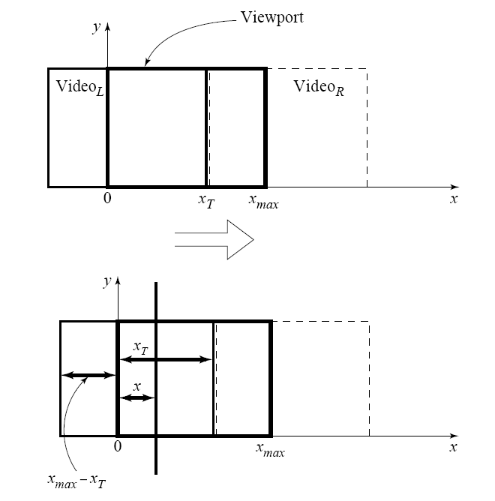
Fig. 2.7:
Geometry of Video_{L} pushing out Video_{R}.
Calculating position in Video_{L} from where pixels are copied to the viewport.
18

Slide 19
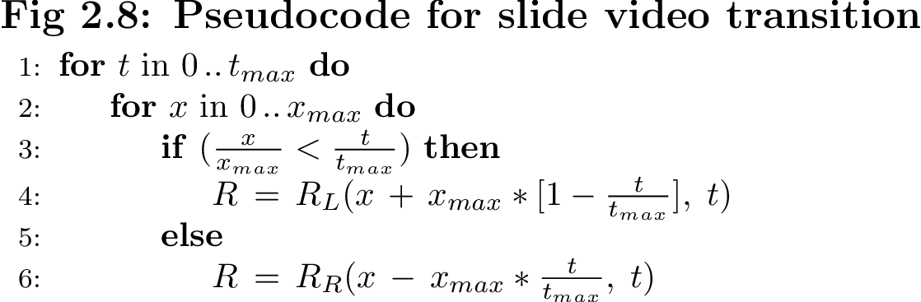
Slide Transition (Cont’d)
Substituting the fact that the transition moves linearly with time, x_{T} = x_{max}(t/t_{max}), a pseudocode solution in shown in Fig. 2.8.
19

Slide 20
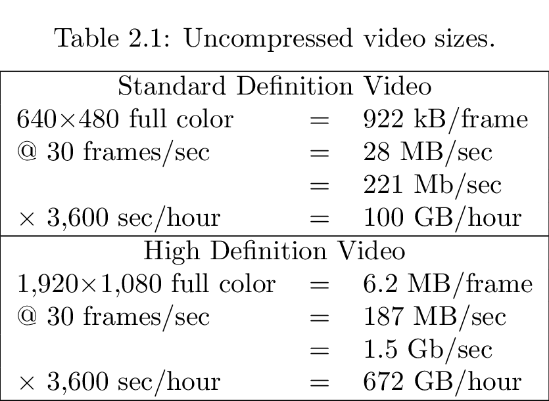
2.3 Data Compression
20

Slide 21
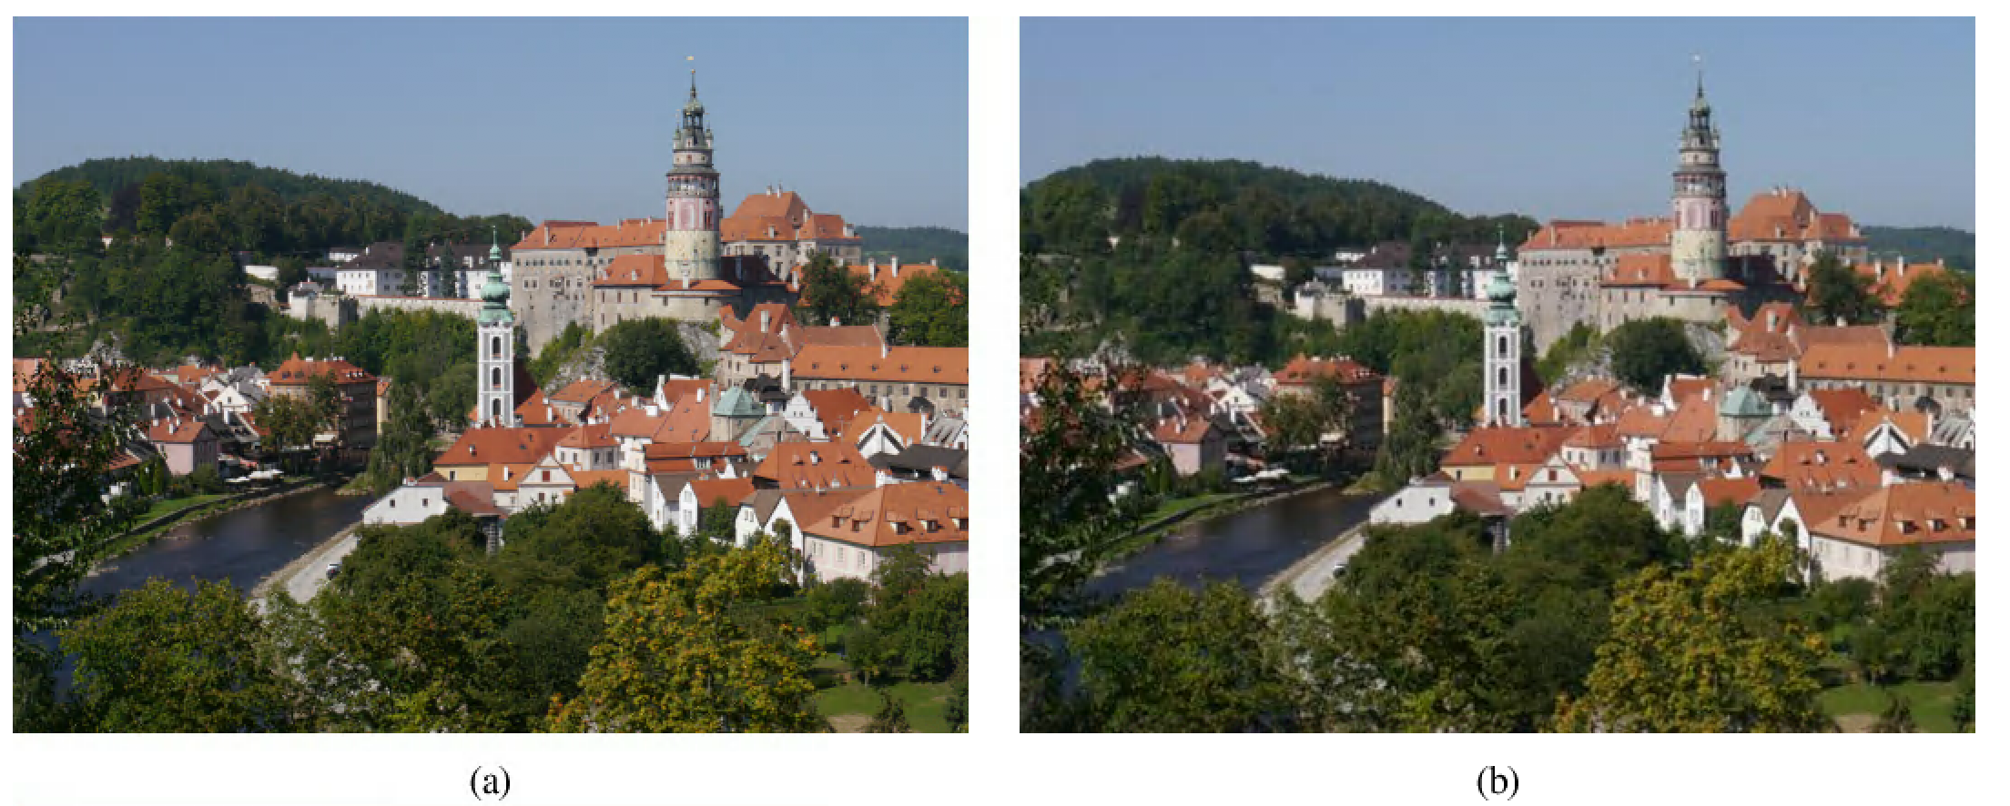
Fig. 2.9: JPEG compression: (a) original uncompressed image; (b) JPEG compression with Quality Factor qf = 75 (the typical default).
21

Slide 22
Fig. 2.9: JPEG compression: (c) Quality Factor qf = 25 and (d) Quality Factor qf = 5.
22
Notes:
22

Slide 23
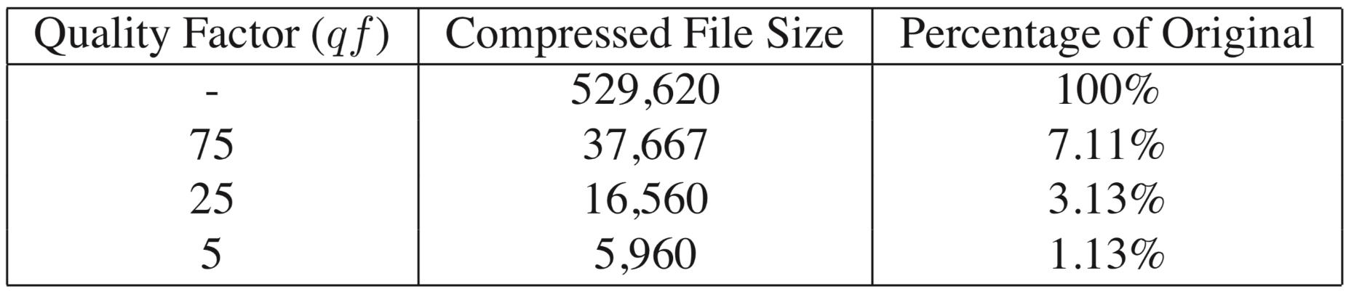
Table 2.2: JPEG file sizes (bytes) and percentage size of data for JPEG compression with Quality Factor qf = 75, 25, and 5.
23
Notes:
23

Slide 24
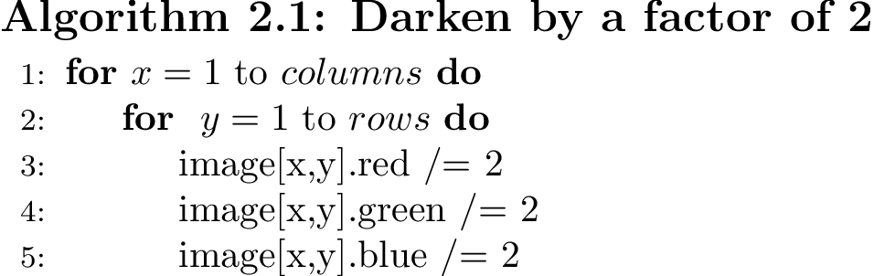
How expensive image and video processing is in terms of CPU cycles?
Suppose we have an image whose pixels we wish to darken, by a factor of 2:
On a RISC machine, 12 instructions per pixel, i.e., per 3 bytes.

Slide 25
2.4 Multimedia Production
Multimedia production can easily involve an art director, graphic designer, production artist, producer, project manager, writer, user interface designer, sound designer, videographer, and 3D and 2D animators, as well as programmers.
25

Slide 26
2.5 Multimedia Sharing and Distribution
Fig. 2.10: The webpage for uploading a YouTube video. The video, titled “Edison Phonograph Multimedia Textbook 3rd Edition” is open to all users (Privacy settings: Public) and can be searched in the YouTube homepage using the title or tags. Note that the video thumbnails are automatically generated by YouTube.
26
Notes:
26

Slide 27
Fig. 2.11: The YouTube page for the video uploaded. The list of related videos are shown on the right side, and users can post their comments, as well.
27
Notes:
27

Slide 28
2.6 Some Useful Editing and Authoring Tools
One needs real vehicles for showing understanding principles of and creating multimedia. And straight programming in C++ or Java is not always the best way of showing your knowledge and creativity.
Some popular authoring tools include the following:
    Adobe Premiere
    HTML5 Canvas
    Adobe Director
    Adobe XD
Hint for studying this section: Hands-on work in a laptop or Lab environment, with reference to the text.
28

Slide 29
Adobe Premiere
Used for video editing and exporting. Features a “score” authoring metaphor, placing video clips in horizontal tracks that resemble a musical score.
Fig. 2.12: Adobe Premiere Screen.

Slide 30
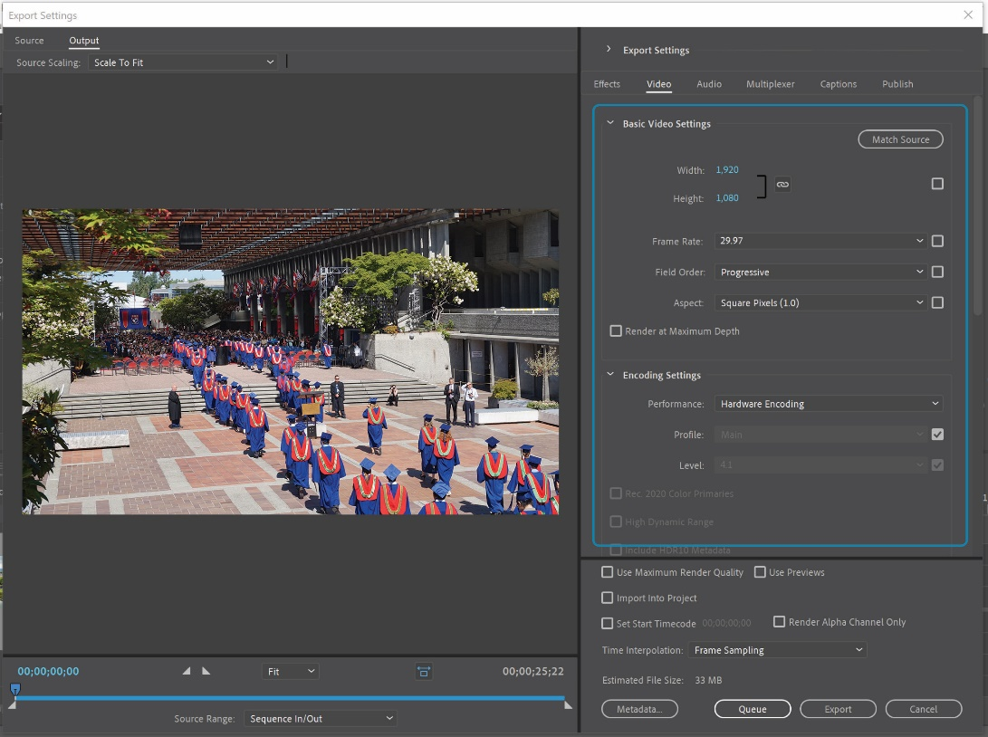
Adobe Premiere
As a professional video editor, Premiere offers many controls for exporting and compressing the final product.
Fig. 2.13: Adobe Premiere export setting screen.

Slide 31
Adobe Premiere
Premiere allows imports of .psd (Photoshop files), which can have alpha channels which can crop specific pixel in the picture.
Fig. 2.14: Adobe Premiere clip viewer.

Slide 32
HTML5 Canvas
HTML5 canvas is an element used to draw animated graphics on a webpage.
The <canvas> element is a container for graphics.
  A rectangular area that generated by HTML code with width and height attributes.
  Using JavaScript, we can actually draw the graphical objects.

Slide 33
Create a Canvas
  <canvas id=“canvas” width=“300” height=“300” style=“background-color: red”> </canvas>
  var canvas = document.getElementById(‘canvas’);
  var ctx = canvas.getContext(‘2d’);
The background color is transparent by default; here we make it red to be visible.
The canvas is filled by grids, acting as an x-y coordinate system.

Slide 34
Draw Graphical Objects
You can draw simple shapes, text, images, path or other objects on the canvas.
    // a rectangle with filled color
    ctx.fillRect(x, y, width, height)
    // a rectangle with border
    ctx.strokeRect(x, y, width, height)
    // clear a rectangle area
    ctx.clearRect(x, y, width, height)

Slide 35
Transform and Animation
The shapes of the graphics can be transformed by
  Translate
  Rotate
  Scale

Slide 36
Steps to Create an Animation
1. clear the canvas: ctx.clearRect(x, y, width, height)
2. save the current state of canvas: ctx.save()
3. draw the graphics
4. restore the canvas state: ctx.restore()

Slide 37
Adobe Director
Director is a complete environment for creating interactive “movies”.

Slide 38
Director Windows
Main window
  Stage, on which the action takes place.
Cast window
  Consists of resources a movie may use, such as bitmaps, sounds, vector-graphics shapes, Flash movies, digital videos, and scripts.
Score window
  Organized in horizontal lines, each for one of the sprites, and vertical frames.

Slide 39
Animation
Animation is created by showing slightly different images over time.
  Using different cast members in different frames.
  To control this process more easily, Director permits combining many cast members into a single sprite.
Fig. 2.17: A tweened sprite. Because several instances may be used for a single cast member, each instance is called a sprite. Typically, cast members are raw media, whereas sprites are objects that control where, when, and how cast members appear on the stage and in the movie.

Slide 40
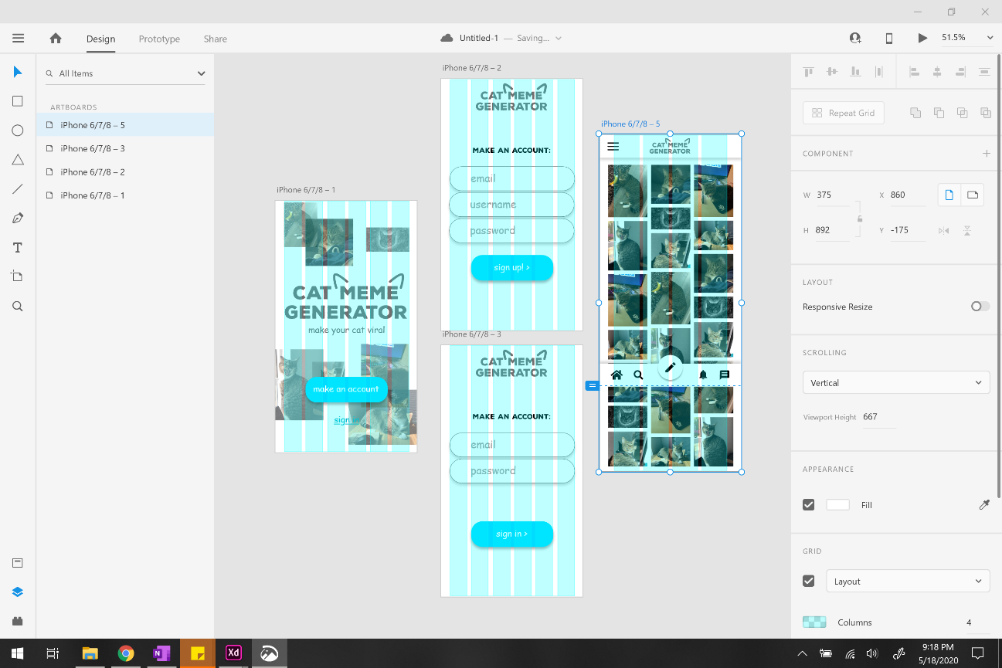
Adobe XD
Used for making prototypes of websites and mobile apps without any code.
Fig. 2.18: The Design Mode in Adobe XD.

Slide 41
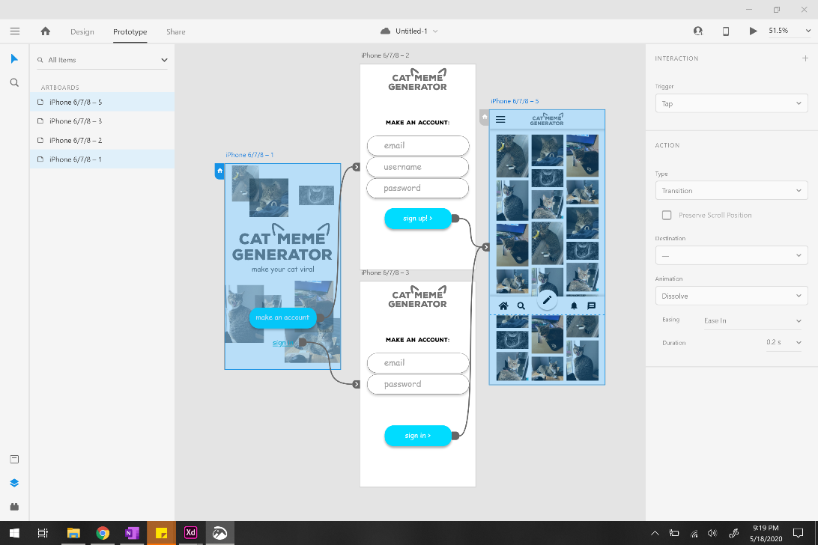
Adobe XD
Screens are linked by making elements clickable, giving the “feel” of a real app.
This is commonly used for UI design to be finalized before sent for programming.
Fig. 2.20: The Prototype Mode in Adobe XD.

