Slide 1
Chapter 5
Fundamental Concepts in Video
5.1 Analog Video
5.2 Digital Video
5.3 Video Display Interfaces
5.4 360º Video
5.5 3D Video and TV
5.6 Video Quality Assessment (VQA)

Slide 2
5.1 Analog Video
An analog signal f(t) samples a time-varying image. So-called “progressive” scanning traces through a complete picture (a frame) row-wise for each time interval.
In TV, and in some monitors and multimedia standards as well, another system, called “interlaced” scanning is used:
  The odd-numbered lines are traced first, and then the even-numbered lines are traced. This results in “odd” and “even” fields — two fields make up one frame.
  In fact, the odd lines (starting from 1) end up at the middle of a line at the end of the odd field, and the even scan starts at a half-way point.

Slide 3
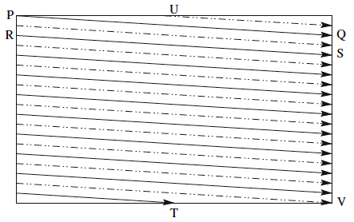
Fig. 5.1: Interlaced raster scan
c) Figure 5.1 shows the scheme used. First the solid (odd) lines are traced, P to Q, then R to S, etc., ending at T; then the even field starts at U and ends at V.
d) The jump from Q to R, etc. in Figure 5.1 is called the horizontal retrace, during which the electronic beam in the CRT is blanked. The jump from T to U or V to P is called the vertical retrace.

Slide 4
Because of interlacing, the odd and even lines are displaced in time from each other — generally not noticeable except when very fast action is taking place on screen, when blurring may occur.
For example, in the video in Fig. 5.2, the moving helicopter is blurred more than is the still background.

Slide 5



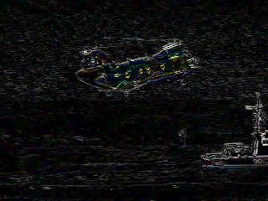
(a)
(b)
(c)
(d)
Fig. 5.2: Interlaced scan produces two fields for each frame. (a) The
video frame, (b) Field 1, (c) Field 2, (d) Difference of Fields.

Slide 6
Since it is sometimes necessary to change the frame rate, resize, or even produce stills from an interlaced source video, various schemes are used to “de-interlace” it.
  The simplest de-interlacing method consists of discarding one field and duplicating the scan lines of the other field. The information in one field is lost completely using this simple technique.
  Other more complicated methods that retain information from both fields are also possible.
Analog video use a small voltage offset from zero to indicate “black”, and another value such as zero to indicate the start of a line. For example, we could use a “blacker-than-black” zero signal to indicate the beginning of a line.

Slide 7
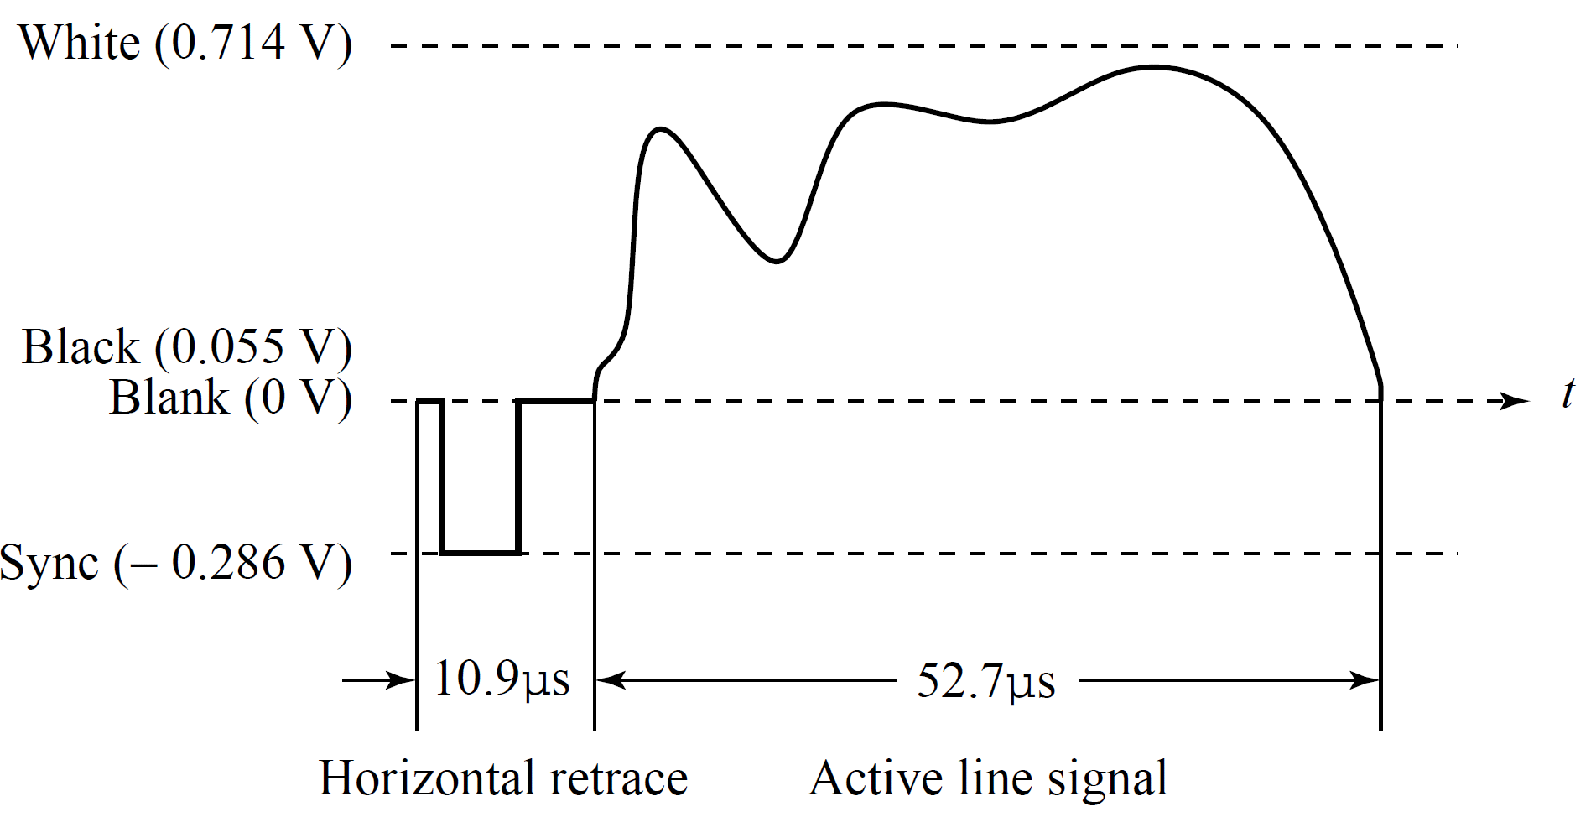
Fig. 5.3: Electronic signal for one NTSC scan line.

Slide 8
5.1.1 NTSC Video
NTSC (National Television System Committee) TV standard is mostly used in North America and Japan. It uses the familiar 4:3 aspect ratio (i.e., the ratio of picture width to its height) and uses 525 scan lines per frame at 30 frames per second (fps).
  NTSC follows the interlaced scanning system, and each frame is divided into two fields, with 262.5 lines/field.
  Thus the horizontal sweep frequency is 525×29.97 ≈ 15, 734 lines/sec, so that each line is swept out in 1/15.734 × 103 sec ≈ 63.6μsec.
  Since the horizontal retrace takes 10.9 μsec, this leaves 52.7 μsec for the active line signal during which image data is displayed (see Fig.5.3).

Slide 9
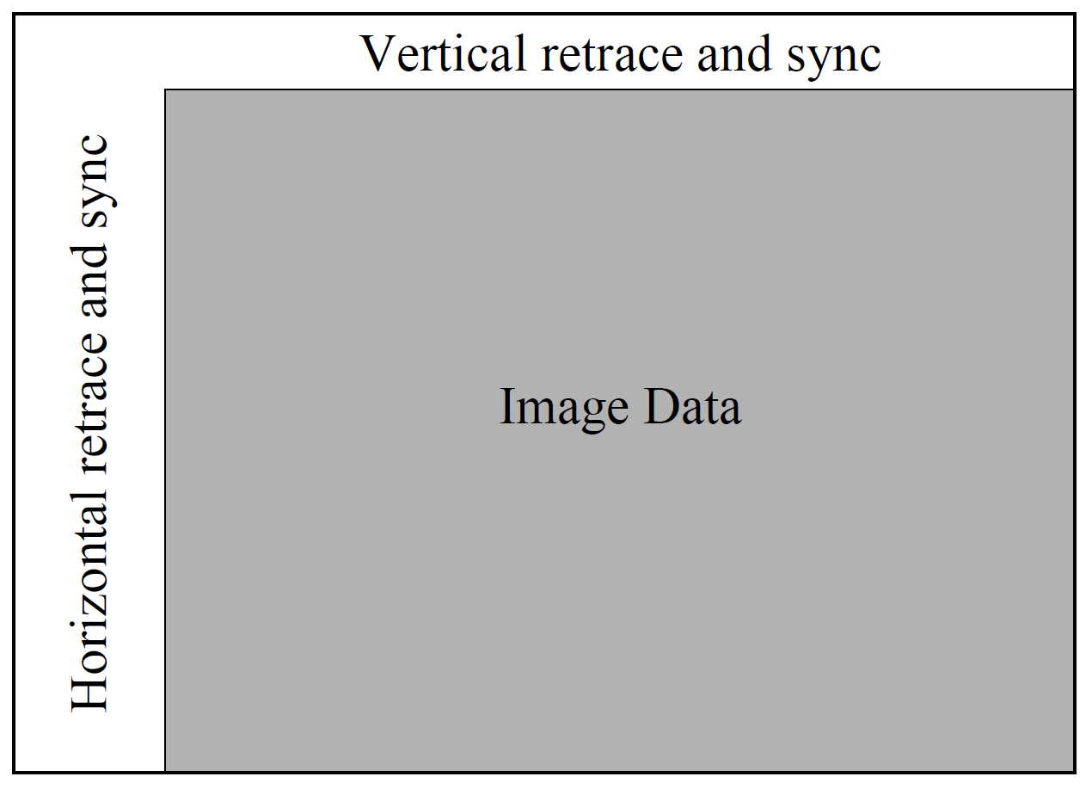
Fig. 5.4 shows the effect of “vertical retrace & sync” and “horizontal retrace & sync” on the NTSC video raster.
Fig. 5.4: Video raster, including retrace and sync data

Slide 10
  Vertical retrace takes place during 20 lines reserved for control information at the beginning of each field. Hence, the number of active video lines per frame is only 485.
  Similarly, almost 1/6 of the raster at the left side is blanked for horizontal retrace and sync. The non-blanking pixels are called active pixels.
  Since the horizontal retrace takes 10.9 μsec, this leaves 52.7 μsec for the active line signal during which image data is displayed (see Fig.5.3).
  It is known that pixels often fall in-between the scan lines. Therefore, even with non-interlaced scan, NTSC TV is only capable of showing about 340 (visually distinct) lines, i.e., about 70% of the 485 specified active lines. With interlaced scan, this could be as low as 50%.

Slide 11
NTSC video is an analog signal with no fixed horizontal resolution. Therefore one must decide how many times to sample the signal for display: each sample corresponds to one pixel output.
A “pixel clock” is used to divide each horizontal line of video into samples. The higher the frequency of the pixel clock, the more samples per line there are.
Different video formats provide different numbers of samples per line, as listed in Table 5.1.
Table 5.1: Samples per line for various video formats
Format | Samples per line
VHS | 240
S-VHS | 400-425
Betamax | 500
Standard 8 m | 300
Hi-8 mm | 425

Slide 12
Color Model and Modulation of NTSC
NTSC uses the YIQ color model, and the technique of quadrature modulation is employed to combine (the spectrally overlapped part of) I (in-phase) and Q (quadrature) signals into a single chroma signal C:
C = I cos(F_{sc}t) + Q sin(F_{sc}t) (5.1)
This modulated chroma signal is also known as the color subcarrier, whose magnitude is , and phase is tan⁻¹(Q/I). The frequency of C is F_{sc} ≈ 3.58 MHz.
The NTSC composite signal is a further composition of the luminance signal Y and the chroma signal as defined below:
composite = Y +C = Y + I cos(F_{sc}t) + Q sin(F_{sc}t) (5.2)

Slide 13
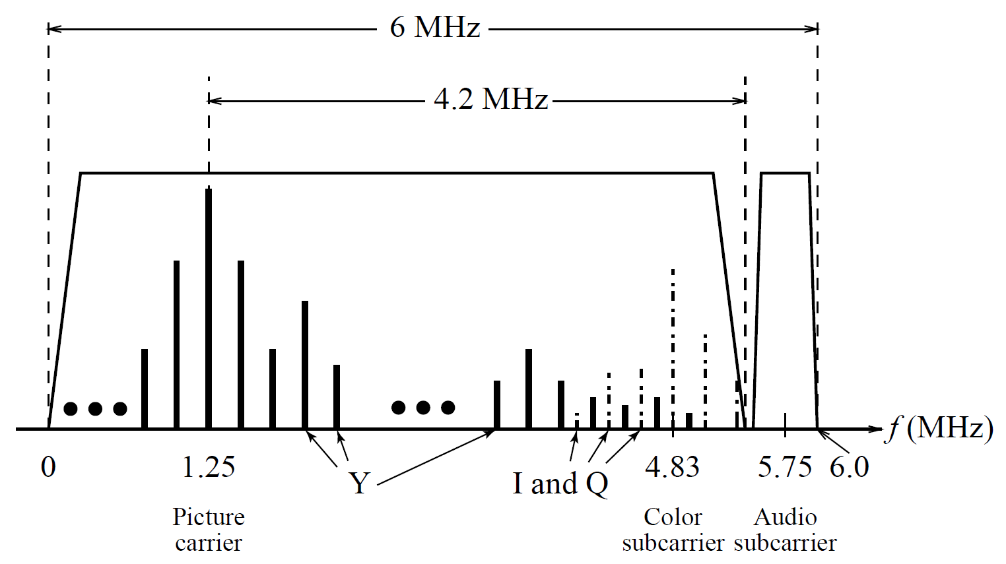
Fig. 5.5: NTSC assigns a bandwidth of 4.2 MHz to Y, and only 1.6 MHz to I and 0.6 MHz to Q due to human insensitivity to color details (high frequency color changes).
Fig. 5.5: Interleaving Y and C signals in the NTSC spectrum.

Slide 14
Decoding NTSC Signals
The first step in decoding the composite signal at the receiver side is the separation of Y and C.
After the separation of Y using a low-pass filter, the chroma signal C can be demodulated to extract the components I and Q separately. To extract I:
  Multiply the signal C by 2cos(F_{sc}t), i.e.,

Slide 15
Apply a low-pass filter to obtain I and discard the two higher frequency (2F_{sc}) terms.
Similarly, Q can be extracted by first multiplying C by 2sin(F_{sc}t) and then low-pass filtering.

Slide 16
The NTSC bandwidth of 6 MHz is tight. Its audio subcarrier frequency is 4.5 MHz. The Picture carrier is at 1.25 MHz, which places the center of the audio band at 1.25+4.5 = 5.75 MHz in the channel (Fig. 5.5). But notice that the color is placed at 1.25+3.58 = 4.83 MHz.

Slide 17
So the audio is a bit too close to the color subcarrier — a cause for potential interference between the audio and color signals. It was largely due to this reason that the NTSC color TV actually slowed down its frame rate to 30×1,000/1,001 ≈ 29.97 fps.
As a result, the adopted NTSC color subcarrier frequency is slightly lowered to
  f_{sc} = 30 × 1,000/1,001 × 525 × 227.5 ≈ 3.579545 MHz,
** 227.5 is the # of color samples per scan line in NTSC broadcast TV.

Slide 18
5.1.2 PAL Video
PAL (Phase Alternating Line) is a TV standard widely used in Western Europe, China, India, and many other parts of the world.
PAL uses 625 scan lines per frame, at 25 frames/second, with a 4:3 aspect ratio and interlaced fields.
  PAL uses the YUV color model. It uses an 8 MHz channel and allocates a bandwidth of 5.5 MHz to Y, and 1.8 MHz each to U and V. The color subcarrier frequency is f_{sc} ≈ 4.43 MHz.

Slide 19
  In order to improve picture quality, chroma signals have alternate signs (e.g., +U and -U) in successive scan lines, hence the name “Phase Alternating Line”.
  This facilitates the use of a (line rate) comb filter at the receiver — the signals in consecutive lines are averaged so as to cancel the chroma signals (that always carry opposite signs) for separating Y and C and obtaining high quality Y signals.

Slide 20
5.1.3 SECAM Video
SECAM stands for Système Electronique Couleur Avec Mémoire, the third major broadcast TV standard.
SECAM also uses 625 scan lines per frame, at 25 frames per second, with a 4:3 aspect ratio and interlaced fields.
SECAM and PAL are very similar. They differ slightly in their color coding scheme:
  In SECAM, U and V signals are modulated using separate color subcarriers at 4.25 MHz and 4.41 MHz respectively.
  They are sent in alternate lines, i.e., only one of the U or V signals will be sent on each scan line.

Slide 21
Table 5.2 gives a comparison of the three major analog broadcast TV systems.
Table 5.2: Comparison of Analog Broadcast TV Systems
TV System | Frame Rate (fps) | # of Scan Lines | Total Channel Width (MHz) | Bandwidth Allocation (MHz)
 |  |  |  | Y | I or U | Q or V
NTSC | 29.97 | 525 | 6.0 | 4.2 | 1.6 | 0.6
PAL | 25 | 625 | 8.0 | 5.5 | 1.8 | 1.8
SECAM | 25 | 625 | 8.0 | 6.0 | 2.0 | 2.0

Slide 22
5.2 Digital Video
The advantages of digital representation for video are many. For example:
  Video can be stored on digital devices or in memory, ready to be processed (noise removal, cut and paste, etc.), and integrated to various multimedia applications;
  Direct access is possible, which makes nonlinear video editing achievable as a simple, rather than a complex, task;
  Repeated recording does not degrade image quality;
  Ease of encryption and better tolerance to channel noise.

Slide 23
5.2.1 Chroma Subsampling
Since humans see color with much less spatial resolution than they see black and white, it makes sense to “decimate” the chrominance signal.
Interesting (but not necessarily informative!) names have arisen to label the different schemes used.
To begin with, numbers are given stating how many pixel values, per four original pixels, are actually sent:
  The chroma subsampling scheme “4:4:4” indicates that no chroma subsampling is used: each pixel’s Y, Cb and Cr values are transmitted, 4 for each of Y, Cb, Cr.

Slide 24
  The scheme “4:2:2” indicates horizontal subsampling of the Cb, Cr signals by a factor of 2. That is, of four pixels horizontally labelled as 0 to 3, all four Ys are sent, and every two Cb’s and two Cr’s are sent, as (Cb0, Y0)(Cr0, Y1)(Cb2, Y2)(Cr2, Y3)(Cb4, Y4), and so on (or averaging is used).
  The scheme “4:1:1” subsamples horizontally by a factor of 4.
  The scheme “4:2:0” subsamples in both the horizontal and vertical dimensions by a factor of 2. Theoretically, an average chroma pixel is positioned between the rows and columns as shown Fig.5.6.
  Scheme 4:2:0 along with other schemes is commonly used in JPEG and MPEG (see later chapters in Part 2).

Slide 25
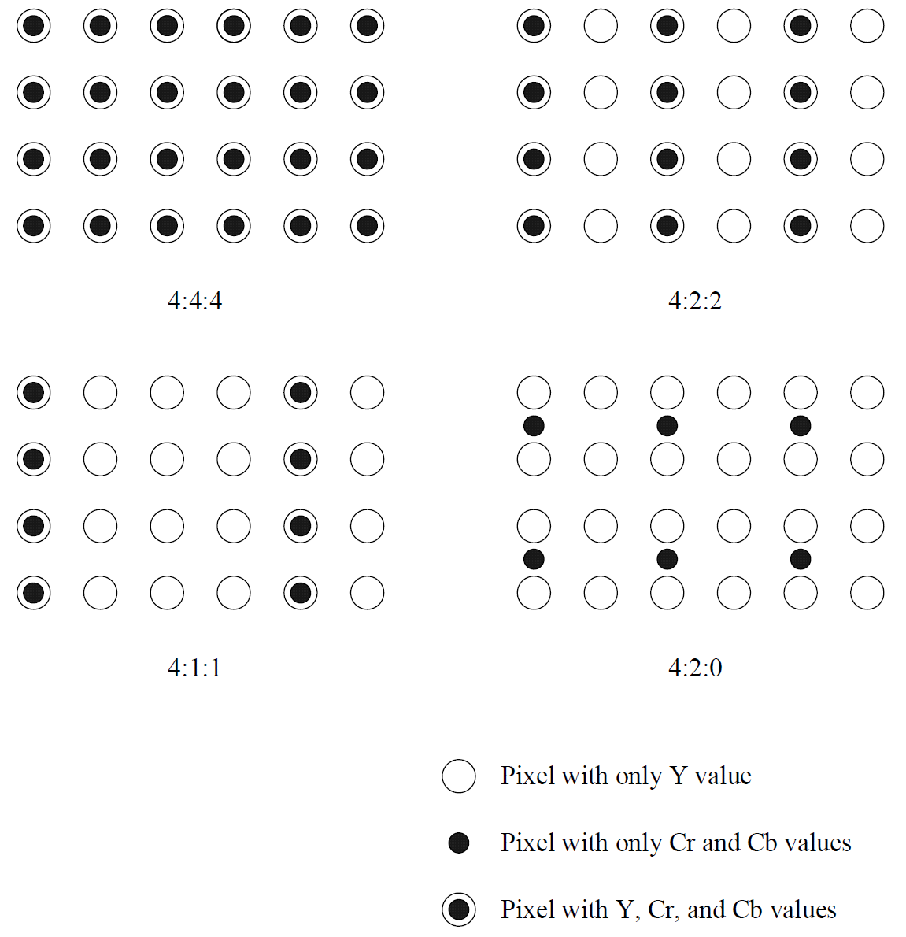
  Fig. 5.6: Chroma subsampling

Slide 26
5.2.2 CCIR and ITU-R Standards for Digital Video
CCIR is the Consultative Committee for International Radio, and one of the most important standards it has produced is CCIR-601, for component digital video.
  – This standard has since become standard ITU-R-601, an international standard for professional video applications
    — adopted by certain digital video formats including the popular DV video.
Table 5.3 shows some of the digital video specifications, all with an aspect ratio of 4:3. The CCIR 601 standard uses an interlaced scan, so each field has only half as much vertical resolution (e.g., 240 lines in NTSC).

Slide 27
CIF stands for Common Intermediate Format specified by the CCITT.
  The idea of CIF is to specify a format for lower bitrate.
  CIF is about the same as VHS quality. It uses a progressive (non-interlaced) scan.
  QCIF stands for “Quarter-CIF”. All the CIF/QCIF resolutions are evenly divisible by 8, and all except 88 are divisible by 16; this provides convenience for block-based video coding in H.261 and H.263, discussed later in Chapter 10.

Slide 28
Note, CIF is a compromise of NTSC and PAL in that it adopts the ‘NTSC frame rate and half of the number of active lines as in PAL.
Table 5.3: ITU-R digital video specifications
 | CCIR 601 525/60 NTSC | CCIR 601 625/50 PAL/SECAM | CIF | QCIF
Luminance resolution | 720 x 480 | 720 x 576 | 352 x 288 | 176 x 144
Chrominance resolution | 360 x 480 | 360 x 576 | 176 x 144 | 88 x 72
Colour Subsampling | 4:2:2 | 4:2:2 | 4:2:0 | 4:2:0
Fields/sec | 60 | 50 | 30 | 30
Interlaced | Yes | Yes | No | No

Slide 29
5.2.3 High Definition TV (HDTV)
The main thrust of HDTV (High Definition TV) is not to increase the “definition” in each unit area, but rather to increase the visual field especially in its width.
  The first generation of HDTV was based on an analog technology developed by Sony and NHK in Japan in the late 1970s.
  MUSE (MUltiple sub-Nyquist Sampling Encoding) was an improved NHK HDTV with hybrid analog/digital technologies that was put in use in the 1990s. It has 1,125 scan lines, interlaced (60 fields per second), and 16:9 aspect ratio.

Slide 30
  Since uncompressed HDTV will easily demand more than 20 MHz bandwidth, which will not fit in the current 6 MHz or 8 MHz channels, various compression techniques are being investigated.
  It is also anticipated that high quality HDTV signals will be transmitted using more than one channel even after compression.

Slide 31
A brief history of HDTV evolution:
  In 1987, the FCC decided that HDTV standards must be compatible with the existing NTSC standard and be confined to the existing VHF (Very High Frequency) and UHF (Ultra High Frequency) bands.
  In 1990, the FCC announced a very different initiative, i.e., its preference for a full-resolution HDTV, and it was decided that HDTV would be simultaneously broadcast with the existing NTSC TV and eventually replace it.
  Witnessing a boom of proposals for digital HDTV, the FCC made a key decision to go all-digital in 1993. A “grand alliance” was formed that included four main proposals, by General Instruments, MIT, Zenith, and AT&T, and by Thomson, Philips, Sarnoff and others.
  This eventually led to the formation of the ATSC (Advanced Television Systems Committee) — responsible for the standard for TV broadcasting of HDTV.
  In 1995 the U.S. FCC Advisory Committee on Advanced Television Service recommended that the ATSC Digital Television Standard be adopted.

Slide 32
The standard supports video scanning formats shown in Table 5.4. In the table, “I” mean interlaced scan and “P” means progressive (non-interlaced) scan.
Table 5.4: Advanced Digital TV formats supported by ATSC
# of Active Pixels per line | # of Active Lines | Aspect Ratio | Frame Rate
1,920 | 1,080 | 16:9 | 60P 60I 30P 24P
1,280 | 720 | 16:9 | 60P 30P 24P
704 | 480 | 16:9 or 4:3 | 60P 60I 30P 24P
640 | 480 | 4:3 | 60P 60I 30P 24P

Slide 33
For video, MPEG-2 is chosen as the compression standard. For audio, AC-3 is the standard. It supports the so-called 5.1 channel Dolby surround sound, i.e., five surround channels plus a subwoofer channel.
The salient difference between conventional TV and HDTV:
  HDTV has a much wider aspect ratio of 16:9 instead of 4:3.
  HDTV moves toward progressive (non-interlaced) scan. The rationale is that interlacing introduces serrated edges to moving objects and flickers along horizontal edges.

Slide 34
The services provided include:
  SDTV (Standard Definition TV): the NTSC TV or higher.
  EDTV (Enhanced Definition TV): 480 active lines or higher, i.e., the third and fourth rows in Table 5.4.
  HDTV (High Definition TV): 720 active lines or higher. So far, the popular choices are:
    720P (1,280 × 720, progressive scan, 30 fps)
    1080I (1,920 × 1,080, interlaced, 30 fps)
    1080P (1,920 × 1,080, progressive scan, 30 or 60 fps).

Slide 35
5.2.4 Ultra High Definition TV (UHDTV)
UHDTV is a new generation of HDTV. The standards initiated in 2012 support 4K UHDTV: 2160P (3,840×2,160, progressive scan) and 8K UHDTV: 4320P (7,680×4,320, progressive scan).
The aspect ratio is 16:9. The bit-depth is 10 or 12 bits per sample, and the chroma subsampling can be 4:2:0, 4:2:2, or 4:4:4.
The supported frame rate has been gradually increased to 120 fps.
The UHDTV will provide superior picture quality, comparable to IMAX movies, but it will require a much higher bandwidth and bitrate.

Slide 36
16K UHDTV has been demonstrated in 2018, targeting applications such as Virtual Reality with true immersion. Its resolution is 15,360 × 8,640 for a total of 132.7 megapixels.
Table 5.5: A Summary of UHDTV
Type of UHDTV | Resolution | Bit Depth | Aspect Ratio | Frame Rate
4K UHD (2160P) | 3840 x 2160 | 10 or 12 bits | 16:9 | Up to 120P
8K UHD (4320P) | 7680 x 4320 | 10 or 12 bits | 16:9 | Up to 120P
16K UHD (8640P) | 15360 x 8640 | 10 or 12 bits | 16:9 | Up to 240P

Slide 37
5.3 Video Display Interfaces
5.3.1 Analog Display Interfaces
Analog video signals are often transmitted in one of three different interfaces: Component video, Composite video, and S-video. Figure 5.7 shows the typical connectors for them.
Fig. 5.7: Connectors for typical analog display interfaces. From left to right: Component video, Composite video, S-video, and VGA.

Slide 38
Component video
Component video: Higher-end video systems make use of three separate video signals for the red, green, and blue image planes. Each color channel is sent as a separate video signal.
  Most computer systems use Component Video, with separate signals for R, G, and B signals.
  For any color separation scheme, Component Video gives the best color reproduction since there is no “crosstalk” between the three channels.
  This is not the case for S-Video or Composite Video, discussed next. Component video, however, requires more bandwidth and good synchronization of the three components.

Slide 39
Composite Video
Composite video: color (“chrominance”) and intensity (“luminance”) signals are mixed into a single carrier wave.
  Chrominance is a composition of two color components (I and Q, or U and V).
  In NTSC TV, e.g., I and Q are combined into a chroma signal, and a color subcarrier is then employed to put the chroma signal at the high-frequency end of the signal shared with the luminance signal.

Slide 40
  The chrominance and luminance components can be separated at the receiver end and then the two color components can be further recovered.
  When connecting to TVs or VCRs, Composite Video uses only one wire and video color signals are mixed, not sent separately. The audio and sync signals are additions to this one signal.
Since color and intensity are wrapped into the same signal, some interference between the luminance and chrominance signals is inevitable.

Slide 41
S-Video
S-Video: as a compromise, (separated video, or Super-video, e.g., in S-VHS) uses two wires, one for luminance and another for a composite chrominance signal.
Less crosstalk between the color information and the crucial gray-scale information.
The reason for placing luminance into its own part of the signal is that black-and-white information is most crucial for visual perception.
  – Humans are able to differentiate spatial resolution in grayscale images with a much higher acuity than for the color part of color images.
  – As a result, we can send less accurate color information than must be sent for intensity information — we can only see fairly large blobs of color, so it makes sense to send less color detail.

Slide 42
5.3.2 Digital Display Interfaces
Digital interfaces emerged in 1980s (e.g., Color Graphics Adapter (CGA)), and evolved rapidly. Today, the most widely used digital video interfaces include Digital Visual Interface (DVI), High-Definition Multimedia Interface (HDMI), and DisplayPort.
Fig. 5.8: Connectors of different digital display interfaces. From left to right: DVI, HDMI, DisplayPort.

Slide 43
High-Definition Multimedia Interface (HDMI)
HDMI is a newer digital audio/video interface developed to be backward compatible with DVI.
  HDMI doesn’t carry analog signal and hence is not compatible with VGA.
  HDMI supports both RGB and YCbCr 4:4:4 or 4:2:2. [DVI is limited to the RGB color range (0-255). ]
  HDMI supports digital audio, in addition to digital video.
The maximum pixel clock rate for HDMI 1.0 is 165 MHz, which is sufficient to support 1080P (1,920 × 1,200) at 60 Hz.
HDMI 2.0 was released in 2013, which supports 4K resolution at 60 frames per second.

Slide 44
5.4 360º Video
360º Video is also known as Omnidirectional Video, Spherical Video or Immersive Video.
360º Video can span 360º horizontally and 180º vertically.
It is captured by cameras at (almost) all possible viewing angles. In actual implementations, the video is usually captured by an omnidirectional camera or a collection of cameras with a wide field of view.
360º Video can be monoscopic or stereoscopic. The latter is especially suitable for VR applications.

Slide 45

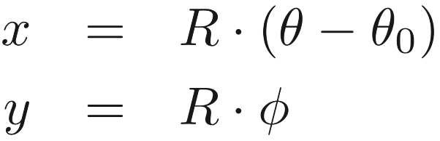
5.4.1 Equirectangular Projection (ERP)
ERP is one of the most common projections in 360◦ Video.
In the spherical coordinate system, a point on the sphere is represented by , where R is the radius of the sphere, θ indicates the longitude and φ the latitude.
In this discussion of the ERP, we will always use the equator as the central parallel, where y = 0.
Let θ₀ be the longitude of the central meridian, where x = 0, then the equations for the ERP are:
(5.3)
(5.4)

Slide 46
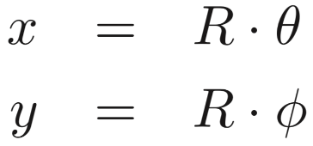
Use the prime meridian (aka. the Greenwich meridian, θ₀ = 0◦) as the central meridian, where x = 0, then the projection coordinates are:
(5.5)
(5.6)
Figure 5.9 illustrates the world map after the ERP, where θ₀ = 0◦. As shown in the figure by the distorted “circles”, ERP has severe distortions, esp. near the poles.

Slide 47
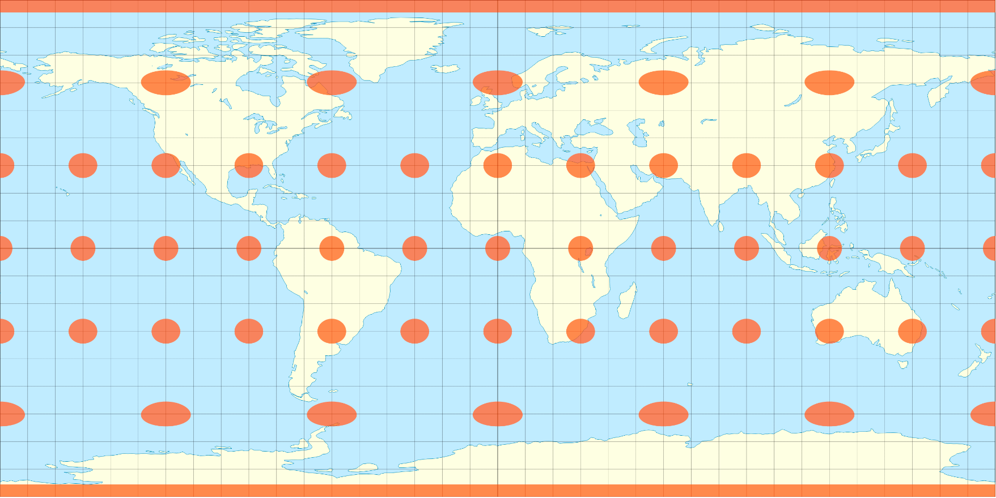
Fig. 5.9: The Equirectangular Projection (ERP) of the
World Map. (* See book for the image copyright info.)

Slide 48
5.4.2 Other Projections
Various projection formats for 360◦ videos are included in the 360Lib platform. Some popular ones are as below.
Cubemap Projection (CMP) — Instead of projecting onto a single plane as in ERP, to reduce the distortion, projections are made onto the six faces of the cube.
Equi-Angular Cubemap (EAC) — This is a variation of CMP, the projection intervals are remapped to new intervals of equal lengths. Adopted by Google.
Pyramid Format — The base of the pyramid provides the full resolution image of the front view. The sides of the pyramid provide the side view images with gradually reduced resolutions. Advocated by Facebook.

Slide 49
5.5 3D Video and TV
Three-dimensional (3D) pictures and movies have been in existence for decades.
The rapid progress in R&D of 3D technology and the success of the 2009 film Avatar have pushed 3D video to its peak.
Increasingly, it is in movie theaters, broadcast TV (e.g., sporting events), PCs, and various hand-held devices.
The main advantage of the 3D video is that it enables the experience of immersion — be there, and really Be there!

Slide 50
5.5.1 Cues for 3D Percept
Monocular Cues:
Shading, Perspective scaling, Relative size, Texture gradient, Blur gradient, Haze, Occlusion, Motion parallax.
Among the above monocular cues, it is said that Occlusion and Motion parallax are more effective.

Slide 51
Binocular Cues:
The human vision system uses binocular vision, i.e., stereo vision, aka. Stereopsis.
Our left and right eyes are separated by a small distance, on average approximately two and half inches, or 65 mm. This is known as the interocular distance.
The left and right eyes have slightly different views. The amount of the shift, or disparity, is dependent on the object’s distance from the eyes, i.e., its depth, thus providing the binocular cue for the 3D percept.
Current 3D video/TV systems are almost all based on stereopsis because it is believed to be the most effective cue.

Slide 52
5.5.2 3D Camera Models
Simple Stereo Camera Model:
The left and right cameras are identical (same lens, same focal length, etc.). The cameras’ optical axes are in parallel, pointing at the Z-direction, the scene depth.
where f is the focal length, b is the length of the baseline,
, is the disparity or horizontal parallax.
Zero disparity for objects at the infinity.

Slide 53
Toed-in Stereo Camera Model:
Similar to human vision system
When humans focus on an object at a certain distance, our eyes rotate around a vertical axis in opposite directions in order to obtain (or maintain) single binocular vision ─ the so-called vergence.
Disparity d = 0 at the object of focus, and at the locations that have the same distance from the observer as the object of focus.
d > 0 for objects farther than the object of focus (the so-called positive parallax).
d < 0 for nearer objects (negative parallax).

Slide 54
5.5.3 3D Movie and TV
Based on Stereo Vision
3D Movie Using Colored Glasses: glasses tinted with complementary colors, usually red on the left and cyan on the right ─ Anaglyph 3D.
3D Movie Using Circularly Polarized Glasses: polarized glasses that the audience wears allows one of the two polarized pictures to pass through while blocking the other, e.g., in the RealD cinemas.
3D TV with Shutter Glasses: the liquid crystal layer on the glasses becomes opaque (behaving like a shutter) when some voltage is applied. The glasses are actively (e.g., via Infra-Red) synchronized with the TV set that alternately shows left and right images in a Time Sequential manner.

Slide 55
5.5.4 The Vergence-Accommodation Conflict
Accommodation ─ to maintain a clear (focused) image on an object when its distance changes.
As in Figure 5.9(a), in human vision, normally,
Focal distance = Vergence distance.
As in Figure 5.9(b), most 3D video/movie/TV viewing requires
Focal distance ≠ Vergence distance.
This creates the Vergence-Accommodation Conflict ─ one of the main reasons for eye fatigue and strain while viewing 3D video/TV/movie.

Slide 56
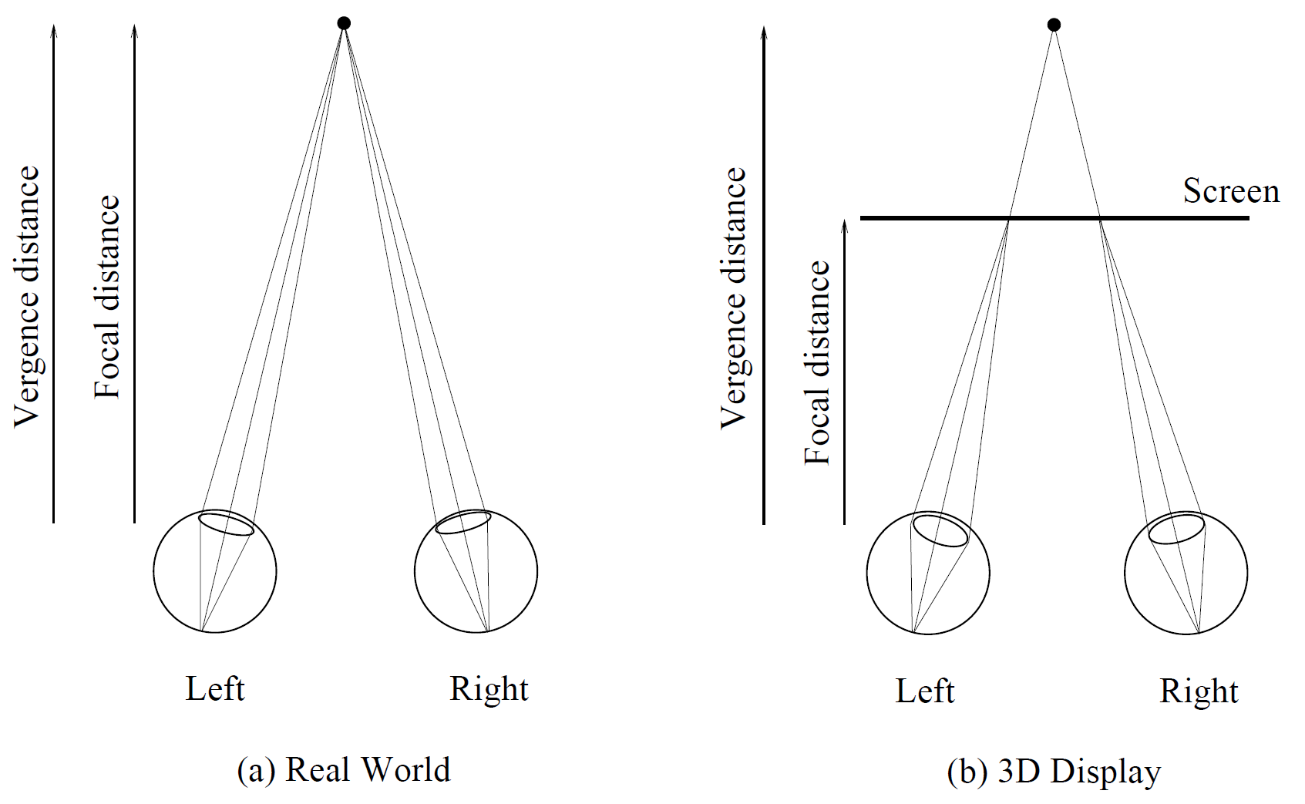
Fig. 5.10: The Vergence-Accommodation Conflict.

Slide 57
5.5.5 Autostereoscopic (Glasses-Free)
Display Devices
Parallax Barrier ─ a layer of opaque material with slits is placed in front of the normal display device, e.g., an LCD. See Fig. 5.10(a). Used in e.g., Nintendo 3DS, Fujifilm 3D camera, and Toshiba’s glasses-free 3D TV.
Lenticular Lens ─ Instead of barriers, columns of magnifying lenses can be placed in front of the display to direct lights properly to the left and right eyes. See Fig. 5.10(b).
Integral Imaging ─ Instead of cylindrical lenses as shown above, an array of spherical convex microlenses can be used to generate a large number of distinct micro-images. It enables the rendering of multiple views from any directions.

Slide 58
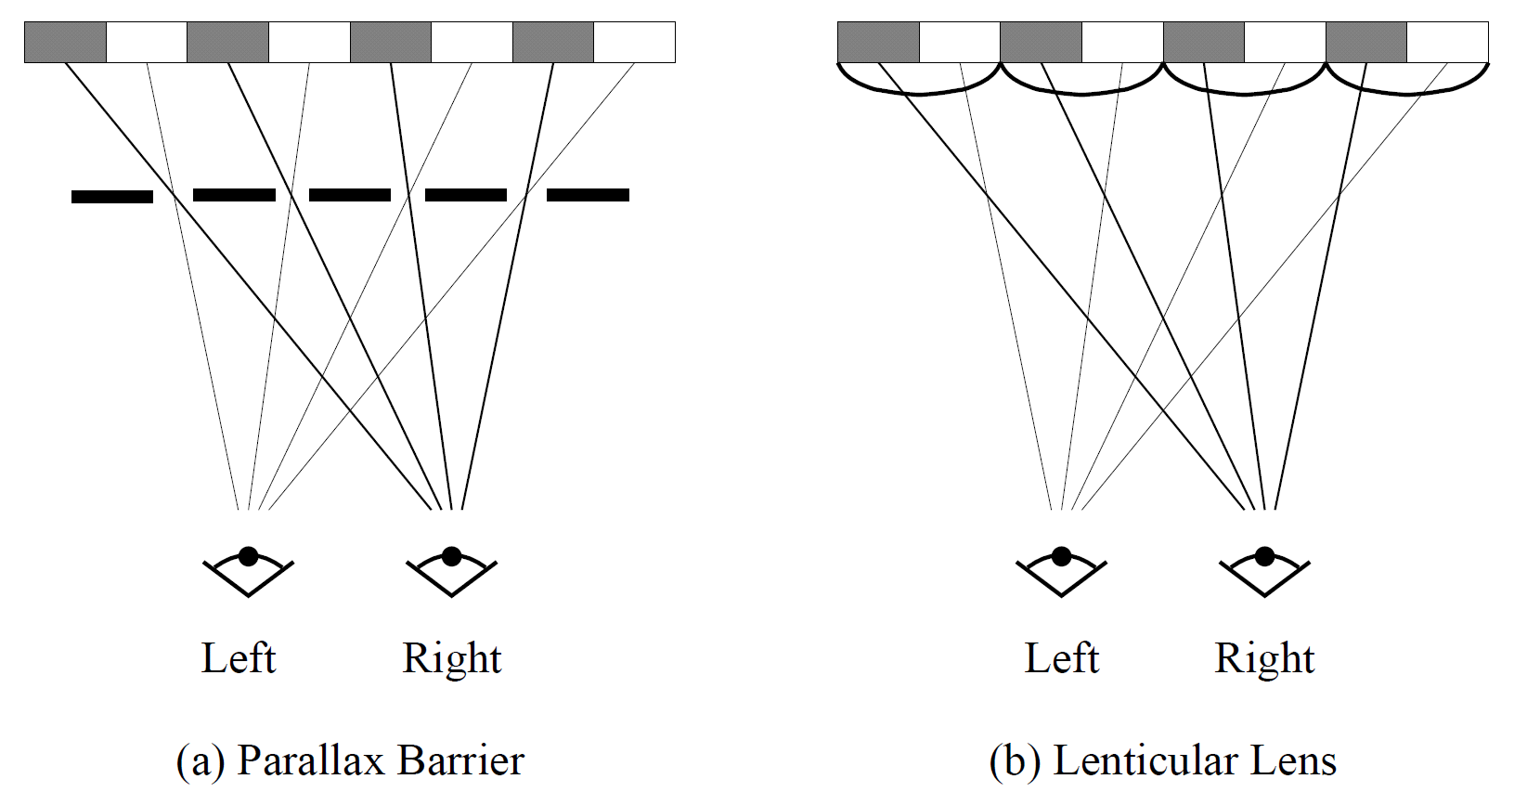
Fig. 5.11: Autostereoscopic Display Devices.

Slide 59
5.5.6 Disparity Manipulation in 3D Content Creation
Disparity Range — map (often suppress) the original disparities into the range that will fit in the comfort zone of most viewers.
Disparity Sensitivity — human vision is more capable of discriminating different depths when they are nearby, so do nonlinear disparity mapping (suppress the far range).
Disparity Gradient — human vision has a limit of disparity gradient in binocular fusion, so avoid it in depth editing.
Disparity Velocity — we cannot rapidly process large accommodation and vergence changes (i.e., disparity changes), so slow it down!

Slide 60
5.6 Video Quality Assessment (VQA)
When comparing the coding efficiency of different video compression methods, a common practice is to compare the bitrates of the coded video bitstreams at the same quality.
The video quality assessment approaches can be objective or subjective: the former is done automatically by computers and the latter requires human judgment.

Slide 61
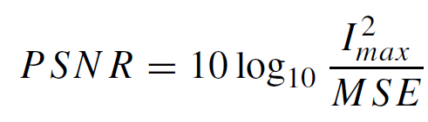
5.6.1 Objective Assessment
The most common criterion used for the objective assessment is peak signal-to-noise ratio (PSNR), where I_{max} is the maximum intensity value, e.g., 255 for 8-bit images, MSE is the Mean Squared Error between the original image I and the compressed image I’.
For videos, the PSNR is usually the average of the PSNRs of the images in the video sequence.

Slide 62
BD-rate (short for Bjontegaard’s delta-rate)
In recent literatures, BD-rate is often adopted for the comparison of coding efficiency.
BD-rate is based on the difference of bitrates between two compression methods, usually the new versus the baseline, when the same PSNR is maintained.
In actual implementations, it is the average bitrate difference over a range of PSNRs (or quality levels).
A negative BD-rate indicates an improvement in coding efficiency (saving of bitrate) achieved by the new method.

Slide 63
5.6.2 Subjective Assessment
The main advantage of PSNR is that it is easy to calculate. However, it does not necessarily reflect the quality as perceived by humans, i.e., visual quality.
For subjective assessment, the original and compressed video clips are shown in succession to the human subjects. The subjects are asked to grade the compressed videos by their quality, 0 — lowest, 10 —highest. The Mean Opinion Score (MOS) is used as the measure for the subjective quality.
Extensively employed in the development of the video compression standards such as H.265 and H.266, especially for HDR videos.
Notes:
J.R. Ohm et al., Comparison of the coding efficiency of video coding standards: including high
efficiency video coding (HEVC). IEEE Trans. Circ. Syst. Video Technol. 22(12), 1669–1684
(2012)

Slide 64
5.6.3 Other VQA Metrics
The main efforts are to find better metrics than the simple measures such as PSNR, so that the assessments can be conducted objectively (by computers) and their results will be comparable to those of human subjects.
Many VQA algorithms are derived from their counterparts in Image Quality Assessment (IQA).
Wang et al. presented the Structural Similarity (SSIM) index that captures some simple image structural information (e.g., luminance and contrast). It has become very popular as a metric in IQA and VQA.
Notes:
J.R. Ohm et al., Comparison of the coding efficiency of video coding standards: including high
efficiency video coding (HEVC). IEEE Trans. Circ. Syst. Video Technol. 22(12), 1669–1684
(2012)

