Slide 1
Chapter 7 Lossless Compression Algorithms
7.1 Introduction
7.2 Basics of Information Theory
7.3 Run-Length Coding
7.4 Variable-Length Coding (VLC)
7.5 Dictionary-based Coding
7.6 Arithmetic Coding
7.7 Lossless Image Compression

Slide 2
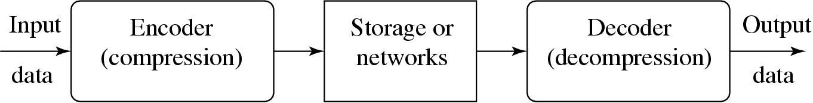
7.1 Introduction
Compression: the process of coding that will effectively reduce the total number of bits needed to represent certain information.
Fig. 7.1: A General Data Compression Scheme.

Slide 3
Introduction (Cont’d)
If the compression and decompression processes induce no information loss, then the compression scheme is lossless; otherwise, it is lossy.
Compression ratio:
(7.1)
B₀ – number of bits before compression
B₁ – number of bits after compression

Slide 4
7.2 Basics of Information Theory
The entropy η of an information source with alphabet S = {s₁, s₂, . . . , s_{n}} is:
(7.2)
(7.3)
p_{i} – probability that symbol s_{i} will occur in S.
– indicates the amount of information (self-information as defined by Shannon) contained in s_{i}, which corresponds to the number of bits needed to encode s_{i}.

Slide 5
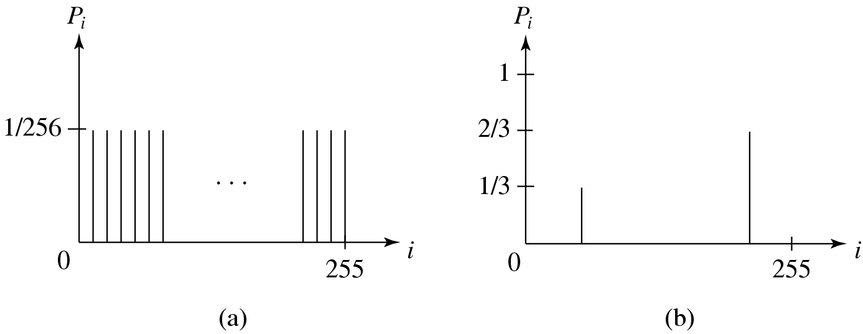
Distribution of Gray-Level Intensities
Fig. 7.2: Histograms for Two Gray-level Images.
Fig. 7.2(a) shows the histogram of an image with uniform distribution of gray-level intensities, i.e., ∀i p_{i} = 1/256. Hence, the entropy of this image is:
log₂256 = 8 (7.4)
Fig. 7.2(b) shows the histogram of an image with two possible values. Its entropy is 0.92.

Slide 6
Entropy and Code Length
As can be seen in Eq. (7.3): the entropy η is a weighted-sum of terms ; hence it represents the average amount of information contained per symbol in the source S.
The entropy η specifies the lower bound for the average number of bits to code each symbol in S, i.e.,
(7.5)
- the average length (measured in bits) of the codewords produced by the encoder.

Slide 7
7.3 Run-Length Coding
Memoryless Source: an information source that is independently distributed. Namely, the value of the current symbol does not depend on the values of the previously appeared symbols.
Instead of assuming memoryless source, Run-Length Coding (RLC) exploits memory present in the information source.
Rationale for RLC: if the information source has the property that symbols tend to form continuous groups, then such symbol and the length of the group can be coded.

Slide 8
7.4 Variable-Length Coding (VLC)
7.4.1 Shannon-Fano Algorithm
— a top-down approach
Sort the symbols according to the frequency count of their occurrences.
Recursively divide the symbols into two parts, each with approximately the same number of counts, until all parts contain only one symbol.
An Example: coding of “HELLO”
Frequency count of the symbols in ”HELLO”.
Symbol | H E L O
Count | 1 1 2 1

Slide 9
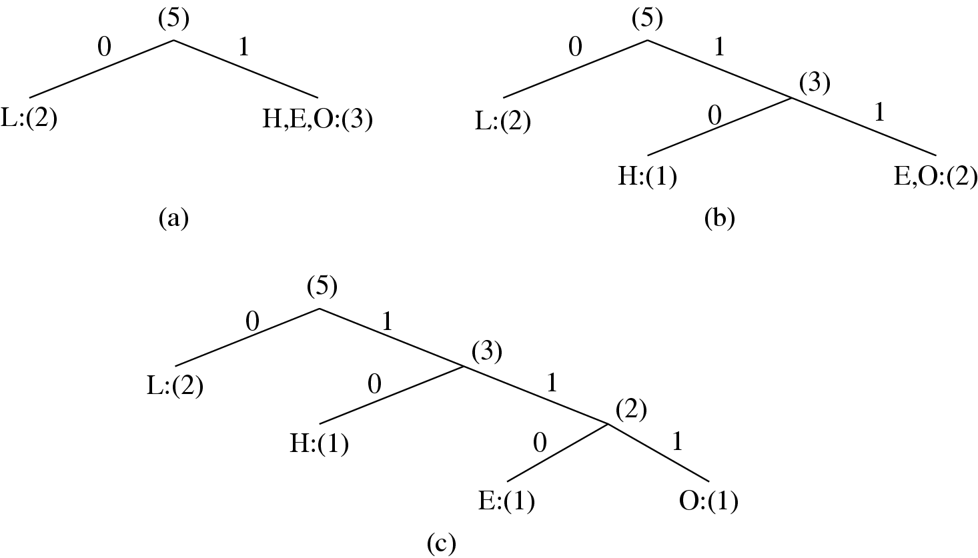
Fig. 7.3: Coding Tree for HELLO by Shannon-Fano.

Slide 10
Table 7.1: Result of Performing Shannon-Fano on HELLO
Symbol | Count | Log₂ | Code | # of bits used
L | 2 | 1.32 | 0 | 2
H | 1 | 2.32 | 10 | 2
E | 1 | 2.32 | 110 | 3
O | 1 | 2.32 | 111 | 3
TOTAL # of bits: |  |  |  | 10

Slide 11
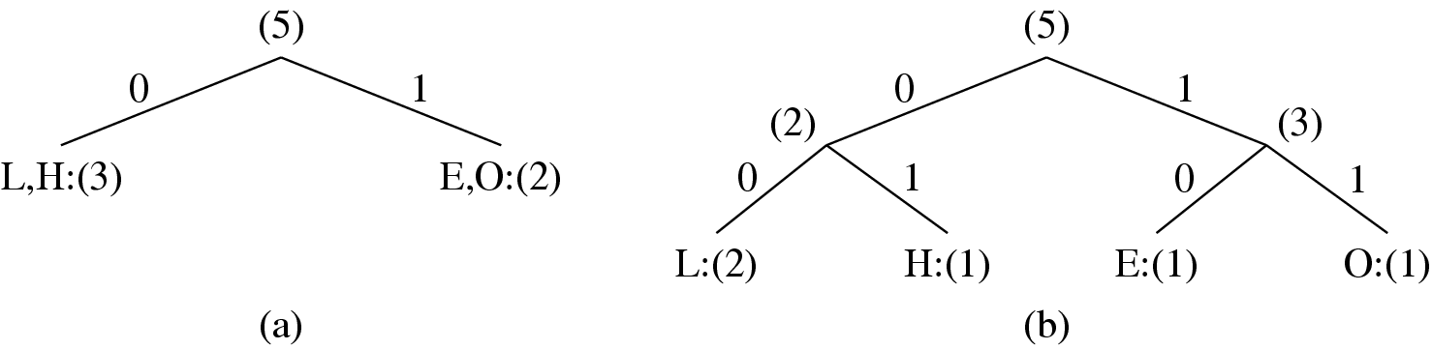
Fig. 7.4: Another coding tree for HELLO by Shannon-Fano.

Slide 12
Table 7.2: Another Result of Performing Shannon-Fano
on HELLO (see Fig. 7.4)
Symbol | Count | Log₂ | Code | # of bits used
L | 2 | 1.32 | 00 | 4
H | 1 | 2.32 | 01 | 2
E | 1 | 2.32 | 10 | 2
O | 1 | 2.32 | 11 | 2
TOTAL # of bits: |  |  |  | 10

Slide 13
7.4.2 Huffman Coding
ALGORITHM 7.1 Huffman Coding Algorithm
— a bottom-up approach
1. Initialization: Put all symbols on a list sorted according to their frequency counts.
2. Repeat until the list has only one symbol left:
From the list pick two symbols with the lowest frequency counts. Form a Huffman subtree that has these two symbols as child nodes and create a parent node.
Assign the sum of the children’s frequency counts to the parent and insert it into the list such that the order is maintained.
Delete the children from the list.
3. Assign a codeword for each leaf based on the path from the root.

Slide 14
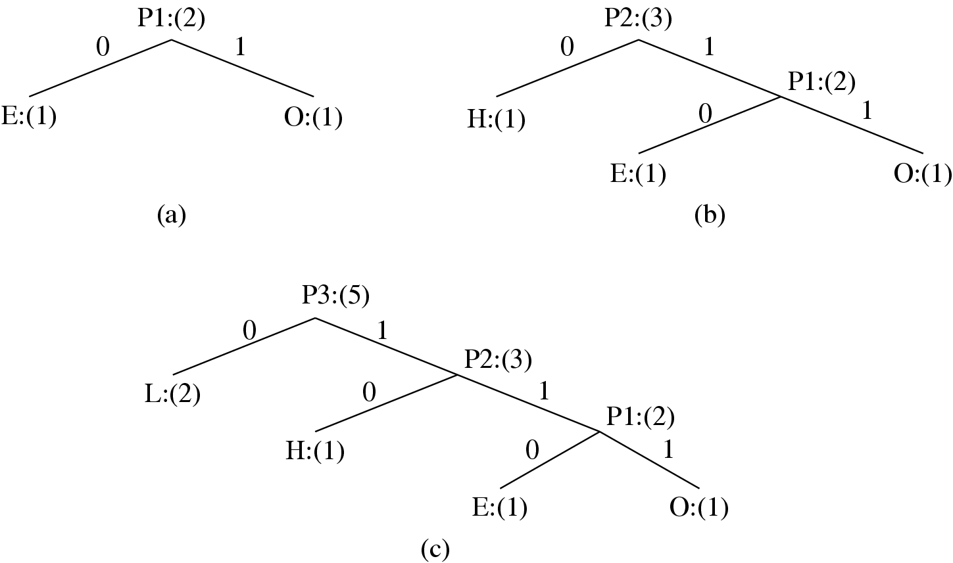
Fig. 7.5: Coding Tree for “HELLO” using the Huffman Algorithm.

Slide 15
Huffman Coding (Cont’d)
In Fig. 7.5, new symbols P1, P2, P3 are created to refer to the parent nodes in the Huffman coding tree. The contents in the list are illustrated below:
After initialization: L H E O
After iteration (a): L P1 H
After iteration (b): L P2
After iteration (c): P3

Slide 16
Properties of Huffman Coding
Unique Prefix Property: No Huffman code is a prefix of any other Huffman code - precludes any ambiguity in decoding.
Optimality: minimum redundancy code - proved optimal for a given data model (i.e., a given, accurate, probability distribution):
The two least frequent symbols will have the same length for their Huffman codes, differing only at the last bit.
Symbols that occur more frequently will have shorter Huffman codes than symbols that occur less frequently.
The average code length for an information source S is strictly less than η + 1. Combined with Eq. (7.5), we have:
(7.6)

Slide 17
Extended Huffman Coding
Motivation: All codewords in Huffman coding have integer bit lengths. It is wasteful when p_{i} is very large and hence is close to 0.
Why not group several symbols together and assign a single codeword to the group as a whole?
Extended Alphabet: For alphabet S = {s₁, s₂, . . . , s_{n}}, if k symbols are grouped together, then the extended alphabet is:
— the size of the new alphabet S^{(k)} is n^{k}.

Slide 18
Extended Huffman Coding (Cont’d)
It can be proven that the average # of bits for each symbol is:
(7.7)
An improvement over the original Huffman coding, but not much.
Problem: If k is relatively large (e.g., k ≥ 3), then for most practical applications where n ≫ 1, n^{k} implies a huge symbol table — impractical.

Slide 19
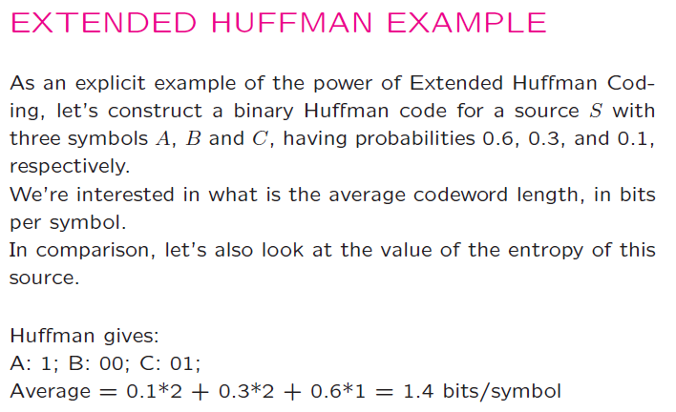
19

Slide 20
20

Slide 21
Fig. 7.6: Huffman Tree for Extended Alphabet
21

Slide 22
22

Slide 23
7.4.3 Adaptive Huffman Coding
• Adaptive Huffman Coding: statistics are gathered and updated dynamically as the data stream arrives.
ENCODER ------- Initial_code(); while not EOF { get(c); encode(c); update_tree(c); } | DECODER ------- Initial_code(); while not EOF { decode(c); output(c); update_tree(c); }

Slide 24
Adaptive Huffman Coding (Cont’d)
• Initial_code assigns symbols with some initially agreed upon codes, without any prior knowledge of the frequency counts.
• update_tree constructs an Adaptive Huffman tree.
It basically does two things:
increments the frequency counts for the symbols (including any new ones).
updates the configuration of the tree.
• The encoder and decoder must use exactly the same initial_code and update_tree routines.

Slide 25
Notes on Adaptive Huffman Tree Updating
Nodes are numbered in order from left to right, bottom to top. The numbers in parentheses indicates the count.
The tree must always maintain its sibling property, i.e., all nodes (internal and leaf) are arranged in the order of increasing counts.
If the sibling property is about to be violated, a swap procedure is invoked to update the tree by rearranging the nodes.
When a swap is necessary, the farthest node with count N is swapped with the node whose count has just been increased to N +1.

Slide 26
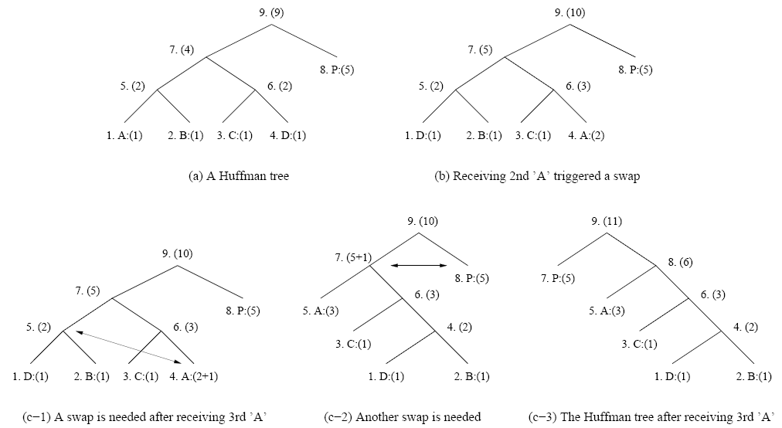
Fig. 7.7: Node Swapping for Updating an Adaptive Huffman Tree

Slide 27
Another Example: Adaptive Huffman Coding
This is to clearly illustrate more implementation details. We show exactly what bits are sent, as opposed to simply stating how the tree is updated.
An additional rule: if any character/symbol is to be sent the first time, it must be preceded by a special symbol, NEW. The initial code for NEW is 0. The count for NEW is always kept as 0 (the count is never increased); hence it is always denoted as NEW:(0) in Fig. 7.7.

Slide 28
Table 7.3: Initial code assignment for AADCCDD using Adaptive Huffman Coding.
Initial Code --------------------- NEW: 0 A: 00001 B: 00010 C: 00011 D: 00100 . . .

Slide 29
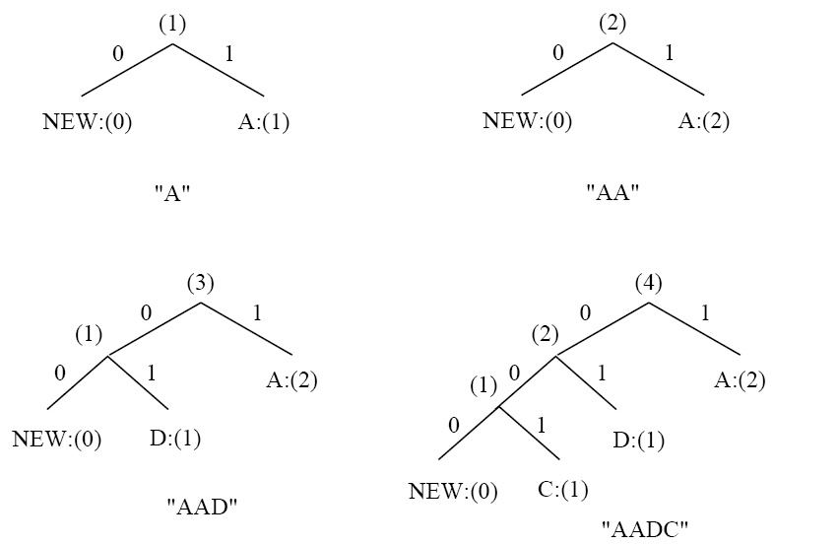
Fig. 7.8: Adaptive Huffman tree for AADCCDD.

Slide 30
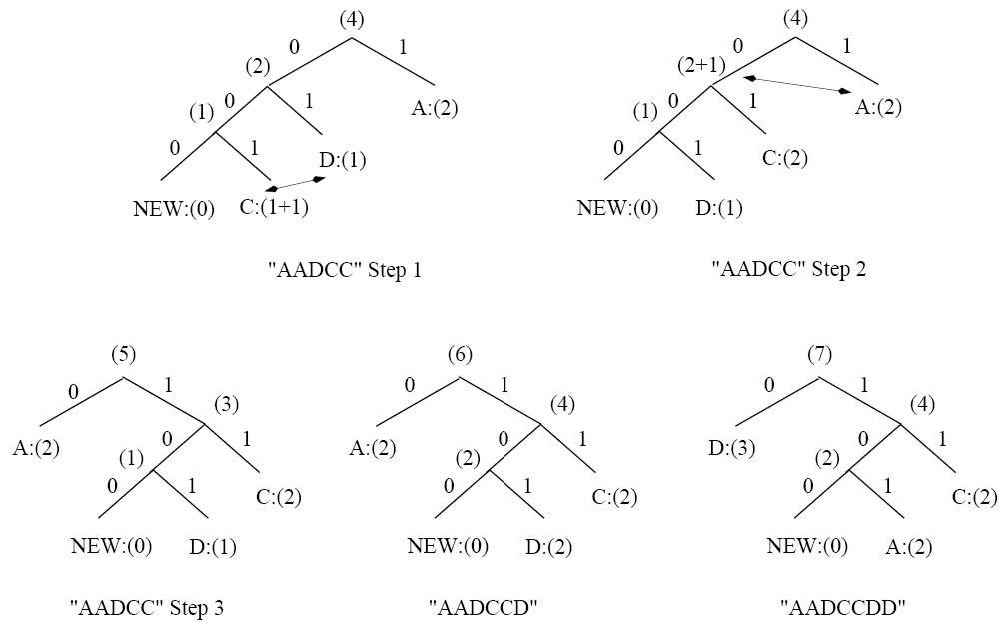
Fig. 7.8 (Cont’d): Adaptive Huffman tree for AADCCDD.

Slide 31
Table 7.4: Sequence of symbols and codes sent to the decoder
Symbol | NEW | A | A | NEW | D | NEW | C | C | D | D
Code | 0 | 00001 | 1 | 0 | 00100 | 00 | 00011 | 001 | 101 | 101
It is important to emphasize that the code for a particular symbol changes during the adaptive Huffman coding process.
For example, after AADCCDD, when the character D overtakes A as the most frequent symbol, its code changes from 101 to 0.
The “Squeeze Page” on this book’s web site provides a Java applet for adaptive Huffman coding.

Slide 32
7.5 Dictionary-based Coding
LZW uses fixed-length codewords to represent variable-length strings of symbols/characters that commonly occur together, e.g., words in English text.
The LZW encoder and decoder build up the same dictionary dynamically while receiving the data.
LZW places longer and longer repeated entries into a dictionary, and then emits the code for an element, rather than the string itself, if the element has already been placed in the dictionary.

Slide 33
ALGORITHM 7.2 - LZW Compression
BEGIN
s = next input character;
while not EOF
{
c = next input character;
if s + c exists in the dictionary
s = s + c;
else
{
output the code for s;
add string s + c to the dictionary with a new code;
s = c;
}
}
output the code for s;
END

Slide 34
Example 7.2 LZW compression for string “ABABBABCABABBA”
Let’s start with a very simple dictionary (also referred to as a “string table”), initially containing only 3 characters, with codes as follows:
Now if the input string is “ABABBABCABABBA”, the LZW compression algorithm works as follows:
Code | String
1 | A
2 | B
3 | C

Slide 35
S | C | Output | Code | String
 |  |  | 1 2 3 | A B C
A B A AB B BA B C A AB A AB ABB A | B A B B A B C A B A B B A EOF | 1 2 4 5 2 3 4 6 1 | 4 5 6 7 8 9 10 11 | AB BA ABB BAB BC CA ABA ABBA
The output codes are: 1 2 4 5 2 3 4 6 1. Instead of sending 14 characters, only 9 codes need to be sent (compression ratio = 14/9 = 1.56).

Slide 36
ALGORITHM 7.3 LZW Decompression (simple version)
BEGIN
s = NIL;
while not EOF
{
k = next input code;
entry = dictionary entry for k;
output entry;
if (s != NIL)
add string s + entry[0] to dictionary with a new code;
s = entry;
}
END
Example 7.3: LZW decompression for string “ABABBABCABABBA”.
Input codes to the decoder are 1 2 4 5 2 3 4 6 1.
The initial string table is identical to what is used by the encoder.

Slide 37
The LZW decompression algorithm then works as follows:
S | K | Entry/output | Code | String
 |  |  | 1 2 3 | A B C
NIL A B AB BA B C AB ABB A | 1 2 4 5 2 3 4 6 1 EOF | A B AB BA B C AB ABB A | 4 5 6 7 8 9 10 11 | AB BA ABB BAB BC CA ABA ABBA
Apparently, the output string is “ABABBABCABABBA”, a truly lossless result!

Slide 38
ALGORITHM 7.4 LZW Decompression (modified)
BEGIN
s = NIL;
while not EOF
{
k = next input code;
entry = dictionary entry for k;
/* exception handler */
if (entry == NULL)
entry = s + s[0];
output entry;
if (s != NIL)
add string s + entry[0] to dictionary with a new code;
s = entry;
}
END

Slide 39
LZW Coding (Cont’d)
In real applications, the code length l is kept in the range of [l₀, l_{max}]. The dictionary initially has a size of 2^{l0}. When it is filled up, the code length will be increased by 1; this is allowed to repeat until l = l_{max}.
When l_{max} is reached and the dictionary is filled up, it needs to be flushed (as in Unix compress, or to have the LRU (least recently used) entries removed.

Slide 40
7.6 Arithmetic Coding
Arithmetic coding is a more modern coding method that usually out-performs Huffman coding.
Huffman coding assigns each symbol a codeword which has an integral bit length. Arithmetic coding can treat the whole message as one unit.
A message is represented by a half-open interval [a, b) where a and b are real numbers between 0 and 1. Initially, the interval is [0, 1). When the message becomes longer, the length of the interval shortens and the number of bits needed to represent the interval increases.

Slide 41
ALGORITHM 7.5 Arithmetic Coding Encoder
BEGIN
low = 0.0; high = 1.0; range = 1.0;
while (symbol != terminator)
{
get (symbol);
high = low + range * Range_high(symbol);
low = low + range * Range_low(symbol);
range = high - low;
}
output a code so that low <= code < high;
END

Slide 42
Example: Encoding in Arithmetic Coding
Probability distribution of symbols.
Fig. 7.9: Arithmetic Coding: Encode Symbols “CAEE$”
Symbol | Probability | Range
A | 0.2 | [0, 0.2)
B | 0.1 | [0.2, 0.3)
C | 0.2 | [0.3, 0.5)
D | 0.05 | [0.5, 0.55)
E | 0.3 | [0.55, 0.85)
F | 0.05 | [0.85, 0.9)
$ | 0.1 | [0.9, 1.0)

Slide 43
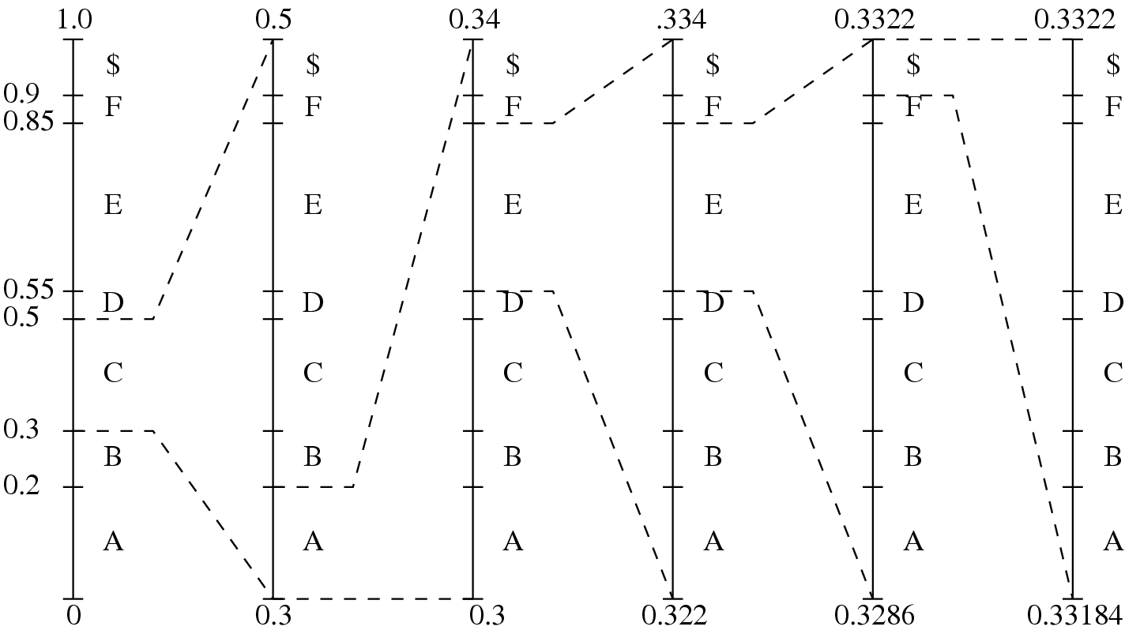
Fig. 7.9(b): Graphical display of shrinking ranges.

Slide 44
Example: Encoding in Arithmetic Coding
(c) New low, high, and range generated.
Fig. 7.9 (Cont’d): Arithmetic Coding: Encode Symbols “CAEE$”
Symbol | Low | High | Range
 | 0 | 1.0 | 1.0
C | 0.3 | 0.5 | 0.2
A | 0.30 | 0.34 | 0.04
E | 0.322 | 0.334 | 0.012
E | 0.3286 | 0.3322 | 0.0036
$ | 0.33184 | 0.33220 | 0.00036

Slide 45
PROCEDURE 7.2 Generating Codeword for Encoder
BEGIN
code = 0;
k = 1;
while (value(code) < low)
{
assign 1 to the kth binary fraction bit
if (value(code) > high)
replace the kth bit by 0
k = k + 1;
}
END
The final step in Arithmetic encoding calls for the generation of a number that falls within the range [low, high). The above algorithm will ensure that the shortest binary codeword is found.

Slide 46
ALGORITHM 7.6 Arithmetic Coding Decoder
BEGIN
get binary code and convert to
decimal value = value(code);
DO
{
find a symbol s so that
Range_low(s) <= value < Range_high(s);
output s;
low = Rang_low(s);
high = Range_high(s);
range = high - low;
value = [value - low] / range;
}
UNTIL symbol s is a terminator
END

Slide 47
Table 7.5: Arithmetic coding: decode symbols “CAEE$”
Value | Output Symbol | Range_low | Range_high | range
0.33203125 | C | 0.3 | 0.5 | 0.2
0.16015625 | A | 0.0 | 0.2 | 0.2
0.80078125 | E | 0.55 | 0.85 | 0.3
0.8359375 | E | 0.55 | 0.85 | 0.3
0.953125 | $ | 0.9 | 1.0 | 0.1

Slide 48
7.6.2 Scaling and Incremental Coding
The basic algorithm described in the last section has the following limitations that make its practical implementation infeasible.
When it is used to code long sequences of symbols, the tag intervals shrink to a very small range. Representing these small intervals requires very high-precision numbers.
The encoder will not produce any output codeword until the entire sequence is entered. Likewise, the decoder needs to have the codeword for the entire sequence of the input symbols before decoding.

Slide 49
Some key observations:
Although the binary representations for the low, high, and any number within the small interval usually require many bits, they always have the same MSBs (Most Significant Bits). For example, 0.1000110 for 0.5469 (low), 0.1000111 for 0.5547 (high).
Subsequent intervals will always stay within the current interval. Hence, we can output the common MSBs and remove them from subsequent considerations.

Slide 50
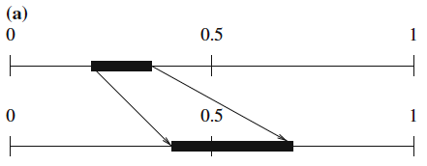
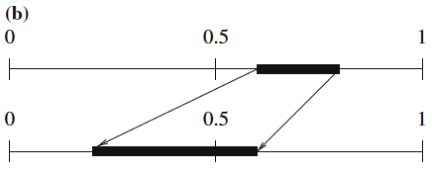
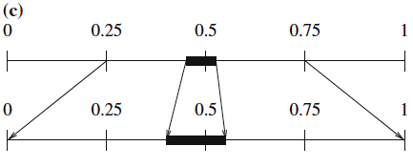
Fig. 7.10: Scaling in arithmetic coding.
(a) E1 Scaling, (b) E2 Scaling, (c) E3 Scaling.

Slide 51
Procedure 7.3: (E1 and E2 Scalings in Arithmetic Coding).
BEGIN
while (high <= 0.5) OR (low >= 0.5)
{ if (high <= 0.5) // E1 scaling
{ output ‘0’;
low = 2 * low; high = 2 * high;
}
else // E2 scaling
{ output ‘1’;
low = 2 * (low - 0.5); high = 2 * (high - 0.5);
}
}
END

Slide 52
Example 7.4: (Arithmetic Coding with Scaling and Incremental Coding).
Assume we only have three symbols A, B, C, and their probabilities are: A: 0.7, B: 0.2, C: 0.1. Suppose the input sequence for this example is ACB, and both the encoder and decoder know that the length of the sequence is 3.

Slide 53
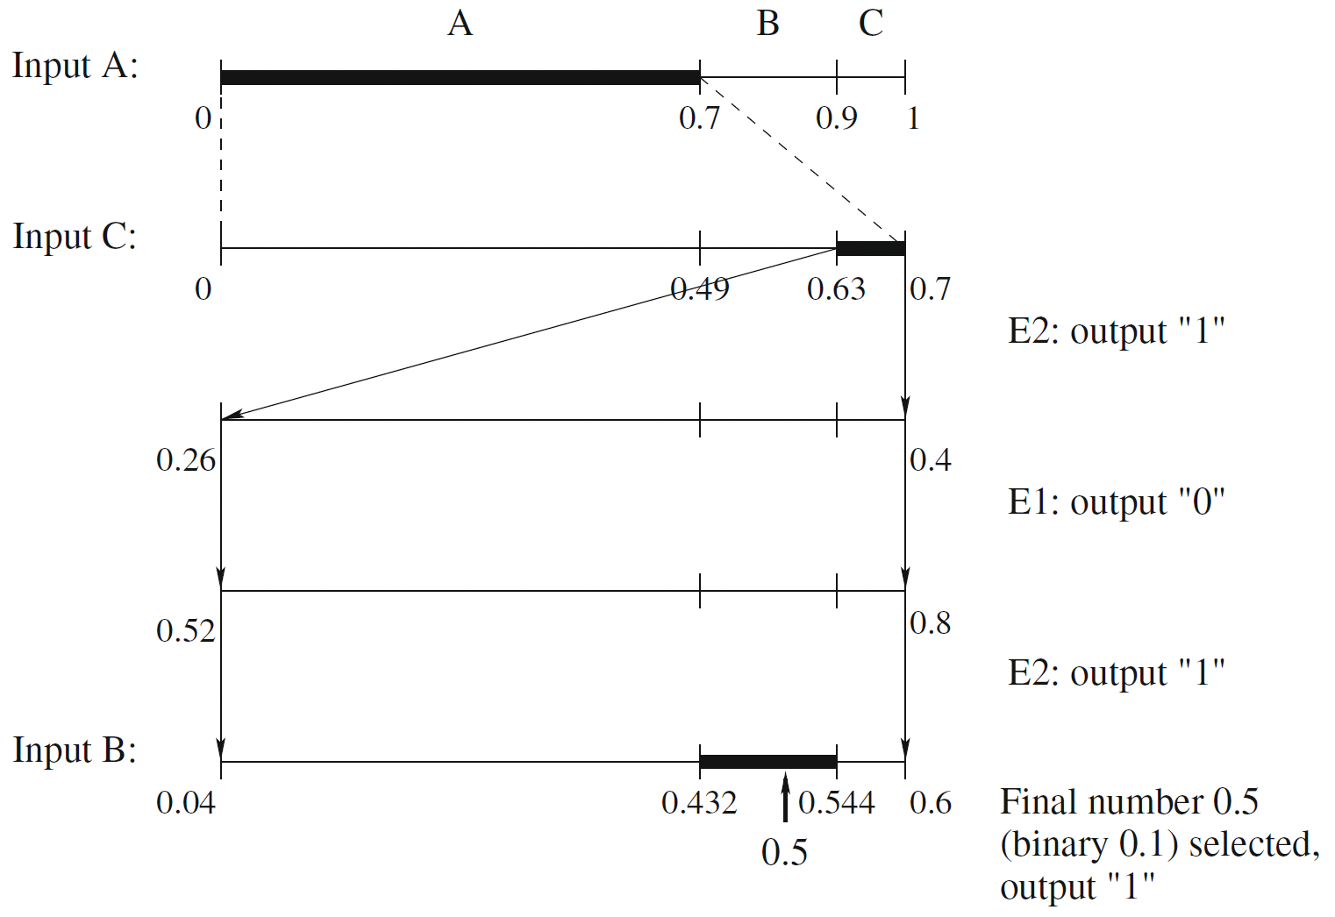
Fig. 7.11: Example: arithmetic coding with scaling and incremental coding—encoder

Slide 54
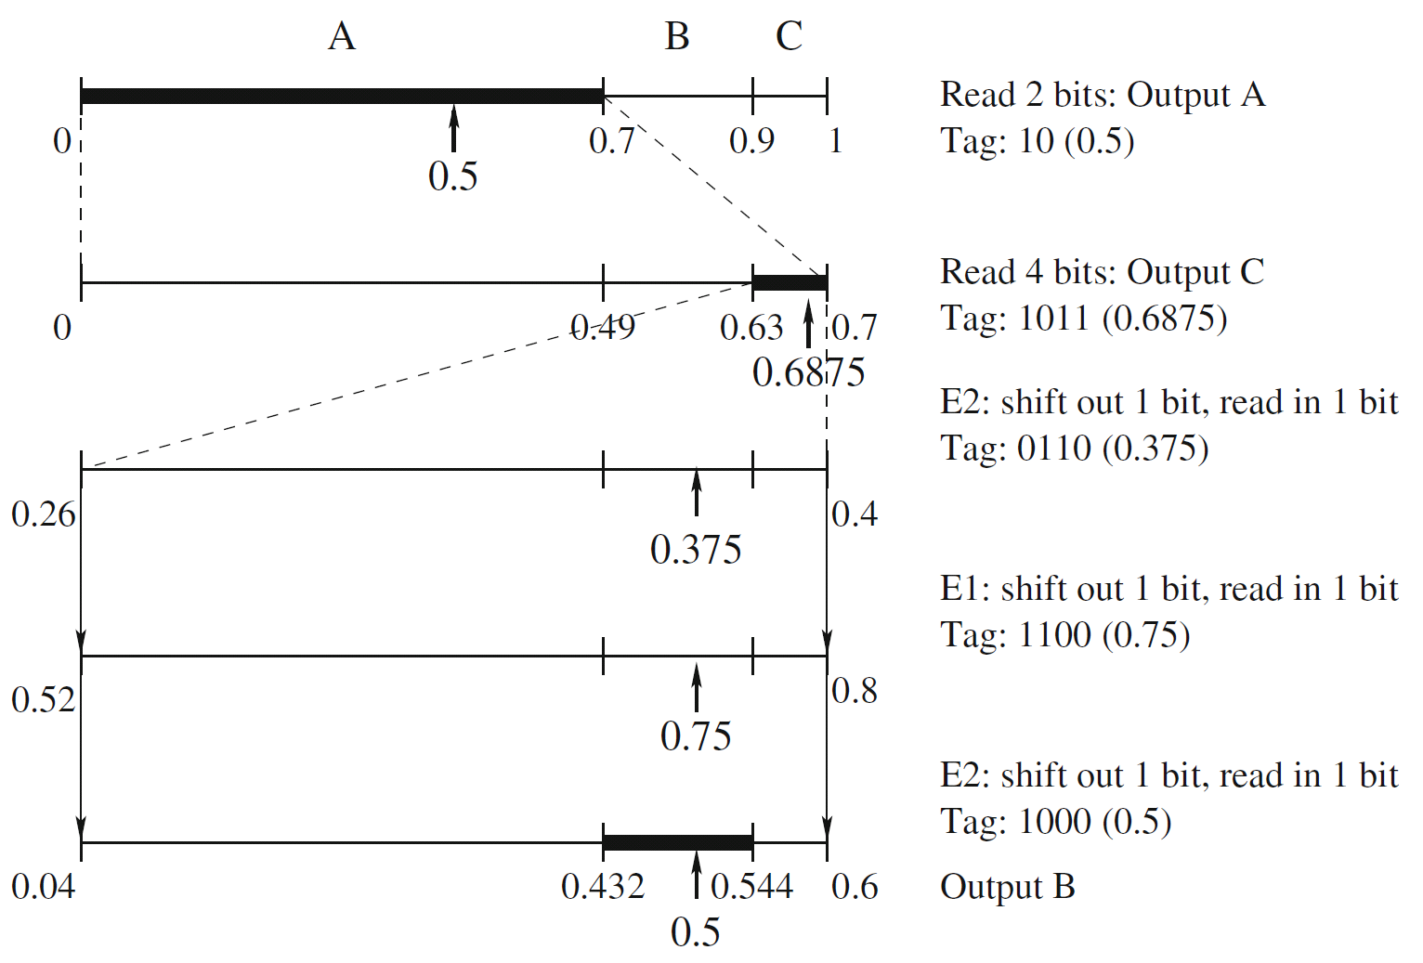
Fig. 7.12: Example: arithmetic coding with scaling and incremental coding—decoder

Slide 55
E3 Scaling
N E3 scaling steps followed by an E1 is equivalent to an E1 followed by N E2 steps.
N E3 scaling steps followed by an E2 is equivalent to an E2 followed by N E1 steps.
Therefore, a good way to handle the signaling of the E3 scaling is: postpone until there is an E1 or E2.
If there is an E1 after N E3 operations, send ‘0’ followed by N ‘1’s after the E1;
if there is an E2 after N E3 operations, send ‘1’ followed by N ‘0’s after the E2.

Slide 56
7.6.3 Integer Implementation
Uses only integer arithmetic. It is quite common in modern multimedia applications.
Basically, the unit interval is replaced by a range [0, N), where N is an integer, e.g. 255.
Because the integer range could be so small, e.g., [0, 255), applying the scaling techniques similar to what was discussed above, now in integer arithmetic, is a necessity.
The main motivation is to avoid any floating number operations.

Slide 57
7.6.4 Binary Arithmetic Coding
Only use binary symbols, 0 and 1.
The calculation of new intervals and the decision of which interval to take (first or second) are simpler.
Fast Binary Arithmetic Coding (Q-coder, MQ-coder) was developed in multimedia standards such as JBIG, JBIG2, and JPEG-2000. The more advanced version, Context-Adaptive Binary Arithmetic Coding (CABAC) is used in H.264 (M-coder) and H.265.

Slide 58
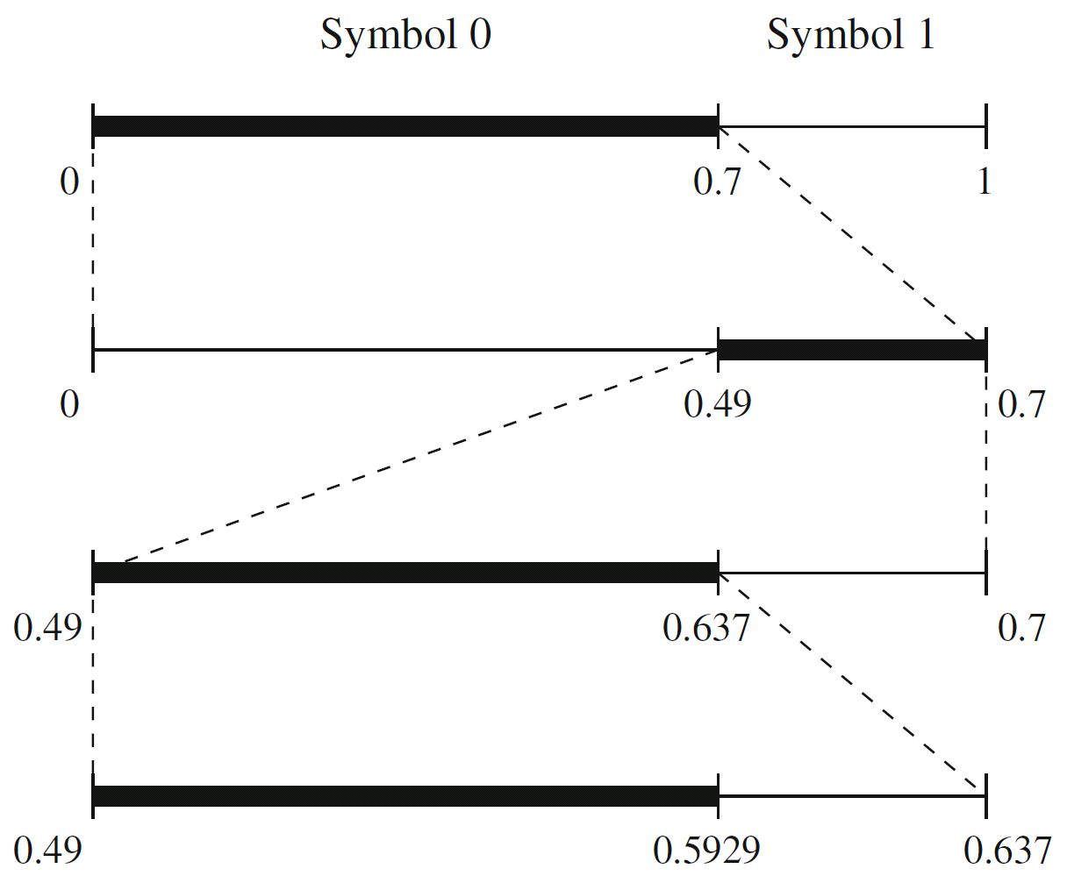
Fig. 7.13: Binary arithmetic coding

Slide 59
Procedure 7.4 (Procedures for Adaptive Arithmetic Coding).
ENCODER DECODER
------- -------
Initialization (reset counters) Initialization (reset counters)
while (symbol != terminator) while (symbol != terminator)
{ {
get(symbol); decode(symbol);
encode(symbol); output(symbol);
update stats and interval; update stats and interval;
} }

Slide 60
Example 7.5: (Adaptive Binary Arithmetic Coding).
Assume the input symbols to the encoder is 10001.
Assume that both the encoder and decoder know the length of the sequence.
** For clarity and simplicity, the scaling procedure (for E1, E2, etc.) will not be used.

Slide 61
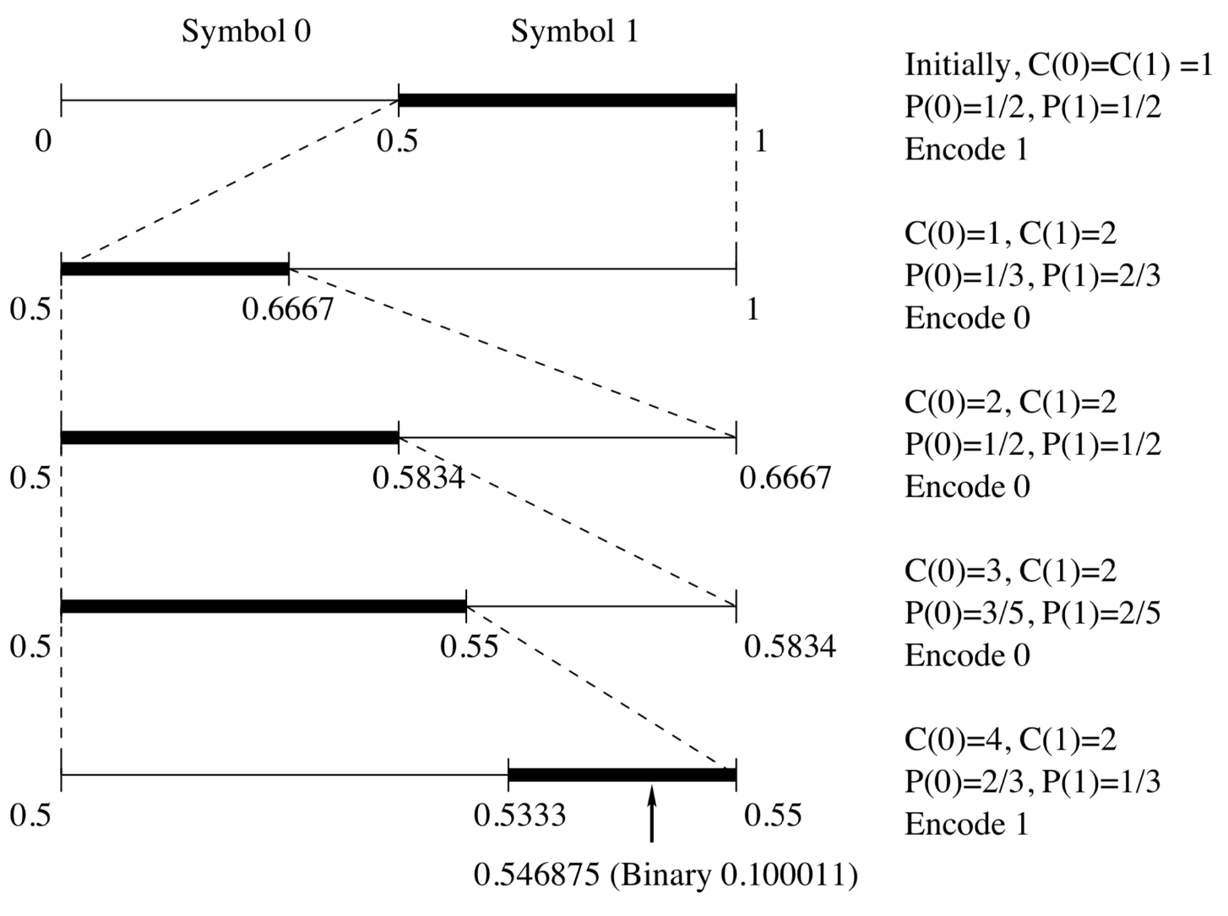
Fig. 7.14: Adaptive binary arithmetic coding—encoder [input symbols:10001]

Slide 62
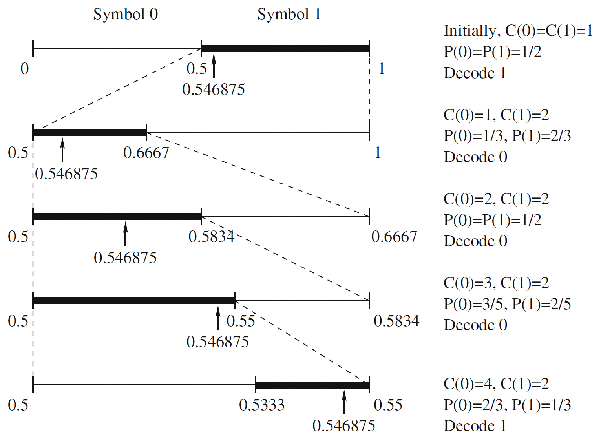
Fig. 7.15: Adaptive binary arithmetic coding—decoder. [input: 0.546875 (binary 0.100011)]

Slide 63
7.7 Lossless Image Compression
Approaches of Differential Coding of Images:
– Given an original image I(x, y), using a simple difference operator we can define a difference image d(x, y) as follows:
(7.9)
or use the discrete version of the 2-D Laplacian operator to define a difference image d(x, y) as
(7.10)
Due to spatial redundancy existed in normal images I, the difference image d will have a narrower histogram and hence a smaller entropy, as shown in Fig. 7.9.

Slide 64
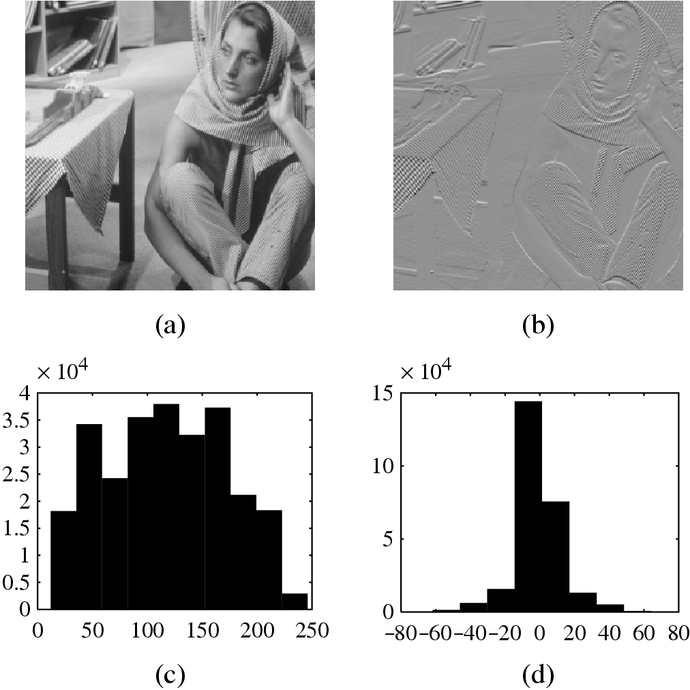
Fig. 7.16: Distributions for Original versus Derivative Images. (a,b): Original gray-level image and its partial derivative image; (c,d): Histograms for original and derivative images.
(This figure uses a commonly employed image called “Barb”.)

Slide 65
7.7.2 Lossless JPEG
• Lossless JPEG: A special case of the JPEG image compression.
• The Predictive method
Forming a differential prediction: A predictor combines the values of up to three neighboring pixels as the predicted value for the current pixel, indicated by ‘X’ in Fig. 7.10. The predictor can use any one of the seven schemes listed in Table 7.6.
Encoding: The encoder compares the prediction with the actual pixel value at the position ‘X’ and encodes the difference using one of the lossless compression techniques we have discussed, e.g., the Huffman coding scheme.

Slide 66
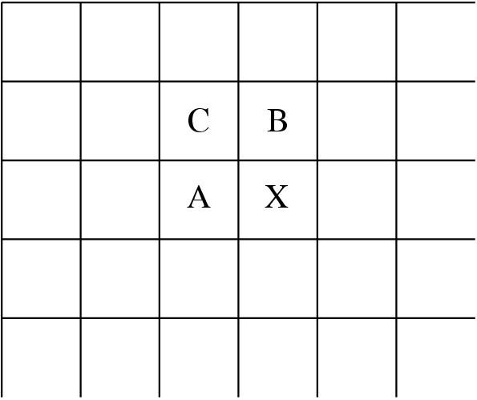
Fig. 7.17: Neighboring Pixels for Predictors in Lossless JPEG.
Note: Any of A, B, or C has already been decoded before it is used in the predictor, on the decoder side of an encode-decode cycle.

Slide 67
Table 7.6: Predictors for Lossless JPEG
Predictor | Prediction
P1 | A
P2 | B
P3 | C
P4 | A + B – C
P5 | A + (B – C) / 2
P6 | B + (A – C) / 2
P7 | (A + B) / 2

Slide 68
Table 7.7: Comparison with other lossless compression programs
Compression Program | Compression Ratio
 | Lena | Football | F-18 | Flowers
Lossless JPEG | 1.45 | 1.54 | 2.29 | 1.26
Optimal Lossless JPEG | 1.49 | 1.67 | 2.71 | 1.33
Compress (LZW) | 0.86 | 1.24 | 2.21 | 0.87
Gzip (LZ77) | 1.08 | 1.36 | 3.10 | 1.05
Gzip -9 (optimal LZ77) | 1.08 | 1.36 | 3.13 | 1.05
Pack(Huffman coding) | 1.02 | 1.12 | 1.19 | 1.00

