Slide 1
Chapter 9
Image Compression Standards
9.1 The JPEG Standard
9.2 The JPEG 2000 Standard
9.3 The JPEG-LS Standard
9.4 Bi-level Image Compression Standards

Slide 2
9.1 The JPEG Standard
JPEG is an image compression standard that was developed by the “Joint Photographic Experts Group”. JPEG was formally accepted as an international standard in 1992.
JPEG is a lossy image compression method. It employs a transform coding method using the DCT (Discrete Cosine Transform).
An image is a function of i and j (or conventionally x and y) in the spatial domain. The 2D DCT is used as one step in JPEG in order to yield a frequency response which is a function F(u, v) in the spatial frequency domain, indexed by two integers u and v.

Slide 3
Observations for JPEG Image Compression
The effectiveness of the DCT transform coding method in JPEG relies on 3 major observations:
Observation 1: Useful image contents change relatively slowly across the image, i.e., it is unusual for intensity values to vary widely several times in a small area, for example, within an 8×8 image block.
Much of the information in an image is repeated, hence “spatial redundancy”.

Slide 4
Observations for JPEG Image Compression
(Cont’d)
Observation 2: Psychophysical experiments suggest that humans are much less likely to notice the loss of very high spatial frequency components than the loss of lower frequency components.
  The spatial redundancy can be explored by largely reducing the high spatial frequency contents.
Observation 3: Visual acuity (accuracy in distinguishing closely spaced lines) is much greater for gray (“black and white”) than for color.
• Chroma subsampling (4:2:0) is used in JPEG.

Slide 5
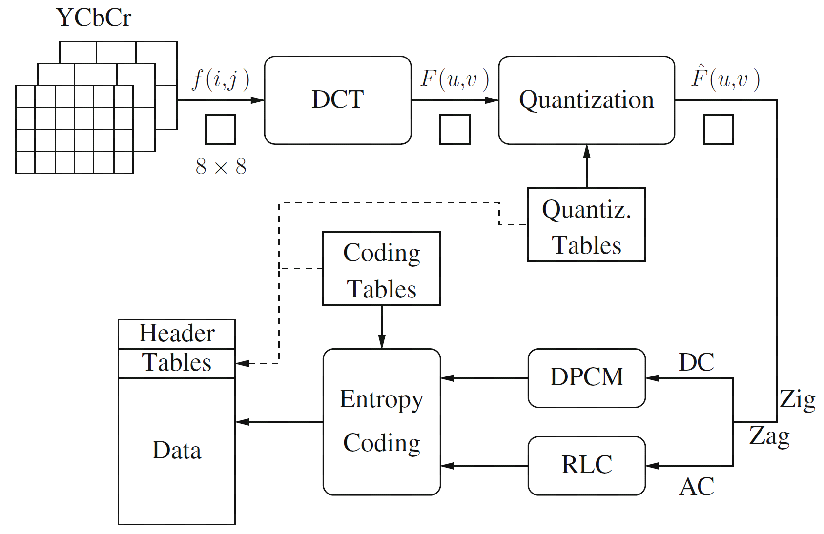
Fig. 9.1: Block diagram for JPEG encoder.

Slide 6
9.1.1 Main Steps in JPEG Image Compression
• Transform RGB to YCbCr and subsample color.
• DCT on image blocks.
• Quantization.
• Zigzag ordering and run-length encoding.
• Entropy coding.

Slide 7
DCT on image blocks
Each image is divided into 8 × 8 blocks. The 2D DCT is applied to each block image f(i, j), with output being the DCT coefficients F(u, v) for each block.
Using blocks, however, has the effect of isolating each block from its neighboring context. This is why JPEG images look choppy (“blocky”) when a high compression ratio is specified by the user.

Slide 8
Quantization
(9.1)
F(u, v) represents a DCT coefficient, Q(u, v) is a “quantization matrix” entry, and represents the quantized DCT coefficients which JPEG will use in the succeeding entropy coding.
  The quantization step is the main source for loss in JPEG compression.
  The entries of Q(u, v) tend to have larger values towards the lower right corner. This aims to introduce more loss at the higher spatial frequencies — a practice supported by Observations 1 and 2.
  Table 9.1 and 9.2 show the default Q(u, v) values obtained from psychophysical studies with the goal of maximizing the compression ratio while minimizing perceptual losses in JPEG images.

Slide 9
Table 9.1 The Luminance Quantization Table
Table 9.2 The Chrominance Quantization Table
16 | 11 | 10 | 16 | 24 | 40 | 51 | 61
12 | 12 | 14 | 19 | 26 | 58 | 60 | 55
14 | 13 | 16 | 24 | 40 | 57 | 69 | 56
14 | 17 | 22 | 29 | 51 | 87 | 80 | 62
18 | 22 | 37 | 56 | 68 | 109 | 103 | 77
24 | 35 | 55 | 64 | 81 | 104 | 113 | 92
49 | 64 | 78 | 87 | 103 | 121 | 120 | 101
72 | 92 | 95 | 98 | 112 | 100 | 103 | 99
17 | 18 | 24 | 47 | 99 | 99 | 99 | 99
18 | 21 | 26 | 66 | 99 | 99 | 99 | 99
24 | 26 | 56 | 99 | 99 | 99 | 99 | 99
47 | 66 | 99 | 99 | 99 | 99 | 99 | 99
99 | 99 | 99 | 99 | 99 | 99 | 99 | 99
99 | 99 | 99 | 99 | 99 | 99 | 99 | 99
99 | 99 | 99 | 99 | 99 | 99 | 99 | 99
99 | 99 | 99 | 99 | 99 | 99 | 99 | 99

Slide 10
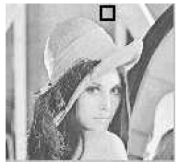
An 8 × 8 block from the Y image of ‘Lena’
200 202 189 188 189 175 175 175 200 203 198 188 189 182 178 175 203 200 200 195 200 187 185 175 200 200 200 200 197 187 187 187 200 205 200 200 195 188 187 175 200 200 200 200 200 190 187 175 205 200 199 200 191 187 187 175 210 200 200 200 188 185 187 186 f(i, j)
515 65 -12 4 1 2 -8 5
-16 3 2 0 0 -11 -2 3
-12 6 11 -1 3 0 1 -2
-8 3 -4 2 -2 -3 -5 -2
0 -2 7 -5 4 0 -1 -4
0 -3 -1 0 4 1 -1 0
3 -2 -3 3 3 -1 -1 3
-2 5 -2 4 -2 2 -3 0
F(u, v)
Fig. 9.2: JPEG compression for a smooth image block.

Slide 11
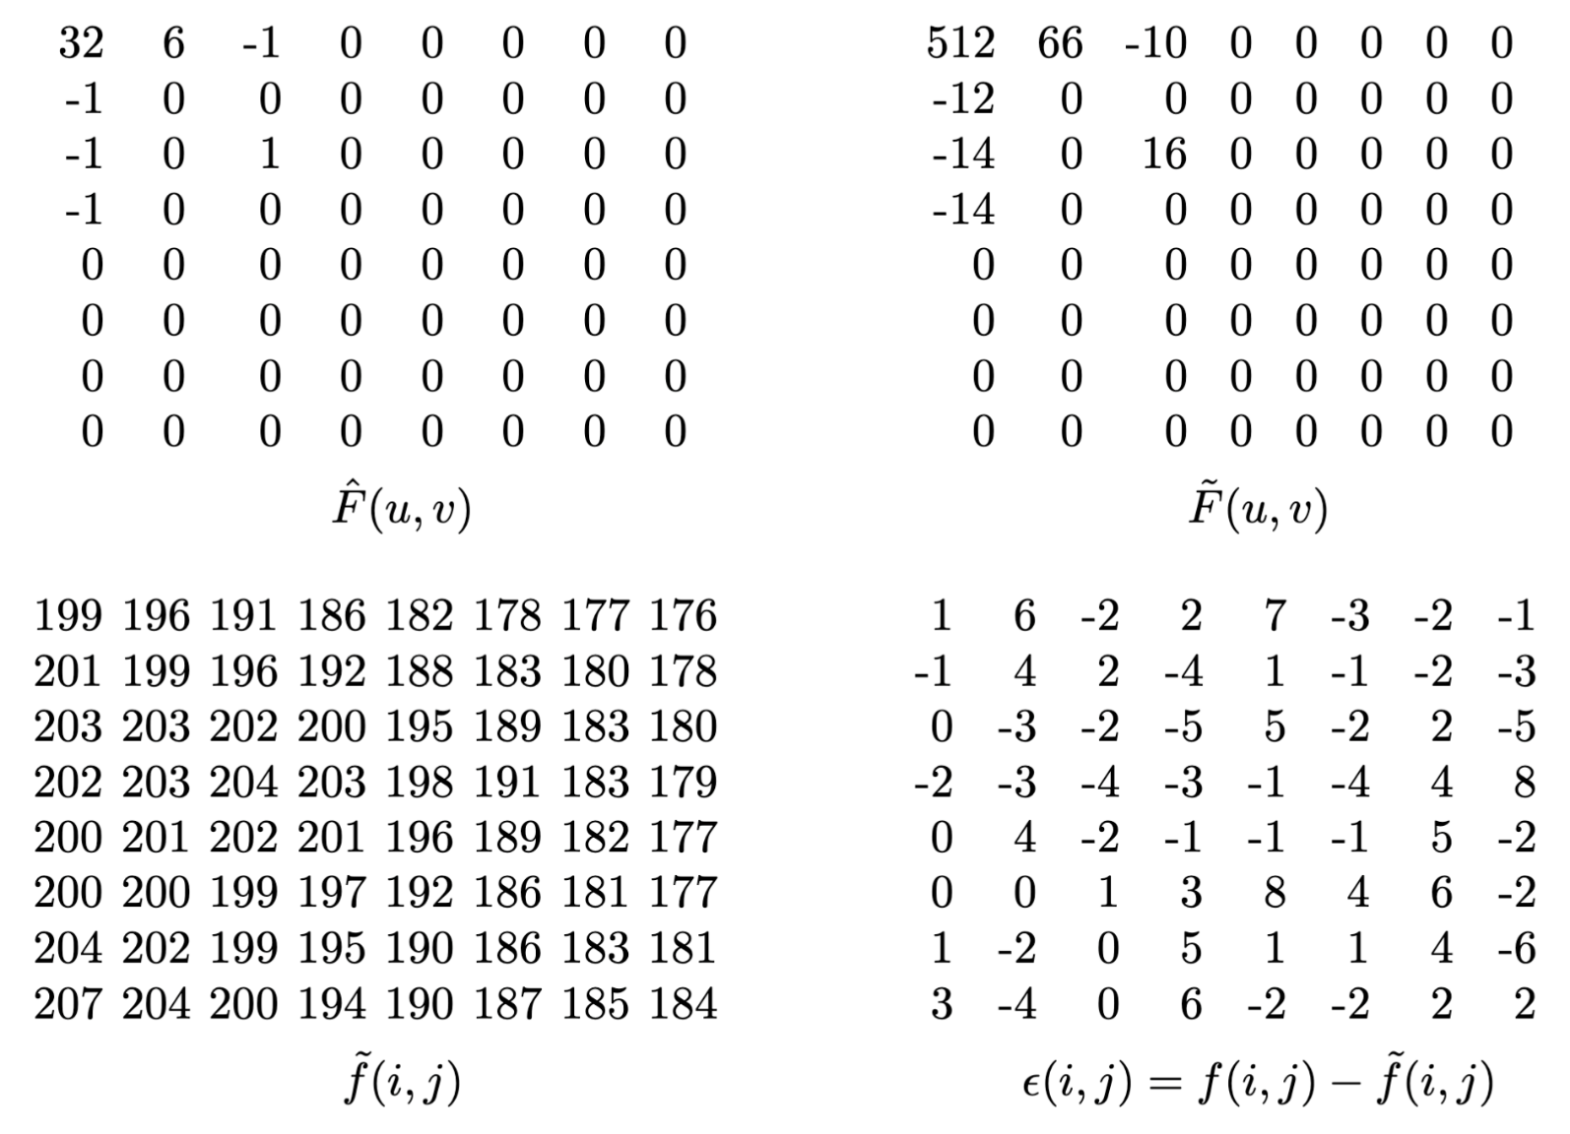
Fig. 9.2 (Cont’d): JPEG compression for a smooth image block.

Slide 12
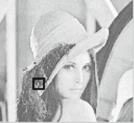
Another 8 × 8 block from the Y image of ‘Lena’
70 70 100 70 87 87 150 187 85 100 96 79 87 154 87 113 100 85 116 79 70 87 86 196 136 69 87 200 79 71 117 96 161 70 87 200 103 71 96 113 161 123 147 133 113 113 85 161 146 147 175 100 103 103 163 187 156 146 189 70 113 161 163 197 f(i, j)
-80 -40 89 -73 44 32 53 -3
-135 -59 -26 6 14 -3 -13 -28
47 -76 66 -3 -108 -78 33 59
-2 10 -18 0 33 11 -21 1
-1 -9 -22 8 32 65 -36 -1
5 -20 28 -46 3 24 -30 24
6 -20 37 -28 12 -35 33 17
-5 -23 33 -30 17 -5 -4 20
F(u, v)
Fig. 9.3: JPEG compression for a textured image block.

Slide 13
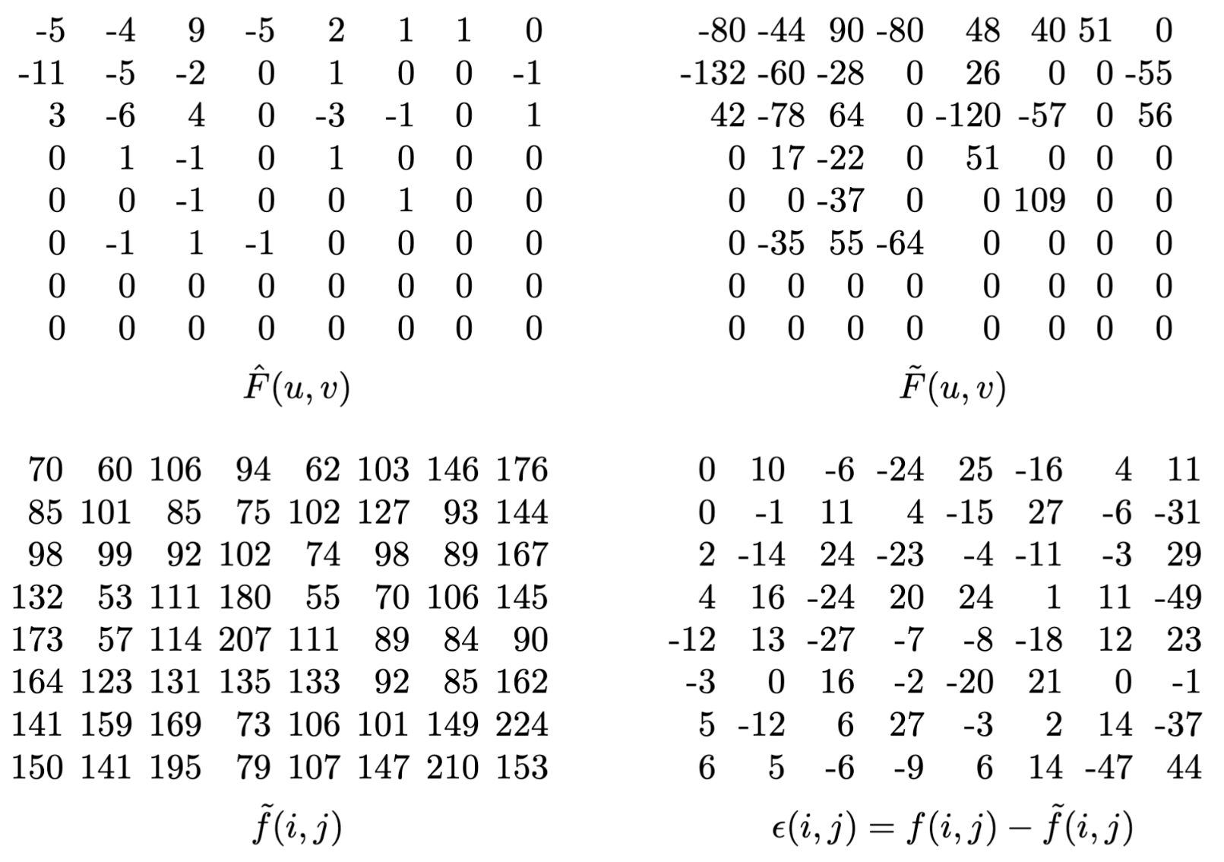
Fig. 9.3 (Cont’d): JPEG compression for a textured image block.

Slide 14
Run-length Coding (RLC) on AC coefficients
RLC aims to turn the values into sets {#-zeros-to-skip, next non-zero value}.
To make it most likely to hit a long run of zeros: a zig-zag scan is used to turn the 8×8 matrix into a 64-vector.
Fig. 9.4: Zigzag scan in JPEG.

Slide 15
DPCM on DC coefficients
The DC coefficients are coded separately from the AC ones. Differential Pulse Code modulation (DPCM) is the coding method.
If the DC coefficients for the first 5 image blocks are 150, 155, 149, 152, 144, then the DPCM would produce 150, 5, -6, 3, -8, assuming d_{i} = DC_{i+1} − DC_{i}, and d₀ = DC₀.

Slide 16
Entropy Coding
The DC and AC coefficients finally undergo an entropy coding step to gain a possible further compression.
Use DC as an example: each DPCM coded DC coefficient is represented by (SIZE, AMPLITUDE), where SIZE indicates how many bits are needed for representing the coefficient, and AMPLITUDE contains the actual bits.
In the example we’re using, codes 150, 5, −6, 3, −8 will be turned into
(8, 10010110), (3, 101), (3, 001), (2, 11), (4, 0111) .
SIZE is Huffman coded since smaller SIZEs occur much more often. AMPLITUDE is not Huffman coded, its value can change widely so Huffman coding has no appreciable benefit.

Slide 17
Table 9.3: Baseline entropy coding details – size category.
SIZE | AMPLITUDE
1 | -1, 1
2 | -3, -2, 2, 3
3 | -7..-4, 4..7
4 | -15..-8, 8..15
. | .
. | .
. | .
10 | -1023..-512, 512..1023

Slide 18
9.1.2 Four Commonly Used JPEG Modes
Sequential Mode — the default JPEG mode, implicitly assumed in the discussions so far. Each graylevel image or color image component is encoded in a single left-to-right, top-to-bottom scan.
Progressive Mode.
Hierarchical Mode.
Lossless Mode — a simple version was discussed in Chapter 7, replaced by JPEG-LS (Section 9.3).

Slide 19
Progressive Mode
Progressive JPEG delivers low quality versions of the image quickly, followed by higher quality passes.
Spectral selection: Takes advantage of the “spectral” (spatial frequency spectrum) characteristics of the DCT coefficients: higher AC components provide detail information.
  Scan 1: Encode DC and first few AC components, e.g., AC1, AC2.
  Scan 2: Encode a few more AC components, e.g., AC3, AC4, AC5.
  ...
  Scan k: Encode the last few ACs, e.g., AC61, AC62, AC63.

Slide 20
Progressive Mode (Cont’d)
Successive approximation: Instead of gradually encoding spectral bands, all DCT coefficients are encoded simultaneously but with their most significant bits (MSBs) first.
  Scan 1: Encode the first few MSBs, e.g., Bits 7, 6, 5, 4.
  Scan 2: Encode a few more less significant bits, e.g., Bit 3.
  ...
  Scan m: Encode the least significant bit (LSB), Bit 0.

Slide 21
Hierarchical Mode
The encoded image at the lowest resolution is basically a compressed low-pass filtered image, whereas the images at successively higher resolutions provide additional details (differences from the lower resolution images).
Similar to Progressive JPEG, the Hierarchical JPEG images can be transmitted in multiple passes progressively improving quality.

Slide 22
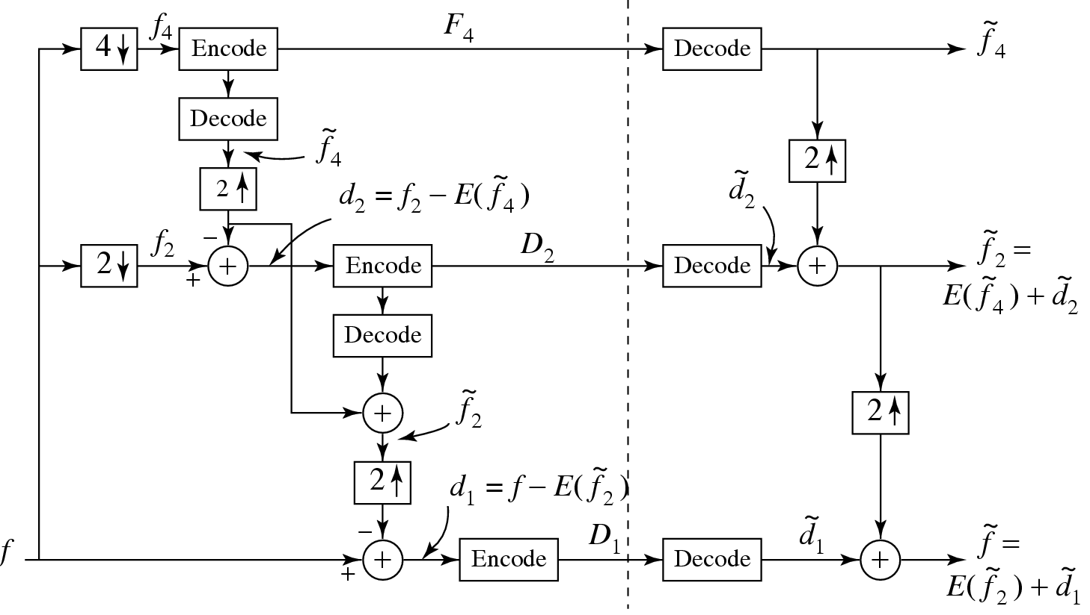
Fig. 9.5: Block diagram for Hierarchical JPEG.

Slide 23
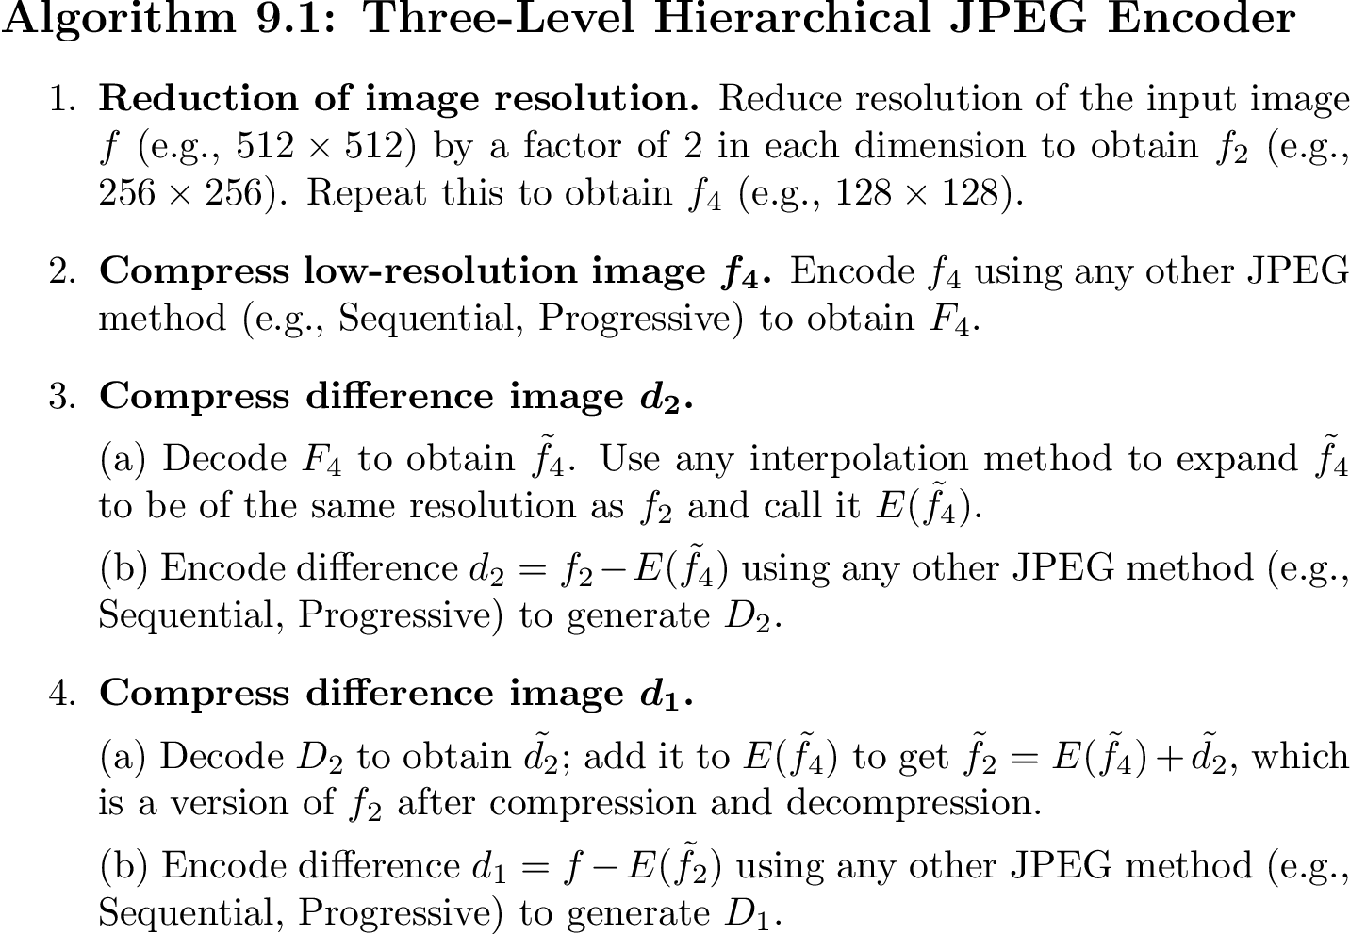

Slide 24
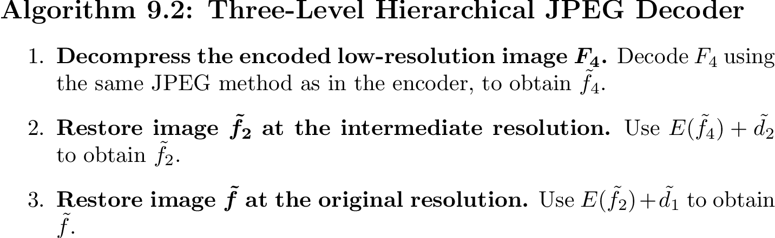

Slide 25
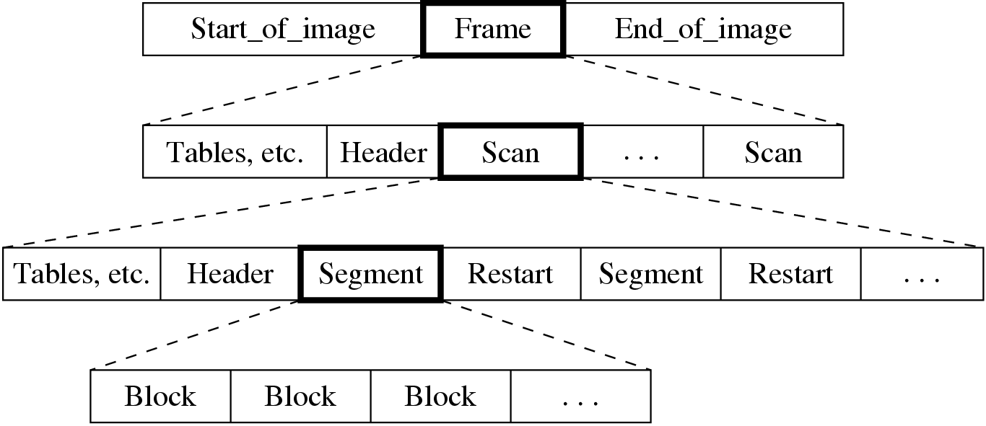
9.1.3 A Glance at the JPEG Bitstream
Fig. 9.6: JPEG bitstream.

Slide 26
9.2 The JPEG 2000 Standard
• Design Goals:
  To provide a better rate-distortion tradeoff and improved subjective image quality.
  To provide additional functionalities lacking in the JPEG standard.
• The JPEG 2000 standard addresses the following problems:
  Lossless and Lossy Compression: There was no standard that could provide superior lossless compression and lossy compression in a single bitstream.

Slide 27
  – Low Bit-rate Compression: The JPEG standard offers excellent rate-distortion performance in mid and high bit-rates. However, at bit-rates below 0.25 bpp, subjective distortion becomes unacceptable. This is important if we hope to receive images on our web- enabled ubiquitous devices, such as web-aware wristwatches and so on.
  – Large Images: The new standard will allow image resolutions greater than 64K by 64K without tiling. It can handle image size up to 2³² − 1.
  – Single Decompression Architecture: The JPEG standard had 44 modes, many of which were application specific and not used by the majority of JPEG decoders.

Slide 28
  – Transmission in Noisy Environments: The new standard will provide improved error resilience for transmission in noisy environments such as wireless networks and the Internet.
  – Progressive Transmission: The new standard provides seamless quality and resolution scalability from low to high bit-rate. The target bit-rate and reconstruction resolution need not be known at the time of compression.
  – Region of Interest Coding: The new standard allows the specification of Regions of Interest (ROI) which can be coded with superior quality than the rest of the image. One may like to code the face of a speaker with more quality than the surrounding furniture.

Slide 29
  Computer Generated Imagery: The JPEG standard was optimized for natural imagery and did not perform well on computer generated imagery.
  Compound Documents: The new standard offers metadata mechanisms for incorporating additional non-image data as part of the file. This may be useful for including text along with imagery, as one important example.
In addition, JPEG 2000 is able to handle up to 256 channels of information whereas the JPEG standard was only able to handle three color channels.

Slide 30
Properties of JPEG 2000 Image Compression
Uses Embedded Block Coding with Optimized Truncation (EBCOT) algorithm which partitions each subband LL, LH, HL, HH produced by the wavelet transform into small blocks called “code blocks”.
A separate scalable bitstream is generated for each code block ⇒ improved error resilience.
Fig. 9.7: Code block structure of EBCOT.

Slide 31
Main Steps of JPEG 2000 Image Compression
Embedded Block coding and bitstream generation.
Post compression rate distortion (PCRD) optimization.
Layer formation and representation.

Slide 32
Embedded Block Coding and Bitstream Generation
Bitplane coding.
Fractional bitplane coding.

Slide 33
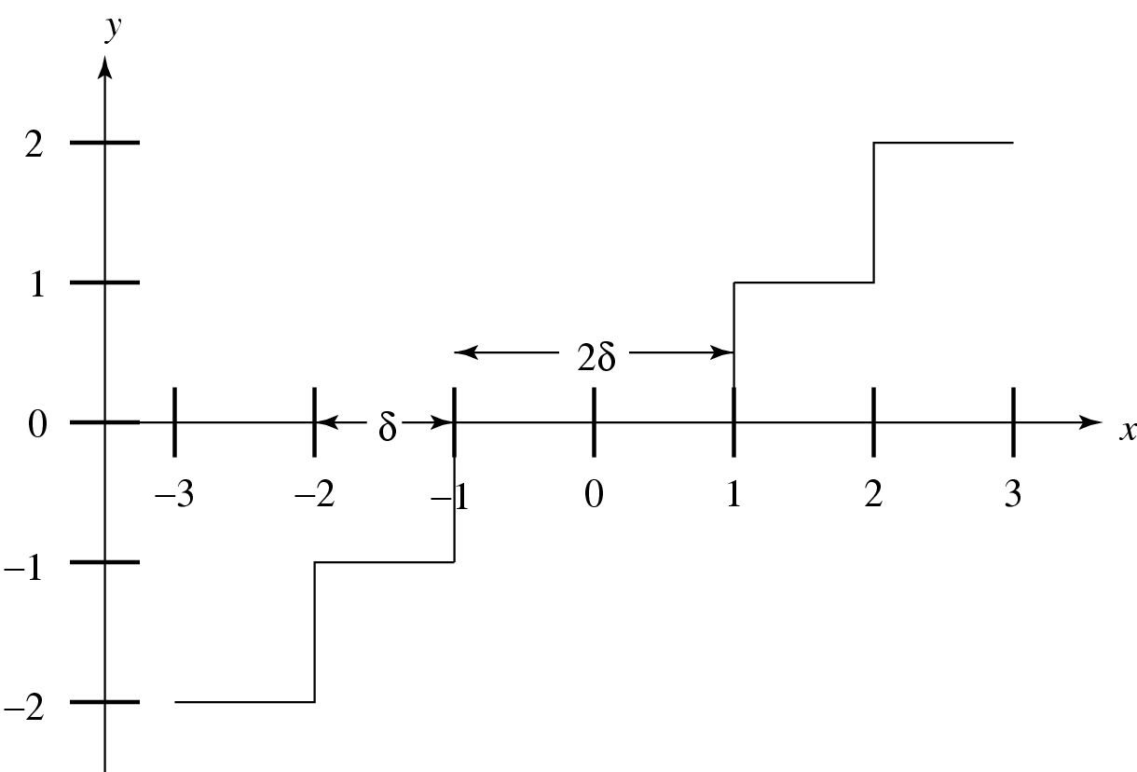
1. Bitplane Coding
Uniform dead zone quantizers are used with successively smaller interval sizes. Equivalent to coding each block one bitplane at a time.
Fig. 9.8: Dead zone quantizer. The length of the dead zone is 2δ. Values inside the dead zone are quantized to 0.

Slide 34
Blocks are further divided into a sequence of 16 × 16 sub-blocks.
The significance of sub-blocks are encoded in a significance map σ^{P} where σ^{p}(B_{i}[j]) denote the significance of sub-block B_{i}[j] at bitplane P.
A quad-tree structure is used to identify the significance of sub-blocks one level at a time.
The tree structure is constructed by identifying the sub-blocks with leaf nodes, i.e., . The higher levels are built using recursion: .

Slide 35
Bitplane Coding Primitives
Four different primitive coding methods that employ context based arithmetic coding are used:
Zero Coding: Used to code coefficients on each bitplane that are not yet significant.
  – Horizontal:
  – Vertical:
  – Diagonal:

Slide 36
Table 9.4: Context assignment for the zero coding primitive.
 | LL, LH and HL subbands |  |  | HH subband
Label | h_{i}[k] | v_{i}[k] | d_{i}[k] | d_{i}[k] | h_{i}[k]+v_{i}[k]
0 | 0 | 0 | 0 | 0 | 0
1 | 0 | 0 | 1 | 0 | 1
2 | 0 | 0 | >1 | 0 | > 1
3 | 0 | 1 | X | 1 | 0
4 | 0 | 2 | X | 1 | 1
5 | 1 | 0 | 0 | 1 | > 1
6 | 1 | 0 | >0 | 2 | 0
7 | 1 | >0 | X | 2 | > 0
8 | 2 | X | x | > 2 | X

Slide 37
Run-length coding: Code runs of 1-bit significance values. Four conditions must be met:
  Four consecutive samples must be insignificant.
  The samples must have insignificant neighbors.
  The samples must be within the same sub-block.
  The horizontal index k₁ of the first sample must be even.

Slide 38
Sign coding: Invoked at most once when a coefficients goes from being insignificant to significant.
  The sign bits χ_{i}[k] from adjacent samples contains substantial dependencies.
  The conditional distribution of χ_{i}[k] is assumed to be the same as χ_{i}[k].
  is 0 if both horizontal neighbors are insignificant, 1 if at least one horizontal neighbor is positive, or −1 if at least one horizontal neighbor is negative.
  is defined similarly for vertical neighbors.
  If is the sign prediction, the binary symbol coded using the relevant context is .

Slide 39
Table 9.5: Context assignment for the sign coding primitive
Label
4 | 1 | 1 | 1
3 | 1 | 0 | 1
2 | 1 | -1 | 1
1 | -1 | 1 | 0
0 | 1 | 0 | 0
1 | 1 | -1 | 0
2 | -1 | 1 | -1
3 | -1 | 0 | -1
4 | -1 | -1 | -1

Slide 40
Magnitude refinement: Code the value of given that ν_{i}[k] ≥ 2^{p+1}.
– changes from 0 to 1 after the magnitude refinement primitive is first applied to s_{i}[k].
– is coded with context 0 if ,
with context 1 if and and with context 2 if .

Slide 41
2. Fractional Bitplane Coding
Divides code block samples into smaller subsets having different statistics.
Codes one subset at a time starting with the subset expecting to have the largest reduction in distortion.
Ensures each code block has a finely embedded bitstream.
Four different passes are used: forward significance propagation pass ; reverse significance propagation pass ; magnitude refinement pass ; and normalization pass .

Slide 42
Forward Significance Propagation Pass
Sub-block samples are visited in scan-line order and insignificant samples and samples that do not satisfy the neighborhood requirement are skipped.
For the LH, HL, and LL subbands, the neighborhood requirement is that at least one of the horizontal neighbors has to be significant.
For the HH subband, the neighborhood requirement is that at least one of the four diagonal neighbors is significant.

Slide 43
Reverse Significance Propagation Pass
This pass is identical to except that it proceeds in the reverse order. The neighborhood requirement is relaxed to include samples that have at least one significant neighbor in any direction.
Magnitude Refinement Pass
This pass encodes samples that are already significant but have not been coded in the previous two passes. Such samples are processed with the magnitude refinement primitive.
Normalization Pass
The value of all samples not considered in the previous three coding passes are coded using the sign coding and run-length coding primitives as appropriate. If a sample is found to be significant, its sign is immediately coded using the sign coding primitive.

Slide 44
Fig. 9.9: Appearance of coding passes and quad tree codes in each block’s embedded bitstream.

Slide 45
Post Compression Rate Distortion
(PCRD) Optimization
• Goal:
  Produce a truncation of the independent bitstream of each code block in an optimal way such that distortion is minimized, subject to the bit-rate constraint.
For each truncated embedded bitstream of code block B_{i} having rate with distortion and truncation point n_{i}, the overall distortion of the reconstructed image is (assuming distortion is additive)
(9.3)

Slide 46
The optimal selection of truncation points n_{i} can be formulated into a minimization problem subject to the following constraint:
(9.5)
For some λ, any set of truncation point that minimizes
(9.6)
is optimal in the rate-distortion sense.

Slide 47
The distortion-rate slopes given by the ratios
(9.7)
is strictly decreasing.
This allows the optimization problem be solved by a simple selection through an enumeration j₁ < j₂ < ... of the set of feasible truncation points.
(9.8)

Slide 48
Layer Formation and Representation
JPEG2000 offers both resolution and quality scalability through the use of a layered bitstream organization and a two-tiered coding strategy.
The first tier produces the embedded block bit-streams while the second tier compresses block summary information.
The quality layer Q₁ contains the initial bytes of each code block B_{i} and the other layers Q_{q} contain the incremental contribution from code block B_{i}.

Slide 49
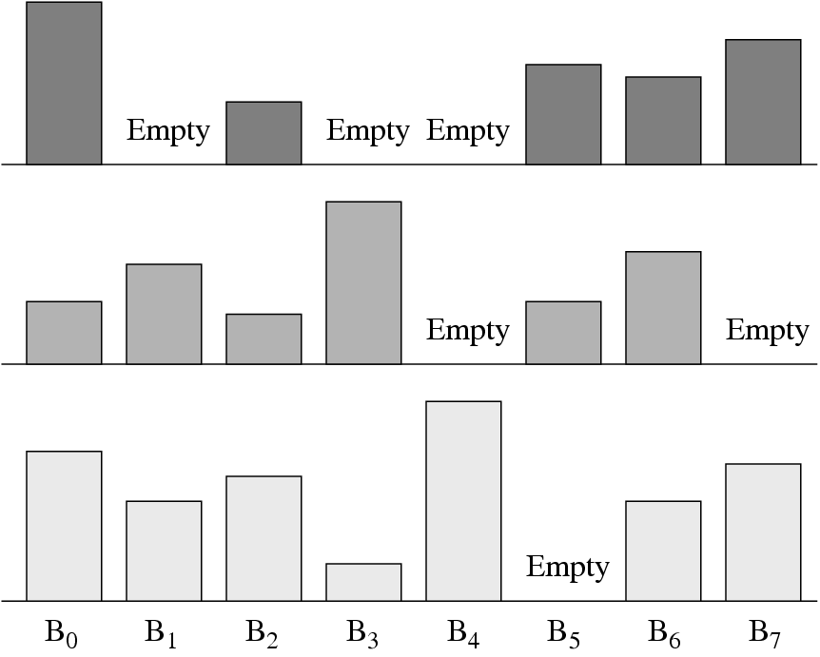
Fig. 9.10: Three quality layers with eight blocks each.

Slide 50
Region of Interest Coding in JPEG 2000
• Goal:
  Particular regions of the image may contain important information, thus should be coded with better quality than others.
Usually implemented using the MAXSHIFT method which scales up the coefficients within the ROI so that they are placed into higher bit-planes.
During the embedded coding process, the resulting bits are placed in front of the non-ROI part of the image. Therefore, given a reduced bit-rate, the ROI will be decoded and refined before the rest of the image.

Slide 51
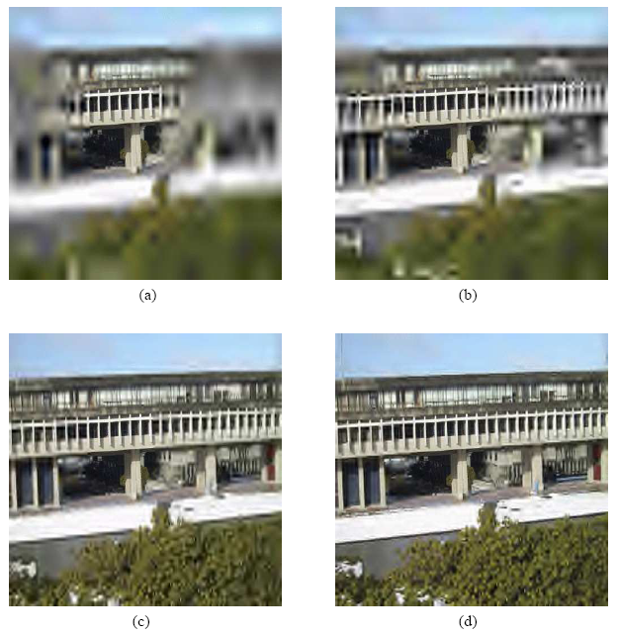
Fig. 9.11: Region of interest (ROI) coding of an image using a circularly shaped ROI. (a) 0.4 bpp, (b) 0.5 bpp, (c) 0.6 bpp, and (d) 0.7 bpp.

Slide 52
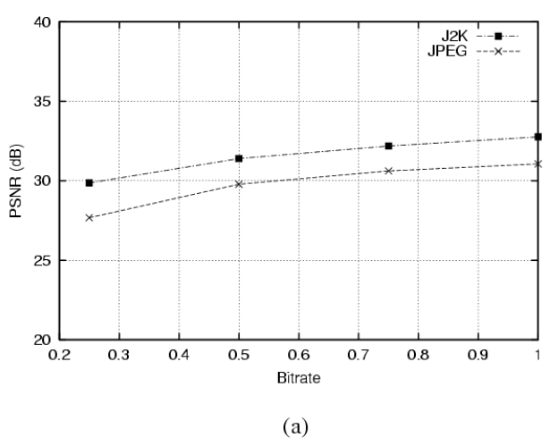
Fig. 9.12: Performance comparison for JPEG and JPEG 2000 on different image types. (a): Natural images.

Slide 53
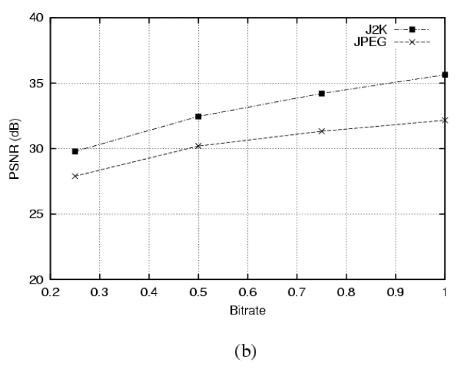
Fig. 9.12: Performance comparison for JPEG and JPEG 2000 on different image types. (b): Computer generated images.

Slide 54
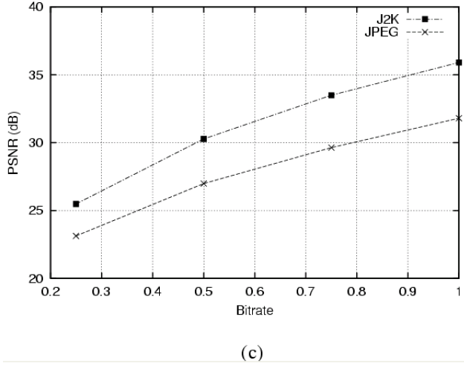
Fig. 9.12: Performance comparison for JPEG and JPEG 2000 on different image types. (c): Medical images.

Slide 55
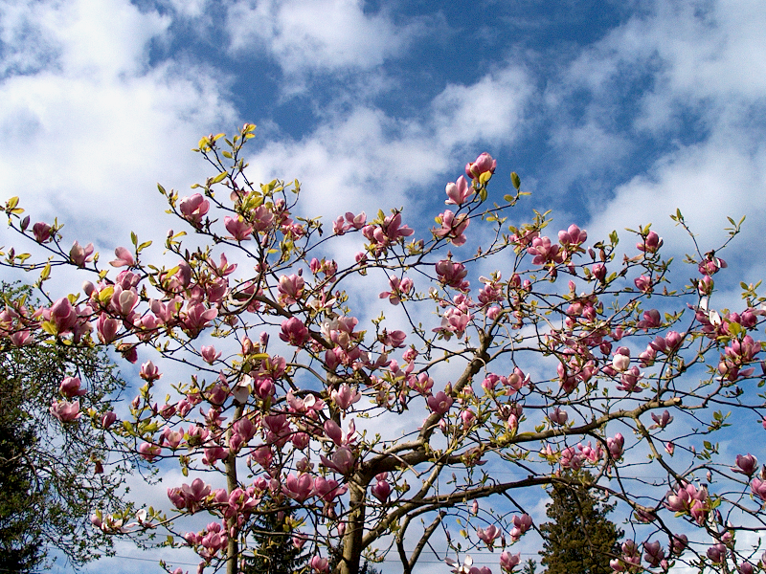
(a)
Fig. 9.13: Comparison of JPEG and JPEG 2000. (a) Original image.

Slide 56
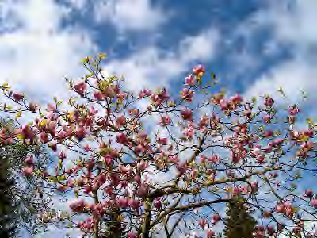


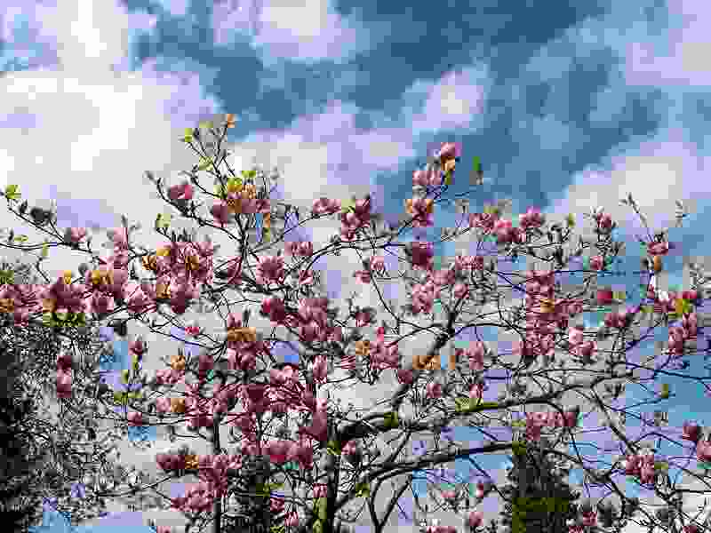
(b)
(c)
Fig. 9.13 (Cont’d): Comparison of JPEG and JPEG 2000. (b) JPEG (left) and JPEG 2000 (right) images compressed at 0.75 bpp. (c) JPEG (left) and JPEG 2000 (right) images compressed at 0.25 bpp.

Slide 57
9.3 The JPEG-LS Standard
JPEG-LS is in the current ISO/ITU standard for lossless or “near lossless” compression of continuous tone images.
It is part of a larger ISO effort aimed at better compression of medical images.
Uses the LOCO-I (LOw COmplexity LOssless Compression for Images) algorithm proposed by Hewlett-Packard.
Motivated by the observation that complexity reduction is often more important than small increases in compression offered by more complex algorithms.
Main Advantage: Low complexity!

Slide 58
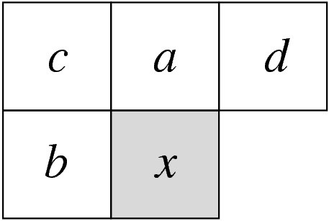
The LOCO-I algorithm makes uses of context modelling.
The idea of context modelling is to take advantage of the structure within the input source – the conditional probabilities.
Fig. 9.14: JPEG-LS Context Model.

Slide 59
9.4 JBIG and JBIG-2: Bi-level Image
Compression Standards
Main Goal: Enables the handing of documents in electronic form.
Primarily used to code scanned images of printed or hand-written text, computer generated text, and facsimile transmissions.
JBIG is a lossless compression standard. It also offers progressive encoding/decoding capability, the resulting bitstream contains a set of progressively higher resolution images.
JBIG-2 introduces model-based coding – similar to context-based coding. It supports lossy compressions well.

