Slide 1
BIOLOGY
Knowledge
Terminology
Biology
Development
Function
Structure
Biology
Biology Lecture E. Anastasiadou Bioinformatics – Biomedical Data Science 2021-2022

Slide 2
Biology Lecture E. Anastasiadou Bioinformatics – Biomedical Data Science 2021-2022

Slide 3
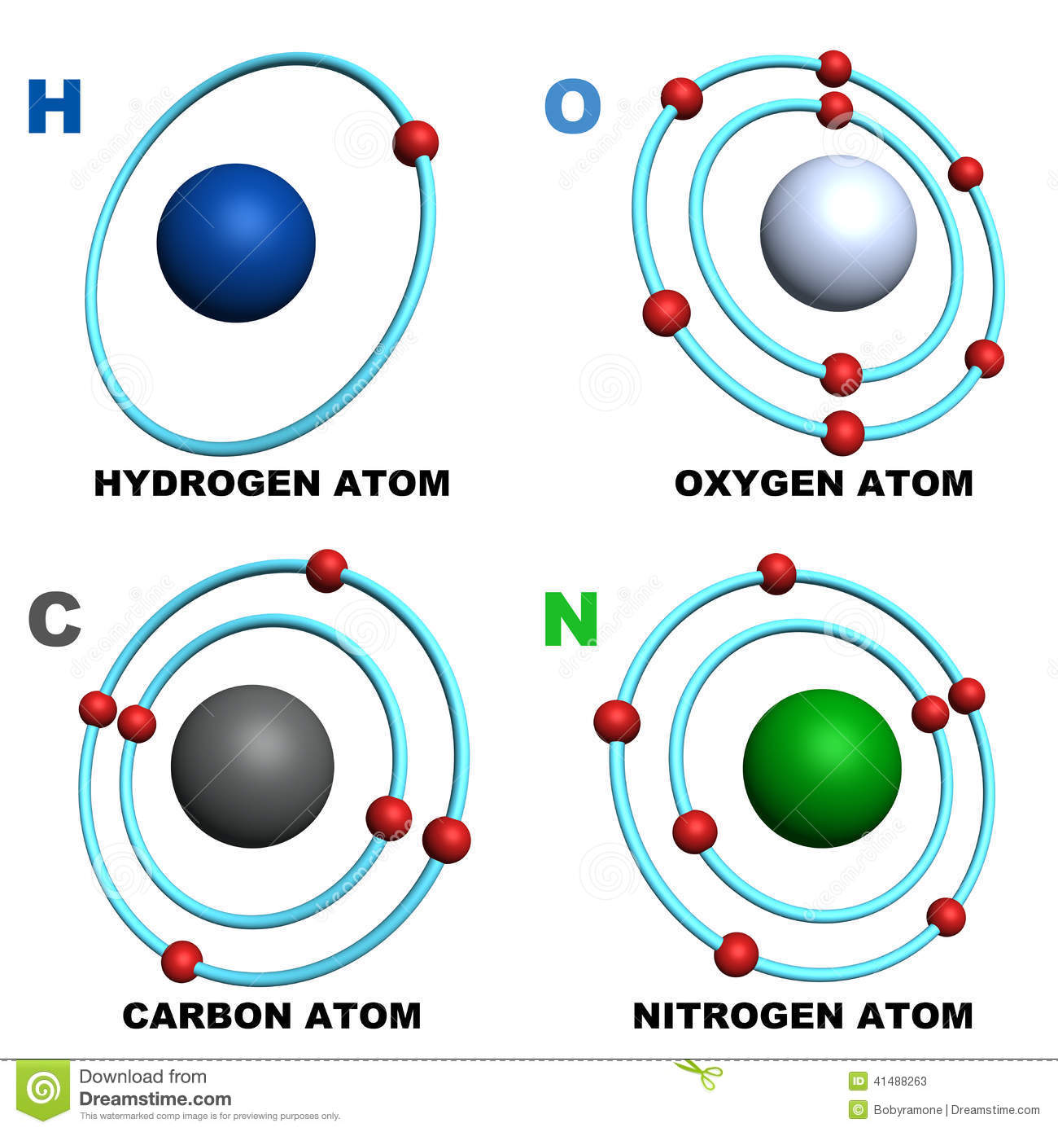
biomolecules
A biomolecule is any chemical molecule that is a structural or functional component of organisms and which is produced by them through metabolism.
Four are the chemical elements that take a significant part in the synthesis of biomolecules: carbon, hydrogen, oxygen and nitrogen.
They synthesize the two essential components of the cells / organisms, the nucleic acids (DNA and RNA) and the proteins.
Biology Lecture E. Anastasiadou Bioinformatics – Biomedical Data Science 2021-2022

Slide 4
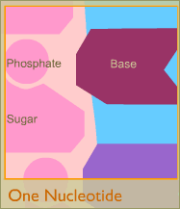
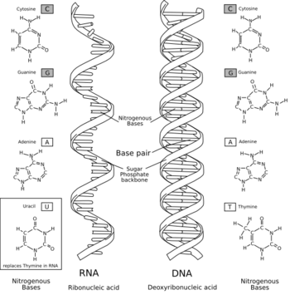
nucleic acid
The nucleic acid consists of nucleotides.
DNA is formed from deoxyribonucleotides while
RNA from ribonucleotides.
Biology Lecture E. Anastasiadou Bioinformatics – Biomedical Data Science 2021-2022

Slide 5
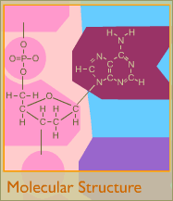
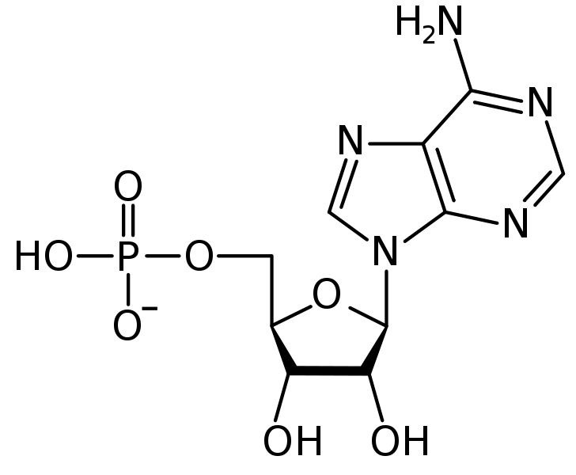
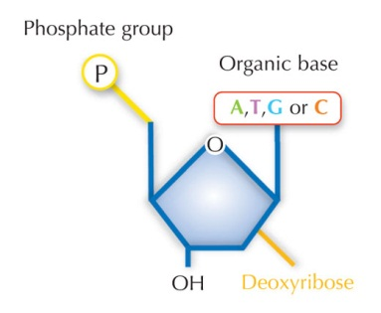
DNA STRUCTURE
Biology Lecture E. Anastasiadou Bioinformatics – Biomedical Data Science 2021-2022

Slide 6
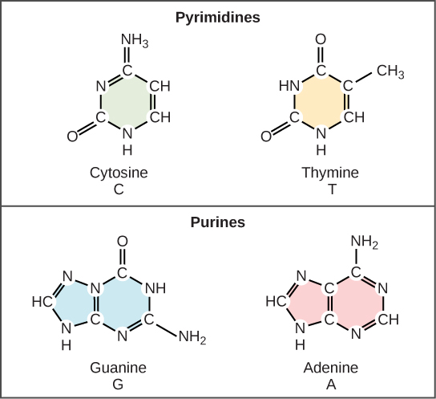
NITROGENOUS BASE
A (adenine), T (thymine),
C (cytosine), G (guanine)
The bases are combined in a specific order and store the genetic information of each organism:
Each DNA molecule can be considered as a string with an alphabet.
Biology Lecture E. Anastasiadou Bioinformatics – Biomedical Data Science 2021-2022

Slide 7
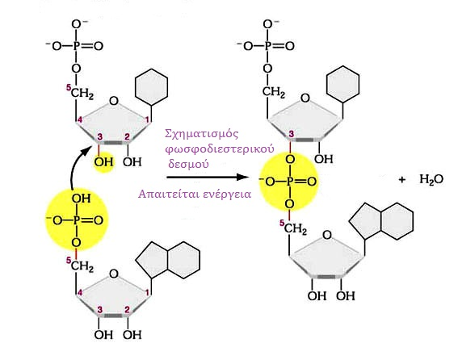
3’-5’ sugar-phosphate bond
3’-5’ sugar-phosphate (phosphodiester) bond is a covalent bond between the 3’ carbon atom of the pentose of the first nucleotide and the phosphate group attached to the 5’ carbon atom of the pentose of the next nucleotide.
Multiple nucleotide association with
covalent bonds forms
the polynucleotide chain.
The phospho-groups and the sugars
are located in the outer side of the
molecule (DNA) και compose
the skeleton.
It is hydrophilic due to the negative
load of the phosphate groups.
Inside: bases (hydrophobic)
Hence the DNA is a polar molecule (hydrophilic skeleton & hydrophobic interior).
Biology Lecture E. Anastasiadou Bioinformatics – Biomedical Data Science 2021-2022

Slide 8
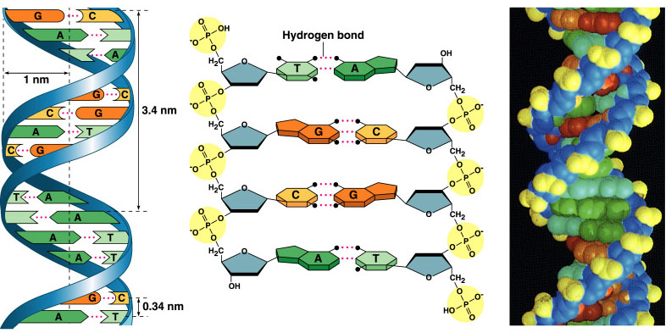
THE DOUBLE HELIX OF DNA & NITROGENOUS BASES
Biology Lecture E. Anastasiadou Bioinformatics – Biomedical Data Science 2021-2022

Slide 9
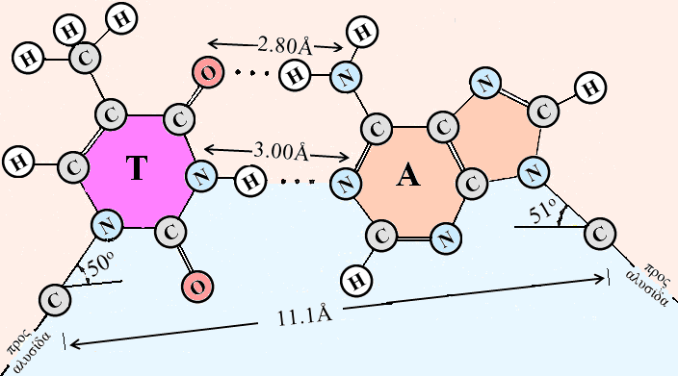
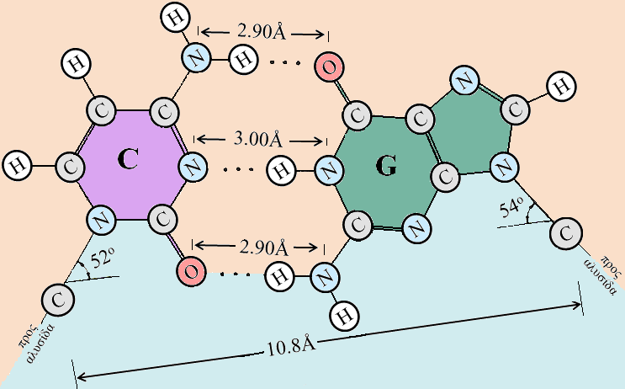
complementarity – hydrogen bonds
  Hydrogen bonds stabilize the structure of DNA by joining the two DNA chains.
  Chain complementarity suggests that the sequence of one also determines that of the other, important property for the preservation and transmission of genetic information through the synthesis of identical DNA molecules.
  Therefore, the number of As = number of Ts & number of Cs = number of Gs
Guanine (G) binds to cytosine (C) with three hydrogen bonds
Thymine (T) binds to adenine (A) with two hydrogen bonds
Biology Lecture E. Anastasiadou Bioinformatics – Biomedical Data Science 2021-2022

Slide 10
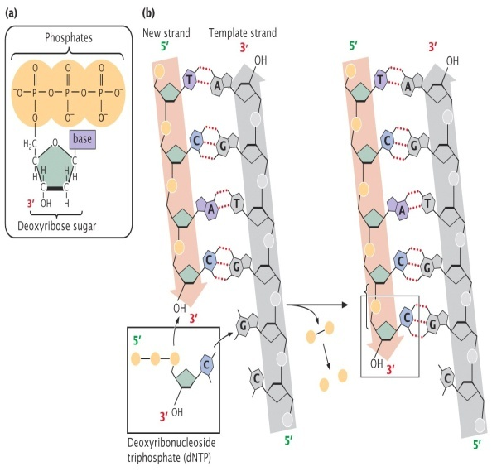
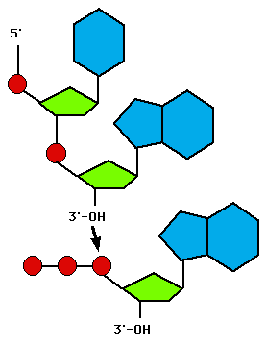
STRUCTURE OF THE DNA DOUBLE HELIX
Biology Lecture E. Anastasiadou Bioinformatics – Biomedical Data Science 2021-2022

Slide 11
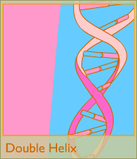
The model of the double helix of DNA
The DNA consists of 2 polynucleotide chains forming a clockwise double helix.
Stable hydrophilic (negative charge) helix backbone of recurring of phosphogroup-deoxyribose molecules joined by phosphodiester bond to the exterior of the molecule and hydrophobic bases to the interior of the helix.
Supplementary rule (A-T, C-G): Hydrogen bonds stabilize the structure of DNA.
Chain complementarity states that the sequence of one determines that of the other, property important for the preservation and transmission of genetic information by complementary chain synthesis by using each of the original strands to form 2 identical DNA molecules.
Direction of each chain is 5’-3’ but they are antiparallel with each other (3’ end of one opposite of the 5’ end of the other).
Biology Lecture E. Anastasiadou Bioinformatics – Biomedical Data Science 2021-2022

Slide 12
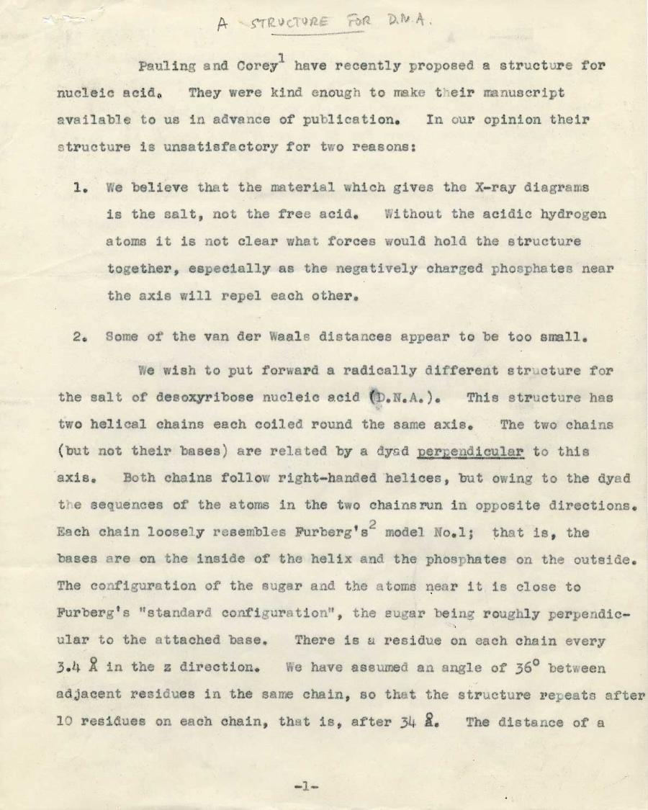
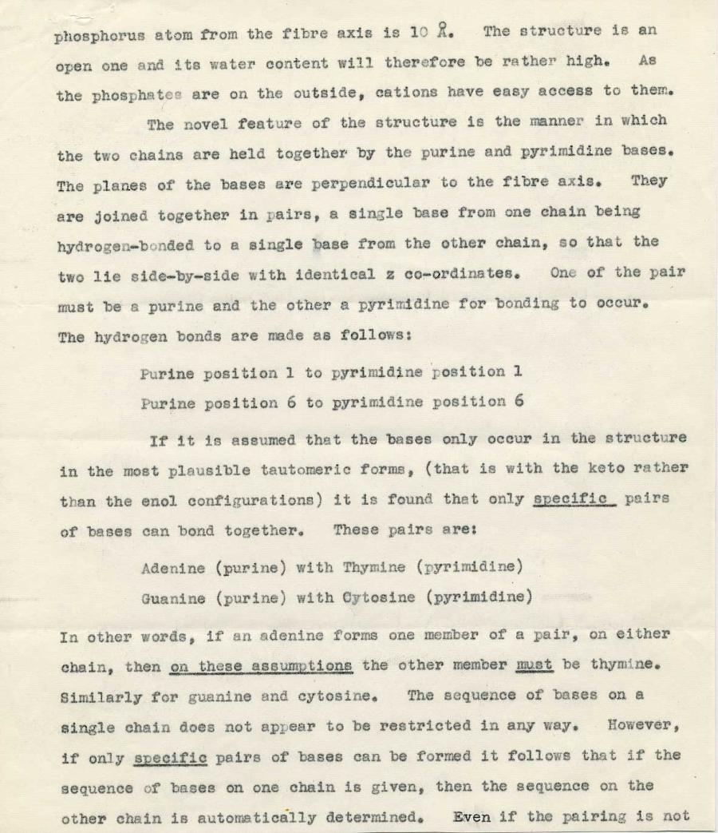
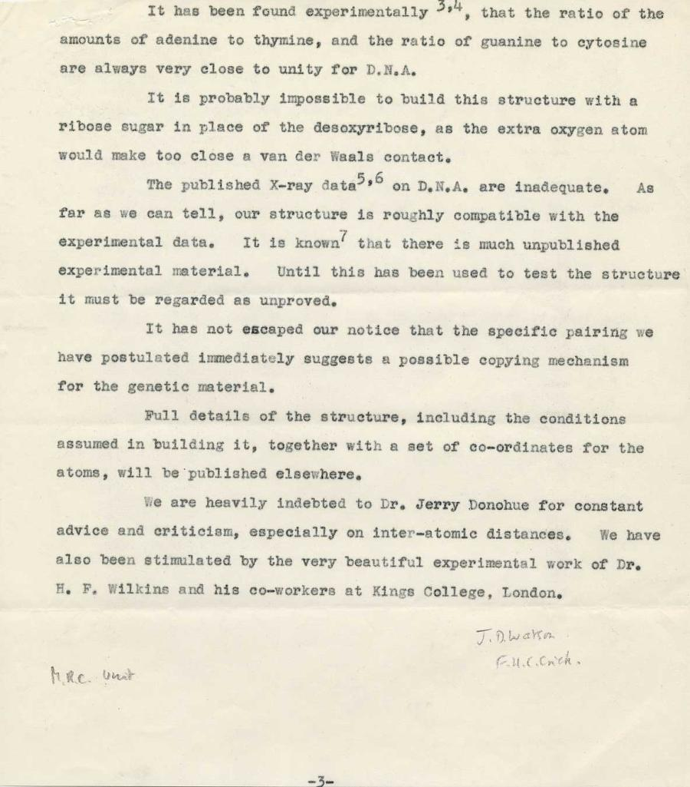
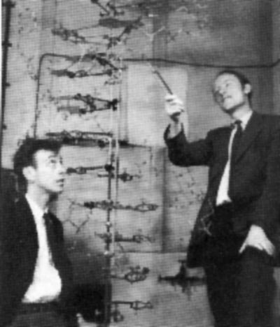
A Structure for DNA
(typescript)
Watson & Crick [Nature 1953]
Watson was 23 at the time!!!
Biology Lecture E. Anastasiadou Bioinformatics – Biomedical Data Science 2021-2022

Slide 13
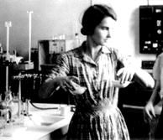
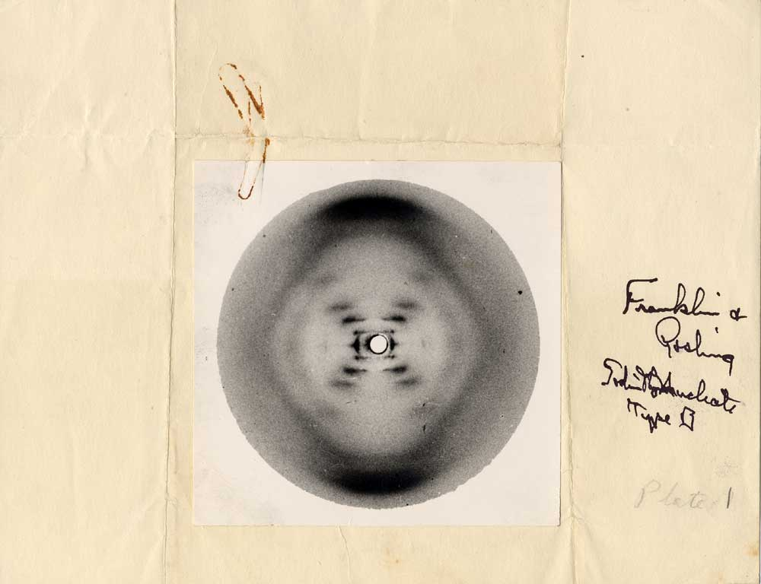
Rosalind Franklin took an exceptional X-ray photograph of a DNA molecule, which provided Watson+Crick with the key to the double-helix puzzle.
Sodium deoxyribose nucleate from calf thymus
Structure B, Photo 51, (May 2, 1952)
by Rosalind E. Franklin and R.G. Gosling
Biology Lecture E. Anastasiadou Bioinformatics – Biomedical Data Science 2021-2022

Slide 14
https://www.youtube.com/watch?v=o_-6JXLYS-k
https://www.youtube.com/watch?v=C1CRrtkWwu0
https://www.youtube.com/watch?v=yDkSWd_ZbbE
Biology Lecture E. Anastasiadou Bioinformatics – Biomedical Data Science 2021-2022

Slide 15
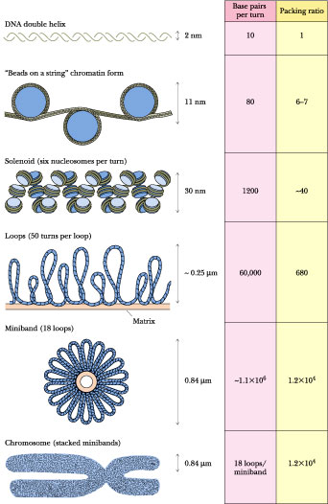
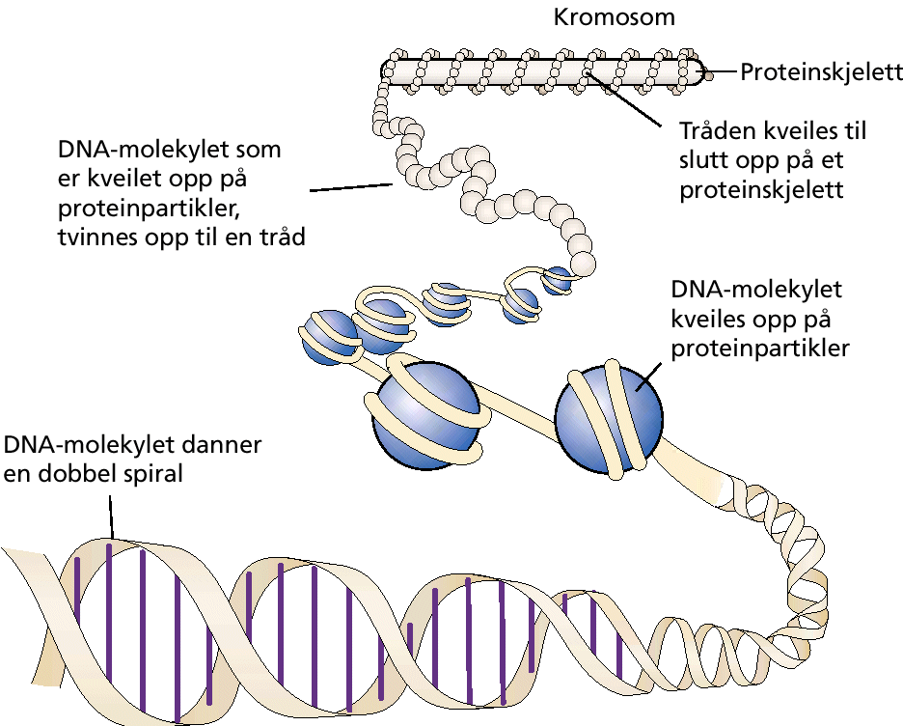
DNA ORGANIZATION
DNA in a human cell is 2 m long but can supercoil rises up to 10 μm.
Their number and length are characteristic of each type of organism.
Biology Lecture E. Anastasiadou Bioinformatics – Biomedical Data Science 2021-2022

Slide 16
nucleosome
~ 200 base pairs per nucleosome
Biology Lecture E. Anastasiadou Bioinformatics – Biomedical Data Science 2021-2022

Slide 17
STRUCTURE OF NUCLEOSOME
It is packaged with the assist of proteins to form chromatin fibrils that resemble beads. Each bead is called a nucleosome and is the basic unit for the organization of chromatin. It is made up of 146 base-length DNA that coild (2 turns) 8 molecules (octamer) of proteins called histones.
Biology Lecture E. Anastasiadou Bioinformatics – Biomedical Data Science 2021-2022

Slide 18
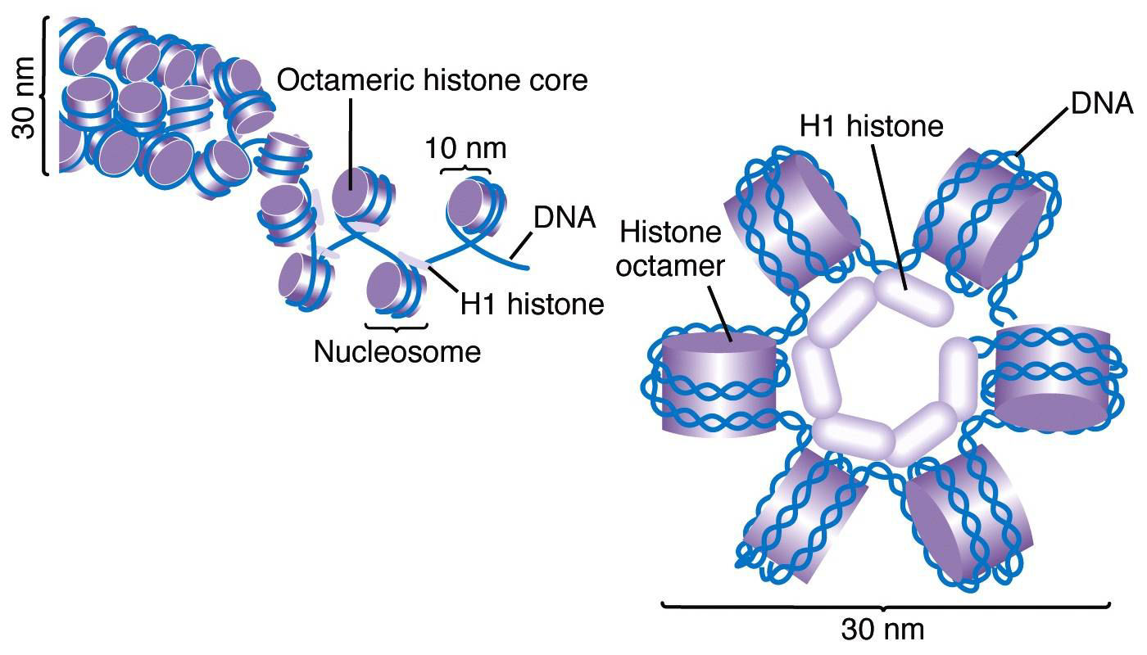
HISTONE PROTEIN Organization
Histones are the major structural proteins of chromosomes.
The DNA molecule is wrapped twice around a Histone Octamer
to make a nucleosome.
Six nucleosomes are assembled into a solenoid in association with H1 histones.
Biology Lecture E. Anastasiadou Bioinformatics – Biomedical Data Science 2021-2022

Slide 19
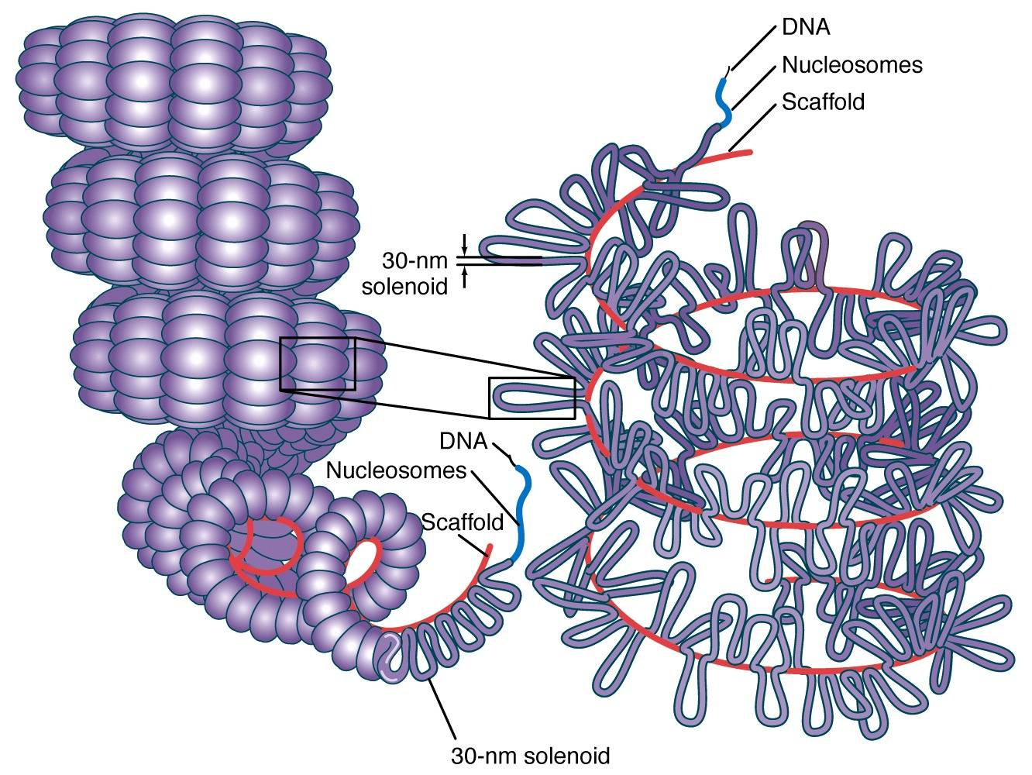
CHROMATIN STRUCTURE & ORGANISATION
The solenoids are coiled onto a scaffold, which is futher coiled to make the chromosomal matrix.
Depending on the stage of the cell cycle, there is a different degree of coiling, low during interphase with formation of chromatin fibrils.
Biology Lecture E. Anastasiadou Bioinformatics – Biomedical Data Science 2021-2022

Slide 20
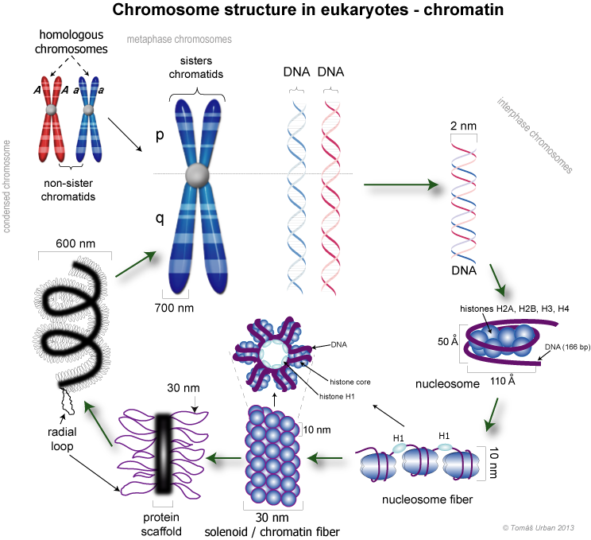
Biology Lecture E. Anastasiadou Bioinformatics – Biomedical Data Science 2021-2022

Slide 21
https://www.youtube.com/watch?v=gbSIBhFwQ4s
Biology Lecture E. Anastasiadou Bioinformatics – Biomedical Data Science 2021-2022

Slide 22
ORGANISATION OF CHROMATIN
Packaging is achieved with proteins to form chromatin fibrils that resemble beads. Each bead is called a nucleosome and is the basic unit for the organization of chromatin. It is consisted of 146 base-length DNA that coils around (2 turns) 8 molecules (octamer) of proteins called histones.
Depending on the cell cycle stage, there is a different degree of coiling, low during Interphase forming chromatin fibrils that are not visible in the optical microscope. When replication is completed, each fibril is doubled forming the sister chromatids which are linked by the centromere.
In the cell division, the sister chromatids obtain a maximum degree of coiling, so metaphasic chromosomes are visible in the optical microscope. At the end of the cell division, 2 new cells are generated, genetically identical to each other and the original, each containing 1 of the 2 sister chromatids from each chromosome.
Biology Lecture E. Anastasiadou Bioinformatics – Biomedical Data Science 2021-2022

Slide 23
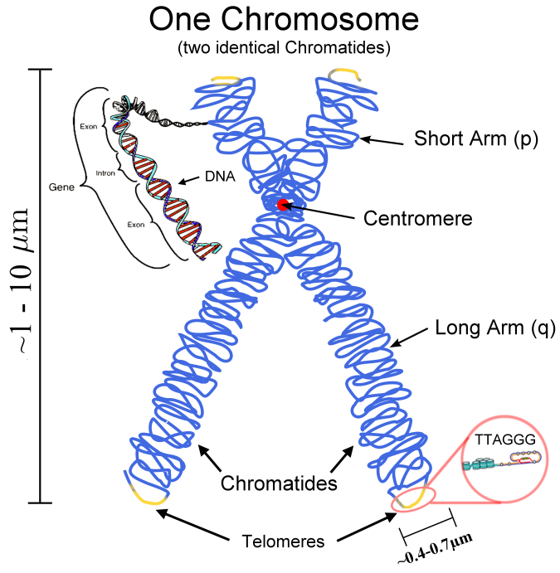
METAPHASIC CHROMOSOME
CHO
HELA
HELA
85.000 bases per loop
Biology Lecture E. Anastasiadou Bioinformatics – Biomedical Data Science 2021-2022

Slide 24
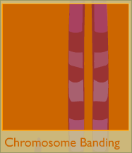
When stained, chromosomes show bands of light and dark areas. The dark bands indicate areas where the structure of the chromosome is dense.
Each of the 23 chromosome types has a unique banding pattern. (A chromosome pair has identical banding.)
In fact, scientists can identify a chromosome based solely on its banding pattern.
Biology Lecture E. Anastasiadou Bioinformatics – Biomedical Data Science 2021-2022

Slide 25
https://www.youtube.com/watch?v=IePMXxQ-KWY
Biology Lecture E. Anastasiadou Bioinformatics – Biomedical Data Science 2021-2022

Slide 26
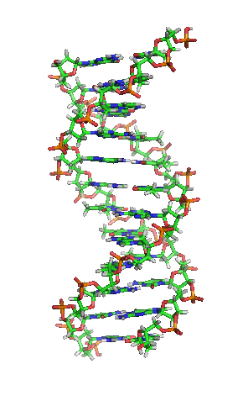
DNA CHARACTERISTICS
Functions
Quantity
Structure
Double-helix model :
  2 antiparallel strands,
  5΄ 3΄ orientation each
  Polarity of a molecule
  3-5 phosphodiester bond
  Complementarity
Biology Lecture E. Anastasiadou Bioinformatics – Biomedical Data Science 2021-2022

Slide 27
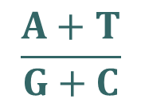
QUANTITY OF DNA
The amount of DNA in each organism is stable regardless of the environment. The amount of DNA is the same in all cells of an organism (spleen, liver, etc.).
Gametes (haploid) of the higher organisms contain half the amount of DNA than somatic cells (diploids).
The amount of DNA is proportional to the complexity of the organism. The higher in evolution, the more DNA contains each cell.
Each organism has a different base ratio
Biology Lecture E. Anastasiadou Bioinformatics – Biomedical Data Science 2021-2022

Slide 28
THE FUNCTIONS OF THE GENETIC MATERIAL
The genetic material controls the cell's functions:
  Storage of genetic information. DNA (RNA in RNA-viruses) contains information about the characteristics of the organism and is organized into units, the genes.
  Conservation and transfer of cell-to-cell and organism-to-organism genetic information: Duplication.
  Expression of genetic information by protein synthesis.
Biology Lecture E. Anastasiadou Bioinformatics – Biomedical Data Science 2021-2022

Slide 29
DNA REPLICATION
Biology Lecture E. Anastasiadou Bioinformatics – Biomedical Data Science 2021-2022

Slide 30
DNA REPLICATION
The replication of DNA evolves as follows:
Hydrogen bonds are broken between complementary bases.
The double-stranded helix unfolds as the bonds break.
The clones are copied simultaneously thanks to the DNA polymerase III enzyme according to the principle of complementarity.
Thus, depending on the base containing each nucleotide of the parent strand, a new nucleotide is aligned against it. The new nucleotides are linked by covalent bonds. Gradually the two parent strands are completely separated as new ones are formed.
Every new strand is complementary to the parent, which is used as blueprint.
In prokaryotics, replication begins at one point, while in eukaryotes at many and so has a higher rate of replication.
Biology Lecture E. Anastasiadou Bioinformatics – Biomedical Data Science 2021-2022

Slide 31
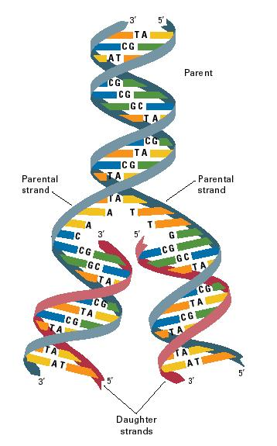
DNA REPLICATION
This way of DNA replication is called semi-conservative, because each new daughter molecule consists of an old (parental) strand and a new (daughter) strand.
Biology Lecture E. Anastasiadou Bioinformatics – Biomedical Data Science 2021-2022

Slide 32

DNA REPLICATION
5 '- 3' replication occurs in both prokaryotic as well as eukaryotic organisms
Biology Lecture E. Anastasiadou Bioinformatics – Biomedical Data Science 2021-2022

Slide 33
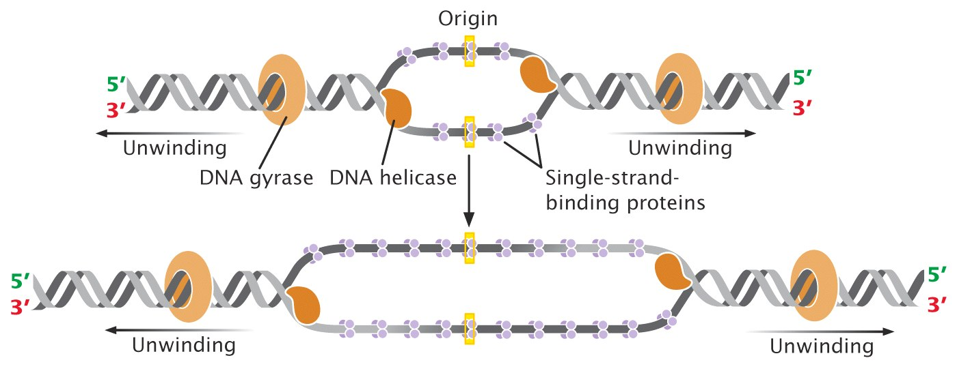

DNA REPLICATION
Replication Bubble Forms
Directionality
Helper proteins
Helper proteins
Biology Lecture E. Anastasiadou Bioinformatics – Biomedical Data Science 2021-2022

Slide 34
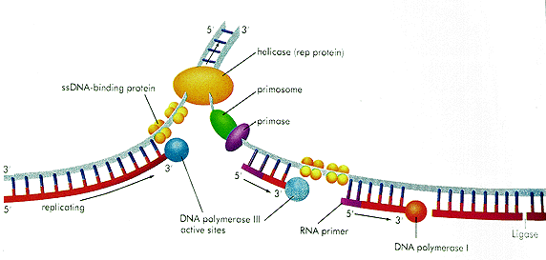
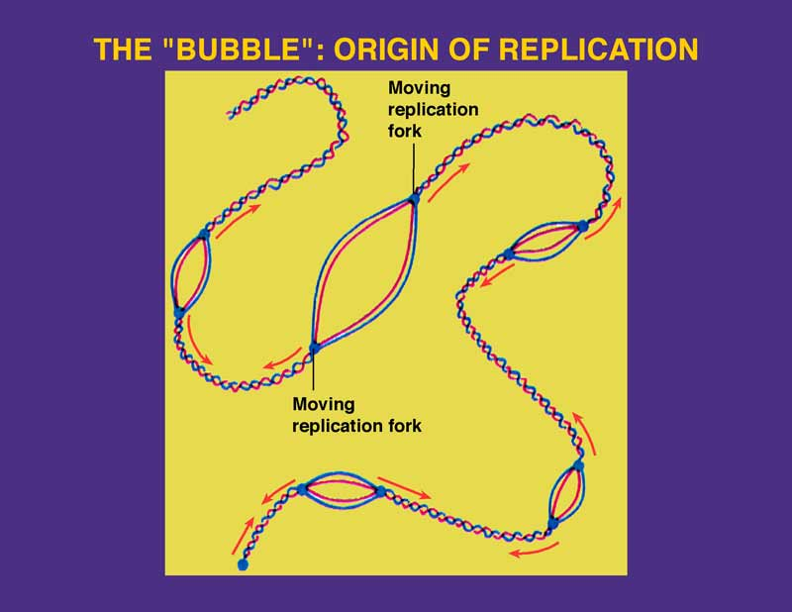
DNA REPLICATION
Leading strand
Helicase
ssDNA binding protein
primosome
primase
E. coli DNA replication
Lagging strand
replicating
DNA polymerase III
Active sites
RNA primer
Ligase
DNA polymerase I
Biology Lecture E. Anastasiadou Bioinformatics – Biomedical Data Science 2021-2022

Slide 35
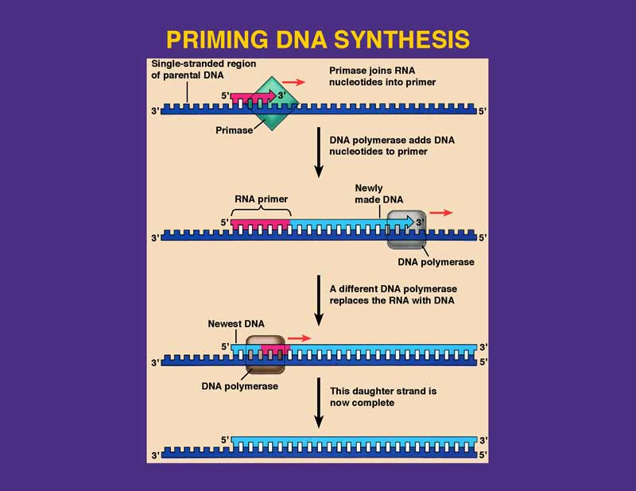
Biology Lecture E. Anastasiadou Bioinformatics – Biomedical Data Science 2021-2022

Slide 36
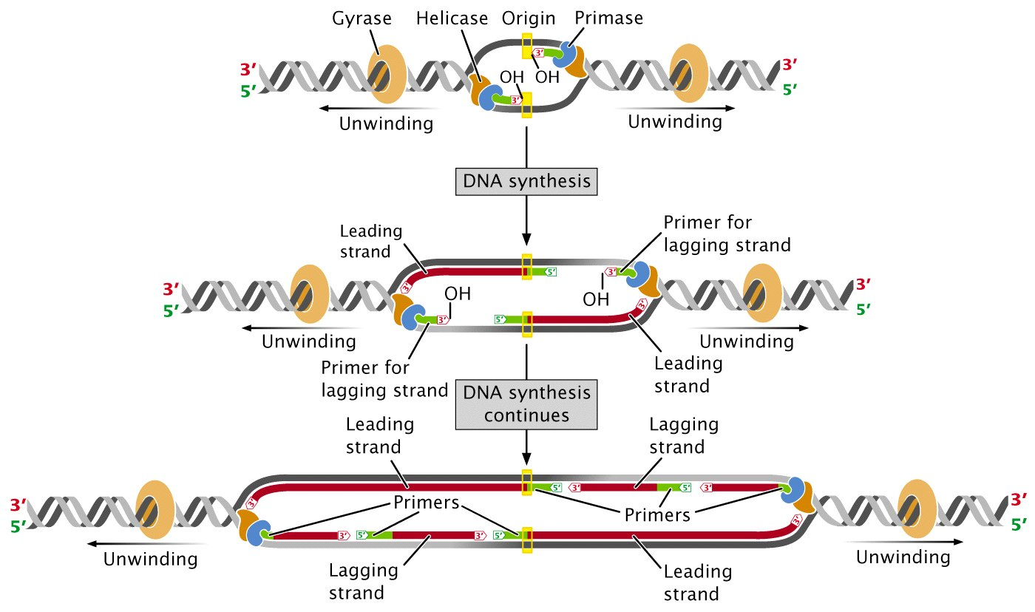
Step 3: Primase
Step 4. Elongation
Okazaki Fragments
Biology Lecture E. Anastasiadou Bioinformatics – Biomedical Data Science 2021-2022

Slide 37
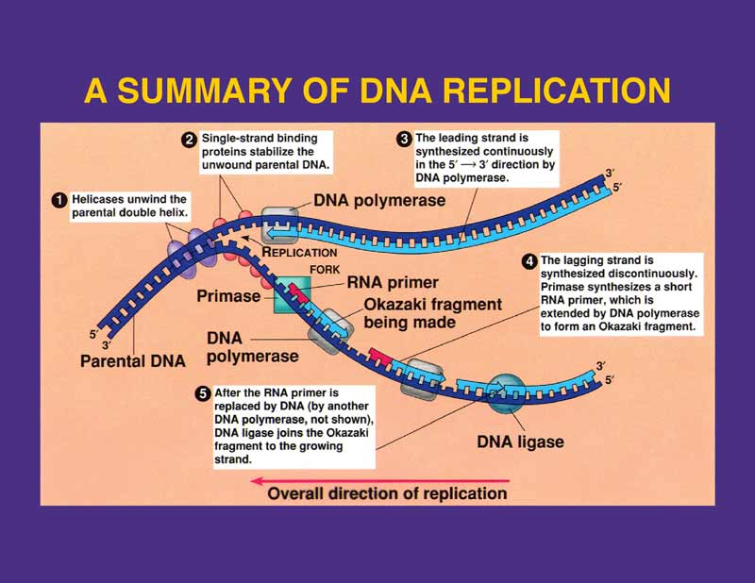
Biology Lecture E. Anastasiadou Bioinformatics – Biomedical Data Science 2021-2022

Slide 38
DNA REPLICATION
Unwind DNA helix with DNA Helicase.
A single strand binding (SSB) protein complex is formed and stabilizes single strand DNA.
RNA primer formation by RNA Primase.
Initiation of synthesis of leading strand by DNA polymerase III.
Initiation of synthesis of the lagging strand by DNA polymerase III.
Construction of Okazaki fragments.
Elongation of the leading strand.
Replace ribonucleotides with deoxyribonucleotides by DNA polymerase I.
Linking the modified Okazaki fragments with Ligase.
Completion of the synthesis of the leading and lagging strands.
Biology Lecture E. Anastasiadou Bioinformatics – Biomedical Data Science 2021-2022

Slide 39
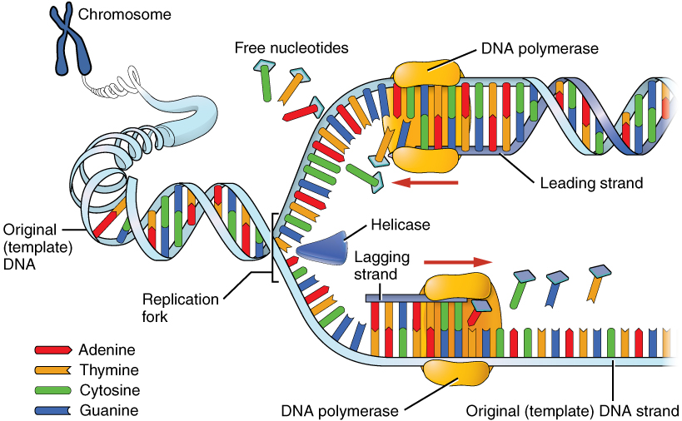
Biology Lecture E. Anastasiadou Bioinformatics – Biomedical Data Science 2021-2022

Slide 40
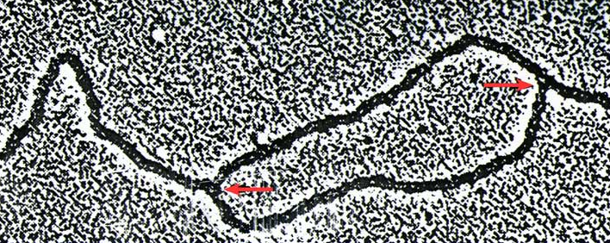
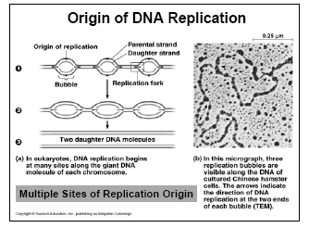
MULTIPLE POSITIONS OF ORIGIN OF DNA REPLICATION
A bubble appears along the DNA. The arrows indicate the direction of DNA replication at the two ends of the bubble (replication bubble).
Biology Lecture E. Anastasiadou Bioinformatics – Biomedical Data Science 2021-2022

Slide 41
Animation:
https://www.youtube.com/watch?v=TNKWgcFPHqw
https://www.youtube.com/watch?v=TEQMeP9GG6M
http://www.youtube.com/watch?v=-mtLXpgjHL0&feature=related
Biology Lecture E. Anastasiadou Bioinformatics – Biomedical Data Science 2021-2022

Slide 43

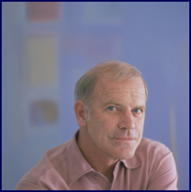
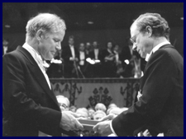
Polymerase Chain Reaction - PCR
Probably the most popular and widely used technique in studies and applications in all areas of biological sciences.
Unusual Origin of PCR Mullis KB, 1990
Scientific American
1966, Thomas Brock discovers thermostable bacteria, Thermus aquaticus, in the hot springs of the Yellowstone National Park.
1983, Kary Mullis captures the concept of PCR (Nobel Prize 1993)
1985, scientists from Cetus Corp. isolate thermostable polymerase (Taq).
1993 Nobel Prize in Chemistry
Biology Lecture E. Anastasiadou Bioinformatics – Biomedical Data Science 2021-2022

Slide 44
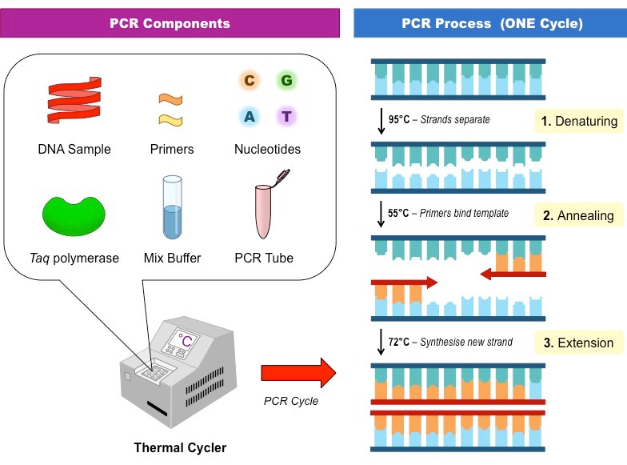
PCR
Stages:
DNA double strand separation.
Primer annealing to complementary DNA strand.
Synthesis of new DNA clones
by DNA-polymerase and dNTPs.
Goal: Amplification of DNA molecules through replication
Biology Lecture E. Anastasiadou Bioinformatics – Biomedical Data Science 2021-2022

Slide 45
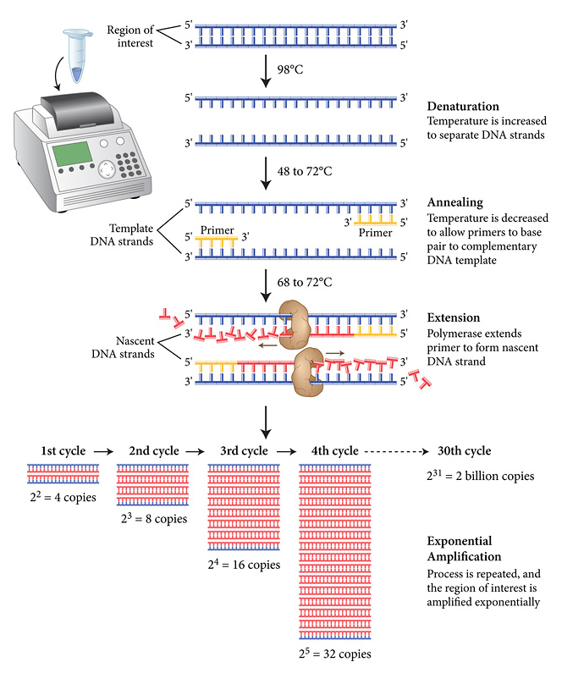
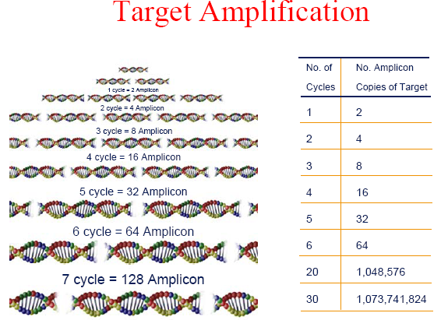
PCR
simple
sensitive
specific
reliable
quick
dynamic
Biology Lecture E. Anastasiadou Bioinformatics – Biomedical Data Science 2021-2022

Slide 46
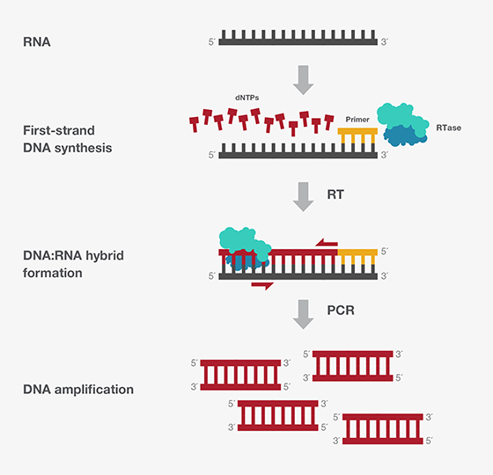
Reverse Transcriptase PCR - RT-PCR
Uses
RNA as template and
DNA polymerase enzyme for
RNA-directed ds cDNA synthesis
Biology Lecture E. Anastasiadou Bioinformatics – Biomedical Data Science 2021-2022

Slide 47
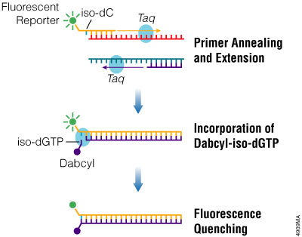
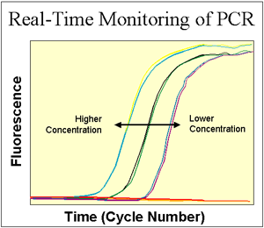
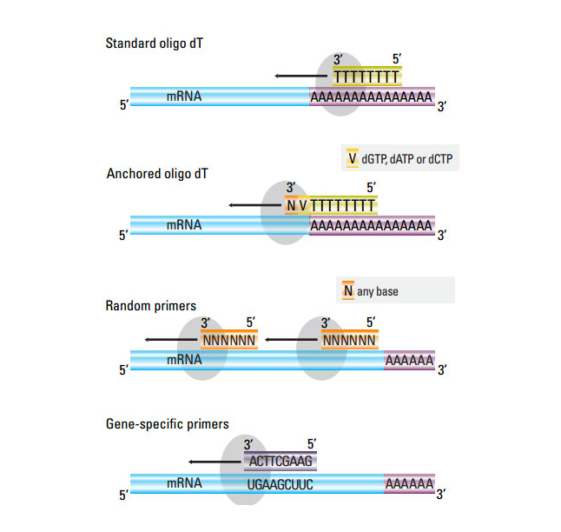
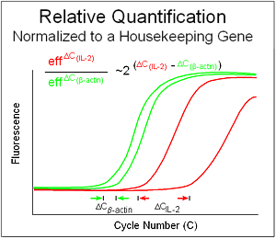
REAL TIME PCR
Biology Lecture E. Anastasiadou Bioinformatics – Biomedical Data Science 2021-2022

Slide 48
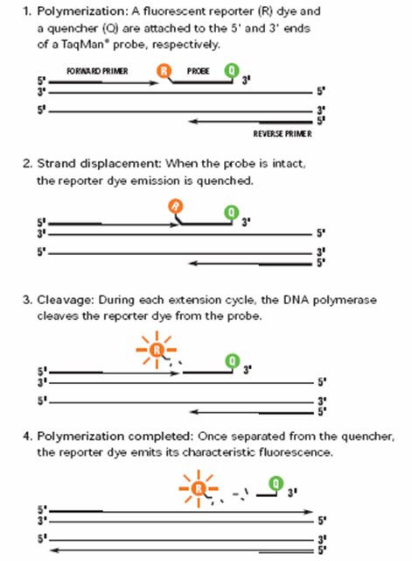
REAL TIME PCR
Biology Lecture E. Anastasiadou Bioinformatics – Biomedical Data Science 2021-2022

Slide 49

Biology Lecture E. Anastasiadou Bioinformatics – Biomedical Data Science 2021-2022

Slide 50

Biology Lecture E. Anastasiadou Bioinformatics – Biomedical Data Science 2021-2022

Slide 51

Biology Lecture E. Anastasiadou Bioinformatics – Biomedical Data Science 2021-2022

Slide 52

Biology Lecture E. Anastasiadou Bioinformatics – Biomedical Data Science 2021-2022

Slide 53

Genes determine the characteristics (brown or blue eyes, long or short fingers, etc.). Genes also control everything from how cells grow to how they interact with each other. A gene can range from 100 base pairs of DNA to several millions.
GENES
Biology Lecture E. Anastasiadou Bioinformatics – Biomedical Data Science 2021-2022

Slide 54

GENES
Genes are the basic units of heredity.
A gene encodes a protein by storing the necessary information for its construction and is the nucleotide sequence of a portion of the DNA, which is a model for the synthesis of an RNA.
The human genome consists of about ~ 25,000 genes.
Biology Lecture E. Anastasiadou Bioinformatics – Biomedical Data Science 2021-2022

Slide 55

GENE ORGANIZATION
The largest known gene (2.4 million bases in length) is associated with Duchenne muscular dystrophy.
Biology Lecture E. Anastasiadou Bioinformatics – Biomedical Data Science 2021-2022

Slide 56
GENOME
The total genetic material of a cell consists the genome of the cell (we usually imply the nuclear genetic material).
Each cell includes the entire genome of an organism.
Cells with 1 copy of genome (prokaryotes, gametes of eukaryotic organisms) are called haploids. Cells with 2 copies of genes (upper eukaryotic organisms) are called diploids. The human genome consists of 46 chromosomes.
To describe the length or sequence of nucleic acid, we use the term DNA sequence, meaning the nucleotide sequence (e.g., DNA: 10000 base pairs, RNA: 5000 bases).
Biology Lecture E. Anastasiadou Bioinformatics – Biomedical Data Science 2021-2022

Slide 57


HUMAN GENOME PROJECT
15 year project sequence 3.2 billion bases
started in 1990
required 4 years to determine the first billion basis
4 months for the second billion bases and in January 2003, 1.5 billion basis
In 1993: $ 10 per base
In April 2003: 10 cents per base
Biology Lecture E. Anastasiadou Bioinformatics – Biomedical Data Science 2021-2022

Slide 58

Biology Lecture E. Anastasiadou Bioinformatics – Biomedical Data Science 2021-2022

Slide 59


1997: E. coli Genome Sequenced
1998: M. Tuberculosis Bacterium Sequenced
1998: Genome of Roundworm C. elegans Sequenced
1999: Chromosome 22
2000: Free Access to Genomic Information
2000: Chromosome 21
2000: Drosophila and Arabidopsis genomes sequenced
2001: First Draft of the Human Genome Sequence Released
2002: Mouse Genome Sequenced
2002: Rice Genome Sequenced
2003: Human Genome Project Completed
2003: ENCODE Program Begins
2004: Rat and Chicken Genomes Sequenced
2004: Refined Analysis of Complete Human Genome Sequence
2005: Chimpanzee Genomes Sequenced
2005: Trypanosomatid Genomes Sequenced
2005: Dog Genomes Sequenced
2006: The Cancer Genome Atlas (TCGA) Project Started
2006: Second Non-human Primate Genome is Sequenced
Biology Lecture E. Anastasiadou Bioinformatics – Biomedical Data Science 2021-2022

Slide 60

THE FUTURE
Data from –omic approaches are increasing.
Need for:
Acquisition
Storage
Access
Analysis
Biology Lecture E. Anastasiadou Bioinformatics – Biomedical Data Science 2021-2022

Slide 61


THE FUTURE
Collection and distribution of data.
Creation and operation of databases.
Software development for large-scale analysis.
Developing tools to compare and interpret the data.
Dissemination of information to the scientific community.
Dissemination of information to the general public.
Technology development.
Large-scale data manipulation faster and cheaper.
Biology Lecture E. Anastasiadou Bioinformatics – Biomedical Data Science 2021-2022

Slide 62

The Central Dogma
Biology Lecture E. Anastasiadou Bioinformatics – Biomedical Data Science 2021-2022

Slide 63
The Central Dogma Of Molecular Biology
DNA acts as a genetic material because it can:
Produce accurate copies to transfer genetic information from one generation of cells and organisms to another.
Determine the composition of the various RNAs and thus the proteins that serve structurally and functionally the cell and therefore the organism.
Biology Lecture E. Anastasiadou Bioinformatics – Biomedical Data Science 2021-2022

Slide 64

The Central Dogma Of Molecular Biology
The DNA replicates and produces two daughter molecules identical to the original.
DNA is transcribed and produces RNA.
RNA is translated and produces proteins.
exception: some viruses that have as genetic material RNA they make DNA from. This process is called reverse transcription.
Biology Lecture E. Anastasiadou Bioinformatics – Biomedical Data Science 2021-2022

Slide 65

The Central Dogma Of Molecular Biology
DNA (RNA-polymerase)
pre-RNA (Τ->U (uracil))
Pre-RNA (Spliceosome) mRNA
RNA (Ribosome) -> Protein
The process involves the portion of DNA that encodes a gene.
The term gene expression refers to the production of RNA from the gene.
Biology Lecture E. Anastasiadou Bioinformatics – Biomedical Data Science 2021-2022

Slide 66


The Central Dogma Of Molecular Biology
Replication
DNA duplicates
4-Letter Code
A,T.G,C
Transcription
RNA synthesis
4-Letter Code
A,U.G,C
Translation
Protein synthesis
20-Letter Code
Amino Acids
Biology Lecture E. Anastasiadou Bioinformatics – Biomedical Data Science 2021-2022

Slide 67
The Central Dogma Of Molecular Biology
Biology Lecture E. Anastasiadou Bioinformatics – Biomedical Data Science 2021-2022

Slide 68
https://www.youtube.com/watch?v=gG7uCskUOrA

Slide 69
TRANSCRIPTION
Biology Lecture E. Anastasiadou Bioinformatics – Biomedical Data Science 2021-2022

Slide 70

TRANSCRIPTION
Transcription is the process during which the genetic information stored and written in the language of the DNA is transcribed in the language of the RNA.
It is based on the principle of complementarity of the bases, but instead of thymine, the uracil nitrogen base is used.
Biology Lecture E. Anastasiadou Bioinformatics – Biomedical Data Science 2021-2022

Slide 71

BASIC UNIT OF TRANSCRIPTION
terminator
Promoter
Transcription start site
RNA coding region
Terminator
Let’s look closely at the process of transcription.
Biology Lecture E. Anastasiadou Bioinformatics – Biomedical Data Science 2021-2022

Slide 72

RNA POLYMERASE ΙΙ PROMOTER
Defines the starting point and the rate of transcription
Biology Lecture E. Anastasiadou Bioinformatics – Biomedical Data Science 2021-2022

Slide 73

eukaryotic RNA POLYMERASES
3 distinct RNA polymerases in a eukaryotic cell nucleus define the three major classes of eukaryotic transcription unit:
There may be as many as 14 subunits in an eukaryotic RNA polymerase; the total molecular weight is typically 500-700 kD.
Eukaryotic RNA polymerases cannot find or bind to a promoter by themselves. They require the binding of assembly factors and a positional factor to locate the promoter and to orient the polymerase correctly. As we will see, the positional factor is the same in all cases.
Class I Transcriptional Units: Class I genes or transcriptional units are transcribed by RNA polymerase I in the nucleolus. The best-studied examples are the rRNA transcription units. RNA polymerase I is a complex of 13 subunits.
Class II Transcription Units: All genes that are transcribed and expressed via mRNA are transcribed by RNA polymerase II. RNA polymerase II (12 subunits) can transcribe RNA from nicked dsDNA templates or from ssDNA templates. However, by itself, it cannot initiate transcription at a promoter. In this respect, it resembles the core form of bacterial RNA polymerase.
Class III Transcription Units: Class III genes are principally those for small RNA molecules in the cell. The best studied examples are the 5S rRNA gene -- which has been studied extensively in Xenopus laevis, and tRNA genes.
The enzyme:RNA polymerase III is the largest of the three RNA polymerases with 17 subunits and a molecular weight of over 700 kD. It is moderately sensistive to a-amanitin. It is also the most active.
polymerase | location | type of RNA transcribed
I | Nucleus/nucleolus | Large rRNA
II | nucleus | pre-mRNA, some snRNAs, some snoRNAs
III | nucleus | small RNA such as tRNA and 5S Rrna, and snRNAs
Biology Lecture E. Anastasiadou Bioinformatics – Biomedical Data Science 2021-2022

Slide 74

ORIGIN OF TRANSCRIPTION
Localization of genes is theoretically easy as DNA sequences, encoding for proteins, start with the ATG bases and end with one or more termination codons (TAA, TAG or TGA). But finding genes is not always easy.
It is easier to identify genes in bacterial DNA than in eukaryotic. In bacteria, the genes are positioned like beads in a row. Each gene consists of a single ORF. The condition in eukaryotic organisms is complicated by the split nature of the genes as most eukaryotic genes consist of alternating exons and introns.
Biology Lecture E. Anastasiadou Bioinformatics – Biomedical Data Science 2021-2022

Slide 75

CODING & NON CODING STRAND OF DNA
In transcription, one DNA strand, the non-coding strand, is used as a blueprint for the RNA synthesis. As the transcription proceeds in the 5 → 3 direction, it is based on the complementarity of the DNA bases of the DNA template clone with the 3 '→ 5' direction. The clone not used as a template is called coding strand and its sequence reflects that of the RNA produced.
Biology Lecture E. Anastasiadou Bioinformatics – Biomedical Data Science 2021-2022

Slide 76

The DNA clone encoding the protein is called sense because its sequence reads the same as that of the messenger RNA. The other strand is the antisense and serves as a matrix for RNA polymerase during transcription.
Biology Lecture E. Anastasiadou Bioinformatics – Biomedical Data Science 2021-2022

Slide 77
http://www.youtube.com/watch?v=WsofH466lqk
https://www.youtube.com/watch?v=zNbycmLouog
Biology Lecture E. Anastasiadou Bioinformatics – Biomedical Data Science 2021-2022

Slide 78
TRANSCRIPTION
DNA genetic material is found in the nucleus, while the ribosomes in which the protein synthesis occurs, are found outside of it, so genetic information has to be reached there. The DNA does not move out of the nucleus for the following reasons:
The nuclear membrane is impervious to DNA.
Often the cell produces multiple molecules of a protein and therefore it would be impossible for the same DNA molecule to be present at different ribosomes simultaneously.
Transmission problems of genetic information are solved with an intermediate molecule, mRNA or messenger RNA.
The mRNA is produced in the nucleus by the DNA transcription process and transfers information from the nucleus to the cytoplasm
Biology Lecture E. Anastasiadou Bioinformatics – Biomedical Data Science 2021-2022

Slide 79

TRANSCRIPTION STAGES
Initiation
Elongation
Termination
Biology Lecture E. Anastasiadou Bioinformatics – Biomedical Data Science 2021-2022

Slide 80

TRANSCRIPTION
RNA transcription from DNA evolves as follows:
The hydrogen bonds between the complementary bases break in the part of the DNA strand that has the requested genetic information and the double helix opens.
Due to the complementarity towards each deoxyribonucleotide of one strand of DNA, a complementary ribonucleotide is aligned. The RNA-polymerase enzyme sequentially connects the ribonucleotides by covalent bonding, thereby forming a single-stranded RNA molecule.
Biology Lecture E. Anastasiadou Bioinformatics – Biomedical Data Science 2021-2022

Slide 81

INITIATION
Transcription begins with the binding of RNA polymerase to the promoter. In prokaryotes, the RNA polymerase is a central enzyme consisting of five subunits (2α, 1β, 1β ', and 1m). At the start of the procedure, the enzyme binds to a sigma factor (number 70) that helps find the appropriate -35 and -10 bases downstream of the promoter.
The onset of transcription is much more complex in eukaryotes. The main difference is that the eukaryotic polymerases do not directly recognize the promoter sequences. In contrast to replication, transcription does not require a primer to initiate its RNA polymerase activity. The DNA unfolds and produces a small open complex and synthesis begins only on the clone-matrix.
RNAP = RNA polymerase
Biology Lecture E. Anastasiadou Bioinformatics – Biomedical Data Science 2021-2022

Slide 82

ELONGATION
In contrast to DNA replication, transcription of the mRNA may involve multiple RNA polymerases on a single DNA matrix, so that many mRNA molecules can be produced from a single copy of a gene. This step also includes a proofreading mechanism that can replace errors in RNA.
Biology Lecture E. Anastasiadou Bioinformatics – Biomedical Data Science 2021-2022

Slide 83

TERMINATION
Bacteria use two different strategies for terminating transcription:
In "Rho-independent termination," transcription stops when the newly synthesized RNA molecule forms a hairpin loop, followed by Us, causing the detachment from the template (DNA).
In the "Rho-dependent" termination pattern, a protein called "Rho" destabilizes the interaction between the template and the RNA, thus releasing the newly synthesized mRNA from the elongation complex.
Ending transcription in eukaryotes is less understandable. It involves "cleavage" of the new transcript and addition of As at the 3 'end, regardless of the DNA sequence that is used as template, during a process called polyadenylation.
Biology Lecture E. Anastasiadou Bioinformatics – Biomedical Data Science 2021-2022

Slide 84

POST-TRANSCRIPTIONAL MODIFICATIONS
5’ cap addition
3' poly(A) tail addition
Splicing
Let’s look closely at the process of transcription.
Biology Lecture E. Anastasiadou Bioinformatics – Biomedical Data Science 2021-2022

Slide 85

5' cap
The 5 'cap is a modified guanine nucleotide added at the 5' end of the pre-mRNA using a 5 ', 5-triphosphate bond. This modification is critical for the identification and proper binding of mRNA to the ribosome as well as 5’ exonuclease protection. It can also be important for other essential processes such as splicing and transport.
Biology Lecture E. Anastasiadou Bioinformatics – Biomedical Data Science 2021-2022

Slide 86

3' poly(A) tail
The 3 'poly (A) "tail" is a long adenine nucleotide sequence (often several hundreds) added to the 3' end of pre-mRNA via the action of an enzyme, the polyadenylate polymerase. In higher eukaryotes, the poly (A) tail is added to transcripts containing a particular sequence, the AAUAAA. The significance of the AAUAAA signal is evidenced by a mutation in the human alpha 2-globin gene, which alters the original AATAAA sequence in AATAAG, leading to hemoglobin dysfunctions.
Biology Lecture E. Anastasiadou Bioinformatics – Biomedical Data Science 2021-2022

Slide 87
https://www.youtube.com/watch?v=DoSRu15VtdM

Slide 88

RNA splicing
Most eukaryotic genes consist of alternating exons and introns. Each exon encodes a protein segment. Introns do not encode amino acids but contain regulatory sequences and internal termination codons.
Biology Lecture E. Anastasiadou Bioinformatics – Biomedical Data Science 2021-2022

Slide 89

Splicing: 3 components are required
Note some important aspects of the 5’ and 3’ ends
5’ phosphodiester of G
2’ OH of A
Biology Lecture E. Anastasiadou Bioinformatics – Biomedical Data Science 2021-2022

Slide 90
https://www.youtube.com/watch?v=AVABXkK5Q_o
https://www.youtube.com/watch?v=OfeYFF85u-U
Biology Lecture E. Anastasiadou Bioinformatics – Biomedical Data Science 2021-2022

Slide 91

One of the surprises of the Human Genome Program was the relatively small number of genes found, ~ 25,000. One could ask, "How can something as complex as humans have only 25% more genes than the small warm C. elegans? Part of the answer seems to be interpreted with alternative splicing. Alternative splicing refers to the process by which a given gene with alternative splices predominates more than one type of mRNA molecule.
Biology Lecture E. Anastasiadou Bioinformatics – Biomedical Data Science 2021-2022

Slide 92

Biology Lecture E. Anastasiadou Bioinformatics – Biomedical Data Science 2021-2022

Slide 93
http://www.youtube.com/watch?v=OEWOZS_JTgk&feature=related
Biology Lecture E. Anastasiadou Bioinformatics – Biomedical Data Science 2021-2022

Slide 95
GENETIC CODE
Biology Lecture E. Anastasiadou Bioinformatics – Biomedical Data Science 2021-2022

Slide 96

GENETIC CODE
Genetic code is called the total of correlation of codons to specific amino acids during translation.
Codon is called any successive triad of nucleotides encoding an amino acid.
Biology Lecture E. Anastasiadou Bioinformatics – Biomedical Data Science 2021-2022

Slide 97

GENETIC CODE
Between deoxyribonucleotides and ribonucleotides, the correlation is one to one.
But the correlation between bases of ribonucleotides and amino acids is more complex. It is not one to one because more than four different amino acids are required.
Neither two to two because the different duplex of bases would be 4²=16 and thus 16 amino acids at the most would be coded.
A triple of bases corresponds to an amino acid. The different triads are 4³=64, so they are sufficient to cover all amino acids.
Biology Lecture E. Anastasiadou Bioinformatics – Biomedical Data Science 2021-2022

Slide 98

GENETIC CODE
A gene starts with a codon for the amino acid methionine (ATG), the start codon, and ends with one of the 3 termination codons (TAA, TAG, TGA). The codons between the start and stop signals encode for the various amino acids of the gene product.
Biology Lecture E. Anastasiadou Bioinformatics – Biomedical Data Science 2021-2022

Slide 99

GENETIC CODE
Biology Lecture E. Anastasiadou Bioinformatics – Biomedical Data Science 2021-2022

Slide 100


OPEN READING FRAME
When examining an unknown DNA sequence, an indication that it may be part of a gene is the presence of an Open Reading Frame or ORF.
An ORF is any part of the DNA that when transcribed into RNA does not contain a stop codon.
A computer program can be used to test an unknown DNA sequence for ORFs. It transcribes each chain of DNA into complementary RNA and translates into amino acids in all three different reading frames, performing six different translations for each given double-stranded DNA sequence.
Biology Lecture E. Anastasiadou Bioinformatics – Biomedical Data Science 2021-2022

Slide 101
GENETIC CODE
The genetic code has the following characteristics:
It is ternary, that is, a nucleotide triad encodes an amino acid.
One (AUG) encodes for initiation of translation and for the amino acid methionine.
Three (UAG, UAA, UGA) encode for the end of the translation.
It is degenerative, that is, each amino acid (except two) is encoded by more than one codon, the so-called synonyms.
It is not overlapping. Translation starting from defined points in the mRNA (AUG) proceeds by one codon at each step. Thus, each nucleotide acts as a member of only one triad.
It is universal. Any codon has the same meaning in all organisms. This is a strong argument in favor of the common origin of species.
Biology Lecture E. Anastasiadou Bioinformatics – Biomedical Data Science 2021-2022

Slide 102

AMINO ACIDS
It is a molecule containing amino and carboxyl groups.
In biochemistry, the term "amino acid" refers to alpha-amino acids with the general formula H₂NCHRCOOH, wherein R is an organic group.
In α-amino acids, the amino and carboxyl groups bind to the same carbon atom, which is called α-carbon.
The α-amino acids differ in the side chain (group R) attached to the α-carbon. It can vary in size from just one hydrogen atom in glycine, a methyl group in alanine, to a large heterocyclic group in tryptophan.
Biology Lecture E. Anastasiadou Bioinformatics – Biomedical Data Science 2021-2022

Slide 103

α-AMINO ACIDS
Alanine ala A CH3-CH(NH2)-COOH
Arginine arg R HN=C(NH2)-NH-(CH2)3-CH(NH2)-COOH
Asparagine asn N H2N-CO-CH2-CH(NH2)-COOH
Aspartic acid asp D HOOC-CH2-CH(NH2)-COOH
Cysteine cys C HS-CH2-CH(NH2)-COOH
Glutamine gln Q H2N-CO-(CH2)2-CH(NH2)-COOH Glutamic acid glu E HOOC-(CH2)2-CH(NH2)-COOH Glycine gly G NH2-CH2-COOH
Histidine his H NH-CH=N-CH=C-CH2-CH(NH2)-COOH
Isoleucine ile I CH3-CH2-CH(CH3)-CH(NH2)-COOH Leucine leu L (CH3)2-CH-CH2-CH(NH2)-COOH
Lysine lys K H2N-(CH2)4-CH(NH2)-COOH
Methionine met M CH3-S-(CH2)2-CH(NH2)-COOH Phenylalanine phe F Ph-CH2-CH(NH2)-COOH
Proline pro P NH-(CH2)3-CH-COOH
Serine ser S HO-CH2-CH(NH2)-COOH
Threonine thr T CH3-CH(OH)-CH(NH2)-COOH
Tryptophan trp W Ph-NH-CH=C-CH2-CH(NH2)-COOH
Tyrosine tyr Y HO-p-Ph-CH2-CH(NH2)-COOH
Valine val V (CH3)2-CH-CH(NH2)-COOH
Biology Lecture E. Anastasiadou Bioinformatics – Biomedical Data Science 2021-2022

Slide 104
PROTEINS
Large organic compound consisting of amino acids arranged in a linear chain.
They are linked by peptide bonds between the carboxyl- and amino-groups of adjacent amino acids.
The sequence of amino acids in a protein is determined by the gene and decoded by the genetic code.
Although the genetic code is defined by 20 amino acids, it is often subject to chemical alterations, post-translational modifications: either to make a protein functional in the cell, or as part of the regulation mechanisms.
Proteins can also work together to achieve a certain function, and often interact to form stable complexes.
Biology Lecture E. Anastasiadou Bioinformatics – Biomedical Data Science 2021-2022

Slide 105
proteins
https://www.youtube.com/watch?v=wvTv8TqWC48
https://www.youtube.com/watch?v=wvTv8TqWC48&t=4s
enzymes
https://www.youtube.com/watch?v=yk14dOOvwMk
Biology Lecture E. Anastasiadou Bioinformatics – Biomedical Data Science 2021-2022

Slide 106
TRANSLATION
Biology Lecture E. Anastasiadou Bioinformatics – Biomedical Data Science 2021-2022

Slide 107

TRANSLATION
Translation is the third and final phase in the expression of the genetic information during which the protein molecule is synthesized in the ribosomes.
The sequence of the nucleotides of an mRNA determines the amino acid sequence of a polypeptide chain.
The protein synthesis develops in three stages:
Initiation
Elongation
Termination
Biology Lecture E. Anastasiadou Bioinformatics – Biomedical Data Science 2021-2022

Slide 108
TRANSLATION
The factors involved in protein synthesis are:
mRNA, encodes and stores the information.
Ribosomes, are the organels where protein synthesis occurs.
Amino acids, are the structural blocks of the proteins.
Enzymes, protein molecules assisting the procedure.
ATP, for power supply.
tRNA, for the transport of amino acids.
Biology Lecture E. Anastasiadou Bioinformatics – Biomedical Data Science 2021-2022

Slide 109
TRANSLATION
Messenger Ribonucleic Acid (mRNA) is an RNA molecule encoding a chemical "blueprint" for a protein.
The short life of a mRNA molecule begins with transcription and eventually ends with degradation. During its lifetime, a mRNA molecule will be processed and transported prior to translation. Eukaryotic mRNA molecules often require extensive processing and transport, whereas prokaryotic molecules, do not.
Biology Lecture E. Anastasiadou Bioinformatics – Biomedical Data Science 2021-2022

Slide 110

TRANSFER RNA (tRNA)
Small RNA chain (73-93 nucleotides) carrying a specific amino acid to a newly synthesized polypeptide chain, at the ribosomal position of the protein synthesis, during translation.
It has a 3’ end for covalent attachment of amino acids catalyzed by an aminoacyl-tRNA synthase.
It also contains a three-base region called the anticodon corresponding each time to the three bases of the codon in the mRNA.
Each tRNA molecule can be linked to only one type of amino acid, but because the genetic code contains multiple codons that define the same amino acid, tRNA molecules carrying different anticodons may also carry the same amino acid.
Biology Lecture E. Anastasiadou Bioinformatics – Biomedical Data Science 2021-2022

Slide 111

TRANSFER RNA (tRNA)
The acceptor stem is a 7- to 9-base pair (bp) stem made by the base pairing of the 5'-terminal nucleotide with the 3'-terminal nucleotide (which contains the CCA 3'-terminal group used to attach the amino acid).
The CCA tail is cytosine-cytosine-adenine sequence at the 3’ end of the tRNA molecule. The amino acid loaded onto the tRNA by aminoacyl-tRNA synthetases to form aminoacyl-tRNA, is covalently bonded to the 3'-hydroxyl group on the CCA tail. This sequence is important for the recognition of the tRNA by enzymes critical in translation.
In most prokaryotic and eukaryotic tRNAs, the CCA sequence is added during processing and therefore does not appear in the tRNA gene.
The D arm is a 4 to 6bp stem ending in a loop that often contains dihydrouracil.
The anticodon arm is a 5bp stem whose loop contains the anticodon.
The T arm is a 4 to 5bp stem containing the sequence TΨC where Ψ is pseudouridine, a modified uridine.
Modified bases, especially by methylation, occur in several positions throughout the tRNA. The first anticodon base is sometimes modified to inosine (derived from adenine) pseudouridine or lysidine (derived from cytosine).
Biology Lecture E. Anastasiadou Bioinformatics – Biomedical Data Science 2021-2022

Slide 112
https://www.youtube.com/watch?v=T54Akbu0ONU
Biology Lecture E. Anastasiadou Bioinformatics – Biomedical Data Science 2021-2022

Slide 113

RIBOSOMAL RNA (rRNA)
RNA synthesized in the nucleus by RNA polymerase I and is the central component of the ribosome, the protein-making machinery of all living cells.
The function of rRNA is to provide a mechanism for the decoding of mRNA to amino acids and to interact with tRNAs during translation by providing peptidyl transferase activity.
Small subunit ribosomal RNA
Biology Lecture E. Anastasiadou Bioinformatics – Biomedical Data Science 2021-2022

Slide 114

RIBOSOME
It consists of two subunits, small and large (depending on how quickly they precipitate when subjected to centrifugation).
Between the small and large subunits, a groove is formed where the mRNA coding for the message to be translated is bound.
An mRNA can be translated simultaneously from multiple ribosomes.
Type | Size | Large subunit | Small subunit
prokaryotic | 70S | 50S (5S, 23S) | 30S (16S)
eukaryotic | 80S | 60S (5S, 5.8S, 28S) | 40S (18S)
Biology Lecture E. Anastasiadou Bioinformatics – Biomedical Data Science 2021-2022

Slide 115
http://telstar.ote.cmu.edu/Hughes/HughesArchive/tutorial/polypeptide/tutorial.swf
Biology Lecture E. Anastasiadou Bioinformatics – Biomedical Data Science 2021-2022

Slide 116

TRANSLATION
Start: mRNA binds to a specific site of the ribosome. Protein synthesis begins after the ribosome localizes the start codon (AUG). Then the tRNA binds to an anticodon complementary to AUG, carrying the amino acid methionine.
Biology Lecture E. Anastasiadou Bioinformatics – Biomedical Data Science 2021-2022

Slide 117

RIBOSOME
The ribosome has 3 binding sites called A, P, and E.
An aminoacyl-tRNA (a tRNA carrying an amino acid) binds to position A. The NH2-group of the amino acid of aminoacyl-tRNA interacts with the carboxyl group of the peptidyl-tRNA (located at position P), which contains the last amino acid of the growing strand.
The tRNA that carried the last amino acid moves to position E, and the aminoacyl-tRNA becomes peptidyl-tRNA.
A new tRNA is squized at the P site and the ribosome catalyzes the formation of a peptide bond between the 2 amino acids attached to the tRNAs.
Biology Lecture E. Anastasiadou Bioinformatics – Biomedical Data Science 2021-2022

Slide 118

TRANSLATION
Elongation: The first tRNA is followed by a second one with an anticodon complementary to the second codon. Its amino acid develops a peptide bond with methionine. The first tRNA is detouched from the methionine and moved towards the cytoplasm while the ribosome is shifted to the third codon whereby the position of first codon becomes occupied by the second that carries the dipeptide.
Biology Lecture E. Anastasiadou Bioinformatics – Biomedical Data Science 2021-2022

Slide 119

TRANSLATION
The Elongation Factor EF-G or EF-2 leads to the ribosome shift along the mRNA.
In combination with the hydrolysis of GTP by EF-1 and EF-2, it promotes protein synthesis.
Biology Lecture E. Anastasiadou Bioinformatics – Biomedical Data Science 2021-2022

Slide 120

TRANSLATION
Termination: the ribosome localizes a stop codon and stops the protein synthesis.
The release factor enters the A position and causes hydrolysis of the peptidyl-tRNA bond leading to protein release.
The polypeptide chain is released from the ribosome
Biology Lecture E. Anastasiadou Bioinformatics – Biomedical Data Science 2021-2022

Slide 121

TRANSLATION
The release of the protein causes the ribosome to break down into its components, in its subunits.
Biology Lecture E. Anastasiadou Bioinformatics – Biomedical Data Science 2021-2022

Slide 122
http://www.youtube.com/watch?v=5bLEDd-PSTQ&feature=related
https://www.youtube.com/watch?v=TfYf_rPWUdY
Biology Lecture E. Anastasiadou Bioinformatics – Biomedical Data Science 2021-2022

Slide 123

https://www.youtube.com/watch?v=gG7uCskUOrA
Biology Lecture E. Anastasiadou Bioinformatics – Biomedical Data Science 2021-2022

Slide 125
CELL CYCLE
Biology Lecture E. Anastasiadou Bioinformatics – Biomedical Data Science 2021-2022

Slide 126

CELL CYCLE
Why do cells divide?
Growth (add cells so organism gets larger in size)
Development (differentiation of the cells)
Repair
Make gametes
Biology Lecture E. Anastasiadou Bioinformatics – Biomedical Data Science 2021-2022

Slide 127


CELL CYCLE
PHASES OF THE CELL CYCLE
G1: Gap1
Cell grows – Duplication of organelles (including centriols) and cytoplasmic components.
Preparation of chromosomes for replication.
S: DNA synthesis (DNA replication)
DNA synthesis
G2: Gap2
Preparing for mitosis – Production of required enzymes and RNA.
M: Mitosis
Nuclear/chromosomal separation
and cytoplasmic division/cytokinesis
Chromosomes must be copied before mitosis so that new cells receive the same chromosomes found in the parental cells.
Biology Lecture E. Anastasiadou Bioinformatics – Biomedical Data Science 2021-2022

Slide 128
https://www.youtube.com/watch?v=JfSgbbjz2rE
https://www.youtube.com/watch?v=1hJDclmVkrg
Biology Lecture E. Anastasiadou Bioinformatics – Biomedical Data Science 2021-2022

Slide 129
ΜΙTOSIS
Biology Lecture E. Anastasiadou Bioinformatics – Biomedical Data Science 2021-2022

Slide 130


INTERPHASE (G1 / S / G2)
The cell administers the metabolic activity and the preparation for mitosis (the next four phases resulting in nuclear division).
Chromosomes are not clearly distinguishable in the nucleus, although a dark spot called nucleolus may be visible.
Nucleolus is a specific part in the nucleus that contains the machinery necessary to assemble the cell's ribosomal RNAs. Ribosomal RNAs then are transported through the nuclear pores into the cytoplasm where they become part of the ribosomes.
The cell may contain a pair of centriols, the microtubule organizing centers.
Biology Lecture E. Anastasiadou Bioinformatics – Biomedical Data Science 2021-2022

Slide 131
INTERPHASE (G1 / S / G2)
A centriole is a cylindrical organelle composed mainly of a protein called tubulin.
Centrioles are typically made up of nine sets of short microtubule triplets, arranged in a cylinder.
A bound pair of centrioles, surrounded by a highly ordered mass of dense material, called the pericentriolar material (PCM), makes up a structure called a centrosome. Additional proteins include centrin, cenexin and tektin.
Centrioles are involved in
- the organization of the mitotic spindle during cell division
and in the completion of cytokinesis
- organizing microtubules in the cytoplasm
- determining the position of the nucleus and playing a crucial role in the spatial arrangement of the cell
- determining the flagella or cilia
Biology Lecture E. Anastasiadou Bioinformatics – Biomedical Data Science 2021-2022

Slide 132

MITOSIS - PROPHASE
Chromatin in the nucleus begins to condense and becomes visible in the microscope as chromosomes.
The nucleolus disappears.
Centriols begin to move towards the opposite sites of the cell and microtubule fibers extend from the centromers. Some cross the cell to form the mitotic spindle.
Biology Lecture E. Anastasiadou Bioinformatics – Biomedical Data Science 2021-2022

Slide 133

CHROMOSE
CHROMOSE
DNA SEQUENCE
CENTROMERE
SISTER CHROMATIDS
Biology Lecture E. Anastasiadou Bioinformatics – Biomedical Data Science 2021-2022

Slide 134

PROMETAPHASE
The nuclear membrane dissolves, signaling the onset of metaphase.
Proteins bind to centromers by creating kinetochore.
Microtubules bind to the chromosomes and the chromosomes begin to move.
Biology Lecture E. Anastasiadou Bioinformatics – Biomedical Data Science 2021-2022

Slide 135

METAPHASE
Spindle fibers align the chromosomes along the equator of the cell.
This organization helps to ensure that in the next phase, when the chromosomes are separated, each new nucleus will receive a copy of each chromosome.
Biology Lecture E. Anastasiadou Bioinformatics – Biomedical Data Science 2021-2022

Slide 136

ANAPHASE
Pairs of chromosomes are separated in the kinetochore and move towards the opposite sides of the cell.
Movement results from a combination of motion along the microtubules of the spindle and through the natural interaction of polar microtubules.
Biology Lecture E. Anastasiadou Bioinformatics – Biomedical Data Science 2021-2022

Slide 137

TELOPHASE
Chromatids end up at the opposite poles of the cell.
New membranes are formed around the nucleus of the separated cells.
The chromosomes are dissolved and are no longer visible under the photonic microscope.
The microtubules of the spindle dissolve.
Cytokinesis (cell separation) can begin at this stage.
Biology Lecture E. Anastasiadou Bioinformatics – Biomedical Data Science 2021-2022

Slide 138


CYTOKINESIS
Cytokinesis is the stage of the cell division during which the cytoplasm of a single eukaryotic cell divides into two daughter cells.
Biology Lecture E. Anastasiadou Bioinformatics – Biomedical Data Science 2021-2022

Slide 139

CYTOKINESIS
In animal cells, cytokinesis occurs when a fibrous ring is generated around the center of the cell, pushing the cell to create two daughter cells.
Initiation
Contraction
Membrane insertion
Completion/Abcission
In plant cells, the rigid wall requires the synthesis of a plaque between the two daughter cells.
Biology Lecture E. Anastasiadou Bioinformatics – Biomedical Data Science 2021-2022

Slide 140
MITOSIS
Prophase
Prometaphase
Metaphase
Anaphase
Telophase
Cytokinesis
Biology Lecture E. Anastasiadou Bioinformatics – Biomedical Data Science 2021-2022

Slide 141

CELL CYCLE DURATION
5 hours
1 hour
10 hours
8 hours
Biology Lecture E. Anastasiadou Bioinformatics – Biomedical Data Science 2021-2022

Slide 142

G0 Phase
Often a cell will leave the cell cycle temporarily or permanently. It exits the circle at G1 and enters a phase defined as G0 (G zero).
A G0 cell is in a "quiescent" state, but this concerns only the cell cycle. Many cells in G0 are all but calm. They are busy carrying out their duties in the organism.
Cells in G0 can be finally differentiated: they never return to the cell cycle, but they perform various functions in the organism until they die.
Other cells in G0 may re-enter the cell cycle. Most lymphocytes in human blood are at G0. However, with appropriate stimulation, e.g. with a suitable antigen, can stimulate, return to the cell cycle (in G1), and proceed to new rounds of alternating S phases and mitosis.
G0 represents not only the absence of a signal for mitosis but an active suppression of the genes required for mitosis. Cancer cells can not enter G0 and repeat the cell cycle indefinitely.
Biology Lecture E. Anastasiadou Bioinformatics – Biomedical Data Science 2021-2022

Slide 143
https://www.youtube.com/watch?v=C6hn3sA0ip0
http://www.youtube.com/watch?v=lf9rcqifx34&feature=related
http://www.youtube.com/watch?v=2WwIKdyBN_s&feature=related
http://www.youtube.com/watch?v=s1ylUTbXyWU&feature=player_embedded#
https://www.youtube.com/watch?v=8uzHTKdv_Sw&t=1s
Biology Lecture E. Anastasiadou Bioinformatics – Biomedical Data Science 2021-2022

Slide 144
MEIOSIS
Biology Lecture E. Anastasiadou Bioinformatics – Biomedical Data Science 2021-2022

Slide 145
MEIOSIS
Meiosis I is like Mitosis.
Meiosis II is similar to mitosis.
However, there is no S phase.
The chromatids of each chromosome are no longer identical due to recombination.
During Meiosis II the chromatids are separated.
Two daughter cells are produced each with 23 chromosomes (haploids), and each chromosome has only one chromatids.
Biology Lecture E. Anastasiadou Bioinformatics – Biomedical Data Science 2021-2022

Slide 146

Biology Lecture E. Anastasiadou Bioinformatics – Biomedical Data Science 2021-2022

Slide 147
Animation:
http://www.biology.arizona.edu/CELL_BIO/tutorials/meiosis/page3.html
http://www.youtube.com/watch?v=MqaJqLL49a0&feature=related
http://www.youtube.com/watch?v=D1_-mQS_FZ0&feature=related
Biology Lecture E. Anastasiadou Bioinformatics – Biomedical Data Science 2021-2022

Slide 148


CELL CYCLE
CELL CYCLE REGULATION
The proteins that regulate the mechanism of action of the cell cycle are:
Cyclins: main switches for cell cycle control
Cdks: Cyclin-dependent protein kinases
add phosphate groups to a protein (a cyclin)
CKIs: Inhibitors of CDKs
Biology Lecture E. Anastasiadou Bioinformatics – Biomedical Data Science 2021-2022

Slide 149


CELL CYCLE REGULATION
Cyclins
cyclin of G1 phase (cyclin D)
cyclins of S/G2 phases (cyclins E and A)
mitotic cyclin (cyclins B)
Their levels in the cell increase and decrease according to the stages of the cell cycle.
Cyclin-dependent protein kinases (CDKs)
CDK of G1 phase (Cdk4)
CDK of S phase (Cdk2)
CDK of G2 and M phases (Cdk1)
Their levels in the cell remain relatively stable. However, they must bind to the appropriate cyclin (the levels of which vary) to be activated. They add phosphate groups to a variety of protein substrates that control cell cycle processes.
Biology Lecture E. Anastasiadou Bioinformatics – Biomedical Data Science 2021-2022

Slide 150

ACTIVATION & DEACTIVATION OF CDKs
CDKs are 34-40 kDa proteins with protein kinase activity. For their activation they bind with the appropriate cyclin. Active cyclin-dependent protein kinases are heterodimers, where kinase provides the site of catalytic activity while cyclin is responsible for the activation of the molecule and for its specific action. The catalytic center of CDKs contains a domain of ​​300 amino acids, where a high degree of homology is observed between the different members of the kinase family. Within this region there is a conserved 16 amino acid sequence that participates in cyclin binding and assists in the specific cyclin-CDK interaction.
In mammals, there are at least seven different catalytic subunits, CDK1-CDK7.
Biology Lecture E. Anastasiadou Bioinformatics – Biomedical Data Science 2021-2022

Slide 151

ACTIVATION & DEACTIVATION OF CDKs
CDKs may appear in both active and inactive formats. The transition between the two forms is regulated in several ways. Specific phosphorylation and dephosphorylation are critical in controlling the CDK activity. CDKs have specific phosphorylation sites, that may exhibit an activating or inhibitory effect.
Phosphorylation of Thr160 of CDK1, Thr161 of CDK2 or Thr172 of CDK4, leads to kinase activation. Phosphorylation of Thr14 and Tyr15 results in inactivation. For activation and inactivation to occur the interaction of the CDK to its corresponding cyclin is required.
Biology Lecture E. Anastasiadou Bioinformatics – Biomedical Data Science 2021-2022

Slide 152

CDK INHIBITOR PROTEINS (CKI)
CKIs are important elements
with an inhibitory effect on the cell cycle that
depends on the ratio of CKIs / cyclin concentration.
Biology Lecture E. Anastasiadou Bioinformatics – Biomedical Data Science 2021-2022

Slide 153

CDK INHIBITOR PROTEINS (CKI)
The p21CIP1 inhibitor has a dual inhibitory effect. It connects the CDK2 complex with cyclins A, D and E and leads to their deactivation and has a binding domain for the complementary Proliferating Cell Nuclear Antigen (PCNA) protein, which is important for DNA synthesis and the binding of polymerase to DNA. Binding of the inhibitor prevents replication of DNA from polymerase, in vitro.
The concentration of p21CIP1 is regulated at its transcription level by the p53 tumor suppressor protein, which promotes p21CIP1 transcription by binding to its promoter. Activation of p53 occurs mainly during DNA destruction. The main purpose of the regulation is to repair the damage or promote apoptosis.
Biology Lecture E. Anastasiadou Bioinformatics – Biomedical Data Science 2021-2022

Slide 154
CDK INHIBITOR PROTEINS (CKI)
The p27KIP1 inhibitor is regulated at the post-translational level and is observed in its inactive form in proliferating cells. It can be activated by TGFβ, increased cAMP concentration and cell communication.
The p16ink4a inhibitor has a tumor-suppressive role as its gene is mutated in many cancer cell lines. There is evidence that the pRb protein has a regulatory role in the transcription of p16ink4a.
Transcriptional regulation of p15ink4a inhibitor has been observed through TGFβ cytokine. The binding of TGFβ to its receptor produces a signal that triggers the transcription of the p15 gene, which may lead to disruption of the cell cycle.
Biology Lecture E. Anastasiadou Bioinformatics – Biomedical Data Science 2021-2022

Slide 155

Reception: A cell detects a signaling molecule from the outside of the cell. A signal is detected when the chemical signal (also known as a ligand) binds to a receptor protein on the surface of the cell or inside the cell.
Transduction: When the signaling molecule binds the receptor it changes the receptor protein in some way. This change initiates the process of transduction. Signal transduction is usually a pathway of several steps. Each relay molecule in the signal transduction pathway changes the next molecule in the pathway.
Response: Finally, the signal triggers a specific cellular response.
Biology Lecture E. Anastasiadou Bioinformatics – Biomedical Data Science 2021-2022

Slide 156
CELL CYCLE REGULATION
The correct course of the cell cycle is ensured through:
regulated changes in the activity of CDKs (by phosphorylation at Thr161 or dephosphorylation at Thr14 & Thr15)
binding to CDK-inhibitors (CKIs) and
ubiquitin-dependent proteolysis of CDKs or CKIs
These processes are intertwined and mutually interdependent.
Biology Lecture E. Anastasiadou Bioinformatics – Biomedical Data Science 2021-2022

Slide 157

CELL CYCLE REGULATION THROUGH UBIQUITIN-DEPENDENT PROTEOLYSIS
Choosing a protein for ubiquitin-dependent proteolysis is via the E3 enzymes of the ubiquitin pathway, which catalyze the binding of ubiquitin to the target protein.
The specificity of ubiquitin-protein binding is determined by the nature of the E3 enzymes, which are composed of several subunits. The composition of this complex varies and can be modified/adapted as required.
It leads to simultaneous and complete deactivation of cell cycle multifunctional proteins, such as cyclins.
Specialized reorganization of subunits of hetero-oligomeric protein complexes, e.g., targeted proteolysis of a CDI.
All the substrates of the cell cycle regulatory enzymes can be inactivated by proteolysis.
􀂃
Biology Lecture E. Anastasiadou Bioinformatics – Biomedical Data Science 2021-2022

Slide 158
UBIQUITINATION COMPLEXES
Two types of E2/E3 complexes are of particular importance for the control CDK activity and therefore the cell cycle:
the SCF (Skp1/cullin/F-box protein), a key player for the G1/S transition (end of G1, S, G2) and
- the APC (anaphase-promoting complex), also called the cyclosome, is a crucial regulator of mitosis (M and beginning of G1). The APC/C: triggers the events that allow the sister chromatids to separate; degrades the mitotic cyclin B.
https://www.youtube.com/watch?v=jbc1QCu9hFg
https://www.youtube.com/watch?v=eZVDmyCbq8s
Biology Lecture E. Anastasiadou Bioinformatics – Biomedical Data Science 2021-2022

Slide 159

CELL CYCLE REGULATION
MPF: maturation promoting factor
Triggers progression through the cell cycle
P53: blocks cell cycle if DNA is damaged
may lead to apoptosis (cell death)
P27: blocks entry into S phase
by binding to cyclin and cdk
https://www.youtube.com/watch?v=Jmqd9Qj_PTA
https://www.youtube.com/watch?v=nEMMKzYQf9A
https://www.youtube.com/watch?v=AHU_7TU7hvw
Biology Lecture E. Anastasiadou Bioinformatics – Biomedical Data Science 2021-2022

Slide 160

p53-DNA damage response pathway
p53 is activated after DNA damage, resulting in either of two cellular responses: induction of the CDK inhibitor p21, which leads to a G1-phase cell cycle arrest, allowing time to repair DNA damage before cellular division and
programmed cell death (apoptosis), whereby the damaged cell undergoes suicide.
In tumors with mutations of p53, DNA damage is not adequately repaired, leading to the accumulation of mutations and genetic rearrangements. Two cellular genes regulate p53 activation: MDM2 and p19-ARF.
Biology Lecture E. Anastasiadou Bioinformatics – Biomedical Data Science 2021-2022

Slide 161
p53-DNA damage response pathway
https://www.youtube.com/watch?v=2RG9caushI0
https://www.youtube.com/watch?v=2yI_SoOWFMU
https://www.youtube.com/watch?v=nd_SMrd1oag
In tumors with mutations of p53, DNA damage is not adequately repaired, leading to the accumulation of mutations and genetic rearrangements. Two cellular genes regulate p53 activation: MDM2 and p19-ARF.
Biology Lecture E. Anastasiadou Bioinformatics – Biomedical Data Science 2021-2022

Slide 162
STEPS OF THE CELL CYCLE
Rising level of G1-cyclins bind to their Cdks and signal the cell to prepare the chromosomes for replication.
Rising level of S-phase promoting factor (SPF) — which includes cyclin A bound to Cdk2 — enters the nucleus and prepares the cell to duplicate its DNA (and its centrosomes).
As DNA replication continues, cyclin E is destroyed, and the level of mitotic cyclins begins to rise (in G₂).
M-phase promoting factor (the complex of mitotic cyclins with the M-phase Cdk) initiates assembly of the mitotic spindle,
breakdown of the nuclear envelope and condensation of the chromosomes. These events take the cell to metaphase of mitosis.
The M-phase promoting factor activates the anaphase-promoting complex (APC/C) which allows the sister chromatids to separate (metaphase) and move to the poles (anaphase), completing mitosis.
  Degradation of cyclin B by attaching to the protein ubiquitin which targets it for destruction by proteasomes.
  Synthesis of G1 cyclin for the next turn of the cycle.
  Degradation of geminin, a protein that keeps the freshly-synthesized DNA in S phase from being re-replicated before mitosis.
Biology Lecture E. Anastasiadou Bioinformatics – Biomedical Data Science 2021-2022

Slide 163

CELL CYCLE OVERVIEW
https://www.youtube.com/watch?v=nEMMKzYQf9A
Biology Lecture E. Anastasiadou Bioinformatics – Biomedical Data Science 2021-2022
Notes:
The cell cycle is an ordered set of events by which cells undertake growth and division into two daughter cells. In
eukaryotes, the cell cycle is described by five phases: G0, G1, S, G2, and M. In G0 phase, cells have entered a
quiescent state or are not dividing. During G1 period, the cells grow and accumulate nutrients for the subsequent S
phase, where DNA replication occurs. The gap between S and M phases is termed G2 period, during which the cells
continue to grow and prepare for mitosis that occurs in M phase. All these processes are elaborately controlled to
ensure proper cell development and renewal. The key molecules that program cell cycle are cyclins and cyclindependent
kinases (CDKs), whereas inhibitors that prevent improper cell division are two families of genes, the Cip /
Kip family and the INK4 family. Notably, these inhibitor genes are also termed tumor suppressor genes as they are
instrumental in the prevention of tumor formation.

Slide 164

Biology Lecture E. Anastasiadou Bioinformatics – Biomedical Data Science 2021-2022

Slide 165
Kinetochore and Mitosis
https://www.youtube.com/watch?v=IvJrDsRuWxQ

Slide 167
The RNA World
Biology Lecture E. Anastasiadou Bioinformatics – Biomedical Data Science 2021-2022

Slide 168
THE RNA WORLD CONCEPT
In primitive Earth's history, about 4 billion years ago, the primary living substance was RNA or something chemically similar.
The main reasoning behind the hypothesis is that RNA is capable of self-replication and could therefore have carried genetic information across generations independently.
Severo Ochoa won the 1959 Nobel Prize in Medicine after he discovered how RNA is synthesized.
In 1967 Carl Woese found the catalytic properties of RNA and speculated that the earliest forms of life relied on RNA both to carry genetic information and
to catalyze biochemical reactions.
This concept has been highly debated in the scientific world over the last 50 years.
Biology Lecture E. Anastasiadou Bioinformatics – Biomedical Data Science 2021-2022
Notes:
The main assumption is there was a period of time in primitive Earth's history — about 4 billion years ago — when the primary living substance was RNA or something chemically similar
The RNA World Hypothesis is a concept put forth in the 1960s by Carl Woese, Francis Crick and Leslie Orgel. It proposes that earlier life forms may have used RNA alone for the storage of genetic material.
Walter Gilbert, a Harvard molecular biologist, was the first to use the term "RNA World" in an article published in 1986. The hypothesis posists that DNA later became the genetic material as a result of evolution because RNA was a relatively unstable molecule. According to the RNA World Hypothesis, around 4 billion years ago, RNA was the primary living substance, largely due to RNA’s ability to function as both genes and enzymes.
The main reasoning behind the hypothesis is that RNA is capable of self-replication and could therefore have carried genetic information across generations independently. This concept has been highly debated in the scientific world over the last 50 years.
Severo Ochoa won the 1959 Nobel Prize in Medicine after he discovered how RNA is synthesized.
In 1967 Carl Woese found the catalytic properties of RNA and speculated that the earliest forms of life relied on RNA both to carry genetic information and to catalyze biochemical reactions.

Slide 169

RNA’s CHEMICAL STRUCTURE
RNA contains ribose, characterized by the presence of the 2'-hydroxyl group on the pentose ring making.
RNA is less stable than DNA because it is more susceptible to hydrolysis.
RNA contains the unmethylated form of the base thymine called uracil (U), which gives the nucleotide uridine.
https://socratic.org/questions/547cfe22581e2a232604f27f
Biology Lecture E. Anastasiadou Bioinformatics – Biomedical Data Science 2021-2022

Slide 170



RNA vs DNA
DNA
RNA
They are both made of building blocks called nucleotides.
The backbones of DNA and RNA are slightly different in their chemical makeup:
The bases in DNA are G, C, A, and T.
The bases in RNA are G, C, A, and U.
Ribose in RNA, deoxyribose in DNA.
Nucleotides in both DNA and RNA form complementary base pairs:
C pairs with G
A pairs with T (DNA) or U (RNA).
Biology Lecture E. Anastasiadou Bioinformatics – Biomedical Data Science 2021-2022

Slide 171

RNA vs DNA
In DNA, each base is paired with another along the entire length of two strands.
In RNA, only some of the bases are paired with their complement, and base-pairing occurs between nucleotides in the same strand.
DNA molecules are huge (typically made up of millions of nucleotides) and have a regular, uniform shape.
RNA molecules are much smaller, typically made up of hundreds or a few thousand nucleotides and have an irregular, varied shape.
Biology Lecture E. Anastasiadou Bioinformatics – Biomedical Data Science 2021-2022

Slide 172




RNA vs DNA
ribose
deoxyribose
Biology Lecture E. Anastasiadou Bioinformatics – Biomedical Data Science 2021-2022

Slide 173

RNA can carry genetic information
Most organisms use DNA to store genetic information.
But some viruses, the retroviruses, such as HIV, use RNA to carry genetic information.
Beyond the Central Dogma
Biology Lecture E. Anastasiadou Bioinformatics – Biomedical Data Science 2021-2022

Slide 174
RNA – other functions
RNA Can Build and Break Molecules
Enzymes are catalysts: they build and break down molecules at a rate quick enough to sustain life. Besides proteins, some RNA molecules can be enzymes too, the so-called ribozymes.
In the ribosome, RNA joins amino acids together, allowing cells to build proteins. Some mRNA molecules contain self-splicing introns, which can break and rejoin the mRNA strand. (Self-splicing occurs for rare introns that form a ribozyme, performing the functions of the spliceosome by RNA alone). A ribozyme in the RNAse P complex activates tRNA molecules by clipping off their ends.
RNA Can Silence Genes (especially viral genome)
Some RNA molecules can silence specific genes, turning off the production of proteins that are not needed at a certain place or time by recognizin specific sequences through complementary base-pairing.
RNA interference is a natural process that cells evolved to destroy RNA-based viruses. Cellular machinery identifies and cuts double-stranded RNA molecules. Then it uses the fragments to find longer complementary RNA strands, which then destroys.
Biology Lecture E. Anastasiadou Bioinformatics – Biomedical Data Science 2021-2022

Slide 175

RNA duplication events
RNA duplication can result in
-> multiple secondary structures that retain elements of the original architecture, and thereby maintain or increase the activity of the RNA.
-> structures that disrupt the original functional element and likely result in a non-functional structure.
The potential to form completely different secondary structures that preserve the original functional element, suggests that sequence duplication may be a potent mechanism for the evolution of novel structures.
Notes:
Duplication of a sequence increases RNA structural plasticity (i.e. the number of available structures of comparable free energy).
This is because parts of the sequence that can base-pair within one copy of a duplicated sequence also have the potential to form base pairs between copies
RNA duplication events -> consequences in folding and RNA evolution

Slide 176
RNA – other functions
RNA Protects the Genome
Some RNAs silence harmful DNA sequences that sit in our genomes as relics of our evolutionary past. Transposons ("jumping genes") and the genes of infecting viruses continue to be passed from parent to offspring. RNAs inactivate viral genes and transposons.
RNA Can Fine-Tune Protein Production
A variety of RNA molecules help the cell to fine-tune when, where, and how much
of a particular mRNA molecule. Regulatory RNAs can act on just about every step of the protein-production process. Some RNAs (called riboregulators) bind DNA switches to turn genes on and off. Others interact directly with mRNA molecules to alter splicing, protect mRNA from harm, or cut it to pieces.
RNA Responds to the Environment
Riboswitches help some cells respond to an external signal, usually a small molecule.
Riboswitches are found on large mRNA molecules, and they fold into intricate shapes.
When the small molecule, such as a metal ion, amino acid, or nucleic acid, binds to the riboswitch, it causes changes in the RNA shape leading to the translation promotion or prevention.
Biology Lecture E. Anastasiadou Bioinformatics – Biomedical Data Science 2021-2022

Slide 177
RNA Therapies and Diagnostics
RNA molecules are used as tools to diagnose and even treat diseases, including cancer, diabetes, arthritis, heart disease, brain diseases, and viral infections.
Misbehaving RNA molecules can also cause diseases, such as Alzheimer's and other neurodegenerative diseases.

Slide 178



Riboswitches and other RNA sensors
Gene regulation in both prokaryotes and eukaryotes is also affected by RNA regulatory elements, called riboswitches (or RNA switches) or ribozymes. The RNA-based mechanisms are used by cells to regulate gene expression in response to internal and external changes without the initial participation of proteins.
Kim, J. N. Biology of the Cell 2008, 100, (1), 1-11
DOI: 10.3390/jcm8010006
Biology Lecture E. Anastasiadou Bioinformatics – Biomedical Data Science 2021-2022

Slide 179
RIBOSWITCHES
Riboswitches are RNA sensors that detect and respond to environmental or metabolic cues and affect gene expression accordingly.
An example, is the RNA thermosensor found in the virulence genes of the bacterial pathogen Listeria monocytogenes. When this bact invades a host, the elevated temperature inside the host's body melts the secondary structure of a segment in the 5' untranslated region of the mRNA produced by the bacterial prfA gene. As a result of this alteration in secondary structure, a ribosome-binding site is exposed, and translation of protein can take place.
Additional riboswitches have been shown to respond to heat and cold shocks in a variety of organisms, as well as to regulate synthesis of metabolites such as sugars and amino acids.
Biology Lecture E. Anastasiadou Bioinformatics – Biomedical Data Science 2021-2022

Slide 180
RIBOZYMES
Ribozymes may play an important role in therapeutic areas, acting as molecules that can tailor specific RNA sequences, serving as biosensors and providing a useful tool in areas such as gene research and functional genomics.
For example, strands of circular ribozymes called viriods have a devastating effect on plants. They have a site, less than 30 nucleotides in length, that has three stems that form a central loop which is referred to as a “hammerhead.” This structure cleaves very specific RNA sequences to release viable RNA daughter strands.
Similar ribozymes could be used to break up RNA viruses and RNA that is required for the transcription and translation of DNA.
Biology Lecture E. Anastasiadou Bioinformatics – Biomedical Data Science 2021-2022

Slide 181

RNA BINDING PROTEINS (RBPs)
RBPs are proteins that bind RNA through one or multiple globular RNA-binding domains (RBDs) and change the fate or function of the bound RNAs.
mRNA localization is critical for regulation of gene expression by allowing spatially regulated protein production. Post-transcriptional regulation of mRNA fate by RNA-binding proteins.
snRNPs are small nuclear ribonucleoproteins (snRNAs associated with proteins).
Biology Lecture E. Anastasiadou Bioinformatics – Biomedical Data Science 2021-2022
Notes:
RBPs are trans-acting elements, that shuttle between the nucleus and the cytoplasm, and influence mRNA fate by binding to regulatory sequences (cis-acting elements).

Slide 182





Argonaute Proteins
key players in post-transcriptional regulation
small-RNA guided gene-silencing processes
heterochromatin silencing
mRNA degradation or translation silencing (depending on the complementarity of the target)
Argonaute Domain Organization
Liu J et al., Science 2004
Faehnle C. et al., Cell Reports, 2013
Biology Lecture E. Anastasiadou Bioinformatics – Biomedical Data Science 2021-2022
Notes:
All members of the Argonaute protein family are characterised by four domains: N-terminal, PAZ, Mid, and PIWI. The PAZ domain is conserved and recognises the 3’ end of siRNA and miRNA, and is responsible for the method of regulation chosen after the ncRNA has bound to its mRNA target. Mid contains a MC motif, which is involved in binding 5’ caps and mediates translational control via a mechanism that will be discussed in more detail later. PIWI has RNase activity and functions to degrade the mRNA target.

Slide 183


RNA-induced silencing complex (RISC)
RISC is a multiprotein complex that incorporates one strand of a small interfering RNA (siRNA) or micro RNA (miRNA). RISC uses the siRNA or miRNA as a template for recognizing complementary mRNA.
When it finds a complementary strand, it activates RNase and cleaves the RNA. This process is important both in gene regulation by microRNAs and in defense against viral infections, which often use double-stranded RNA as an infectious vector.
https://ysjournal.com/rna-interference-the-molecules-that-govern-genetic-control/

Slide 184
Classification of RNAs
NON CODING
RNA
CODING
functional
informative
ribosomal RNA (rRNA)
constructs complexes with proteins
crucial for protein translation
transfer RNA (tRNA)
crucial for protein translation
messanger RNA (mRNA)
intermediate in the decoding of genes into proteins
long non coding RNA lncRNA
circular RNAs circRNA
small nuclear RNA snRNA
small nucleolar RNA snoRNA
small Interfering RNA siRNA
microRNA miRNA
RNA modification
RNA silencing
https://www.youtube.com/watch?v=FThA4Vxs3v4
Biology Lecture E. Anastasiadou Bioinformatics – Biomedical Data Science 2021-2022

Slide 185
LONG NON CODING RNA (lncRNA)
lncRNAs are transcripts that are larger than 200 nt and do not encode proteins.
They constitute the largest percentage of the non-transfer code.
There may be in excess of 15,000 lncRNAs.
They make up a heterogeneous group, not well defined as it is the least studied type of non coding RNA.
Their nucleotide sequence is not well preserved, but they can be found in a wide range of organisms (from animals and plants to prokaryotes and viruses).
They are generally expressed in low levels and considered regulators of almost every cellular process.
Their expression appears to be strictly regulated in physiological conditions as well as in several human diseases, including cancer.
https://www.youtube.com/watch?v=VAtmfBD2BsQ
Biology Lecture E. Anastasiadou Bioinformatics – Biomedical Data Science 2021-2022

Slide 186

circular RNAs (circRNAs)
They are circular RNA molecules.
They are highly represented in the eukaryotic transcript, with the presence of thousands of endogenous circRNAs in mammalian cells.
Their size can range from 100 nt to over 4 kb.
They are extremely stable due to the absence of exposed limbs which are prone to nucleolytic degradation.
They act
as regulators of splicing and transcription,
as modifiers of parental gene expression, and as microRNA sponges (miRNAs).
DOI: (10.1152/physrev.00041.2015)
They are involved in the risk of atherosclerotic vascular disease, neurological disorders, sawdust and cancer.
Biology Lecture E. Anastasiadou Bioinformatics – Biomedical Data Science 2021-2022

Slide 187


circular RNAs (circRNAs)
Five general types of RNA circles have been identified including viroids, intermediates in RNA processing reactions, and products of spliceosomal back splicing of normal nuclear
pre-mRNAs in eukaryotes.
Viroids are small single-stranded, circular RNAs discovered in the 1970s, that are infectious pathogens. Unlike viruses, they have no protein coating. They are inhabitants of angiosperms. Viroids have been recognized as new order of subviral agents.
Biology Lecture E. Anastasiadou Bioinformatics – Biomedical Data Science 2021-2022
Notes:
In addition to the classic tRNA, mRNA, and rRNAs, cells contain a striking diversity of additional RNA types including miRNAs, lncRNAs, piRNAs, siRNAs, tmRNAs, sRNAs, tiRNAs, eRNAs, snoRNAs, snRNAs, and other noncoding RNAs. A growing component of this family of diverse RNA molecules is the increasing numbers and types of circular RNAs.

Slide 188

Production of ciRNAs
Circular intronic RNAs are produced by eukaryotic spliceosome-mediated splicing.
The intron-sequence generated from the splicing reaction evades normal debranching and degradation, and instead the 3′-tail downstream from the branchpoint is trimmed resulting in a stable ciRNA.

Slide 189

Small nuclear RNA (snRNA)
snRNAs were the first family of ncRNAs to be identified.
They are usually about 150 nt long.
They are located into the nucleus and they have a cytoplasmic phase.
There are two classes of snRNAs: sm-class snRNA (U1, U2, U4, U5, U7, U11, U12) and Lsm-class (U6) snRNA and are high in Uridine.
Sm-class is transcribed with RNA polymerase II while Lsm with RNA polymerase III before maturation in the nucleus.
They appear to be involved in protein synthesis, regulation of RNA polymerase II or other transcription factors, and telomere maintenance.
They are components of the spliceosome for the processing / splicing of pre-mRNA (post-transcriptional modification of mRNA).
Biology Lecture E. Anastasiadou Bioinformatics – Biomedical Data Science 2021-2022

Slide 190

Small nuclear RNA (snRNA)
Biology Lecture E. Anastasiadou Bioinformatics – Biomedical Data Science 2021-2022

Slide 191

Small nuclear RNA (snRNA)
Biology Lecture E. Anastasiadou Bioinformatics – Biomedical Data Science 2021-2022

Slide 192



MEDICAL CONDITIONS DUE TO snRNAs MALFUCTION
Dyskeratosis congenita – Mutations in the assembled snRNPs are a cause of dyskeratosis congenita, a rare syndrome that presents by abnormal changes in the skin, nails and mucous membrane
Prader–Willi syndrome –affects as many as 1 in 12,000 people and has a presentation of extreme hunger, cognitive and behavioral problems, poor muscle tone and short stature. It has been linked to the deletion of a region of paternal chromosome 15 that is not expressed on the maternal chromosome. This region includes a brain-specific snRNA that targets the serotonin-2C receptor mRNA.
Medulloblastoma – The U1 snRNA is mutated in a subset of these brain tumors, and leads to altered RNA splicing. The mutations predominantly occur in adult tumors, and are associated with poor prognosis.
Biology Lecture E. Anastasiadou Bioinformatics – Biomedical Data Science 2021-2022

Slide 193

Small nucleolar RNAs (snoRNAs)
A huge number of RNA molecules, 60 to 300 nucleotides long, metabolically stable, called small nuclear RNAs (snoRNAs).
They are located in the nucleolus and the Cajal bodies of eukaryotic cells (the major sites of RNA synthesis).
Their biogenesis is interesting, as most snoRNAs are derived from introns, proving that introns can encode functional RNAs.
There are two main families of snoRNAs, one containing molecules with C / D motifs and the other H / ACA.
DOI: (10.1016/S0092-8674(02)00718-3)
They bind to a set of proteins to form small nuclear RNPs (snoRNPs). They play an essential role in the nucleolytic processing of rRNAs, but mainly in the post-transcriptional synthesis of 2D-O-methylated nucleotides and pseuridins in rRNAs, snRNAs and possibly other cellular RNAs. It also directs telomere DNA synthesis that provides stability to chromosomes.
Biology Lecture E. Anastasiadou Bioinformatics – Biomedical Data Science 2021-2022

Slide 194
microRNA (miRNA)
Non-coding RNAs found only in eukaryotic cells.
They are produced within the cell, transcribed by RNA pol II, from individual miRNA genes, introns of protein-coding genes, or polycistronic clusters of closely related miRNA genes.
The first miRNA (lin-4) was discovered in C. elegans in 1993.
Since then, more than 2000 miRNAs are identified in human cells.
Their mechanism of action seems to be very ancient developmentally, since it has been detected in all plant and animal systems in various forms, even in viruses.
About 50% of the annotated human miRNAs map within fragile sites of chromosomes, which are areas of the genome that are associated with various human cancers.
Gene therapies using miRNAs might be an effective for blocking tumor progression, such as let7 that negatively regulate the Ras oncogenes.
Biology Lecture E. Anastasiadou Bioinformatics – Biomedical Data Science 2021-2022

Slide 195


microRNA (miRNA)
Pri-miRNAs are large molecules of several thousand bases in length while mature miRNA is 22 nts. Pri-miRNAs may contain more than one miRNA.
miRNAs bind to their cognate target RNA through RNA-RNA base pairing that involves not only the Watson-Crick A:U and G:C pairs but also the G:U pair.
miRNAs show complementarity only in a critical region of 2-8 bases in the 5’ region called “seeds”. Therefore, it is possible for some miRNAs to be combined with hundreds of high- and low-affinity mRNA targets, and vice versa, many different miRNAs can target a single mRNA (many-to-one).
https://www.researchgate.net/publication/49827137_MicroRNAs_A_newly_described_class_of_encoded_molecules_that_play_a_role_in_health_and_disease
Biology Lecture E. Anastasiadou Bioinformatics – Biomedical Data Science 2021-2022

Slide 196

Canonical miRNA biogenesis
Transcribed by RNA Polymerase II as a long transcript (pri-miRNAs).
Into the nucleus, pri-miRNAs are processed to
hairpin-like pre-miRNAs by
RNAse III-like enzyme Drosha and DGCR8.
3. Pre-miRNAs are exported to the cytosol
by Exportin 5.
4. In the cytosol RNAse III-like Dicer
processes these precursors to mature miRNAs.
5. miRNAs are incorporated in RISC.
6. miRNAs with imperfect base pairing to the target mRNA, lead to translational repression and/or mRNA degradation.

Slide 197

microRNA (miRNA)
Processed in the nucleus by a "microprocessor complex" containing a ribonuclease specific for double stranded RNA, known as Drosha and its partner Pasha, to produce precursor hairpin structures, "pre-miRNAs»
They are transferred to the cytoplasm by Exportin-5.
Cutting from the Dicer endonuclease results in a double-stranded miRNA which is then integrated into an RNA-induced “silencing” complex (RISC).
A miRNA strand is selected and matures while the other is degraded.
Active miRNAs down-regulate gene expression by translational repression and/or mRNA degradation by RISC in a similar way to short interfering RNA (siRNA).
Biology Lecture E. Anastasiadou Bioinformatics – Biomedical Data Science 2021-2022

Slide 198

microRNA (miRNA)
https://www.youtube.com/watch?v=t5jroSCBBwk
https://www.youtube.com/watch?v=cK-OGB1_ELE
https://www.youtube.com/watch?v=5YsTW5i0Xro
Biology Lecture E. Anastasiadou Bioinformatics – Biomedical Data Science 2021-2022

Slide 199

siRNAs
The most widely distributed among the known eukaryotic small RNAs are artificially synthesized double-stranded RNA molecules.
The mature molecule is 20 – 27 nt long.
They elicit RNAi response upon binding to their target transcript based on the sequence complementarity.
Function: RNA silencing and post-transcriptional regulation of gene expression.
Biology Lecture E. Anastasiadou Bioinformatics – Biomedical Data Science 2021-2022

Slide 200

Piwi-interacting RNAs (piRNAs)
24-30 nt length
Piwi-interacting RNAs bind the PIWI subfamily proteins.
They are involved in maintaining genome stability in germline cells. Piwi-interacting RNAs play a role in gametogenesis.
They regulate gene expression and silencing transposable elements.
https://ysjournal.com/rna-interference-the-molecules-that-govern-genetic-control/
Biology Lecture E. Anastasiadou Bioinformatics – Biomedical Data Science 2021-2022

Slide 201

miRNA vs siRNA
While miRNAs originated from pri-miRNAs, source of siRNAs is double-stranded RNAs.
While miRNAs have the ability to regulate dozens or even hundreds of gene targets through imperfect base pairing, siRNAs bind specifically to a single gene location.
This feature has promoted development of molecular tools and therapies using siRNA since the mechanism was shown to promote specific RNA interference (RNAi) in mammalian cells
Both siRNAs and miRNAs associate with Dicer and Argonaute, whereas some siRNAs and piRNAs share functions to suppress transposons as mentioned in later sections.
Biology Lecture E. Anastasiadou Bioinformatics – Biomedical Data Science 2021-2022

Slide 202

Short hairpin RNA (shRNA)
It is an artificial RNA molecule with a tight hairpin turn.
It can be used to silence target gene expression via RNA interference (RNAi).
Nobel Prize in Physiology/Medicine 2006
"for their discovery of RNA interference - gene silencing by double-stranded RNA."
Andrew Z. Fire
Craig C. Mello
The shRNA sequences usually encoded in a DNA vector that can be introduced into cells via plasmid transfection or viral transduction. shRNA molecules can be divided into two main categories based on their designs: simple stem-loop and microRNA-adapted shRNA.
Biology Lecture E. Anastasiadou Bioinformatics – Biomedical Data Science 2021-2022

Slide 203

RNA Therapies and Diagnostics
Biology Lecture E. Anastasiadou Bioinformatics – Biomedical Data Science 2021-2022

Slide 204
http://www.youtube.com/watch?v=AfXmDAqgFIg&feature=related
http://www.youtube.com/watch?v=gZZyxVP02UU&feature=related
Biology Lecture E. Anastasiadou Bioinformatics – Biomedical Data Science 2021-2022

Slide 206
THE CELL
Biology Lecture E. Anastasiadou Bioinformatics – Biomedical Data Science 2021-2022

Slide 207

PRINCIPLES OF CELL THEORY
Robert Hooke, in the mid-1600s, observing cork bark, saw formations that simulated empty boxes and introduced the term "cell."
All living beings are composed of cells.
The smallest structural and functional unit of life of all organisms is the cell.
All cells are derived from pre-existing cells.
Biology Lecture E. Anastasiadou Bioinformatics – Biomedical Data Science 2021-2022

Slide 208

SIZE OF ORGANISMS
Copyright © The McGraw-Hill Companies, Inc. Permission required for reproduction or display.
0.1 nm
1 nm
10 nm
100 nm
1
m
10
m
100
m
1 mm
1 cm
0.1 m
1 m
10 m
100 m
1 km
protein
chloroplast
plant and
animal
cells
mouse
rose
frog egg
amino
acid
virus
most bacteria
human egg
ostrich
egg
ant
atom
blue whale
electron microscope
human
light microscope
human eye
Unicellular: organisms that consist of individual cells, able to survive and reproduce.
Multicellular: organisms that consist of cooperating cells, with different specialties.
Biology Lecture E. Anastasiadou Bioinformatics – Biomedical Data Science 2021-2022

Slide 209
COMPARISON OF PROKARYOTIC & EUKARYOTIC CELL
Classified in:
bacteria and archaea.
They are lacking a delimited by a membrane, nucleus.
Structurally smaller and simpler than eukaryotic cells.
They may live in extreme habitats.
They are classified into:
fungi, plants, animals.
The nucleus is delimited by a membrane.
Larger in size than prokaryotes, with specialized organelles.
Certain cells (e.g., plant) have a cell wall.
Biology Lecture E. Anastasiadou Bioinformatics – Biomedical Data Science 2021-2022

Slide 210

CHARACTERISTICS OF A PROKARYOTIC CELL
Extremely small size (1-1.5 μm wide and 2-6 μm long).
granular, bacillus, spirillum (stiff) or spirocheite (flexible).
spirillum
spirochete
bacillus
coccus
The cellular envelope includes:
- plasma membrane (protein lipid bilayer).
- cell wall that maintains the shape of the cell and is strengthened by peptidoglycan.
- Glycocalyx, a layer of polysaccharides on the outside of the cell wall that contributes to the organization and resistance of the capsule.
Biology Lecture E. Anastasiadou Bioinformatics – Biomedical Data Science 2021-2022

Slide 211


CHARACTERISTICS OF A EUKARYOTIC CELL
Eukaryotic cells are compartmentalized and contain small structures called organelles that perform certain functions and are usually defined by membranes.
There are two types of organelles:
- Energy-related organelles such as mitochondria and chloroplasts.
They are relatively independent and self-sufficient.
- Organelles constituting the intermembrane system.
They communicate with each other through membrane networks and small vesicles.
ANIMAL CELL
PLANT CELL
Biology Lecture E. Anastasiadou Bioinformatics – Biomedical Data Science 2021-2022

Slide 212


MEMBRANES – LIPIDS
Amphibious molecules with:
hydrophilic (polar) head and
hydrophobic, aliphatic chain (tail)
Biology Lecture E. Anastasiadou Bioinformatics – Biomedical Data Science 2021-2022

Slide 213
MEMBRANES – LIPIDS
Saturated: C-C single bonds (tail can extend freely)
Unsaturated: one or more C-C double bonds
Three types of lipids:
- phospholipids: a (+) charged group is linked via a (–) phosphate group to the rest of the molecule.
- glycolipids: characterized by the presence of oligosaccharide head.
- sterols: contain a planar steroid ring, providing rigidity to a membrane.
Biology Lecture E. Anastasiadou Bioinformatics – Biomedical Data Science 2021-2022

Slide 214
BIOLOGICAL MEMBRANE
The Liquid Mosaic model describes the volatile nature of the lipid - protein bilayer.
oligosaccharids
proteins
Phospholypid bilayer
Organization: delineates the cell and organizes cellular organelles.
Protection.
Identification: there are cell-specific markers.
Communication: recognizes one cell the other and transfers components.
Biology Lecture E. Anastasiadou Bioinformatics – Biomedical Data Science 2021-2022

Slide 215

MEMBRANE PROTEINS
Few molecules move freely: water, carbon dioxide, ammonia, oxygen.
Protein-carriers carry some molecules. These proteins are incorporated into the lipid bilayer.
Channels or Carriers
Trafficking of molecules in one direction.
Receptors
They recognize certain chemicals.
Glycoproteins
Identify the cell type.
Enzyme
They catalyze various substrates.
Biology Lecture E. Anastasiadou Bioinformatics – Biomedical Data Science 2021-2022

Slide 216
Cell membrane
http://www.youtube.com/watch?v=Qqsf_UJcfBc&feature=related
http://www.youtube.com/watch?v=GW0lqf4Fqpg&feature=related
Biology Lecture E. Anastasiadou Bioinformatics – Biomedical Data Science 2021-2022

Slide 217

CYTOPLASM
Vigorous liquid containing organelles.
Components of the cytoplasm:
Connected filaments and fibers
Cytoplasm
Organelles
Stored substances
Biology Lecture E. Anastasiadou Bioinformatics – Biomedical Data Science 2021-2022

Slide 218
CYTOSKELETON
The set of features that together account for the shape of the cell, internal and external.
Consists of
- fiber proteins that form threads and fibers and
“accessory” proteins that connect fibers to one another, to the plasma membrane, or to other structures.
Three functions:
mechanical support
restraining of organelles
- movement of components and cell
Biology Lecture E. Anastasiadou Bioinformatics – Biomedical Data Science 2021-2022

Slide 219


FILAMENTS - CYTOSKELETON
Three types:
Microfilaments (two chains of series of actin subunits). Exert force, either to move a cell on a surface or to change shape internally (e.g. stress fibers, contractile ring).
- Microtubules (tubulin α and β dimmers form profilaments and 13 profilaments are organized to form a hollow cylinder)
- Intermediate filaments (five different types of filaments, with a central region of 300aa that form a rod based on helical organization, found each in a particular cell type). Keratin, Desmin, Vimentin, Neurofilament, GFAP.
Biology Lecture E. Anastasiadou Bioinformatics – Biomedical Data Science 2021-2022

Slide 220


CYTOSKELETON
Microtubules interact with the kinesin and dynein proteins and cause movement of the organelles.
ATP
vesicle
kinesin
receptor
kinesin
vesicle moves, not microtubule
Biology Lecture E. Anastasiadou Bioinformatics – Biomedical Data Science 2021-2022

Slide 221
CYTOSKELETON
https://www.youtube.com/watch?v=gbycQf1TbM0
Microtubules interact with the kinesin and dynein proteins and cause movement of the organelles.
ATP
vesicle
kinesin
receptor
kinesin
vesicle moves, not microtubule
Biology Lecture E. Anastasiadou Bioinformatics – Biomedical Data Science 2021-2022

Slide 222


CENTRIOLES
Cylindrical organelle composed mainly of Tubulin, found in most eukaryotic cells.
They are typically made up of nine sets of short microtubule triplets, arranged in a cylinder.
Pericentriolar material/matrix (PCM) is a highly structured dense mass of proteins that surrounds the two centriols. The PCM contains proteins including γ–tubulin, pericentrin and ninein.
The structure is responsible for most of the centrosome microtubule-organizing activity, including microtubule nucleation and control of microtubule number, polarity, distribution, and flux. Plays an important role in cell division.
Biology Lecture E. Anastasiadou Bioinformatics – Biomedical Data Science 2021-2022

Slide 223
MTOC
Microtubule organizing centers (MTOC) are sites from which microtubules extend.
Biology Lecture E. Anastasiadou Bioinformatics – Biomedical Data Science 2021-2022

Slide 224



MEMBRANE JUNCTIONS
Tight junction
An impenetrable junction that surrounds the cell and prevents leakage e.g. blood-brain barrier, skin.
Desmosome
Localized spot-like adhesions randomly arranged on the lateral sides of plasma membranes. They are one of the stronger cell-to-cell adhesion types and are found in tissue that experience intense mechanical stress, such as bladder, gastrointerstinal mucosa and epithelia.
Gap junction
Allows chemicals to pass from one cell to the other e.g. heart.
Biology Lecture E. Anastasiadou Bioinformatics – Biomedical Data Science 2021-2022

Slide 225


CELL NUCLEUS
The cell management center.
It is usually near the center.
It is separated from the cytoplasm by the nuclear envelope (membrane bilayer with nuclear pores for exchange of components between nucleus and cytoplasm).
Contains chromatin, DNA and proteins.
The nucleoli are dark areas where the RNA synthesis occurs and the ribosomal subunits are generated. Usually 2 or more in each cell.
Biology Lecture E. Anastasiadou Bioinformatics – Biomedical Data Science 2021-2022

Slide 226

Endoplasmic reticulum
Organelles that communicate with each other through membrane networks and small vesicles.
Consists of:
Nuclear Envelope
Endoplasmic reticulum (Rough and Smooth)
Golgi apparatus
Vesicles
Biology Lecture E. Anastasiadou Bioinformatics – Biomedical Data Science 2021-2022

Slide 227

Endoplasmic reticulum
System of membrane canals and flattened, curved vesicles (saccules) along the outer membrane of the nuclear envelope.
Rough Endoplasmic Reticulum
Ribosomes on the cytoplasmic side
Synthesis, modification and processing of proteins
Adding sugar and generate glycoproteins
Smooth Endoplasmic Reticulum
Without ribosomes
Lipid synthesis
Positions of various synthesis, detoxification and storage procedures
Generation of transport vesicles
Biology Lecture E. Anastasiadou Bioinformatics – Biomedical Data Science 2021-2022

Slide 228

GOLGI APPARATUS
It consists of 3-20 flattened, curved vesicles (saccules).
It modifies proteins and lipids.
Take vesicles with molecules from the ER to the cis (internal) side.
2. Fusion of the vesicle and the Golgi membranes.
3. The molecules are modified in Golgi and packed in vesicles.
4. The vesicles are removed from the trans (exterior) side of the ER.
5. Vesicles can be fused to the cytoplasmic membrane and secrete / extracellularize the contents.
Biology Lecture E. Anastasiadou Bioinformatics – Biomedical Data Science 2021-2022

Slide 229

LYSOSOMES
Spherical membrane bags containing digestive enzymes.
They contribute to the renewal of cells as they degrade that ever the cell does not want or need (cell fragments and invaders).
Autolysis is the process by which damaged parts of cells are digested by autophagy.
Biology Lecture E. Anastasiadou Bioinformatics – Biomedical Data Science 2021-2022

Slide 230


PEROXISOMES
Found in both plant and animal cells.
The last organelle to be discovered and characterized in eukaryotic cells
(Hu et al. 2012).
Oxidative organelles that owe their name to hydrogen peroxide (H₂O₂) generating and scavenging activities.
They have a simple structure consisting of two major parts:
a lipid-bilayer membrane and a crystalline core.
The core contains a variety of enzymes of catalysis of cell functions, mainly lipid metabolism and the conversion of reactive oxygen species. The most concentrated of the enzymes, catalase or urate oxidase, can become so high in number that they aggregate to form crystalline core in the center of the organelle, seen in electron micrographs.
Molecular oxygen serves as a co-substrate, from which hydrogen peroxide is then formed.
Biology Lecture E. Anastasiadou Bioinformatics – Biomedical Data Science 2021-2022

Slide 231
MITOCHONDRION
Respiration: Using oxygen converts the food into energy for the cell.
Inner membrane
Energy currency of the cell
Oxidative phosphorylation formation of ATP
Has DNA
matrix
Outer membrane
It resembles a symbiosis of a bacterium with a eukaryotic organism 700 million years ago (Lynn Margulis, 1980) where both organisms benefit.
Further info: https://www.youtube.com/watch?v=vkYEYjintqU
Biology Lecture E. Anastasiadou Bioinformatics – Biomedical Data Science 2021-2022

Slide 232

nucDNA
versus
mtDNA
Alternative Vertebrate Genomes: nuclear & mitochondrial DNA
The nucDNA genome in typical vertebrates consists of several billion base pairs of DNA,
arranged on paired chromosomes, one inherited from each parent.
The human genome shown here comprises 3 billion bp in 22 pairs of autosomal chromosomes and one pair of sex chromosomes, XY in this (male) individual.
The mtDNA genome is a much smaller, circular molecule about 16 ~ 18,000 bp in circumferance in most vertebrate species.
The genome comprises 13 protein-coding regions, two rRNA genes, a replication control region, and 22 tRNA genes.
The order of these is broadly conserved across vertebrates. There are no introns: splicing out of tRNAs produces mRNA templates.
The mtDNA genome is self-replicating with the aid of nucDNA-encoded polymerases.
The genome is locted is the extranuclear mitochondria, the "powerhouses of the cell," where it contributes to cell respiratory systems
in the Cytochrome Oxidase, ATP synthase, and NADH systems. The vertebrate mtDNA genetic code differs from the "Universal" code is several respects.
Unlike the nucDNA genome, the mtDNA genome is inherited solely through the cytoplasm of the maternal egg,
and does not undergo genetic recombination. It has therefore been widely used in evolutionary and population biology
to trace maternal lineages within and between species.
Biology Lecture E. Anastasiadou Bioinformatics – Biomedical Data Science 2021-2022

Slide 233
CHLOROPLAST
Inner membrane
-are found in plants
-contain chlorophyll
-contact photosynthesis (converting light to energy useful for the cell)
-they have DNA (cpDNA)
stroma
granum
Outer membrane
chlorophyll
Carbon Dioxide + Water ---------------> Glucose + Oxygen
radiant energy (food)
Biology Lecture E. Anastasiadou Bioinformatics – Biomedical Data Science 2021-2022

Slide 234

The Chloroplast Genome
The genome of the chloroplasts found in Marchantia polymorpha (a liverwort, one of the Bryophyta) contains 121,024 base pairs in a closed circle.
These make up some 128 genes which include:
duplicate genes encoding each of the four subunits (23S, 16S, 4.5S, and 5S) of the ribosomal RNA (rRNA) used by the chloroplast
37 genes encoding all the transfer RNA (tRNA) molecules used for translation within the chloroplast.
Some of these are represented in the figure by black bars (a few of which are labeled).
4 genes encoding some of the subunits of the RNA polymerase used for transcription within the chloroplast (3 of them shown in blue)
a gene encoding the large subunit of the enzyme RUBISCO (ribulose bisphosphate carboxylase oxygenase)
9 genes for components of photosystems I and II
6 genes encoding parts of the chloroplast ATP synthase
genes for 19 of the ~60 proteins used to construct the chloroplast ribosome
All these gene products are used within the chloroplast, but all the chloroplast structures also depend on proteins
encoded by nuclear genes
translated in the cytosol, and
imported into the chloroplast.
RUBISCO, for example, the enzyme that adds CO₂ to ribulose bisphosphate to start the Calvin cycle, consists of multiple copies of two subunits:
a large one encoded in the chloroplast genome and synthesized within the chloroplast, and
a small subunit encoded in the nuclear genome and synthesized by ribosomes in the cytosol. The small subunit must then be imported into the chloroplast.
The arrangement of genes shown in the figure is found not only in the Bryophytes (mosses and liverworts) but also in the lycopsids (e.g., Lycopodium and Selaginella).
In all other plants, however, the portion of DNA bracketed by the red arrows on the left is inverted. The same genes are present but in inverted order.
The figure is based on the work of Ohyama, K., et al., Nature, 322:572, 7 Aug 1986; and Linda A. Raubeson and R. K. Jansen, Science, 255:1697, 27 March 1992.
The evolution of eukaryotic chloroplasts by the endosymbiosis of cyanobacteria seems to have occurred on three different occasions producing as separate events:
the green algae and plants as described above
red algae
glaucophytes; a small group of unicellular algae
Biology Lecture E. Anastasiadou Bioinformatics – Biomedical Data Science 2021-2022

Slide 235

STRESS GRANULES
Stress granules (SG) are dense aggregations in the cytosol composed of proteins and RNAs.
100-200 nm in size (when biochemically purified)
not surrounded by membrane
associated with the endoplasmatic reticulum
also nuclear stress granules.
They appear when the cell is under stress.
The RNA molecules stored are stalled transcription pre-initiation complexes: failed attempts to make protein from mRNA.
Biology Lecture E. Anastasiadou Bioinformatics – Biomedical Data Science 2021-2022

Slide 236
P-BODIES
Processing bodies (P-bodies) are distinct foci within the cytoplasm, consisting of many enzymes involved in mRNA turnover.
P-bodies are highly conserved structures that play fundamental roles in mRNA decay and miRNA induced mRNA silencing.
Not all mRNAs in P-bodies are degraded; some mRNAs can exit and re-initiate translation.
The mRNAs purified from P-bodies are largely translational repressed upstream of translation initiation and are protected from 5’ mRNA decay.
Activities is P-bodies:
decapping and degradation of unwanted mRNAs
storing mRNAs until needed for translation
translational repression by miRNAs
Biology Lecture E. Anastasiadou Bioinformatics – Biomedical Data Science 2021-2022

Slide 237

PROTEASOME
Protein complexes, which degrade unneeded or damaged proteins by proteolysis, a chemical reaction that breaks peptide bonds.
Proteasomes are part of a major mechanism by which cells regulate the concentration of particular proteins and degrade misfolded proteins.
Proteasomes are located both in nucleus and in cytoplasm.
Proteins are tagged with a small protein called ubiquitin. The reaction is catalyzed by enzymes called ubiquitin ligases. The tagged proteins, with a single ubiquitin molecule, additional ubiquitin molecules are attached. The result is a polyubiquitin chain that is bound by the proteasome, allowing it to degrade the tagged protein.
The degradation process yields peptides of about 7-8 amino acids long, which can be further degraded into shorter amino acid sequences that are used to synthesize new proteins.
Biology Lecture E. Anastasiadou Bioinformatics – Biomedical Data Science 2021-2022

Slide 238

DIAGRAM OF Eukaryotic CELL
Biology Lecture E. Anastasiadou Bioinformatics – Biomedical Data Science 2021-2022

Slide 239


CYTOMEMBRANIC TRANSPORT
Passive Transport
No ATP (energy) is needed and the components are transferred from high to low concentration, e.g. Diffusion, Osmosis.
pressure
load
The proteins bind to the molecules.
The morphology of proteins is changing.
The molecules are moved through the membrane.
Active Transport
Requires ATP (energy) to move molecules from low to high concentration using energy and carriers.
Biology Lecture E. Anastasiadou Bioinformatics – Biomedical Data Science 2021-2022

Slide 240




ACTIVE TRANSPORT
Endocytosis
Transfer of molecules into the cell.
Move parts, organelles, large molecules.
The cell membrane surrounds the material.
2. The edges of the membrane are joined together.
3. The membrane forms a vesicle and the material is encapsulated.
Exocytosis
The inverse of endocytosis.
1. A vesicle is transferred to the cell membrane.
2. The vesicle membrane is fused to the cytoplasm.
3. The material is discarded.
Biology Lecture E. Anastasiadou Bioinformatics – Biomedical Data Science 2021-2022

Slide 241

Biology Lecture E. Anastasiadou Bioinformatics – Biomedical Data Science 2021-2022

Slide 242

ΔΙΑΛΟΓΗ & ΚΥΣΤΙΔΙΑΚΗ ΜΕΤΑΦΟΡΑ ΠΡΩΤΕΪΝΩΝ
Biology Lecture E. Anastasiadou Bioinformatics – Biomedical Data Science 2021-2022

Slide 243
the cell
https://www.youtube.com/watch?v=URUJD5NEXC8&t=139s
https://www.youtube.com/watch?v=GBYZ0aDrlGk
https://www.youtube.com/watch?v=-Au5_2LMd5k
Biology Lecture E. Anastasiadou Bioinformatics – Biomedical Data Science 2021-2022

Slide 244
Signaling:
http://www.youtube.com/watch?v=tMMrTRnFdI4&feature=related
Inner life of cell:
https://www.youtube.com/watch?v=8_24UyJc-qw
https://www.youtube.com/watch?v=FzcTgrxMzZk&t=6s
Biology Lecture E. Anastasiadou Bioinformatics – Biomedical Data Science 2021-2022

Slide 245
Viruses
A virus is:
a chain of nucleic acids (DNA or RNA) that
lives in a host cell,
uses the host’s reagents and its cellular machinery to reproduce and
releases the replicated nucleic acid chains to infect more cells.
Their genetic material is often protected by a protein envelope, that allows the virus to survive between hosts.
The shape, structure, and function of these proteins changes depending on the species of virus.
Biology Lecture E. Anastasiadou Bioinformatics – Biomedical Data Science 2021-2022

Slide 246


Viral Structure
A virus which replicates in mammalian cells will have a protein coat, covering the viral genome, which enables it to attach to and infiltrate mammalian cells. The envelope proteins will enable the virus to interact with the host cell.
Part of the protein coat will then open, puncture through the cell membrane and deposit the viral genome within the cell. The protein coat can then be discarded, as the viral genome will now replicate within the host cell. The replicated virus molecules will be packaged within their own protein coats, and be released into the environment to find another host.
In some plan virus species, the virus is passed from cell to cell within the plant.
In this way the virus can live within cells its entire existence, and never need a protein coat to protect it in the environment.
Biology Lecture E. Anastasiadou Bioinformatics – Biomedical Data Science 2021-2022

Slide 247

Viral Structure
Bacteriophage is a type of virus which specializes on bacterial cells.
The protein coat of a phage is much more complex, and has a variety of specialized parts.
The head portion contains the viral genome.
The collar, sheath, base plate, and tail fibers are part of an intricate system to attach to and inject the genome into a bacterial cell.
The tail fibers grasp the bacterial cell, pulling the base plate up to the cell wall or membrane.
The sheath and collar compress, puncture the cell, and deposit the DNA into the bacterial cell.
Biology Lecture E. Anastasiadou Bioinformatics – Biomedical Data Science 2021-2022

Slide 248
Classification of Viruses
Baltimore classification (first defined in 1971), named after David Baltimore, a Nobel Prize-winning biologist, has seven groups depending on their
nucleic acid (DNA or RNA)
strandedness (single-stranded or double-stranded),
sense and
method of replication.
I: dsDNA viruses (e.g. Adenoviruses, Herpesviruses, Poxviruses)
II: ssDNA viruses (+ strand or "sense") DNA (e.g. Parvoviruses)
III: dsRNA viruses (e.g. Reoviruses)
IV: (+)ssRNA viruses (+ strand or sense) RNA (e.g. Coronaviruses, Picornaviruses, Togaviruses)
V: (−)ssRNA viruses (− strand or antisense) RNA (e.g. Orthomyxoviruses, Rhabdoviruses)
VI: ssRNA-RT viruses (+ strand or sense) RNA with DNA intermediate in life-cycle (e.g. Retroviruses)
VII: dsDNA-RT viruses DNA with RNA intermediate in life-cycle (e.g. Hepadnaviruses
Other classifications are based on disease caused by the virus or its morphology.
Biology Lecture E. Anastasiadou Bioinformatics – Biomedical Data Science 2021-2022
Notes:
Class I virus genomes are made of double stranded DNA, the same as the human genome. This makes it easy for these virus molecules to use the cell’s natural machinery to produce proteins from the virus DNA. However, in order for DNA polymerase (the molecule which copies DNA) to be active the cell must be dividing. Some Class I virus molecules include sections of DNA which make the cell actively start dividing. These virus molecules can lead to cancer. Human papilloma virus is a sexually-transmitted Class I virus, and can cause cervical cancer.
A Class II virus contains only a single strand of DNA. Before it can be read by the host’s DNA polymerase enzymes, it must be converted to double stranded DNA. It does this by hijacking the host cell’s histones (DNA proteins) and DNA polymerase. Instead of waiting for the cell to divide or forcing it to, Class II virus DNA contains coding for a protein called Rep. This replication enzyme replicates the original single-stranded virus genome. Other proteins are created from the DNA and used to create protein coats with the cellular machinery. The single-stranded DNA is then packaged into these protein coats, and new virus packages are created.
Class III virus genomes are created from double-stranded RNA. While this is unusual, these virus packages come with their own protein, RNA polymerase. This protein can create messenger RNA (mRNA) from the double-stranded virus RNA. The virus RNA therefore stays within the virus capsule, and only the mRNA enters the cytoplasm of the host. Here, the mRNA is converted into proteins, some of which include more RNA polymerase. This RNA polymerase creates a new double-stranded RNA, which is encapsulated by the proteins and released from the cell.
Class IV viruses are single-stranded RNA, almost identical to mRNA produced by the host cell. With these viruses the entire protein coat is engulfed by an uninfected host cell. The small RNA genome escapes the protein coat, and makes its way into the cytoplasm. This one mRNA-like strand codes for a large polyprotein, which will be created by the hosts ribosomes. The polyprotein naturally breaks into different parts. Some create protein coats, while others read and replicate the original strand of viral RNA. The virus continues to replicate and create new, fully packed virus particles. When the cell is completely full, it ruptures and releases the virus particles into the blood or environment. Up to 10,000 virus particles can be release from a single cell.
The virus genomes in Class V are also single-stranded RNA. However, they run in the opposite direction from normal mRNA. Therefore, the cell’s machinery cannot read them directly. These virus molecules contain a RNA polymerase molecule which can read in reverse. These virus molecules have large capsules, surrounded by cell membrane and proteins. When the virus approaches a cell, its membrane proteins bind with the cell, and it is drawn into the cytoplasm. Here, it breaks apart, releasing the backwards viral RNA and associated proteins. These small complexes produce regular mRNA, which creates new virus complexes. These unfinished complexes move to the cell surface, where they line the cell membrane with proteins they create. When they are finished, they wrap themselves in this membrane, and tear away from the cell.
Class VI virus genomes are the same as Class V, but they use a different method to replicate. Class VI virus particles are known as retroviruses. Instead of creating mRNA from the viral RNA, these virus molecules work with a different protein. Known as reverse transcriptase, this enzyme is able to create DNA from the virus RNA. In doing so, the viral RNA is converted to double-stranded DNA. This DNA then produces new virus. The DNA can incorporate with the host DNA, and in doing so become endogenized. This means that the DNA will remain in the cell as long as the cell lives. If the cell is found in a germ line, such as a sperm or egg, the virus will permanently become a part of the host’s genome. It is estimated that 5-8% of the human genome is left over retrovirus DNA.
The final class, Class VII, includes the pararetroviruses. Similar to Class VI, these virus genomes use reverse transcriptase. However, these virus genomes are package as DNA, not RNA. These viruses insert themselves directly into the host genome, which begins transposing the viral DNA into RNA. Most of this RNA will be mRNA, used to create a polyprotein. Part of the polyprotein is reverse transcriptase. This reverse transcriptase works on pieces of RNA known as pregenome. It reads these RNA molecules and produces the original virus DNA. This is then packaged into viral protein coats. Class VII viruses are often found in plants, and can travel between cells using the plasmodesmata, or they can be carried by herbivorous insects feeding on the plants. Aphids carry many plant diseases, as their proboscis pierces plant cell walls and they drink the cytoplasm.

Slide 249



BLAST (Basic Local Alignment Search Tool)
Biology Lecture E. Anastasiadou Bioinformatics – Biomedical Data Science 2021-2022

Slide 250



COMPARING SEQUENCES
Look for genes
Functions
Genetic variation
Evolutionary relationships
Biology Lecture E. Anastasiadou Bioinformatics – Biomedical Data Science 2021-2022

Slide 251


CLUSTAL
Cystic fibrosis
For multiple alignments
Biology Lecture E. Anastasiadou Bioinformatics – Biomedical Data Science 2021-2022

Slide 252
https://www.youtube.com/watch?v=URUJD5NEXC8
http://www.youtube.com/watch?v=Q6ucKWIIFmg&feature=related
Biology Lecture E. Anastasiadou Bioinformatics – Biomedical Data Science 2021-2022

Slide 253









Overview of
the Microbiome
ll
1
Lita Proctor
HMP

Slide 254
Definition
Microbiota: the collective microorganisms
Microbiome: the collection of all genomes of microbes (including bacteria, bacteriophage, fungi, protozoa, and viruses) in an ecosystem, particularly the collection living in and on the human body.
Dysbiosis: dysregulated (abnormal) microbiota. Common to many diseases including diabetes, colon cancer, and IBD
Biology Lecture E. Anastasiadou Bioinformatics – Biomedical Data Science 2021-2022

Slide 255

Increasing Interest
Biology Lecture E. Anastasiadou Bioinformatics – Biomedical Data Science 2021-2022

Slide 256

Microbiome By the Numbers
Microbiome by the Numbers
Humans harbor 100+ trillion bacteria
90% of human cells are microbial
100x more microbial genes as compared to human genes
Between individuals, 99% of human genome is similar, whereas < 20% of microbial genome is similar
Lynch. NEJM 2016; 375(24): 2369.
Biology Lecture E. Anastasiadou Bioinformatics – Biomedical Data Science 2021-2022

Slide 257
Microbes Functional Roles
Biology Lecture E. Anastasiadou Bioinformatics – Biomedical Data Science 2021-2022

Slide 258

The Western Microbiota Diverges from that of
Non-Western Populations
Biology Lecture E. Anastasiadou Bioinformatics – Biomedical Data Science 2021-2022

Slide 259

The Gut Microbiota during the human Lifespan
Biology Lecture E. Anastasiadou Bioinformatics – Biomedical Data Science 2021-2022

Slide 260

Intra-Individual Diversity
Biology Lecture E. Anastasiadou Bioinformatics – Biomedical Data Science 2021-2022

Slide 261

Composition and luminal concentrations of dominant microbial species in regions of the gastrointestinal tract
Gastroenterology 2008 134(2)
Biology Lecture E. Anastasiadou Bioinformatics – Biomedical Data Science 2021-2022

Slide 262

Biology Lecture E. Anastasiadou Bioinformatics – Biomedical Data Science 2021-2022
Notes:
262

Slide 263

Gut – CNS Axis
Haas. Immunol 2018; 154: 230.
Biology Lecture E. Anastasiadou Bioinformatics – Biomedical Data Science 2021-2022

Slide 264

Bacterial Dysbiosis
Biology Lecture E. Anastasiadou Bioinformatics – Biomedical Data Science 2021-2022

Slide 265

Fecal Microbiota Transplantation
Biology Lecture E. Anastasiadou Bioinformatics – Biomedical Data Science 2021-2022

Slide 266

Human Microbiome Project
Biology Lecture E. Anastasiadou Bioinformatics – Biomedical Data Science 2021-2022

Slide 267

Methods to study the Microbiome
Biology Lecture E. Anastasiadou Bioinformatics – Biomedical Data Science 2021-2022

Slide 268

Virome
Virgin et al., 2014 Cell 157:142
Biology Lecture E. Anastasiadou Bioinformatics – Biomedical Data Science 2021-2022

Slide 269

CELLS
The basic building block of all living things.
The cells are copies of the parental cells, with certain characteristics, encoded in the genetic material.
Biology Lecture E. Anastasiadou Bioinformatics – Biomedical Data Science 2021-2022

Slide 270

TISSUES
Cells with usually the same morphology grouped and composed tissues.
ORGANS
The sum of cells or tissues that perform a particular function.
SYSTEMS
Set of cells or tissues with a specific primary function.
Biology Lecture E. Anastasiadou Bioinformatics – Biomedical Data Science 2021-2022

Slide 271

HUMAN ORGANISM
Cell set with unique organization and genetic information.
Unicellular, multicellular.
The human body consists of
~100 trillion cells.
Biology Lecture E. Anastasiadou Bioinformatics – Biomedical Data Science 2021-2022

Slide 272

NUCLEUS
Each cell has the nucleus, the control center: growth, metabolism and reproduction.
Biology Lecture E. Anastasiadou Bioinformatics – Biomedical Data Science 2021-2022

Slide 273
EUKARYOTIC ORGANISMS
Biology Lecture E. Anastasiadou Bioinformatics – Biomedical Data Science 2021-2022

Slide 274
ARISTOTELIS: "THE FATHER OF BIOLOGY"
Classification of species in classes based on
Phenotype: morphology (shape, internal structures).
Physiology:
the function of living structures
Differentiation
Biology Lecture E. Anastasiadou Bioinformatics – Biomedical Data Science 2021-2022

Slide 275
ΕΞΕΛΙΚΤΙΚΟ ΔΕΝΔΡΟΓΡΑΜΜΑ ΤΩΝ ΟΡΓΑΝΙΣΜΩΝ
(ταξινομική διαίρεση κατά Whittaker)
5-50 εκατομμύρια είδη
300.000 διαφορετικά σκαθάρια
50.000 διαφορετικά τροπικά δέντρα
3% των ειδών είναι σπονδυλωτά
Biology Lecture E. Anastasiadou Bioinformatics – Biomedical Data Science 2021-2022

Slide 276

CELLULAR & SUBCELLURAL SIZES
Biology Lecture E. Anastasiadou Bioinformatics – Biomedical Data Science 2021-2022

