Slide 1
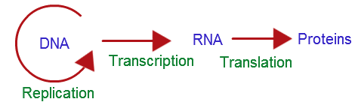
The Central Dogma
Biology Lecture E. Anastasiadou Bioinformatics – Biomedical Data Science 2022-2023

Slide 2
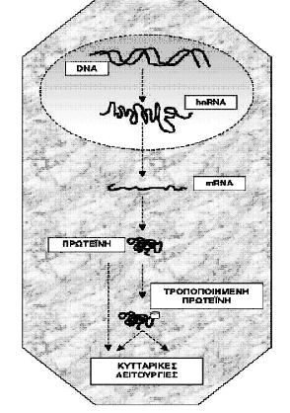
The Central Dogma Of Molecular Biology
DNA acts as a genetic material because it can:
Produce accurate copies to transfer genetic information from one generation of cells and organisms to another.
Determine the composition of the various RNAs and thus the proteins that serve structurally and functionally the cell and therefore the organism.
Biology Lecture E. Anastasiadou Bioinformatics – Biomedical Data Science 2022-2023

Slide 3
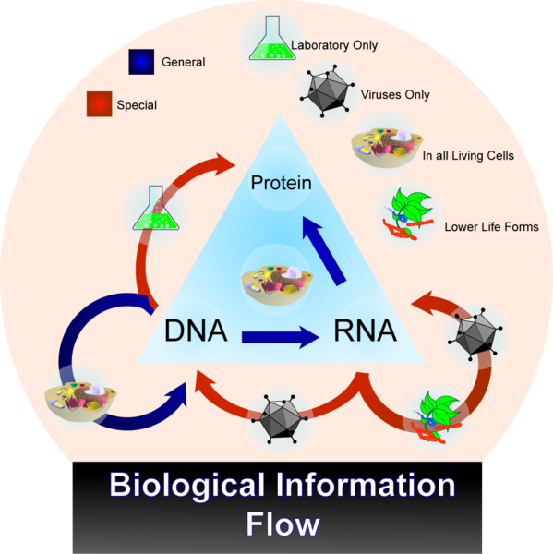
The Central Dogma Of Molecular Biology
The DNA replicates and produces two daughter molecules identical to the original.
DNA is transcribed and produces RNA.
RNA is translated and produces proteins.
exception: some viruses that have as genetic material RNA they make DNA from. This process is called reverse transcription.
Biology Lecture E. Anastasiadou Bioinformatics – Biomedical Data Science 2022-2023

Slide 4
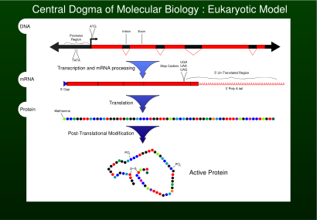
The Central Dogma Of Molecular Biology
DNA (RNA-polymerase)
pre-RNA (Τ->U (uracil))
Pre-RNA (Spliceosome) mRNA
RNA (Ribosome) -> Protein
The process involves the portion of DNA that encodes a gene.
The term gene expression refers to the production of RNA from the gene.
Biology Lecture E. Anastasiadou Bioinformatics – Biomedical Data Science 2022-2023

Slide 5
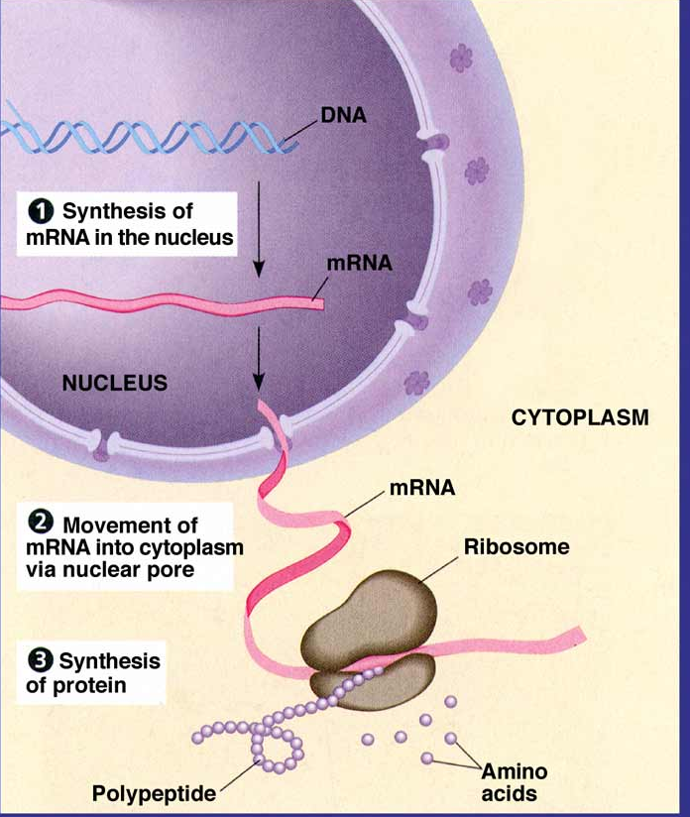
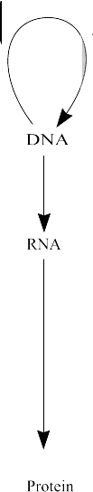
The Central Dogma Of Molecular Biology
Replication
DNA duplicates
4-Letter Code
A,T.G,C
Transcription
RNA synthesis
4-Letter Code
A,U.G,C
Translation
Protein synthesis
20-Letter Code
Amino Acids
Biology Lecture E. Anastasiadou Bioinformatics – Biomedical Data Science 2022-2023

Slide 6
The Central Dogma Of Molecular Biology
Biology Lecture E. Anastasiadou Bioinformatics – Biomedical Data Science 2022-2023

Slide 7
https://www.youtube.com/watch?v=gG7uCskUOrA

Slide 8
The RNA World
Biology Lecture E. Anastasiadou Bioinformatics – Biomedical Data Science 2022-2023

Slide 9
THE RNA WORLD CONCEPT
In primitive Earth's history, about 4 billion years ago, the primary living substance was RNA or something chemically similar.
The main reasoning behind the hypothesis is that RNA is capable of self-replication and could therefore have carried genetic information across generations independently.
Severo Ochoa won the 1959 Nobel Prize in Medicine after he discovered how RNA is synthesized.
In 1967 Carl Woese found the catalytic properties of RNA and speculated that the earliest forms of life relied on RNA both to carry genetic information and
to catalyze biochemical reactions.
This concept has been highly debated in the scientific world over the last 50 years.
Biology Lecture E. Anastasiadou Bioinformatics – Biomedical Data Science 2022-2023
Notes:
The main assumption is there was a period of time in primitive Earth's history — about 4 billion years ago — when the primary living substance was RNA or something chemically similar
The RNA World Hypothesis is a concept put forth in the 1960s by Carl Woese, Francis Crick and Leslie Orgel. It proposes that earlier life forms may have used RNA alone for the storage of genetic material.
Walter Gilbert, a Harvard molecular biologist, was the first to use the term "RNA World" in an article published in 1986. The hypothesis posists that DNA later became the genetic material as a result of evolution because RNA was a relatively unstable molecule. According to the RNA World Hypothesis, around 4 billion years ago, RNA was the primary living substance, largely due to RNA’s ability to function as both genes and enzymes.
The main reasoning behind the hypothesis is that RNA is capable of self-replication and could therefore have carried genetic information across generations independently. This concept has been highly debated in the scientific world over the last 50 years.
Severo Ochoa won the 1959 Nobel Prize in Medicine after he discovered how RNA is synthesized.
In 1967 Carl Woese found the catalytic properties of RNA and speculated that the earliest forms of life relied on RNA both to carry genetic information and to catalyze biochemical reactions.

Slide 10
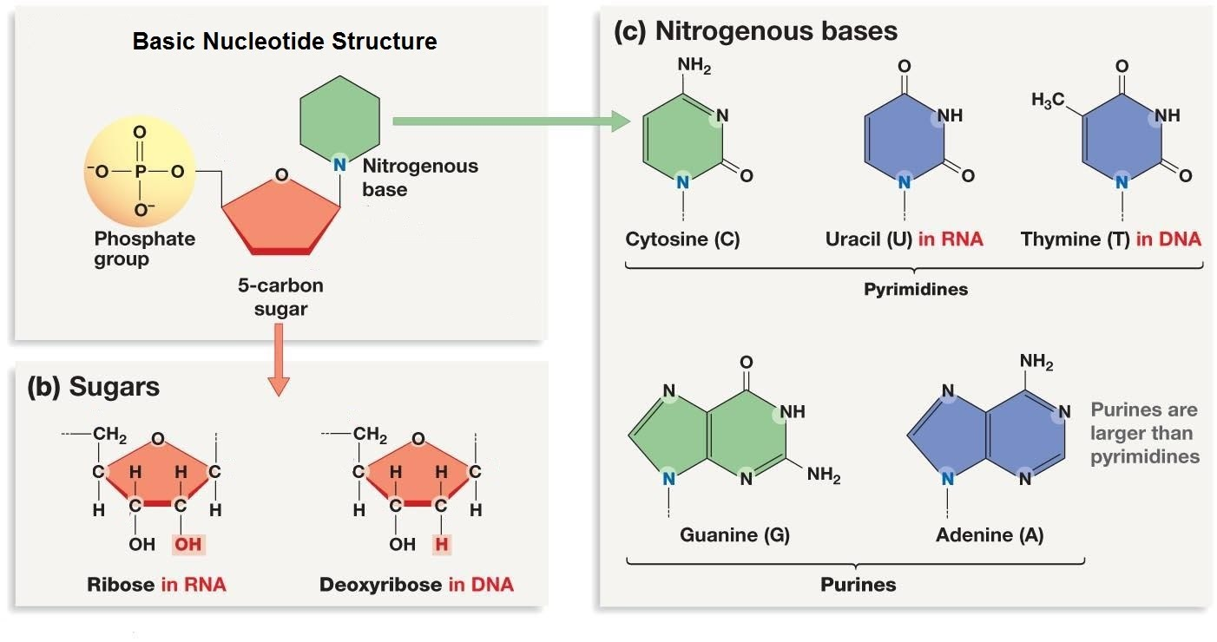
RNA’s CHEMICAL STRUCTURE
RNA contains ribose, characterized by the presence of the 2'-hydroxyl group on the pentose ring making.
RNA is less stable than DNA because it is more susceptible to hydrolysis.
RNA contains the unmethylated form of the base thymine called uracil (U), which gives the nucleotide uridine.
https://socratic.org/questions/547cfe22581e2a232604f27f
Biology Lecture E. Anastasiadou Bioinformatics – Biomedical Data Science 2022-2023

Slide 11
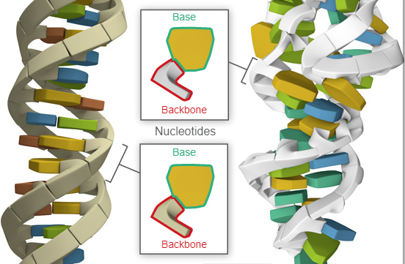
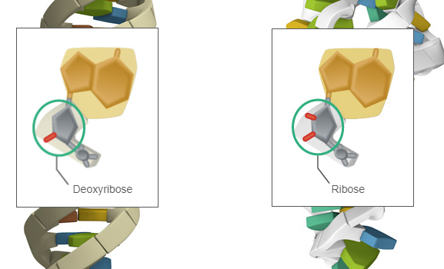
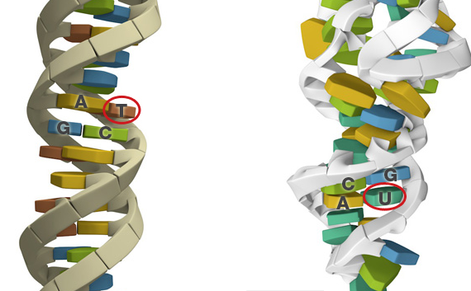
RNA vs DNA
DNA
RNA
They are both made of building blocks called nucleotides.
The backbones of DNA and RNA are slightly different in their chemical makeup:
The bases in DNA are G, C, A, and T.
The bases in RNA are G, C, A, and U.
Ribose in RNA, deoxyribose in DNA.
Nucleotides in both DNA and RNA form complementary base pairs:
C pairs with G
A pairs with T (DNA) or U (RNA).
Biology Lecture E. Anastasiadou Bioinformatics – Biomedical Data Science 2022-2023

Slide 12
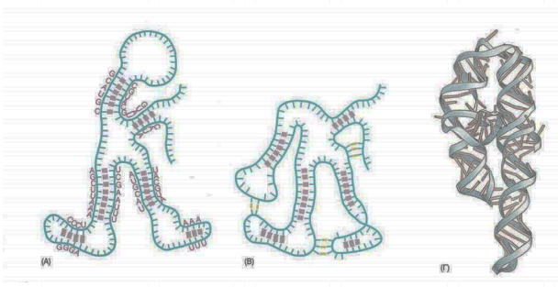
RNA vs DNA
In DNA, each base is paired with another along the entire length of two strands.
In RNA, only some of the bases are paired with their complement, and base-pairing occurs between nucleotides in the same strand.
DNA molecules are huge (typically made up of millions of nucleotides) and have a regular, uniform shape.
RNA molecules are much smaller, typically made up of hundreds or a few thousand nucleotides and have an irregular, varied shape.
Biology Lecture E. Anastasiadou Bioinformatics – Biomedical Data Science 2022-2023

Slide 13
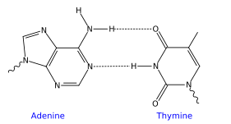
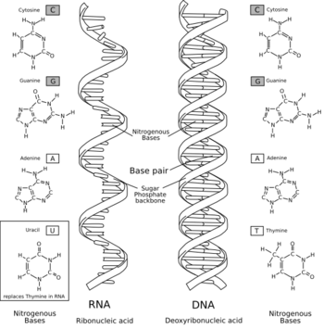
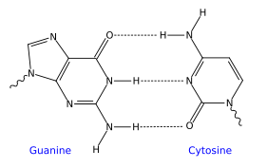
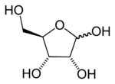
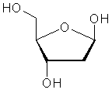
RNA vs DNA
ribose
deoxyribose
Biology Lecture E. Anastasiadou Bioinformatics – Biomedical Data Science 2022-2023

Slide 14
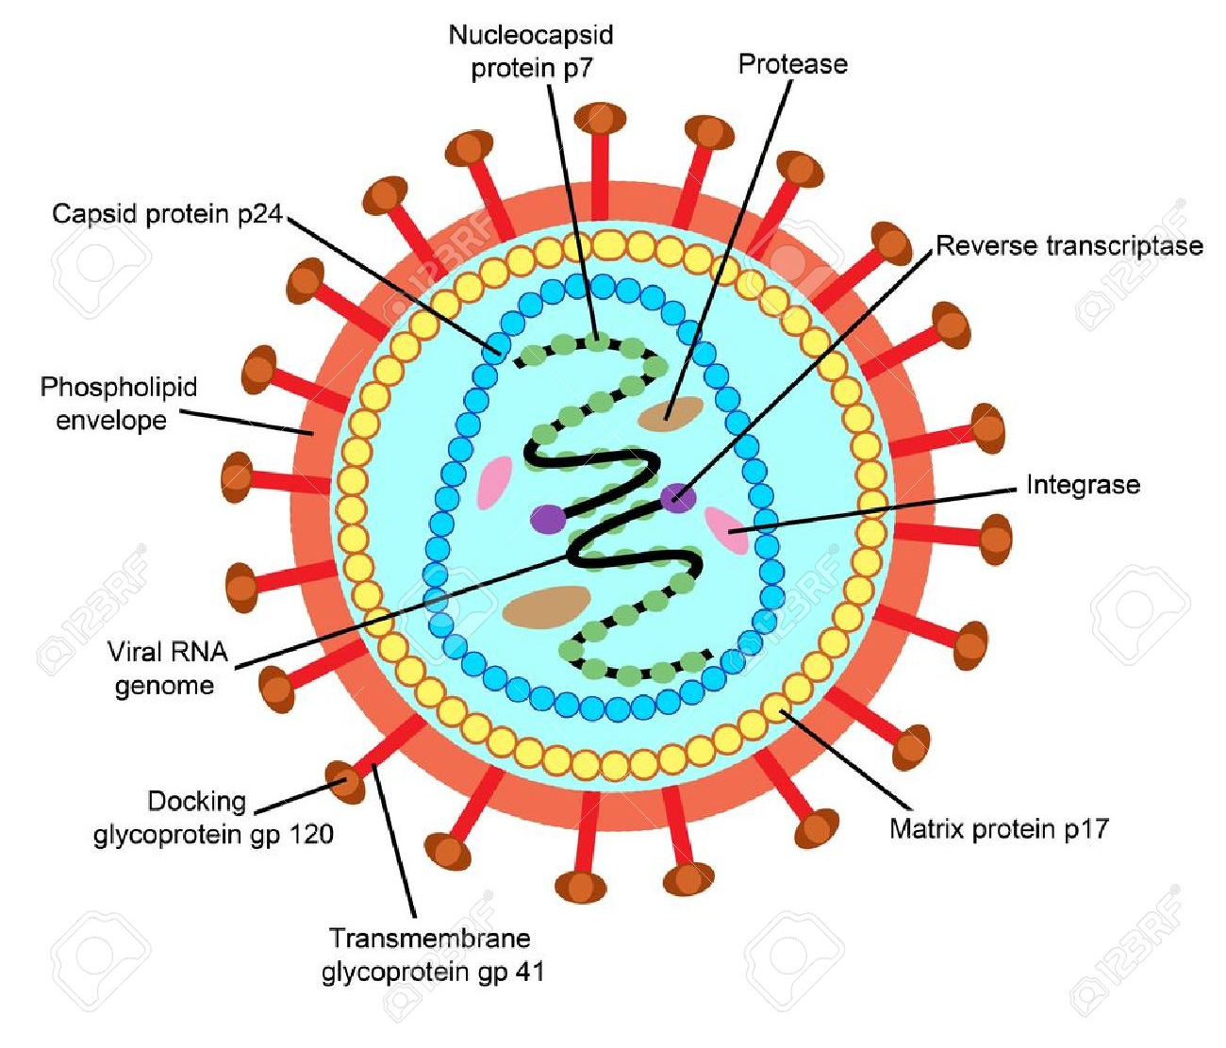
RNA can carry genetic information
Most organisms use DNA to store genetic information.
But some viruses, the retroviruses, such as HIV, use RNA to carry genetic information.
Beyond the Central Dogma
Biology Lecture E. Anastasiadou Bioinformatics – Biomedical Data Science 2022-2023

Slide 15
RNA – other functions
RNA Can Build and Break Molecules
Enzymes are catalysts: they build and break down molecules at a rate quick enough to sustain life. Besides proteins, some RNA molecules can be enzymes too, the so-called ribozymes.
In the ribosome, RNA joins amino acids together, allowing cells to build proteins. Some mRNA molecules contain self-splicing introns, which can break and rejoin the mRNA strand. (Self-splicing occurs for rare introns that form a ribozyme, performing the functions of the spliceosome by RNA alone). A ribozyme in the RNAse P complex activates tRNA molecules by clipping off their ends.
RNA Can Silence Genes (especially viral genome)
Some RNA molecules can silence specific genes, turning off the production of proteins that are not needed at a certain place or time by recognizing specific sequences through complementary base-pairing.
RNA interference is a natural process that cells evolved to destroy RNA-based viruses. Cellular machinery identifies and cuts double-stranded RNA molecules. Then it uses the fragments to find longer complementary RNA strands, which then destroys.
Biology Lecture E. Anastasiadou Bioinformatics – Biomedical Data Science 2022-2023

Slide 16
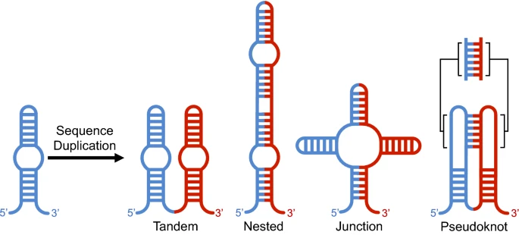
RNA duplication events
RNA duplication can result in
-> multiple secondary structures that retain elements of the original architecture, and thereby maintain or increase the activity of the RNA.
-> structures that disrupt the original functional element and likely result in a non-functional structure.
The potential to form completely different secondary structures that preserve the original functional element, suggests that sequence duplication may be a potent mechanism for the evolution of novel structures.
Biology Lecture E. Anastasiadou Bioinformatics – Biomedical Data Science 2022-2023
Notes:
Duplication of a sequence increases RNA structural plasticity (i.e. the number of available structures of comparable free energy).
This is because parts of the sequence that can base-pair within one copy of a duplicated sequence also have the potential to form base pairs between copies
RNA duplication events -> consequences in folding and RNA evolution

Slide 17
RNA – other functions
RNA Protects the Genome
Some RNAs silence harmful DNA sequences that sit in our genomes as relics of our evolutionary past. Transposons ("jumping genes") and the genes of infecting viruses continue to be passed from parent to offspring. RNAs inactivate viral genes and transposons.
RNA Can Fine-Tune Protein Production
A variety of RNA molecules help the cell to fine-tune when, where, and how much
of a particular mRNA molecule. Regulatory RNAs can act on just about every step of the protein-production process. Some RNAs (called riboregulators) bind DNA switches to turn genes on and off. Others interact directly with mRNA molecules to alter splicing, protect mRNA from harm, or cut it to pieces.
RNA Responds to the Environment
Riboswitches help some cells respond to an external signal, usually a small molecule.
Riboswitches are found on large mRNA molecules, and they fold into intricate shapes.
When the small molecule, such as a metal ion, amino acid, or nucleic acid, binds to the riboswitch, it causes changes in the RNA shape leading to the translation promotion or prevention.
Biology Lecture E. Anastasiadou Bioinformatics – Biomedical Data Science 2022-2023

Slide 18
RNA Therapies and Diagnostics
RNA molecules are used as tools to diagnose and even treat diseases, including cancer, diabetes, arthritis, heart disease, brain diseases, and viral infections.
Misbehaving RNA molecules can also cause diseases, such as Alzheimer's and other neurodegenerative diseases.
Biology Lecture E. Anastasiadou Bioinformatics – Biomedical Data Science 2022-2023

Slide 19
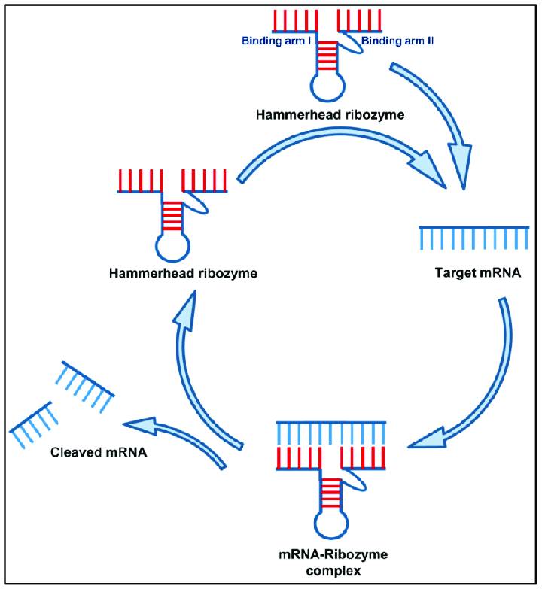
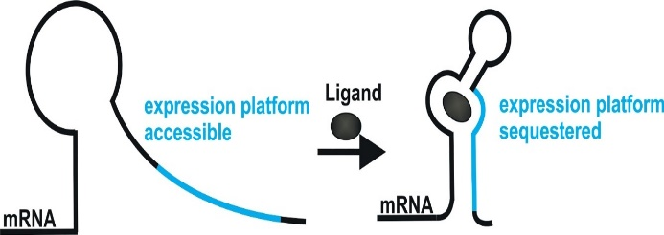
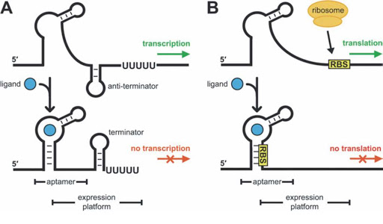
Riboswitches and other RNA sensors
Gene regulation in both prokaryotes and eukaryotes is also affected by RNA regulatory elements, called riboswitches (or RNA switches) or ribozymes. The RNA-based mechanisms are used by cells to regulate gene expression in response to internal and external changes without the initial participation of proteins.
Kim, J. N. Biology of the Cell 2008, 100, (1), 1-11
DOI: 10.3390/jcm8010006
Biology Lecture E. Anastasiadou Bioinformatics – Biomedical Data Science 2022-2023

Slide 20
RIBOSWITCHES
Riboswitches are RNA sensors that detect and respond to environmental or metabolic cues and affect gene expression accordingly.
An example, is the RNA thermosensor found in the virulence genes of the bacterial pathogen Listeria monocytogenes. When this bacterium invades a host, the elevated temperature inside the host's body melts the secondary structure of a segment in the 5' untranslated region of the mRNA produced by the bacterial prfA gene. As a result of this alteration in secondary structure, a ribosome-binding site is exposed, and translation of protein can take place.
Additional riboswitches have been shown to respond to heat and cold shocks in a variety of organisms, as well as to regulate synthesis of metabolites such as sugars and amino acids.
Biology Lecture E. Anastasiadou Bioinformatics – Biomedical Data Science 2022-2023

Slide 21
RIBOZYMES
Ribozymes may play an important role in therapeutic areas, acting as molecules that can tailor specific RNA sequences, serving as biosensors and providing a useful tool in areas such as gene research and functional genomics.
For example, strands of circular ribozymes called viriods have a devastating effect on plants. They have a site, less than 30 nucleotides in length, that has three stems that form a central loop which is referred to as a “hammerhead.” This structure cleaves very specific RNA sequences to release viable RNA daughter strands.
Similar ribozymes could be used to break up RNA viruses and RNA that is required for the transcription and translation of DNA.
Biology Lecture E. Anastasiadou Bioinformatics – Biomedical Data Science 2022-2023

Slide 22
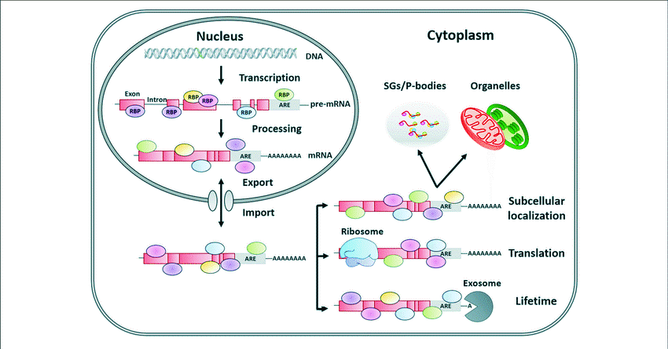
RNA BINDING PROTEINS (RBPs)
RBPs are proteins that bind RNA through one or multiple globular RNA-binding domains (RBDs) and change the fate or function of the bound RNAs.
mRNA localization is critical for regulation of gene expression by allowing spatially regulated protein production. Post-transcriptional regulation of mRNA fate by RNA-binding proteins.
snRNPs are small nuclear ribonucleoproteins (snRNAs associated with proteins).
Biology Lecture E. Anastasiadou Bioinformatics – Biomedical Data Science 2022-2023
Notes:
RBPs are trans-acting elements, that shuttle between the nucleus and the cytoplasm, and influence mRNA fate by binding to regulatory sequences (cis-acting elements).

Slide 23
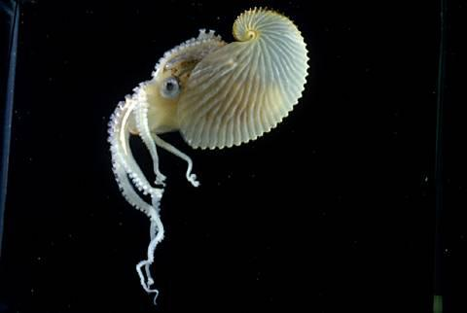
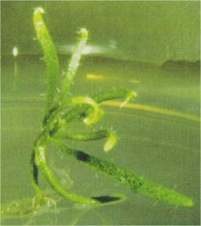
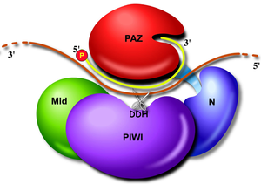
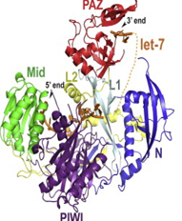
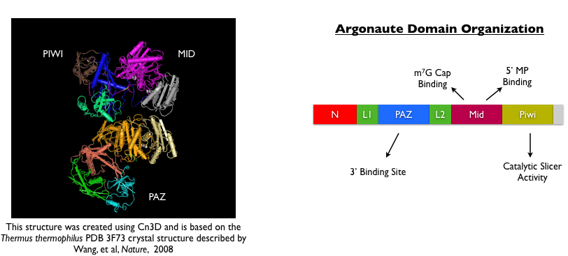
Argonaute Proteins
key players in post-transcriptional regulation
small-RNA guided gene-silencing processes
heterochromatin silencing
mRNA degradation or translation silencing (depending on the complementarity of the target)
Argonaute Domain Organization
Liu J et al., Science 2004
Faehnle C. et al., Cell Reports, 2013
Biology Lecture E. Anastasiadou Bioinformatics – Biomedical Data Science 2022-2023
Notes:
All members of the Argonaute protein family are characterised by four domains: N-terminal, PAZ, Mid, and PIWI. The PAZ domain is conserved and recognises the 3’ end of siRNA and miRNA, and is responsible for the method of regulation chosen after the ncRNA has bound to its mRNA target. Mid contains a MC motif, which is involved in binding 5’ caps and mediates translational control via a mechanism that will be discussed in more detail later. PIWI has RNase activity and functions to degrade the mRNA target.

Slide 24
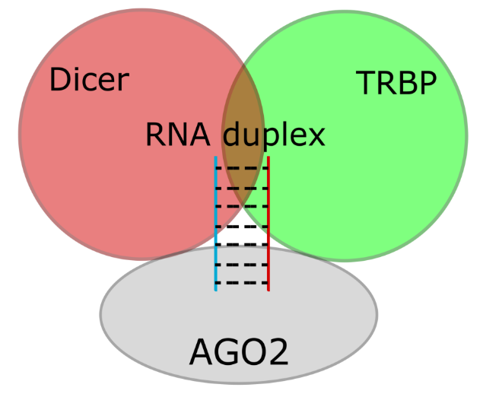
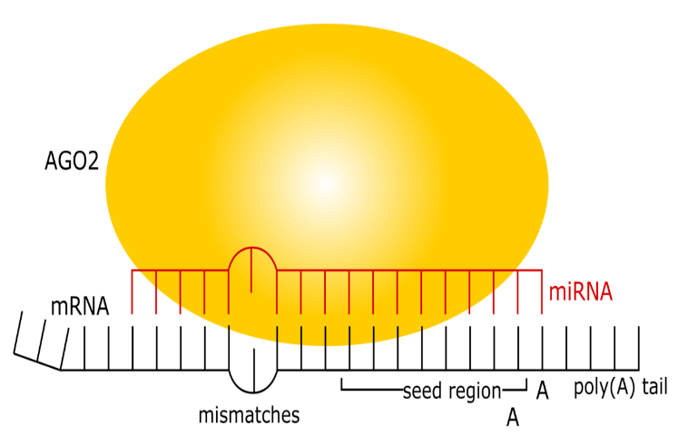
RNA-induced silencing complex (RISC)
RISC is a multiprotein complex that incorporates one strand of a small interfering RNA (siRNA) or micro RNA (miRNA). RISC uses the siRNA or miRNA as a template for recognizing complementary mRNA.
When it finds a complementary strand, it activates RNase and cleaves the RNA. This process is important both in gene regulation by microRNAs and in defense against viral infections, which often use double-stranded RNA as an infectious vector.
https://ysjournal.com/rna-interference-the-molecules-that-govern-genetic-control/
Biology Lecture E. Anastasiadou Bioinformatics – Biomedical Data Science 2022-2023

Slide 25
Classification of RNAs
NON CODING
RNA
CODING
functional
informative
ribosomal RNA (rRNA)
constructs complexes with proteins
crucial for protein translation
transfer RNA (tRNA)
crucial for protein translation
messanger RNA (mRNA)
intermediate in the decoding of genes into proteins
long non coding RNA lncRNA
circular RNAs circRNA
small nuclear RNA snRNA
small nucleolar RNA snoRNA
small Interfering RNA siRNA
microRNA miRNA
RNA modification
RNA silencing
https://www.youtube.com/watch?v=FThA4Vxs3v4
Biology Lecture E. Anastasiadou Bioinformatics – Biomedical Data Science 2022-2023

Slide 26
LONG NON CODING RNA (lncRNA)
lncRNAs are transcripts that are larger than 200 nt and do not encode proteins.
They constitute the largest percentage of the non-transfer code.
There may be in excess of 15,000 lncRNAs.
They make up a heterogeneous group, not well defined as it is the least studied type of non coding RNA.
Their nucleotide sequence is not well preserved, but they can be found in a wide range of organisms (from animals and plants to prokaryotes and viruses).
They are generally expressed in low levels and considered regulators of almost every cellular process.
Their expression appears to be strictly regulated in physiological conditions as well as in several human diseases, including cancer.
https://www.youtube.com/watch?v=VAtmfBD2BsQ
Biology Lecture E. Anastasiadou Bioinformatics – Biomedical Data Science 2022-2023

Slide 27
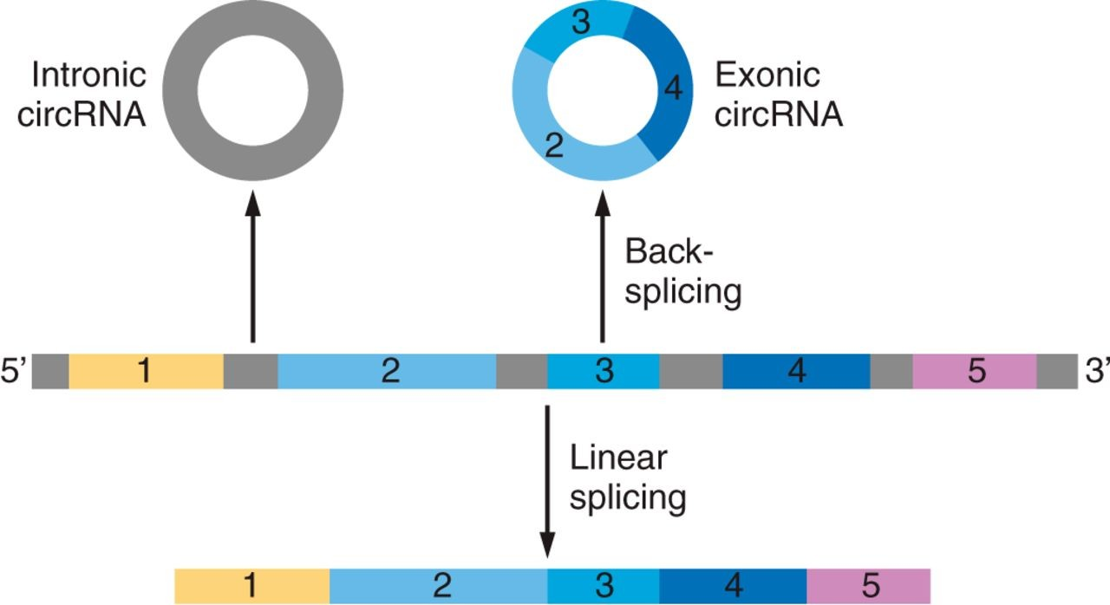
circular RNAs (circRNAs)
They are circular RNA molecules.
They are highly represented in the eukaryotic transcript, with the presence of thousands of endogenous circRNAs in mammalian cells.
Their size can range from 100 nt to over 4 kb.
They are extremely stable due to the absence of exposed limbs which are prone to nucleolytic degradation.
They act
as regulators of splicing and transcription,
as modifiers of parental gene expression, and as microRNA sponges (miRNAs).
DOI: (10.1152/physrev.00041.2015)
They are involved in the risk of atherosclerotic vascular disease, neurological disorders, sawdust and cancer.
Biology Lecture E. Anastasiadou Bioinformatics – Biomedical Data Science 2022-2023

Slide 28
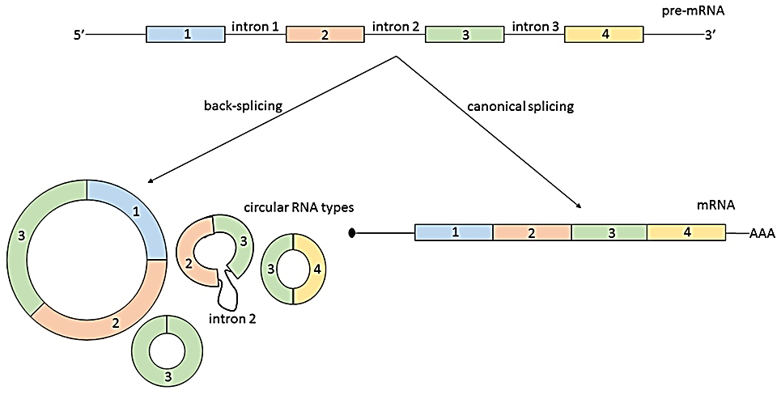
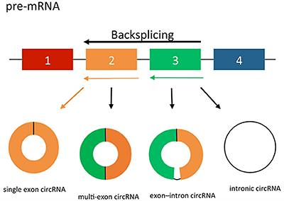
circular RNAs (circRNAs)
Five general types of RNA circles have been identified including viroids, intermediates in RNA processing reactions, and products of spliceosomal back splicing of normal nuclear
pre-mRNAs in eukaryotes.
Viroids are small single-stranded, circular RNAs discovered in the 1970s, that are infectious pathogens. Unlike viruses, they have no protein coating. They are inhabitants of angiosperms. Viroids have been recognized as new order of subviral agents.
Biology Lecture E. Anastasiadou Bioinformatics – Biomedical Data Science 2022-2023
Notes:
In addition to the classic tRNA, mRNA, and rRNAs, cells contain a striking diversity of additional RNA types including miRNAs, lncRNAs, piRNAs, siRNAs, tmRNAs, sRNAs, tiRNAs, eRNAs, snoRNAs, snRNAs, and other noncoding RNAs. A growing component of this family of diverse RNA molecules is the increasing numbers and types of circular RNAs.

Slide 29
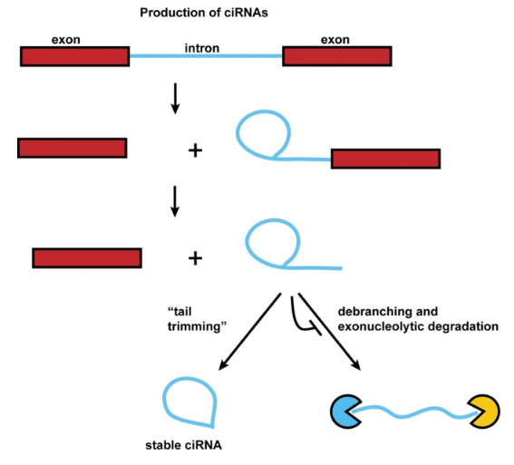
Production of ciRNAs
Circular intronic RNAs are produced by eukaryotic spliceosome-mediated splicing.
The intron-sequence generated from the splicing reaction evades normal debranching and degradation, and instead the 3′-tail downstream from the branchpoint is trimmed resulting in a stable ciRNA.
Biology Lecture E. Anastasiadou Bioinformatics – Biomedical Data Science 2022-2023

Slide 30
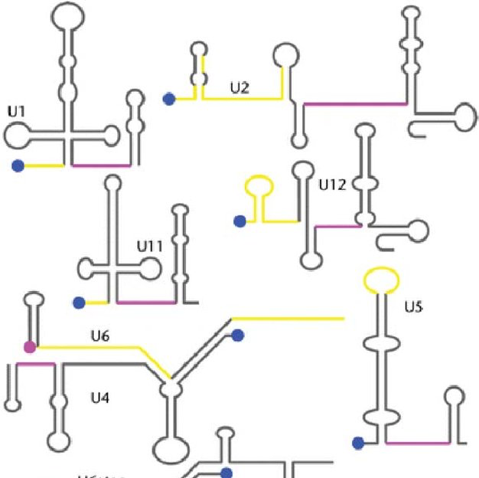
Small nuclear RNA (snRNA)
snRNAs were the first family of ncRNAs to be identified.
They are usually about 150 nt long.
They are located into the nucleus and they have a cytoplasmic phase.
There are two classes of snRNAs: sm-class snRNA (U1, U2, U4, U5, U7, U11, U12) and Lsm-class (U6) snRNA and are high in Uridine.
Sm-class is transcribed with RNA polymerase II while Lsm with RNA polymerase III before maturation in the nucleus.
They appear to be involved in protein synthesis, regulation of RNA polymerase II or other transcription factors, and telomere maintenance.
They are components of the spliceosome for the processing / splicing of pre-mRNA (post-transcriptional modification of mRNA).
Biology Lecture E. Anastasiadou Bioinformatics – Biomedical Data Science 2022-2023

Slide 31
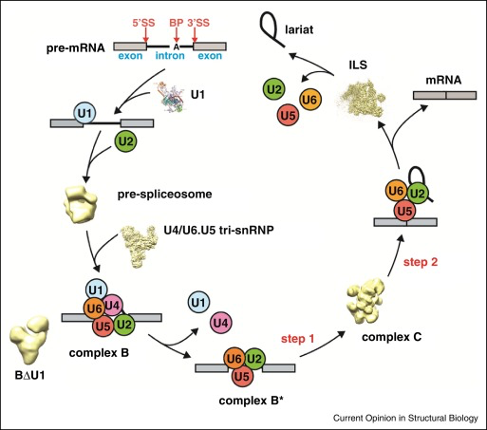
Small nuclear RNA (snRNA)
Biology Lecture E. Anastasiadou Bioinformatics – Biomedical Data Science 2022-2023

Slide 32
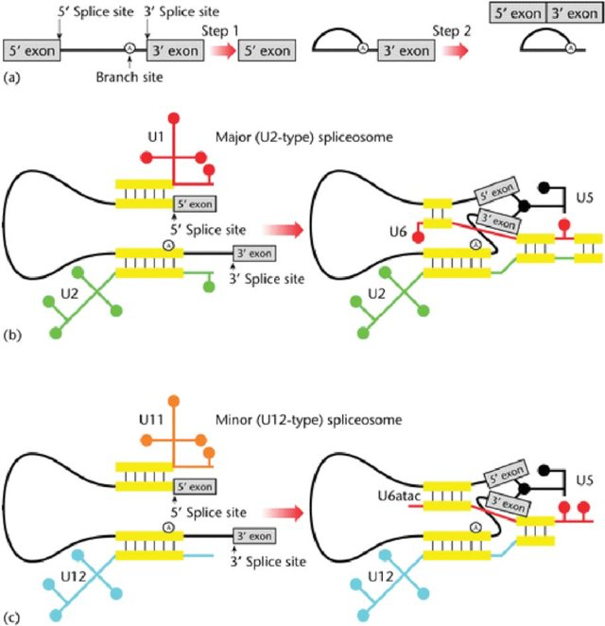
Small nuclear RNA (snRNA)
Biology Lecture E. Anastasiadou Bioinformatics – Biomedical Data Science 2022-2023

Slide 33
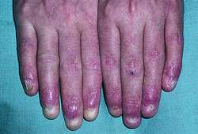

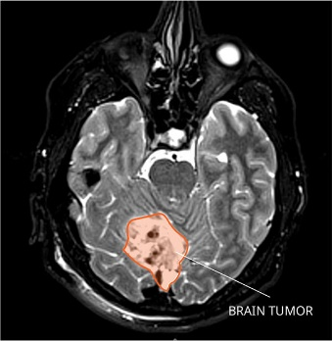
MEDICAL CONDITIONS DUE TO snRNAs MALFUCTION
Dyskeratosis congenita – Mutations in the assembled snRNPs are a cause of dyskeratosis congenita, a rare syndrome that presents by abnormal changes in the skin, nails and mucous membrane
Prader–Willi syndrome –affects as many as 1 in 12,000 people and has a presentation of extreme hunger, cognitive and behavioral problems, poor muscle tone and short stature. It has been linked to the deletion of a region of paternal chromosome 15 that is not expressed on the maternal chromosome. This region includes a brain-specific snRNA that targets the serotonin-2C receptor mRNA.
Medulloblastoma – The U1 snRNA is mutated in a subset of these brain tumors, and leads to altered RNA splicing. The mutations predominantly occur in adult tumors, and are associated with poor prognosis.
Biology Lecture E. Anastasiadou Bioinformatics – Biomedical Data Science 2022-2023

Slide 34
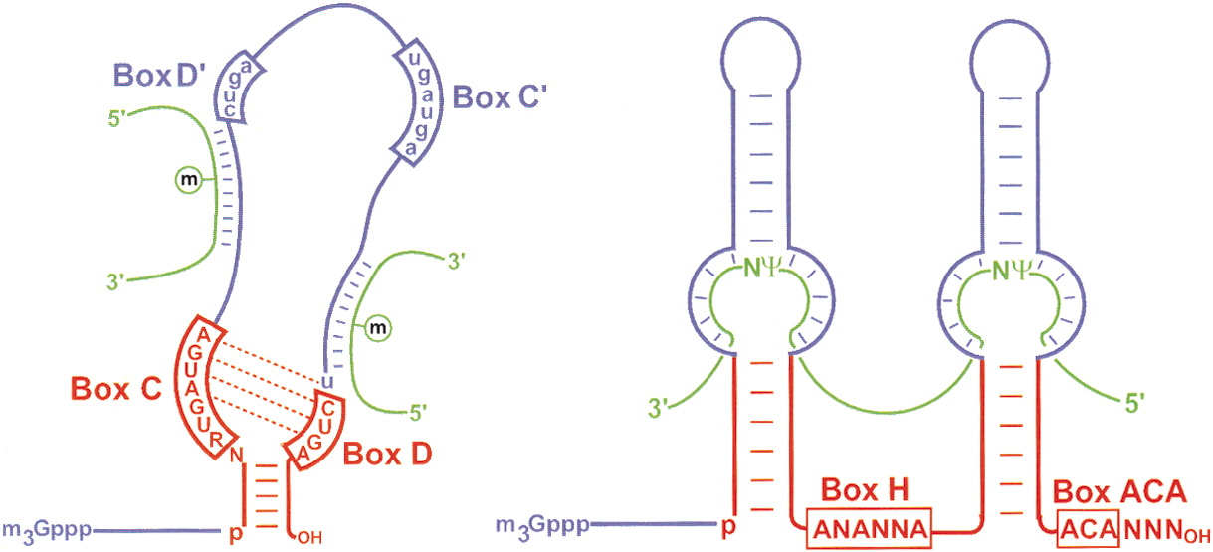
Small nucleolar RNAs (snoRNAs)
A huge number of RNA molecules, 60 to 300 nucleotides long, metabolically stable, called small nuclear RNAs (snoRNAs).
They are located in the nucleolus and the Cajal bodies of eukaryotic cells (the major sites of RNA synthesis).
Their biogenesis is interesting, as most snoRNAs are derived from introns, proving that introns can encode functional RNAs.
There are two main families of snoRNAs, one containing molecules with C / D motifs and the other H / ACA.
DOI: (10.1016/S0092-8674(02)00718-3)
They bind to a set of proteins to form small nuclear RNPs (snoRNPs). They play an essential role in the nucleolytic processing of rRNAs, but mainly in the post-transcriptional synthesis of 2D-O-methylated nucleotides and pseuridins in rRNAs, snRNAs and possibly other cellular RNAs. It also directs telomere DNA synthesis that provides stability to chromosomes.
Biology Lecture E. Anastasiadou Bioinformatics – Biomedical Data Science 2022-2023

Slide 35
microRNA (miRNA)
Non-coding RNAs found only in eukaryotic cells.
They are produced within the cell, transcribed by RNA pol II, from individual miRNA genes, introns of protein-coding genes, or polycistronic clusters of closely related miRNA genes.
The first miRNA (lin-4) was discovered in C. elegans in 1993.
Since then, more than 2000 miRNAs are identified in human cells.
Their mechanism of action seems to be very ancient developmentally, since it has been detected in all plant and animal systems in various forms, even in viruses.
About 50% of the annotated human miRNAs map within fragile sites of chromosomes, which are areas of the genome that are associated with various human cancers.
Gene therapies using miRNAs might be an effective for blocking tumor progression, such as let7 that negatively regulate the Ras oncogenes.
Biology Lecture E. Anastasiadou Bioinformatics – Biomedical Data Science 2022-2023

Slide 36
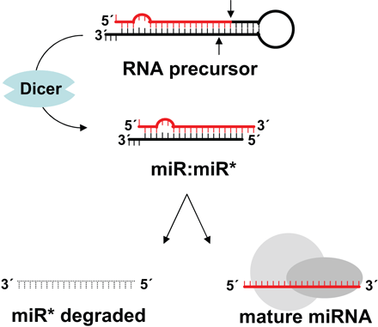
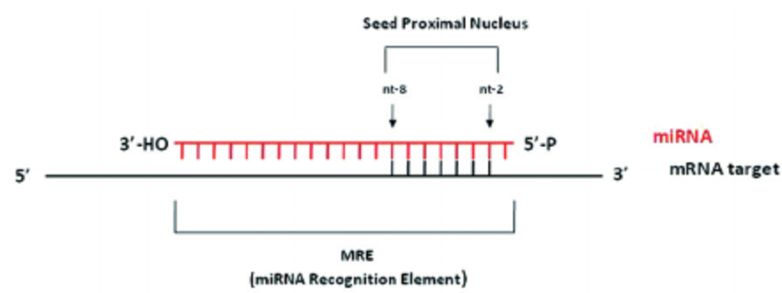
microRNA (miRNA)
Pri-miRNAs are large molecules of several thousand bases in length while mature miRNA is 22 nts. Pri-miRNAs may contain more than one miRNA.
miRNAs bind to their cognate target RNA through RNA-RNA base pairing that involves not only the Watson-Crick A:U and G:C pairs but also the G:U pair.
miRNAs show complementarity only in a critical region of 2-8 bases in the 5’ region called “seeds”. Therefore, it is possible for some miRNAs to be combined with hundreds of high- and low-affinity mRNA targets, and vice versa, many different miRNAs can target a single mRNA (many-to-one).
https://www.researchgate.net/publication/49827137_MicroRNAs_A_newly_described_class_of_encoded_molecules_that_play_a_role_in_health_and_disease
Biology Lecture E. Anastasiadou Bioinformatics – Biomedical Data Science 2022-2023

Slide 37
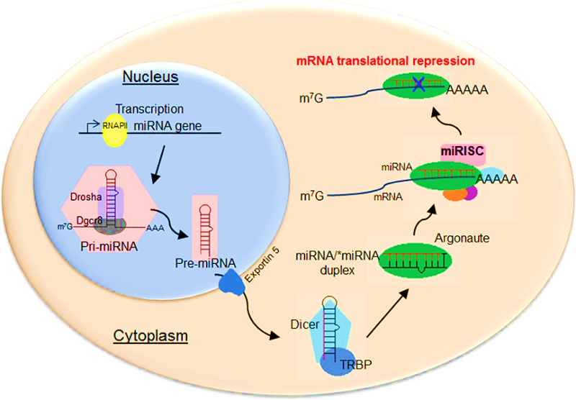
Canonical miRNA biogenesis
Transcribed by RNA Polymerase II as a long transcript (pri-miRNAs).
Into the nucleus, pri-miRNAs are processed to
hairpin-like pre-miRNAs by
RNAse III-like enzyme Drosha and DGCR8.
3. Pre-miRNAs are exported to the cytosol
by Exportin 5.
4. In the cytosol RNAse III-like Dicer
processes these precursors to mature miRNAs.
5. miRNAs are incorporated in RISC.
6. miRNAs with imperfect base pairing to the target mRNA, lead to translational repression and/or mRNA degradation.
Biology Lecture E. Anastasiadou Bioinformatics – Biomedical Data Science 2022-2023

Slide 38
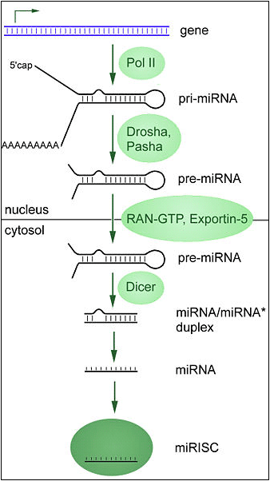
microRNA (miRNA)
Processed in the nucleus by a "microprocessor complex" containing a ribonuclease specific for double stranded RNA, known as Drosha and its partner Pasha, to produce precursor hairpin structures, "pre-miRNAs»
They are transferred to the cytoplasm by Exportin-5.
Cutting from the Dicer endonuclease results in a double-stranded miRNA which is then integrated into an RNA-induced “silencing” complex (RISC).
A miRNA strand is selected and matures while the other is degraded.
Active miRNAs down-regulate gene expression by translational repression and/or mRNA degradation by RISC in a similar way to short interfering RNA (siRNA).
Biology Lecture E. Anastasiadou Bioinformatics – Biomedical Data Science 2022-2023

Slide 39
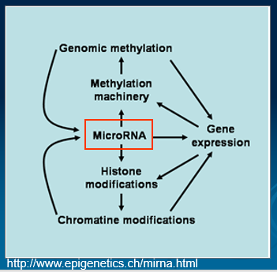
microRNA (miRNA)
https://www.youtube.com/watch?v=t5jroSCBBwk
https://www.youtube.com/watch?v=cK-OGB1_ELE
https://www.youtube.com/watch?v=5YsTW5i0Xro
Biology Lecture E. Anastasiadou Bioinformatics – Biomedical Data Science 2022-2023

Slide 40
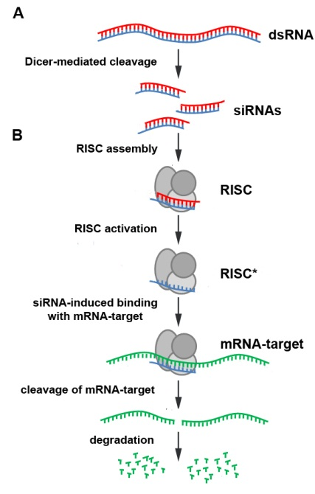
siRNAs
The most widely distributed among the known eukaryotic small RNAs are artificially synthesized double-stranded RNA molecules.
The mature molecule is 20 – 27 nt long.
They elicit RNAi response upon binding to their target transcript based on the sequence complementarity.
Function: RNA silencing and post-transcriptional regulation of gene expression.
Biology Lecture E. Anastasiadou Bioinformatics – Biomedical Data Science 2022-2023

Slide 41
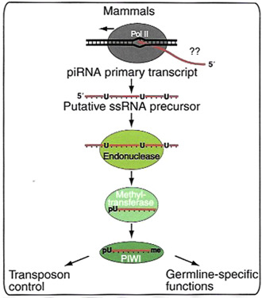
Piwi-interacting RNAs (piRNAs)
24-30 nt length
Piwi-interacting RNAs bind the PIWI subfamily proteins.
They are involved in maintaining genome stability in germline cells. Piwi-interacting RNAs play a role in gametogenesis.
They regulate gene expression and silencing transposable elements.
https://ysjournal.com/rna-interference-the-molecules-that-govern-genetic-control/
Biology Lecture E. Anastasiadou Bioinformatics – Biomedical Data Science 2022-2023

Slide 42
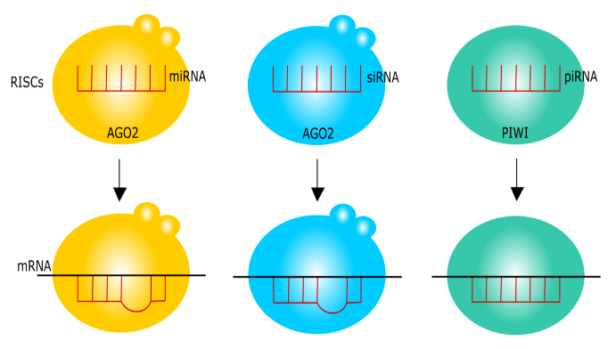
miRNA vs siRNA
While miRNAs originated from pri-miRNAs, source of siRNAs is double-stranded RNAs.
While miRNAs have the ability to regulate dozens or even hundreds of gene targets through imperfect base pairing, siRNAs bind specifically to a single gene location.
This feature has promoted development of molecular tools and therapies using siRNA since the mechanism was shown to promote specific RNA interference (RNAi) in mammalian cells
Both siRNAs and miRNAs associate with Dicer and Argonaute, whereas some siRNAs and piRNAs share functions to suppress transposons as mentioned in later sections.
Biology Lecture E. Anastasiadou Bioinformatics – Biomedical Data Science 2022-2023

Slide 43
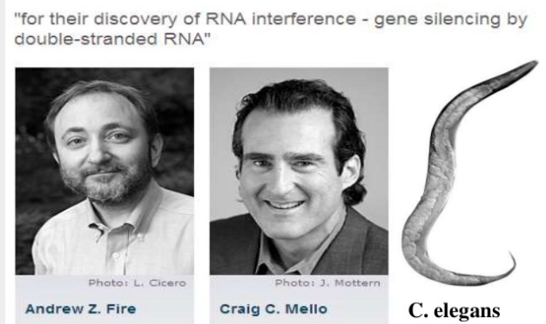
Short hairpin RNA (shRNA)
It is an artificial RNA molecule with a tight hairpin turn.
It can be used to silence target gene expression via RNA interference (RNAi).
Nobel Prize in Physiology/Medicine 2006
"for their discovery of RNA interference - gene silencing by double-stranded RNA."
Andrew Z. Fire
Craig C. Mello
The shRNA sequences usually encoded in a DNA vector that can be introduced into cells via plasmid transfection or viral transduction. shRNA molecules can be divided into two main categories based on their designs: simple stem-loop and microRNA-adapted shRNA.
Biology Lecture E. Anastasiadou Bioinformatics – Biomedical Data Science 2022-2023

Slide 44
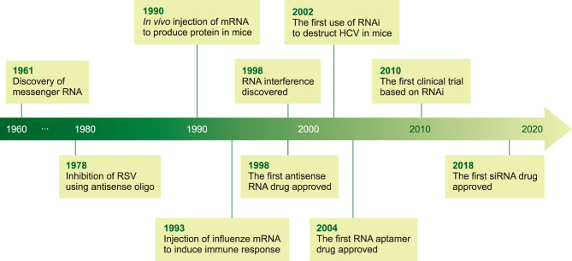
RNA Therapies and Diagnostics
Biology Lecture E. Anastasiadou Bioinformatics – Biomedical Data Science 2022-2023

Slide 45
http://www.youtube.com/watch?v=AfXmDAqgFIg&feature=related
http://www.youtube.com/watch?v=gZZyxVP02UU&feature=related
Biology Lecture E. Anastasiadou Bioinformatics – Biomedical Data Science 2022-2023

