Slide 1
THE CELL
Biology Lecture E. Anastasiadou Bioinformatics – Biomedical Data Science 2021-2022

Slide 2
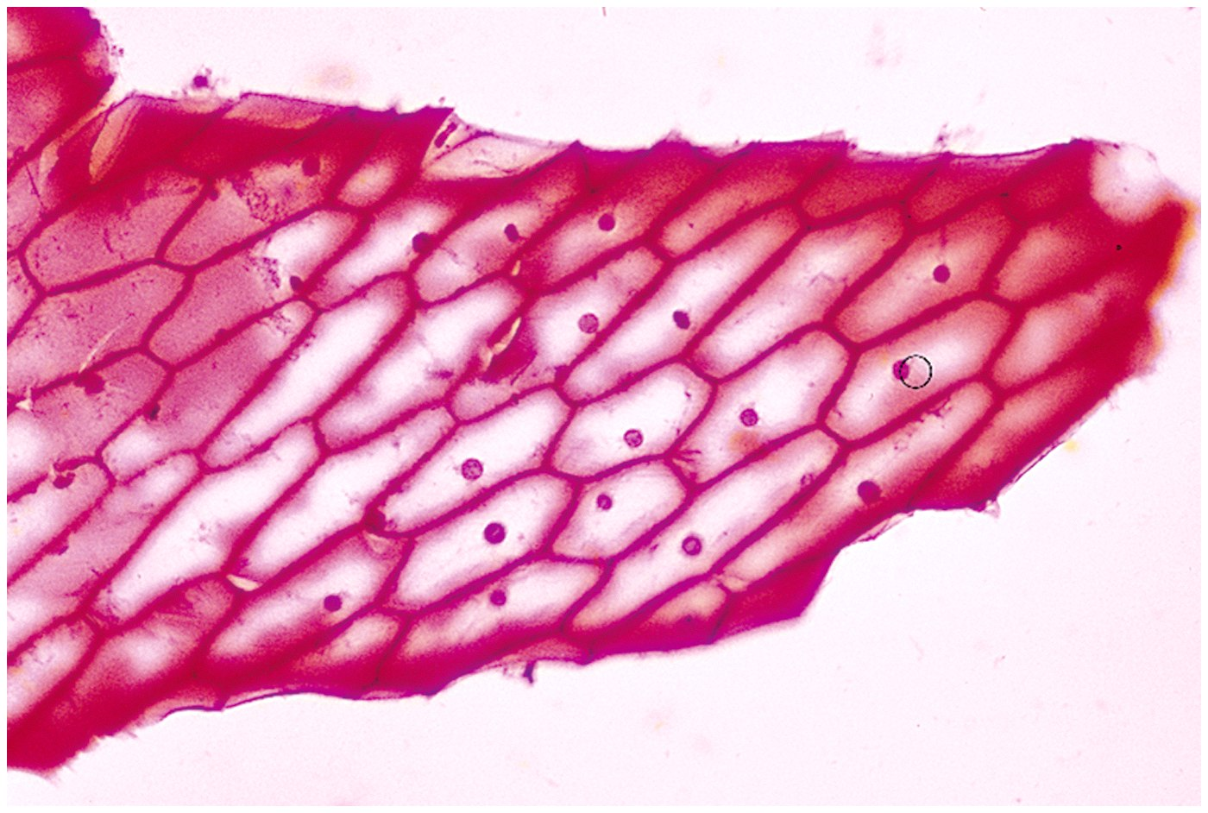
PRINCIPLES OF CELL THEORY
Robert Hooke, in the mid-1600s, observing cork bark, saw formations that simulated empty boxes and introduced the term "cell."
All living beings are composed of cells.
The smallest structural and functional unit of life of all organisms is the cell.
All cells are derived from pre-existing cells.
Biology Lecture E. Anastasiadou Bioinformatics – Biomedical Data Science 2021-2022

Slide 3
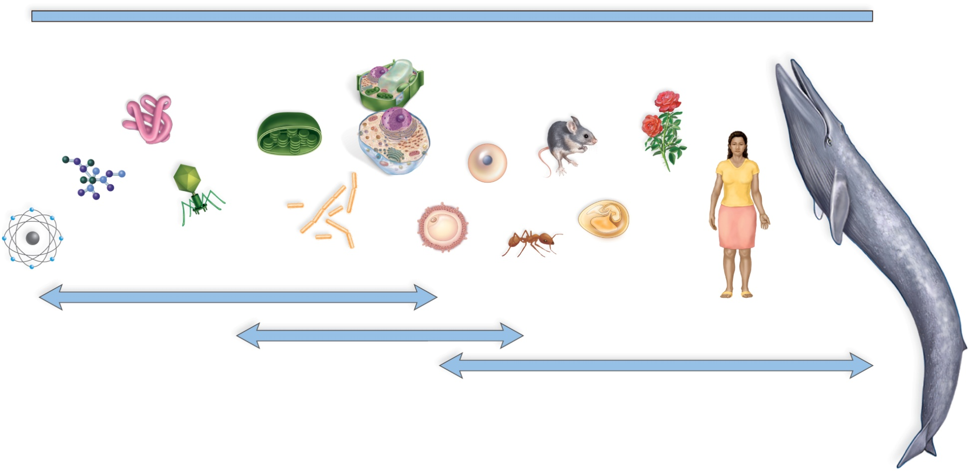
SIZE OF ORGANISMS
Copyright © The McGraw-Hill Companies, Inc. Permission required for reproduction or display.
0.1 nm
1 nm
10 nm
100 nm
1
m
10
m
100
m
1 mm
1 cm
0.1 m
1 m
10 m
100 m
1 km
protein
chloroplast
plant and
animal
cells
mouse
rose
frog egg
amino
acid
virus
most bacteria
human egg
ostrich
egg
ant
atom
blue whale
electron microscope
human
light microscope
human eye
Unicellular: organisms that consist of individual cells, able to survive and reproduce.
Multicellular: organisms that consist of cooperating cells, with different specialties.
Biology Lecture E. Anastasiadou Bioinformatics – Biomedical Data Science 2021-2022

Slide 4
COMPARISON OF PROKARYOTIC & EUKARYOTIC CELL
Classified in:
bacteria and archaea.
They are lacking a delimited by a membrane, nucleus.
Structurally smaller and simpler than eukaryotic cells.
They may live in extreme habitats.
They are classified into:
fungi, plants, animals.
The nucleus is delimited by a membrane.
Larger in size than prokaryotes, with specialized organelles.
Certain cells (e.g., plant) have a cell wall.
Biology Lecture E. Anastasiadou Bioinformatics – Biomedical Data Science 2021-2022

Slide 5
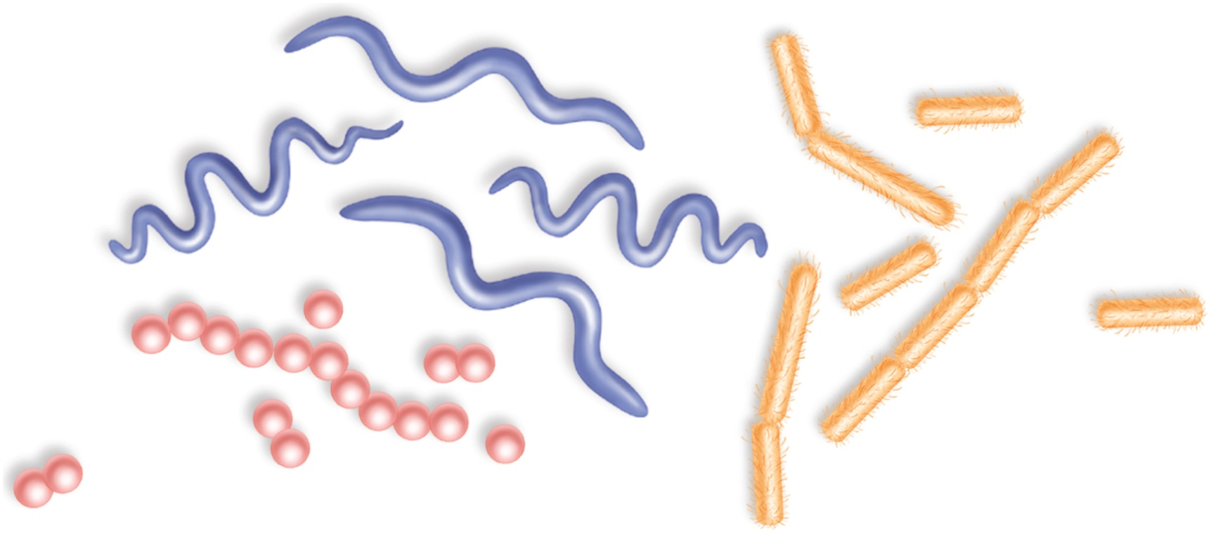
CHARACTERISTICS OF A PROKARYOTIC CELL
Extremely small size (1-1.5 μm wide and 2-6 μm long).
granular, bacillus, spirillum (stiff) or spirocheite (flexible).
spirillum
spirochete
bacillus
coccus
The cellular envelope includes:
- plasma membrane (protein lipid bilayer).
- cell wall that maintains the shape of the cell and is strengthened by peptidoglycan.
- Glycocalyx, a layer of polysaccharides on the outside of the cell wall that contributes to the organization and resistance of the capsule.
Biology Lecture E. Anastasiadou Bioinformatics – Biomedical Data Science 2021-2022

Slide 6
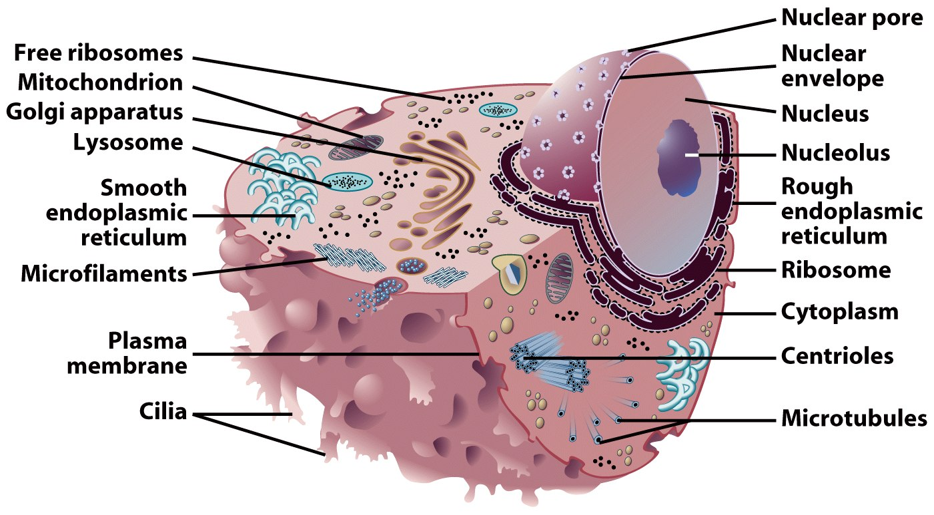
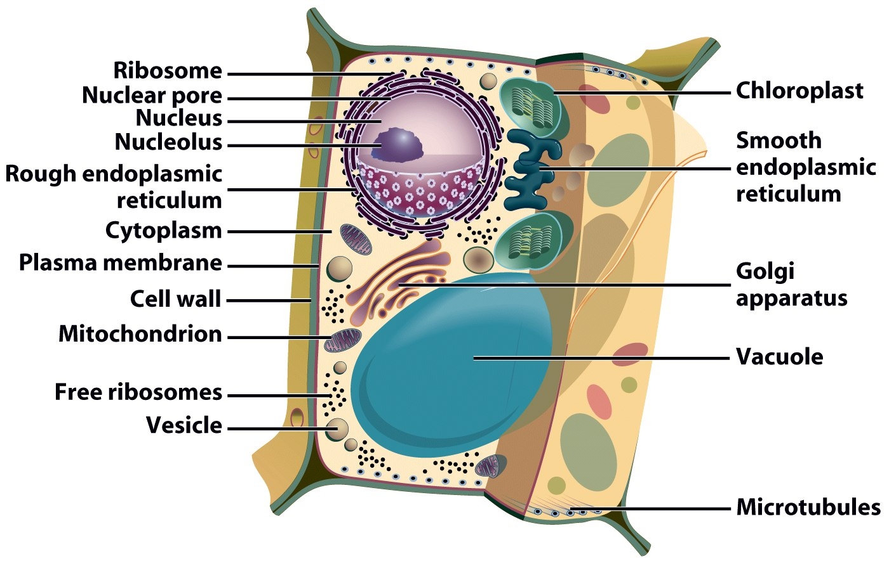
CHARACTERISTICS OF A EUKARYOTIC CELL
Eukaryotic cells are compartmentalized and contain small structures called organelles that perform certain functions and are usually defined by membranes.
There are two types of organelles:
- Energy-related organelles such as mitochondria and chloroplasts.
They are relatively independent and self-sufficient.
- Organelles constituting the intermembrane system.
They communicate with each other through membrane networks and small vesicles.
ANIMAL CELL
PLANT CELL
Biology Lecture E. Anastasiadou Bioinformatics – Biomedical Data Science 2021-2022

Slide 7
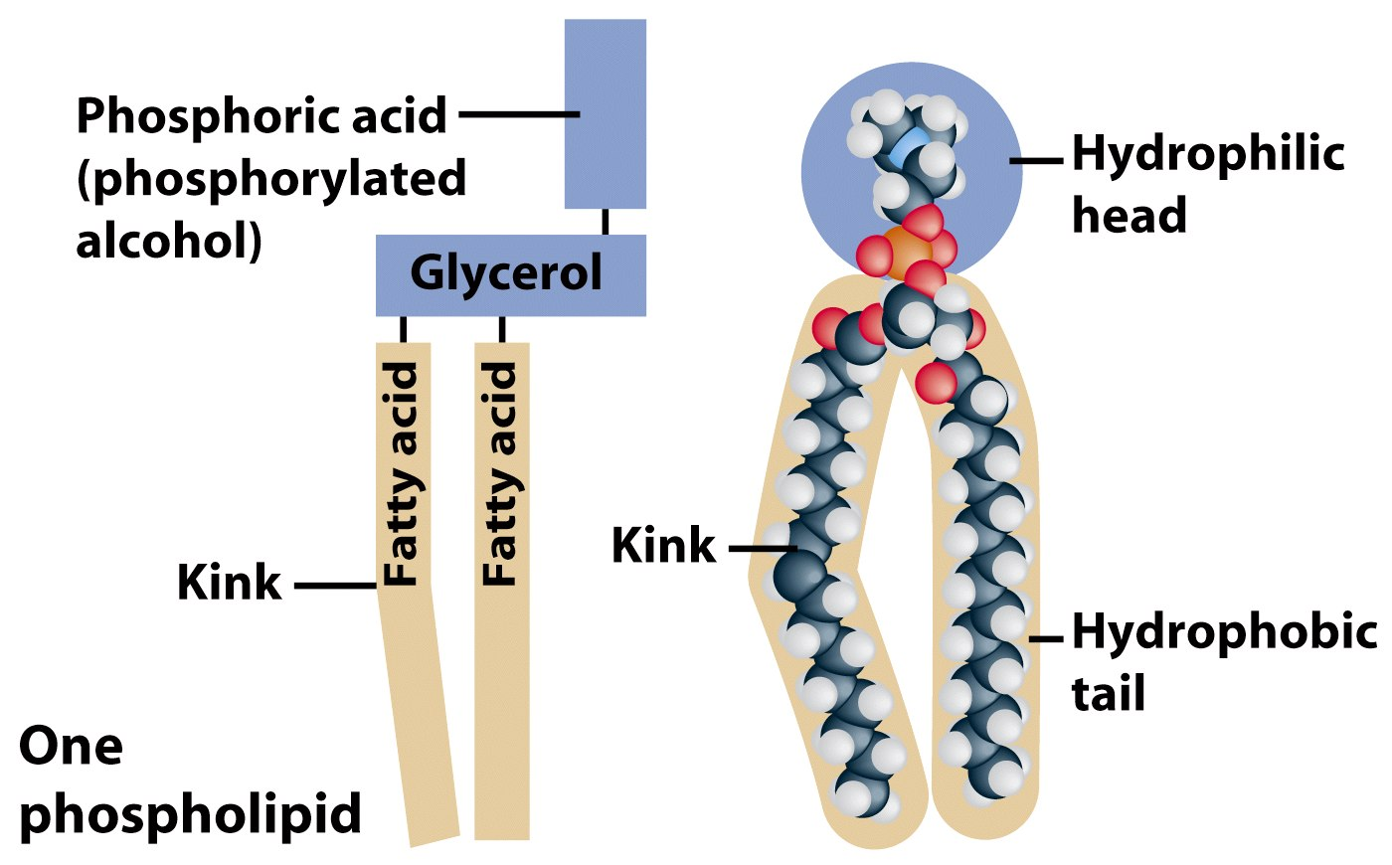
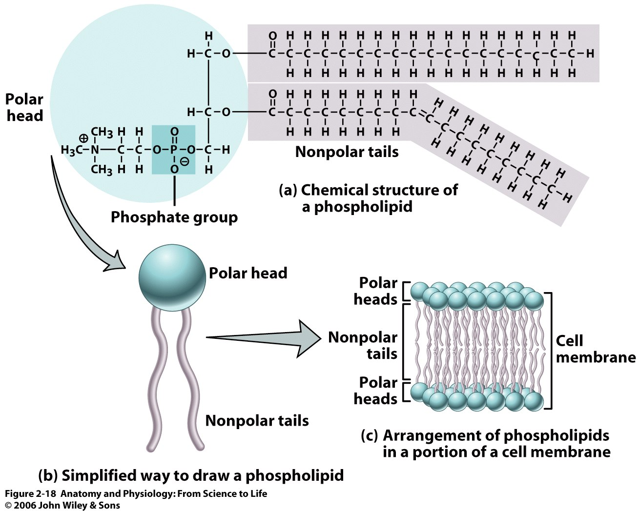
MEMBRANES – LIPIDS
Amphibious molecules with:
hydrophilic (polar) head and
hydrophobic, aliphatic chain (tail)
Biology Lecture E. Anastasiadou Bioinformatics – Biomedical Data Science 2021-2022

Slide 8
MEMBRANES – LIPIDS
Saturated: C-C single bonds (tail can extend freely)
Unsaturated: one or more C-C double bonds
Three types of lipids:
- phospholipids: a (+) charged group is linked via a (–) phosphate group to the rest of the molecule.
- glycolipids: characterized by the presence of oligosaccharide head.
- sterols: contain a planar steroid ring, providing rigidity to a membrane.
Biology Lecture E. Anastasiadou Bioinformatics – Biomedical Data Science 2021-2022

Slide 9
BIOLOGICAL MEMBRANE
The Liquid Mosaic model describes the volatile nature of the lipid - protein bilayer.
oligosaccharids
proteins
Phospholypid bilayer
Organization: delineates the cell and organizes cellular organelles.
Protection.
Identification: there are cell-specific markers.
Communication: recognizes one cell the other and transfers components.
Biology Lecture E. Anastasiadou Bioinformatics – Biomedical Data Science 2021-2022

Slide 10
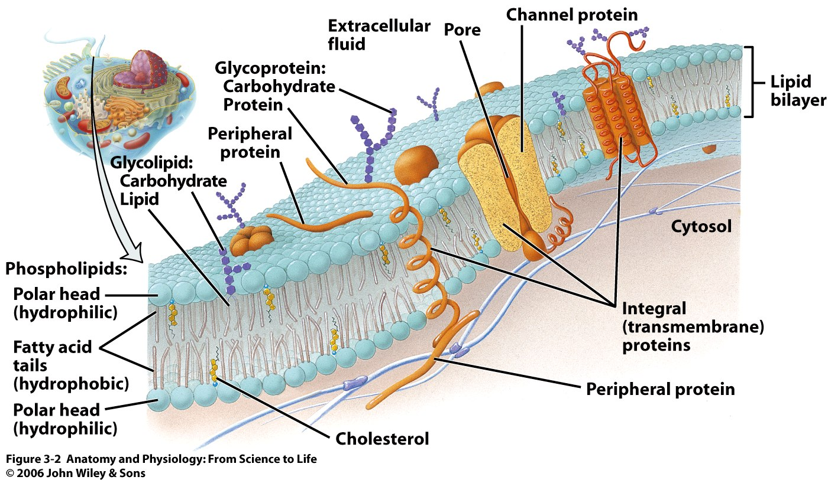
MEMBRANE PROTEINS
Few molecules move freely: water, carbon dioxide, ammonia, oxygen.
Protein-carriers carry some molecules. These proteins are incorporated into the lipid bilayer.
Channels or Carriers
Trafficking of molecules in one direction.
Receptors
They recognize certain chemicals.
Glycoproteins
Identify the cell type.
Enzyme
They catalyze various substrates.
Biology Lecture E. Anastasiadou Bioinformatics – Biomedical Data Science 2021-2022

Slide 11
Cell membrane
http://www.youtube.com/watch?v=Qqsf_UJcfBc&feature=related
http://www.youtube.com/watch?v=GW0lqf4Fqpg&feature=related
Biology Lecture E. Anastasiadou Bioinformatics – Biomedical Data Science 2021-2022

Slide 12
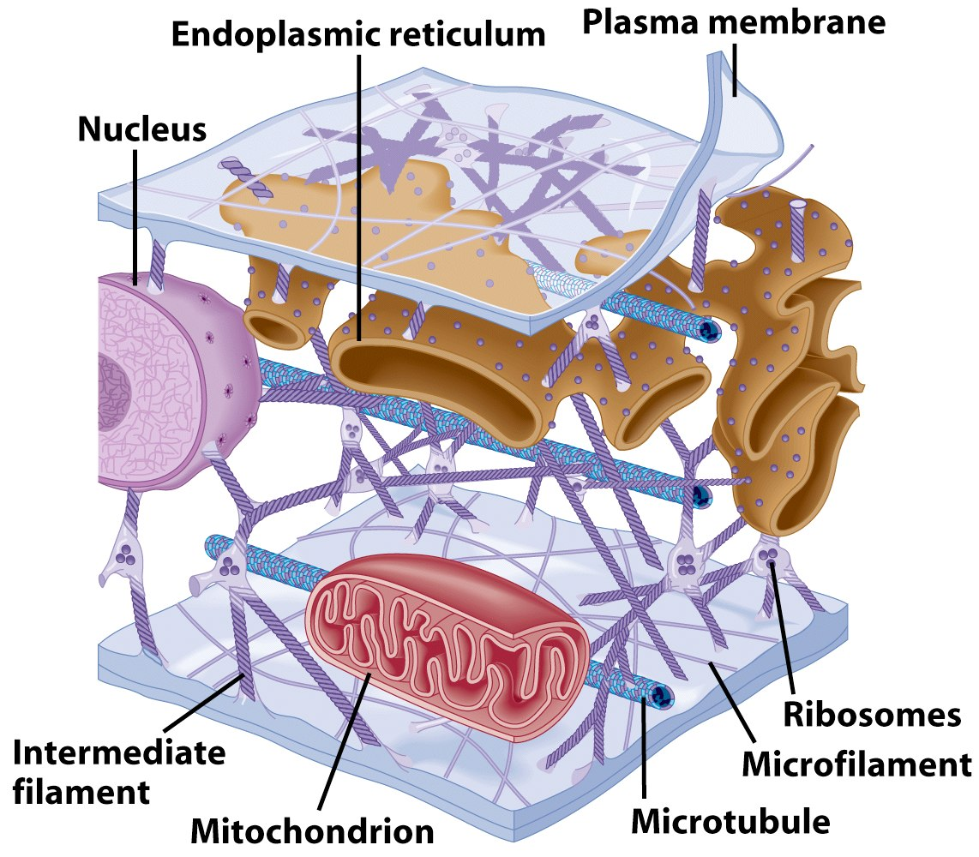
CYTOPLASM
Vigorous liquid containing organelles.
Components of the cytoplasm:
Connected filaments and fibers
Cytoplasm
Organelles
Stored substances
Biology Lecture E. Anastasiadou Bioinformatics – Biomedical Data Science 2021-2022

Slide 13
CYTOSKELETON
The set of features that together account for the shape of the cell, internal and external.
Consists of
- fiber proteins that form threads and fibers and
“accessory” proteins that connect fibers to one another, to the plasma membrane, or to other structures.
Three functions:
mechanical support
restraining of organelles
- movement of components and cell
Biology Lecture E. Anastasiadou Bioinformatics – Biomedical Data Science 2021-2022

Slide 14
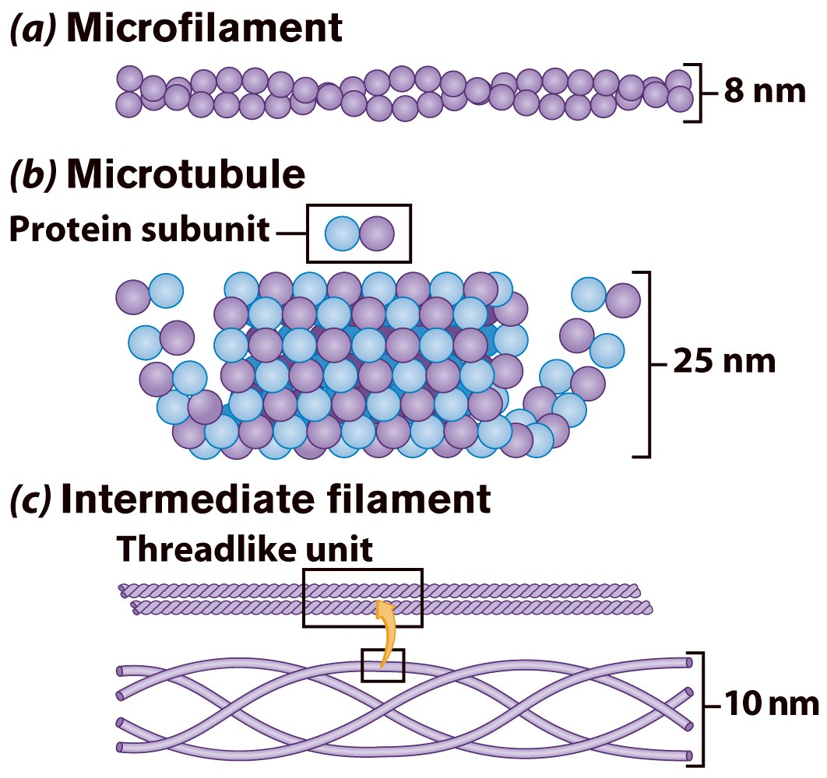
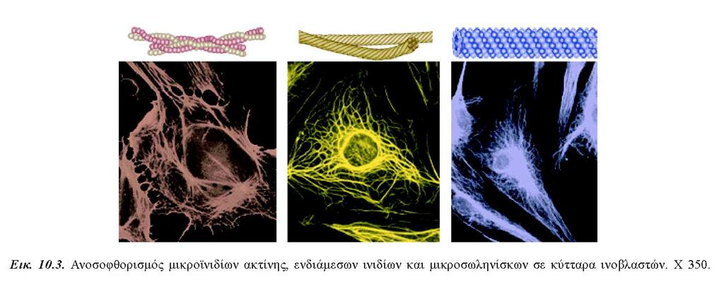
FILAMENTS - CYTOSKELETON
Three types:
Microfilaments (two chains of series of actin subunits). Exert force, either to move a cell on a surface or to change shape internally (e.g. stress fibers, contractile ring).
- Microtubules (tubulin α and β dimmers form profilaments and 13 profilaments are organized to form a hollow cylinder)
- Intermediate filaments (five different types of filaments, with a central region of 300aa that form a rod based on helical organization, found each in a particular cell type). Keratin, Desmin, Vimentin, Neurofilament, GFAP.
Biology Lecture E. Anastasiadou Bioinformatics – Biomedical Data Science 2021-2022

Slide 15
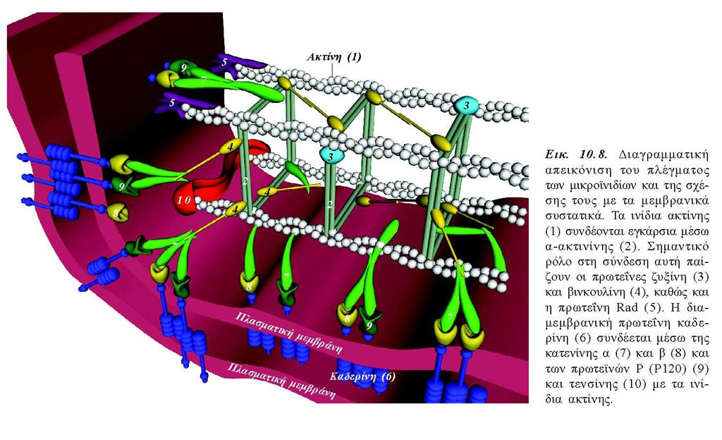
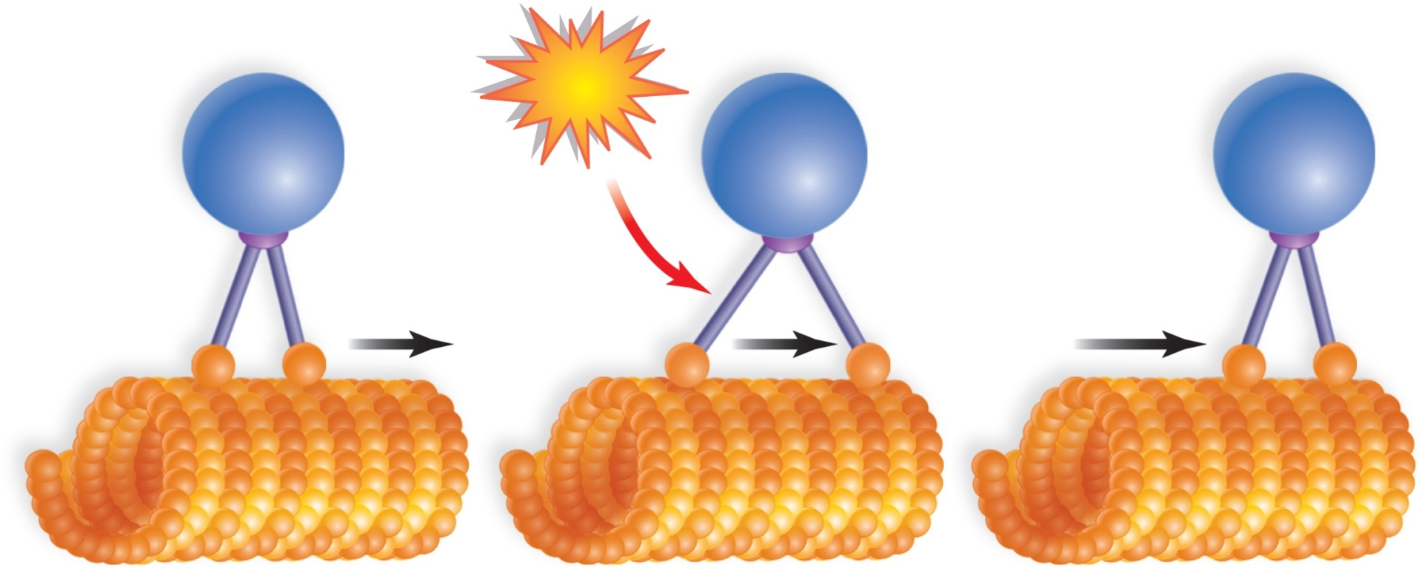
CYTOSKELETON
Microtubules interact with the kinesin and dynein proteins and cause movement of the organelles.
ATP
vesicle
kinesin receptor
kinesin
vesicle moves, not microtubule
Biology Lecture E. Anastasiadou Bioinformatics – Biomedical Data Science 2021-2022

Slide 16
CYTOSKELETON
https://www.youtube.com/watch?v=gbycQf1TbM0
Microtubules interact with the kinesin and dynein proteins and cause movement of the organelles.
ATP
vesicle
kinesin receptor
kinesin
vesicle moves, not microtubule
Biology Lecture E. Anastasiadou Bioinformatics – Biomedical Data Science 2021-2022

Slide 17
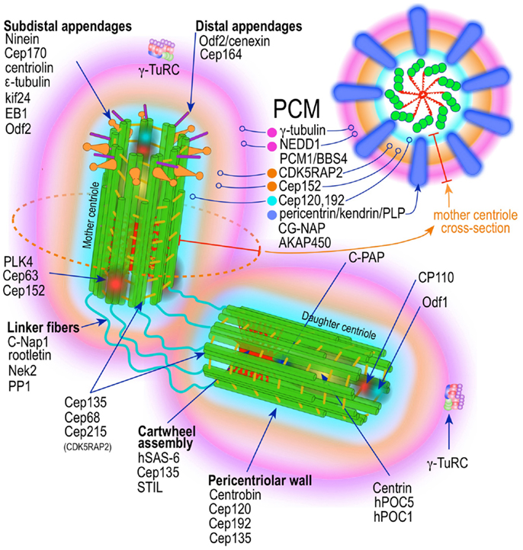
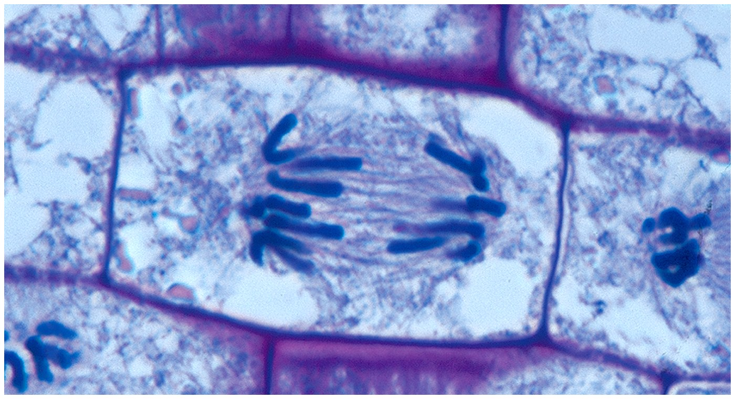
CENTRIOLES
Cylindrical organelle composed mainly of Tubulin, found in most eukaryotic cells.
They are typically made up of nine sets of short microtubule triplets, arranged in a cylinder.
Pericentriolar material/matrix (PCM) is a highly structured dense mass of proteins that surrounds the two centriols. The PCM contains proteins including γ–tubulin, pericentrin and ninein.
The structure is responsible for most of the centrosome microtubule-organizing activity, including microtubule nucleation and control of microtubule number, polarity, distribution, and flux. Plays an important role in cell division.
Biology Lecture E. Anastasiadou Bioinformatics – Biomedical Data Science 2021-2022

Slide 18
MTOC
Microtubule organizing centers (MTOC) are sites from which microtubules extend.
Biology Lecture E. Anastasiadou Bioinformatics – Biomedical Data Science 2021-2022

Slide 19
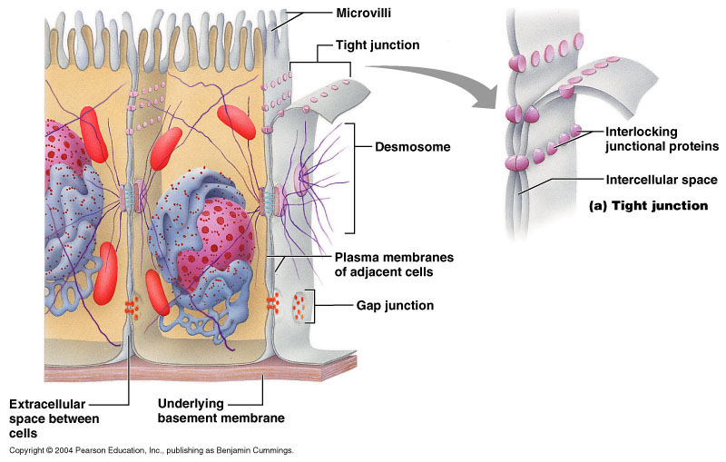
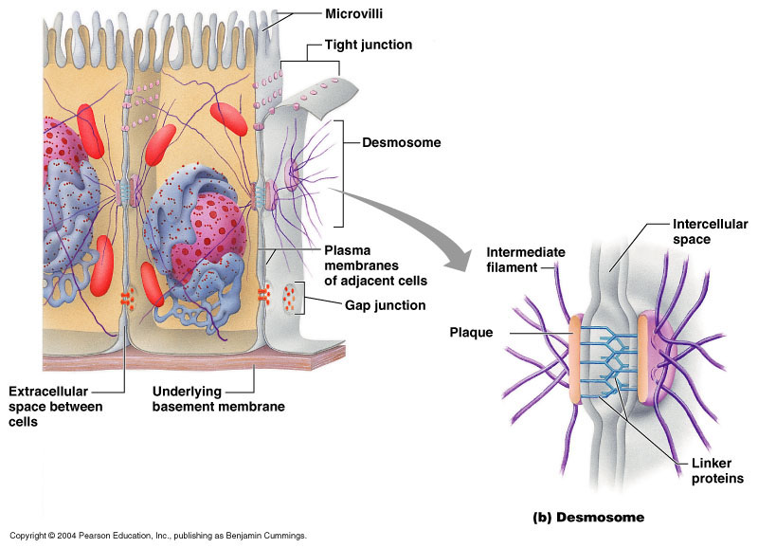
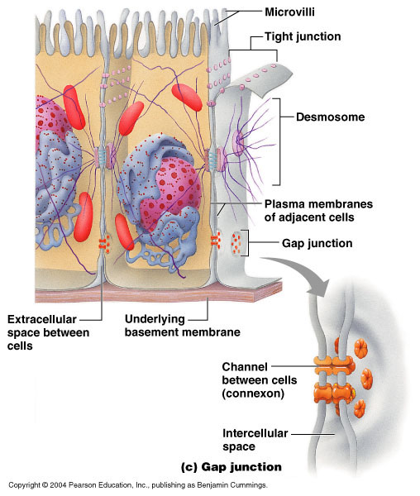
MEMBRANE JUNCTIONS
Tight junction
An impenetrable junction that surrounds the cell and prevents leakage e.g. blood-brain barrier, skin.
Desmosome
Localized spot-like adhesions randomly arranged on the lateral sides of plasma membranes. They are one of the stronger cell-to-cell adhesion types and are found in tissue that experience intense mechanical stress, such as bladder, gastrointerstinal mucosa and epithelia.
Gap junction
Allows chemicals to pass from one cell to the other e.g. heart.
Biology Lecture E. Anastasiadou Bioinformatics – Biomedical Data Science 2021-2022

Slide 20
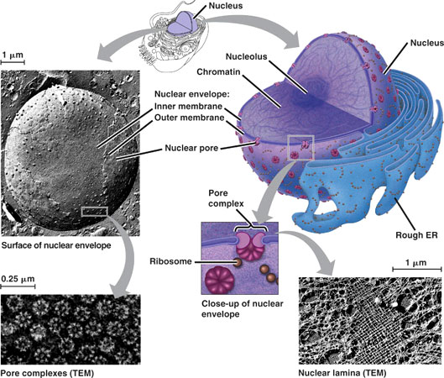
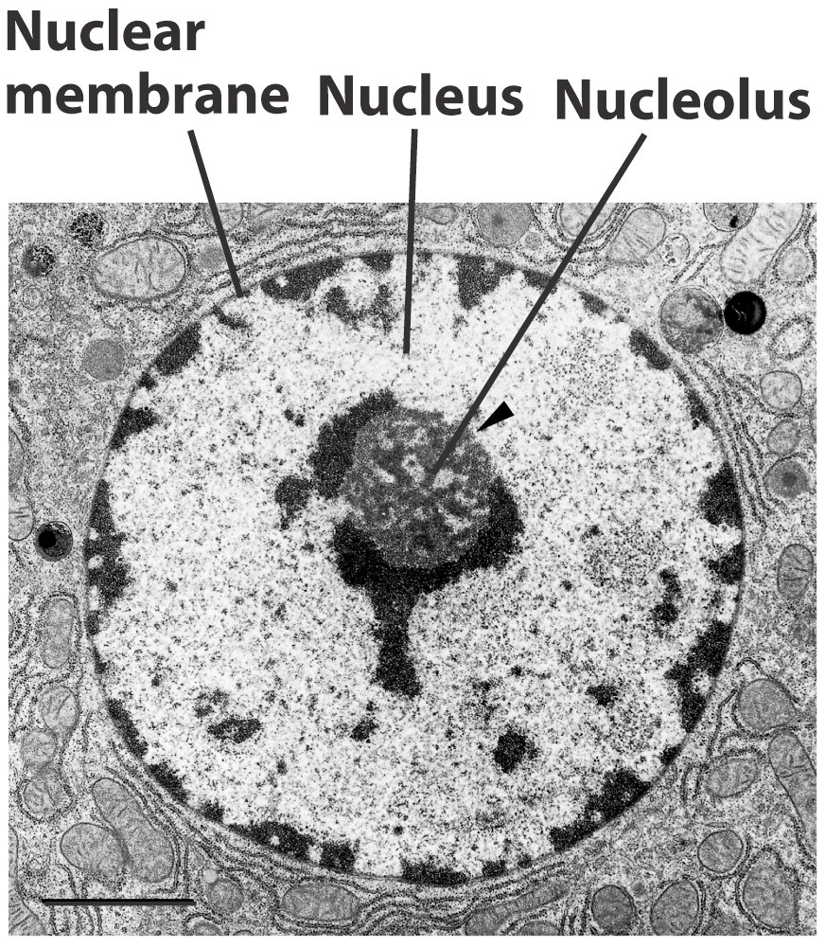
CELL NUCLEUS
The cell management center.
It is usually near the center.
It is separated from the cytoplasm by the nuclear envelope (membrane bilayer with nuclear pores for exchange of components between nucleus and cytoplasm).
Contains chromatin, DNA and proteins.
The nucleoli are dark areas where the RNA synthesis occurs and the ribosomal subunits are generated. Usually 2 or more in each cell.
Biology Lecture E. Anastasiadou Bioinformatics – Biomedical Data Science 2021-2022

Slide 21
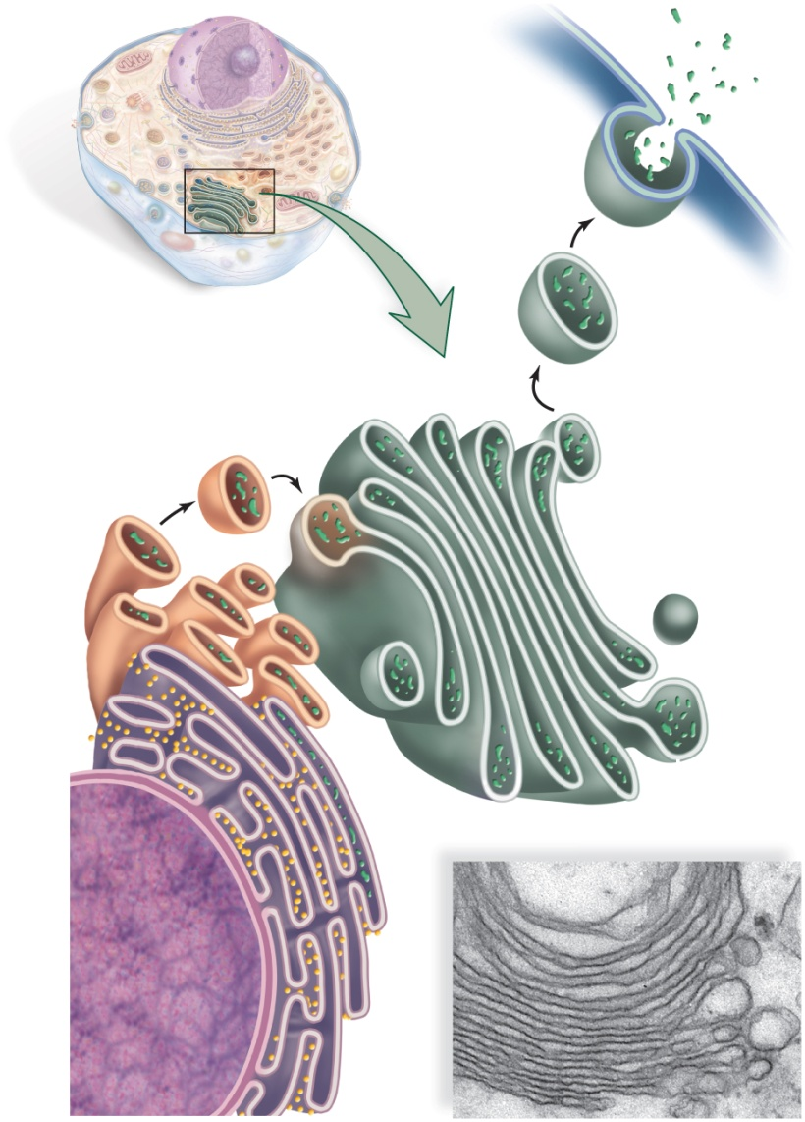
Endoplasmic reticulum
Organelles that communicate with each other through membrane networks and small vesicles.
Consists of:
Nuclear Envelope
Endoplasmic reticulum (Rough and Smooth)
Golgi apparatus
Vesicles
Biology Lecture E. Anastasiadou Bioinformatics – Biomedical Data Science 2021-2022

Slide 22
Endoplasmic reticulum
System of membrane canals and flattened, curved vesicles (saccules) along the outer membrane of the nuclear envelope.
Rough Endoplasmic Reticulum
Ribosomes on the cytoplasmic side
Synthesis, modification and processing of proteins
Adding sugar and generate glycoproteins
Smooth Endoplasmic Reticulum
Without ribosomes
Lipid synthesis
Positions of various synthesis, detoxification and storage procedures
Generation of transport vesicles
Biology Lecture E. Anastasiadou Bioinformatics – Biomedical Data Science 2021-2022

Slide 23
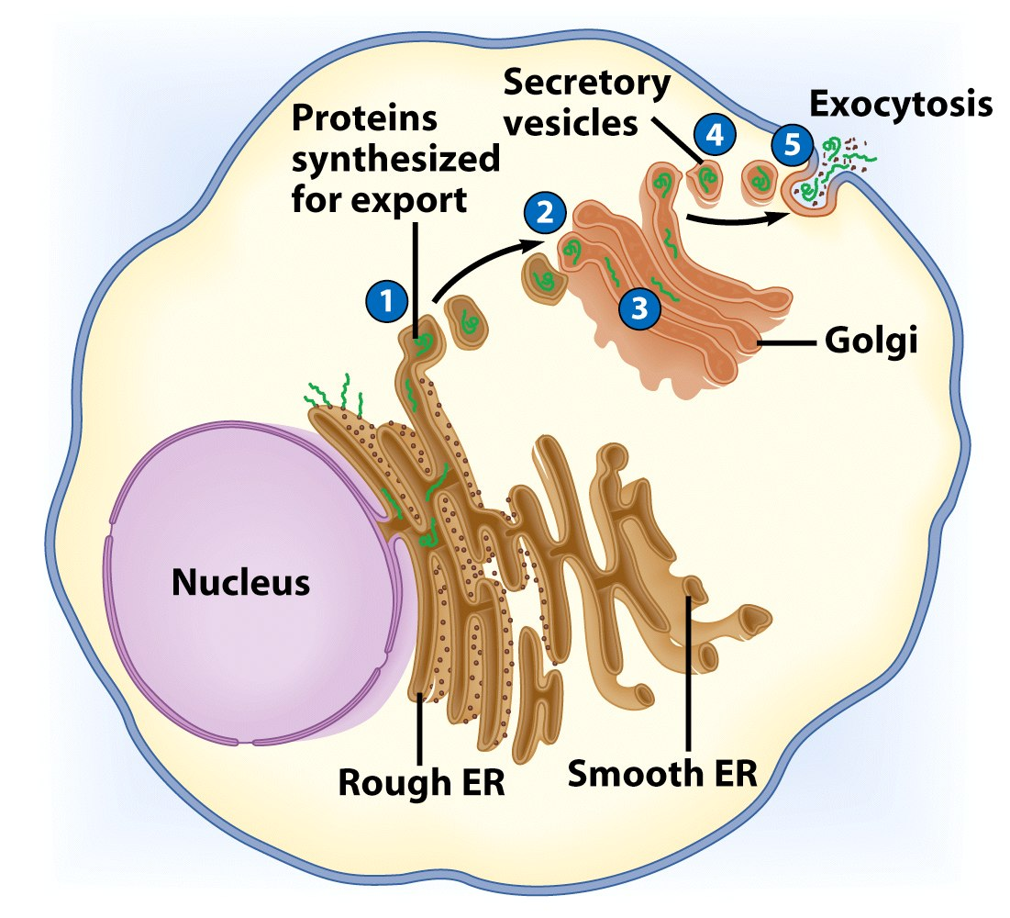
GOLGI APPARATUS
It consists of 3-20 flattened, curved vesicles (saccules).
It modifies proteins and lipids.
Take vesicles with molecules from the ER to the cis (internal) side.
2. Fusion of the vesicle and the Golgi membranes.
3. The molecules are modified in Golgi and packed in vesicles.
4. The vesicles are removed from the trans (exterior) side of the ER.
5. Vesicles can be fused to the cytoplasmic membrane and secrete / extracellularize the contents.
Biology Lecture E. Anastasiadou Bioinformatics – Biomedical Data Science 2021-2022

Slide 24
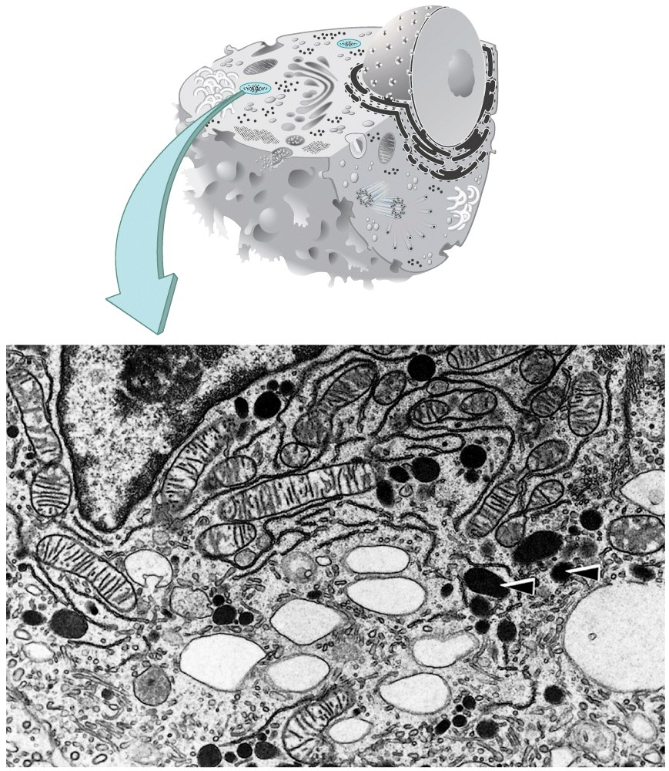
LYSOSOMES
Spherical membrane bags containing digestive enzymes.
They contribute to the renewal of cells as they degrade that ever the cell does not want or need (cell fragments and invaders).
Autolysis is the process by which damaged parts of cells are digested by autophagy.
Biology Lecture E. Anastasiadou Bioinformatics – Biomedical Data Science 2021-2022

Slide 25
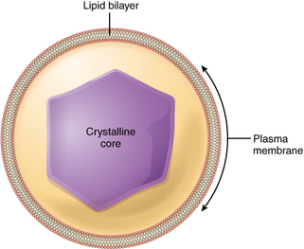
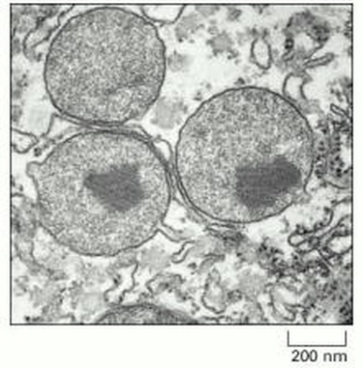
PEROXISOMES
Found in both plant and animal cells.
The last organelle to be discovered and characterized in eukaryotic cells
(Hu et al. 2012).
Oxidative organelles that owe their name to hydrogen peroxide (H₂O₂) generating and scavenging activities.
They have a simple structure consisting of two major parts:
a lipid-bilayer membrane and a crystalline core.
The core contains a variety of enzymes of catalysis of cell functions, mainly lipid metabolism and the conversion of reactive oxygen species. The most concentrated of the enzymes, catalase or urate oxidase, can become so high in number that they aggregate to form crystalline core in the center of the organelle, seen in electron micrographs.
Molecular oxygen serves as a co-substrate, from which hydrogen peroxide is then formed.
Biology Lecture E. Anastasiadou Bioinformatics – Biomedical Data Science 2021-2022

Slide 26
MITOCHONDRION
Respiration: Using oxygen converts the food into energy for the cell.
Inner membrane
Energy currency of the cell
Oxidative phosphorylation formation of ATP
Has DNA
matrix
Outer membrane
It resembles a symbiosis of a bacterium with a eukaryotic organism 700 million years ago (Lynn Margulis, 1980) where both organisms benefit.
Further info: https://www.youtube.com/watch?v=vkYEYjintqU
Biology Lecture E. Anastasiadou Bioinformatics – Biomedical Data Science 2021-2022

Slide 27
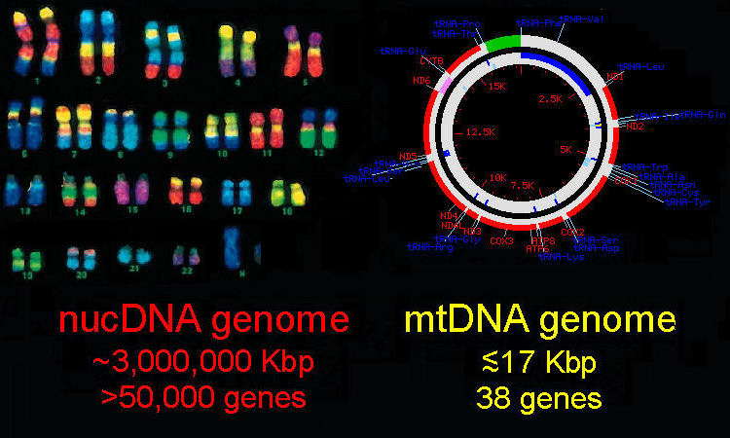
nucDNA
versus
mtDNA
Alternative Vertebrate Genomes: nuclear & mitochondrial DNA
The nucDNA genome in typical vertebrates consists of several billion base pairs of DNA,
arranged on paired chromosomes, one inherited from each parent.
The human genome shown here comprises 3 billion bp in 22 pairs of autosomal chromosomes and one pair of sex chromosomes, XY in this (male) individual. The mtDNA genome is a much smaller, circular molecule about 16 ~ 18,000 bp in circumferance in most vertebrate species.
The genome comprises 13 protein-coding regions, two rRNA genes, a replication control region, and 22 tRNA genes.
The order of these is broadly conserved across vertebrates. There are no introns: splicing out of tRNAs produces mRNA templates.
The mtDNA genome is self-replicating with the aid of nucDNA-encoded polymerases.
The genome is locted is the extranuclear mitochondria, the "powerhouses of the cell," where it contributes to cell respiratory systems
in the Cytochrome Oxidase, ATP synthase, and NADH systems. The vertebrate mtDNA genetic code differs from the "Universal" code is several respects. Unlike the nucDNA genome, the mtDNA genome is inherited solely through the cytoplasm of the maternal egg,
and does not undergo genetic recombination. It has therefore been widely used in evolutionary and population biology
to trace maternal lineages within and between species.
Biology Lecture E. Anastasiadou Bioinformatics – Biomedical Data Science 2021-2022

Slide 28
CHLOROPLAST
Inner membrane
-are found in plants
-contain chlorophyll
-contact photosynthesis (converting light to energy useful for the cell)
-they have DNA (cpDNA)
stroma
granum
Outer membrane
chlorophyll
Carbon Dioxide + Water ---------------> Glucose + Oxygen radiant energy (food)
Biology Lecture E. Anastasiadou Bioinformatics – Biomedical Data Science 2021-2022

Slide 29
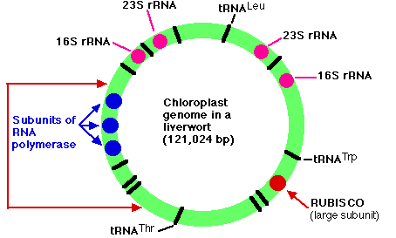
The Chloroplast Genome
The genome of the chloroplasts found in Marchantia polymorpha (a liverwort, one of the Bryophyta) contains 121,024 base pairs in a closed circle.
These make up some 128 genes which include:
duplicate genes encoding each of the four subunits (23S, 16S, 4.5S, and 5S) of the ribosomal RNA (rRNA) used by the chloroplast
37 genes encoding all the transfer RNA (tRNA) molecules used for translation within the chloroplast.
Some of these are represented in the figure by black bars (a few of which are labeled).
4 genes encoding some of the subunits of the RNA polymerase used for transcription within the chloroplast (3 of them shown in blue)
a gene encoding the large subunit of the enzyme RUBISCO (ribulose bisphosphate carboxylase oxygenase)
9 genes for components of photosystems I and II
6 genes encoding parts of the chloroplast ATP synthase
genes for 19 of the ~60 proteins used to construct the chloroplast ribosome
All these gene products are used within the chloroplast, but all the chloroplast structures also depend on proteins
encoded by nuclear genes
translated in the cytosol, and
imported into the chloroplast.
RUBISCO, for example, the enzyme that adds CO₂ to ribulose bisphosphate to start the Calvin cycle, consists of multiple copies of two subunits:
a large one encoded in the chloroplast genome and synthesized within the chloroplast, and
a small subunit encoded in the nuclear genome and synthesized by ribosomes in the cytosol. The small subunit must then be imported into the chloroplast.
The arrangement of genes shown in the figure is found not only in the Bryophytes (mosses and liverworts) but also in the lycopsids (e.g., Lycopodium and Selaginella).
In all other plants, however, the portion of DNA bracketed by the red arrows on the left is inverted. The same genes are present but in inverted order.
The figure is based on the work of Ohyama, K., et al., Nature, 322:572, 7 Aug 1986; and Linda A. Raubeson and R. K. Jansen, Science, 255:1697, 27 March 1992.
The evolution of eukaryotic chloroplasts by the endosymbiosis of cyanobacteria seems to have occurred on three different occasions producing as separate events:
the green algae and plants as described above
red algae
glaucophytes; a small group of unicellular algae
Biology Lecture E. Anastasiadou Bioinformatics – Biomedical Data Science 2021-2022

Slide 30
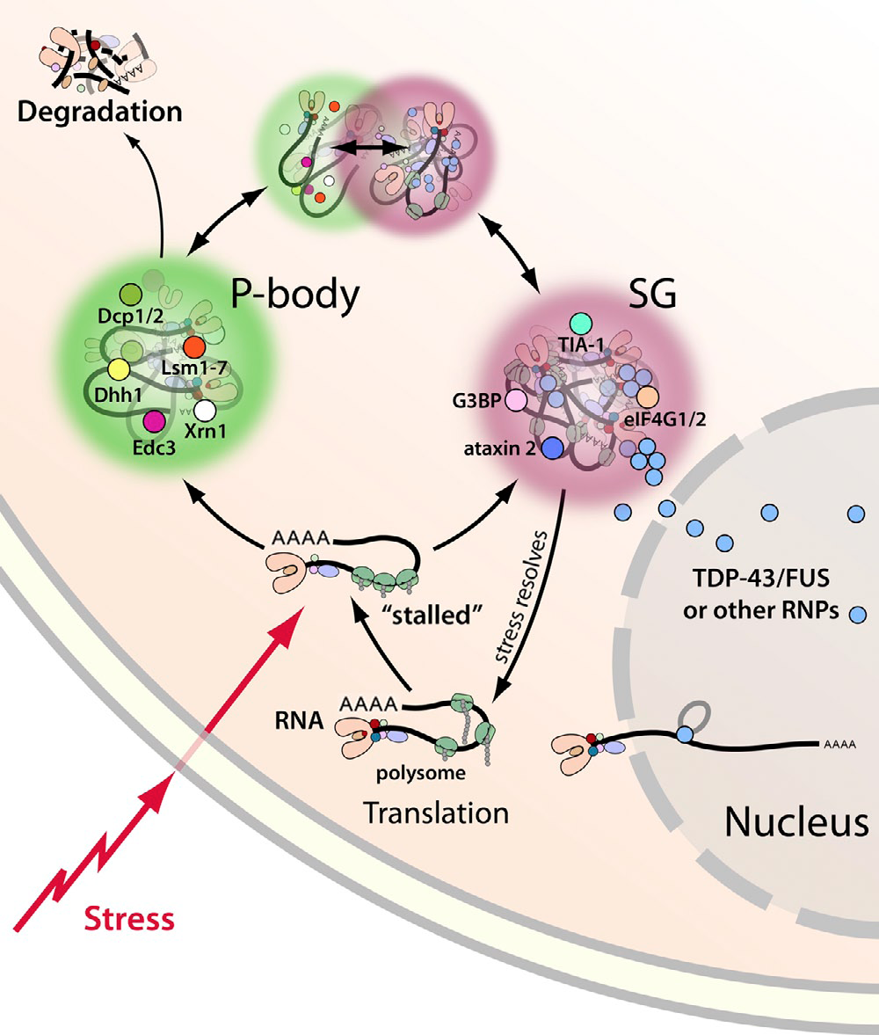
STRESS GRANULES
Stress granules (SG) are dense aggregations in the cytosol composed of proteins and RNAs.
100-200 nm in size (when biochemically purified)
not surrounded by membrane
associated with the endoplasmatic reticulum
also nuclear stress granules.
They appear when the cell is under stress.
The RNA molecules stored are stalled transcription pre-initiation complexes: failed attempts to make protein from mRNA.
Biology Lecture E. Anastasiadou Bioinformatics – Biomedical Data Science 2021-2022

Slide 31
P-BODIES
Processing bodies (P-bodies) are distinct foci within the cytoplasm, consisting of many enzymes involved in mRNA turnover.
P-bodies are highly conserved structures that play fundamental roles in mRNA decay and miRNA induced mRNA silencing.
Not all mRNAs in P-bodies are degraded; some mRNAs can exit and re-initiate translation.
The mRNAs purified from P-bodies are largely translational repressed upstream of translation initiation and are protected from 5’ mRNA decay.
Activities is P-bodies:
decapping and degradation of unwanted mRNAs
storing mRNAs until needed for translation
translational repression by miRNAs
Biology Lecture E. Anastasiadou Bioinformatics – Biomedical Data Science 2021-2022

Slide 32
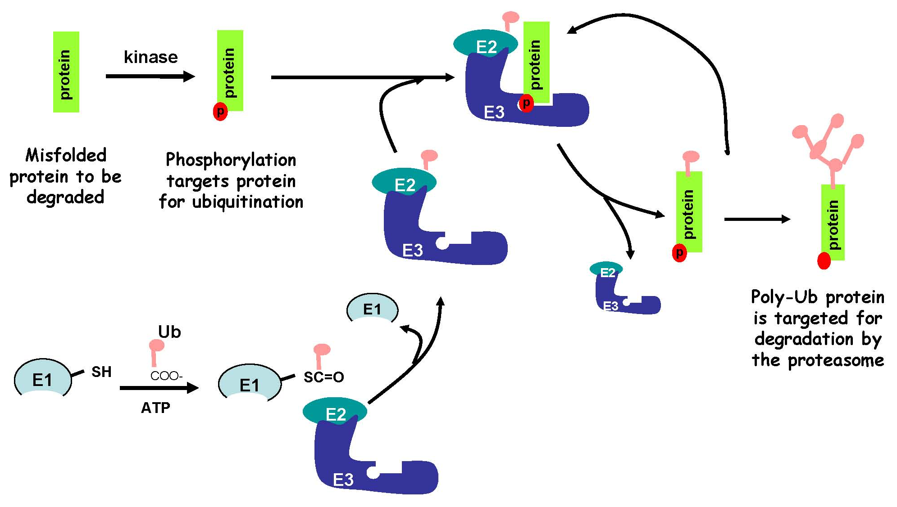
PROTEASOME
Protein complexes, which degrade unneeded or damaged proteins by proteolysis, a chemical reaction that breaks peptide bonds.
Proteasomes are part of a major mechanism by which cells regulate the concentration of particular proteins and degrade misfolded proteins.
Proteasomes are located both in nucleus and in cytoplasm.
Proteins are tagged with a small protein called ubiquitin. The reaction is catalyzed by enzymes called ubiquitin ligases. The tagged proteins, with a single ubiquitin molecule, additional ubiquitin molecules are attached. The result is a polyubiquitin chain that is bound by the proteasome, allowing it to degrade the tagged protein.
The degradation process yields peptides of about 7-8 amino acids long, which can be further degraded into shorter amino acid sequences that are used to synthesize new proteins.
Biology Lecture E. Anastasiadou Bioinformatics – Biomedical Data Science 2021-2022

Slide 33
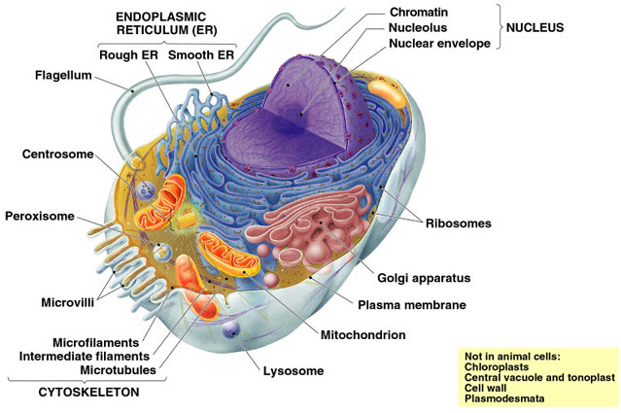
DIAGRAM OF Eukaryotic CELL
Biology Lecture E. Anastasiadou Bioinformatics – Biomedical Data Science 2021-2022

Slide 34
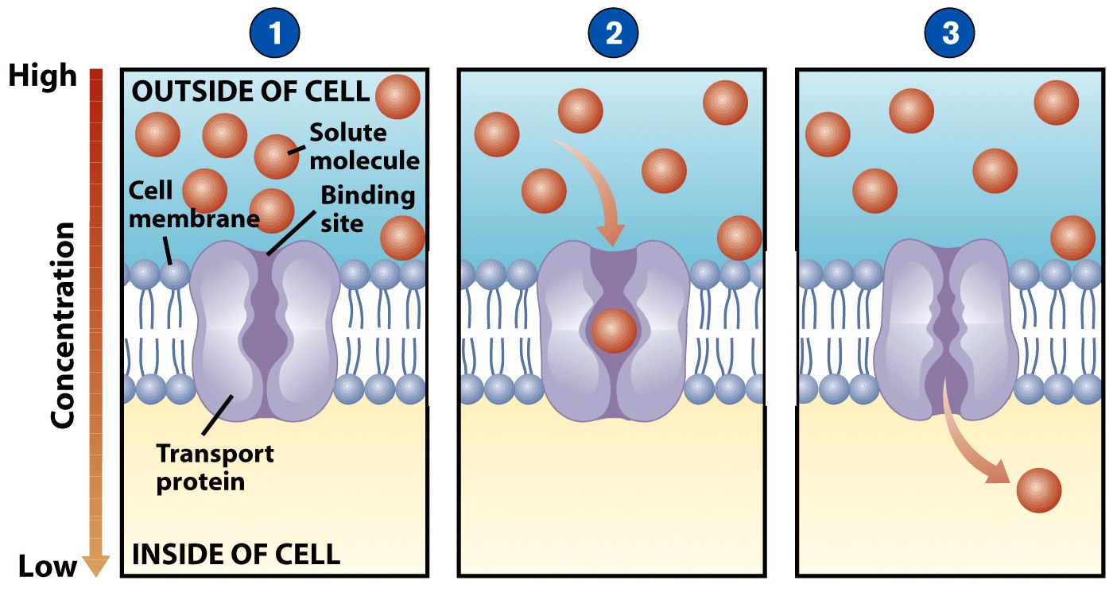
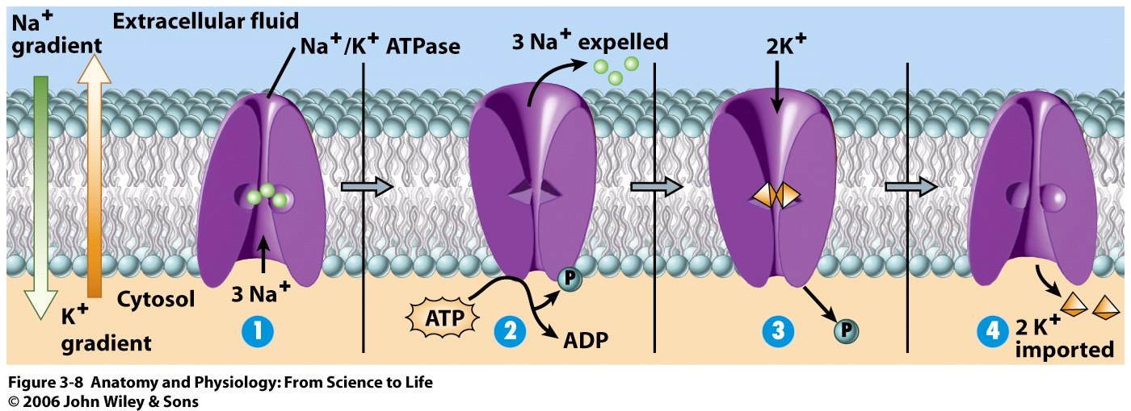
CYTOMEMBRANIC TRANSPORT
Passive Transport
No ATP (energy) is needed and the components are transferred from high to low concentration, e.g. Diffusion, Osmosis.
pressure
load
The proteins bind to the molecules.
The morphology of proteins is changing.
The molecules are moved through the membrane.
Active Transport
Requires ATP (energy) to move molecules from low to high concentration using energy and carriers.
Biology Lecture E. Anastasiadou Bioinformatics – Biomedical Data Science 2021-2022

Slide 35
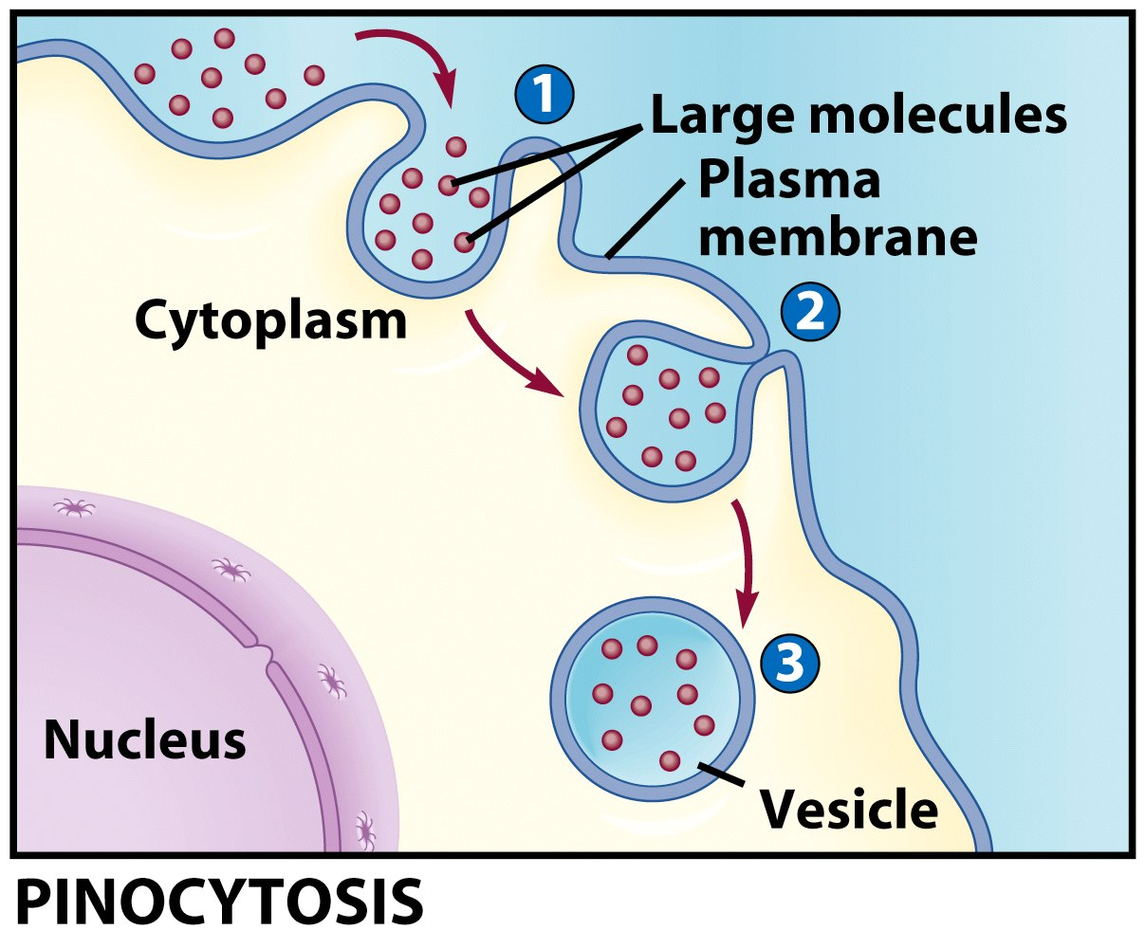
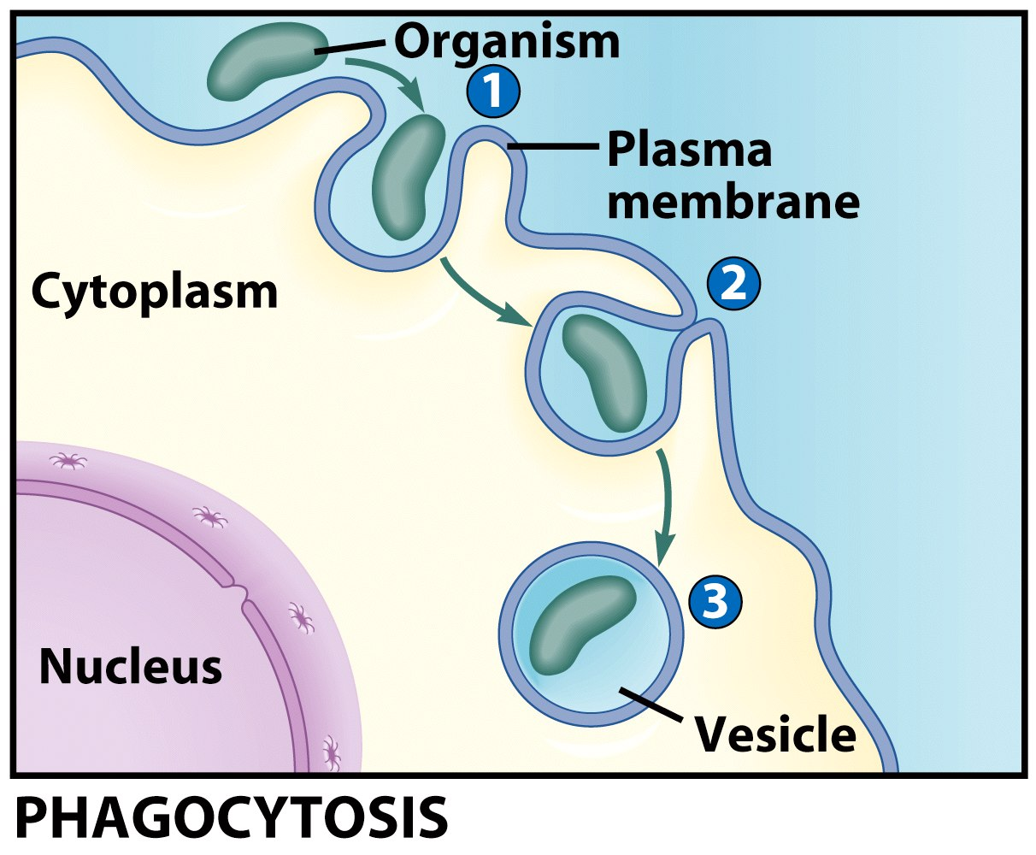
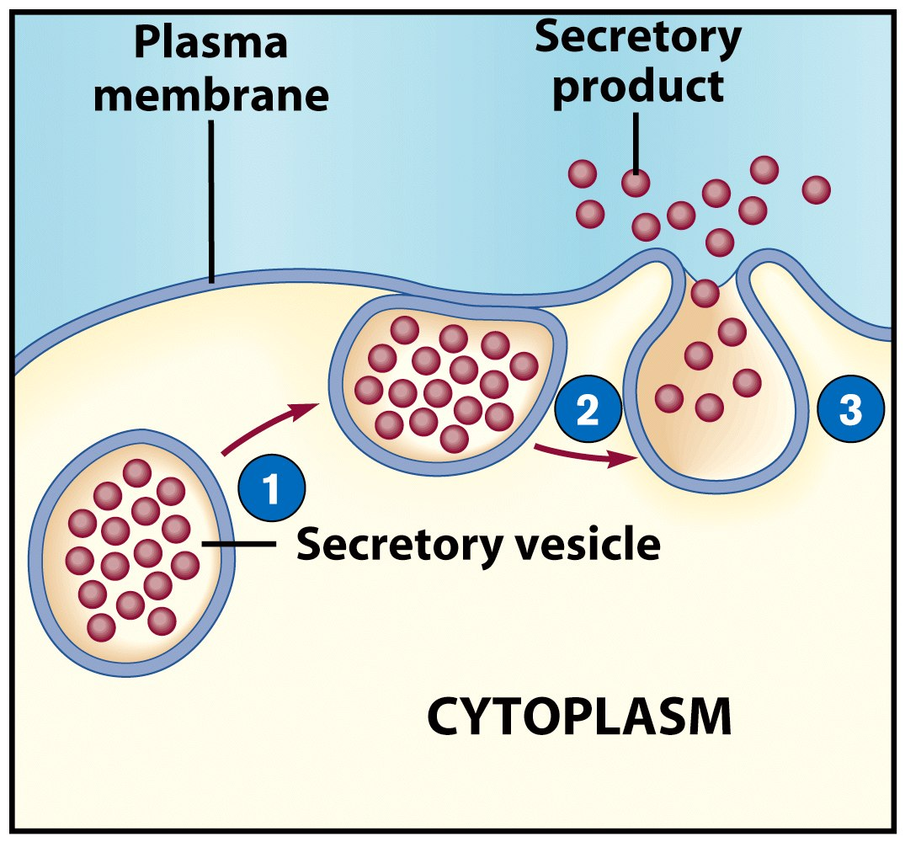
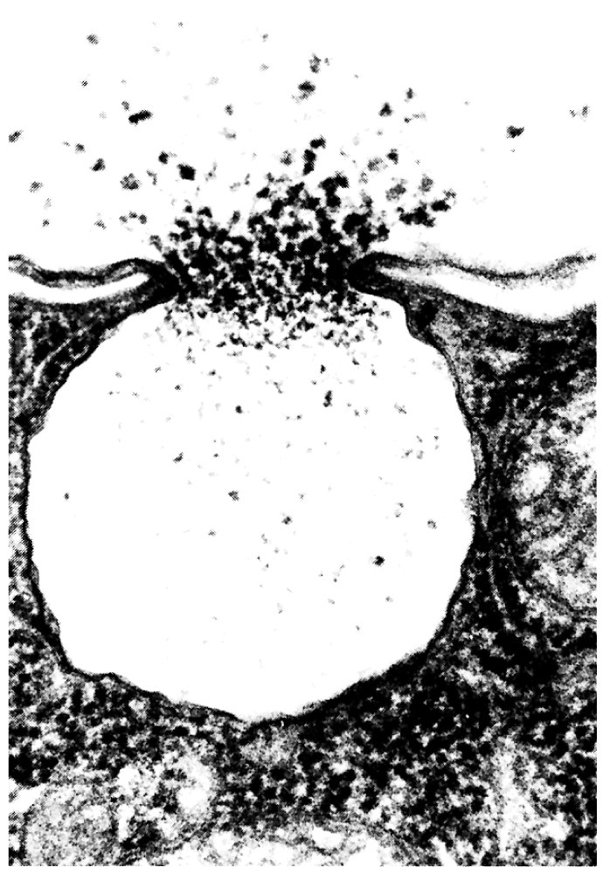
ACTIVE TRANSPORT
Endocytosis
Transfer of molecules into the cell.
Move parts, organelles, large molecules.
The cell membrane surrounds the material.
2. The edges of the membrane are joined together.
3. The membrane forms a vesicle and the material is encapsulated.
Exocytosis
The inverse of endocytosis.
1. A vesicle is transferred to the cell membrane.
2. The vesicle membrane is fused to the cytoplasm.
3. The material is discarded.
Biology Lecture E. Anastasiadou Bioinformatics – Biomedical Data Science 2021-2022

Slide 36
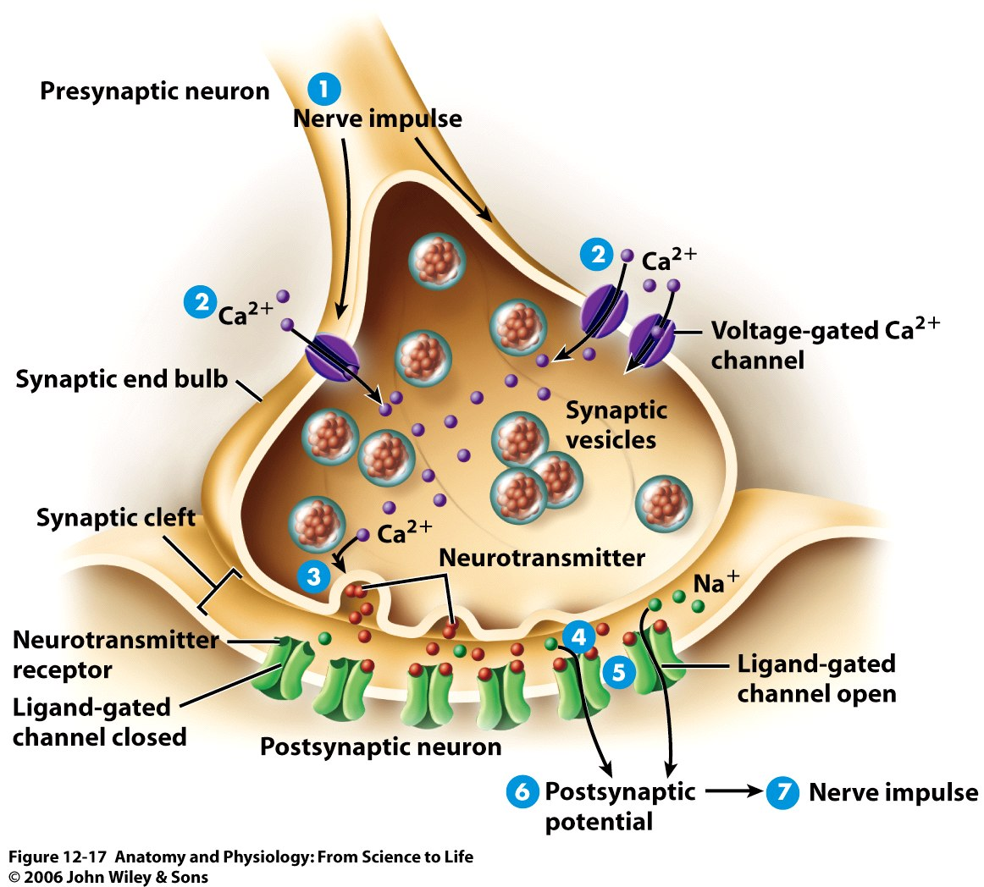
Biology Lecture E. Anastasiadou Bioinformatics – Biomedical Data Science 2021-2022

Slide 37
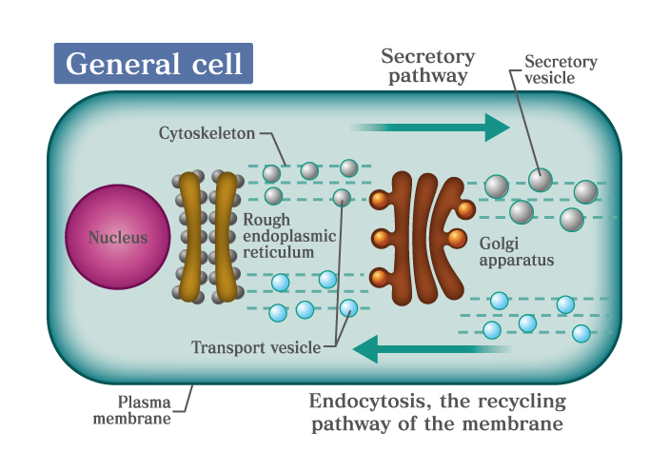
ΔΙΑΛΟΓΗ & ΚΥΣΤΙΔΙΑΚΗ ΜΕΤΑΦΟΡΑ ΠΡΩΤΕΪΝΩΝ
Biology Lecture E. Anastasiadou Bioinformatics – Biomedical Data Science 2021-2022

Slide 38
the cell
https://www.youtube.com/watch?v=URUJD5NEXC8&t=139s
https://www.youtube.com/watch?v=GBYZ0aDrlGk
https://www.youtube.com/watch?v=-Au5_2LMd5k
Biology Lecture E. Anastasiadou Bioinformatics – Biomedical Data Science 2021-2022

Slide 39
Signaling:
http://www.youtube.com/watch?v=tMMrTRnFdI4&feature=related
Inner life of cell:
https://www.youtube.com/watch?v=8_24UyJc-qw
https://www.youtube.com/watch?v=FzcTgrxMzZk&t=6s
Biology Lecture E. Anastasiadou Bioinformatics – Biomedical Data Science 2021-2022

Slide 40
cell signalling overview
https://www.youtube.com/watch?v=9sF_h-bAnIE
http://www.youtube.com/watch?v=hepoJgGJtNc
Biology Lecture E. Anastasiadou Bioinformatics – Biomedical Data Science 2021-2022

Slide 41
Viruses
A virus is:
a chain of nucleic acids (DNA or RNA) that
lives in a host cell,
uses the host’s reagents and its cellular machinery to reproduce and
releases the replicated nucleic acid chains to infect more cells.
Their genetic material is often protected by a protein envelope, that allows the virus to survive between hosts.
The shape, structure, and function of these proteins changes depending on the species of virus.
Biology Lecture E. Anastasiadou Bioinformatics – Biomedical Data Science 2021-2022

Slide 42
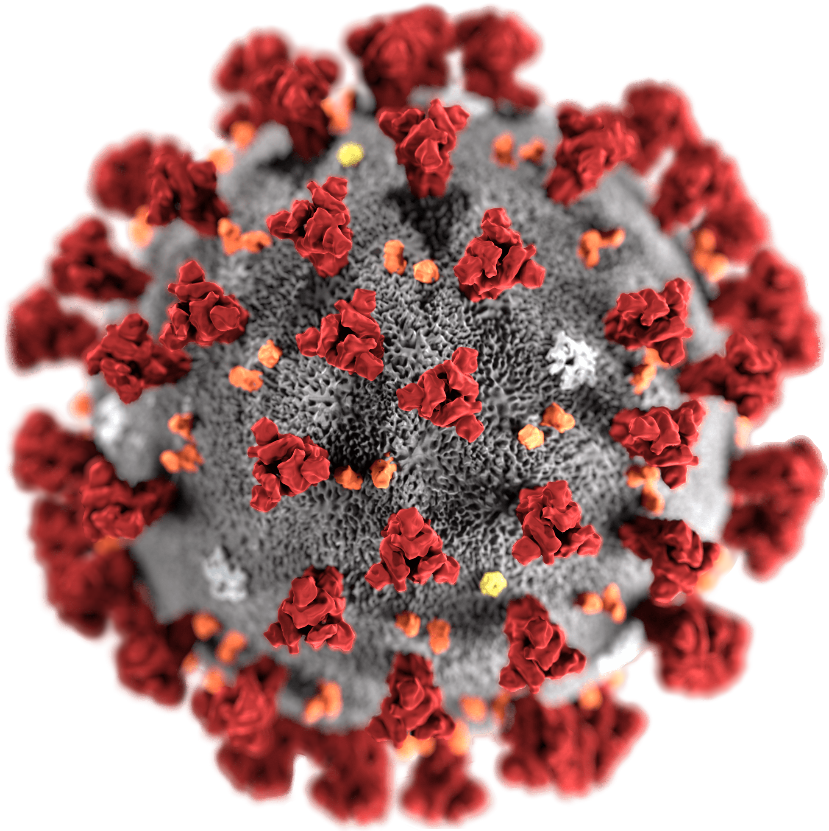
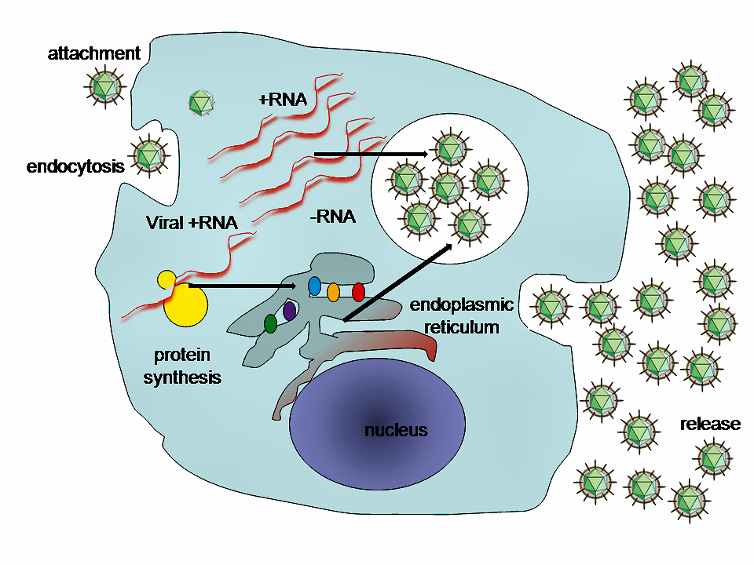
Viral Structure
A virus which replicates in mammalian cells will have a protein coat, covering the viral genome, which enables it to attach to and infiltrate mammalian cells. The envelope proteins will enable the virus to interact with the host cell.
Part of the protein coat will then open, puncture through the cell membrane and deposit the viral genome within the cell. The protein coat can then be discarded, as the viral genome will now replicate within the host cell. The replicated virus molecules will be packaged within their own protein coats, and be released into the environment to find another host.
In some plan virus species, the virus is passed from cell to cell within the plant.
In this way the virus can live within cells its entire existence, and never need a protein coat to protect it in the environment.
Biology Lecture E. Anastasiadou Bioinformatics – Biomedical Data Science 2021-2022

Slide 43
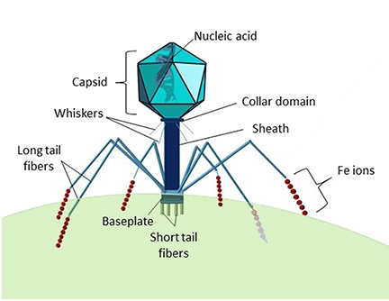
Viral Structure
Bacteriophage is a type of virus which specializes on bacterial cells.
The protein coat of a phage is much more complex, and has a variety of specialized parts.
The head portion contains the viral genome.
The collar, sheath, base plate, and tail fibers are part of an intricate system to attach to and inject the genome into a bacterial cell.
The tail fibers grasp the bacterial cell, pulling the base plate up to the cell wall or membrane.
The sheath and collar compress, puncture the cell, and deposit the DNA into the bacterial cell.
Biology Lecture E. Anastasiadou Bioinformatics – Biomedical Data Science 2021-2022

Slide 44
Classification of Viruses
Viruses must generate mRNAs from their genomes to produce proteins and replicate themselves.
The mechanisms used to achieve this reflects the type of the viral genome, that can be: single-stranded (ss) or double-stranded (ds),
RNA or DNA, and
may or may not use reverse transcriptase (RT).
In addition, ssRNA viruses may be either sense (+) or antisense (−).
Biology Lecture E. Anastasiadou Bioinformatics – Biomedical Data Science 2021-2022
Notes:
Class I virus genomes are made of double stranded DNA, the same as the human genome. This makes it easy for these virus molecules to use the cell’s natural machinery to produce proteins from the virus DNA. However, in order for DNA polymerase (the molecule which copies DNA) to be active the cell must be dividing. Some Class I virus molecules include sections of DNA which make the cell actively start dividing. These virus molecules can lead to cancer. Human papilloma virus is a sexually-transmitted Class I virus, and can cause cervical cancer.
A Class II virus contains only a single strand of DNA. Before it can be read by the host’s DNA polymerase enzymes, it must be converted to double stranded DNA. It does this by hijacking the host cell’s histones (DNA proteins) and DNA polymerase. Instead of waiting for the cell to divide or forcing it to, Class II virus DNA contains coding for a protein called Rep. This replication enzyme replicates the original single-stranded virus genome. Other proteins are created from the DNA and used to create protein coats with the cellular machinery. The single-stranded DNA is then packaged into these protein coats, and new virus packages are created.
Class III virus genomes are created from double-stranded RNA. While this is unusual, these virus packages come with their own protein, RNA polymerase. This protein can create messenger RNA (mRNA) from the double-stranded virus RNA. The virus RNA therefore stays within the virus capsule, and only the mRNA enters the cytoplasm of the host. Here, the mRNA is converted into proteins, some of which include more RNA polymerase. This RNA polymerase creates a new double-stranded RNA, which is encapsulated by the proteins and released from the cell.
Class IV viruses are single-stranded RNA, almost identical to mRNA produced by the host cell. With these viruses the entire protein coat is engulfed by an uninfected host cell. The small RNA genome escapes the protein coat, and makes its way into the cytoplasm. This one mRNA-like strand codes for a large polyprotein, which will be created by the hosts ribosomes. The polyprotein naturally breaks into different parts. Some create protein coats, while others read and replicate the original strand of viral RNA. The virus continues to replicate and create new, fully packed virus particles. When the cell is completely full, it ruptures and releases the virus particles into the blood or environment. Up to 10,000 virus particles can be release from a single cell.
The virus genomes in Class V are also single-stranded RNA. However, they run in the opposite direction from normal mRNA. Therefore, the cell’s machinery cannot read them directly. These virus molecules contain a RNA polymerase molecule which can read in reverse. These virus molecules have large capsules, surrounded by cell membrane and proteins. When the virus approaches a cell, its membrane proteins bind with the cell, and it is drawn into the cytoplasm. Here, it breaks apart, releasing the backwards viral RNA and associated proteins. These small complexes produce regular mRNA, which creates new virus complexes. These unfinished complexes move to the cell surface, where they line the cell membrane with proteins they create. When they are finished, they wrap themselves in this membrane, and tear away from the cell.
Class VI virus genomes are the same as Class V, but they use a different method to replicate. Class VI virus particles are known as retroviruses. Instead of creating mRNA from the viral RNA, these virus molecules work with a different protein. Known as reverse transcriptase, this enzyme is able to create DNA from the virus RNA. In doing so, the viral RNA is converted to double-stranded DNA. This DNA then produces new virus. The DNA can incorporate with the host DNA, and in doing so become endogenized. This means that the DNA will remain in the cell as long as the cell lives. If the cell is found in a germ line, such as a sperm or egg, the virus will permanently become a part of the host’s genome. It is estimated that 5-8% of the human genome is left over retrovirus DNA.
The final class, Class VII, includes the pararetroviruses. Similar to Class VI, these virus genomes use reverse transcriptase. However, these virus genomes are package as DNA, not RNA. These viruses insert themselves directly into the host genome, which begins transposing the viral DNA into RNA. Most of this RNA will be mRNA, used to create a polyprotein. Part of the polyprotein is reverse transcriptase. This reverse transcriptase works on pieces of RNA known as pregenome. It reads these RNA molecules and produces the original virus DNA. This is then packaged into viral protein coats. Class VII viruses are often found in plants, and can travel between cells using the plasmodesmata, or they can be carried by herbivorous insects feeding on the plants. Aphids carry many plant diseases, as their proboscis pierces plant cell walls and they drink the cytoplasm.

Slide 45
Classification of Viruses
Baltimore classification (first defined in 1971), named after David Baltimore, a Nobel Prize-winning biologist, has seven groups depending on their
nucleic acid (DNA or RNA)
strandedness (single-stranded or double-stranded),
sense and
method of replication.
I: dsDNA viruses (e.g. Adenoviruses, Herpesviruses, Poxviruses)
II: ssDNA viruses (+ strand or "sense") DNA (e.g. Parvoviruses)
III: dsRNA viruses (e.g. Reoviruses)
IV: (+)ssRNA viruses (+ strand or sense) RNA (e.g. Coronaviruses, Picornaviruses, Togaviruses)
V: (−)ssRNA viruses (− strand or antisense) RNA (e.g. Orthomyxoviruses, Rhabdoviruses)
VI: ssRNA-RT viruses (+ strand or sense) RNA with DNA intermediate in life-cycle (e.g. Retroviruses)
VII: dsDNA-RT viruses DNA with RNA intermediate in life-cycle (e.g. Hepadnaviruses)
Other classifications are based on disease caused by the virus or its morphology.
Biology Lecture E. Anastasiadou Bioinformatics – Biomedical Data Science 2021-2022
Notes:
Class I virus genomes are made of double stranded DNA, the same as the human genome. This makes it easy for these virus molecules to use the cell’s natural machinery to produce proteins from the virus DNA. However, in order for DNA polymerase (the molecule which copies DNA) to be active the cell must be dividing. Some Class I virus molecules include sections of DNA which make the cell actively start dividing. These virus molecules can lead to cancer. Human papilloma virus is a sexually-transmitted Class I virus, and can cause cervical cancer.
A Class II virus contains only a single strand of DNA. Before it can be read by the host’s DNA polymerase enzymes, it must be converted to double stranded DNA. It does this by hijacking the host cell’s histones (DNA proteins) and DNA polymerase. Instead of waiting for the cell to divide or forcing it to, Class II virus DNA contains coding for a protein called Rep. This replication enzyme replicates the original single-stranded virus genome. Other proteins are created from the DNA and used to create protein coats with the cellular machinery. The single-stranded DNA is then packaged into these protein coats, and new virus packages are created.
Class III virus genomes are created from double-stranded RNA. While this is unusual, these virus packages come with their own protein, RNA polymerase. This protein can create messenger RNA (mRNA) from the double-stranded virus RNA. The virus RNA therefore stays within the virus capsule, and only the mRNA enters the cytoplasm of the host. Here, the mRNA is converted into proteins, some of which include more RNA polymerase. This RNA polymerase creates a new double-stranded RNA, which is encapsulated by the proteins and released from the cell.
Class IV viruses are single-stranded RNA, almost identical to mRNA produced by the host cell. With these viruses the entire protein coat is engulfed by an uninfected host cell. The small RNA genome escapes the protein coat, and makes its way into the cytoplasm. This one mRNA-like strand codes for a large polyprotein, which will be created by the hosts ribosomes. The polyprotein naturally breaks into different parts. Some create protein coats, while others read and replicate the original strand of viral RNA. The virus continues to replicate and create new, fully packed virus particles. When the cell is completely full, it ruptures and releases the virus particles into the blood or environment. Up to 10,000 virus particles can be release from a single cell.
The virus genomes in Class V are also single-stranded RNA. However, they run in the opposite direction from normal mRNA. Therefore, the cell’s machinery cannot read them directly. These virus molecules contain a RNA polymerase molecule which can read in reverse. These virus molecules have large capsules, surrounded by cell membrane and proteins. When the virus approaches a cell, its membrane proteins bind with the cell, and it is drawn into the cytoplasm. Here, it breaks apart, releasing the backwards viral RNA and associated proteins. These small complexes produce regular mRNA, which creates new virus complexes. These unfinished complexes move to the cell surface, where they line the cell membrane with proteins they create. When they are finished, they wrap themselves in this membrane, and tear away from the cell.
Class VI virus genomes are the same as Class V, but they use a different method to replicate. Class VI virus particles are known as retroviruses. Instead of creating mRNA from the viral RNA, these virus molecules work with a different protein. Known as reverse transcriptase, this enzyme is able to create DNA from the virus RNA. In doing so, the viral RNA is converted to double-stranded DNA. This DNA then produces new virus. The DNA can incorporate with the host DNA, and in doing so become endogenized. This means that the DNA will remain in the cell as long as the cell lives. If the cell is found in a germ line, such as a sperm or egg, the virus will permanently become a part of the host’s genome. It is estimated that 5-8% of the human genome is left over retrovirus DNA.
The final class, Class VII, includes the pararetroviruses. Similar to Class VI, these virus genomes use reverse transcriptase. However, these virus genomes are package as DNA, not RNA. These viruses insert themselves directly into the host genome, which begins transposing the viral DNA into RNA. Most of this RNA will be mRNA, used to create a polyprotein. Part of the polyprotein is reverse transcriptase. This reverse transcriptase works on pieces of RNA known as pregenome. It reads these RNA molecules and produces the original virus DNA. This is then packaged into viral protein coats. Class VII viruses are often found in plants, and can travel between cells using the plasmodesmata, or they can be carried by herbivorous insects feeding on the plants. Aphids carry many plant diseases, as their proboscis pierces plant cell walls and they drink the cytoplasm.

Slide 46
Diseases by Viruses
Examples of diseases caused by viruses:
common human diseases include the common cold, influenza, chickenpox, and cold sores.
serious diseases such as rabies, Ebola virus disease, AIDS (HIV), avian influenza, and SARS.
diseases under investigation to discover if they have a virus as the causative agent, such as human herpesvirus 6 (HHV6) and neurological diseases such as multiple sclerosis and chronic fatigue syndrome.
Viruses have different mechanisms by which they produce disease in an organism. Includes cell lysis, the breaking open and subsequent death of the cell; if enough cells die, the whole organism will start to suffer the effects.
They may also exist relatively harmlessly within an organism, remaining in a dormant state within the human body. This is called latency and is a characteristic of the herpes viruses, such as herpes simplex virus, which causes cold sores, Epstein–Barr virus, which causes glandular fever, and varicella zoster virus, which causes chickenpox and shingles. Most people have been infected with at least one of these types of herpes virus.
Some viruses can cause lifelong or chronic infections, where the viruses continue to replicate in the body despite the host's defence mechanisms such as hepatitis B virus and hepatitis C virus infections.
Biology Lecture E. Anastasiadou Bioinformatics – Biomedical Data Science 2021-2022
Notes:
Class I virus genomes are made of double stranded DNA, the same as the human genome. This makes it easy for these virus molecules to use the cell’s natural machinery to produce proteins from the virus DNA. However, in order for DNA polymerase (the molecule which copies DNA) to be active the cell must be dividing. Some Class I virus molecules include sections of DNA which make the cell actively start dividing. These virus molecules can lead to cancer. Human papilloma virus is a sexually-transmitted Class I virus, and can cause cervical cancer.
A Class II virus contains only a single strand of DNA. Before it can be read by the host’s DNA polymerase enzymes, it must be converted to double stranded DNA. It does this by hijacking the host cell’s histones (DNA proteins) and DNA polymerase. Instead of waiting for the cell to divide or forcing it to, Class II virus DNA contains coding for a protein called Rep. This replication enzyme replicates the original single-stranded virus genome. Other proteins are created from the DNA and used to create protein coats with the cellular machinery. The single-stranded DNA is then packaged into these protein coats, and new virus packages are created.
Class III virus genomes are created from double-stranded RNA. While this is unusual, these virus packages come with their own protein, RNA polymerase. This protein can create messenger RNA (mRNA) from the double-stranded virus RNA. The virus RNA therefore stays within the virus capsule, and only the mRNA enters the cytoplasm of the host. Here, the mRNA is converted into proteins, some of which include more RNA polymerase. This RNA polymerase creates a new double-stranded RNA, which is encapsulated by the proteins and released from the cell.
Class IV viruses are single-stranded RNA, almost identical to mRNA produced by the host cell. With these viruses the entire protein coat is engulfed by an uninfected host cell. The small RNA genome escapes the protein coat, and makes its way into the cytoplasm. This one mRNA-like strand codes for a large polyprotein, which will be created by the hosts ribosomes. The polyprotein naturally breaks into different parts. Some create protein coats, while others read and replicate the original strand of viral RNA. The virus continues to replicate and create new, fully packed virus particles. When the cell is completely full, it ruptures and releases the virus particles into the blood or environment. Up to 10,000 virus particles can be release from a single cell.
The virus genomes in Class V are also single-stranded RNA. However, they run in the opposite direction from normal mRNA. Therefore, the cell’s machinery cannot read them directly. These virus molecules contain a RNA polymerase molecule which can read in reverse. These virus molecules have large capsules, surrounded by cell membrane and proteins. When the virus approaches a cell, its membrane proteins bind with the cell, and it is drawn into the cytoplasm. Here, it breaks apart, releasing the backwards viral RNA and associated proteins. These small complexes produce regular mRNA, which creates new virus complexes. These unfinished complexes move to the cell surface, where they line the cell membrane with proteins they create. When they are finished, they wrap themselves in this membrane, and tear away from the cell.
Class VI virus genomes are the same as Class V, but they use a different method to replicate. Class VI virus particles are known as retroviruses. Instead of creating mRNA from the viral RNA, these virus molecules work with a different protein. Known as reverse transcriptase, this enzyme is able to create DNA from the virus RNA. In doing so, the viral RNA is converted to double-stranded DNA. This DNA then produces new virus. The DNA can incorporate with the host DNA, and in doing so become endogenized. This means that the DNA will remain in the cell as long as the cell lives. If the cell is found in a germ line, such as a sperm or egg, the virus will permanently become a part of the host’s genome. It is estimated that 5-8% of the human genome is left over retrovirus DNA.
The final class, Class VII, includes the pararetroviruses. Similar to Class VI, these virus genomes use reverse transcriptase. However, these virus genomes are package as DNA, not RNA. These viruses insert themselves directly into the host genome, which begins transposing the viral DNA into RNA. Most of this RNA will be mRNA, used to create a polyprotein. Part of the polyprotein is reverse transcriptase. This reverse transcriptase works on pieces of RNA known as pregenome. It reads these RNA molecules and produces the original virus DNA. This is then packaged into viral protein coats. Class VII viruses are often found in plants, and can travel between cells using the plasmodesmata, or they can be carried by herbivorous insects feeding on the plants. Aphids carry many plant diseases, as their proboscis pierces plant cell walls and they drink the cytoplasm.

Slide 47
https://www.youtube.com/watch?v=URUJD5NEXC8
http://www.youtube.com/watch?v=Q6ucKWIIFmg&feature=related
Biology Lecture E. Anastasiadou Bioinformatics – Biomedical Data Science 2021-2022

Slide 48
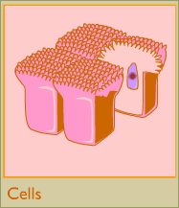
CELLS
The basic building block of all living things.
The cells are copies of the parental cells, with certain characteristics, encoded in the genetic material.
Biology Lecture E. Anastasiadou Bioinformatics – Biomedical Data Science 2021-2022

Slide 49
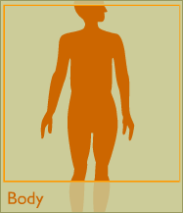
TISSUES
Cells with usually the same morphology grouped and composed tissues.
ORGANS
The sum of cells or tissues that perform a particular function.
SYSTEMS
Set of cells or tissues with a specific primary function.
Biology Lecture E. Anastasiadou Bioinformatics – Biomedical Data Science 2021-2022

Slide 50
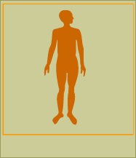
HUMAN ORGANISM
Cell set with unique organization and genetic information.
Unicellular, multicellular.
The human body consists of
~100 trillion cells.
Biology Lecture E. Anastasiadou Bioinformatics – Biomedical Data Science 2021-2022

Slide 51
ARISTOTELIS: "THE FATHER OF BIOLOGY"
Classification of species in classes based on
Phenotype: morphology (shape, internal structures).
Physiology:
the function of living structures
Differentiation
Biology Lecture E. Anastasiadou Bioinformatics – Biomedical Data Science 2021-2022

