Slide 1
BIOTECHNOLOGY

Slide 2
Genetic Engineering
DNA manipulation using molecular biology techniques.
Also known as:
Gene cloning
Genetic manipulation (GM)
Gene editing
NOT TO CONFUSE WITH ANIMAL CLONING
Biology Lecture E. Anastasiadou Bioinformatics – Biomedical Data Science 2021-2022

Slide 3
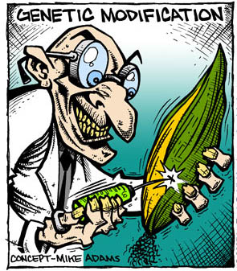
Genetic Engineering
Isolation and amplification of an individual sequence.
Involves the construction of novel DNA molecules by joining DNA from different sources.
Product of the process is Recombinant DNA (rDNA).
Biology Lecture E. Anastasiadou Bioinformatics – Biomedical Data Science 2021-2022

Slide 4
Gene Cloning – Basic Events
Isolation of DNA sequence of interest.
Incorporate DNA into a vector (small replicating DNA molecule, usually circular).
Introduce recombinant vector into host cell via transformation.
Select for the cells that have acquired the recombinant DNA molecule.
Multiply recombinant vector within host cell to produce a number of identical copies of the cloned gene.
https://www.youtube.com/watch?v=sjwNtQYLKeU
Biology Lecture E. Anastasiadou Bioinformatics – Biomedical Data Science 2021-2022

Slide 5
Cloning Vectors
A DNA molecule that contains information for replicating itself, called “origin of replication”. Therefore, if a piece of foreign DNA is incorporated into the vector, then the foreign DNA will be replicated along with the vector DNA.
Marker genes
Unique cleavage site(s)
For expression, must contain control elements,
such as promoters, terminators, ribosome binding sites,
etc...
MCS
Amp^{R}
X
pBR322
Amp^{R}: ampicillin resistance gene
X: sequence of interest
MCS: multiple clonig restriction site
ori: origin of replication
ori
Biology Lecture E. Anastasiadou Bioinformatics – Biomedical Data Science 2021-2022

Slide 6
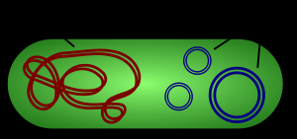
Types of Cloning Vectors
Plasmids. The most commonly used type of cloning vector. It is a small (4000 bp) circular DNA molecule found naturally in various types of bacteria. Plasmids can replicate independently of the bacterial chromosome (up to 15kb).
Cosmids. Plasmid vectors that contain a bacteriophage lamda cos site. The cos site results in efficient packaging of lamda DNA into virus particles. So, with the cos site, larger DNA inserts are possible (up to ~40 kb).
Phages. Viruses that attack bacteria, allowing lytic growth/cell death after infection and replication. Cell death revealed as plaques.
Transformation and selection is very easy and the insert rDNA (up to 30kb).
Yeast Artificial Chromosomes (YACs). Artificially produced mini chromosome with centromere, two teleomeres, origin of replication, plus marker genes. Can accommodate very large inserts (~1,000 – 2,000 kb)
Bacterial Artificial Chromosomes (BACs).
Viral vectors. Used to transfect cells difficult to transfect and in gene therapy.
Biology Lecture E. Anastasiadou Bioinformatics – Biomedical Data Science 2021-2022

Slide 7
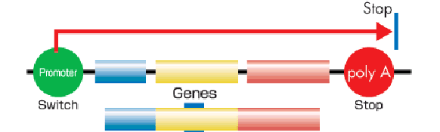
Transcriptional control Sequences
Promoter Element
– Site for initial RNA polymerase binding (eg.TATA-Box required at about 25 bp upstream of start codon)
Enhancer Sequences
– Usually located a few hundred bp upstream that stimulate the expression of genes
Transcription Factor Sequences
– Mediate the binding of RNA polymerase
Coding sequence
STOP codons and polyA tail
Biology Lecture E. Anastasiadou Bioinformatics – Biomedical Data Science 2021-2022

Slide 8
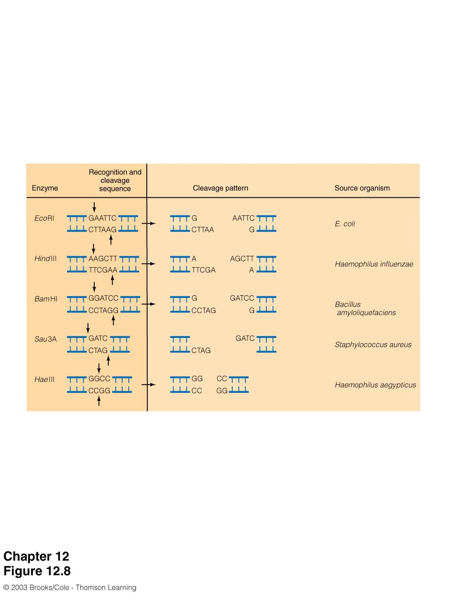
Restriction Enzymes
(Werner Arber, Daniel Nathans and Hamilton O. Smith Nobel Prize 1978)
Recognize a specific DNA sequence (4 to 6 bp) and cut the DNA.
Only found in prokaryotes for protection from foreign DNA (phages=bacterial viruses).
Over 100 different enzymes have been isolated from bacteria.
Biology Lecture E. Anastasiadou Bioinformatics – Biomedical Data Science 2021-2022

Slide 9
DNA Ligase
Seals single stranded nicks between adjacent nucleotides in a duplex DNA chain (catalyze the formation of a phosphodiester bond between adjacent 3’ hydroxyl and 5’ phosphate termini in DNA).
Biology Lecture E. Anastasiadou Bioinformatics – Biomedical Data Science 2021-2022

Slide 10
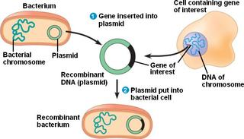
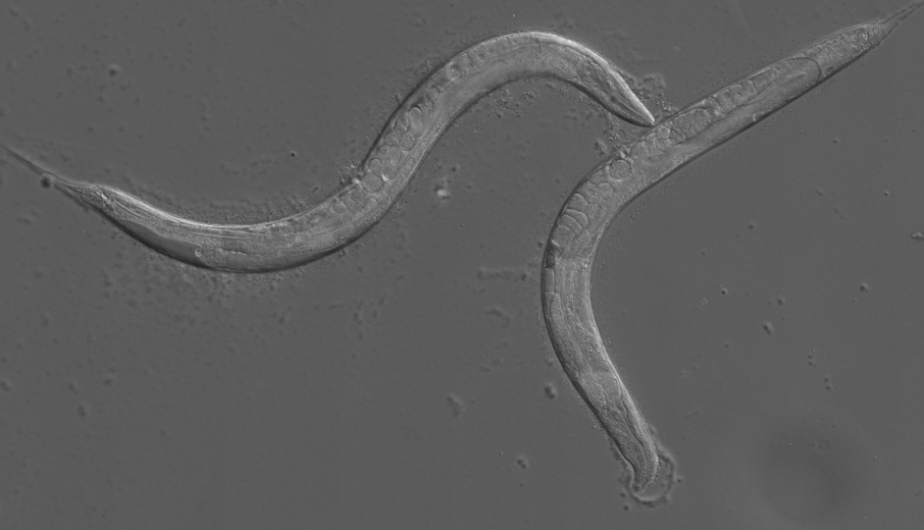
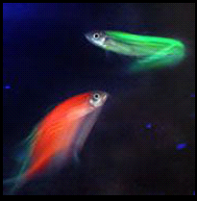
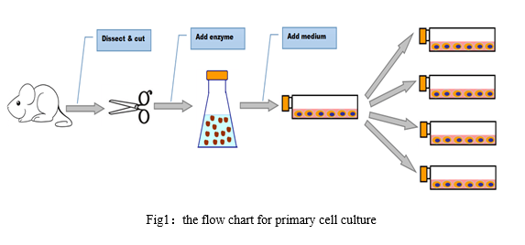
DNA Cloning
in vivo
in vitro
Biology Lecture E. Anastasiadou Bioinformatics – Biomedical Data Science 2021-2022

Slide 11
Transgenic mouse Engineering
Biology Lecture E. Anastasiadou Bioinformatics – Biomedical Data Science 2021-2022

Slide 12
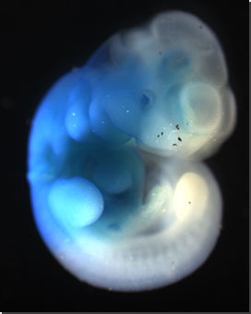
Transgenic mouse
https://www.youtube.com/watch?v=h-Bfc1GPWpE
Biology Lecture E. Anastasiadou Bioinformatics – Biomedical Data Science 2021-2022

Slide 13
Transgenic mouse
Advantages
Relatively quick
Easy cloning
Disadvantages
Spontaneous (random number and position of integration)
Not well controlled
False observations
> THREE FOUNDERS FOR RELIABLE RESULTS!!!!!!!!!!
Biology Lecture E. Anastasiadou Bioinformatics – Biomedical Data Science 2021-2022

Slide 14
Knock in/out mouse
ex6
ex7
exon 8
wt
Homologous Recombination
intron 5
in7
intron 8
ex6
AML
neo
exon 8
HSV tk
loxP
loxP
ex6
AML
neo
exon 8
ki
loxP
loxP
1 Kb
Biology Lecture E. Anastasiadou Bioinformatics – Biomedical Data Science 2021-2022

Slide 15
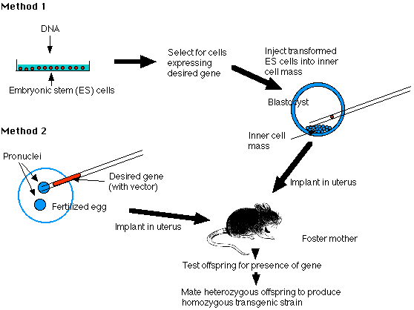
Genetically Engineered mice
KNOCK INS/OUTS
The Nobel Prize in Physiology or Medicine 2007 was awarded jointly to Mario R. Capecchi, Sir Martin J. Evans and Oliver Smithies "for their discoveries of principles for introducing specific gene modifications in mice by the use of embryonic stem cells.”
TRANSGENICS
Biology Lecture E. Anastasiadou Bioinformatics – Biomedical Data Science 2021-2022

Slide 16
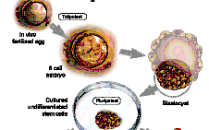
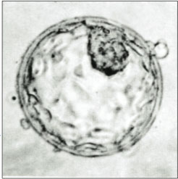
Embryonic Stem Cells
Cells from the inner layer of the blastocyst before implanting it into the uterus.
Blastocyst: 5th-6th day, after egg fertilization.
1998: 1st report of human embryonic stem cell isolation from IVF embryos.
https://www.youtube.com/watch?v=uCn1PQP2yAo
Biology Lecture E. Anastasiadou Bioinformatics – Biomedical Data Science 2021-2022
Notes:
16
Κύτταρα απ’ το εσωτερικό στρώμα της βλαστοκύστης, πριν την εμφύτευση της στη μήτρα
βλαστοκύστη: 5η-6η μέρα, απ’ τη γονιμοποίηση του ωαρίου
1998: 1η αναφορά απομόνωσης εμβρυονικών κυττάρων ανθρώπου, από έμβρυα τεχνητής γονιμοποίησης (IVF)

Slide 17
Embryonic Stem Cells - Definition
Stem cells are primary, undifferentiated cells, which have the ability, under specific conditions, to differentiate into the different cell types of the human body.
2001 Terese Winslow
Biology Lecture E. Anastasiadou Bioinformatics – Biomedical Data Science 2021-2022
Notes:
17
Τα βλαστικά κύτταρα είναι αρχέγονα, μη διαφοροποιημένα κύτταρα, που έχουν την ικανότητα υπό ειδικές συνθήκες να διαφοροποιούνται στους διάφορους κυτταρικούς τύπους, του ανθρώπινου οργανισμού

Slide 18
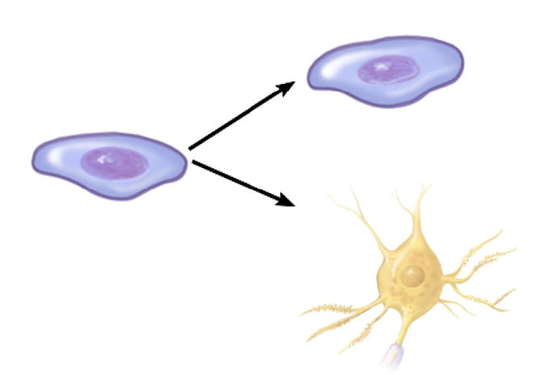
Embryonic Stem Cells - Properties
Proliferation and creation of similar, undifferentiated cells.
Differentiation, creation of different cell types.
stem cell
stem cell
neurocell
Totipotent (omnipotent) stem cells can give rise to any of the 220 cell types found in an embryo as well as extra-embryonic cells (placenta).
Biology Lecture E. Anastasiadou Bioinformatics – Biomedical Data Science 2021-2022
Notes:
18
1.Πολλαπλασιασμός και δημιουργία όμοιων, αδιαφοροποίητων κυττάρων
2.
2. Διαφοροποίηση, δημιουργία διαφόρων κυτταρικών τύπων
διαίρεση σε πανομοιότυπα κύτταρα
ικανότητα διαφοροποίησης σε όλα τα κύτταρα του οργανισμού
Totipotent Stem Cells
Totipotent (omnipotent) stem cells can give rise to any of the 220 cell types found in an embryo as well as extra-embryonic cells (placenta).
Pluripotent Stem Cells
Pluripotent stem cells can give rise to all cell types of the body (but not the placenta).
Multipotent Stem Cells
Multipotent stem cells can develop into a limited number of cell types in a particular lineage.

Slide 19
Genetically Engineered mice
KNOCK INS/OUTS
TRANSGENICS
Biology Lecture E. Anastasiadou Bioinformatics – Biomedical Data Science 2021-2022

Slide 20
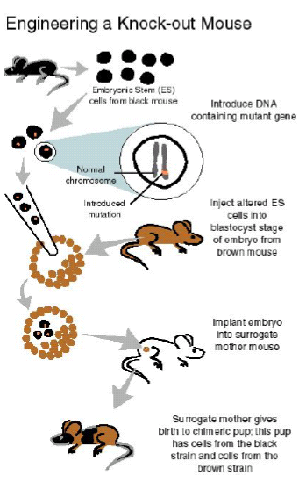
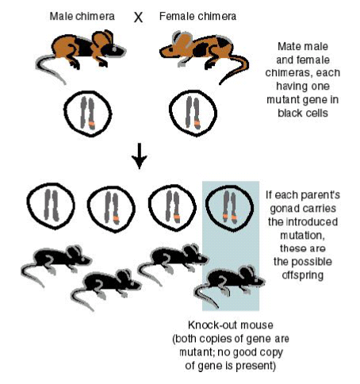
Knock in/out mouse Engineering
https://www.youtube.com/watch?v=1m9kQuKXxEA
Biology Lecture E. Anastasiadou Bioinformatics – Biomedical Data Science 2021-2022

Slide 21
Transgenic mouse
Advantages
Elegant design
Well controlled
Endogenous regulation elements
Disadvantages
Laborious
Time consuming
Embryonic lethality
Biology Lecture E. Anastasiadou Bioinformatics – Biomedical Data Science 2021-2022

Slide 22
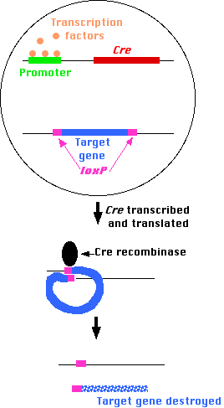
Conditional Expression
Site–specific Recombination systems:
Comprised by an endonuclease and
the DNA target sites (34 bp palindrome with 8 bp core).
FLP/FRT
from 2μ plasmid of Saccharomyces cerevisiae
to produce multiple plasmid copies from a single initiation site.
Cre/loxP
from P1 bacteriophage
to ensure stable plasmid maintenance by resolving DNA dimmers into plasmid monomers.
Biology Lecture E. Anastasiadou Bioinformatics – Biomedical Data Science 2021-2022

Slide 23
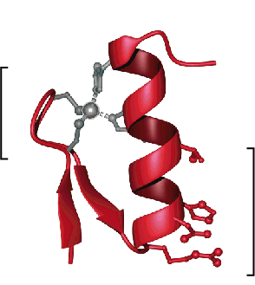
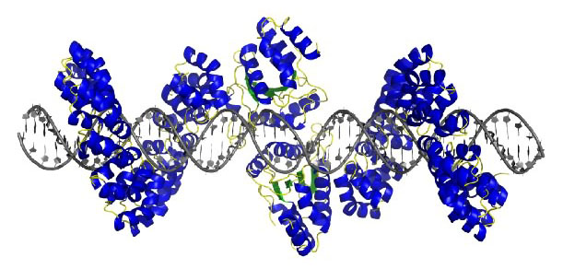
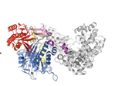
Next Generation Technology – Genome Editing
Tools for in situ gene modification
COOH
Zinc finger
TAL Effector Nuclease
CRISPR/Cas9
NH2
Biology Lecture E. Anastasiadou Bioinformatics – Biomedical Data Science 2021-2022
Notes:
These are various tools carried into cells that modify genes. For instance, the zinc finger technology, currently used in some clinical trials, acts a molecular scissors that cut out gene for CCR5, which mimics the absence of that gene that naturally occurred in the donor in Timothy Brown’s cure.

Slide 24
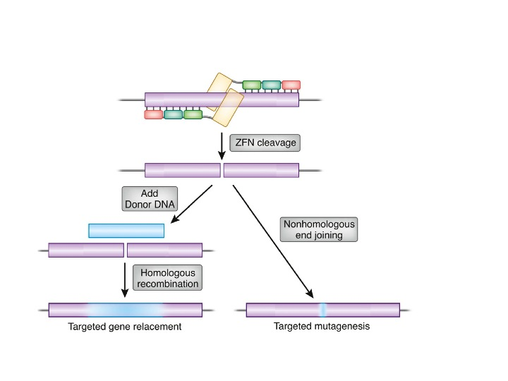
Tools for in situ Genome Editing
Zinc-finger nucleases (ZFNs) are artificial restriction enzymes generated by fusing a zinc finger DNA-binding domain to a DNA-cleavage domain. Zinc finger domains can be engineered to target desired DNA sequences within complex genomes. By taking advantage of endogenous DNA repair machinery, these reagents can be used to precisely alter the genomes of higher organisms.
The non-specific cleavage domain from the type IIs restriction endonuclease FokI used as the cleavage domain in ZFNs. It dimerizes in order to cleave DNA and thus a pair of ZFNs are required to target non-palindromic DNA sites. Standard ZFNs fuse the cleavage domain to the C-terminus of each zinc finger domain. In order to two cleavage domains to dimerize and cleave DNA, the two individual ZFNs must bind opposite strands of DNA with their C-termini a certain distance apart.
Several different protein engineering techniques have been employed to improve both the activity and specificity of the nuclease domain used in ZFNs: FokI variant with enhanced cleavage activity, Structure-based design by modifying the dimerization interface so that only the intended heterodimeric species are active.
The DNA-binding domains of individual ZFNs typically contain between three and six individual zinc finger repeats and can each recognize between 9 and 18 basepairs.
Manipulating the genomes of many plants and animals arabidopsis, tobacco, soybean, corn, Drosophila melanogaster, C. elegans, sea urchin, silkworm, zebrafish, frogs, mice, rats, rabbits, pigs, cattle, and various types of mammalian cells, a mouse model of haemophilia and an ongoing clinical trial is evaluating Zinc finger nucleases that disrupt the CCR5 gene in CD4+ human T-cells as a potential treatment for HIV/AIDS.
Biology Lecture E. Anastasiadou Bioinformatics – Biomedical Data Science 2021-2022

Slide 25
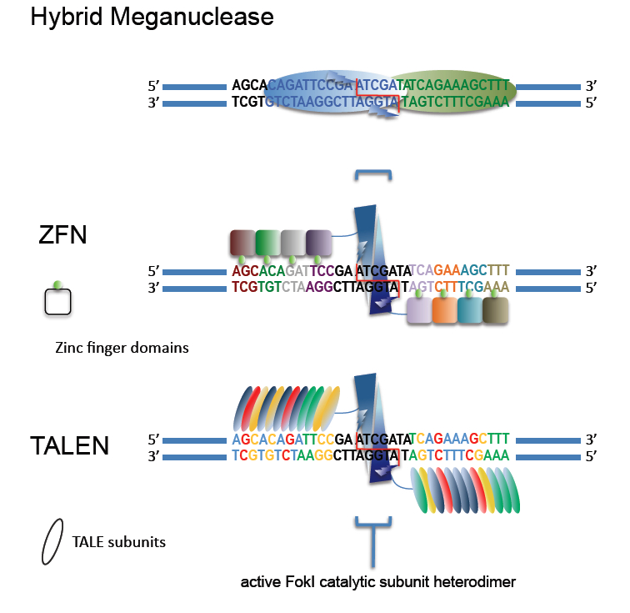
Tools for in situ Genome Editing
TAL (transcription activator-like) effectors are proteins secreted by Xanthomonas bacteria via their type III secretion system when they infect various plant species. These proteins can bind promoter sequences in the host plant and activate the expression of plant genes that aid bacterial infection. They recognize plant DNA sequences through a central repeat domain consisting of a variable number of ~34 amino acid repeats. There appears to be a one-to-one correspondence between the identity of two critical amino acids in each repeat and each DNA base in the target sequence. These proteins are interesting to researchers both for their role in disease of important crop species and the relative ease of retargeting them to bind new DNA sequences.
Non-homologous end joining (NHEJ) reconnects DNA from either side of a double-strand break where there is very little or no sequence overlap for annealing. This repair mechanism induces errors in the genome via insertion or deletion (indels), or chromosomal rearrangement. Alternatively, DNA can be introduced into a genome through NHEJ in the presence of exogenous double-stranded DNA fragments.
Homology directed repair can also introduce foreign DNA at the DSB as the transfected double-stranded sequences are used as templates for the repair enzymes.
TALENs have been used to generate stably modified human embryonic stem cell and induced pluripotent stem cell (IPSCs) clones, to generate knockout C. elegans, knockout rats, and knockout zebrafish.
Biology Lecture E. Anastasiadou Bioinformatics – Biomedical Data Science 2021-2022

Slide 26
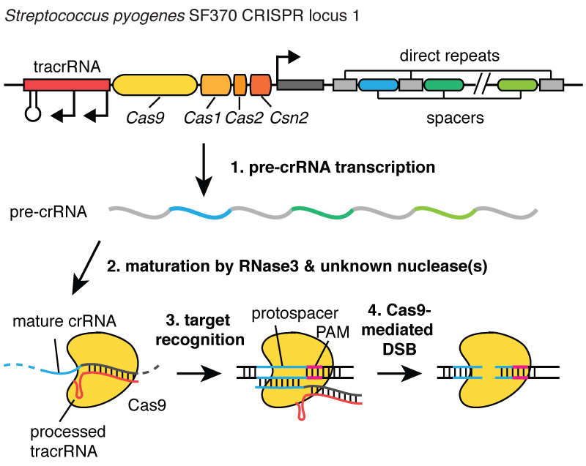
Tools for in situ Genome Editing
CRISPR is a microbial nuclease system involved in defense against invading phages and plasmids. CRISPR loci in microbial hosts contain a combination of CRISPR-associated (Cas) genes as well as non-coding RNA elements capable of programming the specificity of the CRISPR-mediated nucleic acid cleavage. Three types (I-III) of CRISPR systems have been identified across a wide range of bacterial hosts. One key feature of each CRISPR locus is the presence of an array of repetitive sequences (direct repeats) interspaced by short stretches of non-repetitive sequences (spacers). To license the associated Cas nuclease for nucleic acid cleavage, the non-coding CRISPR array is transcribed and cleaved within direct repeats into short crRNAs containing individual spacer sequences, which direct Cas nucleases to the target site (protospacer).
The Type II CRISPR, is one of the most well characterized systems and carries out targeted DNA double-strand break in four sequential steps.
two non-coding RNA, the pre-crRNA array and tracrRNA, are transcribed from the CRISPR locus.
tracrRNA hybridizes to the repeat regions of the pre-crRNA and mediates the processing of pre-crRNA into mature crRNAs containing individual spacer sequences.
the mature crRNA:tracrRNA complex directs Cas9 to the target DNA via Wastson-Crick base-pairing between the spacer on the crRNA and the protospacer on the target DNA next to the protospacer adjacent motif (PAM), an additional requirement for target recognition.
Cas9 mediates cleavage of target DNA to create a double-stranded break within the protospacer.
Biology Lecture E. Anastasiadou Bioinformatics – Biomedical Data Science 2021-2022

Slide 27
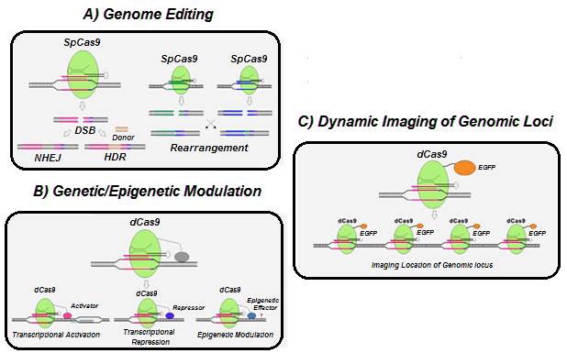
Applications of CRISPR/Cas
CRISPR/Cas application in (a) Genome Editing, (b) genetic/Epigenetic Modulation and (c) Dynamic imagining of Genomic loci.
Cas9 (dCas9) is a form of Cas9 mutated in nuclease domain, attached to the VP64 and P65 subunits of NF-KB, and KRAB domain as activator and suppressor proteins, respectively. It can be used to control the target gene expression.
(C) dCas9 attached to EGFP, useful for molecular genetic studies like telomere.
https://www.researchgate.net/publication/320254256
Biology Lecture E. Anastasiadou Bioinformatics – Biomedical Data Science 2021-2022

Slide 28
Applications of CRISPR/Cas
advances in genome editing
Gene deletions
Gene insertions
Translocations
Single-base editing
gene regulation by cRisPR–cas
Transcription regulators
CRISPR interference
CRISPR activation
Epigenome editing
Dynamic control of Cas9 function
Chemical induction
Optogenetics
cRisPR–cas targeting Rna
Biology Lecture E. Anastasiadou Bioinformatics – Biomedical Data Science 2021-2022

Slide 29
Genome Editing – Important Issues
During cell modification, the percentage of cells modified varies, and a low yield of modified cells is a barrier.
Enough cells must be modified to achieve a phenotypic (or therapeutic) effect.
Precision is key and a serious concern is “off target” editing.
If the genes other than those targeted are modified (off target editing), the potential for serious adverse events exist, including cancer.
https://www.youtube.com/watch?v=4YKFw2KZA5o
https://www.youtube.com/watch?v=2pp17E4E-O8
https://www.youtube.com/watch?v=9q8AGst7KiY
Biology Lecture E. Anastasiadou Bioinformatics – Biomedical Data Science 2021-2022
Notes:
The yield of modified cells is low at this time, and the question remains, what percentage of the cell population needs to be modified to create a clinical benefit?
One hypothesis is that the protected cells will be able to expand in vivo due to HIV targeting of the non-modified cells.
These drugs have side effects

Slide 30
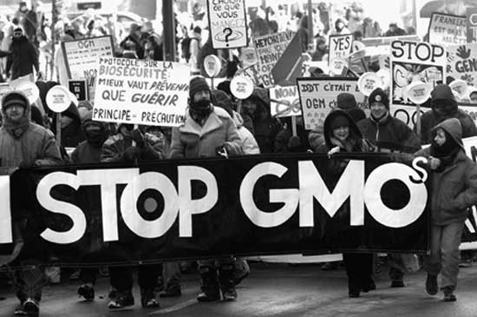
Applications
Microbial fermentations (eg. antibiotic production).
Vaccines (eg. Hepatitis B).
Mammalian proteins (eg. insulin, interferon, clotting factors).
Transgenic plants and animals (eg. insect/disease resistance, improved product quality, production of pharmaceuticals).
Environmental biotechnology
Gene therapy
Biology Lecture E. Anastasiadou Bioinformatics – Biomedical Data Science 2021-2022

Slide 31
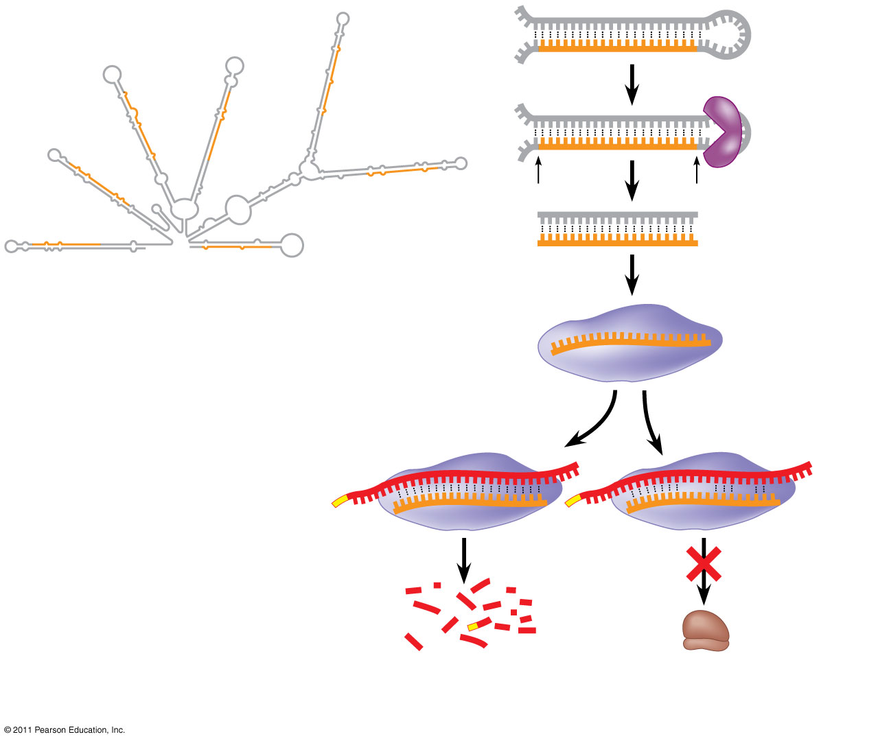
Gene Regulation by small RNA molecules
Two small single-stranded RNAs, miRNAs and siRNAs, that inhibit gene expression through post-transcriptional mechanisms.
The Nobel Prize in Physiology or Medicine 2006 was awarded jointly to Andrew Z. Fire and Craig C. Mello for their discovery of “RNA interference - gene silencing by double-stranded RNA."
mRNA degraded
Translation blocked
http://www.youtube.com/watch?v=AfXmDAqgFIg&feature=related
https://www.youtube.com/watch?v=5YsTW5i0Xro
Biology Lecture E. Anastasiadou Bioinformatics – Biomedical Data Science 2021-2022

Slide 32
Gene Repression by miRNAs & siRNAs
Two post-transcriptional mechanisms for inhibition of gene expression by small single-stranded RNAs were discovered relatively recently in C. elegans.
MicroRNAs (miRNAs) inhibit gene expression by blocking the translation of complementary mRNAs. Humans express about 500 miRNAs, and some plants express over 10⁶ miRNAs. Because a single miRNA can bind to more than one target mRNA, it is estimated that about 1/3 of all human genes may be regulated by miRNAs.
Short interfering RNAs (siRNAs) inhibit gene expression by specifically targeting a complementary mRNA for degradation. The mechanism of gene silencing by siRNA is known as RNA interference (RNAi) and is an important research tool. RNAi is thought to play a natural role in protection of cells from RNA viruses and retrotransposons.
Biology Lecture E. Anastasiadou Bioinformatics – Biomedical Data Science 2021-2022

Slide 33
Animal Cloning – The Fist Clones
In early 1950s in Philadelphia, Briggs and King successfully cloned 27 northern leopard frogs through a process known as nuclear transfer. They emptied frog eggs of their nuclei, sucked nuclei out of cells in frog embryos and injected those nuclei into the empty eggs. Many of the eggs developed into tadpoles that were genetically identical to the embryos that had donated their nuclear DNA.
in 1958 in Oxford, Gurdon et al. cloned frogs with nuclear DNA extracted from cells of fully formed tadpoles. They demonstrated that, when transplanted into an egg, nuclear DNA from a mature cell reverts to the more versatile state of an embryonic cell.
This breakthrough encouraged scientists to try cloning larger animals using DNA from adult cells.
In 1996 researchers in Scotland attempted to clone a female Finn-Dorset sheep.
Biology Lecture E. Anastasiadou Bioinformatics – Biomedical Data Science 2021-2022
Notes:
The first clones
In the early 1950s, at the Lankenau Hospital Research Institute in Philadelphia, Robert Briggs and Thomas King successfully cloned 27 northern leopard frogs through a process known as nuclear transfer. The nucleus, often called the command center of the cell, contains most of a vertebrate's DNA—except for the DNA within bean-shaped, energy-generating organelles named mitochondria. Briggs and King emptied frog eggs of their nuclei, sucked nuclei out of cells in frog embryos and injected those nuclei into the empty eggs. Many of the eggs developed into tadpoles that were genetically identical to the embryos that had donated their nuclear DNA.In 1958 John Gurdon, then at the University of Oxford, and colleagues cloned frogs with nuclear DNA extracted from the cells of fully formed tadpoles. Unlike embryonic cells, which are genetically flexible enough to become a variety of different tissues, a tadpole's cells are "differentiated"—that is, the patterns of genes they express have changed to fit the profile of a specific cell type: a skin, eye or heart cell, for example. Gurdon demonstrated that, when transplanted into an egg, nuclear DNA from a mature cell reverts to the more versatile state characteristic of DNA in an embryo's cells. This breakthrough encouraged scientists to try cloning far larger animals using DNA from adult cells.In 1996 researchers in Scotland attempted to clone a female Finn-Dorset sheep. They injected nuclei extracted from her udder cells into nearly 300 empty eggs derived from Scottish blackfaces, a different sheep breed. Out of those prepared eggs, the scientists managed to create more than 30 embryos. Only five of those embryos developed into lambs after being implanted in surrogate Scottish blackfaces. And only one of those lambs survived into adulthood. The researchers named her Dolly.

Slide 34
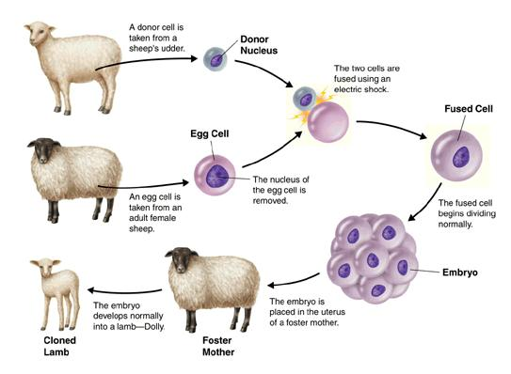
Animal Cloning – Methodology
Most common technique is nuclear transfer:
Nucleus is removed from an egg.
Enucleated eggs are fused with other cells.
- Embryos are transplanted into a surrogate mother.
Biology Lecture E. Anastasiadou Bioinformatics – Biomedical Data Science 2021-2022

Slide 35
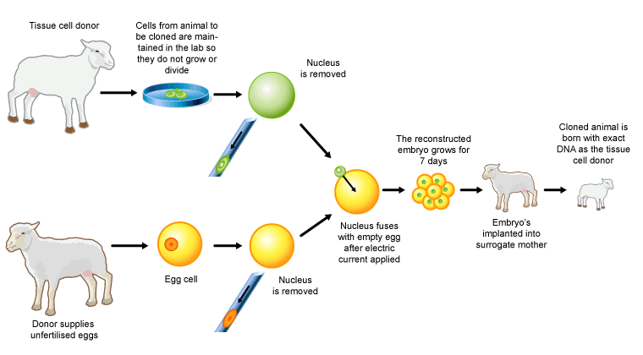
Animal Cloning - Dolly
They injected nuclei extracted from her udder cells into 300 empty eggs derived from Scottish blackfaces (a different sheep breed).
They created more than 30 embryos. Only 5 of those developed into lamps after been implanted in surrogate mothers and only one lamb survived into adulthood, They named her Dolly.
https://www.youtube.com/watch?v=hepoJgGJtNc
http://animalscience.ucdavis.edu/animalbiotech/ucdavis_biotech_streaming.asx
http://www.youtube.com/watch?v=g3PA3qA_ZSA
Biology Lecture E. Anastasiadou Bioinformatics – Biomedical Data Science 2021-2022

Slide 36
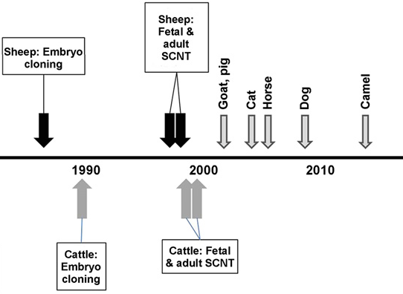
Animal Cloning – Examples
The following species being cloned:
carp, sheep, mice, cattle, goats, pigs, cats, rabbits, mules, horses, rats, and a deer.
Also been cloned (a banteng, a wild cow, and a mouflon, a kind of sheep). A gaur, a wild ox, was cloned but died within two days.
www.pnas.org/cgi/doi/10.1073
Attempts, without success:
monkeys, dogs, pandas, chickens
and at least two extinct species:
the Tasmanian tiger and the woolly mammoth. The mammoth experiment used an elephant surrogate and tissue found in permafrost.
Biology Lecture E. Anastasiadou Bioinformatics – Biomedical Data Science 2021-2022
Notes:
extinct mammal, the bucardo (a type of wild goat also called a Pyrenean ibex). The group of researchers, with members from Spain, France and Belgium, used cells from preserved samples from a bucardo captured in 1999 to produce the cloned animal, according to the study. However, the young goat died only minutes after its birth because of defects in her lungs.
the lone survivor after 1,095 dog embryos were implanted into 123 surrogate mother dogs, leading to just two births (the other puppy died a few weeks later)

Slide 37
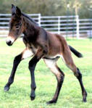

Risks regarding Animal Cloning
Expensive and highly inefficient.
Low success rates.
Cloned animals tend to have more compromised immune function and higher rates of infection, tumor growth and other disorders.
The overall efficiency of cloning is usually between 0 and 3% (number of live offspring as a percentage of the number of nuclear transfer).
Biology Lecture E. Anastasiadou Bioinformatics – Biomedical Data Science 2021-2022

Slide 38
Mouse Bone Marrow Transplantation
5-FU
(150mg/kg)
Prestimulation (IL-3, SCF, IL-6)
Harvest
Viral infection MSCV.H4/PDGFβR
2x450cGy
Spininfection (2x90min)
Retrovirus
Transplant Medium
(IL-3, IL-6, SCF)
Phenotype
Biology Lecture E. Anastasiadou Bioinformatics – Biomedical Data Science 2021-2022

Slide 39
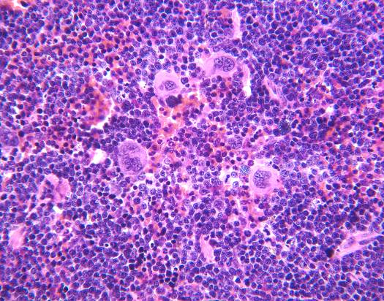
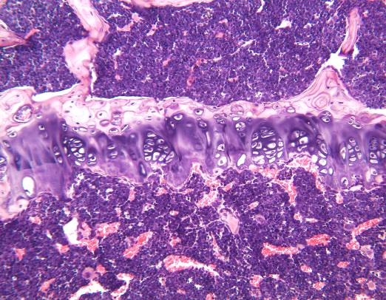
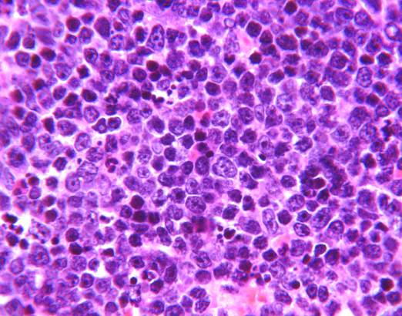
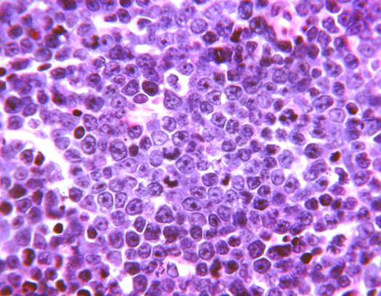
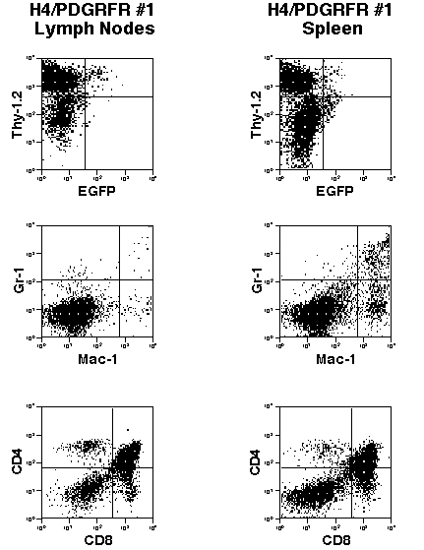
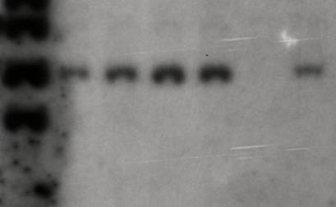
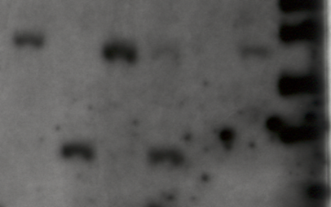
Mouse Bone Marrow Transplantation
Spleen
Bone marrow
H&E stain of tissue section.
Flow-cytometric analysis.
Spleen high
Lymph nodes high
bone marrow
bone marrow
lymph node
thymus
lymph node
thymus
spleen
spleen
heart
lung
heart
lung
10kb
10kb
8kb
8kb
6kb
6kb
5kb
5kb
Southern blot analysis.
Integration of the Provirus
Clonality of the Disease
LTR
LTR
H4/PDGFRβ
IRES
GFP
NheI
EcoRI
probe:
NheI
1kb
Biology Lecture E. Anastasiadou Bioinformatics – Biomedical Data Science 2021-2022

Slide 40
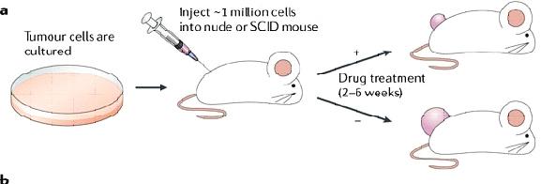
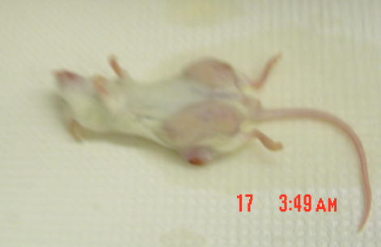
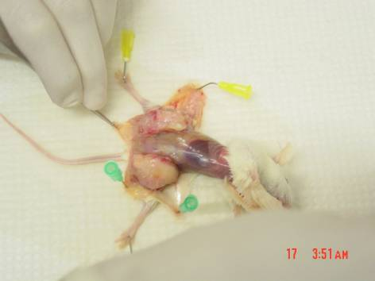
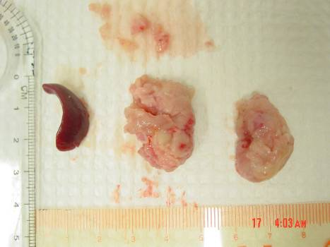
Mouse Xenografts
Biology Lecture E. Anastasiadou Bioinformatics – Biomedical Data Science 2021-2022

Slide 41

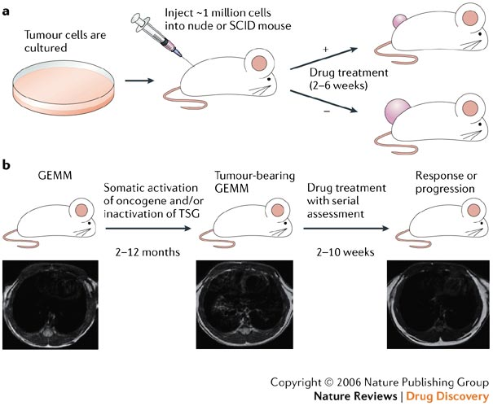
Mouse Xenografts
Mouse Xenografts - Drug pre-clinical trials
Biology Lecture E. Anastasiadou Bioinformatics – Biomedical Data Science 2021-2022

Slide 42
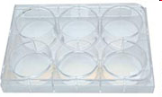

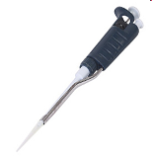
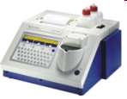
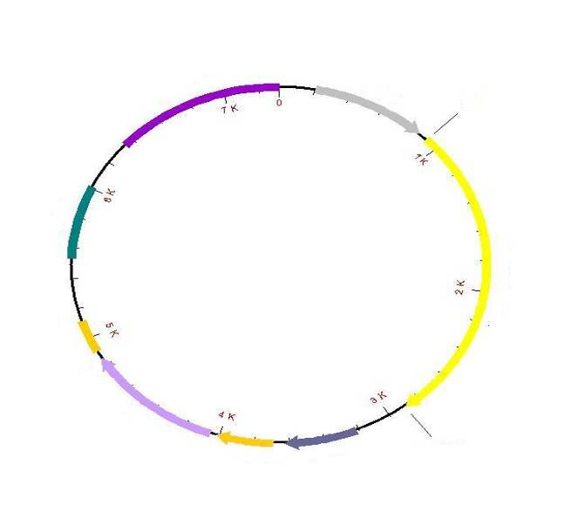
Mouse Xenografts - Experimental Scheme
Cloning
transfection
stable cell lines
in vitro luc measurements
Xenografts / tumor formation
selection
(expressing luc)
(Neo)
LIVE IMAGING
Amp
XhoI
pCMV
Tagged with the luc gene when a substrate is provided. The radiation that is measured corresponds to the number and location of the tagged entities.
ColE1
pCDNA3.1(-).luc
SV40 pA
luc
Neo
SV40 ori
f1 ori
BamHI
Biology Lecture E. Anastasiadou Bioinformatics – Biomedical Data Science 2021-2022

Slide 43
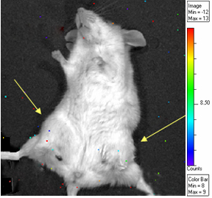
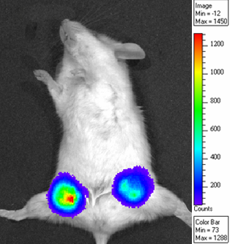
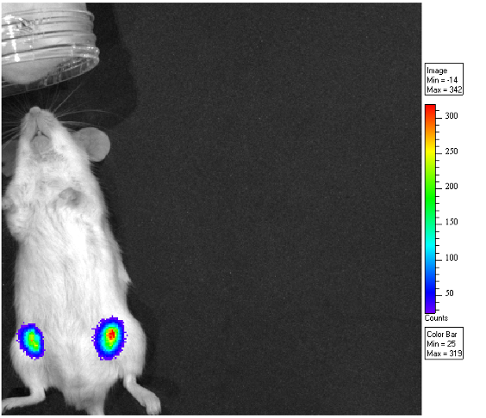
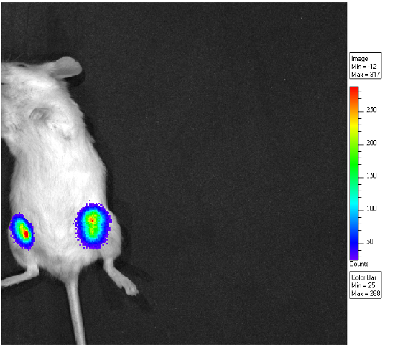
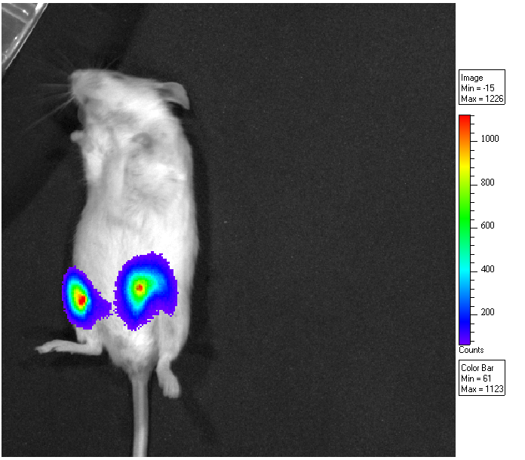
Mouse Xenografts - Live Imaging
Exp: 5sec
Exp: 5sec
Exp: 5sec
luc
luc
luc
2 week after
transplantation
3 week after
transplantation
4 week after
transplantation
Biology Lecture E. Anastasiadou Bioinformatics – Biomedical Data Science 2021-2022

Slide 44
Mouse Xenografts
Advantages
Quick
Humanized
Known (?) genetic events
Disadvantages
Spontaneous
Not well controlled
Compromised immune system
Biology Lecture E. Anastasiadou Bioinformatics – Biomedical Data Science 2021-2022

Slide 45
Genetic Engineering - Applications/Therapeutic Exploitations
Biology Lecture E. Anastasiadou Bioinformatics – Biomedical Data Science 2021-2022

Slide 46

Biology Lecture E. Anastasiadou Bioinformatics – Biomedical Data Science 2021-2022

Slide 47

What are Genetically Modified (GM) Foods?
GM is a special set of technologies that alter the genetic makeup of such living organisms as animals, plants, or bacteria.
Biotechnology, a more general term, refers to using living organisms or their components, such as enzymes, to make products that include wine, cheese, beer, and yogurt.
Combining genes from different organisms is known as recombinant DNA technology, and the resulting organism is said to be "genetically modified," "genetically engineered," or "transgenic."
GM products include medicines and vaccines, foods and food ingredients, feeds, and fibers.
Locating genes for important traits—such as those conferring insect resistance or desired nutrients—is one of the most limiting steps in the process. However, genome sequencing and discovery programs for hundreds of different organisms are generating detailed maps along with data-analyzing technologies to understand and use them.
Biology Lecture E. Anastasiadou Bioinformatics – Biomedical Data Science 2021-2022

Slide 48
Advantages of GM products
Pest resistance
Herbicide tolerance
Disease resistance
Cold tolerance
Drought tolerance/salinity tolerance
Nutrition
Pharmaceuticals
Biology Lecture E. Anastasiadou Bioinformatics – Biomedical Data Science 2021-2022

Slide 49
Examples of GM products
- rice with increased iron and vitamins that may alleviate chronic malnutrition in Asian countries
- variety of plants able to survive weather extremes
- bananas that produce human vaccines against infectious diseases such as hepatitis B
- fish that mature more quickly
- fruit and nut trees that yield years earlier
- plants that produce new plastics with unique properties.
Biology Lecture E. Anastasiadou Bioinformatics – Biomedical Data Science 2021-2022

Slide 50
Benefits of GM products
Crops
  Enhanced taste and quality
  Reduced maturation time
  Increased nutrients, yields, and stress tolerance
  Improved resistance to disease, pests, and herbicides
  New products and growing techniques
Animals
  Increased resistance, productivity, hardiness, and feed efficiency
  Better yields of meat, eggs, and milk
  Improved animal health and diagnostic methods
Environment
  "Friendly" bioherbicides and bioinsecticides
  Conservation of soil, water, and energy
  Bioprocessing for forestry products
  Better natural waste management
  More efficient processing
Society
  Increased food security for growing populations
Biology Lecture E. Anastasiadou Bioinformatics – Biomedical Data Science 2021-2022

Slide 51
Controversies of GM products
Safety
  Potential human health impact: allergens, transfer of antibiotic resistance markers, unknown effects
  Potential environmental impact: unintended transfer of transgenes through cross-pollination, unknown effects on other organisms (e.g., soil microbes), and loss of flora and fauna biodiversity
Access and Intellectual Property
  Domination of world food production by a few companies
  Increasing dependence on industralized nations by developing countries
  Biopiracy—foreign exploitation of natural resources
Ethics
  Violation of natural organisms' intrinsic values
  Tampering with nature by mixing genes among species
  Objections to consuming animal genes in plants and vice versa
Labeling
  Not mandatory in some countries (e.g., United States)
  Mixing GM crops with non-GM confounds labelling attempts
Society
  New advances may be skewed to interests of rich countries
Biology Lecture E. Anastasiadou Bioinformatics – Biomedical Data Science 2021-2022

Slide 52
https://www.youtube.com/watch?v=jAhjPd4uNFY
https://www.youtube.com/watch?v=4YKFw2KZA5o
https://www.youtube.com/watch?v=2pp17E4E-O8
https://www.youtube.com/watch?v=9q8AGst7KiY
https://www.youtube.com/watch?v=7TmcXYp8xu4
Biology Lecture E. Anastasiadou Bioinformatics – Biomedical Data Science 2021-2022

Slide 53

Gene Therapy
WHAT IS GENE THERAPY?
A "normal" gene is inserted into the genome to replace an "abnormal" disease-causing gene.
HOW DOES IT WORK?
A carrier molecule called “vector” is used to deliver the therapeutic gene to the patient's target cells.
WHAT TYPE OF VECTORS ARE COMMONLY USED?
Vectors are usually viral origin that can encapsulate and deliver their genes to human cells.
Biology Lecture E. Anastasiadou Bioinformatics – Biomedical Data Science 2021-2022

Slide 54

Types of Vectors
Some of the different types of viruses used as gene therapy vectors:
Retroviruses - A class of viruses that can create double-stranded DNA copies of their RNA genomes and integrate it into the chromosomes of host cells (Human immunodeficiency virus)
Adenoviruses - A class of viruses with double-stranded DNA (respiratory, intestinal, and eye infections, common cold)
Adeno-associated viruses - A class of small, single-stranded DNA viruses that can insert their genetic material at a specific site on chromosome 19.
Herpes simplex viruses - A class of double-stranded DNA viruses that infect a particular cell type, neurons (Herpes simplex virus type 1 causes cold sores).
Biology Lecture E. Anastasiadou Bioinformatics – Biomedical Data Science 2021-2022

Slide 55
Vectors - Advantages and Disadvantages
Adenovirus
  Infects many cell types.
  Does not integrate into host genome and can be lost.
Retrovirus
  Integrates into host genome and cannot be lost.
  Integrates into host genome and can cause cancer.
Adeno-Associated Virus (AAV)
  Integrates into host genome and cannot be lost.
  Difficult to work with.
Herpes Simplex Virus (HSV)
  DNA stays in nucleus without integrating into host genome.
  Only infects cells of the nervous system.
Biology Lecture E. Anastasiadou Bioinformatics – Biomedical Data Science 2021-2022

Slide 56

Treating severe combined immune deficiency (SCID)
The Boy in the Bubble
A broken gene eliminates the production of an enzyme essential for the development of a normal immune system. The normal copy of the gene was isolated and packaged into a vector.
Biology Lecture E. Anastasiadou Bioinformatics – Biomedical Data Science 2021-2022

Slide 57

Treating severe combined immune deficiency (SCID)
In the laboratory, the gene is transferred into the patient's own bone marrow cells. Bone marrow cells create the immune system. The treated bone marrow cells are then given back to the patient in a germ-free isolation room, where they reconstitute a normal, functioning immune system, freeing the patient from the need to remain in isolation.
Biology Lecture E. Anastasiadou Bioinformatics – Biomedical Data Science 2021-2022

Slide 58
Factors that negatively affect Gene Therapy Treatments
Short-lived nature of gene therapy - Problems with integrating therapeutic DNA into the genome and the rapidly dividing nature of many cells prevent gene therapy from achieving any long-term benefits. Patients will have to undergo multiple rounds of gene therapy.
Immune response - Anytime a foreign object is introduced into human tissues, the immune system is designed to attack the invader. The risk of stimulating the immune system in a way that reduces gene therapy effectiveness is always a potential risk. Furthermore, the immune system's enhanced response to invaders it has seen before makes it difficult for gene therapy to be repeated in patients.
Problems with viral vectors - Viruses, present a variety of potential problems to the patient --toxicity, immune and inflammatory responses, and gene control and targeting issues. In addition, there is always the fear that the viral vector, once inside the patient, may recover its ability to cause disease.
Multigene disorders - The most commonly occurring disorders, such as heart disease, high blood pressure, Alzheimer's disease, arthritis, and diabetes, are caused by the combined effects of variations in many genes. Multigene or multifactorial disorders such as these would be especially difficult to treat effectively using gene therapy.
Biology Lecture E. Anastasiadou Bioinformatics – Biomedical Data Science 2021-2022

Slide 59
Current status of Gene Therapy Research
Little progress has been made since the first gene therapy clinical trial began in 1990.
In 1999, 18-year-old Jesse Gelsinger died from multiple organ failures 4 days after starting the treatment. Jesse was participating in a gene therapy trial for ornithine transcarboxylase deficiency (OTCD). His death is believed to have been triggered by a severe immune response to the adenovirus carrier.
In January 2003, FDA placed a temporary halt on all gene therapy trials using retroviral vectors in blood stem cells, after a second child treated in a French gene therapy trial had developed a leukemia-like condition. Both this child and another who had developed a similar condition in August 2002 had been successfully treated by gene therapy for X-linked severe combined immunodeficiency disease (X-SCID), also known as "bubble baby syndrome”.
However, in 2019, researchers used a different type of virus, one related to HIV, to transport genes that may prevent these side effects. They collected bone marrow from eight newborns with X-SCID and loaded corrective genes into the disabled HIV-related virus. The infants also received low doses of busulfan, a chemotherapy that gave the doctored stem cells room to grow. The study recently added its 12th patient.
Biology Lecture E. Anastasiadou Bioinformatics – Biomedical Data Science 2021-2022
Notes:
n 2019, researchers used a different type of virus — one related to HIV — to transport genes that may prevent these side effects. In an April study, researchers at St. Jude Children’s Research Hospital in Memphis, Tennessee, and UCSF Benioff Children’s Hospital in Oakland collected bone marrow from eight newborns with SCID-X1. They loaded corrective genes into the disabled HIV-related virus, which carried them into the patients’ bone marrow stem cells. The infants also received low doses of busulfan, a chemotherapy that gave the doctored stem cells room to grow. “So far, we haven’t seen anything worrisome,” says Ewelina Mamcarz, a pediatric oncologist at St. Jude who led the research team. The study recently added its 12th patient.
HIV1 & 2: lentivirus, ssRNA, insert capacity 8Kb, broad host range, low cytotoxicity, integration, long-term expression ,

Slide 60
Tools for in situ Genome Editing
CRISPR is a microbial nuclease system involved in defense against invading phages and plasmids. CRISPR loci in microbial hosts contain a combination of CRISPR-associated (Cas) genes as well as non-coding RNA elements capable of programming the specificity of the CRISPR-mediated nucleic acid cleavage. Three types (I-III) of CRISPR systems have been identified across a wide range of bacterial hosts. One key feature of each CRISPR locus is the presence of an array of repetitive sequences (direct repeats) interspaced by short stretches of non-repetitive sequences (spacers). To license the associated Cas nuclease for nucleic acid cleavage, the non-coding CRISPR array is transcribed and cleaved within direct repeats into short crRNAs containing individual spacer sequences, which direct Cas nucleases to the target site (protospacer).
The Type II CRISPR, is one of the most well characterized systems and carries out targeted DNA double-strand break in four sequential steps.
two non-coding RNA, the pre-crRNA array and tracrRNA, are transcribed from the CRISPR locus.
tracrRNA hybridizes to the repeat regions of the pre-crRNA and mediates the processing of pre-crRNA into mature crRNAs containing individual spacer sequences.
the mature crRNA:tracrRNA complex directs Cas9 to the target DNA via Wastson-Crick base-pairing between the spacer on the crRNA and the protospacer on the target DNA next to the protospacer adjacent motif (PAM), an additional requirement for target recognition.
Cas9 mediates cleavage of target DNA to create a double-stranded break within the protospacer.
Biology Lecture E. Anastasiadou Bioinformatics – Biomedical Data Science 2021-2022

Slide 61
Genome Editing - Applications
Microbial fermentations (eg. antibiotic production).
Vaccines (eg. Hepatitis B).
Mammalian proteins (eg. insulin, interferon, clotting factors).
Transgenic plants and animals (eg. insect/disease resistance, improved product quality, production of pharmaceuticals).
Environmental biotechnology
Gene therapy
Biology Lecture E. Anastasiadou Bioinformatics – Biomedical Data Science 2021-2022

Slide 62
Current status of Gene Therapy Research - CRISPR
CRISPR-Cas9 has improved conventional gene therapy because of its potential precision.
Cells from patients immune systems were removed, CRISPR was used to genetically edit the cells in the lab, and then returned them back into the patients’ bodies.
Hundreds of research studies (clinical trials) are under way to test gene therapy as a treatment for genetic conditions, cancer, and HIV/AIDS.
Recently, scientists begun using CRISPR for cancer treatments, such as multiple myeloma or sarcoma, sickle cell disease.
Several other CRISPR studies are in the works to treat a range of inherited disorders, including hemophilia and X-SCID.
Biology Lecture E. Anastasiadou Bioinformatics – Biomedical Data Science 2021-2022

Slide 63
Gene Regulation by small RNA molecules
Two small single-stranded RNAs, miRNAs and siRNAs, that inhibit gene expression through post-transcriptional mechanisms.
The Nobel Prize in Physiology or Medicine 2006 was awarded jointly to Andrew Z. Fire and Craig C. Mello for their discovery of “RNA interference - gene silencing by double-stranded RNA."
mRNA degraded
Translation blocked
http://www.youtube.com/watch?v=AfXmDAqgFIg&feature=related
https://www.youtube.com/watch?v=5YsTW5i0Xro
Biology Lecture E. Anastasiadou Bioinformatics – Biomedical Data Science 2021-2022

Slide 64
Gene Repression by miRNAs & siRNAs
Two post-transcriptional mechanisms for inhibition of gene expression by small single-stranded RNAs were discovered relatively recently in C. elegans.
MicroRNAs (miRNAs) inhibit gene expression by blocking the translation of complementary mRNAs. Humans express about 500 miRNAs, and some plants express over 10⁶ miRNAs. Because a single miRNA can bind to more than one target mRNA, it is estimated that about 1/3 of all human genes may be regulated by miRNAs.
Short interfering RNAs (siRNAs) inhibit gene expression by specifically targeting a complementary mRNA for degradation. The mechanism of gene silencing by siRNA is known as RNA interference (RNAi) and is an important research tool. RNAi is thought to play a natural role in protection of cells from RNA viruses and retrotransposons.
Biology Lecture E. Anastasiadou Bioinformatics – Biomedical Data Science 2021-2022

Slide 65
Cell Therapy - Terminology
Gene therapy is the the delivery of therapeutic gene into a patient's cells to treat disease.
Cell therapy is the delivery of intact, living cells into a patient to treat disease.
A branch of Regenerative Medicine, an emerging field that involves the "process of replacing, engineering or regenerating human cells, tissues or organs to restore or establish normal function” lost due to age, disease, damage, or congenital defects.
Biology Lecture E. Anastasiadou Bioinformatics – Biomedical Data Science 2021-2022

Slide 66

Cell Therapy - Applications
Treatment of neural diseases such as Parkinson’s, Huntington’s and Alzheimer’s.
Repair severe burns, spinal cord injury and skin diseases.
Repair of damaged organs such as the liver and pancreas (eg. in diabetes).
Treatments for AIDS, heart disease, cancer, etc..
Biology Lecture E. Anastasiadou Bioinformatics – Biomedical Data Science 2021-2022

Slide 67

Stem Cells - Definition
The stem cells are progenitor, undifferentiated cells that have the ability to differentiate to various cell types under specific conditions.
2001 Terese Winslow
Biology Lecture E. Anastasiadou Bioinformatics – Biomedical Data Science 2021-2022

Slide 68
Cell Differentiation
Within multicellular organisms, cells work together to carry out a specific function and are organized in communities, the tissues.
The spatial organization of the cells that form a tissue depends in part on polarity, or the orientation of particular cells in their place.
External signals from neighboring cells or from the extracellular matrix are also important influences on the arrangement of cells in a tissue.
The signals dictate different transcriptional programs and dividing rates. Proper regulation of these rates is essential to tissue maintenance and repair.
The exact role of a tissue in an organism depends on what types of cells it contains. For example, the endothelial tissue that lines the human gastrointestinal tract consists of several cell types. Some of these cells absorb nutrients from the digestive contents, whereas others (called goblet cells) secrete a lubricating mucus that helps the contents travel smoothly.
2001 Terese Winslow
Biology Lecture E. Anastasiadou Bioinformatics – Biomedical Data Science 2021-2022

Slide 69


Cell Differentiation
When cells express specific genes that characterise a certain type, the cell has become differentiated.
Once a cell becomes differentiated it only expresses the genes that produce the proteins characteristic for that cell type.
2001 Terese Winslow
Biology Lecture E. Anastasiadou Bioinformatics – Biomedical Data Science 2021-2022

Slide 70

Stem Cells - Definition
Stem cells have the ability to continually reproduce themselves while maintaining the capacity to give rise to other more specialized cells.
Stem cells are found at all stages of development, from embryonic stem (ES) cells that can differentiate into all specialized cells found in the human body, to adult stem cells capable of regenerating their tissue of origin.
www.family.org.au/bioethics/cloning
2001 Terese Winslow
Biology Lecture E. Anastasiadou Bioinformatics – Biomedical Data Science 2021-2022

Slide 71

Stem Cells - Sources
Stem cells can be found in:
Embryos, stem cells function to generate new organs and tissues.
Adults, they function to replace cells during the natural course of cell turnover.
Biology Lecture E. Anastasiadou Bioinformatics – Biomedical Data Science 2021-2022
Notes:
71

Slide 72
Embryonic Stem Cells
ES cells are found at the blastocyst stage, four to five days after the union of the sperm and egg, before the embryo implants in the uterus.
1998: 1st report of isolation of human embryonic cells from in vitro fertilization embryos (IVF).
ability to differentiate to all cell types of an organism.
Biology Lecture E. Anastasiadou Bioinformatics – Biomedical Data Science 2021-2022
Notes:
72

Slide 73

Adult Stem Cells
Stem cells are present within most of the adult tissues, such as bone marrow, liver, epidermis, retina, skeletal muscle, intestine, brain, dental pulp and elsewhere.
Adult stem cells are undifferentiated cells.
They are found in small numbers in most adult tissues.
They are also called “somatic stem cells,”
They are multipotent in nature.
They give rise to a closely related family of cells within the tissue.
Biology Lecture E. Anastasiadou Bioinformatics – Biomedical Data Science 2021-2022

Slide 74
Stem Cells - Types
Pluripotent
Embryonal stem cell
Totipotent stem cells
Totipotent: Can become any cell in body or placenta.
Pluripotent
stem cells
Pluripotent: Can become any cell in body.
Multipotent: Can become any cell within a specific germ layer or cell lineage.
Somatic
stem cell
Germ
Stem cell
Somatic Cell
Endoderm Ectoderm Mesoderm
Primitive
germ cell
Adult Multipotent stem cell
Liver
Intestine
Pancreas
Skin
Hair
Nerves
Blood
Muscle
Bone
Cartilage
Gametes
Biology Lecture E. Anastasiadou Bioinformatics – Biomedical Data Science 2021-2022

Slide 75


Induced Pluripotent Stem Cells (iPSC)
Skin cells are converted back into embryo-like state (pluripotency).
The pluripotent cells are modified.
Modified cells differentiated and returned.
Skin biopsy
Fibroblast reprogramming
iPSCs generation
Gene-modified
Transfer
Biology Lecture E. Anastasiadou Bioinformatics – Biomedical Data Science 2021-2022
Notes:
Y.W. Kan (UCSF) published in 2014 an iPSC approach.
Fibroblasts were removed from a skin biopsy taken from a patient.
Genes were delivered into the cells that reprogrammed them to back to an embryo-like state of pluripotency.
These wild-type induced pluripotent stem cells were gene modified to have the natural CCR5Δ32 mutation (“exactly mimicking the natural mutation”) like the cells of Timothy Brown’s donor.
The pluripotent cells were differentiated into monocytes and macrophages
The modified cells were resistant to HIV infection in vitro.
Could be a limitless source of gene modified immune cells matched to the patient who is the source of cells.

Slide 76

Induced Pluripotent Stem Cells (iPSC)
Virus engineered
to express four
key “pluripotency”
genes
Oct4, Sox2, Klf4, and c-Myc
Pros: No embryos required
No immune rejection?
Disease in a dish?
Cons: May not be = to ESCs
Genetically engineered
Skin cells
iPS cells
Biology Lecture E. Anastasiadou Bioinformatics – Biomedical Data Science 2021-2022
Notes:
Four years ago, Shinya Yamanaka, a Japanese scientist who trained and worked at the Gladstone Institute at UC San Francisco, made a breakthrough discovery and showed that adult skin cells could be REPROGRAMMED (using genes encoded by viruses) into cells that resemble embryonic stem cells.
In induced Pluripotent Stem Cell technology, you FIRST isolate and culture skin cells from a patient. SECOND, you introduce three or four pluripotency genes into the skin cells by using an engineered virus carrier. THE EXPRESSION OF THESE GENES REGENERATES THE STEM CELL PHENOTYPE. The viruses simply deliver the genes of interest and are themselves engineered not to be harmful.
The advantages are that the induced Pluripotent Stem cells would be genetically identical to the person who donated the skin cells, so any cells derived from these iPS cells would not be rejected by the patient’s immune system as with clone-derived cells. So ultimately, this would be a move toward personalized, cell-based therapies.
For now, these cells are perfect for making and studying diseases in a dish to promote basic research. But many important details need to be worked out before this tool is used as an actual technology in the clinic to treat patients.

Slide 77

Biology Lecture E. Anastasiadou Bioinformatics – Biomedical Data Science 2021-2022

Slide 78









Overview of
the Microbiome
ll
1
Lita Proctor
HMP

Slide 79
Definition
Microbiota: the collective microorganisms
Microbiome: the collection of all genomes of microbes (including bacteria, bacteriophage, fungi, protozoa, and viruses) in an ecosystem, particularly the collection living in and on the human body.
Dysbiosis: dysregulated (abnormal) microbiota. Common to many diseases including diabetes, colon cancer, and IBD
Biology Lecture E. Anastasiadou Bioinformatics – Biomedical Data Science 2021-2022

Slide 80

Increasing Interest
Biology Lecture E. Anastasiadou Bioinformatics – Biomedical Data Science 2021-2022

Slide 81

Microbiome By the Numbers
Microbiome by the Numbers
Humans harbor 100+ trillion bacteria
90% of human cells are microbial
100x more microbial genes as compared to human genes
Between individuals, 99% of human genome is similar, whereas < 20% of microbial genome is similar
Lynch. NEJM 2016; 375(24): 2369.
Biology Lecture E. Anastasiadou Bioinformatics – Biomedical Data Science 2021-2022

Slide 82
Microbes Functional Roles
Biology Lecture E. Anastasiadou Bioinformatics – Biomedical Data Science 2021-2022

Slide 83

The Role of Gut Microbiota in Health and Disease
CVD: cardiovascular disease
IPA: indolepropionic acid LPS: lipopolysaccharide SCFA: short chain fatty acids
TMAO: trimethylamine N-oxide
Biology Lecture E. Anastasiadou Bioinformatics – Biomedical Data Science 2021-2022

Slide 84

The Western Microbiota Diverges from that of
Non-Western Populations
Biology Lecture E. Anastasiadou Bioinformatics – Biomedical Data Science 2021-2022

Slide 85

The Gut Microbiota during the human Lifespan
Biology Lecture E. Anastasiadou Bioinformatics – Biomedical Data Science 2021-2022

Slide 86

Intra-Individual Diversity
Biology Lecture E. Anastasiadou Bioinformatics – Biomedical Data Science 2021-2022

Slide 87

Composition and luminal concentrations of dominant microbial species in regions of the gastrointestinal tract
Gastroenterology 2008 134(2)
Biology Lecture E. Anastasiadou Bioinformatics – Biomedical Data Science 2021-2022

Slide 88

Biology Lecture E. Anastasiadou Bioinformatics – Biomedical Data Science 2021-2022
Notes:
88

Slide 89

Gut – CNS Axis
Haas. Immunol 2018; 154: 230.
Biology Lecture E. Anastasiadou Bioinformatics – Biomedical Data Science 2021-2022

Slide 90

Bacterial Dysbiosis
Biology Lecture E. Anastasiadou Bioinformatics – Biomedical Data Science 2021-2022

Slide 91

Fecal Microbiota Transplantation
Biology Lecture E. Anastasiadou Bioinformatics – Biomedical Data Science 2021-2022

Slide 92

Human Microbiome Project
Biology Lecture E. Anastasiadou Bioinformatics – Biomedical Data Science 2021-2022

Slide 93

Methods to study the Microbiome
Biology Lecture E. Anastasiadou Bioinformatics – Biomedical Data Science 2021-2022

Slide 94

Virome
Virgin et al., 2014 Cell 157:142
Biology Lecture E. Anastasiadou Bioinformatics – Biomedical Data Science 2021-2022

