Slide 1
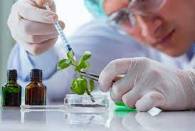
BIOTECHNOLOGY - DEFINITION
Biotechnology is the technology that utilizes biological systems, living organisms or parts of these to develop or create different products through synthesis, breakdown or transformation of materials.
Biotechnology Lecture E. Anastasiadou Bioinformatics – Biomedical Data Science 2021-2022

Slide 2
BIOTECHNOLOGY - HISTORY
Biotechnology has been around for centuries as people have used microorganisms to make beer, wine, bread, yoghurts and cheeses.
But since the beginning of the 20th century, the nature of biotechnology has changed dramatically.
The latest technologies manipulate the DNA to produce genetically modified organisms which can be used to synthesize medicines or other chemicals for medical use.
At the beginning of the 21st century, biotechnology has expanded to include new and diverse sciences, such as genomics, recombinant gene techniques, applied immunology, and development of pharmaceutical therapies and diagnostic tests.
Biotechnology Lecture E. Anastasiadou Bioinformatics – Biomedical Data Science 2021-2022

Slide 3
Biotechnology is a broad area of biology, depending on the tools and applications, it often overlaps with related scientific fields.
Biotechnology Lecture E. Anastasiadou Bioinformatics – Biomedical Data Science 2021-2022

Slide 4
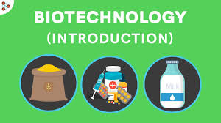
AREAS of BIOTECHNOLOGY
Biotechnology has applications in four major areas including:
Medical (health care),
examples: vaccines, antibiotics
Agriculture and crop production,
examples: pest resistant corps, plant and animal breeding
Industrial (non-food) uses of crops and other products
examples: biodegradable plastics, vegetable oil, biofuels, and
- Environmental
Biotechnology Lecture E. Anastasiadou Bioinformatics – Biomedical Data Science 2021-2022

Slide 5
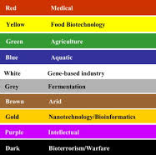
COLORS of BIOTECHNOLOGY
Green biotechnology is applied to agricultural processes, such as the selection and domestication of plants via micropropagation, the designing of transgenic plants to grow under specific environments in the presence (or absence) of chemicals; the engineering of a plant to express a pesticide, thereby ending the need of external application of pesticides; can be seen as a platform to eradicate world hunger or involve microorganisms to clean and reduce waste.
Blue biotechnology is based on the exploitation of sea resources to create products and industrial applications. This branch of biotechnology is the most used for the industries of refining and combustion principally on the production of bio-oils with photosynthetic micro-algae.
Biotechnology Lecture E. Anastasiadou Bioinformatics – Biomedical Data Science 2021-2022

Slide 6
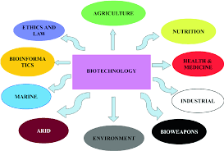
COLORS of BIOTECHNOLOGY
White biotechnology, also known as industrial biotechnology, is applied to industrial processes, such as the designing of an organism to produce a useful chemical, the using of enzymes as industrial catalysts to either produce valuable chemicals or destroy hazardous/polluting chemicals. White biotechnology tends to consume less in resources than traditional processes used to produce industrial goods.
Yellow biotechnology refers to the use of biotechnology in food production (food industry), such as winemaking, cheesemaking, brewing (by fermentation). It also includes biotechnology-based approaches for the control of harmful insects, insects for research with applications in agriculture and medicine.
Biotechnology Lecture E. Anastasiadou Bioinformatics – Biomedical Data Science 2021-2022

Slide 7
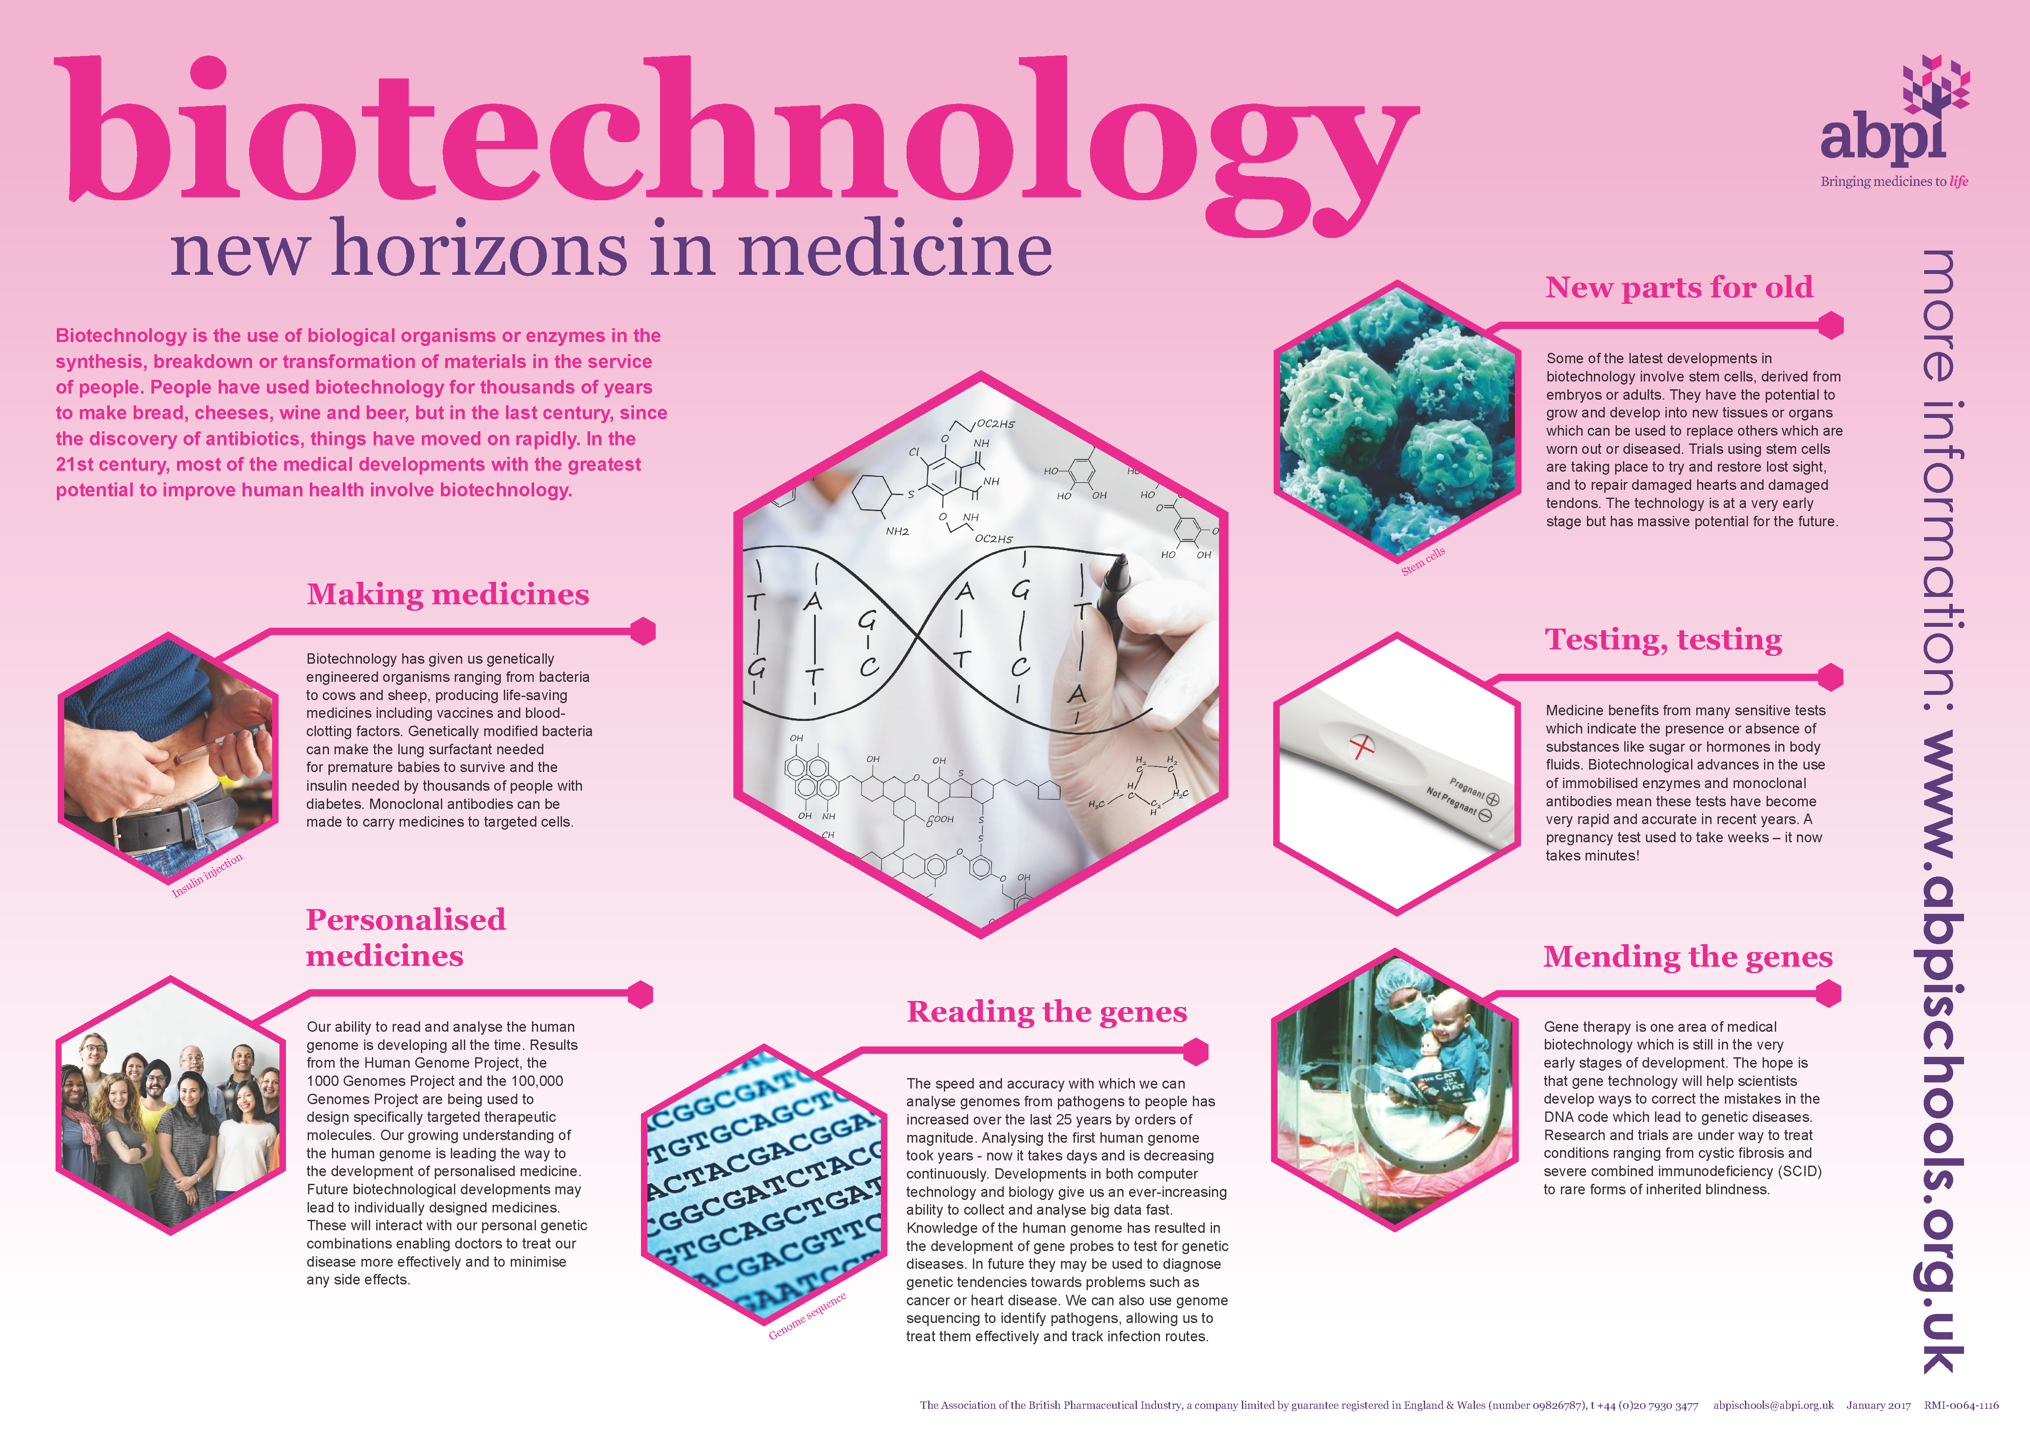
COLORS of BIOTECHNOLOGY
Red biotechnology is the use of biotechnology in the medical and pharmaceutical industries, and health preservation. It involves the production of vaccines and antibiotics, regenerative therapies, creation of artificial organs and new diagnostics of diseases, the development of hormones, stem cells, antibodies, siRNA and diagnostic/prognostic/evaluation tests.
Biotechnology Lecture E. Anastasiadou Bioinformatics – Biomedical Data Science 2021-2022

Slide 8
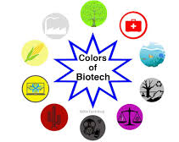
COLORS of BIOTECHNOLOGY
Gray biotechnology is dedicated to environmental applications, and focused on the maintenance of biodiversity and the remotion of pollutants.
Brown biotechnology is related to the management of arid lands and deserts, such as the creation of enhanced seeds that resist extreme environmental conditions, which is related to the innovation, creation of agriculture techniques and management of resources.
Violet biotechnology is related to law, ethical and philosophical issues around biotechnology.
Dark biotechnology is associated with bioterrorism or biological weapons and biowarfare which uses microorganisms, and toxins to cause diseases and death in humans, livestock and crops.
Biotechnology Lecture E. Anastasiadou Bioinformatics – Biomedical Data Science 2021-2022

Slide 9
COLORS of BIOTECHNOLOGY
Gold biotechnology, also called Bioinformatics, is an interdisciplinary field that addresses biological problems using computational techniques, and makes the rapid organization as well as analysis of biological data possible.
It is also referred to as computational biology, and can be defined as, conceptualizing biology in terms of molecules and then applying informatics techniques to understand and organize the information associated with these molecules, on a large scale.
Bioinformatics plays a key role in various areas, such as functional genomics, structural genomics, and proteomics, and forms a key component in the biotechnology and pharmaceutical sector.
Biotechnology Lecture E. Anastasiadou Bioinformatics – Biomedical Data Science 2021-2022

Slide 10
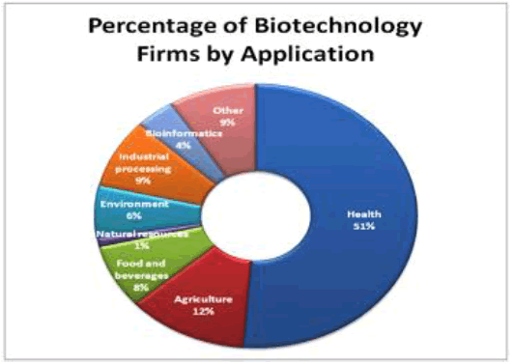
Biotechnology Lecture E. Anastasiadou Bioinformatics – Biomedical Data Science 2021-2022

Slide 11
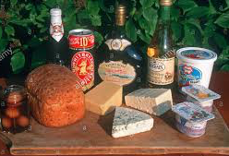
BIOTECHNOLOGY - HISTORY
Biotechnology has been around for centuries as people have used microorganisms to make beer, wine, bread, yoghurts and cheeses.
8000 – 4000 BC
Human domesticate crops and livestock.
Potatoes are cultivated for food.
2000 BC
Egyptians use yeast to leaven bread and ferment beer.
Production of cheese, fermentation of wine in Sumeria, China, Egypt.
500 BC
Chinese use the first antibiotic: moldy soybean curds for treating boils.
Biotechnology Lecture E. Anastasiadou Bioinformatics – Biomedical Data Science 2021-2022

Slide 12
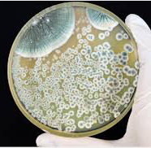
BIOTECHNOLOGY - HISTORY
1797
First vaccination: Edward Jenner inoculates a child with a vial vaccine to protect him from smallpox.
1857
Louis Pasteur proposes that microbes cause fermentation.
1919
The word “biotechnology” is used in print for the first time by Karl Ereky, meaning the production of products from raw materials with the aid of living organisms.
1928
Sir Alexander Fleming discovers the antibiotic penicillin by chance when he realized that Penicillium mold kills bacteria.
1982
Human insulin produced in genetically modified bacteria; approved by the FDA.
Biotechnology Lecture E. Anastasiadou Bioinformatics – Biomedical Data Science 2021-2022

Slide 13
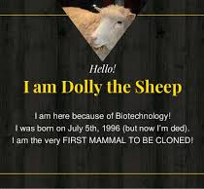
BIOTECHNOLOGY - HISTORY
1970
Restriction enzymes are discovered.
1973
Cut and paste DNA using restriction enzymes.
1977
Genetic engineering is done for the first time, and a human gene was expressed in bacteria.
1981
The first transgenic animals (mice) are produced.
1997
The first animal, Dolly, was cloned from an adult cell.
1998
Human embryonic stem cell lines are established.
2004
The first cloned pet, a kitten, is delivered to its owner. She was called CopyCat (Cc).
Biotechnology Lecture E. Anastasiadou Bioinformatics – Biomedical Data Science 2021-2022

Slide 14
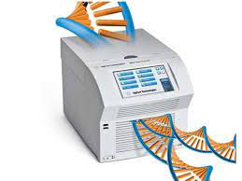
BIOTECHNOLOGY - HISTORY
1983
Polymerase chain restriction (PCR) technique, which makes unlimited copies of genes and gene fragments, is conceived.
Kary Mullis 1993 Nobel Prize
Biotechnology Lecture E. Anastasiadou Bioinformatics – Biomedical Data Science 2021-2022

Slide 15
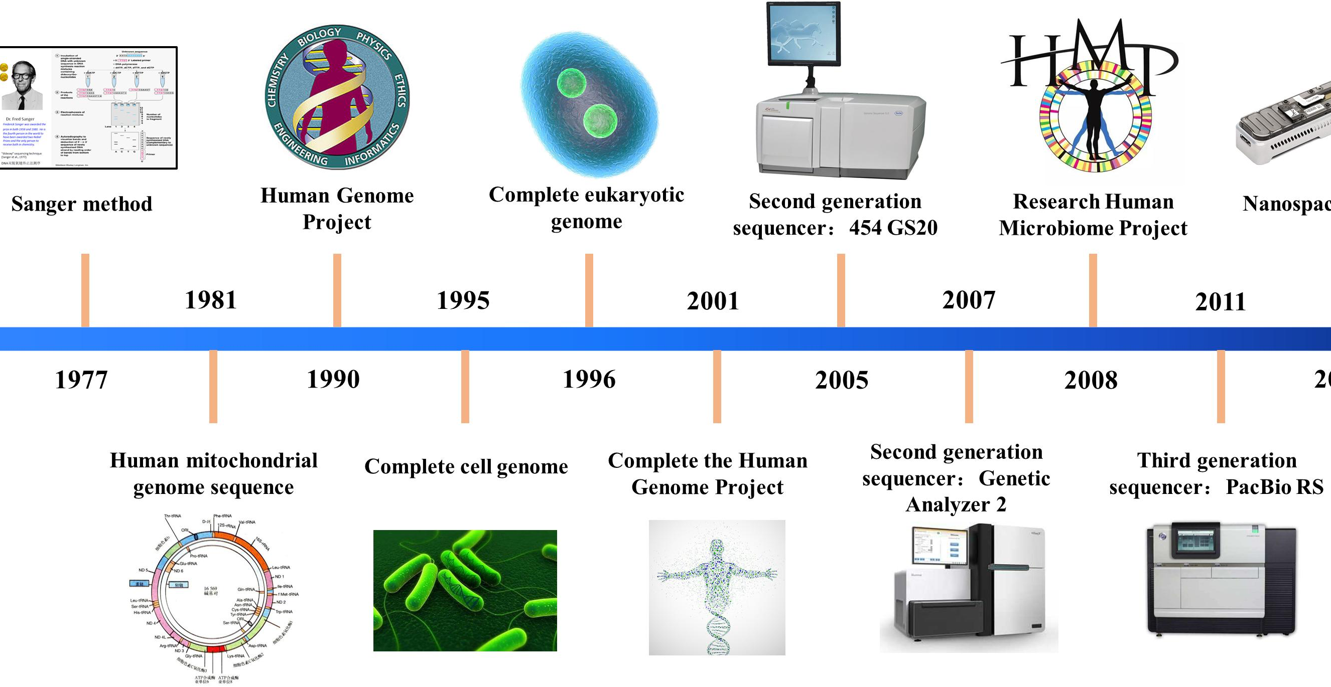
BIOTECHNOLOGY - HISTORY
1990
The Human Genome Project, an international effort to map all of the genes in the human genome, is launched.
2002
Draft version of the complete map of the human genome is published.
Biotechnology Lecture E. Anastasiadou Bioinformatics – Biomedical Data Science 2021-2022

Slide 16
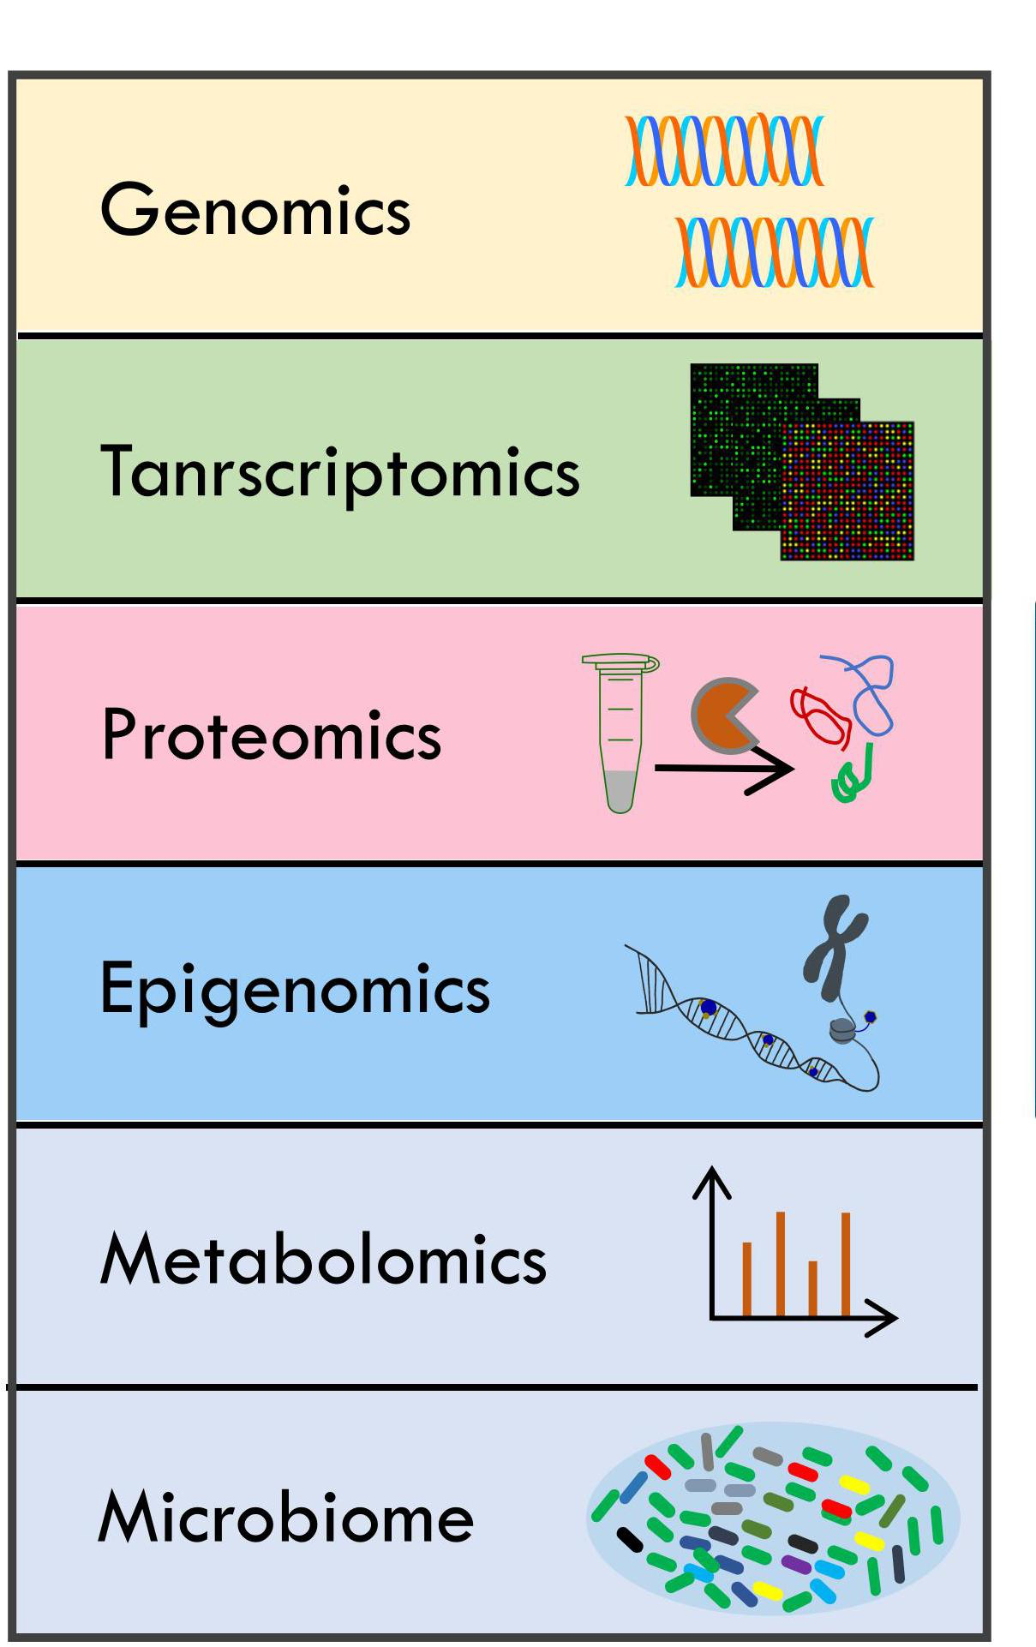
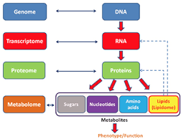
BIOTECHNOLOGY – BIOINFORMATICS ANALYSIS
Biotechnology Lecture E. Anastasiadou Bioinformatics – Biomedical Data Science 2021-2022

Slide 17
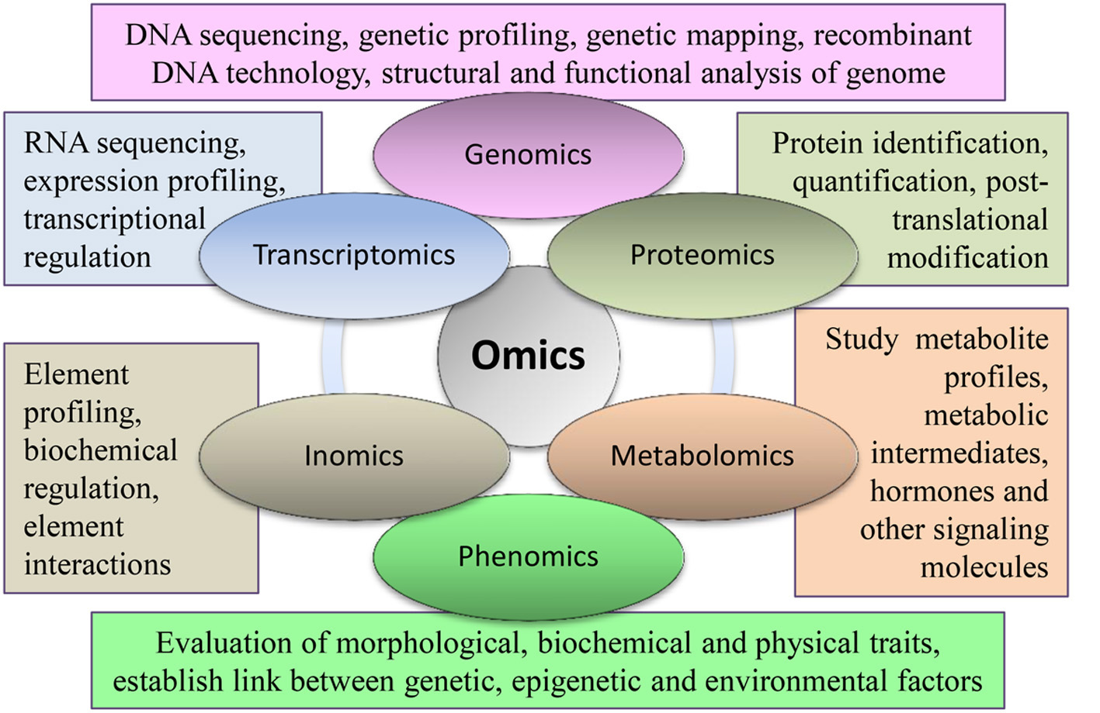
BIOTECHNOLOGY – BIOINFORMATICS ANALYSIS
Biotechnology Lecture E. Anastasiadou Bioinformatics – Biomedical Data Science 2021-2022

Slide 18
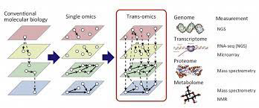
BIOTECHNOLOGY – BIOINFORMATICS ANALYSIS
Biotechnology Lecture E. Anastasiadou Bioinformatics – Biomedical Data Science 2021-2022

Slide 19
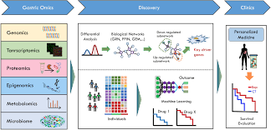
BIOTECHNOLOGY – BIOINFORMATICS ANALYSIS
Biotechnology Lecture E. Anastasiadou Bioinformatics – Biomedical Data Science 2021-2022

Slide 20
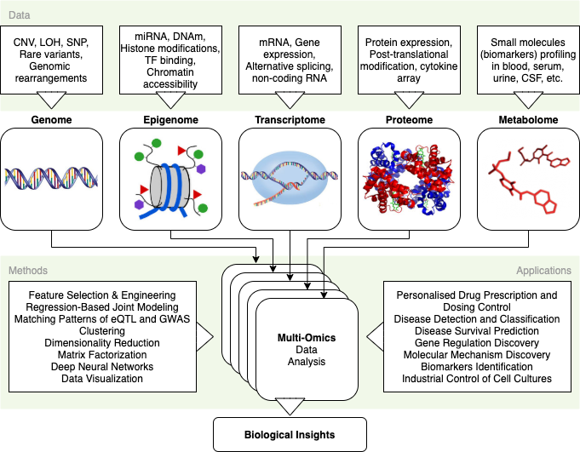
BIOTECHNOLOGY – BIOINFORMATICS ANALYSIS
Biotechnology Lecture E. Anastasiadou Bioinformatics – Biomedical Data Science 2021-2022

