Slide 1
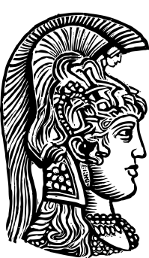
Tweed - Typodont Course 2015
UNIVERSITY OF ATHENS
SCHOOL OF DENTISTRY
DEPARTMENT OF ORTHODONTICS
Introduction into “Tweed Philosophy”
Dimitrios Konstantonis DDS, MS, PhD
Notes:
Ιστορική αναδρομή του μηχανισμού Edgewise
ανάπτυξη της φιλοσοφίας του Tweed
Ανάλυση της μηχανοθεραπείας του Tweed
Εξάσκηση στην κατασκευή συρμάτων

Slide 2
Στόχοι του μαθήματος
-Η διδασκαλία του συστήματος ορθοδοντικής εμβιομηχανικής σύμφωνα με τη φιλοσοφία του Tweed.
-Η πρακτική άσκηση των ορθοδοντικών μετακινήσεων μέσω κατασκευής ειδικών συρμάτινων τόξων πάνω σε κέρινα εκμαγεία αναρτημένα σε αρθρωτήρα.

Slide 3
Ο μεταπτυχιακός φοιτητής θα πρέπει να γνωρίζει
-τη διαγνωστική μεθοδολογία που ακολουθείται στην ορθοδοντική θεραπεία κατά Tweed.
-την εφαρμογή της κεφαλομετρικής ανάλυσης στην διάγνωση, εκτίμηση και αξιολόγηση των ορθοδοντικών περιστατικών.
-την κατασκευή ορθοδοντικών συρμάτων και των κατάλληλων εξαρτημάτων για κάθε στάδιο της ορθοδοντικής θεραπείας.
-την κατανόηση της σημασίας της ορθοδοντικής στήριξης και την εφαρμογή της κατά την μηχανοθεραπεία.
-τα κύρια στάδια εμβιομηχανικής στην θεραπεία περίπτωσης εξαγωγών 4 προγομφίων όπως η ευθυγράμμιση και επιπέδωση των οδοντικών τόξων, η έλξη των κυνοδόντων, η πρόσθια έλξη, η προετοιμασία της στήριξης, η επίτευξη σύγκλεισης 1^{ης} τάξης κατά Angle καθώς και η χρήση εξωστοματικών δυνάμεων και η μηχανική τελειοποίησης.

Slide 4
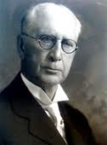
The Angle System 1888
Simplicity
Stability
Efficiency
Delicacy
Inconspicuousness
Edward Angle
(1855 – 1930)

Slide 5
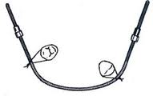
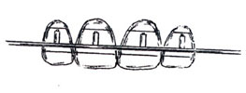
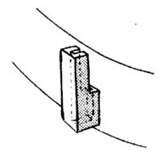
The development of the Edgewise Appliance
The E arch appliance
The Pin and Tube appliance
The Ribbon Arch appliance

Slide 6
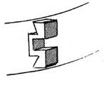
The development of the Edgewise Appliance
The Edgewise appliance consisted of a rectangular box with 3 walls within the bracket 022 x .028 inch

Slide 7
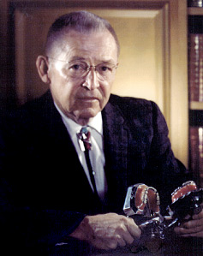
The Tweed Years
Charles Tweed
1895-1970
Applied to the “Angle School of Orthodontia” - refused 1925
Angle Course 1928 (33 yrs old)
Establishes in Arizona the first Edgewise practice in the US
Works very closely with Angle and lectures throughout the country
1932 publishes the first article in the Angle Orthodontist “reports of cases treated with edgewise arch mechanism” and for 3 years holds to the conviction that one never extracts teeth

Slide 8
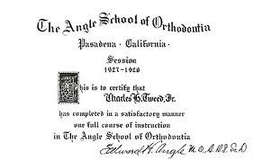
The Tweed Years
Charles Tweed
1895-1970
Angle urged Tweed
-To dedicate his life to the development of the edgewise appliance
-To make every effort to establish orthodontics as a specialty within dentistry

Slide 9
The Tweed Years
Charles Tweed
1895-1970
USA, State of Arizona 1929 AD
The first law limiting the practice of orthodontics to specialists
Tweed receives certificate #1 becoming the first certified specialist in Orthodontics in the United States

Slide 10
The development of the “diagnostic triangle”
FH plane
FMA
FMIA
MP plane
IMPA
Incisor axis
Dr Tweed
-practiced according to Angle’s teaching for 6 years but he felt 80% of the cases had very poor results. IMPA found ≥ 100'
-compared to non treated population with satisfactory dental and facial relationships ......photos, models ......found IMPA at 90'
-tries to apply the 90' IMPA to some of his cases but found it impossible without extractions
-FMA 25' (range 16' -35')
-FMIA had to measure 65'
-FMA ≥ 35 or ≤ 20 results were not satisfactory
Notes:
According to Tweed:
-The greater the FMA the most difficult the case
-Arch expansion produces unaesthetic and unstable results
-Cannot gain arch length by expansion distally

Slide 11
The Tweed Years
Charles Tweed
1895-1970
1936 :First paper on the extraction of teeth
Tweed CH: the application of the principles of the edgewise arch in the treatment of Class II, division !, Part I, Angle Orthod 2:236,1932
1940: Angle society meeting in Chicago displays 100 retreated cases

Slide 12
Η συμβολή του Tweed στην Ορθοδοντική
Πρότεινε 4 στόχους της ορθοδοντικής θεραπείας με έμφαση στην αισθητική του προσώπου:
-αισθητική ισορροπία και αρμονία
-σταθερότητα
-υγιείς οδοντικοί ιστοί
-λειτουργία (1^{η} τάξη κατά Angle)
Ανέπτυξε το θέμα της ανόρθωσης των δοντιών πάνω στην οστική τους βάση δίνοντας έμφαση στους κάτω τομείς.
Κατάφερε να κάνει ευρέως αποδεκτή την εξαγωγή δοντιών για ορθοδοντικούς λόγους και εισήγαγε την εξαγωγή των 4 πρώτων προγομφίων.
Ανέπτυξε την κλινική εφαρμογή της κεφαλομετρικής ανάλυσης.
Εισήγαγε το “διαγνωστικό τρίγωνο του Tweed” (“Tweed facial triangle”) με σκοπό τη:
-διάγνωση
-εκτίμηση θεραπείας
-εκτίμηση αποτελεσμάτων
Ανέπτυξε συγκεκριμένα βήματα-στάδια κατά τη διάρκεια της θεραπείας και εισήγαγε την προετοιμασία στήριξης ως ένα σημαντικότατο στάδιο της θεραπείας.
Ανέπτυξε ένα σταθερό προορθοδοντικό πρόγραμμα καθοδήγησης της σύγκλεισης χρησιμοποιώντας διαδοχικές εξαγωγές νεογιλών και μόνιμων δοντιών.
Notes:
Στόχοι κατά Tweed:
-αισθητική ισορροπία και αρμονία
-σταθερότητα
-υγιείς οδοντικοί ιστοί
-λειτουργία ( 1^{η} τάξη κυνοδόντων και γομφίων)

Slide 13
Διαστάσεις του Οδοντικού Φραγμού Dimensions of the Dentition
Ορθοδοντικές μετακινήσεις σε 6 διευθύνσεις
εγγύς
άπω
παρειακά
γλωσσικά
εμβύθιση
υπερέκφυση

Slide 14
Οι Διαστάσεις του οδοντικού φραγμού περιλαμβάνουν 4 βασικά όρια υπό την προϋπόθεση της μυϊκής ισορροπίας 4 limits of the dentition
Πρόσθιο όριο
Οπίσθιο όριο
Πλάγιο όριο
Κάθετο όριο

Slide 15
Merrifield’s Differential Diagnosis
Facial Disharmony
Z Angle
FMIA
Cranial Disharmony
Skeletal analysis factors
FMA, IMPA, SNA, SNB, ANB, AO-BO
occlusal Plane
posterior facial height
anterior facial height
facial height index
facial height change ratio
Dental Disharmony
Total dentition space analysis
anterior space analysis
midarch space analysis
posterior space analysis

Slide 16
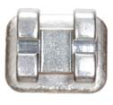
Orthodontic materials to be used
Brackets, bands and tubes, .022 slot
Stainless steel archwires
Elastics
Heavy elastics in lieu of extraoral devices
Auxiliaries
Orthodontic pliers

Slide 17
Bracket placement for the Tweed-Typodont Course
tooth | Placement in relation to the incisal edge
U1 | 4mm
U2 | 3.5mm
U3 | 4mm
U4 | 4mm
U5 | 4mm
U6 | 4mm
U7 | 3,5mm
L1 | 4mm
L2 | 4mm
L3 | 4mm
L4 | 4mm
L5 | 4mm
L6 | 4mm
L7 | 3.5mm
Notes:
For cuspids and premolars the height is measured from the tip of the cusp to the incisal edge of the bracket slot

Slide 18
Accuracy of bracket placement by orthodontists and inexperienced dental students.
Armstrong D, Shen G, Petocz P, Darendeliler MA. Austr. Orthod. J 2007 Nov;23(2):96-103
Abstract
BACKGROUND:
Well-finished orthodontic treatment begins with accurate positioning of the brackets on the teeth.
AIMS:
To compare the positions of orthodontic brackets placed by experienced clinicians and inexperienced trainees.
METHODS:
Twenty orthodontists (13 male, 7 female) representing experienced specialists, and 20 final year dental students (10 male, 10 female) representing inexperienced trainees, were asked to bond pre-adjusted straight-wire brackets at the centres of the clinical crowns of the teeth in a Class I crowded typodont set-up. The teeth were removed from the typodont, placed in a standardised jig and photographed. The vertical, mesiodistal and angular (tip) positions of the brackets, relative to the centres of the clinical crowns, were measured with the aid of imaging software. The accuracy of bracket placement by the groups was compared.
RESULTS:
The dental students took significantly longer than orthodontists to place the brackets (50.65 +/- 16.33 minutes vs 28.53 +/- 9.51 minutes, p < 0.001), but were more accurate than the orthodontists at positioning the brackets vertically (0.90 +/- 0.21 mm vs 1.19 +/- 0.23 mm, p < 0.001). There were no statistically significant differences between the dental students and the specialists in either the mesio-distal or the angular/tip positions of the brackets (p > 0.05). Both groups tended to bond the brackets with a distal tip. The students had slightly more right-left differences than the orthodontists. Mesio-distal errors in bracket placement were associated with rotated and displaced teeth.
CONCLUSIONS:
Accurate direct bonding of orthodontic brackets to teeth does not appear to be related to clinical experience or specialist training.

Slide 19
Tweed - Typodont Course 2015
Preparatory course
-Exercise: wire bending and soldering
-Bonwill Hawley – Revised steps
-Archwires, first-second and third order bands
-Exercise: coordinated ideal arches
.215x.275 first order bands (upper and lower)
.215x.275 first and second order bands (upper and lower)
.215x.275 first, second and third order bands (upper and lower)
Notes:
All covered in this summer preparatory wire-bending course

Slide 20
1st order bends
1st order bends
are made in the horizontal plane, i.e. in out bends. These bends are required to make the wire to conform anatomically to the labial and buccal contours of the teeth in order to arrange the teeth to the most ideal position in respect to the inner and intra-arch position and also to their position in relation to the underlying skeletal structure.

Slide 21
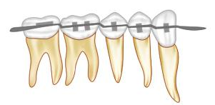
2nd order bends
2nd order bends
are made in the vertical plane and are used to upright teeth or prepare them for anchorage. They are also used to parallel the roots and intrude or extrude individual teeth. Artistic positioning is also achieved through these bends.

Slide 22
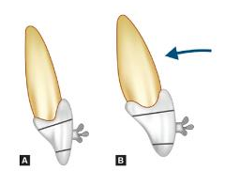
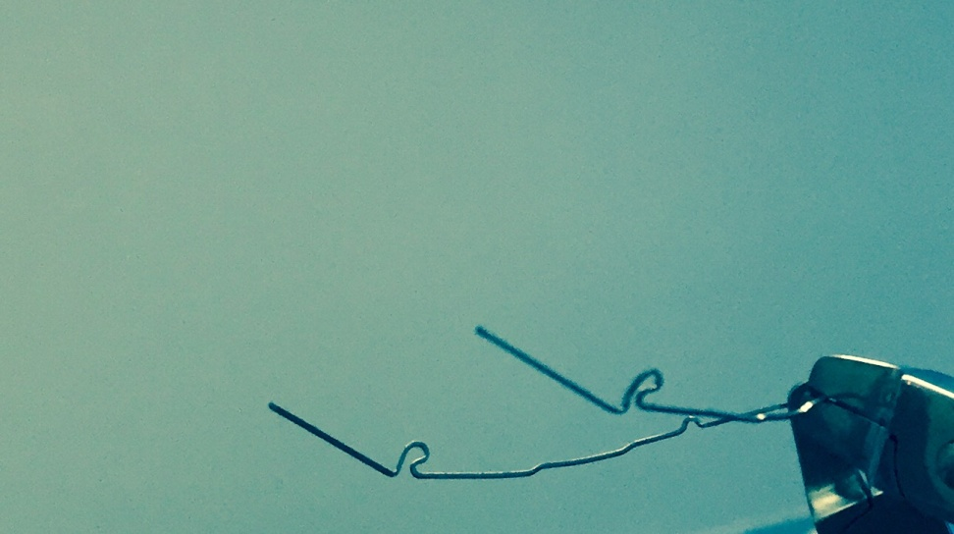
3rd order bends
3rd order bends
are torsional bends along the long axis of the archwire and are used to tip the crown or the roots labially-buccaly or lingually-palately.
Notes:
In the Figure labial root torque is applied for tooth #21

Slide 23
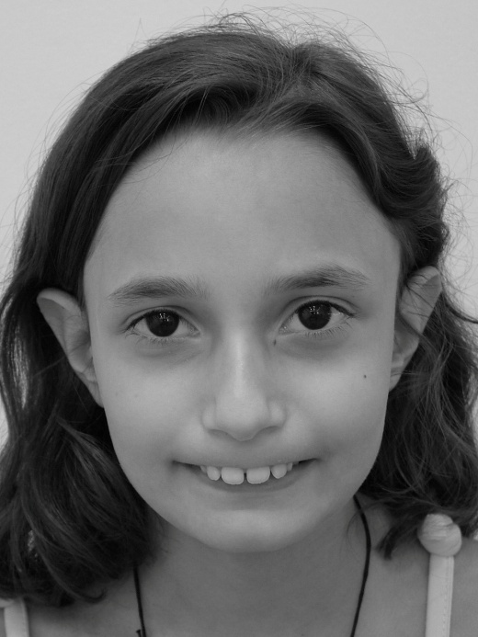
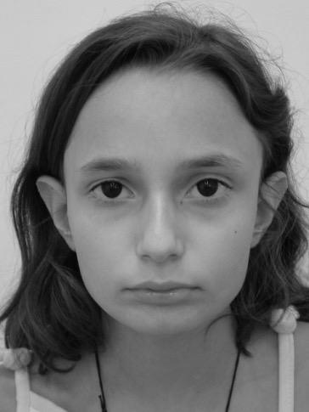
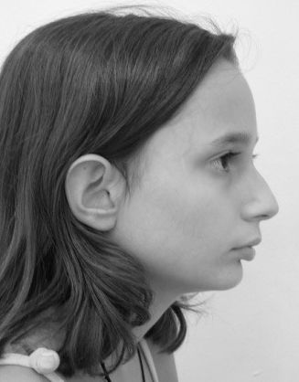
Tweed - Typodont Course 2015
Treatment of a Class II, div 1 case
Patient: Anne Brooks, 12 yr old female
Treatment plan:
Extraction of upper 1st premolars and lower 2nd premolars
Notes:
Patient’s name and records are fictitious.

Slide 24
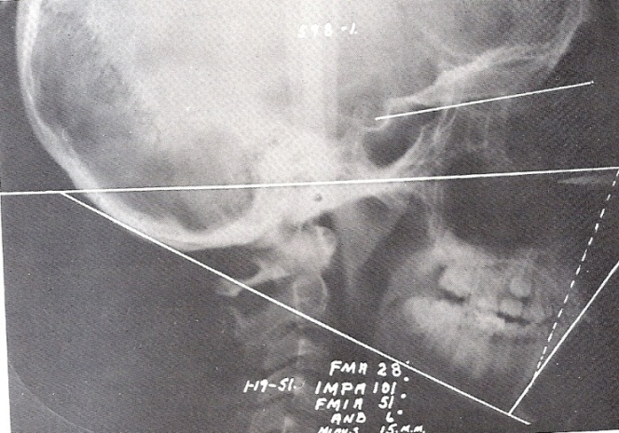
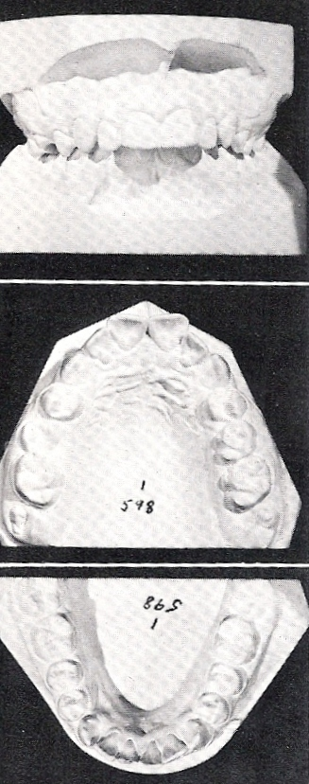
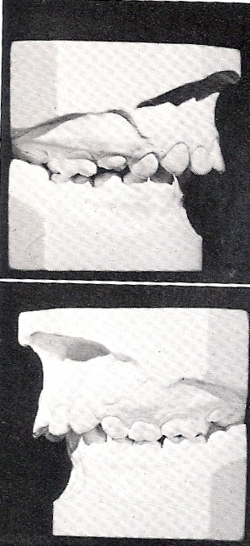
Tweed - Typodont Course 2015
Patient: Anne Brooks, 12 yr old female
class II , div1 malocclusion
flaring max incisors
Deep overbite
Exaggerated curve of Spee
Diagnostic Facial triangle
FMA 28 – IMPA 101 – FMIA 51 (ANB 6)
Notes:
Patient’s name and records are fictitious.

Slide 25
Tweed - Typodont Course 2015
Let’s start orthodontic treatment of Anne
Detailed description of Mechanotherapy
Notes:
Patient’s name and records are fictitious.

Slide 26
Tweed - Typodont Course 2015
Mechanotherapy
LEVELLING ARCHWIRES
Purpose: to level and correct rotations
Total time: 2-3 months
Maxillary and Mandibular Archwires – .016 to .020 ss
fabricated to the malocclusion in the anterior
bypass the cuspid because of its severe mesial angulation
molar offset
tip back and toe in
omega loops ½ to 1 mm short of buccal tubes
maintain molar width (wire should be in occlusal groove)
sling tie laterals because bracket engagement would deform wire
purpose – to level
– to correct rotations

Slide 27
Tweed - Typodont Course 2015
Mechanotherapy
Cuspid uprighting archwires .019 x .025ss
Purpose: to upright the cuspids
Total time: 1-2months
Maxillary and Mandibular Archwire
fabricated to the malocclusion in the anterior (post. is ideal)
mild second order bends to keep teeth upright
omega loops flush to the buccal tubes
mild tip back and toe in
passive torque
attachments:
maxillary
headgear hook to the incisal, mesial to the cuspid for anchorage
pletchercoil hooked from 2nd molar to d eyelet of cuspid – beware of possible rotation
mandibular
hook to the gingival mesial to the cuspid for class iii elastics if anchorage is a problem
“a”lastiks used for cuspid uprighting

Slide 28
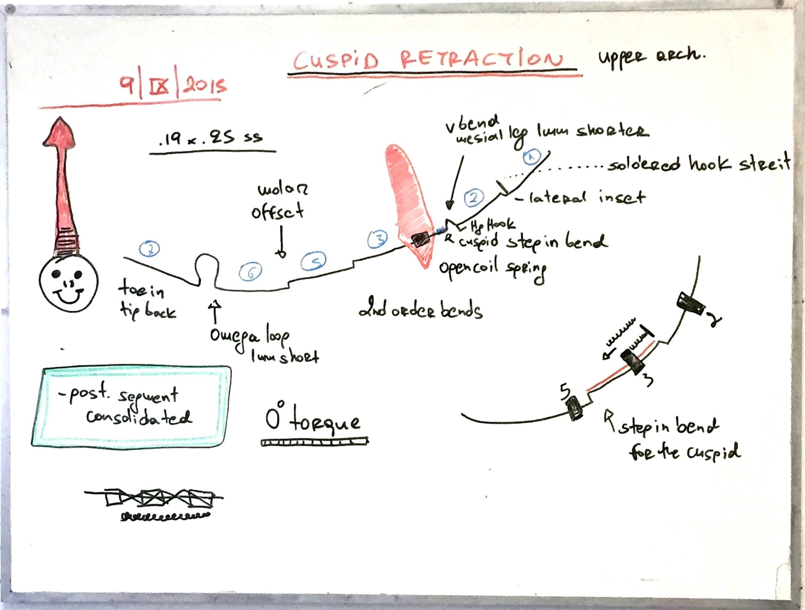
Tweed - Typodont Course 2015
Mechanotherapy
Cuspid retraction
Purpose: to retract the cuspids
Total time 2-3 months
Maxillary Cuspid Retraction Working Archwire . 019x.025 ss
ideal in form except mesial to cuspid there is severe “step in” bend so
it will allow the cuspid to travel in the bone between the two
cortical plates
second order bends to match previous archwires
increase tip back and toe in
third order bends passive in anterior and posterior
omega loops ½ mm short of buccal tubes
“v” bends mesial to cuspid
heat treat and polish
open coil spring on each arch mesial to cuspid
maxillary high pull headgear hook soldered between laterals and cuspid incisally
tie posterior segments together, then tie with .007 ligature to compress coils against cuspids
“v” bend can be modified with a longer distal leg to continue the intrusion of the maxillary anteriors
soldered stops between the centrals and laterals in both arches gingivally for “box” elastics to close down the anterior bite if needed
Lower archwire same as before
next appointment
check for rotations of cuspids
reactivate compression coils

Slide 29
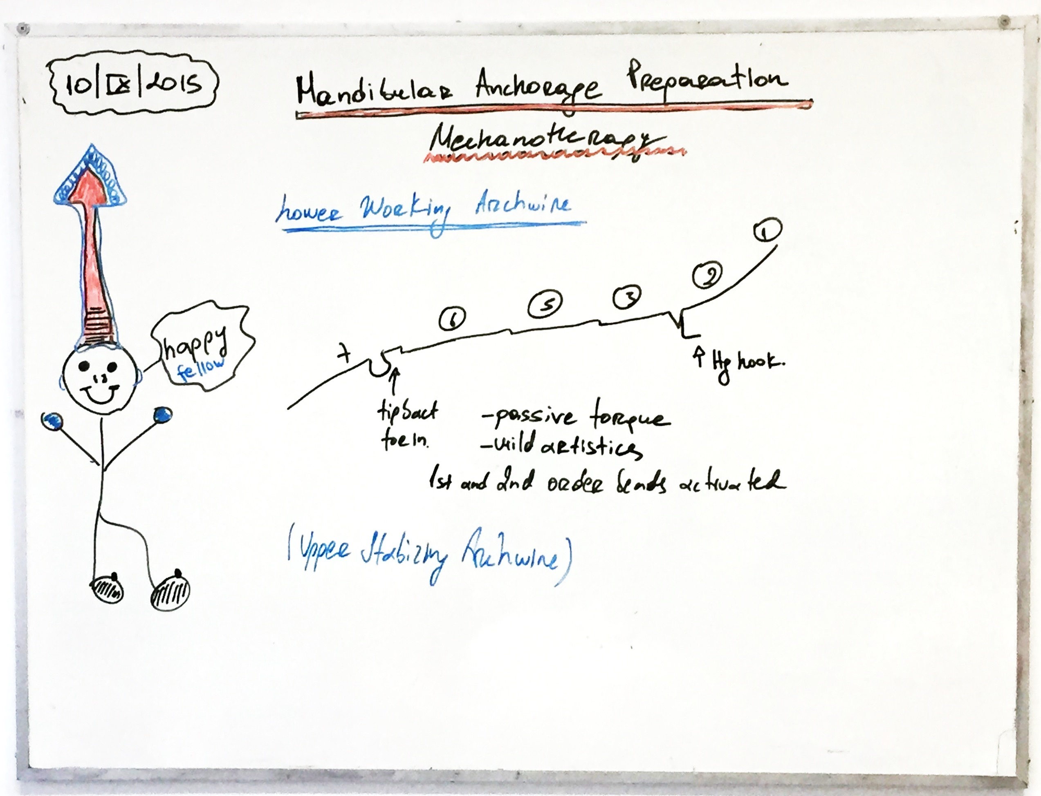
Tweed - Typodont Course 2015
Mechanotherapy
Mandibular anchorage preparation .019 x .025 ss
Purpose: to prepare mandibular anchorage
Total time 1-2 months
MAXILLARY STABILIZING ARCHWIRE .019X.025 SS
A. IDEAL IN FORM WITH FIRST ORDER BENDS
B. SECOND ORDER BENDS – MILD
C. PASSIVE TORQUE
D. MILD ARTISTICS
E. OMEGA LOOPS ½MM SHORTER OF BUCCAL TUBE
HEADGEAR HOOK SOLDERED INCISALLY IN THE “V” BEND MESIAL TO CUSPID HIGH PULL (16 - 18 OZ)
MANDIBULAR WORKING ARCHWIRE .019X.025SS
A. IDEAL IN FORM WITH FIRST ORDER BENDS
B. SECOND ORDER BENDS – MILD AND INCREASED PROGRESSIVELY
PASSIVE TORQUE POSTERIORLY – INCREASED PROGRESSIVELY
OMEGA STOPS FLUSH to maintain arch length – SECOND MOLARS ARE NOT TIED BACK
CLASS III ELASTICS FROM MAXILLARY TERMINAL MOLAR TO MANDIBULAR JIG (4 – 6 OZ) WORN 24 HOURS/DAY – STRAIGHT PULL HG TO MAXILLARY ARCH at least 12h/day
CEPHALOMETRIC X-RAY suggested at the end of this stage to assess:
-the degree of anchorage preparation; the inclination of the incisors; the FMA change; the Occlusal plane

Slide 30
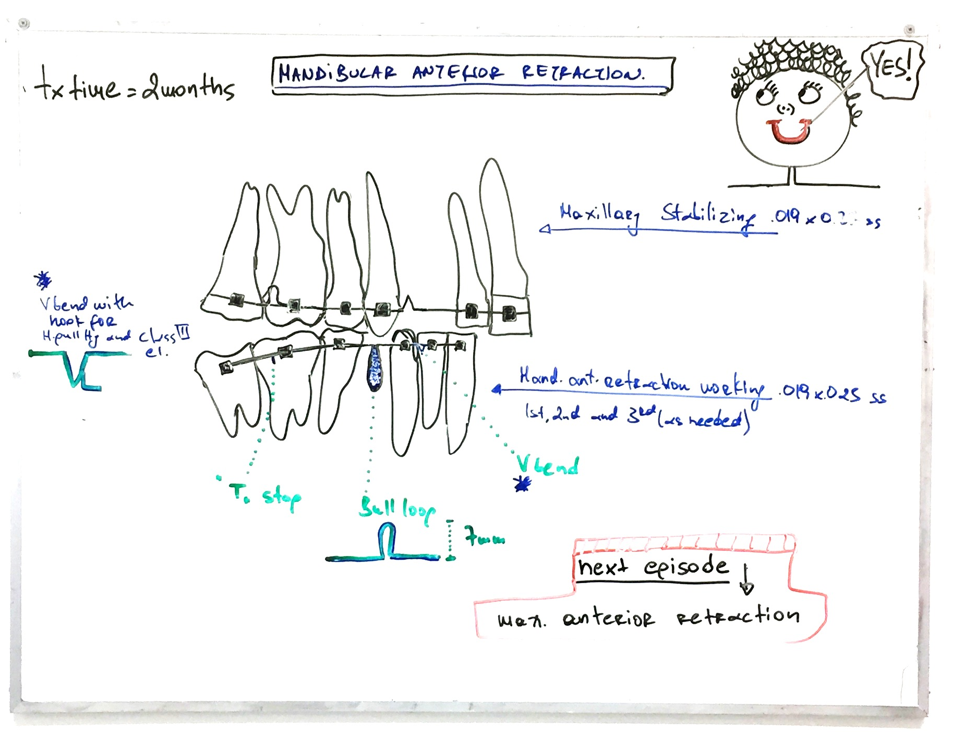
Tweed - Typodont Course 2015
Mechanotherapy
Mandibular anterior retraction 019 x .025ss
Purpose: to retract the mandibular anterior segment
Total time: 2 months
Mandibular Anterior Retraction Working Archwire .019x.025ss
ideal in form with first order bends
“v” bends as closed to lateral bracket as possible
second order bends as in prior archwire and as far forward as possible
third order bends passive in posterior and as much anterior torque as needed
tip back and toe in in the second molar
modifications of first archwire
vertical loops(7mm) immediately distal to the cuspids distal leg is 1 mm longer than mesial leg of loop
heat treat and polish wire 10 seconds
solder:
hook in the “v” bend incisally for high pull headgear
“t” stops as far forward as the distal of first molar bracket will allow multiple activations
modifications of second archwire
heat treat and reduce 2 to 3 min from mesial of cuspid posteriorly so it will slide easily through the brackets
Maxillary stabilizing archwire .019x.025ss
ideal in form with first order bends
“v” bend mesial to cuspid
second order bends as prior archwire
third order bends as needed
tip back and toe in increased in second molar area
heat treat and polish 10 sec.
omega loops ½ mm mesial to buccal tubes

Slide 31
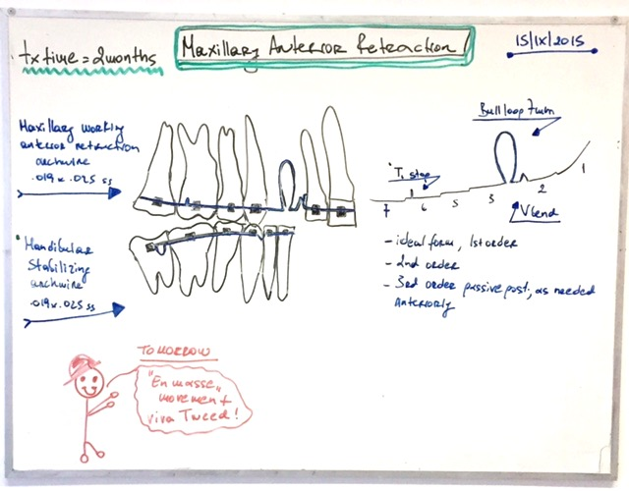
Tweed - Typodont Course 2015
Mechanotherapy
MAXILLARY ANTERIOR RETRACTION AND CLASS II MECHANICS
purpose: to retract upper anteriors utilizing class II mechanics
Total time: 1-2 months
MAXILLARY Anterior Retraction Working Archwire .019x.025ss
ideal in form with first order bends
“v” bends as closed to lateral bracket as possible
second order bends as in prior archwire and as far forward as possible
third order bends passive in posterior and as much anterior torque as needed
tip back and toe in in the second molar
modifications of first archwire
vertical loops(7mm) immediately distal to the cuspids distal leg is 1 mm longer than mesial leg of loop
heat treat and polish wire 10 seconds
solder:
hook in the “v” bend incisally for high pull headgear and class III elastics
“t” stops as far forward as the distal of first molar bracket will allow
modifications of second archwire
heat treat and reduce 2 to 3 min from mesial of cuspid posteriorly so it will slide easily through the brackets
MANDIBULAR STABILIZING ARCHWIRE .019x.025ss
ideal in form with first order bends
“v” bend mesial to cuspid
second order bends as prior archwire
third order bends as needed
tip back and toe in increased in second molar area
heat treat and polish 10 sec.
omega loops ½ mm mesial to buccal tubes

Slide 32
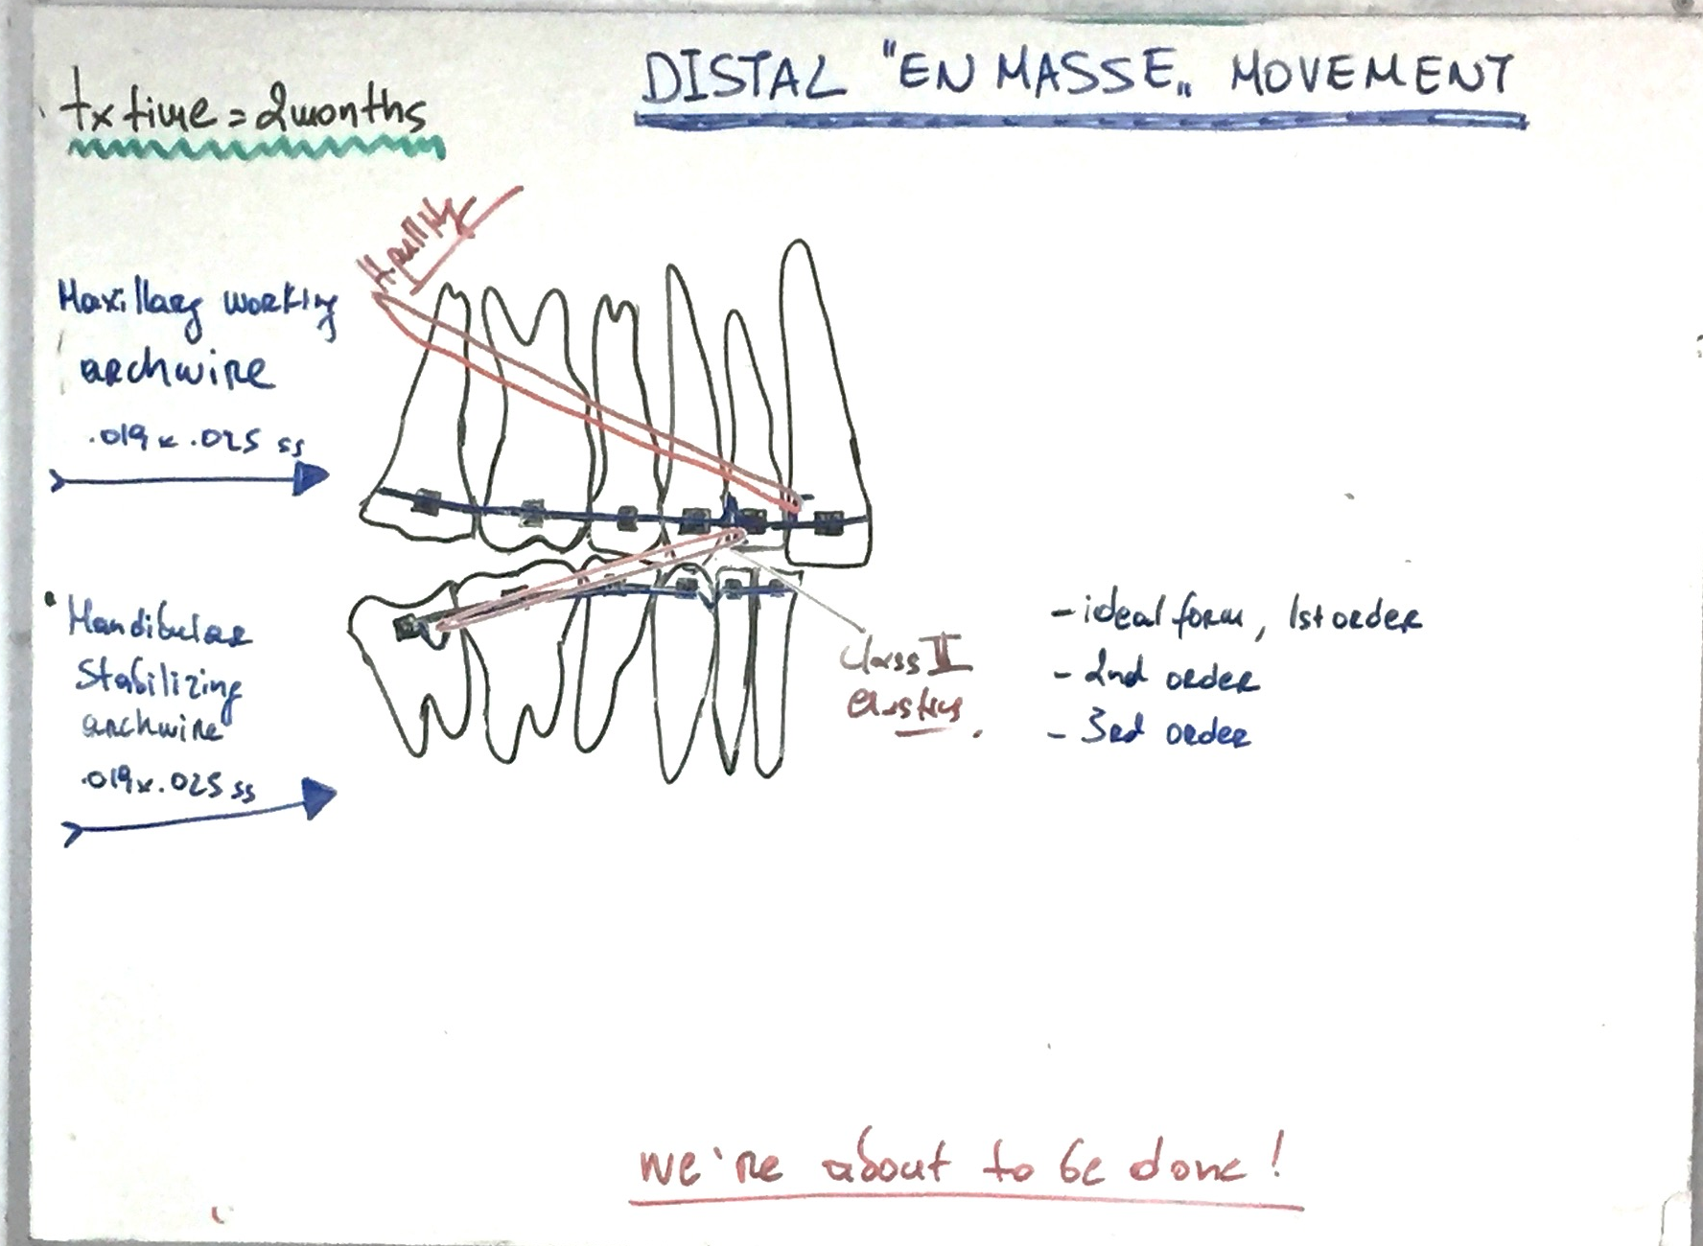
Tweed - Typodont Course 2015
Mechanotherapy
CLASS II CORRECTION (DISTAL EN MASSE MOVEMENT)
Purpose: to correct class II by moving the maxilla posteriorly
Total time: 2 months
Maxillary Working Archwire .019x.025 ss
ideal in form with first order bends but rigorously coordinated arch forms
second order bends – ideal with 20 deg tip at the 2nd molar, active curve of spee
third order bends: ideal
mild artistics
no omegas
headgear hook soldered distal to centrals gingivaly for high pull (16 - 18 oz) and hooks distal to the lateras incisally for class ii elastics
Mandibular Stabilizing Archwire .019x.025ss
ideal in form with first order bends ( increased toe-in at the 2nd molars)
second order bends – ideal , hphg hooks
third order - ideal
omega loops tied back
class ii elastics (4 – 6 oz) worn 24 hours/day, anterior box elastics if needed

Slide 33
Tweed - Typodont Course 2015
Mechanotherapy
CUSP SEATING - ROOT PARALLELING – FINISHING
Purpose: to achieve maximum intercuspation –
finishing mechanics – root paralleling
Total time: 1-2 months
Maxillary Archwire Reduced .019x.025 ss
ideal in form with first order bends and rigorously coordinated arch forms
second order bends ideal
third order bends: ideal (check incisor torque)
attachments: hphg hooks distal to the centrals incisaly, class ii hooks distal to the laterals gingivaly , vertical hooks mesial to 1st bicuspids. elastics are mainly vertical and triangular
Mandibular Stabilizing Archwire Reduced .019x.025ss
ideal in form with first order bends and rigorously coordinated arch forms
second order bends – ideal
third order – ideal (check incisor TORQUE)
omega loops
attacments: vertical hooks distal to the centrals, laterals, cuspids, bicuspids

Slide 34
Tweed - Typodont Course 2015
UNIVERSITY OF ATHENS
SCHOOL OF DENTISTRY
DEPARTMENT OF ORTHODONTICS
Introduction into “Tweed Philosophy”
CONGRATULATIONS ON SUCCESFULLY COMPLETING THE COURSE !
Dimitrios Konstantonis DDS, MS, PhD
Notes:
Ιστορική αναδρομή του μηχανισμού Edgewise
Ανάπτυξη της φιλοσοφίας του Tweed
Ανάλυση της μηχανοθεραπείας του Tweed
Εξάσκηση στην κατασκευή συρμάτων

