Slide 1
Photonic Integrated Circuits
FIBER OPTICS

Slide 2
Historical Perspective
Electrical Era
Optical Era
Telegraph 1836
Telephone 1876
Coaxial Cables 1840
Microwaves 1948
Optical Fibers 1978
Optical Amplifiers 1990
WDM Technology 1996
Multiple bands 2002
Microwaves and coaxial cables limited to B ~ 100Mbps
Optical systems can operate at bit rate > 10 Tbps
Improvement in system capacity is related to the high frequency of the optical waves ( ~ 200THz at 1.5 μm)

Slide 3
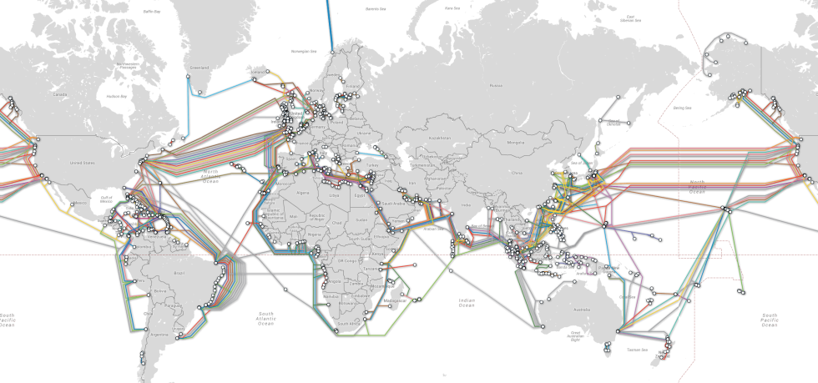
Information Revolution
Industrial revolution of 19th century gave way to information revolution during 1990s.
Fiber-Optic Revolution is a natural consequence of the Internet growth.

Slide 4
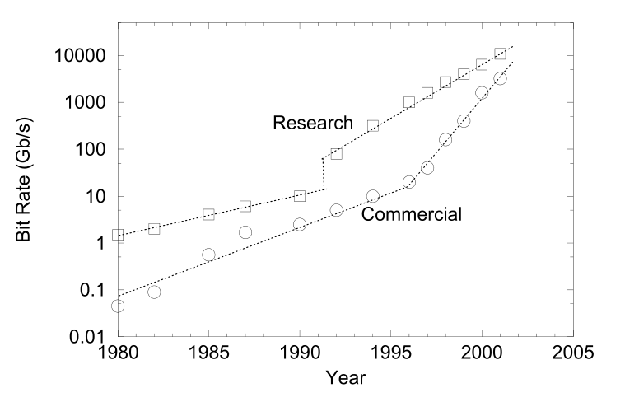
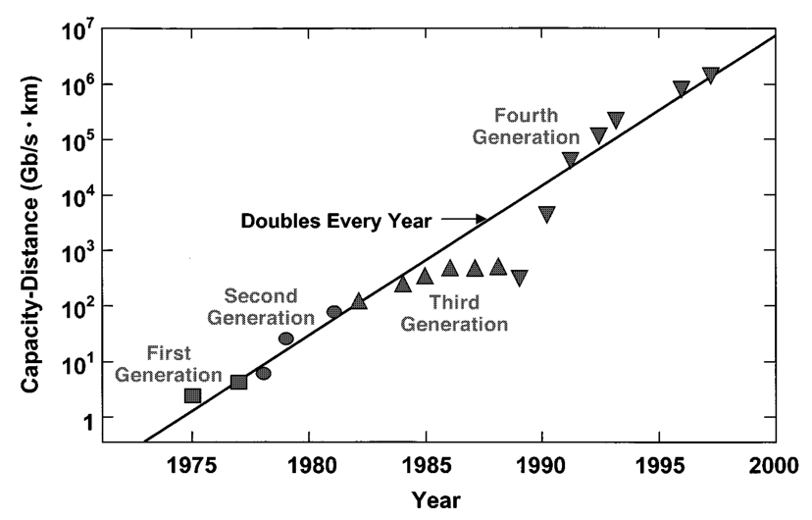
Five Generations
0.8-μm systems (1980); Graded-index fibers
1.3-μm systems (1985); Single-mode fibers
1.55-μm systems (1990); Single-mode lasers
WDM systems (1996); Optical Amplifiers
L and S bands (2002); Raman Amplification

Slide 5
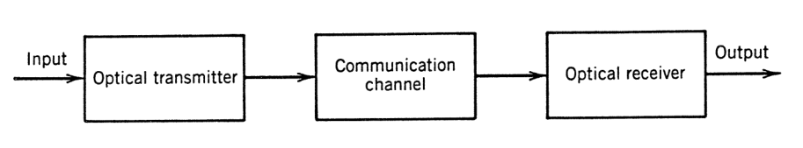
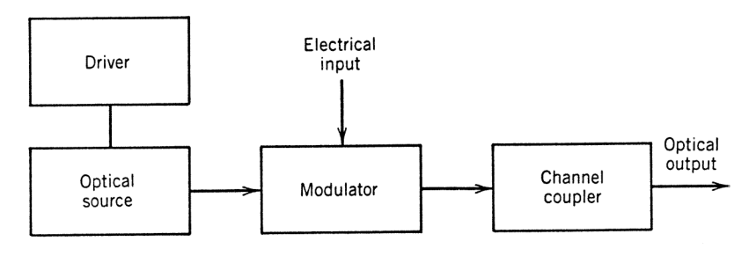
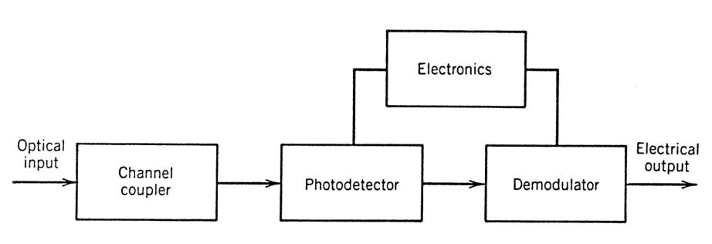
Lightwave System Components
Generic System
Transmitter Module
Receiver Module

Slide 6
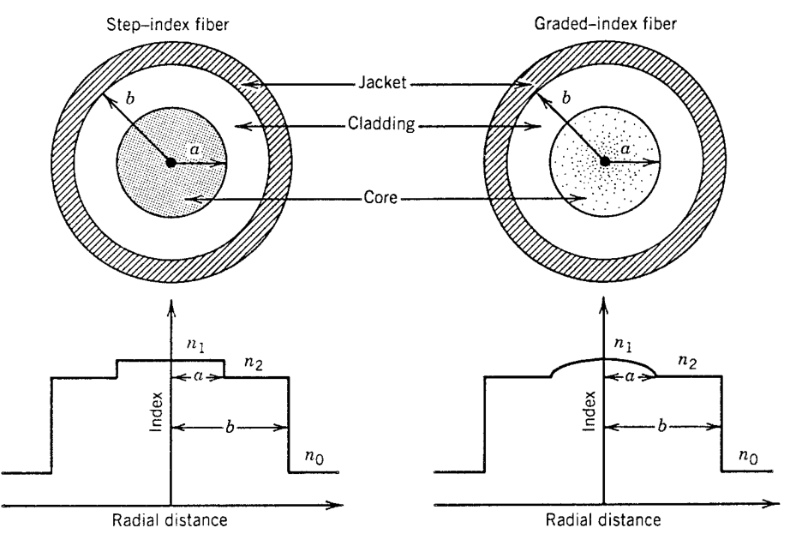
The Optical Fiber
In its simplest form an optical fiber consists of a cylindrical core of silica glass surrounded by a cladding whose refractive index is lower than that of the core. Because of an abrupt index change at the core–cladding interface, such fibers are called step-index fibers. In a different type of fiber, known as graded-index fiber, the refractive index decreases gradually inside the core.
Geometrical optics description : core radius a is much larger than the light wavelength λ
Wave Propagation theory : core radius a is comparable to the light wavelength λ

Slide 7
PROPAGATION MODES IN FIBERS
Step-index fibers
Graded – INDEX FIBERS
FIBER MODE THEORY
SINGLE MODE FIBERS

Slide 8
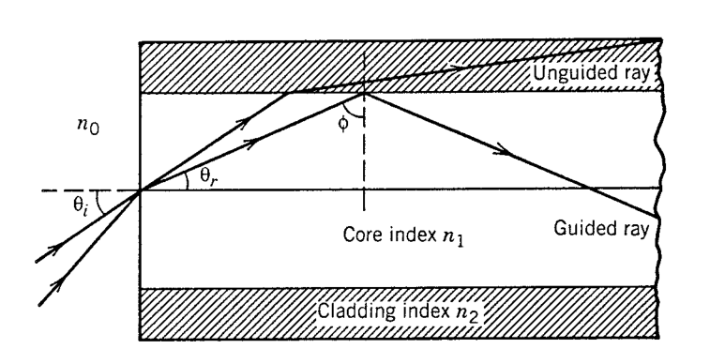

Step – Index Fibers
Total Internal Reflection is the mechanism responsible for waveguiding !!!
Using the Snell’s law at the core facet we get
$$n_{0}\sin{θ_{i}}=n_{1}\sin{θ_{r}}=n_{1}\sin\left(\frac{π}{2}−φ\right)=n_{1}\sqrt{1−\sin^{2}{φ}}$$
Total internal reflection takes place between the core ($n_{1})$ and the cladding ($n_{2})$ for angles larger that a critical angle $φ_{c}$. For $φ=φ_{c}$
$n_{1}\sin{φ_{c}}=n_{2}$
$$n_{0}\sin{θ_{i}}=n_{1}\sqrt{1−{n_{2}^{2}}/{n_{1}^{2}}}=\sqrt{n_{1}^{2}−n_{2}^{2}}=NA$$
Numerical Aperture (NA) represents the light-gathering capacity of an optical fiber.

Slide 9
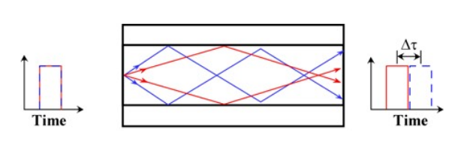

Step – Index Fibers
For $n_{1}≅n_{2}$
$NA=n_{1}{\left(2Δ\right)}^{1/2}, Δ=(n_{1}−n_{2})/n_{1}$
Δ should be made as large as possible to couple maximum light into the fiber. However these fibers are not useful due to the phenomenon known as intermodal dispersion.
Intermodal Dispersion : different rays travel along paths of different lengths. A short pulse would broaden considerably as a result of different path lengths.

Slide 10
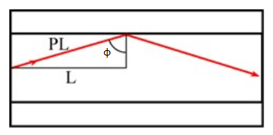

Intermodal Dispersion
The Path PL depends on the propagating angle
$$PL=\frac{L}{\sin{φ}}$$

Slide 11

Intermodal Dispersion
The shortest path is accomplished for a ray with $φ=π/2$
$$PL_{min}=L$$
The longest path is accomplished for a ray with $φ=φ_{c}$
$$PL_{max}=L/{\sin{φ_{c}}}$$
By taking the velocity propagation $v=c/{n_{1}}$ the time delay is
$$ΔT=\frac{n_{1}}{c}\left(PL_{max}−PL_{min}\right)=\frac{n_{1}}{c}\left(\frac{L}{\sin{φ_{c}}}−L\right)=\frac{L}{c}\frac{n_{1}^{2}}{n_{2}}Δ$$
By increasing $Δ$ we simultaneously increase the numerical aperture and intermodal dispersion !!!

Slide 12
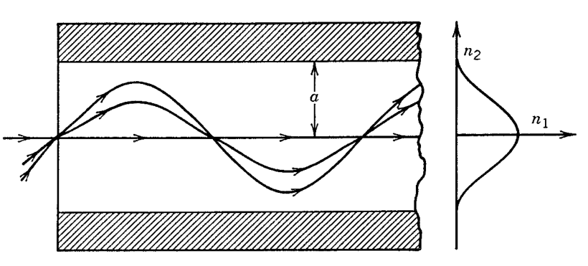

Graded – Index Fibers
Intermodal dispersion is considerably reduced in this case.
The ray velocity changes along the path because of variations in the refractive index. More specifically, the ray propagating along the fiber axis takes the shortest path but travels most slowly as the index is largest along this path. Oblique rays have a large part of their path in a medium of lower refractive index, where they travel faster. It is therefore possible for all rays to arrive together at the fiber output by a suitable choice of the refractive-index profile.
The minimum dispersion occurs for $α=2(1−Δ)$ and depends on $Δ$ as
$$ΔT=Ln_{1}\frac{Δ^{2}}{8c}$$
Since Δ<1 the maximum delay is far smaller than in the case of step index ($Δ^{2}$ as opposed to Δ).

Slide 13


Wave Propagation
Intermodal dispersion can be eliminated by single mode fibers. The core radius is small enough to allow the propagation of a single ray, also known as mode. However radius a is comparable to the light wavelength and as a result we must abandon the ray approach and focus on the more general wave propagation approach.
Maxwell Equations
For non-conducting medium with no free charges we have :
$∇ \vec{D}=0$
$∇\vec{B}=0$
$∇×\vec{E}=−\frac{∂\vec{B}}{∂t}$
$∇×\vec{H}=\frac{∂\vec{D}}{∂t}$
$\vec{D}=ε_{0}\vec{E}+$ $\vec{P}$
$\vec{B}=μ_{0}\left(\vec{H}+\vec{M}\right)=μ_{0}\vec{H}$
In silica glass $\vec{M}$ is approximately zero !!!
Vacuum permittivity
$ε_{0}=\text{8.854187}×{10}^{−12}$ F/m
Vacuum permeability
$$μ_{0}=\text{ 1.2566370614}×{10}^{−6} N/A^{2}$$

Slide 14

Wave Propagation
Applying the curl operator in the third equation
$$∇×\left(∇×\vec{E}\right)=−∇×\frac{∂\vec{B}}{∂t}=−\frac{μ_{0}∂\left(∇×\vec{H}\right)}{∂t}=−\frac{μ_{0}∂^{2}\vec{D}}{∂t^{2}}$$
We use the general identity
$$∇×\left(∇×\vec{E}\right)=∇\left(∇\vec{E}\right)−∇^{2}\vec{E}$$
of vector calculus to write
$$∇\left(∇\vec{E}\right)−∇^{2}\vec{E}=−μ_{0}\frac{∂^{2}\vec{D}}{∂t^{2}}$$
Rearranging the terms we get the following equation
$$∇^{2}\vec{E}−∇\left(∇\vec{E}\right)−\frac{1}{c^{2}}\frac{∂^{2}\vec{E}}{∂t^{2}}=\frac{1}{ε_{0}c^{2}}\frac{∂^{2}\vec{P}}{∂t^{2}} \\ ε_{0}μ_{0}=\frac{1}{c^{2}}$$

Slide 15

Wave Propagation
We are interested in transverse field which satisfy
$$∇\vec{E}=0$$
The wave equation becomes
$$∇^{2}\vec{E}−\frac{1}{c^{2}}\frac{∂^{2}\vec{E}}{∂t^{2}}=\frac{1}{ε_{0}c^{2}}\frac{∂^{2}\vec{P}}{∂t^{2}}$$
For simplicity we assume a single component of a monochromatic field with frequency $ν=ω/2π$ where
$$E\left(\vec{r},t\right)=ℰ\left(\vec{r},ω\right)e^{−iωt}$$
$$P\left(\vec{r},t\right)=𝒫\left(\vec{r},ω\right)e^{−iωt}$$
The terms $ℰ\left(\vec{r},ω\right),𝒫(\vec{r},ω)$ – known as envelopes - vary slowly with time compared to $e^{−iωt}$. Calculating the envelopes and multiplying them by the fast term $e^{−iωt}$ yields the final solutions.

Slide 16
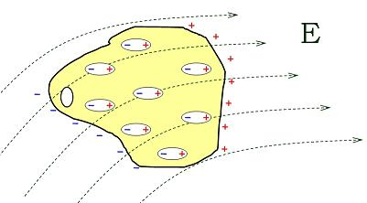

Wave Propagation
The equation reduces to
$$∇^{2}ℰ\left(\vec{r},ω\right)+\frac{ω^{2}}{c^{2}}ℰ\left(\vec{r},ω\right)=−\frac{ω^{2}}{ε_{0}c^{2}}𝒫(\vec{r},ω)$$
If the medium consists of N particles per unit volume, each of which has a dipole moment $\vec{p}$, the polarization density is $N\vec{p}$. We assume that the medium has no polarization in the absence of a field. The induced field causes charge displacements that result in an induced dipole moment
$p\left(\vec{r},ω\right)=α\left(ω\right)ℰ(\vec{r},ω)$
in an atom at $\vec{r}$. The term $α(ω)$ is known as polarizability. The wave equation becomes
$$∇^{2}ℰ\left(\vec{r},ω\right)+\frac{ω^{2}}{c^{2}}ℰ\left(\vec{r},ω\right)=−\frac{ω^{2}}{ε_{0}c^{2}}Nα\left(ω\right)ℰ(\vec{r},ω)$$

Slide 17

Wave Propagation
Helmholtz Equation
$∇^{2}ℰ\left(\vec{r},ω\right)+n^{2}\left(ω\right)\frac{ω^{2}}{c^{2}}ℰ\left(\vec{r},ω\right)=0$
$n^{2}\left(ω\right)=1+\frac{1}{ε_{0}}Nα(ω)$ (Refractive Index)

Slide 18
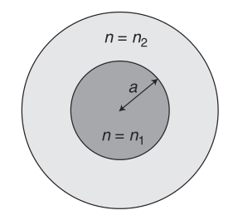

Fiber Modes
A mode is a solution of the Helmholtz equation that satisfies the boundary conditions and retains its form during propagation in the fiber.
For a cylindrical waveguide we change the Helmholtz equation by introducing cylindrical co-ordinates $\vec{r}=(r,φ,z)$ instead of $\left(x,y,z\right).$ The single component equation becomes
$\frac{∂^{2}ℰ}{∂r^{2}}+\frac{1}{r}\frac{∂ℰ}{∂r}+\frac{1}{r^{2}}\frac{∂^{2}ℰ}{∂φ^{2}}+\frac{∂^{2}ℰ}{∂z^{2}}+n^{2}\frac{ω^{2}}{c^{2}}ℰ=0$

Slide 19

Fiber Modes
Since a rotation by 2π about the axis cannot affect the field a solution must not change when 2π is added to φ. Thus, $ℰ$ must vary with φ as exp(imφ) where $m=0,±1,±2,…$
For propagation along the z axis the solution is of the form
$$ℰ\left(r,φ,z\right)=F\left(r\right)e^{imφ}e^{iβz}$$
where $β$ is the propagation constant. The frequency dependence of the envelope is omitted for simplicity ($ℰ\left(\vec{r},ω\right)=ℰ(\vec{r})$).
Substituting in the cylindrical Helmholtz equation we obtain for the radial function F(r) the ordinary differential equation
$$r^{2}\frac{d^{2}F}{dr^{2}}+r\frac{dF}{dr}+\left[r^{2}\left(n^{2}\frac{ω^{2}}{c^{2}}−β^{2}\right)−m^{2}\right]F=0$$
It has the form of the Bessel’s ordinary differential equation
$$x^{2}\frac{d^{2}y}{dx^{2}}+x\frac{dy}{dx}+\left(x^{2}−a^{2}\right)y=0$$

Slide 20

Fiber modes
Bessel’s ordinary equation has the following solution types
First kind : $J_{α}(x)$
Second kind : $Y_{α}(x)$
Modified First kind : $I_{α}(x)$
Modified Second kind : $K_{a}(x)$
For a second-order differential equation the solution is the sum of two linearly independent solutions.
In case α is an integer (as it is in our case) , two possible solutions exist
$${AJ}_{α}\left(x\right)+A^{′}Y_{α}(x)$$
$$CK_{α}\left(x\right)+C^{′}I_{α}(x)$$
where A, A’, C, C’ are constants.

Slide 21
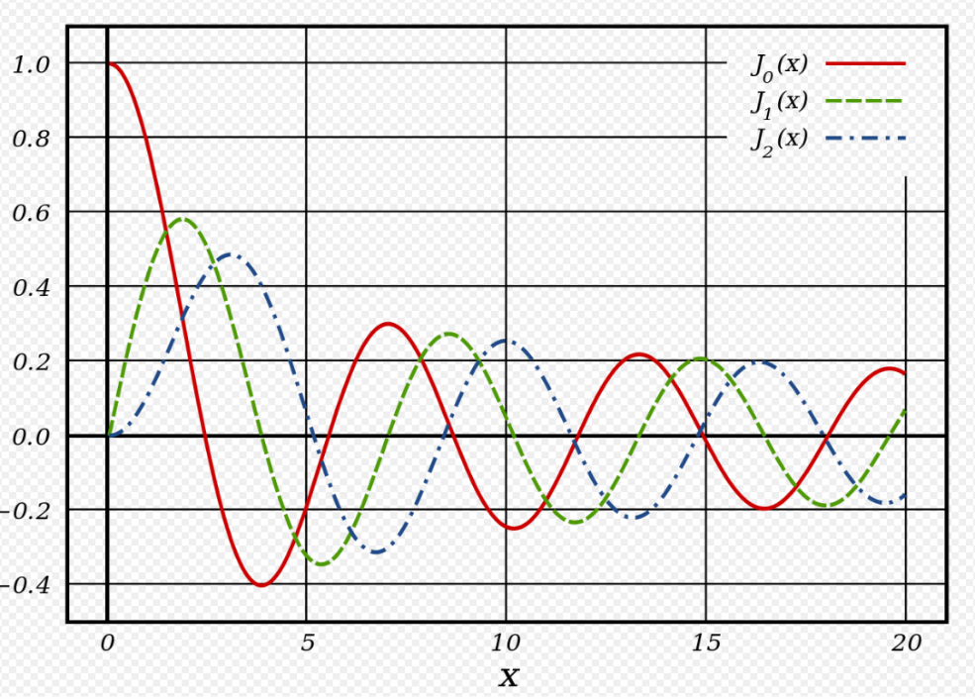
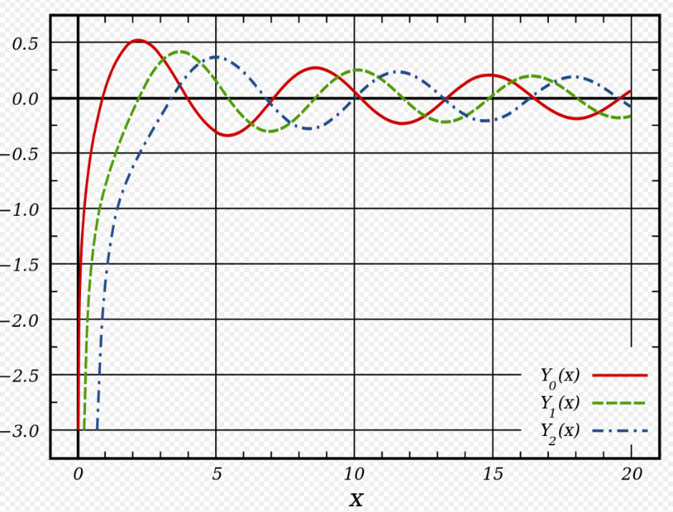
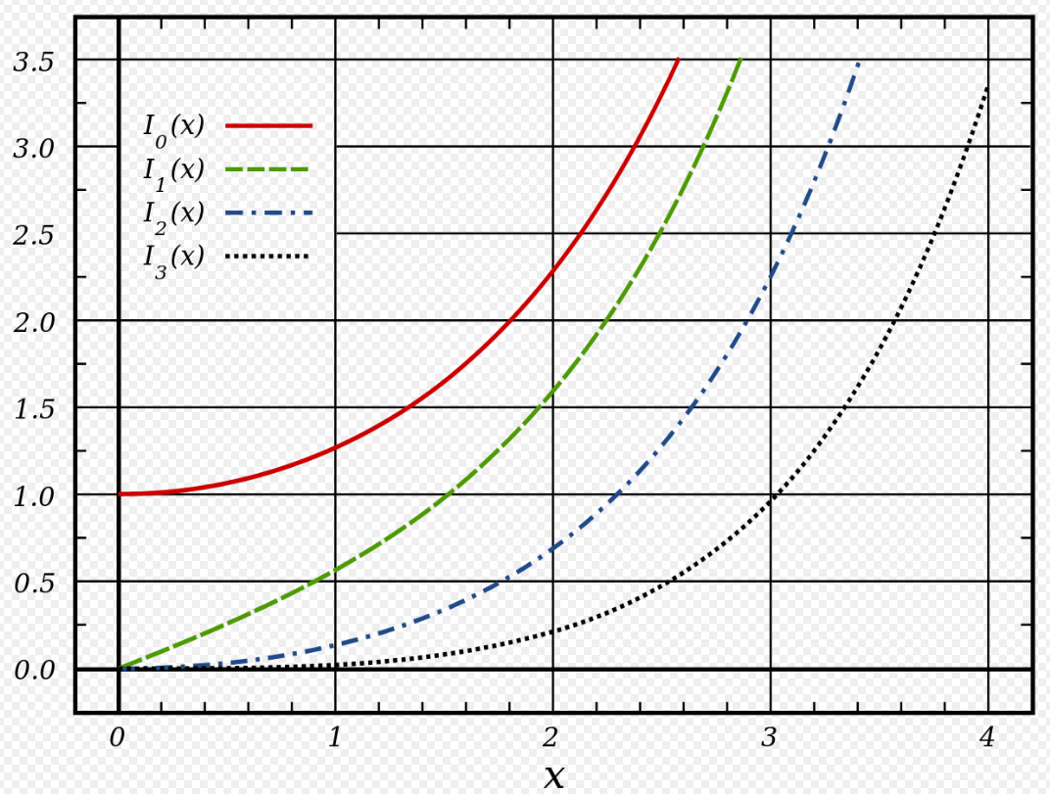
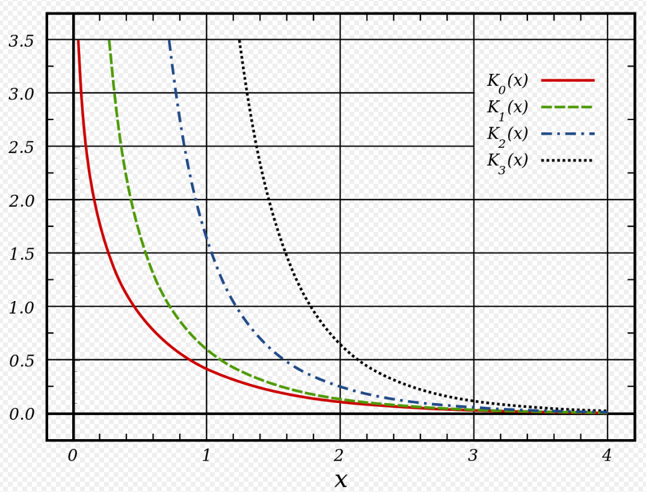
Fiber Modes

Slide 22

Fiber Modes
The field must vanish outside the core (r>a) and is allowed to oscillate inside the core (r<a). By comparison between the F(r) differential equation and the general ordinary Bessel equation we get the two solutions
$F\left(r\right)=AJ_{m}\left(κr\right)+A^{′}Y_{m}\left(κr\right), r≤a$
$F\left(r\right)=CK_{m}\left(γr\right)+C^{′}I_{m}\left(γr\right), r>a$
where $κ^{2}=n_{1}^{2}\frac{ω^{2}}{c^{2}}−β^{2}$, $γ^{2}=β^{2}−n_{2}^{2}\frac{ω^{2}}{c^{2}}$
The solutions have physical meaning when the field at $r=0$ (center) and $r=∞$ (far away) is finite. Observing the form of the Bessel functions it is obvious that we must set A’=0 and C’=0. The solutions now are
$F\left(r\right)=AJ_{m}\left(κr\right), r≤a$
$F\left(r\right)=CK_{m}\left(γr\right), r>a$

Slide 23

Fiber Modes
The electric field solutions are
$ℰ\left(r,φ,z\right)=AJ_{m}\left(κr\right)e^{imφ}e^{iβz}, r≤a$
$ℰ\left(r,φ,z\right) =CK_{m}\left(γr\right)e^{imφ}e^{iβz}, r>a$
In a similar way the magnetic field solutions are
$ℋ\left(r,φ,z\right)=BJ_{m}\left(κr\right)e^{imφ}e^{iβz}, r≤a$
$ℋ\left(r,φ,z\right)=DK_{m}\left(γr\right)e^{imφ}e^{iβz}, r>a$
The Helmholtz equation applies to a single component of the electric field envelope $ℰ(r,φ,z)$, and also to a single component of the magnetic field envelope $ℋ(r,φ,z)$. Given $E_{z}$ and $H_{z}$, for instance, we can obtain $E_{x},E_{y},H_{x},H_{y}$ from the Maxwell equations.

Slide 24

Fiber Modes
Example: Derivation of $H_{x}$
$∇×\vec{E}=iωμ_{0}\vec{H}$ (1)
$∇×\vec{H}=−iωε\vec{E}=−iωn^{2}ε_{0}\vec{E}$ (2)
From (1), considering the $H_{x}$ component we get
$iωμ_{0}H_{x}=\frac{∂E_{z}}{∂y}−\frac{∂E_{y}}{∂z}=\frac{∂E_{z}}{∂y}−iβE_{y}$ (3)
From (2) we get
$E_{y}=\frac{i}{ωn^{2}ε_{0}}(−\frac{∂H_{z}}{∂x}+\frac{∂H_{x}}{∂z})$ (4)
Using (4) in (3) and $ε_{0}μ_{0}=1/c^{2}$, we obtain for the core region ($n^{2}=n_{1}^{2})$
$H_{x}=−\frac{i}{κ^{2}}(ωn_{1}^{2}ε_{0}\frac{∂E_{z}}{∂y}−β\frac{∂H_{z}}{∂x})$

Slide 25

Fiber Modes
In the same fashion we can derive the components $H_{x},H_{y},E_{x},E_{y}$ in the core and cladding regions. The vectors $\vec{E},\vec{H}$ can be expressed also in terms of cylindrical components $E_{r},E_{φ},H_{r},H_{φ}$. We can express the envelopes $ℰ_{r},ℰ_{φ},ℋ_{r},ℋ_{φ}$ in terms of $ℰ_{z},ℋ_{z}$ satisfying
$ℰ_{z}\left(r,φ,z\right)=AJ_{m}\left(κr\right)e^{imφ}e^{iβz}, r≤a$
$ℰ_{z}\left(r,φ,z\right) =CK_{m}\left(γr\right)e^{imφ}e^{iβz}, r>a$
$ℋ_{z}\left(r,φ,z\right)=BJ_{m}\left(κr\right)e^{imφ}e^{iβz}, r≤a$
$ℋ_{z}\left(r,φ,z\right)=DK_{m}\left(γr\right)e^{imφ}e^{iβz}, r>a$

Slide 26

Fiber Modes
Inside the core ($r≤a)$we get the equations
$$ℰ_{r}=\frac{i}{κ^{2}}(β\frac{∂ℰ_{z}}{∂r}+μ_{0}\frac{ω}{r}\frac{∂ℋ_{z}}{∂φ})$$
$$ℰ_{φ}=\frac{i}{κ^{2}}(\frac{β}{r}\frac{∂ℰ_{z}}{∂φ}−μ_{0}ω\frac{∂ℋ_{z}}{∂r})$$
$$ℋ_{r}=\frac{i}{κ^{2}}(β\frac{∂ℋ_{z}}{∂r}−ε_{0}n_{1}^{2}\frac{ω}{r}\frac{∂ℰ_{z}}{∂φ})$$
$$ℋ_{φ}=\frac{i}{κ^{2}}(\frac{β}{r}\frac{∂ℋ_{z}}{∂φ}+ε_{0}n_{1}^{2}ω\frac{∂ℰ_{z}}{∂r})$$
For the cladding region ($r>a)$ the same equations can be used after replacing $κ^{2}$ by $−γ^{2}$ and $n_{1}$ by $n_{2}$.

Slide 27

Fiber Modes
The constants A, B, C, D are determined by applying the boundary condition that the tangential components of $\vec{E},\vec{H}$ be continuous across the core-cladding interface. By requiring the continuity of $ℰ_{z},ℋ_{z},ℰ_{φ},H_{φ}$ at $r=a$ we obtain a set of four homogeneous equations.
In order for the solution (A,B,C,D) to be non-trivia ( not equal to zero) the determinant of the coefficient matrix must be zero which leads to the following relation
$$\left[\frac{J_{m}^{′}\left(κa\right)}{κJ_{m}\left(κa\right)}+\frac{K_{m}^{′}\left(γa\right)}{γK_{m}\left(γa\right)}\right]\left[\frac{J_{m}^{′}\left(κa\right)}{κJ_{m}\left(κa\right)}+\frac{n_{2}^{2}}{n_{1}^{2}}\frac{K_{m}^{′}\left(γa\right)}{γK_{m}\left(γa\right)}\right]=\frac{m^{2}}{a^{2}}\left(\frac{1}{κ^{2}}+\frac{1}{γ^{2}}\right)\left(\frac{1}{κ^{2}}+\frac{n_{2}^{2}}{n_{1}^{2}}\frac{1}{γ^{2}}\right)$$

Slide 28

Fiber Modes
For a given set of parameters $ω,a,n_{1},n_{2}$ the values of $β$ can be determined by the characteristic equation. In general there are multiple solutions, $n=1,2,…,$ for each integer value m.
Each different solution can be denoted as $β_{mn}$ and it defines a mode of the fiber.
In general both $ℰ_{z}$ and $ℋ_{z}$ are nonzero (except for m=0). They are referred as hybrid modes and are denoted by $HE_{mn}$ or $EH_{mn}$, depending on whether $H_{z}$ or $E_{z}$ dominates.
In the special case m=0, $HE_{0n}$ and $EH_{0n}$ are denoted by $TE_{0n}$ and $TH_{0n}$ since they correspond to transverse-electric ($E_{z}=0)$ and transverse-magnetic ($H_{z}=0)$ modes of propagation.
A different notation $LP_{mn}$ is sometimes used for weakly guiding fibers for which both $E_{z},H_{z}$ are nearly zero (LP stands for linearly polarized modes).

Slide 29

Fiber Modes
Guided and Unguided Modes
We are interested in guided modes in which the electric and magnetic fields fall off with radial distance from the fiber. For $γr≫1$ inside the cladding layer we get
$$K_{m}\left(γr\right)={\left(\frac{π}{2γr}\right)}^{\frac{1}{2}}e^{−γr}$$
$γ^{2}>0:e^{−γr}$ and the field decays. The mode is guided.
$γ^{2}<0:e^{−γr}=e^{−i\left|γ\right|r}=\cos\left|γ\right|r−i sin\left|γ\right|r$, it holds no physical meaning and the mode is unguided.
$γ^{2}=0$ defines the “cut-off” between guided and unguided modes.

Slide 30

Fiber Modes
For $γ^{2}=0→β^{2}=n_{2}^{2}\frac{ω^{2}}{c^{2}}$ and $κ^{2}=\frac{ω^{2}}{c^{2}}\left(n_{1}^{2}−n_{2}^{2}\right)$
Normalized propagation constant b
$$b=(\frac{βc}{ ω}−n_{2})/(n_{1}−n_{2})$$
For $b≤0$ the mode β is unguided.
V Parameter (Dimensionless)
  $$V=aκ=\frac{ω}{c}a\sqrt{n_{1}^{2}−n_{2}^{2}}=\frac{ωa}{c}NA$$
  It determines the number of guided modes.
  Fibers with large V have many modes. For $V≫1$ there are approximately $\frac{V^{2}}{2}$ modes.
  For small enough V ( e.g. by lowering the radius a ) it is found that only the fundamental mode $HE_{11}$ is guided.

Slide 31
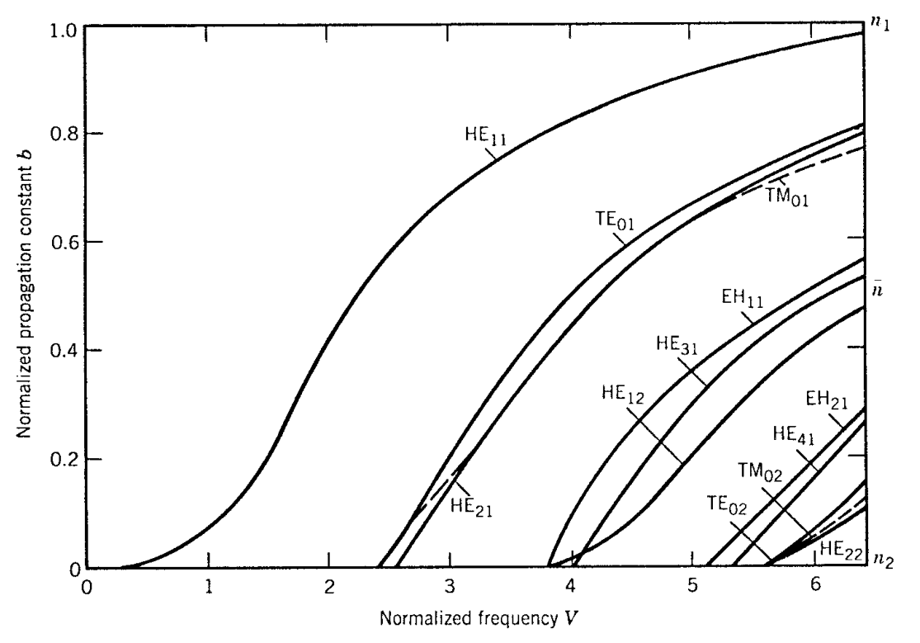
Fiber Modes

Slide 32

Single Mode Fibers
Single mode fibers support only the fundamental mode. The value V must be determined for which the modes $TE_{01}$ and $TM_{01}$ reach cut-off (see previous slide). By setting m = 0 in the characteristic equation we get
$κJ_{0}\left(κa\right)K_{0}^{′}\left(γa\right)+γJ_{0}^{′}\left(κa\right)K_{0}\left(γa\right)=0$
$κn_{2}^{2}J_{0}\left(κa\right)K_{0}^{′}\left(γa\right)+γn_{1}^{2}J_{0}^{′}\left(κa\right)K_{0}\left(γa\right)=0$
Since in cut-off $γ=0$ and $κa=V$ the single mode condition is simply
$$J_{0}\left(V\right)=0$$
The smallest value V that satisfies this condition is 2.405.
A fiber designed such as $V<2.405$ supports only the fundamental mode $HE_{11}$.

Slide 33
Fiber Types
STEP INDEX FIBERs
GRADED – INDEX FIBERs
SINGLE MODE FIBERs
MULTICORE FIBERS
RARE-EARTH FIBERS

Slide 34
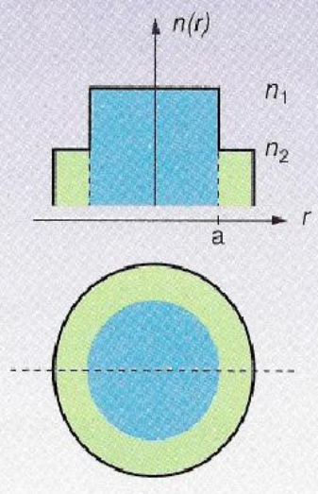

Step Index Fiber
Abrupt change of the refractive index
$n(r)=\left\{\begin{aligned}n_{1}, r<a \\ &n_{2}, r≥a\end{aligned}\right.$
  Core diameter ~ 60μm
  Cladding diameter ~ 125 μm
Operation Characteristics
  Large number of guided modes $M=\frac{V^{2}}{2}$
  Large NA and large core diameter
  Connection with incoherent sources
  No power coupling
  Large intermodal dispersion
  Small available bandwidth

Slide 35
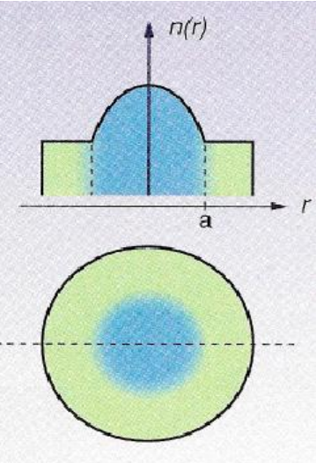

Graded – Index Fiber
Gradual change of refractive index
$n(r)=\left\{\begin{aligned}n_{1}\left[1−Δ{\left(\frac{r}{a}\right)}^{x}\right], r<a \\ &n_{2}, r≥a\end{aligned}\right.$
Operation Characteristics
Number of guided modes $M=\left(\frac{a}{a+2}\right)\left(\frac{V^{2}}{2}\right)$
Restriction of Intermodal Dispersion
Exploitation of bandwidth

Slide 36
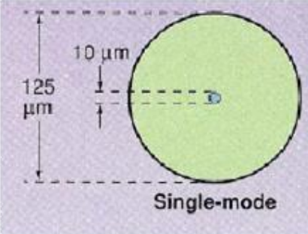
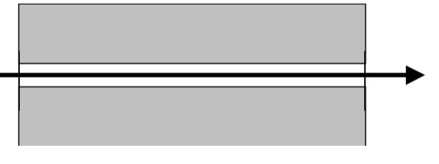
Single Mode Fibers
Efficient exploitation of the bandwidth
Elimination of intermodal dispersion
It can be connected only with monochromatic sources ( laser diodes)
No power coupling

Slide 37
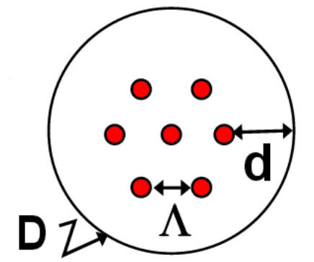

Multicore Fibers
Multiple cores, each can transfer data in high capacity
  Design Parameters
  Core Distance : $Λ$
  Cladding Diameter : D
  Cladding – core distance : d
  Strong isolation of the field in each core
Basic Challenge : Interference between fields in neighboring modes.
Approaches
  Increase the mode isolation factor in each core
  Increase the parameter Λ (>35 μm)

Slide 38
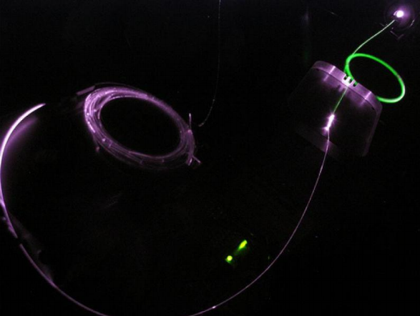
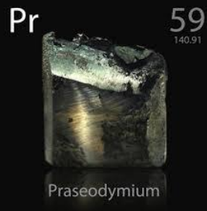

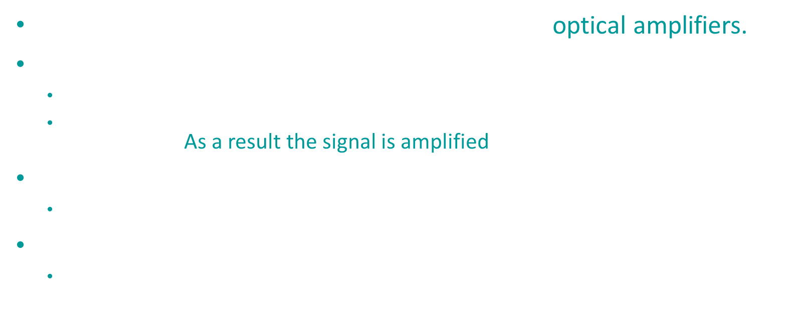
Rare-Earth Doped Fibers
Important component for the development of optical amplifiers.
The core is doped with rare-earth ions.
  Electrons are stimulated to higher energy levels (population inversion)
  The relaxation of electrons produces photons of wavelength equal to the input signal. As a result the signal is amplified.
Amplification around 1550 nm (EDFA)
  Fibers doped with Erbium ions ($Er^{+3}$)
Amplification around 1300 nm (PDFA)
  Fibers doped with Praseodynium ions

Slide 39
Induced Limitations
FIBER LOSSES
Dispersion

Slide 40
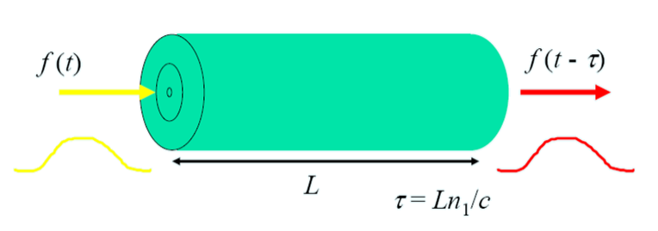
Signal distortion
In case of an ideal optical fiber the transmitted signal maintains its form and intensity after its propagation.

Slide 41
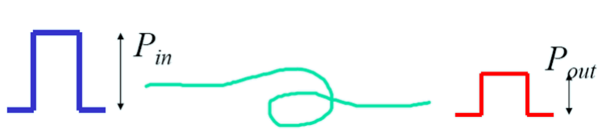
Signal distortion
In reality no optical fiber is ideal.
In the fiber the signal is distorted due to
  Attenuation (optical power losses)
  Dispersion (distortion of the pulse shape)
Fiber losses do not affect the shape of the transmitted pulse. They decrease only its optical power.

Slide 42
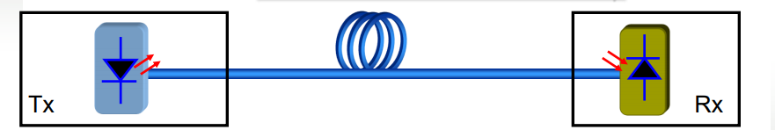

Fiber losses
The optical transmitter is characterized by the maximum power value it can generate : $P_{s}$
The optical receiver is characterized by the lowest power value it can detect, which is also known as detector sensitivity : $P_{R}$
The maximum allowed attenuation inflicted on the transmitted signal is equal to
$a_{link}=\frac{P_{s}}{P_{R}}$

Slide 43

Fiber losses
In an optical fiber the attenuation is measured in terms of the fiber length and as a result longer fibers induce higher losses.
The fiber losses decrease exponentially the optical power of the signal during its propagation.
$$P\left(z\right)=P\left(0\right)e^{−Az}$$
$P(z)$ : Power after propagating distance z
$P(0)$ : Power in the fiber input
A : attenuation factor (1/m)

Slide 44

Fiber losses
After propagation inside a fiber of length L (km), the attenuation (dB) is equal to
$10\log_{10}\left(\frac{P\left(0\right)}{P\left(L\right)}\right)=10\log_{10}{e^{AL}}$
Using the relation $\log_{10}{x}=\ln{x}/\ln{10}$, we get
$$10\log_{10}\left(\frac{P\left(0\right)}{P\left(L\right)}\right)=10\left\{\frac{\ln\left(e^{AL}\right)}{\ln{10}}\right\}=\left\{\frac{10}{ln10}\right\}AL \\ =4,343AL=aL$$
$a$ is the attenuation factor in dB/km

Slide 45
Attenuation factors
Absorption : It depends on the material and its purity.
  Endogenous absorption by the atoms that constitute the fiber.
  Exogenous absorption by undesirable atoms.
  Absorption from glass atoms.
Scattering: Due to inhomogeneous material
  Rayleigh scattering
  Mie scattering
Radiation: Due to discontinuities, i.e. fiber bending, or fabrication defects.
  The bending increases the escaping field percentage.

Slide 46
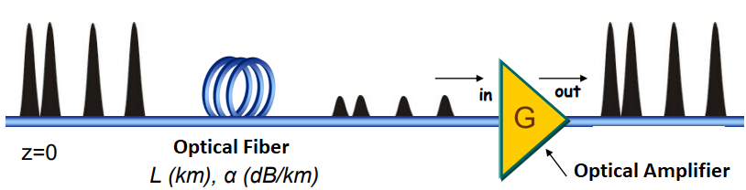
Power compensation
Compensation of power losses can be achieved by periodic placement of optical amplifiers.

Slide 47
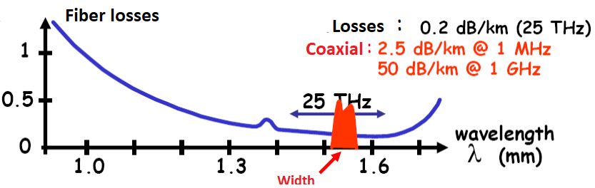
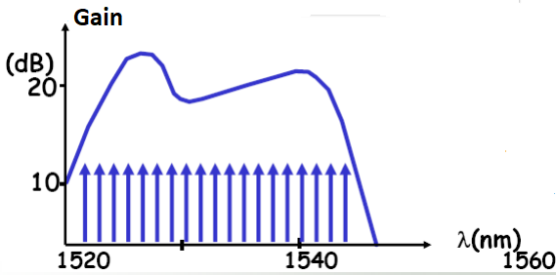

Power compensation
Amplifier Gain : $G=10\log_{10}\left(\frac{P_{out}}{P_{in}}\right)$
We use an amplifier with gain $20 dB$ for almost every 100 km,
where the total wavelength fiber losses are $\sim 20dB$

Slide 48
Dispersion
Dispersion is the phenomenon according to which the temporal form of the input signal is corrupted.
Dispersion Types
Intermodal Dispersion ( We have already covered this topic)
Group – Velocity Dispersion (GVD)
Material Dispersion
Waveguide Dispersion
Polarization – Mode Dispersion

Slide 49

Group Velocity Dispersion
An ideal monochromatic wave is described by the field relation
$$E\left(z,t\right)=E_{0}cos⁡(ωt−kz)$$
with phase velocity $v_{p}=c/n(ω)$, where c is the speed of light and $n(ω)$ is the refractive index.
Such a wave has no beginning and no end and obviously it cannot be realized.
A finite wave has many spectral components.

Slide 50

Group Velocity Dispersion
Let’s consider a field that is the superposition of two plane waves, which differ slightly in frequency $ω$ and wavenumber $k=ωc/n(ω)$.
$$E\left(z,t\right)=\cos\left[\left(ω+Δω\right)t−\left(k+Δk\right)z\right]+\cos\left[\left(ω−Δω\right)t−\left(k−Δk\right)z\right] \\ =2\cos\left(ωt−kz\right)\cos{Δω\left(t−\frac{Δk}{Δω}z\right)}=ℰ\left(z,t\right)\cos{(ωt−kz)}$$
Two components
Carrier : $cos\left(ωt−kz\right)$
Envelope: $ℰ\left(z,t\right)=2\cos{Δω\left(t−\frac{Δk}{Δω}z\right)}$

Slide 51

Group Velocity Dispersion
The carrier has a phase velocity equal to
$$v_{p}=c/n(ω)$$
The envelope propagates with velocity
$$v_{g}=\frac{Δω}{Δk}$$
which is known as group velocity.
If we add waves with small and continuous spread in frequency with phase velocity $c/n(ω)$ we will obtain an envelope that propagates with velocity
$$v_{g}=\frac{dω}{dk}$$

Slide 52

Group Velocity dispersion
Since $k=n\left(ω\right)ω/c$, we have
$$v_{g}={\left(\frac{dk}{dω}\right)}^{−1}=\frac{c}{n+ω\frac{dn}{dω}}$$
The group velocity is commonly written as $c/n_{g}$, where the group index is
$$n_{g}=n+ω\frac{dn}{dω}$$

Slide 53
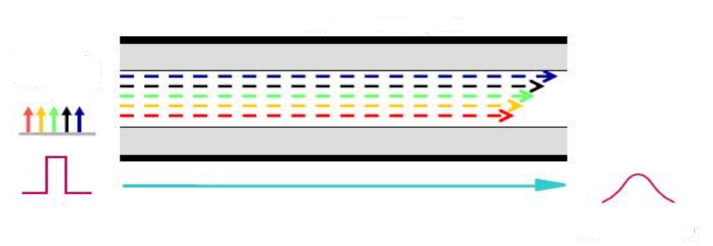
Group Velocity Dispersion
Each spectral component travels with different velocity due to the dependence of the refractive index on frequency. As a result they arrive at different times at the end of the fiber.
Time intervals of the pulse also arrive at different times.

Slide 54
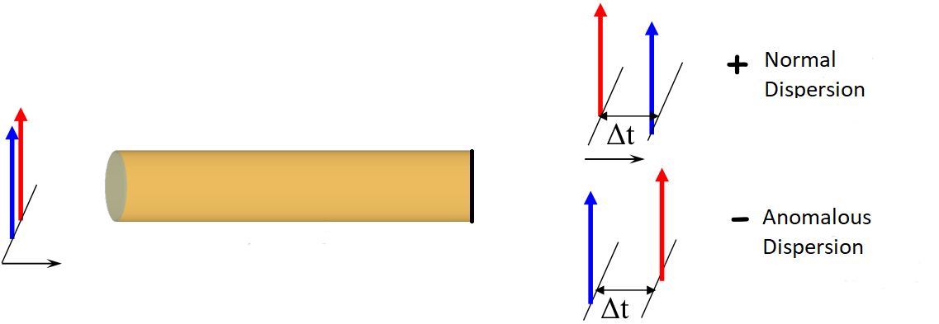
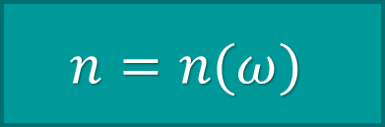

Group Velocity Dispersion
Refractive index is a function of the frequency,
The group velocity is also a function of frequency $ω$
… so each spectral component travels with different velocity
$$n=n(ω)$$

Slide 55
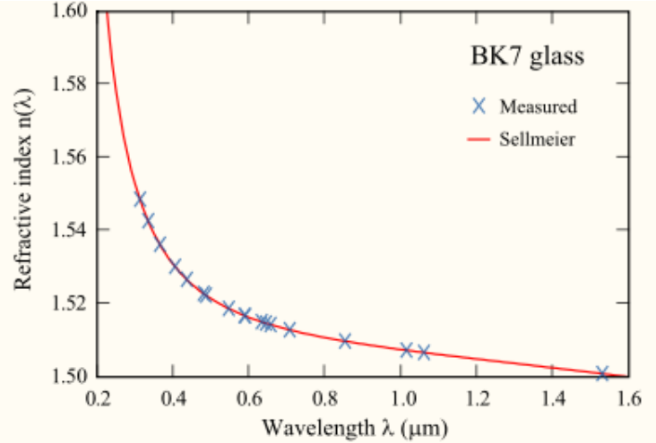

Sellmeier relation
$$n\left(λ\right)=1+B_{1}\frac{λ^{2}}{λ^{2}−C_{1}}+B_{2}\frac{λ^{2}}{λ^{2}−C_{2}}+B_{3}\frac{λ^{2}}{λ^{2}−C_{3}}$$
Each spectral component sees a different refractive index and as a result travels with a different velocity.

Slide 56

Propagation Constant $β(ω)$ and parameter $β_{1}$
Propagation constant $β(ω)$ in Taylor expansion around $ω_{0}$
$$β\left(ω\right)=\frac{n\left(ω\right)ω}{c}=β_{0}+β_{1}\left(ω−ω_{0}\right)+β_{2}{\left(ω−ω_{0}\right)}^{2}+…$$
where $β_{m}={\left[\frac{d^{m}}{dω^{m}}\right]}_{ω=ω_{0}}$
$β_{1}=\frac{1}{c}\left[n+\frac{dn}{dω}\right]=\frac{n_{g}}{c}=1/v_{g}$
$β_{2}=\frac{1}{c}\left[2\frac{dn}{dω}+ω\frac{d^{2}n}{dω^{2}}\right]≅\frac{ω}{c}\frac{d^{2}n}{dω^{2}}≅\frac{λ^{3}}{2 πc^{2}}\frac{d^{2}n}{dλ^{2}}$
where $n_{g}$ is the group refractive index

Slide 57


Propagation Constant $β(ω)$ and parameter $β_{1}$
$β_{1}=\frac{1}{c}\left[n+\frac{dn}{dω}\right]=\frac{n_{g}}{c}=\frac{1}{v_{g}}$
The term $β_{1}$ is inversely proportional to the group velocity
The propagation time for a signal with spectral width $Δω$ inside a fiber of length L is equal to
$$T=\frac{L}{v_{g}}=β_{1}L$$
… as a result the time delay is determined by the group velocity (the term $β_{1})$

Slide 58
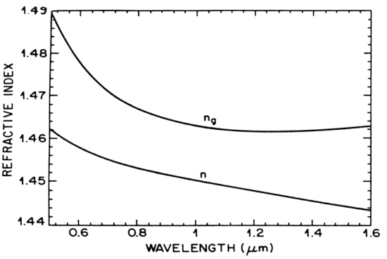


Propagation Constant $β(ω)$ and parameter $β_{2}$
… for a signal with spectral width $Δω$, we assume that the frequencies propagate in a fiber of length L with time difference:
$$ΔT=\frac{dT}{dω} Δω=L\frac{dβ_{1}}{dω} Δω=Lβ_{2}Δω$$
where the term $β_{2}$ results in the widening of the pulse.

Slide 59

Dispersion Parameter D
Alternatively , if we compute $ΔT$with respect to $Δλ$, then $ΔT=DLΔλ$, where D:
$$D=\frac{d\left(\frac{1}{v_{g}}\right)}{dλ}=−\frac{2πc}{λ^{2}}β_{2}$$
where $β_{2}$ is the group velocity dispersion parameter.
$β_{2}=\frac{1}{c}\left[2\frac{dn}{dω}+ω\frac{d^{2}n}{dω^{2}}\right]≅\frac{ω}{c}\frac{d^{2}n}{dω^{2}}≅\frac{λ^{3}}{2 πc^{2}}\frac{d^{2}n}{dλ^{2}}$

Slide 60
Normal and Anomalous Dispersion
Group velocity dispersion (also known as material or chromatic dispersion) is divided into normal and anomalous dispersion

Slide 61


Normal Dispersion
In normal dispersion the group velocity is lower than the phase velocity.
In normal dispersion, the low frequencies travel faster than the high frequencies
$D<0$ and $β_{2}>0$

Slide 62


Anomalous Dispersion
In anomalous dispersion the group velocity is higher than the phase velocity.
In anomalous dispersion, the high frequencies travel faster than the low frequencies
$D>0$ and $β_{2}<0$

Slide 63



Normal and Anomalous Dispersion
Anomalous Dispersion: +D or ${−β}_{2}$
The red components travel faster than the blue components
Normal Dispersion: -D or ${+β}_{2}$
The blue components travel faster than the red components

Slide 64

Waveguide Dispersion
The longer the wavelength, the larger the portion of optical power that propagates through the cladding instead of the core.
Waveguide dispersion in single mode fibers is related to the power distribution of the propagating pulse inside the cladding and the core and it depends on the geometry of the fiber.

Slide 65


Polarization Mode Dispersion
Small asymmetries in the core characteristics leads in a difference between the refractive indices $n_{x},n_{y}$ for the two transverse axis $\hat{x},\hat{y}$.
Two components $ℰ_{x},ℰ_{y}$ propagate with different velocities across the fiber.
This phenomenon is known as birefringence .

Slide 66

Total Dispersion
Multi-mode fibers
  Intermodal dispersion is the dominant effect
  Exploitable bandwidth $∝$ MHz
Single Mode Fibers
  Material dispersion is the dominant effect
  Waveguide and material dispersion have different signs and as a result they can be mutually excluded.
$D=D_{M}+D_{W}$

Slide 67


Total Dispersion
$λ_{ZD}$ : zero dispersion wavelength

Slide 68

Total Dispersion
In the neighborhood of $1.3 μm$, where material dispersion is zero, the waveguide dispersion determines the temporal widening of the pulse.
Total dispersion can be minimized by appropriate regulation of the parameters associated with material and waveguide dispersion (opposite sign).
The value of $λ_{ZD}$ can change even up to $1.55μm$ for appropriate design
  Minimize the parameter V
  Increase the relative difference of the relative index
  Doping the fiber with Germanium.

Slide 69

Special Optical Fibers

Slide 70


Dispersion Compensation Fibers (DCF)
Dispersion is a linear effect and as a result it can be compensated.
Usually Dispersion-Compensating Fibers (DCF).
Assuming a single mode fiber (SMF) of length $L_{SMF}$ with positive dispersion $D_{SMF}≈17\frac{ps}{km×nm}$and a dispersion compensation fiber (DCF) with negative dispersion $D_{DCF}=−100 ps/(km×nm)$
We can have full compensation for DCF of length $L_{DCF}$ if
$D_{SMF}L_{SMF}=−D_{DCF}L_{DCF}$

