Slide 1
Photonic Integrated Circuits
Introduction
Assoc. Professor C. Mesaritakis

Slide 2
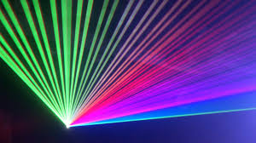
Photonics
Photonics is the physical science of light emission, sensing and transmission through dielectric waveguides, particularly in the range of visible and near-infrared electromagnetic spectrum.
Photonics is related to the quantum optics, optoelectronics, electro-optics and quantum electronics with these areas presenting slightly different connotations by scientific communities.
The basic element in quantum optics and photonics is the laser.

Slide 3
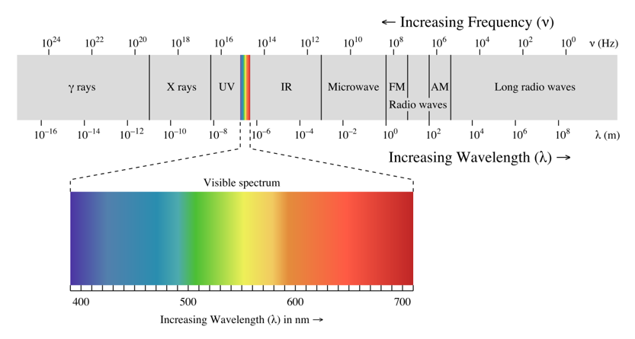
The EM Spectrum

Slide 4
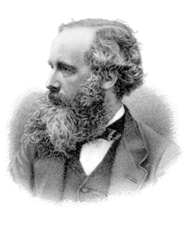

The wave nature of light
Light is a wave (Maxwell 1864) with propagation velocity in empty space equal to: $c=\sqrt{\frac{1}{μ_{0}ε_{0}}}$
In a medium with refractive index $n=\sqrt{μ_{r}ε_{r}}$, the propagation velocity is equal to : $u=\frac{c}{n}=νλ$
where v and $λ$ are the frequency and wavelength of light respectively.
Polarization
Reflection
Refraction
Interference (Young 1802)

Slide 5
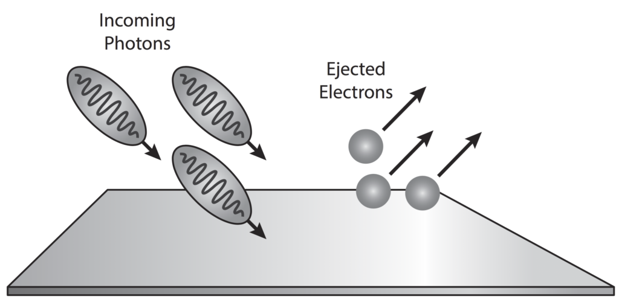
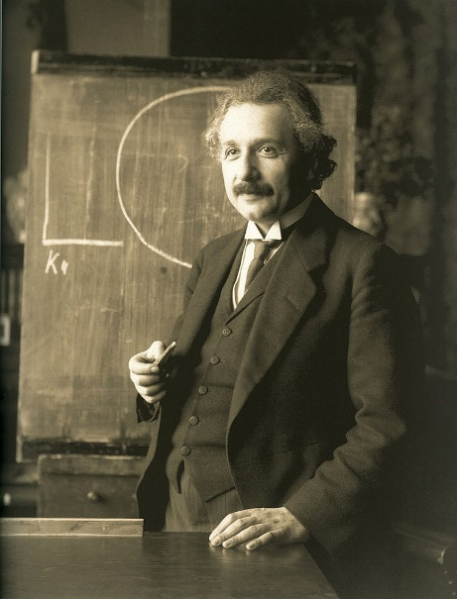

The particle nature of light
Photoelectric effect: Electrons are emitted from atoms when they absorb energy from light. Contrary to the wave theory of light the energy of the ejected electrons depends not on the light intensity but on its frequency (Philipp Lenard-1902).
Albert Einstein explained the phenomenon in 1905 by showing that electromagnetic energy is emitted only in quantized form
$E=hv$, where h is the Planck constant and v is the radiation frequency. Each elementary unit of energy is a photon.

Slide 6
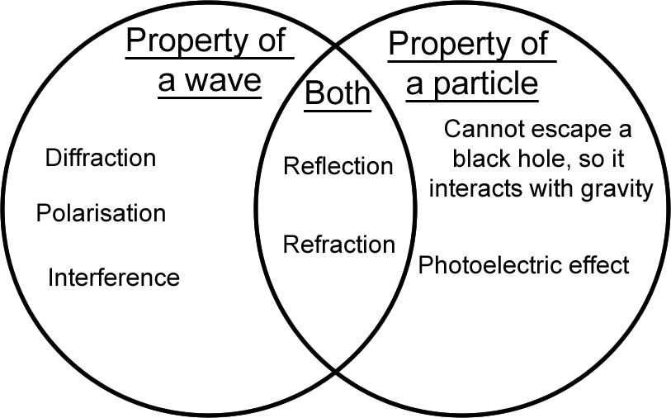
The wave-particle nature of light
Eventually the modern theory of quantum mechanics came to picture light as (in some sense) both a particle and a wave, and (in another sense), as a phenomenon which is neither a particle nor a wave (which actually are macroscopic phenomena, such as baseballs or ocean waves).
Light with light interaction and light propagation: wave nature of light.
Light with matter interaction: particle nature of light.

Slide 7
Historical --> Key Events
Year | Key Event
1865 | A Dynamical Theory of the Electromagnetic Field (Maxwell)
1905 | Photoelectric effect (Einstein)
1917 | Einstein proposes the possibility of stimulated emission
1962 | Invention of the semiconductor laser diode at General Electric,Us
1966 | The first publication on optical fibers (Charles Kao)
1988 | The first transatlantic fiber optic cable between US and Europe
1989 | The idea for the World Wide Web (Tim Berners-Lee)
2007 | Digital cameras and displays become ubiquitous because of the first iPhone
2016 | Intel debuts silicon photonics for ultra-fast connectivity in data centers
2017 | Scientists create brain-like photonic microchips

Slide 8



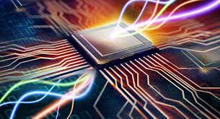


Why Photonics? Are there any interesting applications?

Slide 9
Are photonics related to the “internet”

Slide 10
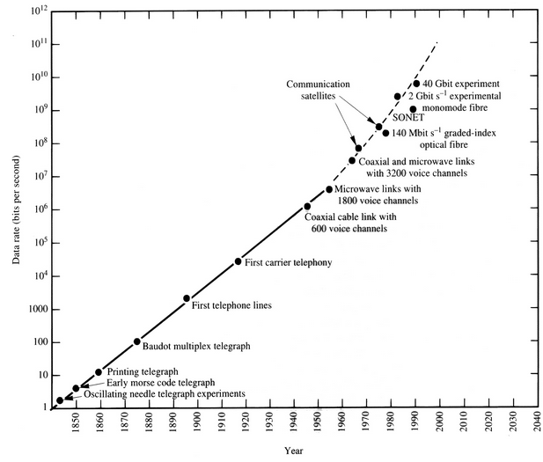
Optical Communication Networks
Five Generations
0.8-μm systems (1980) : Graded-index fibers
1.3-μm systems (1985) : Single-mode fibers
1.55-μm systems (1990) : Single-mode lasers
WDM systems (1996) : Optical amplifiers
L and S bands (2001) : Raman amplification

Slide 11
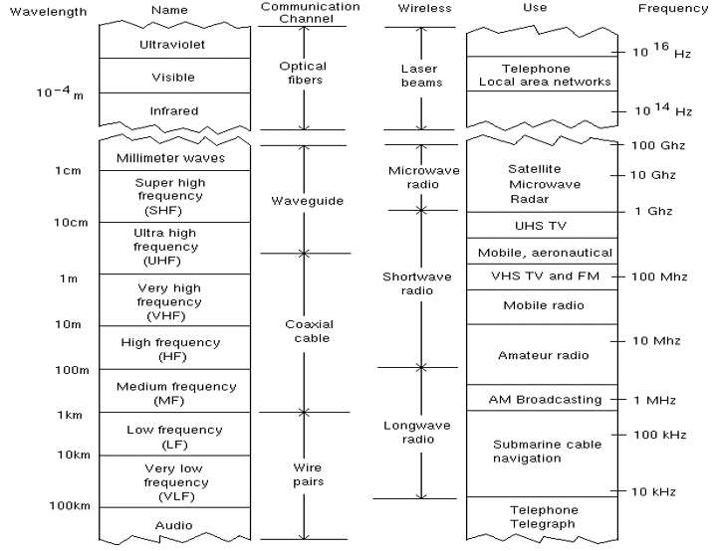
The Optical Spectrum in Telecommunications

Slide 12
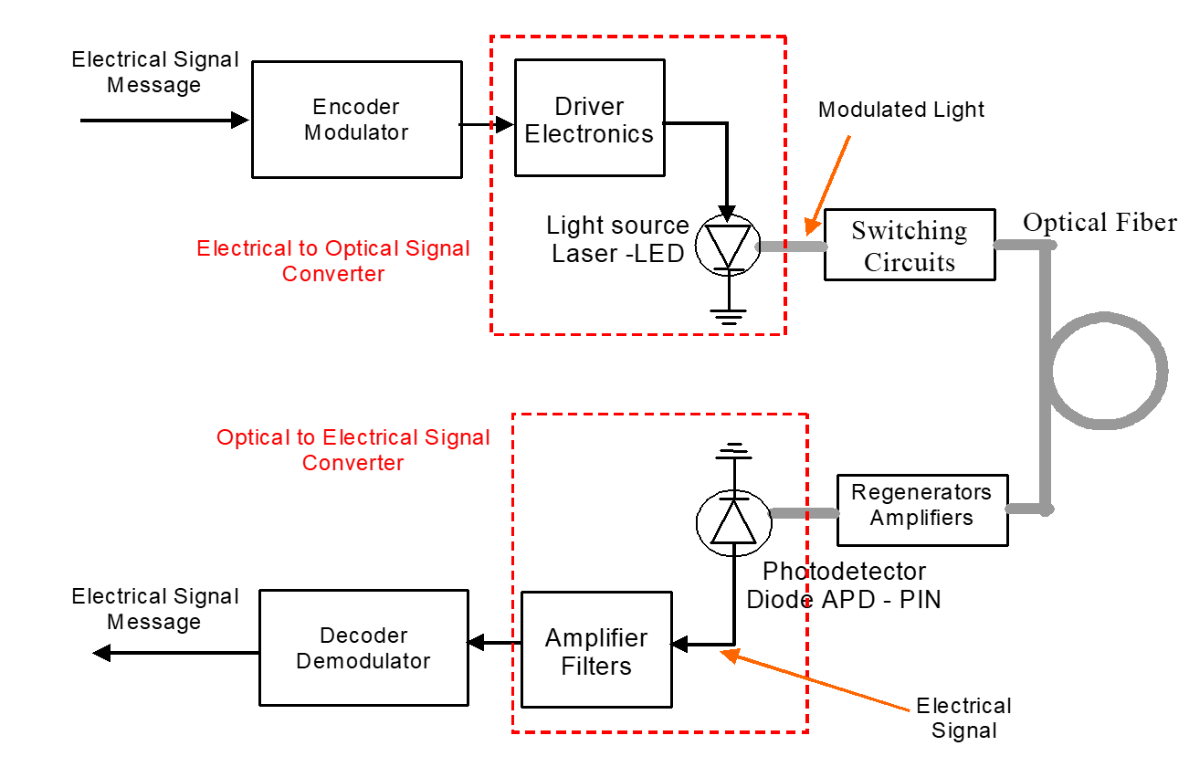
The Basic Optical System

Slide 13
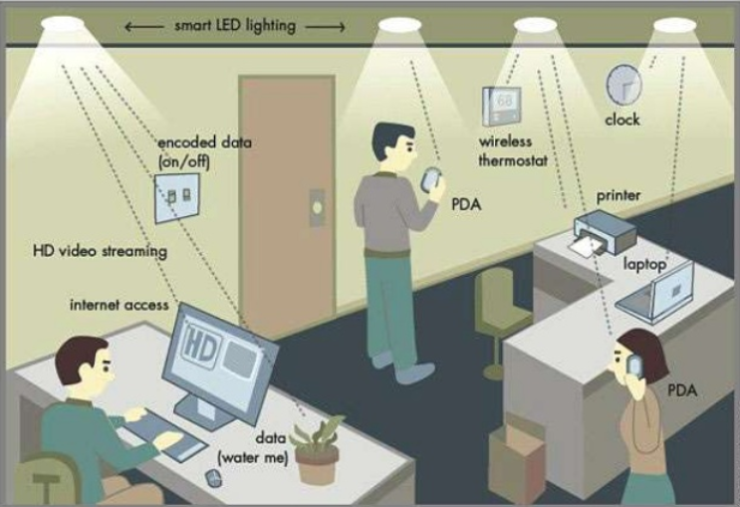
LI-FI (Light-Fidelity)
LI-FI is transmission of data through illumination, sending data through a LED light bulb that varies intensity faster than human eye can follow.
Benefits
  Transfer speed (>1Gbps)
  Visible light spectrum has
  10,000 time broad spectrum
  in comparison to radio waves.
  Cheaper than Wi-Fi because
  free band doesn’t need license
  and it uses light.
Current Limitations
  Interferences from external light
  sources (e.g., sun ,light bulbs).
  How the receiving device will transmit
  back to the transmitter ?
  Li-Fi requires line of sight.

Slide 14
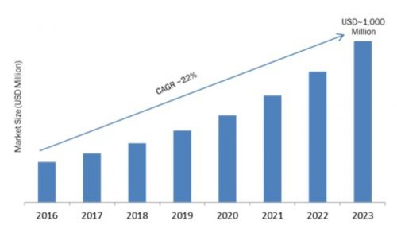
Silicon-Photonics Market - Size
Global Silicon Photonics Market, By Components (Active Components, Passive Components), By Product (RF Circuit, Optical Engine) By Application (Commercial, Telecommunications, Data Communication, Consumer Electronics) – Forecast to 2023 – Source: Reuters

Slide 15
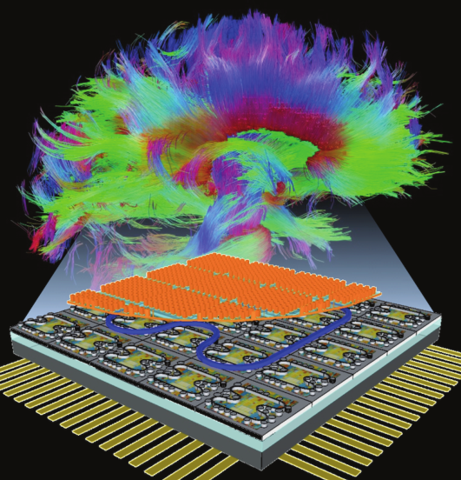
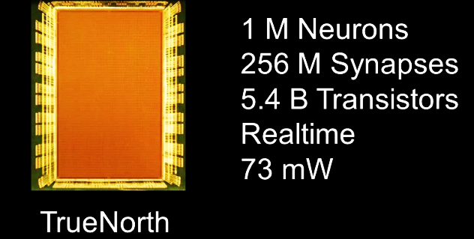
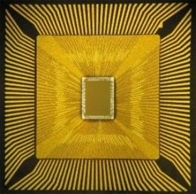
Neuromorphic Processors
Driven in part by incipient limitations in aspects of Moore’s law, there has recently been a renewed investigation of non-von Neumann architectures based on biological neural systems.
Why Photonics ? – Low power consumption, ultra-fast processing , high communication bandwidth, low crosstalk.
Ultrafast cognitive computing or photonic spike processing represents a broad domain of applications where quick, temporally precise, and robust systems are necessary, including: adaptive control, learning, perception, motion control, sensory processing, autonomous robotics, and cognitive processing of the radio frequency (RF) spectrum.

Slide 16
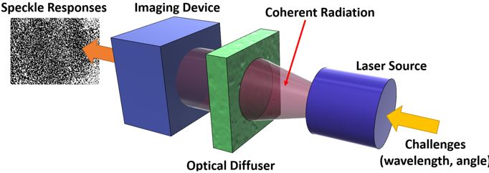
Photonic Physical Layer Security
A PUF (Physical Unclonable Function) is a physical fingerprint that serves as a unique identity for a semiconductor device. They depend on random physical factors introduced during manufacturing. These factors are unpredictable and uncontrollable, which makes it virtually impossible to duplicate or clone the structure.
Applications : cryptographic key generation, software-hardware interconnection, authentication tokens, shield systems against code-reuse attacks.

Slide 17
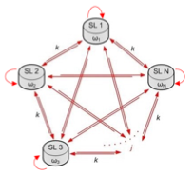
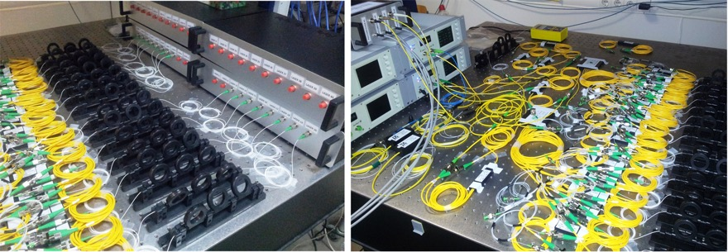
Photonic Encryption: Chaos Dynamics
Use photonic sources as nonlinear coupled systems that generate complex outputs
Seem random they deterministic → rely on the physical properties of the photonic system
Cannot be predicted
Ultra-high bandwidth

Slide 18
Photonic Sensing: Fiber sensors
Change in the external conditions affect light’s guiding
Stress sensing
Temperature sensing
Chemical sensors
Radiation sensors
Distributed sensing!

Slide 19
Photonic Sensing: Integrated Photonic sensors
Change in the environment allows variations in light’s characteristics (phase, amplitude, polarization etc.)
Highly sensitive
Low cost
Minimum footprint

Slide 20
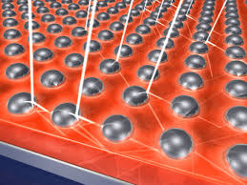
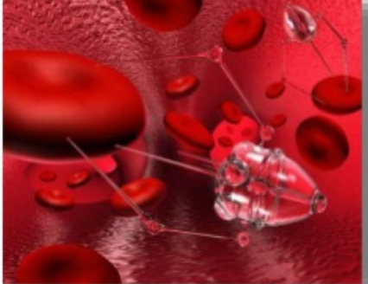
Photonic Sensing: Plasmonics
Plasmonics is concerned with the interaction of light and metal under precise circumstances. Surface plasmons are coupled electromagnetic waves propagating along metal-dielectric interfaces at metal nanostructures.
Key applications
  Plasmonic solar cells
  Plasmonic Led
  Plasmonsters – a faster chip
  Invisibility cloak
  Plasmonic Therapy – Cure for cancer
  Plasmon printing

Slide 21

Core Components
Active elements
  Optical Fibers
  Optical Sources: Laser 1060 nm-1600nm, 2mW – 10mW
  Photodetectors PIN, APD
  Amplifiers (OE-EO, SOA, EDFA) – Regenerators (OE-EO)
Passive elements
  Filters
  Couplers
  Optical Modulators
Signaling
  Digital Modulation (OOK – SCM), bit rate: 2.5 Gbps – 40 Gbps
  BER ${10}^{−9}$ or ${10}^{−12}$
  Tbps rate is feasible with multiplexing

Slide 22
Integrated Optical Devices
1960s : Waveguiding EM energy in optical frequencies in thin dielectric material layers.
Implementation of passive optical core components in a single layer with techniques analogous to the ones used in microelectronics. These methods rapidly reached the semiconductor materials for the implementation of active elements.
These optical core components, characterized by the planar technology are optical integrated circuits (OIC).
The objective of integrated optics is the development of integrated optical devices in a single layer for controlling and processing signals in the optical domain.
OIC: depending on their operation, they demand a) the combination of sources to generate optical power, b) modulators to insert the message, c) couplers to route the signal, d) optical waveguides to connect different structural blocks and e) photodetectors to receive the optical signal.

Slide 23
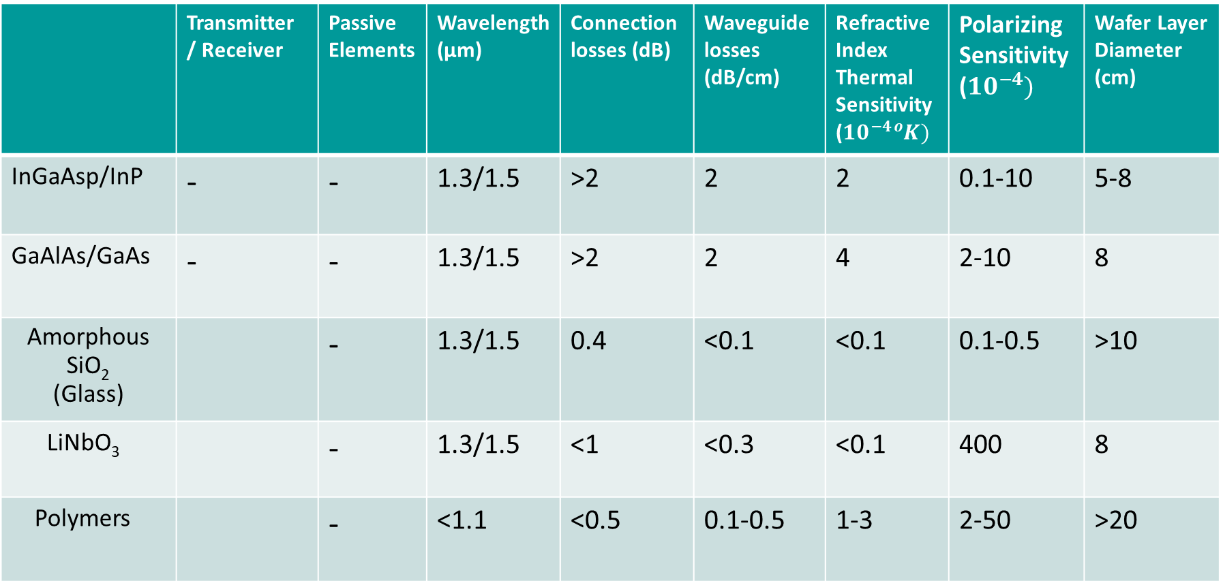
Integrated opto-electronic materials
 | Transmitter / Receiver | Passive Elements | Wavelength (μm) | Connection losses (dB) | Waveguide losses (dB/cm) | Refractive Index Thermal Sensitivity ($10^{−4}{}_{ }^{o}K)$ | Polarizing Sensitivity ($10^{−4})$ | Wafer Layer Diameter (cm)
InGaAsp/InP | - | - | 1.3/1.5 | >2 | 2 | 2 | 0.1-10 | 5-8
GaAlAs/GaAs | - | - | 1.3/1.5 | >2 | 2 | 4 | 2-10 | 8
Amorphous SiO₂ (Glass) |  | - | 1.3/1.5 | 0.4 | <0.1 | <0.1 | 0.1-0.5 | >10
LiNbO₃ |  | - | 1.3/1.5 | <1 | <0.3 | <0.1 | 400 | 8
Polymers |  | - | <1.1 | <0.5 | 0.1-0.5 | 1-3 | 2-50 | >20

Slide 24
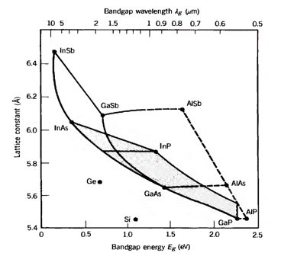
Semiconductor Materials Groups III - V
Compound binary semiconductors III-V: by combining elements of the III group( Al,Ga,In) with elements of the V group (P,As,Sb). These materials and most of all GaAs are used for the development of photodiodes and light sources (LED, Laser).
Compound ternary semiconductors : by combining two elements of the III group with one element of the V group. They present properties related to the percentage composition of the compound materials (Al_{x}Ga_{1-x}As/GaAs ).
Compound quaternary semiconductors: by combining two elements of the III group and two elements of the V group. Quaternary semiconductors are characterized by greater flexibility with respect to the composition of materials with desired properties in relation to the ternary semiconductors. This benefit is due to the extra degree of freedom. The most widely used quaternary semiconductor is In_{1-x}Ga_{x}As_{1-y}P_{y.}
The compound ternary semiconductors are formed by moving along the lines that connect the two points representing the binary compositions. A compound quaternary semiconductor is represented by a point inside the area formed by the 4 binary components. The shaded area represents the range of (band-gap, lattice constant) spanned by the compound In_{1-x}Ga_{x}As_{1-y}P_{y}

Slide 25
Fabrication Techniques
The most popular techniques are similar to the ones used to fabricate microelectronic devices.
Diffusion techniques and implantation techniques – ion implantation – exchange
  LiNbO3 devices
Growing techniques
  The crystalline substance is added on a substrate with similar crystal structure. Two main processes: (a) sputtering [Maissel 1973] and (b) epitaxial growth [Cheo 1973]. The first technique was used in the first steps of integrated optics.

Slide 26
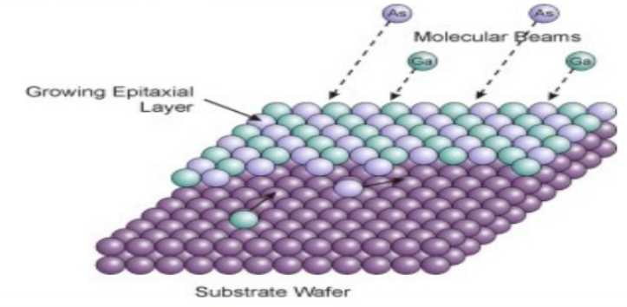
Epitaxy
Epitaxial Crystal Growth is a popular thin film deposition technique
  Previous methods return amorphous or polycrystalline films.
  Epitaxy is the process of growing a crystal of a particular orientation on top of another crystal, where the orientation is determined by the underlying crystal. The term epitaxy comes from the Greek roots epi(επί) and taxis(τάξις) which means “in ordered manner”.

Slide 27
Epitaxy
Today epitaxy techniques are used almost entirely for the fabrication of monolithic integrated circuits. They allow the development of compound ternary or quaternary semiconductors which satisfy the relation
Eg waveguide > Eg optical source > Eg photodetector
Epitaxy Techniques
  Liquid Phase Epitaxy, LPE
  Vapor Phase Epitaxy, VPΕ
  Molecular Beam Epitaxy, ΜΒΕ
  Metal Organίc Chemίcal Vapor Deposition, MOCVD

Slide 28
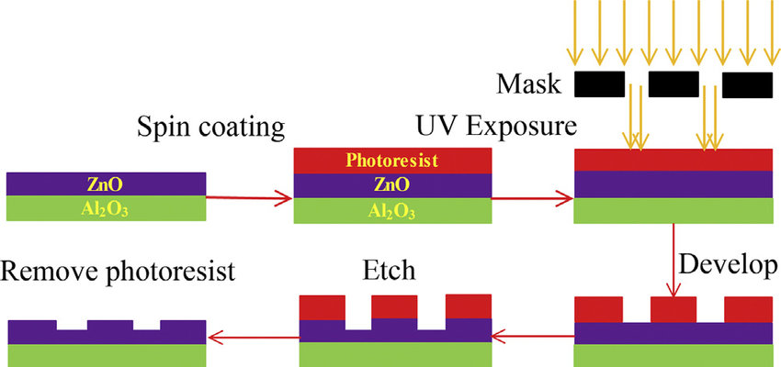
Etching
Etching techniques define the geometry of the integrated circuits.
They are necessary for the development of three dimensional optical waveguides and they are based on typical lithography techniques. These techniques form the pattern to be etched on a photo-sensitive material
Etching Types
  Wet etching
  Reactive Ion Etching – RIE
  Reactive ion beam etching - RIBE

Slide 29
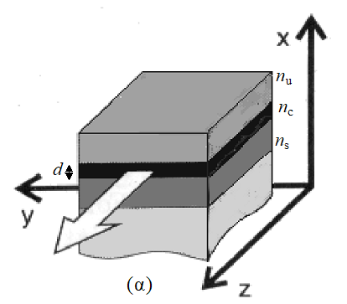
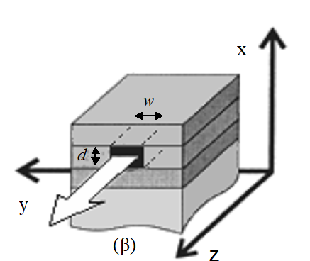
Dielectric Waveguides
Optical waveguides connect the basic components in an optical integrated device.
They collect and direct the optical signal.
(a) slab waveguide and (b) three dimensional channel waveguide

Slide 30
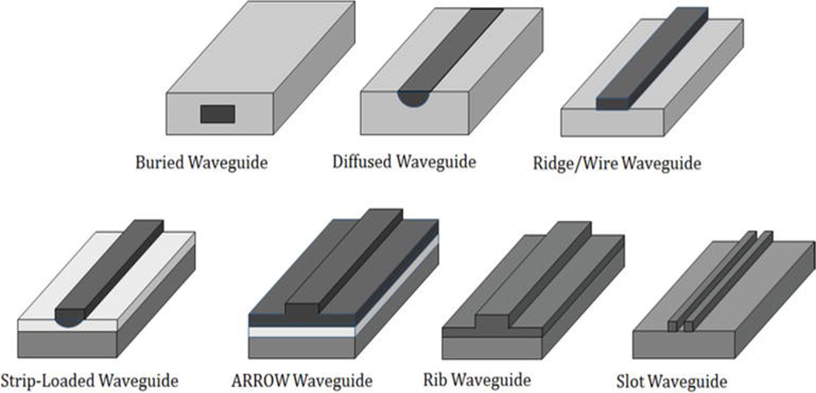
Channel Waveguides

Slide 31
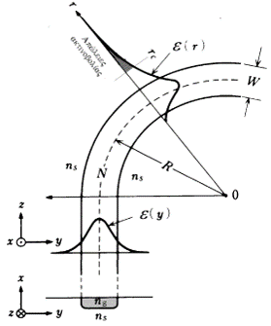
Curved Waveguides
Curve waveguides are used to change the direction of a laser beam and connect various basic components of the OIC. They are described by the radius of curvature R and the bending power losses. In waveguides with lower radiuses of curvature, beams travel a shorter distance to change direction but they suffer from higher bending power losses.
α_{R} = c₁exp(-c₂R)

Slide 32
Why optical systems ?
Optical attenuations at 1,3 μm and 1,55 μm is far lower than electric attenuations regardless of the cable type used.
They can achieve larger distances between optical regenerators as opposed to the electrical regenerators.
Optical frequencies are much higher than the microwave frequencies.
  Higher modulation frequencies and higher transmission rates.
In optical links the bandwidth depends less on the link length than the conventional wired/wireless links.
Optical attenuation does not depend on the modulation frequency.
Higher bandwidth for an optical system can be achieved simply by replacing the transmitter or receiver devices and not the propagation medium

