Slide 1
Edge FaaS
Hadjiefthymiades Stathes
Email: shadj@di.uoa.gr

Slide 2
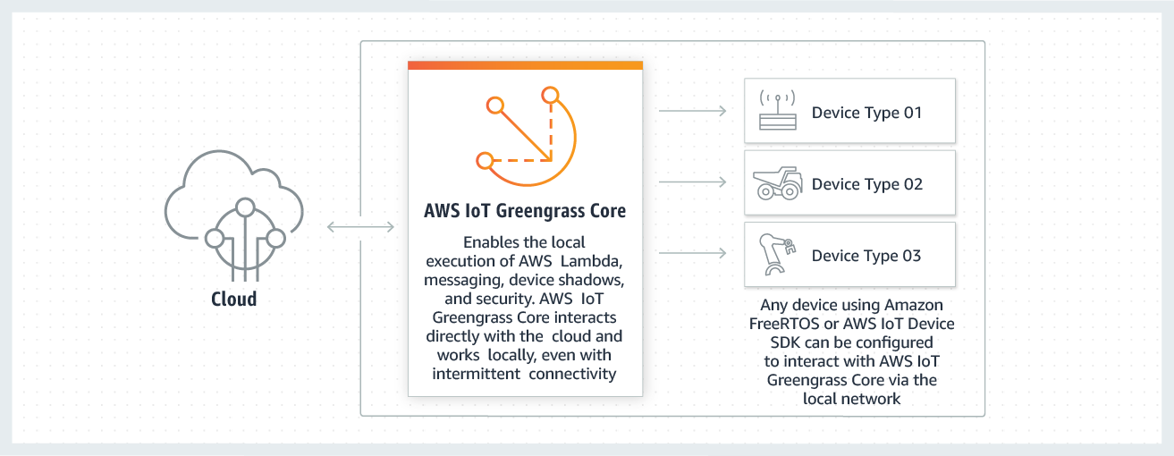
AWS Greengrass
Consists of:
Software distributions
  AWS IoT Greengrass Core software
  AWS IoT Greengrass Core SDK
Cloud service
  AWS IoT Greengrass API
Features
  Lambda runtime
  Shadows implementation
  Message manager
  Group management
  Discovery service
  Over-the-air update agent
  Stream manager
  Local resource access
  Local machine learning inference
  Local secrets manager
  Connectors with built-in integration with services, protocols, and software
AWS IoT Greengrass is software that extends cloud capabilities to local devices
enables devices to collect and analyze data closer to the source of information
react autonomously to local events, and communicate securely with each other on local networks

Slide 3
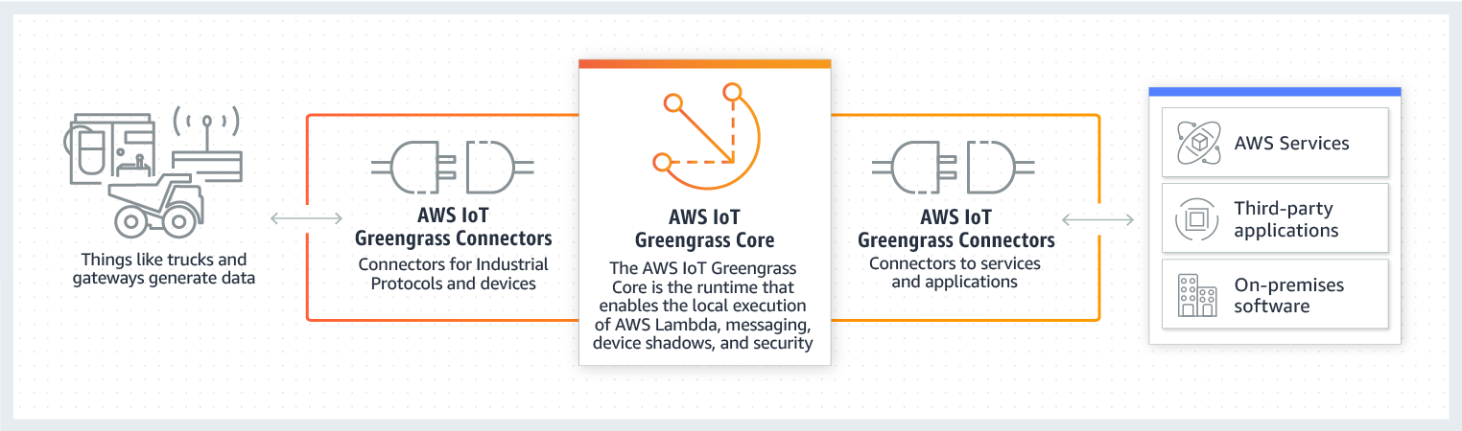
AWS Greengrass
Local devices can also communicate securely withAWS IoT Core and export IoT data to the AWS Cloud.
AWS IoT Greengrass developers can use AWS Lambda functions and prebuilt connectors to create serverless applications that are deployed to devices for local execution.

Slide 4
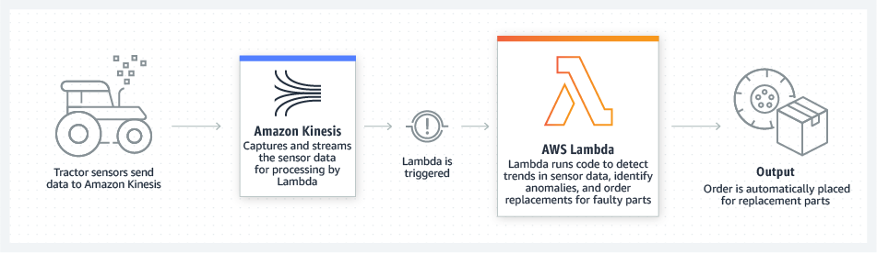
AWS Lambda
AWS Lambda is a serverless, event-driven compute service
run code virtually
any type of application or backend service
no provisioning or managing servers
trigger Lambda from over 200 AWS services and software as a service (SaaS) applications
only pay for what you use.
Run code without thinking about servers or clusters

Slide 5
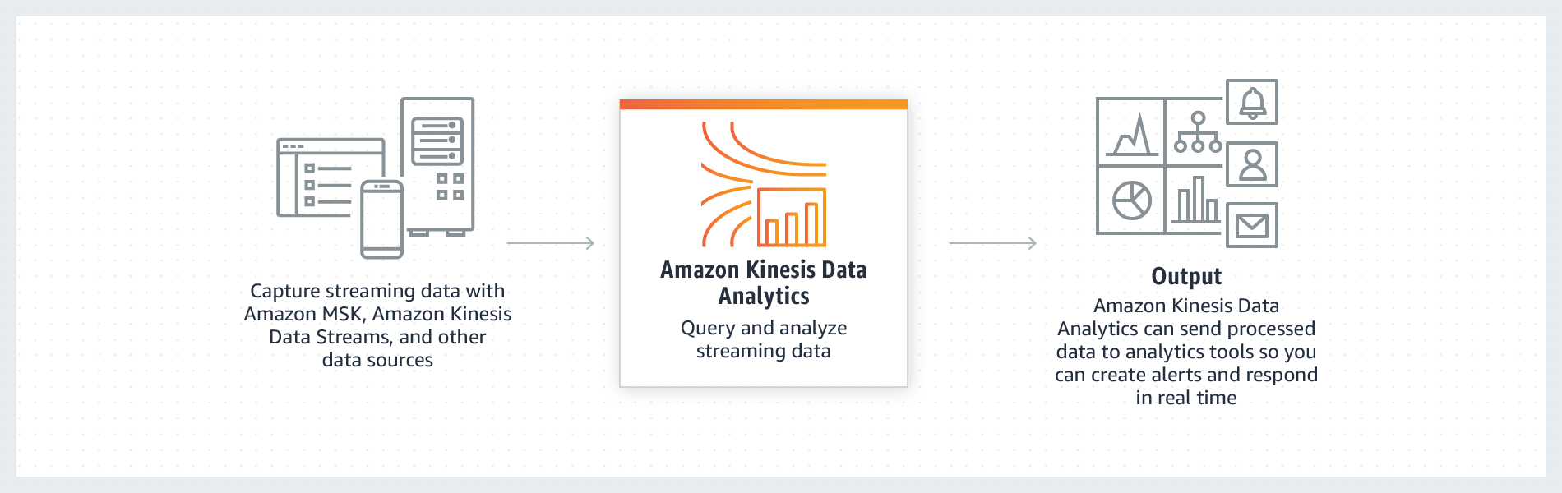
Amazon Kinesis
Benefits
Real-time
Fully managed
Scalable
Collect, process, and analyze real-time streaming data to get timely insights and react quickly to new information.
Key capabilities to cost-effectively process streaming data at any scale
Flexibility to choose the tools that best suit the requirements
Ingest real-time data (video, audio, application logs, website clickstreams, and IoT telemetry) for machine learning, analytics, and other applications.
Process, analyze and respond instantly

Slide 6
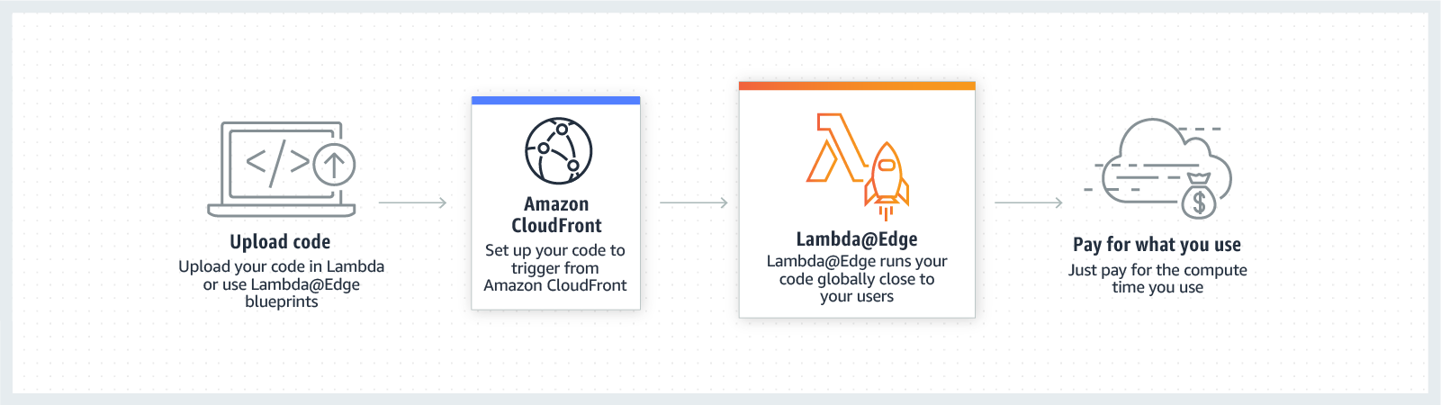
Lambda@Edge
A feature of Amazon CloudFront to run code closer to users , improving performance and latency
No need to provision or manage infrastructure in multiple locations
Pay only the compute time you consume
Zero server administration.
Runs code in response to events generated by the Amazon CloudFront content delivery network (CDN).

Slide 7
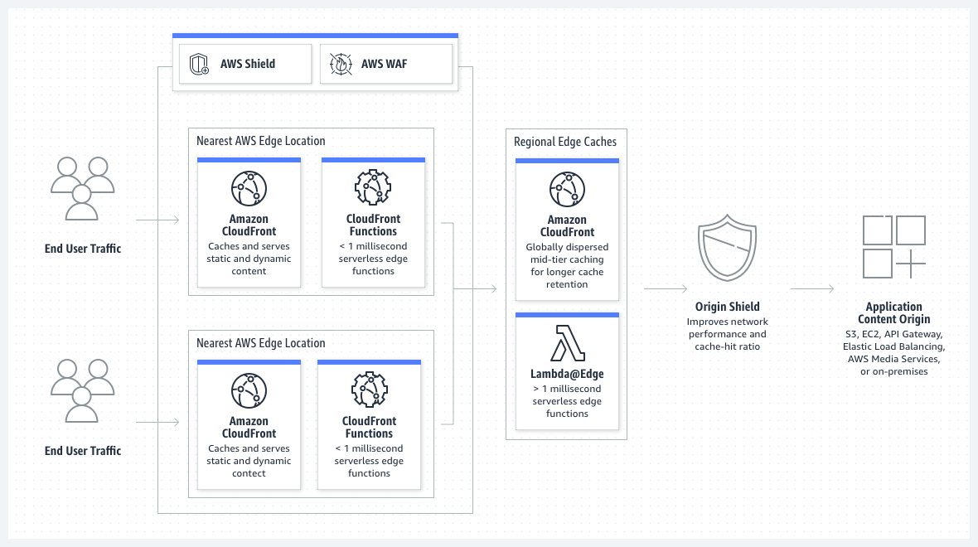
CloudFront
Amazon CloudFront is a content delivery network (CDN) service built for high performance, security, and developer convenience.
Deliver fast, secure websites
Accelerate dynamic content delivery and APIs
Stream live and on-demand video
Distribute patches and updates

Slide 8
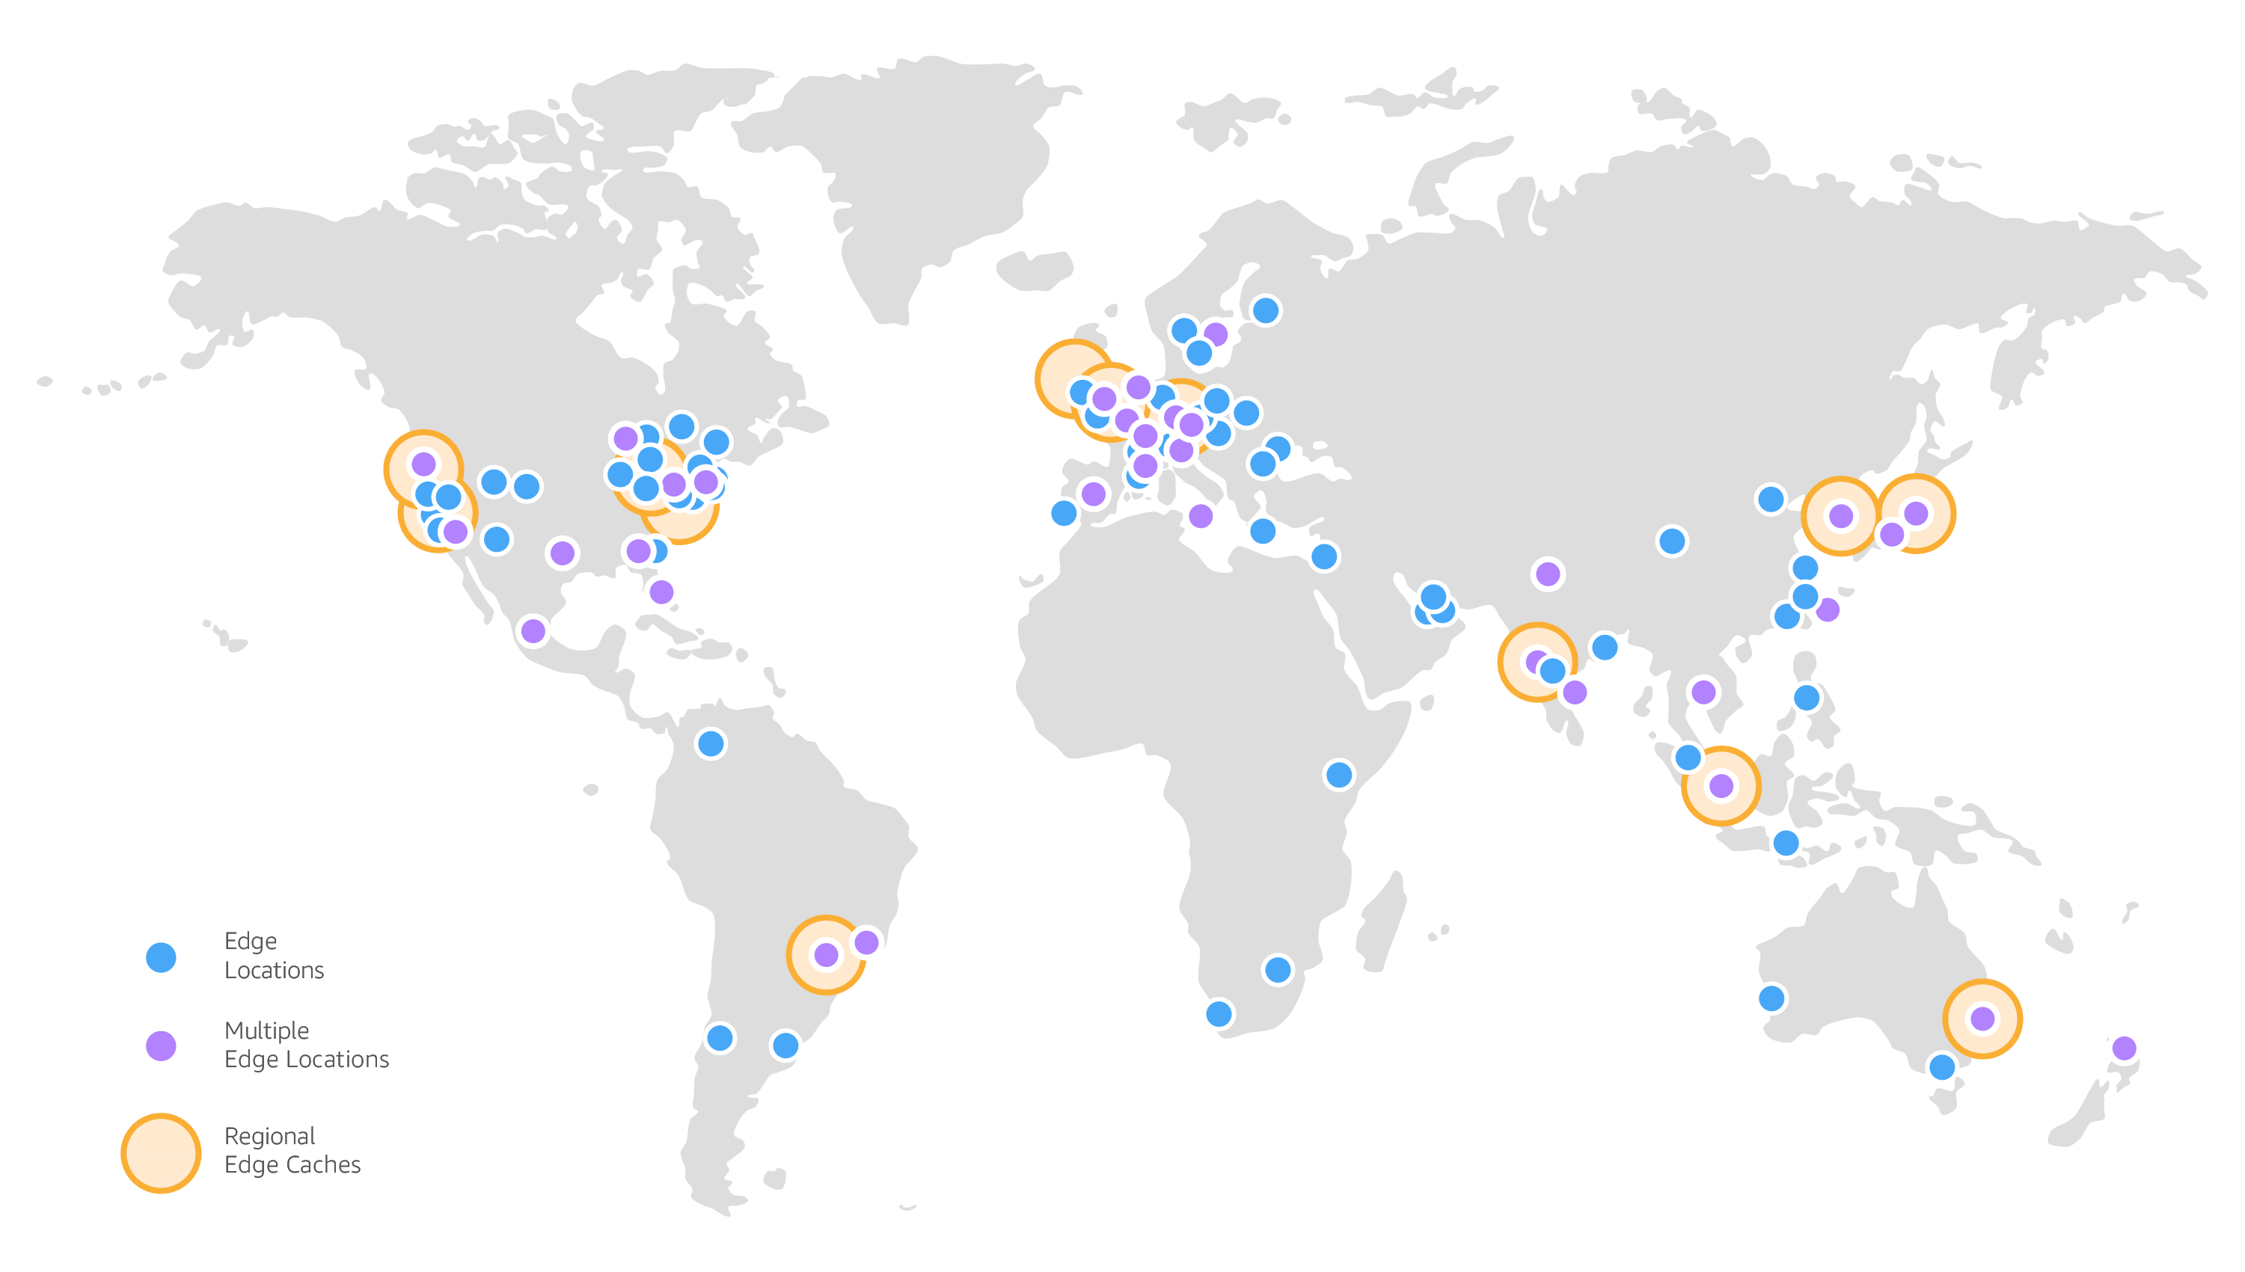
Global Edge Network
Reliable, low latency and high throughput network connectivity
Network Connectivity and Backbone
Amazon CloudFront peers with thousands of Tier 1/2/3 telecom carriers globally, is well connected with all major access networks for optimal performance, and has hundreds of terabits of deployed capacity.
CloudFront Edge locations are connected to the AWS Regions through the AWS network backbone - fully redundant, multiple 100GbE parallel fiber that circles the globe and links with tens of thousands of networks for improved origin fetches and dynamic content acceleration.
To deliver content to end users with lower latency, Amazon CloudFront uses a global network of 310+ Points of Presence (300+ Edge locations and 13 regional mid-tier caches) in 90+ cities across 47 countries.

Slide 9
Lambda@Edge
Benefits
No servers to manage
You can automatically scale and run your code at AWS locations around the world without requiring you to provision, scale, or manage origin servers at multiple locations, or set up any load balancing or domain name system (DNS) routing services.
Build more responsive applications
Lambda@Edge runs your code globally at AWS locations close to your users, so you can deliver full-featured, customized content with high performance, and low latency.
Customize your content delivery
With Lambda@Edge, you can customize the content delivered through the Amazon CloudFront CDN, and you can customize your compute resources and execution time, based on your application performance needs.
Lastly by using Lambda@Edge and Amazon CloudFront, you have less origin infrastructure to manage than with traditional CDNs.
You can add new functionalities without making any changes to your existing applications running at your origin.

Slide 10
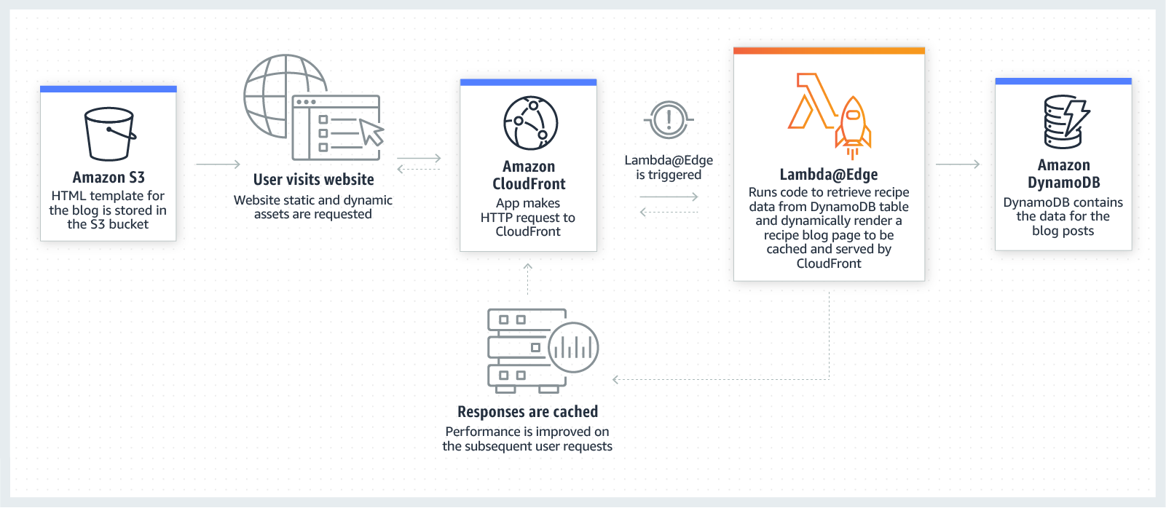
Lambda@Edge - Example
Dynamic Web Application at the Edge
By combining Lambda@Edge with other AWS services, developers can build powerful web applications at the edge that automatically scale up and down — with zero origin infrastructure and administrative effort required for automatic scaling, backups, or data center redundancy.

Slide 11
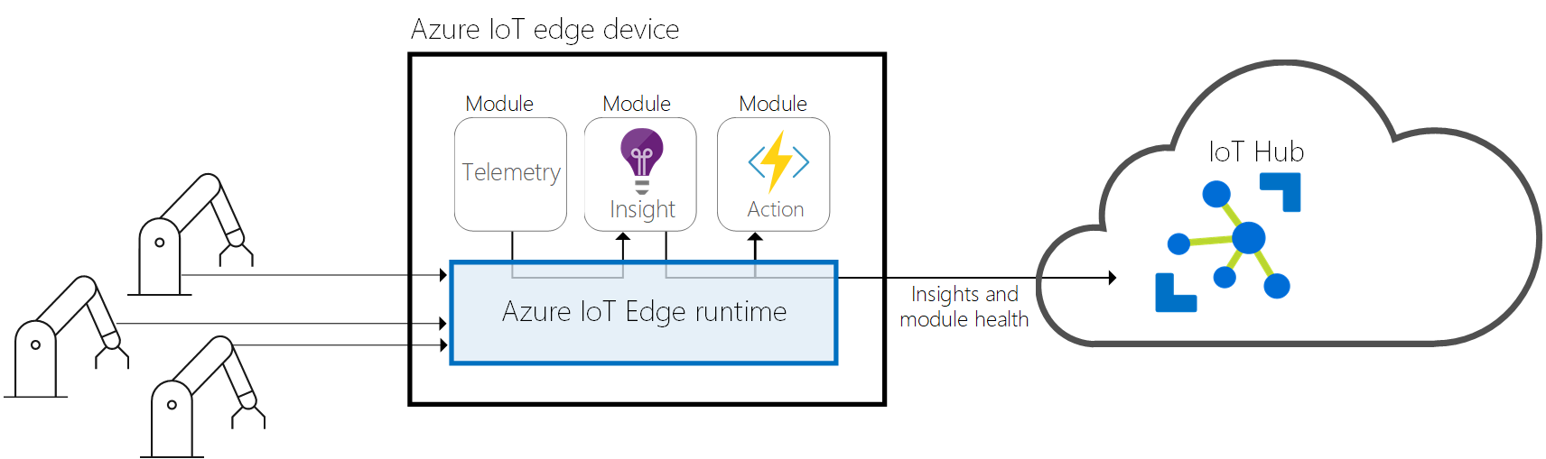
Azure IoT Edge
Deploy Azure IoT Edge on premises to break up data silos and consolidate operational data at scale in the Azure Cloud.
Remotely and securely deploy and manage cloud-native workloads—such as AI, Azure services, or your own business logic—to run directly on your IoT devices.
Optimize cloud spend and enable your devices to react faster to local changes and operate reliably even in extended offline periods.

Slide 12
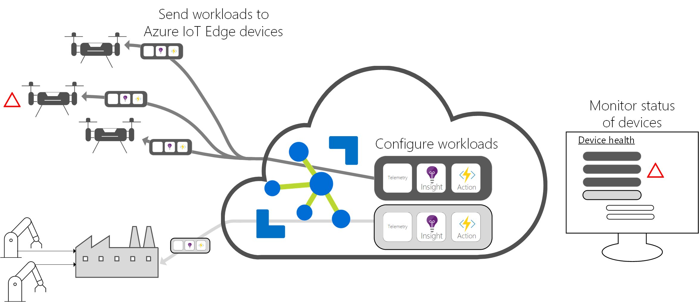
Azure IoT Edge
Certified IoT Edge hardware: Works with your Linux or Windows devices that support container engines
Runtime: Free and open-source under the MIT license to give you more control and code flexibility
Cloud interface: Remotely manage and deploy workloads from the cloud through Azure IoT Hub with zero-touch device provisioning
Modules: Docker-compatible containers from Azure services or Microsoft partners to run your business logic at the edge

Slide 13
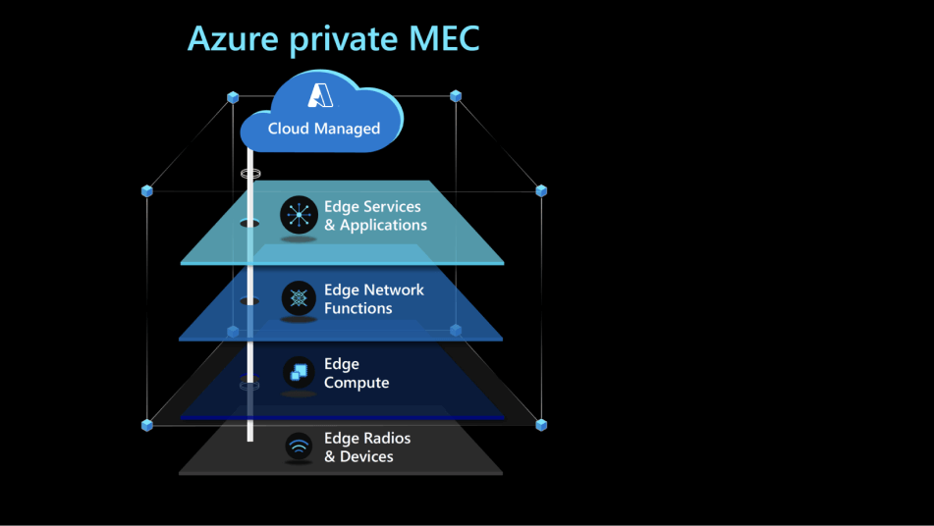
Azure private multi-access edge compute (MEC)
Accelerate time to market, reduce integration complexity and securely manage services in the cloud.
Combines
network functions, applications, edge-optimized Azure services
Delivers
high performance, ultra-low latency solutions that address the modern business needs of enterprise customers.

Slide 14
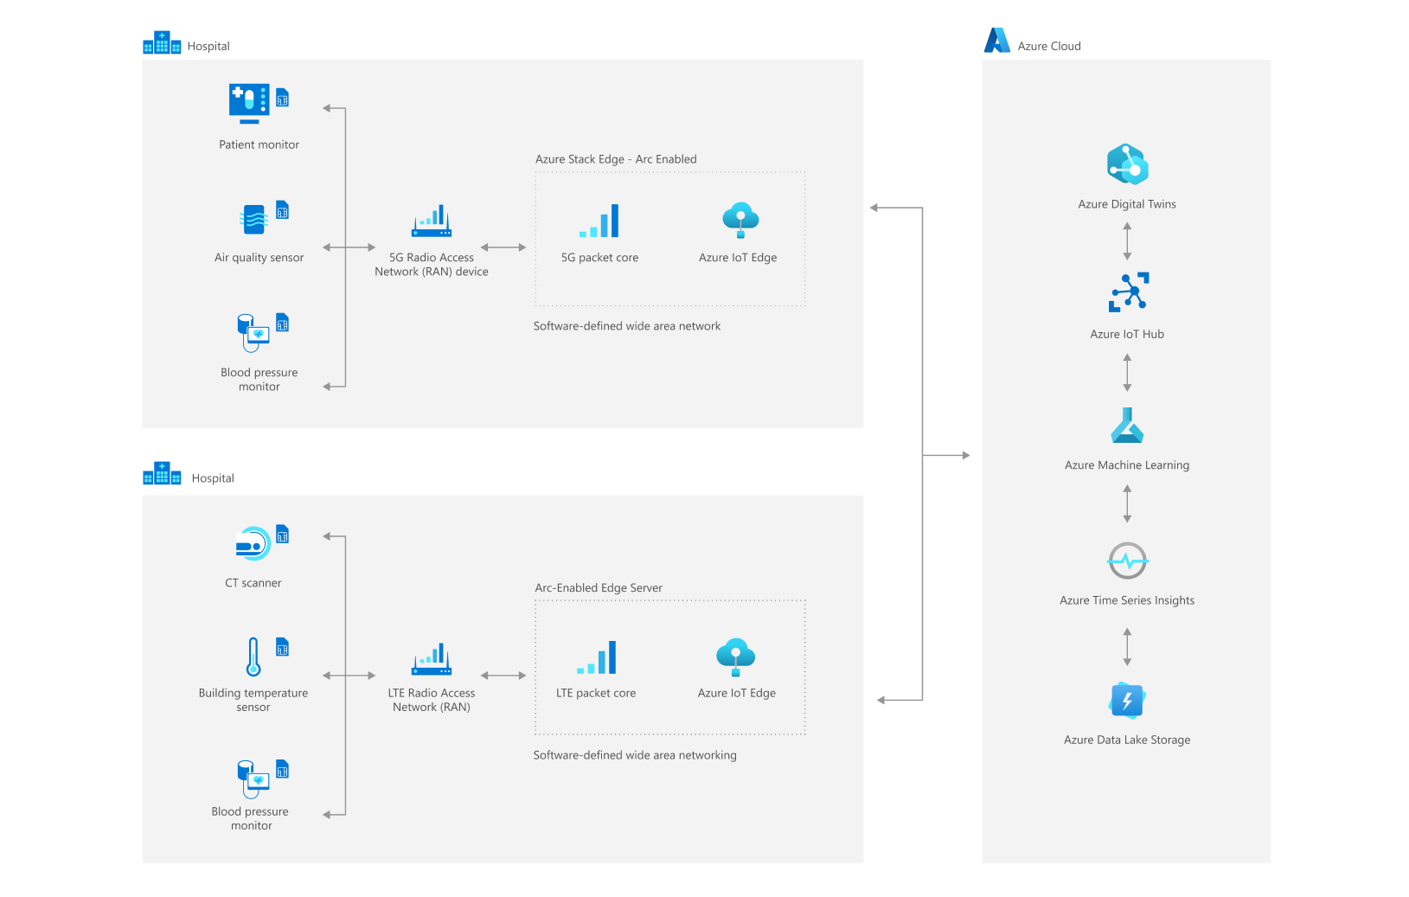
Azure private MEC
Low-latency connections for Industry 4.0 solutions
Manufacturers can use 5G for high performance, low latency connectivity to scale up industrial automation and improve productivity.

Slide 15
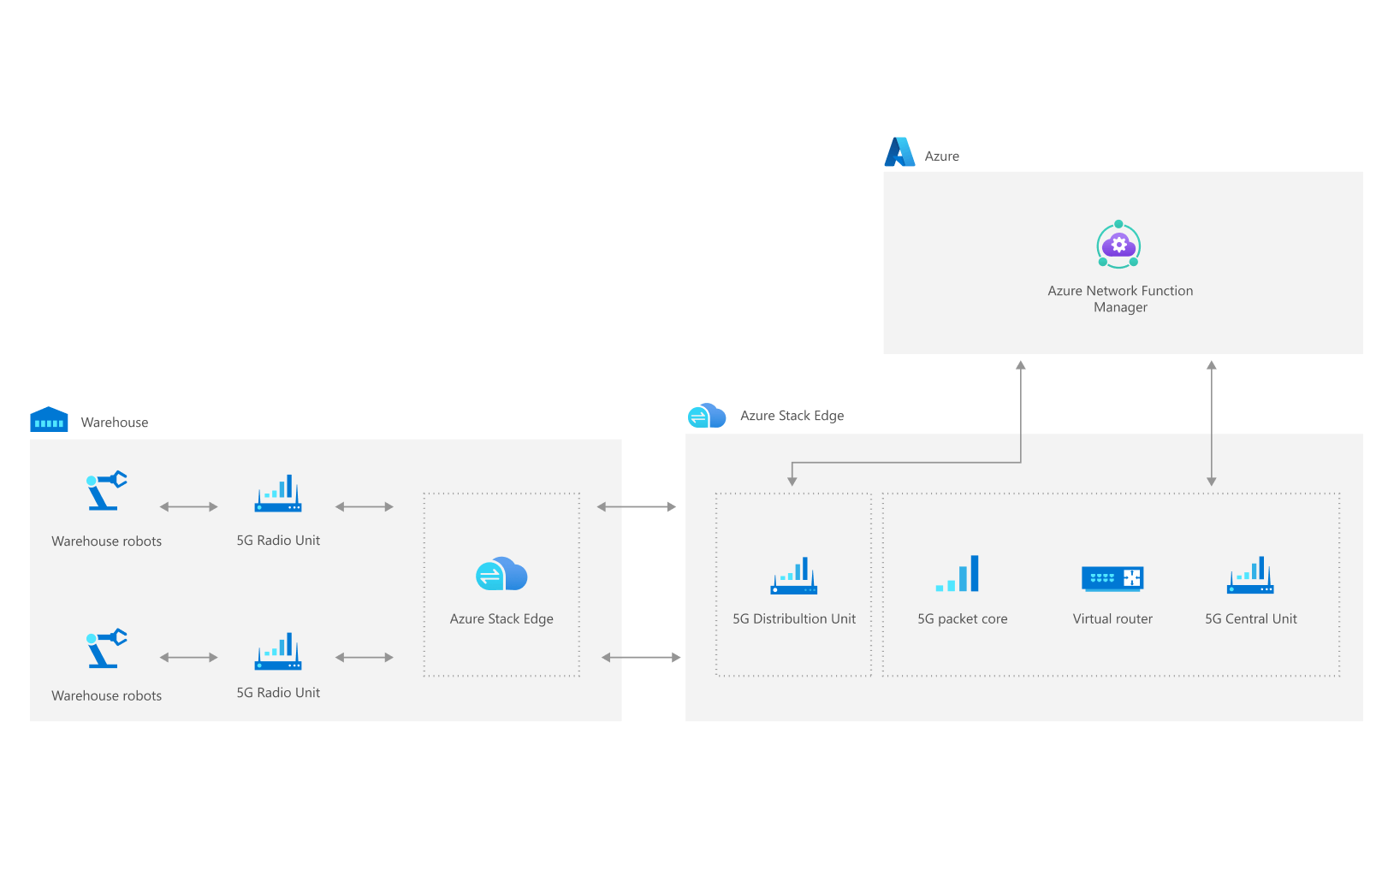
Azure private MEC
Video Analytics to enhance customer experiences at a retail store
Retailers can monitor inventory, track curbside pickup, and cashier queues to take immediate actions to improve customer experience.

Slide 16
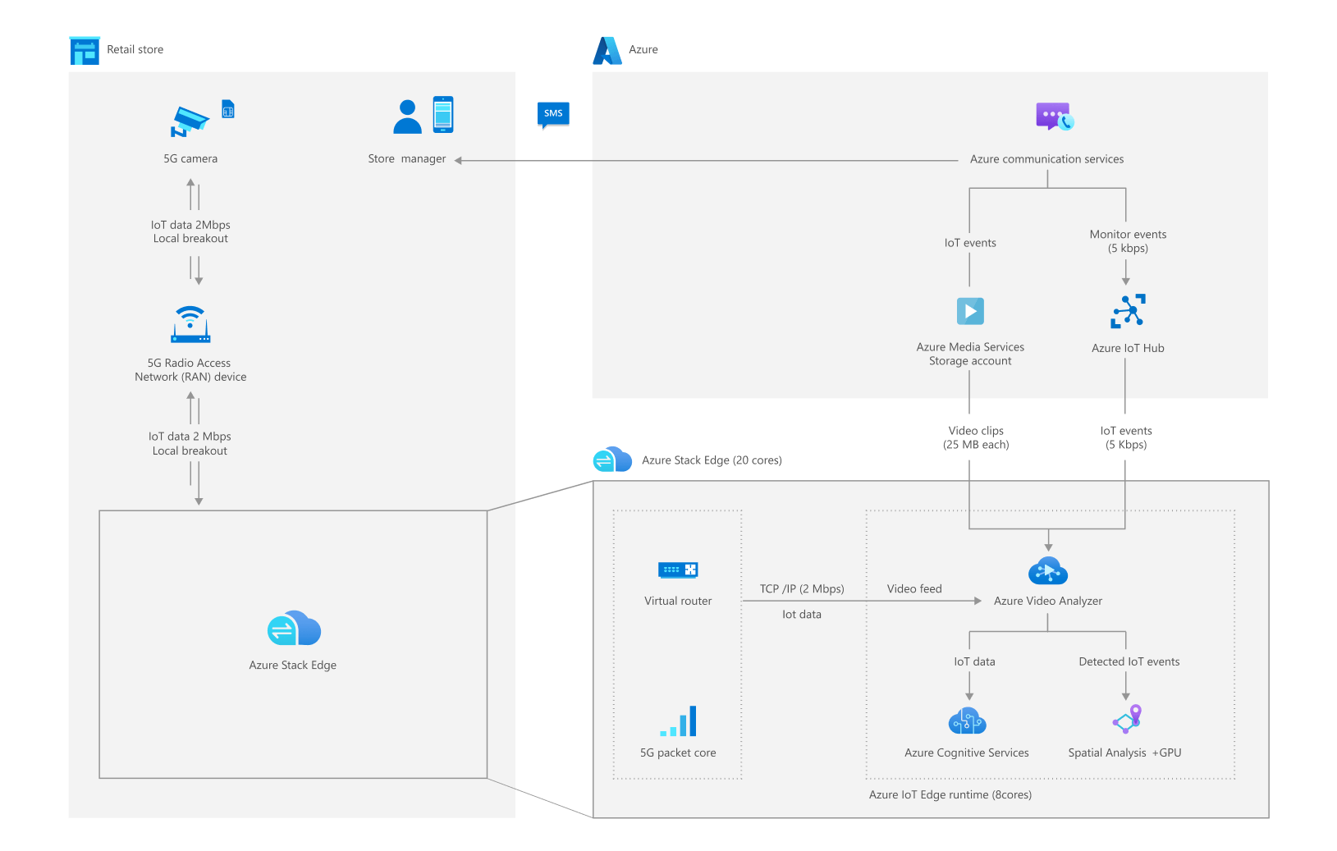
Azure private MEC
Secure and Scalable IoT device connectivity for Smart Buildings and Hospitals
Commercial buildings and hospitals can provide secure, reliable, and scalable connections to on-premises devices and proactively address issues.

Slide 17
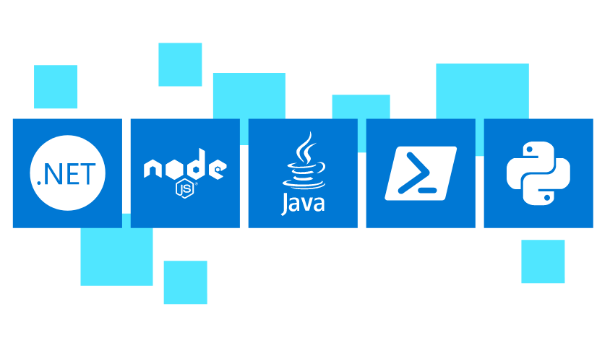
Azure Functions
Accelerate and simplify serverless application development
Automated, flexible scaling to free you from infrastructure management
Integrated programming model to respond to events and seamlessly connect to other services
End-to-end development experience with integrated tools and built-in DevOps capabilities
Variety of programming languages and hosting options to fit each scenario

Slide 18
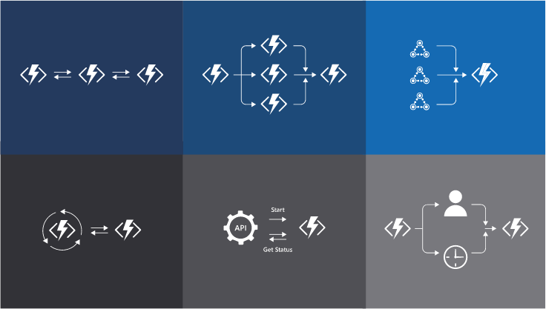
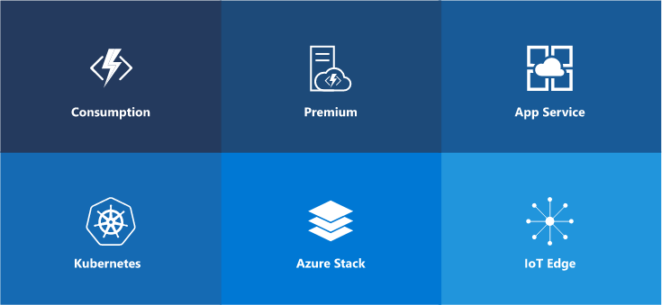
Azure Functions
Simplify complex orchestration challenges resolution
Use the Durable Functions extension to write stateful workflows in a serverless compute environment.
Use your serverless functions on declarative workflows that work with more than 250 connectors in Azure Logic Apps.
Build once, deploy anywhere
Choose from the Functions hosting plan that best meets your business needs.
Deploy the same code to multiple targets—from pay-per-execution in the cloud to your Kubernetes cluster hosted in Azure, or Kubernetes in another public cloud, or IoT devices for edge computing.

Slide 19
Azure Stack Edge
Purpose-built hardware-as-a-service
Run your workloads and get quick actionable insights right at the edge where data is created using purpose-built hardware-as-a-service with Azure Stack Edge.
Easy ordering and fulfillment, you can manage your device from the cloud with standard Azure management tools
Deploy and manage containers from loT Hub and integrate with Azure loT solutions at the edge with rugged options using Kubernetes with multi-node and virtual machine support
Bring hardware acceleration to a diverse set of Machine Learning workloads with NVIDIA T4 Tensor Core GPU and Intel VPU
Keep a local cache of your Azure Storage account, utilizing the storage gateway to automatically upload

Slide 20
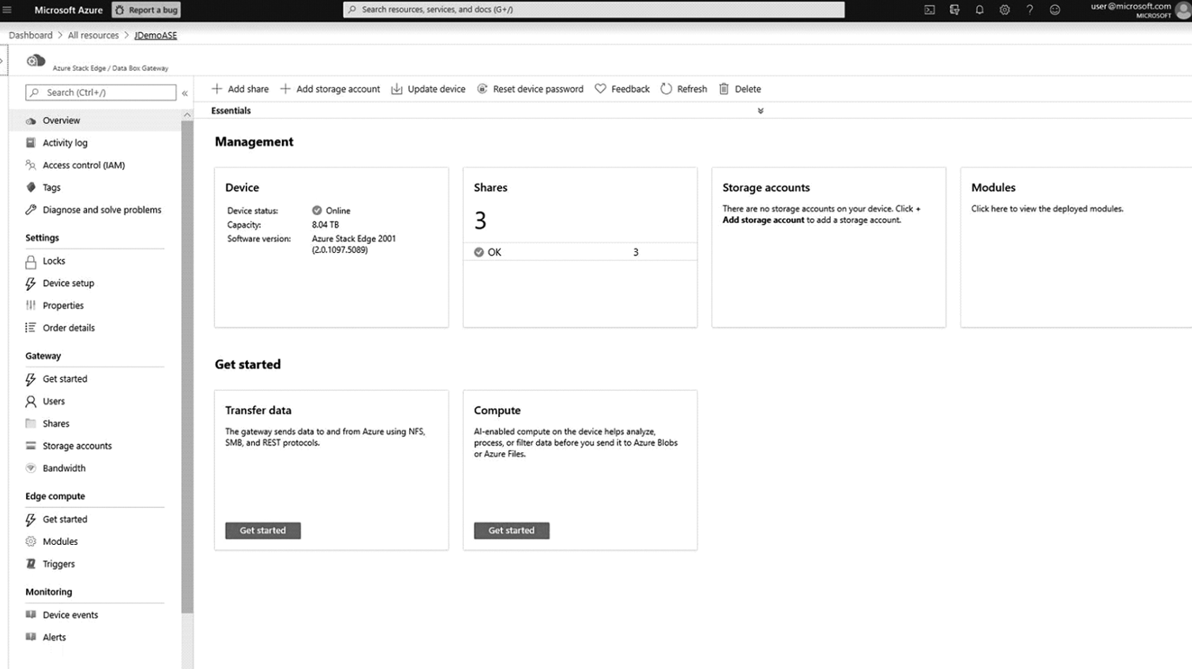
Azure Stack Edge
Simply order appliance from the Azure portal in a hardware-as-a-service model, paid monthly via your Azure subscription.
Seamless cloud-to-edge experience where you configure, monitor and update your Azure Stack Edge with the same management portal and development tools that you’ve come to expect from Azure.
Run applications at the edge close to the data
Analyze data for quick actionable insights with hardware accelerated AI/ML
Transfer data efficiently and easily between the cloud and edge

