Slide 1
The Ramachandran Principle
Phi & Psi Angles
tinyurl.com/RamachandranPrinciple
In Spanish: tinyurl.com/PrincipioRamachandran
by Eric Martz, June 2018
License: Attribution-NonCommercial-ShareAlike 4.0 International
These slides preview scenes that are interactive at bioinformatics.org/molvis/phipsi
or Proteopedia.Org, and are also in a Video.

Slide 2
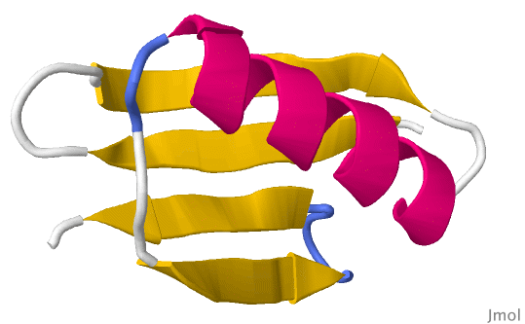
The Ramachandran Principle is that alpha helices, beta strands, and turns are the most likely conformations for a polypeptide chain to adopt, because most other conformations are impossible due to steric collisions between atoms.
Phi (φ) and Psi (ψ) dihedral angles determine the conformation of a polypeptide.
Notes:
Phi and Psi will be explained in slides that follow.

Slide 3
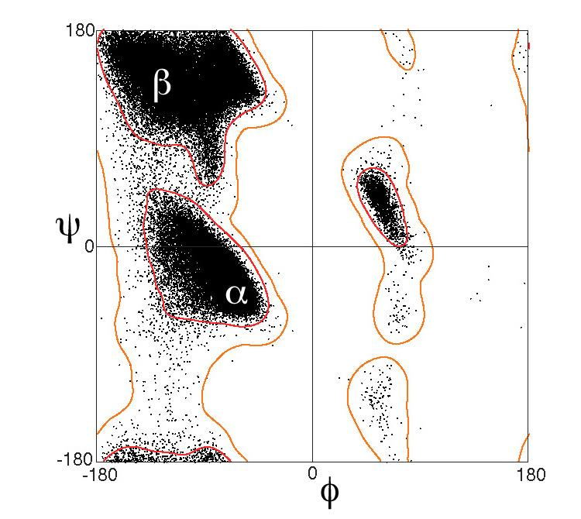
Here is a Ramachandran Plot. Each dot shows a pair of Phi (φ) Psi (ψ) dihedral angles that occurs in a protein structure. Dots cluster into alpha helical (α), beta strand (β), and turn (at right) conformations.
Conformations with no dots do not occur.
100,000 dots taken from high-resolution crystallographic structures. Figure from Wikimedia Commons courtesy Jane and David Richardson (Proteins 50:437, 2003). This plot excludes Gly, Pro, and pre-Pro.
Notes:
Dihedral angles are defined by the positions of 4 atoms covalently bonded in series.

Slide 4
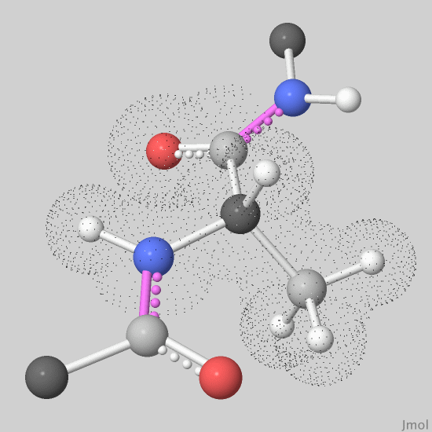
Cα C H N Ox
Black dots mark a single alanine amino acid. Other atoms are fragments of adjacent residues in a polypeptide chain.
There are two peptide bonds.
Notes:
The double bond in the main chain C=O delocalizes into the peptide bond, giving both partially double-bonded character.

Slide 5
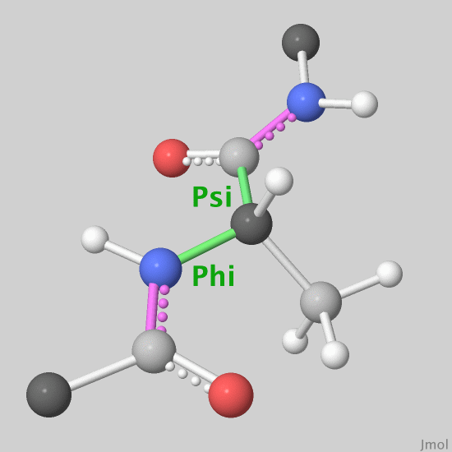
Cα C H N Ox
Each amino acid has two main-chain (backbone) bonds that can rotate, defining dihedral angles
Phi (φ) and Psi (ψ).
Peptide bonds cannot rotate because they are partial double bonds.
Notes:
Speaker: trace the 4 atoms defining Phi, and the 4 defining Psi. Optionally, show the linked dihedral angles page.

Slide 6
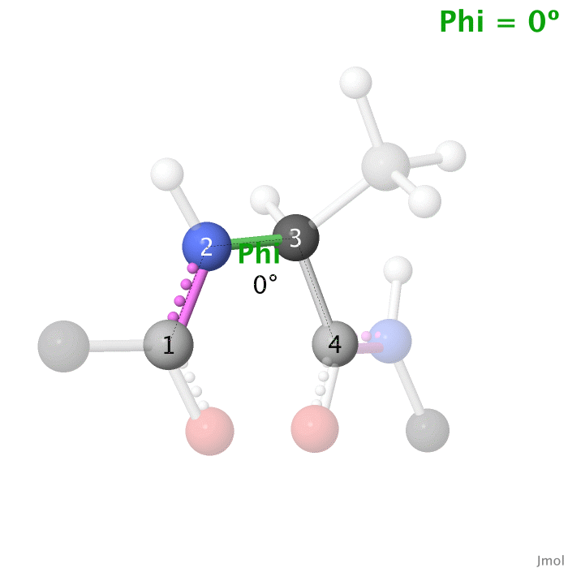
Cα C H N Ox
A dihedral angle is determined by 4 atoms. These 4 determine Phi (φ).
Here, the angle is 0º.

Slide 7
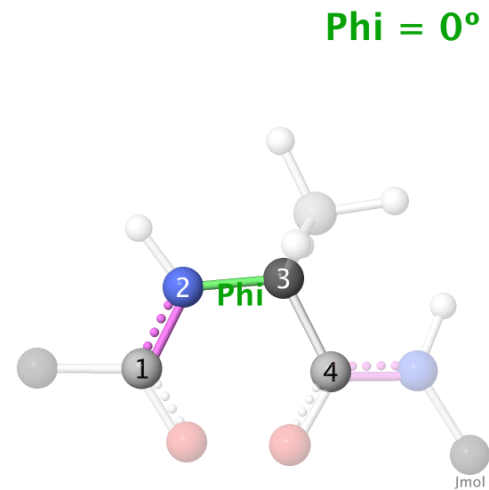
Cα C H N Ox
Clockwise rotation gives dihedral angles from 0º to 180º.
180º is the same as counter-clockwise rotation to -180º.

Slide 8
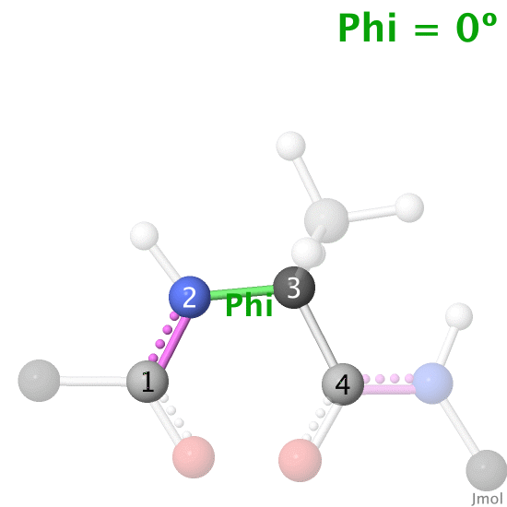
Cα C H N Ox
Counter-clockwise rotation starting at 0º gives negative dihedral angles from -1º through -90º ending at -180º (the same dihedral angle as +180º).

Slide 9
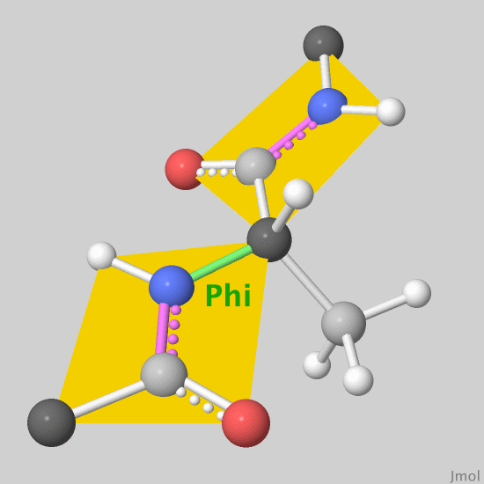
Cα C H N Ox
Because they cannot rotate, each peptide bond holds 6 atoms in a plane.
However, most possible angles of Phi (φ) and Psi (ψ) are impossible due to clashes between atoms. These balls are much smaller than the atoms they represent.

Slide 10
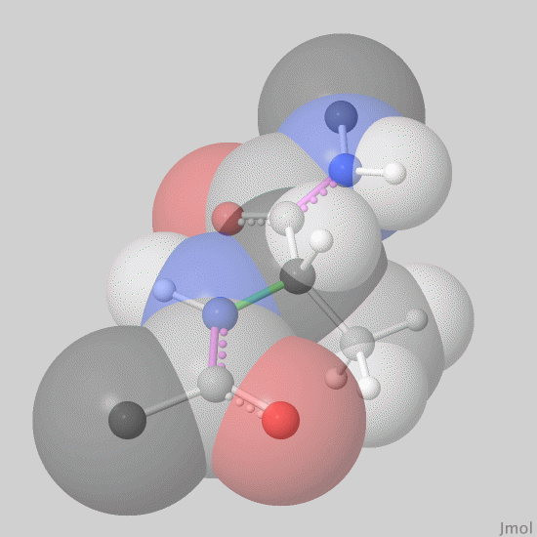
Cα C H N Ox
Here are the actual sizes of the atoms.
Notes:
All van der Waals radii in this slideshow are 88% of actual van der Waals radii. For explanation and references, see footnotes at bioinformatics.org/molvis/phipsi/

Slide 11
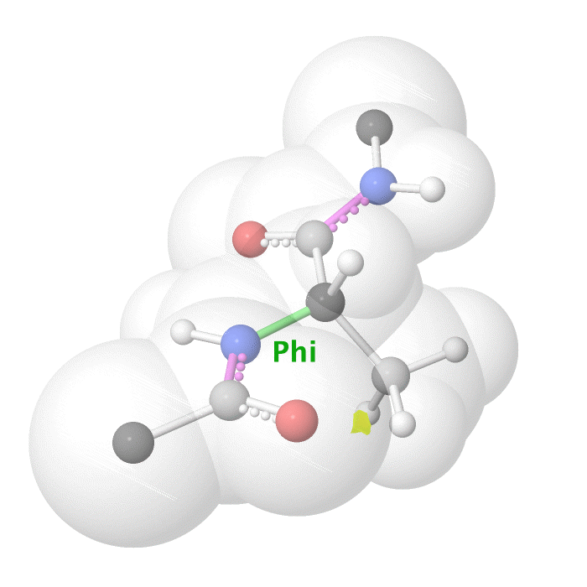
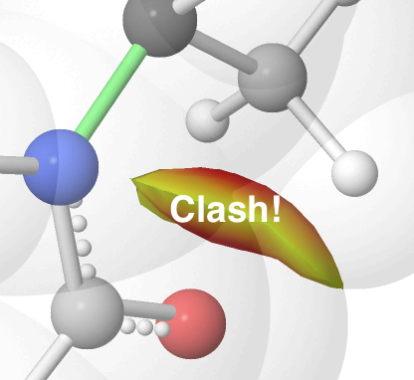
When Psi (ψ) is fixed at 165º, most Phi (φ) angles produce clashes:
This simulation displays clashes while permitting van der Waals overlaps that would be physically impossible.
Cα C H N Ox
Notes:
A “clash” occurs when two atoms need to occupy the same space. In this model simulation, clashes occur when van der Waals radii overlap between two atoms that are not covalently bonded to each other.

Slide 12
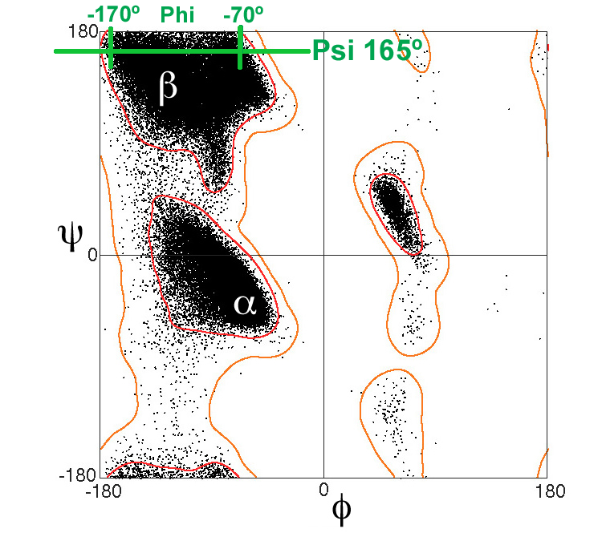
Psi
In the above animation, Psi is fixed at +165º. Clashes occur at all Phi angles except -70º to -170º. This range is in the beta strand region.
Phi
Notes:
Animation is the same as in the previous slide.

Slide 13
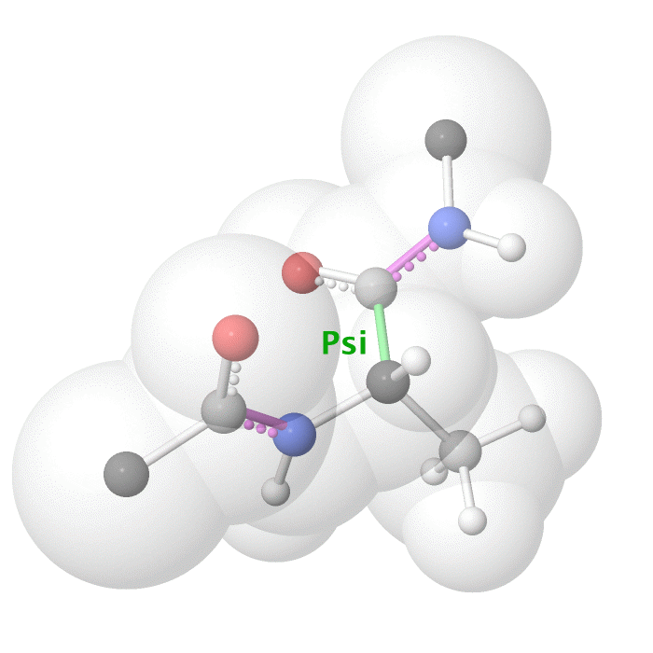
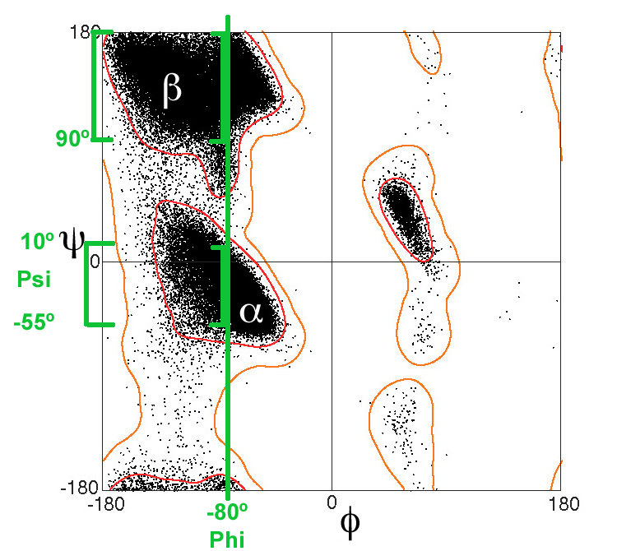
In the above animation, Phi is fixed at -80º. Clashes occur at all Psi angles except:
+10 to -55º (alpha helix)
+90 to 180 (beta strand)

Slide 14
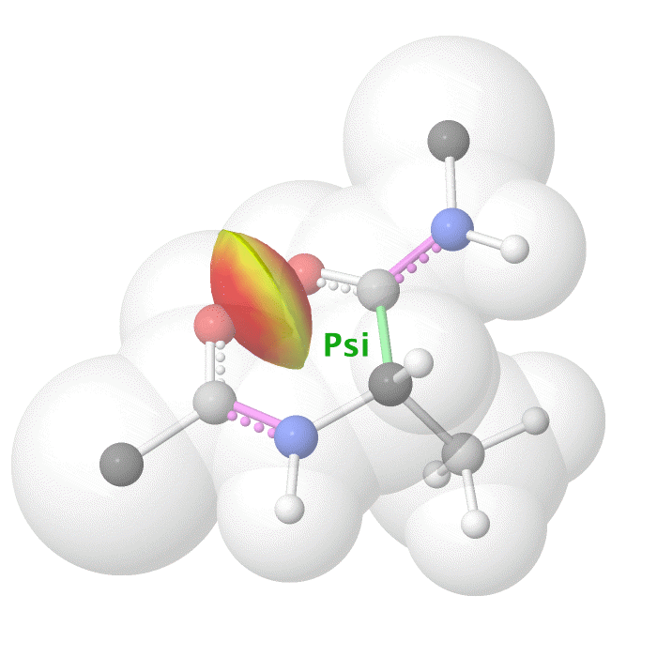
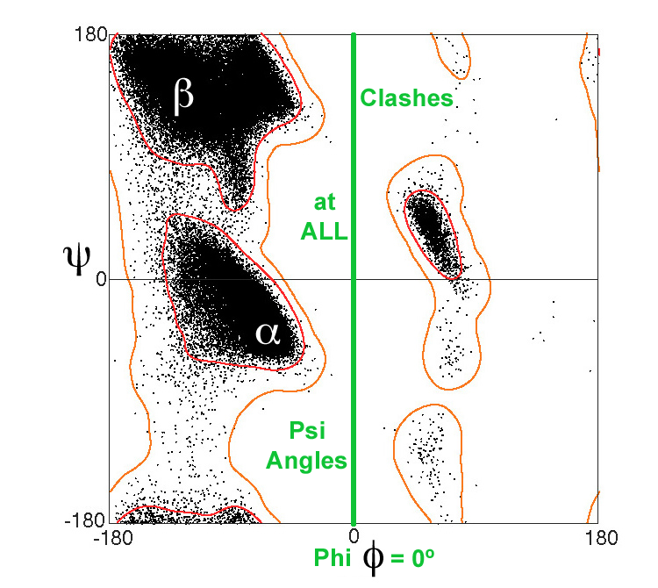
Psi
In the above animation, Phi is fixed at 0º. Clashes occur at ALL Psi angles. Phi = 0º is physically impossible.
Notes:
Notice the absence of black dots at Phi = 0º on the Ramachandran Plot.

Slide 15
The Ramachandran Principle is that alpha helices, beta strands, and turns are the most likely conformations for a polypeptide chain to adopt, because most other conformations are impossible due to steric collisions between atoms.
Phi (φ) and Psi (ψ) dihedral angles determine the conformation of a polypeptide.
Notes:
This is review of an early slide.

Slide 16
Challenge your understanding at the Practice Quiz
See the YouTube Video:
tinyurl.com/RamachandranPrincipleYoutube

Slide 17
The End
Slideshow and animations by Eric Martz
License: Attribution-NonCommercial-ShareAlike 4.0 International
See the interactive version at bioinformatics.org/molvis/phipsi/
or Proteopedia.Org
Related resources:
Dihedral angles in proteins: a very simple visualization of phi and psi angles by Angel Herráez.
Tutorial: Ramachandran Plot Inspection: an interactive Ramachandran plot with many controls and details, by Angel Herráez.
Ramachandran Plot: detailed explanation with example proteins and their plots displayed in JSmol.
Psi and Phi Angles: Determination and display of angles using JSmol.
Another Interactive Ramachandran Plot by David Jollie.
Backbone representations explains the relations between backbone traces and main chain polypeptide bonds, as well as smoothed traces and ribbons.

Slide 18
Versions of this presentation
First released June 24, 2018.
July 7, 2018: Added slides 6-8 about dihedral angles, numbered the slides, made the white atoms in slides 11-14 darker so they show better during projection, and added this slide listing versions.
July 10, 2018: Added links in slides 1 and 16 to the YouTube video.

