Slide 1
Social Accounting Matrices and Applied Computable General Equilibrium (CGE or AGE) Models
Course
Development Microeconomics

Slide 2
Consistency Framework for Macroeconomic Accounting
Consistency is simply the requirement that budget constraints are observed for all participants in the economy.
Budget constraints at the economy-wide level in four identities
1. National accounts (income=expenditure)
2. Fiscal identity (fiscal deficit=total public sector borrowing and reserve changes)
3. Balance of payments identity (current account deficit=foreign borrowing and foreign exchange reserve changes)
4. Monetary identity (increase in money supply=increase in domestic credit and foreign reserves)
Above 4 identities imply the private sector budget constraint
Consistency framework should require that all 4 of the above identities should be simultaneously satisfied

Slide 3
Example
Economic report projects increase in growth in country X from 2.4% in 2010 to 4.8% by year 2020. To support this, the rate if investment is projected to double from 12% of GNP to 24% of GNP. At same time fiscal deficit of 6% of GNP reduced to zero by 2020, financed entirely by tax increases. Public investments and consumption stay constant at 6% and 10% of GNP respectively. Inflation is projected to remain constant at 10% per year. Finally CA deficit remains stable at 3% of GNP. Is this consistent?
Yes, but at very unrealistic values of private sector investment, saving and financial behavior. Private investment ratio increases from 6% of GNP to 18 % of GNP, since total investment doubles while public investment constant. To finance higher investment with given CA deficit, private savings from 9% of GNP to 15% of GNP, while public savings from 0 to 6% of GNP. But higher public saving is financed from taxes, which decreases disposable income. Hence private saving as a percentage of disposable income will have to increase from 10% of income to 18%. This is difficult to imagine.

Slide 4
Institutional units in an economy
Institutional units those that can have independent assets, liabilities and engage in economic activities with other entities
Types of institutions
1. Nonfinancial corporations sector
2. Financial corporations sector
3. General government sector
4. Nonprofit institutions serving the household sector
5. Household sector

Slide 5
Residence
Residents=institutional units that have closer tie with economic territory of the country than with any other country. Based on where unit’s center of interest lies
Economic territory is a geographical territory administered by a government
An institutional unit has a center of economic interest in the country when there exists some location from which it engages in economic activities.
Governments are resident even if they carry activities in other countries (embassies located abroad are treated as residents, while embassies of other countries are not treated as residents of the host country).
Corporations are resident of a country when engaged in significant amounts of production there, of own land or buildings. Foreign branches of resident corporations are regarded as non-resident. Off-shores are resident of the economy where the offshore is located.
A household is resident when it maintains a dwelling. People with temporary absences (short term migrants) are regarded as residents of the country where they maintain their household.

Slide 6
Stocks
A stock is measured at a point in time. They are positions or holdings of assets or liabilities. Assets are owned by an institutional unit and can provide economic benefit (machines, buildings, financial stocks, cash, deposits).
Stocks are recorded in balance sheets at the beginning and end of period. Stock are valued at current market prices on the day the balance sheet is drawn up.
Assets are entities over which institutions have property rights (non-financial or financial). Liabilities are financial obligations of one unit to another, hence counterpart to financial assets (currency, deposits, securities, shares). Difference between unit’s stock of assets and liabilities is unit’s net worth.

Slide 7
Flows
Flows are economic magnitudes measured with reference to a period of time. They include.
1. Transactions (exchanges or transfers)
2. Other economic flows (capital gains and losses, changes in volumes of assets)
Flows measure the changes in the value of stocks
Fundamental identity
Stock (end)=Stock (beginning)+transactions+other economic flows

Slide 8
National accounts
Current accounts, accumulation accounts and balance sheets
Current accounts=production accounts and income accounts
Accumulation accounts=capital accounts (non-financial assets transactions), financial accounts (changes in assets and liabilities), and accounts for other economic flows.
Balance sheets show stocks of assets and liabilities at beginning and end of each period. Balancing item is net worth

Slide 9
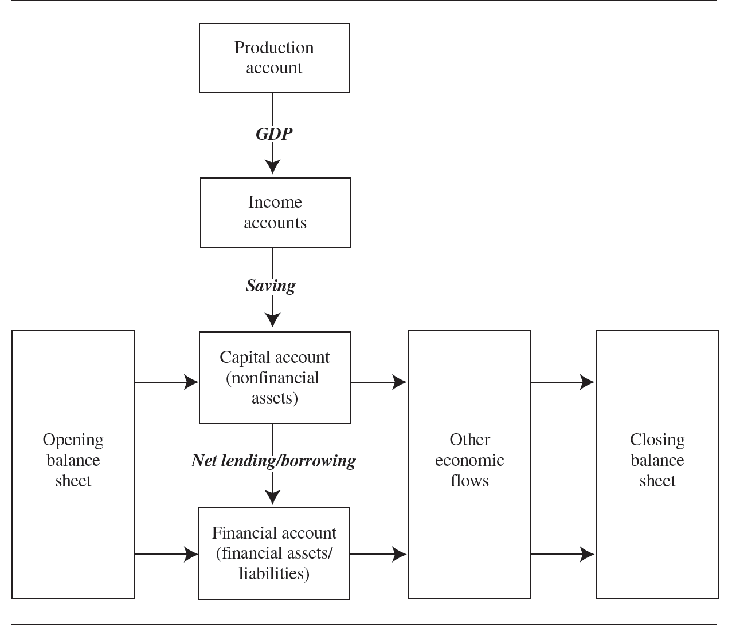

Slide 10
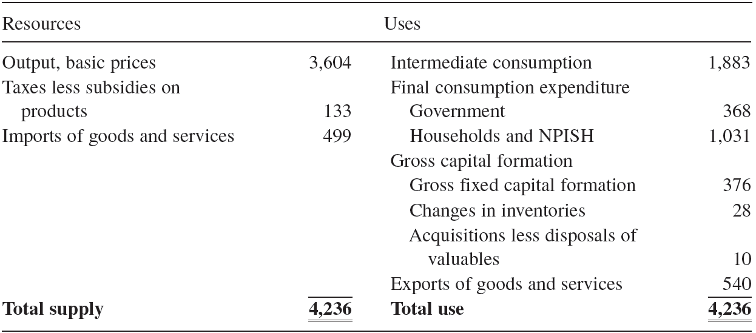
Goods and services account

Slide 11
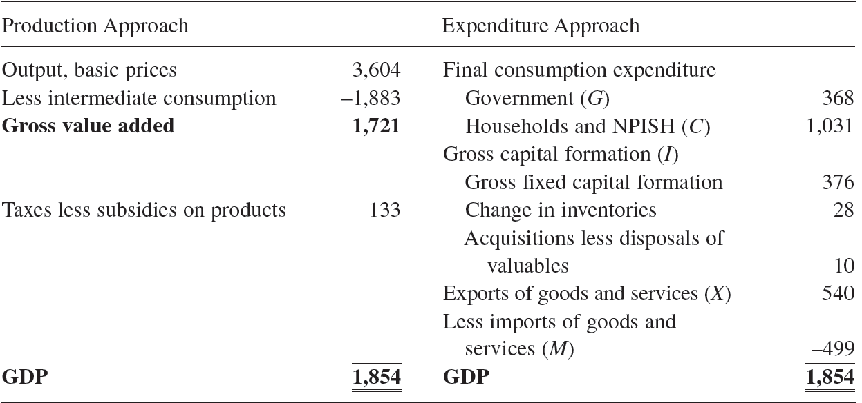
Gross domestic product

Slide 12
Total resources=outputs+imports
Total uses=consumption +investment+ exports
GDP=C+I+G+(X-M)

Slide 13
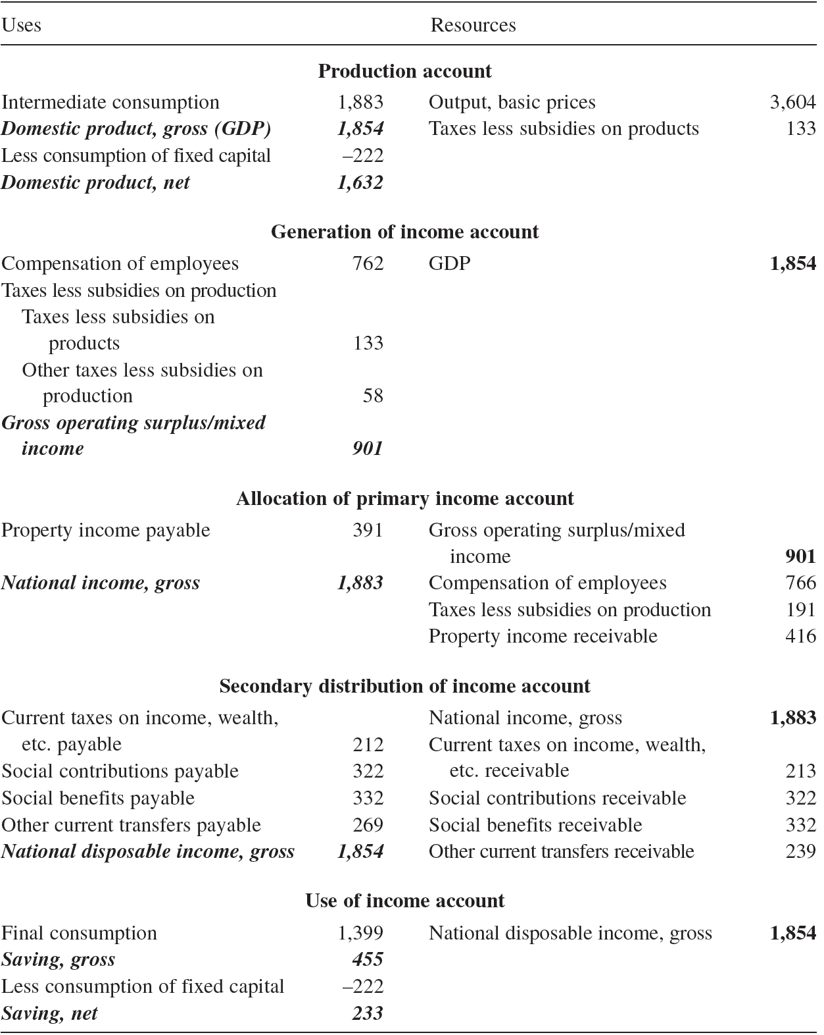
Current accounts

Slide 14
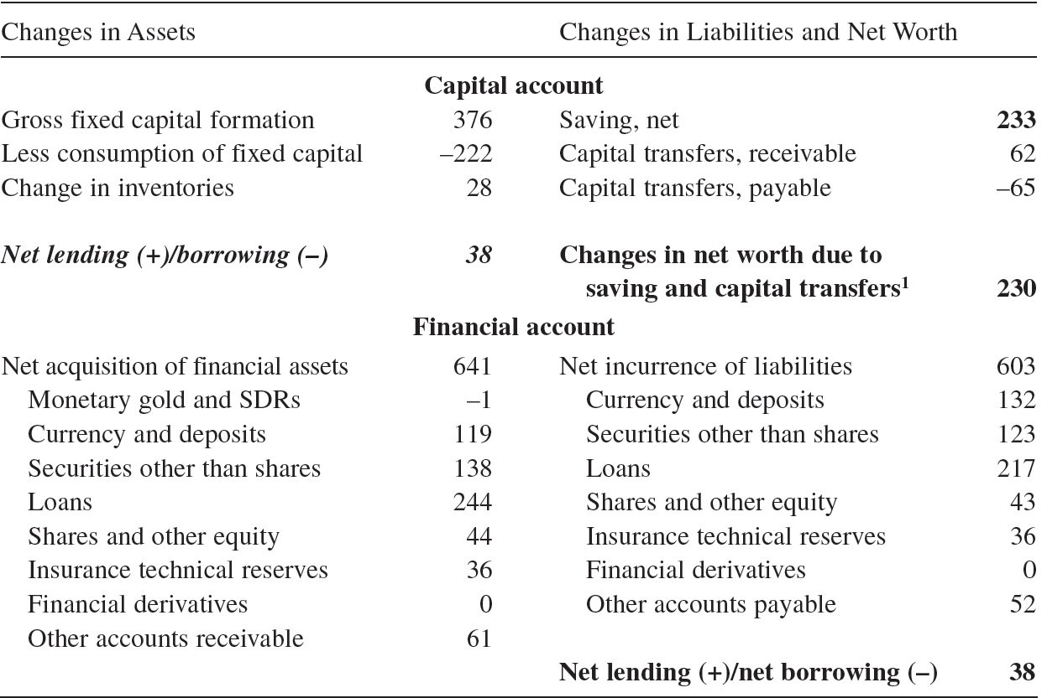
Capital and financial accounts

Slide 15
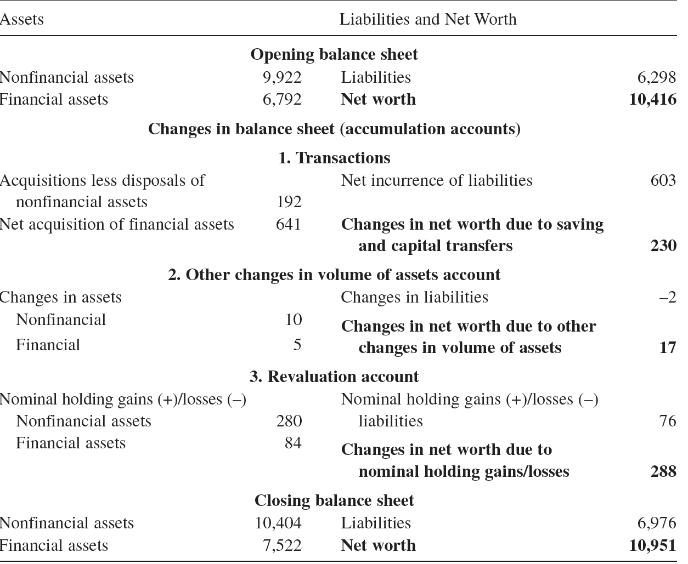
Balance sheet and accumulation accounts

Slide 16
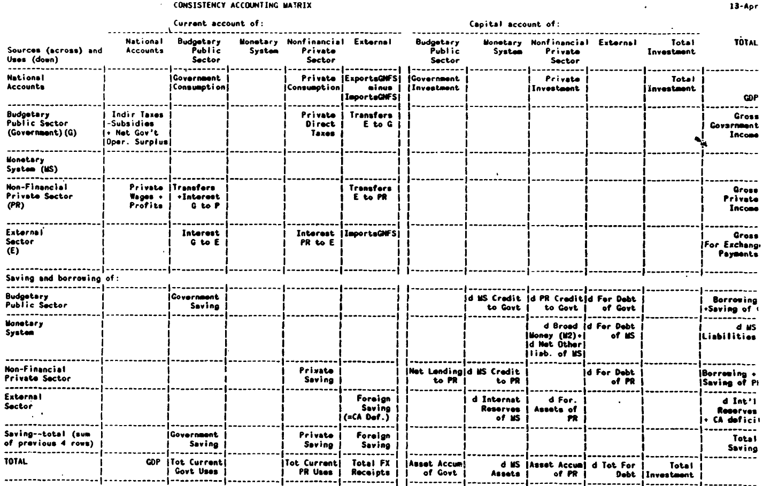

Slide 17
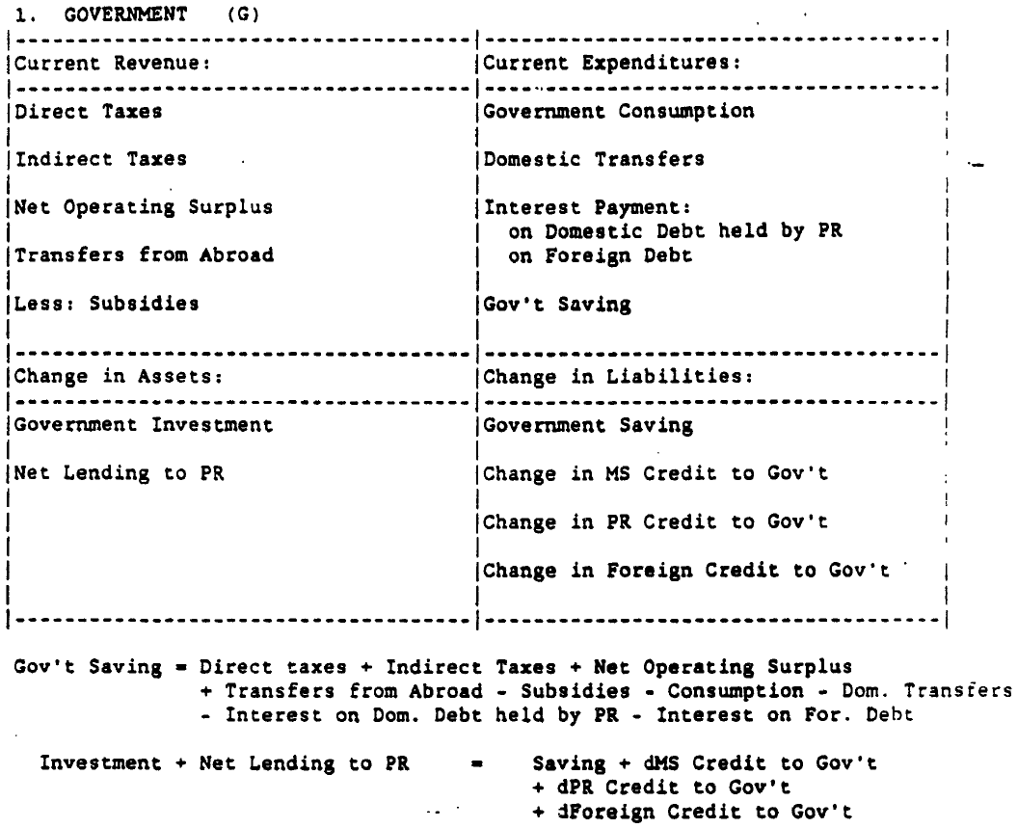

Slide 18
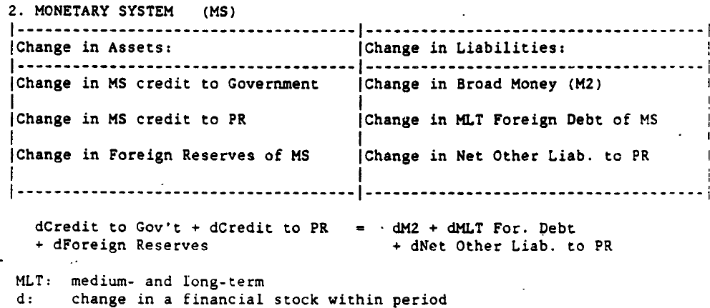

Slide 19
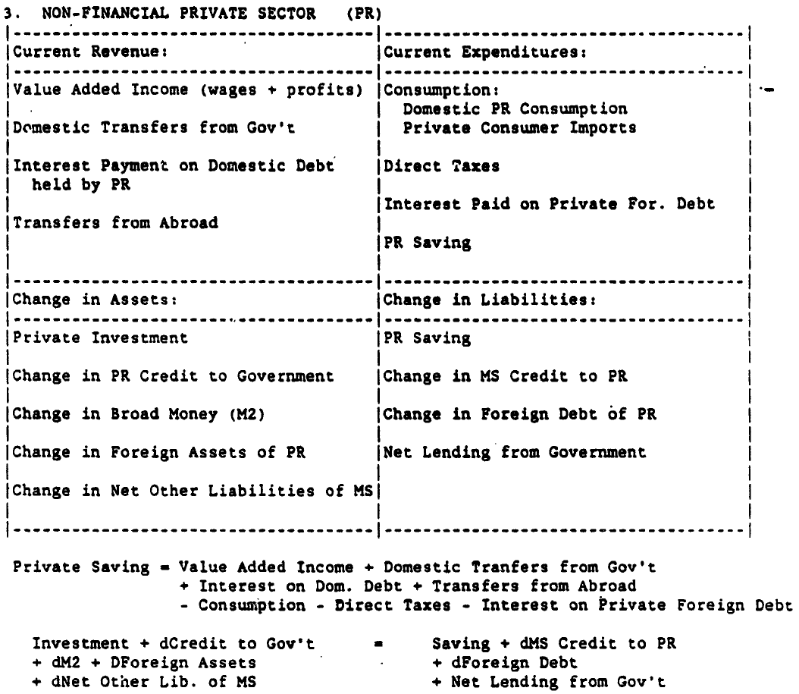

Slide 20
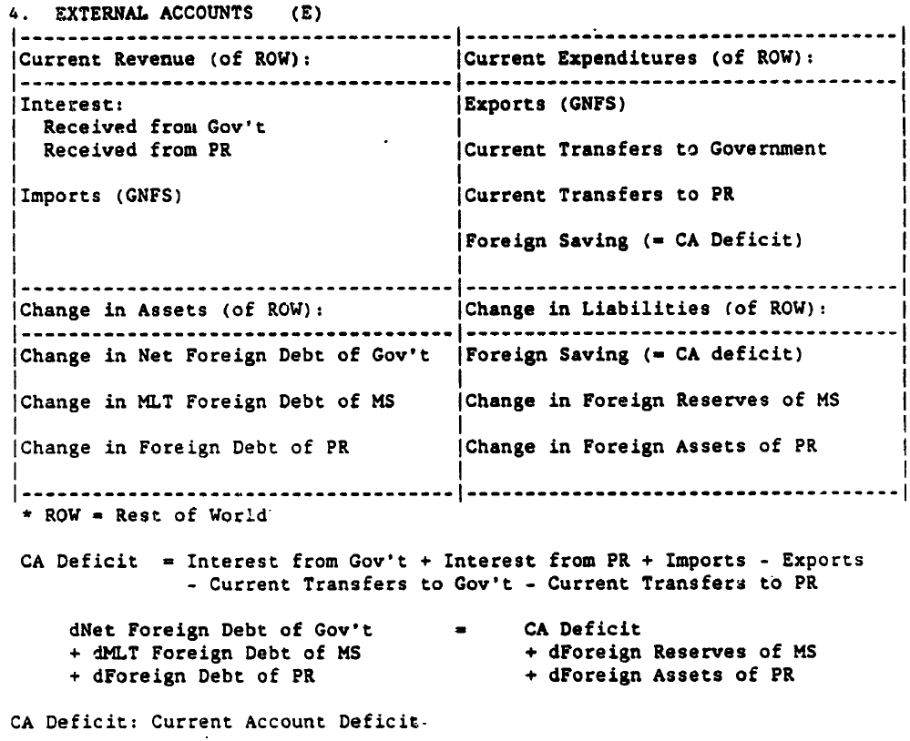

Slide 21
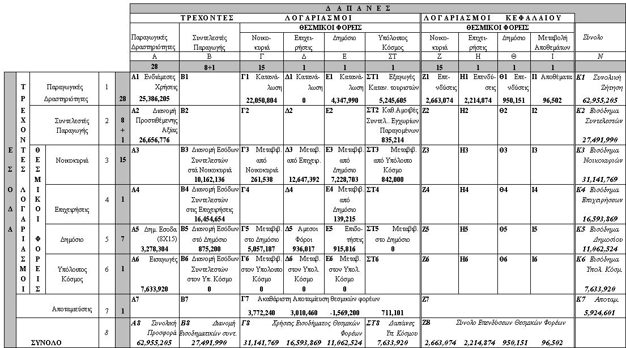
Συνοπτική παρουσίαση του Πίνακα Κοινωνικής Λογιστικής του 1996 (τρέχουσες τιμές, εκατ. δραχμές)

Slide 22
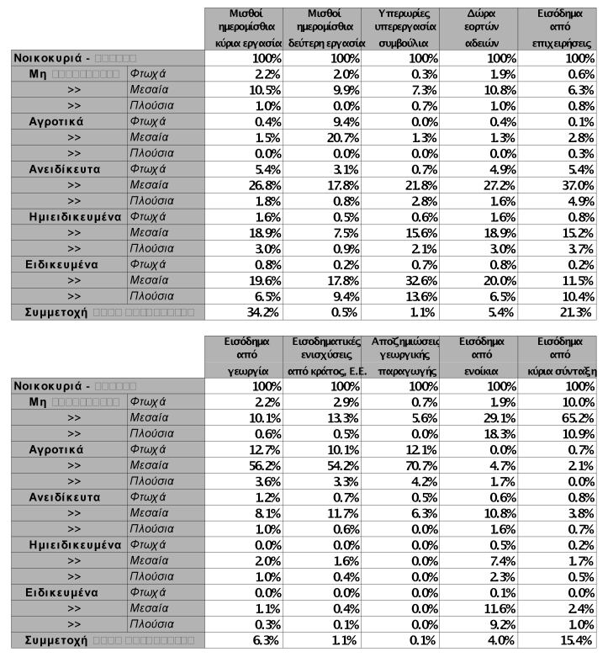
Κατανομή εισοδημάτων στις κατηγορίες των νοικοκυριών με βάση την ΕΟΠ 93/94 (1)

Slide 23
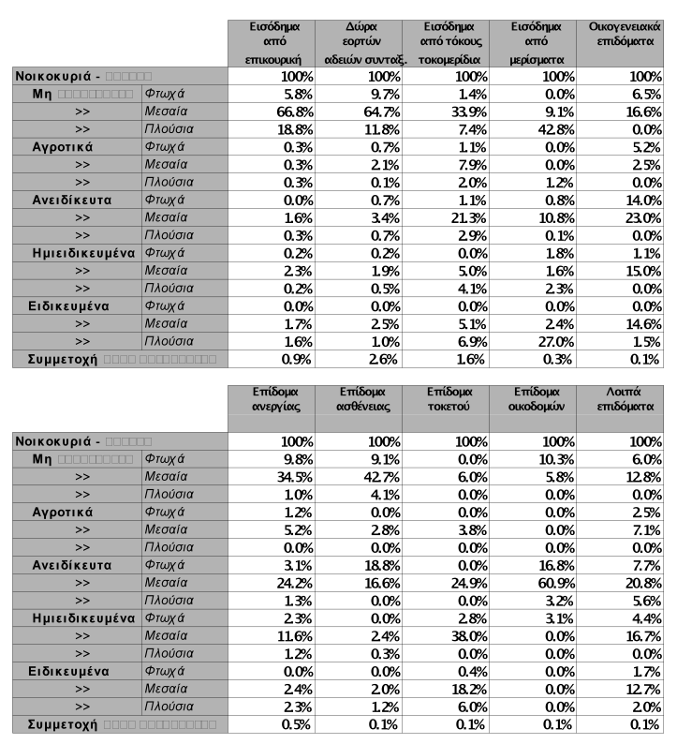
Κατανομή εισοδημάτων στα νοικοκυριά με βάση την ΕΟΠ 93/94 (2)

Slide 24
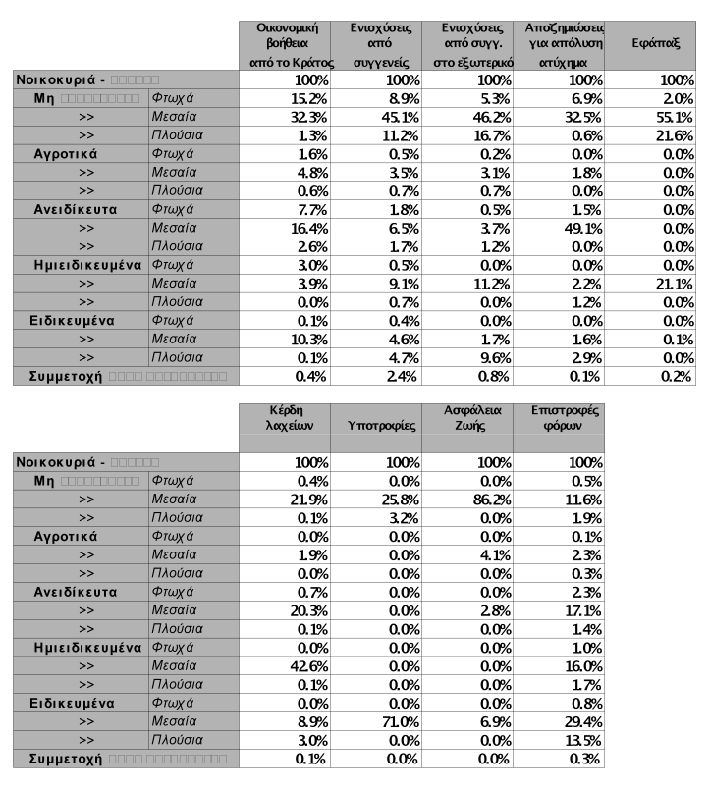
Κατανομή εισοδημάτων στα νοικοκυριά με βάση την ΕΟΠ 93/94 (3)

Slide 25
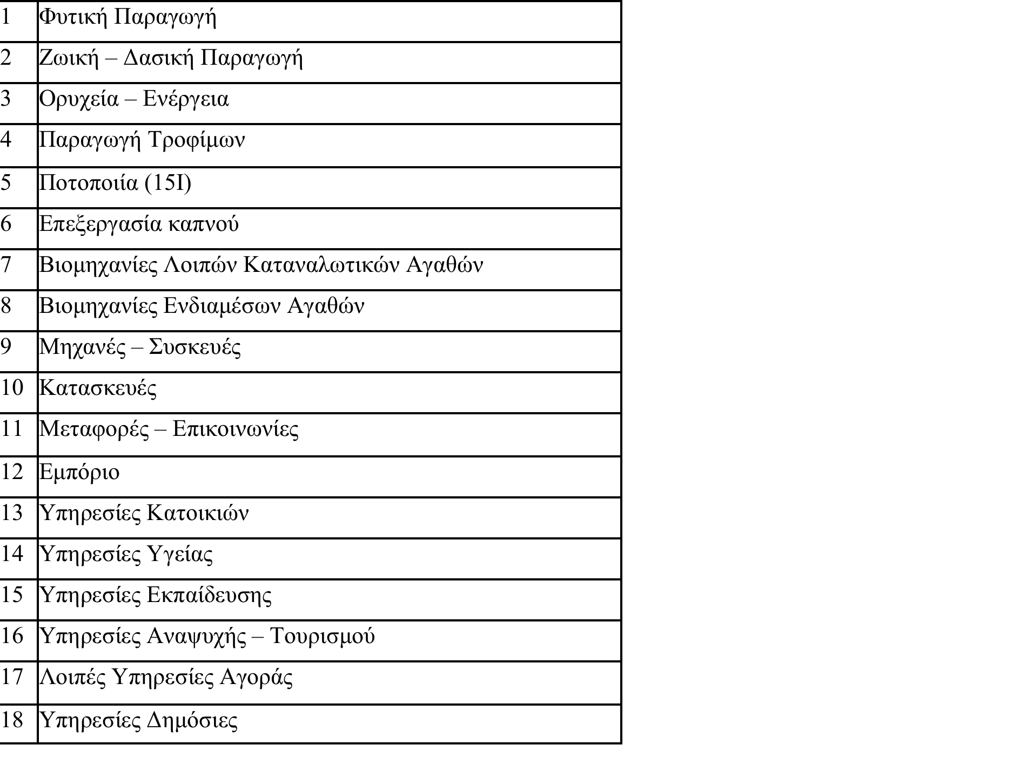
Τα 18 προϊόντα – κλάδοι του Πίνακα Κοινωνικής Λογιστικής

Slide 26
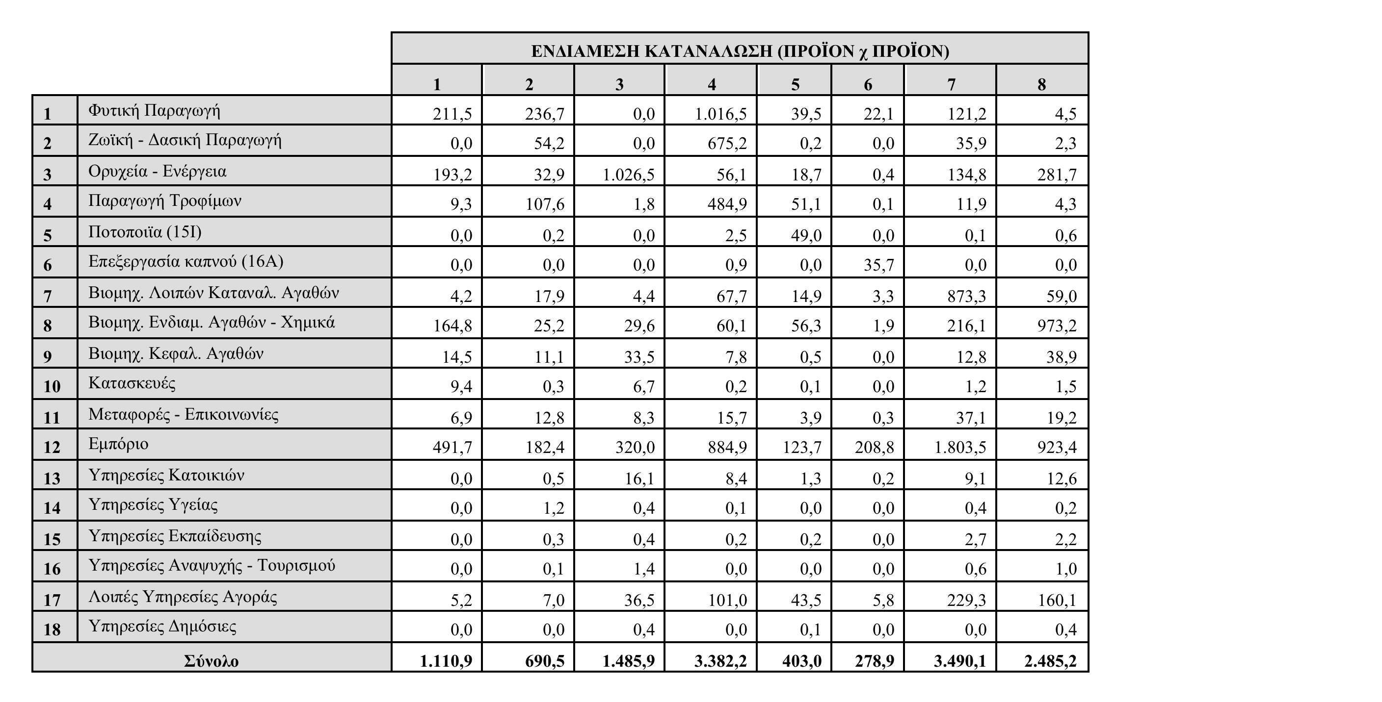
Μήτρα Ενδιάμεσων Χρήσεων (18Χ18) κατά Προϊόν (1996, δισεκ. δραχμές).

Slide 27
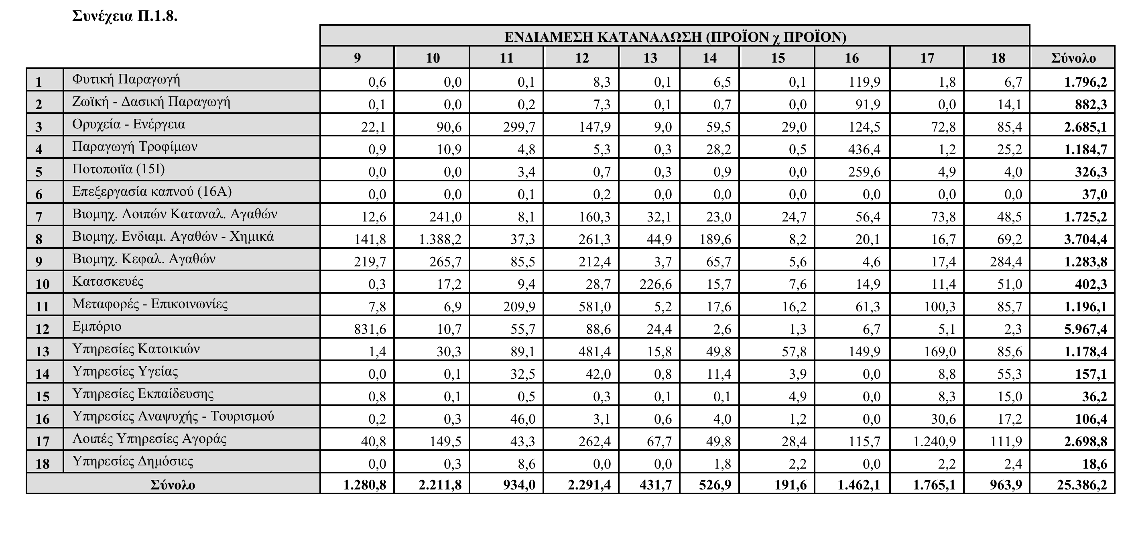
Μήτρα ενδιαμέσων χρήσεων (2)

Slide 28
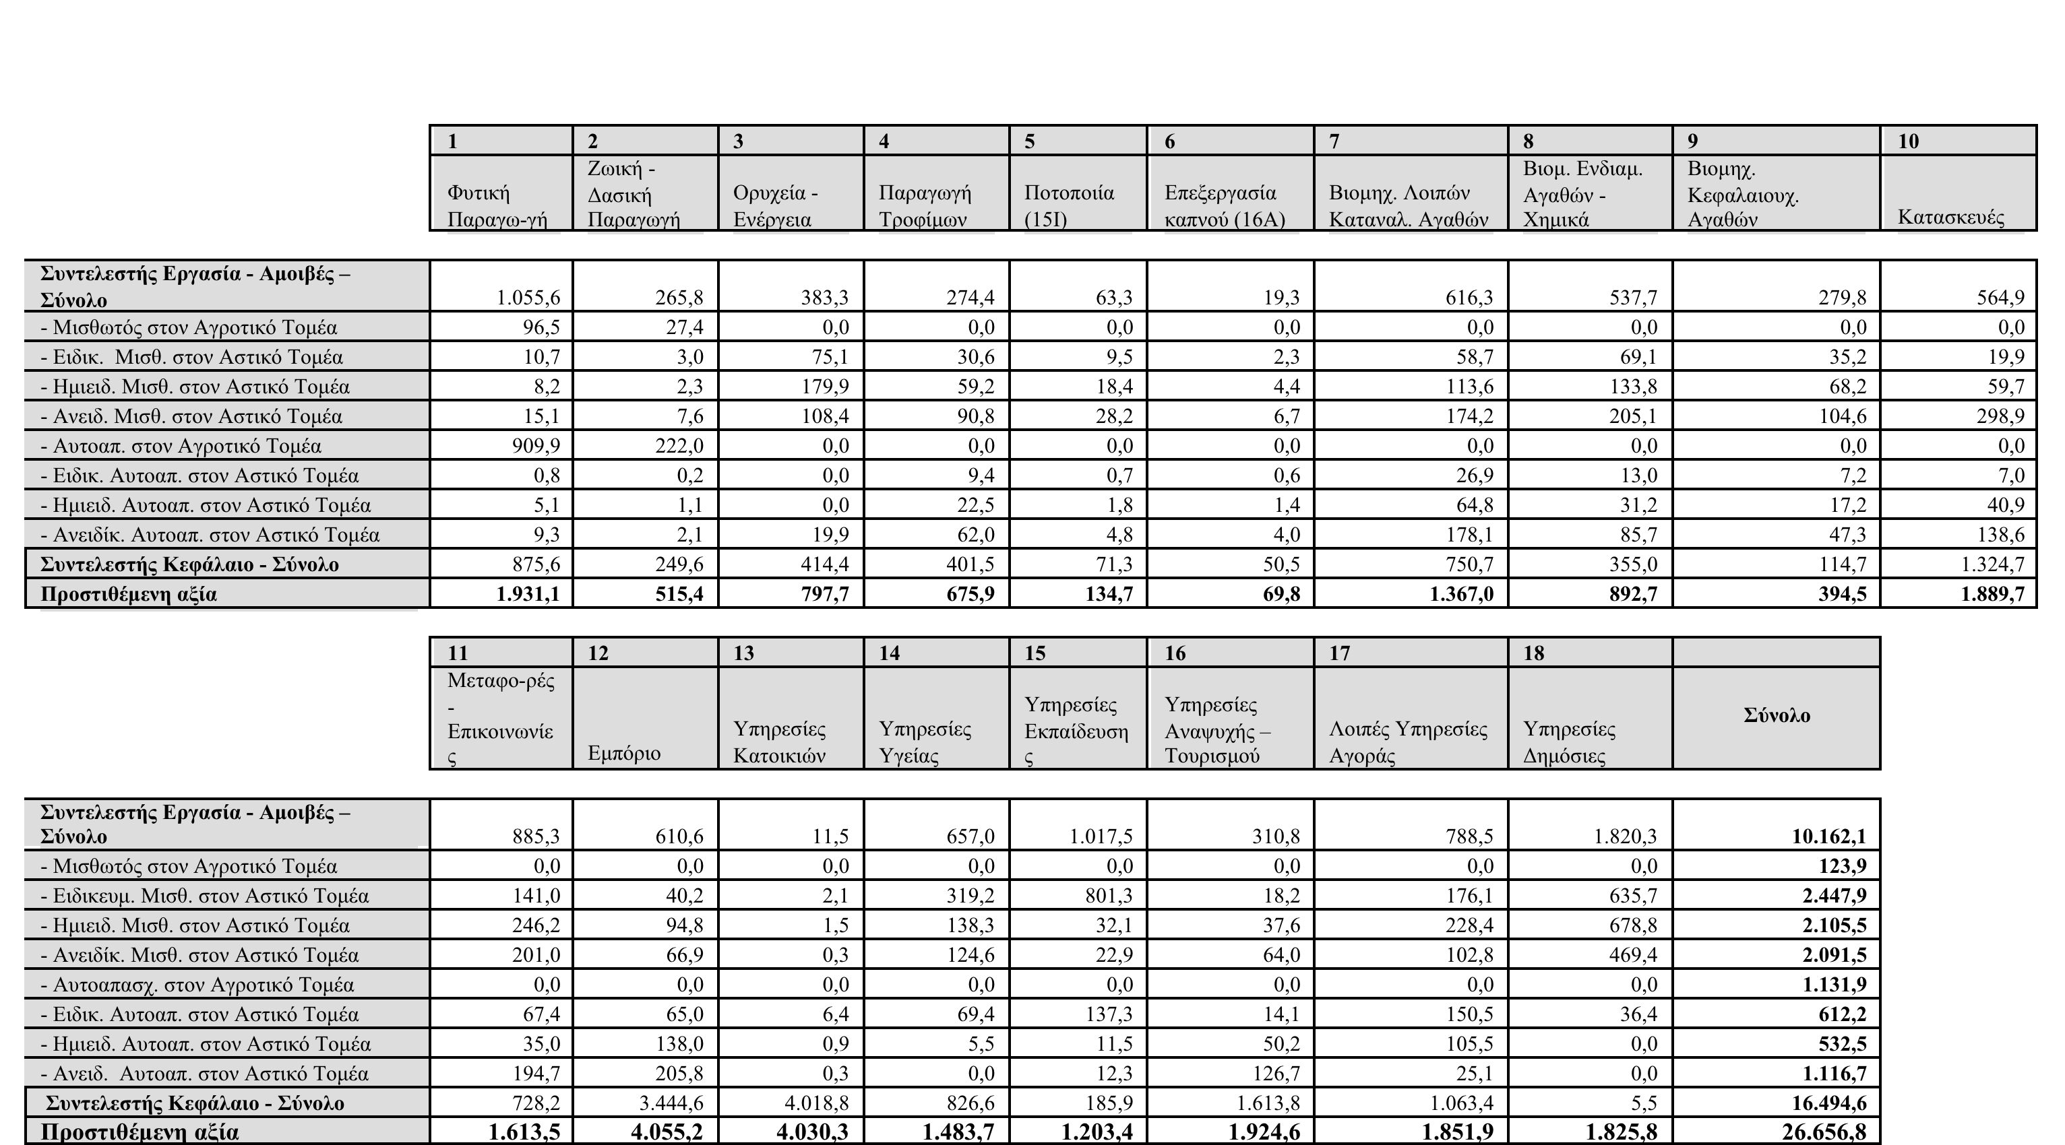
Διανομή Προστιθέμενης Αξίας Παραγωγής κατά προϊόν (1996, δισεκ. δραχμές).

Slide 29
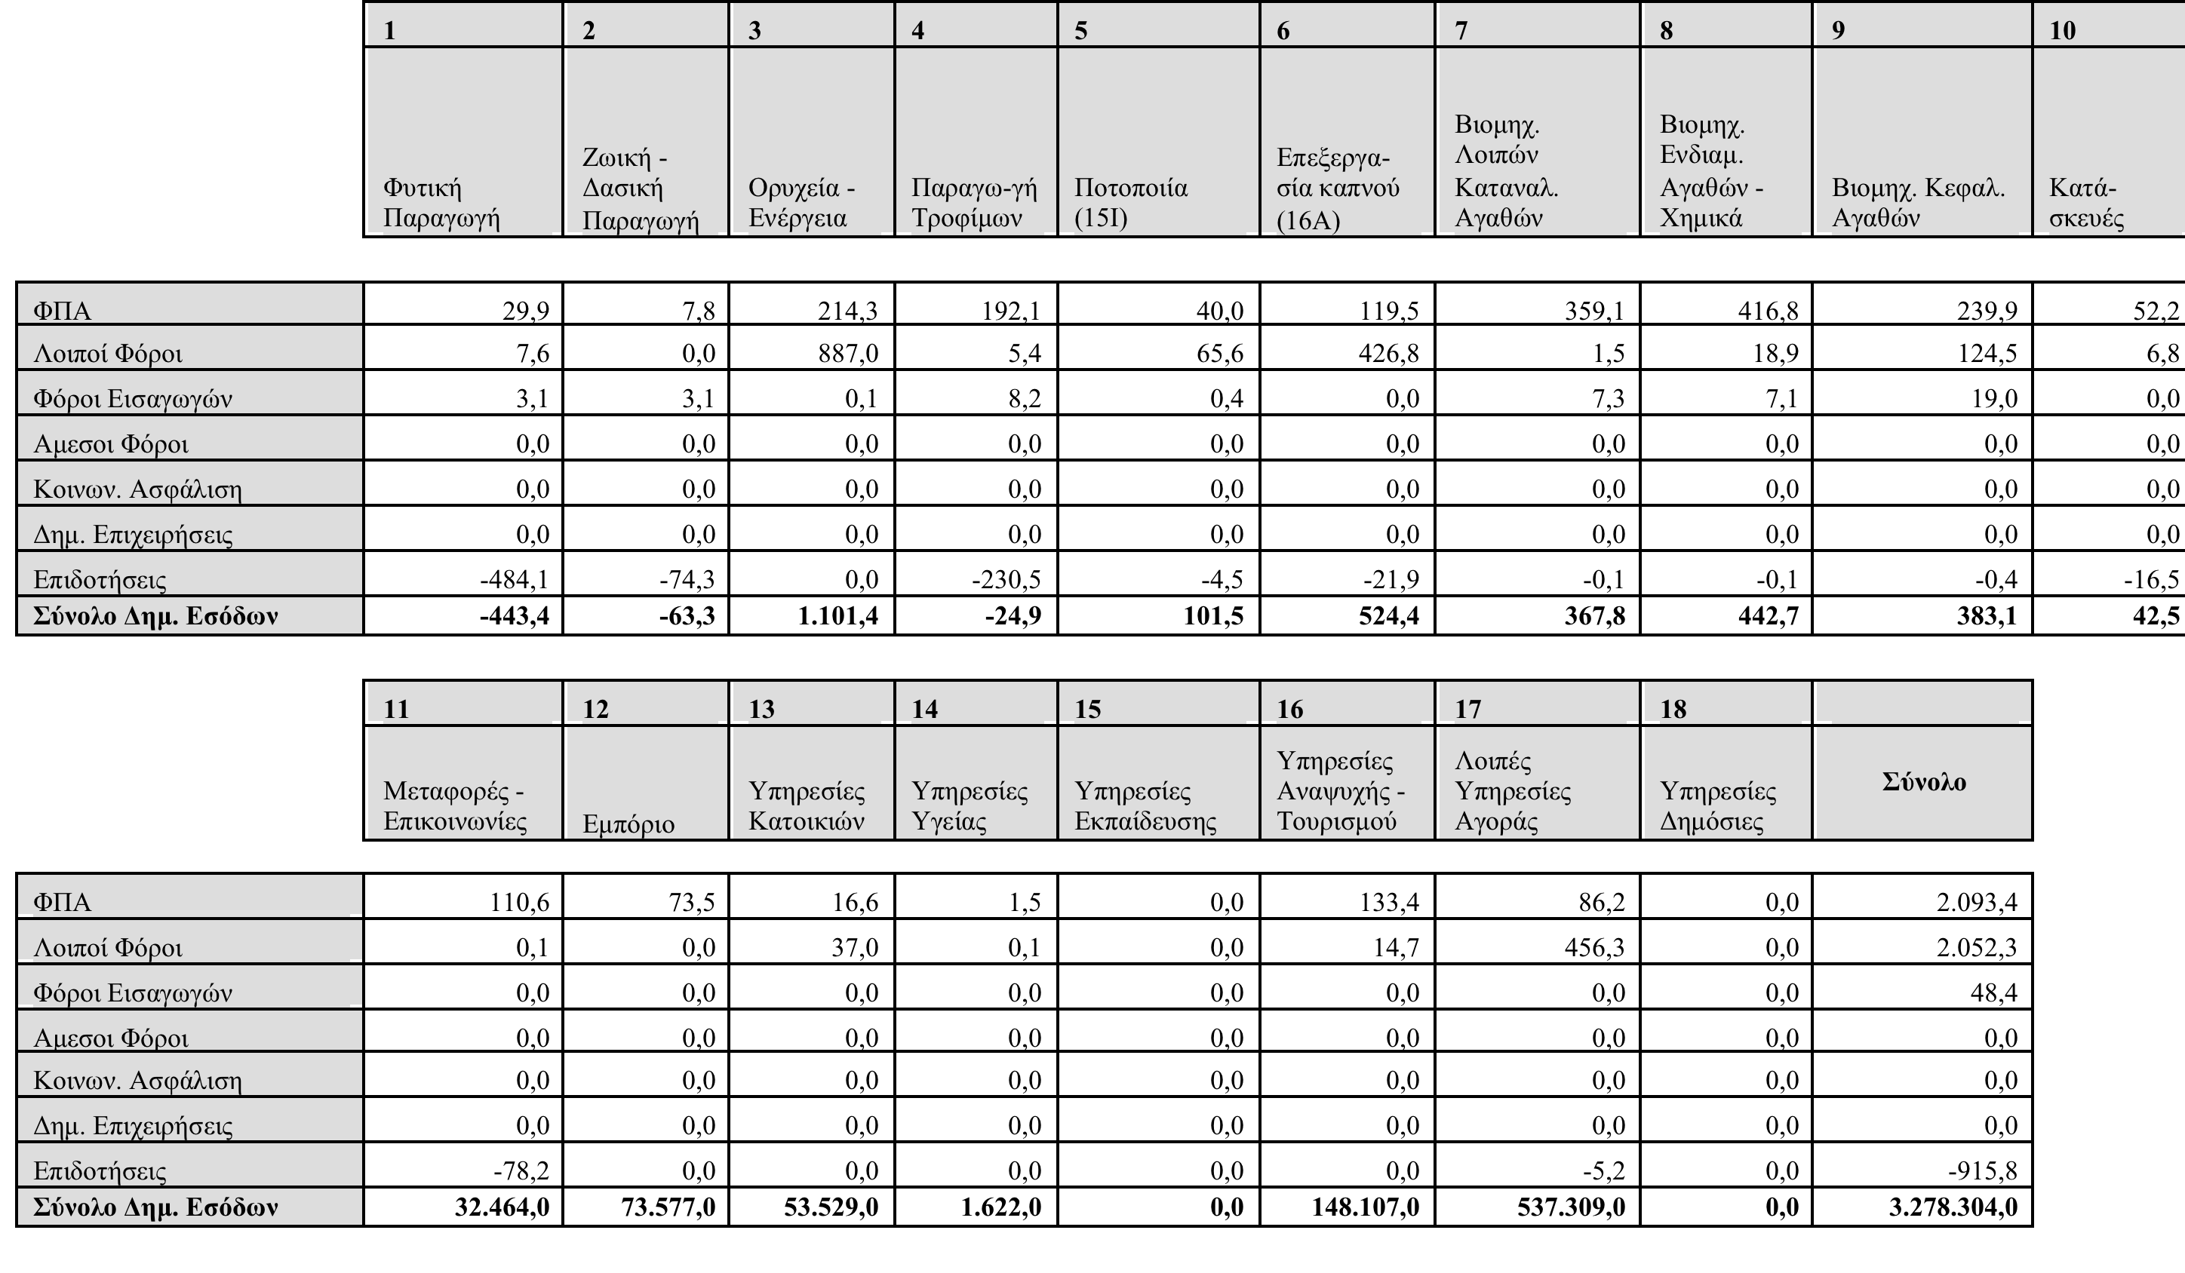
Έσοδα Δημόσιου Τομέα και διάρθρωση κατά προϊόν (1996) σε δισεκ. δραχμές

Slide 30
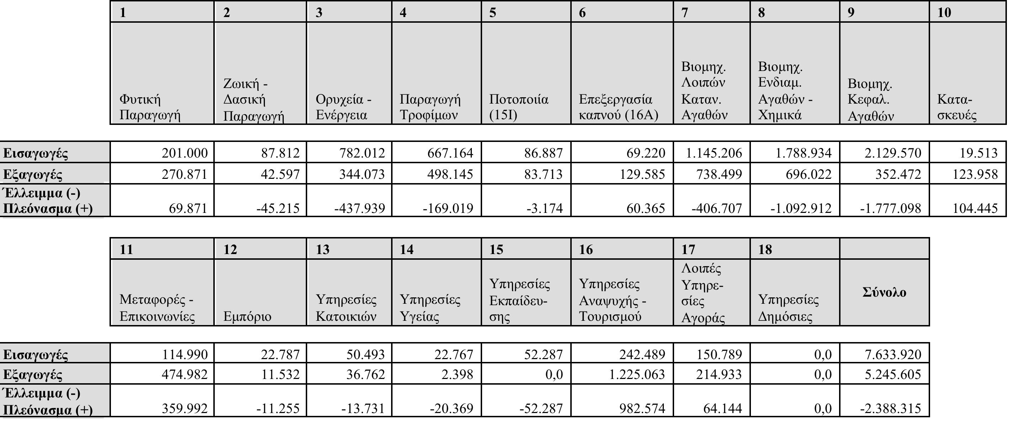
Εξωτερικός Τομέας και Διάρθρωση Εισαγωγών και Εξαγωγών κατά προϊόν

Slide 31
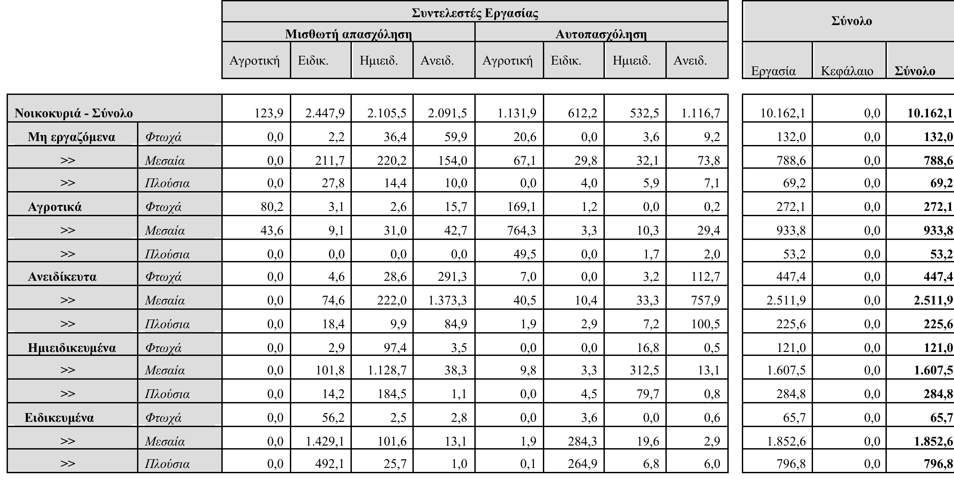
Διανομή εσόδων συντελεστών στα νοικοκυριά (1996 δισ. δρχ.)

Slide 32
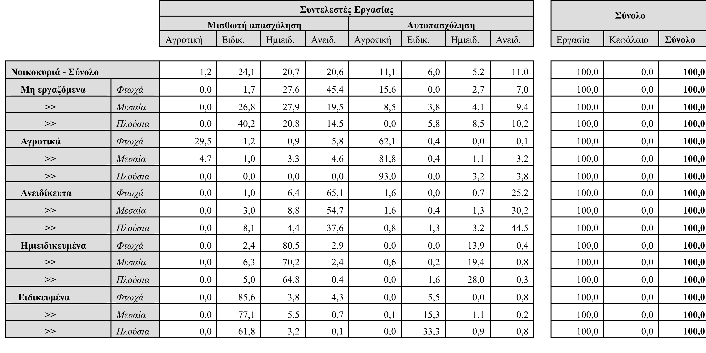
Ποσοστιαία διάρθρωση των εισοδημάτων από εργασία στα νοικοκυριά

Slide 33
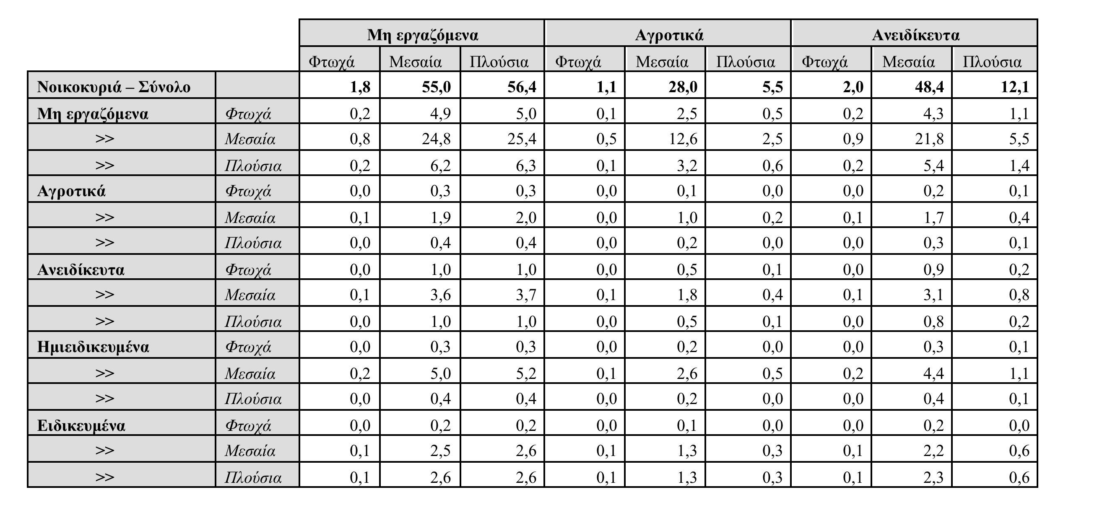
Μεταβιβάσεις από νοικοκυριά σε νοικοκυριά (δισ. Δρχ.)

Slide 34
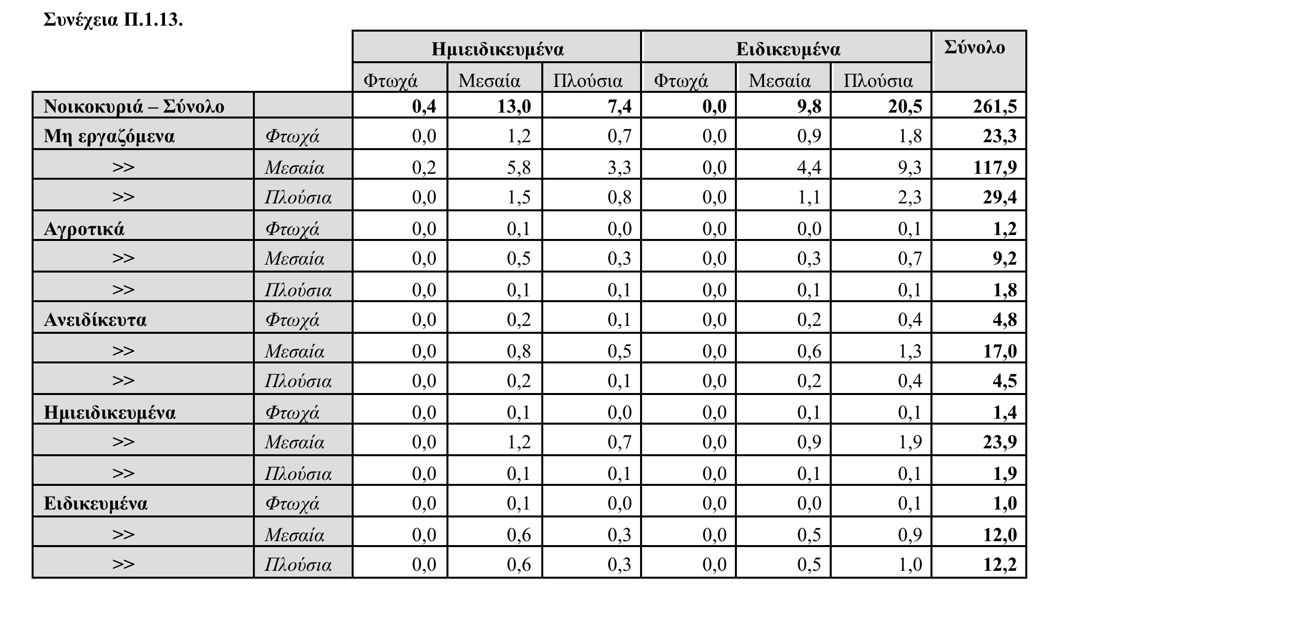
Μεταβιβάσεις από νοικοκυριά σε νοικοκυριά (δισ. Δρχ.) (2)

Slide 35
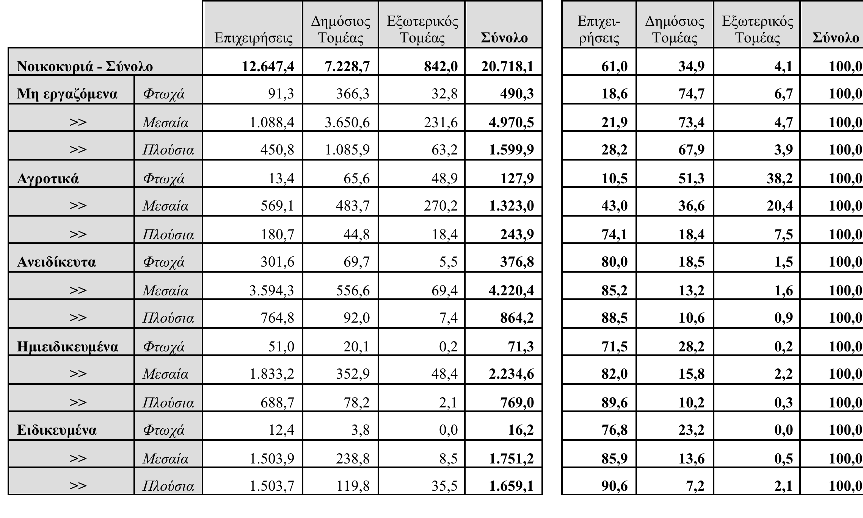
Μεταβιβάσεις στα Νοικοκυριά από Επιχειρήσεις, Δημόσιο, Εξωτ. Τομέα (απόλυτα μεγέθη σε δισεκ. δρχ. και % διάρθρωση).

Slide 36
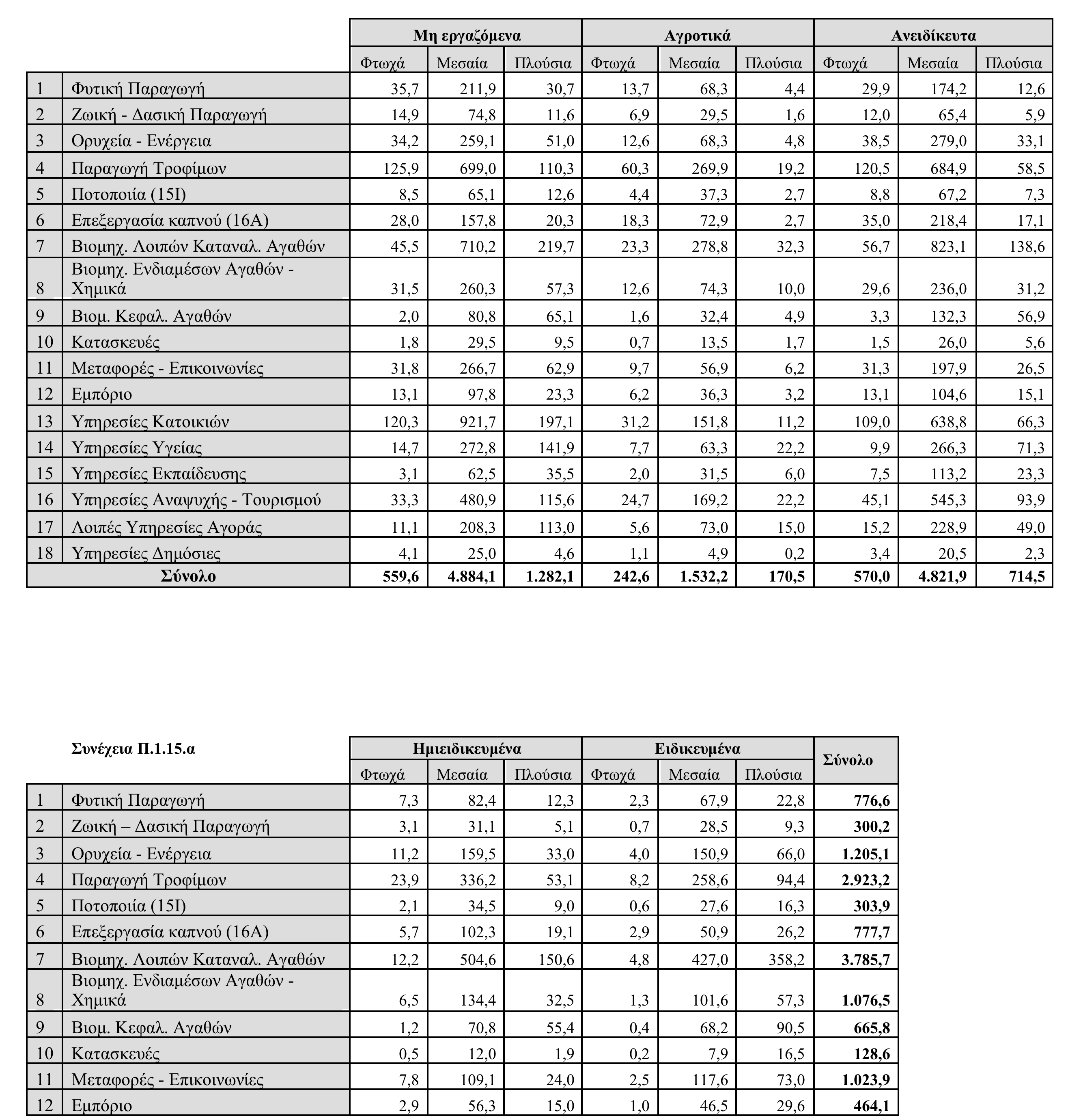
Κατανάλωση Νοικοκυριών κατά προϊόν (1996, δισεκ. δραχμές)

Slide 37
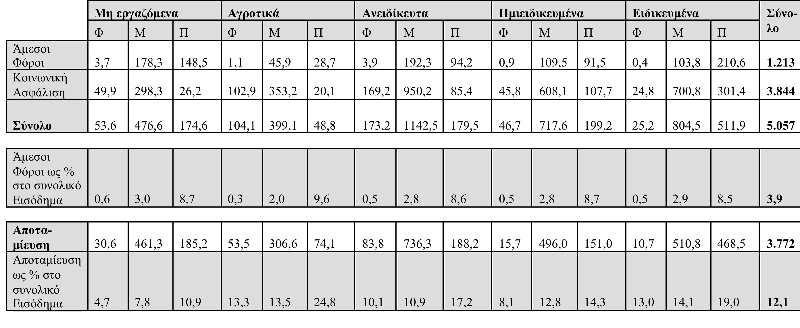
Άμεσοι Φόροι, Κοινωνική Ασφάλιση, Αποταμίευση των Νοικοκυριών.

Slide 38
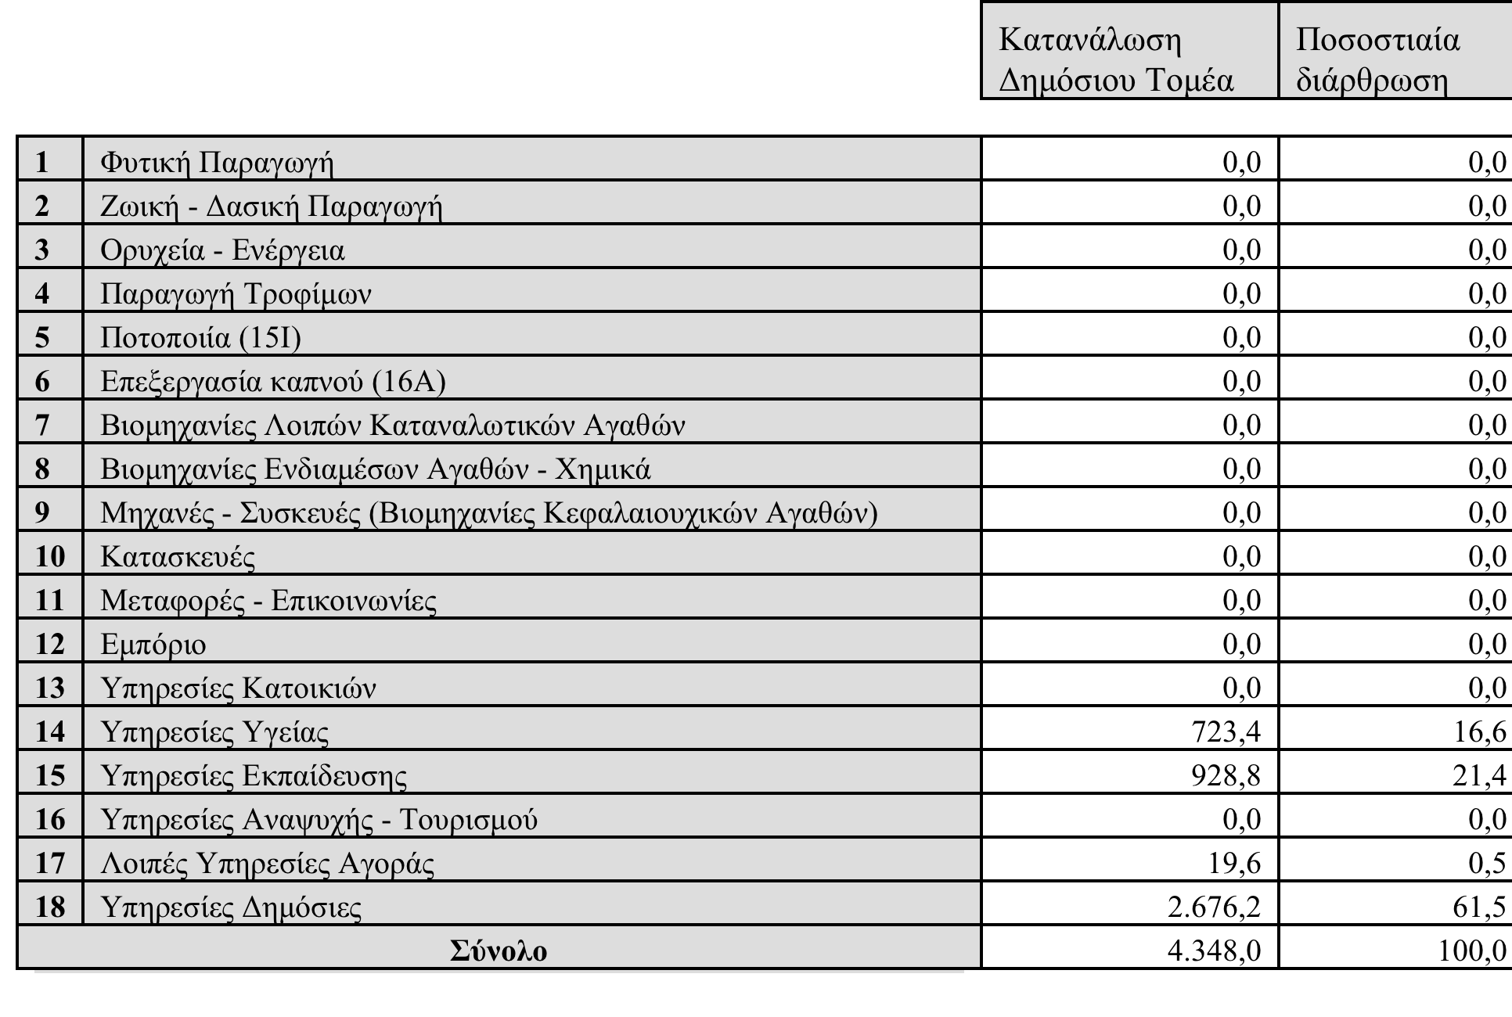
Κατανάλωση Δημόσιου Τομέα και ποσοστιαία διάρθρωση κατά προϊόν.

Slide 39
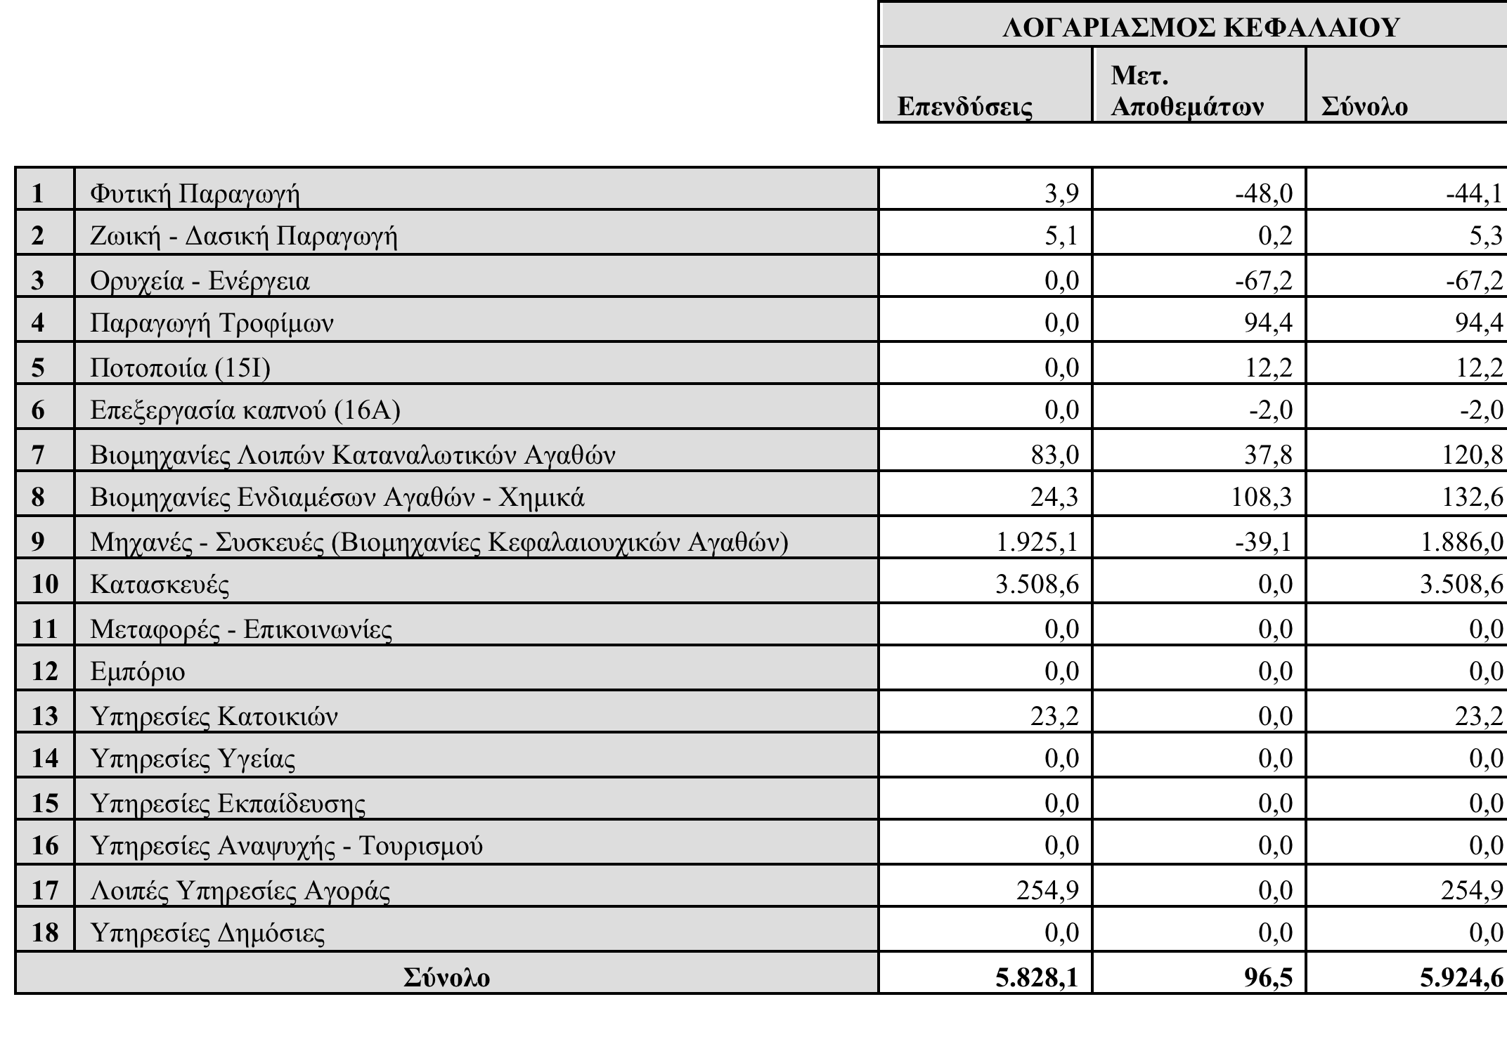
Λογαριασμοί Επενδύσεων - Μεταβολές Αποθεμάτων.

Slide 40
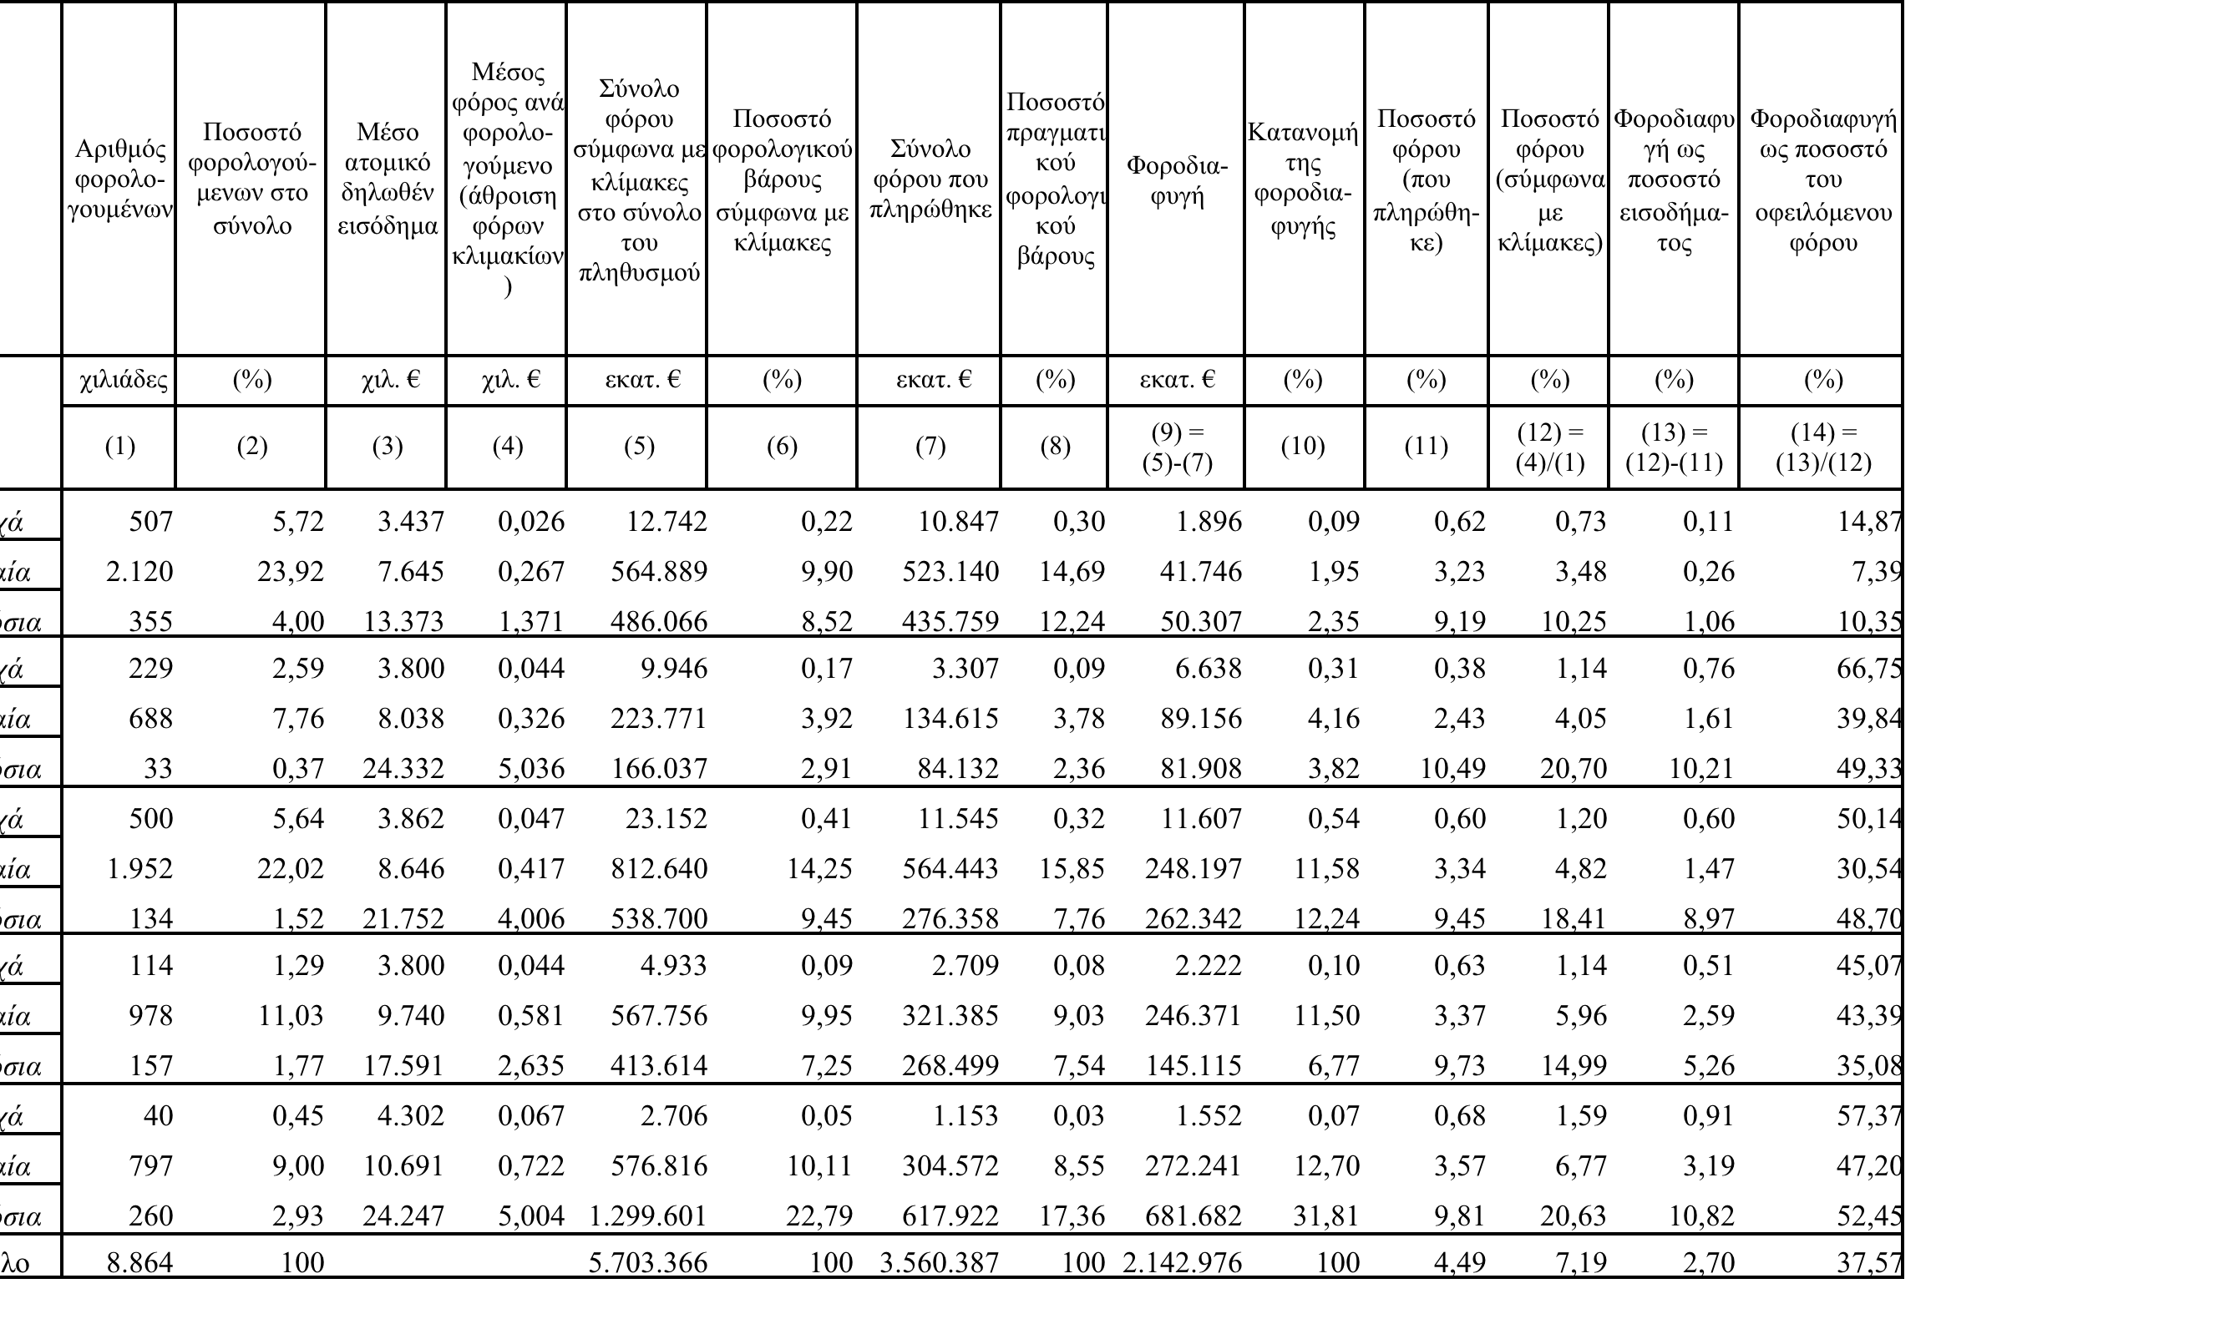
Φορολογική επιβάρυνση των νοικοκυριών από την άμεση φορολογία

Slide 41
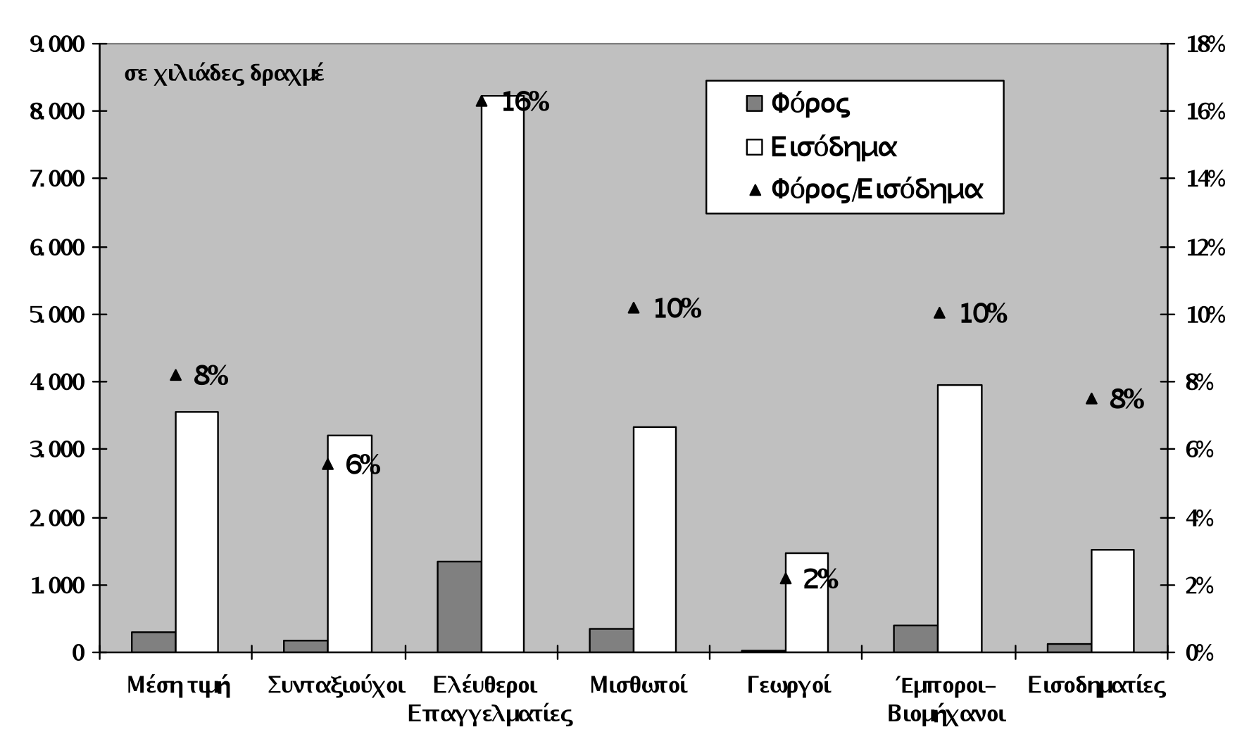
Δηλωθέν εισόδημα και φόρος ανά κατηγορία επαγγέλματος (ανά φορολογική δήλωση)

Slide 42
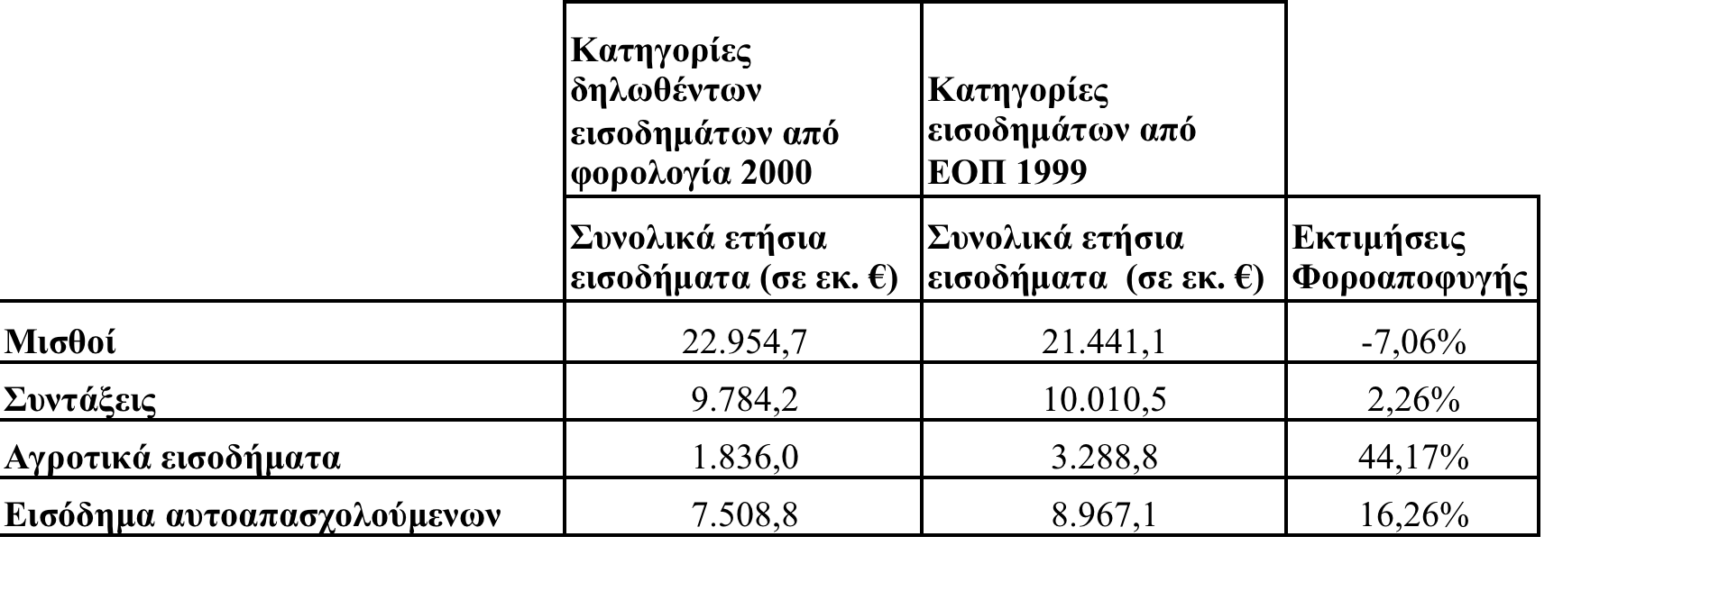
Εκτίμηση φοροαποφυγής (ποσοστιαίες διαφορές στα εισοδήματα που δηλώθηκαν στην ΕΟΠ 1999, και στη Φορολογία Εισοδήματος 2000)

