Slide 1
AGRICULTURE IN ECONOMIC DEVELOPMENT:
AN INTERNATIONAL PERSPECTIVE
WEEK 2
Agriculture / Non-Agriculture Interactions
in Economic Development
1

Slide 2
Agriculture / Non-Agriculture Interactions in Economic Development
Structural change and sectoral composition of the economy
  Factors affecting structural change
The role of agriculture in economic development
  The Lewis model of a dual economy
  The Fei-Ranis model
The contribution of agriculture in development
  Transfer of resources from agriculture to non-agriculture
  Increasing productivity in agriculture and the economy
The post-war world development experience
  Population growth, employment and food
  Agriculture, resources and environment: the broader role

Slide 3
Bibliography
*Lewis, W.A. (1954), “Economic development with unlimited supplies of labour” Manchester School vol. 22, pp. 139-91.
*Syrquin, M. (1988), “Patterns of structural change”, chapter 7 in H. Chenery and T.N.Srinivasan.(editors) Handbook of Development Economics, volume I, Elsevier Science Publishers, Amsterdam.
*Timmer, P. (2007), “Agriculture and Economic Development”,
Kuznets, S. (1982), “The pattern and shift of labor force from agriculture 1950-70”,
*WDR2008, chapters 1-2,3
*J. W. Mellor, and B.F. Johnston (1984), “The World Food Equation: Interrelations among development, employment and food consumption” Journal of Economic Literature, June, pp.
A. Valdes, and W. Foster (2010), “Reflections on the Role of Agriculture in Pro-Poor Growth”, World Development

Slide 4
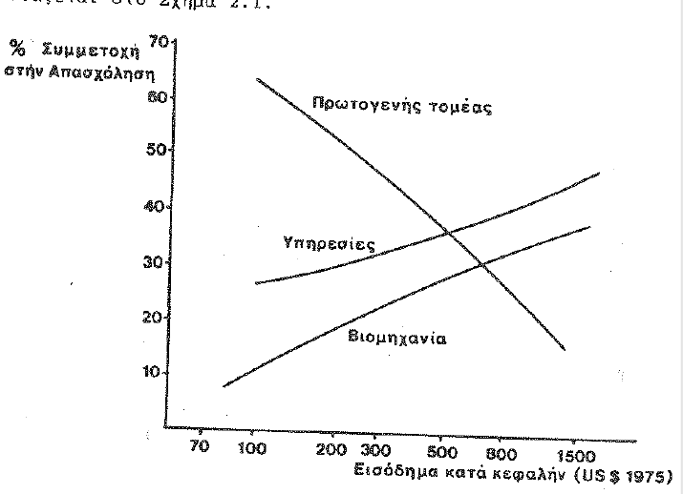
Structural change of the economy

Slide 5
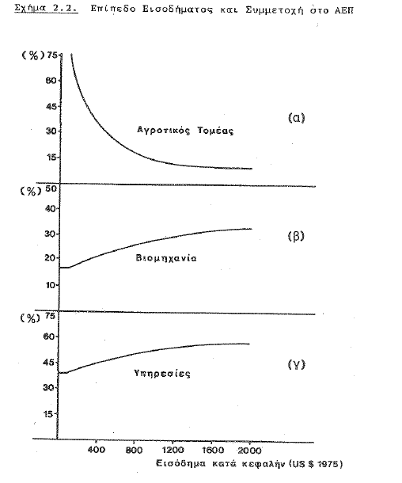

Slide 6
The determinants of structural change
The changing composition of final demand
The rate of capital accumulation in the economy that exceeds that of the labour force
The role of international trade and capital markets
The transfer of technology

Slide 7
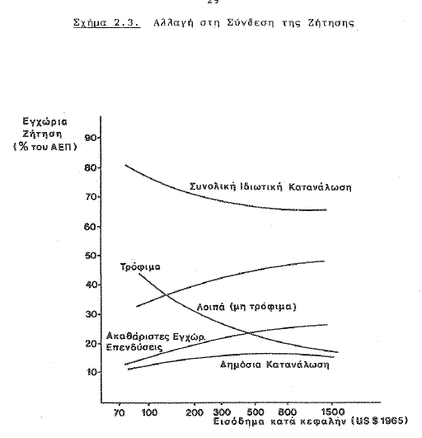

Slide 8
The role of agriculture in development
Two broad categories
(a) the stage models and
(b) the dual economy models
In both common concept the transfer of resources from agriculture to non-agriculture, namely labour and capital
But common denominator to this transfer the ability to increase food production and facilitate the trasnfer

Slide 9
The role of agriculture in development : stage models
List : the change in the composition of employment
Colin Clark: the change in increase in output per worker
Fischer and the role of science and technology
Changing composition of demand- Engel’s Law
Chenery emphasis on supply and the structural change of production of the economy (I-O)
Rostow and the role of the leading sector
Sustaining and declining sectors
Balanced and imbalanced development and the debate on the leading role of industry
Resource base and sectorar development

Slide 10
The role of agriculture in development : Dual economy models
The concept of dualism
The traditional sector, labour intensive sector, not necessarily agricultural with zero marginal labour productivity
The modern, capitalist sector, not necessarily industrial
Differences in income (20:1), employment (5:1), productivity, capital/labour ratio
Other dimensions: infrastructure, living conditions, technology, availability of amenities (electricity, etc)
  The core concept of dualism: surplus labour
The debate about the process:
  Diffusion vs. Polarization
  The role of markets
  Dualism as a transitory or permanent phenomenon
Notes:
,

Slide 11
The Lewis model of a dual economy : conditions
The existence of surplus labour in the traditional – agricultural sector
The wage in the industrial sector depending on the wage in the agricultural sector
Transfer of workers from agriculture to industry without reducing output in the traditional sector
The existence of surplus labour is considered an opportunity for industrialization
Lewis : traditional and capitalist sectors, while in the literature : agriculture and industry

Slide 12
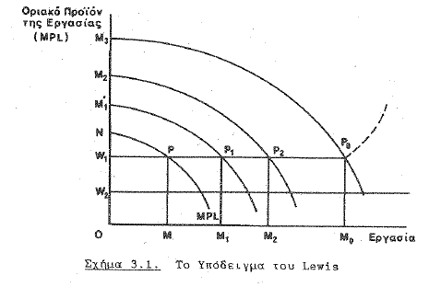
The Lewis model of a dual economy

Slide 13
The Fei-Ranis model
Accepts the assumptions of the Lewis model
Defines the two sectors as (a) food production and (b) manufacturing or industry
Capital accumulation takes place in both sectors
No surplus labour assumed – the importance on increasing productivity in the food producing sector
The zero marginal productivity of labour is interpreted differentlylast
Lewis : perfectly elastic supply of labour
Fei-Ranis : elastic supply in the going wage rate which is higher than subsistence needs
Thus, industry receives labour simply paying a higher wage than in in agriculture
As the surplus is invested in industry the demand for labour increases attracting new entrants from agriculture

Slide 14
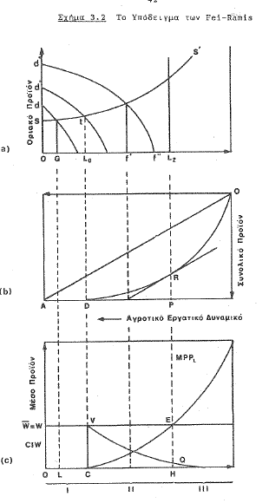

Slide 15
The neo-classical model
Known also as the Jorgenson model
It accepts dualism but not that marginal productivity of labour in agriculture is zero
Assumes that labour in both sectors have wages that equal their marginal productivity and thus labour suplly is not horizontal but with +ve slope
This model is dual, but it does not accept the core concept of dualism: the surplus labour in agriculture

Slide 16
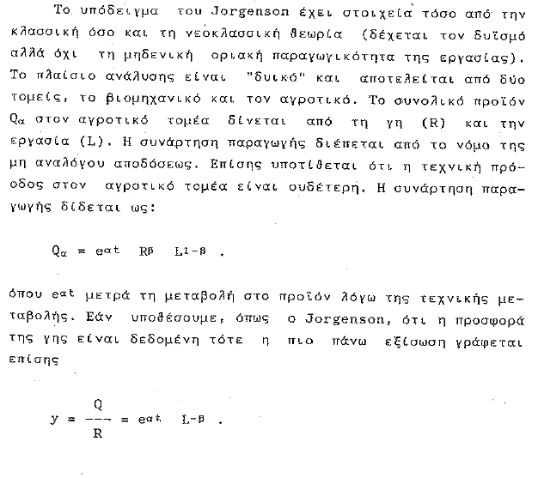

Slide 17
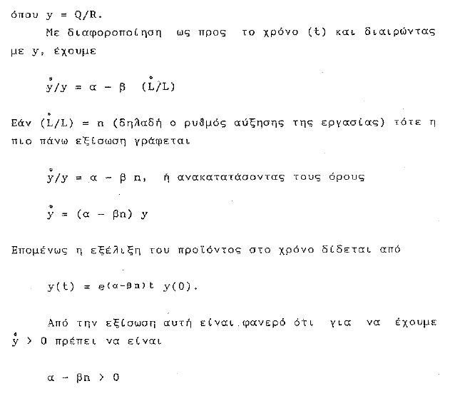

Slide 18
Policy recommendations of the Jorgenson model
Assuming that β is constant, then in order to increase productivity we have either to increase α or to decrease η
Increasing α means introduciong technical change in production (question is how)
Decreasing η means decreasing population growth
If α > η per capita food supply is increasing allowing flow of labour to industry
If α = η per capita food supply is stagnant and flow of labour to industry will create food shortages
If α < η then a situation of hunger is developing

Slide 19
Critic of the models
Jorgenson model is more realistic than the other models
The concept of surplus labour is not confirmed by empirical studies
The concept of zero marginal productivity in agriculture in not confirmed empirically
The problem of the Jorgenson model is that it has no role for capital
Jorgenson used 19th century Japan data for his model, but even there capital accumulation has a strong role
All models ignore services and their role in the development of the traditional sector
The role of trade, banking, the financial system, education
But they may be considered as part of the concept of technology
The important role of technology in increasing productivity in the economy

Slide 20
The contribution of agriculture in development
The core concept of surplus, but what surplus
Labour surplus, vs other ways of defining the surplus
Agriculture as a reservoir of labour, food, savings to fuel non-agricultural activity
This logical sequence of events is confirmed in particular in Japan and other East Asian countries
Need to differentiate : Static and Dynamic transfer of resources
Static : transfer of labour, food and capital directly
Dynamic : increase productivity to allow the transfer to take place
Two concepts with significantly different policy implications
Notes:
And other

Slide 21
The Kuznetz concept of surplus and the transfer process :contribution of agriculture
Increase in domestic food supply and release of labour to expanding industry
Expansion of the domestic market for industrial goods
Increase of savings and available financial resources for investment in industry
Increasing exports of food and other primary products
Increase in the availability of foreign exchange through increasing exports
Taxation of agriculture either directly or indirectly to increase public resources for investment in infrastructure and in industry
The double developmental squeeze of agriculture

Slide 22
The open economy dimension
The models assumed a closed economy
The role of increasing participation in international trade
Exports of food and primary products have been the engine of growth for development in many countries (Argentina, USA, Denmark, Russia, etc
Two questions: how to increase exports without disrupting domestic markets and the Myrdal and Prebish thesis about international markets for primary products
The role of capital and of attracting foreign investment to increase exports
Foreign capital and FDI also improves technology of production and strengthen links with international markets
Hirshman and import substitution and the infant industry
The role of food industry and processing of domestic primary products for export

Slide 23
The experience of 60 years of development: the broader role of agriculture
The record shows significant success
Growth and development , but increasing inequalities, within and between countries
Many countries out of poverty and large parts of global population have better living conditions, but problems remain in Africa
Population growth and employment : the role of agriculture
Population growth and nutrition
The new challenges
  Hunger and malnutrition : the bottom billion
  The problem of providing employment
  Population growth and the demographic transition
  Providing for basic needs: food, health, housing, water, roads, electricity, communications
  Environment and resources
The central role of population growth
Notes:
ularhallenge

