Slide 1
AGRICULTURE IN ECONOMIC DEVELOPMENT:
AN INTERNATIONAL PERSPECTIVE
WEEK 3
Patterns and Models of Development
of the Agricultural Sector
1

Slide 2
Patterns and Models of Development of the Agricultural Sector
The classical theories: Ricardo, Mill, Rostow
Theoretical issues in the development of agriculture
The key role of increasing productivity in food production
Technical change as a lever for agricultural development: Hayami and Ruttan
The role of institutions
Hirshman and the sectoral interactions
Schultz: Efficiency and the role of incentives
Marxist approaches and the dependency theory
Todaro, the urban bias and economic growth

Slide 3
Bibliography
Timmer, C.P. (1988), “The agricultural transformation”, chapter 8 in H. Chenery and T.N.Srinivasan.ChenSriniv)
Bardhan, P.K. (1982), “Unequal exchange in a Lewis-type world”,
Matsuyama, K. (1992), “Agricultural Productivity, Comparative Advantage, and Economic Growth”, Journal of Economic Theory, vol. 58: 317-334.
*Y. Mundlak (2001) ‘Production and supply’, chapter 1 in HANDBKAGECON V1A
*G. Moschini and D. Hennessy (2001), ‘Uncertainty, risk aversion and risk management for agricultural producers’, chapter 2 in HANDBKAGECON V1A
*WDR2008 chapter 4
*Chapters 10, 11, and 12 in SADDEJANVRY

Slide 4
The development of the agricultural sector in perspective
The classical theories, Malthus, Ricardo, Mill
Boserup vs. Malthus : population growth
Stage theories: Rostow, Perkins and Witt
Colin Clark : The conditions of economic progress
Baran and the Marxist approaches – political institutions & mode of production. The Political Economy of Backwardness
Mellor and Johnston –Japan, Taiwan: change towards the market, Broad based vs. enclave based strategy
Schultz: Transforming traditional agriculture – response to incentives
Hayami and Ruttan, emphasis on induced innovation, on new technology and the direction of changing technology
De Janvry : the marxist approach in a neo-classical analytical framework – serious analysis with significant policy results

Slide 5
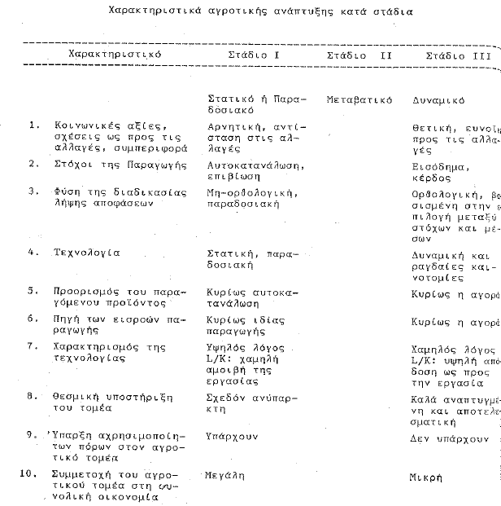

Slide 6
Theoretical Issues in the development of agriculture
Market participation and production objectives:
  Self sufficiency
  The market
  Marketing surplus
Decision making:
  Traditional values, non market incentives
  Rationality, market incentives, income and profit
  Response to market prices, product & factor prices
Attitudes towards risk and uncertainty:
  Risk aversion, structure production to deal with risk & uncertainty
  Diversification – land, product, resources
  Attitude towards adoption of new technology

Slide 7
Theoretical Issues in the development of agriculture (cont)
Choice of technology
  In production,
  Attitude towards innovation
Land ownership, land reform
  Size of the production unit – farm size
  Efficiency and productivity (small vs. large scale of production)
  Irrigation and capital accumulation
Institutional support
  Transfer of production technology
  Marketing channels, market structure, conduct, performance
  Resource use,
  Education and knowledge transfer

Slide 8
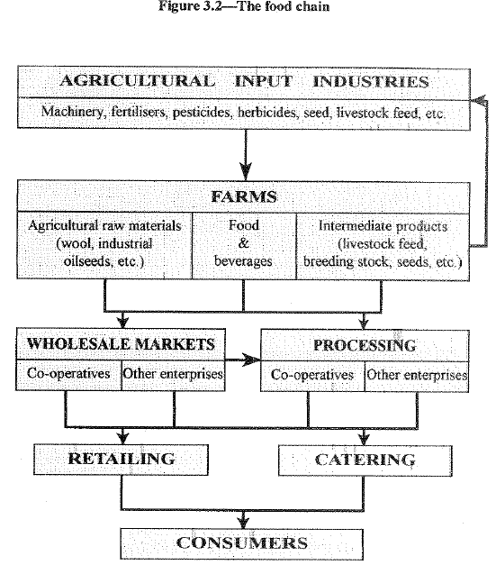

Slide 9
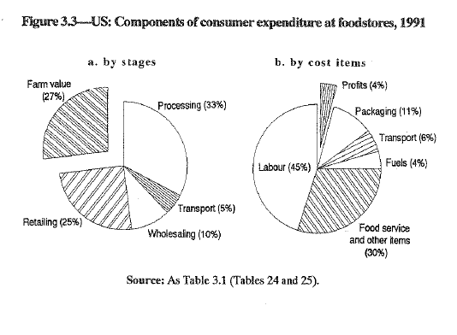

Slide 10
Theoretical Issues in the development of agriculture (cont)
The agricultural sector as a system
  Resources, input industries, production technology
  Product market, market performance
  Processing, Wholesale markets
  Retail markets
Supply chain
  Addressing risks, production decisions and technology choice,
  Market participation (prices) –market performance
  Product quality and consumer protection
  Product certification and diversification
  How to encourage innovation in the entire food system

Slide 11
The key role of increasing efficiency and productivity and the role of the price system
Schultz Transforming traditional agriculture – the role of technical change in efficiency and productivity increase
Efficiency and productivity : Technology – technical change
Question: on the production of new technology
The role of research and innovation
The role of prices as economic incentives
The operation of markets, product and input markets
The “size of farm and productivity” debate
The role of land and land reform
Rural employment

Slide 12
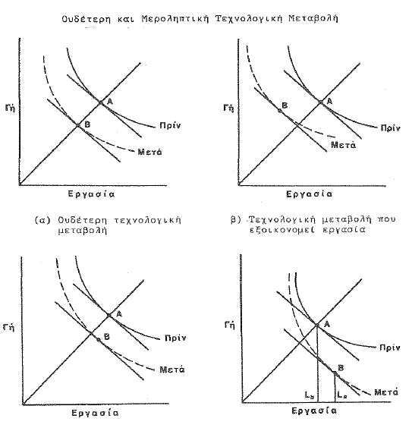

Slide 13
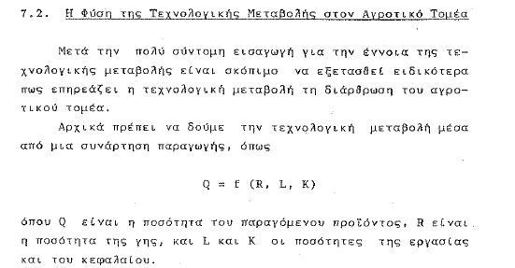
Technological change in agriculture

Slide 14
The nature of technological change in agriculture
Mechanical technology
  Labour saving or capital using technology
  Machinery, mechanical equipment, capital accumulation
Chemical technology
  Land saving or land augmenting technology
  Irrigation and water availability
  Chemical technology (fertilizers, pesticides, insecticides)
Biological technology
  Land augmenting or labour using technology
  Irrigation and water availability
Genetic engineering
  GMOs
Management change, education and knowledge

Slide 15
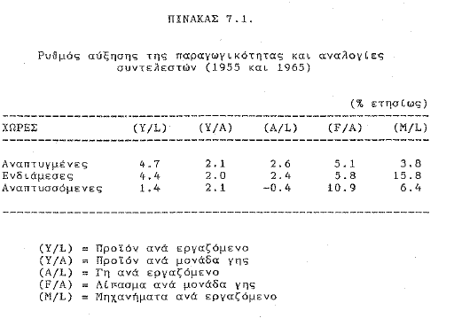
Alternative directions of technological change in agriculture

Slide 16
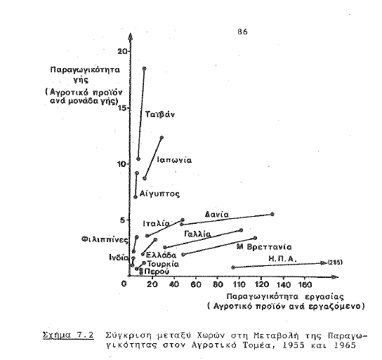

Slide 17
Induced innovation : the theoretical foundation
The Theory of wages (Hicks)
Factor prices as a guide to innovation
Invention and the stock of knowledge
Innovation and new technology
Technology as endogenous in the economic system
Induced innovation in agriculture
Hayami and Ruttan
Innovation in the public sector – strengthening research systems

Slide 18
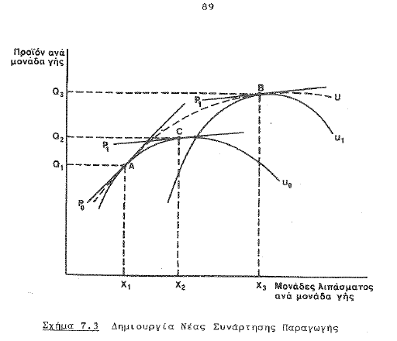

Slide 19
Induced institutional innovation and institutional change
From induced innovation in technology to induced change in institutions governing the operation of the agricultural system and institutional change - the quest for efficiency
Land tenure, land use systems and land reform
The agricultural research system: USA, Germany, Japan
The knowledge transfer system: Extension, education,
The credit system: Short term and long term credit and the operation of the money market, purchase of new technological inputs and financing of investment in capital inputs
Operation of markets: Product markets, input markets. Market structure, conduct, performance
Market integration : institutions and infrastructure
Critical infrastructure, transportation, telecoms, energy
Trade barriers. Trade arrangements: Multilateral and regional

Slide 20
Rural economy and growth in the macroeconomy
The distinction between the agricultural sector and the rural economy
Characteristics of the food and fiber production system (the agricultural system)
Characteristics of the rural economy – includes significant amount of non-agricultural activities, home and small processing, tool production, services
The importance of infrastructure in transforming the rural economy: energy, transport and telecoms
Market integration – market performance
Quality of life dimension

Slide 21
The urban bias, Todaro and economic growth
Urbanization : a universal trend
The urban bias of development. Transfer of resources
The urban bias in policy making: The pressure groups.
Rural population as a development potential: East Asia
The Todaro Migration Model,
The Todaro Paradox examined how an urban public sector job creation program could actually lead to an increased number of workers who are unemployed
The Harris Todaro Model. Assumption that migration decision based on expected income differentials between rural and urban areas rather than just wage differentials. This implies that rural-urban migration in a context of high urban unemployment can be economically rational if expected urban income exceeds expected rural income.

Slide 22
Todaro’s analytical approach to rural urban interactions in economic growth
Todaro lived in Africa, and traveled extensively in Latin America and Asia
Professor of Economics at NYU. Book Economic Development. Policy-oriented approach
Todaro approaches economic development within the context of a major set of problems, such as poverty, inequality, unemployment, population growth, environmental decay, and rural stagnation.
Formal models used to highlight real-world development problems.
Policy-oriented approach to understand issues for policy recommendations
Sees problems of development and underdevelopment from an institutional and structural (noneconomic) as well as an economic perspective, thus combines relevant theory with realistic institutional analysis.
Sees development in domestic and international contexts. Increasing interdependence of the world economy in food, energy, natural resources, technology, information, and financial flows.

Slide 23
Todaro’s analytical approach to rural urban interactions in economic growth (cont)
Many economic, social, and institutional problems of underdevelopment are closely interrelated. Require simultaneous and coordinated approaches to their solution at both the national and international levels.
Areas of focus are : capacity building, convergence, poverty alleviation, addressing inequality, population, migration, urbanization, education, child labor, health, agriculture, environment, roles of markets and government, NGOs, international trade and development, debt, conflict, aid, direct foreign investment, microfinance, public administration and fiscal and monetary policy for development. Recent issues as improving health, education, and microfinance design. Understanding of disparities in the world’s economies that can inform strategy of economic development.
The UNDP Multidimensional Poverty Index (that was released in August 2010) and its New Human Development Index (that was released in November 2010).

