Slide 1
AGRICULTURE IN ECONOMIC DEVELOPMENT:
AN INTERNATIONAL PERSPECTIVE
WEEK 4
Production, Economic Behaviour
and Household Models
1

Slide 2
Production, Economic Behaviour and Household Models
Capital accumulation and the choice of production techniques
  The coexistence of production techniques in agriculture (Mundlak)
  Capital accumulation and the introduction of technical change
Efficiency and economic behaviour of the farm-firm
  Schultz (1964) Transforming traditional agriculture
  Yotopoulos and Lau: a test for relative efficiency
  Addressing risk and uncertainty : multi-product production
Efficiency of sharecropping
Response to economic incentives – prices
  The supply response issue and the work of (Nerlove, 1958)
  Implications for the operation of product and factor markets
The model of the agricultural household
  Non-separability of production and consumption
  The role of the labour market

Slide 3
Bibliography
Y. Mundlak (2001) ‘Production and supply’, ch.1 in HANDBKAGECON
H. Binswanger, J.McIntyre and C. Udry (1989) “Production Relations in Semi-Arid African Agriculture”, chapt. 6 in BARDHAN
Pan A. Yotopoulos and Lawrence J. Lau (1973) A Test for Relative Economic Efficiency: Some Further Results, The American Economic Review, Vol. 63, No. 1
Eswaran, M., and Kotwal, A. “A Theory of Contractual Structure in Agriculture.” American Economic Review, Vol. 75 (1985).
Stiglitz, J.E., (1974) “Incentives and Risk Sharing in Sharecropping” Review of Economic Studies, vol. 41, pp. 219-55
Mergos G (1991) Output Supply and Input Demand in Greek Agriculture: A Multi-Output Profit Function Approach, Studies (New Series) No 6, Centre of Planning and Economic Research, Athens
Stiglitz, (1982) “Credit and Sharecropping in Agrarian Societies”, Journal of Development Economics, December.

Slide 4
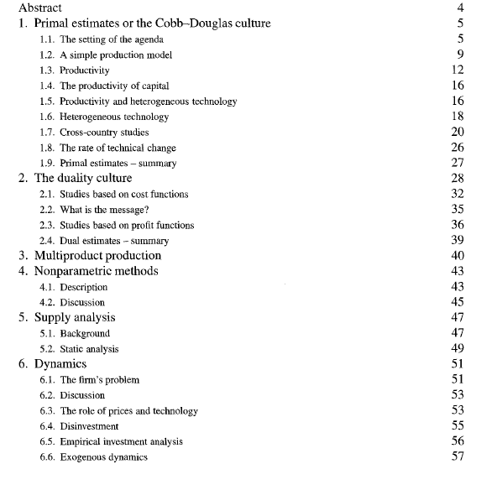
Mundlak - Production and supply :
The issues

Slide 5
Capital accumulation and the choice of production techniques
Capital accumulation and the introduction of new technology are interrelated
Example the “Green Revolution”
In a production function framework : labour is the main factor with capital and new inputs being introduced gradually (elasticities differ)
The introduction of new technology follows a sigmoid curve
  Imperfect information – lack of knowledge
  Risk and uncertainty - demonstration
  Capital non-homogeneity

Slide 6
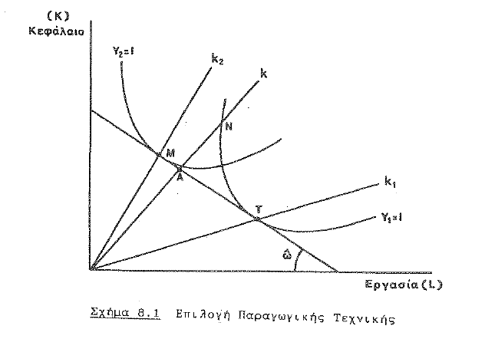
  The coexistence of production techniques in agriculture (Mundlak)

Slide 7
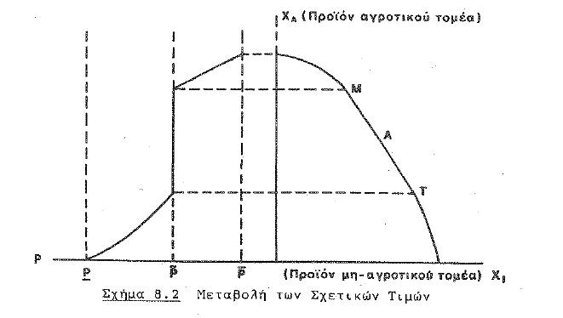
Capital accumulation and introduction of technical change in production– economy level

Slide 8
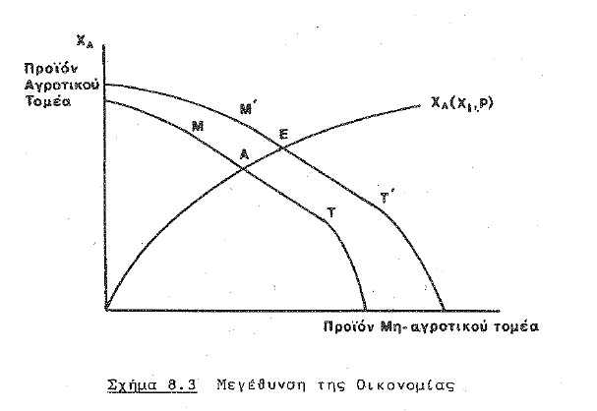
Capital accumulation and introduction of technical change in production – economy level

Slide 9
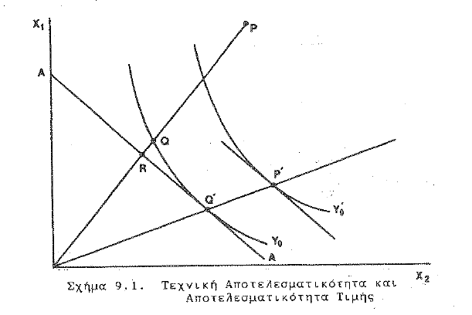
Economic efficiency in resource use

Slide 10
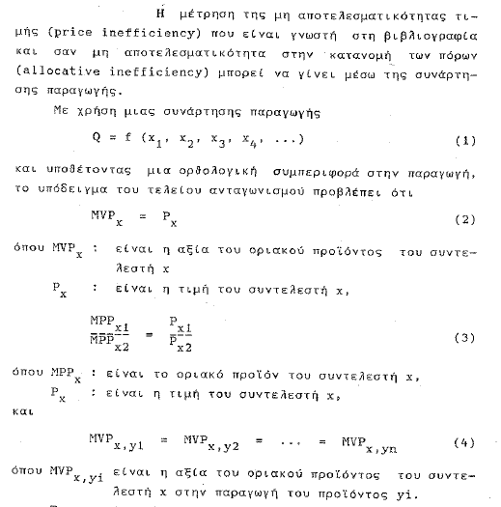
Testing for efficiency

Slide 11
Tests of relative economic efficiency
Schultz (1964)
Yotopoulos (1967)
Lau and Yotopoulos (1971 and 1973)
Duality theory of production
  Profit function
  Cost function
Cross-sectional farm survey data
Perfect competition, sources of price variation and the sue of a profit /cost function
Opportunity cost of labour – lack of labour markets

Slide 12
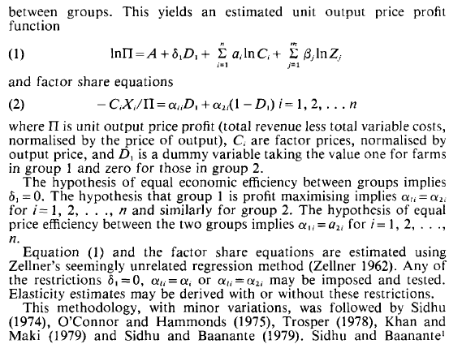
Testing for relative efficiency

Slide 13
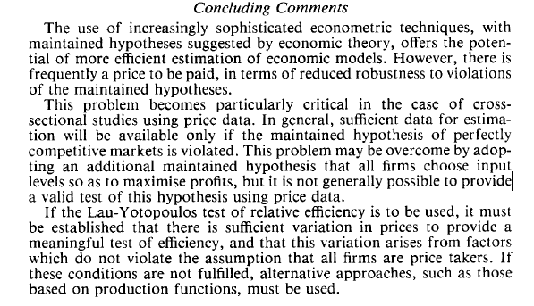
Testing for relative efficiency
Using duality theory (profit function)

Slide 14
The efficiency of sharecropping
  A perennial puzzle – Persistent, coexisting with other forms of tenancy,
  It persists although inefficient, non inducing innovation, non conducive to technology adoption, shares determined by custom
  Approaches - Marshallian, landowner model, imperfect information model (new institutional economics), Marxian (exploitation model)
  Sharecropping links multiple markets
    Land and labour, but also credit, inputs, consumption
    Not always a clear cut landless/landowner distinction
    Often sharecropper small holder also
Notes:
ustm

Slide 15
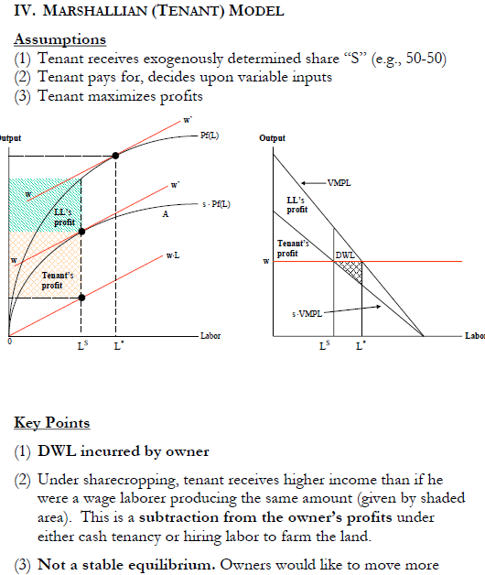

Slide 16
Farmsize – productivity relationship
Ideal productivity measure: = π/unit of economic size
Few empirical studies have come close to measuring this
Those that have indicate a significant negative relationship between farmsize and profit for all but smallest farmsize classes
Lots of empirical work shows this inverse relationship using π/acre or output/acre.
BASIC ANALYTICAL ISSUE : Large farm “assets” vs. Small farm “assets”
Large: Scale economies (lumpy assets) Access to credit Superior (?) management skills, Small: Family L quality advantage, Supervision economies No search costs for family L Better land quality (?)
POINTS
Land rental mkts can dissipate decreasing returns to scale
Empirical evidence (Binswanger & Elgin): “tenants are less efficient than owners, but not by as much as expected”
Decollectivization can have positive impact
IRS may be crop specific (e.g., sisal, sugar) and/or linked to tight processing or marketing requirements (e.g. bananas

Slide 17
The issue of response to economic incentives –prices
The issue: could we use prices and markets as a policy instrument to increase production and supply, in particular food supply ?
The assumption of perfect markets – perfect knowledge – perfect competition does not hold in most developing countries.
Is then price not the suitable policy instrument for increasing domestic supply, for production of goods for export markets, for improving nutrition
If product supply is non-price responsive, then the only policy instrument for the government is to change the technological and/or social conditions
Supply response has been an issue very early
The Nerlovian model - Nerlove (1958).
Econometric analysis using aggregate time series data & farm level data
Seminal book by Askari and Cummings (1977) Agricultural Supply Response – A Survey of Econometric Evidence
The issue can be examined at three levels: at aggregate output, at commodity level, or marketed surplus

Slide 18
Output supply and input demand : duality theory
The duality theory framework
The cost function approach
The profit function approach
Christensen – Jorgenson – Lau : The theoretical framework
Lau Yotopoulos in agriculture
Binswanger, Lopez, et al
Mergos(1991) Output supply and input demand in Greek agriculture, KEPE

Slide 19
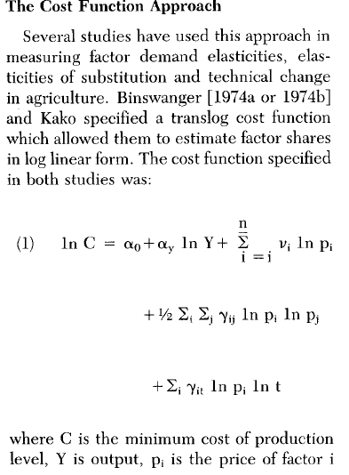
Output supply and input demand : cost function

Slide 20
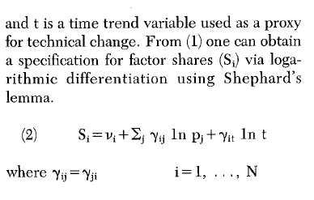
Output supply and input demand : cost function –share equations

Slide 21
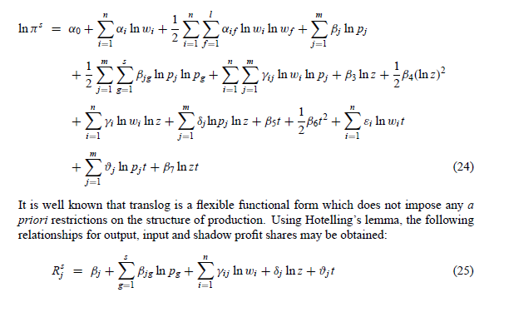
Output supply and input demand : profit function

Slide 22
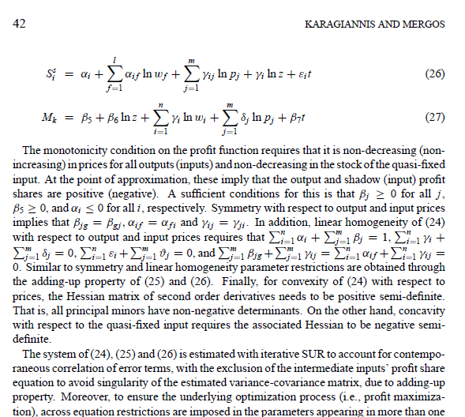
Output supply and input demand : profit function – share equations

Slide 23
The concept and characteristics of Farm Household models
Rural HHs are systematically exposed to market failures (markets do not exist or high transactions costs, constraints on quantities marketed)
Modeling rural household behavior in the context of market failures implies non-separability between production and consumption decisions.
The non-separability concept introduced first by Lau and Yotopoulos (1974) and further developed by Singh, Squire, and Strauss (1986)
A HH model is non-separable when decisions regarding production are affected by its consumer characteristics (consumption preferences, demographic composition, etc.). By contrast, in a separable model, the household behaves as a pure profit maximizing producer. The profit level achieved in turn affects consumption, but without feedback on production decisions.
Examples: transactions costs on the market for a food product, inexistence land market, imperfect labour market, inexistence of credit market

Slide 24
Implications of non-separability
Non-separability affects HH ability to respond to incentives
It explains HH beehavior that otherwise appears irrational from an economically .
Social anthropologists argue for non-economic behaviour (rituals, tradition, etc)
Construction of household models with failures on food, labor, or manufactured goods markets explain this behavior in the context of economic calculus.
Incomplete performance of markets induces behavior that seems contrary to economic logic, not a different logic specific to the peasant households
For example a farm HH producing food and cash crops, faces two market failures, one in the food market and the other in the labor market
A social athropologist would argue that the peasant household has non-economic objectives since it does not respond to a rise in the price of cash crops.
However, lack of response to prices does not come from absence of economic rationality. It is due to lack of food market so HH cannot reallocate land toward cash crops, despite an increase in income and desire to consume more food
Also, from lack of a labor market does not allow hiring workers to expand cash crop production and leisure constraint does not allow increase in own labour supply
Thus, supply response of cash crops cannot come from a decline in food production nor from an increase in family labor.
Therefore, only technological change by increasing use of purchased inputs such as fertilizers that are partial substitutes to land and labor would allow increase supply

Slide 25
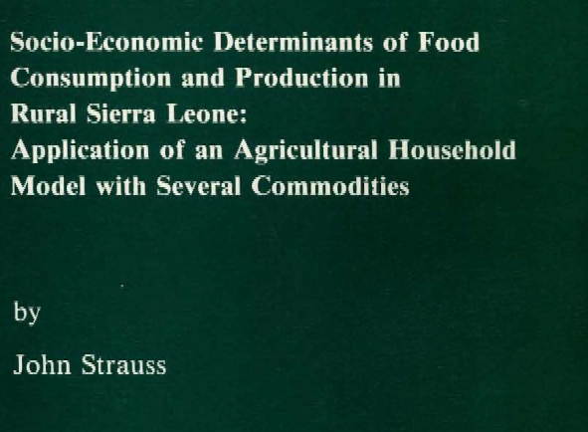
Farm Household models: the Strauss paper (1983) that led to the book Singh, Squire, and Strauss (1986) book

Slide 26
