Slide 1
AGRICULTURE IN ECONOMIC DEVELOPMENT: AN INTERNATIONAL PERSPECTIVE
WEEK 5
Land issues and land policy
1

Slide 2
Bibliography
*Ray, Debraj, Development Economics, Princeton University Press, 1998. Chapter 12 (Land).
*Binswanger, H.P., K. Deininger, and G. Feder (1995), “Power, distortions revolt and reform in agricultural land relations”, chapter 42 in J. Behrman and T.N.Srinivasan Handbook of development economics, vol. IIIB, Elsevier.
K. Deininger and G. Feder (2001). ‘Land institutions and land markets’ . Chapter 6 in HANDBKAGECON V1A.
Otsuka (2007) ‘Efficiency and equity effects of land markets’, chapter 51 in HANDBKAGECON V3
N. Singh (1989), ‘Theories of sharecropping’, chapter 3 in BARDHAN

Slide 3
Issues and questions
Emergence of land rights
Extracting tribute from peasants
Success and failure of land reform
Farm size and productivity
Land-credit links and distortions on land sales markets
Land registration and titling
Land tax
Regulations limiting land sales
Fragmentation and consolidation
Tenancy issues
3

Slide 4
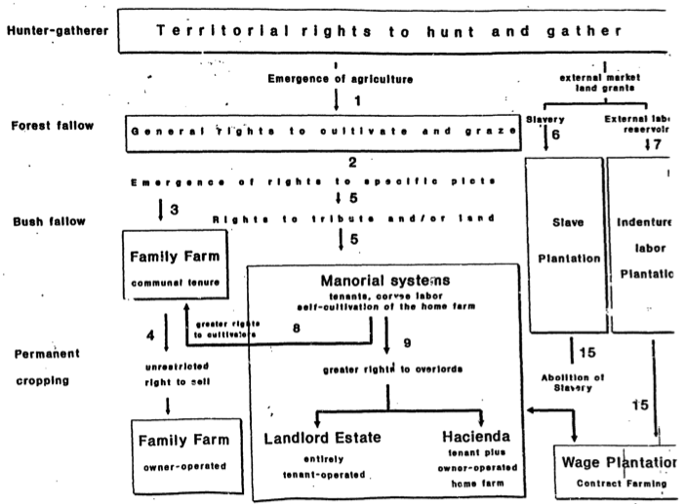
History and legacy

Slide 5
Emergence of land rights
Low population densities imply low incentives to invest in soil fertility, and ownership security not required to induce investment. Basic characteristic is that certain families have cultivation rights while other families excluded.
With rise in population density land is continually cultivated. Labor intensive methods adopted. Ownership security becomes an incentive for investments
As population density increases private rights to land emerge. Usually before private ownership cultivation rights over given area are established. Group property rights and communal land systems arise. Continual cultivation the main criterion for the land right
With increasing population density pledging of land arises (land given to others for some period and then returned, different than sales)

Slide 6
Land rights (continued)
Emergence of families with cultivation rights and those without rights (strangers, migrants, slaves, etc.)
Land lying fallow used for grazing by cultivating families.
Sales to outsiders are either forbidden or subject to approval by whoile community
Higher population density implies rights of inheritance, rights to use land as collateral, and rights of sale arise.
When right to sell includes sales to members outside community, private property rights are complete

Slide 7
Tribute and rent from peasants
Historically transformation of general cultivation rights to owner-operated family farms has involved periods when rulers extracted tribute (taxes or rent) from cultivators.
Various forms of expropriation of land by strong elites and subjecting peasants to tributes. Manorial estates.
Rights of ruling group acquired and enforced with violence, and then institutionalized into for e of state. In Europe contract between peasants and lords as protection for tribute. But asymmetry in power.
Emergence of nobility or aristocracy, follows introduction of short-fallow cultivation with animal draft power. But landlords just extract rents without outright ownership. Use rights normally stay with community

Slide 8
Evolution of agrarian relations: key points
Favorable agric. conditions generate potential for rent seeking or surplus capture by powerful.
Under simple technology no economies of scale, hence independent family farms the economically most efficient form of production.
Under low population density coercion is needed for extracting tribute. Forms include capture of high quality land, differential taxation, limits to market access. All these increase rent to large scale farmers.

Slide 9
Evolution of agrarian relations: key points (2)
When peasants can operate own farms difficult to establish large farms with hired labour (no economies of scale)
Landlords can rent out farms to sharecroppers, or rent out with fixed rents.
With increased labour supply, emergence of landlord estates with tenanted peasants, or haciendas where workers cultivate their own home-farm
Bonded labor characteristic of communities with hierarchic structures but surrounded by a lot of cultivable land. Cannot prevent farmers from setting up subsistence farms except by coercion.

Slide 10
Four forms of coercion
Slavery. In areas of sparse populations and ties to external markets. South US, Latin America, east Brazil, South Africa
Serfdom. In more populated areas, where peasants could not move except to marginal lands to escape. Arose in feudal periods in Europe China and Japan
Indentured labor contract (long term labor contracts) (guest workers?).
Debt peonage or bonded labor. In areas of labor shortage. Vagrancy laws kept workers in prison or indebted.

Slide 11
Economic distortions
When identical technology and competitive output market made cultivation of home farm with wage labor not competitive with free family farm, because of supervision costs, four ways to induce to manorial estates
Reducing land available for peasant cultivation by allocating land rights to the powerful.
Imposing differential taxation by exempting workers on manorial estates
Restricting market access, by setting up monopoly marketing schemes that could buy only from farms of rulers
Confining public goods (roads, extension, credit, etc.) to farms of rulers

Slide 12
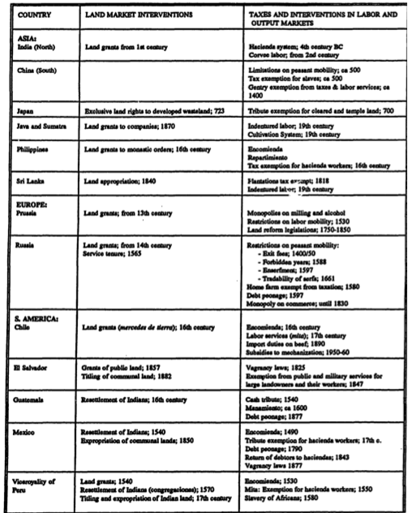

Slide 13
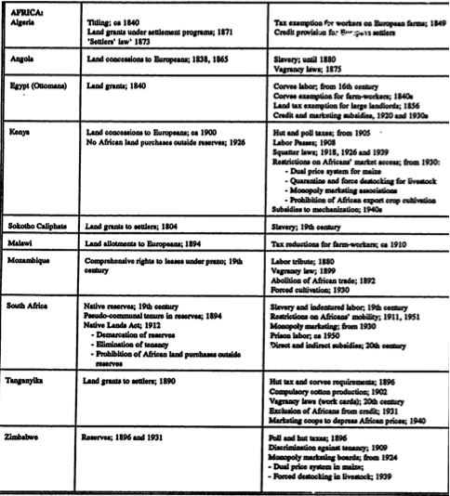

Slide 14
Distribution between landlord and peasant
Bargaining game or class struggle
Nature of voluntary exchange relationships and instrument used to enforce them
Mix of instruments for surplus extraction
Instruments share of produce retained by tenant, size of tenant plot, different types of rent instruments, input provision, etc.
Tenants must at least receive reservation utility if they are free to leave
Issues asymmetry of bargaining, competition for rents among landlords.
Major issue in land relations is evolution of relationship between peasants and landlords over time

Slide 15
Success and failure of land reform
How does manorial estate disappear?
Involves transfer of land rent from ruling class to tenant workers hence mostly by revolts (Bolivia), revolution (Mexico, Chile, China, Cuba, el Salvador, Nicaragua, Russia), conquest (Japan, Taiwan), or demise of colonial rule (Eastern India, Kenya, Vietnam, Zimbabwe). Peaceful land reform rarely transferred much of the land.
Three factors condition outcome. Previous system landlord based or hacienda based. Gradualist with compensation of all at once. Undertaken in market of socialist setting.

Slide 16
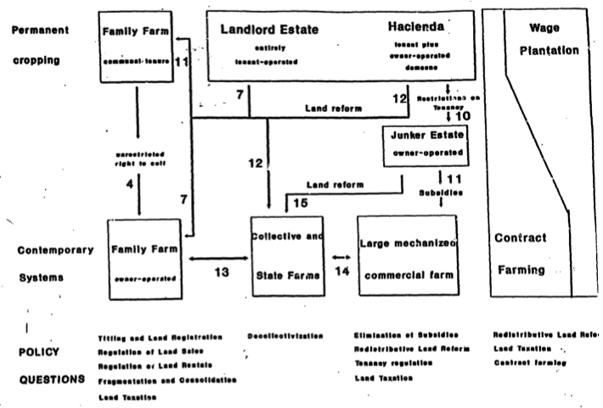

Slide 17
Reform in market based economies
Rapid transition from estates to family farms in market economy has led to stable production systems. Organization of production remains the same. Only change is ownership.
Government involvement large (Bolivia, China, Eastern India, Ethiopia, Iran, Japan, Korea, Taiwan and also Greece).
Productivity increases through work and investment incentives.

Slide 18
Reforms in hacienda systems
Slow and difficult
Emergence of large owner operated “Junker” farms. Less specialized than plantations, less capital intensive than large scale commercial farms.
Usually defensive acts to avoid land reform, but inefficient form of production hence demand for subsidies. Prussia example.
Trade controls used to favor these estates (German Zollverein at end of 19th century), Selective price supports, tariffs, etc. Chile beef, Kenya. Transformation into large scale mechanized farms through cheap credit or subsidies to mechanization.
In some cases haciendas transformed into communal family farms systems (Mexico, Bolivia), but with restrictions on transfer of land

Slide 19
Reforms in socialist economies
Various paths.
Former Soviet Union landlord estates first became family farms, then collectives
In Algeria, Chile, East Germany, Mozambique, Nicaragua, Peru, large commercial farms of Junker estates were converted into state farms. Workers continued as employees. Motivation economies of scale
Two incentive problems. Incentives to workers on basis of effort. Incentives to investment and savings.
Breakup of large state farms to small family farms has increased production (China, Vietnam). Small farms expanded labor input.
(ie maintaining hacienda systems) can be large.

Slide 20
Social cost of delayed reforms
Static efficiency losses of not utilizing fully existing resources.
Resource cost used in rent seeking to create and maintain distortions to support large farms.
Social costs (peasant uprisings, civil wars)
Brazil example of delayed reform
Recently reforms in former Soviet Union, Hungary, Czech republic
Losses from civil conflicts can be large (Zimbabwe, Guatemala, El Salvador, Colombia, Peru)

Slide 21
Analytical issues
Are Junker estaters and large mechanized farms more efficient than smaller family-operated holdings?
If large hjoldings inefficient, why do large landowners not rent to family farmers
What prevents land sales markets from bringing ownership holdings in line with optimal distribution of operational holdings?

Slide 22
Farm size and productivity
Labor major factor of production
Economies of scale arise in processing or marketing (sugar, coffee, bananas). Contract farming
Need coordination of production and marketing/processing. Family farms coexist along with plantations
Today both plantation as well as contract farming
Lumpy inputs (animals, machines, storage) imply economies of scale. Small owners can rent land to larger operators or rent services of lumpy input.
Economies of scale increase minimum farm size, but by less than expected due to rentals possibility.
Management skills are also indivisible. US farms now use specialized farm management personnel
Access to seasonal credit can condition farm size. Larger farms more credit worthy

Slide 23
Empirical specifications
P private or social profits net of private or social cost of family labor
K is assets
L is labor
OP is operated area
OW owned area
H is number of househodl workers
Z vector of exogenous variables (land quality, infrastructure, etc.)
g1<0 because of rising supervision costs
g2>0 ownership implies better access to credit
g3>0 family members have incentives to work and can supervise

Slide 24
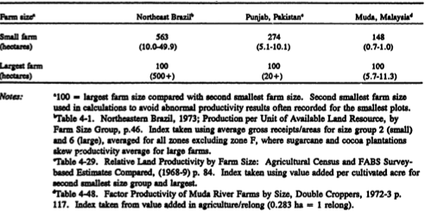

Slide 25
Empirical findings
Productivity differentials are largest when inequalities in land holdings are largest (Latin America, Africa), smallest in Asia where land holdings are more equally distributed
The highest output per unit area often achieved not in smallest farms but second smallest
Plantation crops (e.g. sugarcane in Brazil) do not exhibit negative farm size relationship
Introduction of Green revolution in India led to weakening of farm size relationship
When land quality is introduced negative farm size relationship is weakened

Slide 26
Land-credit links and distortions in land sales markets
Tenancy and land sale markets should bring distribution of operational holding close to optimum suggested by technology, factor prices, land qualities, and farming skills. Does not happen because of distortions.
Covariate risks and imperfect credit markets. Distress sales in bad years. In good years many buyers but few sellers. Lack of insurance implies worsening of land holdings distribution
When credit markets are imperfect land cannot be bought through loans, but only through savings hence thin land markets.
Distress sales major factor in inequality of land ownership

Slide 27
Policy distortions
With growing population and urbanization, land values appreciate but this can be realized only when selling land.
In periods of macro instability such as inflation land used as hedge hence land prices also reflect inflation premium.
Credit subsidies are capitalized into land values
Production subsidies are capitalized in land values (EU CAP)
If above imply higher values of agric land than under undistorted conditions, poor have difficulty buying land.
If small farms have productivity advantage, then large landowners should rent. What form should rental contracts take

Slide 28
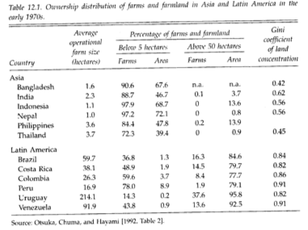
Ownership and tenancy

Slide 29
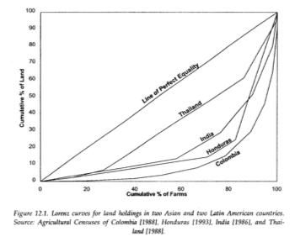

Slide 30
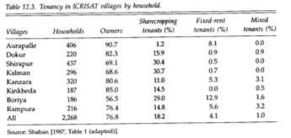

Slide 31
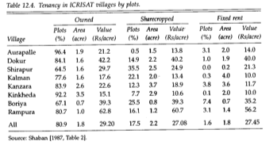

Slide 32
Can land rental markets increase efficiency
Is share tenancy inefficient?
Under certainty form of rental does not matter
Under uncertainty it does
Choice of contract a bargaining problem
Important is to consider incentives

Slide 33
Land policy
Land registration and titling reduces uncertainty of sales transactions. Important for sales to members not in community
Public registers functioning legal system, effective enforcement reduce uncertainty.
Land registration reduces asymmetric information and risk, and enhances credit markets (can use land as collateral).
Land registration may alienate traditional land users.
High transactions cost, favor land concentration
Titling program must be accompanied by publicity campaigns. Conflicts better resolved administratively rather than through litigation
Titling expensive.
Privatizing community lands or resources can be productivity enhancing but distributionally inefficient

Slide 34
Land taxation
In most countries evolved from tribute systems to landlords or colonizing power. Needs strong enforcement through tax collectors
In theory land tax has advantages compared to production tax. 1. If based on potential potential monetary yield then little inefficiency; 2. Facilitates taxation of agricultural sector; 3. If it is not changed frequently does not discourage investment in land improvements
To administer efficiently needs cadastre (official record). High administrative cost
In the US land taxes assigned to local administrations and revenues for local development.

Slide 35
Other issues
Regulations limiting land sales (designed to prevent landlessness). Can reduce access to credit. Used in early years of land reforms. Can prevent large ownerships, but can lead to excessive fragmentation.
Fragmentation and consolidation. Explained by inheritance laws. Can prevent mechanization. Consolidation involves high transactions cost.
Restrictions on land rentals. Rent controls.Bans on share tenancy and ceilings on l;andlord’s shares. Adopted to decrease exploitation but adverse on efficiency

Slide 36
Other issues (2)
Redistributive land reform, towards eficiency and equity improvements. Can be slow and inefficient.
Decollectivization. In CIS and Eastern Europe. Many equity and efficiency issues

