Slide 1
World Trade Organization, Agriculture and the Developing Countries. Part I
Alexander Sarris
February 2014

Slide 2
Part I
History of agriculture in the WTO
The Uruguay Round (UR) agreement
What did the Uruguay Round accomplish
Developments since the UR
The Doha Round
The current state of negotiations

Slide 3
General principles of WTO
Non-discrimination (fairness, efficiency)
Reciprocity (responsibility)
Credible dispute settlement (legitimacy)
Transparency
Safeguards when commitments are too burdensome
Tariffication
Decision making by consensus (legitimacy)
Reliance on members rather than secretariat for operations

Slide 4
Importance of GATT/WTO for developing countries
International legitimacy and recognition
Provides commitment mechanism against domestic pressures
Increases bargaining power versus developed countries
Participation in international “Rules of the Game”
Problems GATT/WTO creates for developing countries
Must participate fully or not at all (take it or leave it)
Most GATT/WTO rules made before many developing countries acceded hence no sense of ownership or GATT/WTO rules
Cost of implementation and participation high
Lack of analytical capacity to evaluate options and implications of commitments

Slide 5
Not all developing countries are WTO members
Developing Country Groupings and WTO membership
  DC – Developing Countries
  LIFDC – Low Income, Food Deficit Countries
  LDC – Least Developed Countries
  SIDS – Small Island Developing States
  LLDC – Land-Locked Developing Countries
  NFIDC – Net Food-Importing Developing Countries

Slide 6
Agriculture in the GATT before the UR
the first four Rounds simply ignored agriculture…
Dillon Round (1960-1962)
Kennedy Round (1963-1967)
Tokyo Round (1973-1979)
modest concessions in agriculture
…agriculture “left out” from GATT
WHY?

Slide 7
Agriculture different than other sectors
Declining terms of trade
Market instability
Adjustment in course of development
From taxation to support

Slide 8
Real agricultural commodity prices have declined in past 40 years. Less so in the 1990s

Slide 9
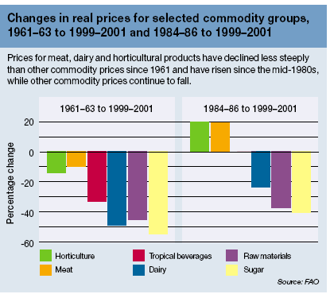
Changes in real prices by commodity group

Slide 10
Real prices of bulk food commodities have tended to decrease but since mid 1980s tendency seems to have stopped

Slide 11
Real prices of vegetable oils have tended to decrease but since mid 1980s tendency seems to have stopped

Slide 12
Real prices of livestock commodities have tended to decrease albeit at slowing pace since mid 1980s

Slide 13
Real prices of sugar and beverages have tended to decrease but since mid 1980s tendency seems to have stopped

Slide 14
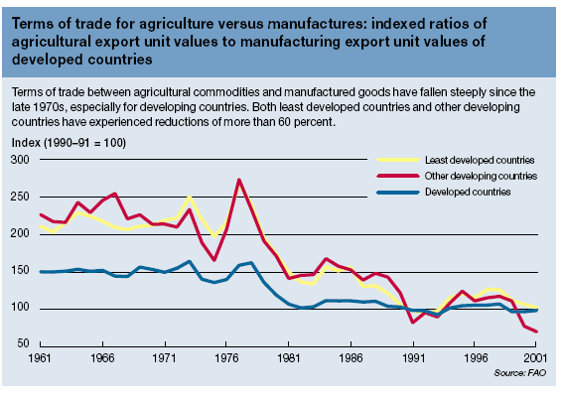
Agricultural terms of trade

Slide 15
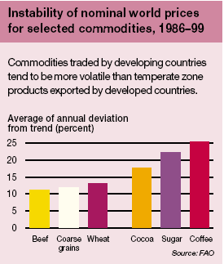
Market Instability

Slide 16
Historic volatilities of international prices seem to increase with price spikes for grains

Slide 17
Historic volatilities of international prices seem to increase with price spikes for rice and soybeans

Slide 18
Historic volatilities of international prices seem not to follow price trends for meats

Slide 19
Historic volatilities of international prices seem to increase with price spikes for tropical beverages and sugar

Slide 20
Historic volatilities of spot prices in organized markets (CBOT) seem to be increasing over time

Slide 21
How have agricultural policies in developed countries evolved?
In US low prices in the 1920s and 1930s led to market support policies
When secular terms of trade kept declining, nominal prices did not follow
In EU post world-war II CAP motivated by desire for European food security (!!!) interpreted as food self sufficiency
CAP designed to ensure food self sufficiency, community preference, and support for small rural producers
In Japan major issue to support rural small producers
In Australia, Canada issue to ensure international competitiveness

Slide 22
The Uruguay Round
Uruguay Round (1986-1994)
agriculture on the center stage of the negotiations
20 September 1986
the declaration of Punta del Este (Uruguay)
agreement to negotiate in order to achieve greater liberalization of trade in agriculture by bringing both border and domestic policies under strengthened GATT rules and disciplines
The Round expected to be concluded by 31 December 1990 (to last 4 years)

Slide 23
the negotiations on agriculture in the Uruguay Round
the lights/boxes approach to policy classification…
the red box contains policy instruments which cannot be used
the green box contains policy instruments which do not distort trade, or have minimal trade distorting effects, and will not be subject to reduction commitments
the amber box contains policy instruments which distort trade and will be subject to reduction commitments

Slide 24
the negotiations on agriculture in the Uruguay Round
October 1990
US “final” proposal
- export subsidies to be reduced by 90% over 10 years
- non-tariff barriers converted in tariffs and all tariffs
to be reduced by 75% over 10 years
- domestic support in the amber box to be reduced, on a
product by product basis, by 75% over 10 years
November 1990
EC “final” proposal
aggregate domestic support in the amber box to be
reduced by 30%
- no specific commitment on export subsidies
- relatively vague proposal on market access

Slide 25
the negotiations on agriculture in the Uruguay Round
(May 1992)
MacSharry reform of the EC Cap
reduction in (coupled) market price support
introduction of “partially decoupled” direct payments
the reform makes it possible for the EC to accept some of the requests made at the negotiations table…

Slide 26
the negotiations on agriculture in the Uruguay Round
20 November 1992
the “Blair house” agreement
bilateral (!) US-EC agreement
turning point for the negotiation on agriculture
a “final draft” (amending the “Dunkel text”):
• EC “partially decoupled” direct payments and US
deficiency payments not to be subject to reduction
commitments (the “blue box”)
• reduction in trade distorting domestic support based on
an aggregate measure (…not product by product)
• export subsidies to be reduced by 21% (instead of 24%)
• peace clause (truce clause?)

Slide 27
the negotiations on agriculture in the Uruguay Round
15 December 1993
the agreement is reached!
…the modalities, then the schedules
15 April 1994
the UR Agreement is signed in Marrakech
the “Agreement on agriculture” is one of the fifteen agreements
[the Sanitary and Phyto-Sanitary (SPS) agreement]
[a new dispute settlement procedure
(from consensus to a “judicial system”)]

Slide 28
the Agreement on agriculture
3 main areas of commitments
• domestic support
• market access
• export competition
six year implementation period (1995-2001)

Slide 29
What the UR achieved in agriculture
a rules-based system that largely reduces arbitrary actions:
NTBs tariffied and reduced + minimum access to ensure trade takes place
commitment to reduce some types of distortive dom. support
commitment to reduce exp subsidies
recognised need for SDT for dev’g countries (time, size of cuts, special exemptions, trade-related TA, etc.)
also, new disciplines under SPS Agr, to minimize discriminatory trade effects of SPS
Overall, a major accomplishment, considering where we were!

Slide 30
What UR did not achieve in agriculture
brought agriculture formally into the WTO but also “legitimatised” remaining distortions
  Members that established the right to certain distorting policies were essentially protected by the system against challenges
very high tariffs, Tariff peaks & Tariff Escalation remain
large trade distorting support (AMS) and vague disciplines on what constitutes non-trade distorting support (Green Box)
large exp subsidies and other means of subsidization
effectively, very little additional market access
plenty of room for circumventing commitments in all areas
highly uneven playing field between those that had the right & the means to take advantage of flexibility and those that did not have either

Slide 31
Differing perceptions of the UR outcome
not accidental that agr was outside the GATT for 40 yrs and that UR took 7.5 yrs to be negotiated.
several countries consider agr not just another sector of the economy. Others wish to see agr fully integrated into the MTS
the first, those protecting agr (mostly dev’d ) consider that bringing agr into the MTS was a major concession for them
not prepared to move quickly on further reform
the second, with competitive agr (both dev’d and dev’g) consider that AoA achieved little real reform
overall message here is that perceptions about agr liberalization and the UR outcome were, and continue to be, wide apart

Slide 32
Implementation of the UR
Not much real reduction in support in developed countries
Income terms of trade have evolved differently for developed and developing countries

Slide 33
the implementation
domestic support commitments
…have not been a problem for hardly any country
1. because of the much lower price support with respect to 1986-88
2. because of the “blue box”

Slide 34
Farm Support in OECD Countries
(US$ 280 billion in 2004)
Japan
EU
OECD
USA

Slide 35
Producer Price Protection
Japan
EU
OECD
USA

Slide 36
EU has kept commitments but not much reduction in domestic support

Slide 37
US has also met its commitments, while increasing total domestic support

Slide 38
market access commitments
“tariffication” of many non-tariff barriers
36% (unweighted average) tariff reduction in six years

Slide 39
the implementation
market access commitments
resulted in a limited reduction of border protection…
1. because of the “market reorientation” of prices in many countries (“water” in the tariffs…)
2. because of the “dirty” tariffication
… but most TRQs have been effective,
although issues related with the
implementation mechanisms

Slide 40
Average-cut routine
 | Tariff 1 | Tariff 2
 | % | %
Initial | 1 | 1400
Final | 0 | 1400
Cut | 100 | 0

Slide 41
Average-cut routine (2)
Countries with highly variable tariffs have important peaks
These can be cut by minimal levels, leaving much of the protective effect, and the variance of tariffs– variance may even be increased
Countries with uniform bindings must bring about a cut in average tariffs

Slide 42
Features of tariff distributions

Slide 43
Developing countries made considerable concessions in the Uruguay Round
Uruguay Round Tariff Concessions Given and Received
 | Bindings (percentage of 1989 imports) |  | Tariff reductions
 | Pre-UR | Post-UR | % of imports | Depth of cut (dT/(1+T)
Tariff concessions given-All merchandise
Developed Economies | 80 | 89 | 30 | 1.0
Developing Economies | 30 | 81 | 29 | 2.3
Tariff concessions received-All Merchandise
Developed Economies | 77 | 91 | 36 | 1.4
Developing Economies | 64 | 78 | 28 | 1.0
Source: Finger and Schuknecht (1999)
Developing country cuts covered the same percentage of imports as developed ones
Developing country tariff cuts were deeper
Concessions received by developing countries were smaller

Slide 44
Agricultural Products: Uruguay Round Tariff Bindings
 | Percent of imports GATT-bound |  | Post –UR bindings that reduce protection
 | Pre-UR | Post-UR
Tariffied and untariffied products
Developed Economies | 72 | 100 | 26
Developing Economies | 37 | 100 | 17
Source: Finger Ingco and Reincke (1996)

Slide 45
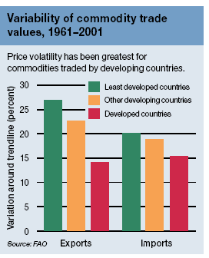
Agricultural trade price volatility

Slide 46
World production shares 1980-2002
 |  | 1980 | 1990 | 2002
Cereals | Developed Countries | 0.51 | 0.46 | 0.42
 | Least Developed Countrs | 0.05 | 0.05 | 0.06
 | (Dev -LDC) | 0.44 | 0.49 | 0.52
Meat, total | Developed Countries | 0.66 | 0.58 | 0.43
 | Least Developed Countrs | 0.03 | 0.03 | 0.03
 | (Dev -LDC) | 0.32 | 0.40 | 0.54
Milk, total | Developed Countries | 0.76 | 0.70 | 0.59
 | Least Developed Countrs | 0.03 | 0.03 | 0.03
 | (Dev -LDC) | 0.22 | 0.27 | 0.38
Oilcrops, primary | Developed Countries | 0.42 | 0.35 | 0.29
 | Least Developed Countrs | 0.05 | 0.04 | 0.03
 | (Dev -LDC) | 0.52 | 0.61 | 0.68
Sugar (centrif) | Developed Countries | 0.45 | 0.40 | 0.29
 | Least Developed Countrs | 0.02 | 0.02 | 0.02
 | (Dev -LDC) | 0.54 | 0.58 | 0.69

Slide 47
World production shares 1980-2002 (cont’d)
 |  | 1980 | 1990 | 2002
Citrus fruit, total | Developed Countries | 0.46 | 0.32 | 0.28
 | Least Developed Countrs | 0.02 | 0.02 | 0.02
 | (Dev -LDC) | 0.53 | 0.67 | 0.70
Bananas | Developed Countries | 0.02 | 0.02 | 0.02
 | Least Developed Countrs | 0.12 | 0.11 | 0.08
 | (Dev -LDC) | 0.86 | 0.87 | 0.90
Tropical beverages | Developed Countries | 0.03 | 0.02 | 0.01
 | Least Developed Countrs | 0.10 | 0.09 | 0.07
 | (Dev -LDC) | 0.87 | 0.89 | 0.92
Fibre crops | Developed | 0.34 | 0.30 | 0.28
 | LDC | 0.09 | 0.07 | 0.08
 | Developing except LDC | 0.57 | 0.63 | 0.64

Slide 48
World export shares 1980-2002
 |  | 1980 | 1990 | 2002
Cereals | Developed Countries | 0.87 | 0.86 | 0.77
 | Least Developed Countrs | 0.00 | 0.00 | 0.00
 | Developing except LDCs | 0.12 | 0.13 | 0.23
Meat, total | Developed Countries | 0.83 | 0.82 | 0.77
 | Least Developed Countrs | 0.00 | 0.00 | 0.00
 | Developing except LDCs | 0.17 | 0.18 | 0.23
Milk, total | Developed Countries | 0.98 | 0.97 | 0.93
 | Least Developed Countrs | 0.00 | 0.00 | 0.00
 | Developing except LDCs | 0.02 | 0.03 | 0.07
Oilcrops, primary | Developed Countries | 0.75 | 0.57 | 0.52
 | Least Developed Countrs | 0.01 | 0.01 | 0.01
 | Developing except LDCs | 0.23 | 0.42 | 0.47
Sugar (centrif) | Developed Countries | 0.35 | 0.41 | 0.35
 | Least Developed Countrs | 0.01 | 0.01 | 0.01
 | Developing except LDCs | 0.64 | 0.58 | 0.64

Slide 49
World export shares 1980-2002 (cont’d)
 |  | 1980 | 1990 | 2002
Citrus fruit, total | Developed Countries | 0.67 | 0.66 | 0.68
 | Least Developed Countrs | 0.00 | 0.00 | 0.00
 | Developing except LDCs | 0.33 | 0.33 | 0.31
Bananas | Developed Countries | 0.04 | 0.04 | 0.15
 | Least Developed Countrs | 0.01 | 0.01 | 0.00
 | Developing except LDCs | 0.95 | 0.95 | 0.85
Tropical beverages | Developed Countries | 0.05 | 0.04 | 0.08
 | Least Developed Countrs | 0.13 | 0.09 | 0.06
 | Developing except LDCs | 0.83 | 0.86 | 0.86
Fibre crops | Developed Countries | 0.50 | 0.49 | 0.68
 | Least Developed Countrs | 0.16 | 0.15 | 0.14
 | Developing except LDCs | 0.34 | 0.37 | 0.18

Slide 50
from Marrakech to Doha
art. 20 of the 1994 UR Agreement on Agriculture: commitment to start a new negotiation on agriculture by the end of 1999
Seattle (Nov 30 - Dec 3, 1999) Failure!
early in 2000 only negotiations on “agriculture” and “services” started, but nothing really happened until the Ministerial in Doha (November 2001)
Notes:
Seattle, III WTO Ministerial Conference, meant to launch the new round…
Agriculture was not the reason for the failure

Slide 51
Doha (November 2001)
Agreement to start a new round!
…but with a very limited agenda
agriculture
services
non-agricultural products market access
trade-related aspects of intellectual property rights (TRIPS)
notification and registration of geographical indications for wines and
spirits
Notes:
The climate: September 11 only few weeks behind… nobody could afford a failure!
The round was supposed to end 1 January 2005.
The negotiations start, slowly

Slide 52
Doha: raised the level of ambition
provided more ammunition to all sides by introducing:
more ambition on what the reform should be
  substantial improvements in market access
  reduction (phasing out) all forms of export subsidies
  substantial reductions in trade-distorting domestic support
also, more ambition on SDT, i.e. “integral part of all elements of the negotiations …, so as to be operationally effective”
similarly, on non-trade concerns
de-linked agr from its in-built mandate and made it part of the “single undertaking”
possibilities for trade-offs yes, but agr. also subject to other pressures (i.e.new issues)
established tight deadlines: essentially fast track

Slide 53
Cancun (September 2003)
Failure!
“failures” are not uncommon in multilateral negotiations (Bruxelles in the UR; Seattle) and are not “the end of the world”; on the contrary, they are part of the process
the failure occurred on the “Singapore issues”, but agriculture could have very likely been “the” reason for the failure
Notes:
Negotiations did not get to the point to find out if a way out for agriculture existed or not…

Slide 54
Cancun (September 2003)
the failure in Cancun, however, was different from the previous ones:
this time the main conflict was between developed and developing countries (with some free riding..)
for the first time developing countries were real players and proved their concerns have to be taken into consideration for an agreement to be reached!
Notes:
For several months nothing happens…
In May the EU made known that it was ready to negotiate a date for the ending of export subsidies…

Slide 55
the August 2004 agreement (Geneva)
the most important achievement was that
an agreement was reached, by itself
it gave a strong political signal, confirming a consensus on the “legitimation” of the WTO and allowing the round to restart
the agreement reached is much less ambitious with respect to the one which was attempted in Cancun, where the proposals tabled were defining in details the structure of the commitments (leaving out only the numbers defining the amount of the reductions…)
Notes:
Geneva, General Council

Slide 56
the August 2004 agreement
market access
tariffs will be reduced using a “tiered formula”
deeper cuts in higher tariffs
cuts are to be applied to bound rates
each developed country member will designate an appropriate number (to be negotiated) of “sensitive products” (lower than otherwise tariff reductions will apply, but TRQ will be expanded)
“tariff escalation” will be addressed
“preference erosion” will be addressed
Notes:
..tariffs will be grouped based on their value and those contained in tiers with higher tariffs will be subject to higher reductions

Slide 57
Main groups in the WTO negotiations
The Cairns Group (comprising both developed and developing countries) backs substantial reform in all areas, including export subsidies, tariffs, and trade and production distorting domestic support.
The US position is similar to the Cairns in terms of the degree of reform stipulated on tariff cuts and reduction of export subsidies. It also supports opening up trade to Genetically Modified (GM) products. However, the US is less forthcoming on other forms of export competition (export credits and food aid) as well as on domestic support.
The "non-trade concern Group" (European Union, Japan, Korea, Switzerland, Norway, etc.), assigns great importance to non-trade issues such as environmental protection, animal welfare, preservation of rural communities and agricultural landscape, Broadly, their interest is in maintaining the level of protection and support to their agricultural sectors.
Developing countries

Slide 58
Developing countries in the WTO negotiations
Developing countries comprise a rather heterogeneous group and consequently their positions in the negotiations are not uniform.
First, there are the net agricultural exporters and some of them have aligned with the Cairns Group of countries;
Second, there are the net-food importers concerned about the implications of the reform process on the cost of food imports as well as on the possibilities for reducing dependence on the world market by increasing domestic food production.
Third, there are large agrarian economies largely self-sufficient, being concerned about maintaining the livelihoods of rural communities and safeguarding food security (some of them have proposed the creation of a "Development Box" to achieve this objectives);
The small agricultural economies dependent on a few agricultural crops for employment and export earnings, are concerned with erosion of preferences as a result of trade liberalization.
The G-20 is a coalition of developing countries, formed to address the concerns of its members that are also common to most developing countries relating to:
  the elimination of practices that distort agricultural trade and production;
  the search for substantial improvement in market access; and
  the rural development, food security and/or livelihood security needs.

Slide 59
Brief overview of the current status of the WTO negotiations

Slide 60
“Roadmap” for the agriculture negotiations
July 2004 Framework Agreement
  Significant achievement, although many issue remained unresolved
6th Ministerial Meeting – Hong Kong 2005
  Some further limited agreements e.g. ES elimination by 2013
  New deadlines (bound in part by US fast track)
Chairman’s questions (9 February 2006)
30 April 2006 deadline for modalities missed
Six weeks of intensive negotiations
  First week May until early June
Negotiations towards the Chair’s new draft
  Week of 29 May DS; Week of 5 June MA; Week of 12 June EC
(Mini?) Ministerial to agree modalities - end June 2006
Not just agriculture....... (Lamy triangle of issues)

Slide 61
Chair’s reference papers
Domestic support
  Blue Box
  Green Box
  Amber Box
  Overall trade distorting domestic support
Export competition
  Food aid
  Exporting STE
  Export credits
Market access
  SSM
  Special Products
  Sensitive Products
  Long standing preferences
  Tropical products

Slide 62
Comments on Domestic Support
Blue Box
  Constraints on the blue box new category
    Originally production limiting - extended to those not requiring production, but base must be fixed
    Could eliminate re-basing, but direct payments could still be linked to market conditions e.g. low prices
    Should the latter be constrained? Problem that it would exclude programmes which it was enlarged for
    Better to reduce size (5% to 2.5%)
    and/or have product specific caps
      Possibility of double trigger discussed (max share of total blue box and max proportion of product VOP)
  Extended transition period for current significant Blue Box users

Slide 63
Comments on Domestic Support
Green Box
  Ensuring inclusion of developing country policies that are not trade distorting
    Income insurance and compensation for natural disasters shouldn’t need threshold trigger
  Ensuring that Green Box measures are not, or at most minimally trade distorting (G-20 vs EU)
    ? Review following completion of round – need to agree this process
  Possibility of re-basing for “new” subsidy programmes

Slide 64
OTDS and TAMS
Overall trade distorting domestic support
  TAMS + de minimis + blue box
    3 bands EU 70 – 80% cut; US/Japan 53-75%; Other 31-70%
  Cut off points at US$10 and US$60 billion?
Amber Box
  TAMS
    3 bands EU 70 – 83% cut; US/Japan 60-70%; Other 37-60%
    Cut offs points at $US12 and $US20 billion?
  de minimis
    Currently 5% for PS and NPS production values in Dd countries
    Reductions of 50% and 80% have been proposed
    Cut of at least 50% needed to be in line with OTDS cut

Slide 65
Sum of components vs overall commitments
Relationship between TAMS and OTDS is critical – cuts need to be at least as great as in OTDS
  Because of Blue box option, deep cuts in TAMS and de minimis are needed to ensure that commitments result in effective reduction in support
  Developing countries with no bound AMS will be exempt from reductions in OTDS and de minimis
  Choice of base year is important – countries have preference to use years when support was high:
    EU 1995-96, US 1999-01

Slide 66
Comments on Export competition
Parallel elimination of all form of export subsidies and disciplines on all export measures with equivalent effect to be completed by end of 2013.....with substantial part be end of first half of implementation period
Exporting STEs
Export credits
Food aid

Slide 67
Exporting STEs
  Elimination of ES, govt financing and underwriting
  July F/W – govt financial support for STEs to be phased out
  No agreement on monopoly power, but greater constraints foreseen
    “Trade policy review” to ensure that exporting STE with monopoly powers subject to periodic reviews (B&J) rather than phasing out
    Special consideration for maintaining monopoly status for developing countries where use for domestic price stability or FS purposes
Export credits
  Programmes less than 180 days need to be self financing and market oriented
  Need to agree on forms of export financing support and entities providing the support
  Disciplines - each element or just core disciplines (maximum repayment, premiums, self financing period)
  SDT and Protection of LDCs and NFIDCs

Slide 68
Food aid
Should conform to following conditions
  Needs driven and results in additional consumption
  Provided in [fully] grant form
  Not tied to commercial exports
  Not linked to market development objectives of donor
  Not re-exported
Identification of emergency situation to allow safe box for bona fide food aid
  Who can trigger – multilateral trigger (agencies incl collaborating NGOs) rather than formal definition
  Include cash based aid
  in-kind food aid should not be precluded but needs notification from donor and recipient in exceptional circumstances

Slide 69
Food aid (cont)
Non emergency food aid
  In addition to above:
    based on assessment of needs
    targeted to individual groups
    provided to address specific development/nutrition objectives
Disciplines
    Safe box – none or basic conditions to account for needs driven and not re-exported?
    On non-emergency have lack of consensus
      in-kind and/or monetization of in-kind subject to disciplines or phased out;
      Re-export prohibited except emergency
    Need to focus on ES component

Slide 70
Comments on Market Access
SSM
  Constraints - limit number of products, or satisfy trigger conditions?
  Triggers:
    quantity - reference period and which imports (MFN vs all)
    price - reference period CIF price and which imports (MFN vs all)
  Remedies – size and duration?
Special Products
  Selection – paper put focus on trade related concerns and number of lines not indicators of FS, LH, RD
  Similar emphasis in proposals from Thailand, Malaysia (and US)
  Problem if selection left to post-modalities phase?
  Treatment (unlikely to have full exemption)
Sensitive Products
  Selection
    Proposals for 1 – 15% - both ends unrealistic, need to focus on treatment
  Treatment
    Deviation from normal cut
    Tariff quota expansion
  SDT

Slide 71
Long standing preferences
  Preference erosion inevitable
    Small number of products in small number of countries
  Focus on adjustment problems and ways of addressing
    Phase in
    Expanded MA
    Lower cuts on preferential products
    Designation as sensitive
    Assistance
  LDC duty free, quota free
Tropical products
  Product coverage
  Treatment
    Fullest liberalisation, but full not realistic (e.g. sugar)
Small Vulnerable Economies

Slide 72
NB - No reference paper on tariff cutting........
  4 tiers, progressive; linear; different rates for Developed vs Developing countries
  Chairman’s questions related to thresholds, cuts in bands; tariff cap .......
Other issues from Chairman’s questions:
  in-quota tariffs,
  tariff escalation,
  tariff simplification;
  future of SSG

Slide 73
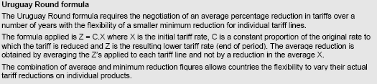
Approaches to tariff cutting

Slide 74
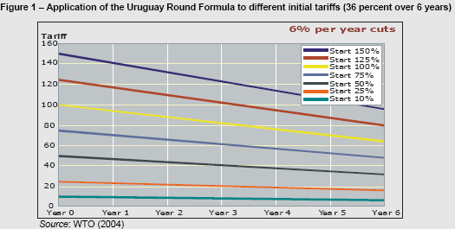
Application of the UR formula

Slide 75

The Swiss formula

Slide 76
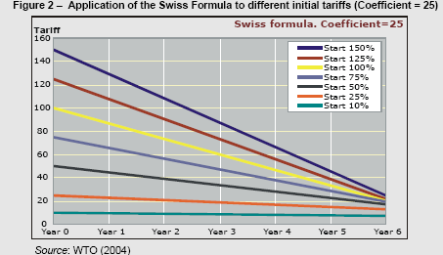
Application of the Swiss formula

Slide 77
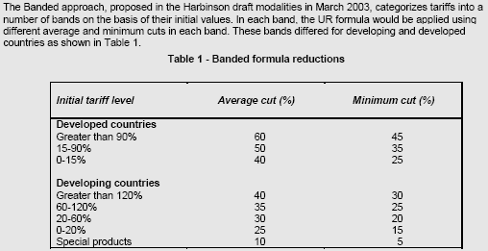
Banded approach

Slide 78

Blended approach

Slide 79

Tiered approach

Slide 80
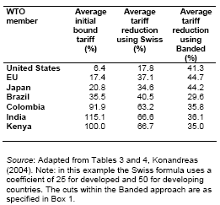

Slide 81
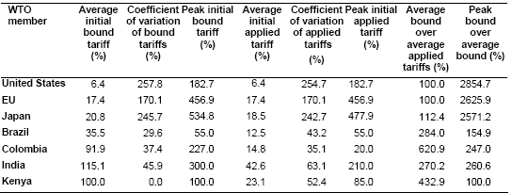

Slide 82
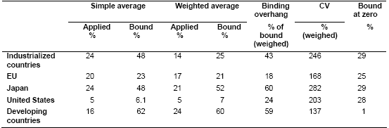

Slide 83
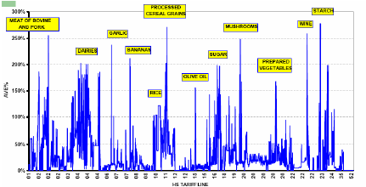

Slide 84
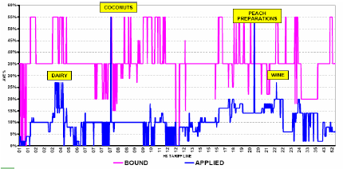

Slide 85
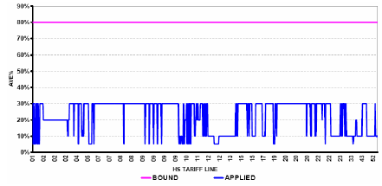

Slide 86

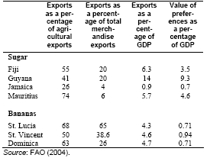

Slide 87
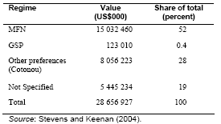

Slide 88
