Slide 1
Agricultural Markets Globalization, and Agricultural Development.
Alexander Sarris
January 2015

Slide 2
Agricultural Markets and Agricultural Trade (AS)
The basic agricultural trade partial equilibrium model
Measures of agricultural policy interventions
Evolution of support in agriculture
World trends and prospects for agricultural trade
Differential performance of developed and developing countries in international markets
Current pattern of protection in agricultural products
Vulnerability of commodity dependent developing countries to trade shocks
Developments in DC and LDC trade related agricultural indicators
Making sense of the declining terms of trade for agricultural commodities
Structural changes in global agricultural markets
Evolution of agricultural trade negotiations
The World Bank “Distortions” study
Speculation and price transmission
Agricultural risk management

Slide 3
Why is a section on Agriculture trade part of this course?
Agriculture is one of the main “sticking points” in the current WTO trade negotiations (the “Doha Round”), and it was important to the formation of the WTO.
Agriculture is important for the EU and all other countries
Policies, particularly those in developed countries, strongly influence agricultural sectors in those countries, and (via international markets) also influence agriculture in developing countries.

Slide 4
Background of Uruguay Round Agriculture Agreement (URAA)
Uruguay Round Agreement on Agriculture sought to bring Ag into GATT. (History, ag exemption, examples of accidental developments, e.g. Europeans had low import restrictions on soybeans when soybeans were not an important crop in the 60s and 70s. Imports increased drastically and Europe sought to impose restrictions, which were resisted by the US)
Trade restrictions cause welfare losses; countries gain by reducing their trade restrictions even if partners maintain their restrictions. Ag policies inflict costs on domestic economies and also on trade partners.
A given level of producer support is more costly to achieve with tariff than with producer subsidy. Production and consumption distortions.
Trade and domestic policies are linked; for example, maintaining a producer price higher than world price requires import barriers or export subsidies, or for govt to hold large stocks. (History of EU's lakes and mountains.)

Slide 5
Background, continued
Trade restrictions may be a cheap way -- in terms of government revenue, not of social welfare -- to provide producer protection. Reduction of trade restrictions increases the fiscal costs of protecting producers. Therefore, a reduction of trade restrictions may put downward pressure on domestic (non-trade) policies.
If an importing country imposes a production subsidy, without a trade restriction, the government has to either buy surplus or make “deficiency payments” – the subsidy.
Payments under farm programs are capitalized into land value. This means that the farmer who is receiving current government payments may already have "paid" for them in paying a higher price for land.

Slide 6
Suppose that the world price is pw. Under free trade, country shown in this diagram is an importer. Government wants to support producers by increasing producer price to p* > pw. (i) Show that tariff and import quota (where quota licenses are auctioned) are “equivalent”. (ii) Show that under either policy, deadweight loss is b+d. (iii) Show that if govt switches from tariff to a producer subsidy, producer price remains at p* and consumer price falls to pw. Consumers gain a+b+c+d and taxpayers lose a+b+c. The net gain is d, the amount by which deadweight loss falls. Producer subsidy is more efficient than trade policy (tariff or quota) but producer subsidy requires higher govt expenditures
P*
a
c
b
d
pw

Slide 7
Basic agricultural trade model
Gains from trade
Comparative advantage
Small country case effects of tariffs and quotas
Large country case effects of tariffs and quotas
Effects of producer subsidies and export subsidies
Effects of tariffs in general equilibrium
Trade policy

Slide 8
Measures of agricultural policy interventions
Nominal protection coefficient (NPC)
NPC=
Where Pd is domestic price, Pb is border price
Nominal rate of protection is NPC-1
Effective protection coefficient
NEPC=
Effective protection rate=NEPC-1

Slide 9
Measures of agricultural policy interventions (2)
Distortion =gap between marginal social cost to seller and the marginal social cost to buyer. In absence of externalities this is the gap between the price paid and the price received irrespective of whether the level of these prices is affected by distortions
Total effect of distortions will depend not only on the size of direct agricultural policy measures but also on policy measure altering incentives in non-agricultural sectors. It is relative prices and hence relative rates of assistance that affect producer incentives

Slide 10
Direct agricultural distortions
In small open perfectly competitive economy with many firms producing a homogeneous farm product, in the absence of externalities, processing and marketing margins, exchange rate distortions, and domestic and international trading costs, maximum welfare is achieved when domestic farm product price and consumer price is equal to E*P where E is the domestic currency value of foreign exchange and P is the foreign currency price of the product in the international market.

Slide 11
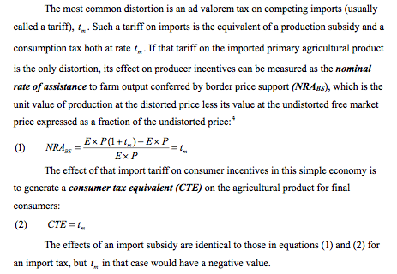
Trade measures at national border

Slide 12
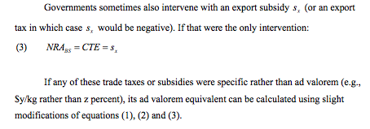
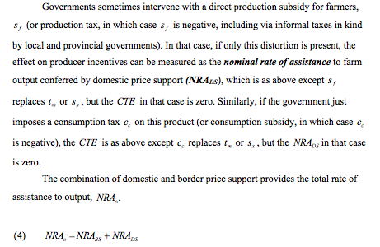
Trade measures at national border (2)

Slide 13
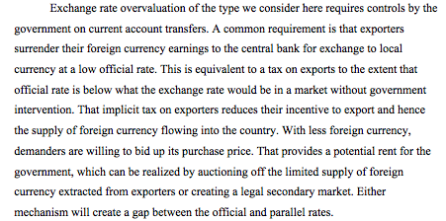
Exchange rate distortions (overvaluation or undervaluation)
Figure 1 supply and demand of foreign exchange. If exchange rate to exporters is E0, while for importers is Em, then the price of importables is raised by Em-E=em*E, while the price of exportables is lowered by E-E0 =ex*E. If Em is much different than E0 then a black market in foreign exchange may emerge. So exchange rate to use in the calculations of the NRA is Em if the product is importable or E0 if the product is exportable.
If taxes or subsidies are applied to intermediate products then they must be considered in computing an effective rate of assistance

Slide 14
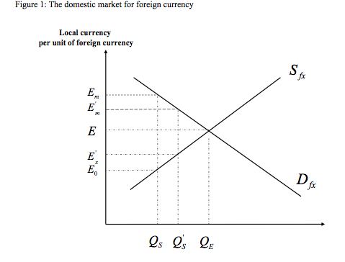

Slide 15
Almost all basic food commodities have seen their international prices rise significantly over the past few years
(Commodity price indices: 1998-2000=100)

Slide 16
But prices for tropical export crops have lagged behind

Slide 17
Real prices of bulk food commodities have tended to decrease but since mid 1980s tendency seems to have stopped

Slide 18
Real prices of vegetable oils have tended to decrease but since mid 1980s tendency seems to have stopped

Slide 19
Real prices of livestock commodities have tended to decrease albeit at slowing pace since mid 1980s

Slide 20
Real prices of sugar and beverages have tended to decrease but since mid 1980s tendency seems to have stopped

Slide 21
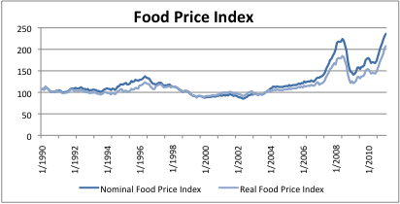
Global food commodity price volatility has been unusually high between 2006-2011.
World food commodity price index 1990-2011 (FAO)

Slide 22
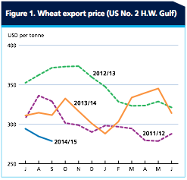
Recent year wheat prices

Slide 23
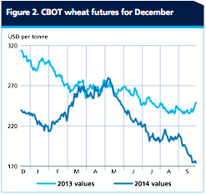
Wheat futures prices

Slide 24
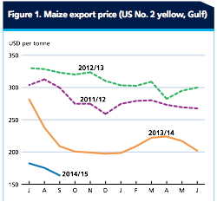
Recent year maize prices

Slide 25
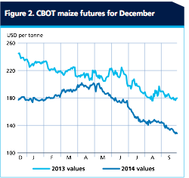
Maize future prices

Slide 26
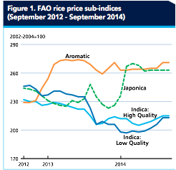
Rice prices

Slide 27
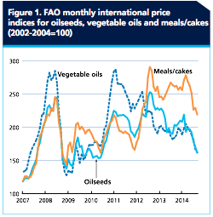
Oilseed prices

Slide 28
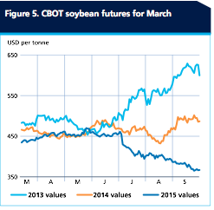
Soybean futures prices

Slide 29
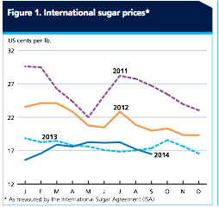
Sugar prices

Slide 30
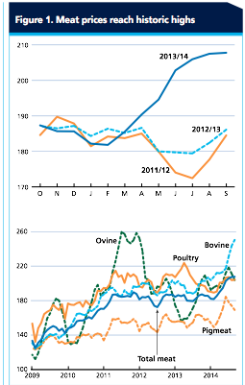

Slide 31
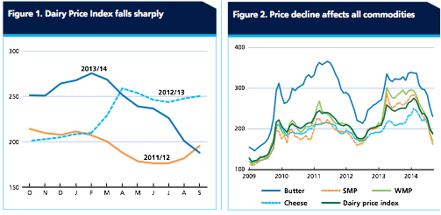
Dairy product prices

Slide 32
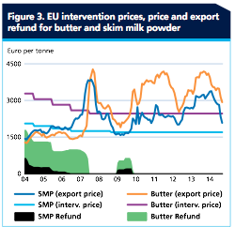

Slide 33
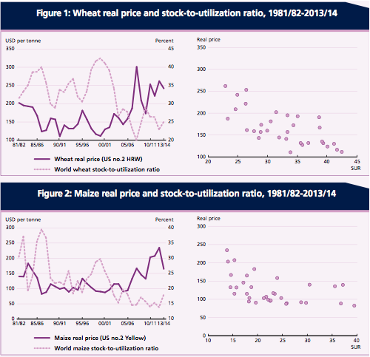

Slide 34
Causes of high commodity prices
Strong growth in demand
  sustained historically high economic growth world wide
  bio-fuel feedstock demand,
    particularly for maize and vegetable oils
  stronger currencies/ weak USD
Constrained supply
  high energy related input costs... crude oil up since 2000
  repeated yield shortfalls in key areas – climate change?
Low commodity stocks
  increased speculation/ demand to rebuild
Increased activity on commodity exchange
  higher volatility
Policies and policy changes
  tariff liberalization by importers
  decoupling of subsidies, reduction in export subsidies, lower public stocks
  increased use of export taxes/ bans
  biofuel subsidies/tariffs/tax credits etc, changing mandates etc

Slide 35
Impact of high prices and global volatility on developing countries
Increase in world agricultural commodity prices may “double squeeze” low-income importers of food and oil, but may benefit agricultural exporters
How do recent price developments affect poor agriculture based economies in the aggregate and at the household levels?
Developing countries have structural features quite different from those of developed economies. How do these affect the impact of world price developments?
What is the role of trade and other structural policies in adjusting to global price developments?
Is domestic risk likely to increase in developing countries?

Slide 36
Net importers of petroleum products and major grains as a percent of domestic apparent consumption - ranked by prevalence of undernourishment

Slide 37
Estimated import bills of total food and major food commodities (US$ million)

Slide 38
Distribution of Low-Income and Lower-Middle-Income Countries according to their Current Account Position and the Estimated Increase in Cereals Import Bill

Slide 39
Summary of changes in domestic prices of main basic food commodities observed in 45 developing countries

Slide 40
Proportion of Net Staple Food Seller Households (percent)

Slide 41
Structural features that are important in an impact and policy analysis context
  backward technologies hence low productivity
  poor infrastructural endowments
  imperfect price transmission
  wide marketing margins
  inadequate production of tradables and low substitutability between tradables and domestically produced goods
  Need framework to capture these features in an analysis

Slide 42
Global food demand: growth is slowing and shifting composition
Population growth slowing
Income growth helps offset slower population growth
Products more sensitive to income growth growing more rapidly
Consumer preferences also shifting
Greatest demand growth in developing countries, particularly Asia.

Slide 43
Slow down population growth

Slide 44
Lower GDP Growth expected to grow fast in Asia

Slide 45
World demand growth slows: income sensitive products grow most

Slide 46
Growth in food demand in 2008-17 much higher in developing countries

Slide 47
Supply: Moderate rate of growth
Real prices firmness continue over medium term
  Moderate level of technical progress (crop yield growth continues, livestock revolution)
  Further trade liberalization unlikely to reverse the price trend
Competition in export-supply is increasing
  Low cost, low policy support countries increase supply most
  South America, especially Brazil has great potential
Uncertain: energy prices, demand for biofuel

Slide 48
In the next ten years trade will continue to grow faster than production…
Notes:
Over the next ten years, trade (as measured by net exports of countries), is anticipated to grow faster than global production, for basic food commodities.
This implies that for these basic foods, countries will become increasingly interdependent in meeting their food needs. Of course, significant reform of trade policies could imply that this interdependence could increase even further.
With increasing inter-dependence, greater attention will be paid to the attributes demanded in trade, with standards playing an increasing role.

Slide 49
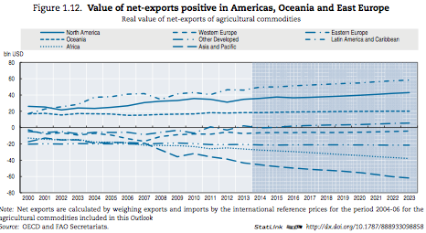

Slide 50
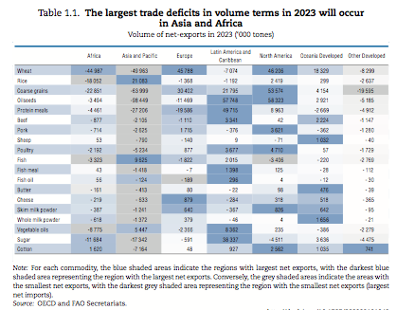

Slide 51
Nominal commodity prices have risen to record highs and will likely stay high

Slide 52
Real international prices: expected to decline (2005-07 average=1)

Slide 53
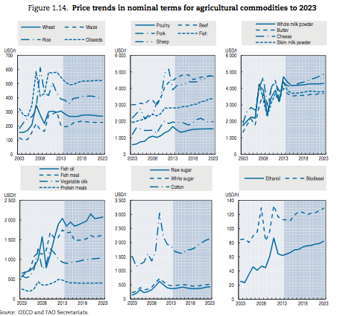

Slide 54
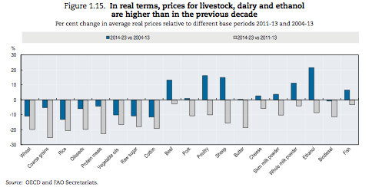

Slide 55
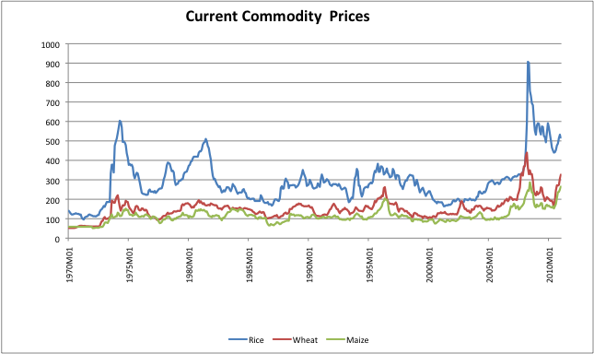
Cereal commodity prices in long term perspective (current prices)

Slide 56
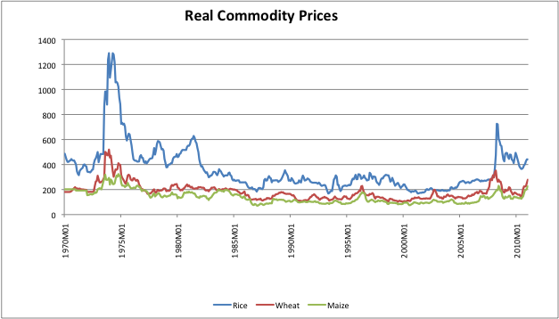
Cereal commodity prices in long term perspective (real prices)

Slide 57
Volatility matters for developing countries because of increasing exposure.
Medium term OECD-FAO projections of agricultural production and trade LDC Countries (Base 1999-2001 =1)

Slide 58
Medium term OECD-FAO projections of agricultural production and trade for other developing countries (non-LDC, non-BRIC) (Base 1999-2001 =1)

Slide 59
Net grain imports other than rice have increased in Asia and Pacific

Slide 60
Net imports of basic foods to grow over 3.6 % annually in LDCs
Net imports by commodity
Notes:
Net food imports by Least Developing Countries will grow by over 6% annually.
The cause of such a level imports is a growth in demand largely due to high population growth, compared to their limited ability to supply. Increasing food import bills by some of these poorest countries may increase their vulnerability to market variations, and hence to their food security.
The most important challenge is that their own farmers become more competitive in their own domestic food markets. This is also the only viable option because most of the poor in these countries are rural people and depend on improved farming for their livelihood
In the longer term,. The LDCs also have to aim for increased export earnings from non-agricultural exports of good and services.
Unless these options are successfully pursued, the alternative is further currency devaluation, indebtedness and dependence on food aid

Slide 61
In summary, over the next ten years….
Global demand growth will slow. Per capita consumption continues to increase, with more growth in higher valued products.
Supply potential continues to meet demand growth, at prices that decline in real terms
Excess supply growth is coming more from low cost suppliers.
Trade continues to grow, with developing country and least developed countries balance of trade in basic foods deteriorating.
Asian economies becoming larger net importers of food products.
Increased potential for inter-Asia and Pacific Trade
Notes:
In summary, global demand growth will slow.
Per capita consumption continues to increase, with more growth in higher valued products.
Supply potential continues to meet demand growth, at prices that decline in real terms.
Trade continues to grow, with developing country and least developed countries balance of trade in basic foods deteriorating.
Markets are liberalizing, but new trade concerns are mounting.
A complete the review of the general supply and demand picture for food, cannot exclude an assessment of the world hunger situation
While there are ample food supplies, at lower real prices, the hunger problem remains stubbornly before us.
Tolerating chronic hunger is not only scandalous because hunger is totally avoidable and because people have a human right to food. Chronic hunger also means represents a missing demand!

Slide 62
The income terms of trade for agriculture have evolved differently for developing and developed countries.

Slide 63
Productivity growth has been different in developed and developing countries: Cereals

Slide 64
Productivity growth has been different in developed and developing countries: Oilcrops

Slide 65
Productivity growth has been different in developed and developing countries: Fiber crops

Slide 66
Productivity growth has been different in developed and developing countries: Fruits

Slide 67
Productivity growth has been different in developed and developing countries: Vegetables

Slide 68
Pattern of trade in all agricultural products.
Export shares to various destinations (2001)

Slide 69
Pattern of trade in all agricultural products.
Import shares from various sources (2001)

Slide 70
Structure of agricultural exports of LDCs by product and destinations (2001)

Slide 71
Protection in agricultural products is high in both developed and developing countries
(ad valorem tariff equivalent of country in column for agricultural products imported from country in row in 2001)

Slide 72
Considerable binding overhang in agricultural tariffs exists for both developed and developing countries (2000-2002)

Slide 73
OECD support falling slowly in real terms
Real Producer Support Estimate
Nominal PSE
Source: OECD, FAO calculation
Notes:
In the OECD area for example, while the estimated “ Producer Support Estimate” has remained high, it is actually falling in “real” terms… that is support has not kept pace with inflation. ( real terms is PSE/US GDP deflator)

Slide 74
SPS notifications to WTO reflect increasing standards affecting trade
Annual notifications to WTO SPS Committee
Source: WTO
Notes:
As both domestic policy and trade policies are reformed, new trade barriers in the form of food standards are increasing. The number of, or changes in, standards notified to the WTO SPS committee has increased annually since 1995. By 2004 these numbered over 5000.
It must be underscored that science-based SPS and TBT standards have been introduced as justified barriers to trade that serve to protect the health of consumers, plants and animals. Such good standards actually may increase trade by improving information between importers and exporters.
If scientifically well justified, countries may even exceed internationally recognized standards
As the WTO Agreement for Agriculture tends to become more liberalized countries may be tempted to introduce further standards with the view of restricting trade to protect their own producers. This should be avoided.
Exceeding science based standards exerts costs on other countries. A good example is the limitation of various African countries who have not met high EU standards for Aflatoxin in peanuts and whose trade has suffered.
Increasing “private standards”, as for large multinational companies may also act to limit trade possibilities for countries that have difficulty meeting the costs of compliance to these standards.

Slide 75
What determines long term commodity prices?
Cost of production of marginal producer
Marginal producers still in developing countries using labour intensive technology with labour paid subsistence wages
Supply of agricultural commodities highly elastic at low wages
Demand for agricultural commodities quite inelastic
Opposite case for non-agriculture
Implication: Differential productivity gains can alter terms of trade between agriculture and non-agriculture

Slide 76
How do productivity gains affect agriculture and non-agriculture?
Productivity affects agriculture differently than non-agriculture
P
P
S
S’
S
p
a
a
c
p
p’
S’
p’
b
d
b
D
D
Q
Q
Panel A. Agricultural Commodity Sector
Panel B. Non-agricultural sector

Slide 77
Declining terms of trade for agricultural commodities due to faster rates of total factor productivity growth for agricultural than non-agricultural products
Rate of growth of TFP has been faster in agriculture than in non-agriculture
Between 1967-92 the average annual growth rate of TFP in manufacturing in developing countries varied between 0.62 and 0.92 percent. In developed countries the range was between 1.91 and 3.29.
In agriculture the average rate of growth of TFP in developing countries ranged between 1.76 and 2.62 percent, while for developed countries the range was between 3.35 and 3.46 percent.
For low-income developing countries, the average rate of TFP growth in agriculture was between 1.44 to 1.99, while in manufacturing it was between 0.22 to 0.93 percent.
The rate of growth of TFP in agriculture seems to be higher than that of manufacturing.
“Globalization” of agricultural research, has contributed to faster TFP growth in agriculture,
Incidence of productivity advances largely on consumers (through lower prices) and little to producers.

Slide 78
Annual TFP growth in agriculture does not appear to have slowed down for the world. Hence most likely reason for real price leveling must be lower inputs and faster demand growth

Slide 79
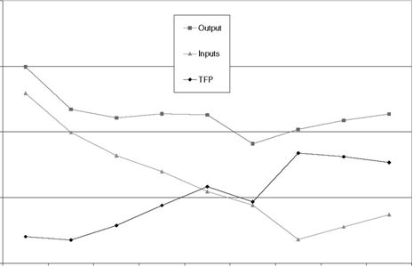
Agricultural productivity developments for the world
Source: Fuglie (2008)

Slide 80
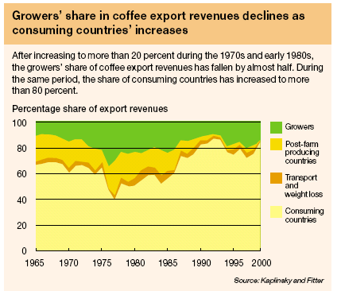

Slide 81
Issues concerning secular declines in prices
Agricultural trade liberalization by developed countries may not increase export earnings by LDCs by much. Most benefits to more developed among developing countries
Attempts to improve market balance through producer-only agreements on production and export control difficult to implement
Commodity demand promotion can work if there is commitment and funds
Diversification a possible solution

Slide 82
Constraints to diversification
Horizontal diversification the only long-run solution to market imbalance?
Product differentiation
Vertical diversification into processed forms to capture value-added – trade in processed forms growing fastest, but developing country participation limited
Constraints of tariff escalation, market barriers to entry and supply conditions

Slide 83
Agriculture in LDCs has remained largely underdeveloped, despite its importance
Agricultural is the backbone of the LDCs
Accounts for between 30-60% of GDP and employs as much as 70% of labour force
Yet, after growing at 2.8% in the 1990s, virtually no increase in output or even a slight decline in 2000-05. More than half of the yield growth has been due to area expansion.
Per caput staple food production has stagnated
As a result, and not being able to import foods as required, between 1995-97 and 2002-04 the proportion of undernourished increased from 34% to 41%, and absolute number undernourished increased from 116 to 169 million.
A strong and vibrant food and agricultural system should form a primary pillar in the strategy of overall economic growth and development.

Slide 84
Can agricultural growth lead to growth and poverty reduction in LDCs?
Most of the LDCs have large rural and agriculture based sectors. Cannot have fast overall growth without growth in agriculture
Most late developing countries faster growth episodes has been spurred by increased agricultural growth (recent successes China, India, Indonesia, Vietnam).
Agricultural growth has been shown to be more conducive to poverty reduction than non-agricultural growth
LDCs have the resource potential (land, labour) to expand agriculture. In about half of the LDCs the land in agricultural use is less than 50% of the potentially arable land.

Slide 85
LDCs continue to be commodity dependent

Slide 86
Despite the commodity dependence of LDCs, the export performance of agriculture has been weak

Slide 87
Main solution consistent with poverty alleviation: Agricultural commodity labour productivity must be improved in LDCs
Increase of wages through general development
Technological improvement at the farm level
Increase farm size?
Increase farmer assets (education, own and borrowed capital)
Improve non-farm assets (infrastructure)
Better producer organizations

Slide 88
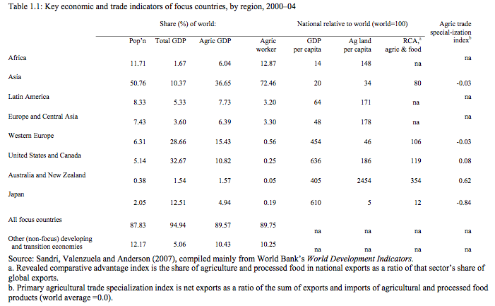

Slide 89
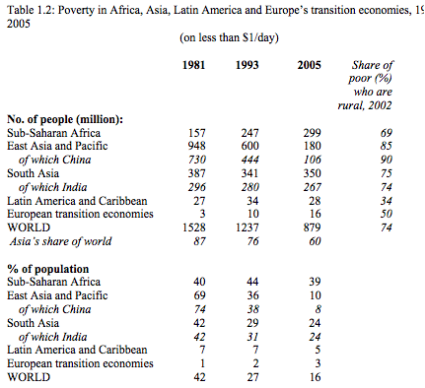

Slide 90
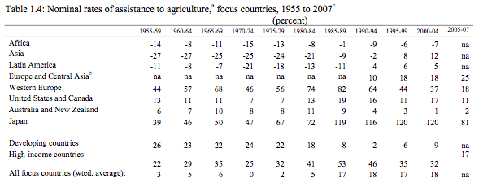

Slide 91
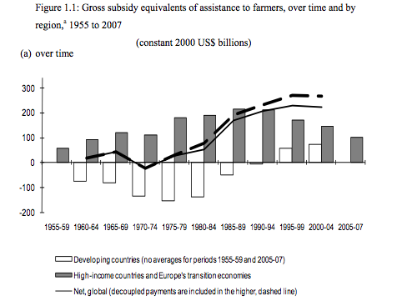

Slide 92
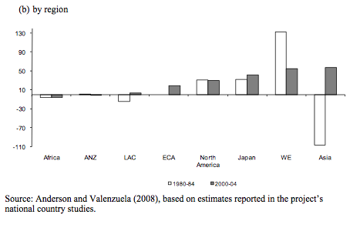

Slide 93
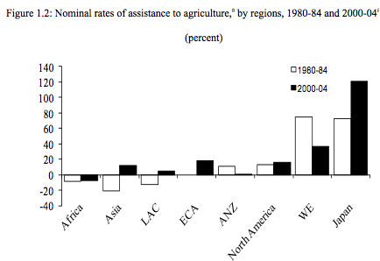

Slide 94
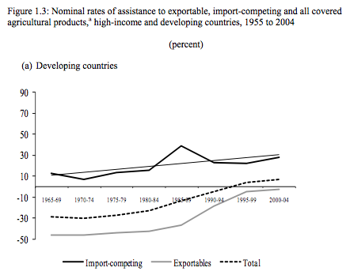

Slide 95
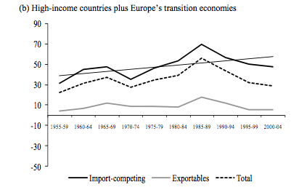

Slide 96
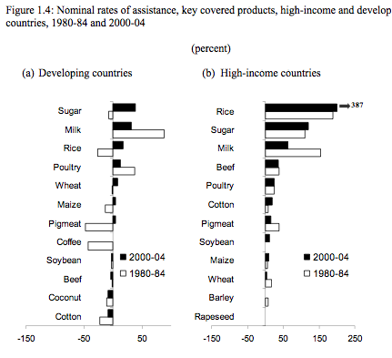

Slide 97
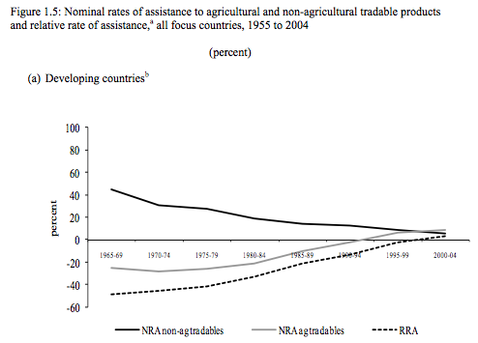

Slide 98
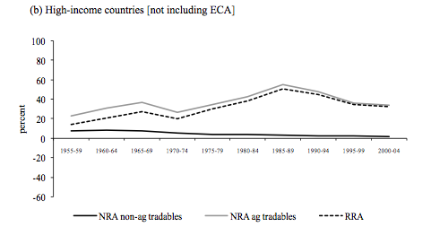

Slide 99
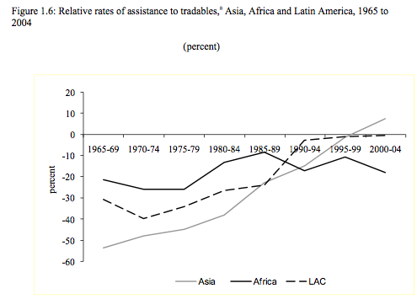

Slide 100
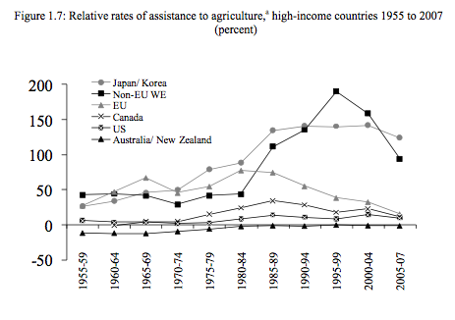

Slide 101
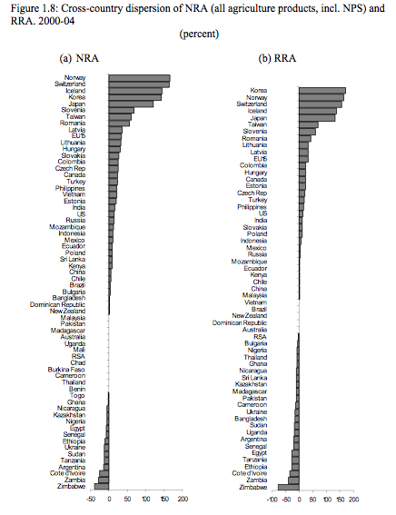

Slide 102
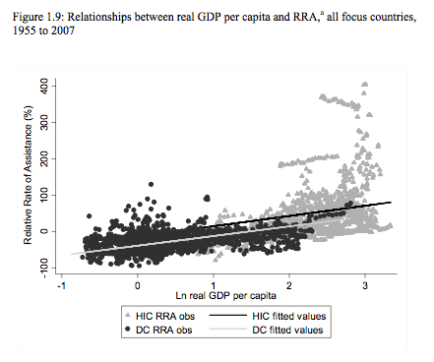

Slide 103
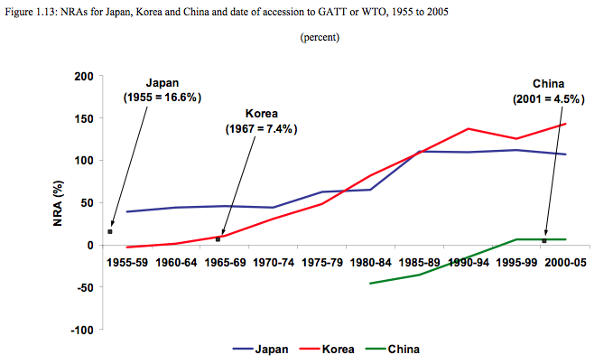

Slide 104
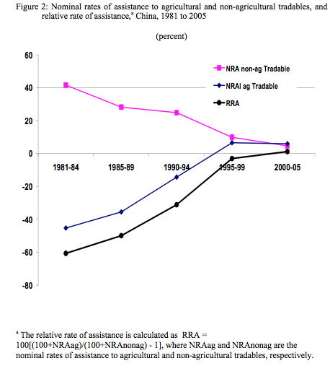

Slide 105
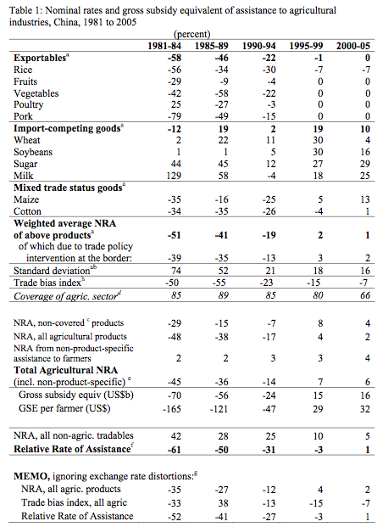

Slide 106
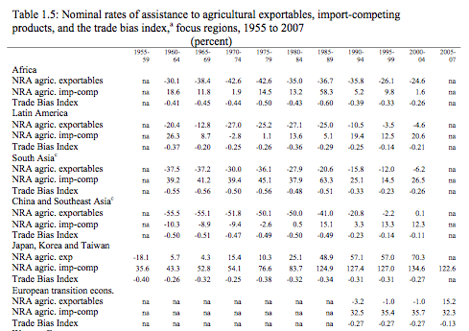

Slide 107

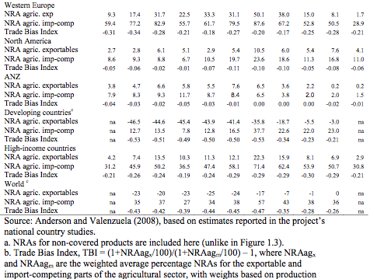

Slide 108
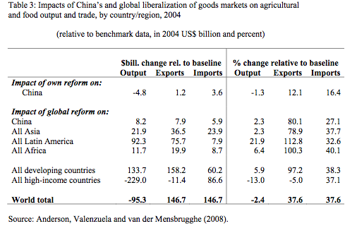

Slide 109
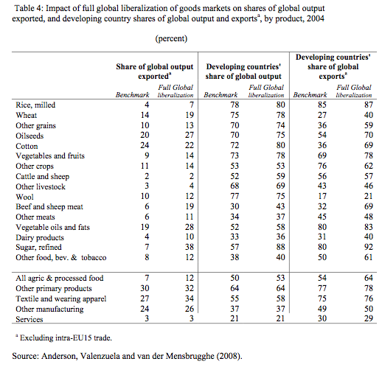

Slide 110
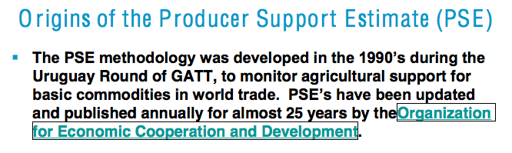
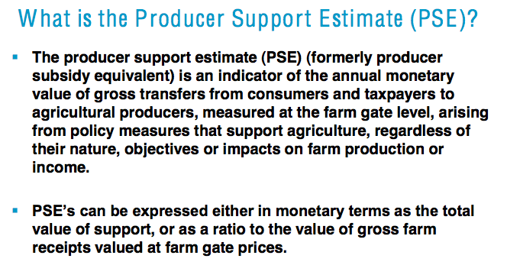
Producer support estimates

Slide 111


Slide 112


Slide 113


Slide 114


Slide 115


Slide 116


Slide 117


Slide 118


Slide 119


