Slide 1
AGRICULTURE IN ECONOMIC DEVELOPMENT: AN INTERNATIONAL PERSPECTIVE
WEEK 9
Productivity, technical change and institutions
1

Slide 2
Productivity, Technical Change and Institutions
The problem: Scarcity of land and water, thus, main source of growth should be increasing productivity
Technical, managerial, institutional constraints
The nature of technical change in agriculture
New technology as endogenous in the economic system
The production of new techniques and the system of production, diffusion and adoption of new technology
Models of technology adoption and diffusion: sigmoid models
Dynamic considerations
Managerial change – education and knowledge transfer – Extension systems
Institutional constraints – market failure. Input and output markets, land use systems, collective action
Innovation systems
Collective action - Producer organizations

Slide 3
Bibliography
*D. Sunding and D. Zilberman (2001), ‘Tha agricultural innovation process: Research and technology adoption in a changing agricultural secrot’ chapter 4 in HANDBKAGECON V1A
*WDR2008, chapt. 7
Feder, G., R.E. Just, and D. Zilberman. 1985. “Adoption of agricultural innovations in developing countries: A survey.” Economic Development and Cultural Change, 33, pp. 255-98.
Foster, A. and M. Rosenzweig. 1995. “Learning by doing and learning from others: Human capital and technical change in agriculture.” Journal of Political Economy, 103(6), pp. 1176-1209.

Slide 4
The yield gap

Slide 5
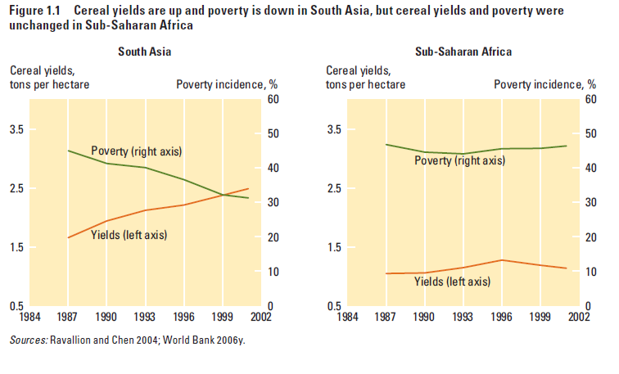

Slide 6
Constraints for increasing productivity: Technical, managerial, institutional
Efficiency and productivity : Technology – technical change
Question: on the production of new technology
What technology
The “size of farm and productivity” debate
The role of land and land reform
The innovation system – endogenous technical change
The role of research and innovation
The knowledge system - relaxing managerial constraints
The role of prices as economic incentives
The operation of markets, product and input markets
Collective action and relaxing institutional constraints

Slide 7
The nature of technological change and technology transfer in agriculture
Mechanical technology (Machinery, mechanical equipment, capital accumulation)
Chemical technology (fertilizers, pesticides, insecticides)
Biotechnology (high yielding varieties, Genetic engineering, GMOs)
Managerial change, education and knowledge (transfer of new knowledge systems – Research and Extension)
Institutional change (market failure is common - operation of input and output markets, land use systems, marketing arrangements, collective action)
The innovation system – change endogenous in the economic system
In market economy science matters less (supply side) and markets matter more (demand side)
Promoting institutional reforms

Slide 8
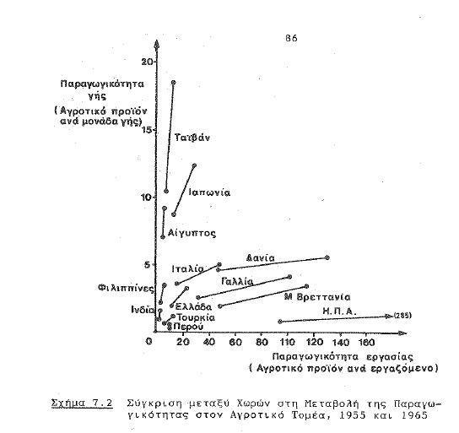

Slide 9
Induced innovation : the theoretical foundation
The Theory of wages (Hicks)
Factor prices as a guide to innovation
Invention and the stock of knowledge
Innovation and new technology
Technology as endogenous in the economic system
Induced innovation in agriculture
Hayami and Ruttan
Innovation in the public sector – strengthening research systems

Slide 10
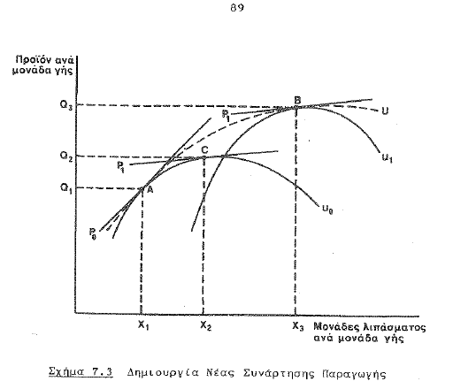

Slide 11
Induced institutional innovation and institutional change
From induced innovation in technology to induced change in institutions governing the operation of the agricultural system and institutional change - the quest for efficiency
Land tenure, land use systems and land reform
The agricultural research system: USA, Germany, Japan
The knowledge transfer system: Extension, education,
The credit system: Short term and long term credit and the operation of the money market, purchase of new technological inputs and financing of investment in capital inputs
Operation of markets: Product markets, input markets. Market structure, conduct, performance
Market integration : institutions and infrastructure
Critical infrastructure, transportation, telecoms, energy
Trade barriers. Trade arrangements: Multilateral and regional

Slide 12
The Bass Diffusion Model (simple differential equation) describes process of new product adoption in a population
The Bass Diffusion model
Model formulation

Slide 13
Adoption distribution

Slide 14
Adoption cumulative distribution

Slide 15
Sigmoid curve of technology adoption

Slide 16
Record of science and technological innovation from three perspectives
The recent impacts and emerging challenges – three types of technologies (a) Technical, (b) Biological and (c) Managerial technologies
The investments in research and development (R&D) to generate new technologies, paying particular attention to growing divides between industrial and developing countries, and within the developing countries themselves
The emerging institutional arrangements that make investments in innovation, including extension, more efficient and effective in meeting market demands through collective action and farmer involvement

Slide 17
Genetic improvement has been enormously successful, but not everywhere

Slide 18
A biotechnology revolution in the making?
Agricultural biotechnology has the potential for huge impacts on many facets of agriculture—crop and animal productivity, yield stability, environmental sustainability, and consumer traits important to the poor.
First-generation biotechnologies include plant tissue culture for micropropagation and production of virus-free planting materials, molecular diagnostics of crop and livestock diseases, and embryo transfer in livestock. Fairly cheap and easily applied, these technologies have already been adopted in many developing countries.
The second-generation biotechnologies based on molecular biology use genomics to provide information on genes important for a particular trait. This allows the development of molecular markers to help select improved lines in conventional breeding (called marker-assisted selection).
The most controversial of the improved biotechnologies are the transgenics, or genetically modified organisms, commonly known as GMOs (see focus E). Transgenic technology is a tool for “precision breeding” transferring a gene or set of genes conveying specific traits within or across species. About 9 million smallholder farmers, mainly in China and India, have adopted transgenic Bt cotton for insect resistance.

Slide 19
Capturing the benefits of Genetically Modified Organisms (GMOs) for the poor
Transgenics, or GMOs result from transferring one or more genes, usually from wild species or bacterium, to a crop plant.
In 2006, farmers in 22 countries planted GMO seeds on about 100 million hectares, about 8 percent of the global crop area.
Though GMOs adoption more rapid in commercial farming, have strong potential for improving the productivity of smallholder farming systems and providing more nutritious foods to poor consumers in developing countries.
However, the environmental, food safety, and social risks of transgenics are controversial, and transparent and cost-effective regulatory systems that inspire public confidence are needed to evaluate risks and benefits case by case.

Slide 20
The adoption of GMOs is on the rise in most regions, but not in Africa and Europe

Slide 21
Management and systems technologies need to complement genetic improvement
The greatest impact on productivity is obtained through production ecology approaches that combine improved varieties and several management technologies, crop-livestock integration, and mechanical technologies to exploit their synergistic effects (e.g. green revolution)
Suitable technologies are still badly needed to conserve and efficiently use scarce water, control erosion, and restore soil fertility for smallholders in less-favored areas.
However, such complex technologies are often labor or land intensive and may be unattractive to farmers where labor costs are high, land is scarce, or discount rates on future returns are very high or the returns risky.
Management and systems technologies can require considerable institutional support to be widely adopted
Scaling up management and system technologies is not easy. Networks of scientists, farmers, private firms, and NGOs take time to develop and become inclusive and effective

Slide 22
Investing more in R&D, extension and innovation systems
Agricultural productivity improvements have been closely linked to investments in agricultural R&D . Published estimates of IRR of nearly 700 cases on R&D and extension investments in LDCs average 43 percent a year. Returns are high in all regions, including Sub-Saharan Africa.
Agricultural R&D is underfunded. No private interest. Public investment is especially important for funding agricultural R&D where markets fail because of the difficulty of appropriating the benefits.
Why does this underinvestment in R&D continue, given the well-documented high rate of return on investment? Three reasons:
First, the political economy of public expenditure decisions tends to emphasize short-term payoffs and subsidies that are “politically visible”
Second, trade distortions and national policies that reduce incentives to farmers in developing countries are a disincentive to both public and private investment in R&D.
Third, because the benefits of much public R&D spill over to other countries, it might not make much economic sense for small countries

Slide 23
Return to agricultural R&D

Slide 24
Public spending in agricultural R&D by region

Slide 25
Increasing public and private funding of R&D will require:
Public funding will need greater political support to agriculture, particularly to finance public goods.
Forming coalitions of producers and agribusinesses around particular commodities or value chains may be the most effective way to lobby for more public funding and for producers and agribusiness to co finance R&D.
In addition, institutional reforms will be needed to make investing in public R&D organizations more attractive and more effective.
Private funding will require removing barriers to private investment in R&D such as IPR (IPR protection is generally weak in many countries)
Demand is also weak because of risk, credit, and knowledge constraints. Removing such constraints demand for R&D will increase demand and thus funding for R&D

Slide 26
Institutional arrangements to increase efficiency and effectiveness of public R&D systems
Although public research organizations dominate in most developing countries, their efficiency and effectiveness in today’s changing world are in question
Institutional reforms of public R&D are: (a) creating well-governed autonomous bodies or public corporations, (b) improving their effectiveness in assessing and responding to farmer demands, © increasing contestability of funding through competitive funding mechanisms.
To succeed, these reforms have to be accompanied by a long-term commitment to build capacity, which has paid off in the now-strong public research systems in Brazil, China, and India.
A challenge for public research systems in Africa is attracting and retaining scientists, who operate in a global marketplace.
While investment in public R&D organizations remains important, the public sector cannot do it alone.

Slide 27
From R&D systems to innovation systems
To improve the efficiency and effectiveness of R&D, collective action and partnerships involving a variety of actors in an innovation systems framework are emerging as important.
Such an innovation system framework recognizes multiple sources of innovation, and multiple actors as developers and users of technologies, in a two-way (nonlinear) interaction.
Such systems have many advantages. Economies of scale and scope. Facilitate technology transfer. Pool resources.
Global and regional partnerships for economies of scale. The high fixed costs of research require economies of scale in R&D.
Public-private partnerships. Given the dominance of public systems for R&D in developing countries, and the global role of the private sector in R&D and in value-chain development, public-private partnerships (PPPs) offer much potential and are proliferating.

Slide 28
PPP in agrobiotechnology research

Slide 29
Innovation in value chains.
A type of PPP partnership is innovation along the value chain stimulated by new markets for high-value products. In such products innovation is less dependent on local R&D (technology is less location-specific than that for traditional staples).
A dynamic system of innovation comprises private business, farmers, processors, regulatory bodies, and public R&D organizations operating in partnerships, networks, or consortia.
Policymakers can facilitate such PPPs providing incentives for innovation through competitive funds co financing both R&D and pilot testing of innovations, in partnership with private actors: farmers, processors, or other agribusinesses.
Making R&D more responsive to farmers and the market. Such collective action can identify constraints, pool indigenous knowledge, and aggregate technological demands. Such partnerships help scale up adaptive research, testing, and dissemination—and facilitate access to inputs, markets, and finance for new technologies.

Slide 30
Using available technology better: extension and ICT innovations
Agricultural extension helps farmers learn how to augment their productivity, raise their incomes, and collaborate with one another and with agribusiness and agricultural research.
New demand-led approaches to extension. Extension programs are shifting from prescribing technological practices (delivery model) to focusing more on building capacity among rural people to identify and take advantage of available opportunities, both technical and economic (empowerment model).
From centralized to decentralized. From central to local governments.
Mixing public and private. Technical and managerial advice delivered by processors and wholesalers to farmers producing high-value crop and livestock products under contract
Farmer to farmer. Informal networks among farmers have always been powerful channels for exchanging information and seeds. Several programs are formalizing and linking such networks for knowledge sharing

Slide 31
Provision and financing of advisory services

Slide 32
Provision and financing of advisory services

Slide 33
Supporting competitiveness through new institutions and institutional innovation
Most countries dismantled the elaborate system of public agencies that provided farmers with access to land, credit, insurance, inputs, and cooperative organizations.
Mechanisms to secure land property rights, facilitate land reallocation and facilitate access to land for the landless.
Innovations in finance can provide smallholders with better access to credit and savings facilities.
Insurance to manage risk. Weather-indexed insurance can provide ways of reducing problems of imperfect information in mitigating farmers’ risks.
Developing efficient input markets. Institutional innovations can also promote more efficient input markets, as new local agro-dealers have emerged and market-smart subsidies are tried.
Producer organizations in the context of value chains and globalization. They can engage in more effective collective action to access services, achieve economies of scale in markets, and acquire voice in policy making.

Slide 34
Producer organizations in value chains and globalization: investing in social capital
Producer organizations are membership based with elected leaders accountable to constituents. They take on various legal forms, such as cooperatives, associations, and societies. (a) commodity specific ,(b) advocacy, (c) multi-purpose.
In industrial countries, producer organizations have been fundamental to the success of the family farm, still the dominant form of organization of production today.
Producer organizations have expanded rapidly, but existence does not guarantee effectiveness. For that, they need to face five major challenges, both internal and external to the organization. (a) Resolving conflicts between efficiency and equity, (b) Dealing with a heterogeneous membership, © Developing managerial capacity for high value Chains, (d) Participating in high-level negotiations., and (e) Dealing with a sometimes unfavourable external environment
Support by donors and NGOs to empower organisations and make them efficient and effective, However, investment in social capital difficult

Slide 35
Promoting institutional reform and encouraging innovation in the private and public sector
Investments in knowledge—especially in the form of science and technology—have featured prominently and consistently in most strategies to promote sustainable and equitable agricultural development at the national level.

Slide 36
Six changes in the context for agricultural development heighten the need to examine how innovation occurs in the agricultural sector:
1. Markets, not production, increasingly drive agricultural development.
2. The production, trade, and consumption environment for agriculture and agricultural products is growing more dynamic and evolving in unpredictable ways.
3. Knowledge, information, and technology increasingly are generated, diffused, and applied through the private sector.
4. Exponential growth in information and communications technology has transformed the ability to take advantage of knowledge developed in other places or for other purposes.
5. The knowledge structure of the agricultural sector in many countries is changing markedly.
6. Agricultural development increasingly takes place in a globalized setting.

Slide 37
Changing approaches for supporting agricultural innovation
As the context of agricultural development has evolved, ideas of what constitutes
“research capacity” have evolved, along with approaches for investing in the capacity to innovate:
• In the 1980s, the “national agricultural research system” (NARS) concept focused development efforts on strengthening research supply by providing infrastructure, capacity, management, and policy support at the national level.
• In the 1990s, the “agricultural knowledge and information system” (AKIS) concept recognized that research was not the only means of generating or gaining access to knowledge. The AKIS concept still focused on research supply but gave much more attention to links between research, education, and extension and to identifying farmers’ demand for new technologies.
• More recently, attention has focused on the demand for research and technology and on the development of innovation systems, because strengthened research systems may increase the supply of new knowledge and technology, but they may not necessarily improve the capacity for innovation throughout the agricultural sector.

Slide 38
The innovation systems concept
An innovation system can be defined as a network of organizations, enterprises, and individuals focused on bringing new products, new processes, and new forms of organization into economic use, together with the institutions and policies that affect their behavior and performance.
The innovation systems concept embraces not only the science suppliers but the totality and interaction of actors involved in innovation. It extends beyond the creation of knowledge to encompass the factors affecting demand for and useof knowledge in novel and useful ways.
The innovation systems concept is derived from direct observations of countries and sectors with strong records of innovation. The concept has been used predominantly to explain patterns of past economic performance in developed countries and has received far less attention as an operational tool.
It has been applied to agriculture in developing countries only recently, but it appears to offer exciting opportunities for understanding how a country’s agricultural sector can make better use of new knowledge and for designing alternative interventions that go beyond research system investments.

