Slide 1
The Medium and Long term Outlook for Global Agricultural Markets and Trade in Light of Climate Change
Alexander Sarris
Professor of Economics, University of Athens,
Presentation at the UoA Dphil Agricultural Development Class
13 March 2014

Slide 2
Overview of presentation
Recent global agricultural markets in perspective
The medium term outlook for global agricultural markets
The long term agricultural outlook
Biofuel impacts and agriculture
Climate change impacts and agriculture
Agriculture and emission of Green House Gasses

Slide 3
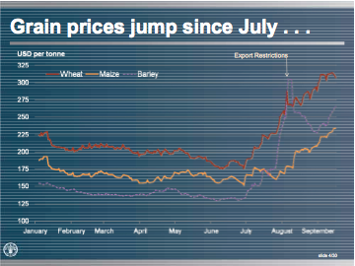
Recent basic food commodity prices highest since 2008.

Slide 4
FAO monthly Indices of Food Prices

Slide 5
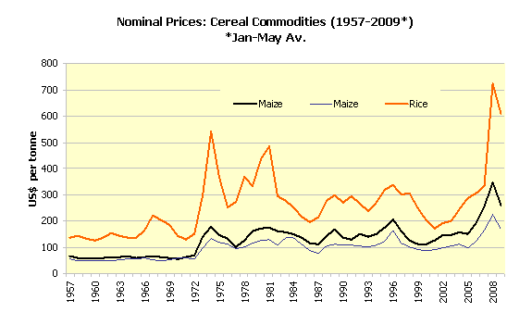
Nominal international grain prices recently at highest levels since early 1970s

Slide 6
FAO annual Indices of Food Prices

Slide 7
Is there an end to cheap food? Real international prices of grains have tended to decrease but since mid 1980s tendency seems to have stopped and may have reversed in 2008-9

Slide 8
Real prices of vegetable oils have tended to decrease but since mid 1980s tendency seems to have stopped

Slide 9
Real prices of livestock commodities have tended to decrease albeit at slowing pace since mid 1980s

Slide 10
Real prices of sugar and beverages have tended to decrease but since mid 1980s tendency seems to have stopped

Slide 11
What determines long term commodity prices?
Supply of agricultural commodities highly elastic at low wages
Demand for agricultural commodities quite inelastic
Opposite case for non-agriculture
Implication: Equal or higher productivity gains for agriculture compared to non-agriculture can decrease terms of trade between agriculture and non-agriculture

Slide 12
How do productivity gains affect agriculture and non-agriculture?
Productivity affects agriculture differently than non-agriculture
P
P
S
S’
S
p
a
a
c
p
p’
S’
p’
b
d
b
D
D
Q
Q
Panel A. Agricultural Commodity Sector
Panel B. Non-agricultural sector

Slide 13
Declining terms of trade for agricultural commodities has been due to faster rates of total factor productivity growth for agricultural than non-agricultural products
Rate of growth of TFP has been faster in agriculture than in non-agriculture
The rate of growth of TFP in agriculture seems to be higher than that of manufacturing.
“Globalization” of agricultural research, has contributed to faster TFP growth in agriculture,
Incidence of productivity advances largely on consumers (through lower prices) and little to producers.
Has productivity growth slowed down?
Has productivity growth lagged in LDCs?

Slide 14
Annual TFP growth in agriculture does not appear to have slowed down for the world. Hence most likely reason for real price leveling must be lower inputs and faster demand growth

Slide 15
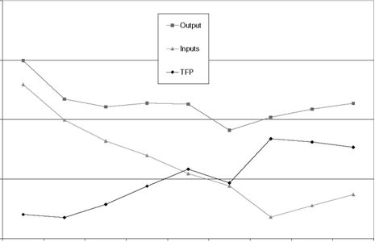
Agricultural productivity developments for the world
Source: Fuglie (2008)

Slide 16
What next?
Given the depth of the shortages:
  it will take some time for food stocks to be replenished, especially if unusual weather events continue to occur over the next few seasons
  biofuel demand is likely to be important for some time, if
  petroleum prices continue increase and policies supporting biofuels sector are maintained
    more energy efficient new generation biofuels that do not compete with land resources for food production do not become widely available commercially for many more years
  likely continued uncertainty and unpredictability of markets

Slide 17
Medium term (10 year) outlook highlights
Real commodity prices 15-40% above 1997-06 levels
Production increases in the range of 10-40%
Strong expansion of biofuels driven by mandates
LAC and Eastern Europe fastest growing production
Developing countries driving production, consumption, and trade gains
Notes:
Income, population and biofuels growth
Higher cost structure

Slide 18
OECD: Recovery after the crisis
Notes:
Start the outlook with the macro economic projections
The recovery from the crisis is the main concern
We get the macro numbers from the World Bank and the OECD
The crisis was mainly a crisis of the developed world, most industrialized economies were in recession in 2009
For 2010 small positive growth is foreseen and a return to 2 – 4% annual growth for the coming decade

Slide 19
Mixed picture for non-OECD economies
Notes:
Outside the leading industrialized economies, for the main emerging econmoies the so called BRIC, only Russia suffrered badly
China India Brazil, slowed their growth from the previous high level, but no recession
But they may not go back to the high value they had before the crisis, grow 6-8% at most.

Slide 20
World Oil price: high levels in nominal terms
Notes:
The last macro indicator is the international crude oil price
In 2009 it fell from its peak, but now is climbing back up, around 85 today.
We project that after the global economy comes out of the crisis the oil price will gradually move up again to about 100$ over 10 years
This has 2 implications for Ag.: on the cost side – fuel and fertilizer costs relative to commodity prices
Demand side for biofuel – ethanol and biodiesel become more competitive at higher costs for fossil fuel

Slide 21
Medium term: World Agricultural production and trade
(Base 1999-2001 =1)
Notes:
In projection period, global production grows 1.7 percent per year, while exports grow at 2.2% per year.

Slide 22
Agricultural production and trade
Industrial Countries
(Base 1999-2001 =1)

Slide 23
Agricultural production and trade
European Union
(Base 1999-2001 =1)

Slide 24
Agricultural production and trade - BRIC
(Base 1999-2001 =1)

Slide 25
Agricultural production and trade
LDC Countries
(Base 1999-2001 =1)

Slide 26
Agricultural production and trade
Other Developing (non-LDC, non-BRIC)
(Base 1999-2001 =1)

Slide 27
Food and fuel drive up demand for wheat
+ 34 Mt

Slide 28
Feed and fuel push coarse grain demand
+ 50 Mt
+ 90 Mt

Slide 29
Oilseeds production grows strongly
Million tonnes
Notes:
Oilseeds are another commodity that experiences a strong demand pull from rising income levels. This comes both from food and fuel demand for oil and the feed demand for protein meals. Here we only show a aggregate for all major oilseeds (soy, rape, sun, palm, ground, cottonseed, copra)
Global production is projected to grow almost 2% a year to nearly 500 million tons, increase by about 25% in 10 years.
It remains a concentrated sector with US, Brazil, China, Argentina, India and EU dominating.
Growth is expected to be slower than in the previous decade, where especially South America grew very fast (4.5%), now only 2.5%, but still the source of most of the additional production (40 mill tons, about 50% of global expansion)
Others to watch are Eastern Europe, India (10 mill tons extra)
The US remains dominant, but no additional area into production all on yield increase.
Compared to the 2007-09 average, world oilseeds acreage and production are expected to be 10% and almost 30% higher, respectively, by 2019, based on sustained profitability and yield improvements (Figure 7.2). Global oilseed area expansion is limited compared to the previous decade due to higher marginal costs of area expansion and new constraints coming from environmental regulations in developing countries, as well as sustained profitability of competing crops, mainly maize, in the US.

Slide 30
Average annual growth rates of vegetable oil consumption
Notes:
The oilseeds market currently is driven by the oils side. Strong food demand especially in Asia and biodiesel in the EU have pushed the value share of the products in favor of the oil.
This chart shows how the different uses are expected to behave in the coming decade compared to last.
Point here is that in the previous decade vegetable oil use in general grew much faster, especially in the developing world (India, China). Growth in the developed world came significantly from biofuel use (total growth is twice that for food)
In the outlook period, total use has slowed down to less than 3% a year, following reasons: prices are higher than before, see in the next slide, Biodiesel slows down in EU, a few other emerging biodiesel producer (ARG and BRA) that used edible oil at a larger scale in the outlook period.
Food use in developed world becomes saturated.
In developing countries, like India China Indonesia food consumption per capita slows down as well
African countries have the growth potential, but at the high prices limit the affordability for many people

Slide 31
2019 consumption projections
% change from 2008-10 % change from 2007-09
Wheat 15.8 beef/veal 14.5
Coarse grains 19.7 pig meat 23.3
Rice 15.4 poultry 28.8
Oilseeds 12.4 butter 27.2
Vegetable oil 28.1 WMP 31.8
Sugar 23.4 Ethanol 113.2
Biodiesel 207.9

Slide 32
International prices remain higher than in the past even in real terms
Price ratio to remain low for wheat/coarse grains
Wheat (US, HRW #2, fob Gulf)
Maize (US, #2 yellow, fob Gulf)
Notes:
The price ratio of wheat over coarse grains is expected to remain low due to a more tighter supply/demand development expected throughout the outlook period. Wheat as a staple food, per-capita demand goes down in many places, demand for feed grain derived from livestock demand remains strong with growing incomes, biofuel demand for maize as well causing the maize price to stay up.
A slight increase is foreseen for the end of the outlook period when the demand increase for corn for ethanol will slowdown, mainly on the account of the developments in the US.
Overall grain prices are expected to remain above levels before the price hike in 2007/08 in nominal as well as in real terms, although real wheat prices may get closer to the levels seen before.
Another interesting issue, but not so precise, so we do not show it, but we consider when explaining supply is to look at prices and cost ratios. There you see most prices are back to the levels they were before the crisis. So prices are higher long term for consumers, but not so much for producers because of high costs.

Slide 33
Prices declining in real terms?

Slide 34
Oilseeds and Oilseed products prices
USD/t
Oilseeds
USD/t
Protein meal
USD/t
Notes:
These supply and demand factors combine to form the price picture for the oilseeds market
World prices for vegetable oils should remain well above levels prior to the food crisis in both nominal and real terms.
Sustained food demand growth in developing countries and ambitious targets for biodiesel consumption, together with strong and increasing crude oil prices throughout the Outlook period are expected to lead to a sustained increase of prices in nominal terms.
The pace of increase should be slower in the later years of the Outlook period as the pressure on biodiesel markets becomes lower because of the assumption of second generation biofuels slowly becoming available in the European Union.
World vegetable oil prices expressed in real terms should remain fairly flat over the projection period.
Compared to the levels prior to the food crisis, also oilseeds and protein meal prices are projected to remain strong over the projection period as global stock-to-use ratios are expected to stay at low levels.
In a context of sustained crush demand and increasing production, oilseeds prices are expected to remain about unchanged in nominal terms and to decrease in real terms all over the course of the projection period.
In line with other feed commodities, protein meal prices are expected to decrease in the early years of the Outlook period before marginally increasing over the rest of the projection period.

Slide 35
How have meat prices responded to the grain price developments?
Notes:
Here I show the international indicator prices for beef pork and poultry and along with them maize and protein meal the two main feed components. (other than pasture for cattle and sheep)
All meat markets are set to recover quickly in the first years of the projection period, and an understanding of this phenomenon requires a review of recent markets events. Over the past two years, meat market prices failed to show the exceptional developments of many other agricultural commodity prices.
Their relative stability can be partially explained by the fact that meat plays a more limited role as a staple food, which combined with limited storage capacities makes panic buying for stockpiling unlikely. In addition, price movements were also buffered by changes in meat trade.
On the supply side, falling profit margins resulting from inflated feed costs pushed beef farmers to liquidate herds, increasing meat supplies and putting a downward pressure on world market prices at the time when other agricultural commodity prices were increasing. Feed is a key input cost of production systems, not only in pig and poultry sectors but also in the bovine meat sectors in certain OECD countries where animals are finished to higher weights for slaughtering with a heavy use of processed feed concentrates: faced with sudden increases in feed costs producers responded as usual, through herd liquidation. After this episode of herd liquidation, supply became tighter but prices failed to increase because of the contraction in demand induced by falling incomes/purchasing power around the world.
All meat sectors were affected, as consumers, confronted with declining budgets, opted for reducing their intake. Indeed, preliminary data for OECD countries in 2009 suggests that aggregate meat production was lower after decades of continuous growth.
Real prices for meat are projected to be higher than those observed during the previous decade, as higher costs constrain the expansion of output in the face of increasing demand. Beef prices are anticipated to be firm for the first half of the projections, mainly due to a tight supply following reduced cattle herds. However, an expansion of output in the second half, coupled with a reduction of import demand by the Russian Federation, are anticipated to exert a downward pressure on prices.
Pigmeat prices are not anticipated to increase much beyond 2014 due to an increase in supply from Brazil and China, both of which are experiencing high productivity gains.
Poultry prices expressed in nominal terms are to remain relatively firm throughout, largely reflecting higher feed costs and increased demand.

Slide 36
Trends in world dairy prices
Notes:
Last sector to cover is dairy. Like to start with the prices here since we had this wild ride in previous years
The anticipated return to global economic growth and rising population are expected to underpin the international dairy markets and prices over the Outlook. In the short run, dairy product prices are expected to be tempered by the downsizing of stocks mainly in the US and the EU. Prices are expected to rise steadily from 2012 in nominal terms, by more than 2% per year on average driven by rising demand but also increasing production costs. Averaging over the Outlook period, world market prices are expected to stay firm and well above the levels seen in the decade preceding the 2007/08 peak.
The prices of milk fat components are expected to strengthen the most; The relative strength of butter prices is partly linked to sustained high energy and vegetable oil prices and to the fact that considerably less butter will be exported from countries such as the European Union or the United States. Emerging exporters concentrate more on milk powder exports which may also be explained by the more demanding logistic requirements of butter exports.
The Outlook price projections reflect the usual assumptions of stability in weather and in economic and policy conditions. It follows that actual price outcomes are likely to exhibit significant annual variations about their average trend than the projection shows. However, after the price rollercoaster of recent years the international prices are expected to stay relatively more stable.
.

Slide 37
Most commodity prices at higher average levels
Percentage change in world prices in real terms relative to 1997-06

Slide 38
World ethanol outlook
Notes:
Weaker energy prices and lower profit margins and reduced investment following the economic crisis, slowed the expansion of the sector in 2009. As a result, when compared to their peak 2008 levels, ethanol prices decreased by 6% in 2009. For the projection period, biofuel markets are projected to be highly influenced by mandates and other incentives in countries all over the world, with the US, Brazil playing major roles,,on ethanol markets.
With mandates calling for growing ethanol use along with higher crude oil prices mean that global ethanol production should increase to 165 billion litres.
With rising domestic demand for domestic use, by a growing fleet of flexi-fuel vehicles, and for exports, ethanol production in Brazil is projected to grow by almost 8% per annum, on average, to reach 55 bnl in 2019, while ethanol exports expand to reach 16.8 bnl by the close of the projection period. Demand should also be strong in Brazil due to the continuation of the government’s blending regulation
In the context of the new Renewable Fuels Standard (RFS2) in the United States, ethanol use for fuel is projected to increase continuously over the projection period to reach almost 82 bnl by 2019, but to remain below the 2019 mandate of 102 bnl.
Based on sustained political support for biofuels, The world ethanol price should follow an increasing trend to reach USD 54.2 per hl in 2019 supported by demand conditions in the US market where the Conventional Renewable Fuels mandate is assumed to be binding over the entire projection period.
On the trade side, Brazil will be the major ethanol international supplier.
Vietnam currently produces ethanol from sugar cane, molasses and cassava, generally for non-fuel purposes. Growth in production is projected to be significant at 11% per year as the government induces an E-5 blending mandate by 2016.
While many developing countries, especially in Sub-Saharan Africa and in South East Asia, have initiated ambitious renewable energy programmes, many have been put on hold during the economic crisis, credit constraints and with the more uncertain market prospects. The OECD-FAO Agricultural Outlook, therefore, presents a conservative view on biofuel prospects in many of the developing countries over the projection period.

Slide 39
World biodiesel outlook
Notes:
Because of increasing mandates and consumption incentives, global biodiesel production is also expected to increase to almost 41 bnl by 2019 far above the average 2007-2009 level (Figure 4.2).
The share of vegetable oil consumption used for biodiesel production is expected to increase from 9% during the base to 15% in 2019, driven by biofuel mandates and consumption incentives in many countries, i.e. almost 16 Mt of vegetable oil will be additionally used to produce biodiesel over the Outlook period, a third of the global use increase.
With 60% of global biodiesel use in 2019 the EU remains the largest biodiesel market in the world. Other countries, notably India, the US and Brazil are set to reach substantial biodiesel use as well. Biodiesel is expected to be only little traded as most countries with consumption programs produce their biodiesel domestically. Argentina should remain the major exporter with exports reaching a plateau after 2015.
The world biodiesel price is projected to increase until 2017 and then to remain at a plateau of USD 144 per hl as it is assumed that second generation biodiesel will increasingly become available in the EU in the latter years of the Outlook period and thus will diminish the pressure on supply globally.
In the EU, vegetable oil used for biodiesel production is expected to represent 9% of worldwide and 53% of domestic vegetable oil consumption by 2019 (Figure 7.6). Vegetable oil use for biodiesel production is expected to increase by 130% over the course of the outlook period compared to the base. The strong annual growth rate should slow-down a little toward the end of the Outlook period when second generation biofuels (based on feedstock other than edible crops) are assumed to take-off. The availability of second-generation biofuels is expected to calm down the pressure on edible feedstock-based biodiesel prices and thus on vegetable oil prices.
Biodiesel consumption in the US should increase to the mandate set by the Renewable Fuels Standard in 2012. Vegetable oil use for biodiesel production should represent about 9% of total vegetable use after 2012. Argentina is expected to continue developing an export-oriented biodiesel industry. Vegetable oil for biodiesel production is expected to reach 3.5 Mt by 2019. Government targets for domestic biodiesel use are projected to encourage the use of vegetable oil for biodiesel production in Brazil which should account for more than 30% of domestic consumption by 2019. The soybean oil based biofuel industries in Argentina and Brazil account for 60% of the expansion in biofuel use of vegetable oils in non-OECD economies.
Malaysia and Indonesia have invested into flexible production structures that will allow channelling more palm oil towards biodiesel production if economically profitable. Currently, biodiesel output is very low, but production is expected to increase over the projection period, mainly to satisfy domestic consumption mandates. Actual outcomes will depend on economic and political conditions.

Slide 40
Biodiesel demand driver for vegetable oil
+ 90 Mt

Slide 41
Biofuel use of global feedstock production
Share of feedstocks used for biofuel production from global production
+ 90 Mt

Slide 42
Trade gains in developing countries
Exports in 2019 compared to the 2007-2009 average (%)

Slide 43
Medium Term: Main points
In 2010, despite the wheat shock, a degree of normalcy has returned to many markets with production closer to historical levels and demand recovering.
The macroeconomic environment reflects the start of global economic recovery in late 2009 and a slow transition towards higher growth.
Average crop prices over the next 10 years are projected to be above the levels of the decade prior to the 2007/08 peaks, based on a higher cost structure particularly in regions where energy inputs are used intensively.
Global agricultural production is anticipated to grow more slowly in the next decade than in the past one. Global sectoral growth will be led by the regions of Latin America and Eastern Europe, and to a lesser extent by certain countries in Asia.
Developing countries will provide the main source of growth for world agricultural consumption and trade. Their demand is driven by rising per capita incomes, and urbanisation, reinforced by population growth.
Diets are expected to slowly diversify away from staple foods towards increased content of animal protein and processed foods that will favour meat and dairy products.
Biofuel markets depend heavily on government incentives and mandates, but prospects remain uncertain.
Notes:
To be updated from the highlights

Slide 44
OECD farm support: Overall trade distortion coefficient is down; but still high
Support Policy | Illustrative Trade-Distortion Coefficient
Market price support | 1.00
Output-based payments | 0.90
Input-based payments | 1.30
Current A/An/R/I | 0.40
Non-current A/An/R/I, fixed payment | 0.10
Other, non-commodity based | 0.05
44
Notes:
Skully constructed a distortion coefficient (…) from 1986 to 2007 weighted by the total value support. The aggregate trade distortion coefficient in OECD agricultural support declines from 0.96 in 1986 to 0.74 in 2007. The blue line is the OECD calculation of the producer subsidy equivalent and it decline from 0.39 and 0.23 in 2007.
The trade-distorting effects of other support policies are measured relative to market price support.
*
07/16/96
*
##

Slide 45
While in developed countries import protection has declined it has increased in developing countries

Slide 46
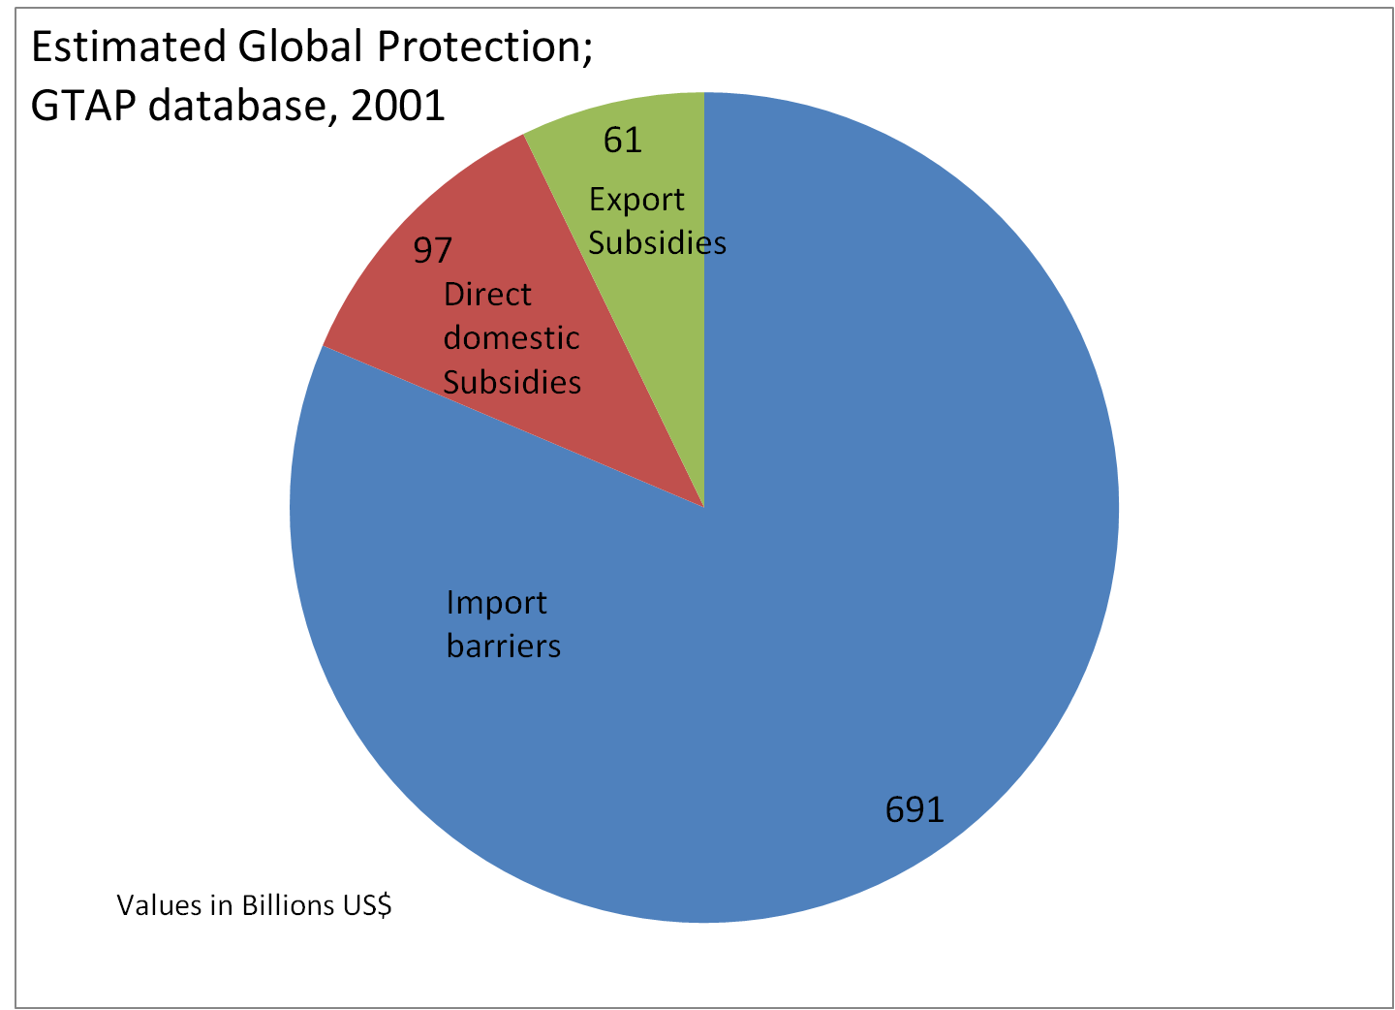
Import barriers by far dominate support for agriculture at global level
46
Notes:
*
07/16/96
*
##

Slide 47

The long term outlook
What is the long-term outlook for global agriculture and what are its main drivers?
How does bioenergy use affect international agricultural markets and prices?
Do we have the resources to feed the world and cater for some of its energy needs?

Slide 48

1. The main drivers of the long-term outlook
The driving forces of demand to 2030
A drastic slow-down in world population growth
12.0
0.9
0.8
9.0
0.7
0.6
0.5
Annual increments (billions)
6.0
Total population (billions)
0.4
0.3
3.0
0.2
0.1
0.0
0
1750
1800
1850
1900
1950
2000
2050
Source: UN, World Population Assessment 2006
Notes:
The population projections we take from the UN. The one we used in this round of work was the Medium Variant of the 2000 round of the UN demographic projections.
For every long-term outlook on global food and agriculture, population growth is the key driving factor. It is one of key drivers for longer-term demand. The dynamics creates its dynamics for food demand. It is, as we will see later, the main reason for a drastic decelerating in global agricultural supply and demand that we expect over the next 30years.
Pop growth peaked in the 1960s with developing countries reaching 2.5% p.a., this has declined to 1.5% currently, will further decline to 1.0% by 2030 and to 0.5% by 2050.
We are at a crucial (inflection) point in the long-term population growth, about a decade ago, the annual increments of the world population started to decline. This does not mean that population growth is over, far from it, but means that growth is slowing down and with a view to 2050, it is slowing down considerably.
The demographers who venture an outlook even beyond 2050 even suggest that there is a good chance that we reach a non-growing, steady state world population between 2050 and 2100, at a level of about 9-10 bn people. Within the 300 year time frame that we have in front of us, such a view point should be allowed. Within this time horizon, we are really close to an entirely new set of conditions for world agriculture, food and way beyond. For world agriculture, a steady state population would, amongst many other things, mean:
End of the treadmill to increase yields
Less pressure to encroach on new land,
Catching up in the race between population growth and food production, and the possibility to focus only on feeding the existing population better, and so on. But we are not yet there!
But within the next 30 years, there will still be a considerable increase of more than 2 billion people. And let me now delve a little bit more into where these people will be living.

Slide 49
The main drivers of the nutrition transition
1. The main drivers of the long-term outlook
Source: UN, World Population Assessment 2007
Notes:
World population will increase from 6.1 billion currently to 9.1 billion in 2050.
More than 100% of the growth is expected to take place in developing countries.
100% of the growth will be urban.
Urbanization:
better infrastructure: roads, ports, cold chains
Proximity to consumers
More processed food, higher processing margins
More convenience food
Change in food trade (imports)
Change in food diets, less roots and tubers, more meat, etc.
Sedentary lifestyles, 10-15% lower calorie expenditures: 2% error in the long-term energy balance leads to obesity!

Slide 50
How much agricultural output needs to be increased by 2050 to feed the world?
The resource outlook to 2050
Absolute increments in percent
future
70
Agricultural production
World
past
148
future
23
Developed
past
63
future
97
Developing
past
255
0
50
100
150
200
250
300
past = 1961/63 to 2005/07; future = 2005/07 to 2050

Slide 51
Where will agricultural growth come from?
Area expansion?
  1.6 billion hectares currently used for crop production, another 2.6 billion with production potential, mostly in SSA and LAC
  but concerns about biodiversity loss, carbon emissions, erosion
  also economic feasibility, but that is changing with prices
Climate change will affect land suitability and yields, but unevenly
  initially adversely in SSA and LAC, positively elsewhere
  eventually adversely in all regions, especially SSA and LAC
Yield increases have accounted for the majority of production growth in recent decades, and will continue to do so in the future
  about half from improved seeds
  about half from increased inputs (esp. water and fertilizer)

Slide 52
The resource base
How much land is in use, how much is available now and in 2030?
1200
1066
1031
1000
874
Suitable for rainfed crop
800
production
Arable land use, 1997/99
million ha
600
497
400
366
220
387
200
228
232
99
265
203
207
86
0
Latin America
sub-Saharan
East Asia
South Asia
Near
Industrialized
Transition
and
Africa
East/North
countries
Economies
Caribbean
Africa
Source: Global Perspective Studies Unit, FAO

Slide 53
Source of growth for the future
Agricultural resource use: state, challenges and options for the future
But production growth in the past came from higher productivity, not from area expansion!
Source: Global Perspective Studies Unit, FAO
Notes:
The lion’s share of future production growth in DCs will come from higher yields (70%); 10% will come from higher cropping intensity (multiple cropping and shorter fallow periods) and 20% from area expansion.
This is largely a continuation of past trends, i.e. the relative importance of yields, area and cropping intensity will remain – by and large - the same (somewhat smaller contribution from yields).

Slide 54
Agricultural resource use: state, challenges and options for the future
Are yield potentials already exhausted?
Wheat: actual versus potential yields
(high input, suitable land, rain-fed)
8
7
Potential
6
Actual
5
t/ha
4
3
2
1
0
USA
Iran
Brazil
Germany
Ukraine
Turkey
Ethiopia
Tanzania
Argentina
Source: Global Perspective Studies Unit, FAO
Notes:
Let me make clear again how we arrive at these estimates and what these numbers mean. The basis for the calculation of the potential yields is the so-called global agro-ecological zone (GAEZ) data base, jointly developed by IIASA (International Institute for Applied Systems Analysis) and FAO. This data base is essentially a multi-layered map of the agro-ecological conditions (soil quality, location, altitude, inclination, rainfall, temperatures (high, low, average), water retention capacity, etc, etc.) The information is available on a very detailed level, i.e. on grid cells of 5x5 km. With this information, we are able to identify grid cells with largely identical agro-ecological conditions. We then compare the yields on these grid cells. Differences in yield under the same natural growing conditions are used as an indicator for the yet untapped yield potential, as they must result from different management skills, different economic incentives (product and input prices), policies, etc. In other words, if farmers in the low-yield environment had the same skills and incentives as those in the high-yield environment, they could raise yields without being constraints by biological/genetic limits. Let me finally emphasize in this context that we can also assume that the genetic limits - as they exist today - will be pushed up to higher levels in the future. Particularly biotechnology affords us with a considerable potential for shifting the biological yield frontier higher up.
Nonetheless, it is important to note that even if no more new technologies become available, there is still scope for increasing crop yields in line with requirements. Indeed, if just 11 of the countries that produce wheat, accounting for less than 40% of world production, were to bridge only half the gap between their maximum obtainable and their actual yields, then the world’s wheat output would increase by almost a quarter.

Slide 55
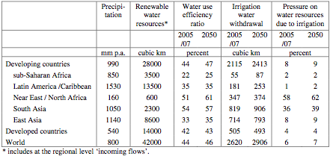
Is there enough Water?

Slide 56
Agricultural resource use: state, challenges and options for the future
Is there enough water?
Irrigation water withdrawal as a share
of renewable water resources (%)
70
60
Today
in 2030
50
40
30
20
10
0
South Asia
East Asia
sub-Saharan Africa
Latin America
Near East/North Africa
All developing countries
Source: Global Perspective Studies Unit, FAO
Notes:
Only about 7% of renewable water resources in DCs were withdrawn for irrigation in 1997-99. 2% in sub-Saharan Africa, 1% in water-rich Latin America, but 36% in South Asia and 53% in Near East/North Africa.
The importance of irrigation is expected to increase further in the next three decades. Based on the potential for irrigation, national plans for the sector and the moisture needs of crops, the developing countries as a whole can be expected to expand their irrigated area from 202 million ha in 1997-99 to 242 million ha by 2030
Although the projected expansion is ambitious, it is less daunting than what has already been achieved. Since the early 1960s, no less than 100 million ha of new irrigated land have been created. The net increase projected for the next three decades is only 40% of that. The expected annual growth rate of 0.6% is less than a third of the rate achieved over the past 30 years.

Slide 57
Biofuels in 2020 and 2030
Projections in Million Tons Oil Equivalent
TARGET V1 TARGET V3
2020 2030 2020 2030
Developed Countries
Transport Fuels 1505 1486 1505 1486
1st Gen. Biofuels 113 146 79 87
2nd Gen. Biofuels 5 32 39 91
Biofuels in Transp Fuel 8% 12% 8% 12%
Developing Countries
Transport fuels 1174 1529 1174 1529
1st Generation Biofuels 72 112 69 94
2nd Generation Biofuels 0 4 2 22
Biofuels in Transp Fuels 6% 9% 6% 9%
Dev’d ctries. United States, European Union, Japan, Canada, Australia ...
D’ing ctries Brazil, China, India, Indonesia, Thailand, South Africa …
Notes:
57

Slide 58

Suitability for rain-fed
Sugar cane production, high input level
Potential VS and S Land
Current Land 135 Mill Ha
Forests 228 Mill Ha
Grasslands 87 Mill Ha
Current Sugarcane Land 22 mill Ha (Brazil + India 50%)
Notes:
58

Slide 59
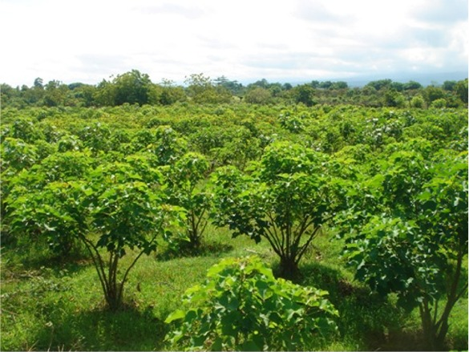
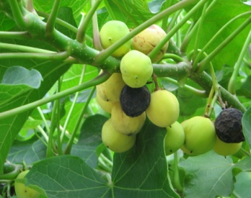
Suitability for rain-fed
Jatropha production
Potential VS and S Land Mill Ha
Jatropha Developed Developing
Current Land 17 286
Forests 28 348
Grasslands 6 264
Current Land - 1.5
Notes:
59

Slide 60
Impacts of first-generation biofuels on agricultural prices in 2020
Notes:
60

Slide 61
Change of cereal use relative to baseline REF-01, in 2020
a) Change in direct food use
b) Change in feed use
Notes:
61

Slide 62
Risk of hunger in REF-01 and TAR-V1 scenarios
a) Scenario REF-01
b) Scenario TAR-V1
Notes:
62

Slide 63
In summary …
Strong increases in global demand for agricultural products, about 70 percent in 2050 compared to 2000.
Expected increasing integration of agriculture, forestry and energy sectors through land competition for biomass.
Limited availability of additional high-quality land for 4F sectors; uncertainty regarding viability of using marginal land.
Growing risks of yield damage due to extreme weather episodes; widespread negative climate change impacts after middle of century.
Notes:
63

Slide 64
New challenges for the international agricultural trading system
Recent food crisis created mistrust of the international trading system and moves to promote food self sufficiency
Many middle and high income NFIDCs started thinking about investments in food production in other countries with contractual commitments to buy back products. This is likely to change world trade patterns for agricultural products.
There will be a growing need for medium and long term supply arrangements with main exporters
To promote developments along agricultural comparative advantage, need to create system to assure net food importing countries (both developing and higher income) that their physical import supplies can be guaranteed through imports
Will need to create system to manage increased price volatilities
Will need system to ensure low income food deficit countries appropriate finance to import in times of high food prices
Freer trade has increased concentration. Need to define competition rules for international agrifood trade
Lower protection has seen increase in application of standards (especially private ones). Will need system to regulate the proliferation of such standards

Slide 65
Climate change. Concentration and temperature
65
Concentration (left axis)
Temperature (right axis)
Source: Simulation results with World Bank’s ENVISAGE model.
Notes:
65
Insert a map of your country.

Slide 66
Figure TS.3. Regional temperature and precipitation changes across a range of models to end of 21st century

Slide 67
Potential impact of climate change
Real income, percent difference from baseline with no damage in 2030
Source: Simulations with World Bank’s ENVISAGE model.
Notes:
67

Slide 68
Sensitivity of cereal yield to climate change

Slide 69
Potential impact on agricultural production due to climate change—without carbon fertilization effect
Losses
25+ %
15-25%
5-15%
0-5%
Gains
25+ %
15-25%
5-15%
0-5%
Not
Available
Source: Cline 2007.

Slide 70
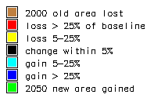
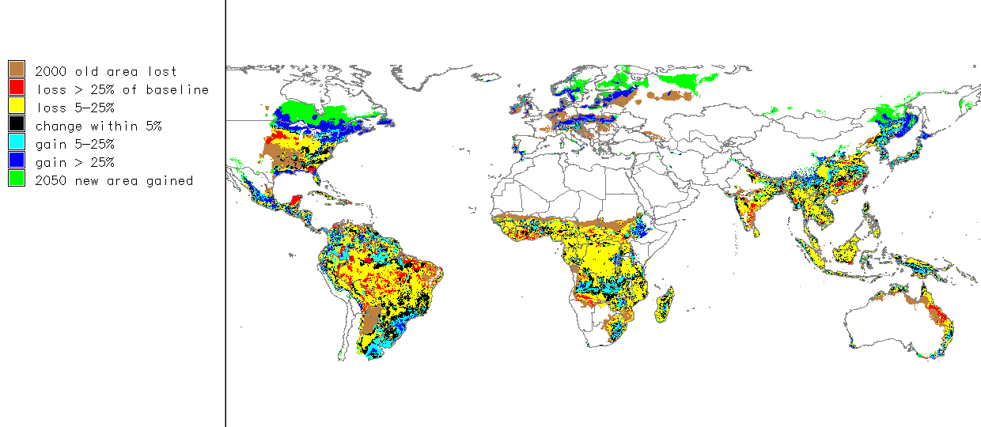
Climate Change Effects on Maize Yield - Global rainfed maize yields decline by 17%
Hadley GCM, SRES Scenario A2a, Maize Variety IB0041
Source: G. Nelson, J. Koo, R. Robertson, “Simulating the Yield Consequences of Climate Change: Combining Crop Models with Location-specific Climate and Physical Constraints” , EPTD, IFPRI, in draft
Notes:
70

Slide 71
Impact of climate change on land suitability and potential production of cereals on current rainfed cultivated land
Notes:
71

Slide 72

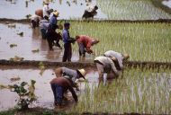
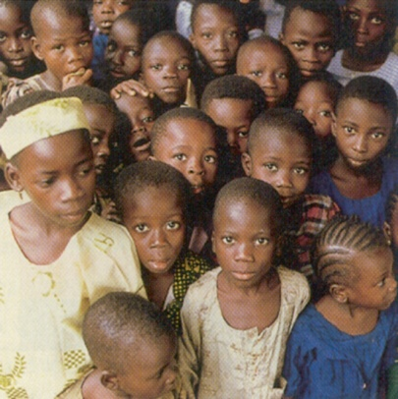
Impacts of Climate Change 1:
The impacts of climate change on crop production are geographically very unevenly distributed and aggregate global figures reveal little.
Autonomous adaptation (planting dates, cultivar changes, moisture conservation tillage, deploying irrigation where economical, switching crops) will offset some (gradual) warming (temperate climate +3-5°C, tropics +0-2°C).
Aggregate impacts of projected climate change on the global food system are relatively small. The global balance of food demand and supply is not likely to be challenged until middle of the century.
Notes:
72

Slide 73
Impacts of climate change on regional
net irrigation water requirements in 2080
HADCM3 A2
271 million ha irrigated out of total 1540 million ha cultivated (~ 18 %).
Agriculture uses 2630 billion m³ out of 3816 billion m³ annual water withdrawals (~ 70%).
On average, annual global crop water deficit is 500 mm (i.e., 1350 billion m³ in 2000); about 970 mm water per irrigated hectare were applied.
Notes:
73

Slide 74

Impacts of Climate Change 2:
While atmospheric changes (CO₂ fertilization) may initially increase productivity of current agricultural land, climate change, if not halted, will have a clearly negative impact in the second half of this century.
Changes in frequencies of extreme events (droughts, heat waves, severe storms) are more troublesome in the near term than gradual changes in average conditions.
Impacts of climate change on increasing net irrigation water demand could be as large as changes projected due to socio-economic development in 2000-2080.
Notes:
74

Slide 75
Trends in causes for food emergencies, 1986-2007

Slide 76
Adaptation to Climate Change
Farmers in developing countries have adapted to more extreme climate change in the past
Scientific research, new technology, infrastructure, and higher growth and profits should make adaptation easier
Specific adaptations needed are not predictable at this time
General capacity to adapt to change and to extreme weather needs strengthening
Notes:
76

Slide 77
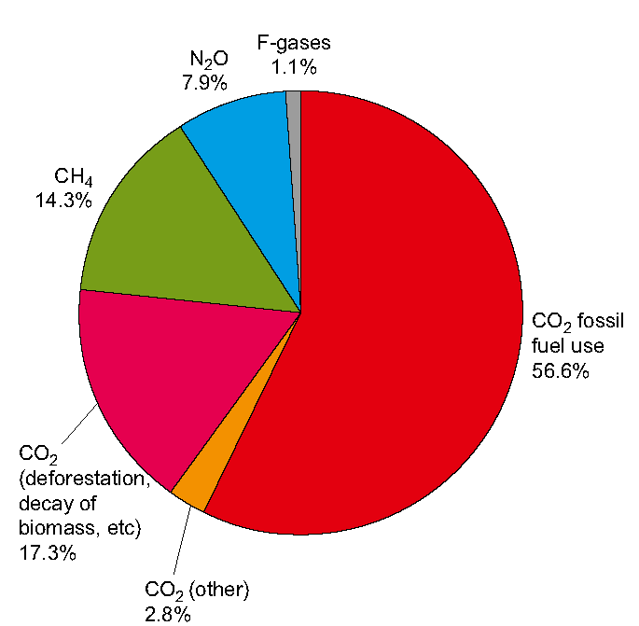
Agriculture is an important emitter of GHGs.
Emissions by sector (2004)
70 % N₂O
50 % CH₄

Slide 78
Sources of GHG emissions
Key sources of GHG emissions from agriculture
  Agricultural soil management
  Enteric fermentation
  Manure management
  Rice cultivation
  Biomass burning (savannah and grassland burning, agricultural residues
  Land use and land-use change
  Fossil fuel combustion during inputs manufacture, production, processing and transport

Slide 79
Drivers of Greenhouse Gas Emissions from Agriculture
Demand drivers
  Population growth
  Urbanization
  Income growth
  Changing dietary patterns
  Demand for inputs by non-food sector

Slide 80
Demand drivers: Income growth
Per capita GDP growth rates

Slide 81
Demand drivers: Dietary changes (1)

Slide 82
Demand drivers: Dietary changes (2)
Rising incomes and changing dietary patterns

Slide 83
Demand drivers: Non-food sector demand for inputs
Industrial use
  oilseeds for paints, detergents, lubricants, oleochemicals
  8 to 25 million mt
  oilseeds (1980s – 2006)
Biofuel production
  demand for feedstock
    maize, sugarcane, palm oil, rapeseed, sugar beet, sorghum, cassava
USA: 20% of corn and 15% of sorghum for ethanol production (2006)
BRAZIL: > 50% of sugar cane for ethanol production (2005)
EU:37% oilseeds, 4.3% sugar beet, 0.2% of cereals(2005)

Slide 84
Drivers of greenhouse gas emissions
Supply Drivers
  Technological innovations
    advanced breeding and feeding techniques, genetic improvement, improved crop varieties, irrigation, agrochemicals, mechanization
  Trade Liberalization and FDI in agriculture
  Changing production systems

Slide 85
Supply drivers: Technological Innovations
Irrigation techniques
Fertilization techniques
Improved crop varieties,
Mechanization
Advanced breeding and feeding techniques
Improved animal genetics
Agrochemicals
Animal health improvements

Slide 86
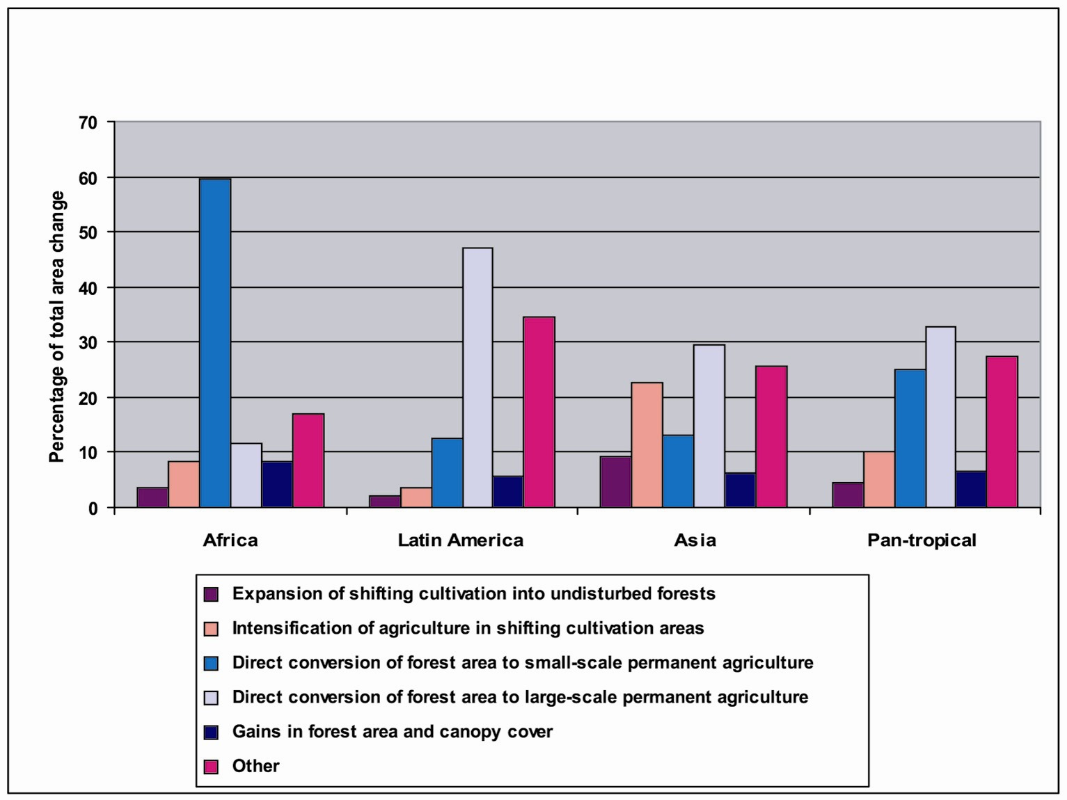
Regional Forest Area Change
Notes:
In Asia and Latin America 30 respectively 48 % of forest conversion is done for later large scale production of agricultural crops or cattle raising, and only about 10 % for small scale farming, while in Africa small scale farming accounts for 60 % of the land-use change.

Slide 87
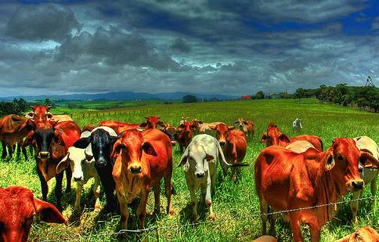
Forest Conversion for
Agricultural crop production
(small & large scale)
Cattle raising
Land speculation
Infrastructure & mining
Only minor % for logging!!!
Bio-fuel production ???
Notes:
The major percentage of forest conversion aims at agricultural production and cattle raising – certainly with regional differences.
In some regions land speculation leads to forest conversion
Other enduses of former forest land are mining or infrastructure.
Only a minor percentage of forests are converted due to logging. On the other hand, logging provides windfall profits when forest areas are converted to other land-uses.
With the new impetus on biofuels there is a high likelihood that forests will also be converted for biofuel production.

Slide 88
Conclusions
Climate change affects and is affected by agriculture
Climate change will affect location and variability of agricultural production
Climate change induced food crises are likely to increase
Increases in food insecurity and undernourishment are likely to be largest in already vulnerable and poor regions and populations
Rising petroleum demand and biofuel induced demand for feedstocks is new global agricultural market factor that may alter the global agricultural market trends
Climate change is a manageable challenge and presents opportunities for carbon sequestration
Adaptation requires mainstreaming of climate change into a general agricultural development strategy: Technology, markets, risk management
Aimed at improving adaptation capacity, not specific adaptations
Unless considerable resources are dedicaed to improving incomes and resilience in poor vulnerable countries (sub-Saharan Africa, North Africa, Middle East, South Asia) undernourishment and food insecurity will rise, and may induce large population movements

Slide 89
THANK YOU

