Slide 1
The shifting paradigm of the
Common Agricultural Policy: drivers and impacts for EU and international agricultural policies
Economics Department, University of Athens
Athens, 11 March 2014
Tassos Haniotis
Director, Economic Analysis, perspectives and evaluations
DG Agriculture and Rural Development
European Commission

Slide 2
Outline
Part 1. Drivers of the food security debate
Part 2. Drivers of CAP reform
Part 3. EU and international policy implications

Slide 3
Part 1. Drivers of the food security debate
Where are we today and how did we end up here?
  From price volatility, to food security and productivity concerns
  Uni- and multi-dimensional interpretations of price volatility
  Identifying trends and drivers in market developments

Slide 4
Annual real commodity price indexes
Source: World Bank

Slide 5
Annual real farm prices, area and yield
Source: World Bank, USDA, OECD-FAO

Slide 6
Did the price talk match the price walk?
What sort of "insecurities" drove the "price talk"?
  The three-dimensional commodity price focus: volatility, co-movement, level
  Price volatility and co-movement initially led the debate, but seem to be declining
  The agricultural price level, despite initial expectations, continues to remain high
The "price talk": alternative, but uni-dimensional approaches
  The demand story: global population and income growth, China and India
  The stock level story: is it, or is it (at least) not (just) the stocks that matter?
  The speculation story: commodities as assets, and the impact from financialisation
The "price walk": energy link and its potential implications
  Biofuels: initially the main focus, but recent developments place impact in context
  The shale gas "revolution": direct and indirect impacts throughout the economy
  The supply/demand gap, and the potentially differential impacts across countries

Slide 7
Placing differing views into perspective
Income growth by emerging economies as the main driver of food prices
  Krugman (2008), Wolf (2008), National Geographic (2009), especially in China/grains
  Others assume similar impact [Roberts and Schlenker (2013); Hochman et al. (2011)]
  Conditions of "perfect storm" strengthened belief of reversal of past trends
Engel's law in the background…
  “[t]he poorer a family, the greater the proportion of its total expenditure that must be devoted to the provision of food”
  “… the wealthier a nation, the smaller the proportion of food to total expenditure”
…and Kindelberger into the picture
  “[t]he terms of trade [ToT] move against agricultural and raw material countries as the world’s standard of living increases…and as Engel’s Law of consumption operates
  “[i]f the agricultural and raw material countries of the world want to share the increase in the world’s productivity, … they must join in the transfer of resources from agriculture, pastoral pursuits, and mining to industry.”

Slide 8
Indeed, per capita income grew a lot … (in US$, PPP)
World
China & India
Source: World Bank

Slide 9
.. but so did prices in manufacture and in agriculture
Manufacture
Agriculture
Source: World Bank

Slide 10
Food security drivers
Macro linkages (GDP, interest rates, exchange rates)
Domestic and trade policies (from G-2 and 3 pillars to G-20 and export bans)
Weather variability increased due to climate change
Food supply and demand interaction
Energy links (high energy prices, biofuels)
Financialisation of commodities
Research, Innovation, Productivity

Slide 11
Level of GDP - major economies
Source: Global Insight.

Slide 12
Level of GDP - BRICs
Source: Global Insight.

Slide 13
Annual GDP growth rate – major economies
Source: World Bank.

Slide 14
Annual GDP growth rate – BRICs
Source: World Bank.

Slide 15
Currency moves with respect to the US dollar
Source: Global Insight.

Slide 16
Food security drivers
Macro linkages (GDP, interest rates, exchange rates)
Domestic and trade policies (from G-2 and 3 pillars to G-20 and export bans)
Weather variability increased due to climate change
Food supply and demand interaction
Energy links (high energy prices, biofuels)
Financialisation of commodities
Research, Innovation, Productivity

Slide 17
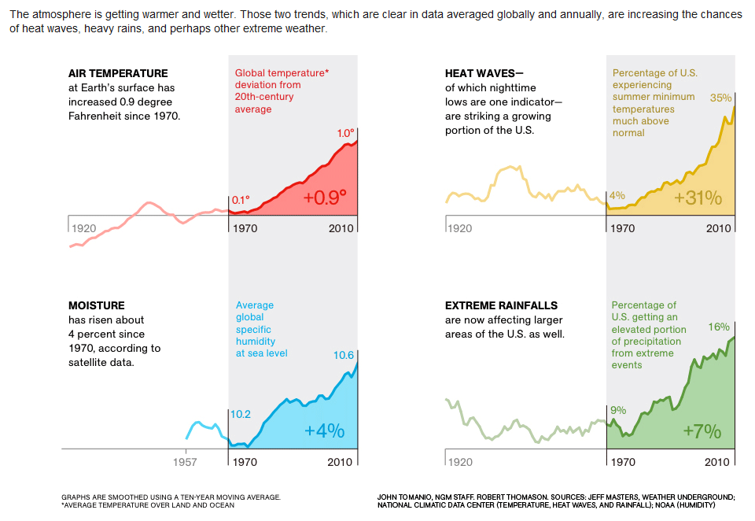
Weather trends
Source: National Geographic Magazine, September 2012.

Slide 18
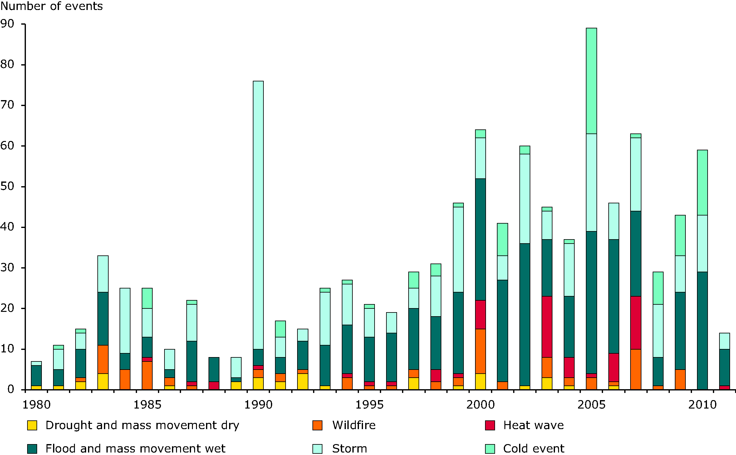
Reported extreme weather events and wildfire in Europe
Source: Munich RE, NatCatSERVICE 2012.
Notes:
Source: NatCatSERVICE database (NatCatSERVICE, 2012) maintained by Munich RE (an insurance company in DE) that provides data on insured and overall losses.
This figure shows the yearly number of extreme weather events (cold, storm, flood and wet mass movement, heat wave, wildfire, drought and drymass movement dry) in EEA member and collaborating countries in the period 1980 - 2011.

Slide 19
Food security drivers
Macro linkages (GDP, interest rates, exchange rates)
Domestic and trade policies (from G-2 and 3 pillars to G-20 and export bans)
Weather variability increased due to climate change
Food supply and demand interaction
Energy links (high energy prices, biofuels)
Financialisation of commodities
Research, Innovation, Productivity

Slide 20
Biofuels consumption
In million tonnes of oil equivalent (or 1.5% of 2013 global oil demand)
Source: DG Agriculture and Rural Development Outlook based on OECD-FAO, Eurostat and ENERDATA
Note: In 2012 world consumption took a rest in its upward trend, the low US maize production and the possibility to roll-over mandates between years caused this temporal occurrence.

Slide 21
US energy prices…
Source: World Bank.
21

Slide 22
…and their link to world natural gas prices
( $ per mmbtu )
Source: World Bank.
22

Slide 23
Food security drivers
Macro linkages (GDP, interest rates, exchange rates)
Domestic and trade policies (from G-2 and 3 pillars to G-20 and export bans)
Weather variability increased due to climate change
Food supply and demand interaction
Energy links (high energy prices, biofuels)
Financialisation of commodities
Research, Innovation, Productivity

Slide 24
Commodity assets under management (US $ billion)
Source: BarclayHedge

Slide 25
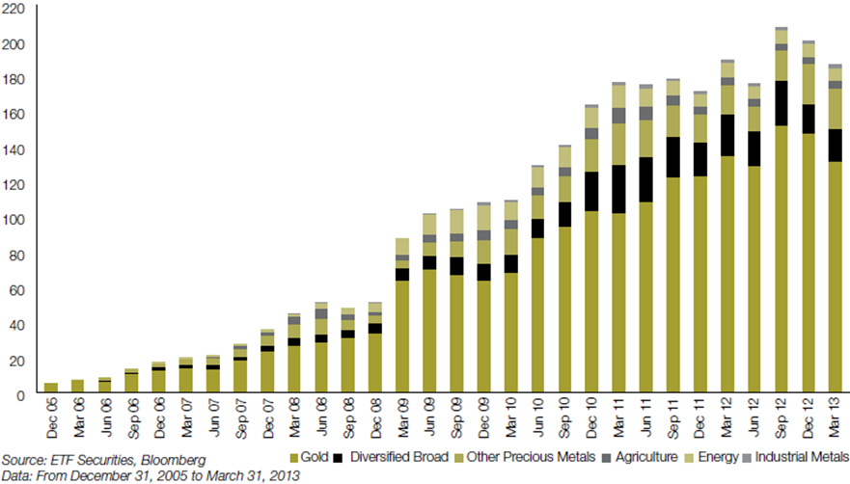
Global commodity Exchange-Traded Products (ETP)
Quarterly, USD billions

Slide 26
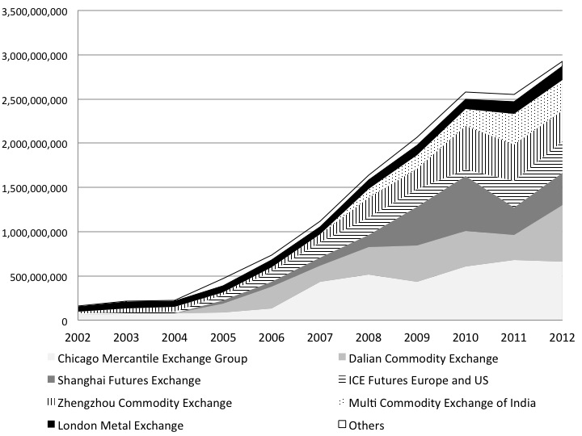
Growth of commodity futures, number of contracts
Source: CEPS report "Price formation in commodities markets"

Slide 27
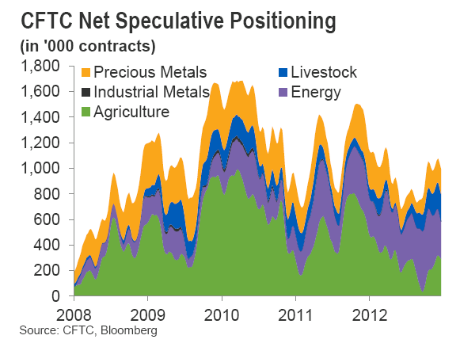
Financialisation

Slide 28
Food security drivers
Macro linkages (GDP, interest rates, exchange rates)
Domestic and trade policies (from G-2 and 3 pillars to G-20 and export bans)
Weather variability increased due to climate change
Food supply and demand interaction
Energy links (high energy prices, biofuels)
Financialisation of commodities
Research, Innovation, Productivity

Slide 29
Trade – value of exports of agricultural products
Sources: Comtrade (1993-2002) and GTA (2003-2012).

Slide 30
Food security drivers
Macro linkages (GDP, interest rates, exchange rates)
Domestic and trade policies (from G-2 and 3 pillars to G-20 and export bans)
Weather variability increased due to climate change
Food supply and demand interaction
Energy links (high energy prices, biofuels)
Financialisation of commodities
Productivity, Research, Innovation

Slide 31
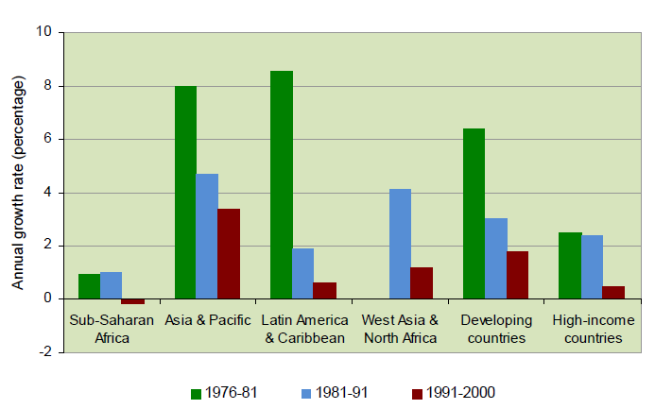
Annual growth rate in agricultural research

Slide 32
Food security drivers
Macro linkages (GDP, interest rates, exchange rates)
Domestic and trade policies (from G-2 and 3 pillars to G-20 and export bans)
Weather variability increased due to climate change
Food supply and demand interaction
Energy links (high energy prices, biofuels)
Financialisation of commodities
Research, Innovation, Productivity

Slide 33
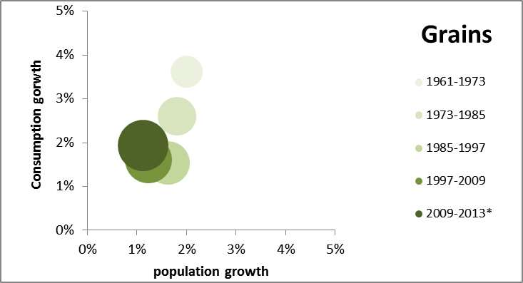
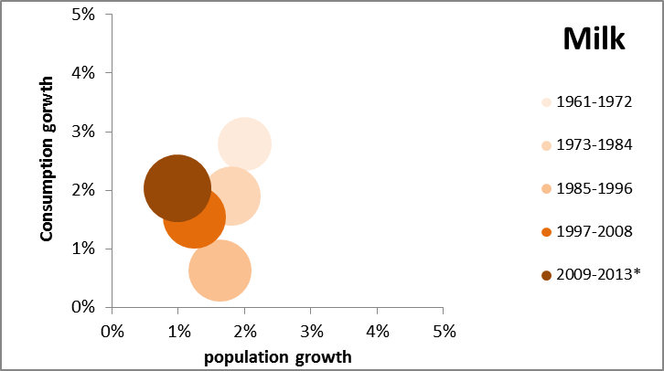
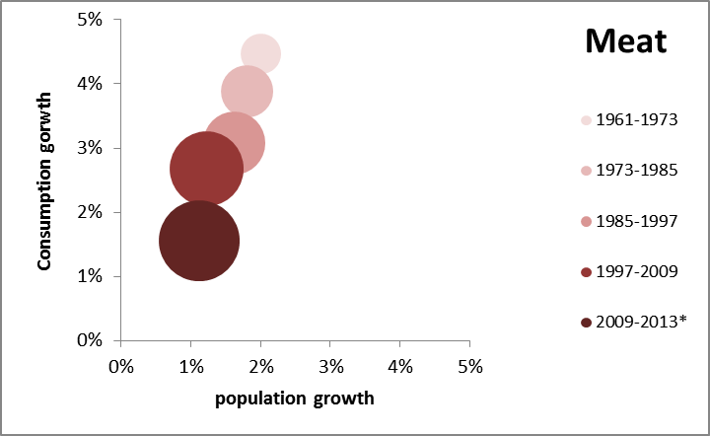
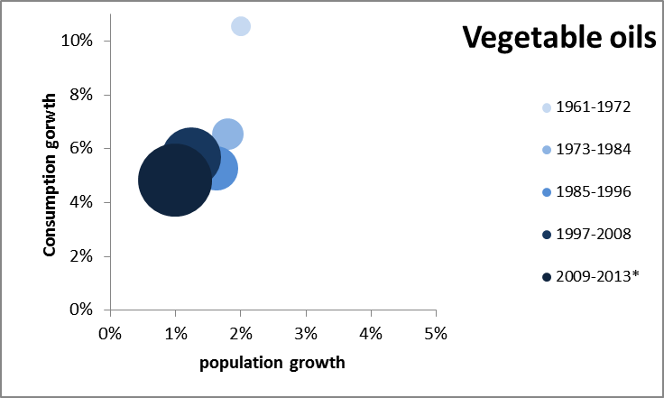
World annual growth: consumption vs population (%)
* provisional/estimation for 2012-2013.
Size of bubbles represents total average consumption over the period.
Sources: FAO, OECD, USDA

Slide 34
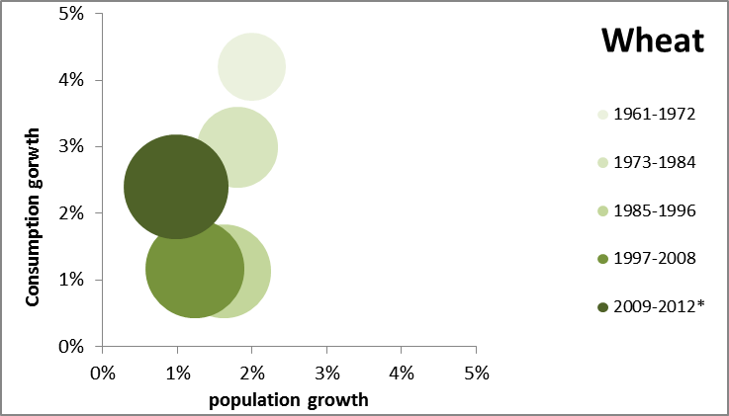
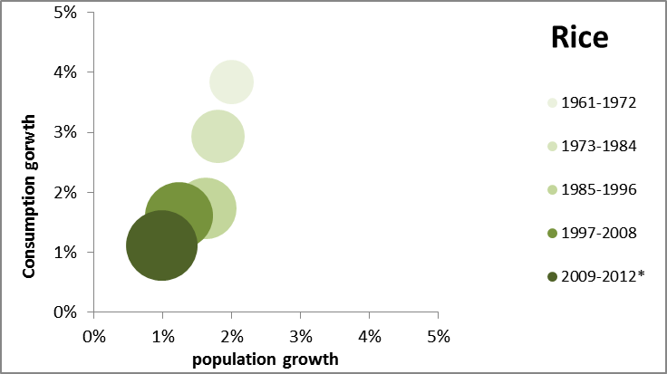
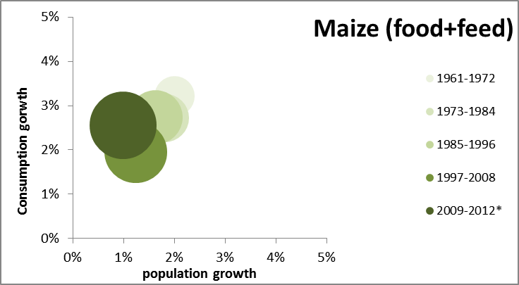
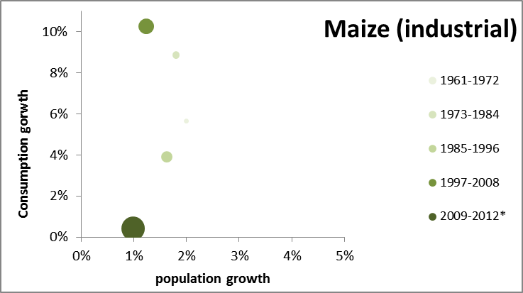
World grain demand: annual growth rates (%)
* Data on 2013 not homogeneous.
Size of bubbles represents total average consumption over the period.
Sources: FAO, OECD, USDA

Slide 35
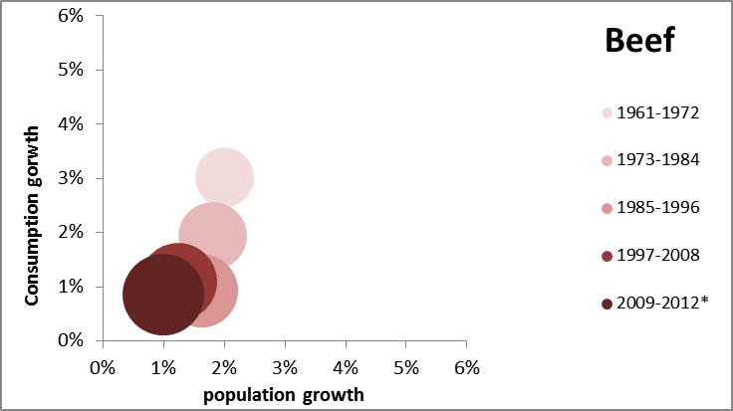
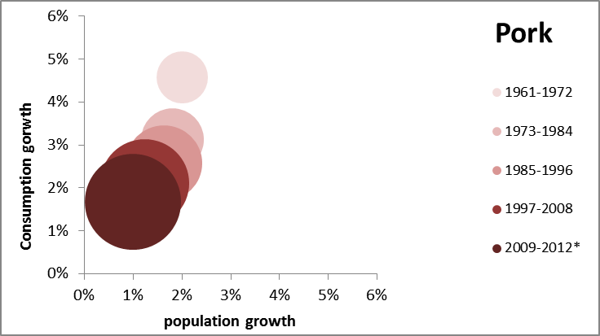
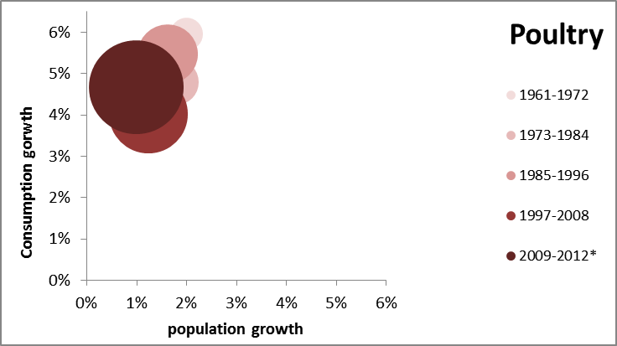
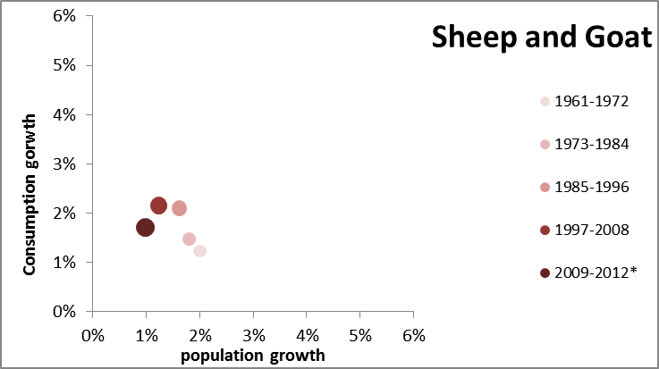
World meat demand: annual growth rates (%)
* Data on 2013 not homogeneous.
Size of bubbles represents total average consumption over the period.
Sources: FAO, OECD, USDA

Slide 36
Changes in grain demand, 2005 to2012
Sources: Comtrade (1993-2002) and GTA (2003-2012).

Slide 37
Part 2. Drivers of CAP reform
Four basic questions of (any) reform
  How much?
  How much?
  Why?
  How?

Slide 38
How much: the path of CAP expenditure 1980-2020
EU-10
EU-12
EU-15
EU-25
EU-27
Source: DG Agriculture and Rural Development.
Notes:
Notes:
2011 = Budget; 2012 = Draft Budget; 2013 = EAGF subceiling for direct payments and market-related expenditure + pillar 2 in commitments.
Rural development for 2013 includes UK voluntary modulation and Article 136 “unspent amounts”. As these cease to exist end 2013, the corresponding amounts are put back to direct aids as from 2014.

Slide 39
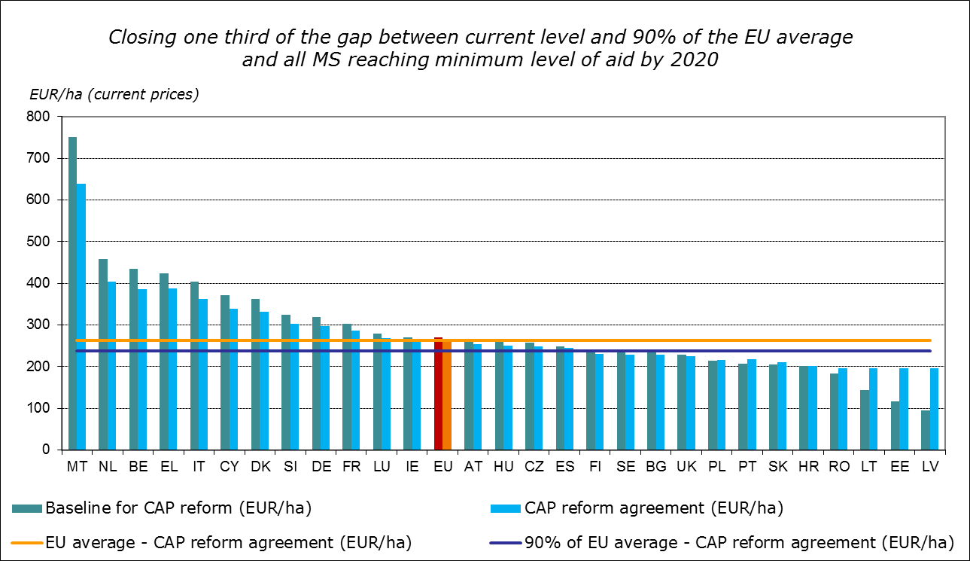
For whom: redistribution of Direct Payments
Source: DG Agriculture and Rural Development.
Notes:
Source: Impact Assessment
Updated: 31.8.2011
EU-27 average = 266.7 EUR/ha

Slide 40
Why: the main drivers of CAP reform
What sort of "insecurities" drive the current policy debate?
  Commodity price developments: volatility, co-movement and level
  Supply concerns: terms of trade, productivity, climate change
  Demand concerns: food chain "bottlenecks" in price transmission, economic crisis
The CAP reform process can be viewed as an effort to address
  Market failures, especially those linked to economic and environmental sustainability
  Policy failure in areas linked to the fairer distribution and "green" targeting of support
  ″Jointness″ in delivery of private and public goods (one as prerequisite for the other)
The CAP shifts its focus and its policy paradigm
  Retargeting of support shifts reference from farmer/beneficiary to (fixed) land
  "Greening" in all its aspects moves focus to condition support on land use
  Research, Innovation, Monitoring and Evaluation to better target land use changes

Slide 41

The objectives of CAP reform
Challenges
Policy objectives
Reform objectives
Economic
Viable food production
Enhanced
competitiveness
Fairer
Environmental
Sustainable management of natural resources and climate action
Improved
sustainability
Greener
Territorial
Balanced territorial development
Greater
effectiveness
Simpler
Notes:
During the consultation process before and after the Communication of November 2010, one of the main issue concerns the challenges and objectives of the CAP for the future. Three broad areas are at the core of the CAP - viable food production, sustainable management of natural resources and balanced territorial development.
Viable food production implies a need to contribute to farm income and limit income volatility; we don't want farmers to face an environment of fixed income. We want them to get a market signal, that has been the philosophy of the reforms of the last 15 years, but we want them to be able to minimize/mitigate this volatility with a certain level of fixed income support. We need to further improve the competitiveness of the agricultural sector and more importantly to increase its share of the food chain value added and to compensate areas that do have natural constraints.
Through the sustainable management of natural resources, we need to guarantee the provision of public goods, stemming from agricultural activities, to promote green growth through innovation (and that is a very direct link to the Europe 2020 strategy) and to pursue climate change mitigation and adaptation with the strategies throughout all agricultural areas.
And finally, with respect to the balanced territorial development, we want to continue supporting rural vitality and employment, promote diversification in agricultural areas and allow social structural diversity in rural areas. That doesn't mean that we want to stop structural changes, as we are often criticized; it implies to accommodate structural change with the type of measures that would allow the farmers that stay in these regions to become more competitive, and the ones that leave agriculture in these regions, hopefully to find other type of employment in the same area.

Slide 42
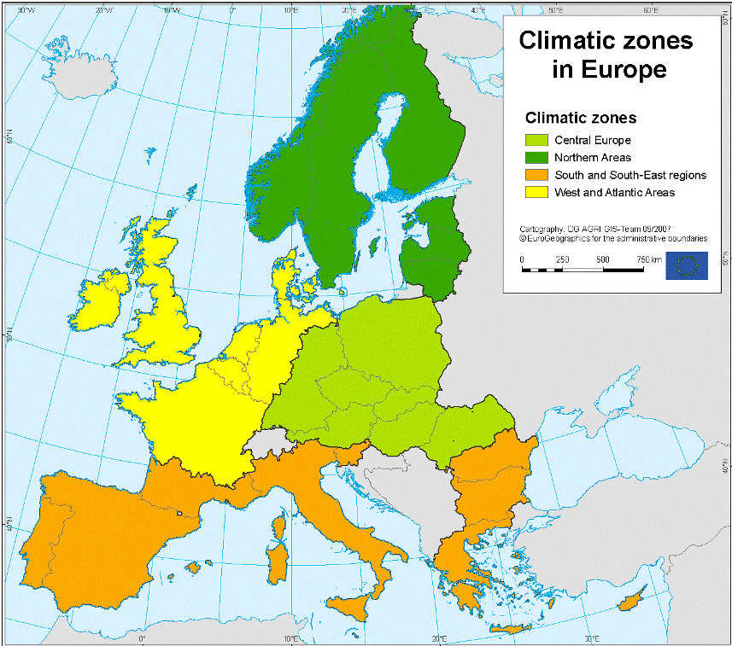
Climate change – Possible impacts on EU agriculture
▲ Floods risk
▲ Hotter and drier summers
▲ Sea levels
▲ Risk crop pests, diseases
▲ Crop, forage yields
▼ Animal health, welfare
▼ Summer rainfall
▲ Winter storms, floods
▲ Length growing season, yields
▲ Suitable farmland
▲ Pests, diseases risks
▲ Winter rainfall, floods
▼ Summer rainfall
▲ Risk drought, water stress
▲ Soil erosion risk
▲ Yields, range of crops
▼ Water availability
▲ Risk drought, heat spells
▲ Risk soil erosion
▼ Growing season, crop yields
▼ Optimal crop areas
Source: DG Agriculture and Rural Development, based on EEA reports, JRC and MS academic studies.

Slide 43
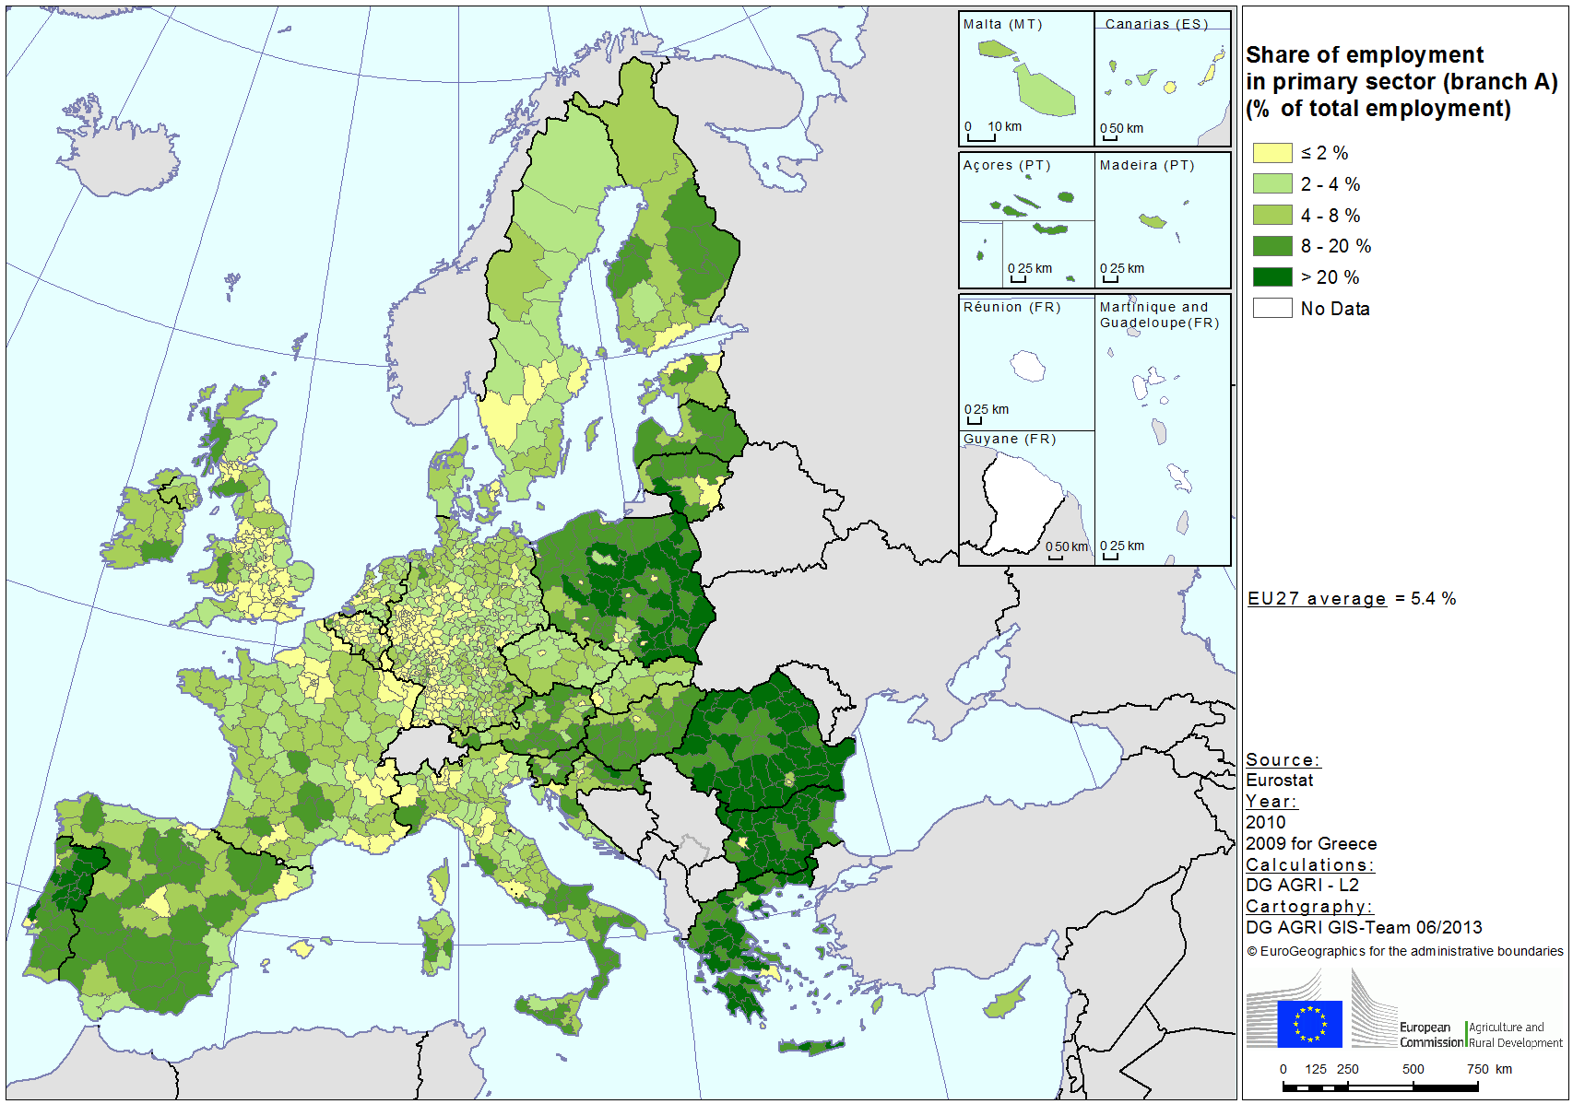
Importance of primary sector in employment

Slide 44
How: the future CAP at a glance
Enhanced
competitiveness
Improved
sustainability
Greater
effectiveness
Enhanced market orientation |  | Greener Direct Payments |  | Improved targeting
Better functioning of the food supply chain |  | Greener Rural Development |  | More equitable distribution
Bridging the gap between knowledge and practice |  | Increased focus on research and innovation |  | Strategic approach to spending

Slide 45
How: enhanced competitiveness
Enhanced market orientation
Phasing out of quotas and other restrictions to production
Streamlining market measures; enhancing the safety net
Strengthening the crisis management mechanism
Better
functioning of the food supply chain
Reinforced framework for POs and IBOs
Financial support for creation of Producer Organisations
Strengthened support to short supply chains
Bridging the gap between knowledge and practice
European Partnership for Innovation in Agriculture
Enhance agricultural research and knowledge transfer
Enhance Farm Advisory Services

Slide 46
EU-28 agricultural trade structure, 2003-13

Slide 47
EU competitiveness - Wheat
101.31
Source: elaboration by DG Agriculture and Rural Development

Slide 48
EU competitiveness - Beef
347
324
301
156
Source: elaboration by DG Agriculture and Rural Development

Slide 49
EU competitiveness - Milk
282
263
244
225
220
215
Source: elaboration by DG Agriculture and Rural Development

Slide 50
How: improved sustainability
Greener direct payments
Introduce mandatory "green" practices at farm level
Link these practices to 30% of direct payment budget
Reinforce cross-compliance
Greener rural development
Priorities on "resource efficiency" & "eco-systems"
Enhance ambition for environment/climate measures
Mandatory min of 30% for environmental actions spending
Increased focus on research and innovation
European Partnership for Innovation in Agriculture
Enhance agricultural research and knowledge transfer
Enhance Farm Advisory Services

Slide 51
How: greater effectiveness
Improved targeting
Provisions for active farmer and young farmers
Green payment
Specific support to regions, sectors and farm size
More equitable
distribution
Convergence of payments among MS
Convergence of payments among farmers
Flexibility in choice of regionalisation for MS
Strategic approach to spending
Improved integration with other EU policies
Strategic approach in rural development programming
Improved monitoring and evaluation of policy

Slide 52
The new greening architecture of the CAP
Agricultural Research
Implementation mechanism
European Innovation Partnership
Farm Advisory System
Voluntary
with compensation
for cost incurred
and income forgone
Rural
development
Cumulative environmental benefits
Mandatory
with financial
support
(decoupled “green”
payment per hectare)
Greening
Cross compliance
Regulatory
(Statutory
Management
Requirements and
Good Agricultural
Environmental
Conditions)
Agricultural area
(eligible for direct payments)

Slide 53
Part 3. EU and international policy implications
A non-exhaustive list of policy responses for discussion
  Back to the EU, the US and the WTO? Most likely not…
  The shifting role of agriculture in trade negotiations
  The G20 and beyond – in search for productivity gains

Slide 54
The shifting balance of constant needs
Food
Population, income
and demand drivers
Policy challenges
in globalised
markets
Fibre
Fuel
Supply constraints
and productivity
Feed

Slide 55
Two relevant examples of agriculture's transition
1. The role impact of income growth on agriculture
2. The transformation of Brazilian agriculture
These examples are based on presentations made at the 2013 IATRC Symposium on
"Productivity and Its Impacts on Global Trade"
All presentations are available here:
http://www.iatrcweb.org/

Slide 56
1. Shifts in income and in the role of agriculture
Presented by Julian Alston at the 2013 IATRC Symposium on
"Productivity and Its Impacts on Global Trade"

Slide 57
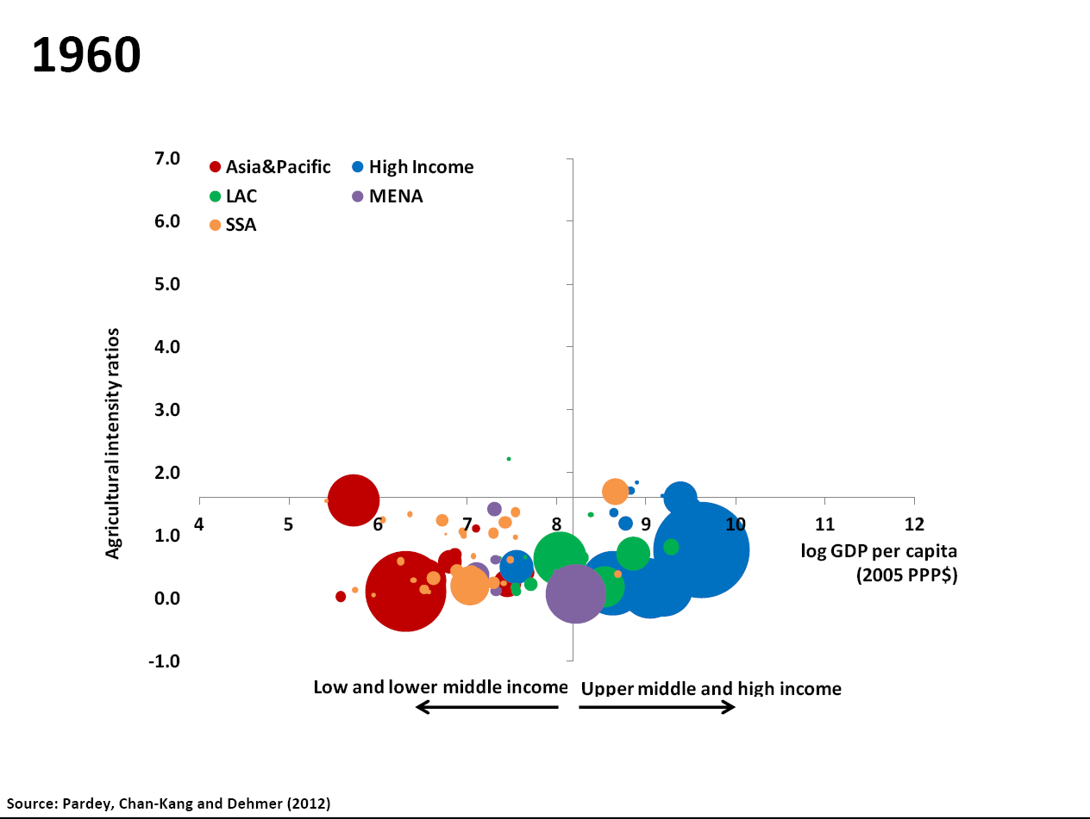
Source: Julian Alston, University of California, Davis 2013 IATRC Symposium, June 2-4 2013

Slide 58
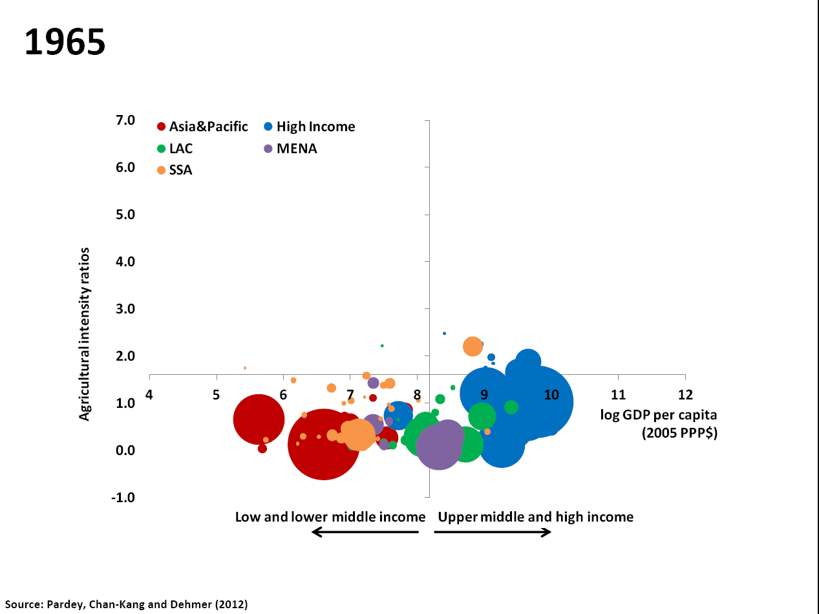
Source: Julian Alston, University of California, Davis 2013 IATRC Symposium, June 2-4 2013

Slide 59
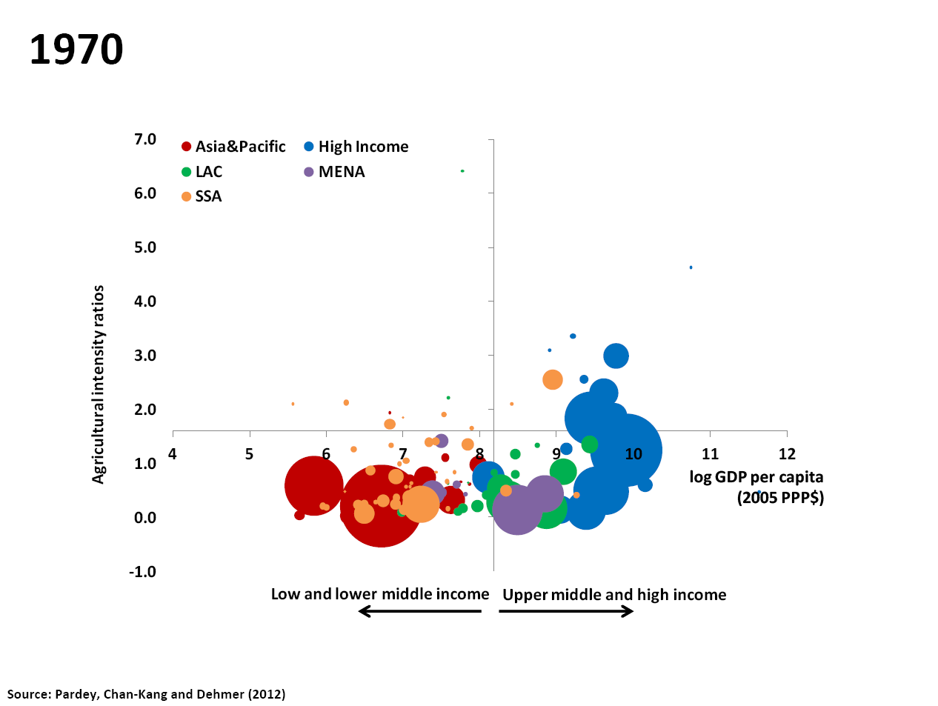
Source: Julian Alston, University of California, Davis 2013 IATRC Symposium, June 2-4 2013

Slide 60
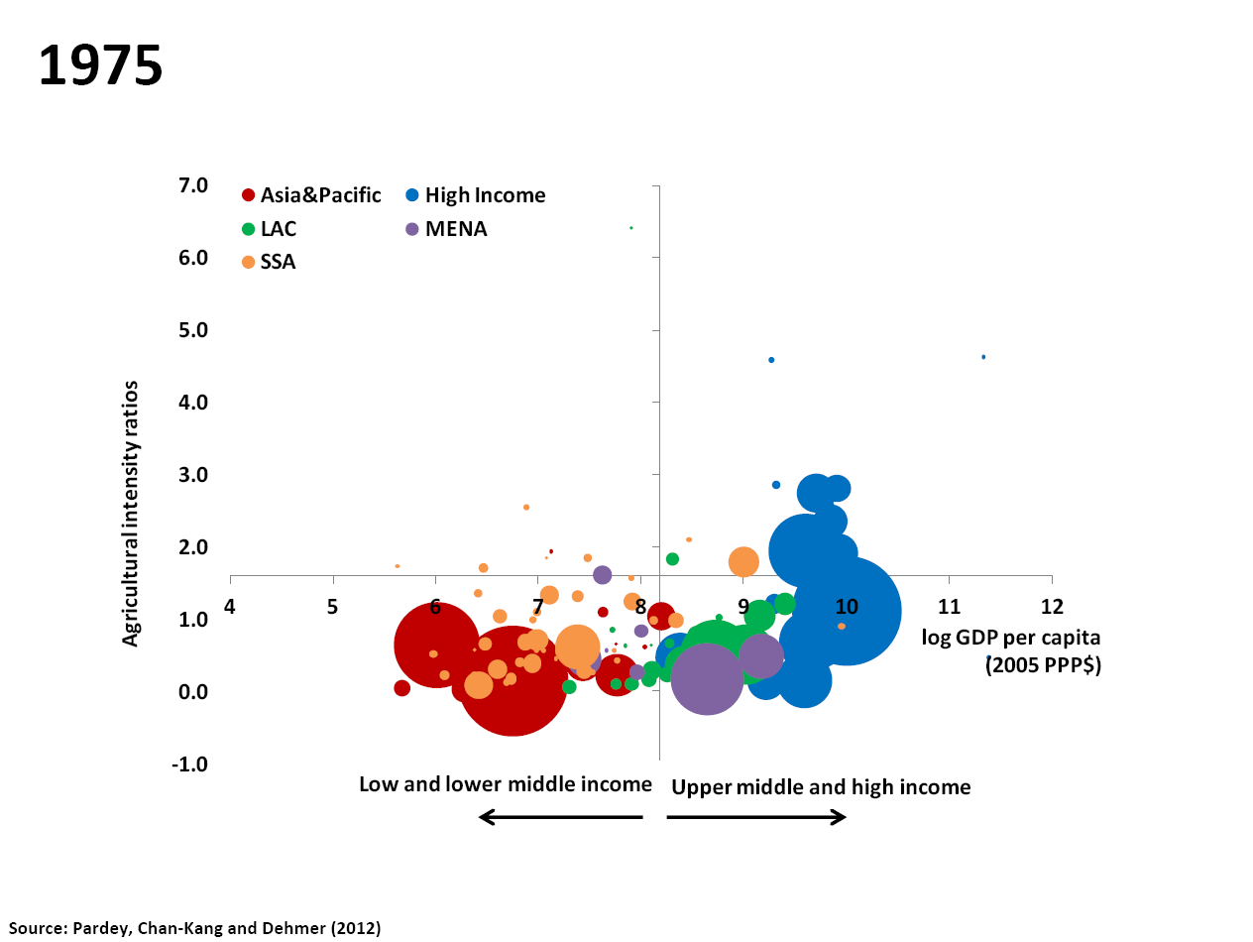
Source: Julian Alston, University of California, Davis 2013 IATRC Symposium, June 2-4 2013

Slide 61
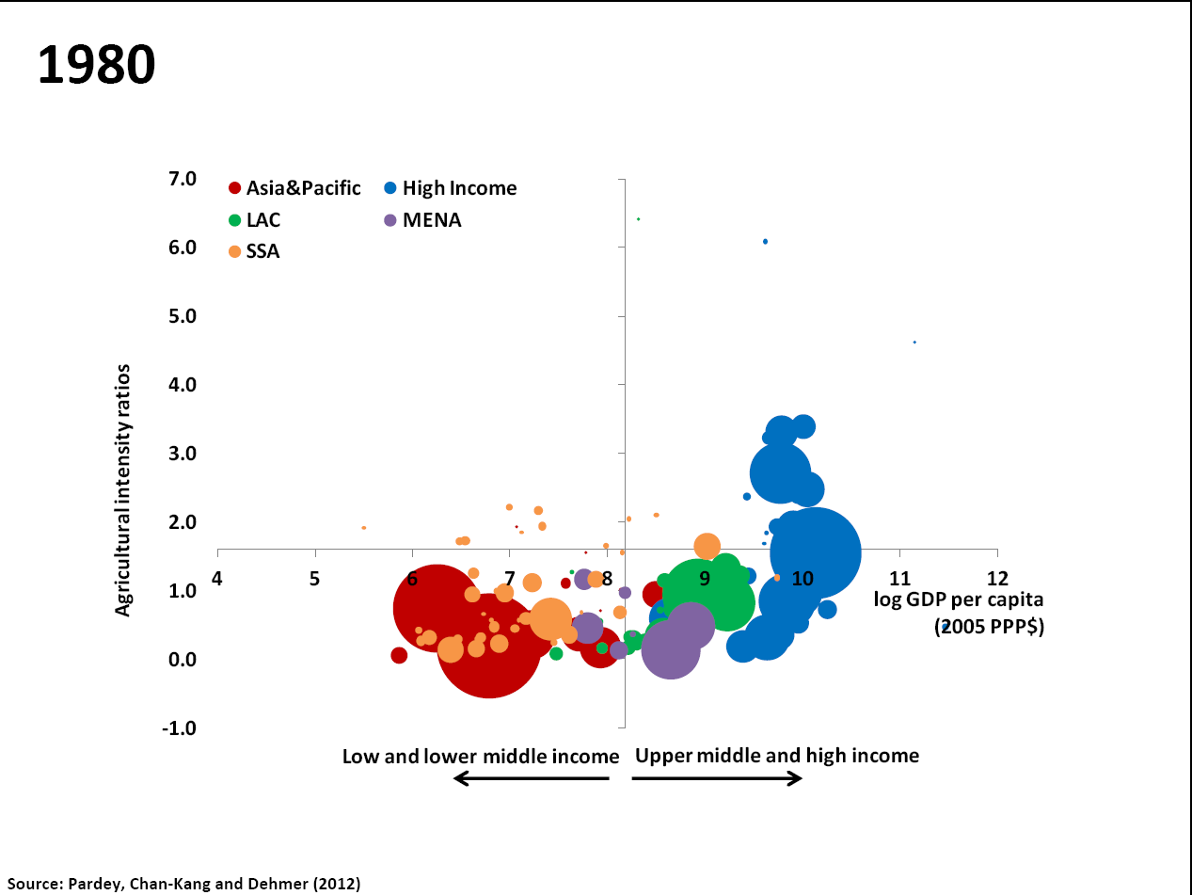
Source: Julian Alston, University of California, Davis 2013 IATRC Symposium, June 2-4 2013

Slide 62
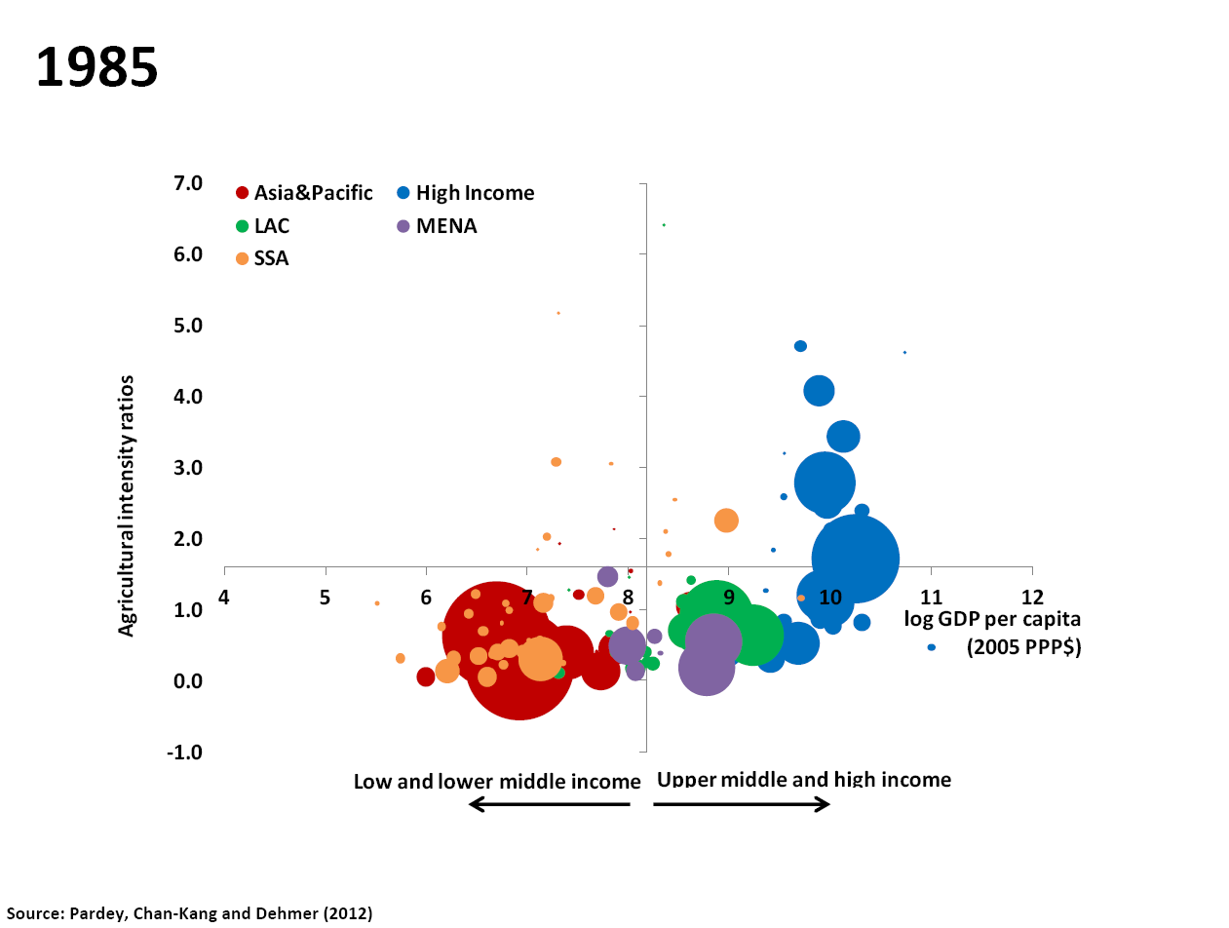
Source: Julian Alston, University of California, Davis 2013 IATRC Symposium, June 2-4 2013

Slide 63
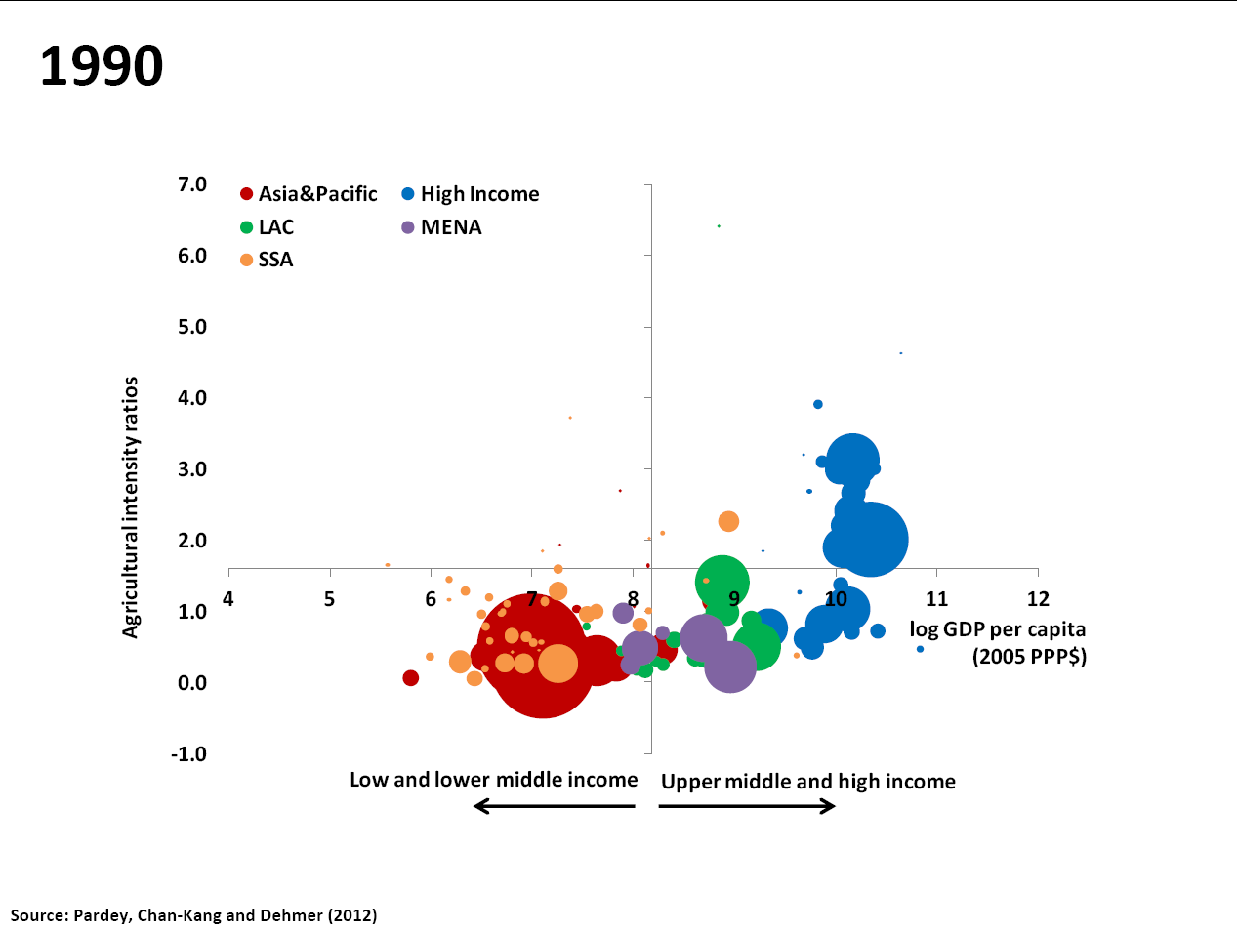
Source: Julian Alston, University of California, Davis 2013 IATRC Symposium, June 2-4 2013

Slide 64
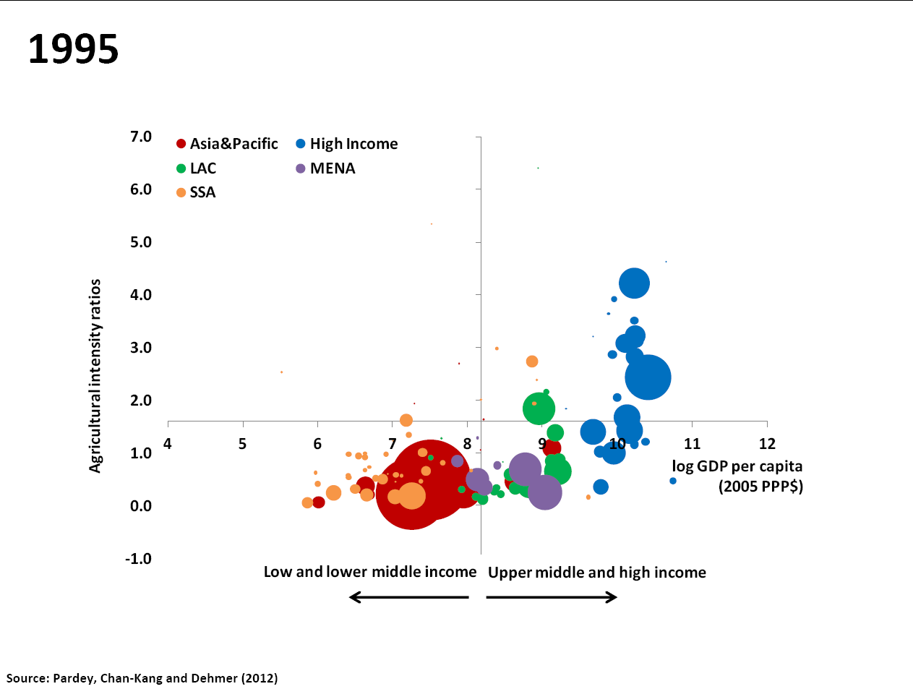
Source: Julian Alston, University of California, Davis 2013 IATRC Symposium, June 2-4 2013

Slide 65
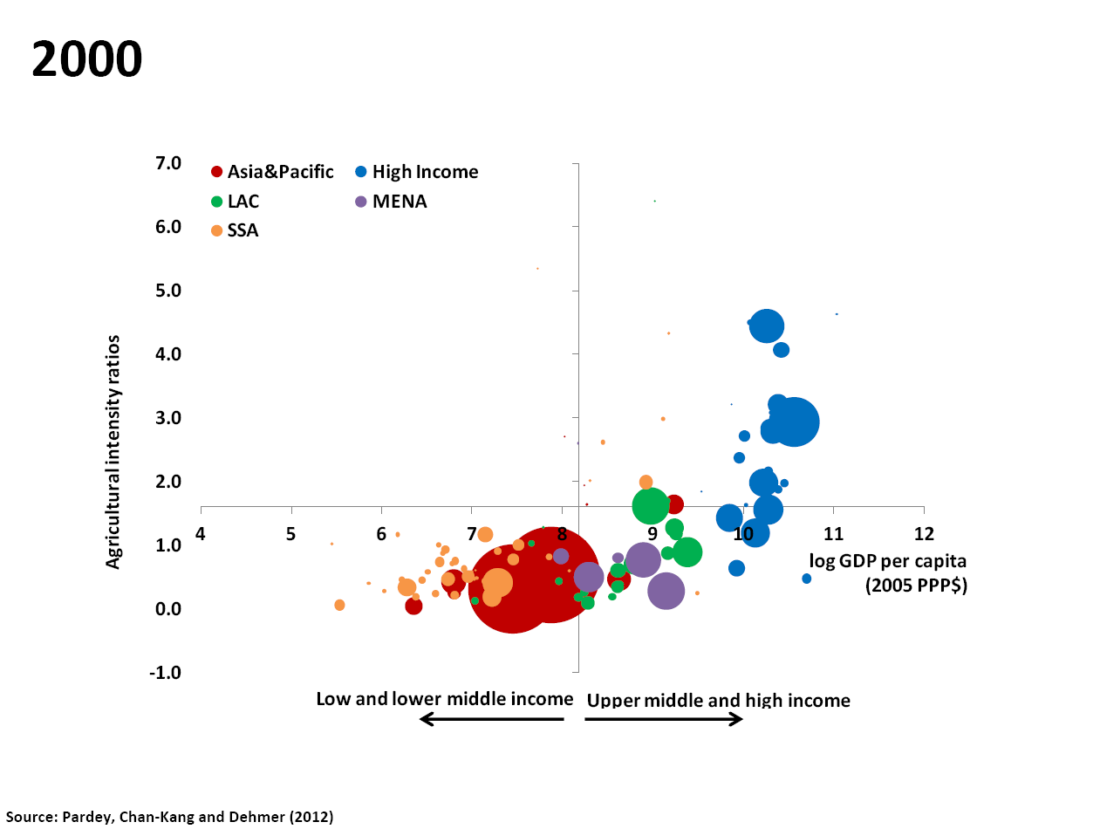
Source: Julian Alston, University of California, Davis 2013 IATRC Symposium, June 2-4 2013

Slide 66
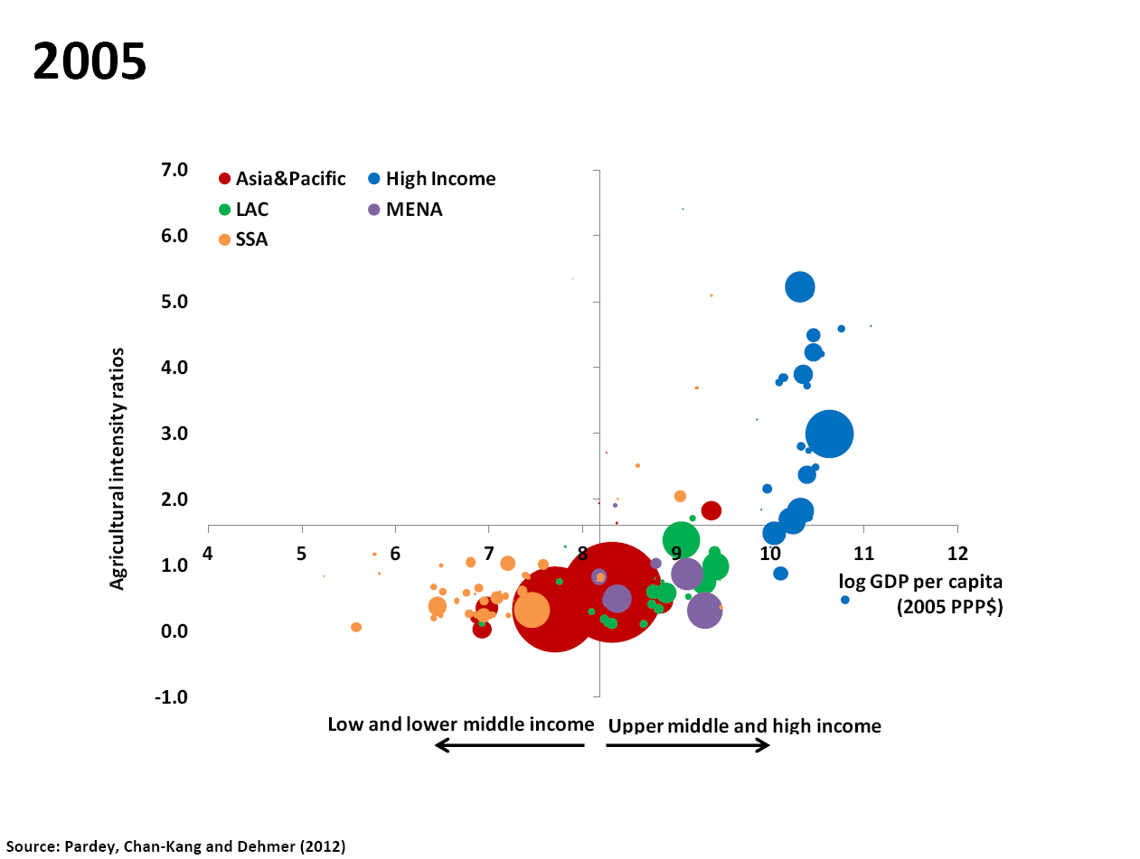
Source: Julian Alston, University of California, Davis 2013 IATRC Symposium, June 2-4 2013

Slide 67
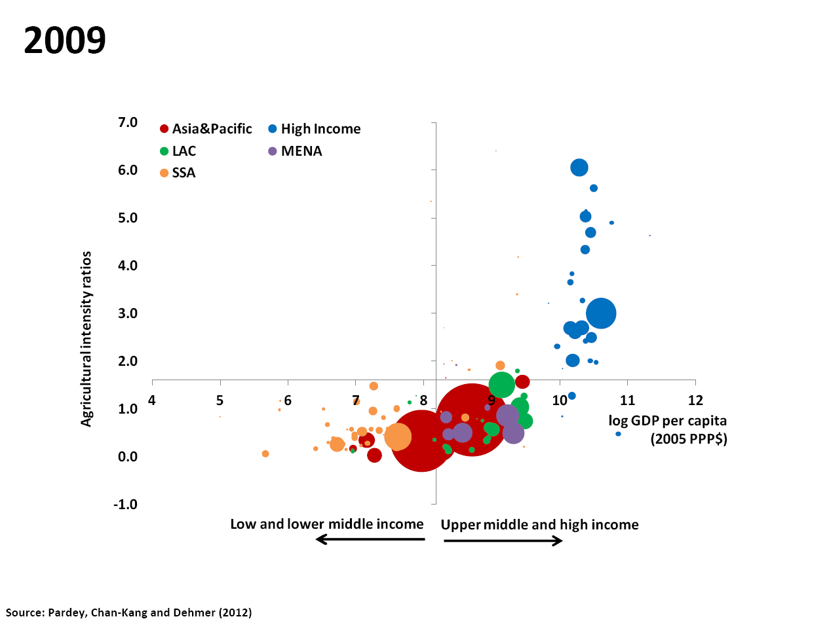
Source: Julian Alston, University of California, Davis 2013 IATRC Symposium, June 2-4 2013

Slide 68
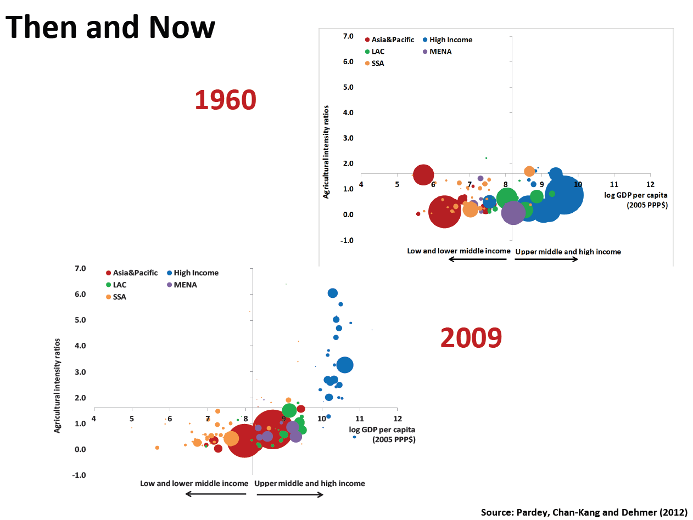
Source: Julian Alston, University of California, Davis 2013 IATRC Symposium, June 2-4 2013

Slide 69
2. Brazil's shift in incomes and its agriculture's role
Presented by Marcos Jank at the 2013 IATRC Symposium on
"Productivity and Its Impacts on Global Trade"

Slide 70
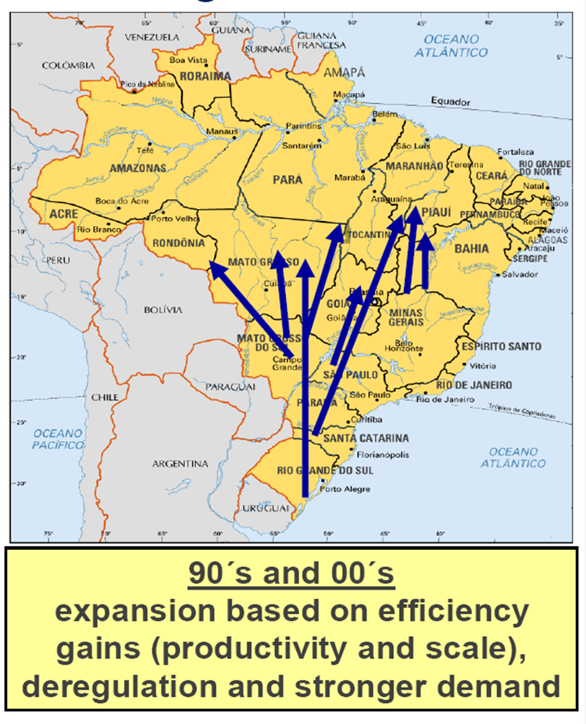
Expansion of the Brazilian frontier
Source: IBGE and ICONE; Marcos Sawaya Jank, Plataforma Agro , 2013 IATRC Symposium, June 2-4 2013

Slide 71
Source: Marcos Sawaya Jank, Plataforma Agro 2013 IATRC Symposium, June 2-4 2013

Slide 72
Source: Marcos Sawaya Jank, Plataforma Agro 2013 IATRC Symposium, June 2-4 2013

Slide 73
Source: Marcos Sawaya Jank, Plataforma Agro 2013 IATRC Symposium, June 2-4 2013

Slide 74
Source: Marcos Sawaya Jank, Plataforma Agro 2013 IATRC Symposium, June 2-4 2013

Slide 75
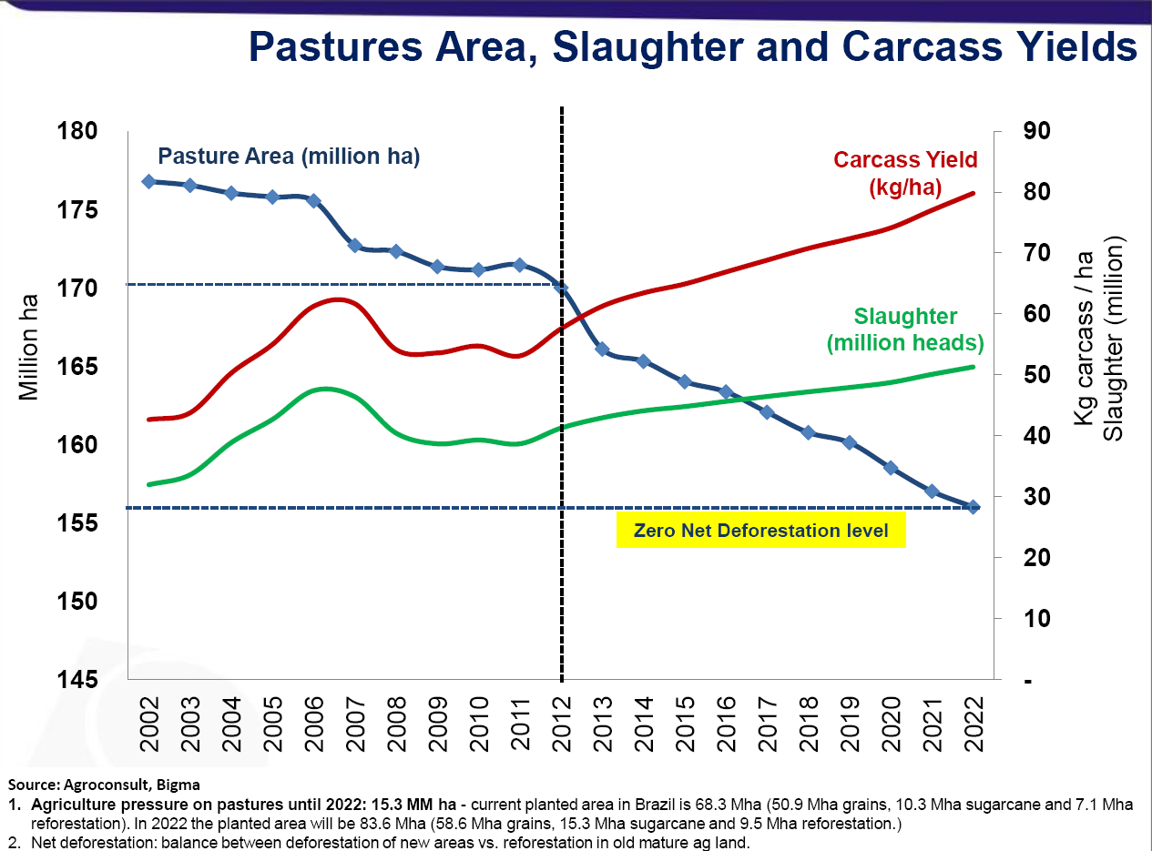
Source: Marcos Sawaya Jank, Plataforma Agro 2013 IATRC Symposium, June 2-4 2013

Slide 76
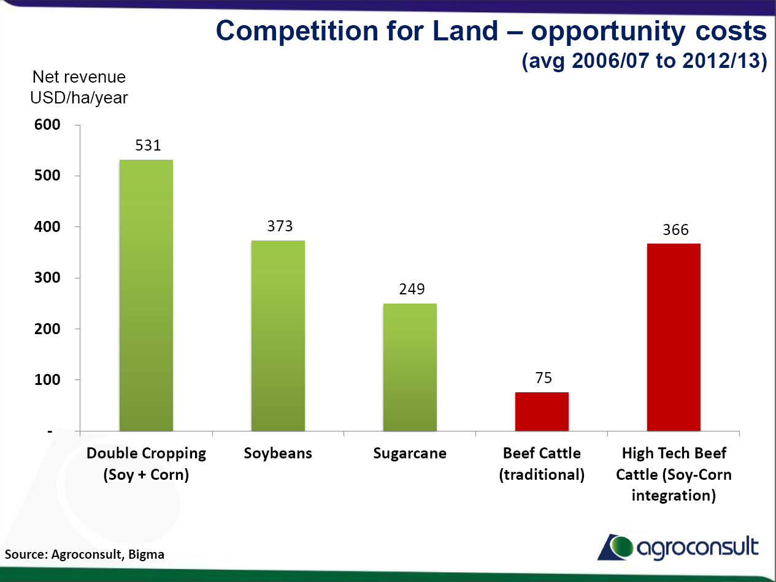
Source: Marcos Sawaya Jank, Plataforma Agro 2013 IATRC Symposium, June 2-4 2013

Slide 77
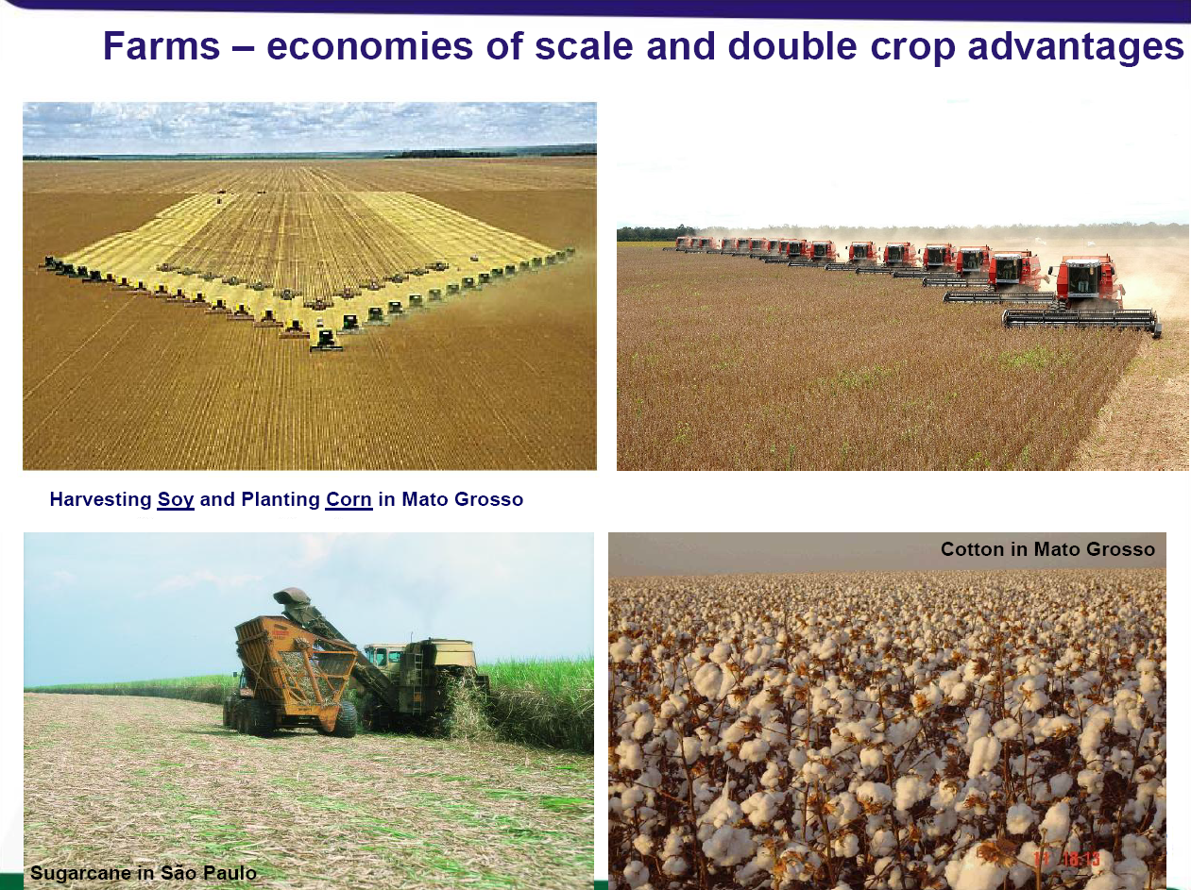
Source: Marcos Sawaya Jank, Plataforma Agro 2013 IATRC Symposium, June 2-4 2013

Slide 78
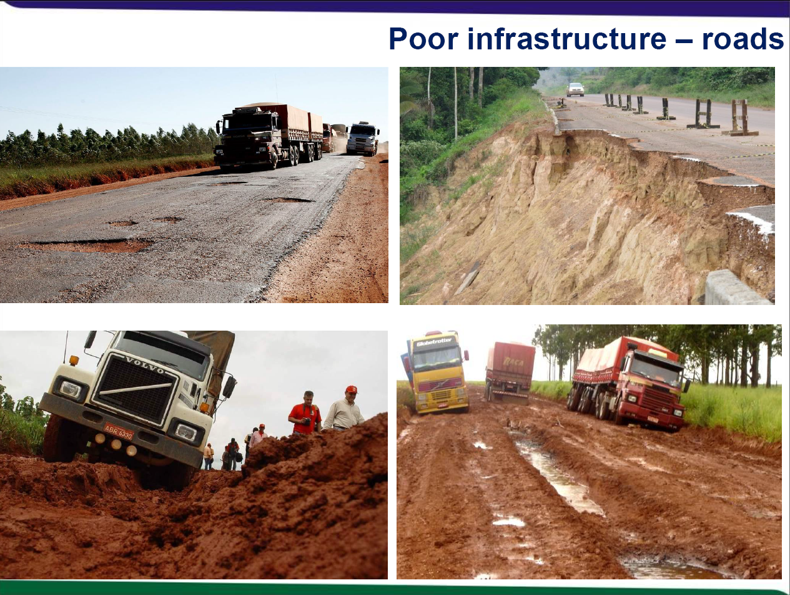
Source: Marcos Sawaya Jank, Plataforma Agro 2013 IATRC Symposium, June 2-4 2013

Slide 79
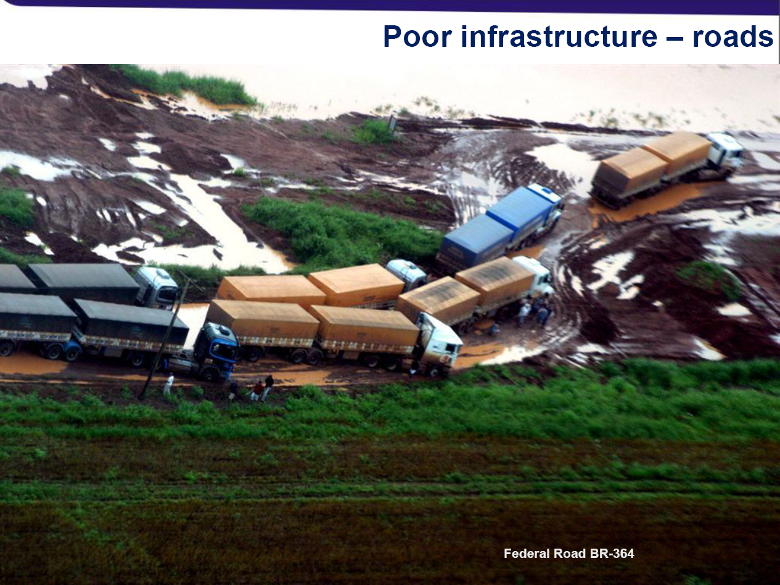
Source: Marcos Sawaya Jank, Plataforma Agro 2013 IATRC Symposium, June 2-4 2013

Slide 80
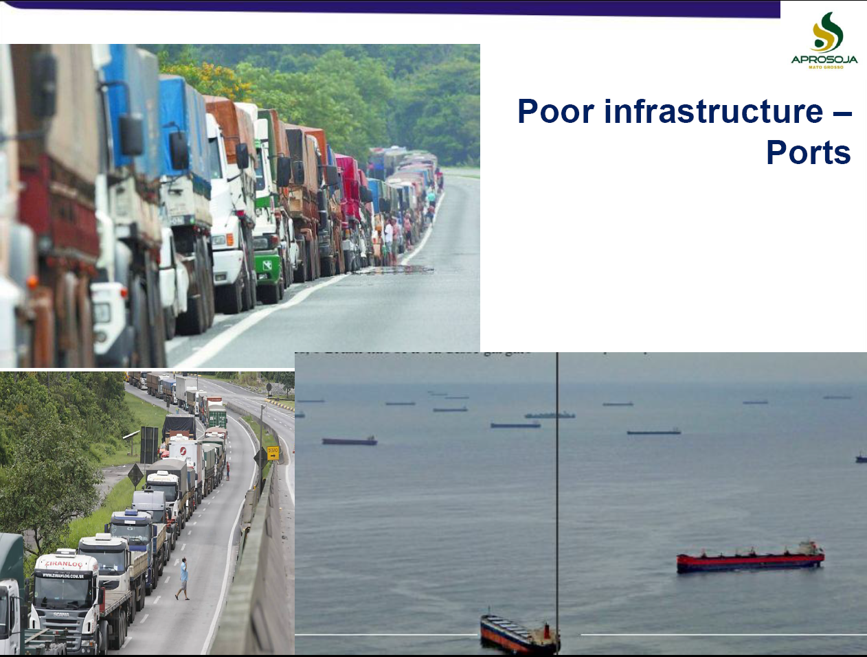
Source: Marcos Sawaya Jank, Plataforma Agro 2013 IATRC Symposium, June 2-4 2013

Slide 81
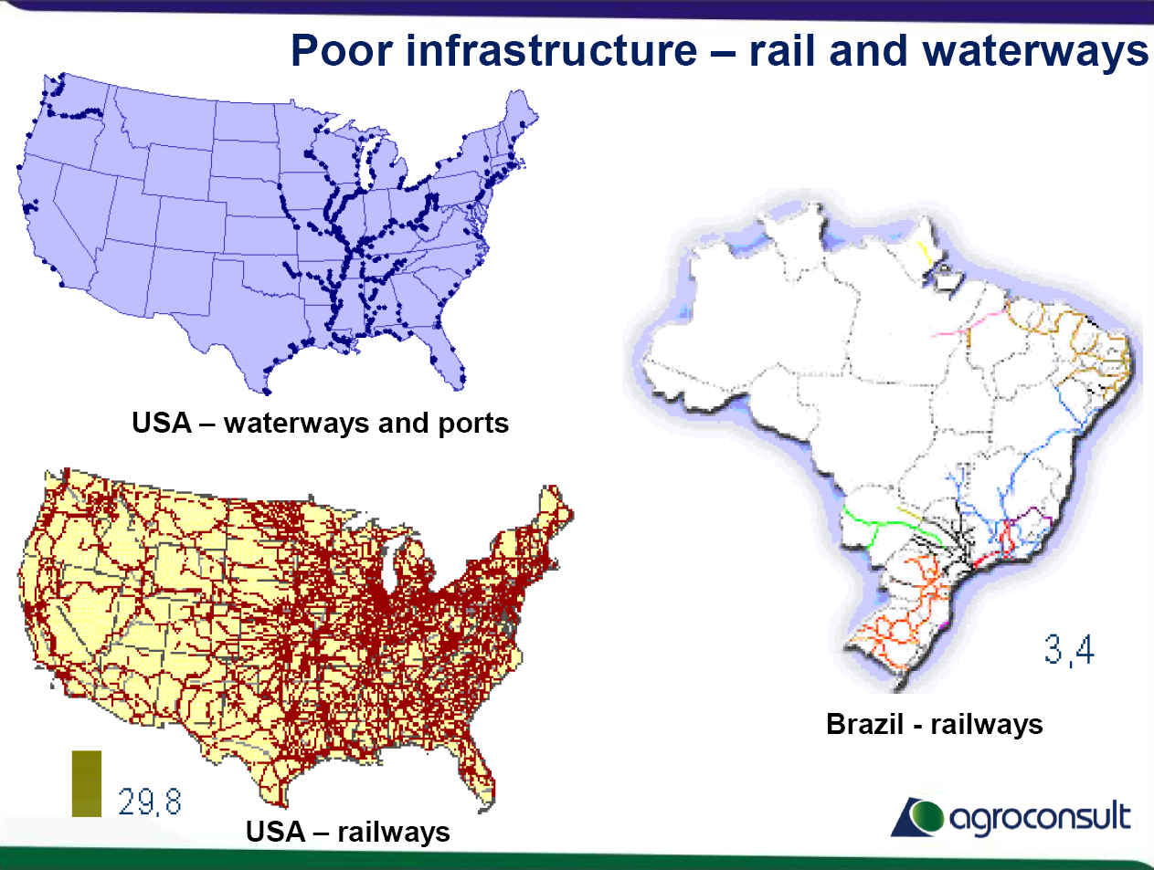
Source: Marcos Sawaya Jank, Plataforma Agro 2013 IATRC Symposium, June 2-4 2013

Slide 82
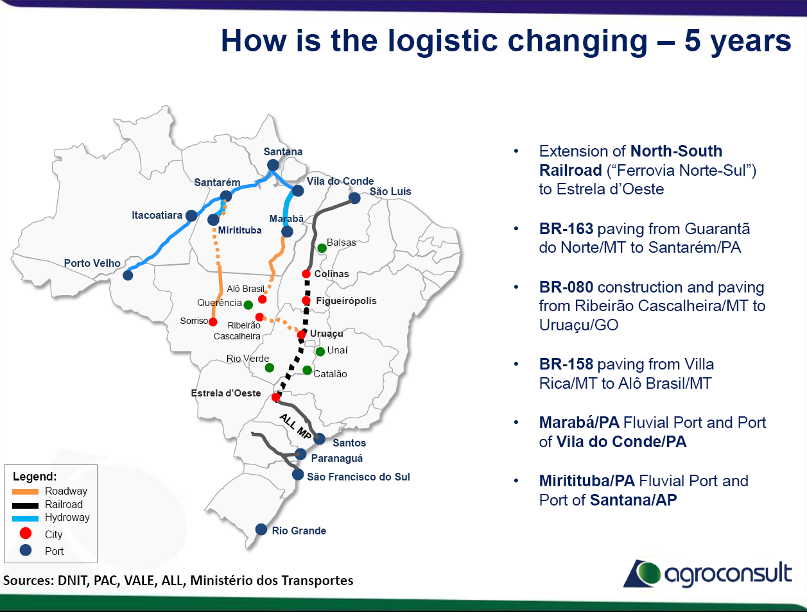
Source: Marcos Sawaya Jank, Plataforma Agro 2013 IATRC Symposium, June 2-4 2013

Slide 83
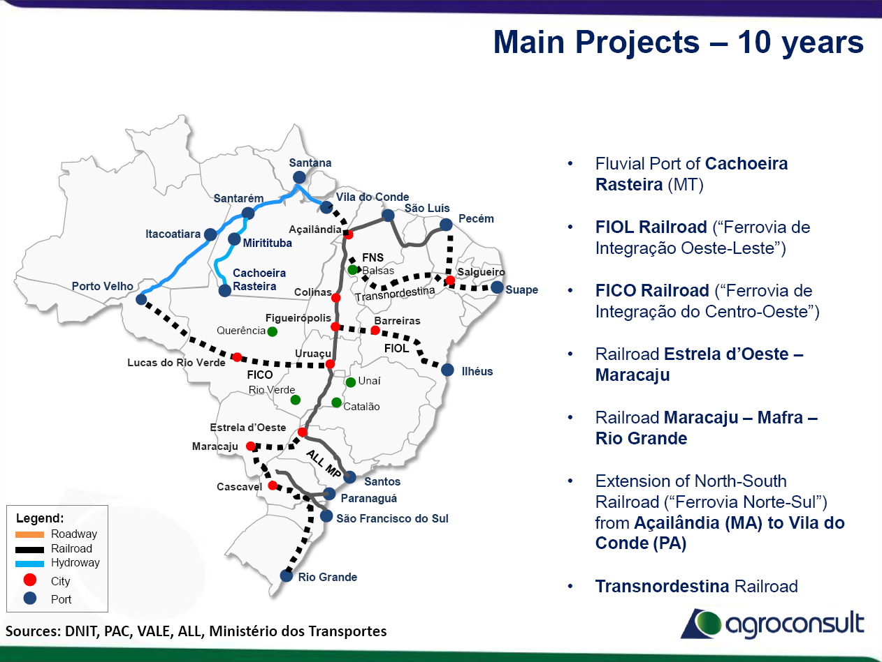
Source: Marcos Sawaya Jank, Plataforma Agro 2013 IATRC Symposium, June 2-4 2013

Slide 84
On the policy debate and its relevance
The world economy is in transition, and agriculture is no exception
  Macro linkages more complex and wide-spread (and quite recent…)
  Energy link is the new, controversial and uncertain factor (in direction, duration)
  Are we heading towards very distinct models of agriculture?
Is there a need for policy intervention to address the impacts of volatility?
  The joint delivery of the private and public good (at this stage, mainly an EU issue)
  Public stocks and the price interests of the rural and urban poor (a DCs issue)
  The gap between existing research, innovation and productivity (an issue for all)
What impacts for trade and trade policy?
  Trade shifts vs trade policy developments (DDA and the existing policy toolkit)
  Productivity drivers vs demand drivers (role of Brazil, China and the US)
  Grains vs livestock production (biofuels, biotech, and land use changes)

Slide 85
Putting the farm policy debate in its broader context
The U-turn of the US farm policies – choices and impacts
  US farm policy is still dominated by a few crops and commodity-specific instruments
  US agricultural trade is the best reflection of the US farm policy (contrasting the EU's)
  US institutional characteristics explain and affect choices (for others as well)
The changing role of the BRICs and the G20
  Brazil and India dominated the early stage of DDA on farm policy demands
  What will change with China increasingly pro-active and Russia in the WTO?
  G-20 and the complex interrelationship of multi-lateral and regional trade negotiations
The shifting role of the CAP in influencing global farm policies
  CAP reform and market prices imply decouple CAP from negatively impacting DCs
  Demand-driven concerns (especially on environment) shape EU farm policy responses
  GMOs and the potential role of public research in guiding technology responses

Slide 86
Thank you

