Slide 1
Lecture III Hermeneutics and Semiotics for Economics use
Constantinos Repapis
Lecturer in Political Economy
National and Kapodestrian University of Athens

Slide 2
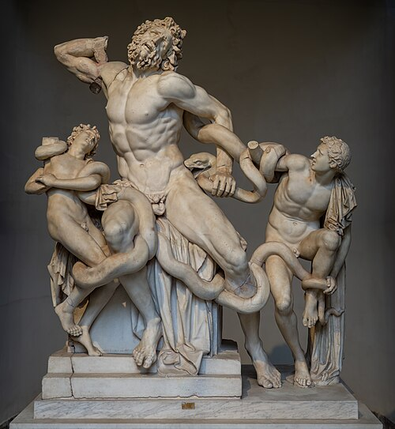
Laocoön
Excavated in 1509 – put in the Vatican

Slide 3
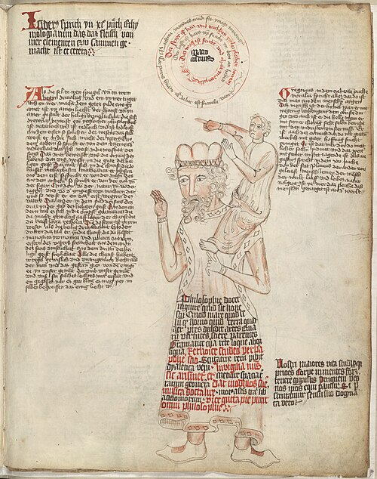
nani gigantum humeris insidentes
If we can see further its because we are sitting on the shoulders of Giants. Newton

Slide 4
Laocoon – An Essay on the Limits of Painting and Poetry – 1766 – Gotthold Ephraim Lessing
“…Painting, in its imitations, makes use of entirely different means and signs from those which Poetry employs; the former employing figures and colours in space, the latter articulate sounds in time” (Lessing 1874: 149).
For Lessing, this separation is essential as it sets limits to the ability of each art to imitate nature.
He notes approvingly this distinction which he finds in the ancient writers noting that “Arts differed, as well in the object as the manner of their imitation” (Lessing 1874: 3).
For Lessing, this is essential for the artist to convey naturally true sentiment to their audience. His whole treatise is about the distinction between conveying Laocoön’s suffering in poetical form or in sculptural depiction and the aesthetic criteria guiding each art. He notes that the screams a poet writes on paper the sculptor must “soften …. into signs” (Lessing 1874: 19).
The same feeling is expressed through different forms if the artist intends (as they should according to Lessing) to capture the beauty of the natural world.

Slide 5
Lessing – Ancients and Moderns
Ancients and Moderns- Lessing created the groundwork both for renewing the link between the perception of reality and representation and for distinguishing the domain of the different arts in what they can faithfully capture.
The central core of this programmatic vision is the link between ancient and modern aesthetics in their interest in realistic representation through an improvement of the theory and practice of imitation.
Implicit in this viewpoint is the belief that there is an optimum division between disciplines with remits that would achieve the best result in this singular quest for the representation of reality.

Slide 6
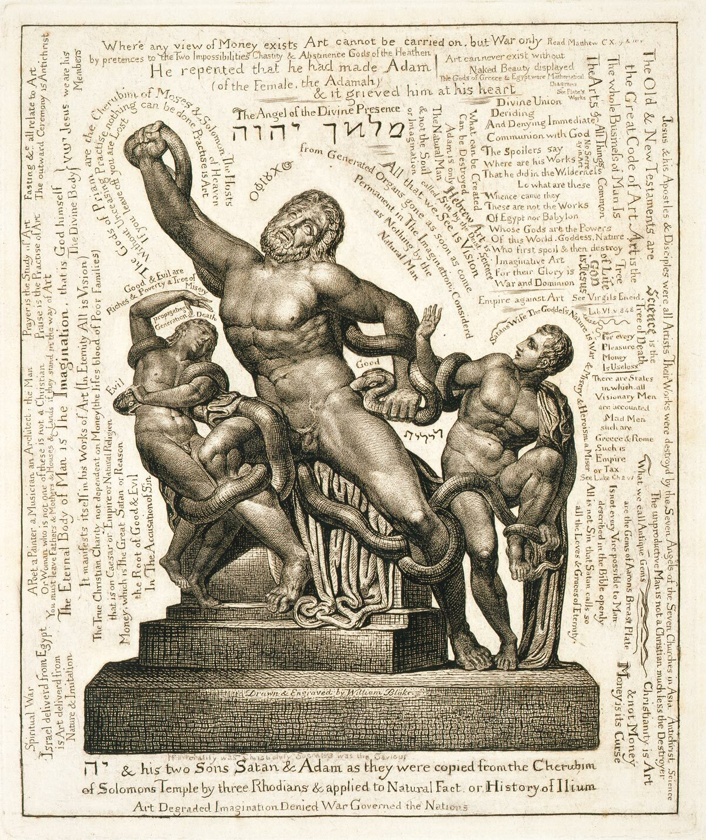
William Blake – Laocoon (~1815)
Not as a classical but as biblical allusion
As the archetypical struggle between good and evil
“Art can never exist without Naked Beauty displayed,” reads one of the slogans on the image
Under the snake at the right, the Hebrew letters spell out “Lilith,” a name that may be derived from a class of ancient Mesopotamian spirits called lilītu.
In one Kabbalistic tradition, Lilith is Adam’s first wife. She refuses her husband’s attempts to dominate her, telling him that they are made of the same substance (earth) and are equals. When Adam refuses to capitulate, she flies into the air and disappears, and Adam is gifted with a new, more subservient wife named Eve.
What is blake trying to achieve by carving Lilith’s name in the heart-shaped space?

Slide 7
Enter the Romantics – representation is passe
In contrast, the Romantics, and in particular the work of August Schlegel, distinguished between ancient and modern aesthetics.
By problematizing the very nature of representation in art
By the distinct separation of fields of art.
Schlegel - central figure of the German Romantic movement.
Modern art relates to the environment that arose within specific historical conditions and, as a result, requires a completely new framework of understanding.
Art cannot be seen to mimic nature, an aspiration of ancient art that was re-affirmed during the Enlightenment and is the basis of neoclassical aesthetics.
Art could not be a mere “imitation” or “representation” of nature; it is the product of a creative force and, therefore, of expression.
“but in the fine arts mere imitation is always fruitless; even what we borrow from others to assume a true poetical shape, must, as it were, be born again within us” (Schlegel 1861: 19).

Slide 8
Enlightenment vs. Romantics- two visions of reality
At the core of this debate between Lessing and Schlegel are the contesting definitions of art.
Lessing sees the different types of art as compartments, each with its strengths and limits in capturing and representing particular aspects of reality.
For example, statues are good as capturing something at rest.
Poetry is good at telling us of something in motion.
Each can do specific things which determine it as a field, what it can represent and its limits.
In contrast, for Schlegel, art does not anymore mimic reality but, instead, is an expression of modern concerns, aspirations and thought patterns.
What fields of knowledge or expression fall within the label of “the arts” or “art” differs depending on how you define the term
Lessing and Schlegel would see it very differently.
If art essentially relates to the world as something that can be moulded, shaped and transformed, then it is nothing more than a mode of expression, a state of mind.
Can, then, economics – with all its devices and other trappings – be itself considered an art? According to some of its practitioners, economics appears to be a rational, enlightenment-inspired machine to uncover our social and economic nature. Economic theory has been described as representing, predicting, abstracting, imagining, mimicking and simplifying reality in its effort to define its method of investigation.
Pluralism : see economic theory as a romantic reengineering of our society, its values and its processes.
How does economics mediate this difficult relation between reality, representation and expression?

Slide 9
Starting with Semiosis – the nature of the sign
Argument:
The use of the semiotic framework developed by Saussure can become a useful device in doing analysis in the history of ideas, as it allows the development of a system that can track concept change in one sign as an indication of broader change.
A brief presentation of the Saussurian sign.
Saussure and diachronic analysis- reflections on charting the evolution of concepts.
The problem of change- a Marshallian tool for historical analysis.
Testing the framework: Comparative Advantage

Slide 10
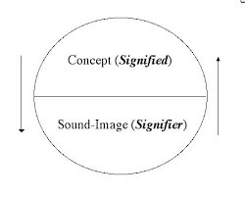
Sassure and the sign
The sign is a composite entity that comprises of two separate but entangled parts.
The signified is the concept of the sign- what you think when I say a tree, a chair, a balloon.
The signifier is the sound this concept is associated with. When you hear the vocalization “balloon” you think of a balloon.

Slide 11
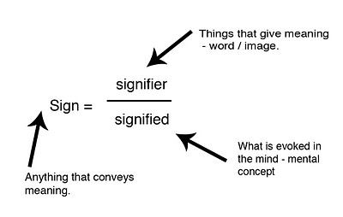
The sign
Anything that tells us about something other than itself is a sign.

Slide 12
The notion of arbitrariness
Signs are arbitrary in the sense that there is no reason a specific sound (signifier) is associated with a specific concept (signified).
Different languages can have the same concept articulated through different sounds.
This, in itself, is a tautology. But it is an important realization when trying to attempt analysis over time. If the link between the two parts is analytically found to be arbitrary, it is then, also open to change.
Saussure also notes that the relationship is linear.
By this he –presumably- means that the signifier comes temporally before the signified. I.e. you hear a word before you conceive the concept- the process then being linear in temporal terms.
Saussure calls this a key properly, although this linearity is difficult to defend in reality. It is easy to think of situations where you have thought of something, and you hear what you want to hear.
So I take this to be one of the approximations that the Saussurian model requires to operate.

Slide 13
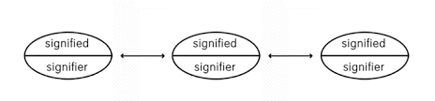
But, once established, a sign is not arbitrary- its socially embedded
Sign relates to sign creating a framework of meaning.
It is in the interaction between signs that encodes meaning, both by the relation and, more importantly by the differences the signs stand for and convey.
Once a sign exists in the social sphere it is set in (social) stone.
“In a sign what matters more than any idea or sound associated with it is what other signs surround it. The proof of this lies in the fact that the value of a sign may change without affecting either meaning or sound, simply because some neighboring sign has undergone change.” (Saussure, p.141)

Slide 14
At any point in time, a sign is both arbitrary and fixed in meaning
No one individual can, entirely autonomously, change the sign in a social system.
These are fixed by social conventions and although arbitrary, they are fairly stable constructions which persist.
This allows us to focus on two distinct aspects of the sign.
At one end it is almost seen as an external object from the perspective of the individual. When someone points to a tree and says “tree”, they expect people to see the same object.
At the other, the sign, as a combination of signifier and signified, is liable to change wholly or in part at the social level, exactly because it is, at its core, an arbitrary social convention.

Slide 15
Over time, however, signs change
Signs are not fixed for ever. Over time both the signifier and the signified change in a continual social process of transformation.
In historical real time this happens continuously- as Saussure notes language does not move in generations in the same way that humans may be seen to do, but more organically over time.
Nevertheless, from an analytical perspective, the analysis of a system at every point in time is different to an analysis of the system as it evolves over time. Saussure outlines two frameworks:
Synchronic analysis
Diachronic analysis

Slide 16
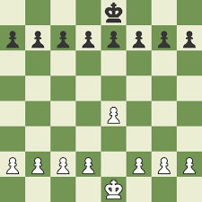
A chess board Synchronic Analysis
At every point in time the description of a chess board is part of synchronic analysis.

Slide 17
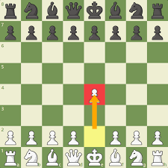
Diachronic analysis
However, any move or change of any piece on the board, does not only change its place, but the importance of all pieces on the board.
This move changes the relative value of pieces, making some now more important than others, compared to the state before this change occurred.

Slide 18
The problem of change
This kind of analysis is fundamentally different than the kind that simply attempts to record and describe the relative positions of the pieces- i.e. their place on the board [synchronic analysis].
However, and this is hidden in the Saussure view, both are acts of interpretation and therefore have inbuilt a dynamic subjective element in them. Describing a system in a rest state almost prepares us to think of possible movement, and the act of description itself would condition the imagination in some specific way.
Therefore, the dichotomy, although useful, is not to be taken as an analytical fact, but mostly as a useful approximation to start creating tools for empirical analysis.
In a model environment, as the chess game above, one may be able to completely isolate the move of this one chess piece and try to describe the change in the system at large.

Slide 19

Synchronic analysis and point of view
In Synchronic analysis Saussure noted that in order to make sense of things we need a fixed vantage point, a perspective – like the viewpoint of the artist on the mountain.
We extend this principle by arguing that also diachronic analysis needs a perspective- there needs to be an ordering of the past from a particular perspective to make it coherent.

Slide 20
Historical time vs abstract time
However, in reality, things do not move by themselves in an otherwise fixed system. Instead, many things change all at the same time.
This means we have to deal, analytically, with two important problems:
The separation of the description of the system from the description of change of the system is at best an approximation, useful in that it allows us to do real world analysis.
The separation of the change of part of the system from the stream of historical time is another problem that has no analytical solution- at best it rests on another approximation of trying to separate the main effects from the secondary.

Slide 21
Alfred Marshall’s practical wisdom
“The element of time is a chief cause of those difficulties in economic investigations which make it necessary for man with his limited powers to go step by step; breaking up a complex question, studying one bit at a time, and at last combining his partial solutions into a more or less complete solution of the whole riddle. In breaking it up, he segregates those disturbing causes, whose wanderings happen to be inconvenient, for the time in a pound called Caeteris Paribus. The study of some group of tendencies is isolated by the assumption other things being equal: the existence of other tendencies is not denied, but their disturbing effect is neglected for a time. The more the issue is thus narrowed, the more exactly it can be handled: but also the less closely it correspond to real life. Each exact and firm handling of a narrow issue, however, helps towards treating broader issues, in which that narrow issue is contained, more exactly than would otherwise have been possible. With each step more things can be let out of the pound; exact discussions can be made less abstract, realistic discussions can be made less inexact than was possible at an earlier stage.” (p. 366, vol. I)

Slide 22
The Marshallian conjecture
The Marshallian conjecture has three parts
The change of the sign (either the signifier or the signified or their relation) is not part of an independent internal process, but, in strictly temporal linear terms, external to it. It happens in the ecosystem of the sign, and therefore it’s a change of the relation of signs between themselves and within themselves.
In historical time, all signs change as the system transforms. However, in any attempted diachronic analysis we should be able to postulate the following: From a well-chosen perspective, it is possible as a thought experiment, to cognitively isolate the transformation of one sign and analyse it.
Assuming the first two parts of the conjecture hold, and it’s the only way through which change between signifier and signified can take place and be observed, then it follows that any observed change of a sign must indicate systemic dislodgement in the ecosystem of signs and, can tell us something about the broader changes of the system.

Slide 23
Marshall’s gambit- and how truth may come from lies
Simply speaking this is not an approximation of reality, because no amount of refinement can make it converge to any external reality that does not depend on a particular perspective. It is simply an approximation of a viewpoint.
Instead, this approximation works because although strictly false, can be useful.
We therefore maintain this paradox:
We have an approximation that is useful, i.e. it can yield results that make sense and add to our understanding of a situation extending analytical knowledge in the history of ideas.
However, this approximation is analytically unfounded, and we can see that it can never be refined to not depend on the description of the situation we started with, and therefore free from the original perspective imposed.
Thus, the process makes sense because the conclusions make enough sense. The validity of the two (process and findings) are intertwined.

Slide 24
An application: The story of comparative advantage
In the next few slides I will try to say the story of comparative advantage from its inception to its neoclassical formulation.
I chose this sign over other more obvious ones (prices, costs, company, demand, supply, etc.) because it has, analytically a start which is traceable, and also because it had a very specific kind of interpretation which evolved over time and is tractable.
The transformation of a sign that has such specificity is, if we apply the Marshallian conjecture, a better guide to show us the general change among signs as we move from the classical to the neoclassical world.

Slide 25
The famous formulation of Ricardo – the sign has yet to take full form as the concept has no signifier.
“England may be so circumstanced, that to produce the cloth may require the labour of 100 men of one year; and if she attempted to make the wine, it might require the labour of 120 men for the same time. England would therefore find it her interest to import wine, and to purchase it by the exportation of cloth.
To produce the wine in Portugal, might require only the labour of 80 men for one year, and to produce the cloth in the same country, might require the labour of 90 men for the same time. It would therefore be advantageous for her to export wine in exchange for cloth.” (p. 135)

Slide 26
Ricardo continued….
“Though she [Portugal] could make the cloth with the labour of 90 men, she would import it from a country where it required the labour of 100 men to produce it, because it would be advantageous to her rather to employ her capital in the production of wine, for which she would obtain more cloth from England, than she could produce by diverting a portion of her capital from the cultivation of vines to the manufacture of cloth.”
“This England would give the produce of the labour of 100 men, for the produce of the labour of 80. Such an exchange could not take place between the individuals of the same country. The labour of 100 Englishmen cannot be given for that of 80 Englishmen, but the produce of the labour of 80 Portuguese, 60 Russians, or 120 East Indians.” (p. 135)

Slide 27
James Mill- The start of the construction of the signifier in the Elements of Political Economy
“If two countries can both of them produce two commodities, corn, for example, and cloth, but not both commodities, with the same comparative facility, the two countries will find their advantage in confining themselves, each to one of the commodities, bartering for the other. If one of the countries can produce one of the commodities with peculiar advantages, and the other the other with peculiar advantages, the motive is immediately apparent which should induce each to confine itself to the commodity which it has peculiar advantages for producing. But the motive may no less exist, where one of the two countries has facilities superior to the other in producing both commodities.”
“When both countries can produce both commodities, it is not greater absolute, but greater relative, facility, that induces one of them to confine itself to the production of one of the commodities, and to import the other.” (1844 edition)
Jacob Viner notes that the first use of the term “comparative cost” is by Torrens in 1827.

Slide 28
Pareto- the introduction of tastes as a criticism of the concept
Pareto does not treat extensively the theory in his Manual of Political Economy, but he writes:
“Ricardo provides a very simple example, in which the communities are each reduced to a single individual. ‘Two men can both make shoes and hats, and one is superior to the other in both employments; but in making hats, he can only exceed his competitor by one-fifth or 20 percent, and in making shoes he can excel him by one-third or 33 percent; will it not be for the interest of both, that the superior man should employ himself exclusively in making shoes, and the inferior man in making hats?’
Professor Bastable, who cites this example, adds: ‘It is merely a matter of calculation to see that both parties would gain by such an arrangement.’
But this is not true. It is strange that he did not see that is it true in some cases only and not in others. Ricardo’s reasoning serves only to indicate a possible case, not a necessary one.”( Pareto, 2014 [1906], p. 256)
The issue that Pareto introduces is a new one- it is not a question of doubting the increase in production, but only if this increase meets individual demand so as to increase welfare.
For him this qualification changes the scope of the sign as seen in Ricardo.
He gives a numerical example and as conclusion he writes:
“The total amount to be shared between the two is larger for B but smaller for A [A and B are the two products], and we do not know whether, taking the individuals’ tastes into account, these offset each other or not. If they do, Ricardo’s proposition is true; if not, the proposition is false” (Pareto, 2014 [1906], p. 257)
The introduction of tastes in the concept, the signified, changes drastically the validity and universality of this sign, and, in this preliminary state it challenges its very existence as a coherent sign.

Slide 29
Haberler – the final neoclassical formulation.
Tastes and demand and supply analysis now become a constituent part of the concept of comparative advantage.
In Haberler’s definition the labour theory of value, which is the central aspect of Ricardo’s formulation of comparative advantage is taken out:
“However many factors there maybe, the relative prices of the two commodities will be determined (given the demand) by their costs -but we must now follow the Austrian school in measuring costs not by the absolute amount of labour required but by the alternatives forgone. Thus the marginal cost of a given quantity of commodity A must be regarded as that quantity of commodity B which must be forgone in order that x instead of x-1, units of A can be produced. The exchange-ratio on the market between A and B must equal their costs in this sense of the term.” (Haberler, 1933, 177)
“We should have to set out, instead of a series of absolute labour-costs …,a series of relative prices or exchange-ratios, using any one commodity as a numeraire with which to measure prices. This series would equally represent the substitution-ratios, since these are the same as the exchange-ratios.” (Haberler, 1933, p. 182)
Now comparative advantage is defined not in terms of real costs, but in terms of opportunity cost, making it part of the new neoclassical armory of signs and finding a meaning within the neoclassical universe.

Slide 30
The two Palgrave editions (1894-1987)
In the first edition of the Palgrave dictionary, we find the following entry, which is a paragraph in length:
Cost (comparative and relative) “It is held that the labour and capital of a country naturally flow into those departments of production in which it has the greatest comparative advantage, or in which the comparative cost is least.” (1894, vol. I, p. 434)
In the New Palgrave (1987) the entry is over 4 pages and reads:
Comparative Advantage:
“Suppose that a unit of labour in Portugal can produce 1 unit of cloth or 1 unit of wine while in England a unit of labour can produce 4 units of cloth or 2 units of wine. Thus, the opportunity cost of a unit of wine is 1 unit of cloth in Portugal while it is 2 units of cloth in England” ( Vol. 1, 514)
The entry gives an extensive history of the discovery by Ricardo and evolution of the term until the 1980s. It is also claiming a generalisation of the basic principle:
“Though the logic applies equally to interpersonal, interfirm, and interregional trade, it was in the context of international trade that the principle of comparative advantage was discovered and has been investigated ever since” (Vol. I, 514)
What we observe is not only the change of the signifier, but also its final standardization into an accepted linguistic term.
The 1987 term is defined by use of another complex technical term, opportunity cost- signalling its final acceptance in the neoclassical linguistic universe.

Slide 31
Viner- setting the history straight
Viner writes a history of the term comparative advantage to show
Its evolution from Ricardo to the 1930s
Its continual refinement to its more exact modern formulation
He writes that:
“The doctrine of comparative costs originated as an improvement and development of the eighteenth-century criticism of mercantilist policy, and it has continued to command attention mainly because of its use as the basic “scientific” argument of free-trade economists in their attack on protective tariffs. Protectionists have an obvious motive for attacking the doctrine, but it has also been rejected by economists whose animus seems to arise from the fact that it was one of the outstanding products of the English classical school, by economists who deal with it as an exercise in pure price theory and as such find it unsatisfactory…”(Viner, 1937, 438)
It is interesting to note that the diachronic analysis that Viner does is not external to the sign, but actually is part of the signified, the content of the sign.
Diachronic analysis is a way to understand more precisely the sign, its content and not only to chart its evolution.
History of the discovery of the term, and the analytical ramifications of this discovery are part of its signification.
Which brings me to a general point: In most instances the explanation of the meaning of comparative advantage, even if intended for synchronic analysis, includes an analytical narrative of its past, as a guide of its meaning and use.

Slide 32
Diachronic analysis as a part of the sign?
This is like saying that to understand what a soldier piece does in chess, is related to why it is where it is. Therefore, you need to know a bit of its history and past use, as an indication of its capacities. Its part of what the piece signifies today.
Analytically its history cannot be separated from an analysis of its current state.
Its not an objective history as such which is our point of interest, but it is our interpretation, our perspective of its history that informs our understanding of the sign in synchronic analysis.
Each piece on the chess board has meaning which is partly given to it by the narrative of the history the observer imposes on it.
Our perspective on historical evolution and analytical argument are intertwined as parts of our cognitive approximation of the sign.

Slide 33
Some preliminary conclusions I
Saussure can give us new tools to do concept analysis and evolution in the history of economic ideas.
The case of comparative advantage gave us an example in which we could observe the phases of evolution of a complex term:
From its conceptual foundation- before the sign is complete, a signifier is yet not found, and the concept is said periphrastically
To its first standardization during the classical period
To the crisis of its validity as the terms around it change re-orienting priorities during the neoclassical revolution
To its new standardization that excludes previous external links as part of its signification (the labour theory of value) and introduces new ones (opportunity cost) re-orienting itself in the new universe.
Furthermore, the sign, here comparative advantage, is seen not only from a perspective of transformation, but also from one of discovery and even perceived improvement.
Academics who transformed the concept were eager to prove that it is the same concept that they are working on and improving- the sign is ascribed a history (Saussure called it diachronic identity).
Narratives of the history of the sign become part of its content.
Changes of the sign, when presented by users, have always motives that relate to new social realities of use.
In this example change is presented as an internal evolution of the sign, (discovery of new analytical refinements).
However, it’s the new mind-frame and the external factors (the overall structure of analytical thought in economics) which are the instigators of this discovery process.

Slide 34
Some preliminary conclusions II
But the case of comparative advantage also shows what we need to be careful of when applying this framework:
It is dangerous to consider as analytically robust the distinction between synchronic and diachronic analysis. It is robust only to the extent that it is useful as an approximation that allows an understanding of the concept to emerge.
This historical analysis of the term is not, superior to Viner’s simply because we use a semiotic theory to problematize teleological narratives of concept evolution.
Viner’s history was effective given its own end use- a teleological explanation of the concept to the period of the 1930s.
This narrative starts analytically from another vantage point. To analyze the evolution of comparative advantage through the use of Saussure’s semiotic scheme.
Both (Viner’s celebrated one and this rather more pathetic one) are attempts in analysis (or approximations) of those pre-imposed viewpoints.
The comparison of these viewpoints, although not in itself impossible in scope, (and academics habitually do it as they should) is not something that can emerge from the internal investigation of the viewpoint, or the process of constructing an argument.

Slide 35

From word analysis to textual hermeneutics
Thinking of texts as objects, with different characteristics:
Texts as complete stand-alone coherent structures
Texts as mosaics composed by suggestive fragments

Slide 36
Friedrich Schlegel on fragments: completeness was a mirage of the past
“Many works of the ancients have become fragments. Many works of the moderns are fragments at the time of their origin.”
“Schlegel posits, works that appear to possess unity at a glance in fact do so only superficially and, in the negative sense, fail to be more than a mere fragment.”
Thus the fragment is complete simply because it function as a vehicle for new ideas, for the space it gives to the reader/interpreter to imbue it with meaning and develop new avenues of thought.

Slide 37
From Fragment to Spolia
Spolia which comes from the latin ‘spoils of war’, is an architectural term used for stones repossessed from one building or ruin and embedded into another.
Spolia carry with them part of their past, their own aesthetic and other signifiers and point into meaning and association that these repositions do not obliterate.
Spolia become part of the language of the new object and an element of its identity and meaning.
This meaning does not admit a single interpretation exactly because it is composed of allusions to many different buildings, ages, people, and aesthetic and other languages.

Slide 38
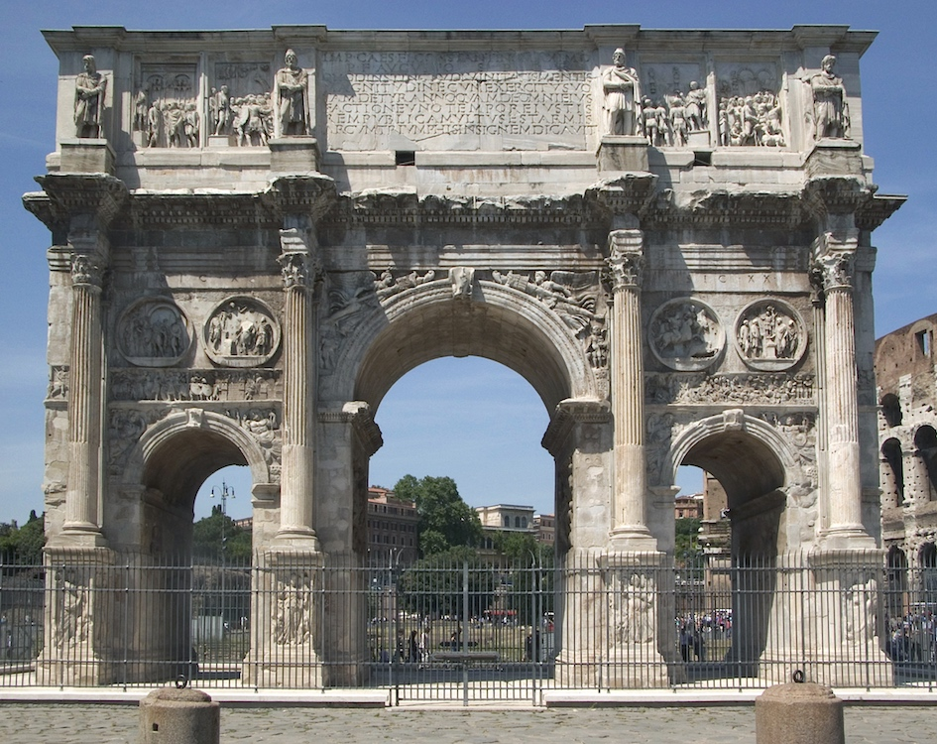
The Arch of Constantine

Slide 39
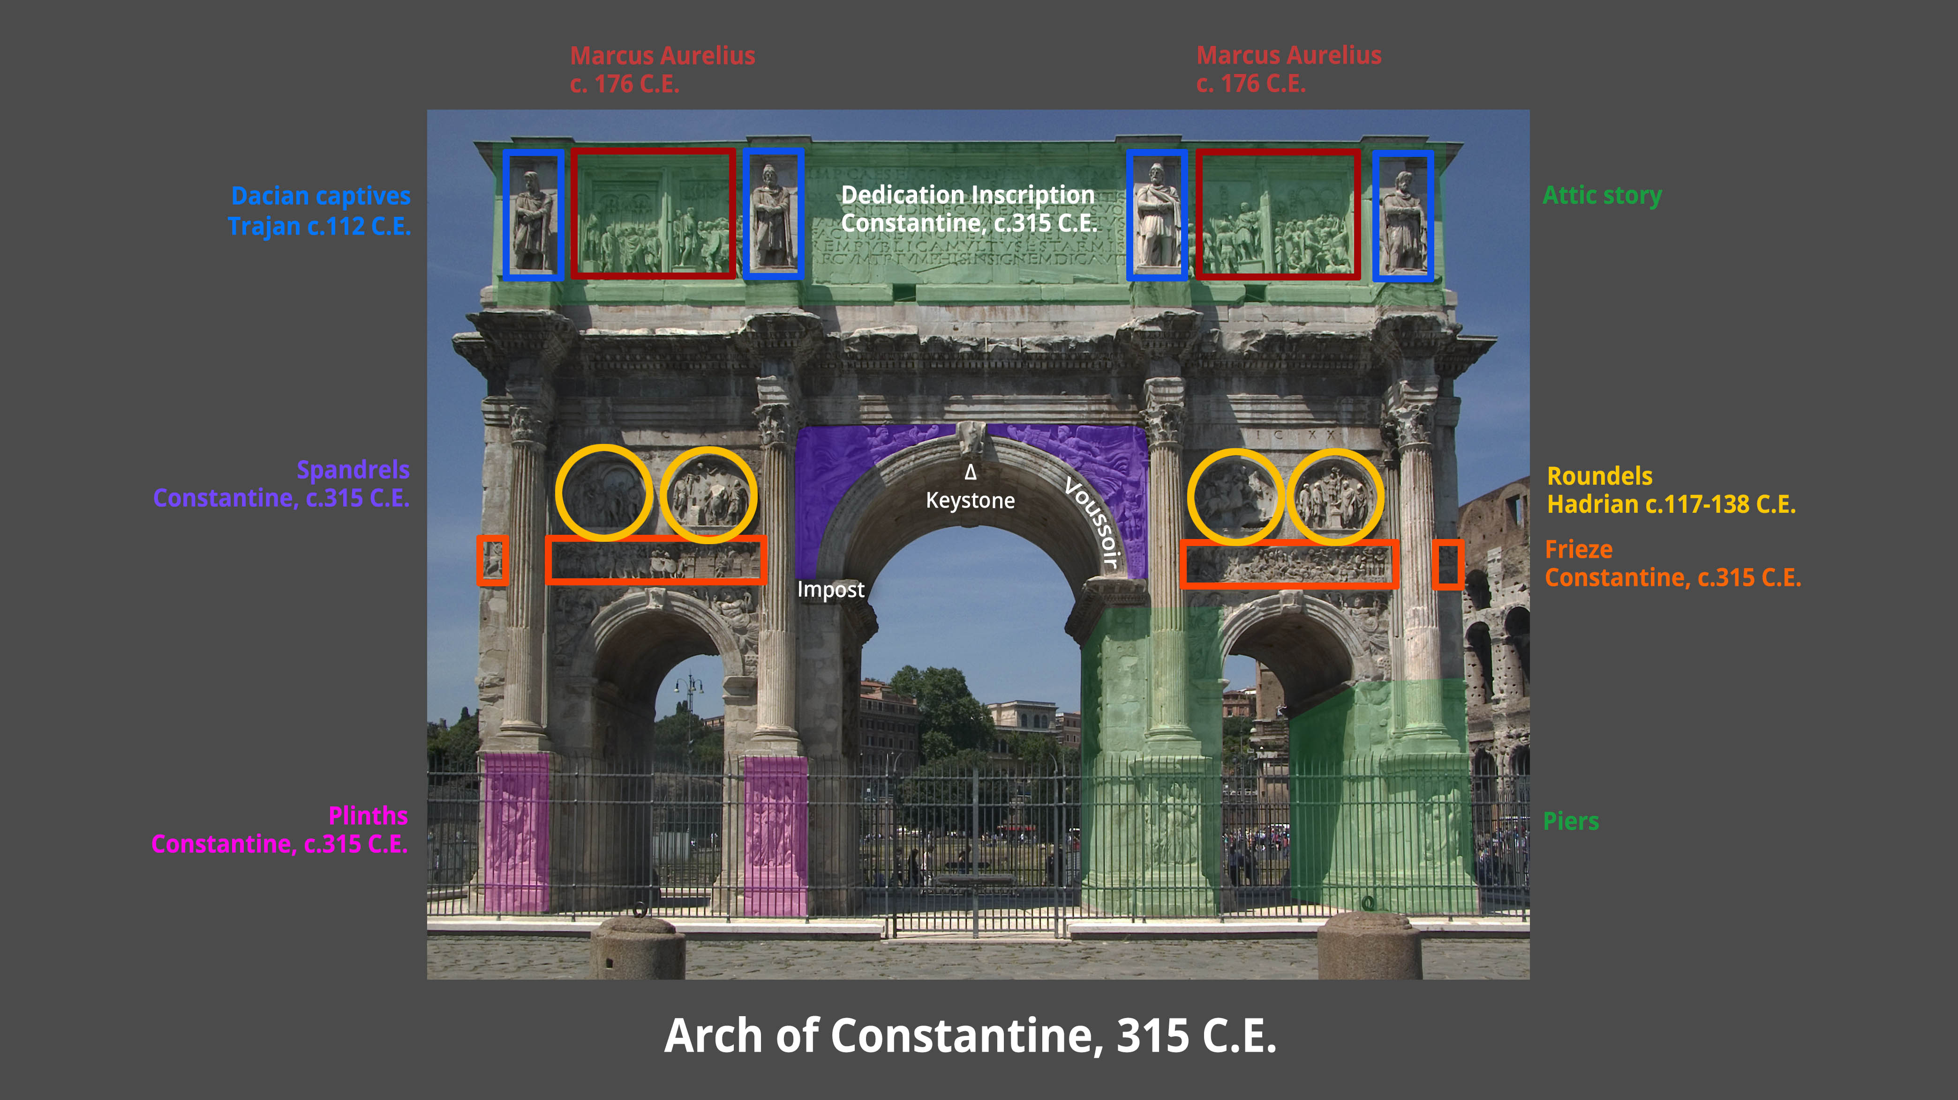
Spolia

Slide 40
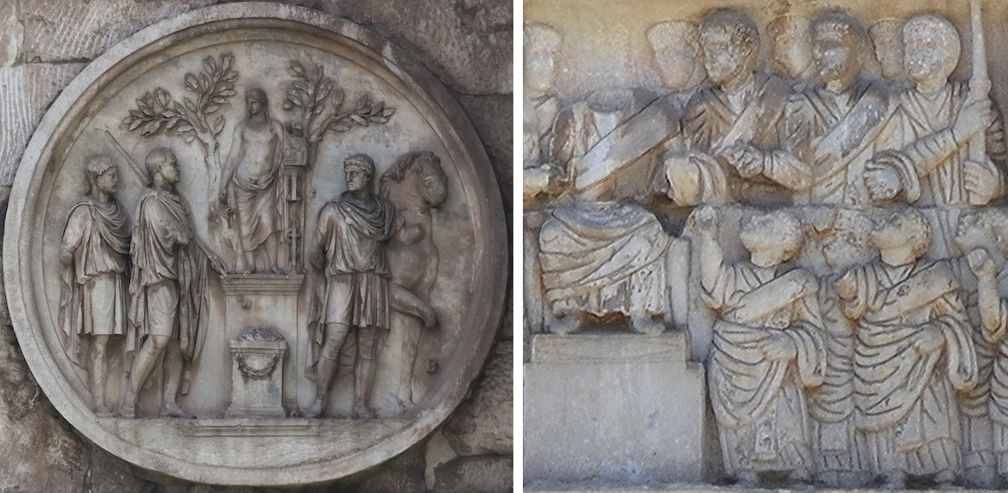
Different styles, different messages?

Slide 41
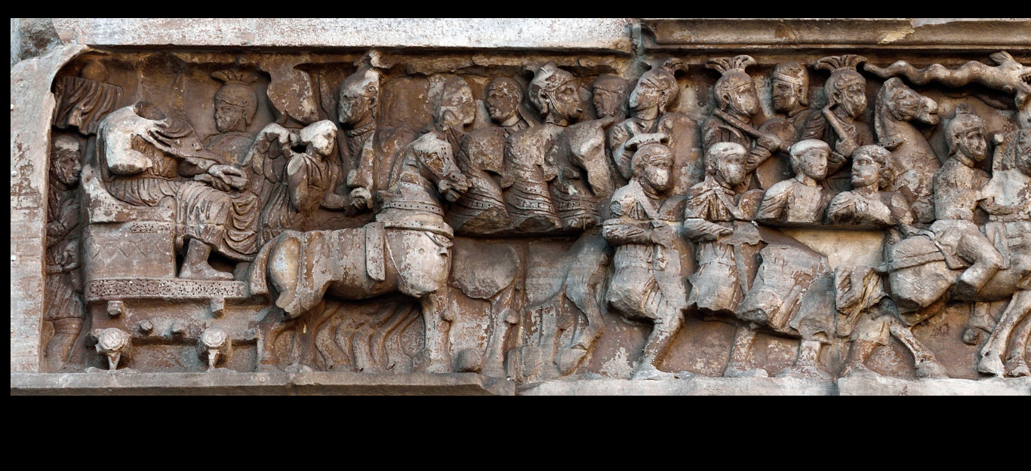
Constantine's army and triumph

Slide 42
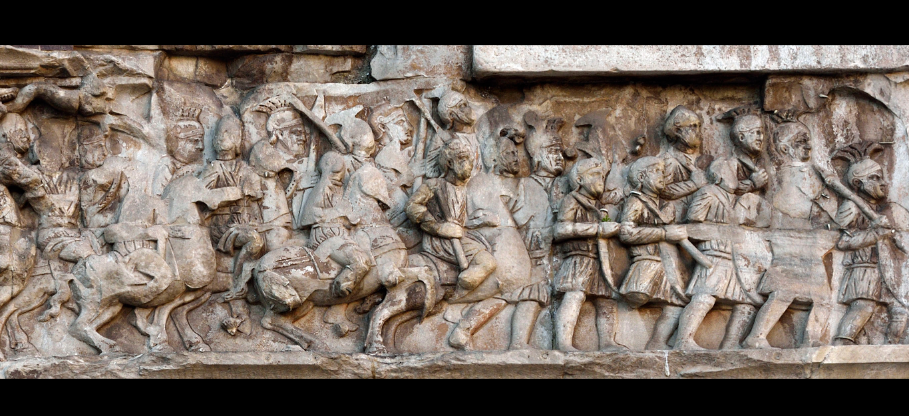

Slide 43
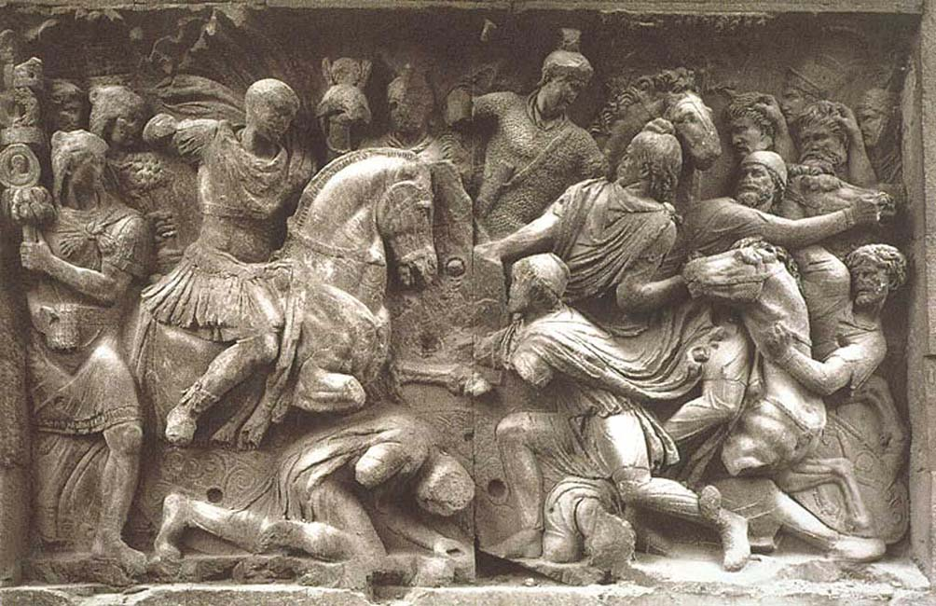
Trojan’s army- Spolia

Slide 44
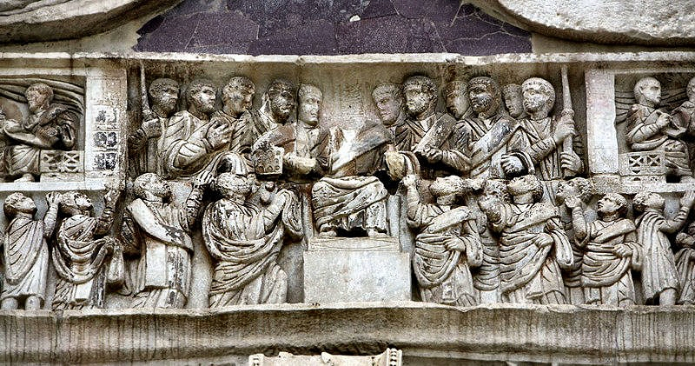
Kingly power: Constantine’s frieze

Slide 45
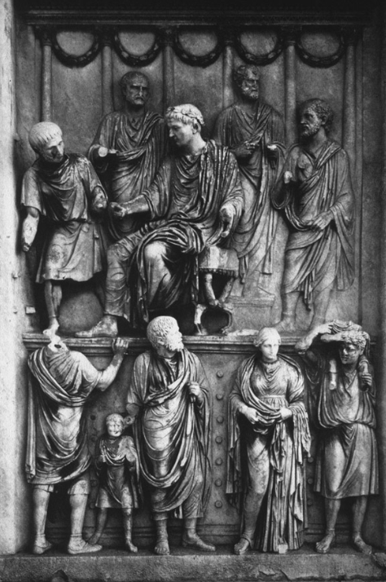
Libertas (distribution of gifts to the people): Kingly power in spolia

Slide 46
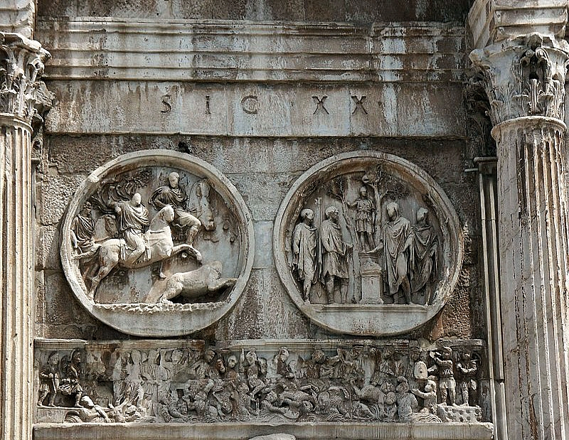
The dialogue of spolia and new sculpture

Slide 47
The dedication on the Arch
To the emperor Flavius Constantine, the Great, pious and fortunate, the Senate and People of Rome, because by divine inspiration and his own great spirit with his army on both the tyrant and all his faction at once in rightful battle he avenged the State, dedicated this arch as a mark of triumph. (Translated by Claridge 1998: 272)
“by divine inspiration” (INSTINCTV DIVINITATIS) is nebulous enough to please all viewers – both pagan and Christian
This text displays the very same characteristics that are observed in the pictorial composition of the arch- tradition and innovation, stock phrases and expression with new, open-ended meanings and messages

Slide 48
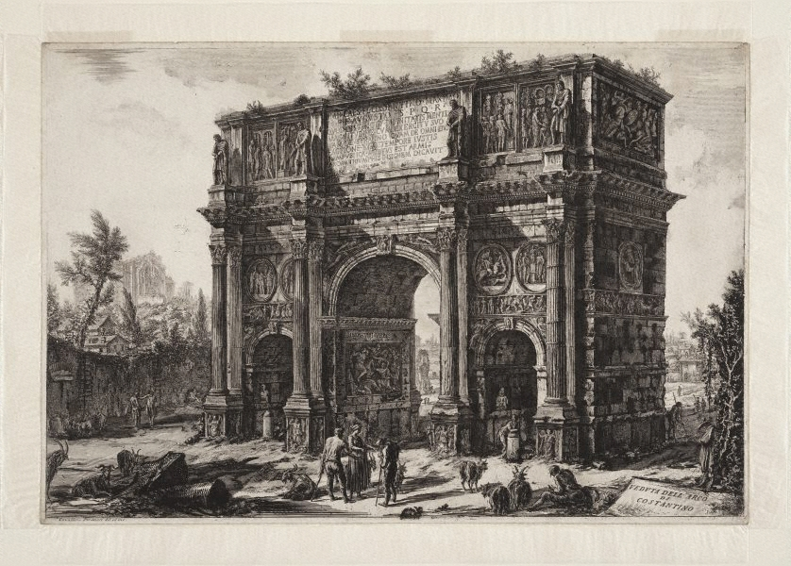
Viewer reception (1771)

Slide 49
Keynes’ General Theory (GT)
Spolia in se: Pieces removed and placed in a different building than what they were originally a part of.
Spolia in re: monuments or works of art purporting to belong to an earlier period by using typology, proportions or styles of the past.
Keynes’ General Theory displays both artistic borrowings- both direct quotations of theories he approves of and quotations of theories he disproves of.
He does this both through direct quotations (Spolia in se) and through imitation of the argumentative and persuasion style of older treatises in economics (Spolia in re).
We can therefore separate between a direct quotation or reference, the insertion of another text into the host text or an explicit appeal to some external text or author by mimicking the other text’s characteristics.
The argument of the GT appropriates whole theoretical schemes as spolia in a developing narrative that is built around a realisation that reality is fragmented, and only a polyphony of schemes can start to uncover facets of reality and reach some understanding of social processes.

Slide 50
The use of Irony and self-negation
VI. With the aid of the notation introduced in chapter 20, we can, if we wish, express the substance of the above in symbolic form. Let us write MV=D where M is the quantity of money, V is its income-velocity (this definition differing in the minor respects indicated above from the usual definition) and D the effective demand…
(Keynes 1936: 304)
And a few pages before, the book directly refers to this passage with the following words:

Slide 51
The object of our analysis is, not to provide a machine, or method of blind manipulation, which will furnish an infallible answer, but to provide ourselves with an organised and orderly method of thinking of particular problems; and, after we have reached a provisional conclusion by isolating the complicating factors one by one, we then have to go back to ourselves and allow, as well as we can, for the probable interactions of the factors amongst themselves. This is the nature of economic thinking. Any other way of applying our formal principles of thought (without which, however, we shall be lost in the wood) will lead us into error. It is a great fault of symbolic pseudo-mathematical methods of formalizing a system of economic analysis, such as we shall set down in section VI of this chapter, that they expressly assume strict independence between the factors involved and lose all their cogency and authority if this hypothesis is disallowed; whereas, in ordinary discourse, where we are not blindly manipulating but know all the time what we are doing and what the words mean, we can keep ‘at the back of our heads’ the necessary reserves and qualifications…. (Keynes 1936: 297)

Slide 52
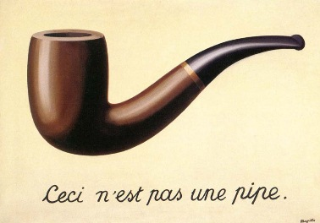
Keynes as Magritte
Words are not thoughts.
Maths are not words.
Realistic analysis is an illusion of the mind.
The signified and the signifier are not characterized by harmony but by tension and uncertainty.
The relation is constantly re-interpreted and re-evaluated, it is never settled.

Slide 53
Different tools (historical analysis, analytical modeling, scenario planning) for different problems
So far we have been primarily concerned with the way in which changes in the quantity of money affect prices in the short period. But in the long run is there not some simpler relationship?
This is a question for historical generalisation rather than for pure theory. (Keynes 1936: 306)

Slide 54
Text hermeneutics- monoliths and spolia in textual analysis
Some texts (Walras’ Elements famously) are supposed to be self contained narratives that require little external frame of reference.
These texts hide the unclear elements of their narrative.
They appear definitive and atemporal in their frame of reference, respecting Lessing’s Laocoon message of true meaning and separation of fields.
Other texts display their contemporality- and at the same time do their best to display their incompleteness.
They use irony and play on shades of interpretation
Appear incomplete and steeped at their historical point of reference blearing the nines between different disciplines, meaning and sound, symbol and signified.
Both authors through their texts - lie
Nothing is complete, nothing is entirely devoid of synthetic value.
All text has context, and all text creates new context through appropriation and re-appropriation.
Text that displays its context may also be the greatest survivor in the history of art or theory. Contexuality does not mean the text will lose its meaning and atemporality does not guarantee survival.
Then again Keynes may be different:
Friedrich Schlegel often remained incomprehensible even to his friends.
[Attributed to Walter Benjamin (Barnett, 2001, 1)

