Slide 1
Χρηματοπιστωτικές Φούσκες, Μανίες και Κρίσεις.
Από την κρίση των τουλιπών (1620) έως σήμερα.
Κωνσταντίνος Ρεπαπής
Επίκουρος καθηγητής ΕΚΠΑ

Slide 2


Slide 3
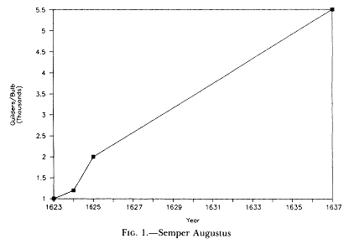
If you were living in Amsterdam in February 1637, this tulip would cost more than 12 acres of land, or 10 times the annual income of a skilled craftsman (according to some accounts).
This price boom (and subsequent collapse) of tulip bulb prices was called “tulip mania”.
It is considered to be the first episode of a financial bubble and a subsequent economic crisis.

Slide 4
Historical setting
The United Provinces where a highly urbanized, cosmopolitan republic.
  Holland had colonies in the Caribbean, South and North America and the Far East.
It had a strong merchant class that had accumulated substantial wealth.
  Rest of Europe still had more the medieval organisation of Lords and peasants.
It was the commercial hub of Europe, and the big company was the Dutch East India Company charted in 1602 and given monopoly of trade with Asia.
In 1568 the Dutch where in revolt against the Spanish. The war lasted until 1648.
In 1635 Bubonic plague reached Holland, and kills 20% of the population over the next two years.

Slide 5
Financial setting
The Dutch East India company was the biggest trading company in Europe and the prime importer of luxury products like spice and porcelain from Asia.
  It yielded enormous profits to the shareholders (was a joint-stock company).
  It was the first company that issues common stock tradable in the stock exchange.
  This made stocks highly liquid investments, as there was a market constantly trading in them.
The Bank of Amsterdam was establishes in 1609.
  It was the largest bank in the 17nth century.
  It created ‘bank money’ i.e. held credit against deposits that where settled at specific intervals in the month.
    This facilitated financial transactions as it standardized currency and offered the authority of the bank in bills for settlement.

Slide 6
Facts about Tulips
The tulip was cultivated by the Ottoman Turks in the sixteenth century.
  It was imported to Holland around 1593.
Tulips can breed many varieties through cross-breeding.
There are two basic categories.
  Breeders: common, simple, single-coloured tulips.
  Varietals: broken tulips, multi-coloured, and the product of a virus.
Tulips can grow either from seeds or by cultivating the offsets that the mother bulb created by cloning itself.
  Seeds do not display Varietals, as they are not infected by the virus. It also takes 7-12 years to grow a tulip from seed.
  A mother bulb yielded maximum 2-3 clones per year. It takes 2-3 years for them to become mature bulbs.
  Varietals had shorter life span than normal bulbs due to the virus.
  Each infected bulb was slightly different- influence of virus on bulbs varied.

Slide 7
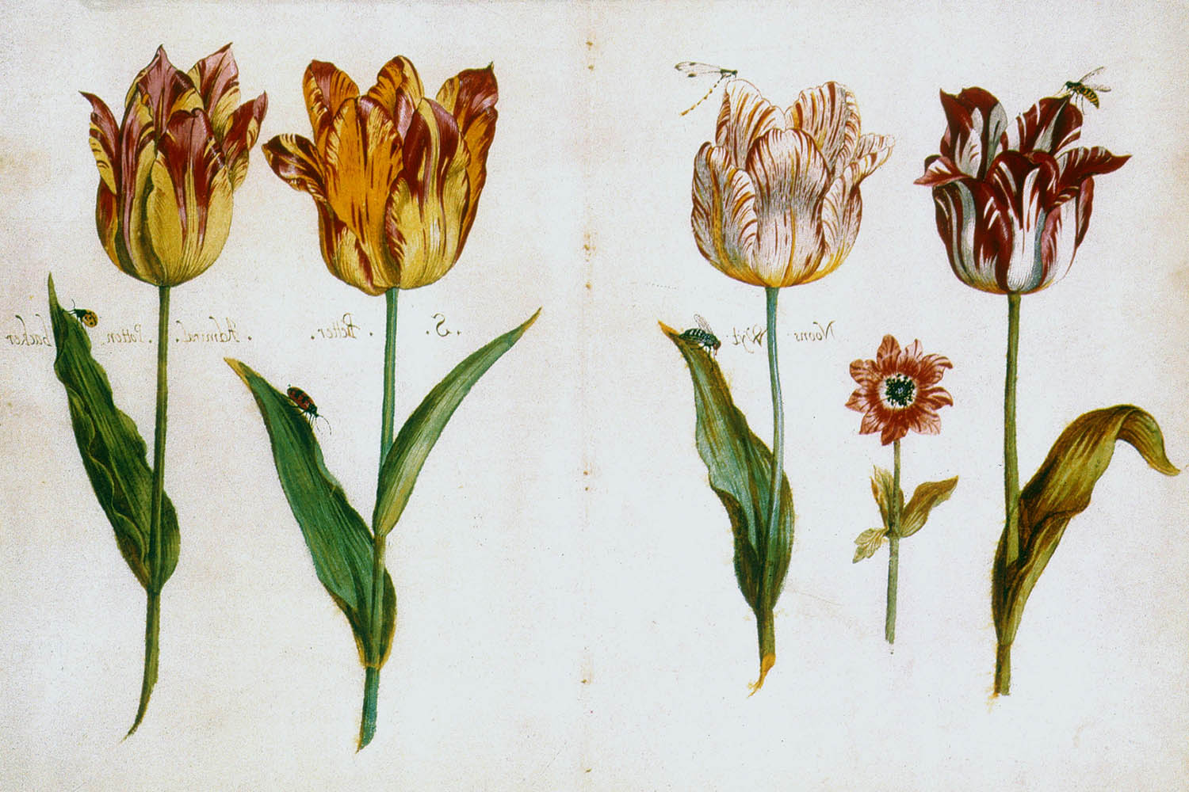

Slide 8
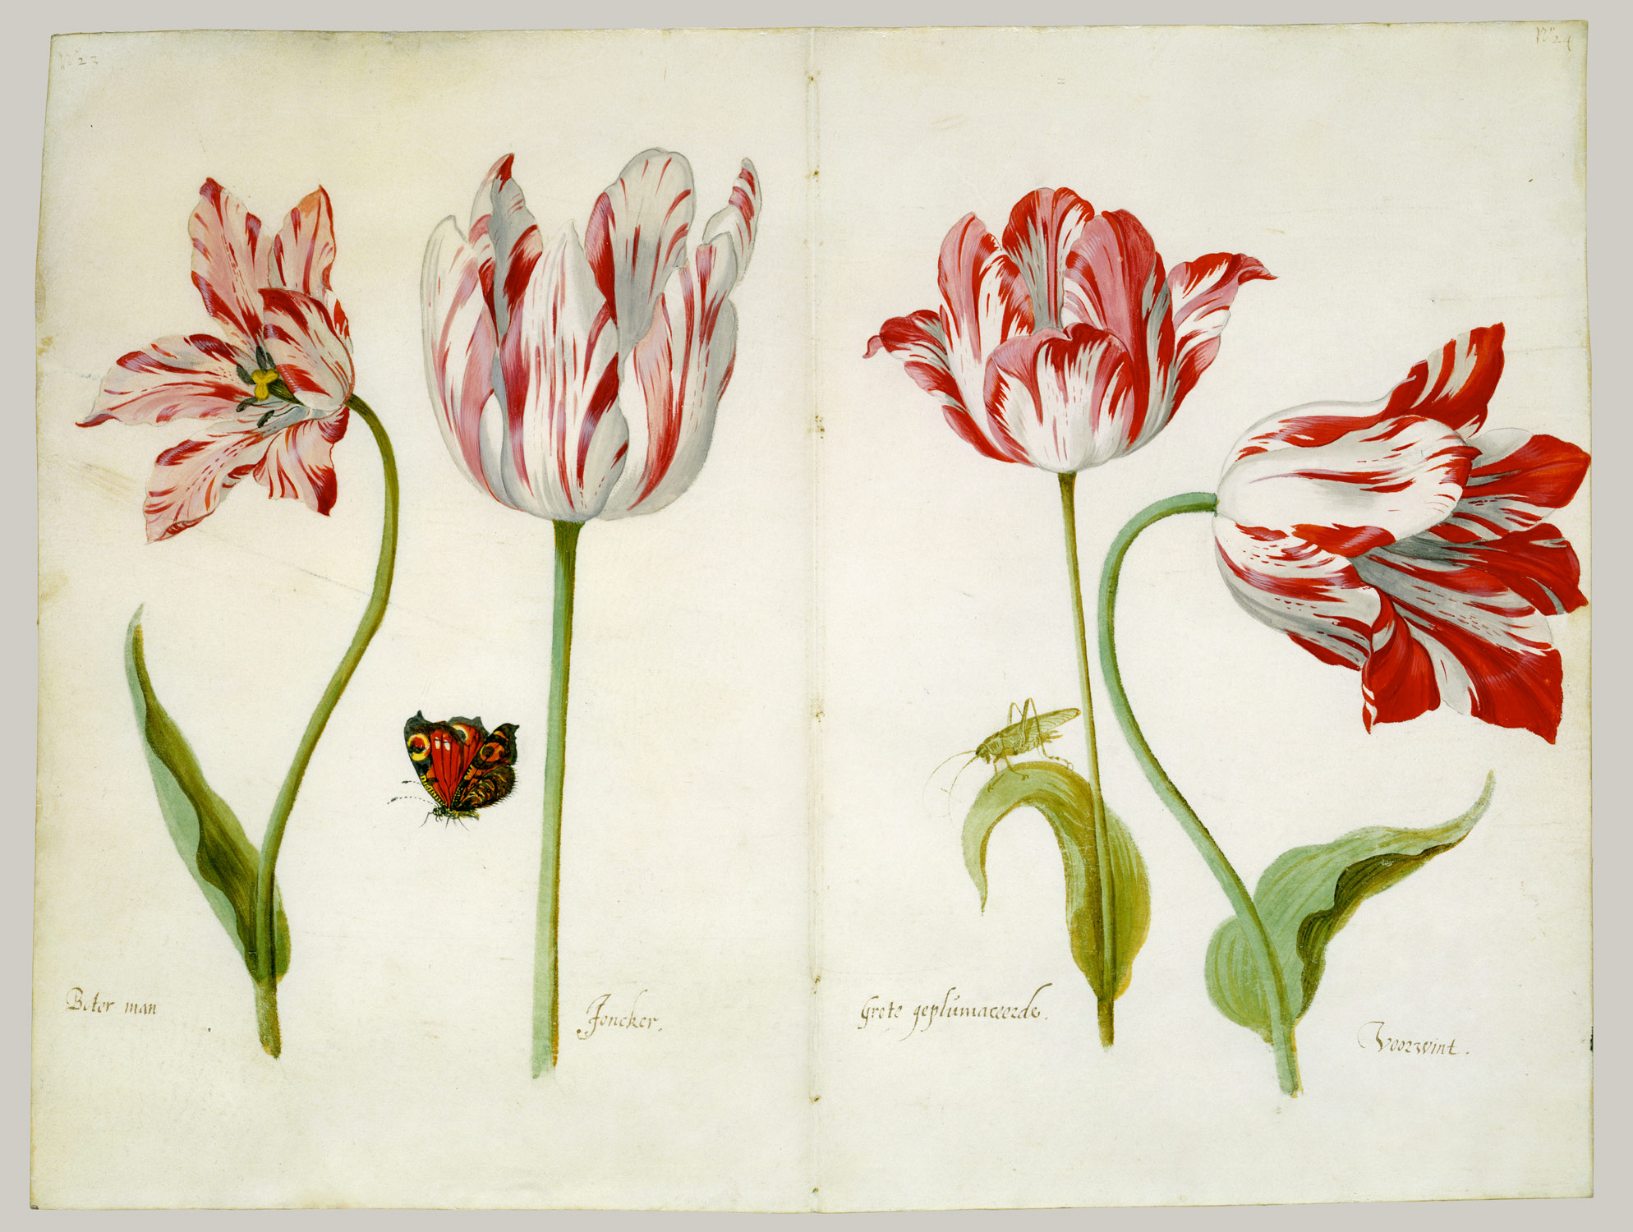

Slide 9
Tulips and contracts
Tulips bloom from April to June for one to two weeks.
During the bulb’s dormant phase (June to September) they can be uprooted and planted elsewhere.
Bulbs remained in the ground from September to their next bloom in Spring.
Bulbs where originally traded after their bloom in spot markets (Αγορές άμεσης παράδοσης). I.e. markets that bulbs changed hands for money.
From about 1636 it became possible to have forward contracts (Προθεσμιακές συναλλαγές/ προθεσμιακή σύμβαση αγοράς) during the winter months. I.e. from September contracts could be made for delivery of bulbs for a price next September.
Transfers of bulbs for money where usually enforced by written contacts before a notary.
  Some forward contracts where less formal contracts and their legal status more uncertain (more about this later).

Slide 10
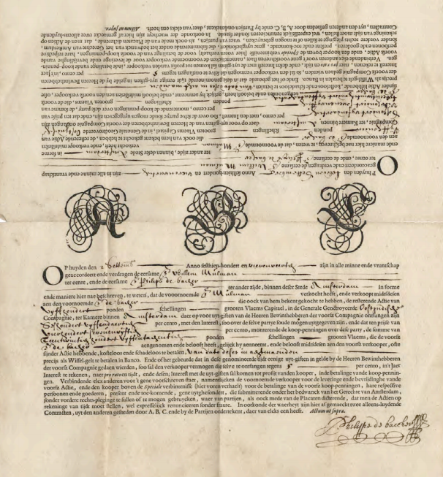
Forward contract used in a transaction on 2 Sept, 1644.
This is on Dutch East India company shares and not tulips.
Formal forward contracts in the Amsterdam stock exchange existed before they were introduced in the tulip bulb trade.

Slide 11
Forward contracts in detail
(προθεσμιακή σύμβαση αγοράς)
In Forward contracts the parties (buyer/seller) specify the price, good and date the exchange will take place.
  I.e. I will buy this bulb in September for this amount of money.
The forward contact may require a down payment (pay e.g. 5% of the price now and the rest on delivery) but this is not always the case.
  In the tulip trade in 1636 there was usually no down-payment- the deal was sealed with buying of wine by the seller in the tavern where the two parties met.
The seller could require some cover, in case the buyer could not pay the agreed funds at the time agreed.
  For example, pledge of property, your house, as a guarantee that you will honour the contract.
  Enforcement became a matter of arbitration- the law courts.

Slide 12
It is up to the seller to agree to extend credit to the buyer. I.e. to believe that the buyer will be able to honour their agreement.
  The buyer did not, usually, have to prove that they had guarantees by the bank that they could pay that amount.
  For this reason, these transactions can be seen as speculative.
The buyer could sell the forward contract to someone else.
  I.e. the contract was transferable.
Prices fluctuated when the bulbs where in dormant phase for a number of reasons:
  Uncertainty on future price (both in Holland and abroad)
  Uncertainty on the weight of the bulb when dug up
  Uncertainty on the number of clones
This environment meant that a buyer could buy a contract in November for £100, and if prices further rise sell it for £110 in Dec.
  As long as the buyer of his contract could pay £110 and the producer deliver the bulb, this person can make £10 without ever having the money to pay the contract of £100 out in the first place!
  If prices fell to say £95, and he sold his forward contract, he only needed to pay from his pocket £5 to cover his initial contract. Thus the person had to only be able to cover the marginal position of the contract- not be expected to cover the whole amount.
  This kind of trade deals the Dutch called wind trade.

Slide 13
Chain of contracts
(αλυσίδα συναλλαγών)
Forward contracts could themselves be sold to other buyers.
So the promise to buy the bulb could be sold and resold during the same winter between traders.
Cash payments would be paid when the contract matured. Meanwhile, at best, only a premium was paid.
As long as you sell the contract higher than you bought it, you will be able to repay your seller.
  As long as your buyer pays you!
Original owner of bulb
Promise to deliver bulb in Sept.
Promise to pay agreed price
1st buyer- forward contract
2nd buyer- forward contract with 1st.
Final (?) Purchaser of bulb

Slide 14
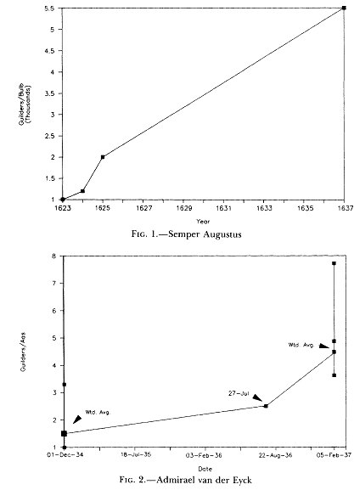
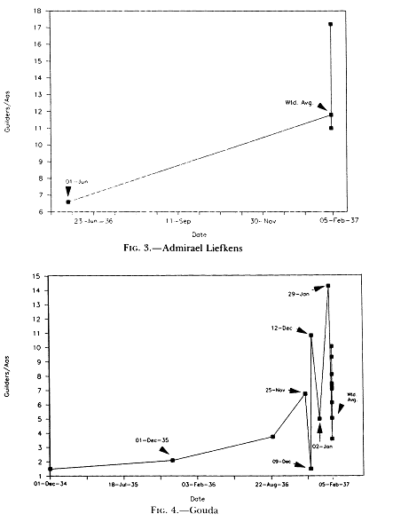
Rare Tulips

Slide 15
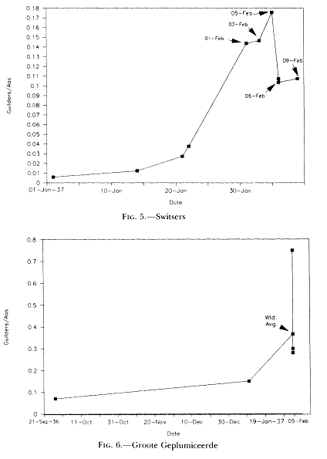
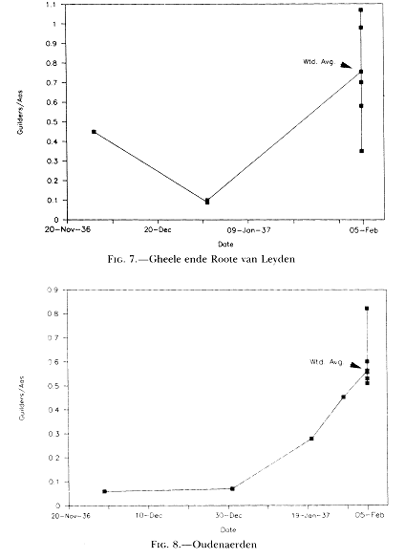
More common tulips
All from Garber (1989)

Slide 16
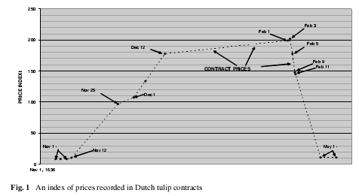
A General Index of tulip prices during 1636-7
Source Thompson (2006, 101)

Slide 17
Timeline
(based on Bilginsoy 28-29)
time | event
1600-30 | Tulip market expands in Europe and Holland. Tulips become fashionable luxury item across a large merchant class.
1630 | Traders who start to buy for capital gain (rather than interest in the product per se) enter the market.
Dec. 34 | First recorded sale of bulb by weight.
1635 | First bubonic plague victims in Holland.
Fall 1636 | Development of forward market in bulbs- bulbs now traded through the whole year.
November 36 | Sharp rise of tulip-bulb prices.
3 Feb. 1637 | Peak of bulb forward contracts. Contracts not honoured.
23 Feb. | First attempt between buyers and sellers to settle contracts after Nov. 30 1636 at 10% of price. Agreement not reached.
25 April, 1637 | All contracts on bulbs suspended awaiting decision of Court of Holland.
May 1638 | Haarlem city council rules all contracts can be cancelled at 3.5% of original sale price.

Slide 18
Was there really a tulipmania?
Finding reliable data on the prices of the bulbs remains a problem.
  This is compounded by the fact that the bulb market was both a new and a semiformal establishment.
The effects on the economy at large are contested by economists.
Some find the effects substantial
  Goldgar (2007) notes the negative effect this episode had on mutual trust between merchants.
  There where extended periods of litigation to deal with the financial mess.
Others argue that some contemporary accounts may be misleading.
  Effects localised and the outcome of institutional design.
Modern economists disagree- we will investigate 3 views.

Slide 19
Galbraith’s view
“It was the first great speculative explosion”.
“In the aftermath the bitterness, recrimination, and search for scapegoats – all normal – were extreme, as was the avoidance of mention of mass mania that was the true cause.”
“Those who had contracted to buy at enormously inflated prices defaulted en masse. Angry sellers sought enforcement of their contracts of sale; the courts identifying it as a gambling operation where unhelpful”.
Galbraith views this as a psychological and institutional phenomenon.
  The expected outcome of mass psychology in an expanding, new, unregulated market, where speculative activity is allowed to operate unchecked.

Slide 20
Garber’s view
It makes sense that tulips where expensive in the beginning.
  This is determined by supply conditions. It takes time to grow new ones.
As supply increases prices naturally fall over time.
The discounted value of bulb sales can justify extremely high prices for the unique bulb of a new variety when first created.
However, in January 1637 common bulbs where trading very high.
  “We would be hard pressed to find a market fundamental explanation for these relative price movements”
Garber sees an irrational bubble for a few months and in limited products.
  Thus a more limited phenomenon that generally believed.

Slide 21
Thompson’s view
“Despite outward appearances the tulipmania was not a bubble because bubbles require the existence of mutually-agreed-upon prices that exceed fundamental values.”
Instead Thompson’s explanation focuses on institutional changes.
On February 1637 Dutch florists (the buyers) declared that all contracts written after Oct. 1636 where not binding.
The price of the forward contract was not binding, but only a small percentage of it (eventually decided around 3%) had to be exchanged to unhull the contract.
“Future prices in the original contract became option exercise prices in options contracts.”
  This the prices before and during the bubble are for different types of contracts.
“Tulipmania” is a contractual artefact.

Slide 22
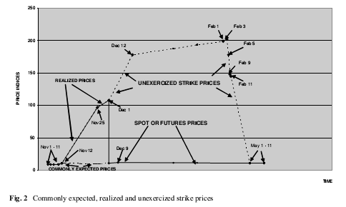
Source: Thompson (102)

Slide 23
Which view convinces you and why?

Slide 24
Joseph de la Vega’s
Confusion de Confusiones
This book published in 1688 is one of the first accounts (if not the first one) on the working of stock markets.
  In this case the Amsterdam stock market- the most advanced financial centre in Europe in the 18nth century.
It is written in a style that combines a moralising tone, with an explanation of the operations of the market and anecdotal evidence of transactions and the characters involved.
  It stands at the beginning of a long literature of popular writings on the stock exchange- books like A random walk down wall street: The Time-Tested Strategy for Successful Investing, which combine recipes of wall street success with historical examples and descriptions of the various operations.

Slide 25
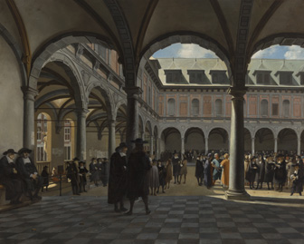
Vega did not describe the tulip bulb market- but the much more formal market of the stock exchange about 40 years after the tulip crisis.
The stock exchange traded primarily in stocks of the two grand trading companies:
  Dutch East India company (for whose shares the Amsterdam Stock exchange was set up in 1602)
  Dutch West India company (a smaller and less profitable operation started in 1621)

Slide 26
Vega- Three classes of investors
“Three classes of men are to be distinguished on the stock exchange”
“The princes of business belong to the first class”
  These are powerful stockholders from rich families who live off dividends of the company and do not engage in day to day buying and selling of stocks.
    “They do not care about the movements in the price of the stock”.
  They engage in buying and selling of stocks through brokers.
  They are interested primarily in the continual welfare and profitability of the company (both short and long term).
“The merchants to the second”
  These are less wealthy individuals who buy and sell shares over time.
  They are primarily interested in the fluctuations of the price of stocks, as their gains come from the variations in price.
  They buy and sell both directly and through brokers.

Slide 27
  “They prefer to gain little, but to gain that little with [relative] security; to incur no risk other than the solvency of the other party in the forward contract; and to have no worries other that those bound up with unforeseen events”.(page 5)
“The speculators to the last”.
  De la Vega considers these people lacking moral scruples and interested only in short term gains by any –mostly immoral if not illegal- means.
  These are people who trade for short term profits both in the underlying asset (shares) and in future markets (future contracts).
  Their primary interest is to make money through a variety of means including:
    Using privileged/inside information
    Spreading false information
    Playing on the psychology of the crowd to influence the direction of the price of shares.
  They form cabals, or rings, to raise capital and create both bubbles and crashes in stock prices that will make them gain money at the expense of other traders.

Slide 28
An aside: Uncertainty and identity: a post Keynesian approach (Davis 2010)
The paper considers entrepreneur identity in which radical uncertainty plays a central role.
  Entrepreneurs’ survival plays into their investment behavior, when there is radical uncertainty.
“Though the economy is a system of change, and though much also changes in the characteristics of economic agents, including the disappearance of some (through bankruptcy or voluntary withdrawal), when economic agents act, they act as if they retain their respective identities through time.”

Slide 29
“Different types of agents have different types of identities, so that the functioning of the economy needs to be understood in terms of the interaction of identifiably different (or heterogeneous) types of economic agents.”
In our ordinary way of thinking, of course, we maintain a separation in our minds between individuals and what they own, allowing us to imagine that individuals continue and may somehow sustain their identities should they go bankrupt and cease to be wealth owners. But the analysis here does not distinguish between agent identity and personal identity,… individuals are subsumed by the roles they play in the economy, so that difference arguably does not exist there either
The risk that Keynesian entrepreneurs face in losing their ‘identity’ portfolios makes the unsettled character of long-term expectations an even more serious matter.
Radical uncertainty is not only about what entrepreneurs cannot know about the future (an epistemological uncertainty), but also ultimately about whether they themselves may even exist in the future (an ontological uncertainty).

Slide 30
The brokers
The Amsterdam Stock exchange had both:
  Licenced brokers (χρηματιστές). They are appointed by the municipal authorities and called “sworn” brokers. “They take an oath not to do business on their own account.” Their numbers are limited.
  Unlicensed (free) brokers. It appears any individual could (and many did) behave as a broker to represent a client. [This appears to be illegal, but they are rarely prosecuted].
All brokers receive –from the client- some brokerage fee from their clients (which appear to depend on a number of things).
Brokers are used for honest and dishonest purposes.
  Honest purposes include buying and selling of stocks of people they represent at prices agreed between the brokers and their client. The client does not intent to mislead either the broker or the market with this commission.
  Dishonest purposes include buying and selling of stocks of other contracts (forward/options etc.) which the client does not wish to appear to do, and the broker allows anonymity that has ulterior motive (e.g. a speculator who is trying to inflate the price of the stocks, while betting the price will go down through the broker).

Slide 31
Credit and settlement in the bank
The Bank of Amsterdam issued credit to buyers and sellers who engaged in stock exchange transactions.
It appears both buyers and sellers held deposits in the bank, and Stocks appear to be “payable at the bank”.
  Some of this payment would have been transferred immediately (i.e. if you buy a stock) or only a premium (if e.g. it’s a forward contact).
It appears that settled of accounts in the bank (clearing of the different positions of buying/selling, etc.) that determined your remaining capital took place once a month, around the 20th of the month.

Slide 32
The operations/trades curried out
Spot contract/market: the exchange of a good for an amount of cash on the spot.
Forward or Futures contract: The agreement between two parties to exchange a specific volume of goods (or shares) for an agreed price at a certain date.
  Here a premium is usually present, with size depending on the contract.
  The primary reason for Futures is hedging. I.e. to avoid the risk of unexpected price fluctuations in the future.
Option contracts (σύμβαση για χρηματοπιστωτικό δικαίωμα): The selling of the right to purchase a given transaction at specific price at a certain date. A premium is paid by the buyer for the privilege of the contact.
  Call option (Δικαίωμα προαίρεσης για αγορά): “a party agrees to deliver a given amount of stock at a specified price upon ‘call’ by the other party at a specified time.”
  Put option (οψιον πώλησης): “a party agrees to accept a given amount of stock at a specified time and price if it is ‘put’ upon them then.” (De la Vega, p. XVI)

Slide 33
Other terminology
Long position: This means buying and holding a stock or bond in the expectation of it rising in price.
Short position (Ανοικτή/ακάλυπτη θέση): This is a complex operation that requires a broker or lender.
  You believe that the price of the stock will go down, (lets say from £100 that it currently trades).
  You ask your broker to borrow a stock from his portfolio and sell it for £100.
  You get through the sale the £100 and you have to give the broker back the stock at a future specified date.
  If at that date (or between then and that date) the stock is at £70, you buy it at £70, give it to the broker to cover your position, and gain from this operation £30 minus any brokerage fees.
Short position is the opposite to a long position. In a long position you expect the price of the stock to increase. In a short position you are betting that it will fall (and you will make money by buying it more cheaply in the future- if the price increases you will lose money).
Many regulatory authorities (starting with the Dutch) are suspicious of short positions seeing them as vehicles of speculation and market manipulation.

Slide 34
Concluding thoughts
Amsterdam’s financial market in the 17th century had sophistication that mirrored modern financial markets.
The problem of speculation and bubbles was something that worried contemporary merchants and the government.
At the same time financial sophistication came together with substantial growth and the creation of new consumer goods for a rich merchant class.

