Slide 1
Lecture 5: The recession of 1870s

Slide 2
Recap:
1620 Tulipmania- a crisis of private credit that was transferable.
1720 Mississippi crisis- a crisis emanating from an overextension of paper credit, and a crisis of confidence on the convertibility ability of the Banque Royale.
1825 Banking crisis- a crisis emanating from the relation between the market, the banking sector and the central bank.
  The central bank’s reluctance to be a lender of last resort created bank failures.
In this crises we discussed the financial system and its increasing sophistication.
Today we will discuss more the effects on the real economy following the crisis- and how this effects growth and distribution.

Slide 3
The Gilded Age in the US
The Gilded Age was a period of US history (from the 1870s to about the 1st world war) where there was rapid economic growth, especially in the new territories of the USA.
  Between 1865 and 1898, the output of wheat increased by 256%, corn by 222%, coal by 800% and miles of railway track by 567%
  In 1869, the First Transcontinental Railroad opened up the far-west mining and ranching regions. Travel from New York to San Francisco now took six days instead of six months.
High real wages drove millions of Europeans to migrate to the USA.
At the same time big monopolies created a class of very rich Americans.
  Income inequality was rising with the top 2% of American households owning more than 1/3 of total wealth.
Phenomenally rich self-made men, captured the popular imagination.
  Their ways and lifestyle influenced millions who could only aspire to this level of wealth. The US economy was expanding fast and this was a period of growth but also of widening inequality in the distribution of income.
Herbert Spencer proposed the idea of social Darwinism.
  It justified the stratification of the wealthy and poor. Spencer coined the term "survival of the fittest".

Slide 4
The US banking system
From 1863, the US started created a system of national banks, with the office of the Comptroller of Currency (OCC) as the central supervisor and ability to grant federal charters to national banks.
National banks had to have Treasury securities as assets for their banknote issue.
All banks had to have reserves against notes and deposits.
  National banks at 25%
  Country banks at 15% (a proportion could be held as deposits in national banks).
There was the creation of a three tier system.
1) central-reserve city banks on top , esp. NYC, Chicago and St. Lewis.
2) The rest of national/reserve city banks- about 47.
3) Country banks
No lender of last resort bank yet in the US until the early 20th century.
  The Federal reserve (the central bank of the US) will be established as a result of the financial crushes in 1873, 1893 and 1907.
Hierarchical structure meant that the national banks could determine the fate of country banks.

Slide 5
Securities markets
By the 1870s there where a number of exchanges in New York.
  The New York Stock Exchange was not the only place trading in securities and bonds.
  Other places include: Public Stock Board, The Open Board of Stock Brokers, Gallagher’s Evening Trading etc.
  So there where many markets trading, in some cases the same securities and bonds- this allowed some market manipulation by traders.
Trading in railroad securities was one of the main activities.
Owners of railroad companies in many cases did not care about actually providing a good product, but more interested in manipulation of the stock value.
  Through the creation of news (true and false).
  By increasing the stock issue, buying back issue and other stock market manipulations, usually without an underlying need to e.g. fund an extension.

Slide 6
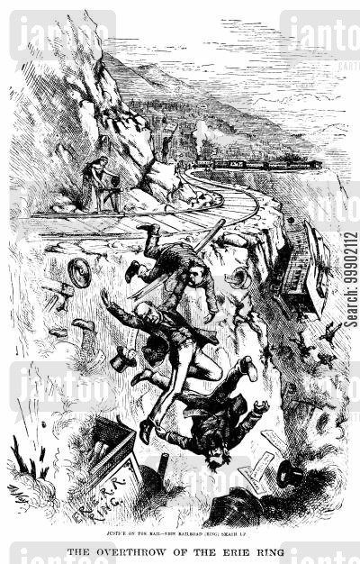
The age of the robber baron- Daniel Drew
Started as a cattle driver.
  He would have his cattle lick salt and drink water before selling them, so that they would weigh more.
Founder of the “watered stock” method in the NYSE.
  Watered stock is an asset that has an artificially inflated value.
  It made the stock appear to be more valuable that it is.
At the zenith of his power he had a $13 million fortune.
He lost everything in the panic of 1873, and filed from bankruptcy in 1876. Died in 1879.
Criticism “He holds the honest people of the world to be a pack of fools”

Slide 7
How to water a stock- guide to the perplexed
The institutional framework allowed you to issue stock and bonds in excess of the company’s assets and profitability.
A manager could issue stock at an inflated par value (face value of stock).
With issuing more bonds with inflated par value (i.e. face value for stocks) the overall value of the company would increase.
  So lets say the company owned assets of $5,000.
  The company owner could issue stock of $10,000.
  Immediately the company could declare that its worth $10,000 as its capital was (by law) at least the addition of all its stock.
  This would mean that the value of its asset overnight doubled from $5000 to $10000!
How to make money with this racket:
So you could make money by issuing unauthorised shares, and buying short contracts that the value of the share will go down.
Pay dividend from part of the money collected (to sweeten the sale) and then push the stock price down to cover the short contracts you have bought.
Drew on short selling: “He who sells what isn’t his’n, must buy it back or go to pris’n”

Slide 8
The panic of 1873
To finance the Civil War, President Lincoln’s administration issued paper currency called the greenbacks.
  This was legal tender but not convertible to gold and silver.
  Greenback period 1862-1879.
An increased money supply, together with rising demand for goods and public construction and subsidies stimulated the economy.
As we saw there was also speculation in company shares- the system was unregulated and highly volatile.
Furthermore, railroads had low profitability and had chronic problems of undercapitalisation- “watered stock”.
Cooke and company, an important banking house, had underwritten $100 million worth of Northern Pacific bonds in 1869.

Slide 9
The bonds of Northern Pacific where promoted and sold, but the railway company was not really going anywhere- only 455 miles of track where laid.
February 1873, President Grant signed the Coinage Act. Which established a gold standard (and made silver not legal tender).
  This reduced the money supply and increased the interest rates.
By the spring of 1873 the popular press was wondering if there was another stock market crisis coming- they were becoming a common phenomenon.
From September 8 stock market prices of railroad companies went under, and in September 18 Cooke and Company was forced to close down.
  (during this crisis Daniel Dew’s firm also become insolvent).
Cooke and Company was a big and important bank, its closure send shockwaves through the system.

Slide 10
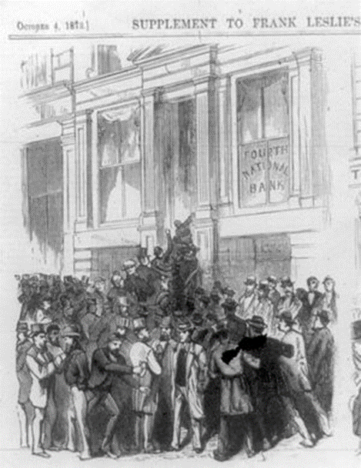
Cooke and Company was a big and important bank, its closure send shockwaves through the system.
If Cooke was insolvent who was solvent?
  Depositors tried to withdraw their funds, but banks were unable to deal with the requests.
Stock prices plummeted.
  The total decline of shares was 26% between January and Nov. 1873.
The government eventually responded by buying back $17 million of gov. bonds.
The panic ended by Oct. 1873, but bankruptcies continued.
The economy moved into the Long Depression.

Slide 12
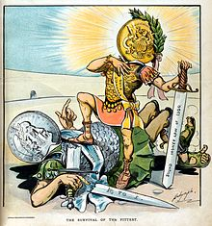
Coinage Act of 1873
The Mint of the United States was established in 1792. The Mint traditionally coined gold and silver coins at as fixed rate. Silver and Gold could be brought by individuals to be made legal tender.
Both metals were legal tender, a dollar was equal to both a legally defined weight of silver, and another legally defined quantity of gold.
  Having a currency be defined in terms of two different metals is called bimetallism.
The act by abolishing the right of holders of silver bullion to have their metal struck into fully legal tender dollar coins, it ended bimetallism in the United States.
  The matter became a major political controversy pitting those who valued the deflationary gold standard against those who believed free coinage of silver to be necessary for economic prosperity.
The Specie Payment Resumption Act of January 14, 1875 allowed the redemption of previously-unbacked “greenbacks” into gold.
  The decision further contracted the nation's money supply

Slide 13
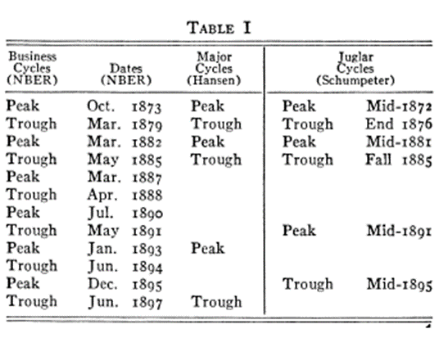
The Long Depression
The depression lasted from 1873 to 1879.
This is the longest period of economic contraction in US history.
It lasted for 65 months, from October 1873 to March 1879.
Approximately 18,000 businesses failed between 1873-1875, including a quarter of the country’s railroad firms.
Average price level declined by about 1/3 (deflation).
Unemployment reached 14% by 1876.

Slide 14
Production
Between 1870 and 1890, iron production in the five largest producing countries increased from 11 to 23 million tons, steel production increased twentyfold and railroad development boomed.
At the same time, prices in several markets collapsed - the price of grain in 1894 was only a third what it had been in 1867 and the price of cotton fell by nearly 50 percent from 1872 to 1877
  Imposed great hardship on farmers and planters.
Similarly, while the production of iron doubled the price of iron halved.
Industry | % decline in output
Durable goods | 30%
Iron and steel | 45%
Construction | 30%
Overall | 10%
Estimated declines in United States manufacturing output (1872–1876)
So after 1879 you see production increase in a number of goods in the US and globally, but a continuing trend of lower prices and lower wage rates.
This has prompted this period to be seen by some as a Great Depression with substantial redistribution of income between sectors, and others to not see it as a depression as production soon started to increase, and simply as a realignment of the economy as it grows.

Slide 16
Unemployment and wages
In the US after the Civil War many people found employment in the railway boom.
  Outside of agriculture it was the largest employer.
There was a decrease in nominal wages (reduction in money wages).
  But was there a decrease in real wages? Remember there was price deflation.
  Opinion is divided on this.
Data for unemployment is very sketchy- even in developed economies the full scale of unemployment is conjectural.
  In the UK and the US it seems to be higher during 1874-95, but even within that period it seemed to have fluctuated widely.

Slide 17
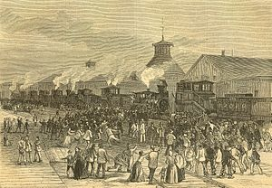
Social ramifications
Increasing Labour-Capital (or Labour-Management) conflict.
At the time, the workers were not represented by trade unions.
Railway workers went on strike in West Virginia, protesting on worker conditions and wage cuts in one year.
  By 1877, 10 percent wage cuts, distrust of capitalists and poor working conditions led to workers conducting numerous railroad strikes
    Strikes spread to Maryland, Pennsylvania, Illinois, and Missouri.
The Great Railroad Strike of 1877 brought railroads to a standstill for 45 days.
  Disruption was widespread and at its height, the strikes were supported by about 100,000 workers. With the intervention of federal troops in several locations, most of the strikes were suppressed by early August.
  Labor continued to work to organize into unions to work for better wages and conditions. Fearing the social disruption, many cities built armories to support their militias; these defensive buildings still stand as symbols of the effort to suppress the labor unrest of this period.
  Strike action as well as civil disobedience left 100 dead.

Slide 18
The international angle- Great Britain
This long depression had international ramifications.
The economy of the United Kingdom had been in continuous depression from 1873 to 1896.
  Production and productivity grew at a slower rate; capital investment was checked; British agriculture was seriously depressed.
  Britain ceased to be the world's workshop and, as a result of foreign competition, found increasing difficulty in expanding her export trade; but her imports of food and raw materials continued to grow rapidly.
  A fundamental change in British trading policy, away from free trade and back to protectionism and imperial preference.
The collapse in global prices provoked protectionism in many countries, such as France, Germany, and the United States, while triggering mass emigration from other countries such as Italy, Spain, Austria-Hungary, and Russia.

Slide 19
A recap – the Long Depression
The Long depression had the following general characteristics:
  A general fall in prices and money wages.
  Initial decrease in production of primary material and industrial products in the US (this picked up after 1880s, and was not immediately global- UK seems to have done ok in 1873-5).
  Unemployment increased on average, but data is sketchy and the actual figured varied alot between countries and areas.
  Protectionism increased.
  Social unrest.
  Monetary upheavals (end of bimetallism) and liquidity restrictions.
  What about income distribution?
    Data sketchy, but there is from the 1860s increased wealth concentration in the US at least.

Slide 20
J.A. Hobson: The Industrial System
John Atkinson Hobson (6 July 1858 – 1 April 1940), was an English economist, social scientist and critic of imperialism, widely popular as a lecturer and writer.
He was a prolific writer writing more than 40 books during his life, that became extremely popular.
  Some of his readers where John Maynard Keynes and Lenin, both of which admired his work.
He was, however, not popular with the academic economists at the time, who disliked (and never appointed him for a position).
He is an early proponent of underconsumption theory, and a believer that the industrial system could produce sustained unemployment.

Slide 21
The Industrial System (1909)
The Industrial System, an inquiry into Earned and Unearned Income is Hobson’s most complete work in economics, that brings together many of his thoughts and contributions.
He did not believe that the economic system as a whole can be explained through competition, so that factors of production are paid their marginal products.
  “If we were justified in holding that the whole of the product of industry was thus regularly and automatically absorbed in the payments necessary to evoke from the owners of the factors the output of this productive energy, no problem of distribution would arise.” (Hobson, 1909. vi)
But because this is not the case in the modern economy payments are not necessarily related to the contribution a factor makes towards production.

Slide 22
This means that the economy produces a surplus. A surplus above the minimum that it needs to pay the factors of production for production to continue.
However, for Hobson, the action of production and distribution of this surplus must be seen together, as the economy exists as an organic whole.
He distinguished between cost and surplus.
  Cost: what an industry needs in resources to continue operating.
  Surplus: the income earned above this cost.
What determines the distribution of surplus is no general economic law.
Different institutional environments allow different factors to command a larger or smaller part of that surplus.

Slide 23
At the superficial level, this surplus is given as payment to what is perceived to be the most scarce resources in the production process.
  This scarcity may be a naturally occurring one (land for example) or created (specialist knowledge, e.g. knowing about bubbles and working in the stock market).
  Note here that this perceived scarce factor has a payment well above its cost of production, and this payment is to some degree arbitrary- or rather it depends on the surplus derived from the system.
The problem of the system and its stability arises out of the arbitrariness by which this surplus is distributed.
Hobson distinguished between two possible uses of the surplus:
  Productive Surplus
  Unproductive Surplus

Slide 24
Productive Surplus: “Consists of such payments to owners of factors of production in excess of costs” which will lead to further investment and capital in the economy.
  This surplus is what drives economic growth, as it is “bringing into productive use more or better capital, labour, or ability” (VIII)
Unproductive Surplus: But not all surplus goes into productive activities, i.e. some is wasted.
  Surplus may be diverted to “economic rent of land, and such payments made to capital, ability or labour, in the shape of high interests profits, salaries, or wages, as do not tend to evoke a fuller or better productivity of these factors.” (VIII)
“This unproductive surplus is the principal source not merely of waste but of economic malady”(VIII)

Slide 25
The problem is that this unproductive surplus is very unstable. It can change demand for different sectors as taste change, destabilising the whole system and creating waste in ventures that are bound to fail.
  “As ‘unearned income’ acts upon its recipients as a premium on idleness and inefficiency; spent capriciously on luxuries, it imparts irregularly of employment to the trades which furnish these; saved excessively, it upsets the right balance between the volume of production and consumption in the industrial system”
Note that this problem of instability grows with the development of more sophisticated production processes that earn a higher surplus which again is divided between productive and unproductive uses.
This unearned income -or unproductive surplus- should be the source of tax revenue, and this would both:
  Stabilise to some extent the system
  Produce funds for the government without injuring growth and industrial production

Slide 26
In the distribution between productive and unproductive surplus, finance plays a substantial role.
Hobson observed that in a modern business almost all assets owned by a business can be liquidated (turned into money) and therefore, the whole asset base of a business (from raw materials, to finished stocks, to even brand-name and other intangible assets) can be used for credit.
  This credit ability will fluctuate, but if a firm is not excessively leveraged, it will pay back any loans with the sale of goods.
A real problem here is the valuation of intangible assets. What price do you place for ‘goodwill’ and ‘creditworthiness’?
“That the goodwill of a business is a genuine asset, and that, as such, when properly valued, it may form as sound a basis of loan credit as the material assets themselves is true.” (258)

Slide 27
“But the valuation of such a property is essentially precarious and lends itself to the creation of excessive speculative values.”
“For such a calculation is based on several ‘unknowns’.” These are:
  “The amount of future demand operative at various prices”
  “The amount of future supply operative at these same prices”
  “The proportion of total demand that will be supplied by this particular business”
These unknowns means these valuations are very precarious.
“Yet skilled company promoters and dealers in shares are largely engaged in capitalising businesses upon this basis, creating as much fictitious share value or ‘water’ as they can.“ (258)

Slide 28
“This fictitious capital, so long as confidence supports it, can be utilised along with tangible assets and genuine ‘goodwill’ as a means of loan credit.
This at certain seasons large quantity of this bubble money must be endowed with an actual purchasing power, though it must eventually collapse; meanwhile it helps to swell the total mass of purchasing power, and to operate upon prices of actual commodities.
Even honestly computed assets based on estimated earnings capacity are subject to rapid changes from fluctuations of demand and changes in the margin of profit. That the monetary system should become more and more dependent upon the values imputed to these intangible assets is one of the great dangers of our time.”

Slide 29
Unemployment and unproductive surplus
This financial structure inevitably creates crises when the bubbles burst.
This does not only influence one industry, or the reallocation of labour and resources between industries, because “the characteristic feature of a full trade depression is its general character” (282)
Where do the crisis come from?
“It is not unnatural that, for the chief underlying cause of those trade depressions which exhibit large under-employment of several factors of production over the whole field of industry, we should look to the operation of that ‘surplus’ of rents and other ‘unearned’ income which lies heavy upon the economic system.”

Slide 30
Consumption deficiencies
“If some great spiritual or hygienic preacher could impose the gospel of a ‘simple life’ so effectively upon an entire industrial community as to induce an abandonment of the consumption of all luxuries and comforts, leaving only the use of bare physical necessaries of life, it is obvious that these could be supplied by about one-half of the existing capital and labour of the community, and that the other half would remain unemployed.”
  Therefore decreases in demand for even luxury goods would lead to what Keynes would later call a decrease in aggregate demand.
Of course this is a highly simplified example, Hobson explained that in an industrial economy the process is more complex and it has to do with the distribution between consumption and saving.

Slide 31
Hobson distinguished between three ‘types’ of economies.
  A ‘Robinson Crusoe’ one, which has one individual.
  A communist society.
  A liberal society composed of many individuals.
He explained that for the first two societies the problem of the unearned surplus does not arise.
  Crusoe can calculate his future and present pleasure and pains and organise his economy accordingly.
  In a communist society a central authority would calculate present and future satisfaction of its members and plan accordingly.
  However, he argued, the modern capitalist individualistic economy has no automatic tendency to regulate the aggregate levels of saving and spending that would be appropriate for the whole economic system.

Slide 32
The reason this is not the case in a complex capitalistic society is because of the existence of ‘unearned income’.
  This income does not exist either in the Crusoe or in the Communist economy.
Hobson believed people behaved differently if their income was earned and an outcome of their work and toil, from when their income was ‘unearned’ from the surplus of the economic system which was the outcome of, in many cases, fictitious scarcity.
  “unearned in origin, such ‘surplus’ is not allocated to the supply of any particular human needs, as is the case with the income required to maintain or stimulate human efficiency of production”
He rejected the neoclassical notion that a rich man playing in the stock exchange is thinking about present and future consumption in the same way as a worker earning a wage.

Slide 33
The cycle
Therefore, the cycle according to Hobson is as follows.
In periods of euphoria there is a lot of lending into businesses based on real and intangible assets and potential that they have.
As firms start to produce more, they compete to deliver goods for the market and, due to perceived scarcity of some good in production, increase the amount they pay it, increasing the payment to the “unproductive surplus factor” of the economy.
This creates a disharmony between the level of saving and consumption the economy needs to maintain the momentum, and the actual consumption taking place.
There is underconsumption and overproduction, at the same time, as the economy funnels income to the richer part of society that has a lower propensity to consume. (These are the rentiers who receive unearned income).
The result is falling prices as firms try to sell their goods but there is no demand.

Slide 34
6) The outcome of falling prices is that firms start to appear to be insolvent- banks are worried that they will not pay back their loans- they revise downwards their estimation of the intangible element of their assets and cut lending.
7) A crisis occurs. Unemployment increases, consumption and output contract.
8) The crisis is made worse by the transference of wealth from the poor who sell their limited assets to survive to the rich unproductive class, who buy assets at low prices and hoard, further reducing the aggregate demand.
9) The crisis comes to an end as output has contracted enough to come into line with aggregate consumption- as consumption does not reduce further as it is based on demand for necessities and habitual consumption. This starts another cycle of euphoria and eventual crisis.

Slide 35
Hobson final thoughts
Business cycles have a financial element but are real in their basis, and this real aspect is the “chronic impulse towards over-saving due to surplus income”(296)
The way out of this continual cycle is to tax this surplus and enact government expenditure that will raise wages and stabilise the system.
This policy would create growth and stop the violent cycles of the economy, as taxation funnels income from the ‘unproductive surplus’ class to the public and eventually to wage earners.

Slide 36
Milton Friedman – the monetarist view
Hobson’s argument is one of distribution of income between the different classes of society and underconsumption.
Milton Friedman argued that crises are primarily monetary phenomena.
Milton Friedman, on the other hand, blamed this prolonged economic crisis on the imposition of a new gold standard, part of which he referred to by its traditional name, The Crime of 1873. (Freedman, 1990)
Friedman attributes the recession to the falling prices, and that to the resumption of a deflationary gold standard in the U.S. due to the act of 1873.

Slide 37
The U.S. Coinage Act of 1873 eliminated provision for the free coinage of silver. Gold became the only legal tender.
The increased world demand for gold for monetary purposes coincided with a slowing in the rate of increase of the world's stock of gold and a rising output of goods and service. These forces put downward pressure on the price level.
With gold scarcer relative to output in general, the price of gold in terms of goods went up, which means that the nominal price level (under a gold standard, the price level in terms of gold) went down.
  The downward pressure was relieved somewhat by a rapid expansion of the banking system, which increased the amount of money that could be pyramided on each ounce of gold.
On the other hand, rising real income, plus the spreading monetization of economic activities, plus the declining price level itself increased the downward pressure on prices by leading the public to hold larger cash balances relative to their income (i.e., velocity of circulation declined).
The outcome was deflation from 1875 to 1896 at a rate of roughly 1.7 percent per year in the United States and 0.8 percent per year in the United Kingdom.

Slide 38
“A 1.7 percent a year decline in prices may seem too mild to generate the kind of agitation that bedeviled the two decades from resumption to the end of the century. But several considerations argue otherwise:” (Friedman, 1990, 170-72)
The 1.7 percent refers to a price index that covers all goods and services (the implicit price deflator). The wholesale prices of agricultural and other basic commodities doubtless fell at a greater rate (3.0 percent a year by one index).
An additional factor was that farmers are generally net monetary debtors and, as such, are harmed by a fall in prices, which raises the real value of their debt, and benefited by a rise in prices, which reduces the real value of their debt.
  So farmers are particularly hard hit by deflation

Slide 39
“This entire silver episode is a fascinating example of how important what people think about money can sometimes be. The fear that silver would produce an inflation sufficient to force the United States off the gold standard made it necessary to have a severe deflation in order to stay on the gold standard. In retrospect, it seems clear that either acceptance of a silver standard at an early stage or an early commitment to gold would have been preferable to the uneasy compromise that was maintained, with the uncertainty about the ultimate outcome and the consequent wide fluctuations to which the currency was subjected.” [Friedman and Schwartz, 1963, pp. 133-34]

