Slide 1
Χρηματοπιστωτικές Φούσκες, Μανίες και Κρίσεις. Από την κρίση των τουλιπών (1620) έως σήμερα.
Κωνσταντίνος Ρεπαπής
Επίκουρος καθηγητής ΕΚΠΑ

Slide 2
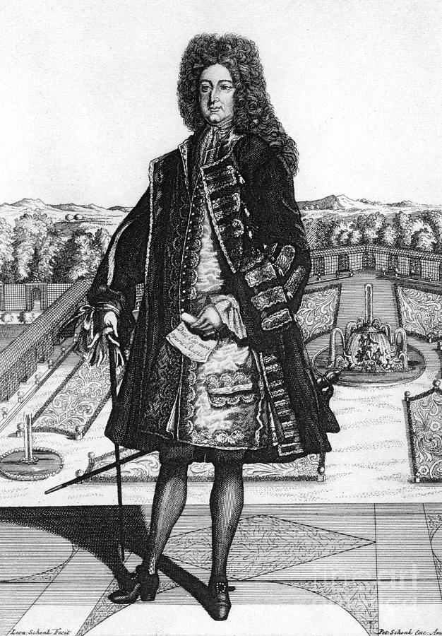
John Law
(baptised) 21 April 1671 – 21 March 1729
9 April 1694, John Law fought a duel with Edward "Beau" Wilson, in Bloomsbury Square, London
Law killed Wilson
Convicted of murder, but escaped death sentence.
Money and Trade Considered:(1705)
Law's propositions of creating a national bank in Scotland were ultimately rejected
1716 Law established the Banque Générale, a private bank (originally), in France.
Scheme collapsed in 1720.
Law initially moved to Brussels on 22 December 1720 in impoverished circumstances as his properties in France were confiscated.
Died in Venice, a poor man in 1729

Slide 3
Money and Trade Considered (1705)
John Law first proposed his scheme of a revolutionary new currency in Scotland where he published anonymously his book:
Money and Trade Considered
With a Proposal for Supplying the Nation with Money
Scotland did not adopt his scheme, but it became the blueprint for the Banque Royale and the Mississippi company that took place in France.
As a treatise of high monetary theory it is one of the most innovative and pioneering texts ever produced.
“John Law…I have always felt in a class by himself. He worked out the economics of is projects with a brilliance and, yes, profundity, which places him in the front ranks of monetary theorists of all time.” Joseph Schumpeter

Slide 4
Basic argument
Trade and the supply of money are fundamentally related.
More primitive production and trade societies use barter, but this limits the amount of production that can take place.
Benefits in trade and production happen in tandem with improving financial services.
More importantly, if at any point in time, there isn’t enough money in the country then there is unemployment.
With unemployment everyone suffers. Both the unemployed, and the landed class who could have used the unemployed for higher yields.
Therefore it is of outmost importance that a country is properly furnished with money, so that its trade and commerce prosper.
Therefore this book is an investigation of the nature of money in a complex exchange/trade economy.

Slide 5
Function of money- silver
Silver is supposed to fulfil the following functions:
Be brought to a standard fineness – so that all coins curry the same amount of silver.
Be easy to deliver as payment.
Has similar value between different places. (To facilitate trade)
Does not spoil with time.
It is divisible.
People would save any excess income they have in silver for future use.
Law also adds the following interesting idea on futures, or why bonds are denominated in silver:
Future contracts are denominated in silver (the accepted money) more than other goods, because it is perceived that silver’s value is less uncertain than the value of other goods- only because it is accepted as money.
Therefore because silver is used as money its price and prestige remain high as a prised commodity.

Slide 6
Money and stages of development
Law tantalisingly argues that in order to have complex production and trade economies you need more sophisticated financial structures.
Barter (the exchange of goods for goods) is good for only primitive agricultural economies.
Money is necessary to start having trade and manufacture and having a thriving economy.
In theory credit could achieve the same result. But because personal credit is usually a bilateral agreement (between 2 people) and not transferable, it cannot go very far in a complex economy, which credit should be transferable between unknown people.
A good national credit system run by a bank (the Bank of Amsterdam) was for John Law the reason behind the success of the Dutch- a country of little land and few natural resources, that was then the richest country in Europe.
Holland was a pioneer in the creation of a credit currency system backed by silver in the bank vaults.

Slide 7
He argued that there is no natural tendency for silver to vary in value so that all transactions that ought to take place do so.
If silver is too scarce there will be unemployment of resources and people.
If silver is too much, it will lead to a depreciation of its value- inflation.
Law observed that both conditions held at that time in Europe.
Across Europe in the last 200 years the value of silver has decreased because of all the silver brought to Europe by the Spanish from the Americas.
In Scotland, which was a peripheral, non-silver producing country, silver coin was scarce. The outcome was trade was depressed and unemployment existed.

Slide 8
Why use silver?
So the real question is why use silver for money anyway?
According to Law it performed its task as money inadequately- it was neither stable enough over time, or achieved full employment and prosperity.
If you try to increase the number of coins in circulation by clipping, or reducing the fineness of the silver, then you create crises of confidence and the coins lose their value.
He also noted that mercantilist policies that tried to increase the amount of circulation of silver in Scotland (by running a balance of payment surplus) where hit and miss.
No general policy could be devised that always achieved a steady increase of silver (which would have meant a reduction elsewhere anyway).
An alternative is to create a bank and use the silver as reserves. With the bank issuing paper notes based on its reserves.
But Scotland has too little silver compared to the volume of trade it needs to carry.
With too little silver the bank would be undercapitalised and there would be constant bank runs.

Slide 9
Land….Land….Land
But there is no reason to use silver as coin anyway.
Or even to do as the Dutch did, issue paper currency backed by silver reserves.
Any commodity which fulfils the functions of money as good (or better) than silver can work.
Law hit upon the idea that land actually is a much better commodity to base the monetary system on!

Slide 10
The reasons are the following:
Land is of fixed quantity and does not vary with time (like silver) so future uncertainty on its value and quantity is lower.
As the economy grows land becomes more expensive- this means that any scheme based on land would naturally be able to yield dividends, and would be stable as the underlying asset appreciates in value.
Land can never fall entirely in value as all goods are derived from it directly or indirectly.
So it would make sense to put it at the centre of our financial system.
Land is better than silver because it can be both productive and money at the same time!
Silver is either jewellery or coin. It cannot be both at the same time. But land can be both producing goods and (if it is monetised) backing paper currency at the same time.

Slide 11
Land and the problem of homogeneity
“Money to be qualified to serve as the measure by which goods are valued and as the value in which contracts are made payable ought not only to be certain in its value, but likewise to be capable of being brought to a standard, i.e. that the different pieces of money have a value equal to their denomination, that by it the value of goods in the same or different places may be measured and that both he who is to pay and he who is to receive may be certain that the sum contracted for shall be of the same value at the time of payment that it was of when the contract is made…” (Land Bank, 1705)
“That the lands for which these notes are given out be of equal value to the notes according as lands to be appointed and valued by Parliament as a standard are the making of the Act”
the creations of a standard acre unit with given productivity (so better land accorded ‘more’ banknotes, ie. More standard units)

Slide 12
Law’s analysis of Money
Functions of money | Qualities Necessary for Money | Categories of Money | Examples of Money
Measure of Value | Stability of Value | Category I Money | Category I Money
 | 2)Homogeneity |  | Land Money
Means of Payment or medium of exchange |  | Money Possesses qualities 1-6, and fulfils the three functions of money | Banknotes Goldsmiths’ notes Silver money
Standard of deferred payments | 3) Durability
 | 4) Divisibility | Category 2 Money | Category 2 Money
 | 5) Transferability 6) Have a stamp that denotes the value of money | Money that possesses qualities 2-6 and fulfils only the payment and exchanges functions of money | Bank of England shares East India Company Shares Irish debentures

Slide 13
How the scheme would work (pages 90-92)
Suppose you have an island owned by one man.
He has 10 tenants, each tenant a family of 10 people. In total 1000 people.
Assume there is also 300 people unemployed.
Originally there is no money. Rents are paid directly to the landlord in kind.
Tenants trade with each other in barter bilaterally for any goods they want from each other.
alms
Landlord
Poor/
Unemployed
Rent/food
paid in kind
Exchanges
goods
Tenants/
farmers
Manufacture
Goods/Abroad
The island has no manufacture. It simply reproduces the goods it can create, and distributes it between the different people to reproduce production.
Rent is given in kind to the landlord, some alms are given to the unemployed, the rest goes into consumption for the tenant/workers and their families. This cycle is reproduced every year.

Slide 14
Money is introduced
The landlord introduces paper currency.
He declares that from now on he will collect rent in paper currency.
He starts paying for goods he buys in paper.
He coins paper to the value of a year’s rent and pays with.
He employs workers for jobs and pays them in paper.
The workers go to the land tenants and buy corn giving the tenants paper.
The tenants collect the paper in order to pay the rent.
This has now become a monetised economy, based on the paper currency issued by the landlord.
The landlord becomes the issuer of legal tender in this economy.

Slide 15
Landlord
Paper money to
buy commodities
Money to pay
For rent
Tenant/Farmers
(Agricultural sector)
Money to buy food
Manufacturing
sector
(Adapted from Murphy, 2009, 51)
By this system a means of employing the unemployed is found.
They can be brought into employment by the landlord, be given paper, and exchange their paper for food produced by the tenants.
The economy can develop a manufacturing sector and become more complex because of this national credit system.
This can also increase saving, as credit now allows the creation of a bigger production surplus in this economy than before.

Slide 16
The landlord can regulate the quantity of paper currency in this economy to meet its full production capacity.
If the paper given for goods to the farmers is not enough to cover the rent. (Manufacturers hoard the extra cash)
The price of paper money begins to increase.
Appreciation of paper vis-à-vis other goods (i.e. deflation).
The landlord can issue more money.
This will further invigorate the manufacturing industry as it creates increased demand for manufactured goods.
It will employ more people, and even bring people from abroad if it runs against full internal employment.
More people will need more food, and this will mean more money to the agricultural sector. It can now meet its rent.
Thus the system has reached internal stability.
“This money tho’ it has no value but what the proprietor gives it, by receiving it in payments of his rent; yet it will be esteem’d equal to the product payed before.” (Law, 1705, 92)

Slide 17
Why a land backed paper scheme is better than silver
It fulfils the role of money better.
“Trade and money depend mutually on one another; when trade decays, money lessens; and when money lessens, trade decays.” (Law, 1705, 93)
Without land backed paper, “money being scarce they cannot get any to borrow, tho’ their security be good; nor cannot well have credit for the goods from so many different people they are strangers to.” (Law, 1705, 107)
“Money is not the value for which goods are exchanged, but the value by which they are exchanged” (Law, 1705, 92)

Slide 18
The story of the Mississippi bubble
A very complicated story that involved the following issues:
A trading company (the Mississippi Company) and some subsidiary companies it absorbed (not important details).
A commercial bank, then national bank (the General, then Royal Bank).
Shares of the Mississippi company
Paper currency issued by the National Bank, which became, for a period, the sole legal tender.
The national debt, which was bought by the Company at some point.
The big problem in France was a huge government debt and no well established financial sector (in comparison to England and the Dutch).

Slide 19
what banks do
A private bank is set up with capital (i.e. initial funding) from private individuals as a joint stock company.
It accepts deposits (e.g. silver coin) and gives out loans. By doing this it creates credit in the economy.
It may (and in the 1720s in France it did) issue paper currency- banknotes.
This paper is a promissory note that says that anyone holding it can redeem it for gold or silver at the bank.
Thus the bank has:
On the asset side (στοιχεία ενεργητικού): loans and reserves of gold and silver it keeps in its vaults.
On the liability side (υποχρεώσεις): shares of the investors, deposits with the public, and banknotes held by the public.
Banks have two major problems (will cover this next week):
Liquidity problem – has made good loans, but has no cash at present.
Solvency problem – has not made good loans and is insolvent.

Slide 20
A brief simplified account
King Louis XIV died in 1715, leaving his nephew Philippe II, Duke of Orleans, as regent.
France had serious financial problems- Louis had spent a lot in palaces and wars.
French government debt was in arrears- financial markets discounted debt at 50% of face value.
In May 1716 Law is given permission from Philippe to establish the General Bank. A private bank with a capital base of 6 million Livre.
Capital was raised by selling shares to the public. Law, Phillippe and the aristocracy participated.
Government bonds where accepted as payment for shares.
In 1717. Banknotes issued by the General Bank could be paid for taxes and where given out by the government for money payments.
Law guaranteed that the banknotes where redeemable in silver and gold.
In 1718 bank becomes nationalised and renamed Bank Royale.
Notes are not any more guaranteed to be redeemable.

Slide 21
Mississippi Company
August 1717 Law purchases the Mississippi company that had monopoly trading rights with the French colony of Louisiana.
Law Launched it as a joint stock company, 200,000 shares, with 500L per share.
Government debt was accepted for payment for shares.
1717-19. Law takes over almost all other smaller trading companies in France and merges them with the Mississippi company.
1719 – Law buys the Royal mint, and the right to collect all indirect and direct taxes in France.
1719 – More shares issued- another 100,000. Dividends from all the activities of the company (oversees trade, tax collection, government bond interest, etc.) promised.
1719 – Law allowed shares rights to be sold with only a down-payment to be given at sale. The sale would be complete when full payment is payed in the future.
This was equivalent to selling investors an option on the share, as they only paid the right to buy it in the future.

Slide 22
The boom
Mississippi Company share prices rose from 500L in 1717 to 3,600L in August 26, 1719.
Law now had the Mississippi company assume the whole public debt of France, and become the state’s sole creditor.
This was achieved through a swap. Holders of national debt swapped their paper for Mississippi company stocks.
This was done voluntarily by the public.
The public must have believed that the company could pay higher dividends to what the government was paying in interest payments, and the stock price of the company would rise.
The Royal bank and the company worked together- the bank extended credit (in banknotes) to the company to meet any cash needs it had.
And since there was no convertibility to silver, this was an unbounded operation.

Slide 23
The operations in one graph
Public
Gives paper notes to support
activities
Buying shares with A) silver/cash
B) Royal Bank paper
Selling Shares
Paying dividends
Bank
Royale
Effectively merged
Mississippi
Company
revenues
Commercial
Activities
Extended Credit
Payed Tax lease
Taxes
Extends paper
Notes to the state
Interest
To Gov. debt
State
Initial capital of the Bank through capitalisation by shareholders (when it was General bank). Some of the capital was gov. debt.
(from Bilginsoy p. 45)

Slide 24
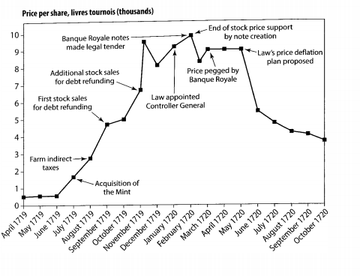
Stock prices of the Mississippi Company (Compangie des Indes) (Garber, 1990, 44)

Slide 25
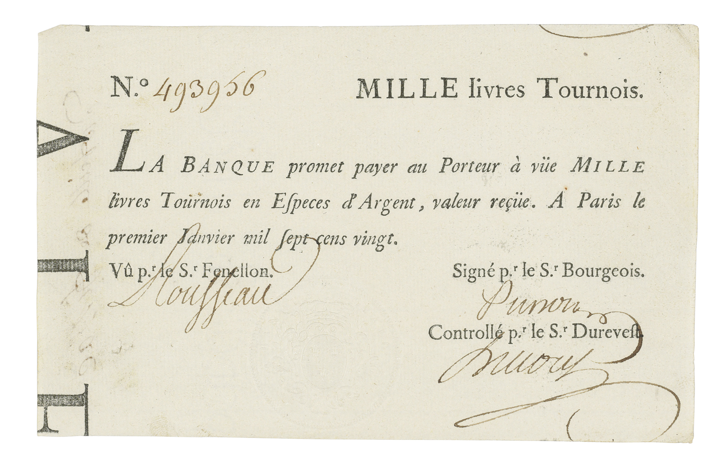
Law’s paper money
BANQUE ROYALE.A bank note for 1,000 livres Tournois (no.493956) of John Law's Banque royale, Paris, 1 January 1720

Slide 26
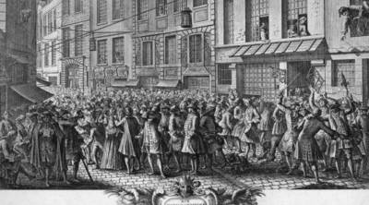
The stock exchange
“The Rue de Quinquempoix, which is their Exchange Alley, is crowded from early in the morning to the late at night with princes and princesses, dukes and peers and duchesses erc. In a way all that is great in France. They sell estates and pawn jewels to purchase Mississippi” (Murphy, 1997: 205)

Slide 27
The crush
July 1719- Law announces that the shares will pay 12% dividend.
Law also guaranteed the price by saying it will buy back the company shares below a threshold.
From September 1719 prises of shares really rose to around 10,000L.
The Royal Bank continued to extend credit for shareholders to buy more shares.
By Dec. 1719, Bank Royale had issued 769 million Livres in banknotes and had extremely low silver and gold reserves in its vaults.
The gov. made banknotes legal tender and penalised use of silver and gold in transactions. Hoarding silver was prohibited.
In February 1720, Law stopped supporting the share price. It fell 26% in one week.
Political pressure made the company guarantee the share at 9,500L in March, 1720. Bank Royale actively traded printing banknotes to support the price share.
Supply of banknotes increased to 2 billion Livres by April 1720.

Slide 28
May 1720- Mississippi company takes over the Royal Bank.
Law declares a gradual reduction of the price of stocks and to withdraw banknotes from circulation.
Share price collapse, with a fall of 17% in 6 days.
29 May 1720- Law in house arrest. His reduction of share price support abandoned.
Shares dropped to 4,116 Livres by May.
Royal bank facing run- cannot convert bank paper into gold.
Law released- but the game was up!
Street demonstrations- violence, and problem of provision of basic foodstuff as the financial system disintegrated.
Law’s system abandoned. Gold and silver return to circulation, Government debt issued outside the Mississippi company.
November 1720- Royal Bank closes down.
March 1721- Mississippi company folds.

Slide 29
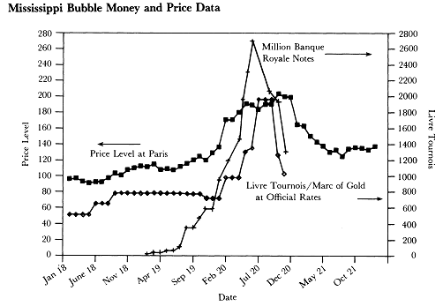
The price level for foodstuff in Paris according to Garber.
(Garber, 1990, 46)

Slide 30
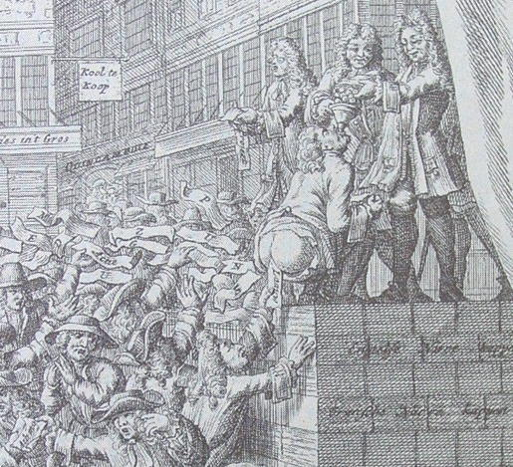
Contemporary reaction to Law’s scheme
A contemporary scatological rendering of John Law making fiat money. (Amsterdam 1720)
He is on the platform being fed gold and then passing paper money out the other end.
(Murphy, 1997, 256)

Slide 31
Timeline | Event
1716 | John Law sets us General Bank in Paris
Aug. 1717 | Law buys Mississippi Company (MC)
Sept. 1717 | First issue of MC shares (200,000)
4 Dec. 1718 | General bank named Royal Bank and nationalised
March 1719 | Restrictions in use of silver coin for large transactions
May/Jun1719 | MCV absorbs several trading companies, and makes second issue of shares (50,000) at 500L, old shares trade at 650L
July 1719 | Third issue of shares (50,000) shares over 1,000L. MC takes over mint
August 1719 | MC buys national debt, and swaps it with shares. Gets privilege of tax collection for nine years. Share price at 5,000L
Sept-Nov. | More issues of shares, share prise at 6500L. Banknote stock 640 million
Dec. 1719 | Royal Bank notes are legal tender. Restrictions in all other forms of money
Jan. 1720 | Law appointed Controller General. MC share peaks at 10,100L
Feb 1720 | Law withdraws support of share price- decline of 26%
May 1720 | Decline of share price. MC takes over Royal Bank. Law dismissed.
July 1720 | Street demonstrations by people who want to return paper for silver and gold
End of 1720 | Repeal of Royal Bank notes as legal tender. Law flees France

Slide 32
Law -not a common swindler
He did not profit from his scheme, or try to liquidate and run at the height of the boom.
He also did not appear to believe that huge and unreasonable profitability of the Mississippi company was necessary for the success of the scheme.
He believed that the creation of paper credit would create a sustained financial boom in France- and for a time it did!
Law writes in 1722:
“The Prince headed a rich nation and increased his revenues while reducing the burden of his people. There was no unutilised land or unemployed workers. Manufactures, navigation, and trade increased. The peasants were fed and clothed and owed nothing to the king or to their master. Credit together with specie had made money so abundant that one could ordinarily borrow at the notaries at ½ percent and only repay the principal at will… when paper money was preferred and commanded a premium over specie [meaning gold and silver].” (Murphy, 1977, 319)

Slide 33
Revisiting Garber’s view
Should this be interpreted as a bubble?
Let us observe what is happening to fundamentals at different points in time.
The original investor (Law) claims the scheme will produce great dividends. The new investors (buyers of shares) believe him, as they do not have better information.
Problem of asymmetric information.
The original investor uses a Ponzi scheme- pays dividends of old investors with capital from new investors.
Both new and old investors see these pay-outs as proof that fundamentals of the company are strong.
The scheme may be - to some degree - a success, so there is no bubble then! Some highly speculative companies make their owners rich (see e.g. Dutch East India Trade company).
If these profits did not materialise and the company is a failure, fundamentals change- the drop in the price of the stock represents this new information.
Thus what happened can be described by rational behaviour and perceived fluctuating valuation of fundamentals during the different stages of the cycle.

Slide 34
“ In the end, one can take one’s pick: market fundamental explanations of events or bubble and crowd psychology theories. It is my view that bubble theories are the easy way out-they are simply names that we attach to that part of asset price movements that we cannot easily explain. As tautological explanations, they can never be refuted. The goal here is to find explanations with some measure of economic and refutable content” (Garber, 2001, 126)
So for Garber psychological theories of the crisis are essentially non-scientific, as they are not refutable.

Slide 35
Hans-Joachim Voth’s view
The Mississippi bubble has evidence of overvaluation.
Agents, however, where fairly rational. Buying and holding overvalued paper was a sensible investment strategy at the time.
They engage in ‘risk shifting’. Agents take risks because in the upside they can make lots of money, and try to shift losses to other players.
Remember shares in the Mississippi company where more like options, as you payed a small down payment and then the rest in instalments. You could walk out if share prices went down.
Market participants try to judge the mood of the market. They buy and sell at exaggerated prices if they feel that these prices will be sustainable in the short run.
However, the rationality of the players in pursuing profits did not create an efficient market or non-bubble prices.

Slide 36
General remarks
The story of the tulipmania is essentially one of private credit in an informal economy setting.
This private credit was transferable between people.
The bank of Amsterdam did not play a role- in some ways it did not have complicated central bank operations by later standards.
The story of the Mississippi bubble is one of paper credit with the creation of a commercial bank dealing in very complicated financial operations.
Leverage and sophistication of the scheme exceeds what we saw in the tulipmania or indeed in the Amsterdam stock exchange.
This central bank dealt in stock value directly with the public, and was effectively, both the stock exchange and the clearing house of these claims.

