Slide 1
Χρηματοπιστωτικές Φούσκες, Μανίες και Κρίσεις.
Από την κρίση των τουλιπών (1620) έως σήμερα.
Κωνσταντίνος Ρεπαπής
Επίκουρος καθηγητής ΕΚΠΑ

Slide 2
Περιεχόμενα μαθήματος
Εισαγωγή και Περίγραμμα Μαθήματος
Η Ολλανδική κρίση των τουλιπών το 1630.
Η Χρηματοπιστωτική φούσκα της εταιρείας του Μισισιπή στην Γαλλία και της εταιρείας εμπορίου της Νότιας Θάλασσας στην Μεγάλη Βρετάνια το 1720.
Ο τραπεζικός πανικός των περιφερειακών τράπεζων στο Ηνωμένο Βασίλειο το 1825, και οι κρίσεις μετατρεψιμότητας του νομίσματος σε χρυσό.
H διαρκής κρίση (long depression) στην Αμερική και την Ευρώπη της δεκαετίας του 1870.
Η μεγάλη ύφεση (Great Depression) του 1930.
H Ιαπωνική κρίση των ενεργητικών των επιχειρήσεων του 1991.
Η Ασιατική χρηματοπιστωτική κρίση του 1997.
Η φούσκα της αξίας των εταιριών dot-com στα τέλη του 1990.
Η Κρίση του 2008 και η σημερινή κατάσταση circa 2023-24

Slide 3
Κεντρικά κείμενα της εποχής
De La Vega, 1688, Confusion de Confusiones
John Law, 1705, Money and trade considered: with a proposal for supplying the nation with Money
Henry Thornton, 1802, An Enquiry into the Nature and Effects of the Paper Credit of Great Britain
J.A. Hobson, 1909, The Industrial System
Fisher, I. (1933) "The Debt-Deflation Theory of Great Depressions," Econometrica 1 (4): 337-57 Fisher, Debt deflation theory
Hyman Minsky, 1986, Stabilizing an Unstable Economy
Furman, J. and Stiglitz, J. (1998) ‘Economic Crises: Evidence and Insights from East Asia’, Brookings Papers on Economic Activity, Vol. 29, No. 2, pp. 1–136.
Robert Shiller, 2000, Irrational Exuberance, Princeton: Princeton University Press
Dow S., 2017, “Central banking in the twenty-first century.” Cambridge Journal of Economics, 41 (6), pp. 1539-1557.
Gennaioli, Nicola, Andrei Shleifer, and Robert Vishny. 2015. "Neglected Risks: The Psychology of Financial Crises." American Economic Review, 105 (5): 310-14
Samuel G. Hanson, Anil K Kashyap, and Jeremy C. Stein, 2011, “A Macroprudential Approach to Financial Regulation”, Journal of Economic Perspectives, 25 (1). pages 3–28

Slide 4
Μοντέρνες οπτικές των κρίσεων
Cihan Bilginsoy, 2015, A history of financial crises: dreams and follies of expectations, Κεφάλαιο 2 που ασχολείται με την κρίση των τουλιπών.
John Kenneth Galbraith, 1996, A short history of financial euphoria, New York: Penguin, Κεφάλαιο 2 σχετικό με την ‘παράλογη’ συμπεριφορά.
Robert Z. Aliber; Charles Poor Kindleberger; Charles Poor Kindleberger, 2011, Manias, panics, and crashes: a history of financial crises, London: Palgrave Macmillan διαβάστε σελ. 213-228)
Friedman, Milton, 1990, “The Crime of 1873” Journal of Political Economy, Vol. 98 (6), σελ. 1159-1194
Richard Koo, 2009, The Holy Grail of macroeconomics: lessons from Japan's great recession, Singapore: John Wiley and sons
Joseph E. Stiglitz, 1999, “Reforming the Global Economic Architecture: Lessons from Recent Crises”, The Journal of Finance, Vol. 54, No. 4, σελ. 1508-1521

Slide 5
Μεθοδολογικό πλαίσιο Ι – οικονομικά «ερωτήματα» και η εποχή τους
Η θέση του Karl Mannheim και των Karl Niebyl και Werner Stark για την εξελικτική πορεία των οικονομικών
  Οι ιδέες και η σχέση με την εποχή τους.
Άλλες απόψεις
  Joseph Schumpeter
  Paul Samuelson
Η σχέση του πλαισίου αυτού με ετερόδοξες οικονομικές σχολές.
  Μαρξισμός
  Μετα-Κευνσιανισμος

Slide 6
Μεθοδολογικό πλαίσιο ΙΙ- εντοπίζοντας το θεωρητικό πρόβλημα
Πως μπορούμε να προσδιορίσουμε τiς χρηματοπιστωτικές φούσκες (Bubbles);
Ορισμός - Ως οικονομικές φούσκες εννοούμε ότι οι τιμές των στοιχείων του ενεργητικού (η αξίας των μετοχών) δεν αντικατοπτρίζονται στην αξία όπως διαμορφώνεται από τα θεμελιώδη της χαρακτηριστικά.
  A bubble is conventionally defined as market prices which are not supported (cannot be explained) by an analysis of the fundamentals of the asset.
  By fundamentals we mean a valuation of the asset that we believe reflects its true value, and may (under conditions), in time become its true price.
Η διαφορά της αξίας από την τιμή της αγοράς, απορρέει, σε κάποιον βαθμό τουλάχιστον, από ψυχολογικούς λόγους.
  The departure from this valuation by the market is, to some degree at least, a psychological phenomenon.
“In general these events are viewed as outbursts of irrationality: self-generating surges of optimism that pump up asset prices and misallocate investments and resources to such a great extent that a crash and major financial and economic distress inevitably follow.” (Garber, 2001, 3)

Slide 7
Xρηματοπιστωτικές φούσκες; Μπορεί να υπάρχει ορισμός;
“I don’t even know what a bubble means. These words have become popular. I don’t think they have any meaning.” (Eugene Fama, interview in January 2010).
  Ο Eugene Fama είναι ένα από τους κεντρικούς θεωρητικούς της efficient-market hypothesis (EMH) που υποστηρίζει ότι οι τιμές των μετοχών αντικατοπτρίζουν πλήρως όλες τις σχετικές πληροφορίες σε πραγματικό χρόνο.
“A bubble may be defined loosely as a sharp rise in price of an asset or a range of assets in a continuous process, with the initial rise generating expectations of further rises and attracting new buyers” (Kindelberger, 1987, vol. I, 281)
  Ο Kindleberger είναι Κευνσιανός οικονομολόγος και το βιβλίο του κάνει μια ιστορική αναδρομή σημαντικών χρηματοπιστωτικών επεισοδίων από το 1630 έως σήμερα.

Slide 8
Φούσκες (bubbles) και γενική οικονομική κατάσταση
Κατά τον Fama ο όρος «bubbles and crises» δεν μπορεί να οριστεί επαρκώς. Εάν δημιουργούνται οικονομικές φούσκες τότε είναι εντελώς απρόβλεπτες και καταρρέουν σχεδόν αμέσως.
  Οι μεγάλες αυξομειώσεις συμβαίνουν λόγο της μεταβολής της πληροφορίας στην αγορά.
Για τον James Galbraith οι φούσκες (bubbles) είναι ένα δομικό στοιχείο του καπιταλιστικού συστήματος λόγο της γενικής αβεβαιότητας που το σύστημα παράγει.
Μια άλλη οπτική που έχει απασχολήσει έντονα τα οικονομικά και τον δημόσιο διάλογο είναι ότι οι κρίσεις απορρέουν από κακό σχεδιασμό η ανεπαρκή θεσμικά πλαίσια (bad institutional design).
  Ο κρατικός μηχανισμός δίνει λάθος σήματα (signals) η κίνητρα (incentives).

Slide 9
Μια σύντομη ιστορία του Αγγλικού όρου ‘bubbles’
“The term has been commonly applied since the 17th century to any unsound commercial undertaking accompanied by a high degree of speculation.” (Palgrave dictionary, vol. I, 1894, 182-3)
  First of times the term has been used is in relation to the tulip prices in Holland in the 1630s.
  Then the term was used in conjunction with the Mississippi scheme of 1719-1720 in France.
  At the same time in England the term was used in relation to the South Sea Bubble, of 1720.
  The term has been in use ever since in the popular and academic press.

Slide 10
Methods of analysis: what can an economist do to analyse each situation?
Pluralism of method and evidence
  Quantitative and qualitative data
  Historical example and abstract theorising
  Induction and Deduction in theorising
Use of alternative interpretative devices
  Reasoned argument. Building logical sequences of events and consequences
    Open Systems: Understanding the social realm and exploring the insight of key concepts
    Closed systems: Building (mathematical) models and fitting them to real world data
  By example. Finding historical or contemporary parallels and judiciously extrapolating.
  Synthetically. By using a mix of the above techniques.

Slide 11
Reasoned argument: Closed Systems
Method: Theorists build a mathematical model that clearly distinguishes between endogenous and exogenous variables.
Data: Quantitative, fit of model to data.
Context of use: Explaining past data series or trying to understand a particular mechanism in the economy.
Heuristics: Simple models that you can fit to data or use to discuss the effects of changes on a limited set of variables.
Example: An IS/LM analysis of conducting monetary policy.
Limits of approach: It is highly abstract by construction and its unclear if it is capturing the relevant variables for the situations you may wish to use it.

Slide 12
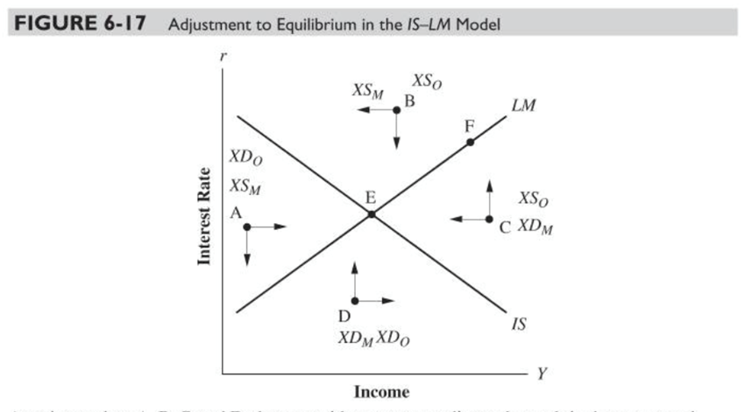
Example: The IS/LM model
Endogenous variables: determined in the model.
Exogenous variables: considered given in the model.
LM: combinations of Y and r whereby money market is in equilibrium
IS: combinations of Y and r whereby commodities market is in equilibrium
Intersection E: equilibrium in both markets

Slide 13
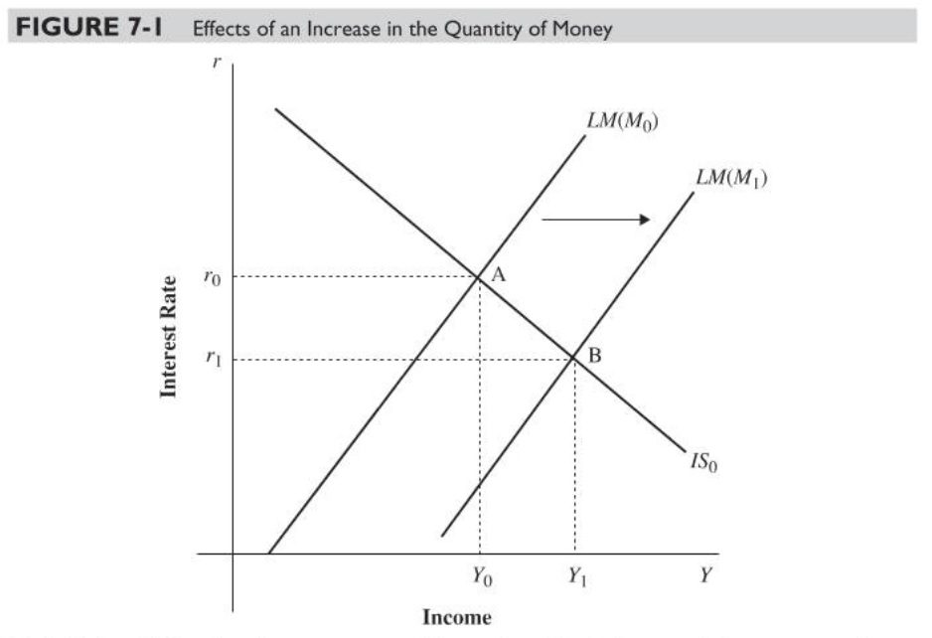
Monetary influences: shifts in LM
Let’s consider an increase in money supply
We start at point A. Increase in money supply creates excess supply for money, which causes r to fall → I increases → Y rises → C rises
Lower r and higher Y → M^{d} is higher until it is equal to new M^{s}
New equilibrium at B: lower r, higher Y

Slide 14
Reasoned argument: Open Systems
Method: Theorists discuss possible factors that are linked to observed phenomena.
Data: Qualitative, textual and historical.
Context of use: Framing policy decisions, discussion of alternatives, and informing selection of specific models to be used in quantitative analysis.
Heuristics: Understandings about the nature of social and economic reality that act as key fundamental concepts.
Example: the distinction between different types of uncertainty among the post Keynesians.
Limits of approach: Cannot really be used to do quantitative or even, on occasion, qualitative predictions of events.

Slide 15
Open systems – Critical Realism & Tony Lawson
Link between ontology and methods of use.
Central question: are we using the right tool for the right job?
Mainstream closed system thinking has a deep systemic problem.
  Wrong uses of method given the nature of social reality.
Open system theorising defines what method is appropriate for the nature of social reality.
  Systemic thinking is still possible, and it is there to uncover deep elements of the economic system that we live in.
  Some questions (i.e. measuring how a change in basis point interest rates influences inflation) are simply mis-specified as they are not closed system event regularities.

Slide 16
Open Systems – post-Keynesian variety (Sheila Dow/Victoria Chick)
Opening happens in different ways.
A closed system has the following characteristics:
  All relevant variables can be identified;
  The boundaries of the system are definite and immutable; ie. Endogenous and exogenous variables are clearly defined and fixed;
  Only the specified exogenous variables affect the system, and they do this in a known way;
  Relations between variables are either knowable or random;
  Economic agents are treated atomistically;
  The nature of the agent is constant;
  The structure of the relationships between the components is knowable or random.
  The structural framework in which agents act is a given.
The focus is to identify properly the problem under question and the method to use.
Closed systems have their uses, but one should be aware of the dangers involved.

Slide 17
Example: Different types of uncertainty
Definition of Risk:
I know the set of possible states of the world that can happen
  A state of the world is a description that takes into account relevant aspects for that decision
I know the effect each state of the world will have on my payoff
  I know the effect they have on the decision I make
I know the probability with which each state of the world will happen
Definition of weak uncertainty:
I know the possible events that can happen, and the effect on my payoff
But I don’t know their probability
Definition of strong uncertainty:
We don’t even know all the relevant states of the world, let alone their probability

Slide 18
By Example. Finding historical or contemporary parallels and comparing/extrapolating.
Adam Smith’s method of doing economics: analytical examples in historical time used to build a general broad narrative.
Economists of all schools substantially use past experience when doing theory and empirical analysis today to understand and test their understanding of what is happening.
  Some only focus on the past as data to test their closed system models.
  Others investigate the historical conditions of a boom, bubble or crush and see if there are parallels in institutions or human/social behaviour then that can explain what happened today.
Examples are more useful in situations that are uncommon and we do not experience frequently. There past discussions that retain memories of the problem and the solutions sought could be very useful for dealing with a situation today.

Slide 19
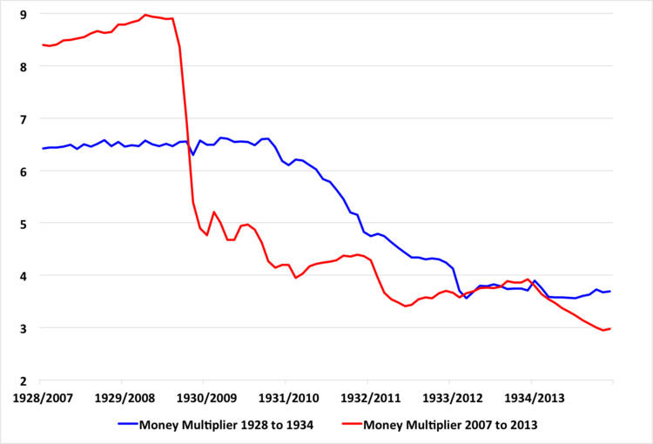
The Great depression and the 2008 financial crisis. Are there parallels?
The money multiplier during the great depression and the current (2007-13) crisis.
Are there parallels?
What are they?
Did it collapse in the same way or are the similarities only superficial?

Slide 20
The use of contrasting perspectives
Economists from different schools of economic thought place different emphasis to the use of the tools discussed above.
Some see closed system model building as the only proper way of doing analysis.
  They do not see historical examples as useful (only as material providing quantitative data).
  They do not see open systems as a scientific approach to economics.
    Model selection is dictated by goodness of fit of each model to data.
  They find limited use to an understanding of broad historical context.
Others find that closed system model building is not suited for social analysis. They concentrate on an open system approach.

Slide 21
Ideology, theory and point of view- a complex relationship.
Werner Stark’s position of embedding ideology to historical reality.
The identification of ideology with theoretical positions has diachronic links, but also experience change- language is at times more shared by contemporary ideological rivals than by sympathetic readers across ages that identify with the same (broadly) ideological position.
Issues of incommensurability between positions emanating from different theoretical systems (Marxist vs neoclassical) and due to historical and social change.

Slide 22
Competing interpretations
We will investigate these crises from perspectives that differ in the following way:
They have different ideological bias.
  Some are in favour of free markets others in favour of government intervention.
They have different methodological positions.
  Some employ models and closed system logic, others use a more open system approach.
They have different ontological positions.
  Their belief about the nature of social reality is different.
They understand historical context (both then and now) in different ways.

