Slide 1
“Computers will not replace teachers. However, teachers who use computers will replace those who don’t” Ray Clifford, Defense Language Institute
Notes:
Ray Clifford

Slide 2
What is “Educational Technology”?
Educational technology is a combination of the processes and tools involved in addressing educational needs and problems, with an emphasis on applying the most current tools: computers and their related technologies

Slide 3
A short Computer Story
The evolution of computers

Slide 4
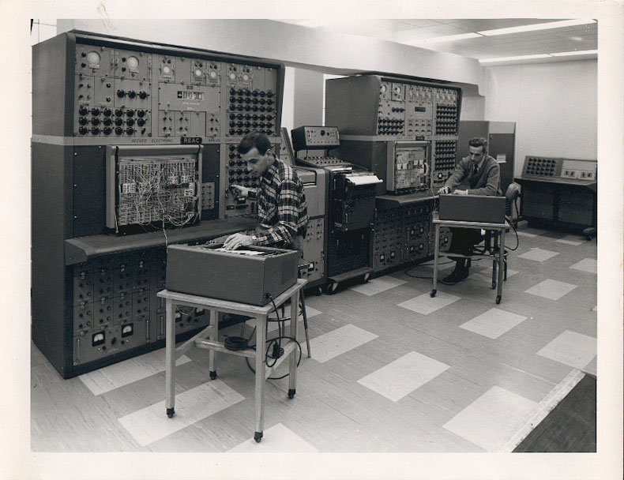
An analogue computer
1960

Slide 5
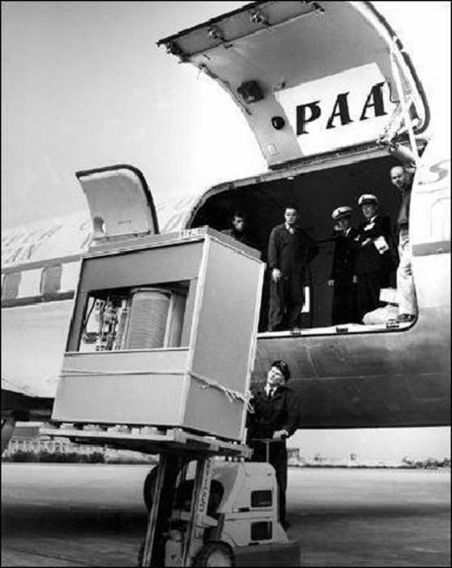
5MB Hard Disk
1956

Slide 6
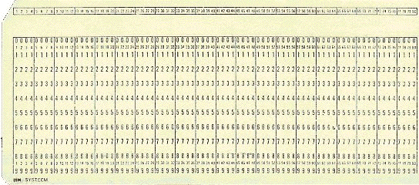
A Punch card

Slide 7
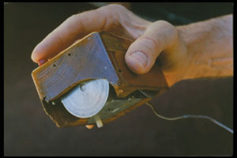
The first computer mouse underside view held by inventor Douglas Engelbart

Slide 8
Early Days of CALL
CALL was influenced by Skinner’s “programmed learning”
CALL revolves around presenting and testing forms
Notes:
CALL has always been influenced by TEFL and Computer Technology. CALL was influenced by Skinner’s “programmed learning” (breaks learning up into its components, which are described as observable behaviors- breaking up syllabuses into forms, functions, rules etc. This leads to ‘synthetic syllabi’ – accumulating parts of the language - STILL USED in the VAST majority of classrooms

Slide 9
Early Days of CALL
Notes:
Early Days of CALL Pictures of photofit

Slide 10
Parallel Evolution of Technology and CALL
1960s -70s
‘Behaviouristic CALL’
‘Communicative CALL’
‘Integrative CALL’ (task-based, project-based and content-based integrated into the curriculum)
Mainframe technology
PC technology
Multimedia networked computer technology
1970s - 90s
1990s -
Warschauer, M., & Healey, D. (1998). Computers and language learning: An overview. Language Teaching, 31, 57-71
Notes:
Warschauer & Healey (1998) saw a parallel evolution between computer technology and CALL approaches. They associate the earliest ‘behaviouristic CALL’ with the mainframe technology, the ‘communicative CALL’ with the PC technology and the latest ‘integrative CALL’ with the multimedia networked computer technology

Slide 11
Approaches to CALL
CONTENT | TASK | POSITION IN CURRICULUM
Restricted CALL | Drills, Quizzes | Optional extra
Open CALL | Simulations, Games | Toy, Optional extra
Integrated CALL | CMC, email | Tool for Learning, Normalised
Bax, S. (2003). CALL–Past, present and future. System, 31, 13-28

Slide 12
The Evolution of CALL
1980-1995
CRUDE CALL
1995-2005
TASK-BASED REFINED CALL
2005- TODAY
CALL 2.0

Slide 13
Educational Software can be…
Authorable or Non-authorable
CALL can be employed…
in Synchronous or Asynchronous mode

Slide 14
New/Digital literacies
computer literacy (comfort and fluency in keyboarding and using computers)
information literacy (the ability to find and critically evaluate online information)
multimedia literacy (the ability to produce and interpret complex documents comprising texts, images, and sounds)
computer-mediated communication literacy (knowledge of the pragmatics of individual and group online interaction)

Slide 15
New Literacies
Multimodality in communication services
Read/Write web (Web 2.0)
Encyclopaedia Britannica → Britannica online → Wikipedia
Publication vs. Participation
Digital natives vs. digital immigrants

Slide 16
Two different perspectives
“English is not an end in itself, but just a tool for being able to make use of information technology”
“Both English and information technology are tools to allow individuals to participate fully in society”

Slide 17
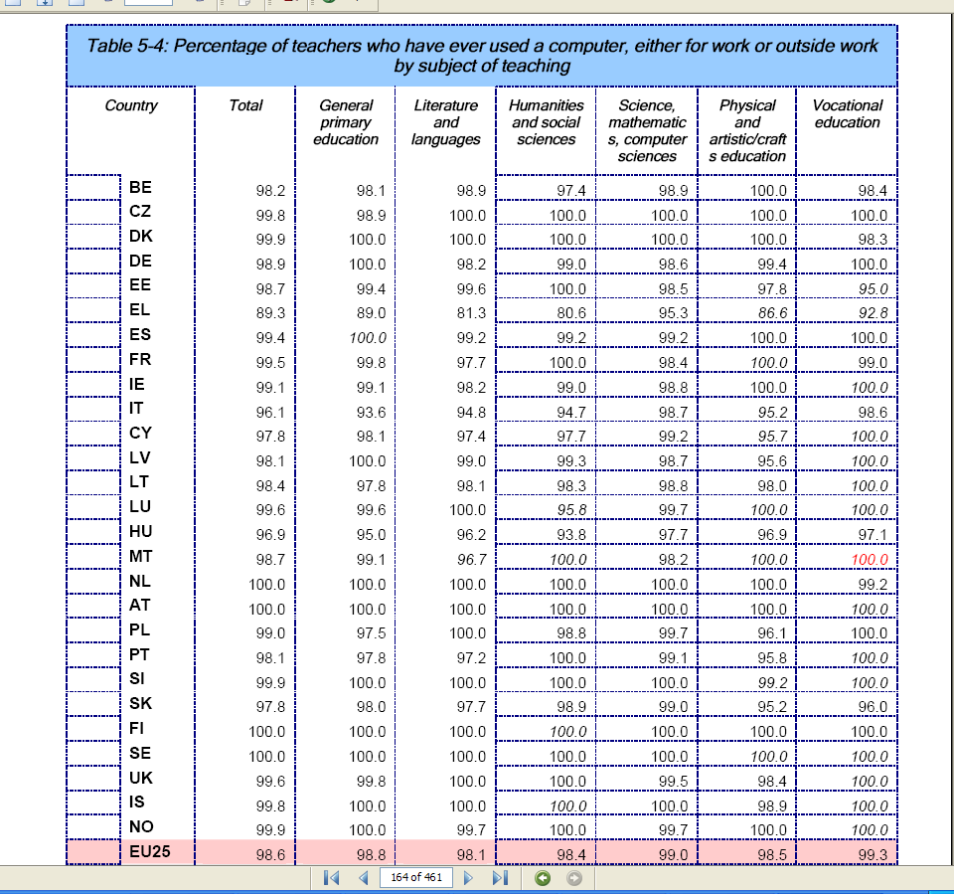

Slide 18
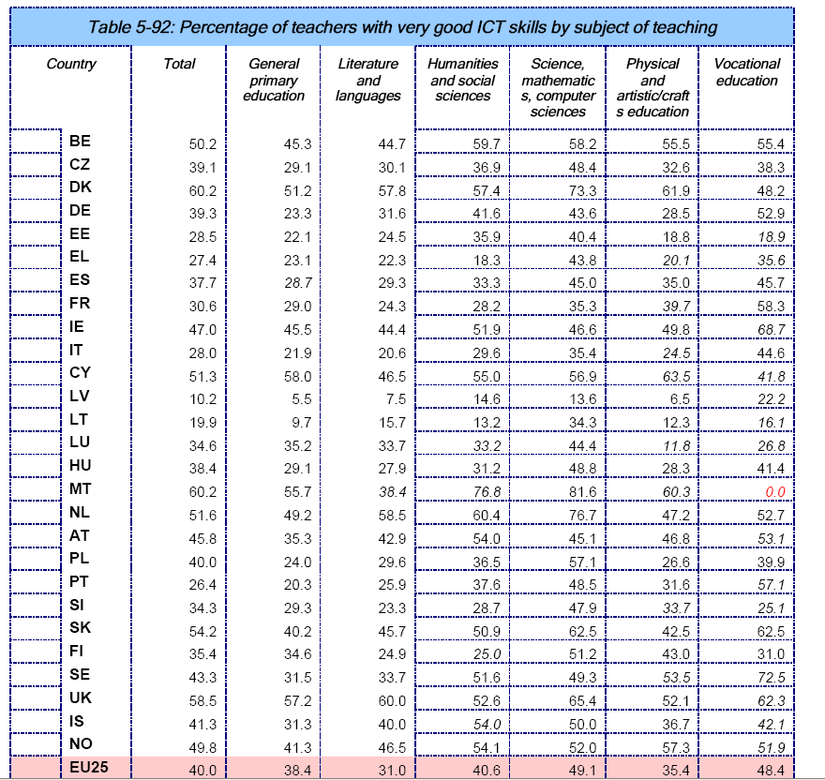

Slide 19
What else can I do with the Internet?
Example Activities

Slide 20
Trivia Quiz (level: Lower-Intermediate) Source: The Internet and the Language Classroom, Gavin Dudeney, CUP 2000
Sites needed:
www.google.com, www.yahoo.com, www.ask.com
Materials:
A sheet with a trivia quiz
(maybe two or three different quizzes for different groups)

Slide 21
Trivia Quiz
What’s the name of the President of the US?
Who invented the aspirin?
How many players are there in a baseball team?
What’s the capital of Australia?
What’s the weather like in Paris today?
How many albums has Britney Spears recorded?
What product is Jamaica famous for?
Which film won the Oscar for Best Picture in 1996?
Who was the first person in space?
Who wrote One Hundred Years of Solitude?

Slide 22
Trivia Quiz Lesson Plan
Introduce Search Engines
In groups let students finish the trivia quiz (maybe in limited time as a competition for extra motivation)
Let students prepare a trivia quiz themselves (and practise question forms)

Slide 23
Weblogs
Blogs

Slide 24
Blogs (Weblogs)
Easy to setup
Easy to update
Interactive
Multiple authors allowed
The above lead to…
Flexible aims
Content and purpose modification

Slide 25
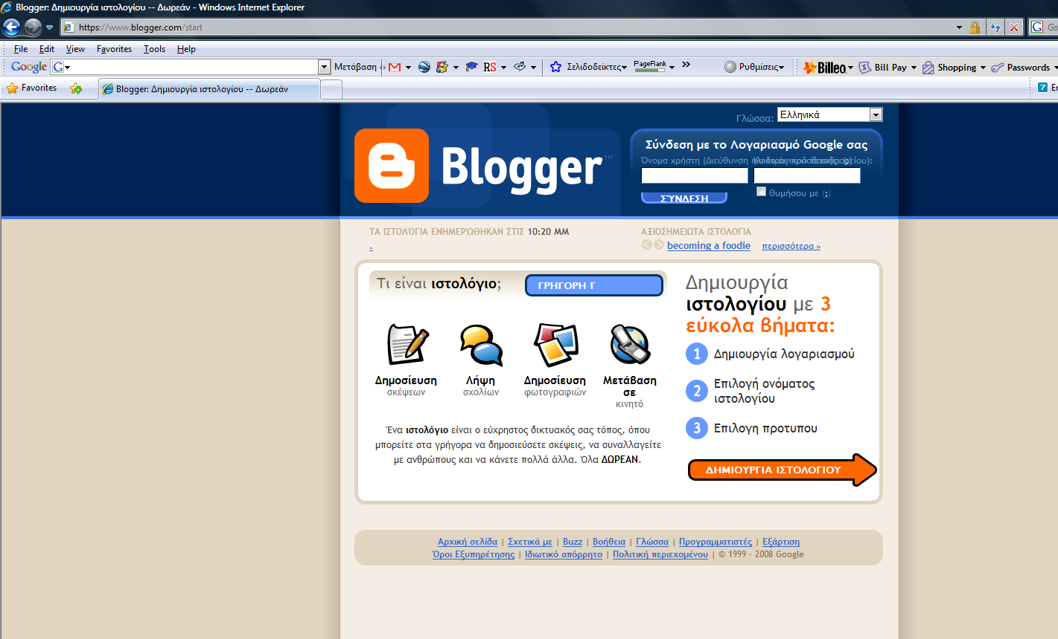
www.blogger.com/start

Slide 26
Blogs - Applications
Class portal (online filing cabinet, publishing projects, store materials)
E-Portfolio
Collaborative Space
A New Writing Genre: “Connective writing”
Posting Assignments
Journaling (“This is what I did today”)
Links with descriptive annotation (teach students how to describe websites and ask them to find interesting sites of information)
Links with analysis of content

Slide 27
Flickr

Slide 28
Flickr.com
Publishing photos
Annotating published photos
Inviting visitors to add comments
Setting up groups of students to publish photos on a given topic

Slide 29
Flickr in class
Real life use of photos to communicate with people
Publishing a photo requires some writing on the part of the author
Title, short desciprtion
Key words (to help visitors find the photo and comment on it)
Comments on the photos

Slide 30
www.flickr.com/photos/27803538@N05/2595183772

Slide 31
Webquests

Slide 32
Parts of a Webquest
introduction
task (the problem)
resources
Process (activities and research tasks)
guidance
conclusion

Slide 33
Wallwisher

Slide 37
http://www.freetech4teachers.com/

