Slide 1
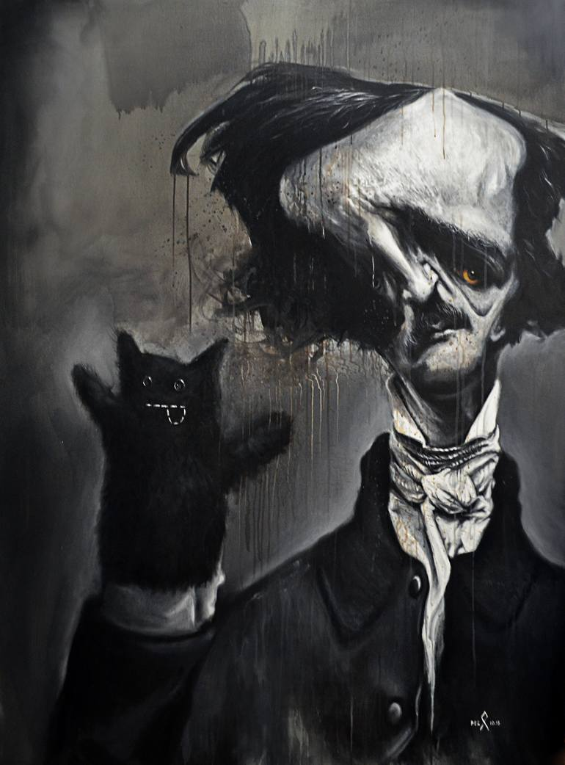
Edgar Allan Poe and the Failure of the Rational Mind Introduction to American Fiction Course Instructor: Dr. Theodora Tsimpouki
"Words have no power to impress the mind without the exquisite horror of their reality" ​ ​
Presented by Maria Zafeiriou and Danae Michael
Student ID : 1563202200059. Student ID : 1563202200240

Slide 2
Edgar Allan Poe: A Haunted Mind or an Injured Soul?
Edgar Allan Poe was born January 19, 1809, in Boston Massachusetts, United States.
He was orphaned at the age of 2 after his mother' s death and his father' s abandonment.
He was never officially adopted by the family that raised him (which created insecurities, early exposure to loss and instability influenced his focus on death, isolation, and disturbed psychology which, later contributed to his difficulties with alcohol.)
He studied languages and literature at the University of Virginia. Later he attended West Point, where he was exposed to mathematics, logic, and discipline.
In his studies he developed strong interest in aesthetics and poetic theory, psychology and perception as well as construction of emotional effect in fiction.
“From childhood's hour I have not been. As others were, I have not seen. As others saw, I could not awaken. My heart to joy at the same tone. And all I loved, I loved alone.”

Slide 3
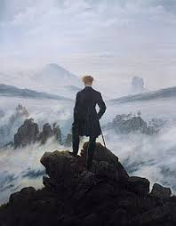
American Romanticism & Transcendentalism Dominant Literary Movement (1830s–1850s)
Emphasized intuition and spirituality
Belief in the inherent goodness of humanity
Nature as a source of truth and healing
Individual self as divine and trustworthy
Two of its major thinkers were Ralph Waldo Emerson and Henry David Thoreau
“I went to the woods because I wished to live deliberately, to front only the essential facts of life.” — Henry David Thoreau, Walden (1854)

Slide 4
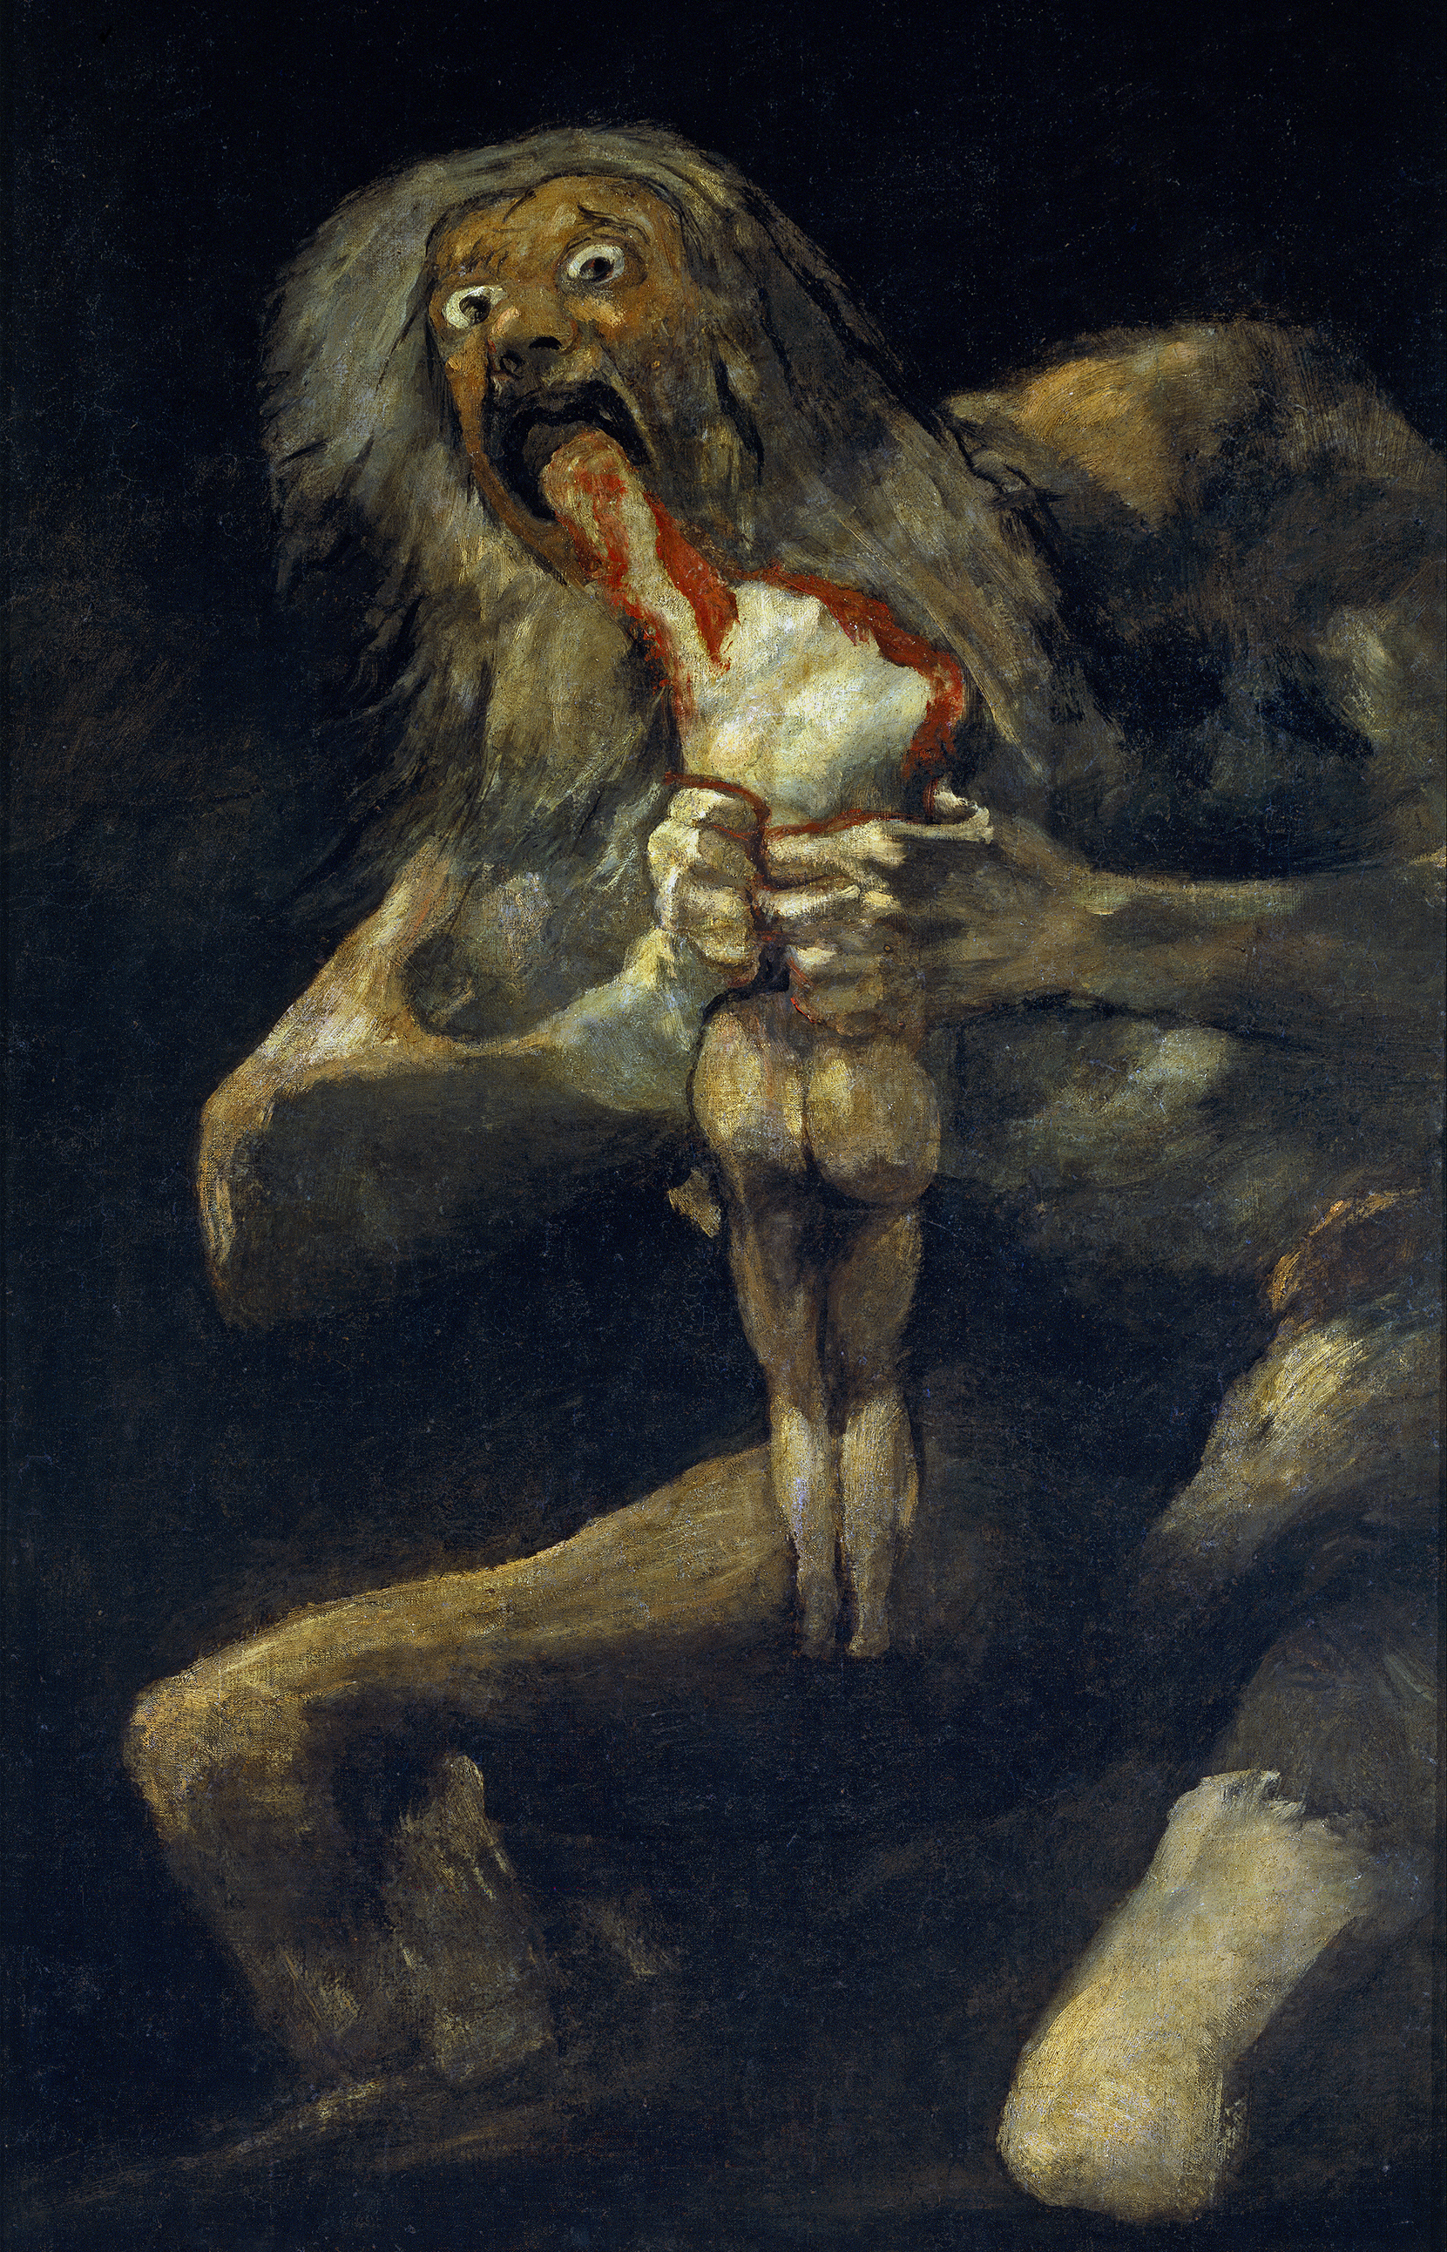

Dark Romanticism – Anti Transcendentalism A Reaction Against Optimism
Focus on human imperfection and sin
Exploration of guilt, fear, and obsession
Distrust of reason and moral certainty
Interest in death, decay, and the supernatural
Psychological rather than spiritual exploration
"To the Transcendentalists... we say: You are metaphor-run-mad. You are too spiritual. You see a soul in a cabbage."

Slide 5
Poe as Anti-Transcendentalist Philosophical Opposition
Transcendentalism
Poe' s vision
Humans are good by nature
The mind leads to the truth
Nature heals
The self is divine
Humans are self-destructive
The mind creates illusion
Isolation corrupts
The self is unstable

Slide 6
Psychology & Mental Illness in Poe
Recurring Psychological Themes:
Obsession and fixation
Paranoia and anxiety
Guilt-induced hallucinations
Fragmented identity
Unreliable narrators
Narrative Technique:
Stories told from inside disturbed consciousness.
Readers experience madness directly.
Interpretation:
Mental instability becomes a literary method for exploring human limits.

Slide 7
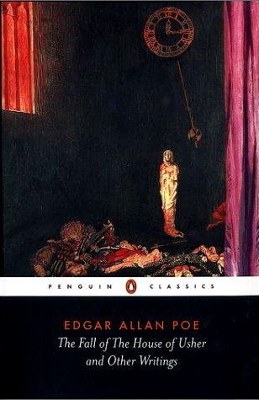
Mental and physical decay are interconnected
Isolation intensifies psychological instability
Blurred boundary between reality and hallucination
The Fall of the House of Usher
Key Themes:
Symbolism
The house reflects Roderick Usher’s mind.
The house collapsing depicts the collapse of consciousness
Dark Romantic Idea
The self cannot escape internal darkness.
"I shall perish," said he, "I must perish in this deplorable folly. Thus, thus, and not otherwise, shall I be lost."

Slide 8
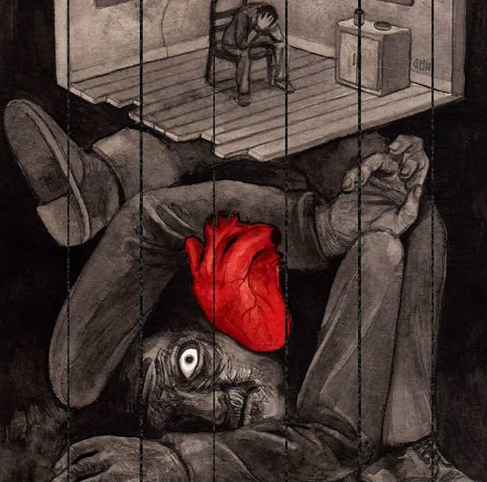
The Psychology of Inner Darkness
The "Imp of the Perverse" (Self-Sabotage / intrusive thoughts): drives us to do the wrong thing just because it is appealing
The Feedback Loop of Environment and Mind: our mental health affects our surroundings. In ''The Fall of the House of Usher'' the crack in the building depicts Usher's split psyche
The Terror of "Hypersensitivity"(censor overload): when Roderick gets disgusted by the scent of flowers the light or sounds Poe shows how mental illness can make you despise even the beauty of nature
The "Buried Alive" Metaphor (taphophobia): even when Poe's characters try to hide their guilt like in ''The Tell – Tale Heart'' the emotions still burst out and expose the true self (repressed trauma)
"Madness" becomes Poe’s critique of Transcendental optimism.
Psychological horror expresses philosophical skepticism.
"Hear “The Tell-Tale Heart” read aloud. The Tell-Tale Heart True! — nervous — very, very dreadfully nervous I had been and am; but why will you say that I am mad?"

Slide 9
The inability to reach the "sublime"
"And thus when by Poetry, or when by Music, the most entrancing of the poetic moods, we find ourselves melted into tears, we weep then, not... through excess pleasure, but through a certain petulant, impatient sorrow at our inability to grasp now, wholly, here on earth, at once and forever, those divine and rapturous joys of which through the poem, or through the music, we attain to but brief and indeterminate glimpses."

Slide 10
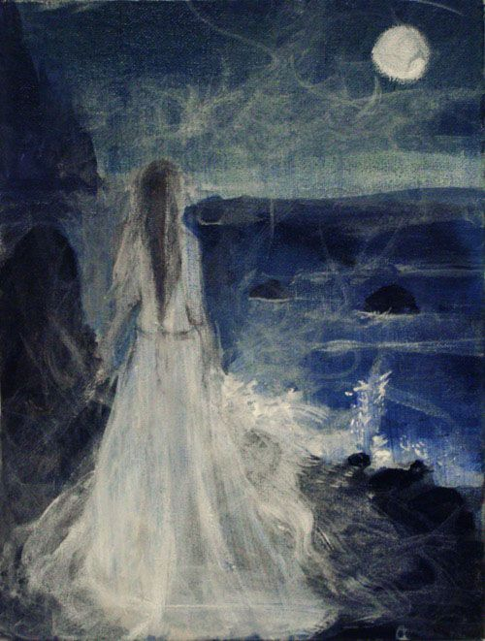
Conclusion:
The Human Mind as Poe’s True Horror
Edgar Allan Poe shifts supernatural horror into psychological exploration.
Dark Romanticism exposes the instability hidden beneath reason and morality.
Poe’s narrators reveal a mind divided against itself.
Psychological collapse becomes a form of philosophical insight.
Based on Poe's fiction, the mind is the true horror and not the supernatural.
The search for self-knowledge leads not to enlightenment, but to uncertainty and fear.
Our greatest terror is not death or the supernatural, but the realization that we cannot fully trust our own minds.

Slide 11
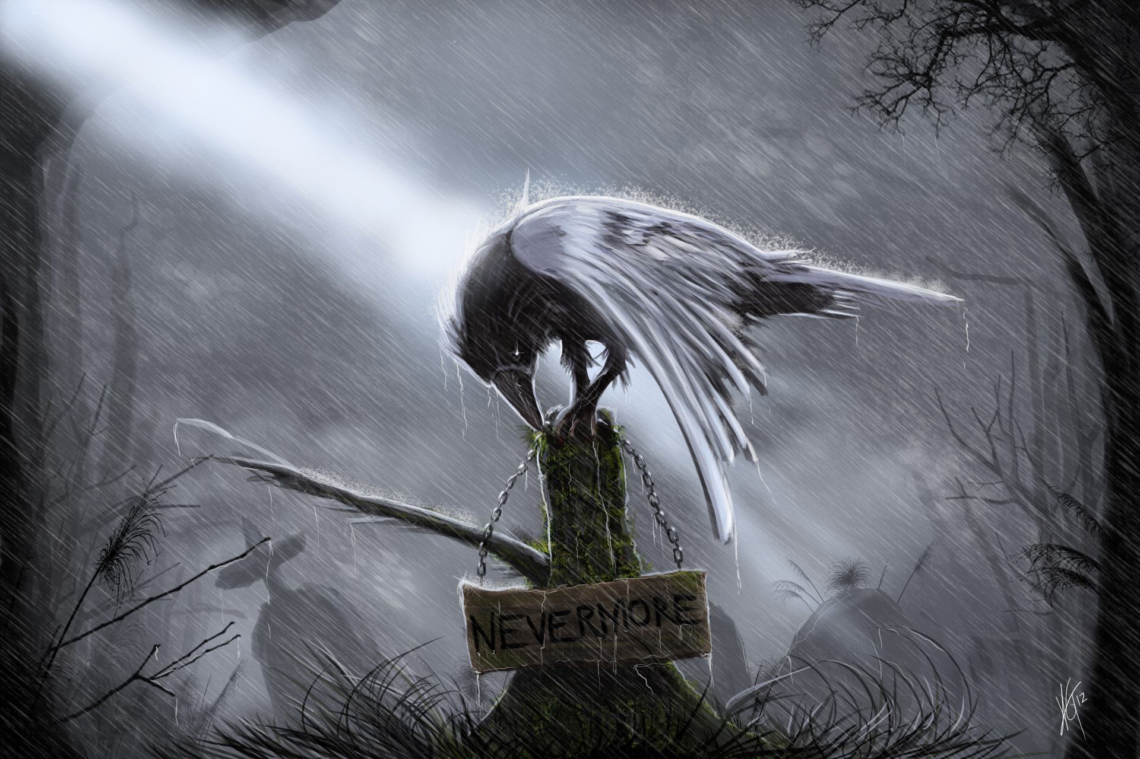
QUOTH THE RAVEN,

Slide 12
Works Cited
Emerson, Ralph Waldo. “The Transcendentalist.” 1842.
Gabani, Yassine. Psychological Dimensions in Edgar Allan Poe’s Fiction. University of Ouargla Repository, 2017.
Poe, Edgar Allan. “Alone.” 1829.
Poe, Edgar Allan. The Fall of the House of Usher. 1839.
Poe, Edgar Allan. The Imp of the Perverse. 1845.
Poe, Edgar Allan. The Tell-Tale Heart. 1843.
Poe, Edgar Allan. “The Poetic Principle.” 1850.
Thoreau, Henry David. Walden; or, Life in the Woods. 1854.
“Edgar Allan Poe.” Poetry Foundation, 2024.
“10 Best Edgar Allan Poe Quotes.” Penguin Books, 2023.
Images
Goya, Francisco. Saturn Devouring His Son. 1820–1823.
“Romanticism.” Wikipedia, 2024.
“Edgar Allan Poe.” Saatchi Art, 2024.

