Slide 1
https://submit.survey.uoa.gr/index.php/survey/index/sid/576999

Slide 2
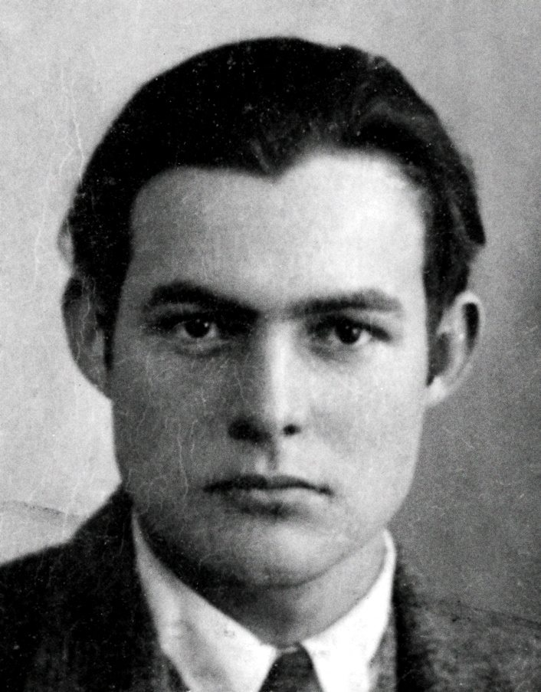
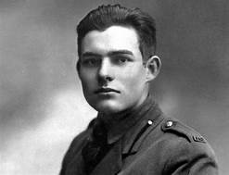
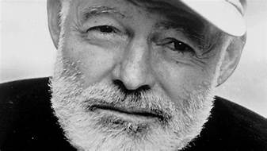
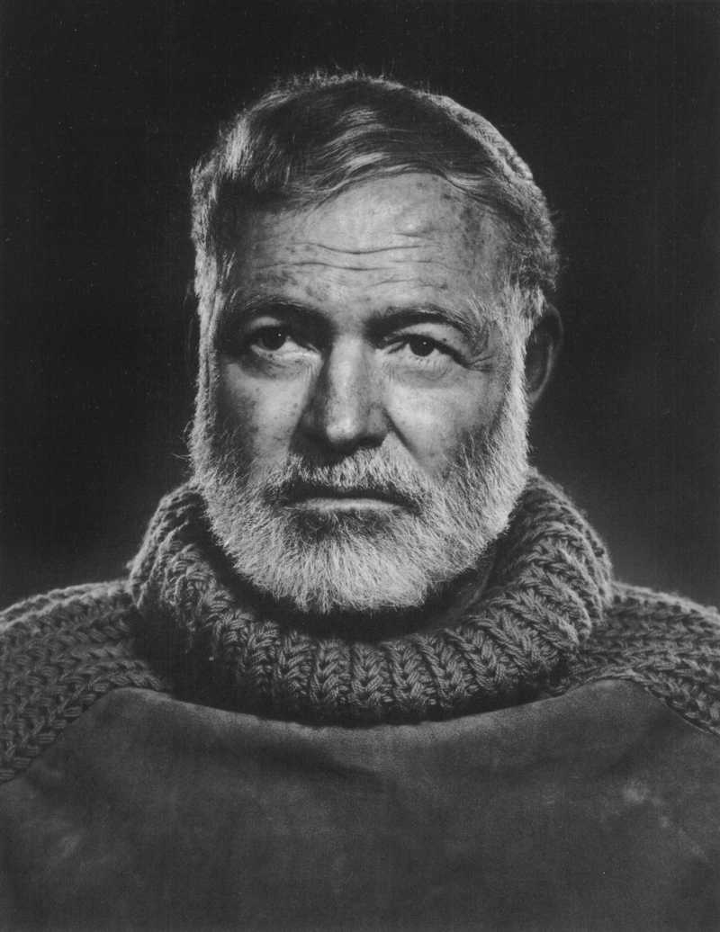
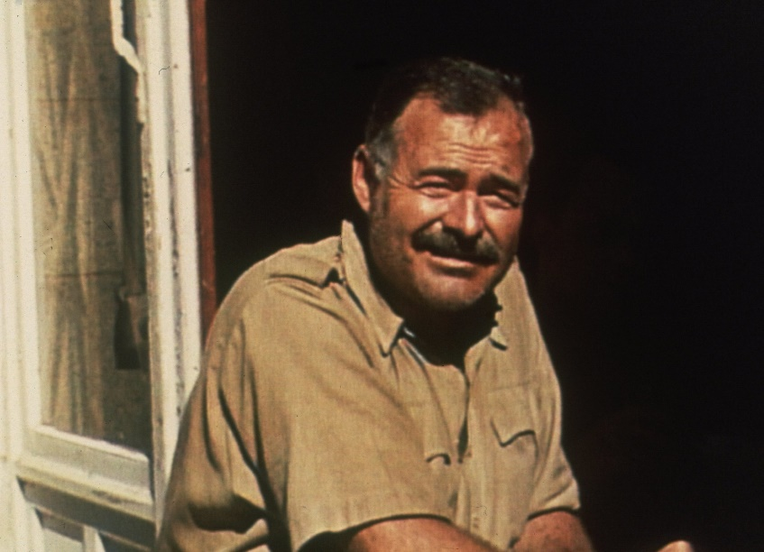
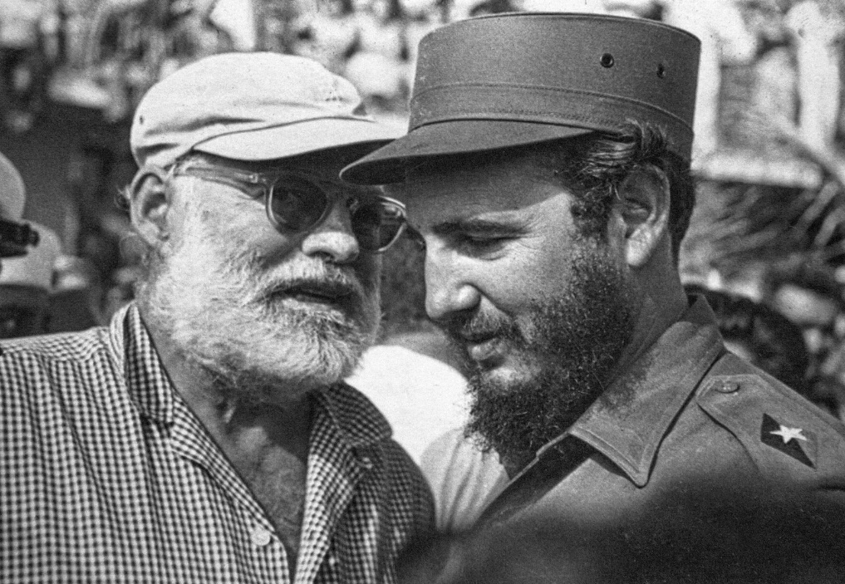
Ernest Hemingway 1899-1961

Slide 3
Life and creation
Hemingway worked as a reporter for Kansas city Star after graduating from high school in 1917.
During World War I he served as an ambulance driver and was wounded just before his 19th birthday.
In 1920, got married left for Paris. Supported by her money and his journalism, he became involved with the expatriate literary and artistic circle surrounding Gertrude Stein (Pound, Fitzgerald, Anderson, Eliot).
During the Spanish Civil War, he served as a war correspondent
He fought in World War II and then settled in Cuba in 1945.
In 1954, he was awarded the Nobel Prize for Literature.
He was increasingly plagued by ill health and mental problems, and in July, 1961, he committed suicide by shooting himself.

Slide 4
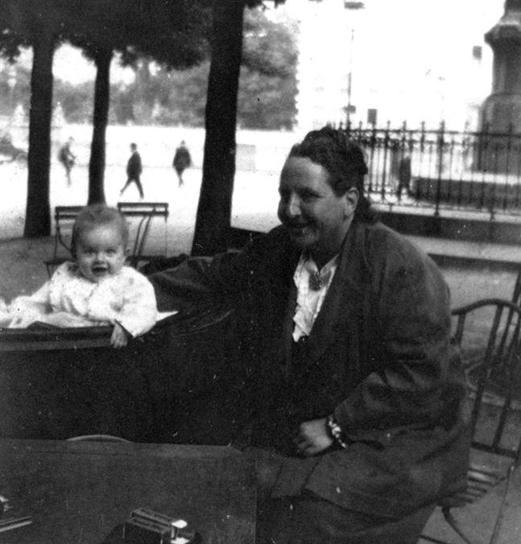
The Lost Generation
the social generational cohort that came of age during World War I. "Lost" refers to the "disoriented, wandering, directionless" spirit of many of the war's survivors in the early post-war period.
The term is particularly used to refer to a group of American expatriate writers living in Paris during the 1920s. Gertrude Stein is credited with coining the term, and it was subsequently popularized by Ernest Hemingway who used it in the epigraph for his 1926 novel The Sun Also Rises: "You are all a lost generation".
Gertrude Stein with Ernest Hemingway's son, Jack in 1924

Slide 5
Main works:
In Our Time (1925)
The Sun Also Rises (1926) –Hemingway style
Men without Women (1927) experimental, telegraphic style, minimum commentary
A Farewell to Arms (1929)
The Snows of Kilimanjaro (1936)
For Whom the Bell Tolls (1940)
The Old Man and the Sea (1952)

Slide 6
Modernism
What is Modernism?
industrialization and urbanization
search for an authentic response to a much-changed world
a sense of disillusionment and fragmentation
What did Modernism do?
changed self-consciousness about modernity
revitalize and update tradition
radical formal experimentation
serious responsibility of the artist
Where is Modernism today?

Slide 7
The modernist period also saw a radical experimentation in literary form and expression. In part this developed in response to new insights provided by recently established disciplines such as psychology. This was certainly true of the stream-of-consciousness technique, and in many respects modernist prose narrative begins with the complex later novels of Henry James.
A further reason for modernist experimentation lay in technological innovations, such as the telephone and the cinema, which were changing the forms and the very meaning of communication
American modernism was of two kinds:
cosmopolitan and expatriate writers, especially Pound, H. D. (Hilda Doolittle) (1886-1961), Stein, and Eliot. Based in urban centers such as London and Paris
a group of non-expatriate American modernists, even though several of them did spend time abroad. Stevens, Frost, Williams, Marianne Moore, F. Scott Fitzgerald, William Faulkner, and Hemingway developed a modernist literature that was connected to American traditions, and the heavy concentration on region and place.
http://www.pbs.org/wnet/americannovel/timeline/modernism.html

Slide 8
Modernism -an artistic and cultural movement beginning at the turn of the 20th cen, bt World War I and World War II -sought to better represent reality in a new, more industrialized world -Against Romanticism that focused on nature and being. -In an era characterized by industrialization, rapid social change, and advances in science and the social sciences (e.g., Freudian theory), Modernists felt a growing alienation -Modernist fiction spoke of the inner self and consciousness. - Modernists saw progress and the decline of civilization. -new technology and cold machinery and increased capitalism, which alienated the individual and led to loneliness

Slide 9
Modernism In Literature
Modernism In Arts And Architecture
T.S. Eliot’s poem The Waste Land (1922)
James Joyce’s Ulysses (1922)
Virginia Woolf,
Marcel Proust,
Gertrude Stein,
William Faulkner
Pound's famous exhortation "Make it new"
Arnold Schoenberg,
Igor Stravinsky
Édouard Manet
Ludwig Mies van der Rohe
Le Corbusier

Slide 10
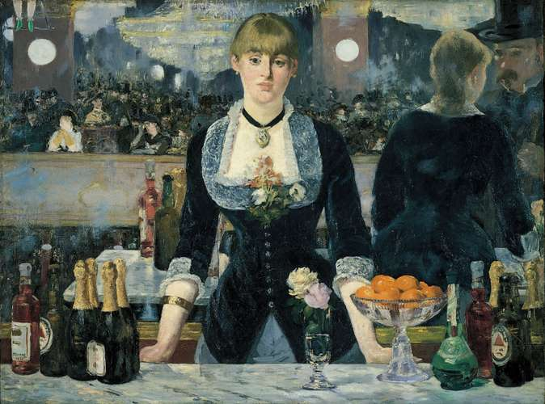

Slide 11
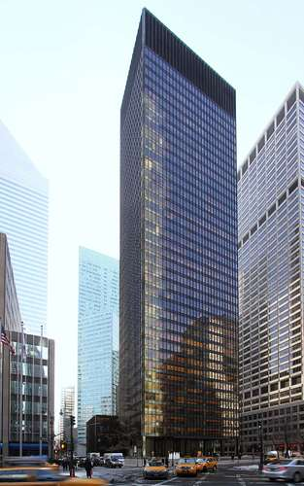
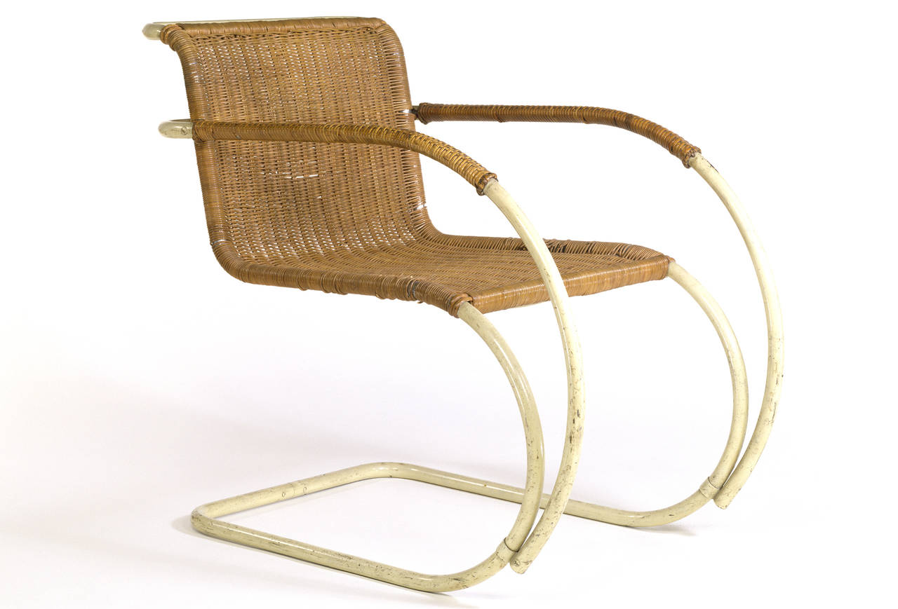
Seagram Building in New York City
The Seagram Building (1958), designed by
Ludwig Mies van der Rohe and Philip Johnson

Slide 12
fiction usually focuses on people living adventurous, dangerous lives: (soldiers, fishermen, athletes, bullfighters) who meet the pain and difficulty of their existence with stoic courage.
hero: How to live in pain, hero learns to live in grace under pressure. Almost all of his characters are worldly-weary, but they maintain their grace under the inescapable pressure of reality’s violence.
prose style: simple, clear, direct and precise. His diction is fundamental, favoring plain words. His sentences are short, declarative. He uses the technique of the repetition of words, phrases and sentence structure.
use of dialogue: another feature of his style
master of pause: the action of his stories continues during the silence, during the times his characters say nothing. Pauses full of meaning

Slide 13
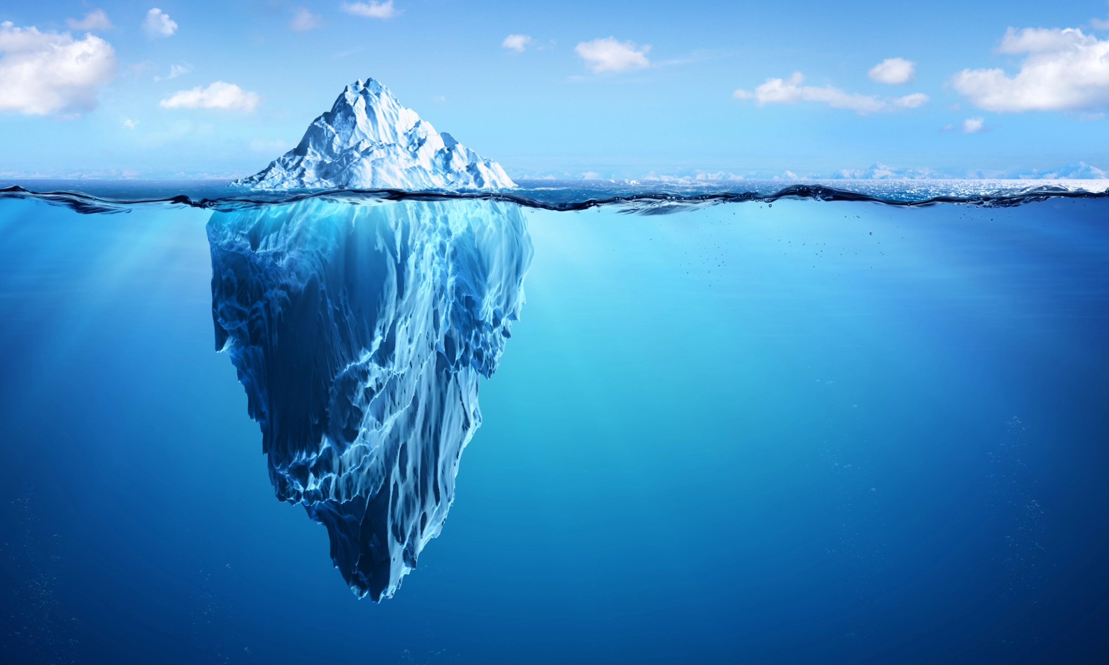
Hemingway’s Iceberg Theory
“If a writer of prose knows enough about what he is writing about he may omit things that he knows and the reader, if the writer is writing truly enough, will have a feeling of those things as strongly as though the writer had stated them. The dignity of movement of an iceberg is due to only one-eighth of it being above water.”
Hemingway said that only the tip of the iceberg showed in fiction—your reader will see only what is above the water—but the knowledge that you have about your character that never makes it into the story acts as the bulk of the iceberg. And that is what gives your story weight and gravitas. —Jenna Blum in The Author at Work, 2013

Slide 14
Hemingway’s Iceberg Theory
“If a writer of prose knows enough about what he is writing about he may omit things that he knows and the reader, if the writer is writing truly enough, will have a feeling of those things as strongly as though the writer had stated them. The dignity of movement of an iceberg is due to only one-eighth of it being above water. A writer who omits things because he does not know them only makes hollow places in his writing.”
Hemingway said that only the tip of the iceberg showed in fiction—your reader will see only what is above the water—but the knowledge that you have about your character that never makes it into the story acts as the bulk of the iceberg. And that is what gives your story weight and gravitas. —Jenna Blum in The Author at Work, 2013

Slide 15
Hemingway's iceberg theory highlights the symbolic implications of art. He makes use of physical action to provide an interpretation of the nature of man's existence. It can be convincingly proved that, "while representing human life through fictional forms, he has consistently set man against the background of his world and universe to examine the human situation from various points of view."

Slide 16
Hemingway’s Code heroes: to live with dignity, and grace, honesty and the restraint while playing an unwinnable game.
Code: in his novels, life is full of tension and battle; the world is in chaos; man is always fighting desperately a losing battle. However, though life is but a losing battle, man can live in such a way that loss becomes dignity; man can be physically destroyed but never defeated spiritually.
His masculine heroes—the tough men fond of outdoor sports such as bullfighting , hunting and fishing.
Relation to women– seemed to admire women who would play the game well; but, believed men were better off without women and women who wanted “equality” were competitive threats to men.
Married 4 times, all 3 later wives were talented reporters whom he expected to give up their careers.

Slide 17
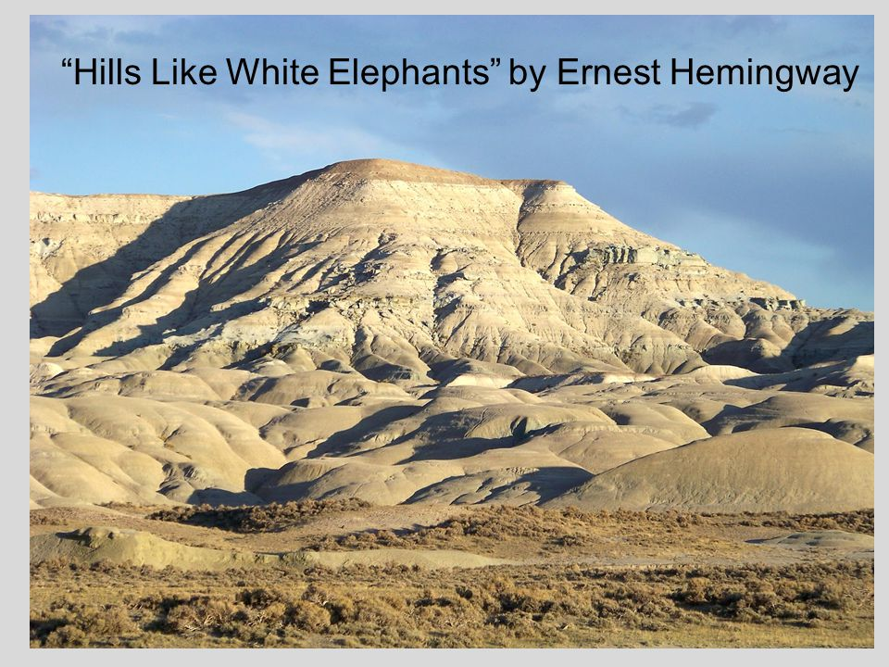
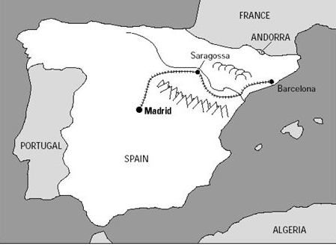
setting
Train station in the Ebro valley in Spain
Dry vs green side
At the crossroads – not the final destination

Slide 18
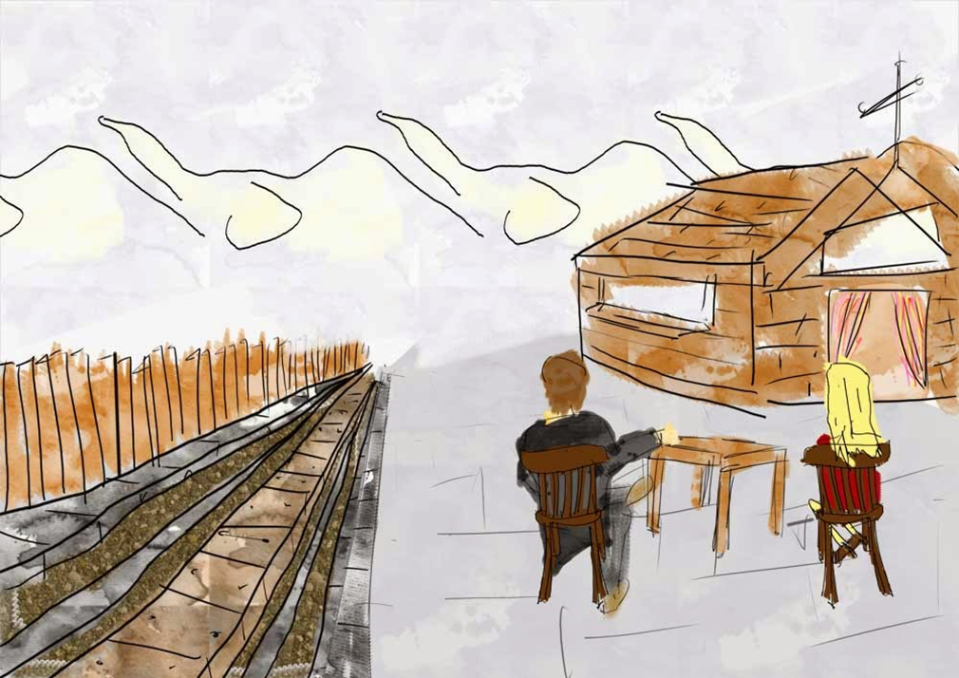
themes
symbolism
White elephants
colour of white in Western tradition (innocence-sacrifice)
Conflict bt personal responsibility + hedonism
Rhetorical + psychological manipulation
Coming of age
Dynamics of the relationship
Motifs - drinking

Slide 19
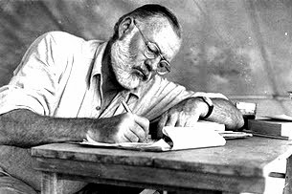
Ending –open ended
To have the abortion and stay together
To have the abortion and not stay together
Not to have the abortion and stay together
Not to have the abortion and not stay together
Narrator
3rd person objective narrative point of view
or
The camera eye
or
A fly on the wall

