Slide 1
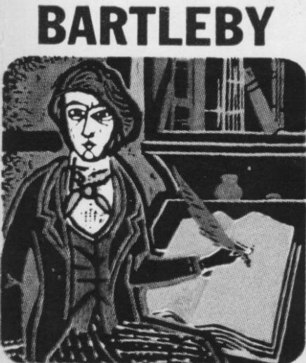
“Bartleby, the Scrivener” 1853
Herman Melville
At present I would prefer not to be a little reasonable, was his mildly cadaverous reply.

Slide 2
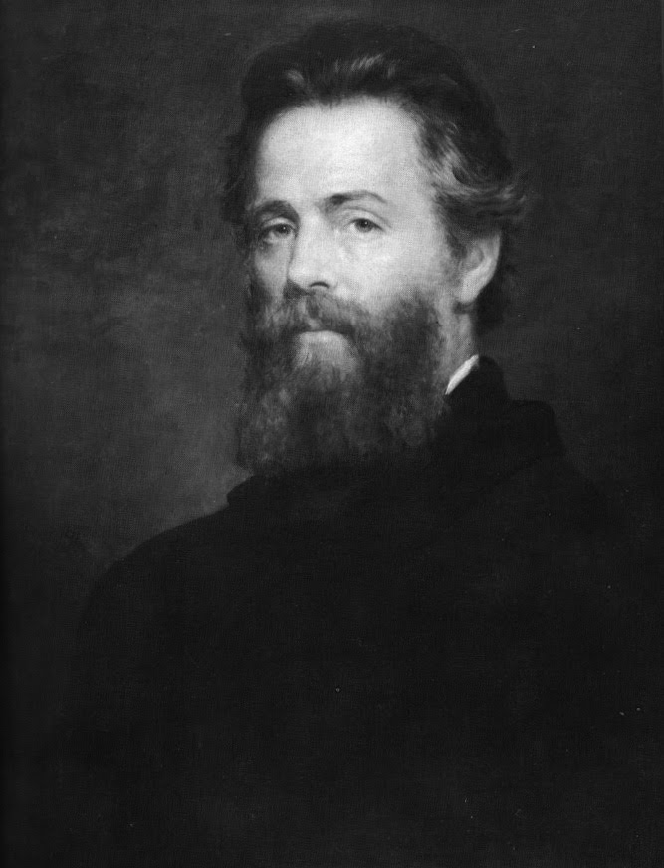
The Author
New York 1819 into a wealthy family.
Father, Allan Melville, was a dry goods merchant 3rd out of 8 children
Became fatherless by the age of 13, dropped school to work as a bank clerk and would henceforth educate himself
At 21, signed for a whaling voyage to the South Pacific because he could not find a decent gob as a legal scrivener
Married Elizabeth Shaw, daughter of judge Lemuel Shaw and chief of justice of Massachusetts
Father of 4 children (1st killed himself 1867, 2nd drifted away without career, 3rd suffered from sever arthritis, 4th married lived until 1934, refused to talk about him)
Died in obscurity 1891
His ambivalent way of writing made him incomprehensible to his contemporaries
“Forgotten writer” from Civil War till WWI

Slide 3
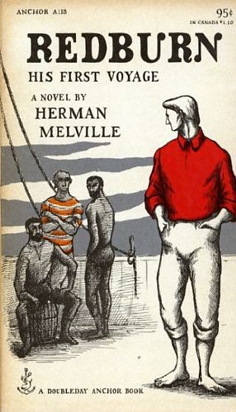
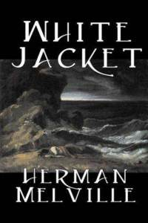
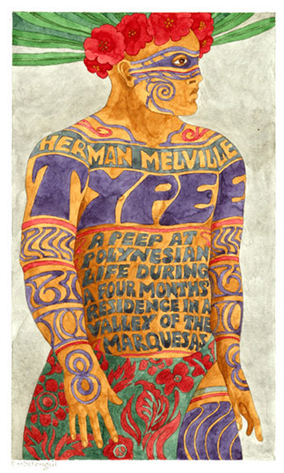

Popular and Financial Successes
Typee 1846
Omoo 1847
Redburn 1849
Whitejacket 1850

Slide 4
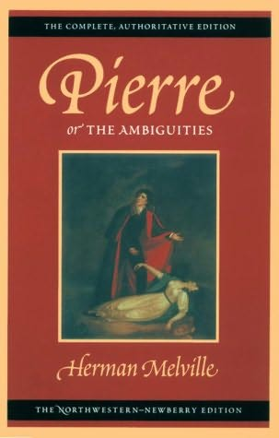

Herman Melville (1819-1891)
launched on a more literary, philosophical direction
with Mardi (1849);
followed by his masterpiece Moby-Dick (1851),
Pierre (1852); critics were not happy
Newspaper account: “HERMAN MELVILLE CRAZY”

Slide 5

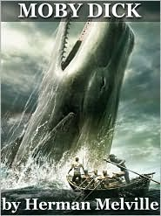
Critical and Financial Failures
Mardi 1849
Moby Dick 1851
  “writ de lunatico”
Pierre 1852
  “Herma Melville is Crazy”

Slide 6
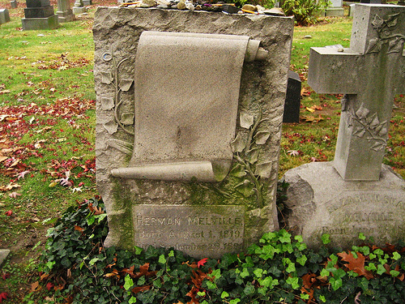
1860s and 70s:
poetry, including Battle-Pieces (1866) about Civil War; reputation in decline;
Last great work:
Billy Budd, Sailor
Woodlawn Cemetery, Bronx

Slide 7
admired Shakespeare and Hawthorne
particularly interested in the Romantic hero, the Byronic wandering outlaw
wrote realistically of life at sea but there are romantic elements in his heroes
quietly criticized for his romance and more intensely for his realism
He died in New York on September 28,1891

Slide 8
Literary period and historical background
  Romanticism (in America 1800s – 1860)
    Deals with bizarre, out-of-the ordinary people and events
  Gothic conventions subtly employed (confinement, madness, claustrophobia)
  Romantic concern with good and evil
  His work occurs in the midst of the Industrial Revolution in America

Slide 9
Dark Romantics
shares characteristics with other Romantics but more pessimistic view
Authors: (Hawthorne), Melville, Edgar Allan Poe
View of Man: moral struggle with evil; feelings and intuition; dark interior
View of God: good v. evil; sin and its psychological effects on people
View of Nature: evil found in setting and symbol; often the supernatural
View of Society: must be reformed
Bartleby: Written and published after Engels and Marx’s Communist Manifesto (1848)
Published in the same collection with “Benito Cereno,” which tells a story of an exploited class of people (slaves) from the perspective of a complacent Northerner blind to social injustice and his own role in it.

Slide 10
Plot
A lawyer in Wall Street narrates the story of Bartleby the scrivener, his employee, who was timid but industrious. To the narrator’s great surprise, he refuses to follow certain orders until he refuses to work altogether simply stating he «would prefer not to». Even though the lawyer attempts in vain to reason him, he is unable or unwilling to make him leave; he relocates his premises, leaving Bartleby behind. Upon request of the new tenants the lawyer tries one last time to persuade him to go. Later on he discovers that Bartleby was removed from the premises and imprisoned. On his second visit he finds him newly dead because he had starved himself to death. Some time afterwards he hears a rumor according to which Bartleby was an employee at a Dead Letter Office at Washington and had lost his job there.

Slide 11
Setting
New York, Wall Street; Subtitled “A Story of Wall-Street”: the chief financial street in New York
story revolves only around the working premises and there is no reference of any of the characters’ dwelling.
Wall Street, “echoes with sheer vacancy” outside working hours,
The lawyer’s chambers are on the 2nd floor surrounded by buildings of “great height”
Wall has symbolic meaning as well: chambers face “white wall” of light shaft on one side; black brick wall on the other side
There is a “small side window” in one side of the room where the narrator places Bartleby, who stares at the “dead brick wall” outside the window.
Divider between narrator and scriveners; Bartleby is on the narrator’s side of divider, behind a screen, facing window looking out on wall
Bartleby finds accommodation in the office

Slide 12
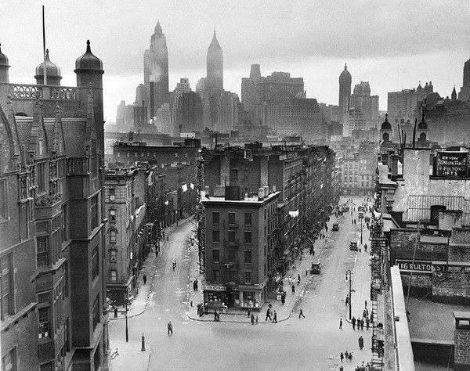
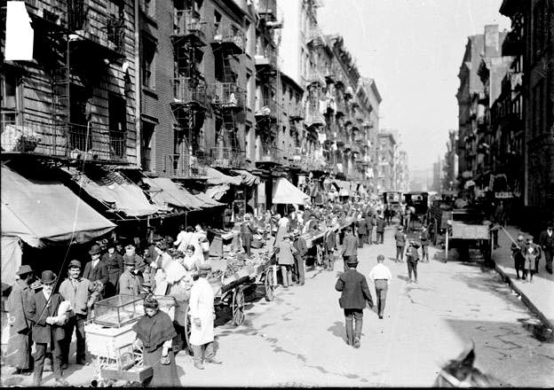
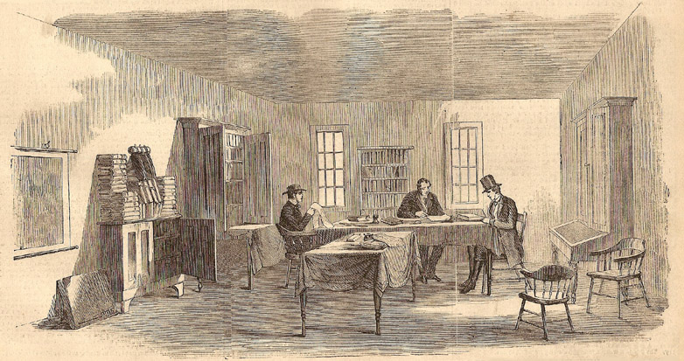
19th century NYC

Slide 13
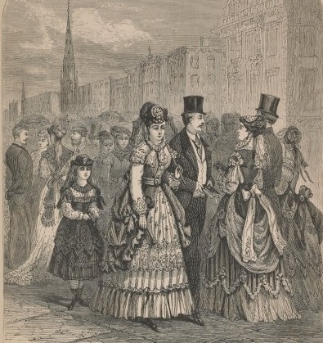
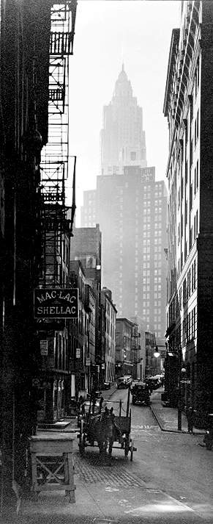
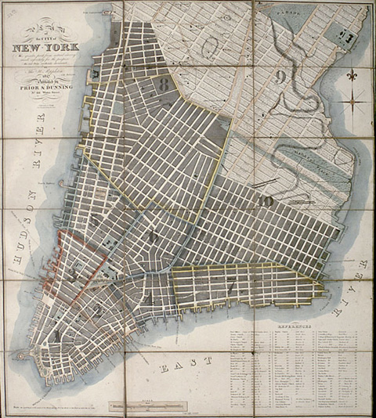
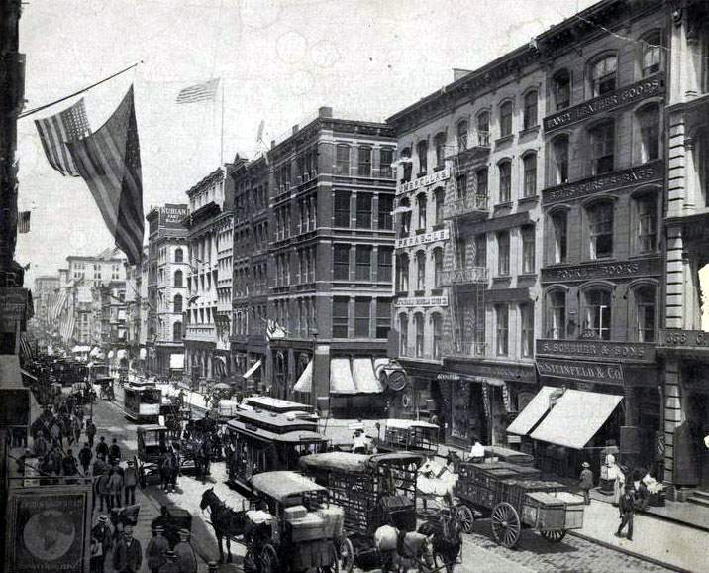
New York 1850s

Slide 14
Narrative viewpoint
First person point of view; allows us to see the effect Bartleby has on those around him
Lawyer narrates his experience with Bartleby; character involved in the story, his narration is based on memory
(Un)reliable narrator because he does not know all the facts about Bartleby’s life, his thoughts and motives and does not present himself objectively
Instances where we question his self-claimed generosity and intentions regarding Bartleby because they may stem from curiosity or fascination
The tolerance towards the eccentricities of his employees indicates his non-confrontational nature
His egotism and materialism influences the interpretation of the story

Slide 15
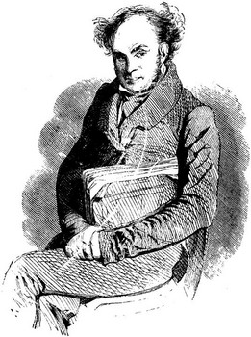
Characters
Narrator
Bartleby
Turkey
Nippers
Ginger Nut
New tenants, landlord
Grub-man
All the above are nicknames and narrator remains unnamed

Slide 16
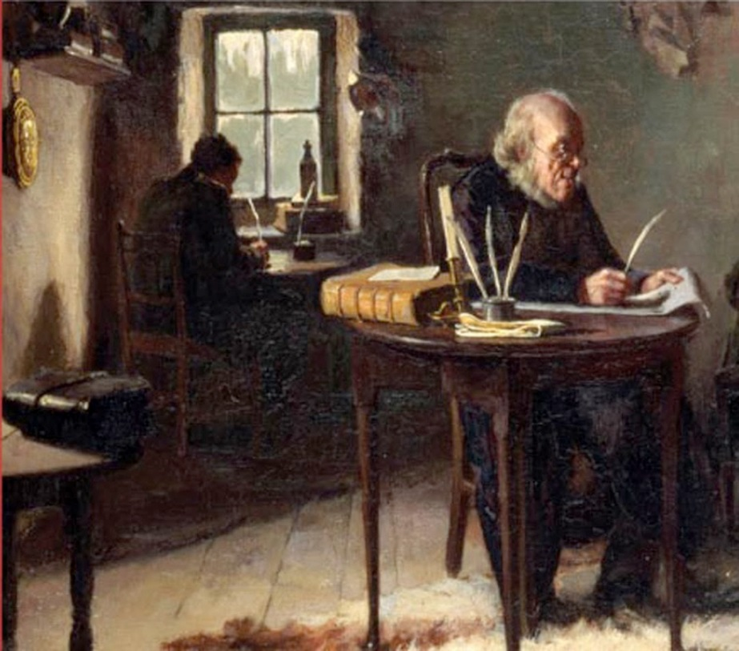
Narrator
I am a man who, from his youth upwards, has been filled with a profound conviction that the easiest way of life is the best.

Slide 17
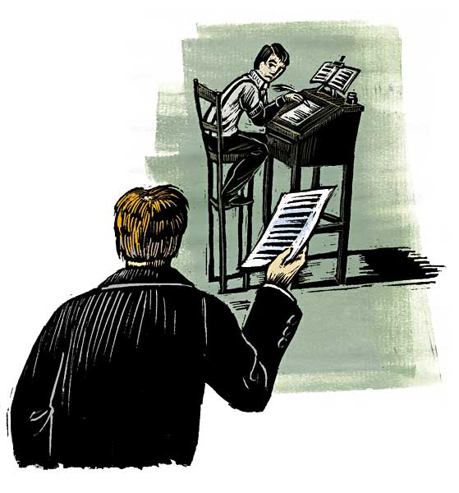
I can see that figure now—pallidly neat, pitiably respectable, incurably forlorn! It was Bartleby.

Slide 18
Narrator
Bartleby
A man who seeks security and pleasure, rarely loses his temper and believes that «the easiest way of life is the best»
According to John Jacob Astor, his strong points are prudence and method
A straightforward man who tries to approach Bartleby, reacts to the conflict between him and his employee
Narrator tolerates Bartleby. Why?
A new copyist, “pallidly neat, pitiably respectable, incurably forlorn”; he writes “silently, palely, mechanically
A shy, industrious, «incurably forlorn» young man
“a mild, firm voice” replies: “I would prefer not to.” “Not a ripple of agitation”
Bartleby’s nature is passive (suggested by passive voice): “What is wanted?”
Eventually he refuses to follow orders and to work at all, thus showing his defiance
He retreats to his reveries, sits in silence and complete passivity as if he has given up on life

Slide 19
Narrator & Bartleby, Phase 1
Nothing so aggravates an earnest person as a passive resistance.” Narrator doesn’t reject Bartleby because:
  He tries to understand him imaginatively, sympathetically: “charitably construe to his imagination”
  He feels good about himself for tolerating Bartleby: “delicious self-approval”
  Bartleby “strangely disarmed” and “touched and disconcerted me”

Slide 20
Narrator & Bartleby, Phase 2
Narrator, on way to Trinity Church on Sunday, stops by office and finds Bartleby there
  Bartleby’s “gentlemanly nonchalance”
  Narrator feels “unmanned” and complies to Bartleby’s wishes
  Finding that Bartleby has been living in the office, narrator is moved: feels “overpowering stinging melancholy” for first time: “For both I and Bartleby were sons of Adam”

Slide 21
Narrator & Bartleby, Phase 3
Narrator recognizes Bartleby’s “quiet mysteries”
    Bartleby’s “dead-wall reveries”: “for long periods he would stand looking out, at his pale window behind the screen, upon the dead brick wall”
    Melancholy→Fear→Repulsion: because pity goes against common sense if Bartleby can’t be helped: “his soul I could not reach”
    Narrator resolves to fire Bartleby if he refuses to answer questions
“something superstitious knocking at my heart and forbidding me to carry out my purpose”

Slide 22
Narrator & Bartleby, Phase 4
Bartleby gives up copying
Narrator gives Bartleby 6 days notice, then asks him to leave, offers money
Next morning, Bartleby is still there
Narrator resorts to religion: “love one another” and Jonathan Edwards on predestination: “I penetrate the predestined purpose of my life. I am content”

Slide 23
Narrator & Bartleby, Phase 5
Narrator is “held . . . to terrible account” regarding Bartleby; he fears “being exposed in the papers”
Narrator interviews Bartleby in old premises: Bartleby: “I am not particular.”
Desperate, the narrator invites Bartleby to “to go home with me now” ; Bartleby prefers not to
Narrator takes vacation: travels into suburbs in his “rockaway” carriage: “I almost lived in my rockaway”

Slide 24
Narrator & Bartleby, Phase 6
Rumors about Bartleby threaten narrator’s business and reputation
Narrator resolves to change offices, departs
“I tore myself from him whom I had so longed to be rid of”
Bartleby remains, but narrator denies him: “the man you allude to is nothing to me”

Slide 25
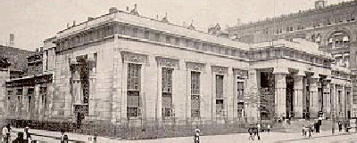
Narrator & Bartleby, Phase 7
Police take Bartleby to the Tombs prison “as a vagrant” ; Bartleby doesn’t resist
Narrator visits Bartleby in Tombs
Bartleby, free “to wander about the prison,” faces outer wall
Bartleby to Narrator: “I know you and I want nothing to say to you”
Narrator contracts meals for Bartleby from Mr. Cutlets; Bartleby refuses
Returning a few days later, narrator finds Bartleby dead, with eyes open, in prison yard

Slide 26
Sequel: “vague report”
“Bartleby had been a subordinate clerk in the Dead Letter Office at Washington”
  “On errands of life, these letters speed to death”; “Ah Bartleby, Ah humanity!”
  Bartleby is a dead letter; unable to communicate:
  as a legal scrivener, he deals in dead language

Slide 27
dOUBLES
In “Bartleby,” the narrator’s identity becomes intertwined with the strange, intractable scrivener Bartleby
The humor, and the tragedy, of this story lie in the narrator’s inability to either understand Bartleby or to separate from him

Slide 28
Narrator and Bartleby as Doubles
Like Bartleby, the narrator:
Is, as he describes Bartleby, “pitiably respectable”
Is unambitious and passive
Deals in dead letters
Appears to have no real friends, family
Becomes a vagrant—lives in his rockaway
part of his personality, perhaps a product of his mind since he does not give us Bartleby’s story

Slide 29
Who is the protagonist ?
We start off believing that Bartleby is the protagonist of the story, but gradually we realize that the narrator is in fact the crucial character because:
he tries to understand Bartleby’s behavior
he rationalizes his behavior towards Bartleby
ultimately it is his own character portrayed, we witness his own self-understanding and change to some degree
In that sense, we detect irony because the narrator believes that he is telling the story of Bartleby when he is really telling the story of a part of his life

Slide 30
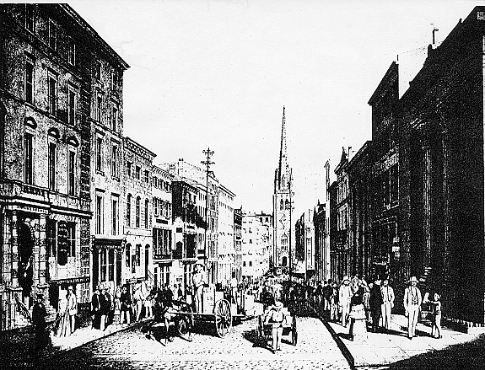
Wall-Street & Trinity Church
Now, one Sunday morning I happened to go to Trinity Church, to hear a celebrated preacher, and finding myself rather early on the ground, I thought I would walk around to my chambers for a while.

Slide 31
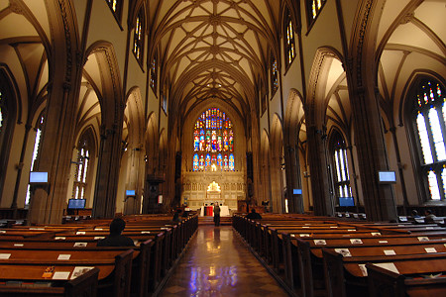
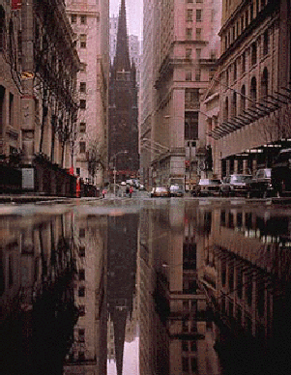
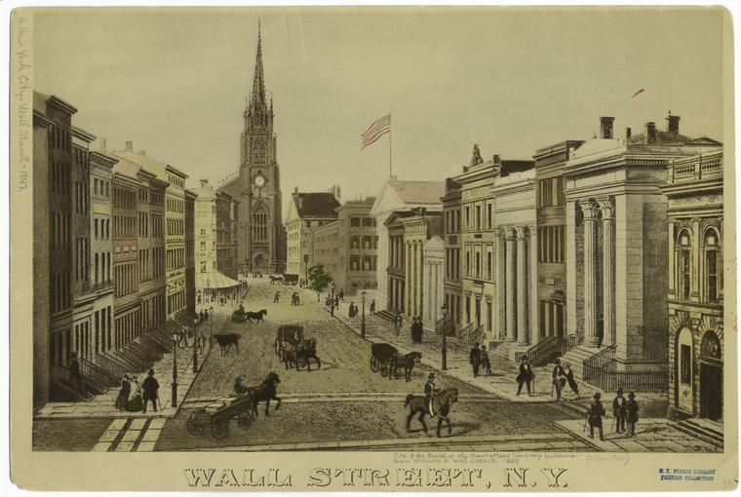
Wall Street, New York City,
Trinity Church in Background

Slide 32
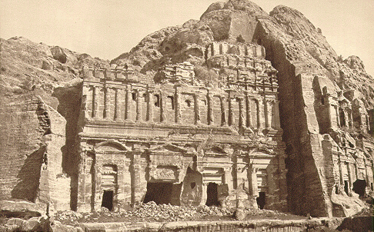
Wall-Street, “deserted as Petra” (see picture, right, in modern-day Jordan), contrasts with “the bright silks and sparkling faces” of Broadway
“the circumstance of being alone in a solitary office . . . Unhallowed by humanizing domestic associations” contributed to Colt’s murder of Adams

Slide 33
Bartleby is imprisoned in the Tombs, a New York city prison, where he is found by the narrator with “his face towards a high wall”
In the end Bartleby dies from voluntary starvation “at the base of the wall”
Wall : a recurrent image that symbolizes confinement.
Many allusions to confining areas which highlight the isolation of characters and create an environment of rigid constraints
e.g. “blank walls”, “privacy screens”

Slide 34
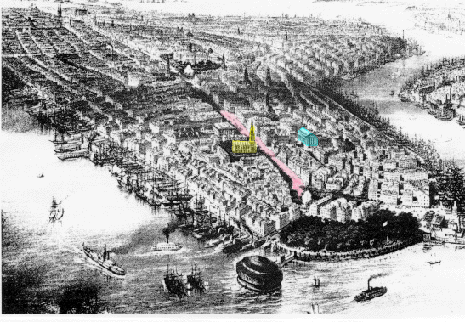

Slide 35
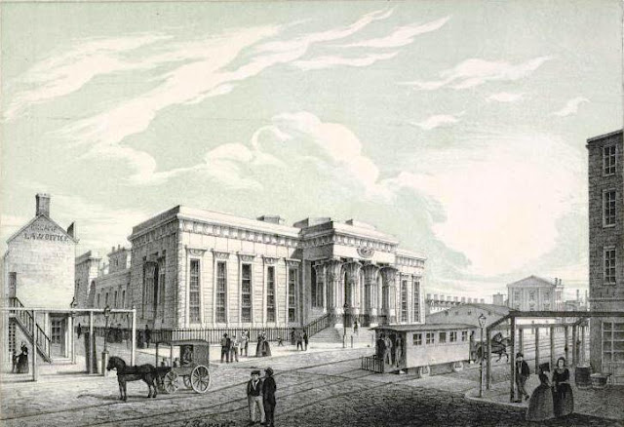
The Tombs Prison

Slide 36
Interpretive Possibilities
Story
Critiques
Story
can be
dehumanizing, restrictive labor that crushes the spirit of employees who are used as tools in the production of wealth by obtuse, smug capitalists such as the narrator.
the excesses of transcendental freedom, as embodied by Bartleby, and affirms the limits of such freedom by illustrating its consequences.
reveals the growing gap between poor employees increasingly confined and degraded by labor that creates superfluous wealth and the managers who use them. The story uses symbols such as “dead letters” and vision-obstructing walls to illustrate the blindness of apparently respectable men such as the narrator to their increasingly dissatisfied, spiritually and intellectually enslaved employees.
-an illuminating dramatization of conscientious objection
--Other?

Slide 37
Bartleby can be interpreted in various ways because there are so few details about his life that he remains obscure and mysterious
suffers from clinical depression : lack of motivation, passivity, resignation, no positive emotions- never smiles
An imprisoned man within the walls of society : refuses to conform to conventions of his profession and others’ expectations of him
Biography: represents Melville’s unwillingness to conform to conventional literary modes; refuses to compromise his art

Slide 38
Themes
Isolation - failure to connect
                Mortality
                Passivity
Compassion and responsibility
Rules, Law and Order
                Freedom, captivity, and the workplace
Doubling
Choices
                World of work and business
Morality and ethics

Slide 39
